Slide 1
Upgraded Injector Test Facility 2015 Users Group Board of Directors Update
Akers/Experimental Nuclear Physics January 13, 2015

Slide 2
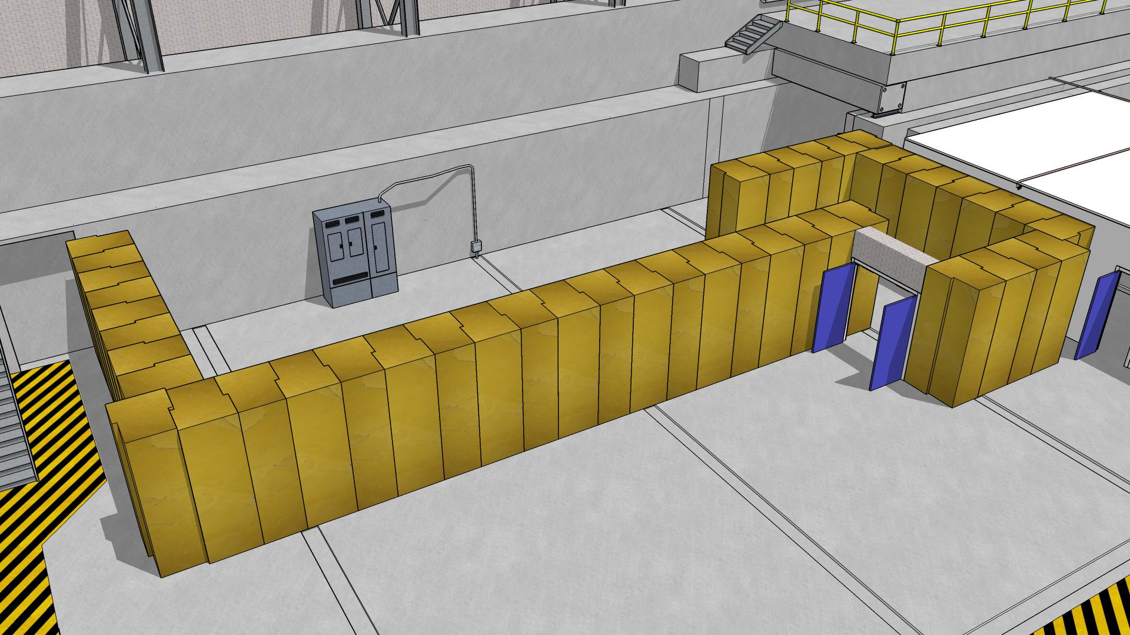
Upgraded Injector Test Facility
Primary Shielding Block Installation
Akers/Experimental Nuclear Physics January 13, 2015

Slide 3
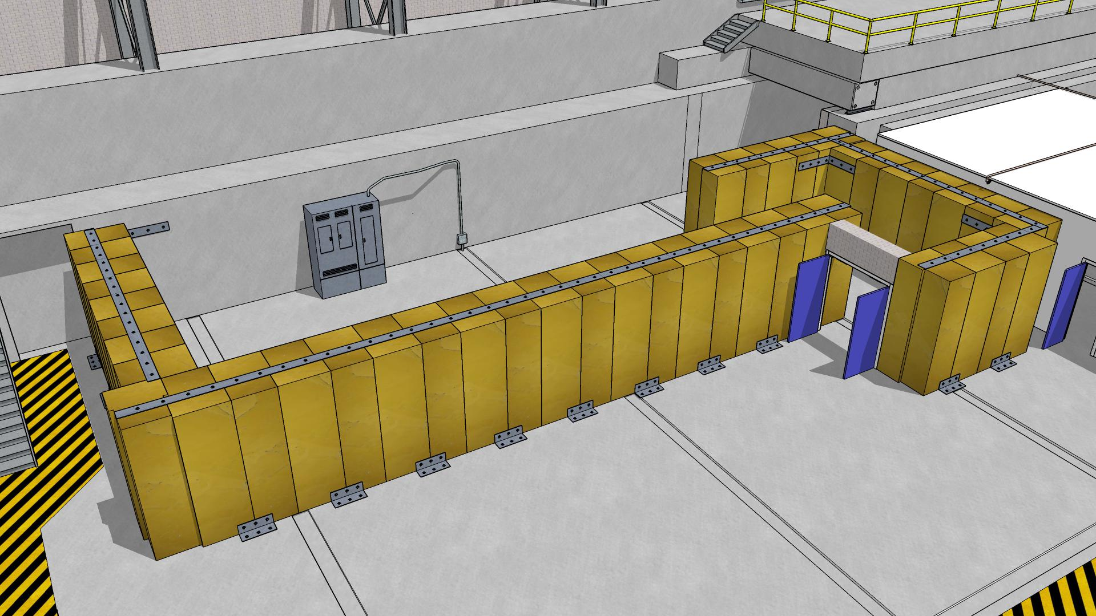
Upgraded Injector Test Facility
Installation of Seismic Protection (Concept)
Akers/Experimental Nuclear Physics January 13, 2015

Slide 4
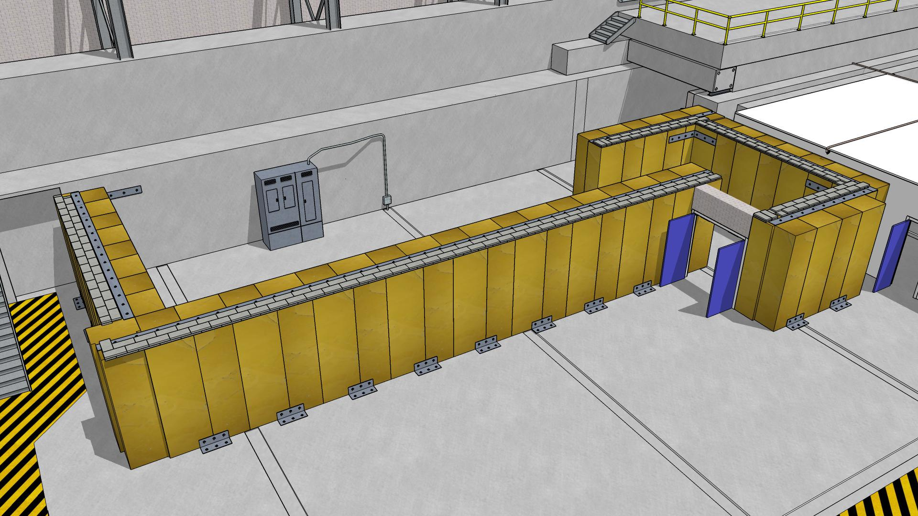
Upgraded Injector Test Facility
Installation of Leveling Blocks
Akers/Experimental Nuclear Physics January 13, 2015

Slide 5
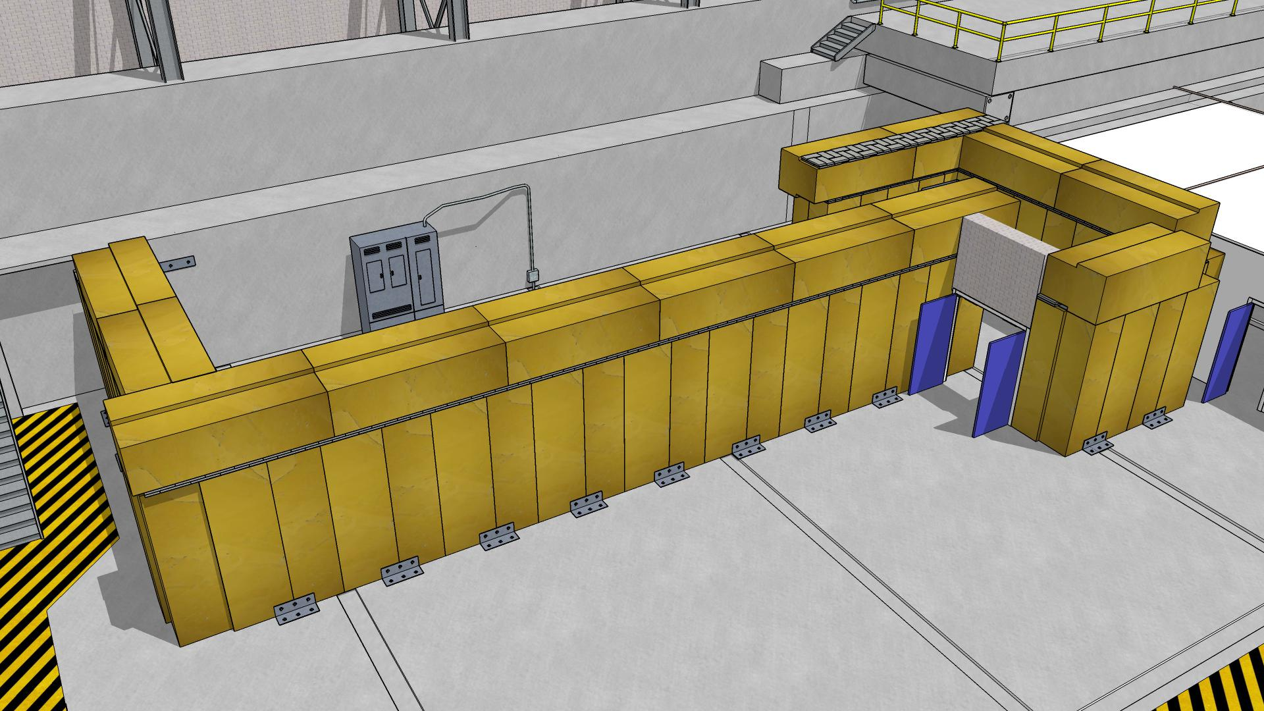
Upgraded Injector Test Facility
Installation of Upper Level Shielding
Akers/Experimental Nuclear Physics January 13, 2015

Slide 6
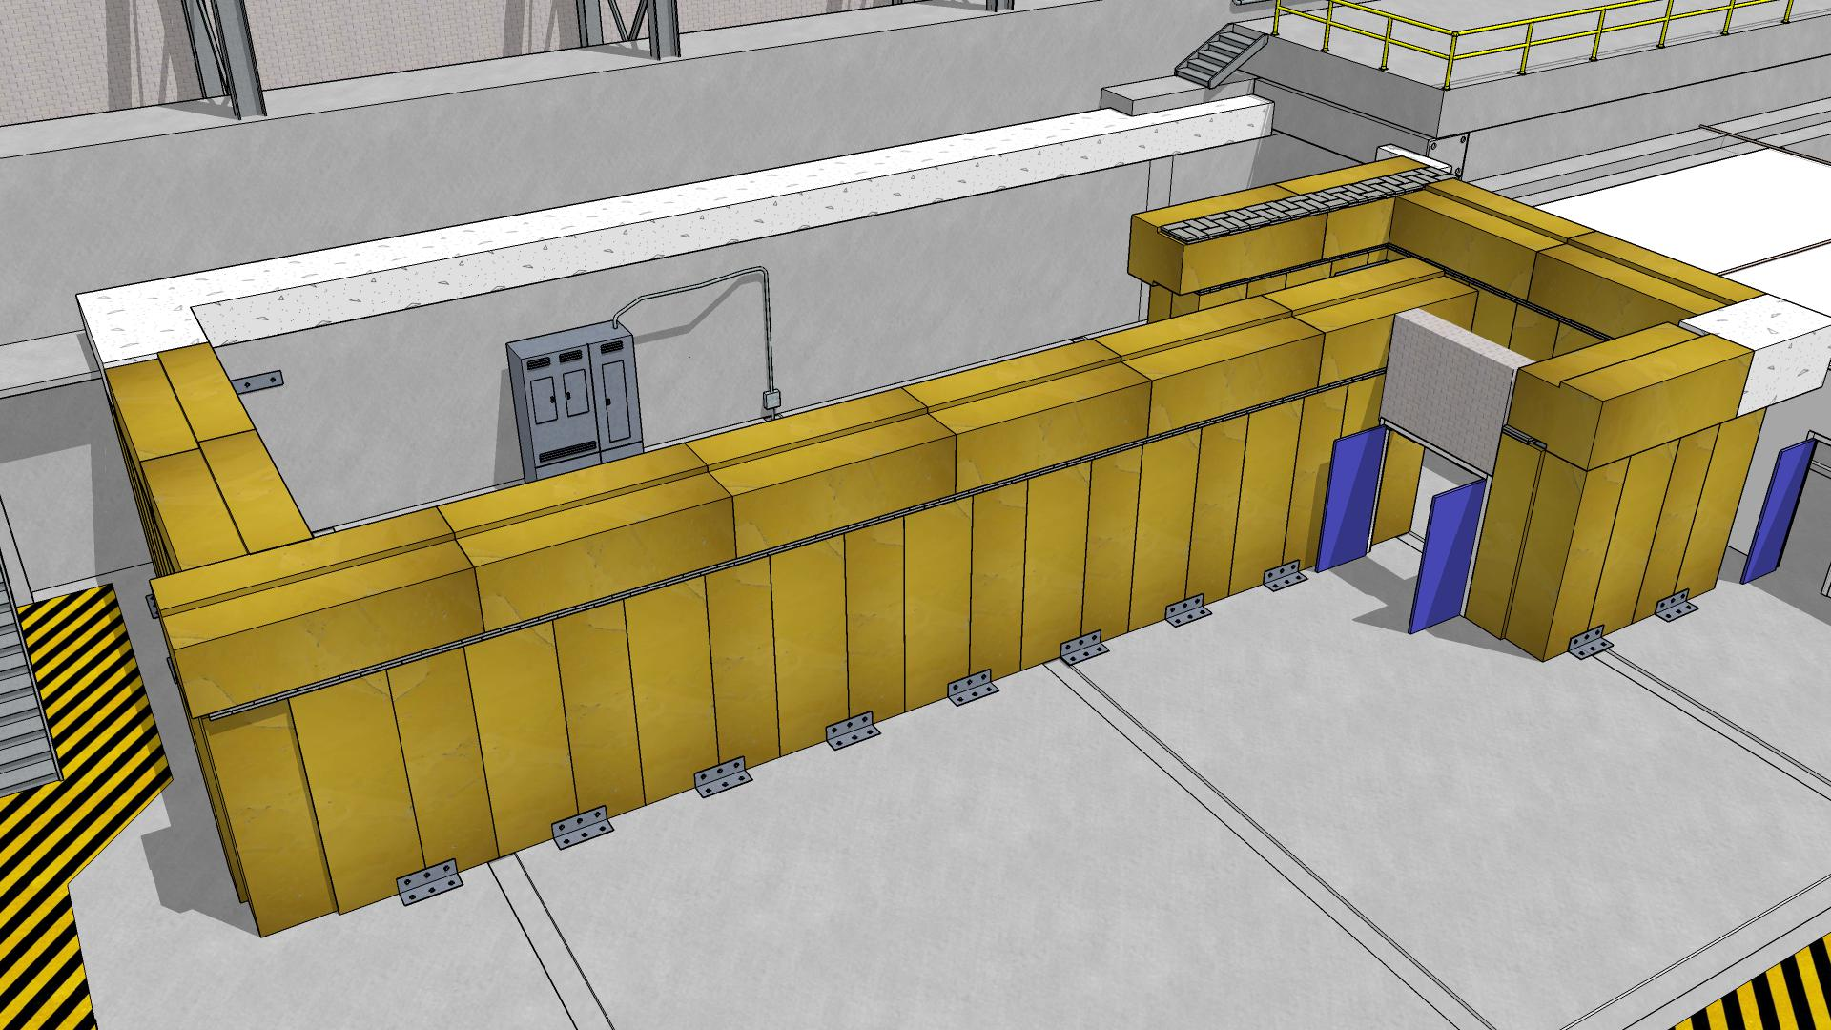
Upgraded Injector Test Facility
Installation of Cast in Place Concrete
Akers/Experimental Nuclear Physics January 13, 2015

Slide 7
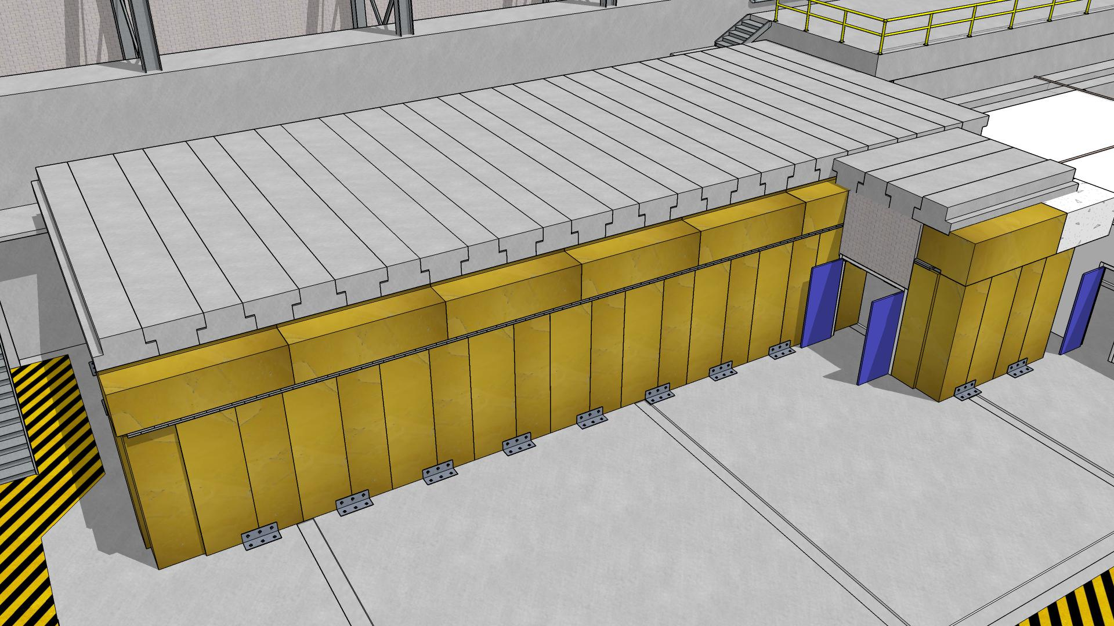
Upgraded Injector Test Facility
Installation of Roof Beams
Akers/Experimental Nuclear Physics January 13, 2015

Slide 8
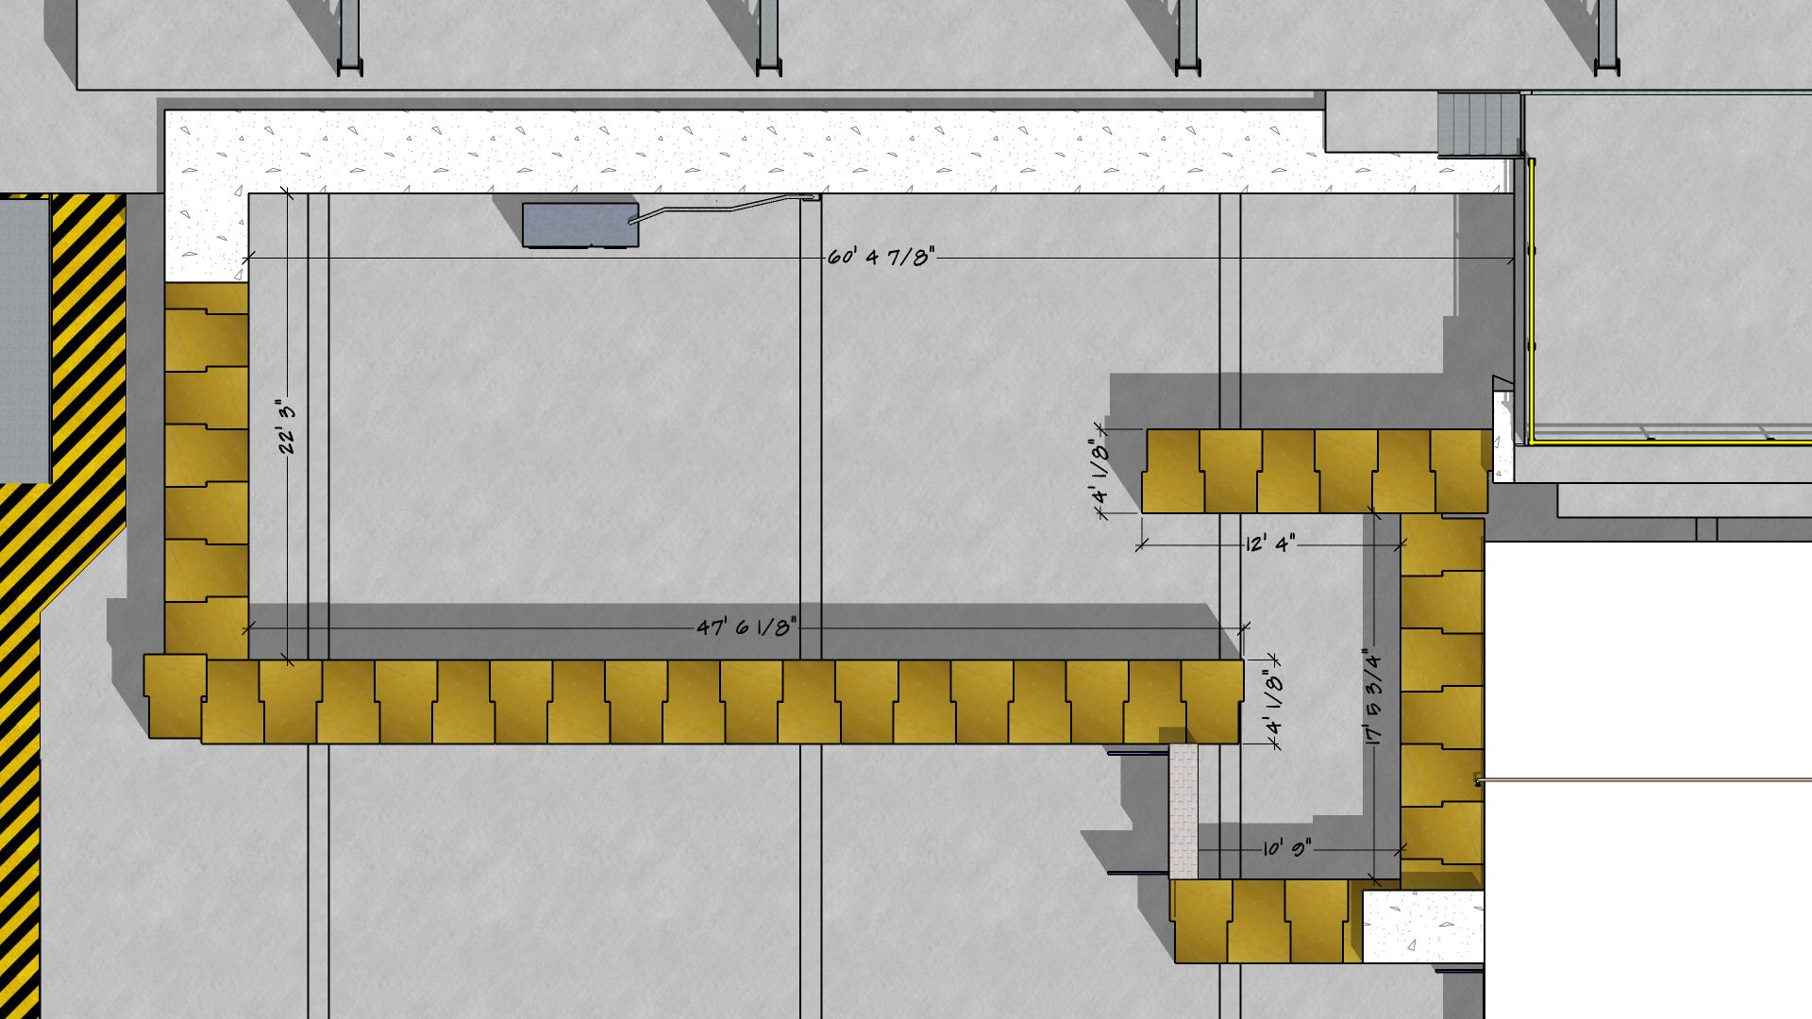
Upgraded Injector Test Facility
Dimensions of Extended Cave
Akers/Experimental Nuclear Physics January 13, 2015

Slide 9
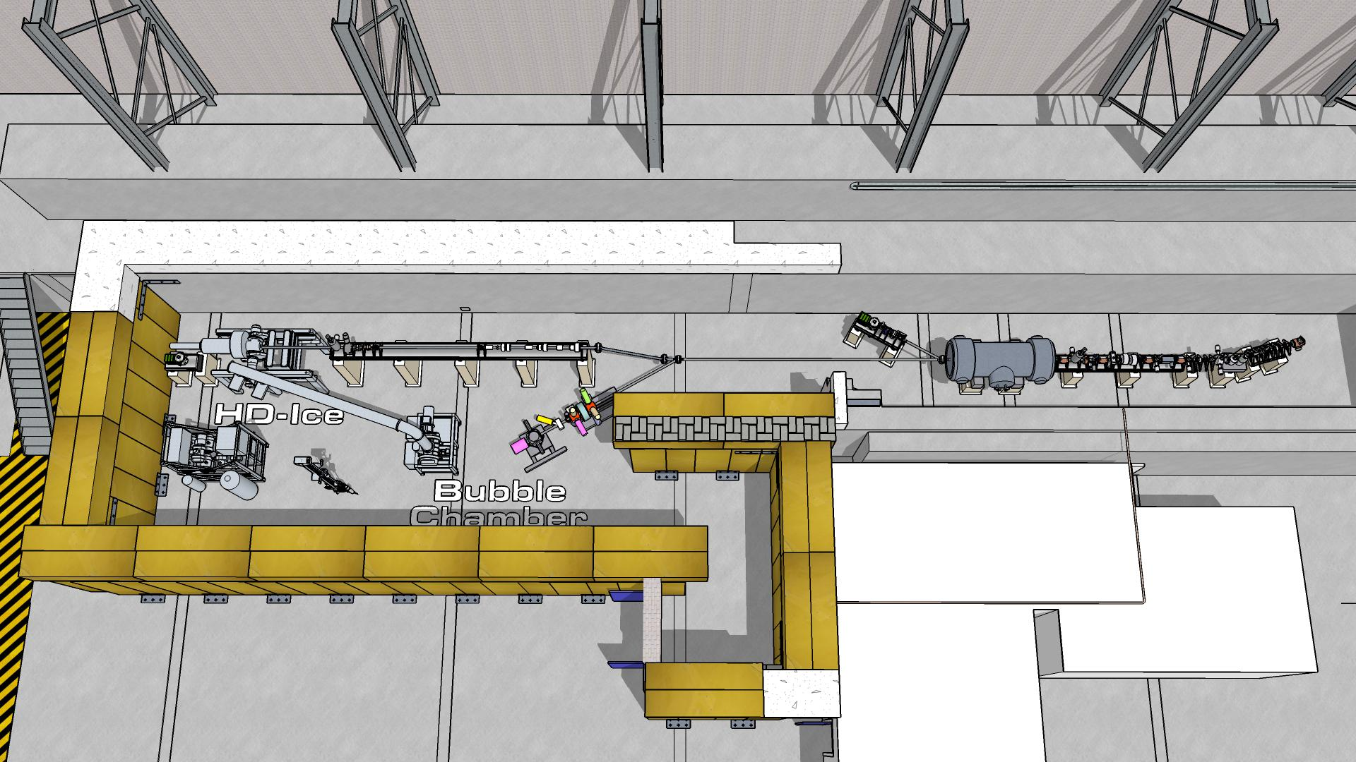
Upgraded Injector Test Facility
Installation of Experimental Equipment
Akers/Experimental Nuclear Physics January 13, 2015

Slide 10
Counting House Renovation 2015 Users Group Board of Directors Update
Akers/Experimental Nuclear Physics January 13, 2015

Slide 11
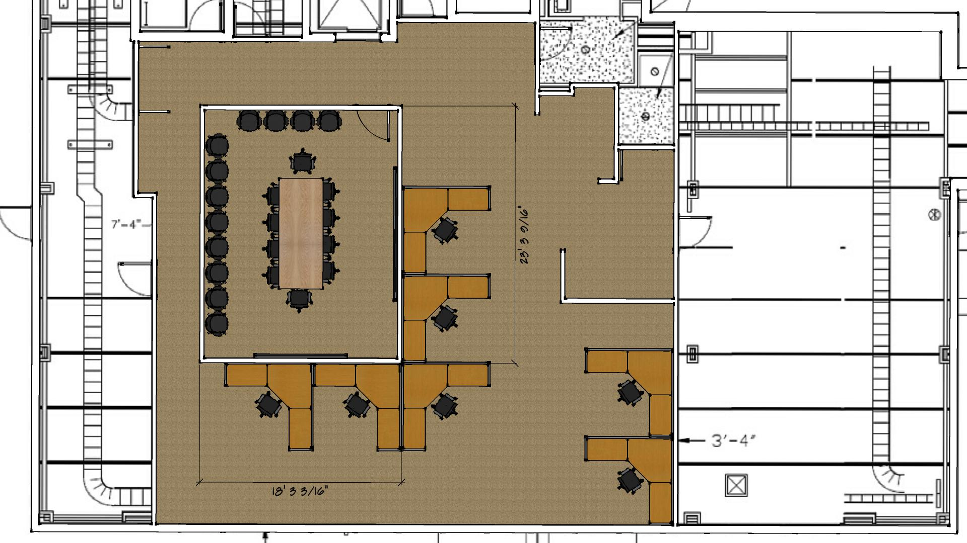
Counting House Renovation – Second Floor
Akers/Experimental Nuclear Physics January 13, 2015

Slide 12
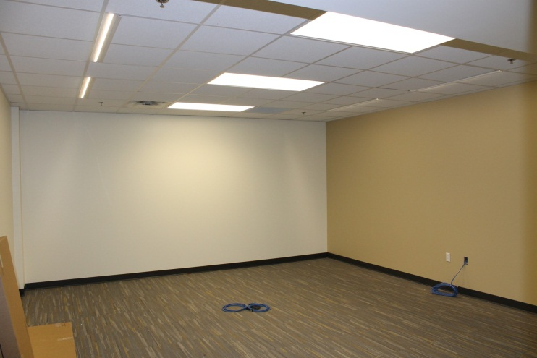
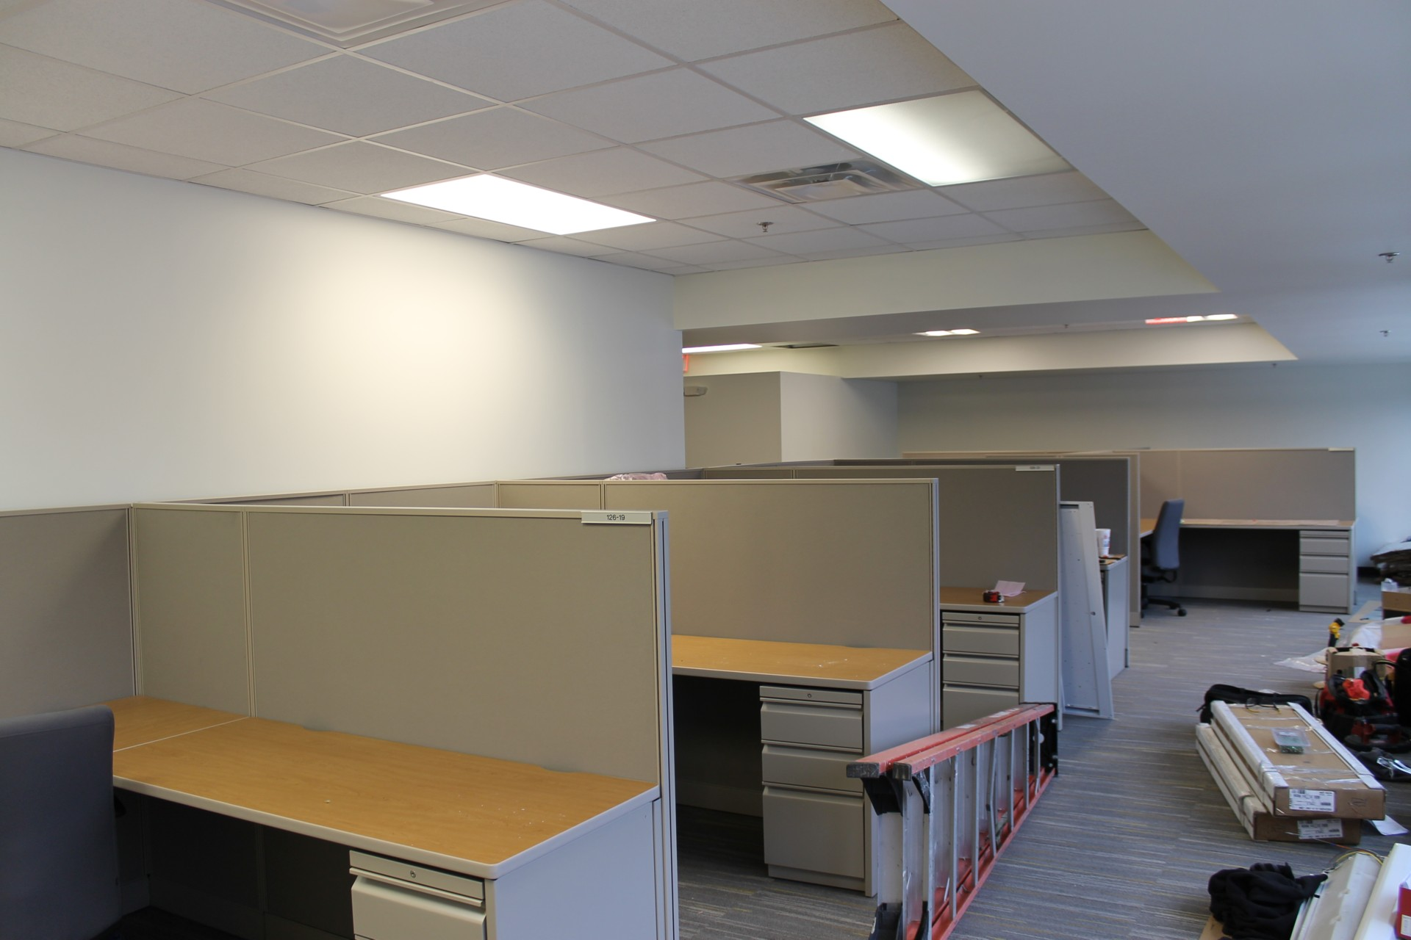
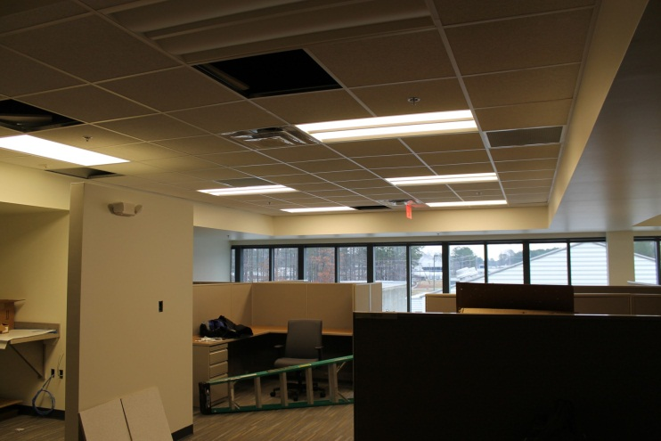
Counting House Renovation – Second Floor
Akers/Experimental Nuclear Physics January 13, 2015

Slide 13
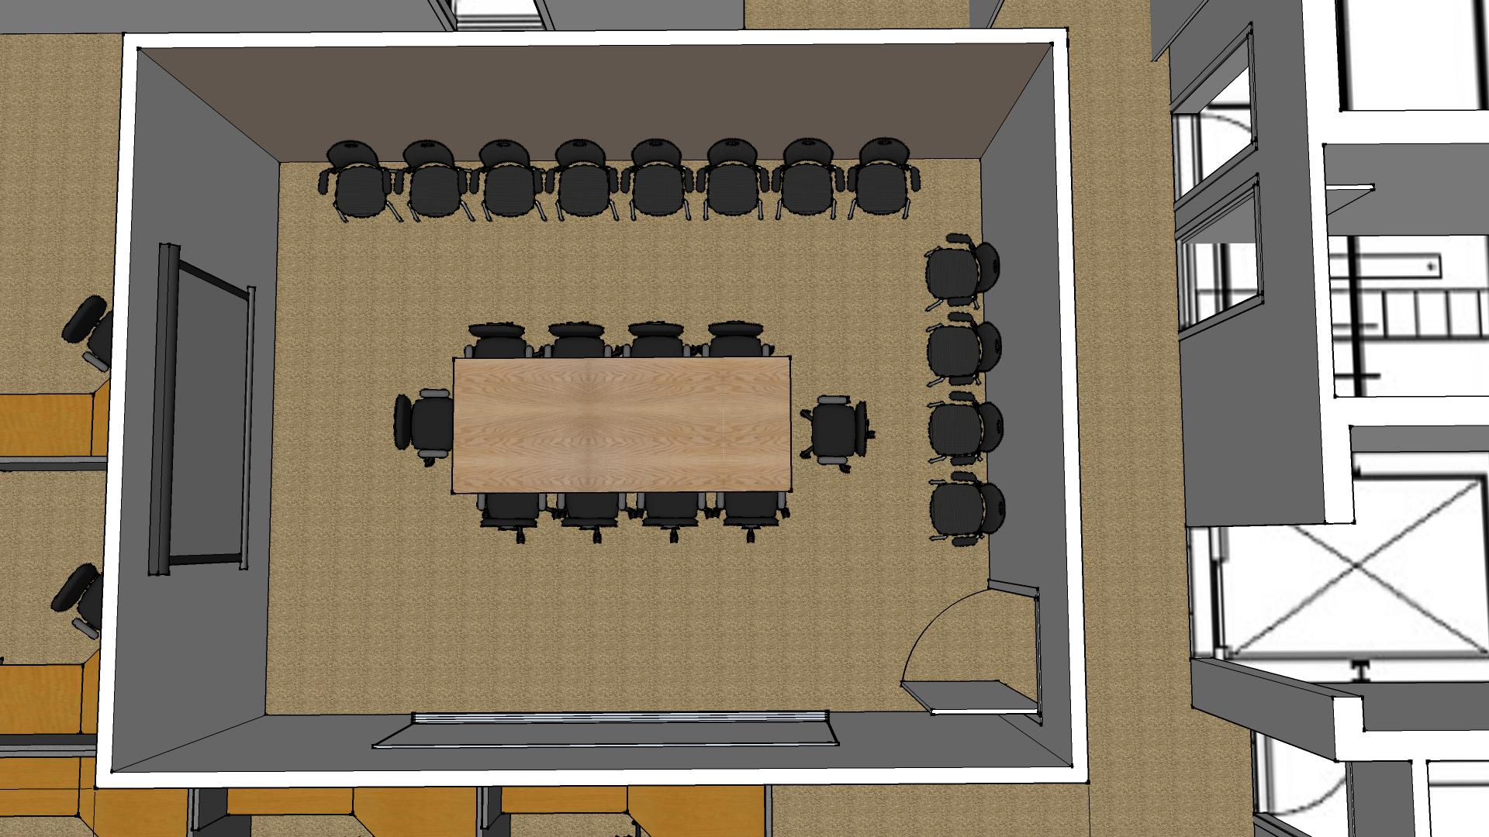
Single Rectangular Conference Table
Counting House Conference Room
Akers/Experimental Nuclear Physics January 13, 2015

Slide 14
Single Oval Conference Table
Counting House Conference Room
Akers/Experimental Nuclear Physics January 13, 2015

Slide 15
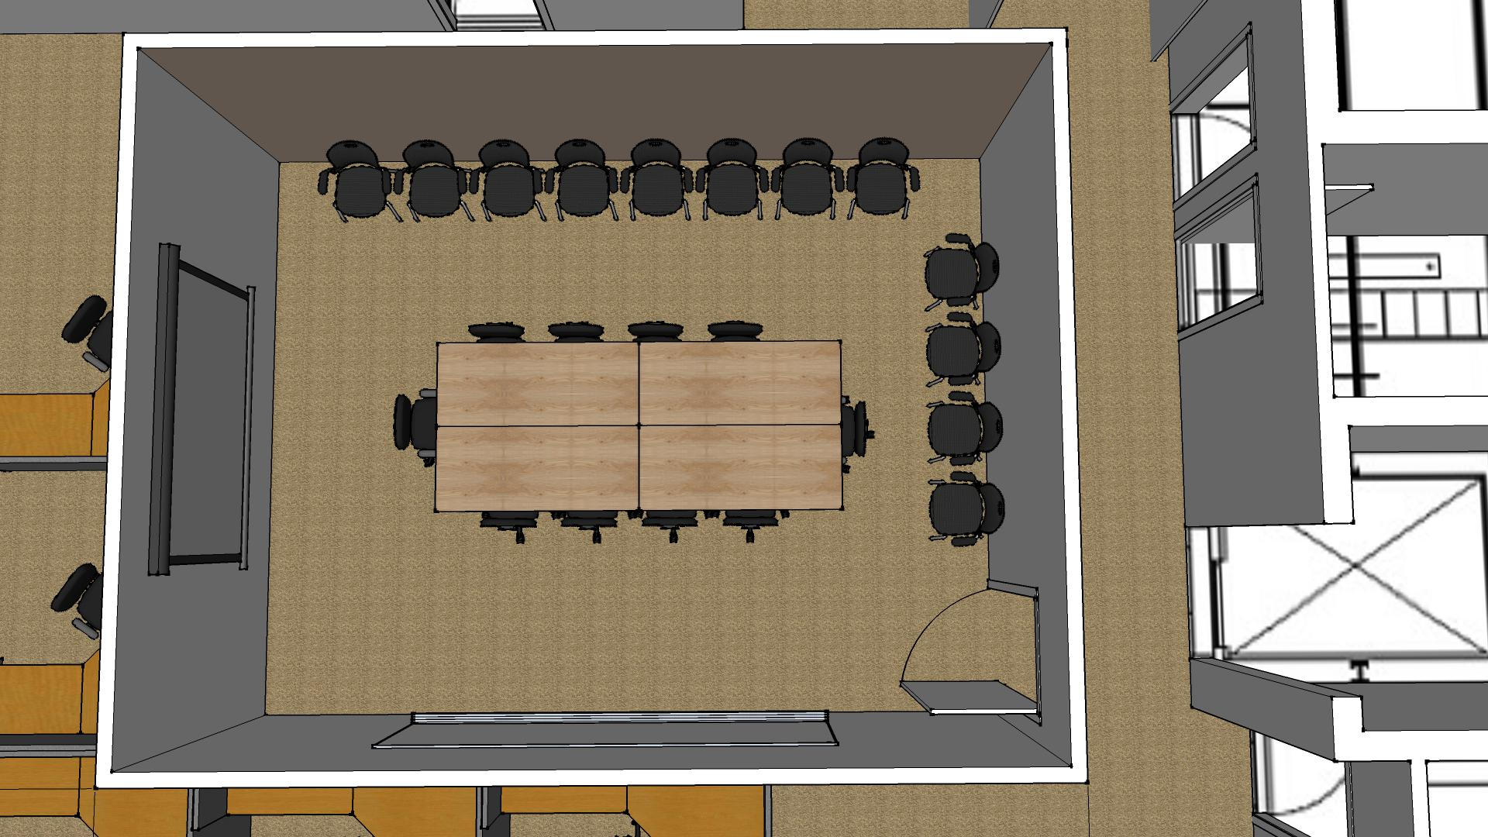
Multi-Rectangular Conference Table
Counting House Conference Room
Akers/Experimental Nuclear Physics January 13, 2015

Slide 16
Experimental Nuclear Physics
Other Facilities/Infrastructure Projects
Utilities Infrastructure Modernization Project
Facilities is near completion on electrical upgrade.
Cooling plant upgrade will begin in Summer 2015.
Automatic Flood Gates
Facilities has started the design for the Hall B automatic flood gate.
The Hall B gate should be installed by the end of summer.
The Hall B design will be adopted for all other experimental halls.
Water proof personnel doors will be considered in locations where they are needed.
General Space Requirements
Availability of space in the TEDF, Test Lab, Physics Chalet, Physics Storage and ESB varies.
Keep your Hall Leaders advised of space needs so arrangements can be made.
Akers/Experimental Nuclear Physics January 13, 2015

