Slide 1
HALL B UPDATE
Volker D. Burkert
Jefferson Lab
User Group Board of Directors Meeting
JLab, January 13, 2015
Outline: CLAS Physics Highlights
Early Physics in 12 GeV Era – HPS, PRAD
CLAS12 Overview User driven upgrades
Commissioning & Software
Tentative Run Schedule

Slide 2

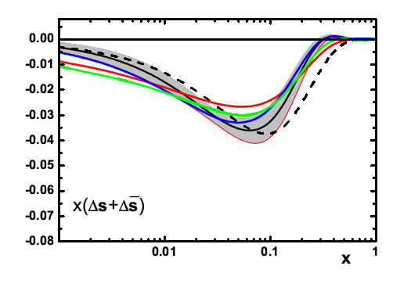
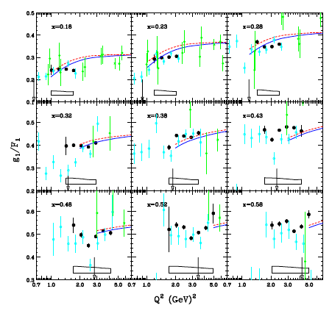
Precision g_{1p} and g_{1d} data and NLO QCD analysis
Y. Prok et al., PRC 90, 025212, 2014
Analysis that include semi-inclusive data give positive values for strange quark polarization.
Proton
E. Leader, A.V. Sidorov, D.B. Stamenov, arXiv.1410.1657 (2014)
Similar set on Deuteron
The NLO QCD analysis with precise new inclusive CLAS data shows “strange quark polarization is significantly negative”.

Slide 3
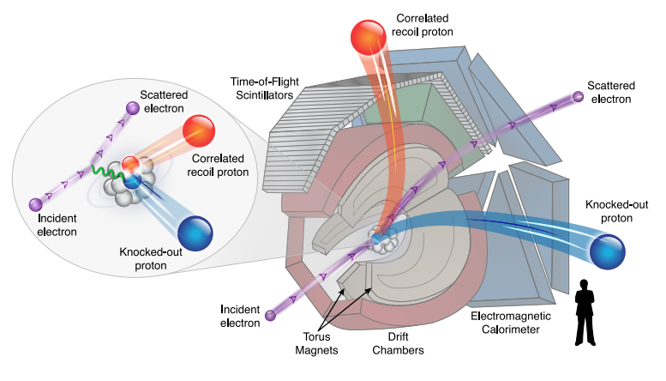
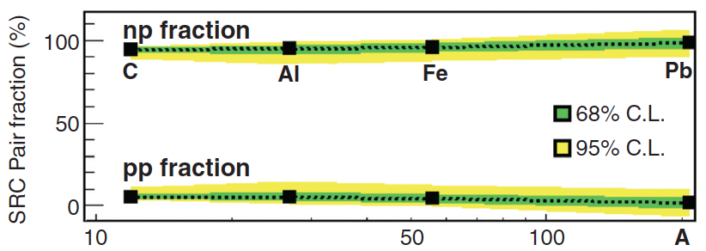
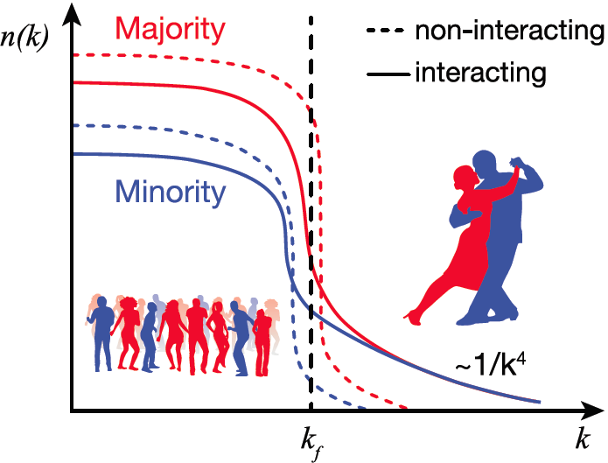
Momentum sharing in imbalanced Fermi systems
O. Hen et al., Science 346 (2014) 614, doi:10.1126/science.1256785
The Jefferson Lab CLAS Collaboration
Selected for Science Express (16 October 2014)
For momenta greater than the Fermi momentum (k_{f}), proton-neutron pairs dominate over proton-proton and by inference neutron-neutron pairs, even in neutron-rich heavy nuclei.
CEBAF Large Acceptance Spectrometer
The average proton momentum is increased by this pairing more than the average neutron momentum, completely unlike the effects of non-interacting Fermions in a mean field.
This type of momentum sharing in an imbalanced Fermi system has implications for the equations of state of neutron stars and atomic interactions in ultra-cold atomic gases and can be studied not only in nuclei but also in atomic systems
There will be an invited session at the APS meeting in Baltimore

Slide 4
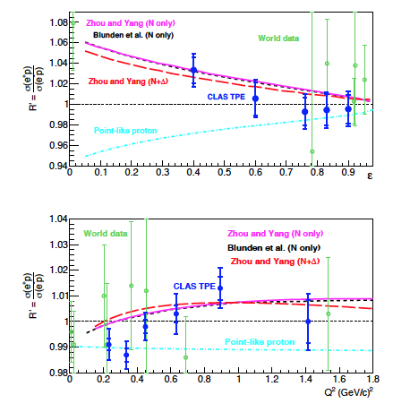
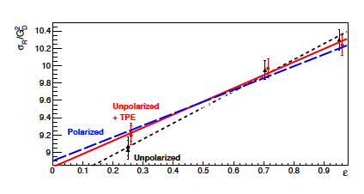
TPE Effects in Elastic ep Scattering
D. Adikaram et al. (CLAS Collaboration), arXiv:1411.6908, accepted by PRL.
Q²=1.45GeV²
Comparison of unpolarized form factor ratio with polarization transfer results after corrections for TPE.
ε=0.88

Slide 5
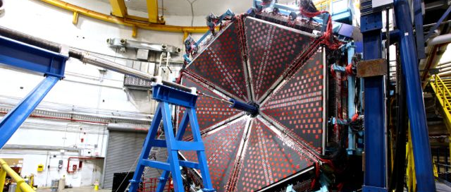
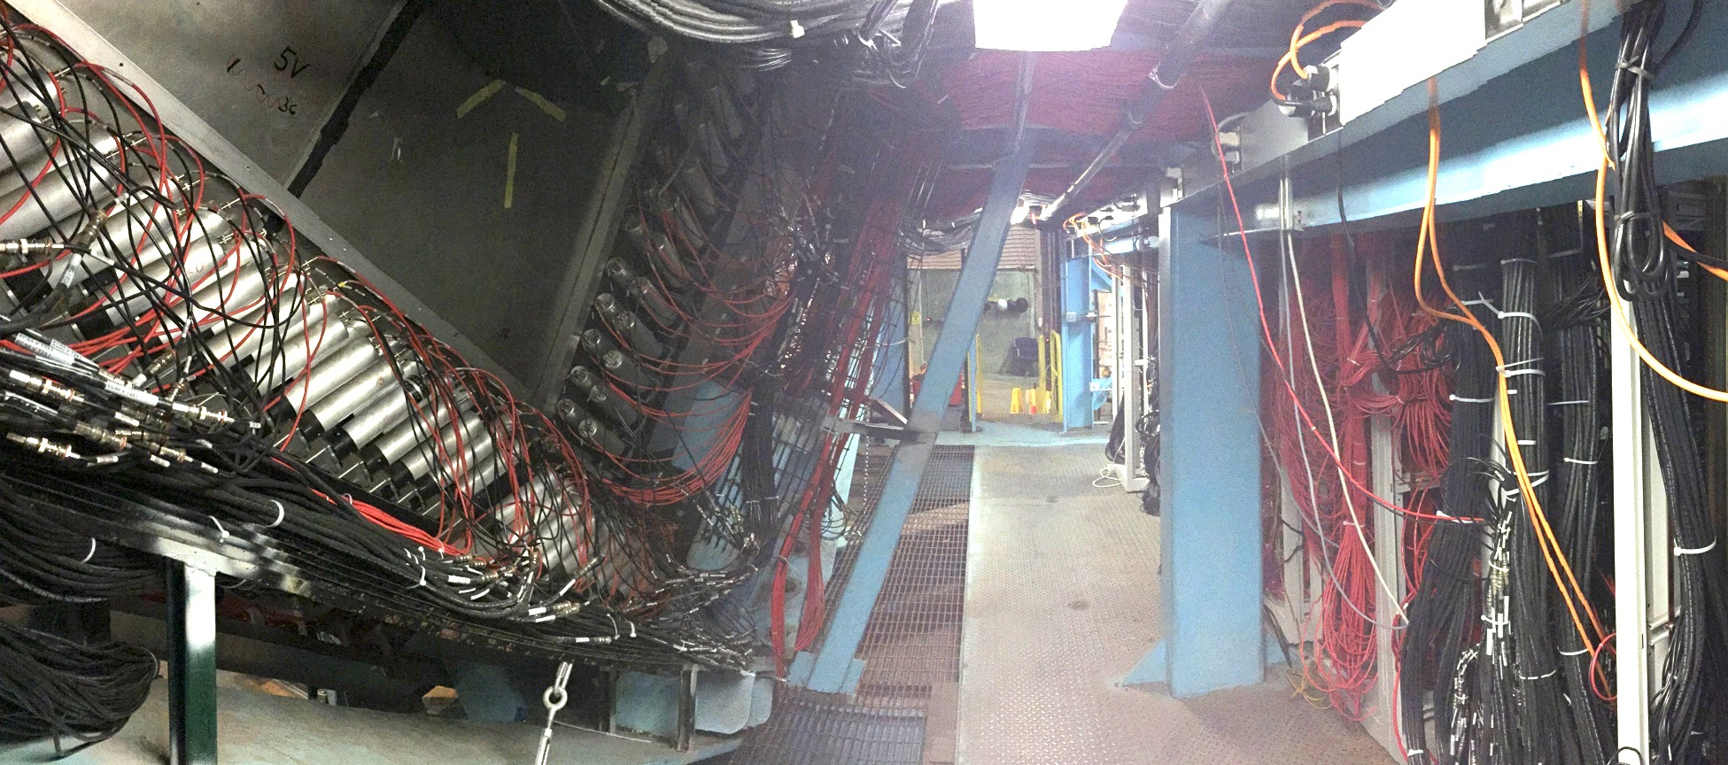
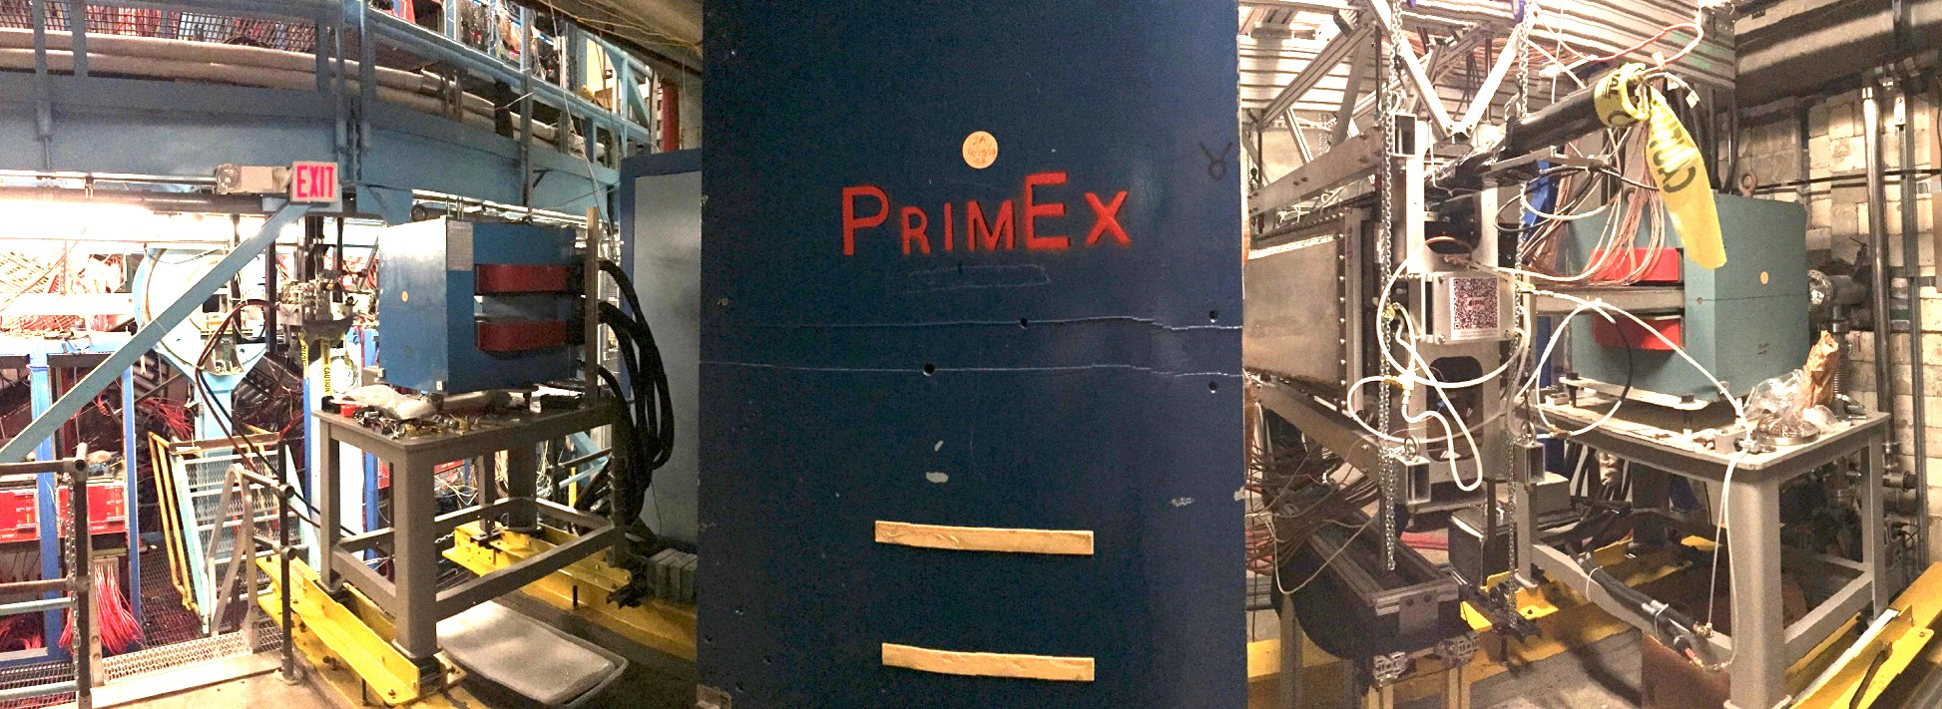
Status of HALL B
Forward Carriage
FTOF1a, FTOF1b, PCAL and EC essentially operational 2+ years prior to scheduled beam commissioning.
Checkout and Commissioning
Function and performance
Cables, PMTs, front-end electronics
Slow controls
Readout lists and translation tables
Firmware
Trigger timing, synchronization
Pedestal subtraction
FADC, TDC calibration
Stability issues
Beam Line
Commissioned up to Faraday cup.
BPMs, harps, halo counters.
HPS engineering runs receiving 1.8 GeV electrons up to 200 nA.

Slide 6

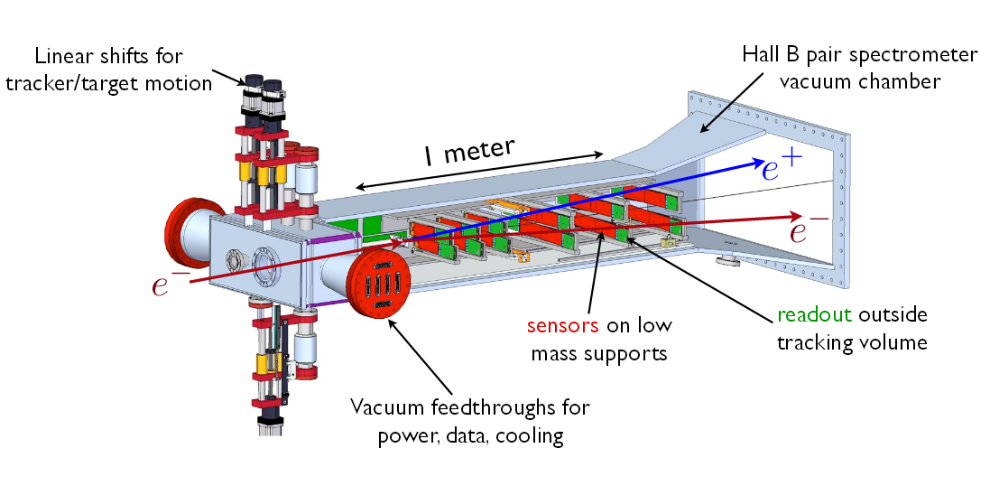
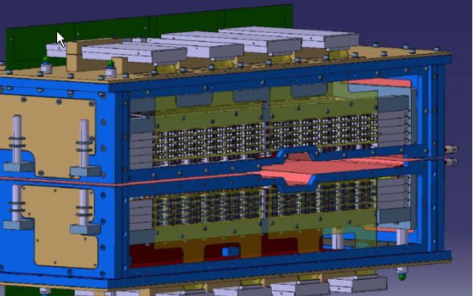
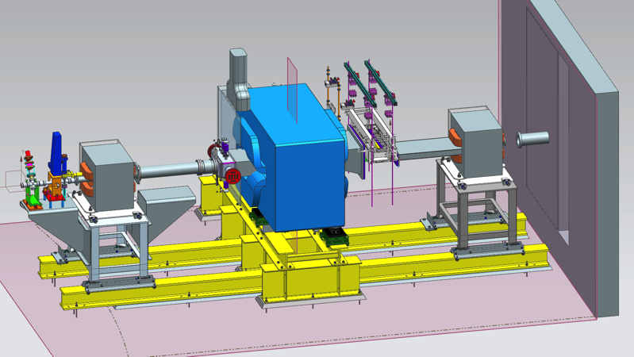
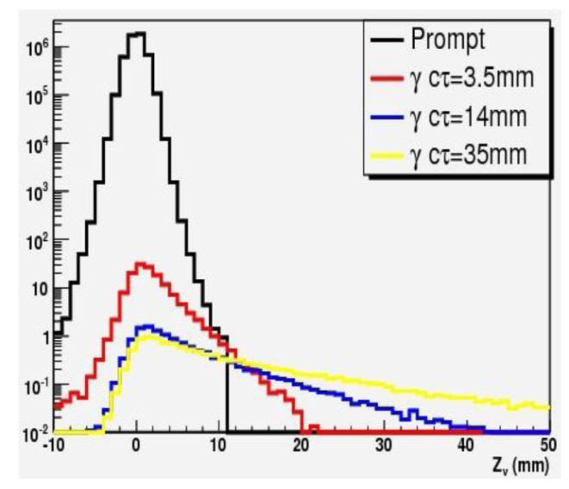
Heavy Photon Search at JLAB
Si Vertex Tracker
PbWO₄ ECal
HPS explores very small couplings
10⁻⁸ >ε²>10⁻¹⁰ for 15 < m_{A’}< 200 MeV
Small couplings mean
* small signals and large backgrounds
* long lived A’ with detached vertices
Small signals need large luminosities: good acceptance, fast electronics, high data rates, good mass resolution
Vertex cut eliminates trident backgnd
tridents
Z > 10 mm
A magnet chicane directs the electron beam onto a W foil, producing heavy photons. They decay to e⁺e⁻ pairs, which are measured by the Si vertex tracker inside an analyzing magnet. A PbWO₄ ECal provides a fast trigger

Slide 7
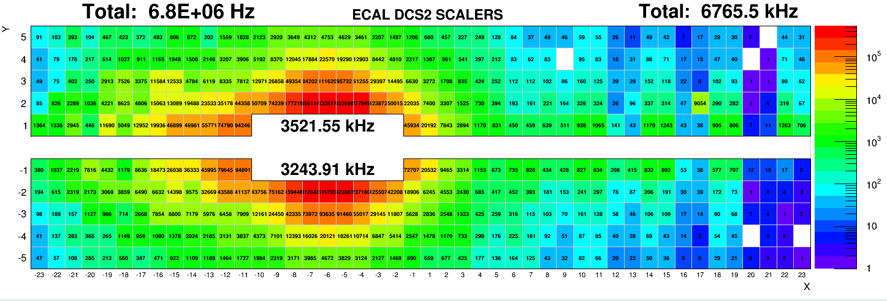
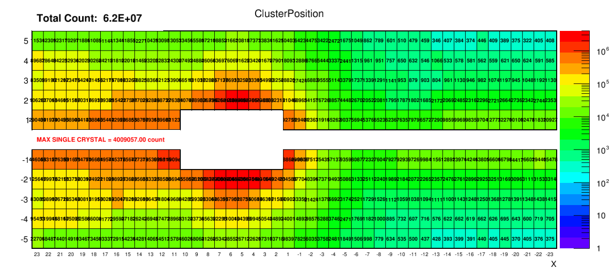
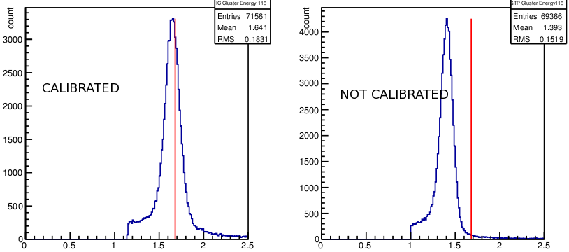
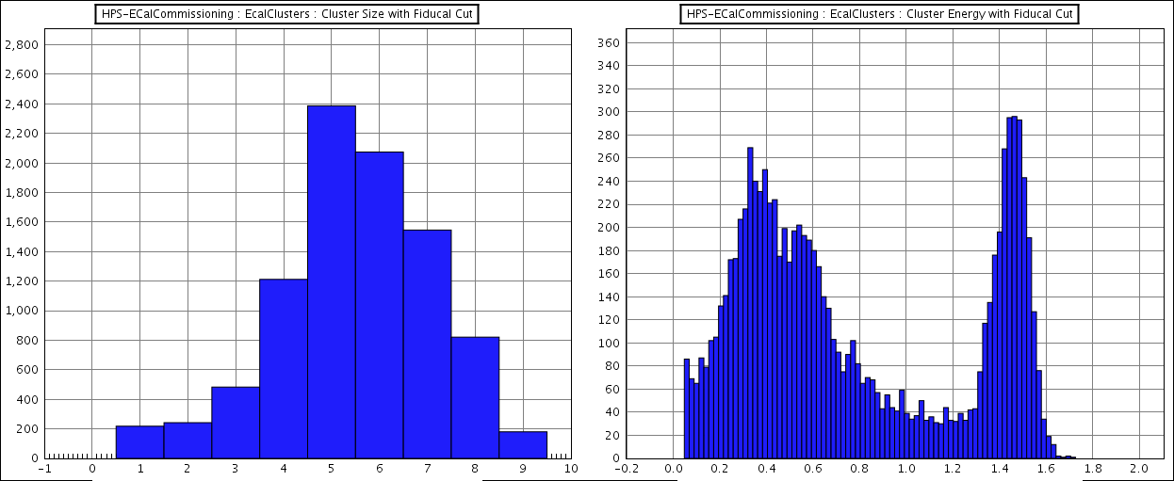
ECAL commissioning with beam
ECAL showed excellent performance during the commissioning run
Singles rates were as expected from simulations
Dead-timeless trigger rate of 80kHz has been achieved (HPS needs ~25kHz)
Data with single cluster and two cluster trigger were acquired for calibration and trigger studies
On-line Scalers, singles rates
Trigger monitoring, cluster position and rates
Coulomb scattered beam electrons will be used to re-calibrate ECAL module gains
Preliminary analysis looks very promising, gains found using “seed” hit energy
On-line cluster monitoring
Elastic electrons
Number of hits in 3x3 cluster
Energy distribution in 3x3 cluster
Cluster energy (GeV), before correcting for leakage

Slide 8
2015 Reach and Existing Limits
HPS is scheduled to run in Spring 2015 with ~2.2 GeV electron beams. Additional running at 1.1 and 4.4 GeV is possible.
The 2015 running will search for A’s at small couplings with the vertex search. The same data are sensitive to larger couplings with a traditional bump hunt.
Additional running in 2017 and beyond will extend the reach to higher masses, and discover True Muonium (μ⁺μ⁻ atom)
Contours on the plot represent 1 week of running at 1.1 GeV and 2.2 GeV and 2 weeks at 4.4 GeV
Bump Hunt
HPS
(1 week of 2.2 GeV)
Vertex search

Slide 9

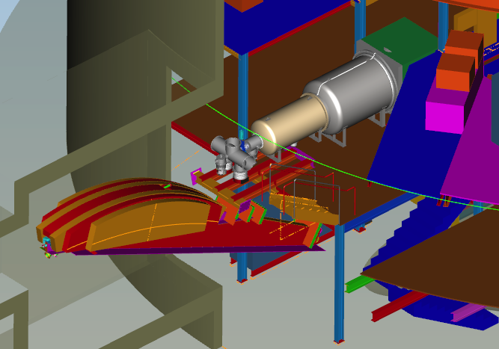
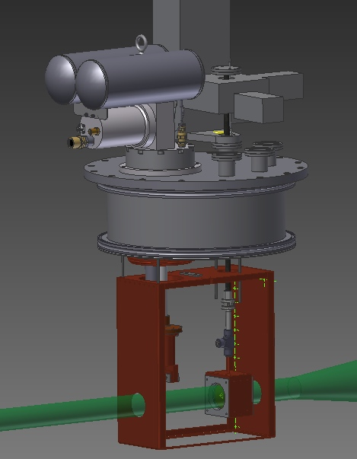
PRad preparations
Experiment layout
Target chamber
tagger magnet
Gas target cell
HyCal
Windowless gas target is being built by JLab target group.
Vacuum box is being fabricated by Meyer Tool
Vaccum box

Slide 10
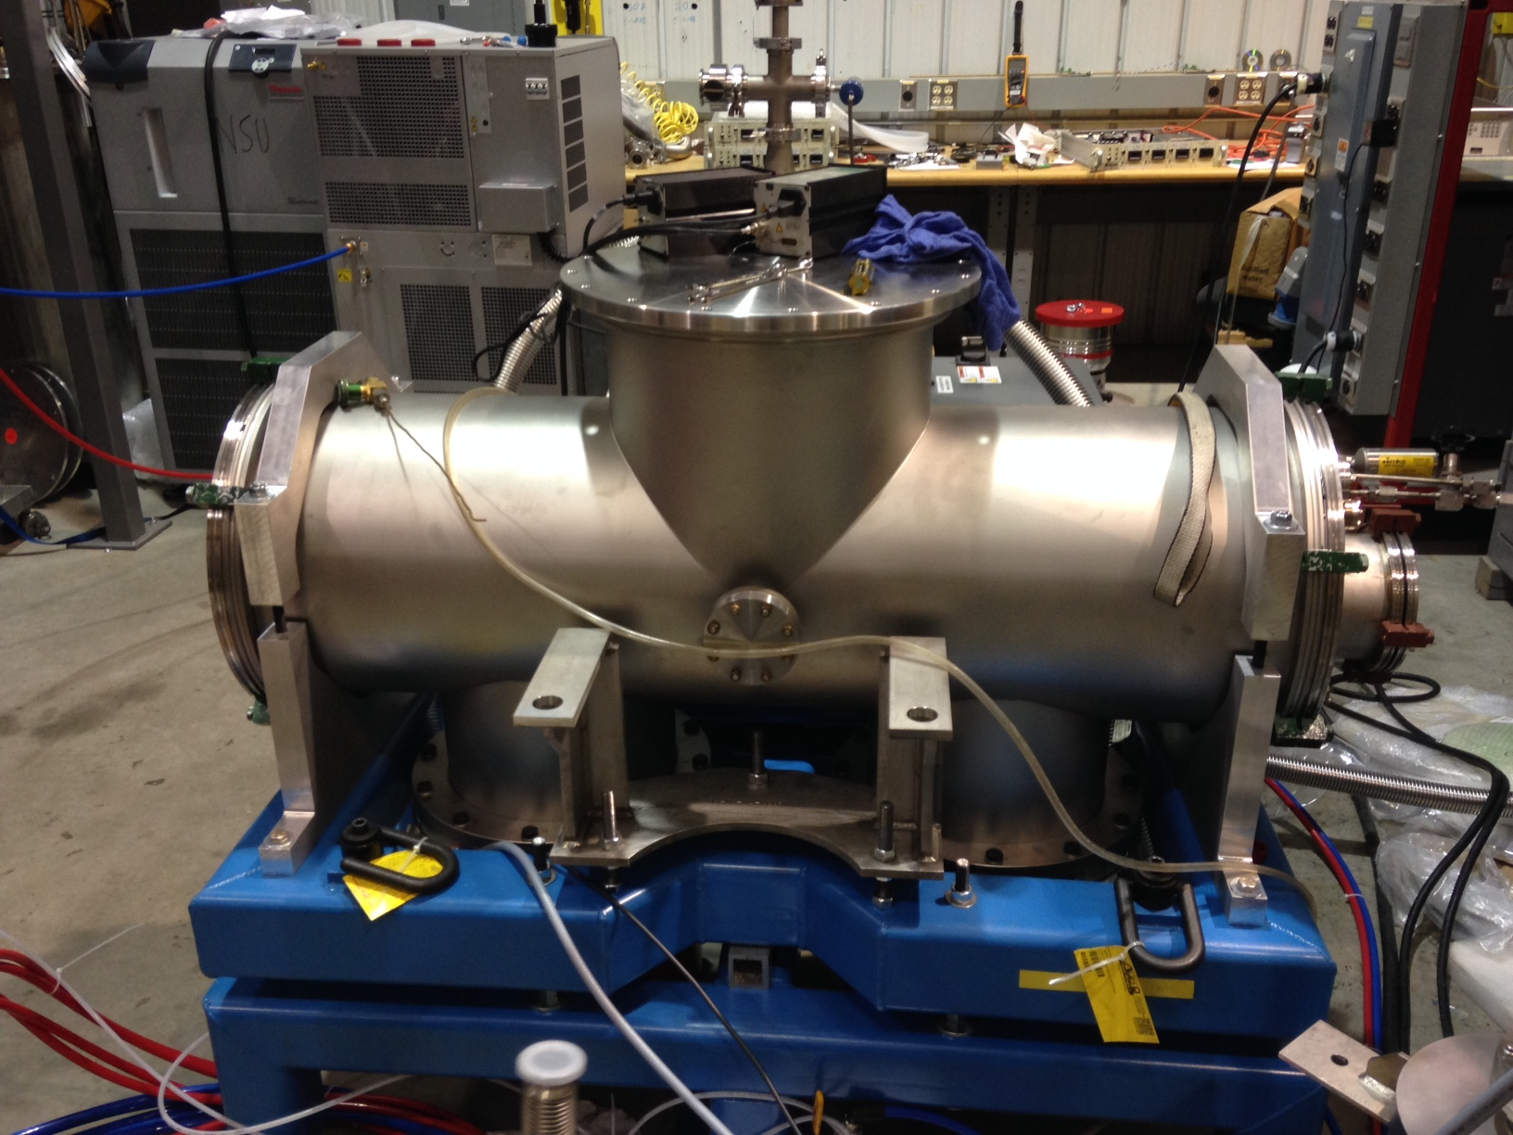
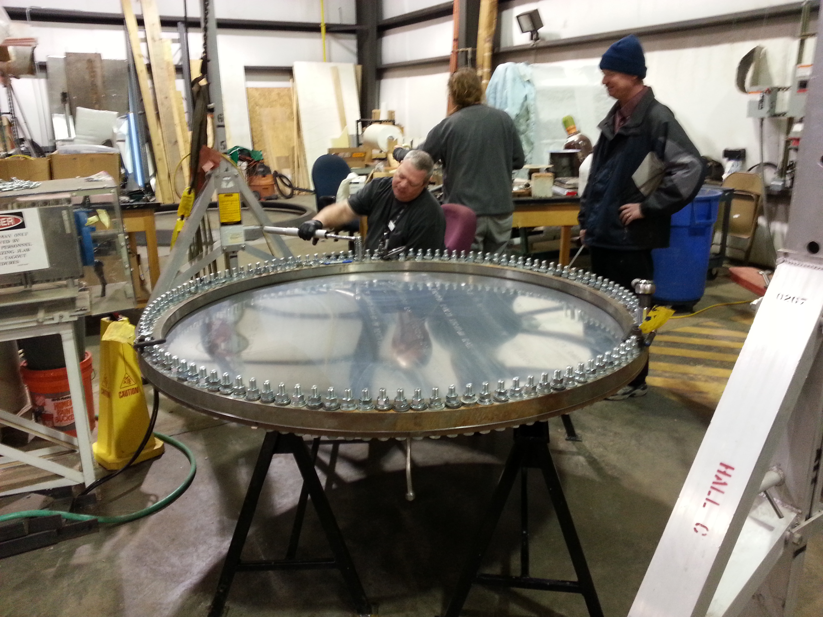
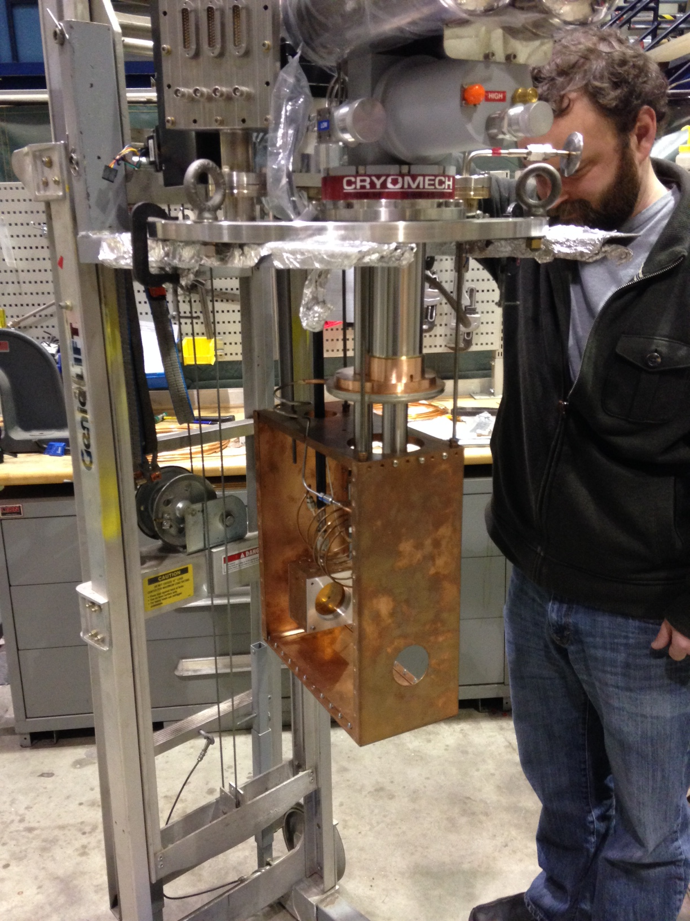
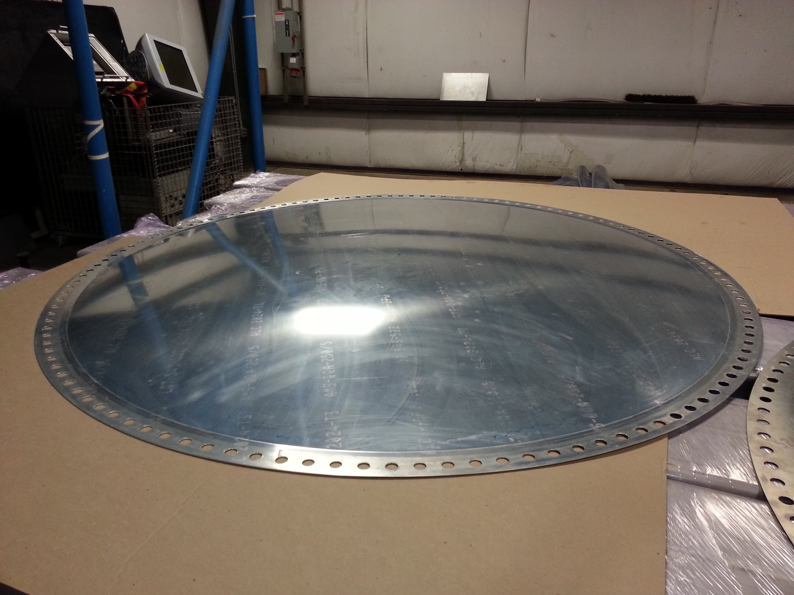
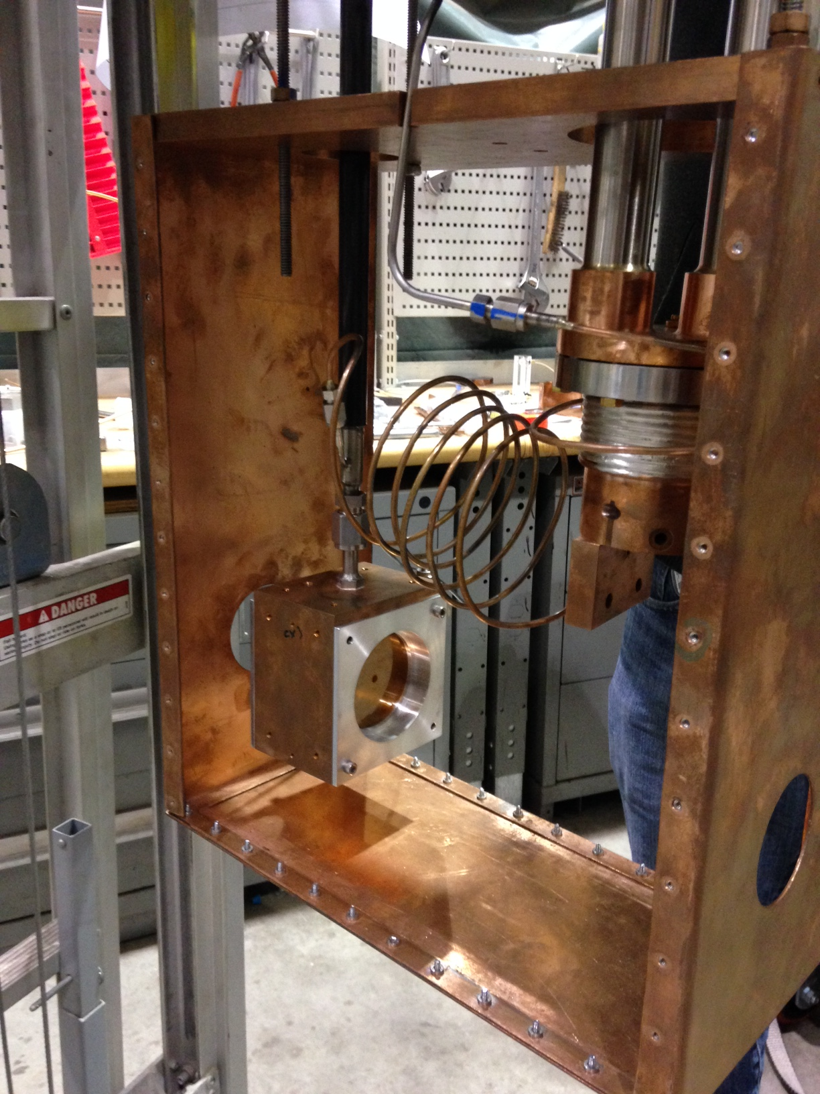
PRad preparations
Hydroforming vacuum window
Windowless gas target construction
target chamber
target head
target cell

Slide 11
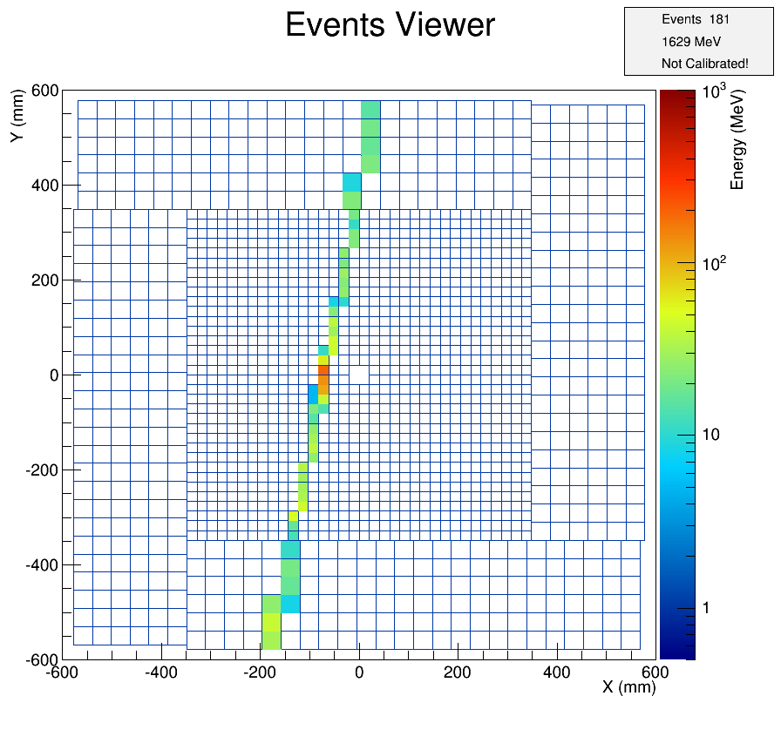
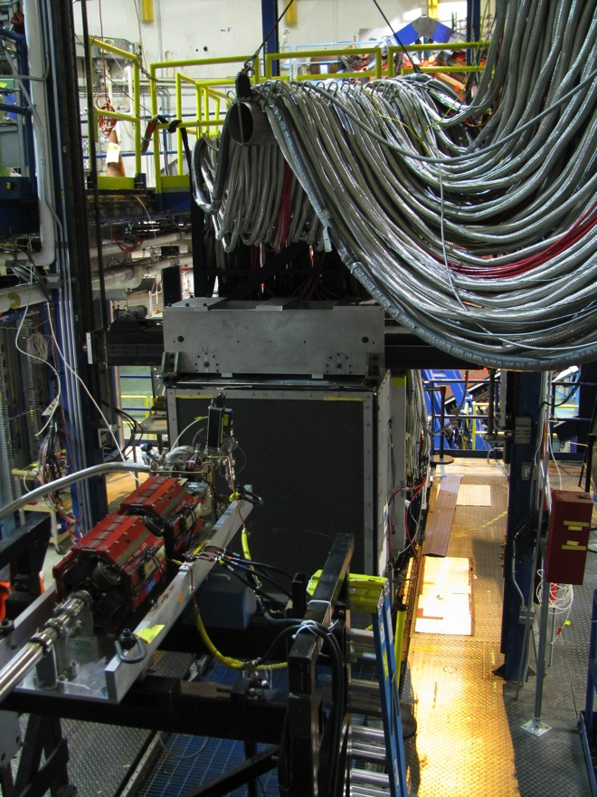
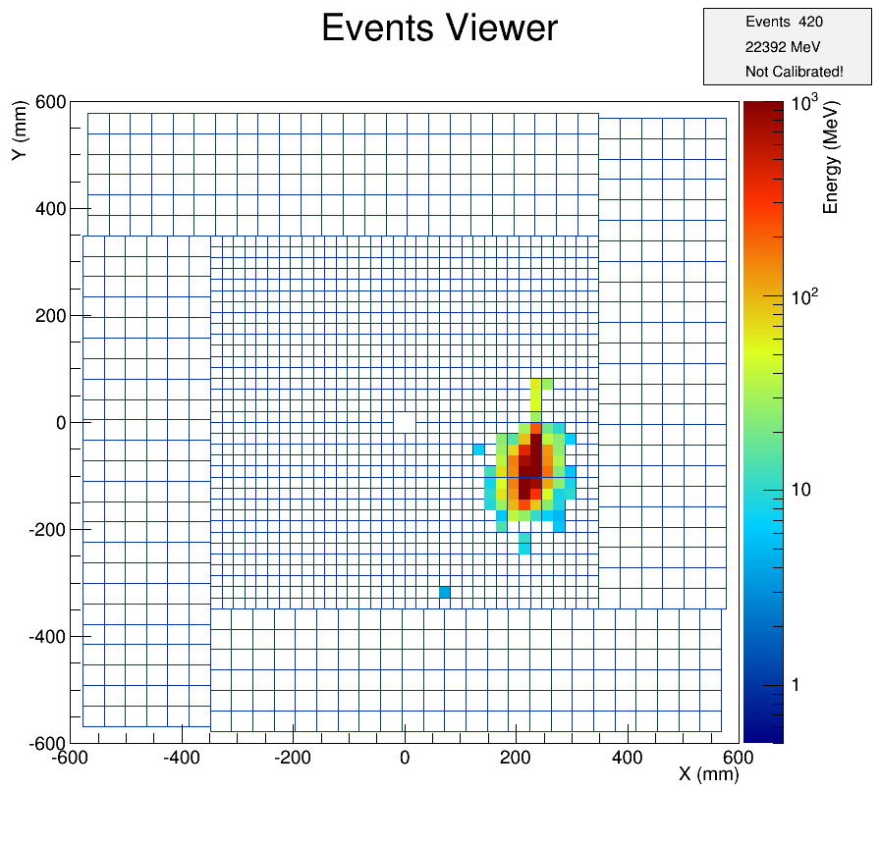
PRad preparations
sample cosmic events
HyCal is ready:
  All detectors checked/repaired
  Cooling is operational
  Light monitoring system checked/repaired
  Transporter operational
  DAQ is operational.
GEM detector is being built at UVA
HyCal on the transporter

Slide 12
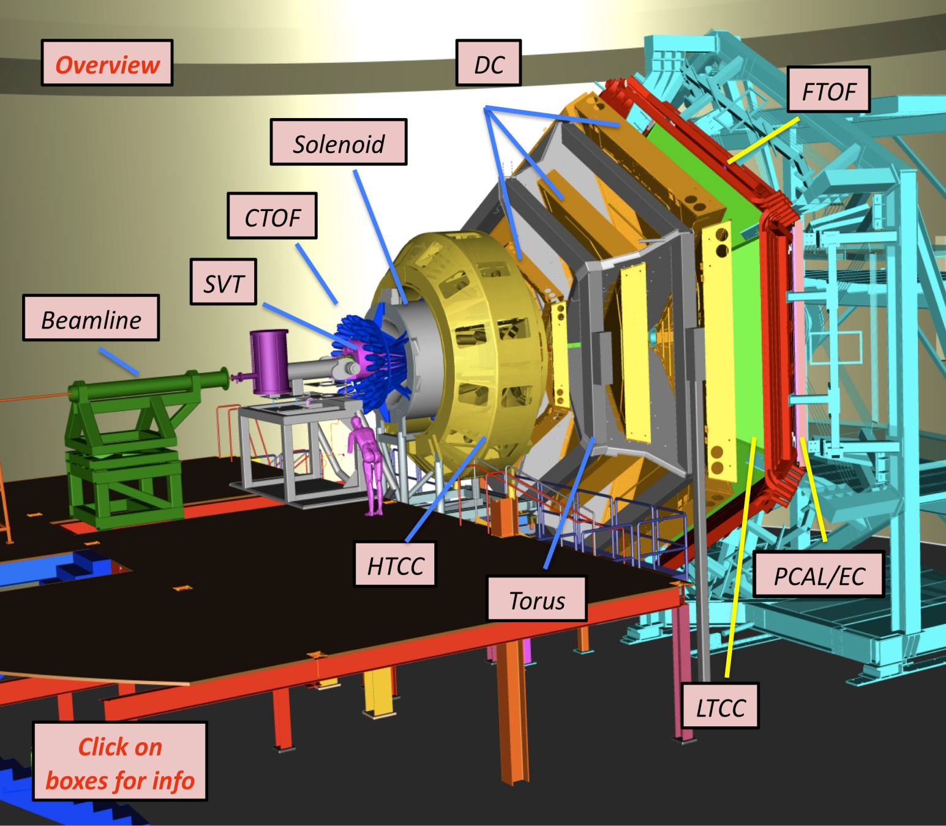
Scope & upgrades to the baseline
CLAS12
Forward Detector (FD)
  - TORUS magnet (6 coils)
  HT Cherenkov Counter
  Drift Chamber System
  LT Cherenkov Counter
  Forward ToF System
  Pre-Shower Calorimeter
  E.M. Calorimeter
Central Detector (CD)
  SOLENOID Magnet
  Barrel Silicon Tracker
  Central Time-of-Flight
Beamline
  Targets
  Moller Polarimeter
  Photon Energy Tagger
Upgrades to the baseline
- Central Neutron Detector - MicroMegas
  Forward Tagger
  RICH Detector (2 sectors)
  Polarized Target (long.)

Slide 13
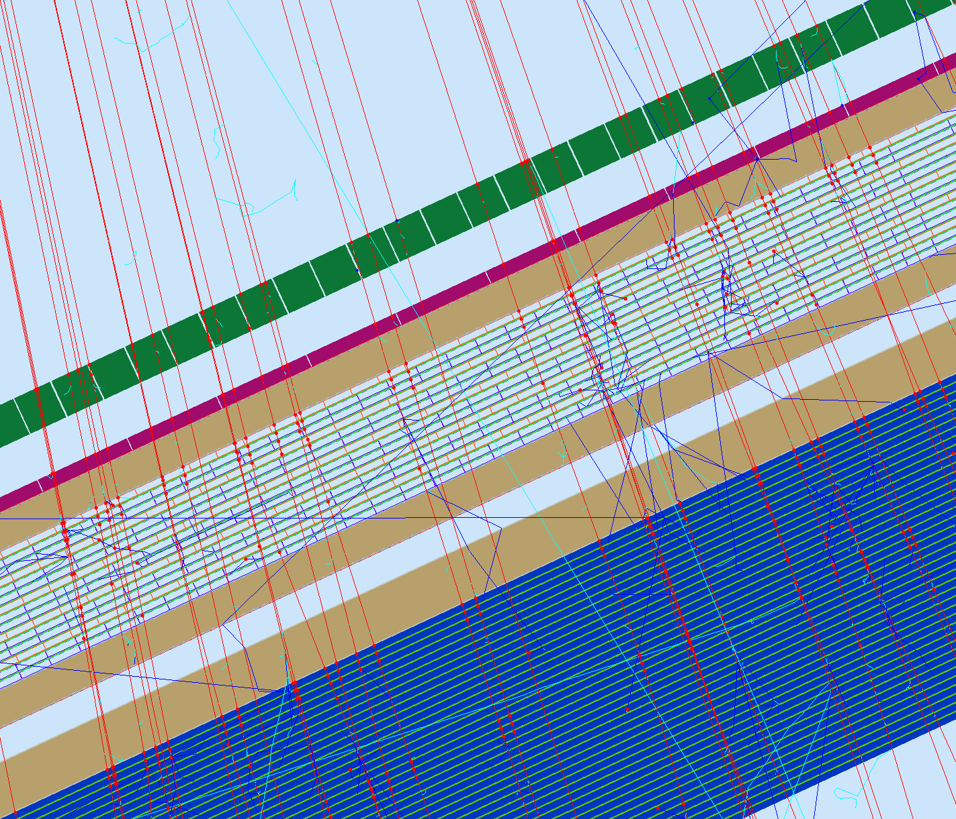
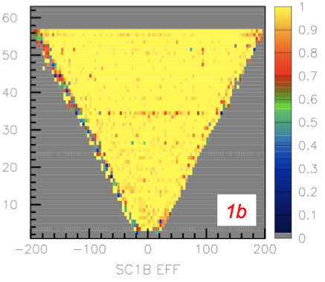
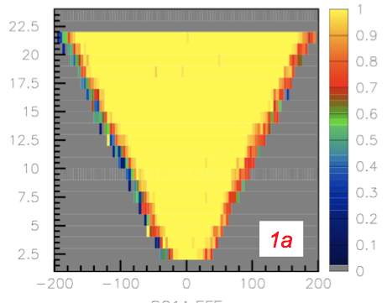
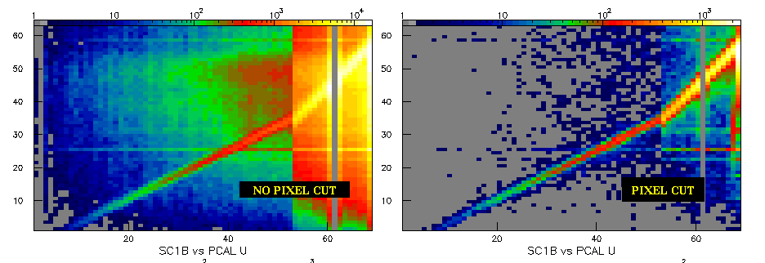
FTOF/PCAL : Alignment and Efficiency Studies
Use PCAL pixel filter to select vertical muon tracks for energy calibration and predict FTOF hit x,y coordinates for efficiency and alignment studies.
Measured efficiencies > 99% for both 1A and 1B planes for Sector 5.
SC 1B
Pixel Cut
SC 1A
From CLAS NOTE 2014-006
PCAL
EC
μ
SC1B Efficiency
Geometry offsets
SC1A Efficiency
PCAL U coordinate

Slide 14
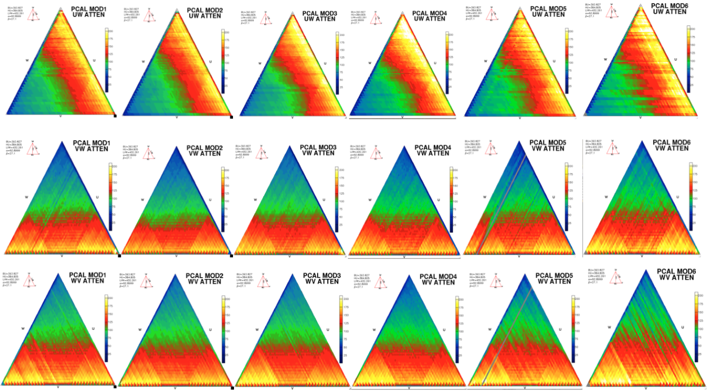
PCAL Light Response from Cosmic Rays
Spatial distribution of light response for all 6 modules for UW,VW and WV planes
Sector 4
Sector 3
Sector 2
Sector 1
Sector 6
Sector 5

Slide 15
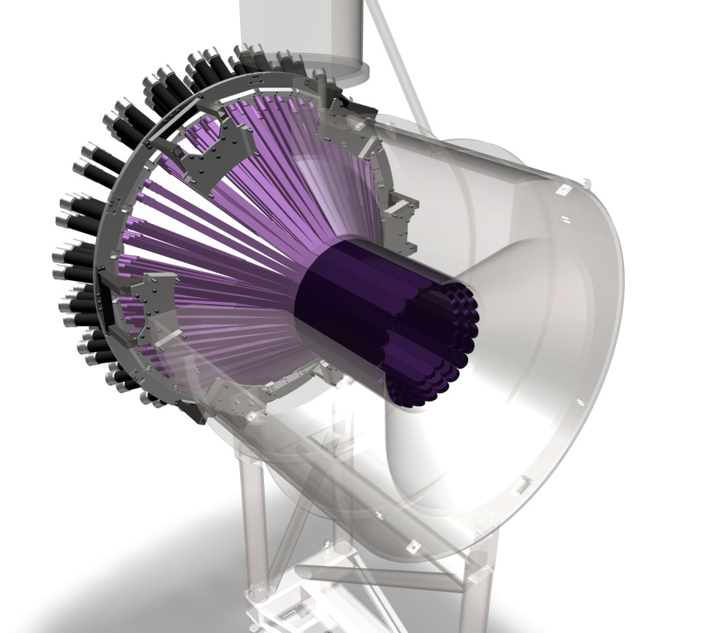

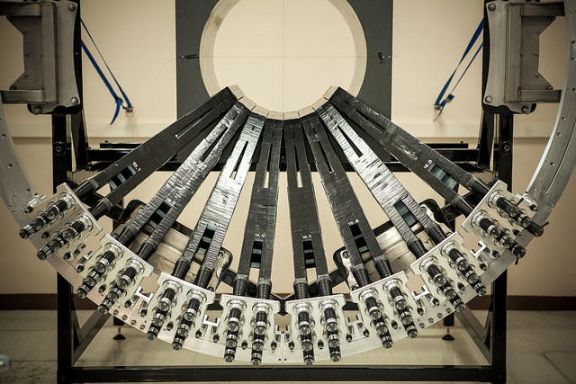
Central Neutron Detector
CLAS12
1/3 of the CND assembled in mock-up solenoid
Detect neutrons in range 0.2< p < 1.0GeV/c
at θ = 40º - 120º, Δφ = 360º
48 segments in azimuth, 3 radial layers
72 u-turn shaped light guides connect
neighboring segments for light readout
144 PMTs Hamamatsu R10533 with triple
layers of magnetic shielding
Time resolution δT = 130ps.
As of 11/25: CND is 2/3 complete. Expect shipping to JLab: Spring 2015

Slide 16
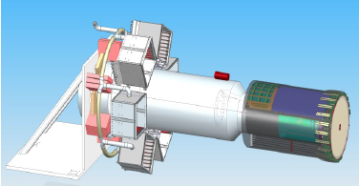
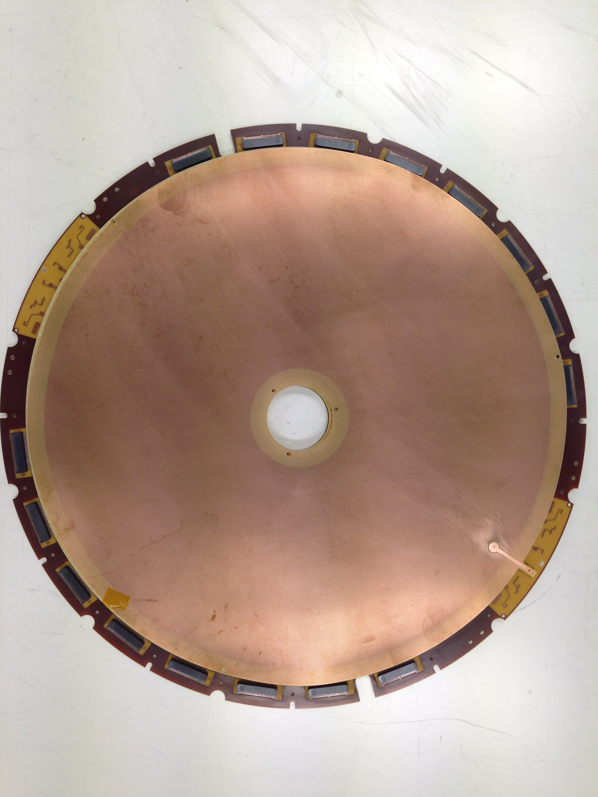

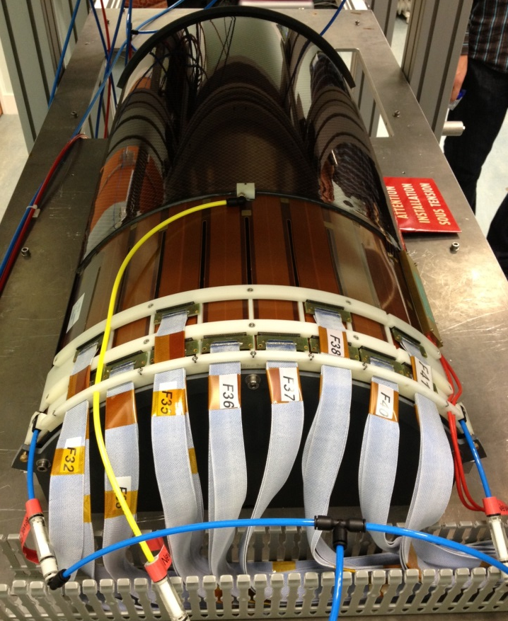
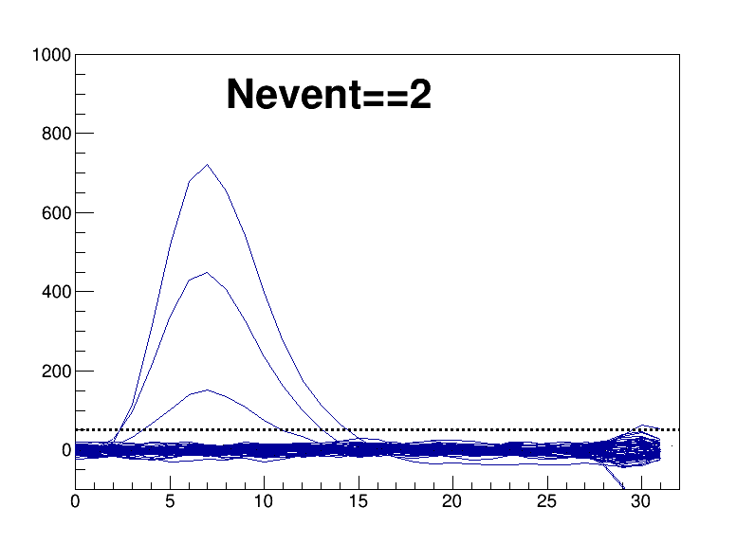
MicroMegas Vertex Tracker
CLAS12
MVT
Forward FMT
Prototype
Schedule:
FMT: Ship all 6 detectors to JLab by mid-2015
BMT: Ship 2 layers to JLab mid-2015,
Remaining 4 layers in 2016
Barrel BMT - 120º layer prototype

Slide 17
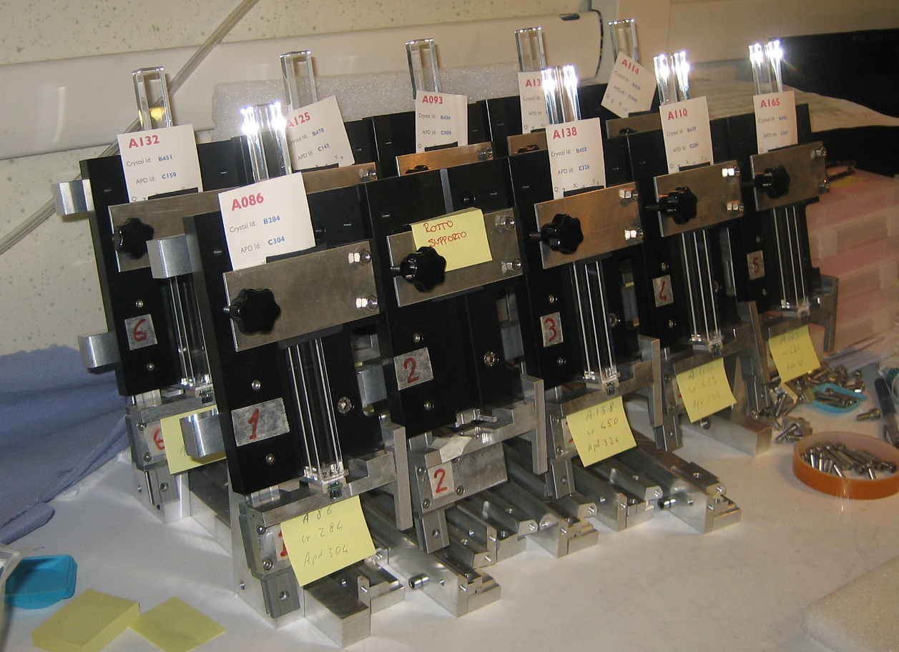
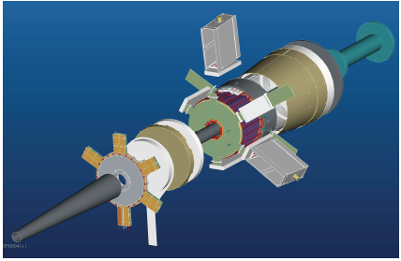
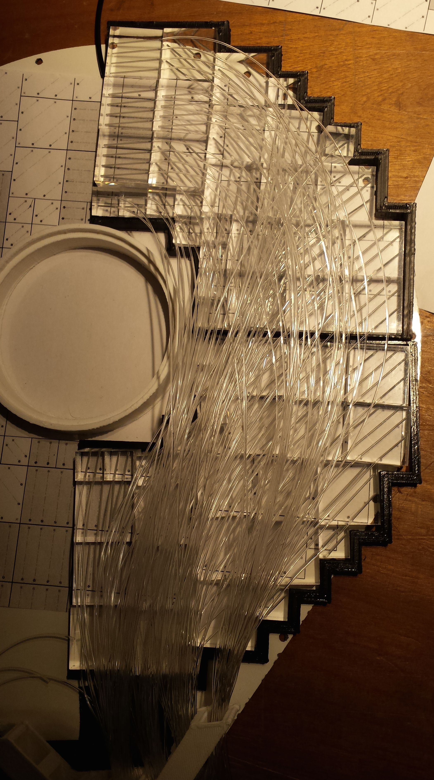
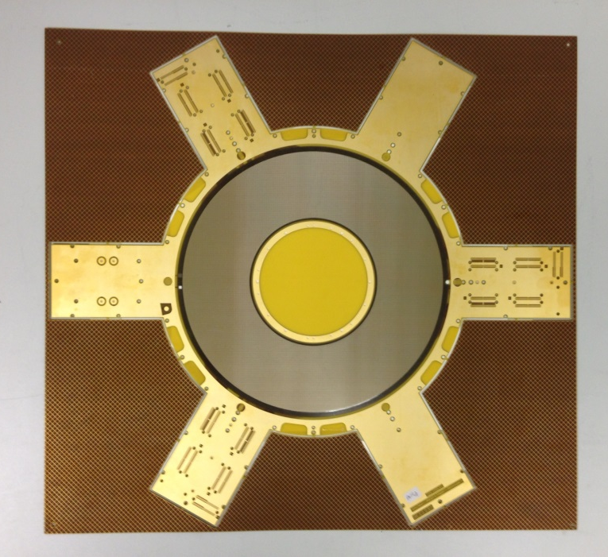
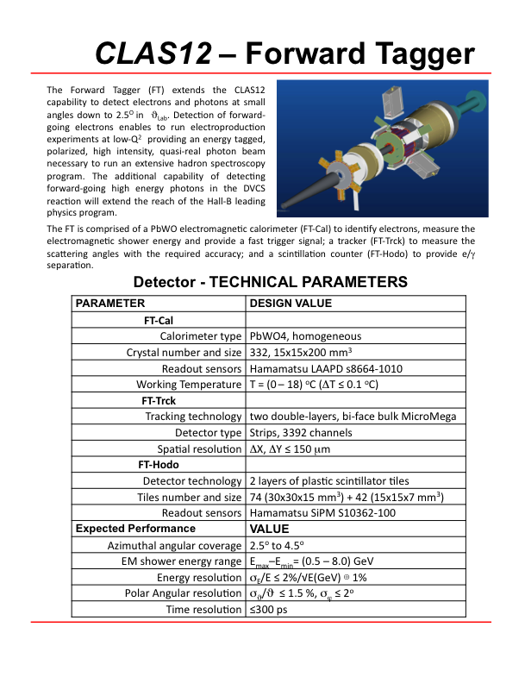
Forward Tagger System
CLAS12
Tags quasi-real photons through small angle electron scattering
INFN, CEA, Glasgow
Battery of crystals ready for wrapping
FT-Trk prototype
FT-Hodo tiles and fibers

Slide 18
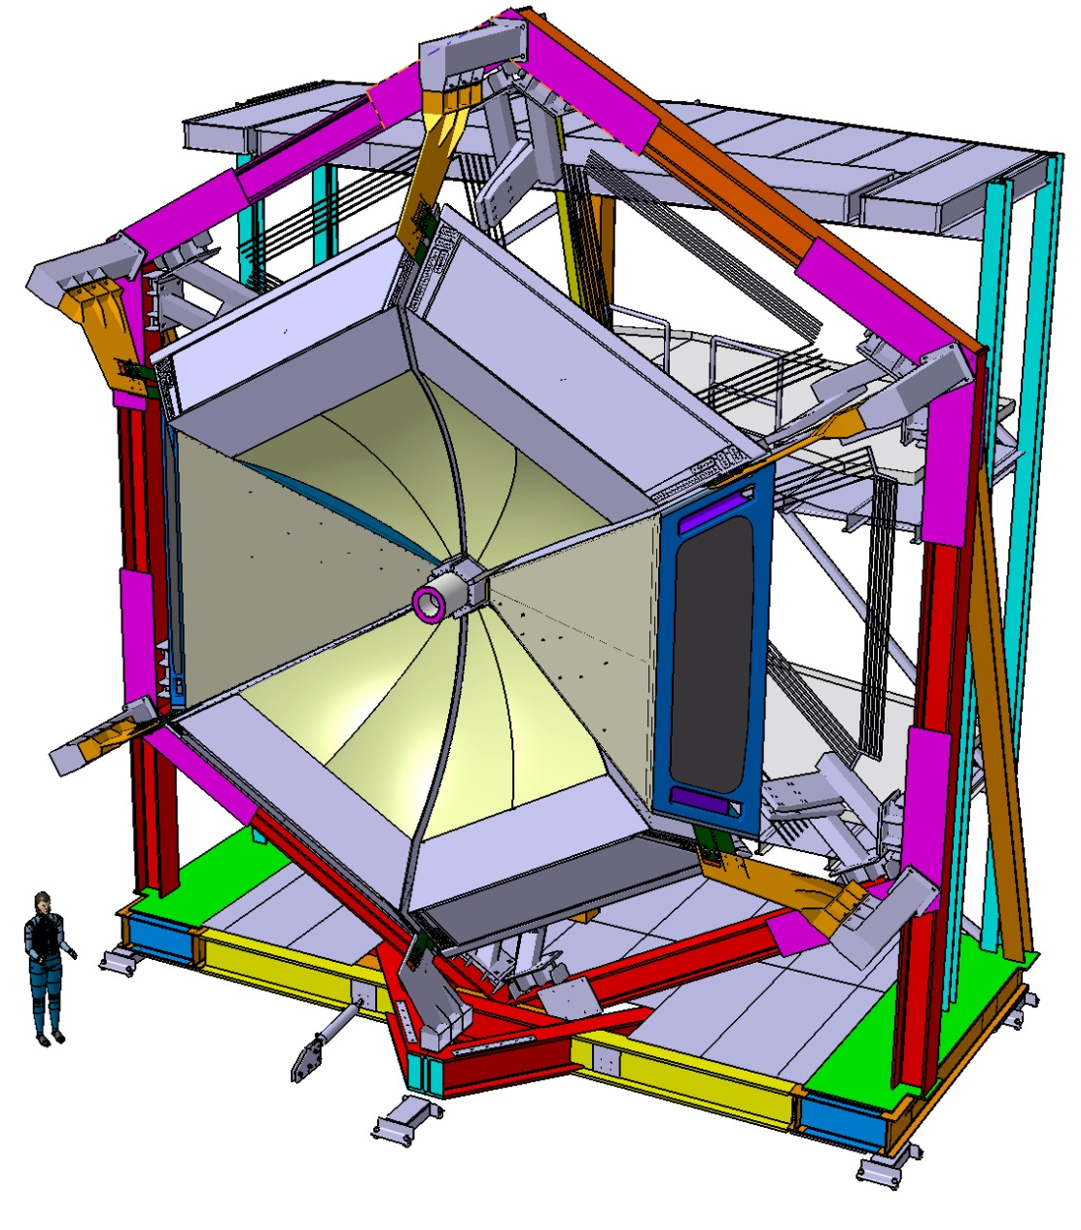
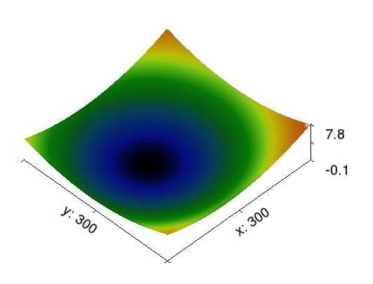
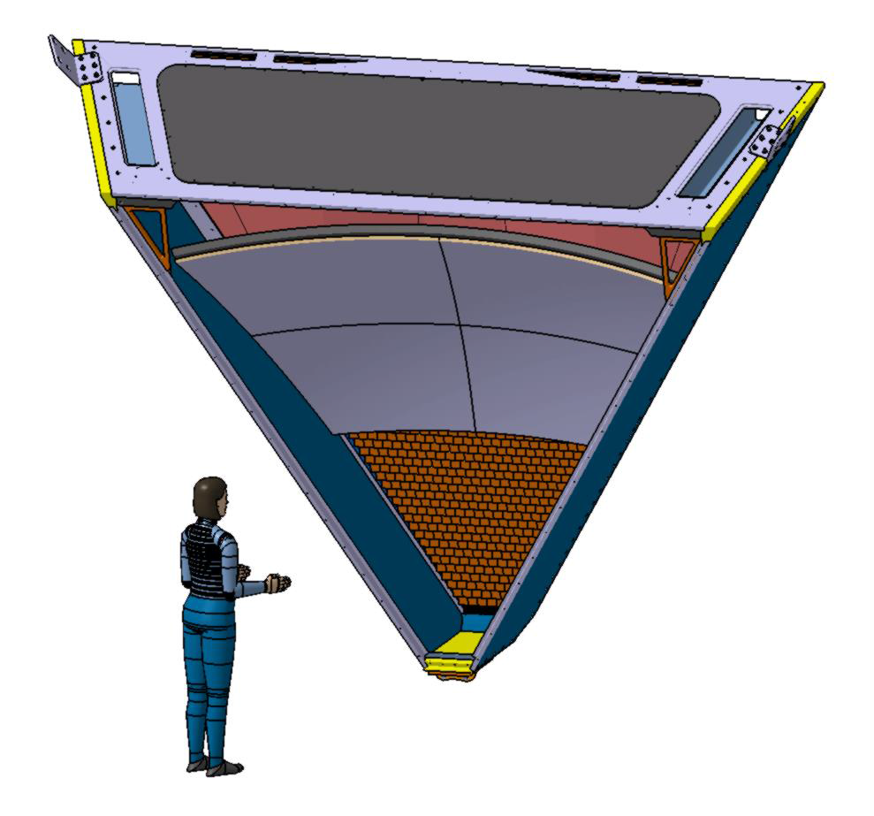
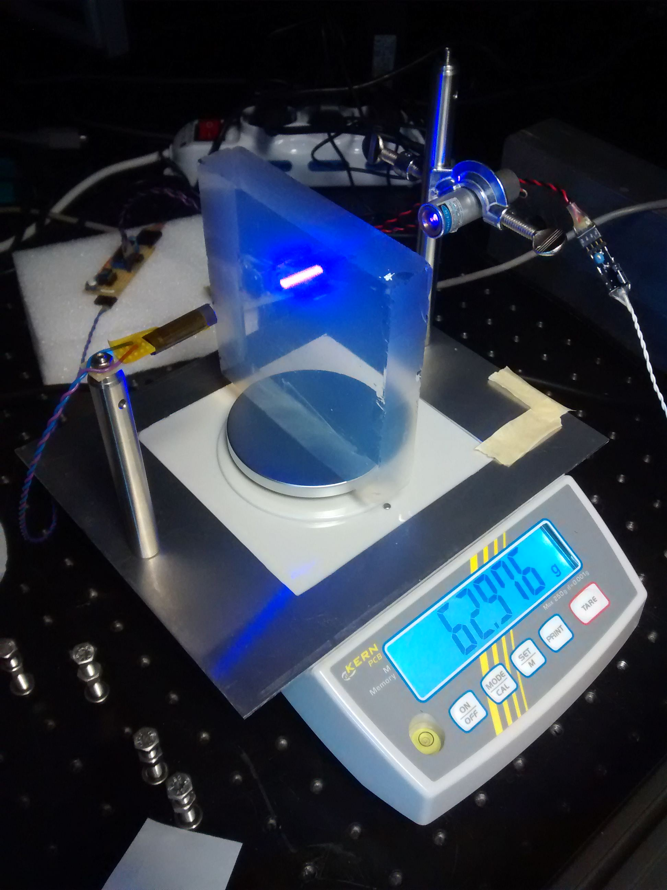
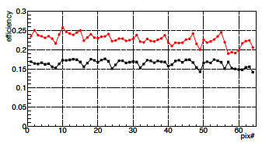

RICH Detector
CLAS12
INFN(Italy), JLab,
Argonne National Lab, Duquesne University,
Kyungpook National University (Republic of Korea),
J. Gutenberg Universitat Mainz (Germany),
Universidad Tecnica Federico Santa Maria (Chile),
University of Connecticut, University of Glasgow (UK)
Schedule: One sector ready mid-2017
Spherical mirror demos characterization
Large aerogel tile (20x20 cm² production started, long term stability tests ongoing
Initial shape ok
Aging test ongoing
H12700
Front-end board prototypes delivered
RICH Module
mechanics has
passed review
by JLab engineers
H8500
MAPMT tests

Slide 19

Commissioning & Software
CLAS12
Nearly all detector components included in GEMC and in detector reconstruction software
Internal Software review – 11/6-7, 2014
Commissioning with Beam Review – 01/15/2015
Plan to be ready for in-beam commissioning in the summer of 2016.

