Slide 1


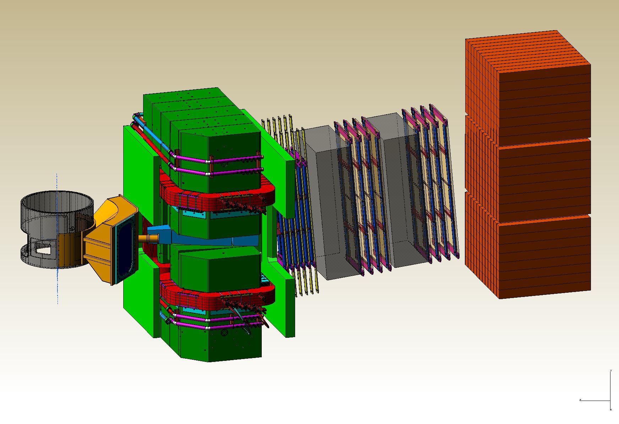
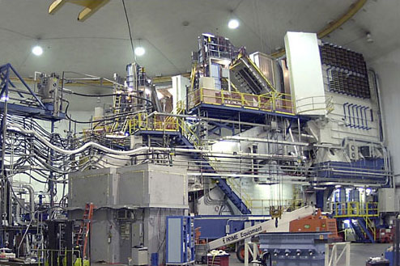
Hall A Update
Thia Keppel
User Group Board of Directors
January 2015

Slide 2
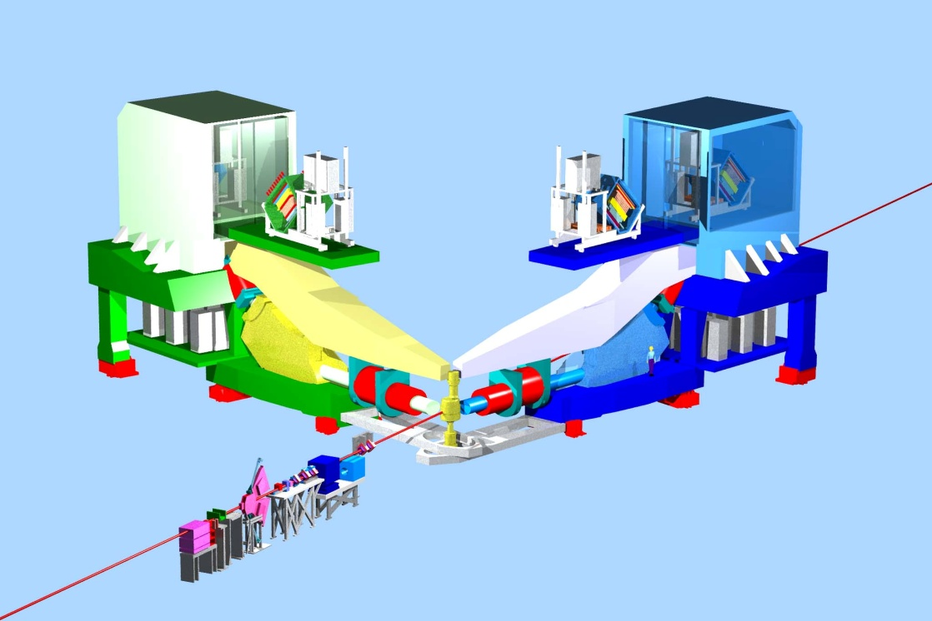
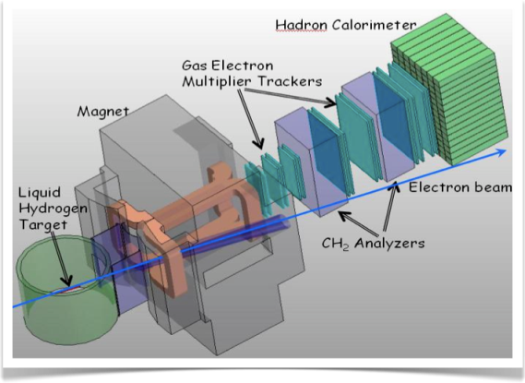
Hall A Planning
3 A-rated experiments in first years of running
G_{M}^{p} (HRS-R) and DVCS (HRS-L + calo) run is combined
Some flexibility incorporated
16 mo. Shutdown
12 GeV Commissioning
Early Experiments
DVCS-I and G_{M}^{p}
³H/³He APEX/PREX (A1n)
Access to GPDs
Photon calorimeter to be installed on floor
EM Form Factor
d/u at High x
Requires tritium target, venting system and BigBite spectrometer
Dark photon A’/Neutron skin
Both require additional small angle septum magnets
Neutron spin structure
Polarized 3He target
12 GeV Projects:
1. Moller polarimeter
2. Compton polarimeter
3. Energy measurement upgrade
SBS Experiments
EM Form Factors
at high Q²
SBS Project
11 GeV
SuperBigbite
Spectrometer
Beam 1st to Hall A
FY 2013
FY 2014
FY 2015
FY 2016
FY 2017
commissioning beam

Slide 3
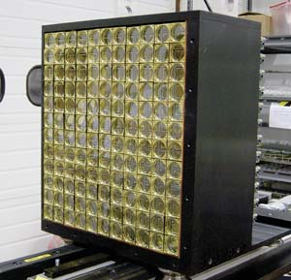
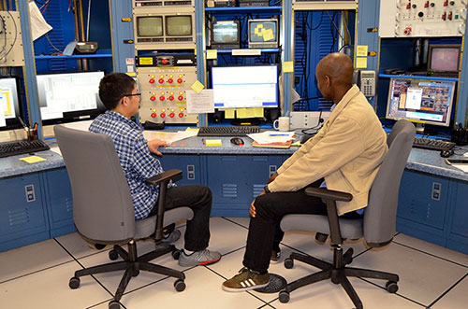
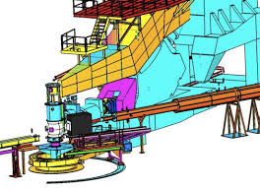
DVCS / G_{M}^{p} Experiments in the Hall now
Spring/Fall 2014, Spring 2015
5 graduate thesis students, 3 sabbatical faculty, 3 postdocs
Start up again mid February with 5 pass, 10+ GeV beam
Problems with HRS Q1-R (L too?)
Target test cell
Notes:
F2 and C12 scans good for acceptance studies

Slide 4
March Checkout Run: Electrons in Right HRS spectrometer at 2.0 GeV/c on carbon target and set beam energy of 6.1 GeV!
On JLab home page, also made DOE Office of Science “Headlines”

Slide 5
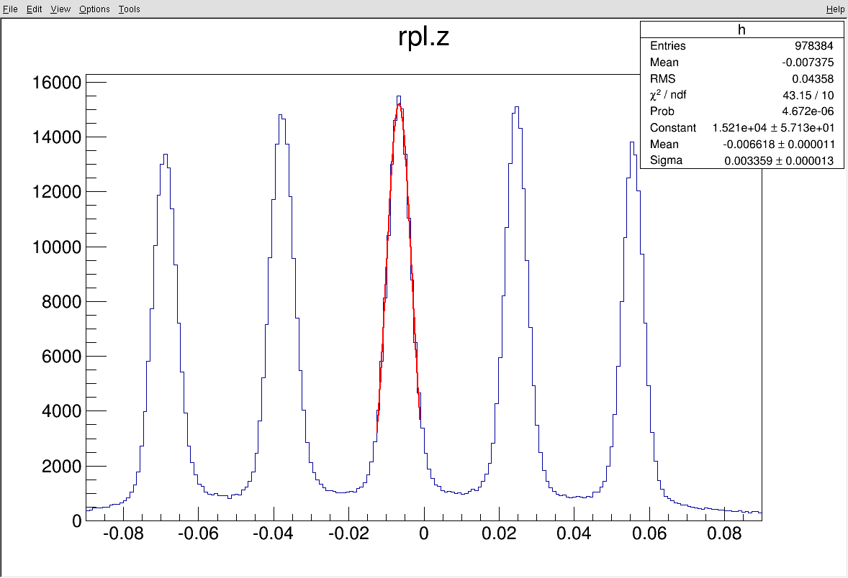
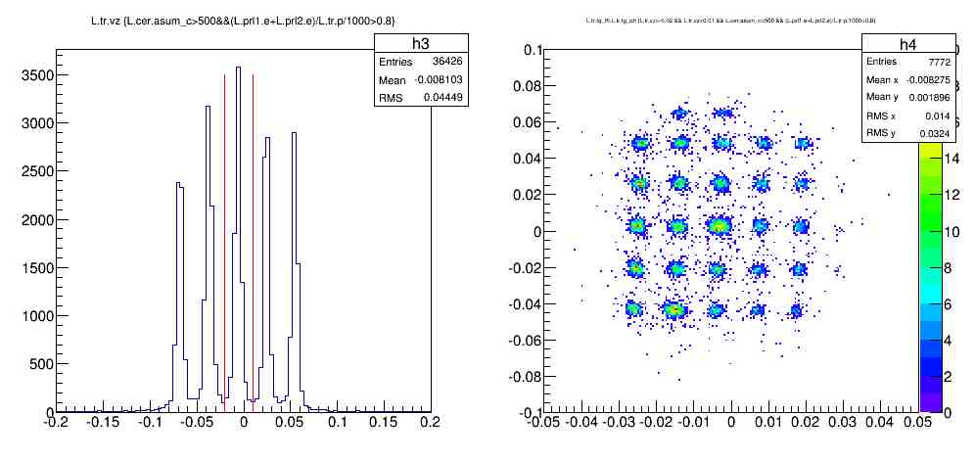
HRS commissioning in the Fall
Detector checkout completed
(efficiency, calibrations…)
Optics calibrations
DAQ commissioning
(DVCS & GMp co-existing DAQs)

Slide 6
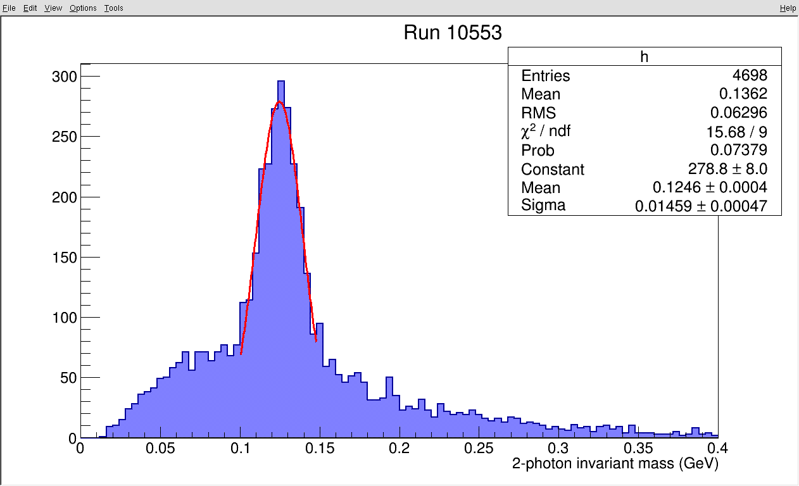
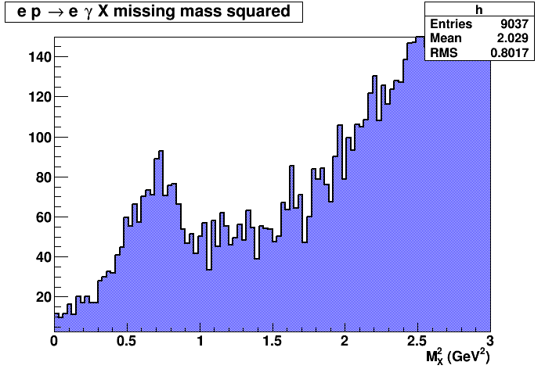
DVCS: online results from Fall’14 run
Beamline commissioning:
Moller measurement (88% polarization)
BPM calibration (+ harps operational)
BCM calibration
New raster
Beam dump
π⁰ ’s reconstructed in DVCS calorimeter
DVCS events
(1.5 h of beamtime)
DVCS experiment commissioning:
Coincidence (e + γ) trigger
1 GHz sampling electronics
ep → ep calorimeter elastic calibration
Completed the 1st DVCS kinematic setting

Slide 7
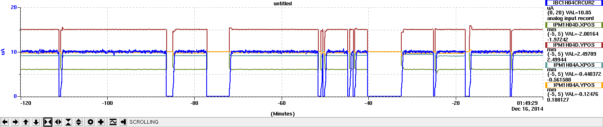
DVCS/G_{M}^{p} experiment in Hall A at “11 GeV”
Smooth running after Thanksgiving break with occasional (« few » hours) interruptions
Ended Fall run with good conditions
Commissioning of the beamline, HRS and DVCS detectors
List of lessons learned and repairs ongoing in Hall
Replacing Q1-R with old Hall C SOS Quad
Still [portion of] ~80 PAC days of running left: looking forward to a very productive 2015 Spring run!!
On the accelerator side:
FFB and current lock ON
Managed to run up to 20 μA on the 15cm LH2 target
Significant smaller beam energy than initially expected (7.3 instead of 8.8 GeV at 4-pass)

Slide 8
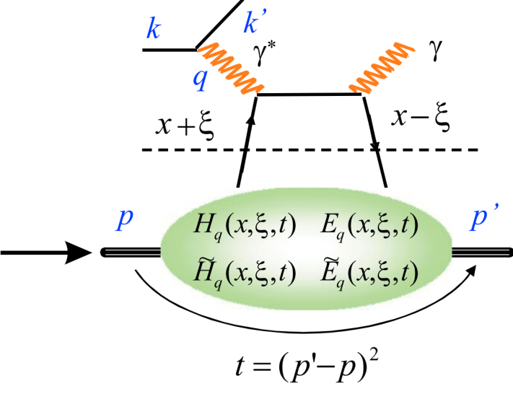
E12-06-114: DVCS experiment in Hall A at 11 GeV
Scaling tests of the DVCS cross section
High impact experiment for nucleon 3D imaging program
High precision Q² dependence of the DVCS cross section at constant x_{B} .
CEBAF12 will allow to explore for the first time the high x_{B} region
6.6
8.8
11 GeV
Fall’14
x
x
x
= 6 days
2
3
1 days
5 weeks in Spring’15
6.6
11 GeV
x
x
x
x
8.8
= 20 days
5 days
4
4
4
x
x
x
x
8.8
11 GeV
= 62 days
13
16 days
13
20
Total = 100 days (88+12 days calibration) approved
Notes:
For questions: munoz@jlab.org (Dec 17, 2014)

Slide 9
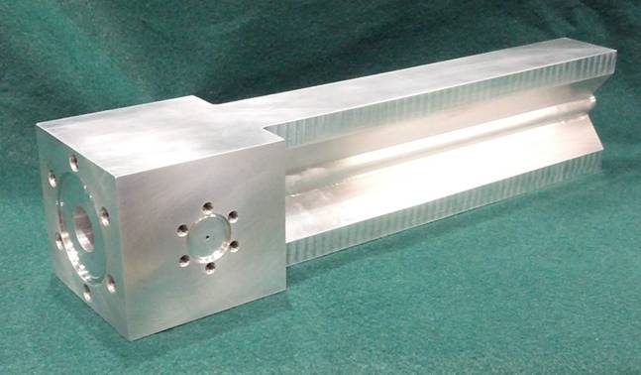
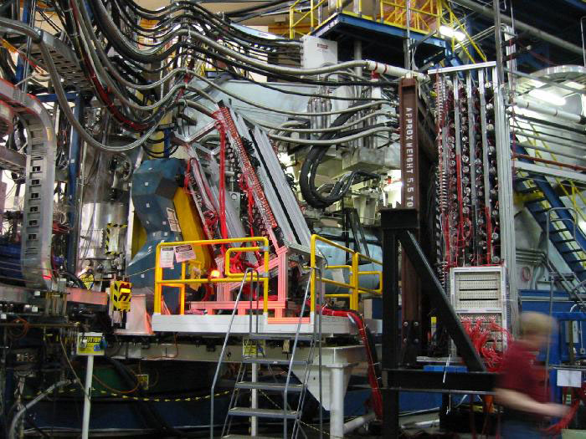
Tritium Experiment Preparations
Two new experiments approved by PAC 42, now 4 total
Preparing for (target) safety/design review ~April 2015
BigBite under (re-)construction in test lab
  Active collaboration, 5+ students on site
  Design for modified Cerenkov
  Plan to add SBS GEM plane

Slide 10
Beyond ³H
    Polarized ³He target improvements and continued development
        Convection, new lasers, metal windows, …
    PREX/CREX
        Pb targets, new coils purchased
        Shielding designs underway
        Computation fluid dynamics for target design
        Polarimetry
          Plan to test Compton (photon) in Spring 2015 Run
          New superconducting magnet purchased
          Upgrading electron detectors
    APEX
        New septum magnet purchased by collaboration now in test lab
        Shielding designs underway
        Computation fluid dynamics for target design

Slide 11
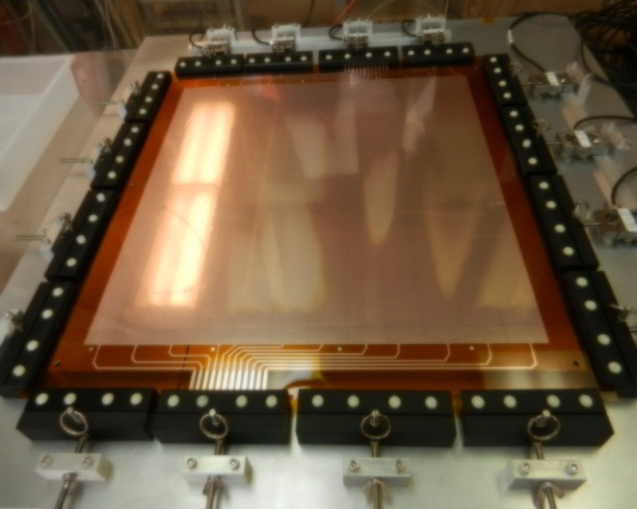
SBS Construction
Project started October 2013
  Just passed second annual review
  Some recommendations, but overall very positive, project on track
Spectrometer, ECAL work at JLab
  Power Supply in hall
  48D48 magnet modified, assembled, tested in test lab
  Working on support, stand, vacuum, beamline
  Thermal annealing of ECAL
GEM construction at UVA
Coordinate detector at Idaho State
HCAL Hadron calorimeter at CMU

Slide 12
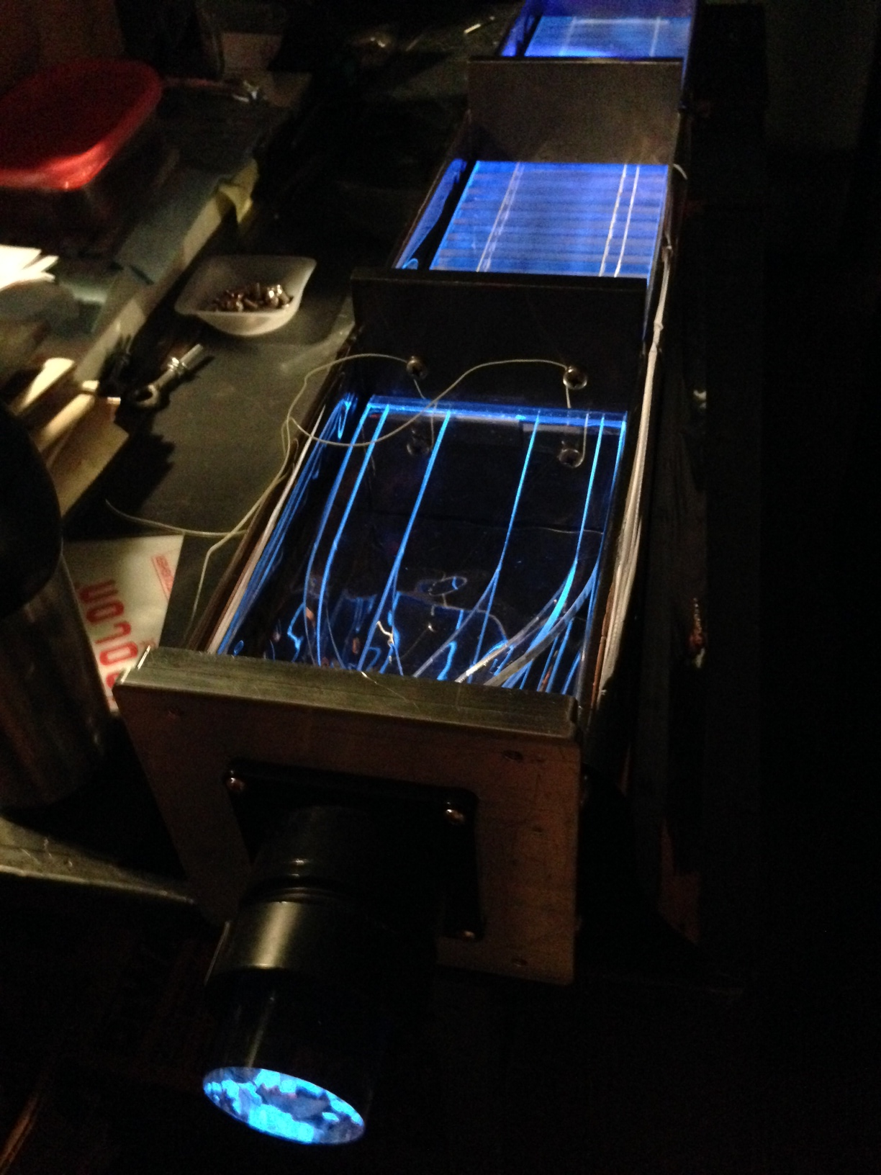
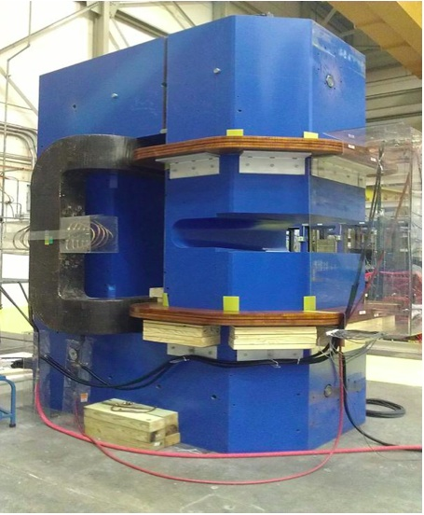
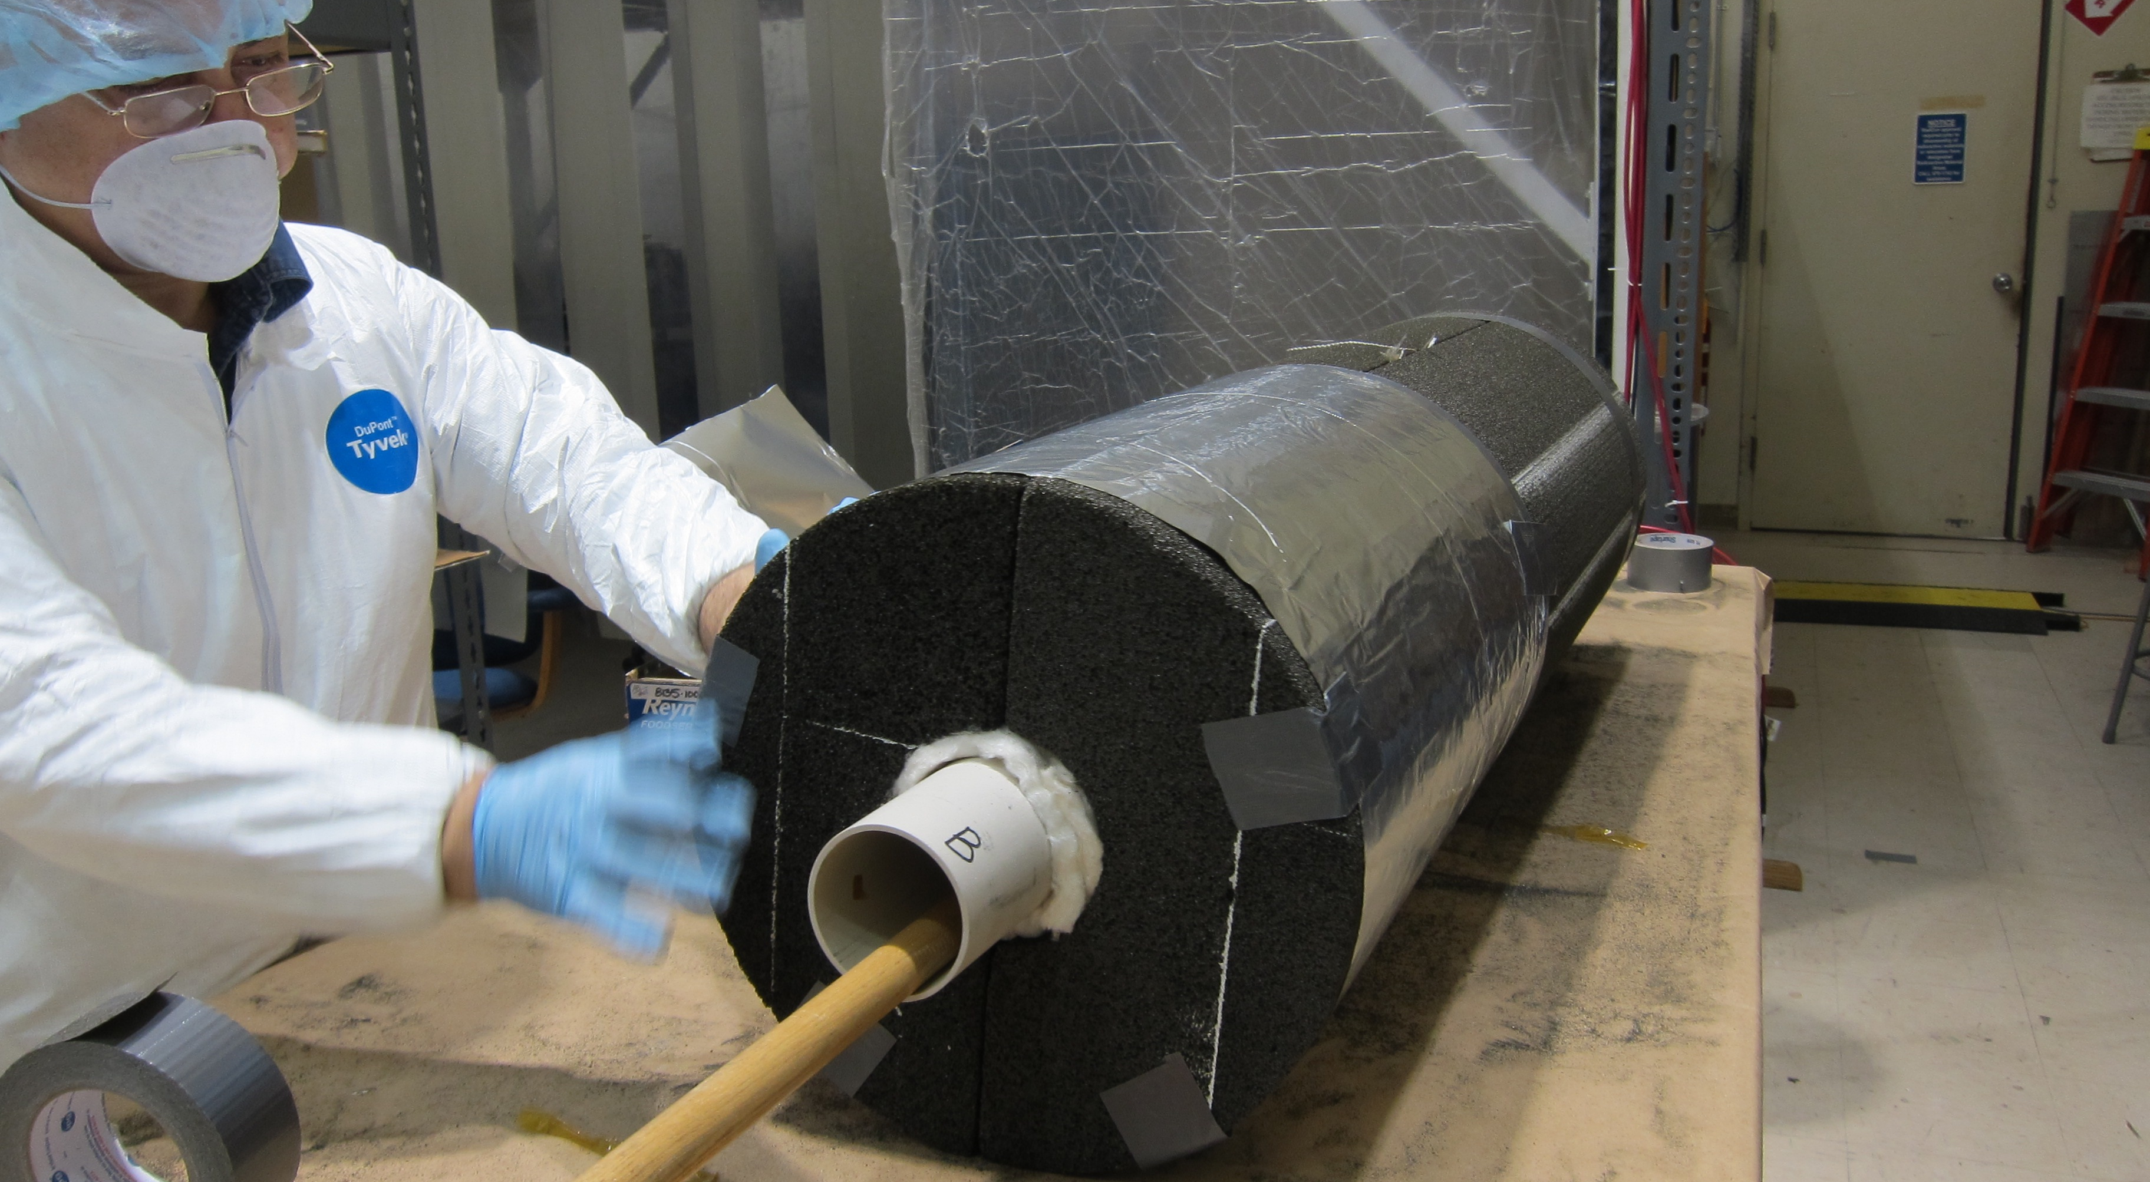
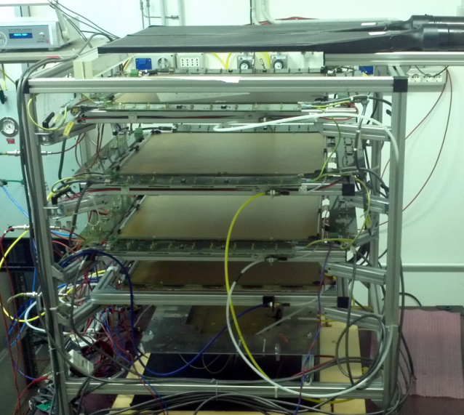

Slide 13
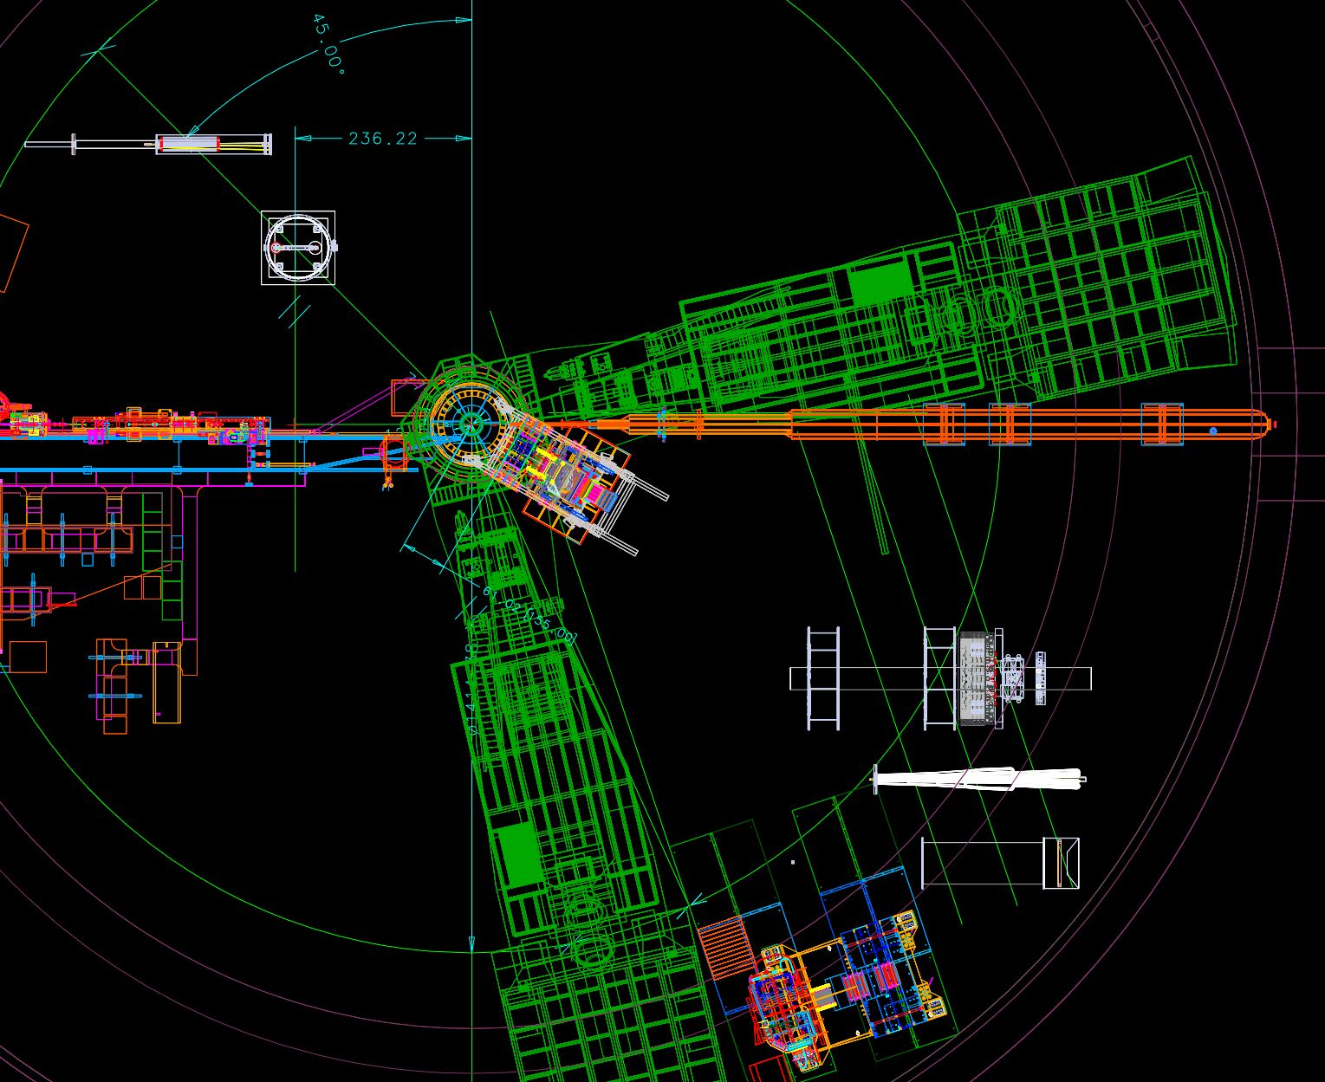
Starting to plan for future installations – example: Hall A with HRS-R, SBS, MOLLER (in 4 sections) removed from beamline, BigBite and HRS-L functional

Slide 14
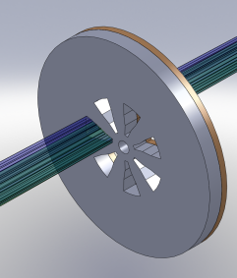
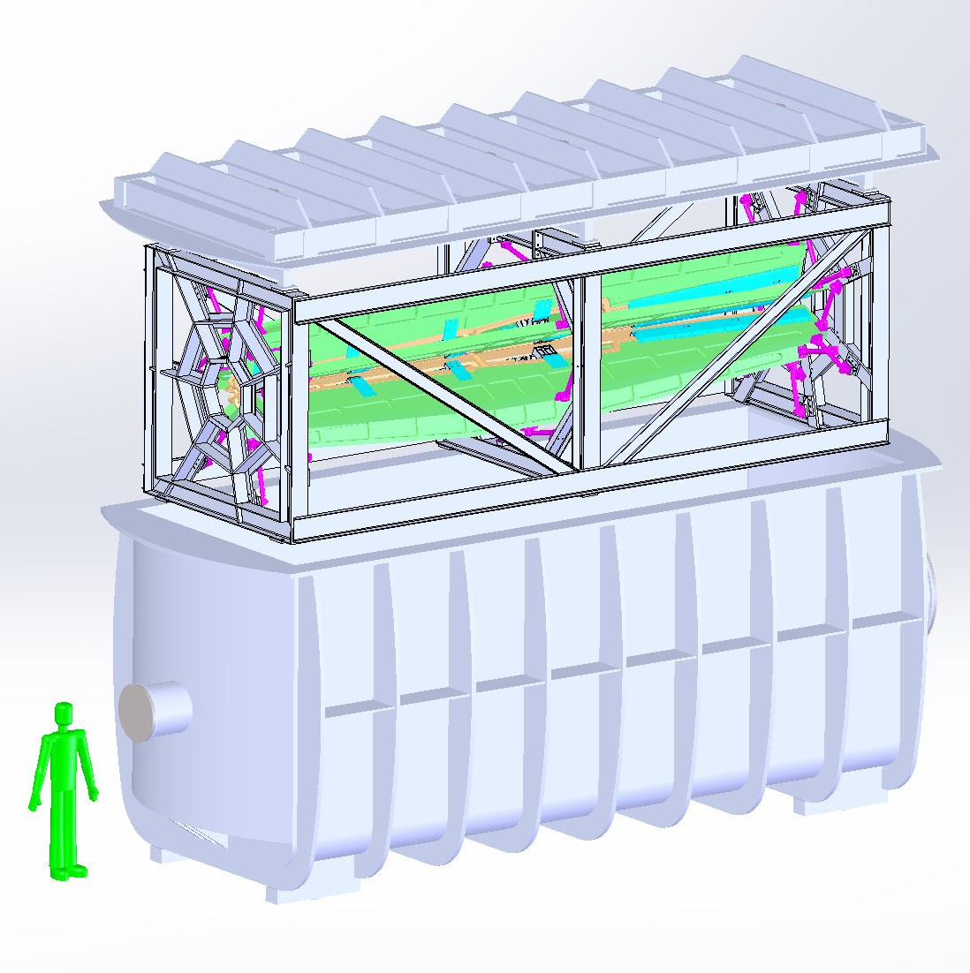
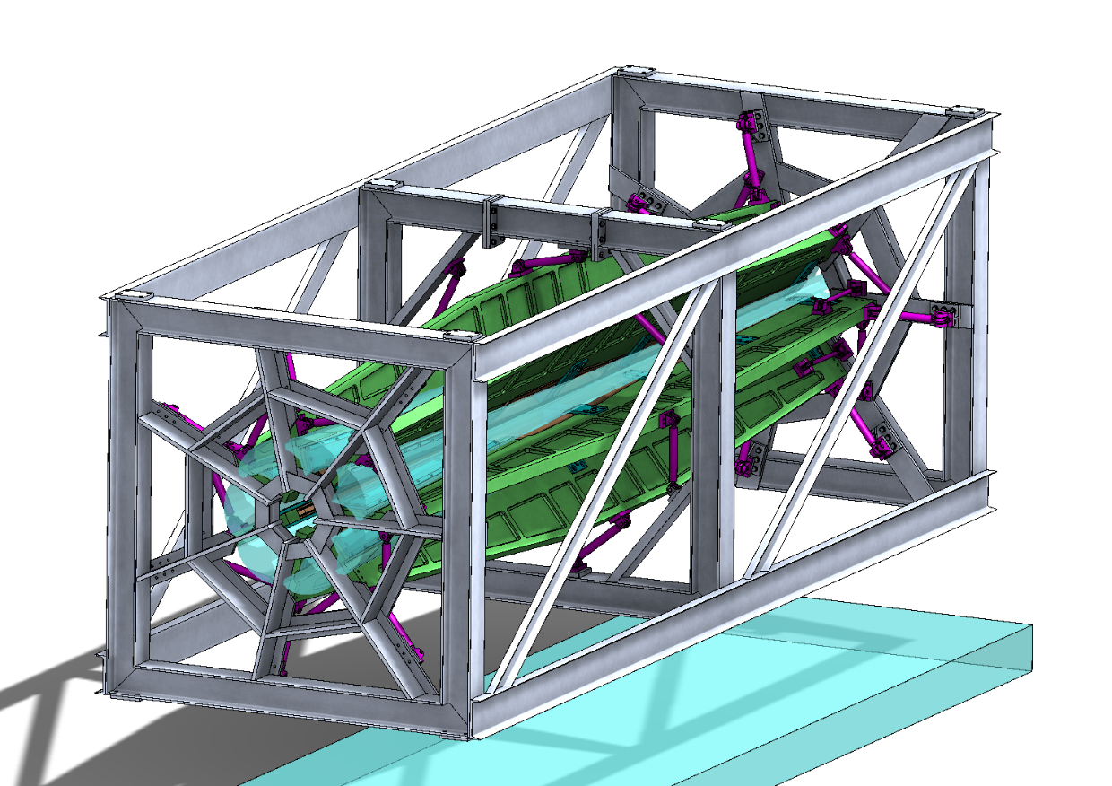
MOLLER
    Successful Science Review September 2014
      MOLLER dependencies drafted
    Supporting ongoing magnet. Collimator development work at MIT
    Upgrading Moller polarimeter (new magnet, work at RPI/Temple)
    LRP Process Important
    Looking towards CD0

Slide 15

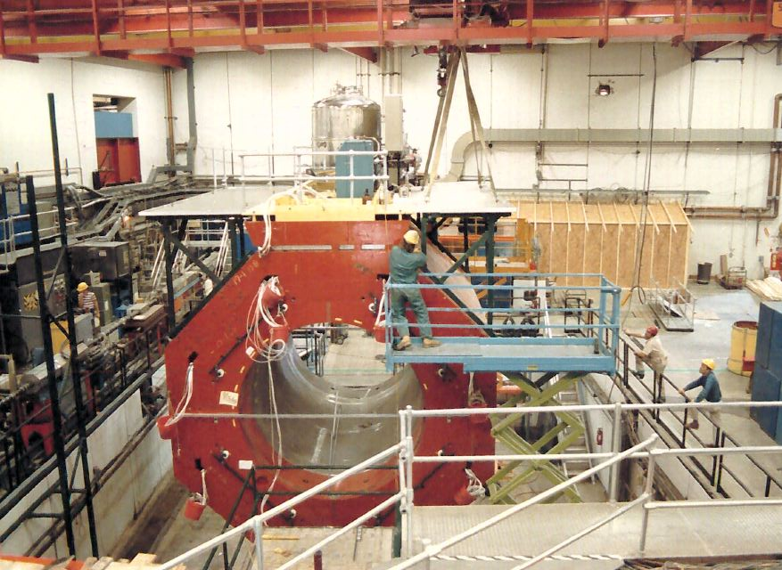
SoLID
    Director’s Review February 23,24, 2015
    Continued detector optimization
      Background studies
    Working with Cornell to move solenoid ~Summer 2016
        Hall A E&D had June 2014 planning trip to Cornell
    LRP Process Important

Slide 16
More?.... 7 New Proposals to PAC42 (5 approved, 2 run group + ~1 LOI)
12-14-009 | A | The EMC PVDIS Experiment: A Constraint on Isovector Dependent Nuclear Modification Effects Using Parity-Violating Deep Inelastic Scattering
12-14-010 | A | Measurements of Semi-Inclusive DIS Double-Spin Asymmetries on a Longitudinally Polarized 3He Target
12-14-011* | A | Ratio of the electric form factor in the mirror nuclei 3He and 3H
12-14-012* | A | Dihadron Electroproduction in DIS with Transversely Polarized 3He Target at 11 and 8.8 GeV
12-14-013 | A | Measurement of Tagged Deep Inelastic Scattering (TDIS)
12-14-014* | A | Proton and Neutron Momentum Distributions in A = 3 Asymmetric Nuclei
12-14-015* | A | Measurement of the Spectral Function of 40Ar through the (e,e2p) reaction
LOI12-14-006 | A or C | Dark matter search in a Beam-Dump eXperiment (BDX) at Jefferson Lab
E12-11-108/E12-10-006* | A | Target Single Spin Asymmetry Measurements in the Inclusive Deep-Inelastic $\vec{N}(e,e^\prime)$ Reaction on Transversely Polarized Proton and Neutron ($^3$He) Targets using the SoLID Spectrometer

Slide 17
Questions?

Slide 18
Hall A Projected Experiment Schedule, updated 12/2014
- available on Hall A wiki
Spring | Fall | Spring | Fall | Spring | Fall
DVCS –I/ GMp | ³H/³He group (1+1+2)
 |  | APEX PREX12 CREX A₁^{n} Ar(e,e’p) | APEX PREX12 CREX A₁^{n} Ar(e,e’p) DVCS-II
 |  |  |  | APEX PREX12 CREX A₁^{n} Ar(e,e’p) DVCS-II | SBS run I
CY 2015
CY 2016
CY 2017
Experiment lists in italics represent potential schedule options, in no order
PAC41 High Impact Experiments including SBS G_{e}^{p}
New experiments approved by PAC42
MOLLER, SoLID

Slide 19
Hall A Projected Experiment Schedule, updated 12/2014
- available on Hall A wiki
??
Spring | Fall | Spring | Fall | Spring | Fall
DVCS –I/ GMp | ³H/³He group (1+1+2)
 |  | APEX PREX12 CREX A₁^{n} Ar(e,e’p) | APEX PREX12 CREX A₁^{n} Ar(e,e’p) DVCS-II
 |  |  |  | APEX PREX12 CREX A₁^{n} Ar(e,e’p) DVCS-II | SBS run I
CY 2015
He processing and UIM
CY 2016
CY 2017
Experiment lists in italics represent potential schedule options, in no order
PAC41 High Impact Experiments including SBS G_{e}^{p}
New experiments approved by PAC42
MOLLER, SoLID

