Slide 1
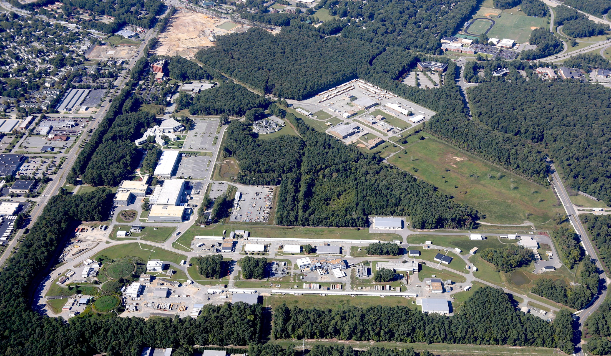
Jefferson Lab Status
R. D. McKeown
UGBOD
January 13, 2015

Slide 2
Outline
PAC Update
Experiment Scheduling
Status of experimental projects
Electron Ion Collider
NSAC Long Range Plan

Slide 3
PAC42
Scheduled for July 28-August 1
Proposals were due June 2
Charge:
Review new proposals, previously conditionally approved proposals, and letters of intent for experiments that will utilize the 12 GeV upgrade of CEBAF and provide advice on their scientific merit, technical feasibility and resource requirements.
Identify proposals with high-quality physics that, represent high quality physics within the range of scientific importance represented by the previously approved 12 GeV proposals and recommend for approval.
Also provide a recommendation on scientific rating and beam time allocation for proposals newly recommended for approval.
Identify other proposals with physics that have the potential for falling into this category pending clarification of scientific and/or technical issues and recommend for conditional approval. Provide comments on technical and scientific issues that should be addressed by the proponents prior to review at a future PAC.
12 new proposals, 1 returning conditional
5 new parallel experiments
6 Letters of Intent

Slide 5
12 GeV Approved Experiments by Physics Topics
Topic | Hall A | Hall B | Hall C | Hall D | Other | Total
The Hadron spectra as probes of QCD (GluEx and heavy baryon and meson spectroscopy) |  | 1 |  | 3 |  | 4
The transverse structure of the hadrons (Elastic and transition Form Factors) | 5 | 3 | 2 | 1 |  | 11
The longitudinal structure of the hadrons (Unpolarized and polarized parton distribution functions) | 2 | 3 | 6 |  |  | 11
The 3D structure of the hadrons (Generalized Parton Distributions and Transverse Momentum Distributions) | 5 | 9 | 7 |  |  | 21
Hadrons and cold nuclear matter (Medium modification of the nucleons, quark hadronization, N-N correlations, hypernuclear spectroscopy, few-body experiments) | 6 | 3 | 7 |  | 1 | 17
Low-energy tests of the Standard Model and Fundamental Symmetries | 3 | 1 |  | 1 | 1 | 6
TOTAL | 21 | 20 | 22 | 5 | 2 | 70

Slide 6
12 GeV Approved Experiments by PAC Days
Topic | Hall A | Hall B | Hall C | Hall D | Other | Total
The Hadron spectra as probes of QCD (GluEx and heavy baryon and meson spectroscopy) |  | 119 |  | 540 |  | 695
The transverse structure of the hadrons (Elastic and transition Form Factors) | 145.5 | 85 | 102 | 25 |  | 357.5
The longitudinal structure of the hadrons (Unpolarized and polarized parton distribution functions) | 65 | 230 | 165 |  |  | 460
The 3D structure of the hadrons (Generalized Parton Distributions and Transverse Momentum Distributions) | 409 | 872 | 212 |  |  | 1493
Hadrons and cold nuclear matter (Medium modification of the nucleons, quark hadronization, N-N correlations, hypernuclear spectroscopy, few-body experiments) | 180 | 175 | 201 |  | 14 | 570
Low-energy tests of the Standard Model and Fundamental Symmetries | 547 | 205 |  | 79 | 60 | 891
TOTAL | 1346.5 | 1686 | 680 | 644 | 74 | 4430.5

Slide 7
Issues raised by Hall B users
Treatment of new parallel running proposals
- not listed in table for PAC closeout
- not listed in table in PAC report, comment material placed after LOI section in report
- not listed on approved expt.s website
- create new category for these
- concern that they do not have same status as approved expts in scheduling discussions
Phone meeting – BMCK, Ent, Burkert, Ireland.
Response letter drafted and sent
- tables and report will properly include parallel proposals
- website improved, links fixed
- internal collaboration reports to be submitted to PAC
Appreciative response from original complainants

Slide 8
New Language for PAC43
As we started with PAC40, the Hall B collaboration should submit proposals for complete run groups at one PAC meeting, where all of the anticipated physics associated with the proposed run group will be considered. Each run group can submit up to 4 individual proposals (up to 3 physics topics plus 1 summary of additional topics) and will be granted a maximum of 4 presentations corresponding to these proposals. The PAC may consider each of these for grading, but will attempt to provide an common assessment of the whole run group. New experimental proposals that run in parallel with previously approved run groups should be considered internally by the CLAS collaboration. It is also requested that documentation (e.g., proposal and report) from the internal review be submitted to the PAC for their information. A CLAS representative will have the opportunity to report on these to the PAC, and the PAC will then provide comments on them in its report. Proposed parallel running in other halls should be handled in a similar fashion.

Slide 9
PAC43 & PAC Proposal Submission
Call for new proposals for PAC43 has been sent to cuga
Deadline proposal submission: May 18 by 8 am (EDT). Deadline will be strict as last time
Will ask more detailed information on collaboration list to be able to better deal with annual user call from DOE (e.g. there are many Mark Jones’s, people do change affiliation). We need a good database we can track of user/affiliation/experiment. We are still considering how to make this easiest for all.
PAC43 meeting scheduled for week of July 6-10

Slide 10
PAC Membership
Retired this year:
N. Makins
M. Vanderhaegen
J. Ahrends
B. Sherrill
New members starting next year:
R. Fatemi
F. Maas
D. Dean
W. Vogelsang
New PAC Chair: J. Napolitano
Need to discuss role of UGBOD chair (1 year tenure)

Slide 11
Experiment Scheduling
Experiment scheduling process re-started
1 scheduling request per year Experiments can only submit requests when floor layouts frozen (passed the readiness review) and construction near-final
Schedule will remain rough and tentative, to fold in:
12 GeV pre-ops
establishing robust accelerator operations
budget uncertainties
Indeed, FY15 budget forces us to stop FY15 run by May 4.
Setting priorities amongst Halls/experiments will still be important to avoid conflicts
Nominal Dates for Scheduling Process
June 1 Call for Scheduling (Beam Time) Request
June 30 Deadline for Scheduling Request Submissions
September 1 Draft 18-Month Schedule Released
September 15 Deadline for Input of User Community on Draft Schedule
October 1 18-Month Schedule Released
Year 1 January – June Schedule Reaffirmed
Year 1 July – December Firm Schedule
Year 2 January – June Tentative Schedule
March 1 Draft 18-Month Schedule Released
March 15 Deadline for Input of User Community on Draft Schedule
April 1 18-Month Schedule Released
Year 1 July – December Schedule Reaffirmed
Year 2 January – June Firm Schedule
Year 2 July – December Tentative Schedule

Slide 12
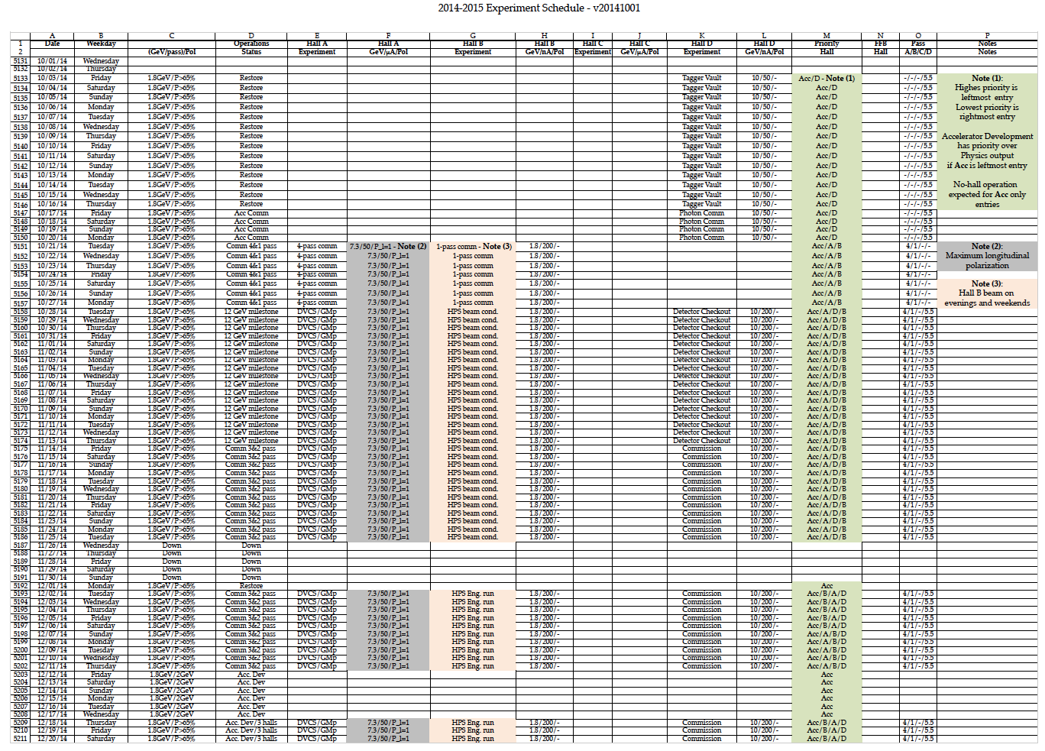
15-Months Schedule Released
Oct 2014 - Dec 2015
This schedule covers the first experiment run period of the “12 GeV Era’’ to be executed in parallel with the Accelerator Commissioning and Development necessary to bring the machine to its design performance and meet the 12 GeV JLab upgrade project goals.
http://www.jlab.org/exp_prog/experiment_schedule/
We plan to release the March 2015 – July 2016 schedule in February
Anticipating Hall A PREX & Integrated engineered Tritium target/beam line, Hall B/Prad, and DarkLight readiness reviews before June 1

Slide 13
Other Projects
HPS funded by DOE HEP
Installed in FY14
Scheduled in Hall B in FY15
Readiness Review completed
PRad NSF MRI funded
Request for install in FY14/15
Hope for Scheduling in Hall B in FY15 ( very unlikely)
CLEO solenoid committed for SoLID project, final negotiations
SoLID pre-CDR submitted to JLab management
– Director’s review scheduled Feb. 23-24
Decision by DOE-HEP re: Babar DIRC for GlueX
Hall B RICH detector reviewed September 5-6, 2013
DOE participation, very positive
Second sector to be funded by INFN
DarkLIGHT NSF MRI funded – agreement with DOE on operations
MOLLER Science Review – very successful

Slide 14
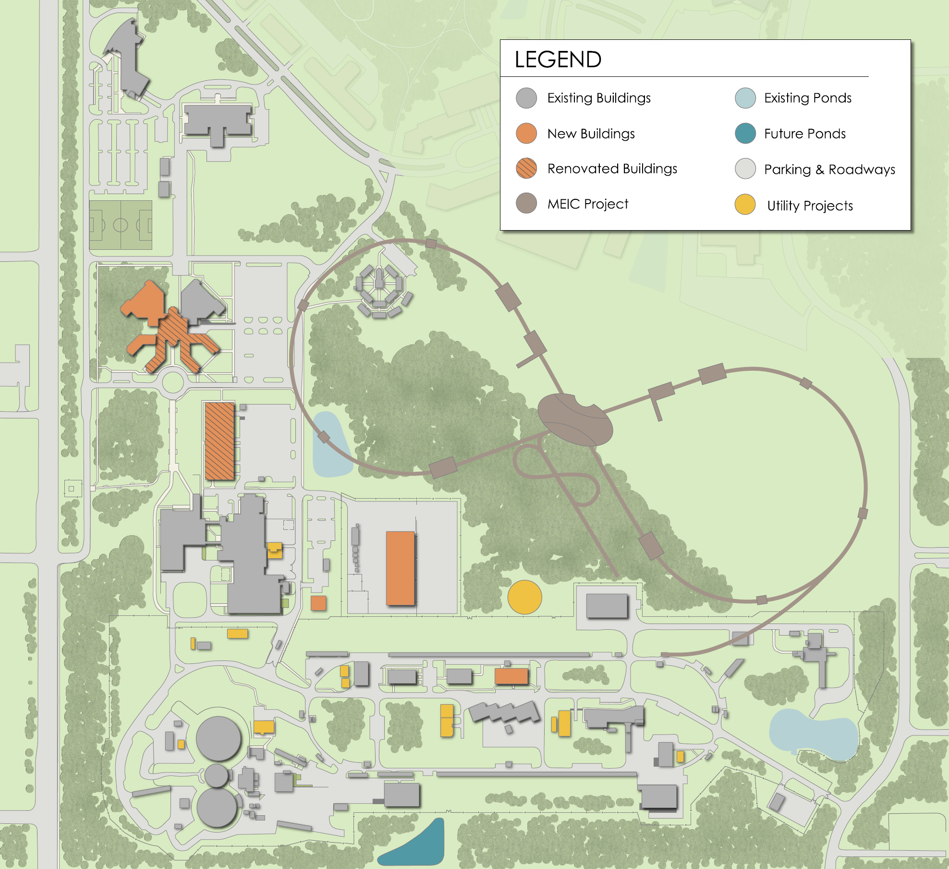
EIC at Jefferson Lab
Jefferson Lab Design
12 GeV CEBAF is electron injector
Figure 8  high polarization
Crab crossing  high luminosity
Initial configuration (MEIC):
3-12 GeV on 20-100 GeV ep/eA collider
Upgradable to higher energies
250 GeV protons + 20 GeV electrons
Present Activities
Fulvia Pilat appointed as accelerator lead
Site evaluation
Design optimization
Accelerator, detector R&D
Cost estimation

Slide 15
NSAC EIC Cost Review – Jan 26-28
From the Charge:
Understanding that a detailed conceptual design has not been completed, the Subcommittee is asked to provide NSAC with its best current estimate of the costs of the projects, including R&D, construction, pre-operating and operating costs. NSAC is aware that there are uncertainties regarding siting and other issues that limit the precision of such an estimate at this time. Nevertheless, the advice of the Subcommittee will be of great value to NSAC as it evaluates the relative merit of this and other initiatives. Since the charge to NSAC for the long range plan explicitly discusses resources in terms of the 2015 President’s Budget Request, we ask that the results of this review be presented in FY2015 dollars. If the laboratories choose to present staging options to incrementally reach the science goals, please consider these as well.
The subcommittee is asked to provide a written report to NSAC by the end of February 2015. I expect it will be considered by NSAC in a meeting in late March 2015.

Slide 16
Preparations for Cost Review
Design changes to reduce costs (next slide)
Internal Review (Dec. 18)
Iteration in progress

Slide 17
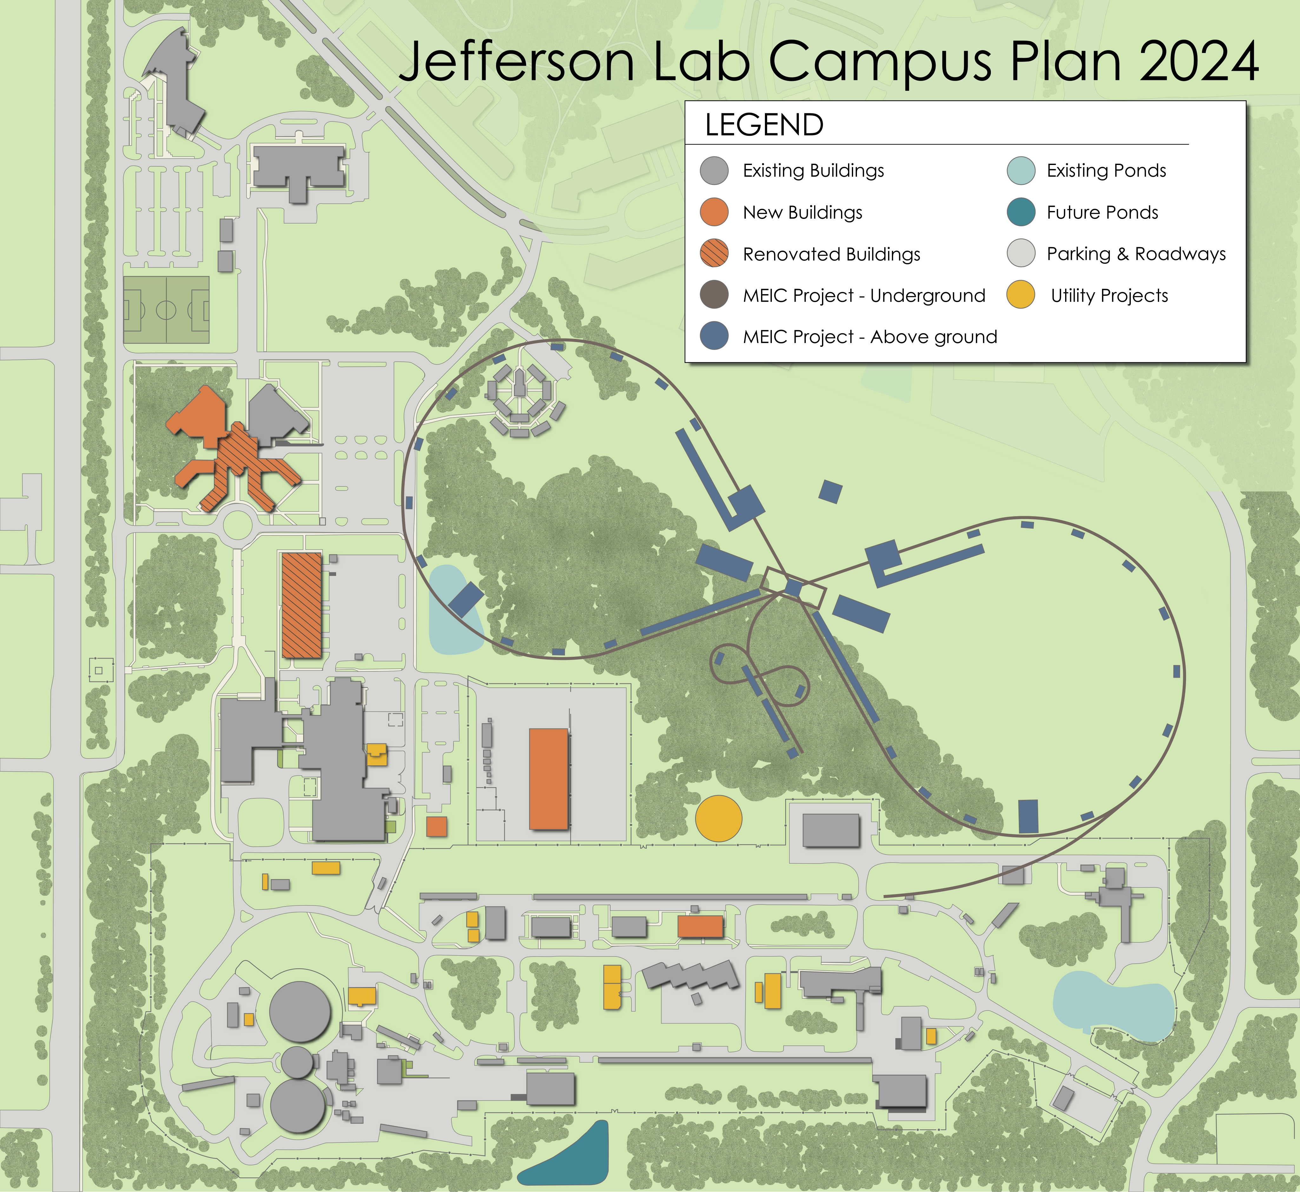
MEIC – present design
~2.2 km circumference
E-ring from PEP-II
Ion-ring with super-ferric
No high-energy booster
Tunnel already compatible
with a 250+ GeV upgrade

Slide 18
NSAC LRP Schedule
NSAC Charge (April 2014)
Town Meetings (July-Sept. 2014)
LRP Working Group Preliminary Meeting (Mid Nov. 2014)
LRP Working Group Resolution Meeting (Apr 2015)
Final report (Oct. 2015)

Slide 19
LRP Town Meetings
Computational Nuclear Physics July 14,15 SURA
Education and Innovation, Aug. 6-8, NSCL, Michigan State U.
Nuclear Structure and Nuclear Astrophysics, August 21-23 Texas A&M U.
QCD (Hadronic & Relativistic Heavy Ion), Sept 13-15, Temple U.
Fundamental Symmetries, Sept 28, 29, Chicago O’Hare
Good JLab participation in all meetings

Slide 20
QCD and Hadron Physics
• Recommendation 1:
With highest priority, we recommend both completion of construction and full operation of the 12 GeV CEBAF at the Thomas Jefferson National Accelerator Facility, along with targeted instrumentation investments, such as the SoLID and MOLLER projects.
• Recommendation 2:
A high luminosity, high-energy polarized Electron Ion Collider (EIC) is the highest priority of the U.S. Nuclear Physics QCD community for new construction after FRIB. (voted jointly with Phases of QCD community)

Slide 21
QCD and Hadron Physics
• Recommendation 3:
We recommend strong support for other existing facilities, such as the polarized proton facility at RHIC, university-based laboratories, and the scientists involved in these efforts, in order to guarantee the effective utilization of such resources for continued scientific leadership and discovery, and for educating the next generation of nuclear scientists in the USA.
• Recommendation 4:
We recommend that support for the hadron theory program be increased in a balanced manner and in proportion to new and continuing investment in experiment so as both to guarantee that all aims of the existing program can most rapidly be achieved and to secure a promising future for the next generation of nuclear scientists and the nation. Given the breadth of the hadron physics enterprise, this program must necessarily be multifaceted and
capable of reacting quickly to the new opportunities that innovative experiment and creative theory will reveal.

Slide 22
Summary and Outlook
PAC41 prioritization successful – PAC42 approved new proposals
Fine tuning of parallel proposals for PAC43
Experiment scheduling restarted for 12 GeV era
EIC science and designs are making good progress
We are actively engaged in the NSAC Long Range Plan activities
NP day on the hill: March 23

