Slide 1
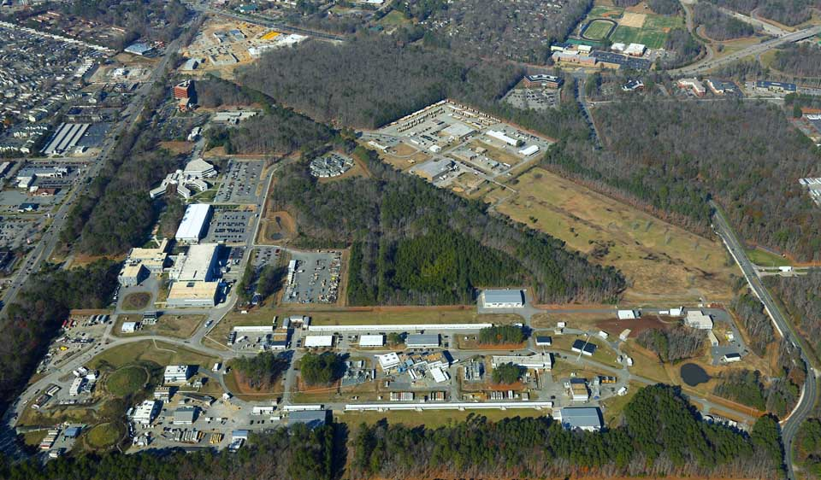
Jefferson Lab
Hugh Montgomery
Jefferson Lab UGBOD January 2015

Slide 2
Outline
JSA/Jefferson Lab Performance 2014
Highlights
Budgets
FY15 Federal Budget
(FY16 Federal Budget)
Commonwealth of Virginia Budgets
Conclusions

Slide 3
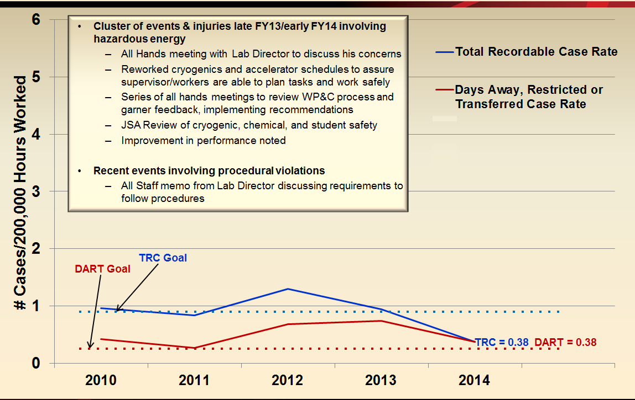
Jefferson Lab: A Safe Place to Work
Jefferson Lab Safety History - Injury Rates Continue Downward Trend

Slide 4
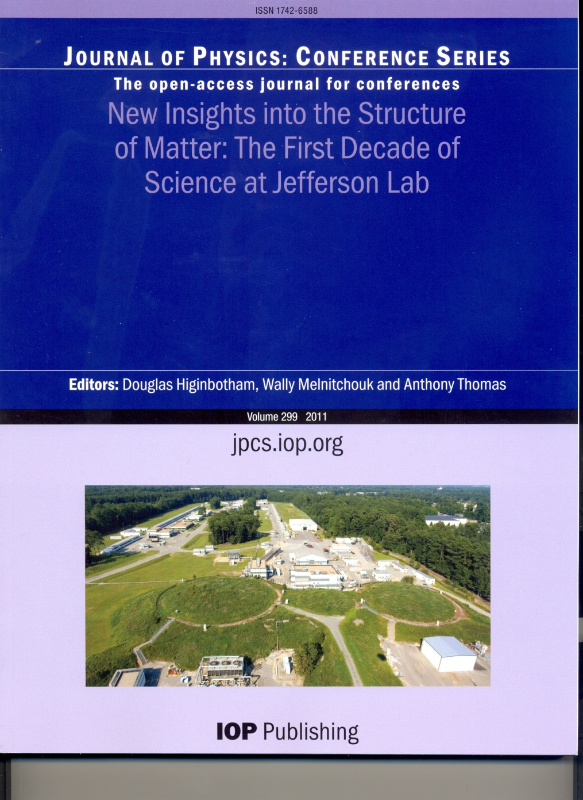
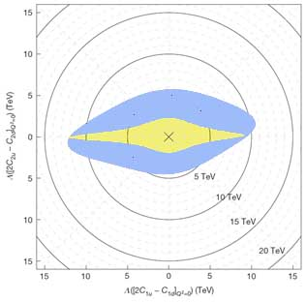
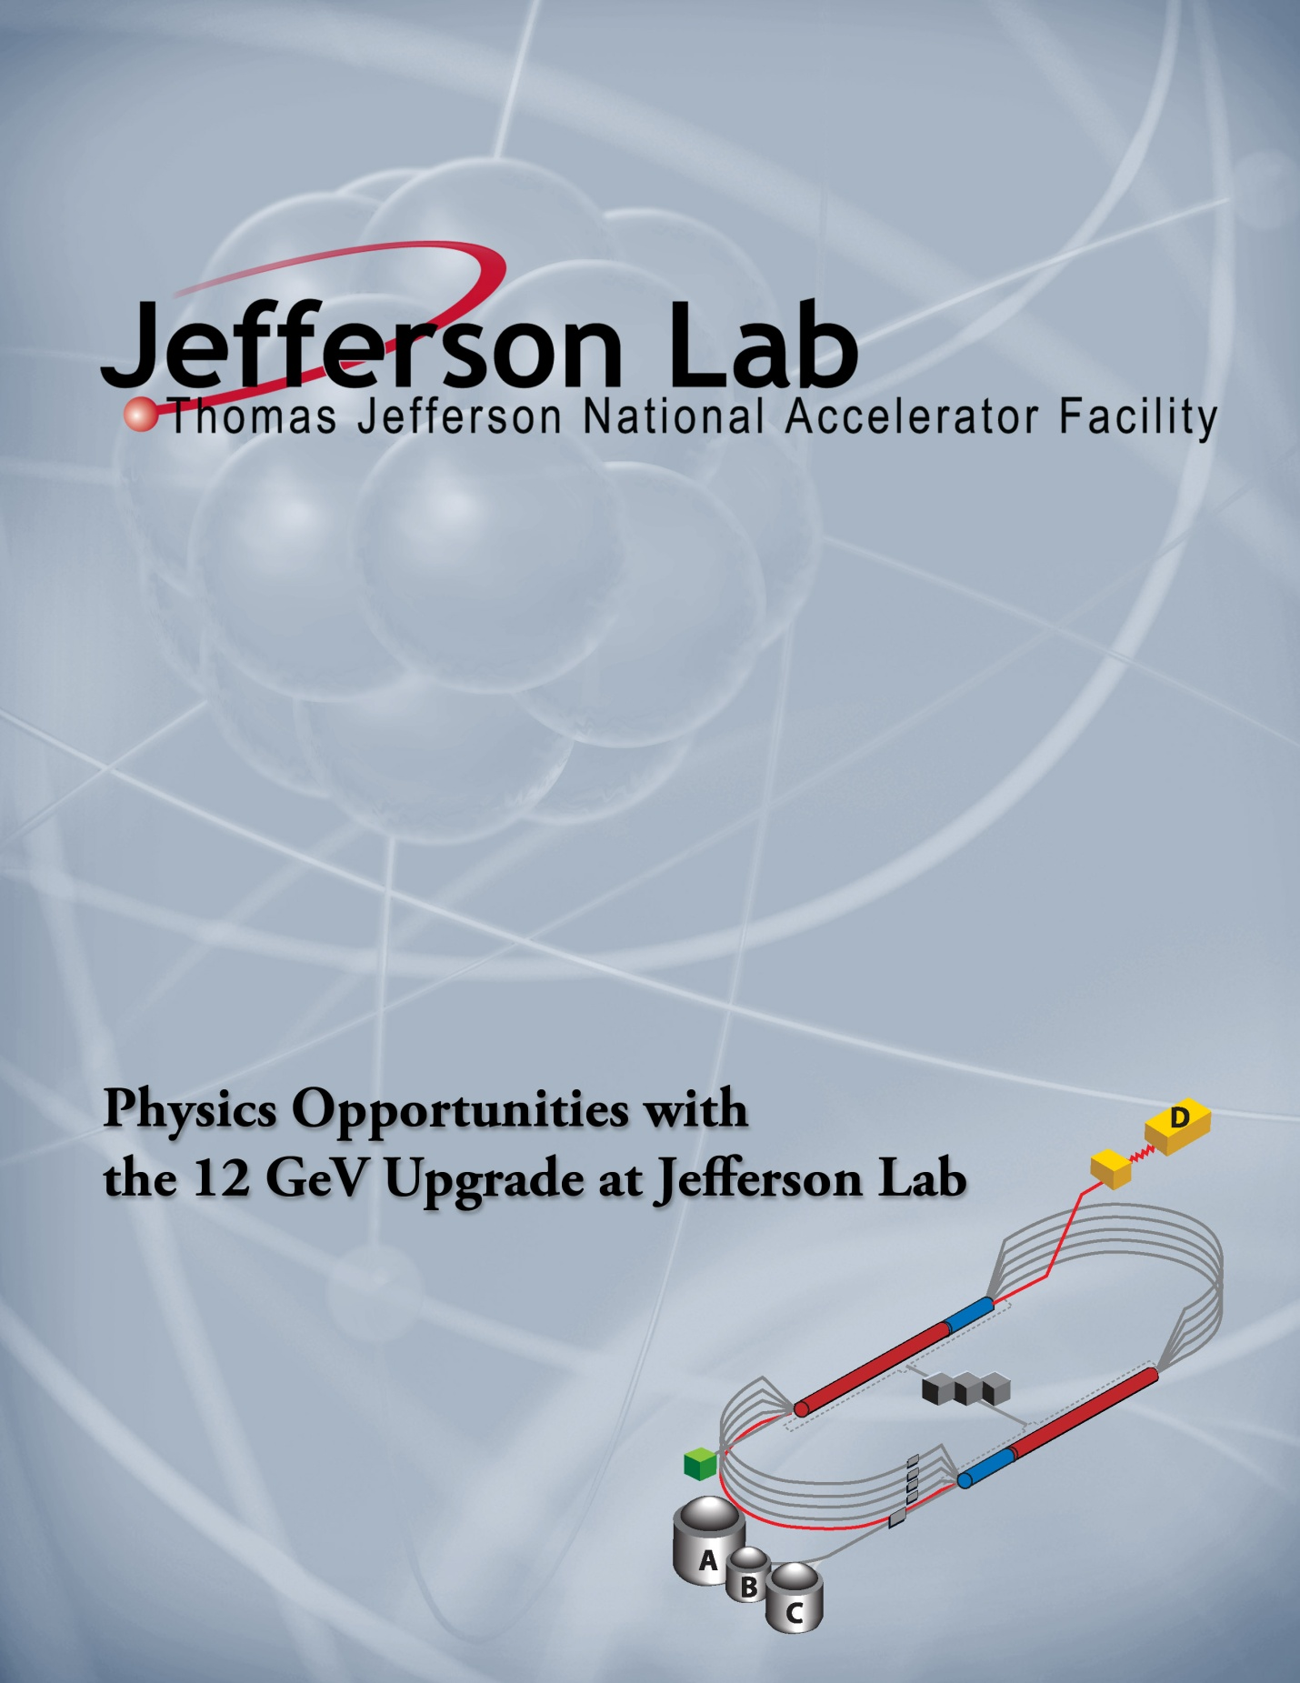
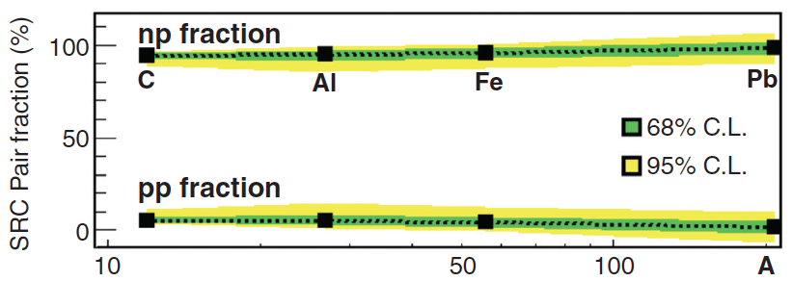
Scientific Results
Nature 506, 67–70 (06 February 2014)
Parity Violating DIS
Science 346, 614 (October 2014)
Short Range NN Correlations

Slide 5
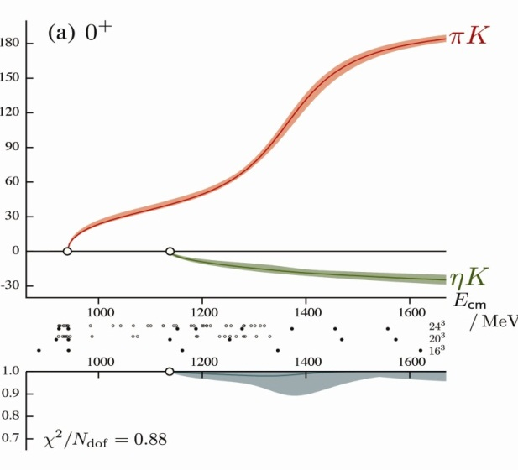
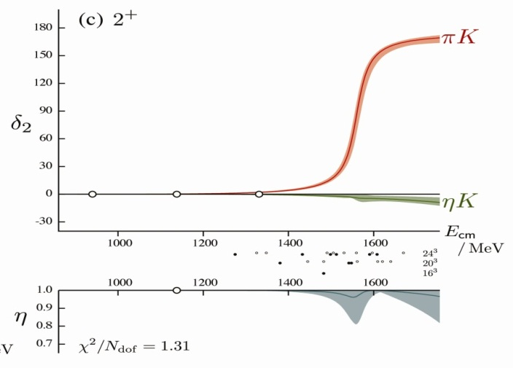
Theory and Computation Highlight New Technology + Innovative Techniques
π
π
η
Lattice QCD Advance:
First scattering calculation of
Inelastic channels
,
Now published in PRL
K
K
0⁺
πK
πK
δ₀
2⁺
πK
δ₂
ηK
E_{cm}
MeV
ηK
η
E_{cm}
MeV
η
Work on leadership GPU systems
such as DOE Titan (ORNL) and
NSF Blue Waters (NCSA - University of Illinois)
Large ASCR Computing Challenge Award
in May 2014: 250M core hours
Notes:
5

Slide 6
Physical Review Letters Vol. 113, Issue 2 (11 July 2014)

Slide 7
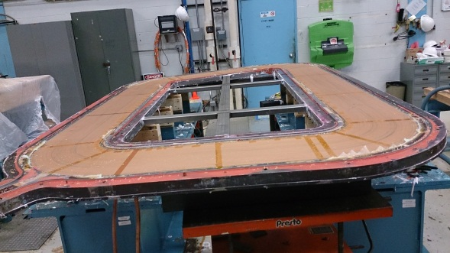
Jefferson Lab CEBAF 12 GeV Upgrade
Civil Construction essentially complete:
Accelerator in commissioning:
Received CD-4A Approval ahead of schedule; ESAAB July 30, 2014
‘Accelerator Project Complete and Start of Operations’
Hall A operational
Hall D/GlueX essentially complete
Commissioning in progress
Hall B – detector installation, magnet construction
Hall C – infrastructure installation, detectors ready, magnet construction
Director’s Review, OPA Review, both in November 2014,
Cost and Schedule Performance are an issue

Slide 8
Upgrade in December 5 Montage
The status of the project was given thorough reviews – two, in fact. One was commissioned as a JSA Director’s Review and chaired by Ed Temple. The second was the DOE version, the Office of Project Assessment review. Both reviews recognized the progress we had made. However, both reviews were also concerned with our progress against the schedule and with the cost we have incurred. By this stage of the project, the dollar value remaining is a fraction of the total cost of the project. But that puts a premium on our care for these precious resources, time and money. Indeed, there was considerable emphasis on the need to treat this phase of the project, the end game, quite differently than the earlier stages. One analogy used was that in the red zone, a football game changes; with a small space in which to deploy the receivers, extra precision is required. We cannot afford the luxury of spending time on leisurely R&D; we need to be taking decisions with care but with alacrity. We need to look for ways to substantially strengthen our cost and schedule performance so as to ensure successful completion of the project.

Slide 9
The Governor’s Visit
CD-4A Celebration → 5 months ahead of schedule

Slide 10
CEBAF 2014 Commissioning

Slide 11
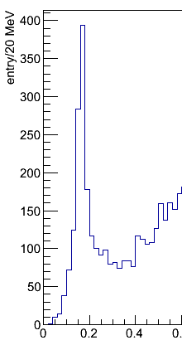
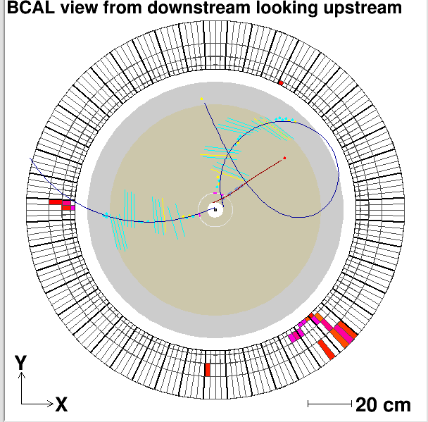
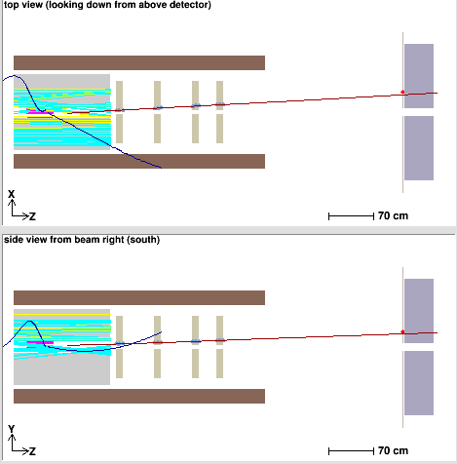
Jefferson Lab: Hall D Commissioning
Hall D complex: facility for experiments with linearly polarized photon beam
Main goal: search for gluonic excitations in light meson spectra (experiment GlueX)
Photon beam line + large acceptance spectrometer for charged particles & photons
Commissioning with beam Nov. & Dec. 2014: KPP have been demonstrated
Hall D Experiment
Tagger station
γ
e-
e-
Charged particles tracking
Neutral particles reconstruction
Vertex
reconstruction
π°→γγ
Event Display
Drift chambers
Target location
Electromagnetic calorimeters
Spectrometer in solenoidal magnetic field
γγ mass, GeV
Z,cm

Slide 12
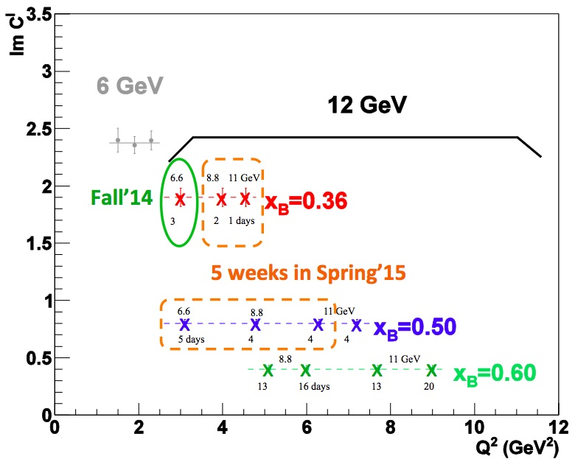
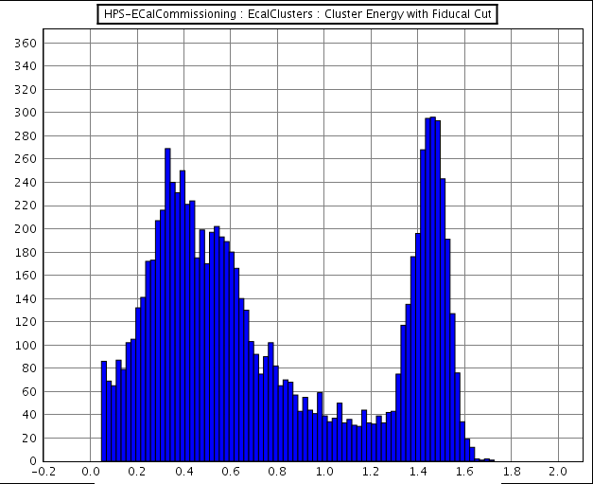
Early Science of 12 GeV Era in Halls A and B
Heavy Photons Search (HPS)
DVCS
The peak from elastic electron-platinum scattering is used to calibrate the response of the 420 lead-tungstate crystals.
Count rate in individual crystals located near the beam (below) shows the experiment can achieve its objective to run at high luminosity.
DVCS: A High impact experiment for 3D nucleon imaging
Deeply Virtual Compton Scattering (DVCS) provides access to Generalized Parton Distributions (GPDs)
Demonstration of scaling critical to full JLab 12 GeV GPD program
Runs concurrently with a high Q² Form Factor G_{M}^{p} experiment
Enabling experiment for High Impact Super BigBite program
7 graduate thesis students on site taking data
HPS: High impact experiment to search for the proposed carrier of Dark Matter interacting with Light Matter.
Test Run in December 2014 successfully completed. Commissioned beam line and the e.m. calorimeter
Funded by DOE HEP and NP.

Slide 13
Federal Budget FY15
FY15 President’s Budget Request supports ~ 20 weeks running
House Markup supported increase to ~ 27 weeks running
Senate Markup supported increase to ~ 30 weeks running
ONP has also encouraged us in our efforts to run for commissioning and physics
In turn, we were pleased by this recognition of our need, support from users was important
Started FY15 with a Continuing Resolution
We are ensured Fall Running
Omnibus appropriation provided only +$1M:
Therefore we are planning on spring run from Feb 13 to May 4.
FY16 Guidance for ONP Budget Briefing suggests no more running than in FY2015

Slide 14
Jan 2015 Draft/Strawman
Jefferson Lab Three-Year Schedule
Jefferson Lab Three-Year Schedule
Jan. 2015
Calendar Year
2015
2016
2017
Fiscal Year
2015
2016
2017
CEBAF
Activity
Comm.
Physics
Physics
Physics
Beam
Activity
SBS Construction/Installation
Hall A
Activity
Comm.
Physics
Physics
Physics
Beam
CLAS12 Construction/Installation
Hall B
Activity
Activity
Non-CLAS12 Ops
Comm.
Beam
Hall C
Activity
SHMS Construction/Installation
Activity
Comm.
Physics
Beam
Hall D
Activity
Comm.
Comm.
Physics
Physics
Beam
Beam for Commissioning
Beam for Physics
Non-CLAS12 Ops

Slide 15
Commonwealth of Virginia Funding
Special Request $4.6M in the FY15 - FY16 biennium to help improve Virginia’s competitive position for the Electron Ion Collider:
Virginia decided to fund no new initiatives in higher education
In Fall 2014, we met with the Department of Planning and Budgets, Secretary of Commerce, and representative of Secretary of Education.
$3.7M in FY16 to initiate the site studies; $2.4M in FY16 to complete the site studies
$0.5M in FY16 to attract a leading scientist to Virginia
Included in Governor’s Budget for FY16
Annual Funding
We are to reduce the Virginia funding for FY15 by 5% and for FY16 by 7%

Slide 16
LCLS II at SLAC
4 GeV Superconducting Linac in existing SLAC tunnel
Collaboration: ANL, Cornell, FNAL, LBNL, SLAC, TJNAF
Jefferson Lab responsibilities:
Cavities and cryomodules for ~ half of linac
Cryoplant acquisition
Q0 R&D, Low Level RF, Machine Phys
Reviews
CD1 in Spring, AWARD made
Preliminary Design Review; August, 2014 at Jefferson Lab
OPA Review Sep 30, 2014 at Jefferson Lab (successful)
CD2/3 in Spring 2015

Slide 17
Conclusions
Good Management Performance Results
Maintaining Science Productivity
Accelerator Commissioning exciting
12 GeV Project making good progress
Nuclear Physics Operating Budget challenges
Collaborating on NCLS II
Exciting Times Continue!

