Slide 1
Introduction to ERLs
C. Tennant
USPAS - January 2011

Slide 2
Outline
What is an ERL?
Why do you want an ERL?
History of ERLs at Jefferson Lab
  CEBAF with Energy Recovery
  FEL Drivers (Demo and Upgrade)
Beam Dynamical Issues
  Halo
  Longitudinal Match
  Incomplete Energy Recovery
Collective effects
  Beam Breakup (BBU)
  Coherent Synchrotron Radiation (CSR)
  Transverse and Longitudinal Space Charge

Slide 3
Types of Accelerators
Storage Rings
Linacs
  Finite number of particles travelling through the lattice an infinite number of times
  High beam powers for modest input power: efficient acceleration
    MW of RF + MW of DC → GW beam power (e.g. 0.5 A at 2 GeV)
  Circulation of beam → radiation excitation → inherently limited beam quality
  An infinite number of particles traveling through the lattice a finite (i.e. 1!) number of times
  Beam power inherently less than power required for acceleration (wall losses): inefficient acceleration
    MW of RF + MW of DC → MW beam power (e.g. 50 μA at 20 GeV)
  BUT… beam is not in machine long enough for quality to degrade: performance is source limited
(courtesy D. Douglas)

Slide 4
Motivation for Recirculation
Recirculation
  Reduce linac length/single-pass energy gain → cost control
    SRF, cryo costs high/beam transport costs low
    Could save 100s M$ in cost of large system
  Provide handles on phase space
    Can provide multiple stages of bunch compression and curvature correction
    Betatron matching
  Alters machine footprint
    reduce length/increase width
But, RF power still a problem:
CEBAF: 200 μA × 4 GeV = 0.8 MW
LS: 100 mA × 5 GeV = 0.5 GW
Linacs provide great beam quality, so its worthwhile to try to make them more cost effective!
Continuous Electron Beam Accelerator Facility
(courtesy D. Douglas)

Slide 5
Generic ERL-based Light Source
Accelerating
E_{z}(z)
Decelerating
Injector
Linac
Transport
…
Beam
Dump
photons
Undulator

Slide 6
What is an ERL?
Linear
Accelerator
Energy
Recovering
Linac
Excellent beam quality
equilibrium does not have time to develop
Efficient
power required to drive the cavity is independent of the beam current
Storage
Ring
High beam power
Beam quality limited
Beam start
Beam end
Excellent beam quality
Beam power limited
Accelerating cavity
(courtesy G. Krafft)

Slide 7
Efficiency of Energy Recovery
IR FEL Demo Performance
Required linac RF power is independent of average beam current!

Slide 8
Outline
What is an ERL?
Why do you want an ERL?
History of ERLs at Jefferson Lab
  CEBAF with Energy Recovery
  FEL Drivers (Demo and Upgrade)
Beam Dynamical Issues
  Halo
  Longitudinal Match
  Incomplete Energy Recovery
Collective effects
  Beam Breakup (BBU)
  Coherent Synchrotron Radiation (CSR)
  Transverse and Longitudinal Space Charge

Slide 9
Timeline of ERL Development
1965 M. Tigner proposes energy recovery for use in colliders
1972 SCA (Stanford) first utilizes a superconducting linac
1977 Chalk River demonstrates energy recovery (normal conducting)
1986 SCA demonstrates energy recovery in an SRF environment
1993 CEBAF Front End Test (FET) demonstrates energy recovery
1998 JLab FEL Demo successfully operated with energy recovery
1965
1975
1985
1995
2005
2003 CEBAF successfully operated with energy recovery
2003 JLab FEL Upgrade successfully operated with energy recovery

Slide 10
ERL Landscape (SRF, same-cell)
Cornell ERL
JLAMP
BNL e- Cooler
ALICE

Slide 11

Motivation for CEBAF-ER
Requirement
  ERL-based light sources require energy recovering high energy beam (GeV scale). This is a significant extrapolation from ERL-based FELs which energy recovery on the order of 100 MeV.
The Challenge
  Demonstrate sufficient operational control of two coupled beams of substantially different energies in a common transport channel, in the presence of steering and focusing errors
In an effort to address the issues of energy recovering a high energy beam, D. Douglas proposed a minimally invasive energy recovery experiment utilizing the CEBAF superconducting, recirculating linear accelerator
(JLAB TN-01-018)

Slide 12
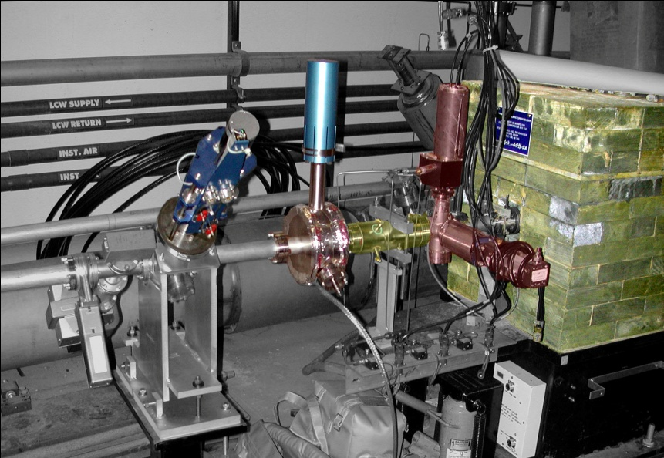
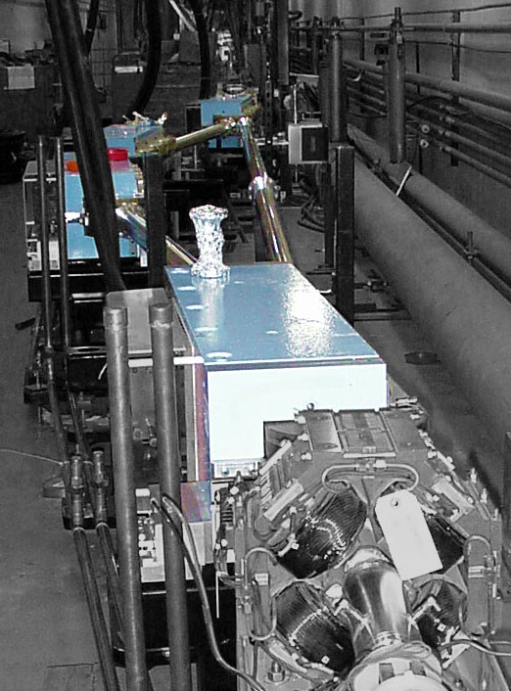
CEBAF Modifications for Energy Recovery
Modifications include the installation of:
λ_{RF}/2 path length delay chicane
Dump and beamline with diagnostics

Slide 13
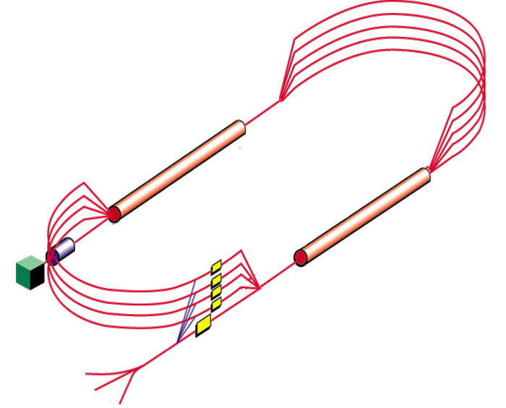

“1 Pass Up / 1 Pass Down” Operation
Arc 1
Linacs set to provide 500 MeV energy gain
555 MeV
555 MeV
55 MeV
555 MeV
555 MeV
55 MeV
Injector
1055 MeV
Arc 2
1055 MeV
λ_{RF}/2 chicane
Beam dump

Slide 14
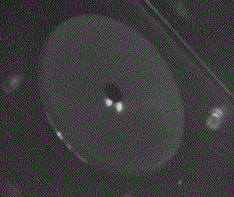
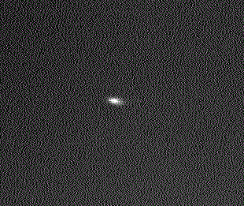
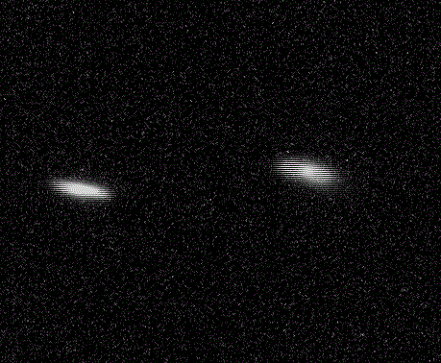
Summary of CEBAF-ER Experimental Run
Achievements
Demonstrated the feasibility of energy recovering a high energy (1 GeV) beam through a large (~1 km circumference), superconducting (300+ cavities) machine
80 μA of CW beam accelerated to 1055 MeV and energy recovered at 55 MeV
1 µA of CW beam, accelerated to 1020 MeV and energy recovered at 20 MeV
Voltage (arb. units)
250 μs
Time (μs)
March 2003
2L10 Viewer
Dump OTR
Tested the dynamic range by demonstrating high final-to-injector energy ratios (E_{final}/E_{inj}) of 20:1 and 50:1
1st pass
2nd pass
SLM
FEL Demo 5:1 || FEL Upgrade 16:1

Slide 15
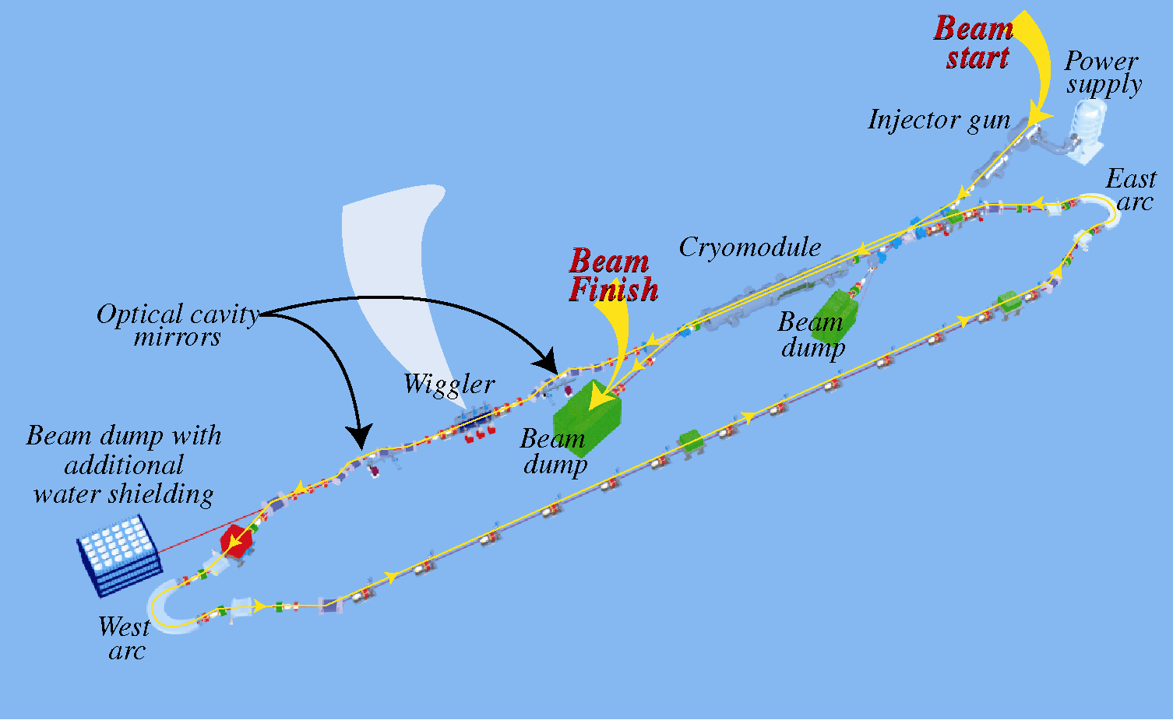
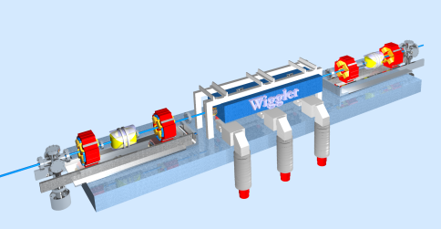
Jefferson Lab FEL: Past
IR FEL Demo
Chose SRF linac to maintain superior beam quality
CW operation allows high average output power at modest charge per bunch
Invoking energy recovery increases system efficiency
The IR FEL Demo recovered 48 MeV of 5 mA beam through a single cryomodule
Established a world record of 2.3 kW output laser power

Slide 16
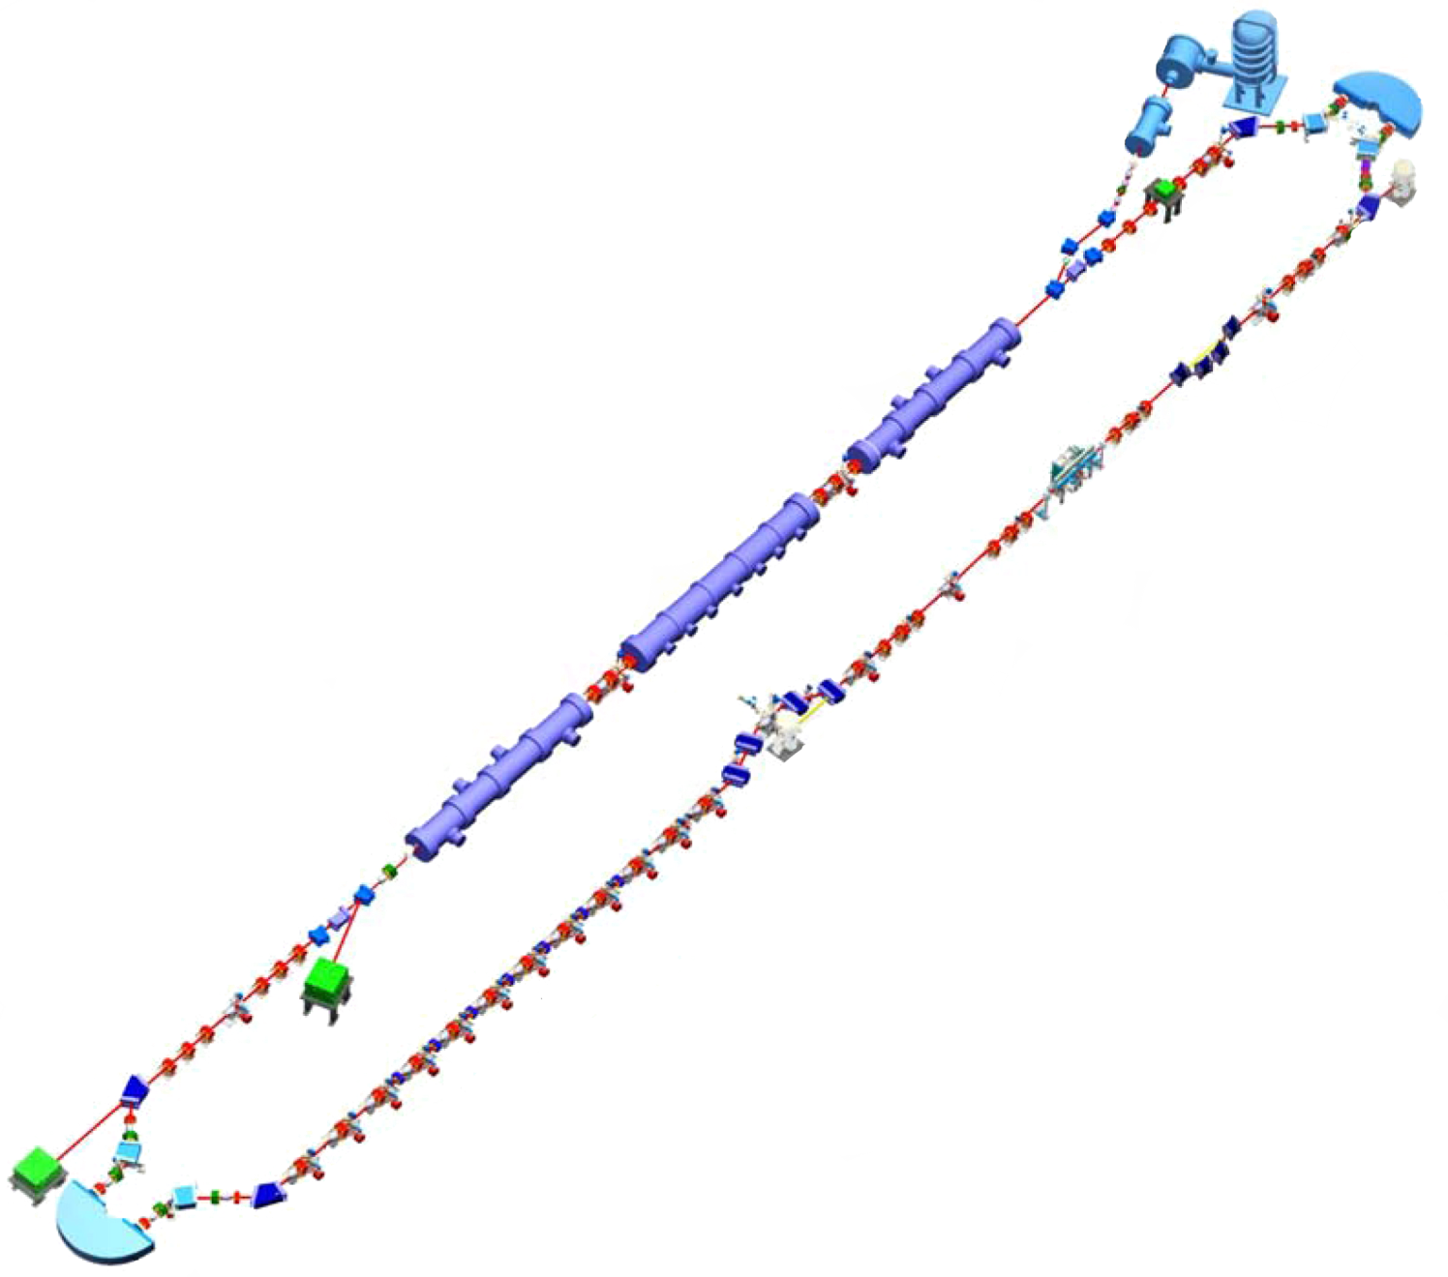
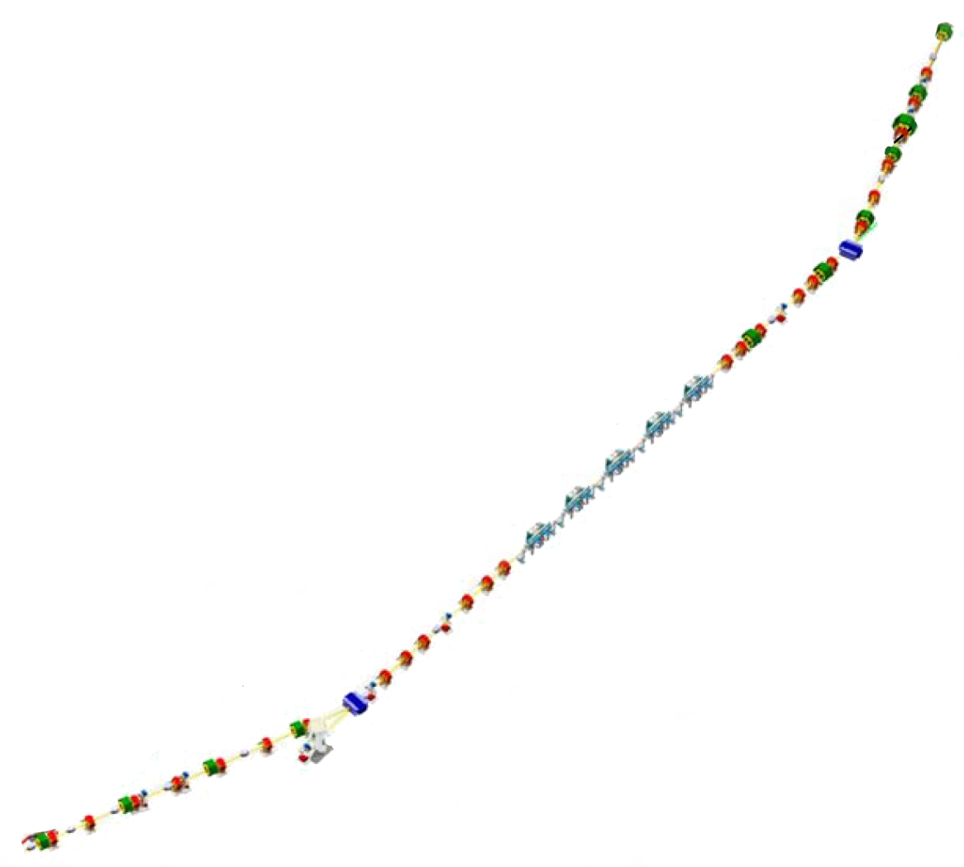
Jefferson Lab FEL: Present
Beam Parameters | Specification | Achieved
Energy {MeV} | 145 | 160
Peak Current {A} | 240 | 400
σ_{t} {ps} at wiggler | 0.20 | 0.13
σ_{ΔE} {%} at wiggler | 0.4 | 0.3
ε_{x,y} (rms) {mm-mrad} | 30 | 7
ε_{z} (rms) {keV-ps} | 65 | 80
DC Gun
IR Wiggler
SRF Linac
Bunching Chicane
UV FEL Transport Line
Dump

Slide 17
Outline
What is an ERL?
Why do you want an ERL?
History of ERLs at Jefferson Lab
  CEBAF with Energy Recovery
  FEL Drivers (Demo and Upgrade)
Beam Dynamical Issues
  Halo
  Longitudinal Match
  Incomplete Energy Recovery
Collective effects
  Beam Breakup (BBU)
  Coherent Synchrotron Radiation (CSR)
  Transverse and Longitudinal Space Charge

Slide 18
Beam Dynamics Issues
space charge
BBU
other wakes/impedances
  linac, vacuum chamber, diagnostic impedences
  resistive wall
vacuum effects
  ions
  gas scattering
intrabeam scattering
  IBS
  Touschek
halo
  formation
  gas scattering
  beam formation processes
Coherent SR
  microbunching instabilities
Incoherent SR
  emittance, δp/p...
Error analysis
  Alignment
    Magnets, cavities, diagnostics
  Powering
    Excitation, ripple, reproducibility
  field tolerance
    Homogeniety, calibration
  timing & synchronism
  phase & gradient
  diagnostic errors
RF drive
  transient analysis
(courtesy D. Douglas)

Slide 19
Halo in CW Systems
Beam is extremely non-uniform
  In some places the transverse distribution looks like 2 or 3 superposed Gaussians in one or both directions
  In dispersed locations, the beam shows structure (filamentation) that appears to evolve through the system
Huge operational problem
Many potential sources
  Ghost pulses from drive laser
  Cathode temporal relaxation
  Scattered light on cathode
  Cathode damage
  Field emission from gun surfaces
  Space charge/other nonlinear dynamical processes
  Gas scattering
  Intrabeam scattering
  Dark current from SRF cavities
Much of our tuning-up time is spent getting halo to “fit” though (can’t throw it away; get activation and heating damage; can’t collimate it, it just gets mad…)
Need to avoid “putting power where you don’t want it”
(courtesy D. Douglas)

Slide 20
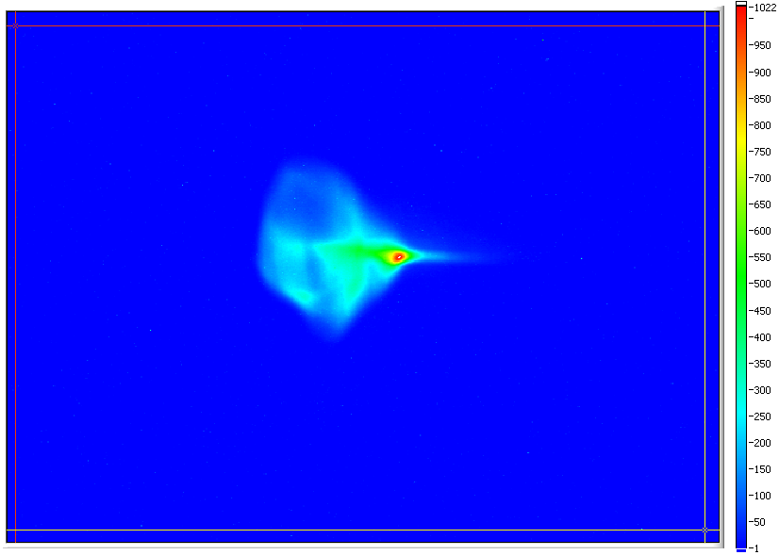
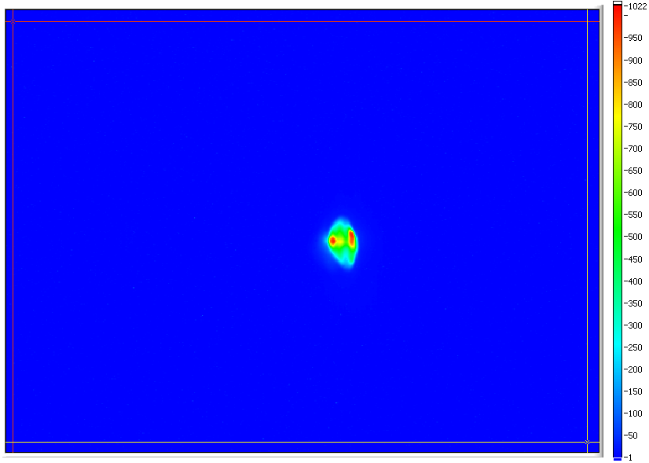
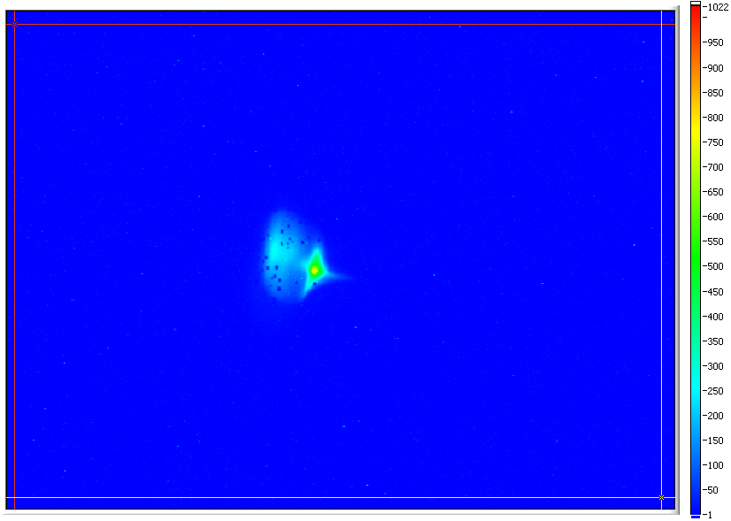
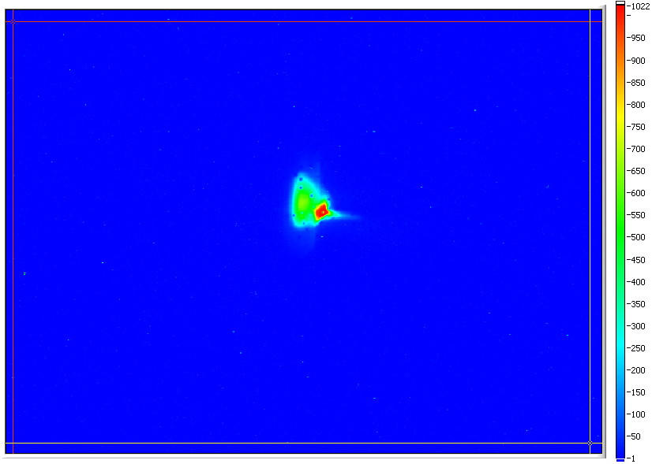
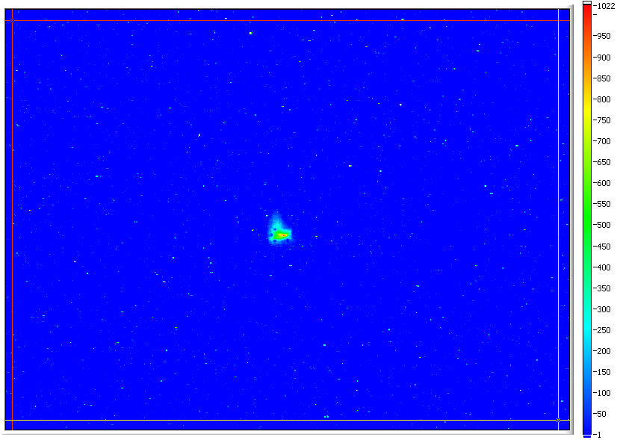
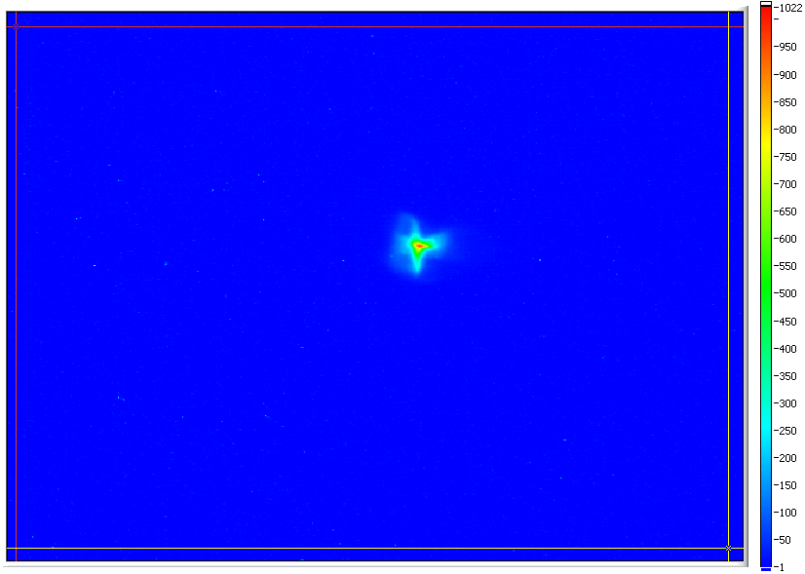
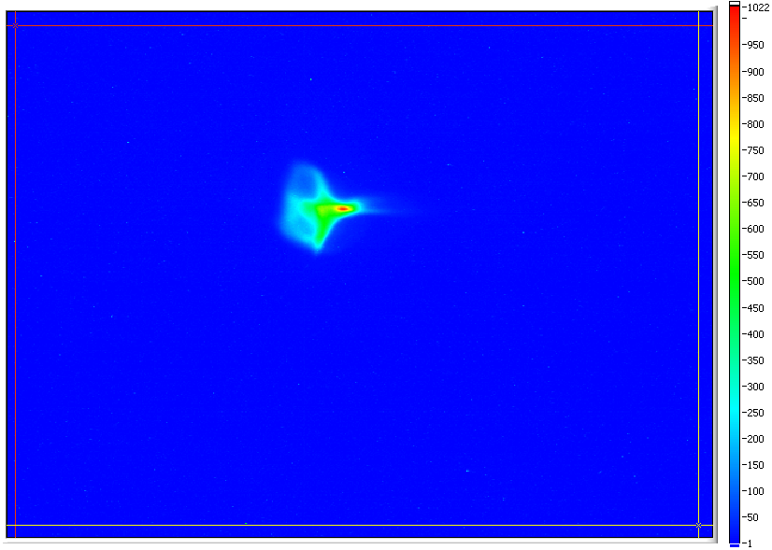
3F Region: Drift
(courtesy P. Evtushenko)

Slide 21
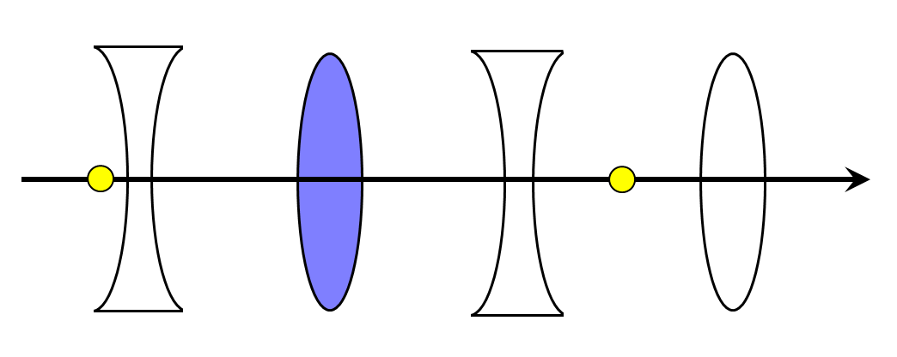
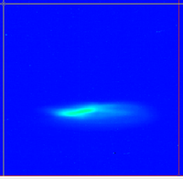
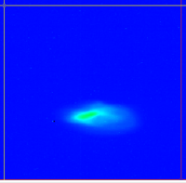
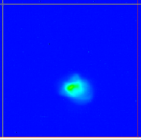
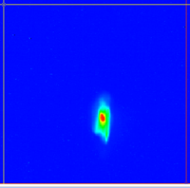
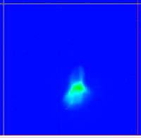
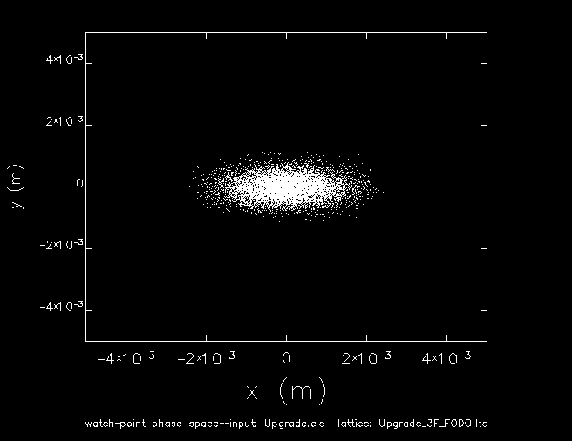

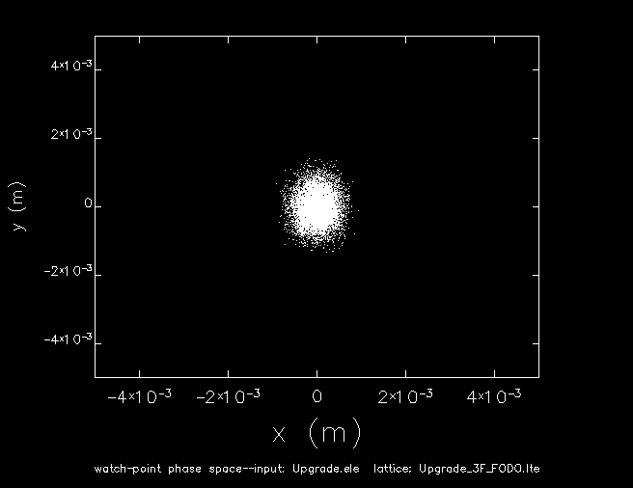
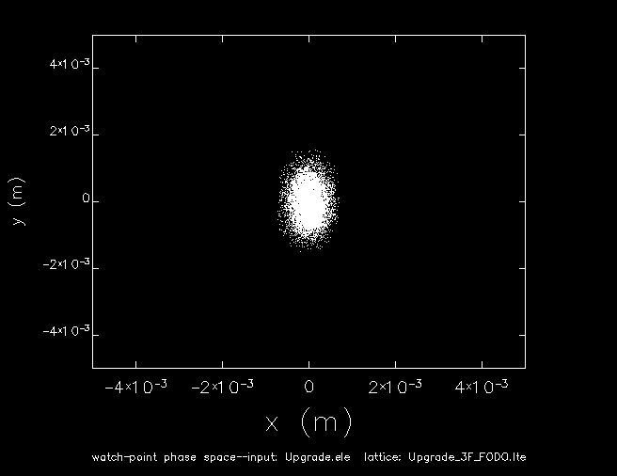
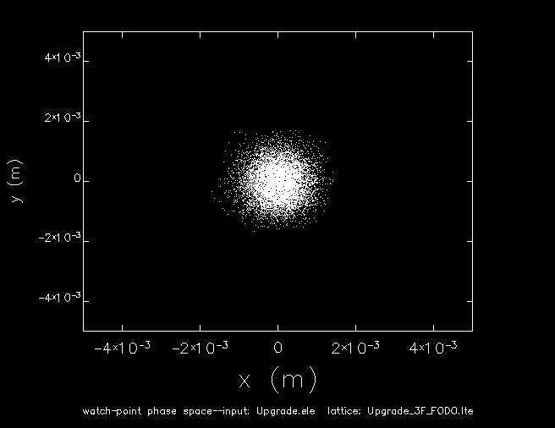
Transverse Phase Space Tomography
3F region setup as six 90º matched FODO periods
Scan quad from 1500 G to 5500 G and observe beam at downstream viewer
This generates an effective rotation of 157˚ of the horizontal phase space
monitor
observation point
5 mm
5 mm
1500 G
2500 G
3500 G
4500 G
5500 G

Slide 22
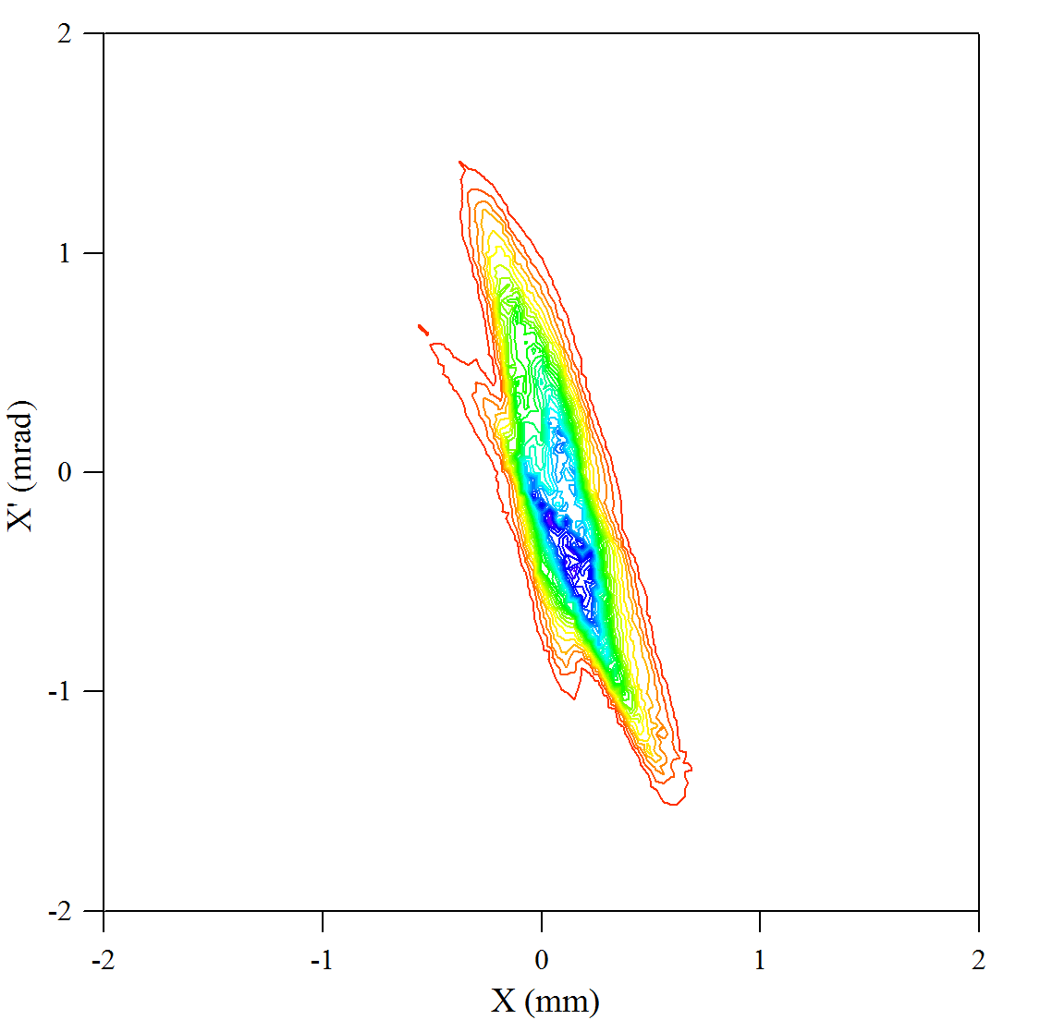
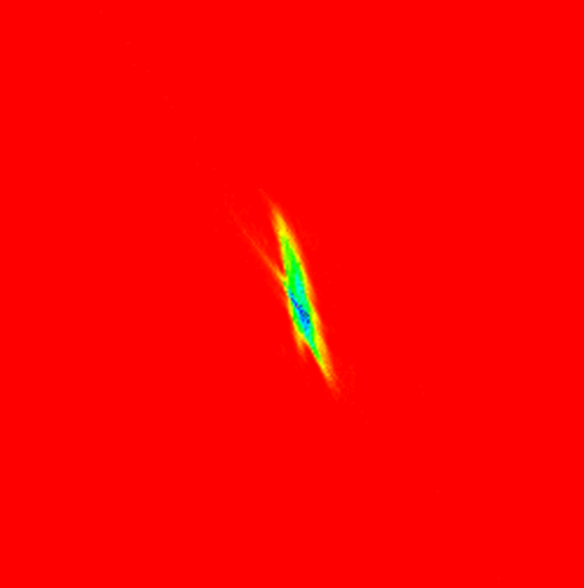
Phase Space Reconstruction
Use Maximum Entropy algorithm (J. Scheins, TESLA 2004-08)
  Most likely solution while minimizing artifacts
Reconstructed horizontal phase space at 115 MeV
Extracted parameters:
ε_{n} = 15.36 mm-mrad
β_{x} = 0.48 m
α_{x} = 1.14
2 mm
2 mrad

Slide 23
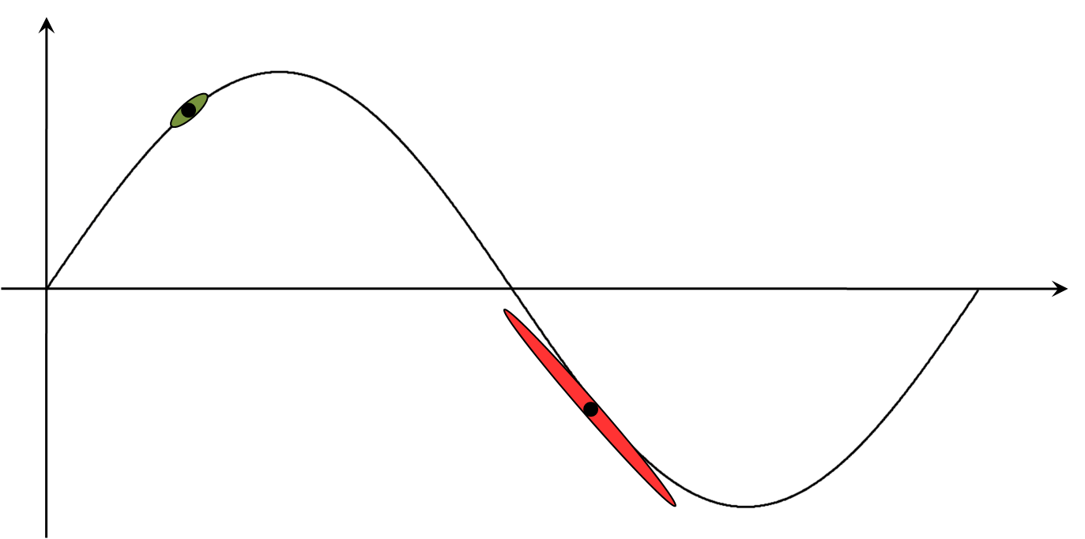
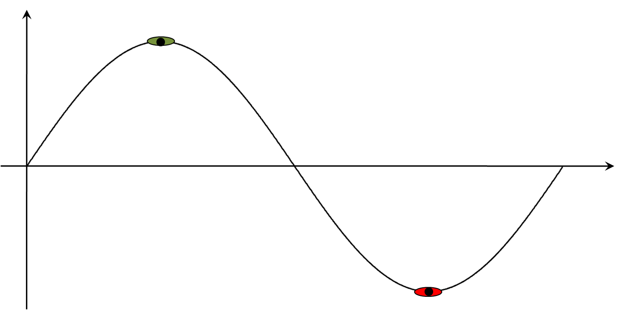
The Function of an ERL
We’ve discussed some of the details of ERLs but how do you use them?
At some point the beam interacts with a target, makes light, something, which typically
  takes energy out
  degrades the phase space
This creates challenges for energy recovery
As a result, ERL operation is not just a matter of riding the RF crest up and RF trough back down…

Slide 24
Longitudinal Match
1. Longitudinal Match to Wiggler
  Inject long, low-energy-spread bunch to avoid LSC problems
    need (1-1.5)° rms with 1497 MHz RF at 135 pC in our machine
  Chirp on the rising part of the RF waveform
    Alleviates LSC
  Compress (to required order, including curvature and torsion compensation) using recirculator momentum compactions (M₅₆, T₅₆₆, W₅₆₆₆)
2. Longitudinal Match to Dump
  FEL exhaust bunch is short with very large energy spread (10-15%)
  Therefore, must energy compress during energy recovery to avoid beam loss linac during energy recovery
  Recovered bunch centroid usually not 180º out of phase with first pass
  For specific longitudinal match, energy and energy spread at dump does not depend on lasing efficiency, exhaust energy, or exhaust energy spread
(courtesy D. Douglas)

Slide 25
Longitudinal Match for ERL-Driven FEL
E
E
φ
injector
φ
linac
dump
E
E
E
E
φ
φ
φ
φ
wiggler
Important Features:
Energy transient when FEL turns off/on → phase transient at reinjection → transient beam loading
Must provide adequate RF power to manage these transients
No energy transients at dump when system properly tuned
Properly designed system can readily manage nonlinear effects:
  Sextupoles compensate RF curvature, octupoles manage torsion…
(courtesy D. Douglas)

Slide 26
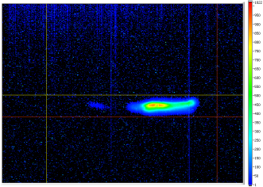
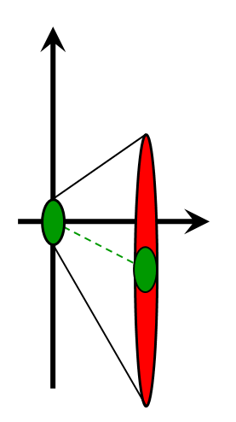
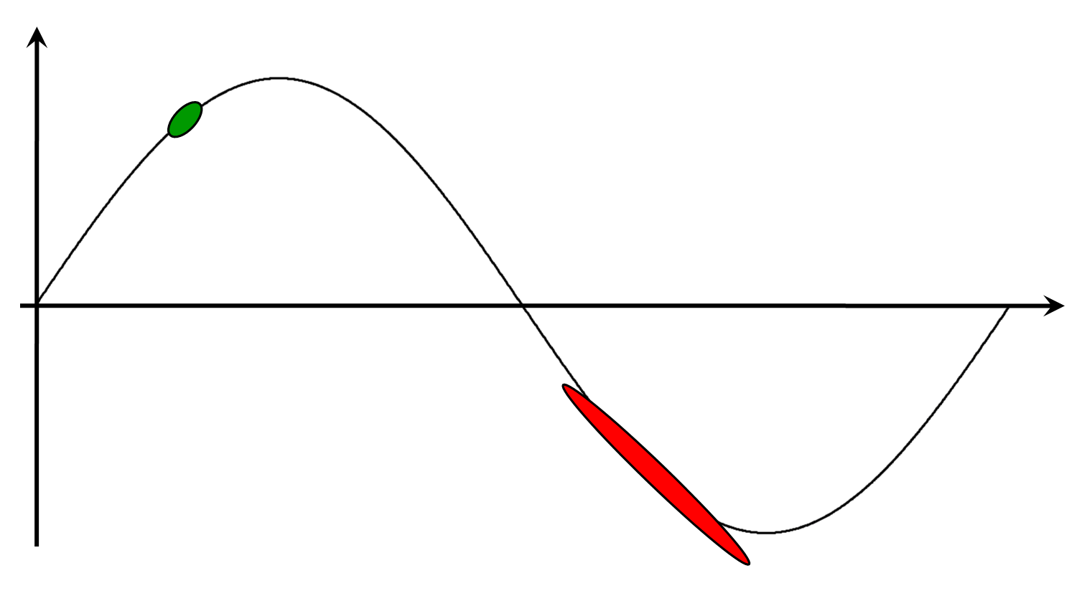
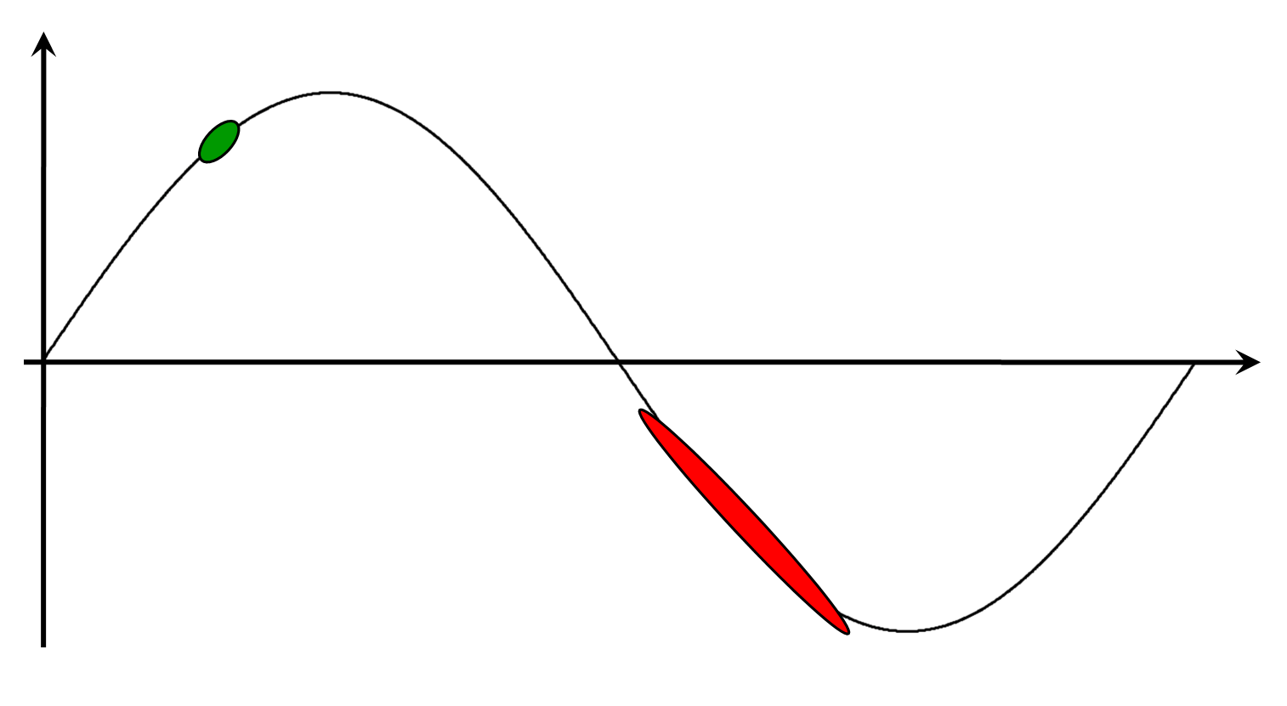
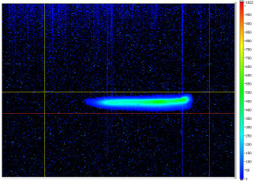
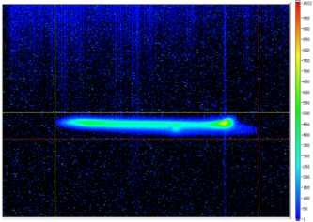
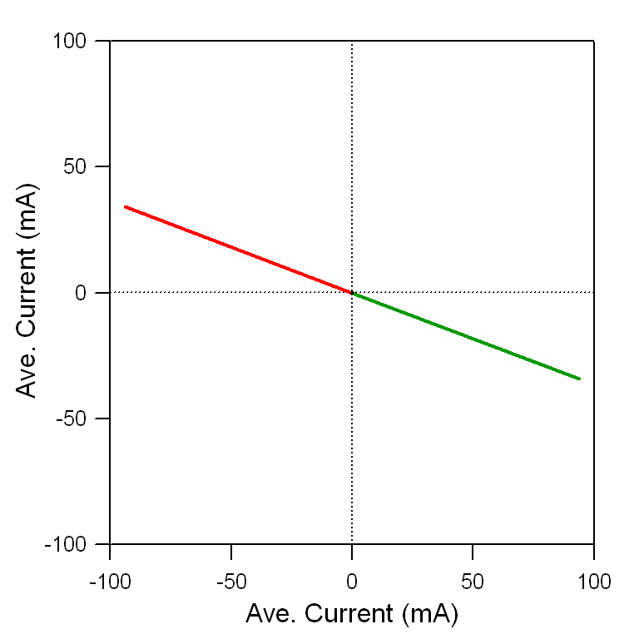
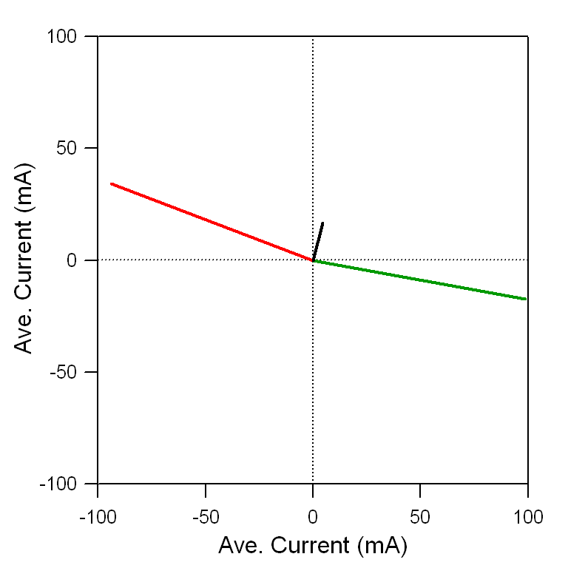
Incomplete Energy Recovery
no lasing
E
E
E
weak lasing
t
t
t
strong lasing
180˚− δ
180˚
During lasing, the beam central energy drops and energy spread increases
Deceleration must occur far enough up the RF waveform to prevent beam from falling into trough
To first order the deceleration phase must exceed:
Ave. Current (a.u.)
Ave. Current (a.u.)
Ave. Current (a.u.)
Ave. Current (a.u.)

Slide 27
Outline
What is an ERL?
Why do you want an ERL?
History of ERLs at Jefferson Lab
  CEBAF with Energy Recovery
  FEL Drivers (Demo and Upgrade)
Beam Dynamical Issues
  Halo
  Longitudinal Match
  Incomplete Energy Recovery
Collective effects
  Beam Breakup (BBU)
  Coherent Synchrotron Radiation (CSR)
  Transverse and Longitudinal Space Charge

Slide 28
Collective Effects
ERLs function to generate high brightness, high power beams
Very bright, high power beams → many phenomena are relevant
  Beam interacts with itself
    Longitudinal space charge (LSC)
    Coherent Synchrotron Radation (CSR)
      Microbunch Instability (MBI)
  Beam interacts with environment
    Beam Breakup (BBU)
    Resistive wall
    Environmental wakes/impedances…
  Stray power deposition
    Propagating HOMs, CSR/THz, halo, etc…
(courtesy D. Douglas)

Slide 29
Multipass Beam Breakup (BBU)
B
E
TM₁₁-like Mode
Dipole HOM
y
y
z
x
E
B
A positive feedback between the recirculated beam and poorly damped dipole HOMs

Slide 30
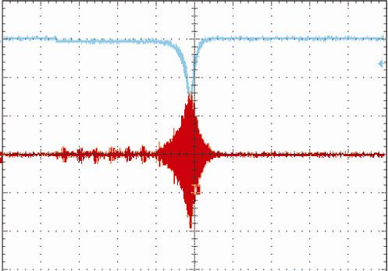
Benchmarking BBU Simulation Codes
Screenshot of the HOM voltage and power during beam breakup
Identify the cavity and HOM causing BBU
 | Method | I_{threshold} (mA)
Simulation | MATBBU (Yunn, Beard) | 2.1
 | TDBBU (Krafft, Beard) | 2.1
 | GBBU (Pozdeyev) | 2.1
 | BI (Bazarov) | 2.1
Experimental | Direct Observation | 2.3 + 0.2
 | Growth Rates | 2.3 + 0.2
 | Kicker-based BTF | 2.3 + 0.1
 | Cavity-based BTF | 2.4 + 0.1
Analytic | Analytic Formula | 2.1
5 ms/div
Simulate BBU in the FEL with several codes
Experimentally measure the threshold current using variety of techniques
Simulation codes have been benchmarked with experimental data

Slide 31
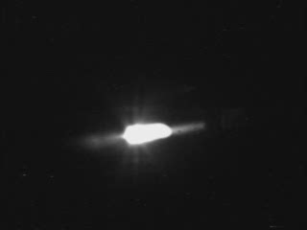
Beam Breakup at the FEL (Realtime)

Slide 32
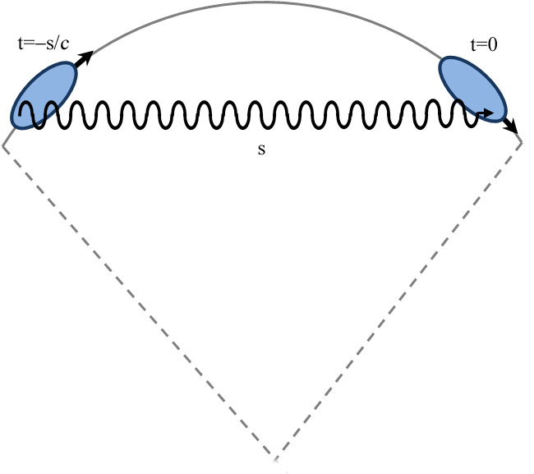
Coherent Synchrotron Radiation
CSR describes the self-interaction of an electron bunch with its own radiation field
Short bunches can radiate coherently at wavelengths comparable to the bunch length.
CSR is a tail-head instability where the radiation emitted from the tail of the bunch overtakes the head as the beam travels along a curved trajectory
the tail of the bunch loses energy while the head of the bunch gains energy → modulation of the energy distribution in a dispersive region (dipole) → transverse emittance growth in the bending plane.
Thus both the longitudinal and transverse emittances are degraded due to CSR.

Slide 33
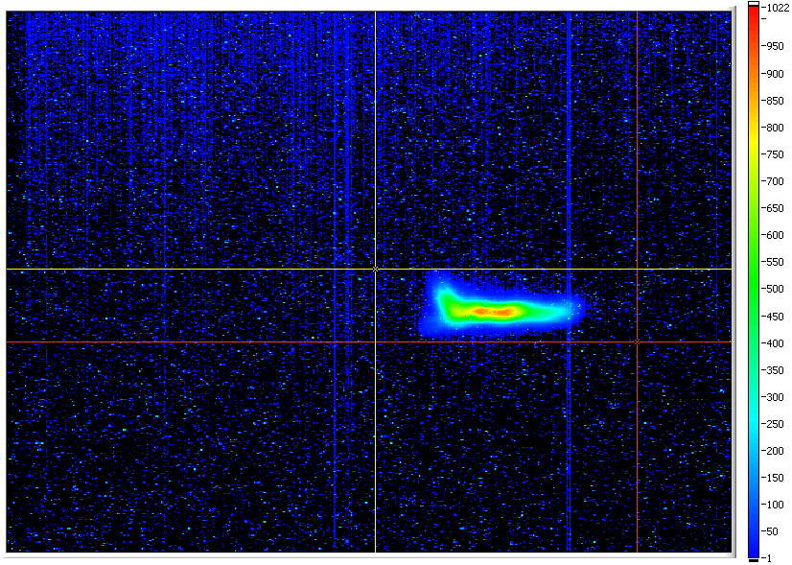
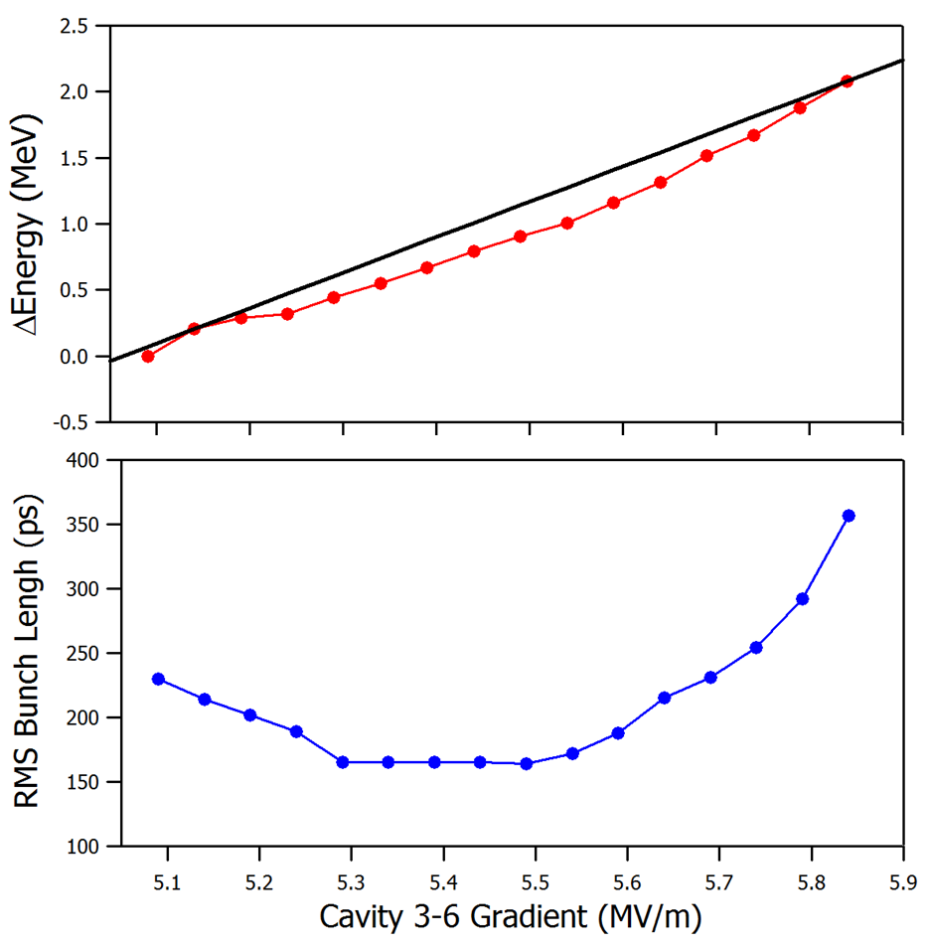
Coherent Synchrotron Radiation
CSR does not present an operational impediment (used it as a diagnostic)
In the past we had generated so much CSR (THz) that we heated the FEL mirrors up and distorted them, limiting power output
Observe beam filamentation as we vary bunch length compression
(change energy → offset through sextupoles → modify M₅₆)
y
E
(courtesy P. Evtushenko)

Slide 34
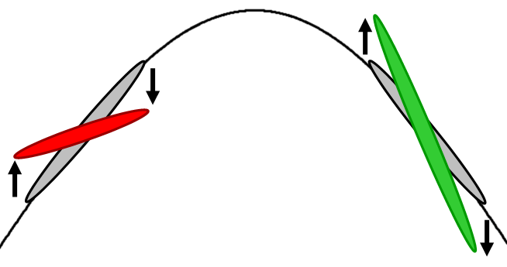
Space Charge Force
At 135 pC transverse space charge does not present problems
However longitudinal space charge does
Initial signature: momentum spread asymmetric about linac on-crest phase
Head of bunch accelerated, tail of bunch decelerated
  Before crest (head at low energy, tail at high) observed momentum spread reduced
  After crest (head at high energy, tail at low) observed momentum spread increased
BEFORE
crest
AFTER
crest
Small changes in injector setup allowed us to increase the bunch length at injection which alleviated LSC; additionally, uncorrelated energy spread reduced
C. Hernandez-Garcia et al., 2004 FEL Conference

Slide 35
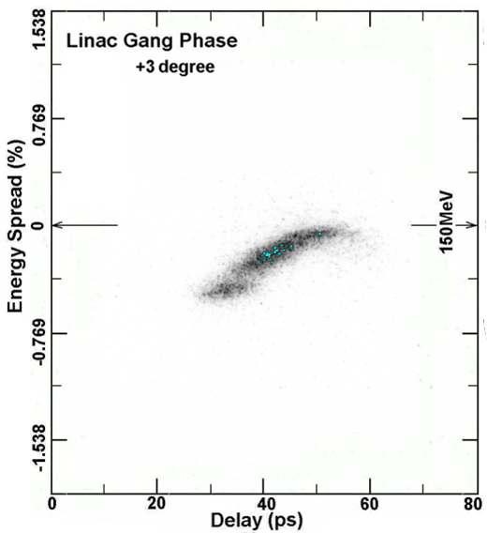
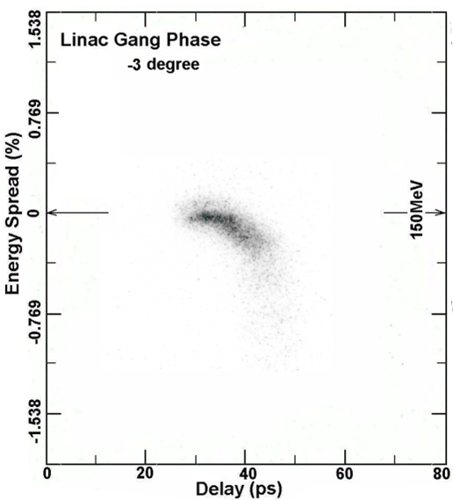
Measurements Showing LSC Effects
3 degrees before crest
3 degrees after crest
S. Zhang et al., 2006 FEL Conference
Streak camera measurements showing longitudinal phase space at the midpoint of the first 180˚ bend at a bunch charge of 110 pC
(observed bunch compression is due to non-zero M₅₆ from linac to measurement point)

Slide 36
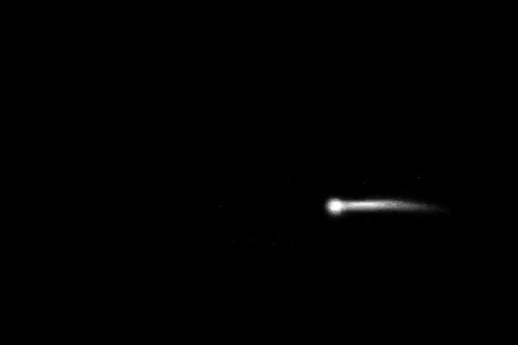
CSR/LSC Effects
(courtesy K. Jordan)

Slide 37
Summary
ERLs offer tremendous advantages and also present new and interesting challenges
The Jlab FEL is one of the most unique accelerators in the world…
This afternoon you’ll have the opportunity to see it on the tour and starting tomorrow you’ll start operating it and taking data!

Slide 38
Monday, January 17th Schedule
“Course Overview” (C. Tennant)
“Introduction to ERLs” (C. Tennant)
“JLab FEL Overview” (D. Douglas)
“Beam Diagnostics Overview” (P. Evtushenko)
LUNCH
“Using the FEL as a Beam Diagnostic” (S. Benson)
“Longitudinal Matching” (D. Douglas)
FEL Tour

