Slide 1
Ecal prototype test
M. Jones
B. Wojtsekhowski

Slide 2
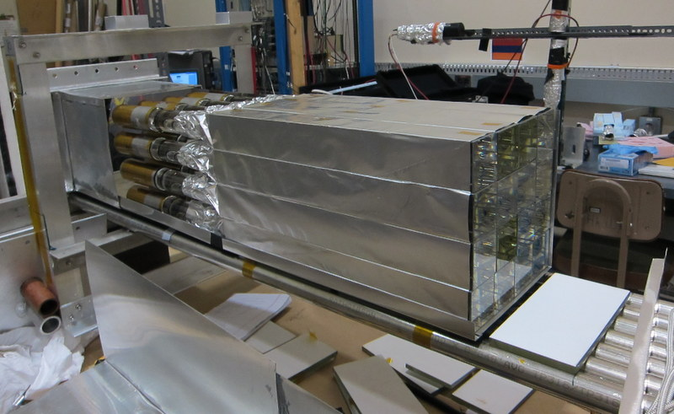
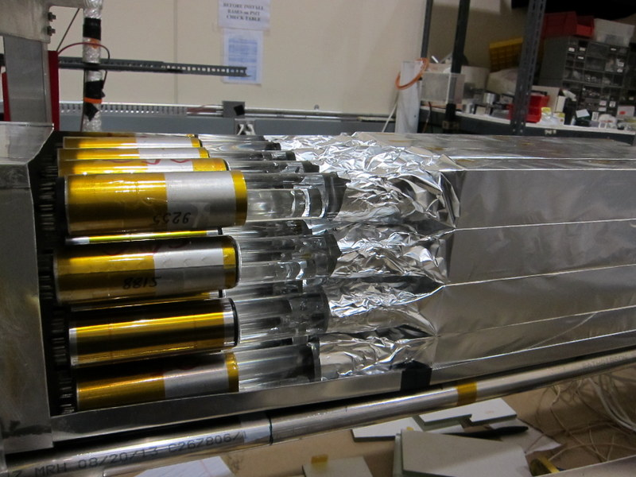
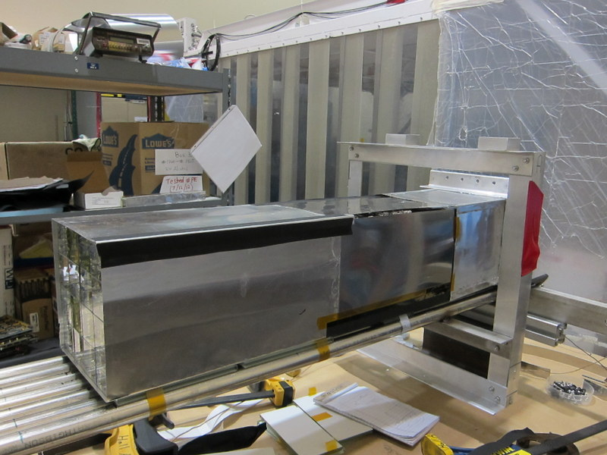
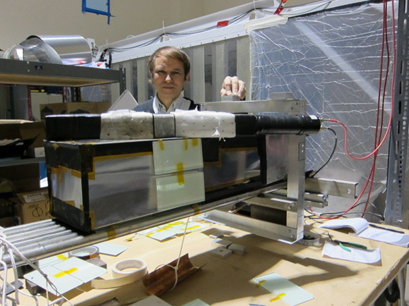
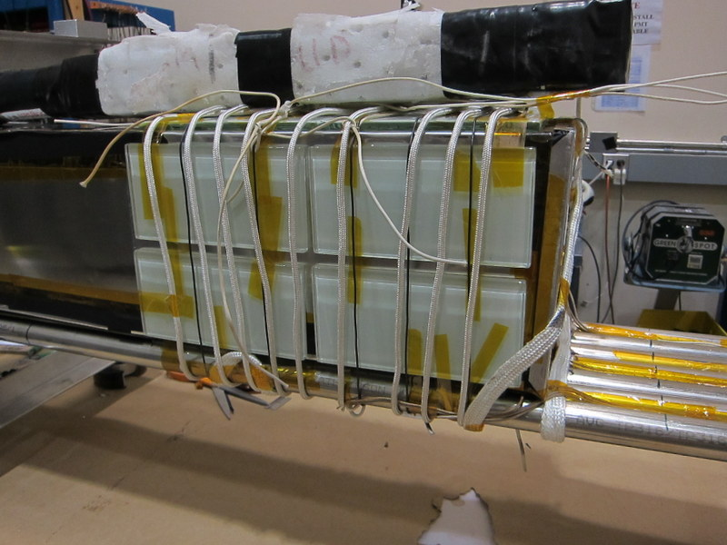
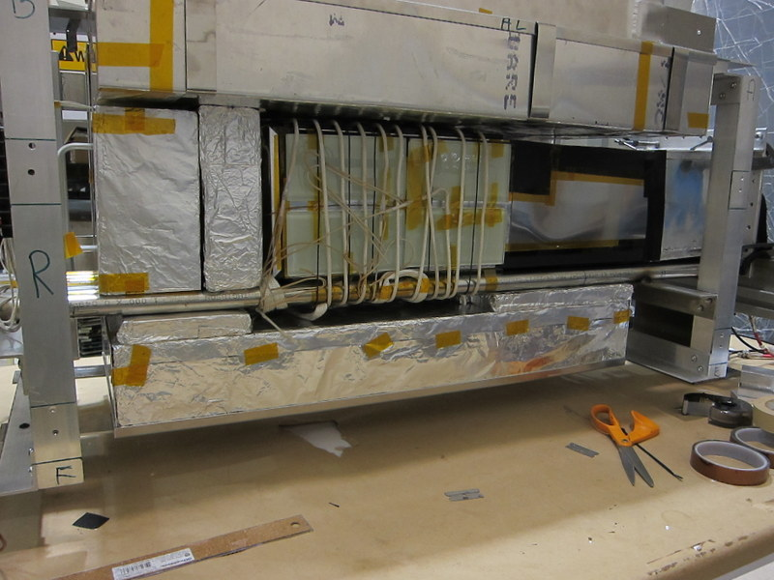
Construction of C16
4x4 array of 4.2x4.2x30cm³ lead glass
15cm light guide, then PMT
Light tight enclosure
Check signals and light tightness
Wrap heating coil and glass tile between coil and glass.
Glass foam insulation

Slide 3
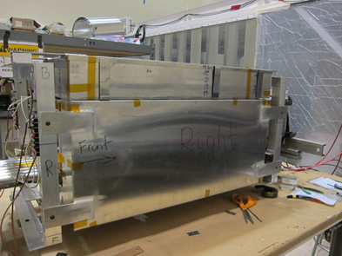
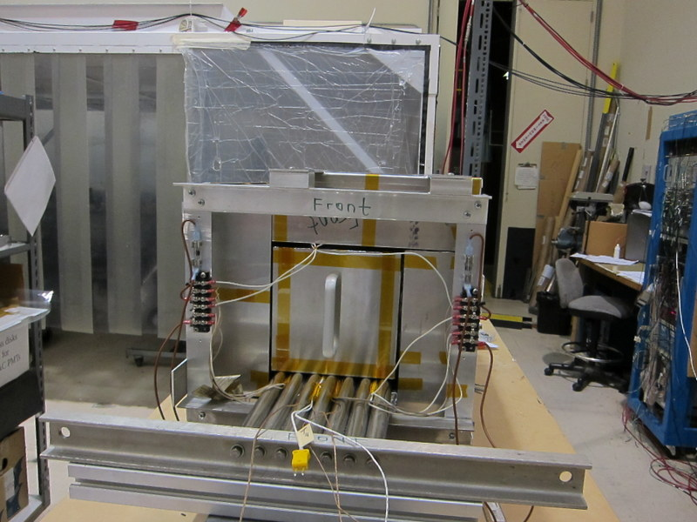
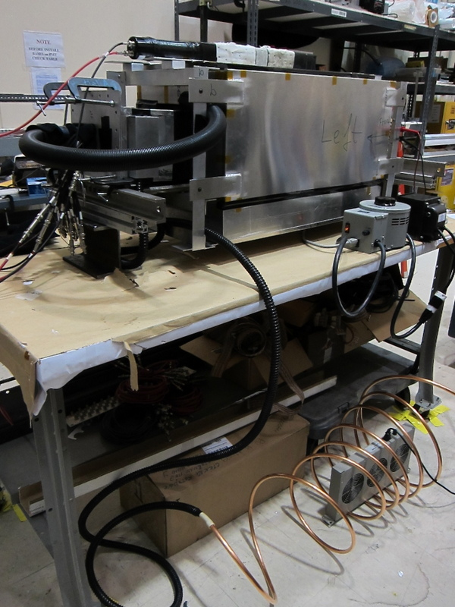
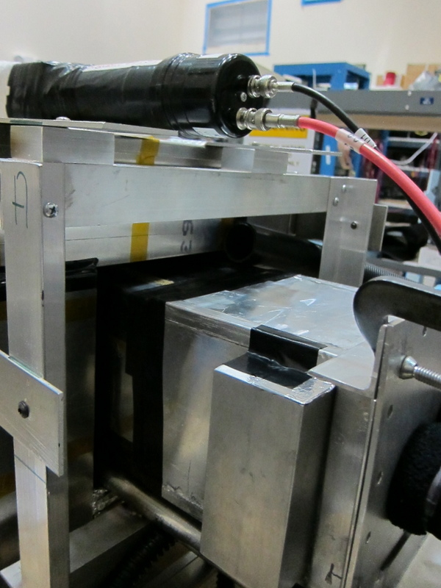
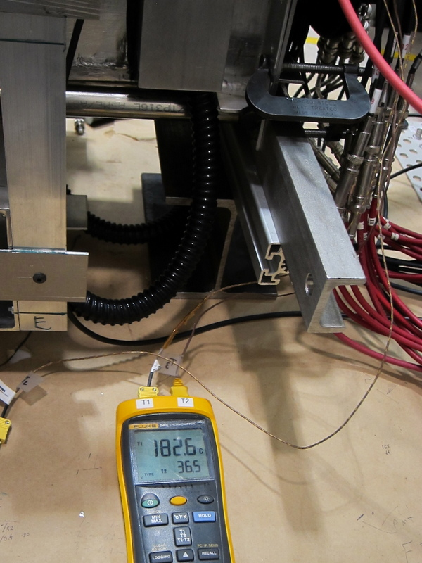
Construction of C16 ( part 2)
Enclose in thin aluminum
Cool air blow in back to cool PMT
Temperature monitored at multiple places 225º, 185º and 38º C at PMT

Slide 4
Test of C16 in Hall A
Test done between April 30th at 17:00 to May 2nd at 10:00 am.
Beam energy = 2.056 GeV, 15 cm LH2 target.
RHRS set for elastic protons at 48.74º and 1.07 GeV/c
C16
placed at 31º and elastic electrons with 1.574 GeV/c .
at 6.9m from target so covers about 25x25msr.
Expect about 1.5% change in elastic electron momentum across the face of C16.
DAQ system used RHRS scintillators as trigger and readout the C16 in FADC250. Readout in sampling mode with time window of 60 samples x 4ns = 240 ns.

Slide 5
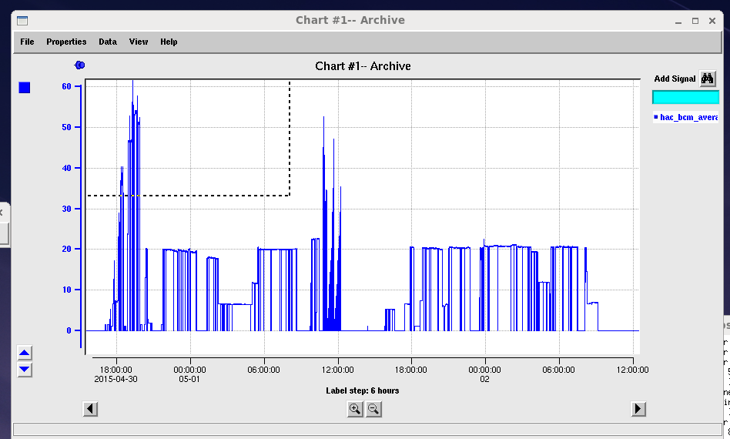
Timeline
LH2 data
Determine
latency
Move C16 to 10º and 6.1m
Dose rate 100x higher
Oven on
Place blocks to monitor radiation
C16 positioned
Oven off
755
772
743
Access to slightly move C16
Move C16 back to 31º and 6.9m
Oven at 250, 190 and 38

Slide 6
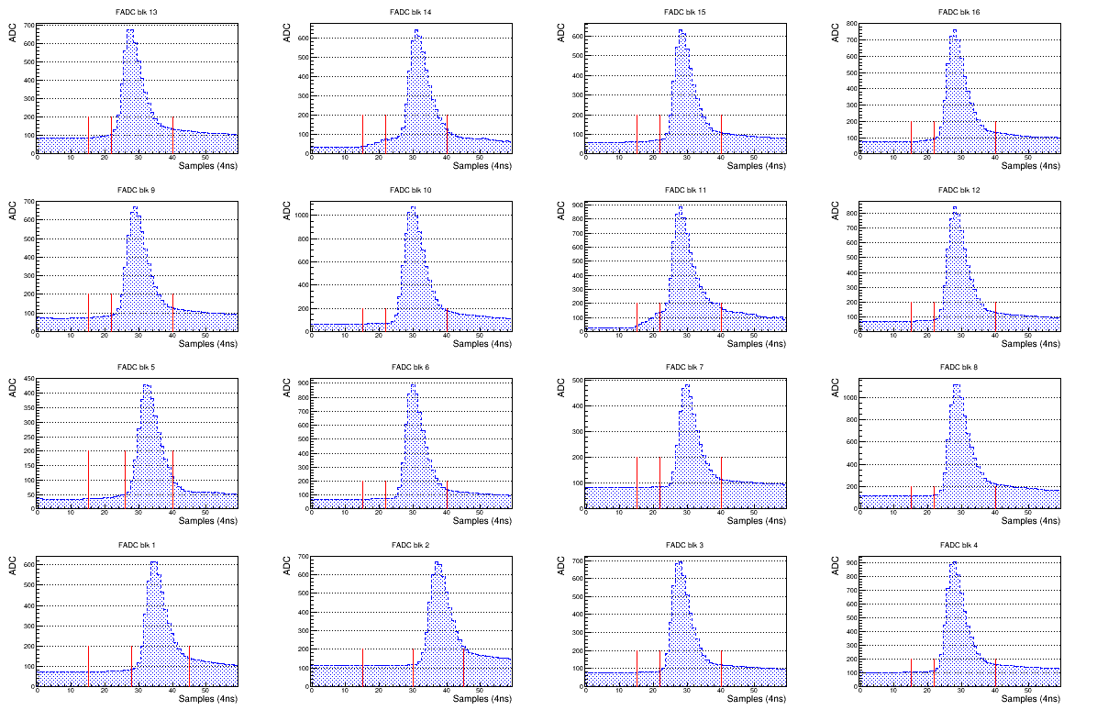
FADC250 Sampling histogram

Slide 7
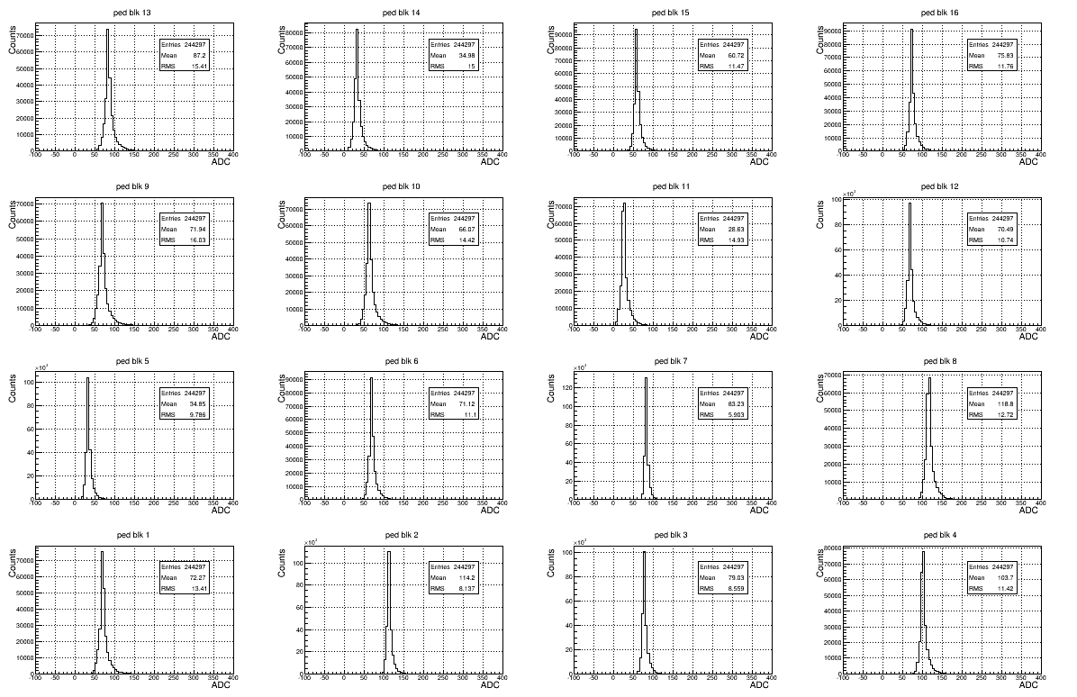
Pedestals

Slide 8
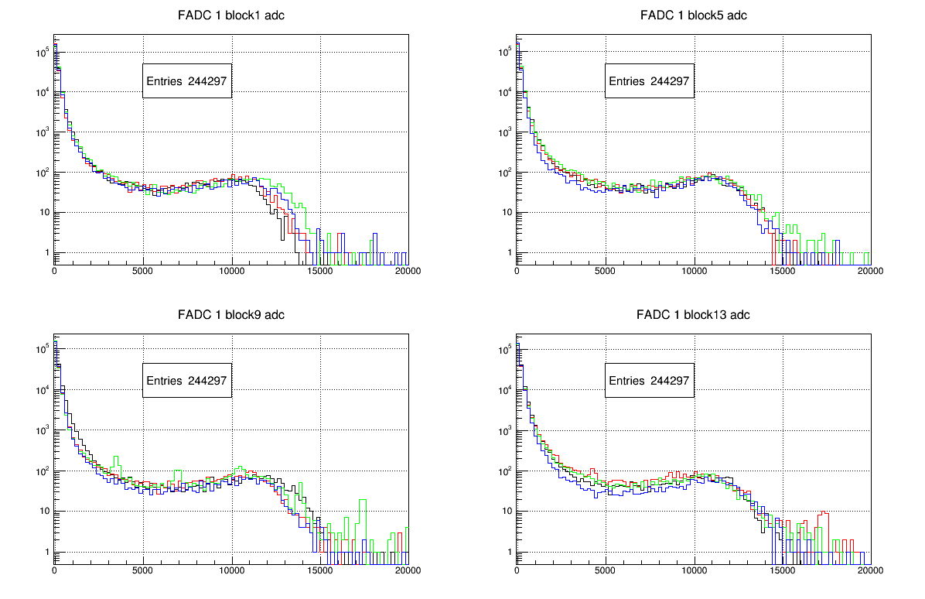
ADC spectra

Slide 9
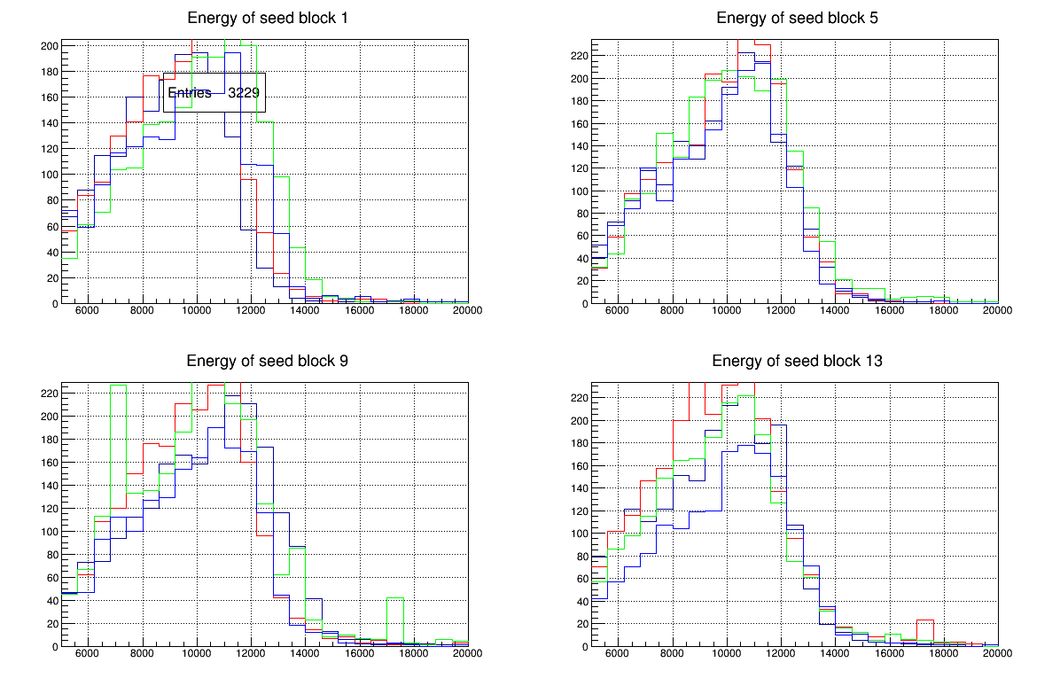
ADC spectra of block with highest energy

Slide 10
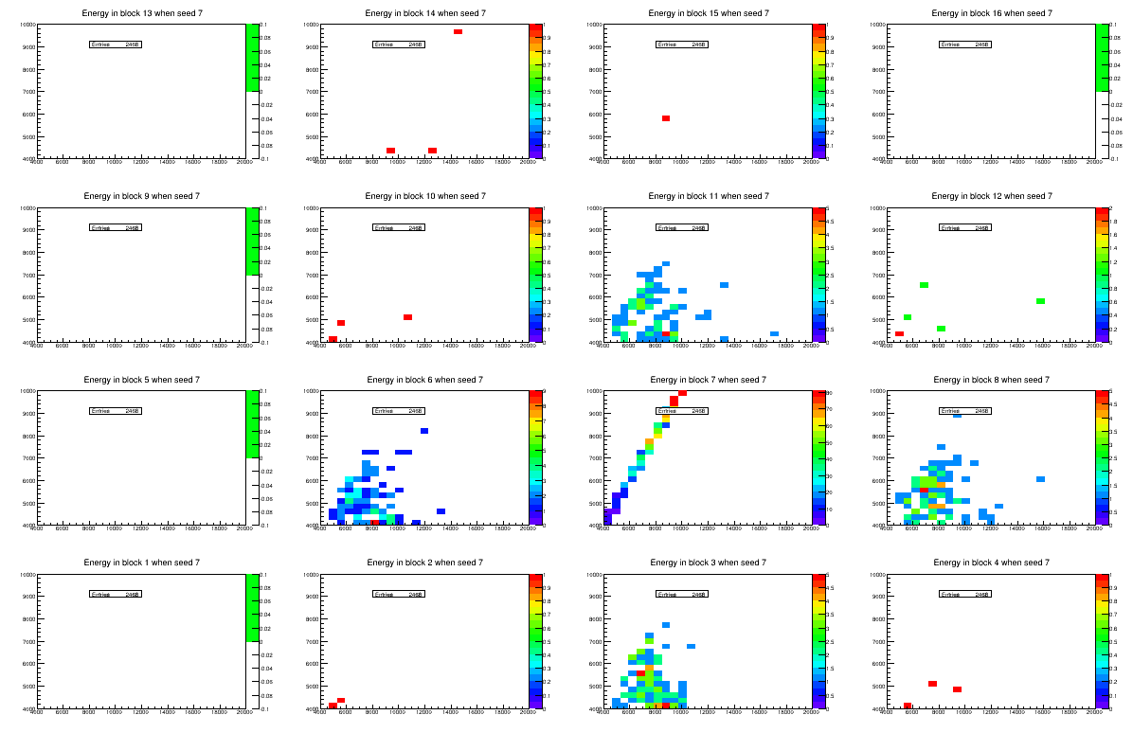
Energy in Seed block 7 versus other blocks

Slide 11
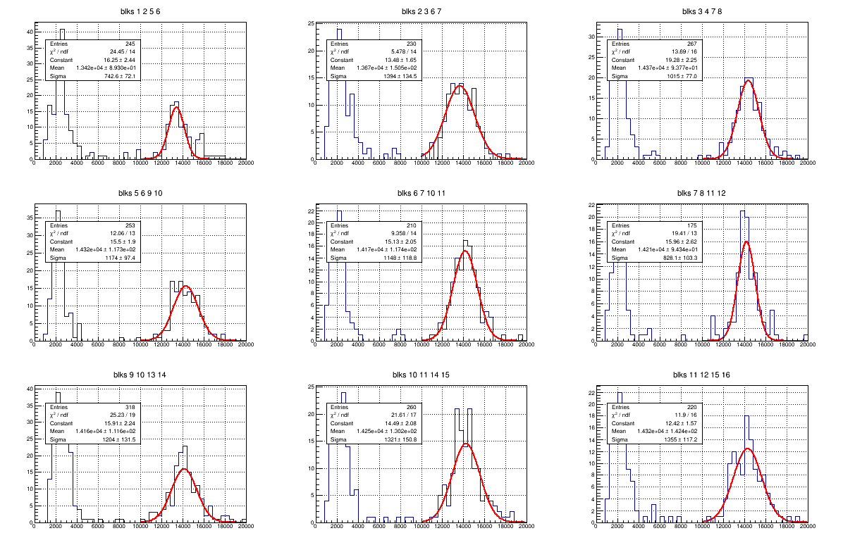
Energy resolution for run 743 at 6 uA
Sum energy in four neighbor blocks which each 1/6 of the energy seed block

Slide 12
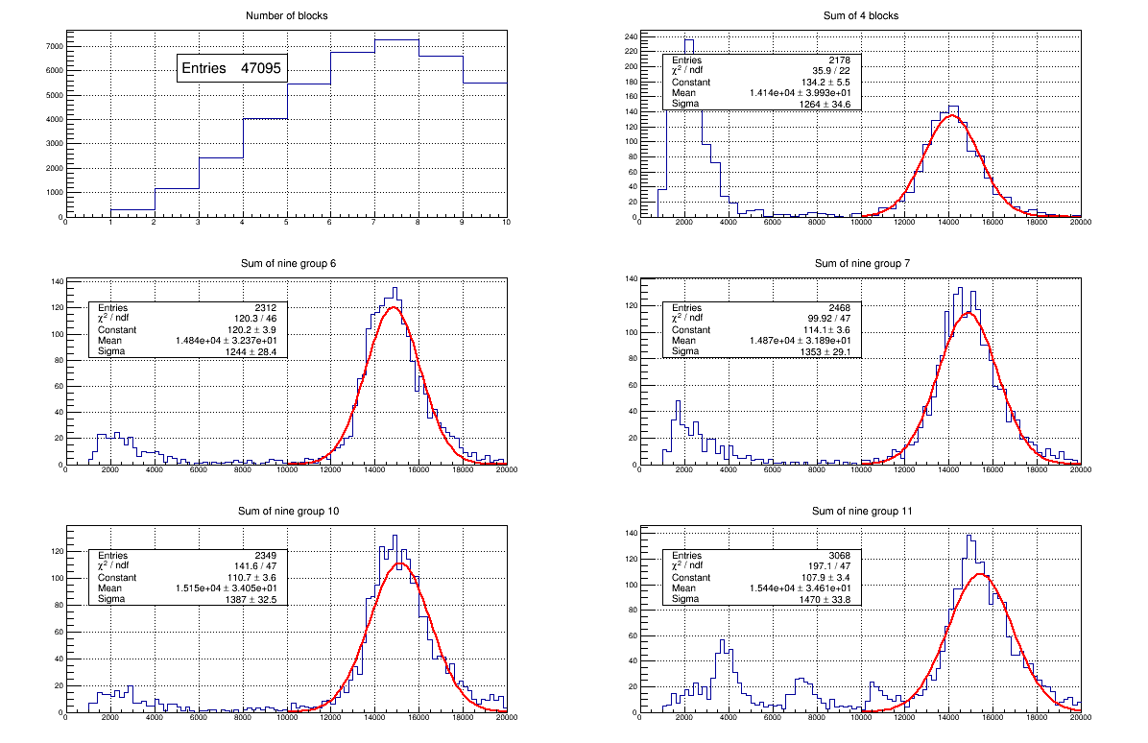
Energy resolution for run 743 at 6 uA
σ = 8.9 +/- 0.3 %

Slide 13
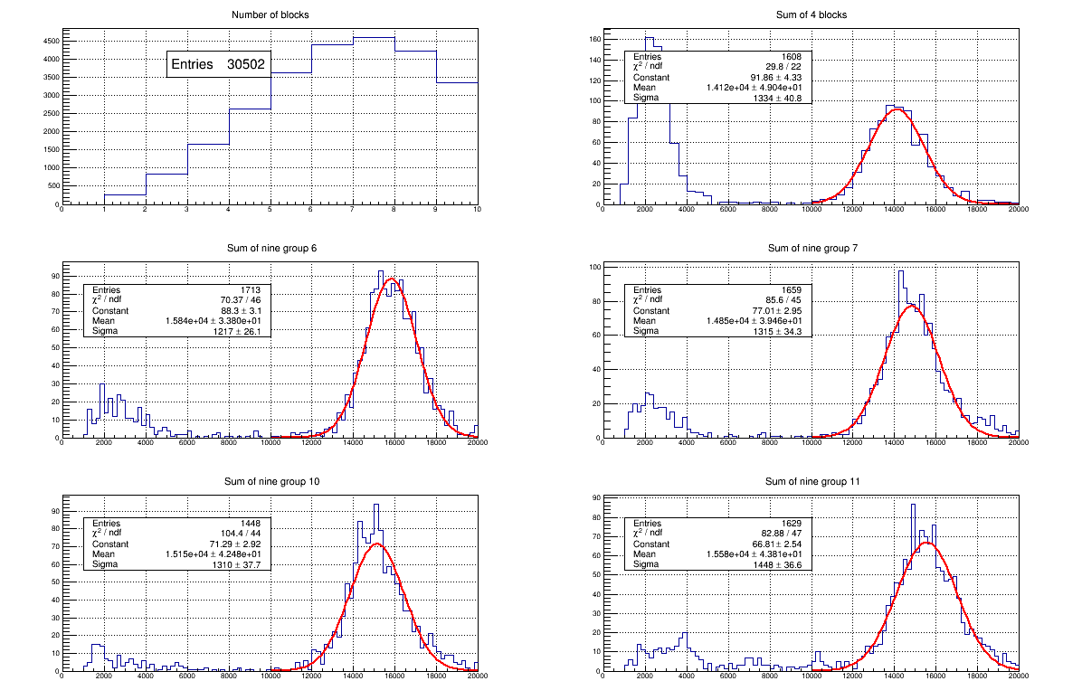
Energy resolution for run 755 at 6 uA
σ = 9.4+/- 0.3 %

Slide 14
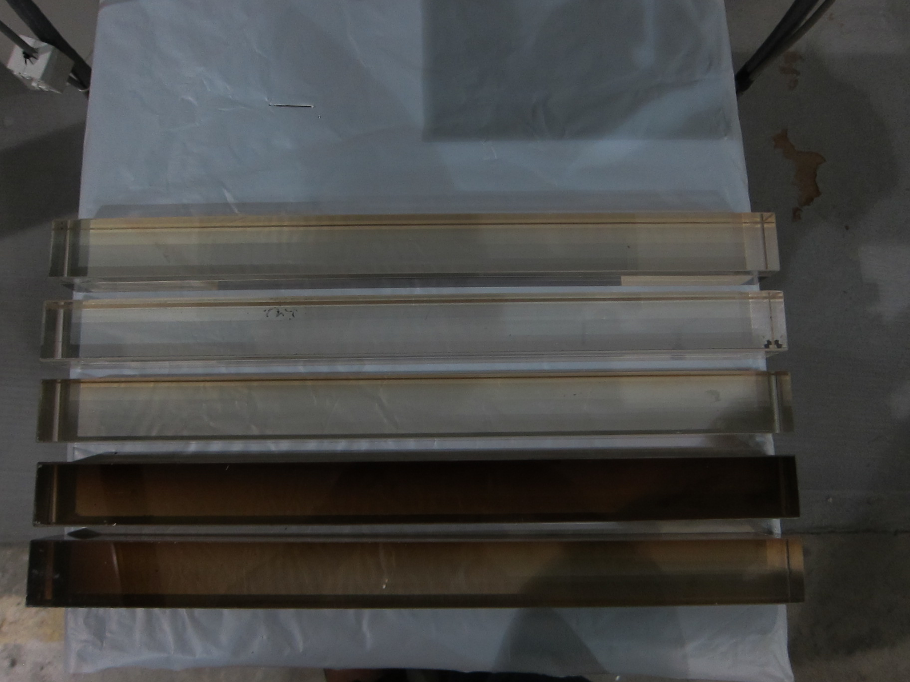
Radiation damage monitor
Lead glass bars placed at different locations to monitor radiation damage
On spectrometer frame, only slightly damaged
Perpendicular to C16 face
Parallel to C16 side

Slide 15
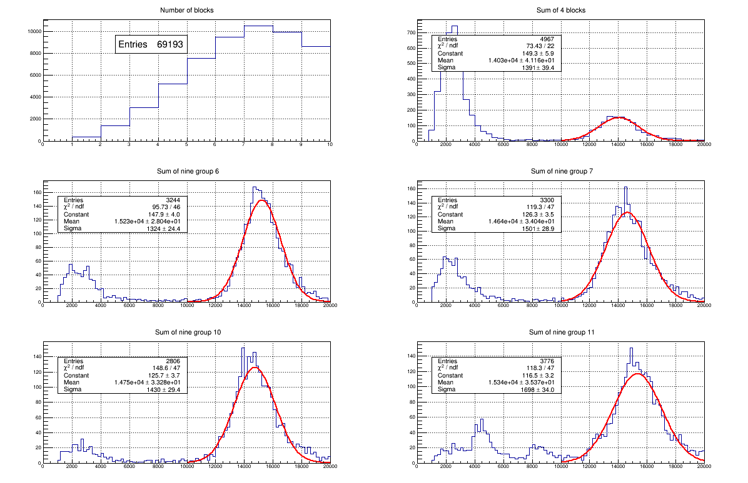
Energy resolution for run 772 at 6 uA
σ = 9.9+/- 0.3 %

