Slide 1
SPIN
ASYMMETRIES ON THE
NUCLEON
EXPERIMENT
Spin
Spin
Spin
Spin
Spin
( E07-003)
Anusha Liyanage
Experiment Nuclear Physics Group Meeting
Hampton University
May 11, 2009

Slide 2
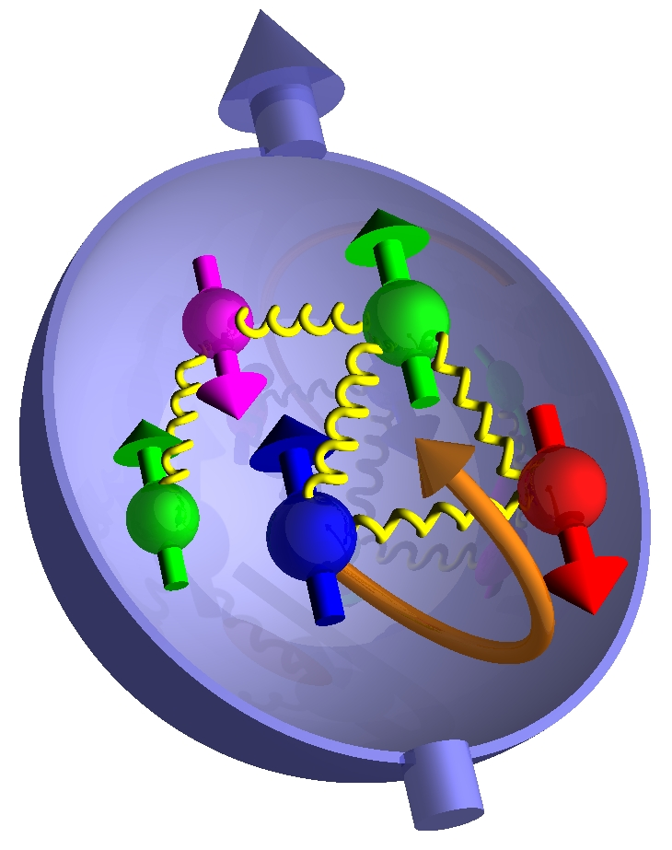
CONTENTS
Introduction
Apparatus setup
BETA Detector
HMS Detector
Target
Subsystems
Kinematic
Analysis
Detector Calibration
Detector Efficiencies
MC Simulation
Work Status

Slide 3
SANE Physics
SANE is a single arm inclusive scattering experiment.
Used
Big Electron Telescope Array –BETA In single arm mode
High Momentum Spectrometer – HMS in both single arm and coincidence mode
● Measure proton spin structure function g2(x, Q²) and
spin asymmetry A1 (x, Q²)
at four-momentum transfer 2.5 ≤ Q² ≤ 6.5 GeV² and
Bjorken x ,0.3 ≤ x ≤0.8
by measuring anti-parallel and near-perpendicular spin asymmetries
● we can learn about proton SSF's from inclusive polarized measurement:
- twist-3 effects from moments of g2 and g1
- comparisons with Lattice QCD, QCD sum rules, bag models, chiral quarks
- Study x dependence (test nucleon models) and Q² dependence (evolution)
- Exploration of "high" x region: A1's approach to x = 1

Slide 4
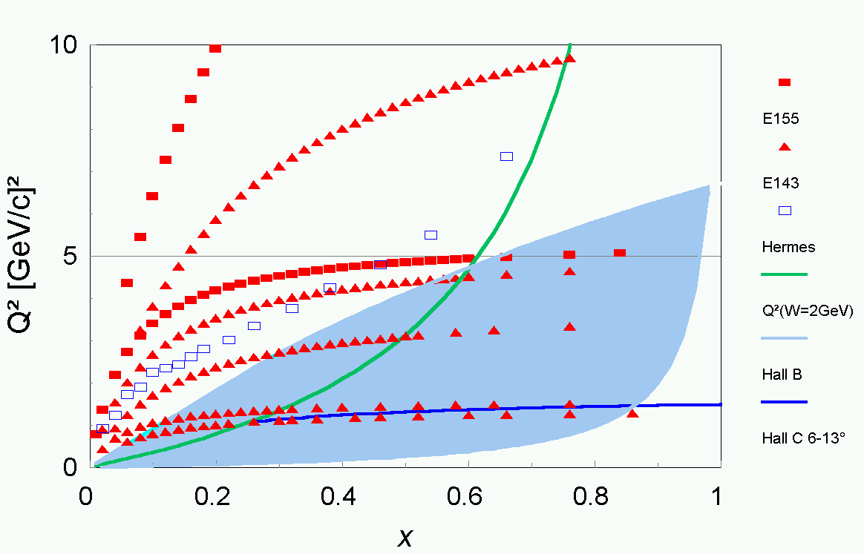
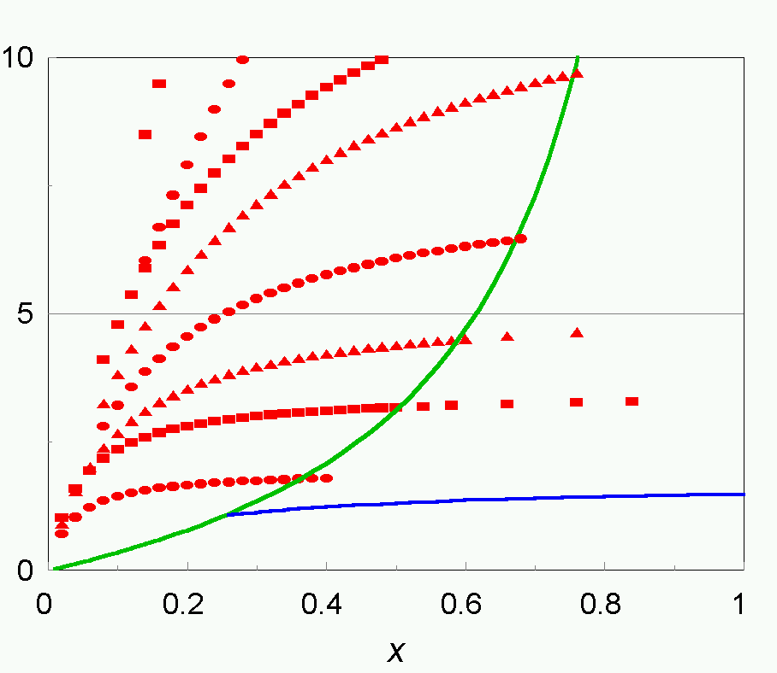
World data on A_{ll}, A and SANE kinematics
A_{ll}
A
CLAS
RSS
SANE
● Two beam energies: 5.9 GeV, 4.7 GeV
● Very good high x coverage with detector at 40°

Slide 5
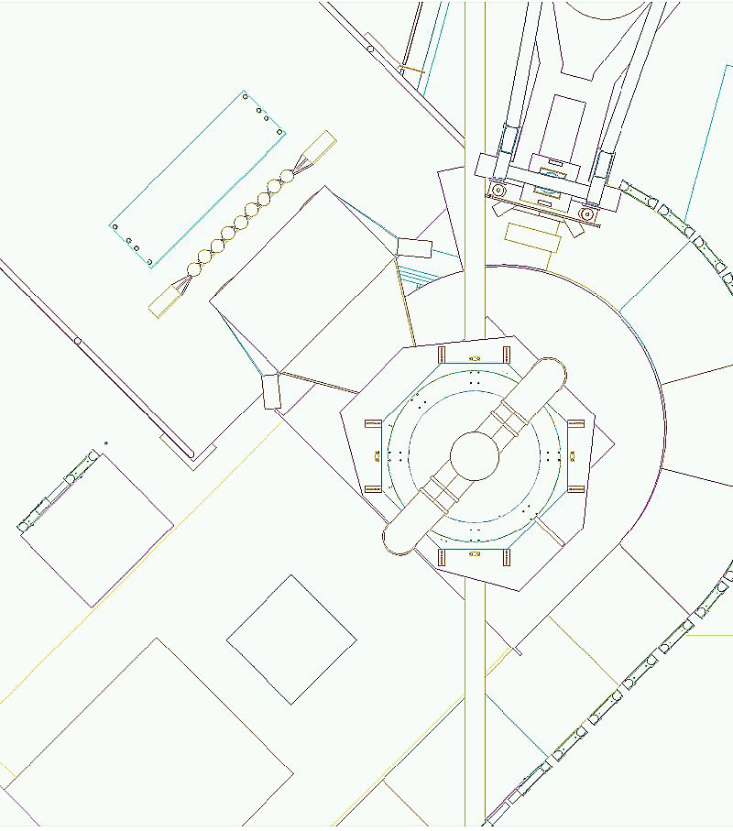
SANE Layout
BETA (40°)
HMS (14°- 48°)
BigCal
Polarized Target
Lucite Hodoscope
Polarized Compton
radiator (~20 cm)
Gas Cherenkov
Target Beam
position monitor
Forward Hodoscope
Beam Line
B at 80° OR 180°

Slide 6
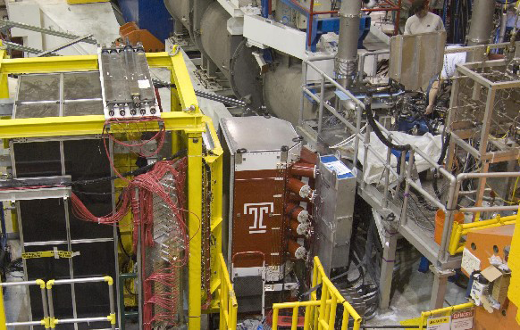
Big Electron Telescope Array – BETA
Used for electrons detection.
● BigCal lead glass calorimeter:
main detector used in GEp-III.
● Tracking Lucite hodoscope
● Gas Cherenkov: pion rejection
● Tracking fiber-on-scintillator
forward hodoscope
● BETA's characteristics
– Effective solid angle = 0.194 sr
– Energy resolution 8%/√E(GeV)
– 1000:1 pion rejection
– vertex resolution ~ 5 mm
– angular resolution ~ 1 mr
● Target field sweeps low E background
– 180 MeV/c cutoff
BigCal
Tracker
Lucite Hodoscope
Cherenkov

Slide 7
What do we expect from HMS ?
Protons in the HMS in coincidence with BETA will define electrons of known energy in the calorimeter from e+p elastic scattering.
The HMS will detect protons of 1 to 2.2 GeV/c.
The HMS will be used to measure the rate of positron events
as a function of scattered energy
The HMS also will be used to check effects of magnetic field on
tracks to BETA.
In single arm mode HMS can be used to measure accurate pair
symmetric backgrounds from γ → e⁺e⁻ pair production.
HMS will detect positrons up to 2.2 GeV/c.
For the packing fraction it will detect electrons, with momenta from 1 to around 5 GeV/c.

Slide 8
High Momentum Spectrometer-HMS
S1Y
S2Y
DC1
DC2
S1X
Cerenkov
S2X
HMS Vacuum pipe exit
Calorimeter

Slide 9
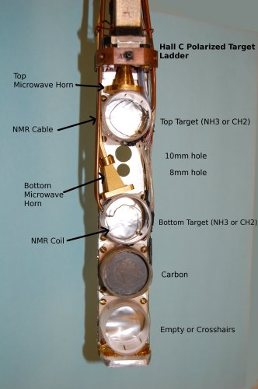
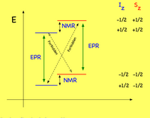
Target
C ,CH₂ and NH₃
Dynamic Nuclear Polarization (DNP) polarized the protons in the NH₃ target upto 90%.
Used microwaves to excite spin flip transitions.
Polarization measured using NMR coils

Slide 10
Closer look at the target setup ….
• Refrigerator - 1 K
• Magnetic Field - 5 T
• Microwaves - 55 GHz - 165 GHz
• NMR system

Slide 11
SANE – Subsystems
● Upstream beam line:
– Girder with chicane
– Rasters: fast and slow
– BPM's and BCM's
– Target Beam Position Monitor (Secondary Emission Monitor):
● needed to determine beam raster position (1 cm radius spiral)
Downstream beam line:
– He gas bag plus short beam pipe section
– In-hall beam dump

Slide 12
Beam Time
Energy Θ_{N} Time (Proposal FOM h)
GeV Proposal Actual Fraction
Calibration 2.4 off, 0 ,180 47 25 53%
Production 4.7 180 70 20 29%
4.7 80 130 98 75% 5.9 80 200 143 72%
5.9 180 100 ≥35 ≥35%
Commissioning [calendar days] 14.0 99
Total [calendar days] 70.0 141

Slide 13
Table of HMS Kinematic For Electron

Slide 14
Table of HMS Kinematic For Proton
Setting HMS_P HMS_theta Q2
2.399 1.360 41.00 1.340
2.399 1.443 38.25 1.469
2.399 1.555 35.51 1.647
2.399 1.670 32.75 1.834
2.399 1.789 43.10 2.030
2.399 1.907 30.00 2.228
4.725 3.585 22.30 5.193
5.891 4.170 22.00 6.260
5.891 4.400 15.40 6.682
Elastic Calibration
Runs
Production Runs

Slide 15
Kinematics plot of HMS electron inclusive data

Slide 16
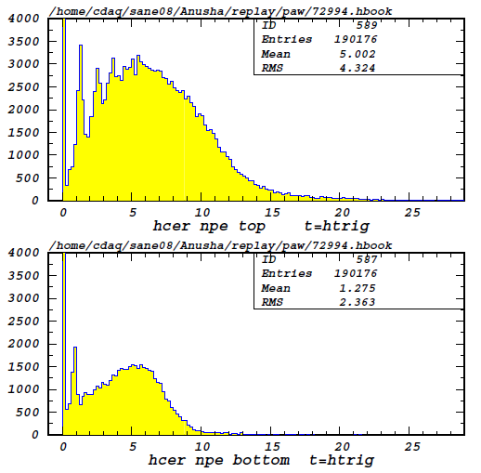
Analysis
Calibration
Cerenkov Calibration
ADC plot
NPE plot

Slide 17
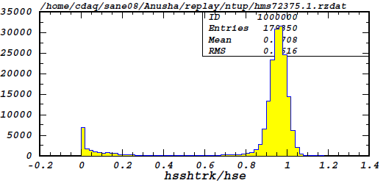
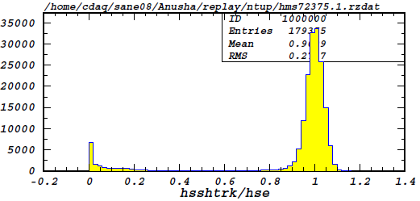
Calorimeter Calibration
Before Calibration
After Calibration

Slide 18
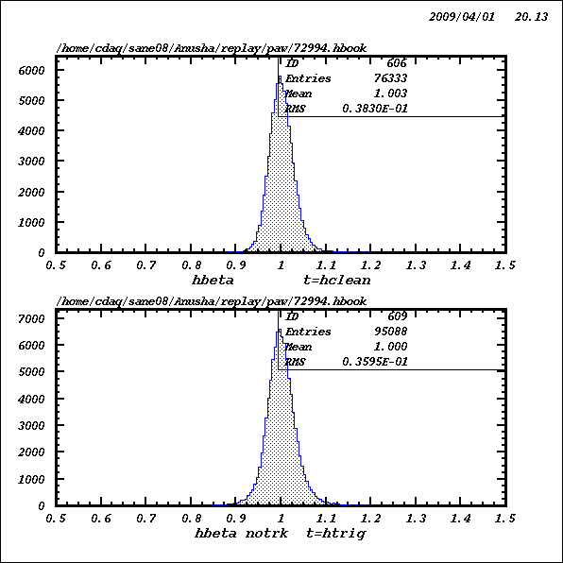
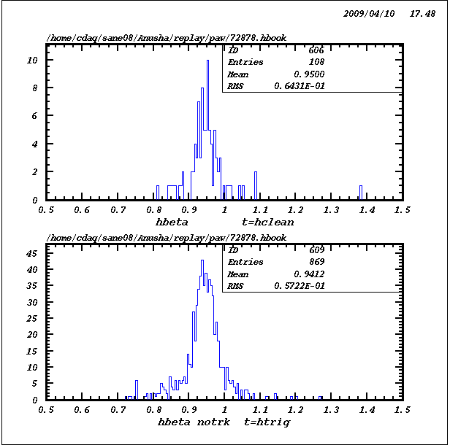
TOF Calibration
For Electrons
For Protons

Slide 19
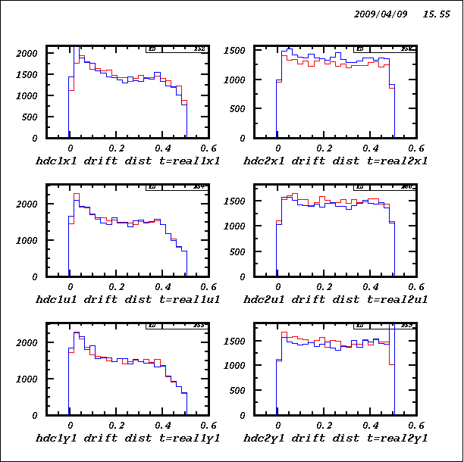
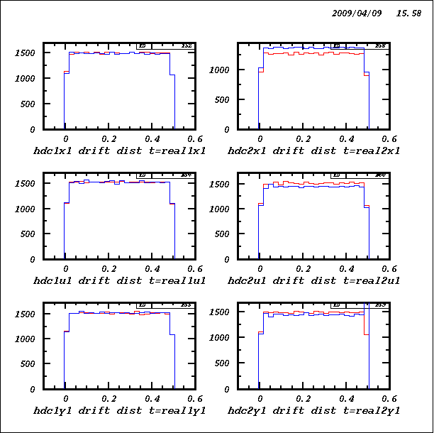
DC Calibrations
Before
After

Slide 20
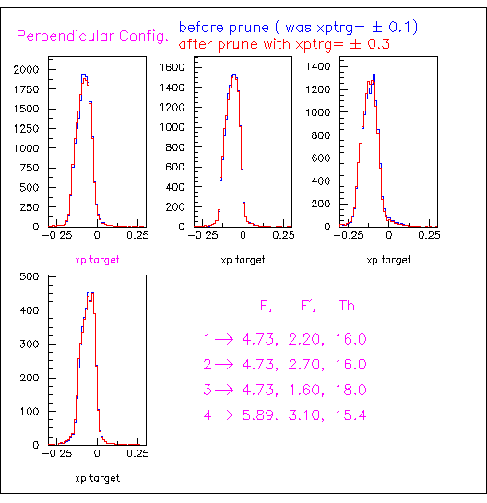
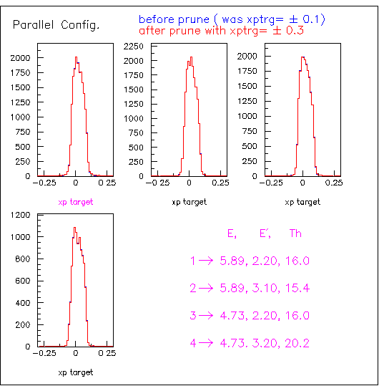
Select the more efficient tracks ……
If we have more than one track, use ‘prunning’ with defined parameters including chi2, xptarget,…..etc to select more efficient tracks.

Slide 21
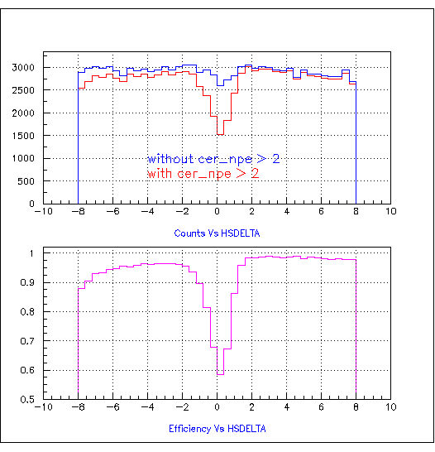
Detector Efficiency
Cerenkov Efficiency
We have very low tracking Efficiency

Slide 22
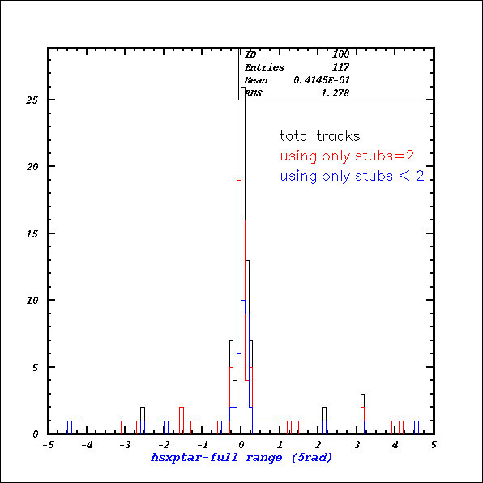
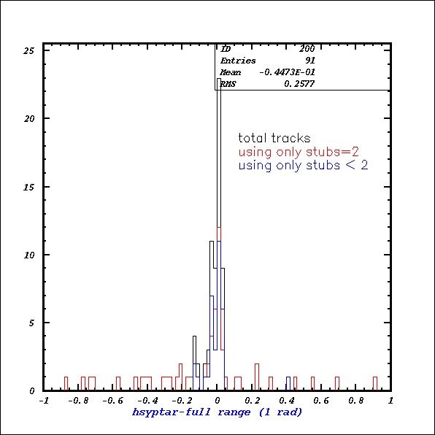
Modification Of the Tracking Efficiency ……

Slide 23
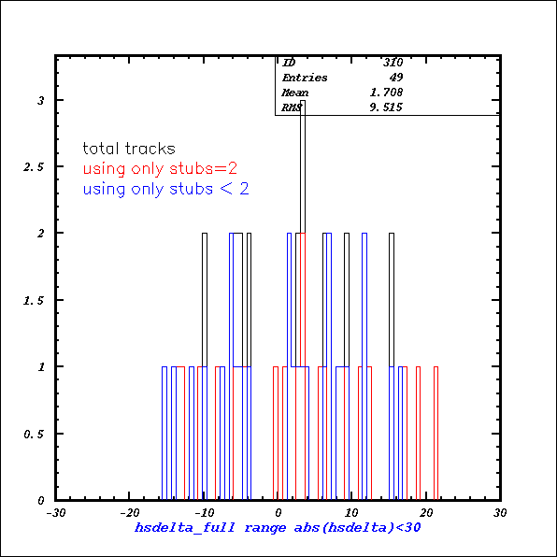
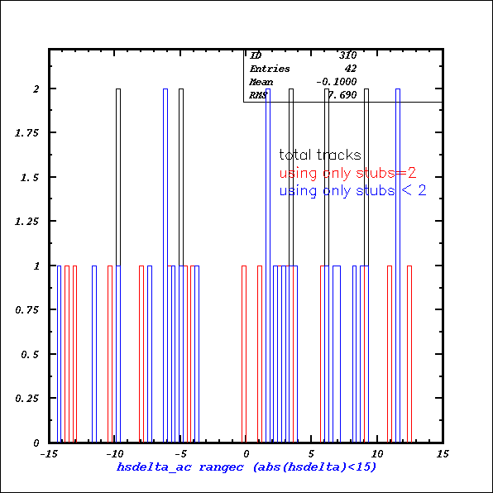

Slide 24
MC Simulation
Including the
Radiation Correction
Cerenkov Efficiency correction
Target-Field correction

Slide 25
Work Status
Calibration – completed
Modifying the tracking algorithm
In progress
To Do …..
Improve MC simulation
Will concentrate on
Elastic Form Factors ……

