Slide 1
Study of Λ-Hypernuclei with Electromagnetic Probes at JLAB
Liguang Tang
Department of Physics, Hampton University
&
Jefferson National Laboratory (JLAB)
Oct. 13-17, 2009, 3rd Joint Meeting of the Nuclear Physics Division of the APS and JPS

Slide 2
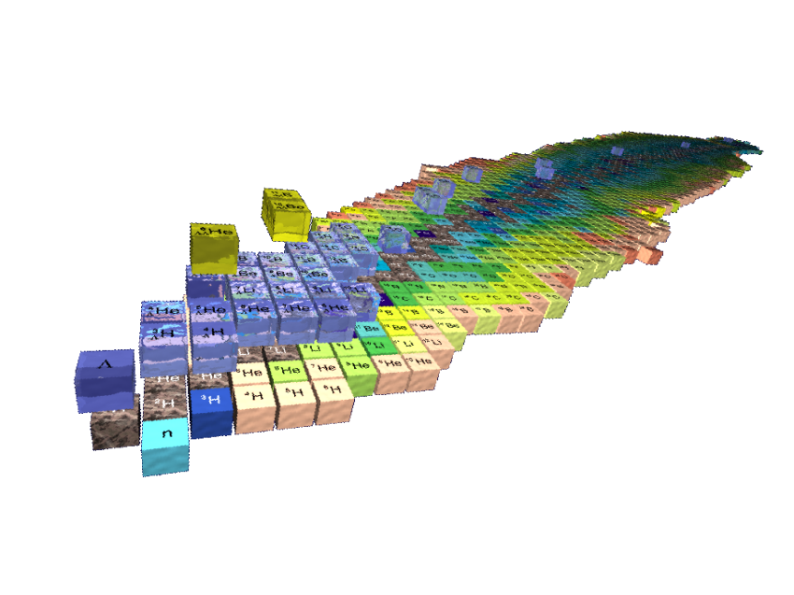
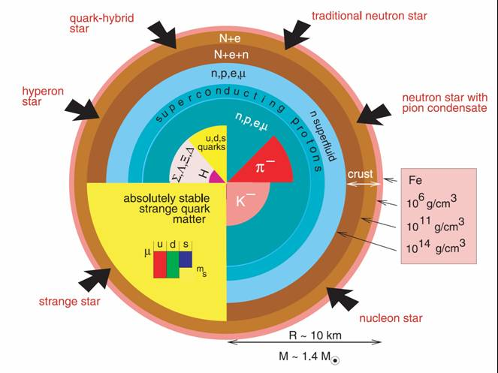
Introduction – Baryonic Interactions
Baryonic (B-B) interaction is an important nuclear force that builds the “world”;
H (1p)
C (3α )
Astronomical Scale - Neutron Stars -
He
(α - 2p, 2n)
Fully understand the B-B int. beyond the basic N-N (p and n) interaction is essential
Y-N interaction is still not fully understood – An important gate way to the other flavors

Slide 3
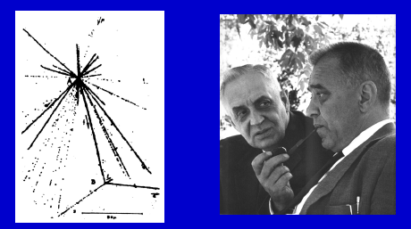
Introduction – Hypernuclei
A nucleus with one or more nucleons replaced by hyperon, Λ, Σ, …
A Λ-hypernucleus is the nucleus with either a neutron or proton being replaced by a Λ hyperon
Since first hypernucleus found 50 some years ago, hypernuclei have been used as rich laboratory to study YN and YY interactions – Solving many-body problem with Strangeness
Discovery of the first hypernucleus by pionic decay in emulsion produced by cosmic rays, Marian Danysz and Jerzy Pniewski, 1952

Slide 4
Introduction – Λ-Hypernuclei
Sufficient long lifetime, g.s. Λ-hypernucleus decays only weakly via Λ → π N or ΛN→ NN, thus mass spectroscopy with narrow states (~100 keV) exists
Description of a Λ-hypernucleus within two-body frame work – Nuclear Core (Particle hole) ⊗ Λ (particle):
(Few example states)
(Example of the lowest mass states)
P
7/2⁺ & 5/2⁺
⊗ Λ
¹²_{Λ}C or ¹²_{Λ}B substitution states
5/2⁻ & 3/2⁻
S
1/2⁻
¹²_{Λ}C or ¹²_{Λ}B core excitations
⊗ Λ
3/2⁻
⊗ Λ
¹²_{Λ}C or ¹²_{Λ}B g.s. (deeply bound)
¹¹C or ¹¹B Core

Slide 5
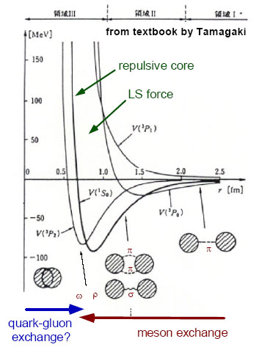
Introduction – Λ-Hypernuclei (cont.)
Two-body effective Λ-Nucleus potential (Effective theory):
V_{ΛN}(r) = V_{c}(r) + V_{s}(r)(S_{Λ}•S_{N}) + V_{Λ}(r)(L_{N}•S_{Λ}) + V_{N}(r)(L_{Λ}•S_{N}) + V_{T}(r)S₁₂
The right Λ-N and Λ-Nucleus models must correctly describe the spectroscopy of Λ binding energies, excitations, spin/parities, …
A novel feature of Λ-hypernuclei
  Short range interactions
    ΛΣ coupling, ΛNN 3-B forces
  Change of core structures
  Existence of Isomerism?
  Drip line limit
No Pauli blocking to Λ
  Probe the nuclear interior
  Baryonic property change (μ_{Λ})
Important for Λ−N
& Λ-Nucleus Int.
Λ N

Slide 6
Production of Λ-Hypernuclei
(K, π) Reaction
(π, K) Reaction
K⁻
π⁻
π⁺
K⁺
CERN → BNL → KEK & DAΦNE → J-PARC (Near Future)
n
Λ
n
Λ
A
_{Λ}A
A
_{Λ}A
Low momentum transfer
Higher production cross section
Substitutional, low spin, & natural parity states
Harder to produce deeply bound states
High momentum transfer
Lower production cross section
Deeply bound, high spin, & natural parity states
(e, e’K) Reaction
e
e’
γ
K⁺
CEBAF at JLAB
(MAMI-C Near Future)
p
Λ
A
_{Λ}A
High momentum transfer
Small production cross section
Deeply bound, highest possible spin, & unnatural parity states
Neutron rich hypernuclei

Slide 7
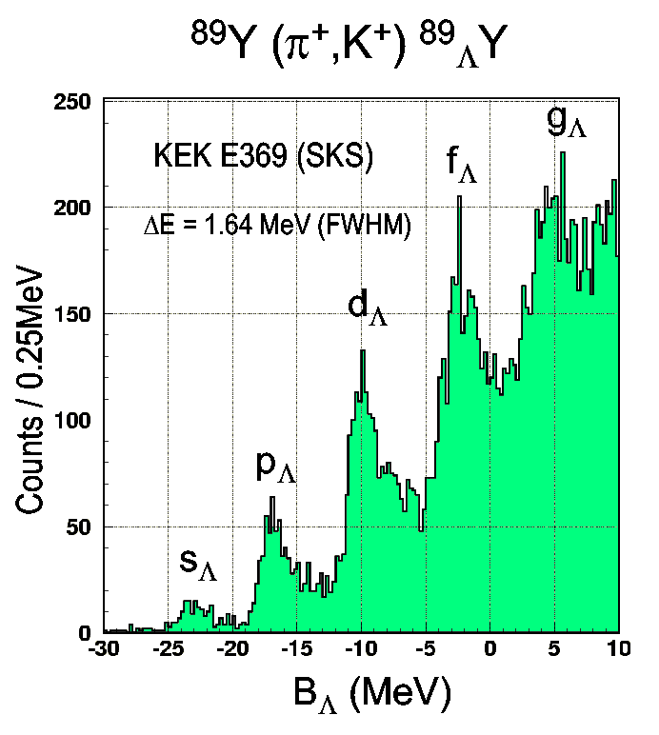
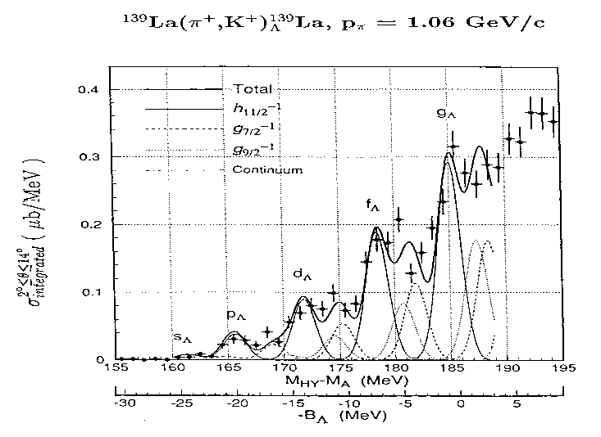
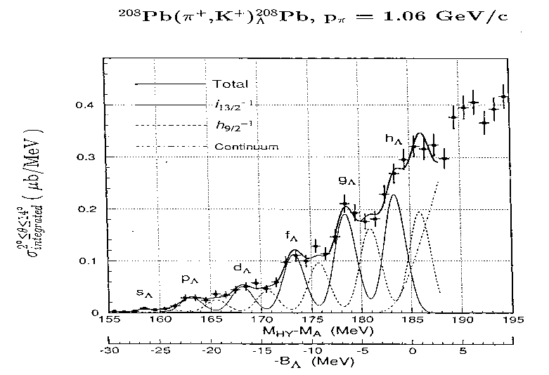
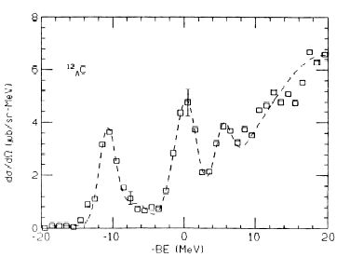
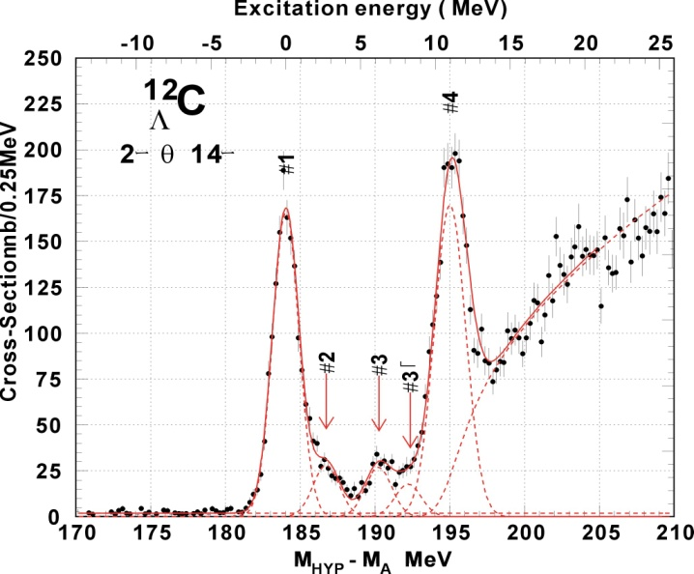
Keys to the Success on Λ-Hypernuclei
Textbook example of single-particle orbits in nucleus (limited resolution: ~1.5 MeV)
Energy Resolution
Hotchi et al., PRC 64 (2001) 044302
Precision on Mass
Λ single particle states ⇒ Λ-nuclear potential depth = -30 MeV ⇒ V_{ΛN} < V_{NN}
KEK E140a
Hasegawa et. al., PRC 53 (1996)1210
BNL: 3 MeV(FWHM)
KEK336: 2 MeV(FWHM)
KEK E369 : 1.45 MeV(FWHM)
¹²_{Λ}C
High Yield Rate

Slide 8
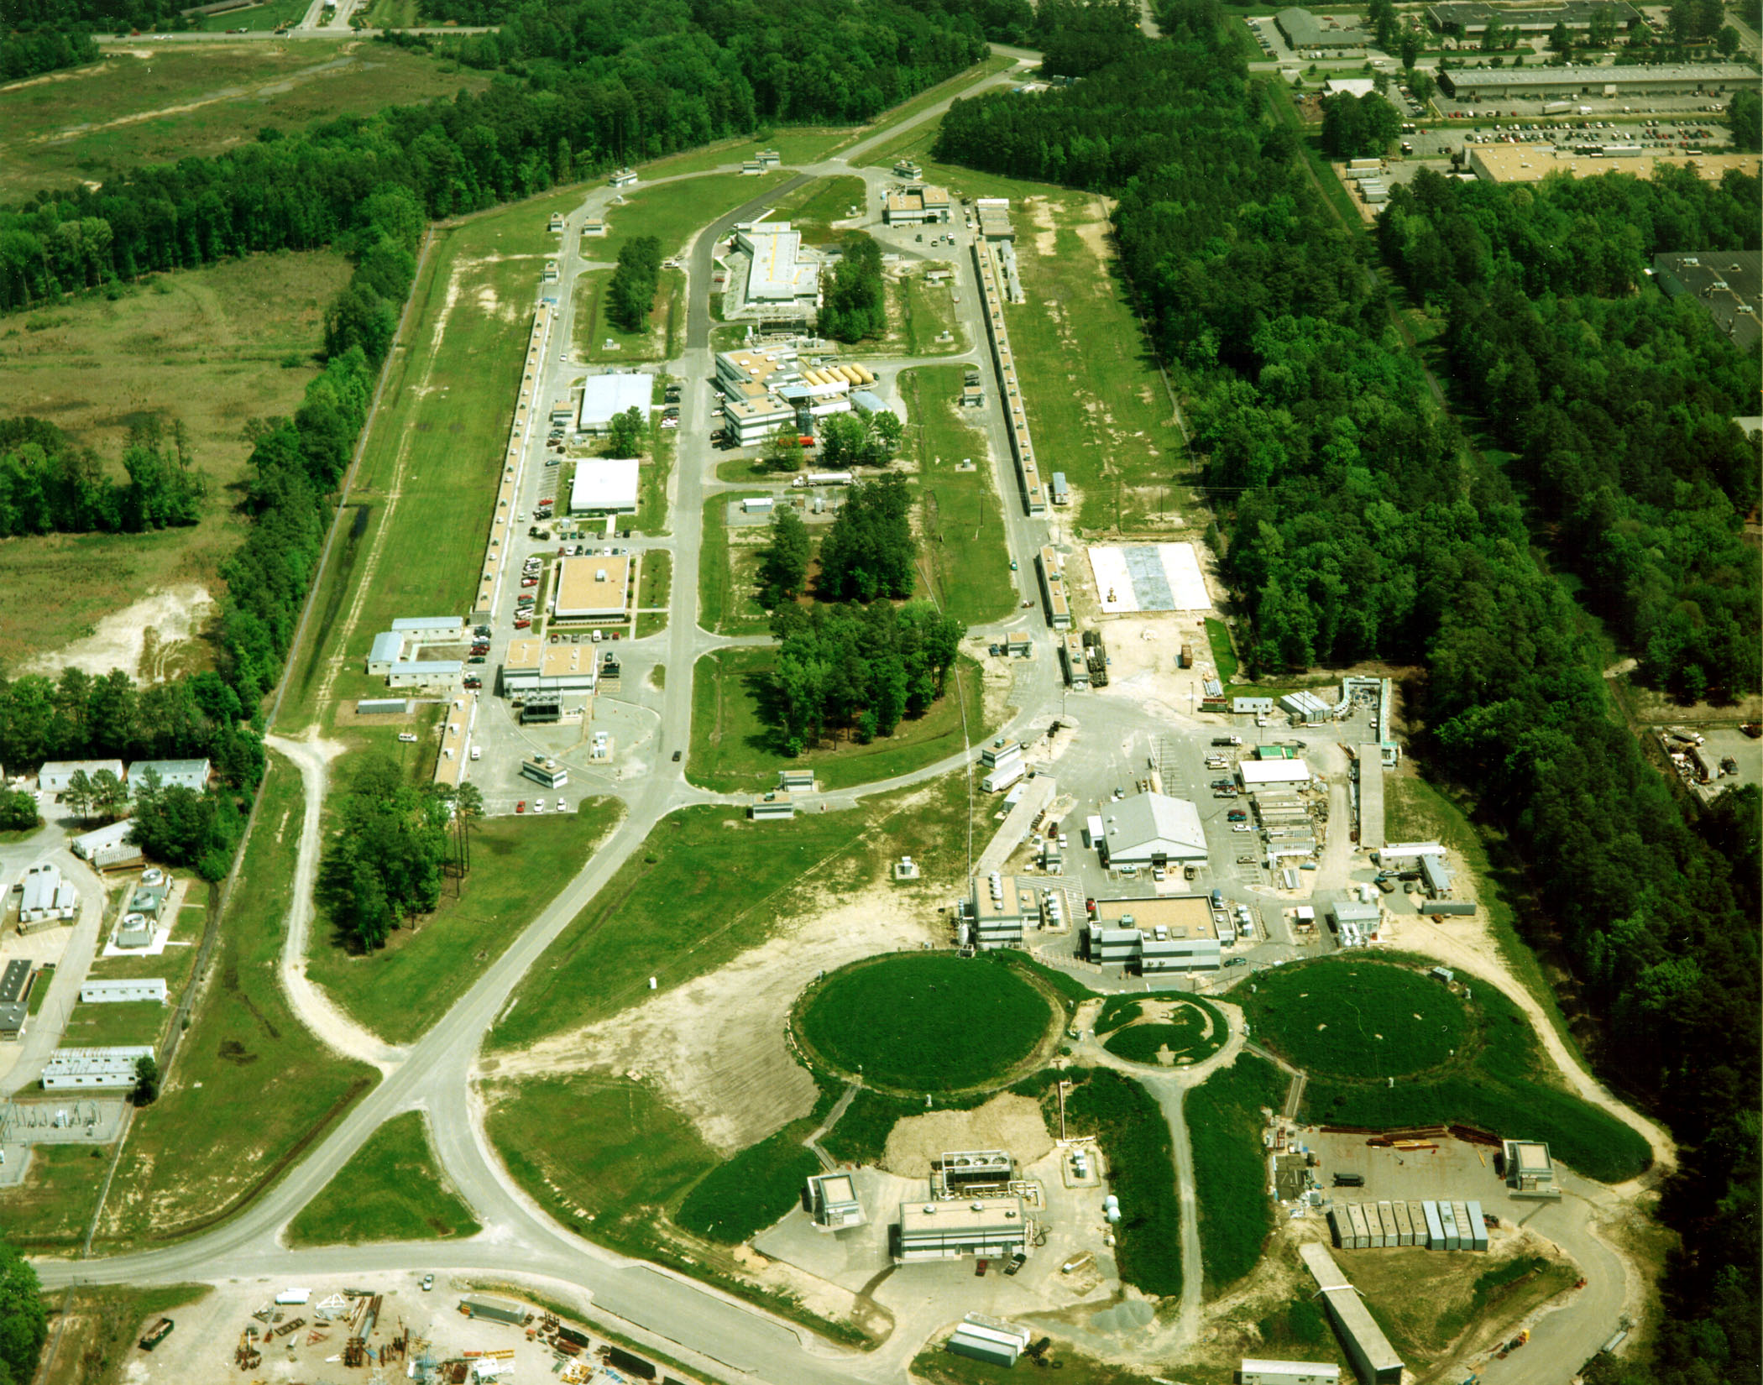
Continuous Electron Beam Accelerator Facility (CEBAF)
East Arc
CW Beam (1 – 5 passes)
2 ns pulse separation
1.67 ps pulse width
~10⁻⁷ emittance
I_{max} ≈ 100μA
FEL
North
Linac
+400MeV
South
Linac
+400MeV
MCC
Hyperon Physics
Electro- & photo-production
West Arc
Injector
A
C
B
Hypernuclear Physics
(e, e’ K⁺) reaction

Slide 9
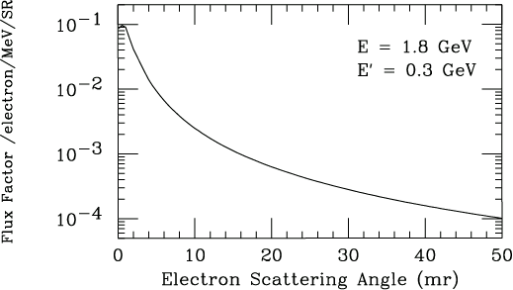
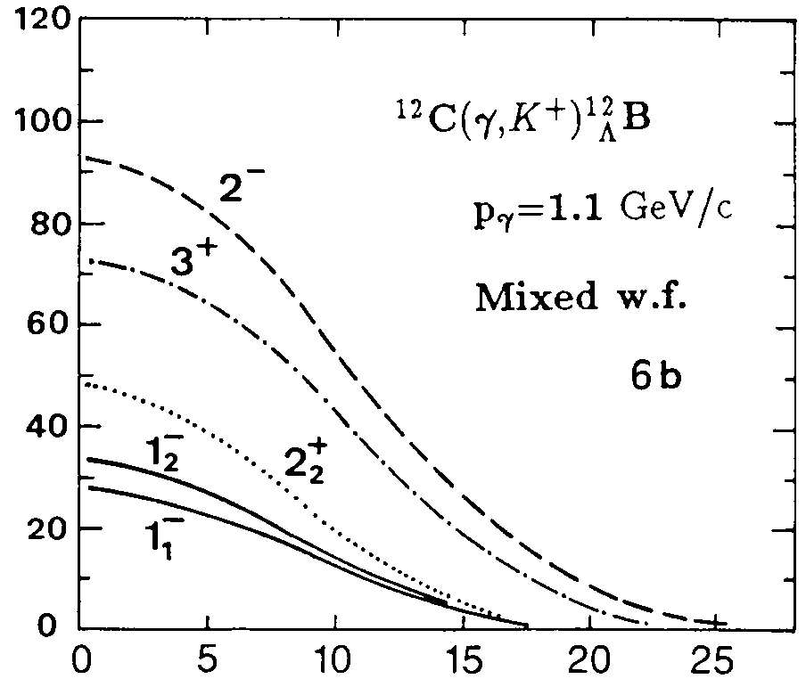
Key Kinematics Considerations
e
e’
p(γ,K⁺)Λ Total cross section
γ
K⁺
2.0
p
Λ
σ_{total}(μb)
1.0
A
_{Y}A
Phys. Lett. B 445, 20 (1998)
M. Q. Tran et al.
1
1.2
1.4
1.6
1.8
2
E_{γ}(GeV)
T.Motoba et al., Prog. Theo. Phys. Suppl. 117, 123 (1994)
d²σ/dΩ_{k} is completely transverse as Q² → 0
→ Coincidence of e’ and K⁺
→ Keep ω=E-E’ ≈ 1.5 - 2.0 GeV
→ Maximize Γ –- e’ at forward angle
→ Maximize yield –- K⁺ at forward
angle
dσ/dΩ (nb/sr)
Angle (deg)

Slide 10
Features of Electroproduction at JLAB
Technical Advantages
  100% duty factor (CW beam)
  High intensity - Overcome small cross sections to produce hypernuclei in wide mass range
  High precision - Highest possible mass spectroscopic precision (resolution & binding energy precision)
Technical Disadvantages
  More complicated kinematics – Detect both e’ and K⁺ at small forward directions
  High particle rates – Complicated detector system
  Accidental coincidence background – High electron rates from Bremsstrahlungs and Moller Scattering at small scattering angles

Slide 11
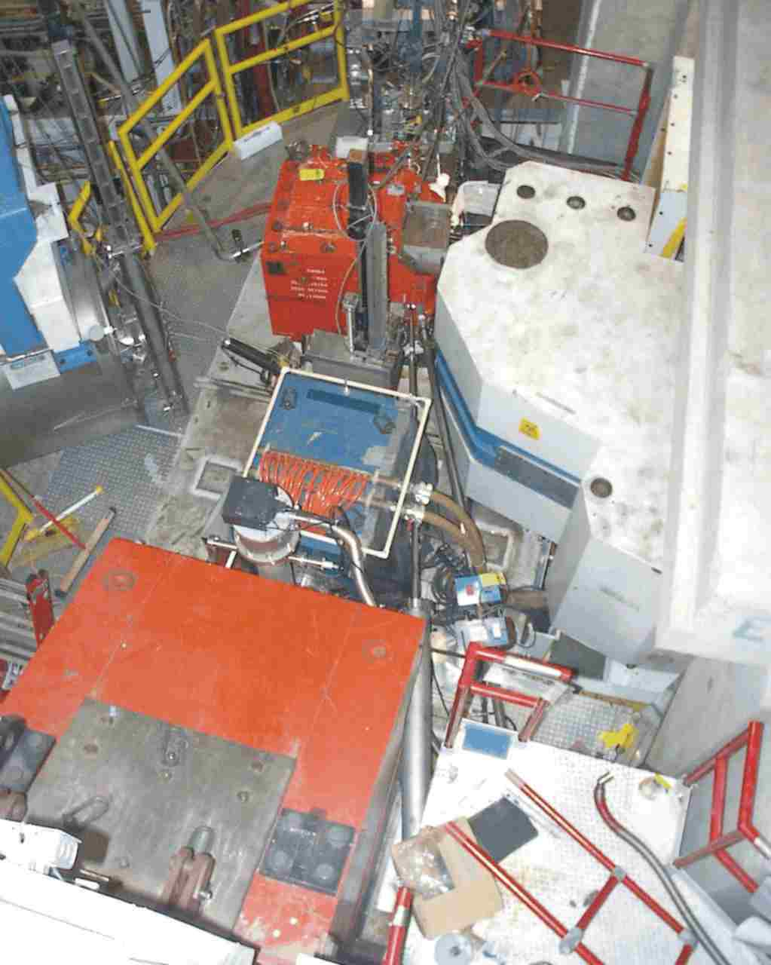
Hypernuclear Physics Programs in Hall C
E89-009 (Phase I, 2000) – Feasibility
Existing equipment
Common Splitter – Aims to high yield
Zero degree tagging on e’
Electron beam
  High accidental background → Low luminosity → Low yield
Side View
e’
K
+
  Sub-MeV resolution – 800 keV FWHM
_
Target
D
D
Splitter
K⁺
Q
Top View
  First mass spectroscopy on ¹²_{Λ}B using the (e, e’K⁺) reaction
  T. Miyoshi, et al., Phys. Rev. Lett. Vol.90 , No.23, 232502 (2003)
  L. Yuan, et al., Phys. Rev. C, Vol. 73, 044607 (2006)
_
Q
Electron
K
+
D
D
Beam
(1.645 GeV)
Target
Focal Plane
( SSD + Hodoscope )
SOS spectrometer (K⁺)
Mom. resolution: 6×10⁻⁴ FWHM
Solid angle acceptance : 5msr
Central angle: 2 degrees
Beam Dump
ENGE Spectrometer (e’)
Mom. resolution: 5×10⁻⁴ FWHM
Solid angle acceptance: 1.6msr
0
1m

Slide 12
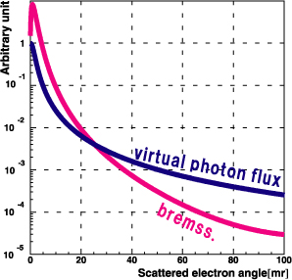
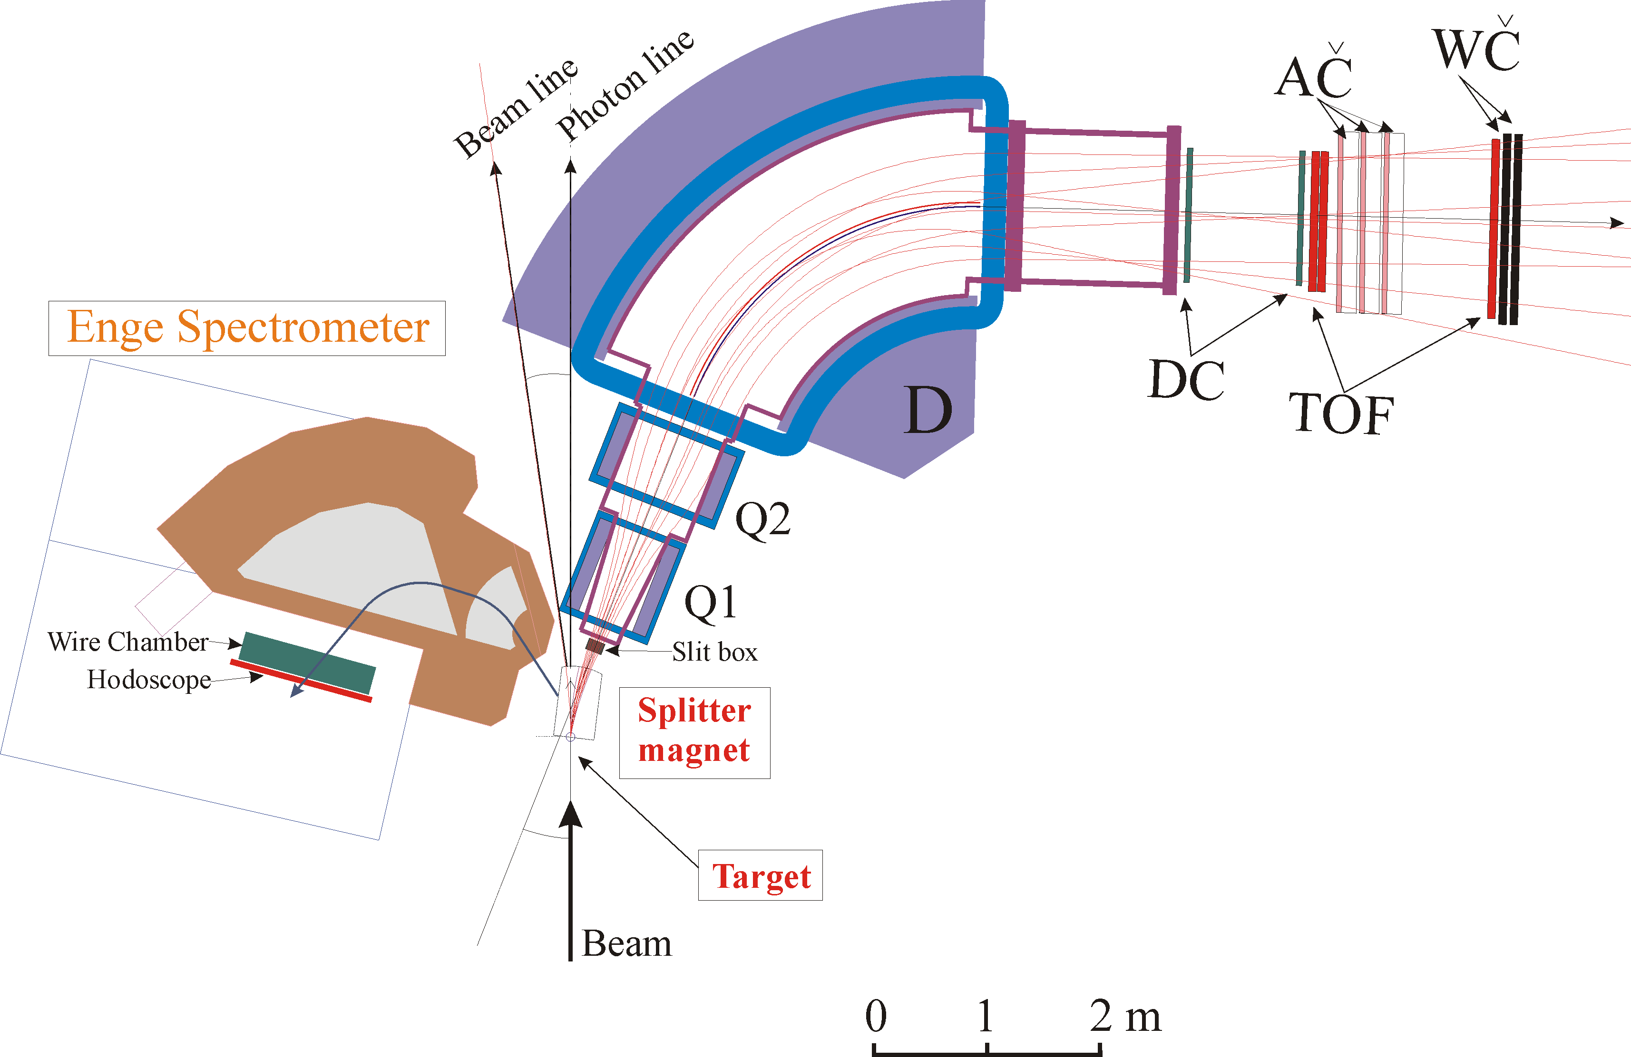
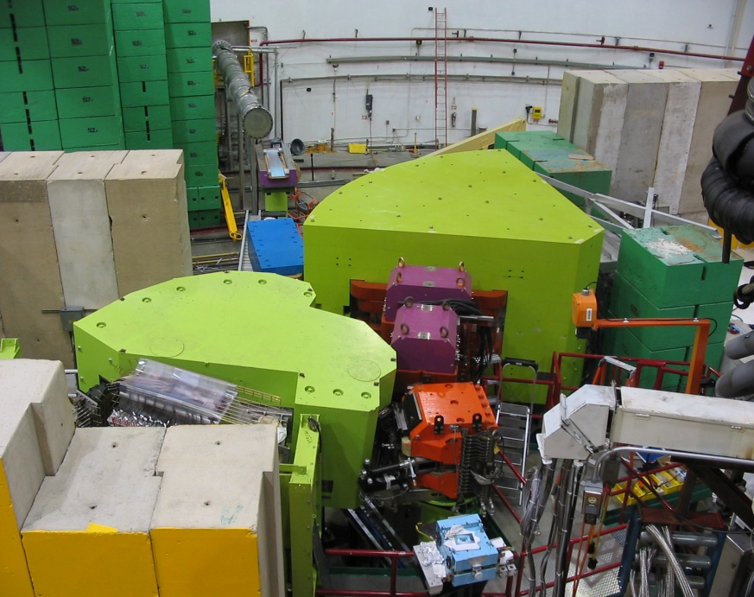
Hypernuclear Physics Programs in Hall C
E01-011/HKS (Phase II, 2005) – First upgrade
Replaced SOS by HKS w/ new KID system
Tilted Enge (7.5º) with a small vertical shift
HKS
Mom. Resolution: 2x10⁻⁴ FWHM
Solid angle acceptance: 15msr
E_{e}=1850 MeV
ω=1494 MeV
  Electron single rate reduction factor – 0.7x10⁻⁵
  Allowed higher luminosity – 200 times higher
K⁺
  Physics yield rate increase – 10 times
e’
To beam dump
  Energy resolution improvement – ∼450 keV FWHM
  Hypernuclei: ⁷_{Λ}He, ¹²_{Λ}B, ²⁸_{Λ}Al
Tilted Enge
Mom. Resolution: 5x10⁻⁴ FWHM
Scattering angle: ∼4.5º
Electron beam

Slide 13
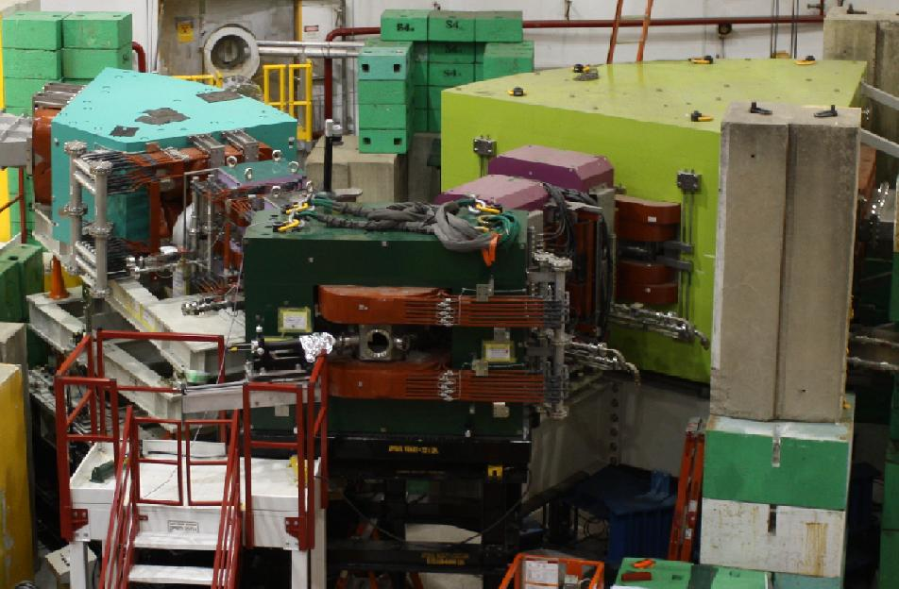
Hypernuclear Physics Programs in Hall C
E05-011/HKS-HES (Phase III, 2009) – Second upgrade
Replaced Enge by new HES spectrometer for the electron arm
Tilted HES
Mom. Resolution: 2x10⁻⁴ FWHM
Angular acceptance: ∼10msr
e’
  4 times more physics yield rate than HKS (100 HNSS)
e
γ
  Further improvement on resolution (~350 keV) and precision
  Hypernuclei: ⁷_{Λ}He, ⁹_{Λ}Li, ¹⁰_{Λ}Be, ¹²_{Λ}B, ⁵²_{Λ}V
K⁺
Beam
2.34 GeV
HKS
Remain the same

Slide 14
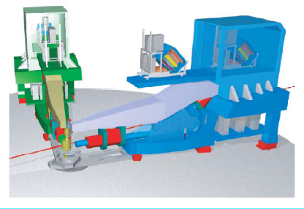
Hypernuclear Physics Programs in Hall A
E94-107: Designed basing on a pair of standard HRS spectrometers
HRS
Basic kinematics and luminosity requirements:
E_{beam} ≈ 4.016 GeV; P_{e} ≈1.80 GeV/c; P_{K}= 1.96 GeV/c
θ_{e} = θ_{K} = 6°; W ∼ 2.2 GeV Q² ~ 0.07 (GeV/c)²
Beam current : 100 μA Target thickness : ~100 mg/cm²
Counting Rates ~ 0.1 – 10 counts/peak/hour (¹²_{Λ}B)
Major Additions
Hypernuclei:
¹²_{Λ}B and ⁹_{Λ}Li (03 & 04)
¹⁶_{Λ}N (2005)

Slide 15
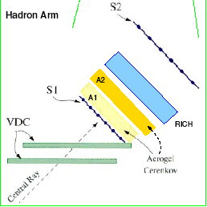
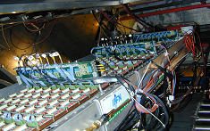
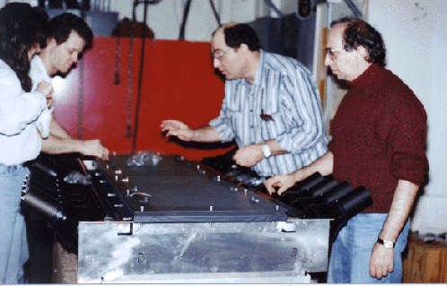
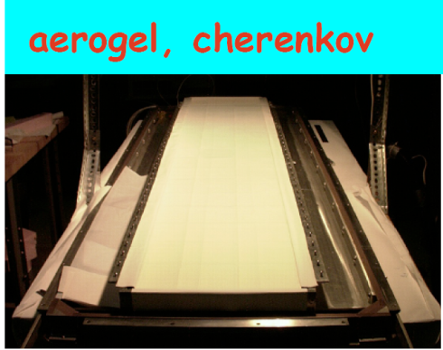
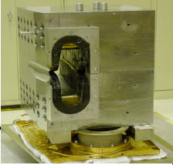
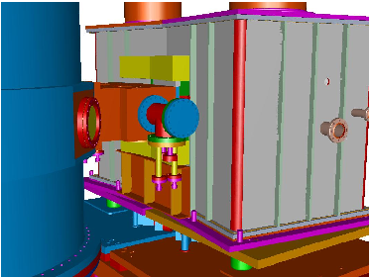
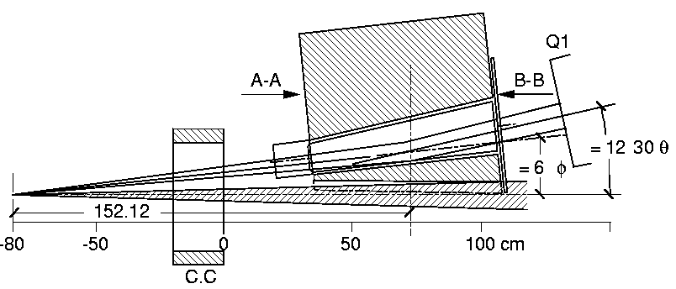
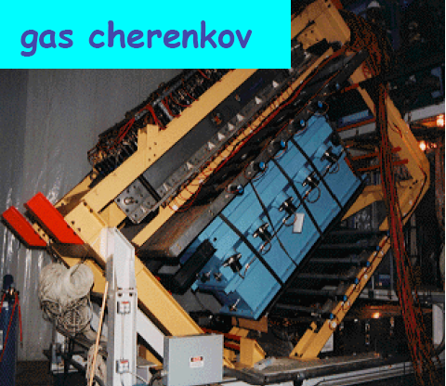
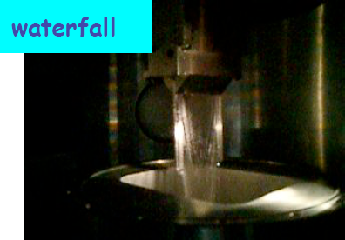
Hypernuclear Physics Programs in Hall A
- Additional equipment for the experiment
aerogel first generation
Hadron arm
RICH Detector
Two septum magnets
ΔP/P (HRS + septum) ~ 10⁻⁴
aerogel second generation
Electron arm

Slide 16
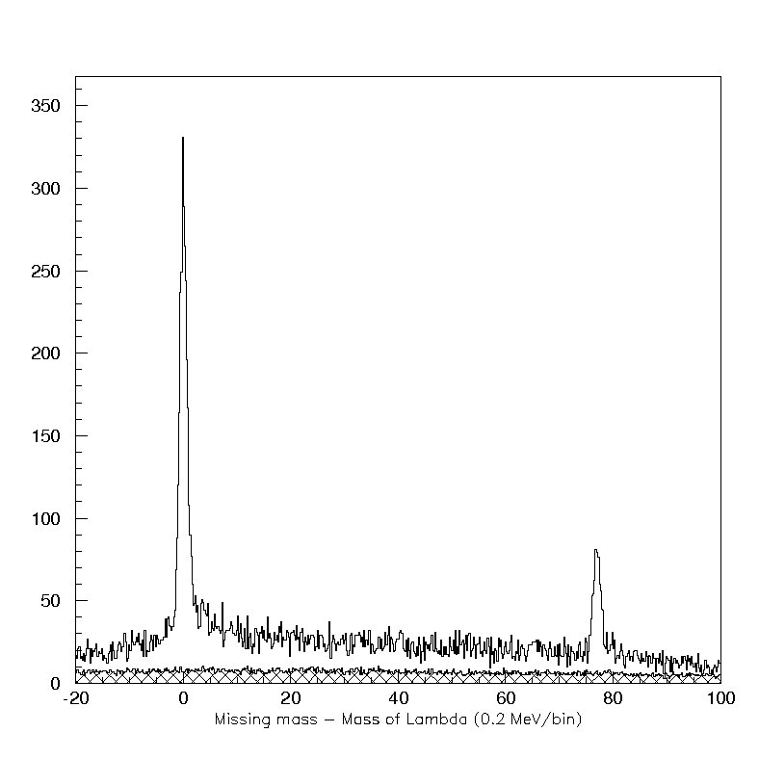
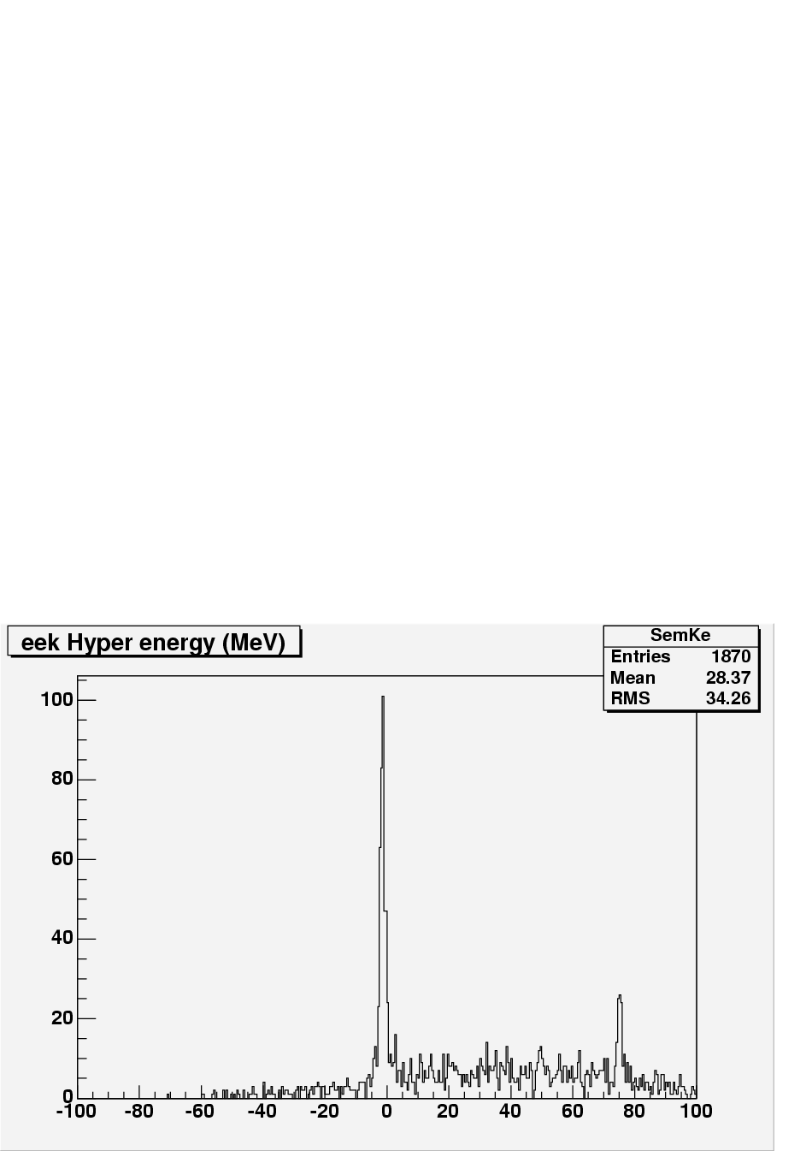
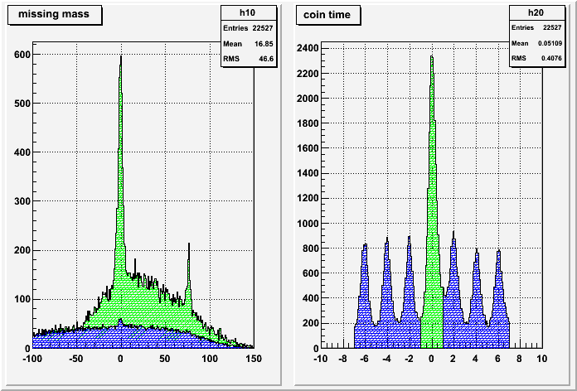
Highlights: Elementary Λ(Σ⁰) Production
H(e, e’ K⁺) Λ(Σ⁰) w/ CH₂ Target
Water Target
CH₂ Target – 28 hours
Coin./acc. kaons
Λ
HKS-Hall C, 2005
Hall A, 2005
Λ
Λ
Λ
HKS-HES 2009
HKS-HES 2009
Counts (200 keV/bin)
  4 times more physics yield rate is proven by the new system
Σ⁰
Σ⁰
Σ⁰
Σº
B_{Λ} (MeV)
B_{Λ} (MeV)
The known mass of Λ and Σ⁰ provided crucial calibrations
for the experimental systems
B_{Λ} (MeV)
Coincidence Time (ns)

Slide 17
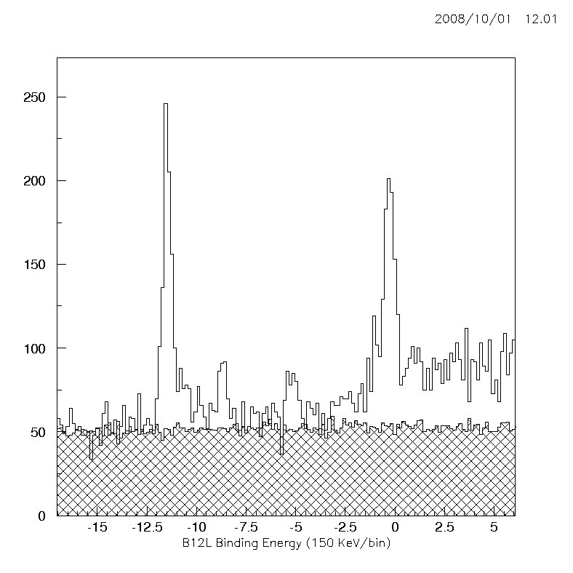
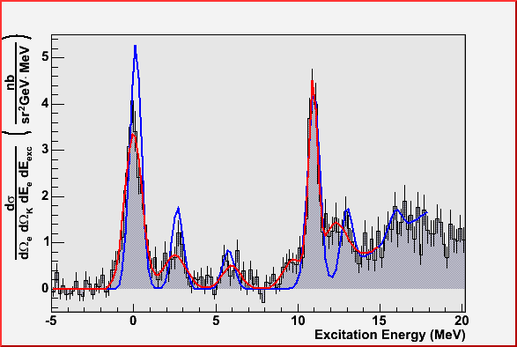
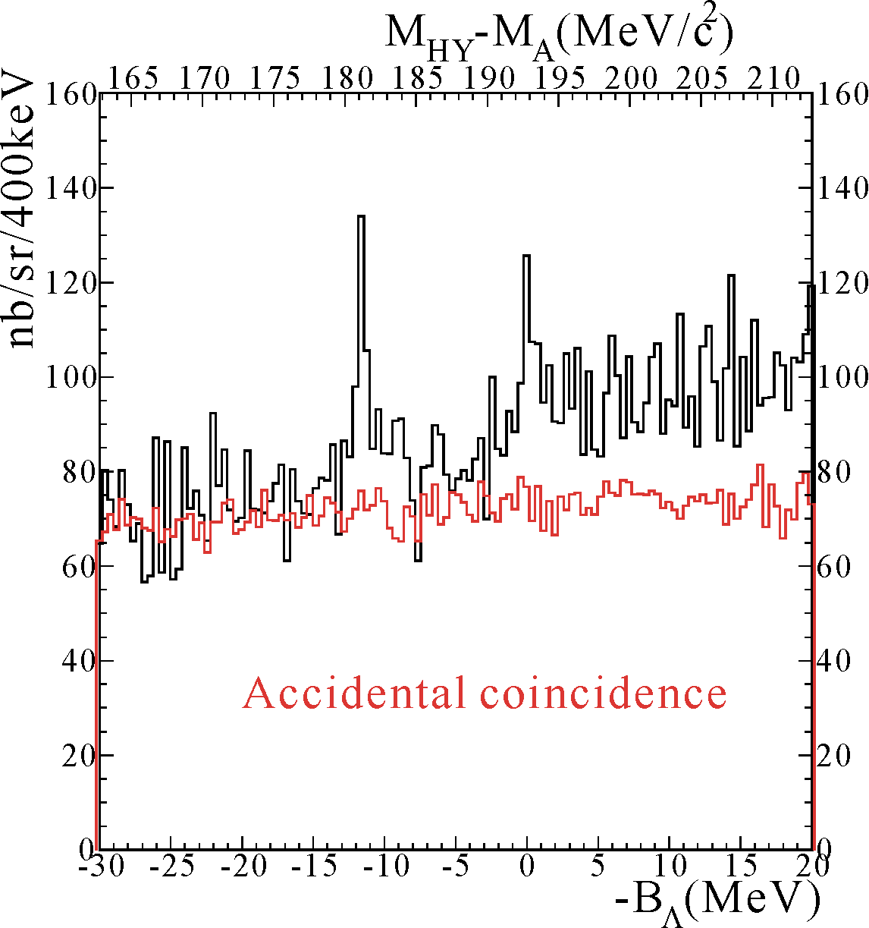
Highlights: Spectroscopy of ¹²_{Λ}B
¹²C(e, e’K⁺)¹²_{Λ}B, Phase II in Hall C
E94-107 in Hall A (2003 & 04)
HKS 2005
Phase I in Hall C
~450 keV
FWHM
~635 keV
FWHM
Λ_{s}
(2⁻/1⁻)
Λ_{s}
(2⁻/1⁻)
Λ_{p}
(3⁺/2⁺’s)
E89-009 ¹²_{Λ}B spectrum
Λ_{p}
(3⁺/2⁺’s)
HNSS in 2000
~800 keV
FWHM
Λ_{s}
Λ_{p}
Core Ex. States
K⁺
Core Ex. States
Counts (150 keV/bin)
Accidentals
(π⁺,K⁺)¹²_{Λ}C
K⁺
1.2GeV/c
_
B_{Λ} (MeV)
D
Phase I in Hall C
Red line: Fit to the data
Blue line: Theoretical curve: Sagay Saclay-Lyon (SLA) used for the elementary K-Λ electroproduction on proton. (Hypernuclear wave function obtained by M.Sotona and J.Millener)
M.Iodice et al., Phys. Rev. Lett. E052501, 99 (2007)
E89-009 ¹²_{Λ}B spectrum
~800 keV
FWHM
HNSS in 2000
Λ_{s}
Λ_{p}
Local Beam Dump
K⁺
K⁺
1.2GeV/c
_
D
Local Beam Dump

Slide 18
Comparison of the detected levels of ¹²_{Λ}B by Hall C & A
HKS/E01-011 (Hall C) B_{Λ} (MeV) Ex (MeV) | E94-107 (Hall A) Ex (MeV)
-11.559 ± 0.11 0.0 | 0.0 ± 0.03
-8.758 ± 0.11 2.801 ± 0.12 | 2.52 ± 0.11
-5.239 ± 0.12 6.320 ± 0.12 | 5.97 ± 0.13
- | 9.76 ± 0.15
-0.359 ± 0.11 11.200 ± 0.12 | 10.95 ± 0.27
- | 12.22 ± 0.11
Preliminary
Emulsion result of ¹²_{Λ}B g.s. doublet: -11.37±0.06±0.04
Emulsion result of ¹²_{Λ}C g.s. doublet: -10.76±0.19±0.04

Slide 19
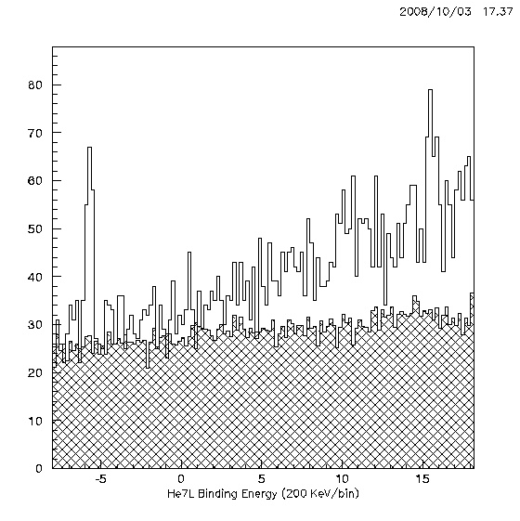
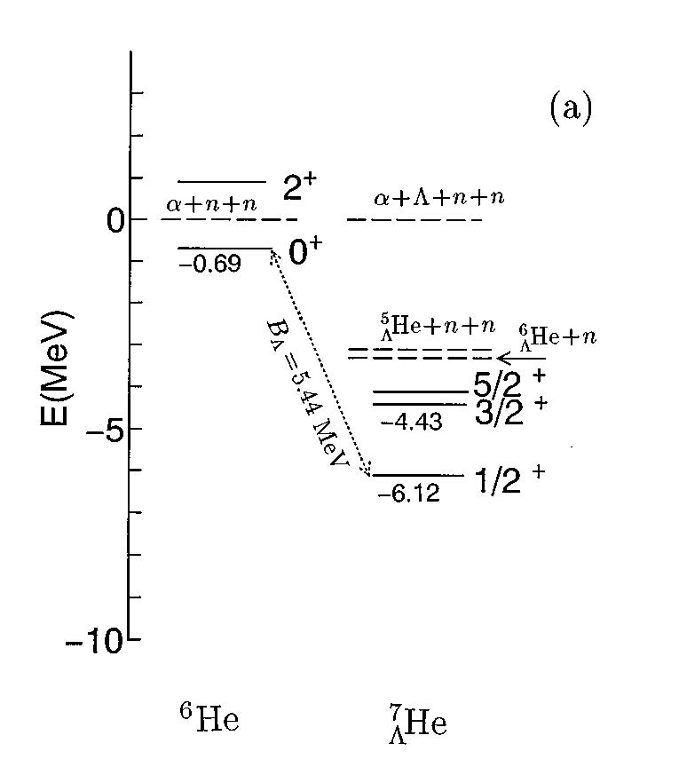
Highlights: Spectroscopy of ⁷_{Λ}He
⁷Li(e, e’K⁺)⁷_{Λ}He (n-rich)
1st direct observation of ⁷_{Λ}He G.S.
HKS
JLAB
HKS (Hall C) 2005
n
⁶He core
Λ_{s}
α
Λ
n
Counts (200 keV/bin)
Sotona
Accidentals
B_{Λ} (MeV)
⁷_{Λ}He
⁷_{Λ}Li*
⁷_{Λ}Be
T=1
Iso-triplet
Λ
n
n
Λ
n
p
Λ
p
p
α
α
α
B_{Λ} : -5.7±0.2 -5.58±0.04* -5.16±0.08*
* Emulsion results (core?)
E. Hiyama, et al., PRC53 2078 (1996)

Slide 20
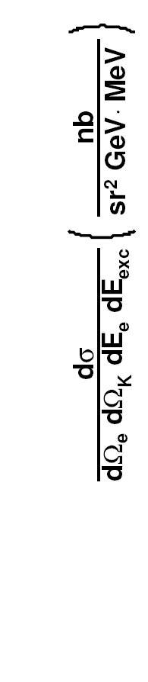
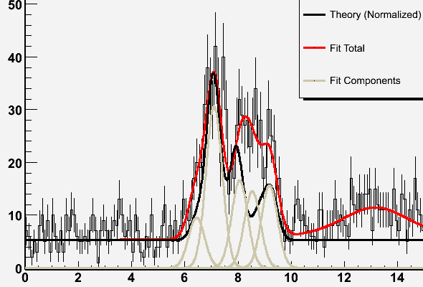
Highlights: Spectroscopy of ⁹_{Λ}Li
Energy resolution ~ 500 KeV (E94-107 Hall A)
Preliminary!
1.4
1.0
0.6
-4
-2
0
2
4
6 Ex (MeV)

Slide 21
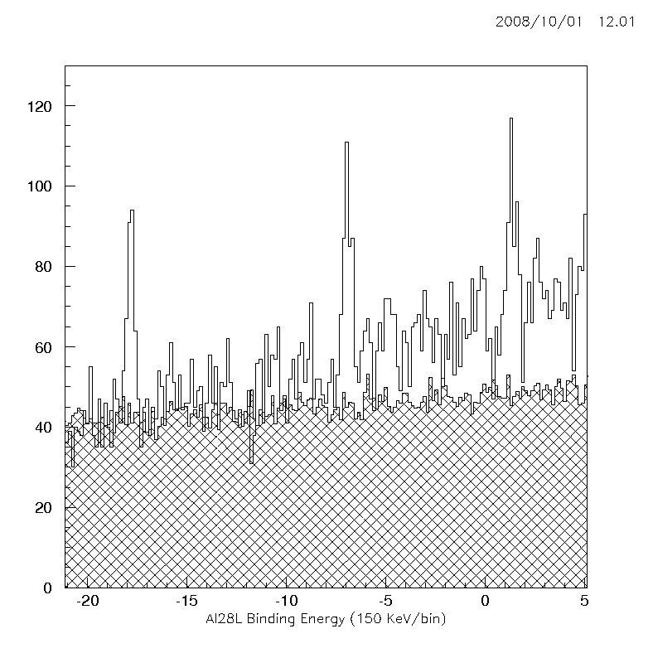
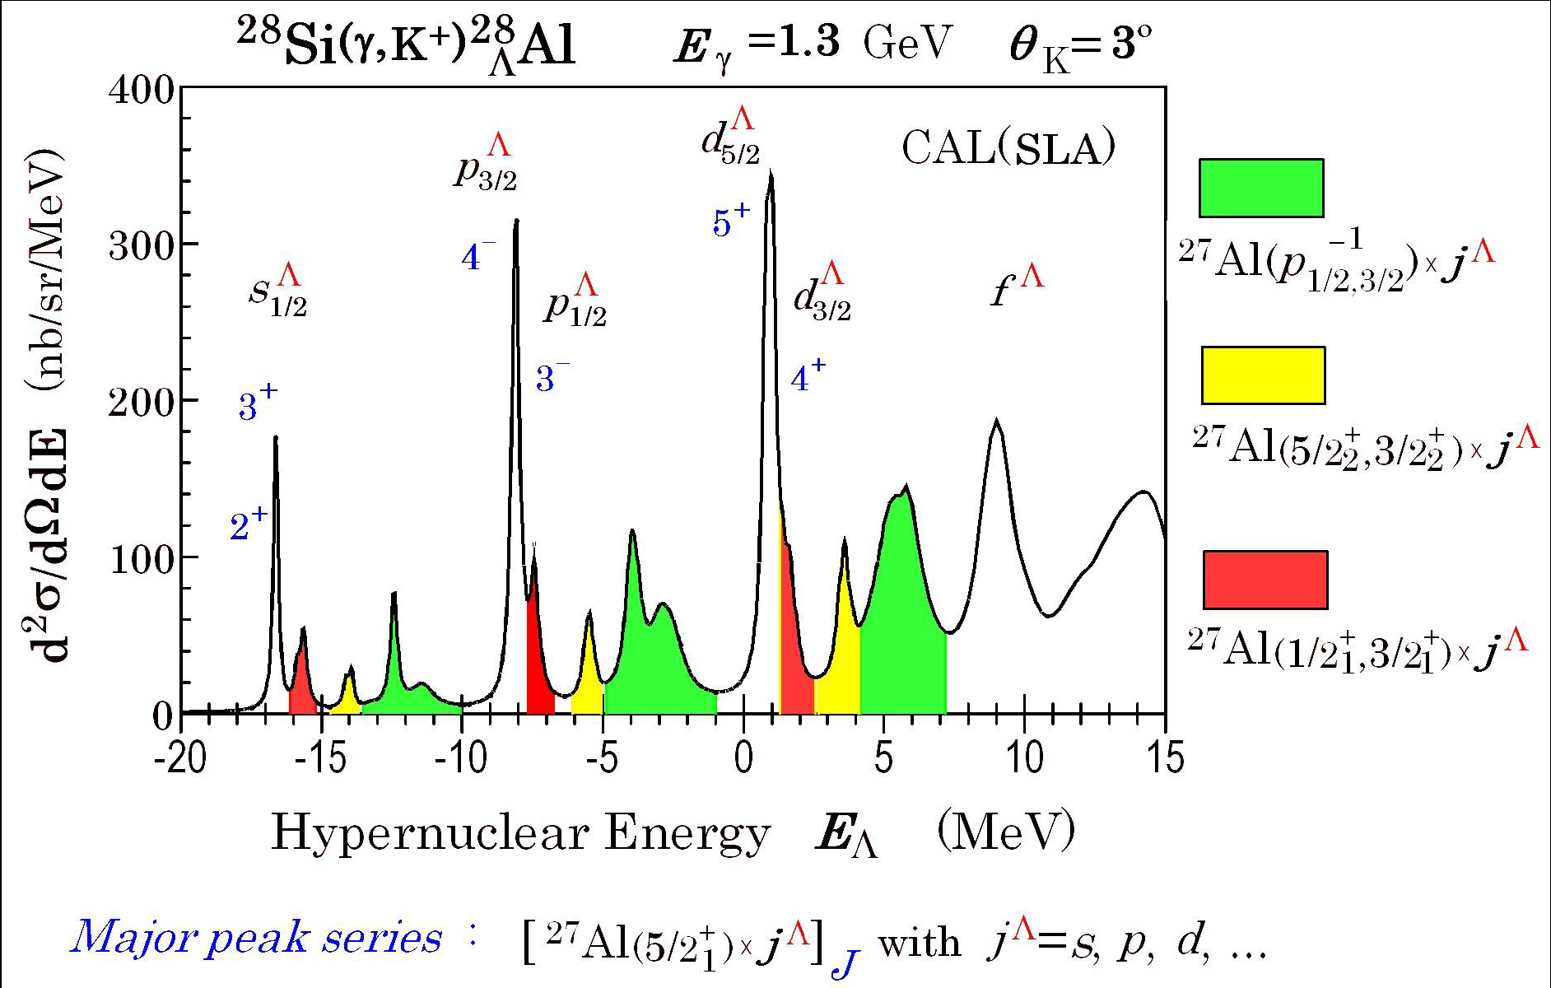
Highlights: Spectroscopy of ²⁸_{Λ}Al
²⁸_{Λ}Al
1st observation of ²⁸_{Λ}Al
~400 keV FWHM resol.
Clean observation of the shell structures
²⁸Si(e, e’K⁺)²⁸_{Λ}Al
HKS
JLAB
HKS (Hall C) 2005
Λ_{p}
Λ_{d}
Λ_{s}
Peak B_{Λ}(MeV) E_{x}(MeV) Errors (St. Sys.)
#1 -17.820 0.0 ± 0.027 ± 0.135
#2 -6.912 10.910 ± 0.033 ± 0.113
#3 1.360 19.180 ± 0.042 ± 0.105
Counts (150 keV/bin)
KEK E140a
Accidentals
SKS
²⁸Si(π⁺,K⁺)²⁸_{Λ}Si
B_{Λ} (MeV)

Slide 22
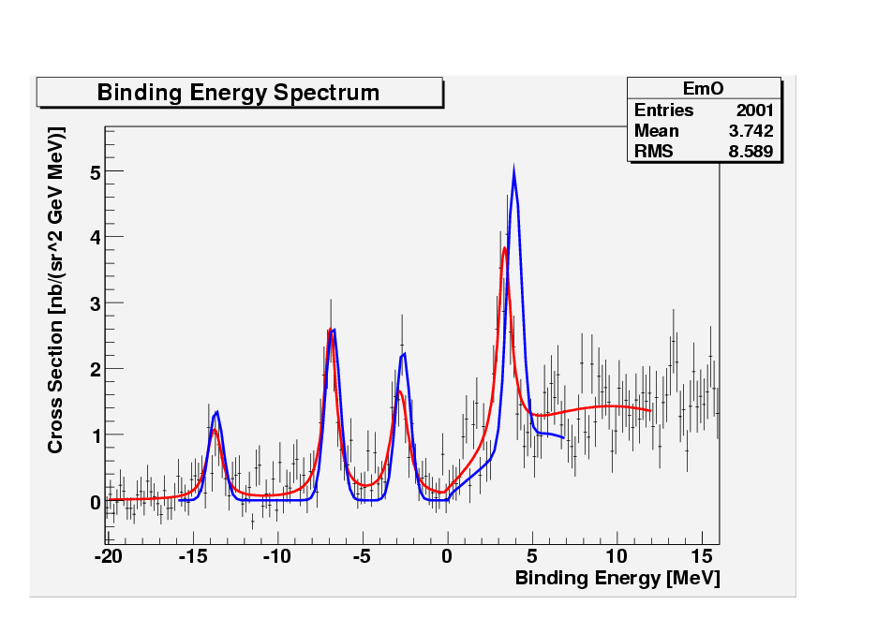
Highlights: Spectroscopy of ¹⁶_{Λ}N (E94-107, Hall A)
¹⁶O(e, e’K⁺)¹⁶_{Λ}N (2005)
Peak search: 4 regions above background,
fitted with 4 Voigt functions
χ²_{/ndf} = 1.19
Theoretical model superimposed curve based on
  - SLA p(e,e’K+)Λ (elementary process)
  - ΛN interaction fixed parameters from KEK and BNL ¹⁶_{Λ}O and ¹⁵_{Λ}Nspectra
B_{Λ}=13.76 ± 0.16 MeV
  measured for the first time with this level of accuracy

Slide 23
Hypernuclear Experiments Currently in the Queue at CEBAF (JLAB)
Hall C: E05-115 (Phase III), Aug. – Oct., 2009
Spectroscopy in wide mass range (A = 6 – 52)
Hall A: E07-012, April, 2012
(1) Spectroscopy and differential cross section
of ¹⁶_{Λ}N; and
(2) Elementary production of Λ(Σº) at Q² ≈ 0

Slide 24
Summary
High quality and high intensity CW CEBAF beam at JLAB made high precision hypernuclear programs possible.
Electroproduced hypernuclei are neutron rich and have complementary features to those produced by mesonic beams. Together with J-PARC’s new programs, as well as those at other facilities around world, the hypernuclear physics will have great achievement in the next couple of decades.
The mass spectroscopy program will continue beyond JLAB 12 GeV upgrade in Hall A. The original Hall A and C collaborations will become one collaboration.

