Slide 1
Measurement Of the Proton Form Factor Ratio at High Q² by Using The Double Spin Asymmetries
SANE Collaboration
( E07-003)
Anusha Liyanage
Hampton University
January 12, 2010

Slide 2
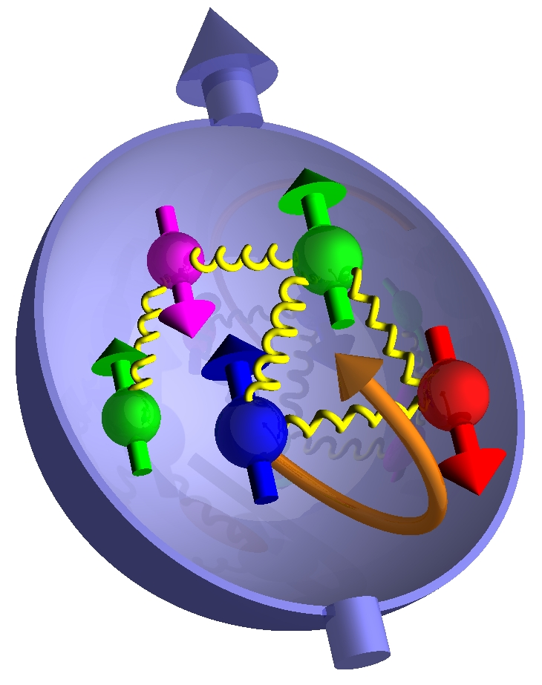
CONTENTS
Experimental Setup
Physics Motivation &
HMS Kinematic
Analysis Status
SIMC Simulation
Work Status

Slide 3
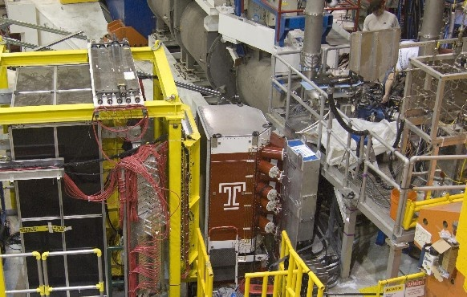
Big Electron Telescope Array – BETA
Used for electrons detection.
● BigCal lead glass calorimeter:
main detector used in GEp-III.
● Tracking Lucite hodoscope
● Gas Cherenkov: pion rejection
● Tracking fiber-on-scintillator
forward hodoscope
● BETA's characteristics
– Effective solid angle = 0.194 sr
– Energy resolution 8%/√E(GeV)
– 1000:1 pion rejection
– vertex resolution ~ 5 mm
– angular resolution ~ 1 mr
● Target field sweeps low E background
– 180 MeV/c cutoff
BigCal
Tracker
Lucite Hodoscope
Cherenkov

Slide 4
High Momentum Spectrometer-HMS
S1Y
S2Y
DC1
DC2
S1X
Cerenkov
S2X
HMS Vacuum pipe exit
Calorimeter

Slide 5
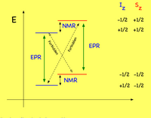
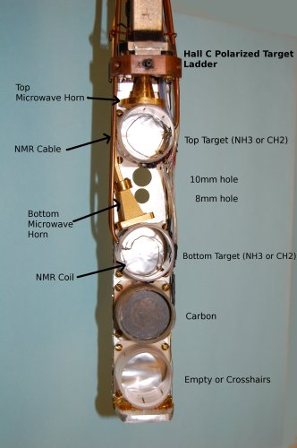
Target
• C ,CH₂ and NH₃
• Dynamic Nuclear Polarization (DNP) polarized
the protons in the NH₃ target up to 90%
• Used microwaves to excite spin flip transitions
• Polarization measured using NMR coils
• Refrigerator - 1 K
• Magnetic Field - 5 T
• NMR system
• Microwaves - 55 GHz - 165 GHz
The Polarized Target Assembly

Slide 6
SANE – Subsystems
● Upstream beam line:
– Chicane Magnets
– Both fast raster and slaw rasters
– BPM's and BCM's
– Target Beam Position Monitor (Secondary Emission Monitor):
● needed to determine beam raster position (1 cm radius spiral)
Downstream beam line:
– In-hall beam dump
(Used at the parallel magnetic field configuration)
– He gas bag plus short beam pipe section
(Used at the perpendicular mag. Field configuration)

Slide 7
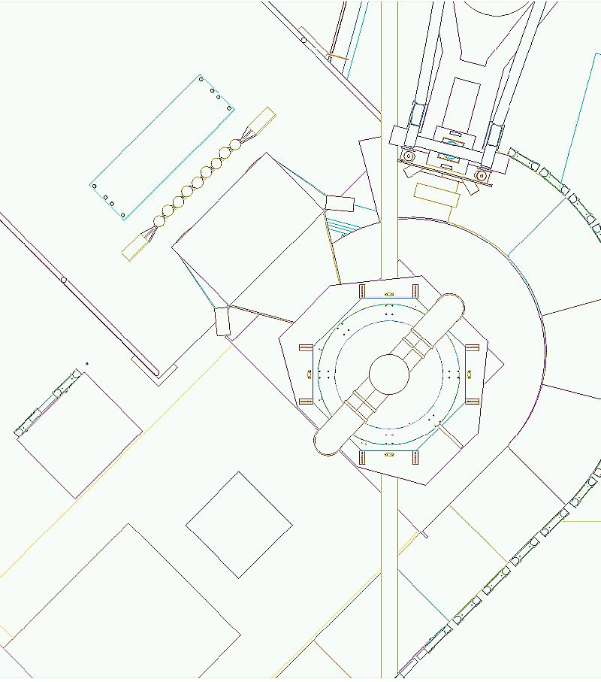
SANE Layout
BETA (40°)
HMS (14°- 48°)
P
e⁻
BigCal
Polarized Target
Lucite Hodoscope
Θ_{P}
Θ_{e}
Gas Cherenkov
Target Beam
position monitor
Forward Hodoscope
Beam Line
B at 80° OR 180°

Slide 8
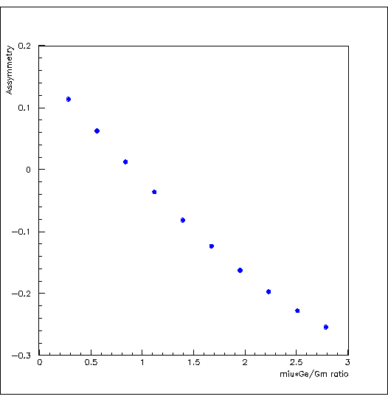
Physics Motivation
The raw asymmetry,
The elastic asymmetry,
The beam-target asymmetry,
Here,
The calculated asymmetry vs μG_{E}/G_{M}
At Q²=6.259 (GeV/C)²

Slide 9
HMS Kinematic For Proton
E Beam GeV | 4.725 | 5.891
P GeV/C | 3.585 | 4.170
Θ (Deg) | 22.30 | 22.00
Q² (GeV/C)² | 5.170 | 6.259
e-p Events | ~153 | ~948
Dramatic discrepancy !
between Rosenbluth and recoil polarization technique.

Slide 10
Analysis Status
HMS Detector Calibration is Completed.
Detector Efficiency.
Modification of the DC tracking efficiency algorithm is done.
(The tracking efficiency is increased by 15%-20%)
Extracted the elastic events.
Correlation corrections are completed.

Slide 11
Tracking Efficiency Corrections
Tracking Efficiency Vs Run Number
Could increase the tracking efficiency
by 15%-20%
by modifying the tracking algorithm.

Slide 12
1. Polygon cut on the BigCal effective area
Y_clust positions Vs x_clust positions
Used the polygon cut on the
BigCal effective area
The Tracking Efficiency
increased
only ~ 1-2 %.

Slide 13
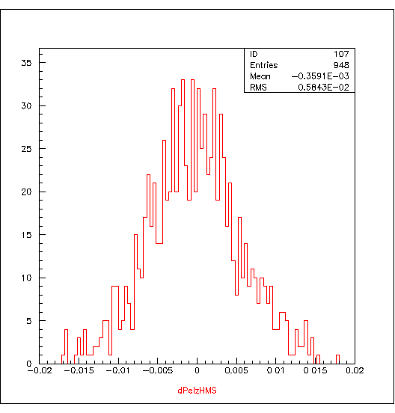
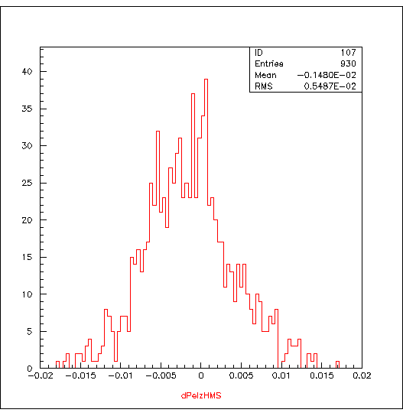
Extracted the elastic events
Momentum Difference , dPel_hms
By using slow raster y offset = - 0.66 cm

Slide 14
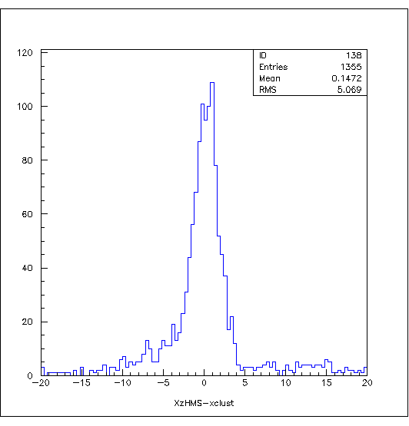
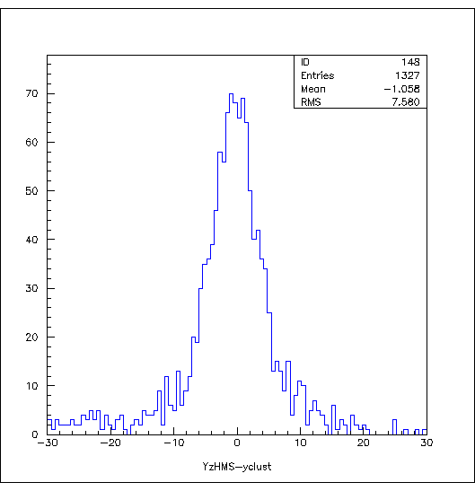
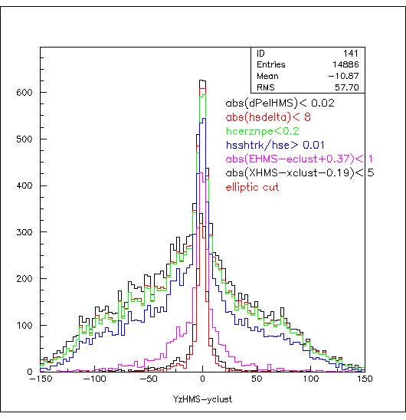
X/Y position difference
X position Difference
Y position Difference

Slide 15
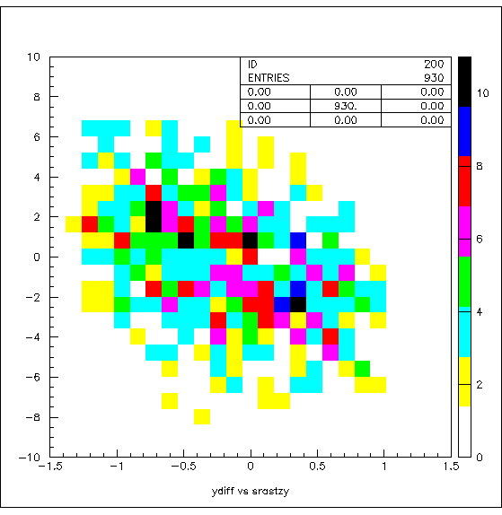
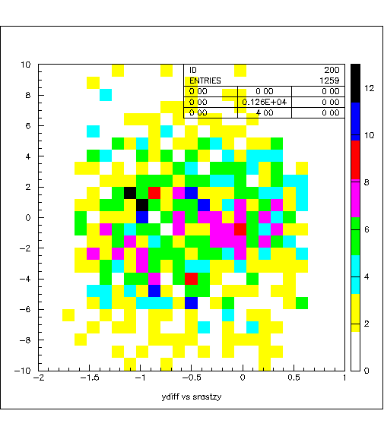
Correlation Corrections for ….
The dPel_hms vs srast_y ....
The Y position difference Vs srast Y ….

Slide 16
SIMC Simulation
HMS Single Arm Variables
HMS Coincidence with BIGCAL Variables
SIMC Simulation
Experimental Data

Slide 17
Work Status
HMS Calibration – completed
Elastic event selection – completed
To Do …..
Improve SIMC simulation
Work on the Efficiency Corrections
Extract the Asymmetry and the G_{E}/G_{M} Ratio

