Slide 1
HKS Drift Chamber Tracking -Play With High Multiplicity -
Chunha Chen
Hampton University
Hampton Group Meeting on Mar.16,2010

Slide 2
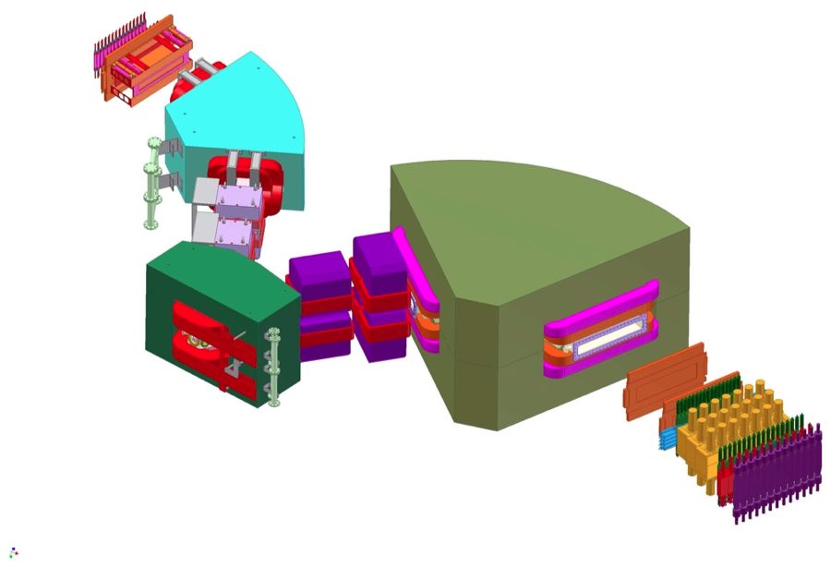
E05-115 setup
y
z
HES
x
HES detector
D
HKS
e’
Q2
Q1
D
New
splitter
Q2
Q1
HKS detector
K⁺
2.344GeV
e beam
Target
Notes:
HKS spectrometer:
QQD configuration
Momentum acceptance : 1.2GeV/c ±12.5%
Solid angle : 11msr
δp/p : 2 x 10⁻⁴
Angle acceptance : 1 〜 13 deg
Rate capability : 1.5MHz
HES spectrometer:
QQD configuration
Momentum acceptance : 0.844GeV/c±17%
Solid angle : 7msr
Angle acceptance : 3 〜 9 deg
δp/p : 2 x 10⁻⁴(FWHM)
Rate capability : 5MHz

Slide 3
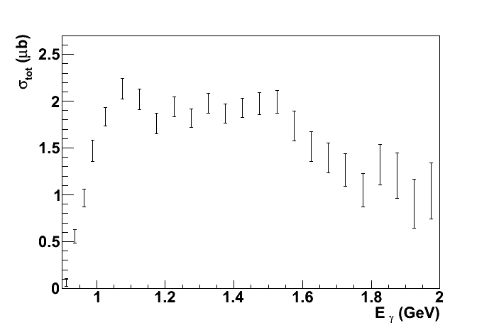
Kinematics of the E05-115 Experiment
Scattered electron
Target
nucleus
Electron beam
Momentum: 0.844GeV/c ±17%
Angular acceptance: 3°〜9°
Momentum: 2.344GeV/c
Λ
Coincidence measurement
γ+p →Λ+K⁺
1.5GeV γ*
p
K⁺
Momentum: 1.2GeV/c ±12.5%
Angular acceptance : 1°〜13°
M.Q.Tran et al.
PLB445 (1998) 20

Slide 4
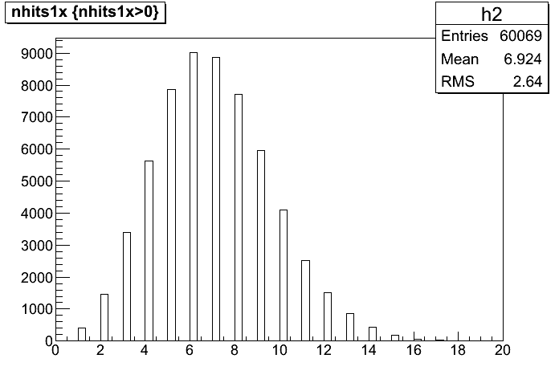
HES-HKS Data Condition -High multiplicity -
Particles on HKS side: kaon, pion, positron and proton

Slide 5
HKS Drift Chamber Tracking Idea
Start time of the drift time can not involve momentum information- Do Timing Counter Pre tracking, project the time to HDC1&2 by geometry.
The most possible hit selection is necessary for the case that there are several hits on the same layer of HDC1&2 for one space point.
Both Start time and Stop time should be decided individually for every single track compare to do average.

Slide 6
HKS Drift Chamber Tracking Idea
-Geometry-
DC1
DC2
1X
2X

Slide 7
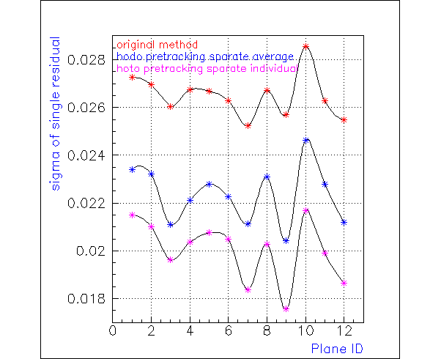
Preliminary Improvement

