Slide 1
Effective Kaon-Nucleon Cross Section from Nuclear Transparency Measured in A(e, e´ K⁺) Reaction
Nuclear Physics Group Meeting
10th February 2011
Advisors
Dr. Liguang Tang
(http://www.jlab.org/~tangl)
Dr. Dipangkar Dutta
(http://www2.msstate.edu/~dd285/)
Nuruzzaman
(http://www.jlab.org/~nur/)
Grant No.:DE-FG02-07ER41528

Slide 2
Overview
Motivation & Basics
Experimental Background
Analysis
Results
Conclusion & Summary

Slide 3
Hadron Structure
Basics Experimental Background Analysis Results Summary
In particle physics, a hadron is a composite particle made of quarks held together by the strong force.
u
u
u
s
u
s
u
d
d
d
d
Similar to how atoms and molecules are held together by the electromagnetic force.
p
π⁺
Λ⁰
Σ⁰
d
s
u
s
d
K⁺
Σ⁻
In particle physics, a hadron is a composite particle made of quarks held together by the strong force
We assumed h = c = 1
Ref: Wikipedia

Slide 4
Motivation
Basics Experimental Background Analysis Results Summary
The propagation of hadrons in the nuclear medium is an essential element of the nuclear many body problem.
Interactions of hadrons produced in nuclear matter are a tool for, and a measure of, our understanding of the strong force.
Hadron propagation has been studied using hadron scattering from nuclei before. For kaons these measurements show significant discrepancy compared to theoretical calculations.
We want to measure kaon propagation through nuclear matter, using an alternative technique to verify these discrepancies.

Slide 5
Motivation
Basics Experimental Background Analysis Results Summary
Such an alternative technique is to use electron scattering, which has the following advantages.
Since the electromagnetic interaction is weaker than the strong interaction, electrons can probe deeper into the nucleus.
Electromagnetic interaction is understood much better than the strong interaction.
Exclusive process like Quasi-free electron scattering from nuclei provides an excellent tool for a microscopic examination of hadron propagation effects in the nuclear medium.
Proton propagation in nuclei has been studied extensively in last decade and pion propagation in nuclei has also been studied recently using quasi-free electron scattering.
Kaon transparency from electro production has never been measured before!!!

Slide 6
Nuclear Transparency
Basics Experimental Background Analysis Results Summary
e + p → e´ + K⁺ + Λ⁰
e + A → e´ + K⁺ + Λ⁰ + X
The kaon electro production cross section can be expressed as a function of Q², W and t, φ_{pq}
e + p → e´ + K⁺ + Σ⁰
e + n → e´ + K⁺ + Σ⁻
e + A → e´ + K⁺ + Σ⁰ + X
e + A → e´ + K⁺ + Σ⁻ + X
K⁺
(E_{K}, p_{K})
e´
(E´, k_{f})
Q² = 4EE´sin²(θ/2)
W = √M_{A}² + 2M_{A}ν − Q²
| t | = (q − p_{K})²
θ_{e}
γ_{ν}
θ_{qK}
p(m_{p}, 0)
q= (ν, q)
e
(E, k_{i})
Y
(E_{Y}, p_{Y})
φ_{pq}
Scattering plane
Reaction plane

Slide 7
Nuclear Transparency
Basics Experimental Background Analysis Results Summary
Ratio of cross sections for exclusive processes from nuclei to those from nucleons is termed as Nuclear Transparency
σ₀ = Free (nucleon) cross section
σ_{N}
T =
σ_{N} = Nuclear cross section
Aσ₀
T = A^{α-1}
σ_{N} parameterized as = σ₀A^{α}
.˙.
Experimentally α = 0.72 – 0.78, for p, k, π

Slide 8
Transparency with Pions and Kaons
Basics Experimental Background Analysis Results Summary
Experiment ran in July `04 and December `04 at Jefferson Lab
JLab Experiment E01-107: A(e,e΄ π⁺)
Spokespersons : D. Dutta & Rolf Ent
Data collected on LH₂, LD₂, ¹²C, ⁶³Cu, and ¹⁹⁷Au at
P_{π} of 2.8, 3.2, 3.4, 4.0 and 4.4 (GeV/c)
Q² of 1.1, 2.15, 3.0, 4.0 and 4.7 (GeV/c)²
The experiment was measuring pion transparency, however one
gets kaons along with pions during data collection because kaons fall
within the coincidence window.

Slide 9
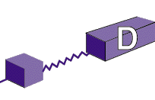
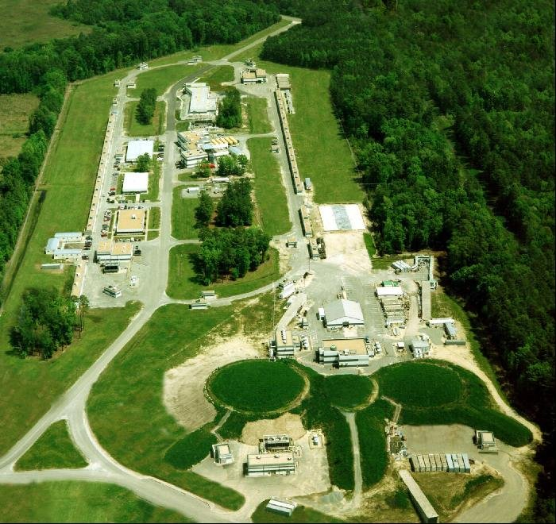
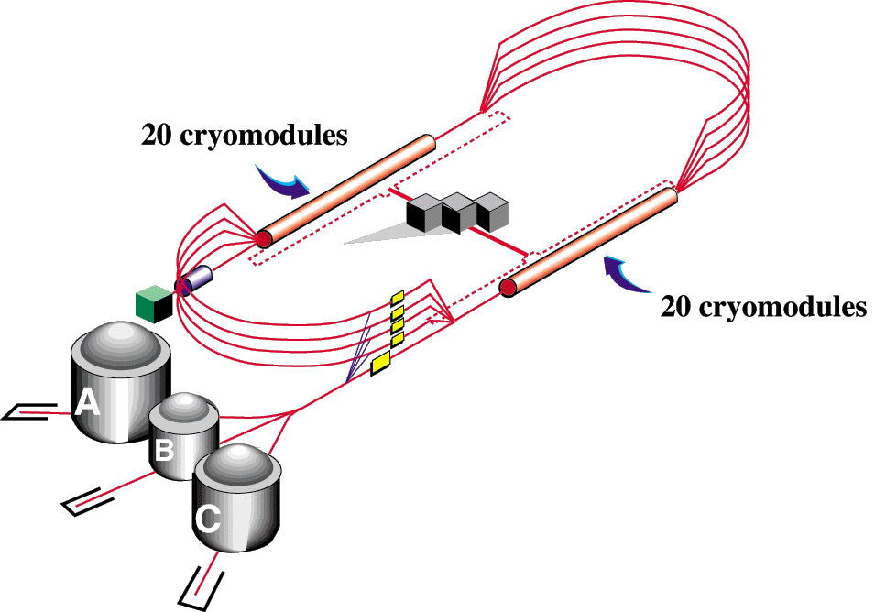
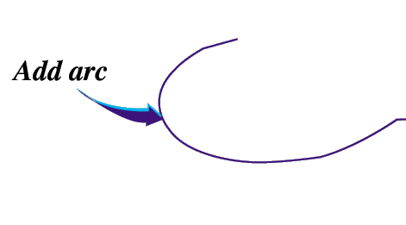
Jefferson Lab
Basics Experimental Background Analysis Results Summary
Add new hall
12
11
6 GeV CEBAF
Upgrade magnets and power supplies
CHL-2
A
B
C
Enhance equipment in existing halls

Slide 10
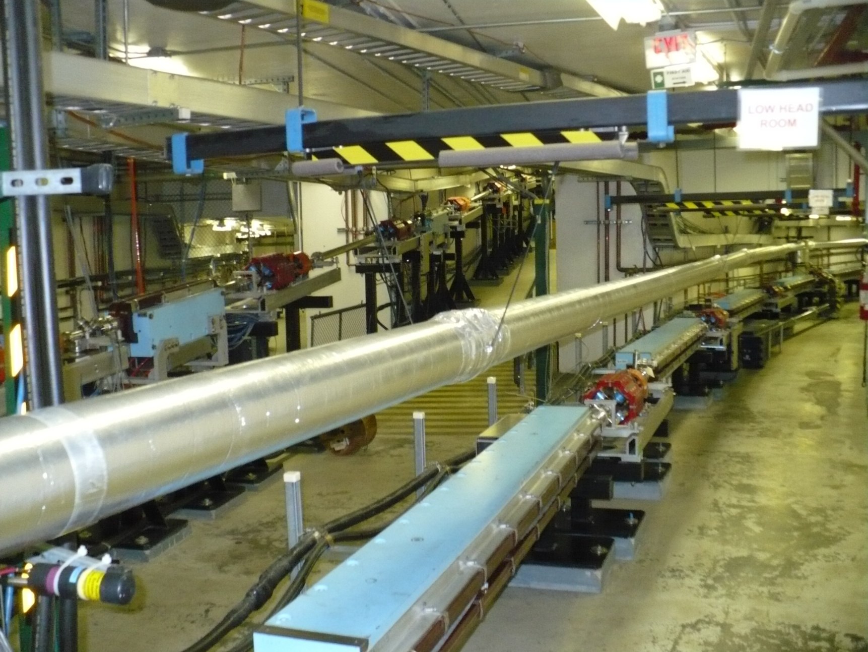
Jefferson Lab
Basics Experimental Background Analysis Results Summary
C
B
A
Quadrupole
Dipole

Slide 11
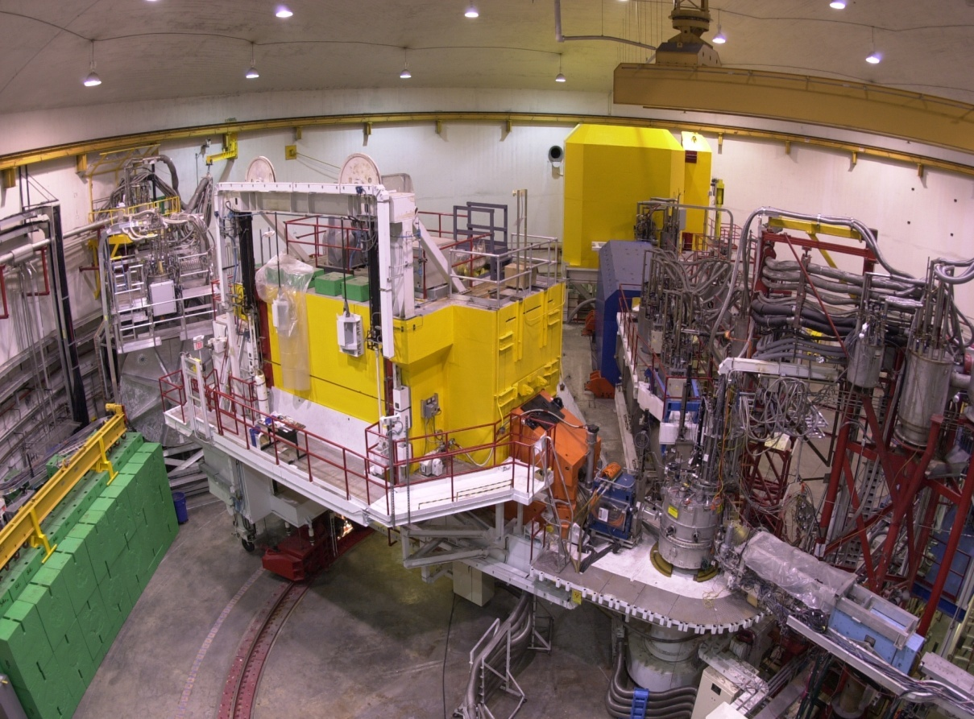
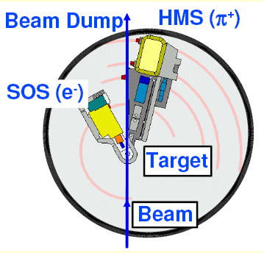
Hall-C
Basics Experimental Background Analysis Results Summary
HMS
HMS
SOS
SOS
Tgt
HMS- High Momentum Spectrometer
SOS- Short Orbit Spectrometer
Experimental Background: 4/5

Slide 12
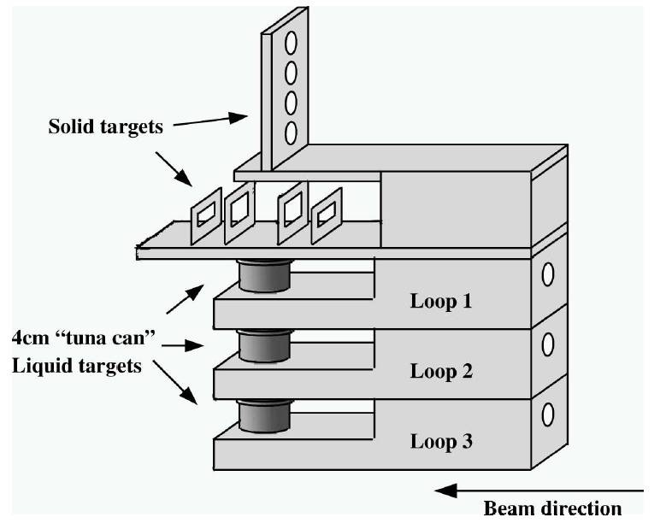
Target
Basics Experimental Background Analysis Results Summary
Beam

Slide 13
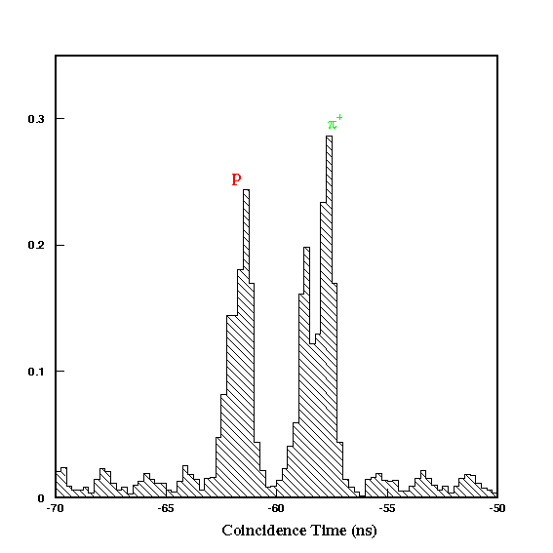
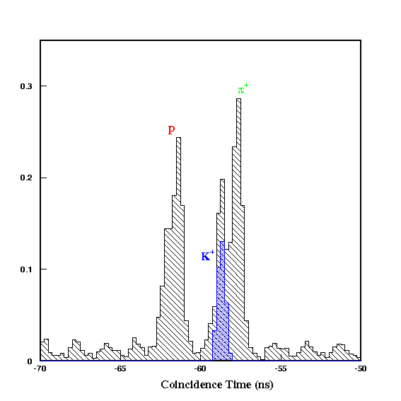
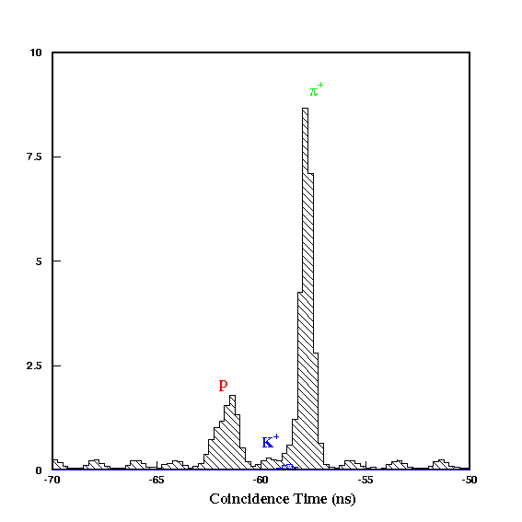
Particle Identification
Basics Experimental Background Analysis Results Summary
Coincidence Time:
Coincidence time = Time taken by electron to reach SOS - Time taken by hadrons to reach HMS (within a 30 ns window)‏
Coincidence time = Time taken by electron to reach SOS - Time taken by hadrons to reach HMS (within a 30 ns window)‏
Typical coincidence time spectrum showing the different particles detected
After applying all the cuts
Kaon transparency from electro production has never been measured before!!!
Coincidence Time (ns)
Coincidence Time (ns)
Coincidence Time (ns)

Slide 14
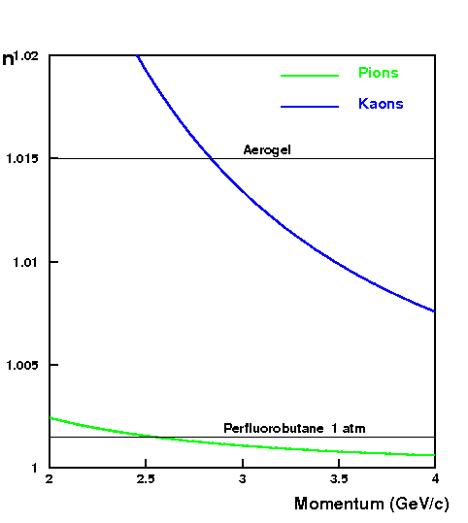
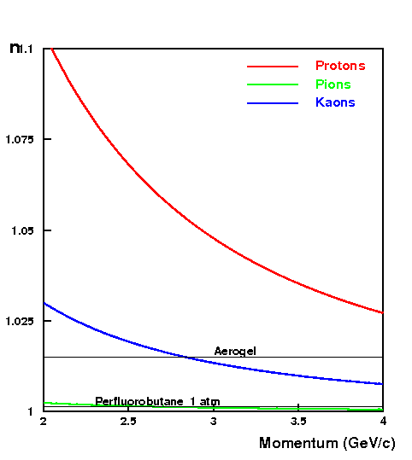
Particle Identification
Basics Experimental Background Analysis Results Summary
Cherenkov:
n
Aerogel Cherenkov
(Aerogel of n = 1.015)
(for K⁺/p separation)‏
Gas Cherenkov
(Perflurobutane at 1 atm.)‏
(for π⁺/K⁺ separation)‏
Momentum (GeV/c)

Slide 15
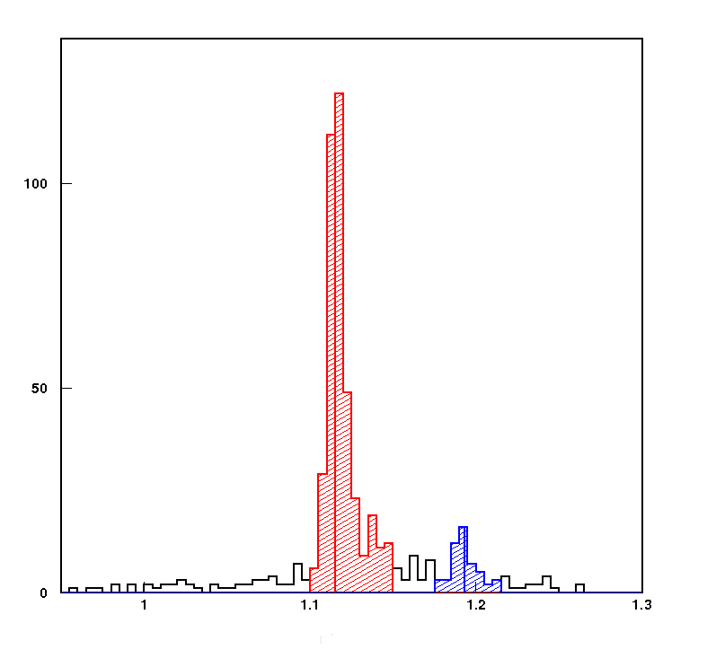
Particle Identification
Basics Experimental Background Analysis Results Summary
Missing Mass:
e´
Κ⁺
e´
Κ⁺
e + p → e´ + K⁺ + Λ
e + A → e´ + K⁺ + Λ + X
Reactions
Λ
Λ
missing mass
e
e
A-1
p
A
Energy & Momentum Conservation
E_{e} + M_{p} = E_{e´} + E_{K+} + E_{X}
P_{e} + 0 = P_{e´} + P_{K+} + P_{X}
M_{Λ} = 1.115 (GeV/c)²
Missing Mass M_{X} = [E_{X}² - P_{X}² ]^{1/2}
M_{Σ} = 1.193 (GeV/c)²
M_{Λ}
M_{Σ}

Slide 16
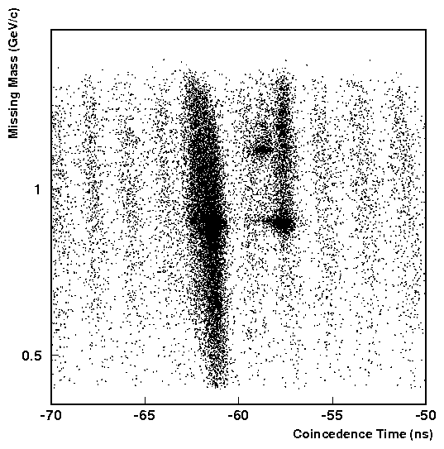
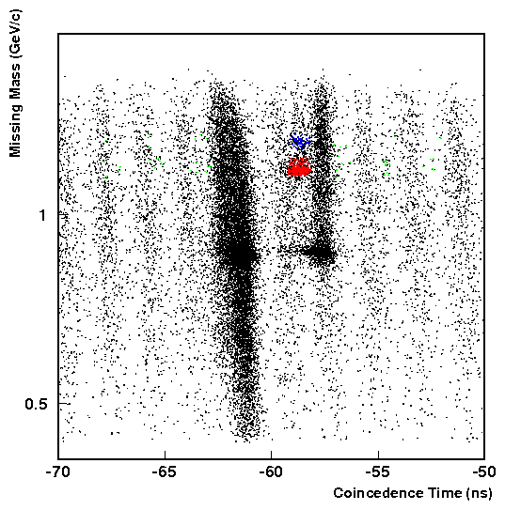
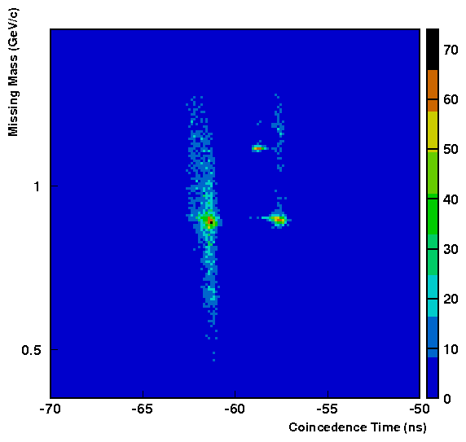
Before and After Applying PIDs on Kaon Hydrogen Data
Basics Experimental Background Analysis Results Summary
Kaons after application of all constraints for H₂ target
Missing Mass:
1.10<M_{x} <1.15 for Λ,
1.17<M_{x} <1.22 for Σ
Coincidence Time:
abs(cointime+58.63)<0.26
Gas Cherenkov:
SOS, N_{(p.e)}>1; HMS, N_{(p.e)}<1
Aerogel Cherenkov:
HMS, N_{(p.e)}<0
Other acceptances
Hsyptar, hsxptar, hsdelta, ssdelta
Kaons
M_{Σ}= 1.193
Pions
M_{Λ}= 1.115
Protons
Pions, Protons, Kaons (in coincidence time vs missing mass ) using a loose Constraints
Q²=2.2 (GeV/c)²

Slide 17
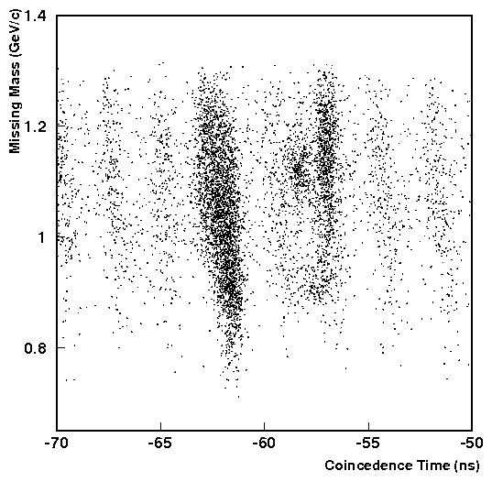
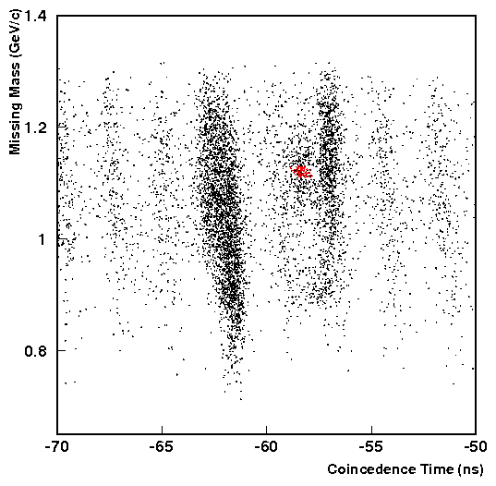
Before and After Applying PIDs on Kaon Deuterium Data
Basics Experimental Background Analysis Results Summary
Kaons separated after application of all constraints on LD₂ target
Missing Mass:
1.09<M_{x} <1.22
Coincidence Time:
abs(cointime+58.63)<0.26
Gas Cherenkov:
SOS, N_{(p.e)}>1; HMS, N_{(p.e)}<1
Aerogel Cherenkov:
HMS, N_{(p.e)}<0
Other acceptances
Hsyptar, hsxptar, hsdelta, ssdelta
Pions, Protons & Kaons before application of all constraints for LD₂ target
Q²=2.2 (GeV/c)²

Slide 18
Experimental Simulation SIMC
Basics Experimental Background Analysis Results Summary
Ingredients of SIMC: 1. Realistic Models of the magnetic spectrometers including multiple
scattering and energy loss in all intervening material encountered by
the particles. 2. Decay of kaons in flight, and radiative corrections for all particles. 3. Model of the electro production of kaons from free protons and
neutrons. 4. For heavier targets the free proton model is convoluted with a realistic spectral function for each target.
Spectral function = probability of finding a proton inside the nucleus with a certain energy and momentum.
(Y/ Y_{MC})_{A}
Transparency to be extracted as
T =
(Y/ Y_{MC})_{H}

Slide 19
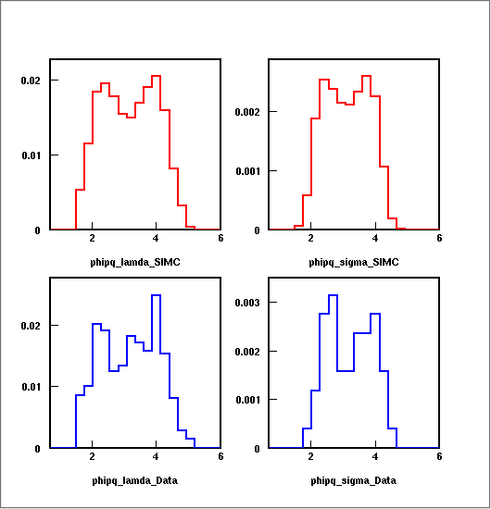
Comparison of Kaon Hydrogen Data with SIMC after all Cuts
Basics Experimental Background Analysis Results Summary
All particle identification and acceptance constraints applied
SIMC Λ
SIMC Σ
σ = σ (Q², W, t, ϕ_{pq})‏
ϕ_{pq}= Angle Between
Reaction Plane &
Scattering Plane
ϕ_{pq}
ϕ_{pq}
The ratio of Λ/Σ is determined from the LH₂ data
Data Λ
Data Σ
Q²=1.1 (GeV/c)² : 15.6 Q²=2.2 (GeV/c)² : 9.7 Q²=3.0 (GeV/c)² : 6.4
Q²=2.2 (GeV/c)²
Red – SIMC
Blue – Data
ϕ_{pq}
ϕ_{pq}

Slide 20
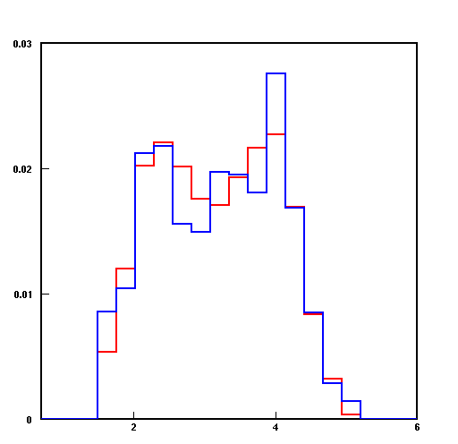
Comparison of Kaon Hydrogen Data with SIMC after all Cuts
Basics Experimental Background Analysis Results Summary
All particle identification and acceptance constraints applied
σ = σ (Q², W, t, ϕ_{pq})‏
SIMC Λ + Σ
&
Data Λ + Σ
ϕ_{pq}= Angle Between
Reaction Plane &
Scattering Plane
H(e, e´ K⁺) Λ
H(e, e´ K⁺) Σ⁰
Q²=2.2 (GeV/c)²
Red – SIMC
Blue – Data
ϕ_{pq}

Slide 21
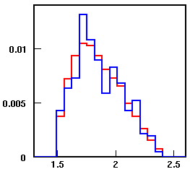
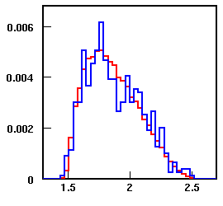
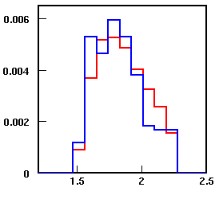
Comparison of Kaon Data with SIMC after all Cuts
Basics Experimental Background Analysis Results Summary
All particle identification and acceptance constraints applied
σ = σ (Q², W, t, ϕ_{pq})‏
LD₂
C
Q² = Four Momentum Transferred Squared
Q²
Q²
A(e, e´ K⁺) Λ
A(e, e´ K⁺) Σ⁰
Au
A(e, e´ K⁺) Σ⁻
Cu
Q²=2.2 (GeV/c)²
Red – SIMC
Blue – Data
Q²
Q²

Slide 22
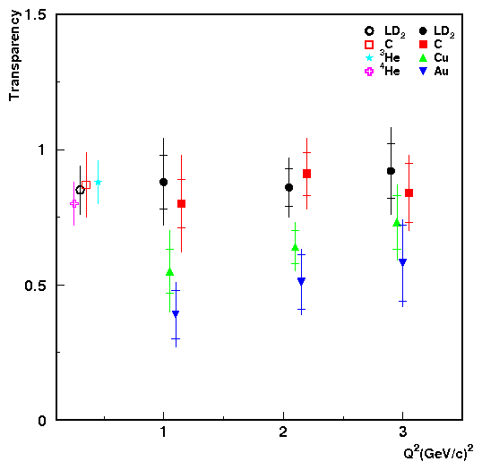
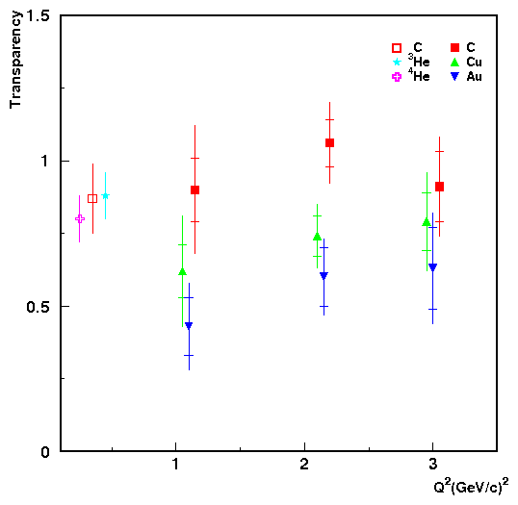
Nuclear Transparency
Basics Experimental Background Analysis Results Summary
Cu, C, LD₂ are shifted by - 0.05, 0.05,-0.10 in Q² respectively
Cu, C are shifted by -0.05,0.05,-0.10 in Q² respectively
p
p
n
p
n
p
n
Transparency w.r.t LH₂.
n
Transparency w.r.t LD₂.
p
p
n
n
H
LD₂ has one proton and one neutron.
It is more logical to measure transparency w.r.t. LD₂
D
p
p
n
C
e + p → e´ + K⁺ + Λ⁰
e + A → e´ + K⁺ + Λ⁰ + X
(Y/ Y_{MC})_{A}
(Y/ Y_{MC})_{A}
e + p → e´ + K⁺ + Σ⁰
e + n → e´ + K⁺ + Σ⁻
e + A → e´ + K⁺ + Σ⁰ + X
e + A → e´ + K⁺ + Σ⁻ + X
T =
T =
(Y/ Y_{MC})_{H}
(Y/ Y_{MC})_{D}

Slide 23
Error Calculation
Basics Experimental Background Analysis Results Summary
Item | Point-to-Point (%)‏ | Scale (%) | Total (%)
Particle ID | 2.0 | 0.4-0.7
Charge | 0.3 | 0.5
Target thickness | 0.5
Coin blocking | 0.1
Trigger(HMS+SOS)‏ | 0.7
Dead time correction | 0.1
Tracking(HMS+SOS)‏ | 0.5 | 0.5
Kaon Absorption | 0.5 | 2.0
Beam Energy | 0.1 | 0.1
Cut dependence | 2.5 | 0.5
Kaon Decay | 0.5 | 1.0
Pauli Blocking | 0.5
Radiative Corrections | 0.5 | 1.0
Collimator | 1.0
Acceptance | 0.5 | 2.0
Spectral Function | 1.0 | 2.0
TOTAL | 3.8 | 3.9 | 5.4
Statistical Uncertainty:
Systematic Uncertainty:
We are using same set of data set used for pion transparency calculation.
Most of the uncertainty remains same.
Total charge
normalized yield Y =
Y_{i}
1
-1
( )
n
( )
∑
n
∑
(Y_{i} / √N_{i} )²
(Y_{i} / √N_{i} )²
i
i
n
-1/2
( )
Statistical Uncertainty dY =
∑
N_{i} /Y_{i}²
i
Statistical uncertainty
in the transparency dT_{stat} =
T √
([dY/Y]²+[dY/Y]²_{SIMC})_{D} + ([dY/Y]²+[dY/Y]²_{SIMC})_{A}
here i represents the i^{th} run of a kinematic setting and N_{i} the number of events inside the experimental acceptance

Slide 24
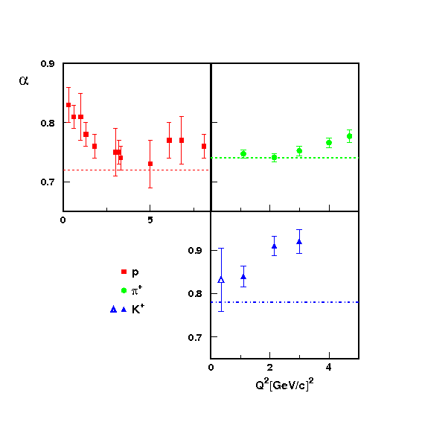
α vs Q²
Basics Experimental Background Analysis Results Summary
T= (A/2)^{α-1}

Slide 25
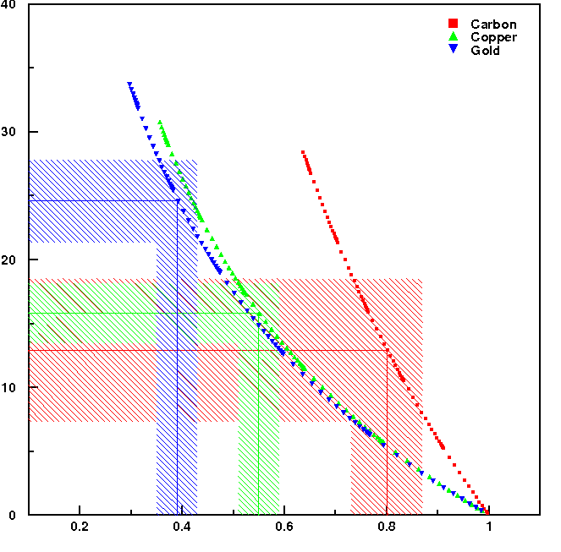
Effective Cross Section
Basics Experimental Background Analysis Results Summary
1
[
∫
∫
-
T =
d³r ρ_{z}(r)exp
dz´ σ_{eff} ρ_{A-1}(r´)
[
Z
ρ_{z}(r) is charge density distribution along z at r
Effective Cross Section (mb)
ρ_{A-1}(r´) is r´ for (A-1) nucleon.
Z is the number of protons.
Q²=1.1 (GeV/c)²
Transparency

Slide 26
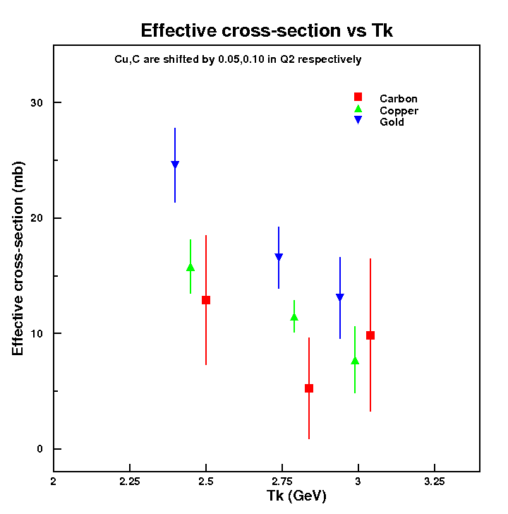
Effective Cross Section
Basics Experimental Background Analysis Results Summary
σ^{C}_{eff} = Effective cross section for Carbon
σ^{Cu}_{eff} = Effective cross section for Copper
σ^{Au}_{eff} = Effective cross section for Gold
Effective Cross Section (mb)
∆σ^{C} = Error on effective cross section for Carbon
∆σ^{Cu} = Error on effective cross section for Copper
∆σ^{Au} = Error on effective cross section for Gold
T_{k} (GeV)

Slide 27
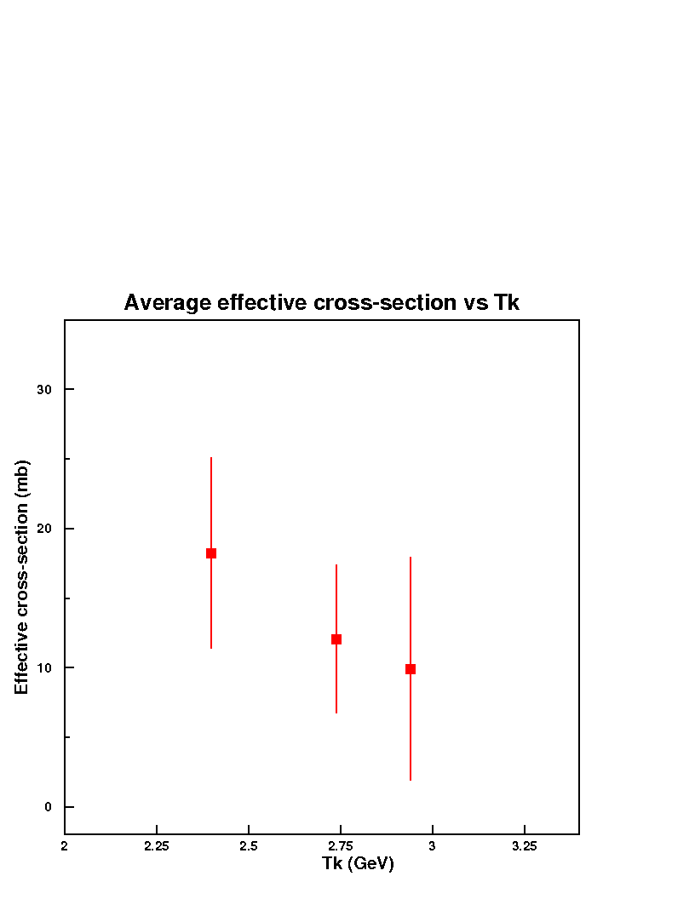
Effective Cross Section
Basics Experimental Background Analysis Results Summary
1
1
1
(
2
(
2
(
2
(
+
(
+
(
Δσ^{C}
σ^{C}_{eff}
Δσ^{Cu}
σ^{Cu}_{eff}
Δσ^{Au}
σ^{Au}_{eff}
σ^{av}_{eff} =
(
(
1
1
(
2
2
1
2
(
+
(
+
(
Δσ^{C}
Δσ^{Cu}
Δσ^{Au}
Effective Cross Section (mb)
T_{k} (GeV)

Slide 28
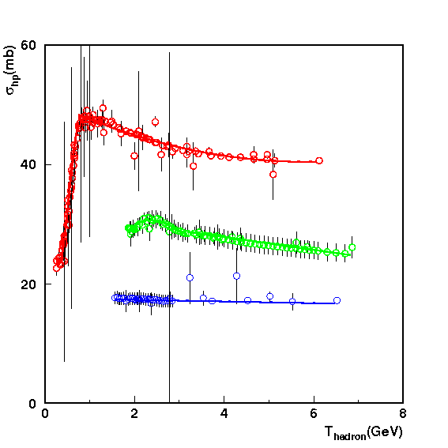
World Data Fit
Basics Experimental Background Analysis Results Summary
p-p cross section
π⁺-p cross section
K⁺-p cross section
p-p cross section fit
π⁺-p cross section fit
K⁺-p cross section fit
Ref: PDG

Slide 29
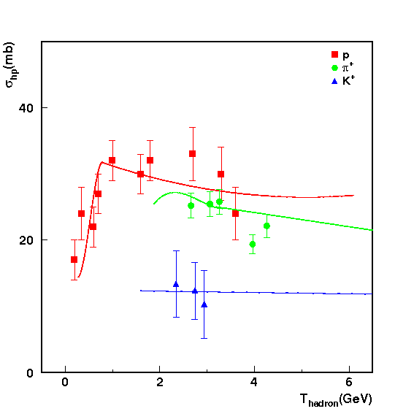
Effective Cross Section
Basics Experimental Background Analysis Results Summary
p-p cross section fit
π⁺-p cross section fit
K⁺-p cross section fit
Hadron scattering cross section scale factor
p -p 0.68
π⁺-p 0.81
K⁺-p 0.59

Slide 30
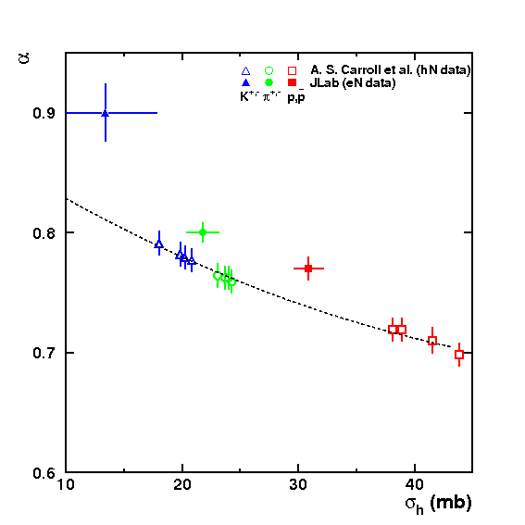
α vs Q²
Basics Experimental Background Analysis Results Summary
T= A^{α-1}
Comparison of α with other experiments

Slide 31
Conclusion
Basics Experimental Background Analysis Results Summary
Nuclear transparency of kaons in the reaction A(e, e´ K⁺) was measured for LD₂, C, Cu and Au targets with kinematic settings of Q² = 1.1, 2.2 and 3.0 (GeV/c)².
Energy and A dependence of the transparency are consistent with traditional nuclear physics expectations within experimental errors.
We extracted effective kaon-nucleon cross sections from transparency.
The energy dependence of effective kaon-nucleon cross sections are also consistent with the hadron scattering world data.
Due to the large statistical uncertainties, our results do not really constrain the traditional nuclear physics expectations.

Slide 32
Summary
Basics Experimental Background Analysis Results Summary
Experiment E01-107 was performed at Jefferson Lab to extract pion
transparency during Fall 2004.
Same set of data have been used for this analysis.
Separated Kaons(K⁺) from Pions(π⁺) and Protons using different
particle identification.
Data compared with Jefferson Lab Hall-C simulation SIMC.

Slide 33
Summary
Basics Experimental Background Analysis Results Summary
Extracted transparency using K⁺ yields.
Calculated effective cross section using transparency.
Compared results with existing kaon-nucleon scattering cross section world
data.
Due to low statistics we get large statistical error.
Waiting to compare analysis with theoretical calculation and writing
paper.

Slide 34
Future Research
Basics Experimental Background Analysis Results Summary
JLab will upgrade it’s energy from 6 GeV to 12 GeV and the nuclear
transparency effect will be probed at higher Q².
Studies of hadronization in nuclei by deep inelastic scattering and L-T
separated kaon electro production cross section from 5-11 GeV will be
performed by experiments E12-07-101 and E12-09-011 respectively.
We hope these experiments will give us a better understanding of the
reaction mechanism of kaon electro production and kaon propagation
through nuclei.
This work is sponsored by the
Department of Energy
Office of Science
Grant No.: DE-FG02-07ER41528

Slide 35
Basics Experimental Background Analysis Results Summary
Thank You

Slide 36
General
Basics Experimental Background Analysis Results Summary
Kaon was discovered in 1947
They were essential in establishing the foundations of the Standard Model of particle physics, such as the quark model of hadrons and the theory of quark mixing (the latter was acknowledged by a Nobel Prize in Physics in 2008). Kaons played a distinguished role in our understanding of fundamental conservation laws: the discovery of CP violation, a phenomenon generating the observed matter-antimatter asymmetry of the universe, was made in the kaon system, which was acknowledged by a Nobel prize in 1980.
Different type of Kaons are K⁺(K⁻), K⁰(K⁰), K⁰_{S}(K⁰_{S}) and K⁰_{L}(K⁰_{L})
K±: 493.667±0.013 (MeV/c)²

Slide 37
General
Basics Experimental Background Analysis Results Summary
γ + n → K⁻ + p γ + ⁴He → K⁻ + p + X
Bremsstrahlung Radiator
⁴He
LH₂/LD₂ Target
p/n
K^{+/-}
Interactions of hadrons produced in nuclear matter are a tool for, and a measure of, our understanding of the strong force.
γ + ⁴He → K⁻ + p + X
T ≈
γ + n → K⁻ + p

Slide 38
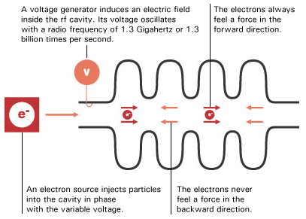
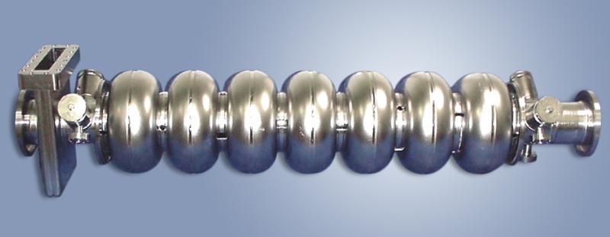
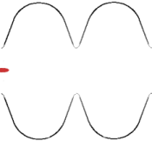
General
Basics Experimental Background Analysis Results Summary

Slide 39
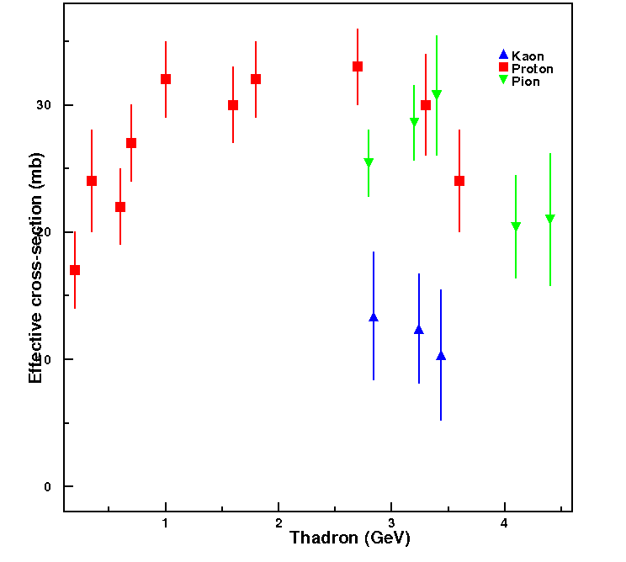
General
Basics Experimental Background Analysis Results Summary
T_{hadrons}

Slide 40
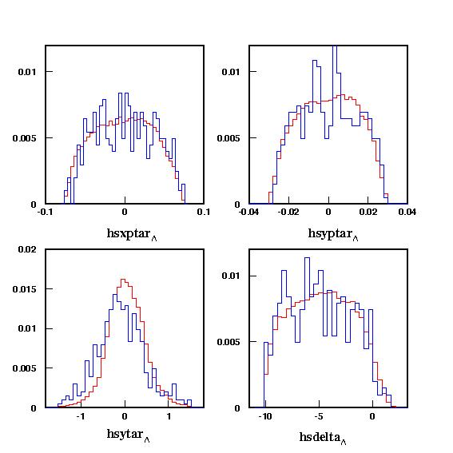
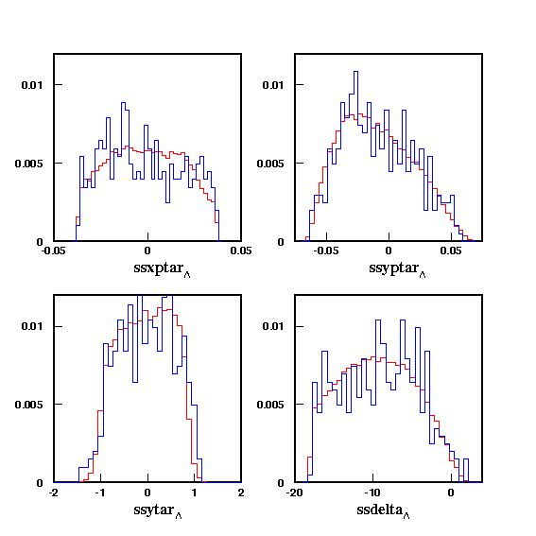
General
Basics Experimental Background Analysis Results Summary
Reconstructed Variables:
HMS
SOS
The reconstructed
angle and momentum fraction at the target
Q²=2.2 (GeV/c)²
Red – SIMC
Blue – Data

Slide 41
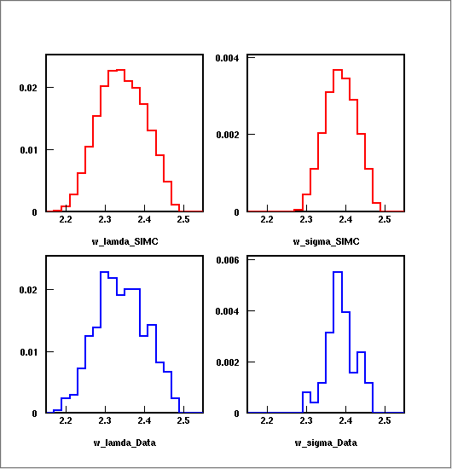
General
Basics Experimental Background Analysis Results Summary
All particle identification and acceptance constraints applied
σ = σ (Q², W, t, ϕ_{pq})‏
SIMC Λ
SIMC Σ
W = Centre of
Mass Energy
w
w
Data Λ
Data Σ
Q²=2.2 (GeV/c)²
Red – SIMC
Blue – Data
w
w

Slide 42
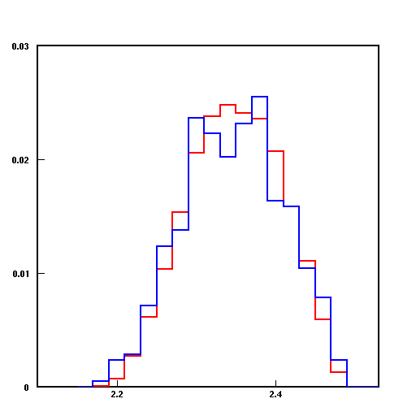
General
Basics Experimental Background Analysis Results Summary
All particle identification and acceptance constraints applied
σ = σ (Q², W, t, ϕ_{pq})‏
SIMC Λ + Σ
&
Data Λ + Σ
W = Centre of
Mass Energy
Q²=2.2 (GeV/c)²
Red – SIMC
Blue – Data
w

Slide 43
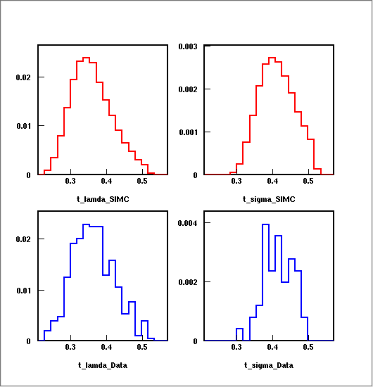
General
Basics Experimental Background Analysis Results Summary
All particle identification and acceptance constraints applied
σ = σ (Q², W, t, ϕ_{pq})‏
SIMC Λ
SIMC Σ
t = Mandelstam Variable
t
t
Data Λ
Data Σ
Q²=2.2 (GeV/c)²
Red – SIMC
Blue – Data
t
t

Slide 44
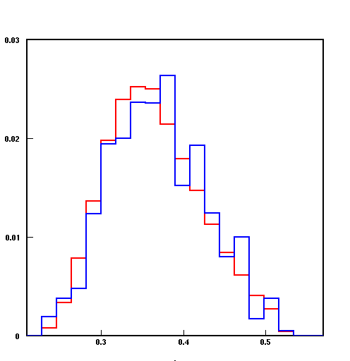
General
Basics Experimental Background Analysis Results Summary
All particle identification and acceptance constraints applied
σ = σ (Q², W, t, ϕ_{pq})‏
SIMC Λ + Σ
&
Data Λ + Σ
t = Mandelstam Variable
Q²=2.2 (GeV/c)²
Red – SIMC
Blue – Data
t

Slide 45
General
Basics Experimental Background Analysis Results Summary
e + p → e´ + K⁺ + Λ⁰
e + A → e´ + K⁺ + Λ⁰ + X
e + p → e´ + K⁺ + Σ⁰
e + p → e´ + K⁺ + Σ⁻
e + A → e´ + K⁺ + Σ⁰ + X
e + A → e´ + K⁺ + Σ⁻ + X
e + A → K⁺ + Λ + X
T ≈
e + p → K⁺ + Λ
Quasi-free electron scattering from nuclei provides an excellent tool for a microscopic examination of hadron propagation effects in the nuclear medium.

Slide 46
General
Basics Experimental Background Analysis Results Summary
Electro production of K⁺ from nuclei provides an additional, strangeness, degree of freedom, which is inaccessible with nucleons and pions.
Exclusive processes (processes with completely determined initial and final states), can be used to study propagation of hadrons in the medium.
Exclusive processes
Nucleons
Nuclei
A + B → C + D
A + B → C + D + X
N
^{A}N_{Z}

Slide 47
General
Basics Experimental Background Analysis Results Summary

