Slide 1
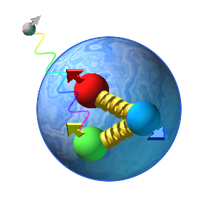
The Overview/Update Of
Spin
Asymmetries of the
Nucleon
Experiment
( E07-003)
Outline
Introduction
Physics Motivation
Detector Setup &
Polarized Target
Data Analysis
Future Work
Anusha Liyanage
Hampton University group meeting
10/04/2011

Slide 2
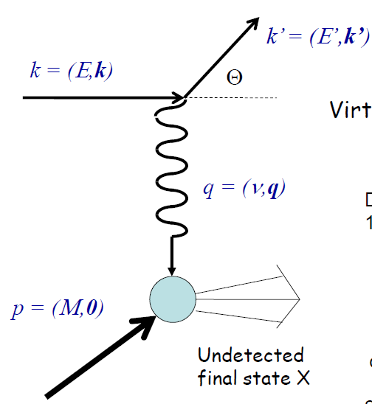
Introduction
From the elastic scattering of electron from the proton target,
and
Elastic,
Electric and Magnetic Form Factors (Sachs form factors)
Provide the information on the spatial distribution
of electric charge and magnetic moment within the
proton
Are functions of the four-momentum transfer
squared,
Fourier transforms of the charge,
and magnetic moment, distributions in Breit Frame
At low
The four-momentum transfer squared,
At

Slide 3
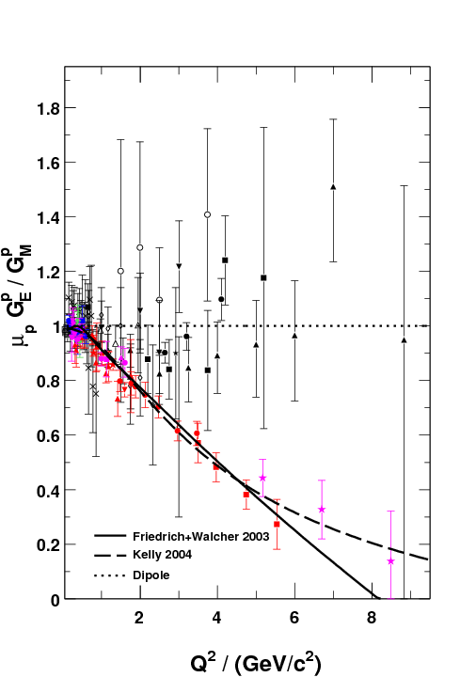
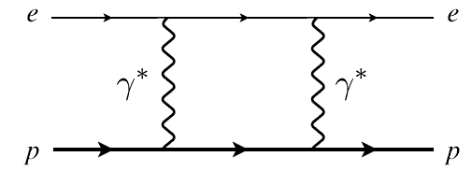
Physics Motivation
M. Jones et al., PRC74 (2006) 035201
Dramatic discrepancy between
Rosenbluth and recoil polarization
technique.
Multi-photon exchange considered
the best candidate for the
explanation
Double-Spin Asymmetry
is an Independent
Technique to verify
the discrepancy
RSS (Jlab)
Q² = 1.50 (GeV/c)²
Dramatic discrepancy !
A. Puckett , GeP-III
SANE
2.20
5.17
6.25
Q² / (GeV/c²)

Slide 4
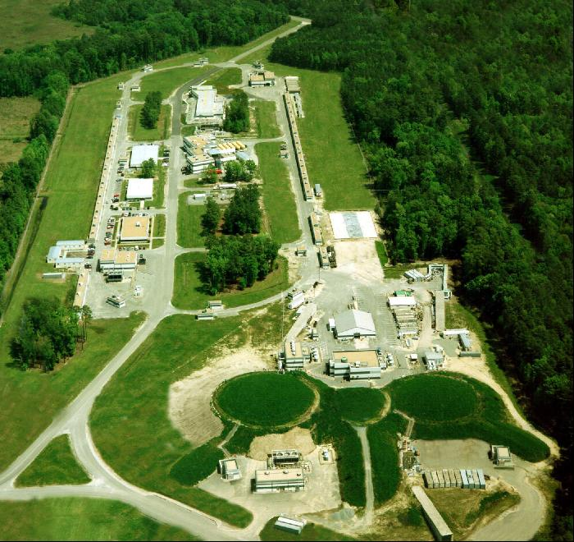
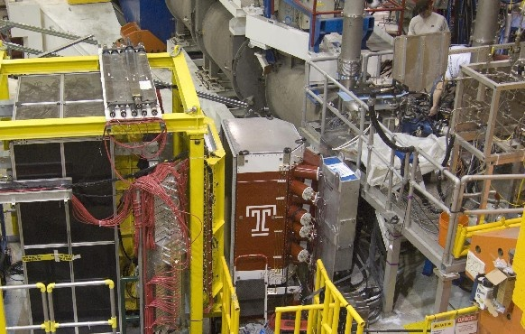
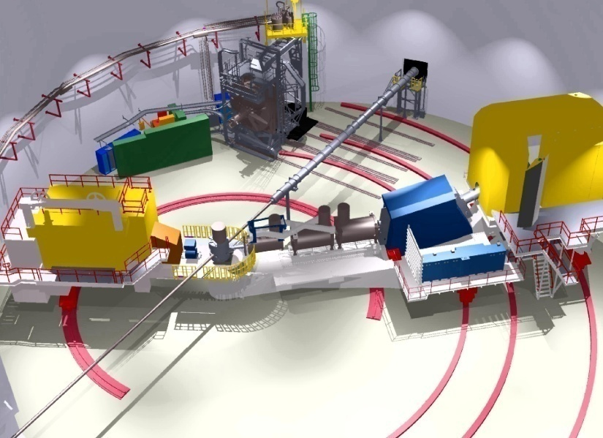
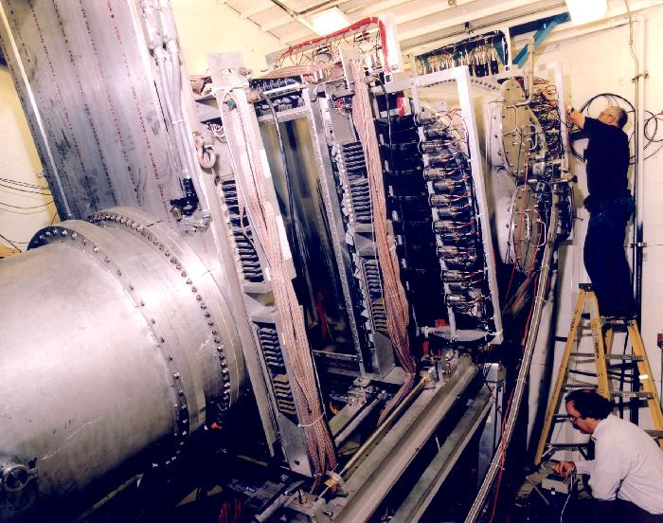
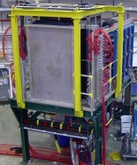
Detector Setup
BETA for coincidence electron
detection
Central scattering angle :40 °
Over 200 msr solid angle
coverage
Hall C at Jefferson Lab
HMS for the scattered
electron/proton
detection
Central angles are
15.4°, 22.3° and 22.0°
Solid angle ~10 msr
Elastic (e , e’p) scattering from
the polarized NH₃ target using a longitudinally polarized electron
beam
(Data collected from Jan – March ,2009)
e⁻p → e⁻p

Slide 5
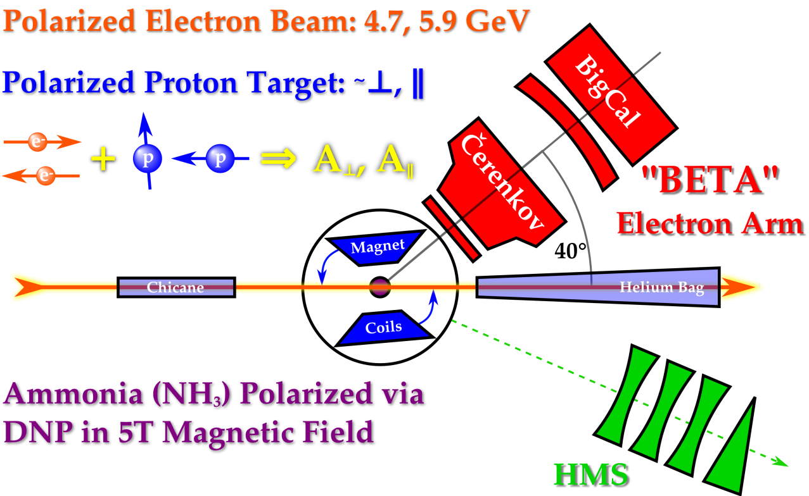
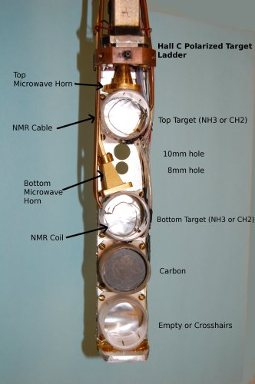
Polarized Target
• C, CH₂ and NH₃
• Dynamic Nuclear Polarization (DNP)
polarized the protons in the NH₃
target up to 90% at
1 K Temperature
5 T Magnetic Field
Temperature is maintained by
immersing the entire target in the
liquid He bath
• Used microwaves to excite spin flip
transitions
(55 GHz - 165 GHz)
• Polarization measured
using NMR coils
Θ_{B} = 80°
Θ_{B} = 180°
( 80 and 180 deg )
Used only perpendicular magnetic
field configuration for the elastic data
Average target polarization is ~ 70 %
Average beam polarization is ~ 73 %

Slide 6
Run Dates | Beam Energy | Magnet Orientation | Run Hours/ Proposed PAC hours | Average Beam Polarization
Elastic Kinematics
( From HMS Spectrometer )
Spectrometer mode | Coincidence | Coincidence | Single Arm
HMS Detects | Proton | Proton | Electron
E Beam GeV | 4.72 | 5.89 | 5.89
P_{HMS} GeV/c | 3.58 | 4.17 | 4.40
Θ_{HMS} (Deg) | 22.30 | 22.00 | 15.40
Q² (GeV/c)² | 5.17 | 6.26 | 2.20
Total Hours (h) | ~40 (~44 runs) | ~155 (~135 runs) | ~12 (~15 runs)
e-p Events | ~113 | ~824 | -

Slide 7
Data Analysis
Electrons in HMS
By knowing the
incoming beam energy, E and
the scattered electron angle,
E’
Θ
e⁻
E
e⁻ p e⁻ p

Slide 8
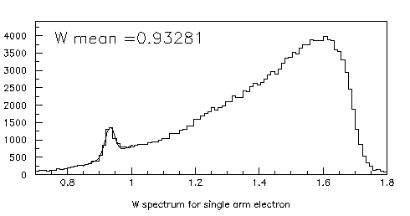
Extract the electrons
• Used only Electron selection cuts.
# of Cerenkov photoelectrons > 2 - Cerenkov cut
> 0.7 - Calorimeter cut
< 8 - HMS Momentum Acceptance cut
Here,
- Detected electron momentum/energy
at HMS
P_{c} - Central momentum of HMS
- Total measured shower energy
of a chosen electron track by
HMS Calorimeter
The Invariant Mass, W (GeV)

Slide 9
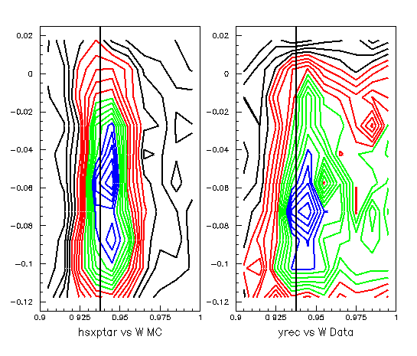
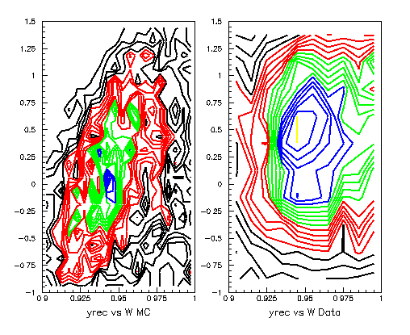
Corrections
Checking the target magnetic field
application
Needs more investigation !!!!!!

Slide 10
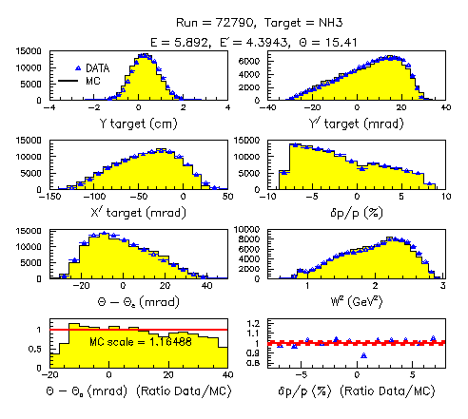
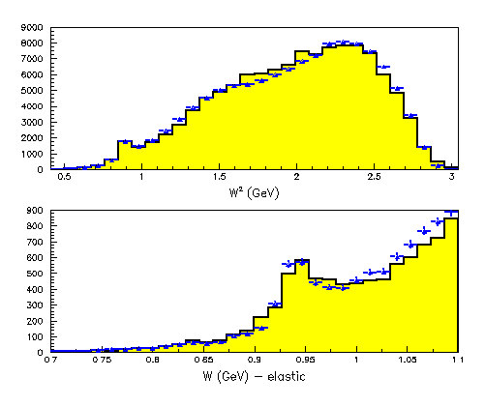
MC Comparison
X beam offset = 0.3 cm
Y beam offset = 0.0

Slide 11
Need To Do..
In Data..
More investigation of the target magnetic field.
In MC..
Adjust acceptance edges in Y, Y’ and X’ from adjusting the z target, x beam and y beam.
Make some adjustments to HMS kinematic offset ( HMS central angle in the limit of +/- 0.3 mrad) to center W at 938 MeV.
Check the MC comparison with the parallel field runs.

