Slide 1
Spectroscopic Investigation
of P-shell Λ
hypernuclei by (e,e'K+)
-Analysis Updated Status-
Chunhua Chen
Hampton Universithy
Nov.29,2011/HU group meeting

Slide 2
Outline
Experimental Goal of E05115
Kinematics of the E05115
Experimental Setup of E05115
Analysis process and status
Preliminary results

Slide 3
Experimental Goal
The 3rd Generation (e,e’K+) Hypernuclear Spectroscopy in JLab-HallC
Medium - heavy hypernuclear spectroscopy
⁵²Cr(e,e’K+) ⁵²_{Λ}V
Λ hyperon bound in the mean field
quark picture vs. conventional picture
Light Λ hypernuclear spectroscopy
ΛN interaction, ls coupling, Charge Symmetry Breaking
p shell hypernuclei : ¹²C(e,e'K+)¹²_{Λ}B , ⁷Li(e,e'K+)⁷_{Λ}He, ¹⁰B(e,e'K+)¹⁰_{Λ}Be , and ⁹Be(e'K+)⁹_{Λ}Li
Calibration by the elementary process p(e,e’K+)Λ or Σ: H2O and CH2
Notes:
We plan to determine high-precision binding energies of lambda single particle states with various l from the excitation spectra of lambda hpernuclei up to A=52
3

Slide 4
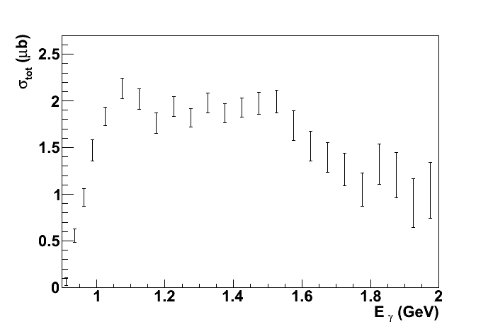
Kinematics of the
E05-115 Experiment
Scattered electron
Target
nucleus
Electron beam
Momentum: 0.844GeV/c ±17%
Angular acceptance: 3°〜9°
Momentum: 2.344GeV/c
Λ
Coincidence measurement
1.5GeV γ*
γ+p →Λ+K⁺
p
K+
Momentum: 1.2GeV/c ±12.5%
Angular acceptance : 1°〜13°
M.Q.Tran et al.
PLB445 (1998) 20
Notes:
4

Slide 5
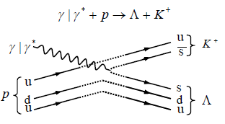
Kinematics of the
E05-115 Experiment
Scattered electron
Target
nucleus
Electron beam
Momentum: 0.844GeV/c ±17%
Angular acceptance: 3°〜9°
Momentum: 2.344GeV/c
Λ
Coincidence measurement
1.5GeV γ*
γ+p →Λ+K⁺
p
K+
Momentum: 1.2GeV/c ±12.5%
Angular acceptance : 1°〜13°
M.Q.Tran et al.
PLB445 (1998) 20
Notes:
5

Slide 6
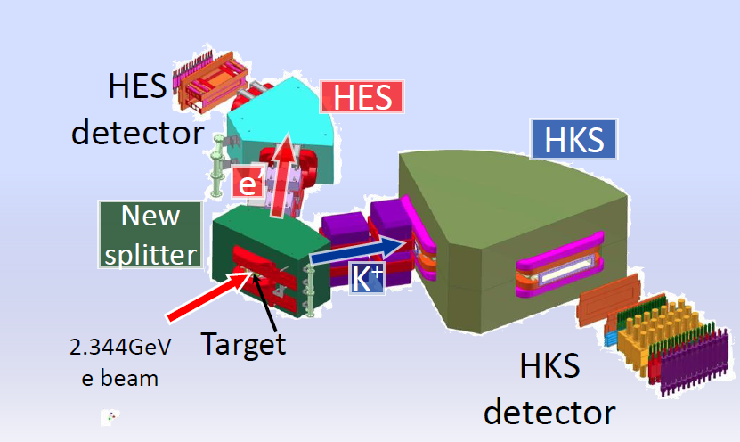
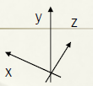
Experimental Setup

Slide 7
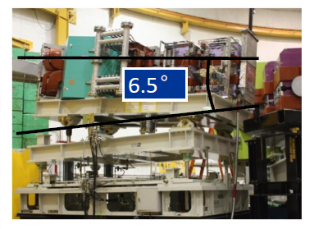
Experimental Setup
Notes:
In order to avoid the high rate of Blau and moller, we used title hes by 6.5 degree similar as the experiment in 2005.Here, our new spectrometer HES and the new Splitter enlarge the acceptance of angle and momentum, which allow us to get higher beam energy, at the same time improve the signal to noise ratio. At this case, we are able to run the heavy target.
7

Slide 8
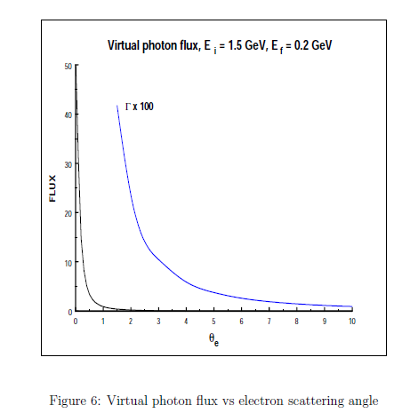
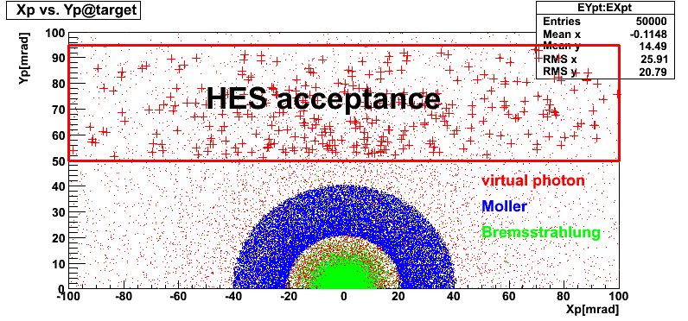
Experimental Setup
-Tilt Method-
$$\frac{d^{5}σ}{dE_{e}^{′}dΩ_{e}^{′}dΩ_{K}}=Γ\frac{dσ}{dΩ_{K}}$$
Electroproduction differential cross section(Miloslav Sontana)
Г : virtual photon flux
$\frac{dσ}{dΩ_{K}} :$Photoproduction cross section by virtual photon

Slide 9
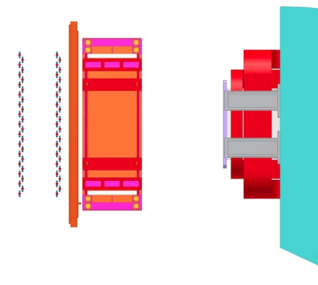
Experimental Setup
-Detector Package-
HES Detectors
EDC2
EDC1
e’
HES-D
EHOD2
EHOD1

Slide 10
Flow Chart
Tracking
(KDC)
Geant4 Simulation
Need to do
Data & Info
HKS Focal Plane
(X,X’,Y,Y’,T_{fp})
TOF
(Hodoscopes)
Optics
(HKS+Splitter)
HKS
HKS Target Plane
(X’, Y’, P, T_{tar})
HKS Sieve Slit
KID
(AC,WC,LC)
Kinematics Correction
(Beam, Target effects, Momentum, Angular)
Coincident
(RF )
Missing Mass
Raw Data
Lambda&Sigma
Spectra
Tracking
(EDC)
HES Sieve Slit
Optics
(HES+Splitter)
HES
HES Focal Plane
(X,X’,Y,Y’, T_{fp})
HES Target Plane
(X’, Y’, P, T_{tar})
TOF
(Hodoscopes)

Slide 11
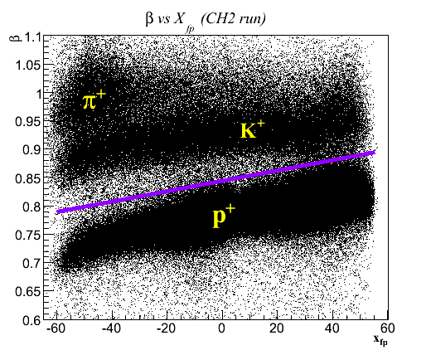
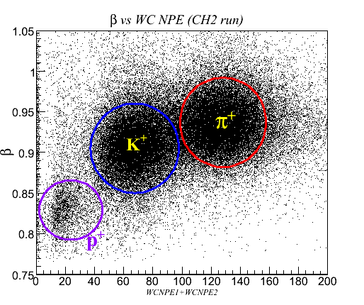
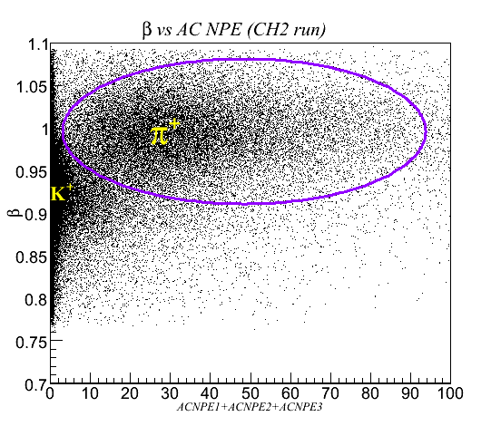
Particle ID
Online Trigger: (2/3 ($\overline{AC1×AC2×AC3}$)) $×$ (WC1$×$WC2)
AC (rejecte $π$⁺> 99%), WC (rejecte p⁺>99%),
Offline KID: Cuts on number of photon electrons (NPE)
Optimize Cutting values – More Kaon(95%), less Pion &Proton

Slide 12
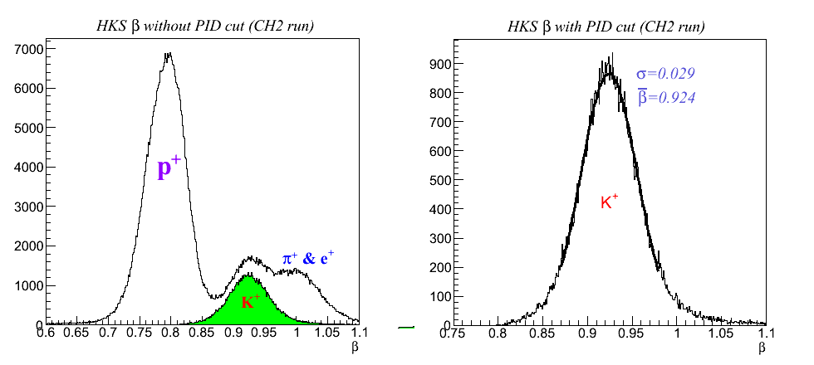
Particle ID
Online Trigger: (2/3 ($\overline{AC1×AC2×AC3}$)) $×$ (WC1$×$WC2)
AC (rejecte $π$⁺> 99%), WC (rejecte p⁺>99%),
Offline KID: Cuts on number of photon electrons (NPE)
Optimize Cutting values – More Kaon(95%), less Pion &Proton

Slide 13
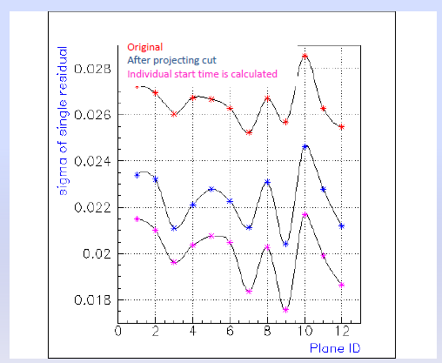
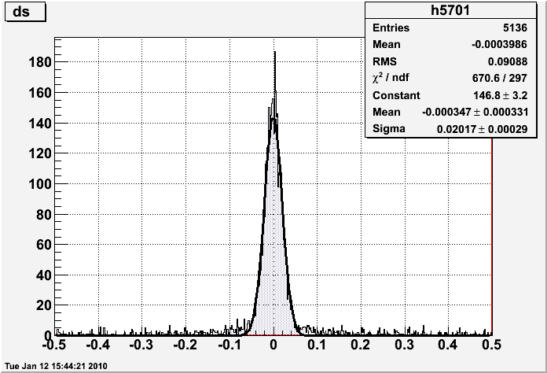
Tracking Status
HKS tracking residual~200µm
EDC1-1 single residual
@ CH2 Run(76312)

Slide 14
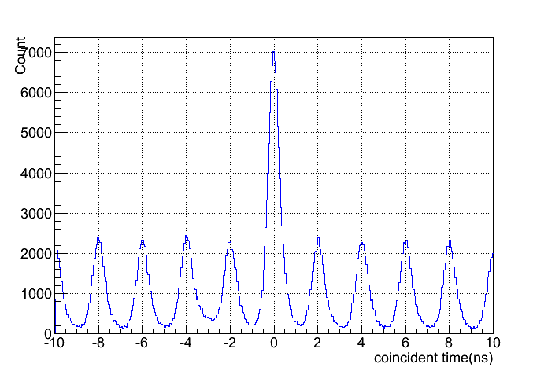
Coincident Events Selection
Real events
Coincident Time:
The correlation of HKS target time and HES target time, give us the coincident spectrum:
Accidental
abs( coincident time)<=1
Path-length correction has done

Slide 15
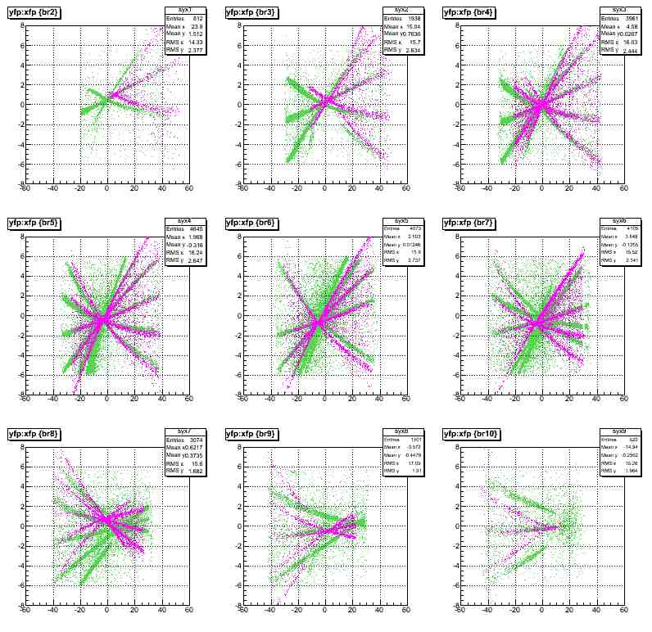
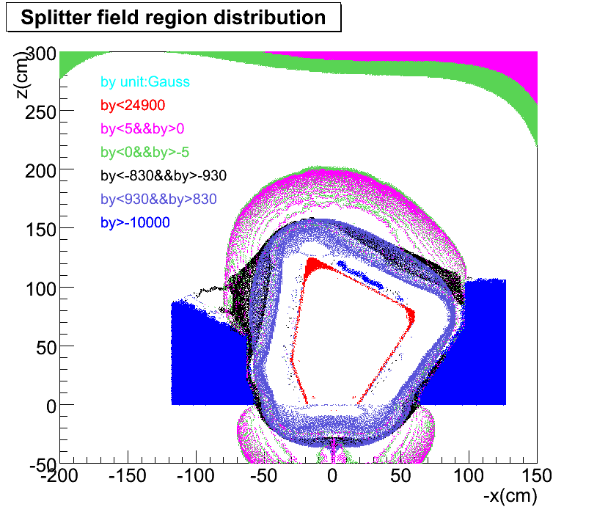
Forward Optics Tuning
Beam
Kaon
Q2
Q1
Target
Purple: Real HKS SS data Blue: Geant4 Simulation
Splitter field contour on xoz plane
The leakage of splitter fringe field causes the cross talk between the splitter and quadrupole

Slide 16
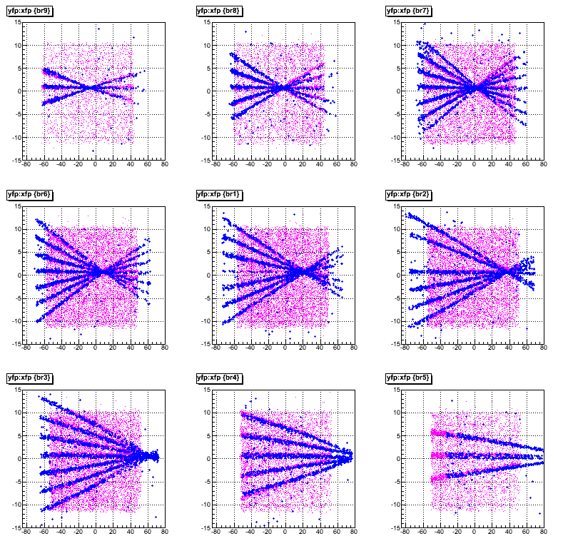
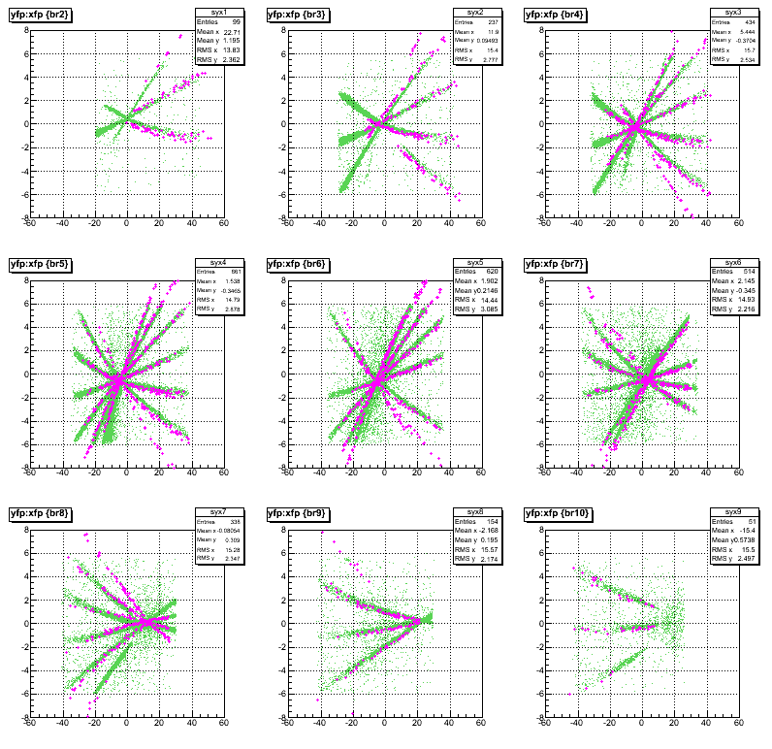
Forward Optics Tuning
The asymmetry functions are introduced and tuned for HKS&HES quadrupole field Bx and By, independently.

Slide 17
Spectrometer System Calibration
$\left({x^{′} \atop \begin{aligned}y′ \\ δ\end{aligned}}\right)$=M$\left({xf \atop \begin{aligned}{xf}^{′} \\ yf \\ {yf}^{′}\end{aligned}}\right)$
$$p=p0(1+δ/100)$$
Kinematics calibration
(ΔE_{beam0} , Δ P_{K},Δ_{Pe’})
Optical calibration
M

Slide 18
Spectrometer System Calibration -Minimize $χ2$-
Kinematics calibration: utilizing well known masses of Λ, Σ⁰ produced from CH₂ , ¹²_{Λ}Bgs from ¹²C to determine binding energy to a level of precision ~100keV
$$χ_{1}^{2}=ω_{Λ}{(m_{Λ}^{fit}−m_{Λ}^{0})}/{{σ_{Λ}}^{2}+}ω_{Σ}{(m_{Σ}^{fit}−m_{Σ}^{0})}/{{σ_{Σ}}^{2}}$$
$$χ_{2}^{2}=ω_{Λ}{(σ_{Λ}^{fit})}/{{{<σ}_{Λ}>}^{2}+}ω_{Σ}{(σ_{Σ}^{fit})}/{<{σ_{Σ}>}^{2}+ω_{gs}{(σ_{gs}^{fit})}/{<{σ_{gs}>}^{2}}}$$
Optical calibration: Minimize Chisquare w.r.t reconstruction matrix M by an Nonlinear Least Square method.
Mgs: fitted mean
M_{Λ} &M_{Σ} : theoretical data
ω_{i} : statistic weigth

Slide 19
Preliminary Results
Start Point
Current Status

Slide 20
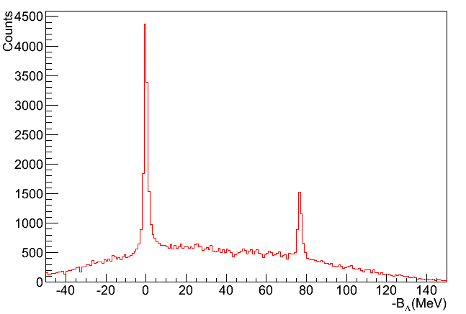
Preliminary Results
Preliminary
Preliminary
Resolution : ~1.7MeV (FWHM) for $Λ$.

Slide 21
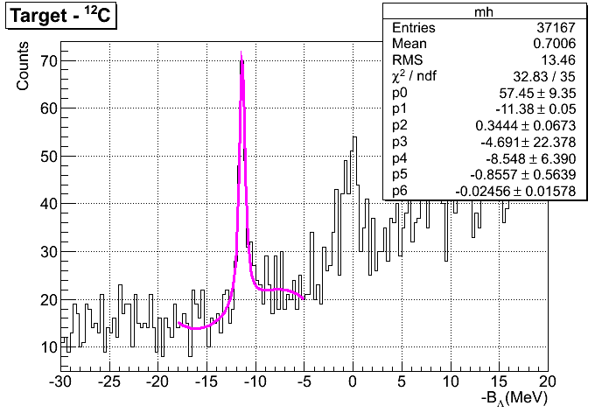
Preliminary Results
⁷Li(e,e'K+)⁷_{Λ}He
¹²C(e,e'K+)¹²_{Λ}B
Preliminary
Preliminary
Resolution : ~850 keV (FWHM) for g.s.
Resolution : ~700 keV (FWHM) for g.s

Slide 22
Thank you for your attention!

Slide 23
BACK UP

Slide 24
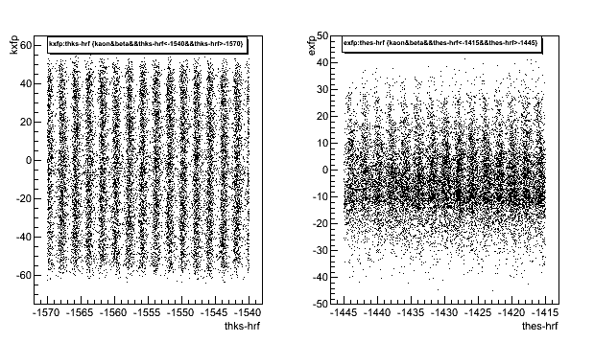
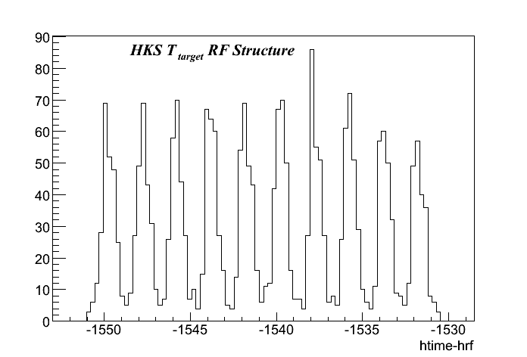
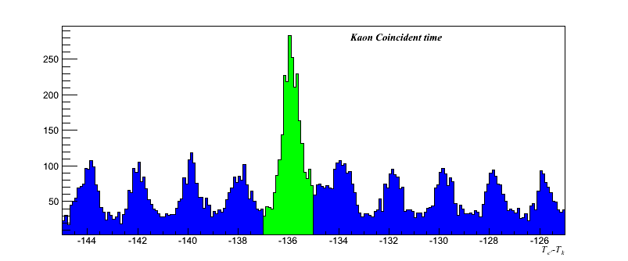
Coincident
Electron pulse
RF Structure:
Jlab electron beam has a 2ns pulse pattern.
After path length correction, we have the structure of HKS target time:
2 ns
t
2ns
RF vs HKS X
RF vs HES X
After Path length correction
Coincident Time:
The correlation of HKS target time and HES target time, give us the coincident spectrum:
Real Events
Accidental

