Slide 1
ÖZGÜR ATES HAMPTON UNIVERSITY 4 September 2012-Hampton University Group Meeting
OLYMPUS GEM LUMINOSITY MONITORS
And
Status of the OLYMPUS Experiment

Slide 2
CONTENTS
Two Photon Exchange in Elastic ep Scattering
Principle of OLYMPUS Experiment
Control of Systematics
Triple-GEM Telescope Construction at Hampton U
Testing at DESY Test Beam Facility 22
Installation and Running at DORIS
4 September 2012-Hampton University Group Meeting

Slide 3
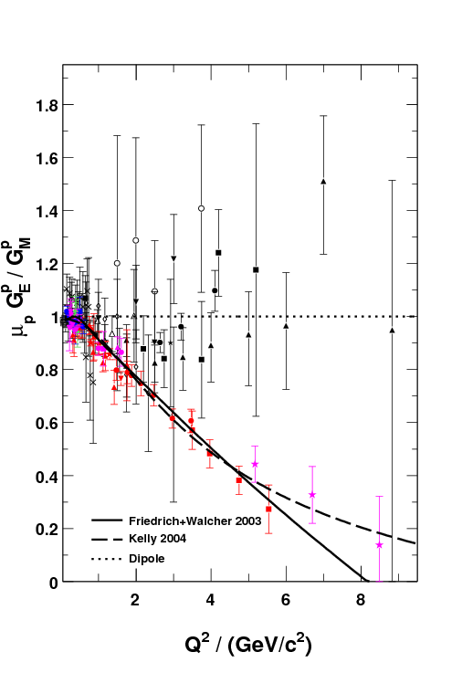
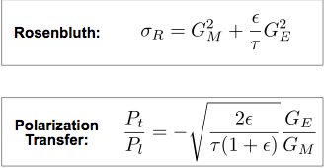
Proton Form Factor Ratio
All Rosenbluth data from SLAC and Jlab in agreement
Dramatic discrepancy between Rosenbluth and recoil polarization technique
Multi-photon exchange considered the best candidate to explain the dramatic discrepancy.
Dramatic Discrepancy!
Notes:
3

Slide 4
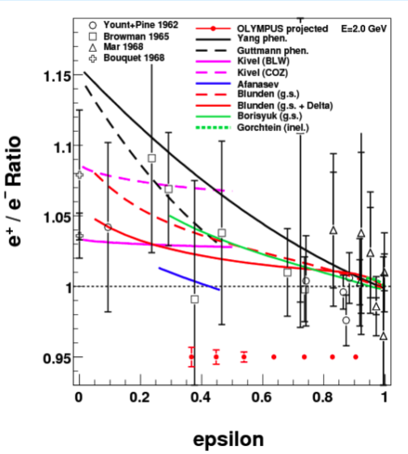
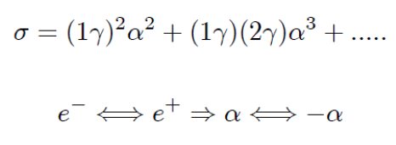
Elastic e⁺-p /e⁻-p Ratio ‏
Two-photon exchange theoretically suggested :
Interference of one- and two-photon amplitudes
→ Measure ratio of positron-proton to electron-proton unpolarized elastic scattering to 1% Precision!! in stat.+sys.

Slide 5
Electrons/positrons (100mA) in multi-GeV storage ring DORIS at DESY, Hamburg, Germany
Unpolarized internal hydrogen target (buffer system)
Large acceptance detector for e-p in coincidence Previous BLAST detector from MIT-Bates

Slide 8
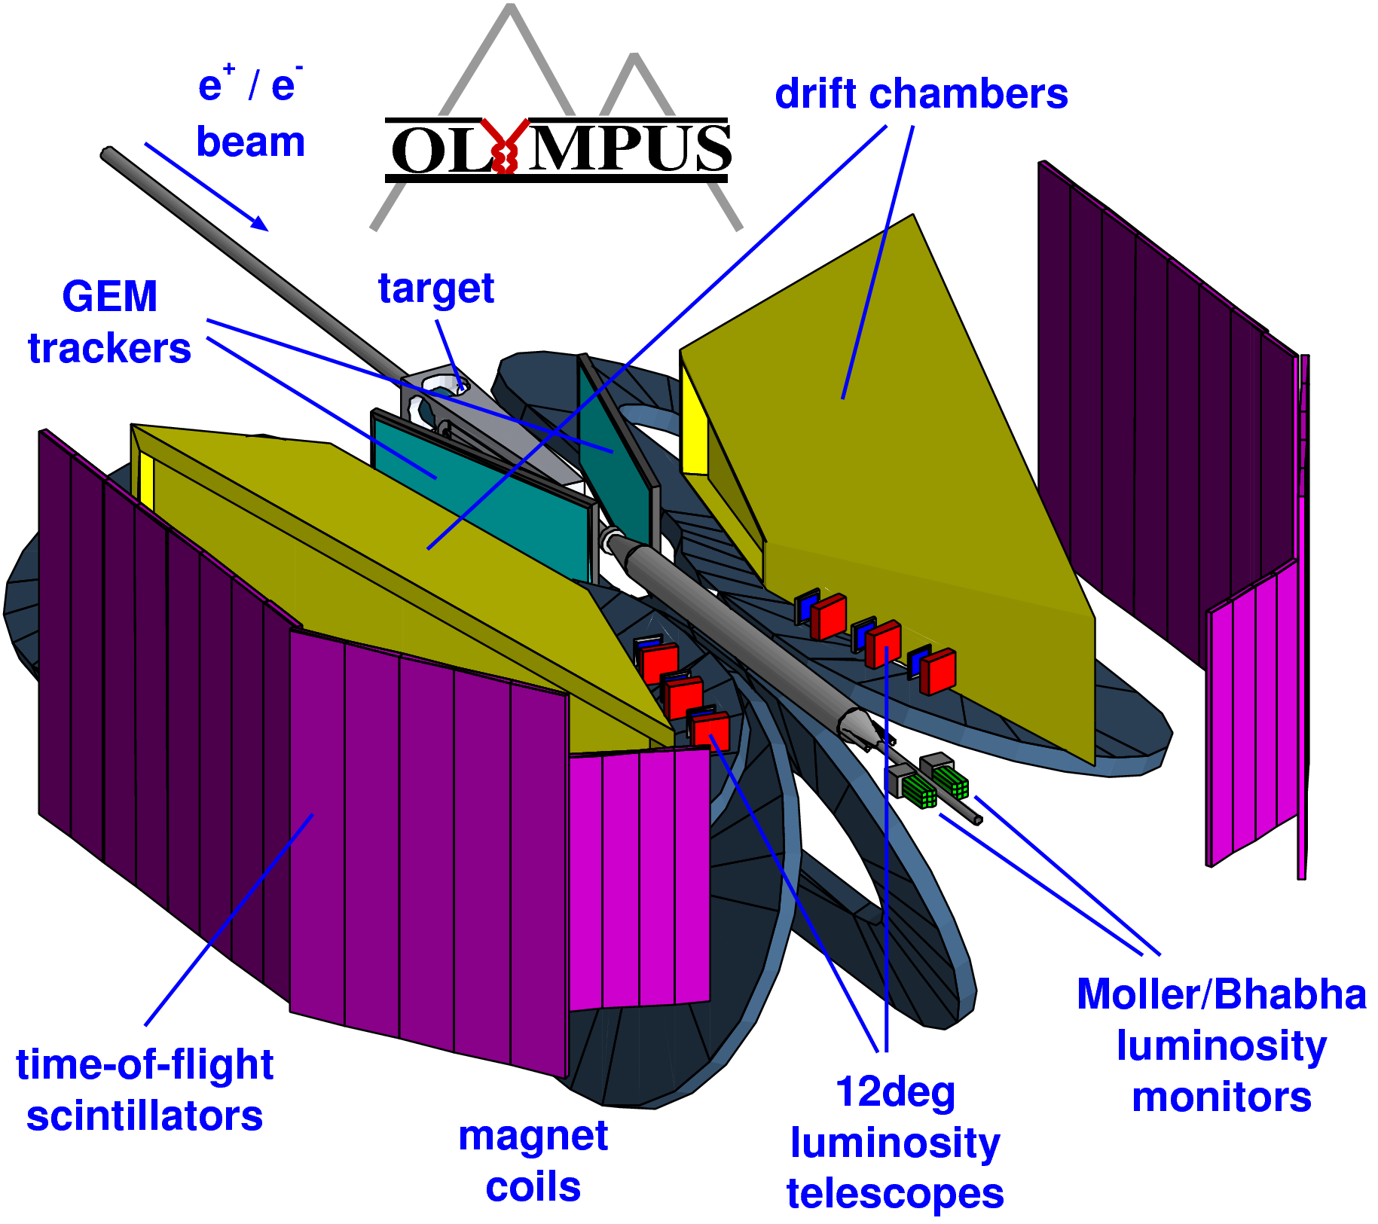
The OLYMPUS Detector

Slide 19
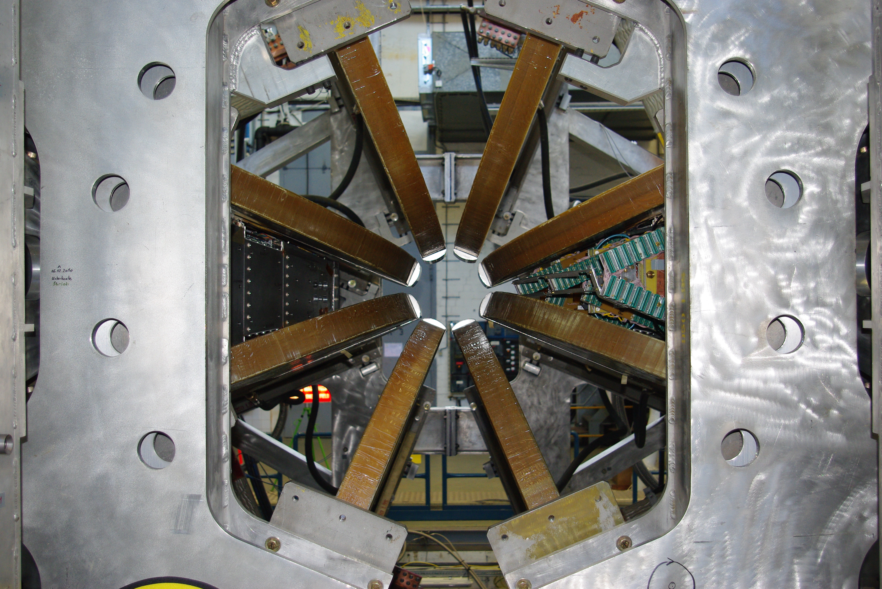
Left arm installed (July 5, 2011)

Slide 20
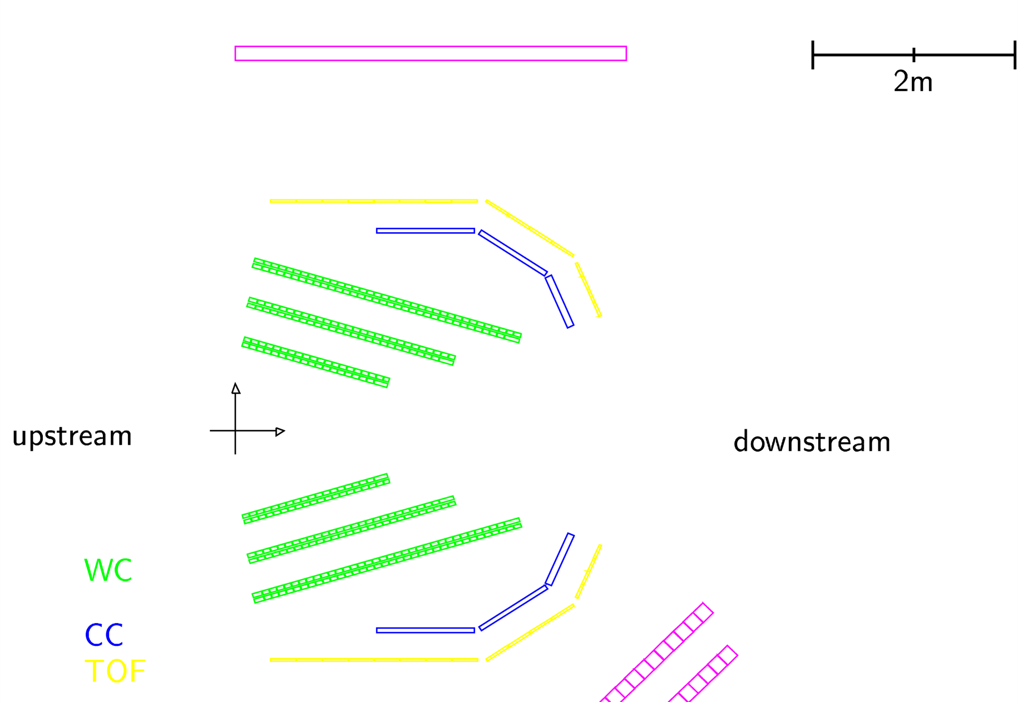
GEM LUMINOSITY MONITORS
“Luminosity monitors for LEPTON in coincidence with Recoil PROTON detected in the opposite sector, and vice versa”
2 tGEM telescopes, 1.2msr, 12º,
R=187/237/287cm, dR=50cm, 3 tracking planes
Forward telescopes
PROTON
LEPTON
12º
LEPTON
PROTON
TOF

Slide 21
Control of Systematics
Triple Super Ratio:
Run the Exp. For the “4 different states”
i= e⁻ vs e⁺ j=toroidal magnet polarity(+-)
Repeat cycle many times
Ratio of counts
Ratio of luminosities
Ratio of acceptances
(phase space integrals)
Forward-angle (high-epsilon, low-Q) elastic scattering (s_{e+} = s_{e-}) means there is no two-photon exchange
Separately determine three super ratios
Left-right symmetry = Redundancy

Slide 22
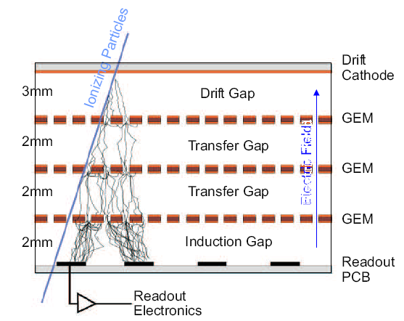
How does a GEM Detector work?
GEM = Gas Electron Multiplier introduced by F. Sauli in mid 90’s, F. Sauli et al., NIMA 386 (1997) 531
High Rate Capability
Good spatial and angular resolution

Slide 24
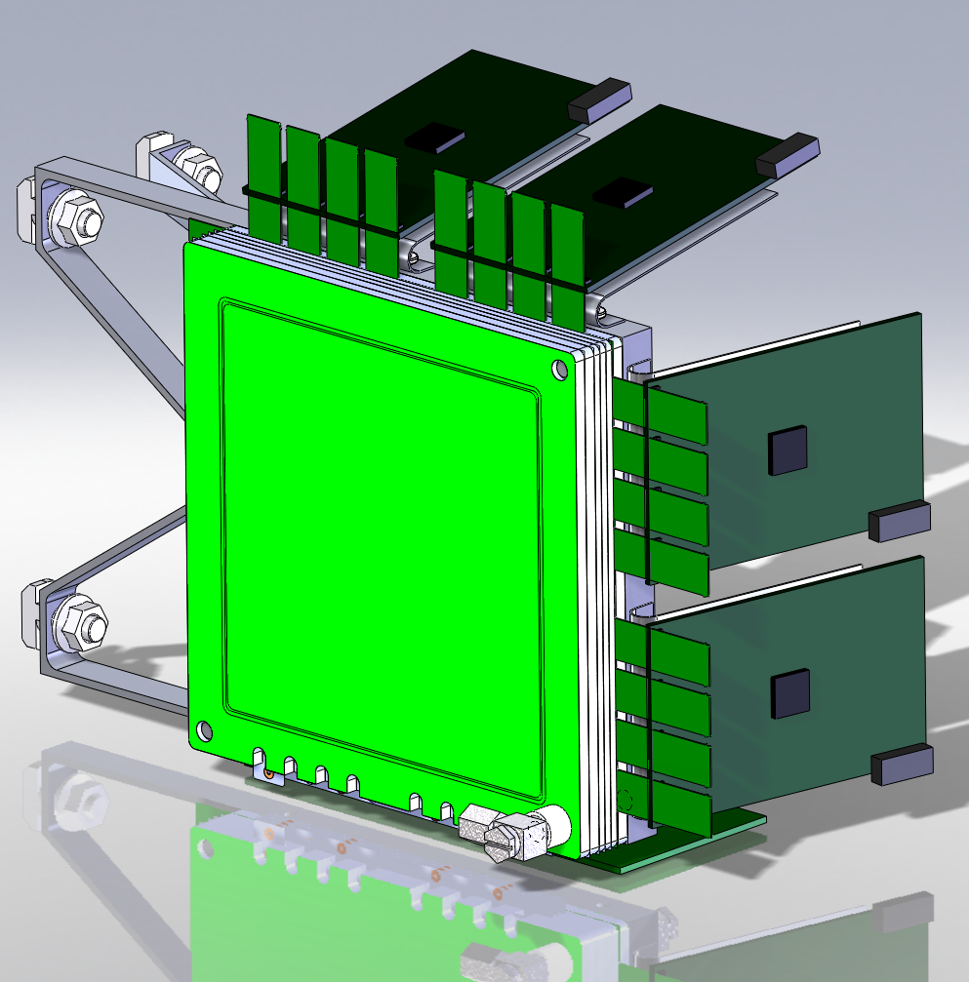
Manufacturing The GEMs at HU-GEM LAB in 2010-2011

Slide 25
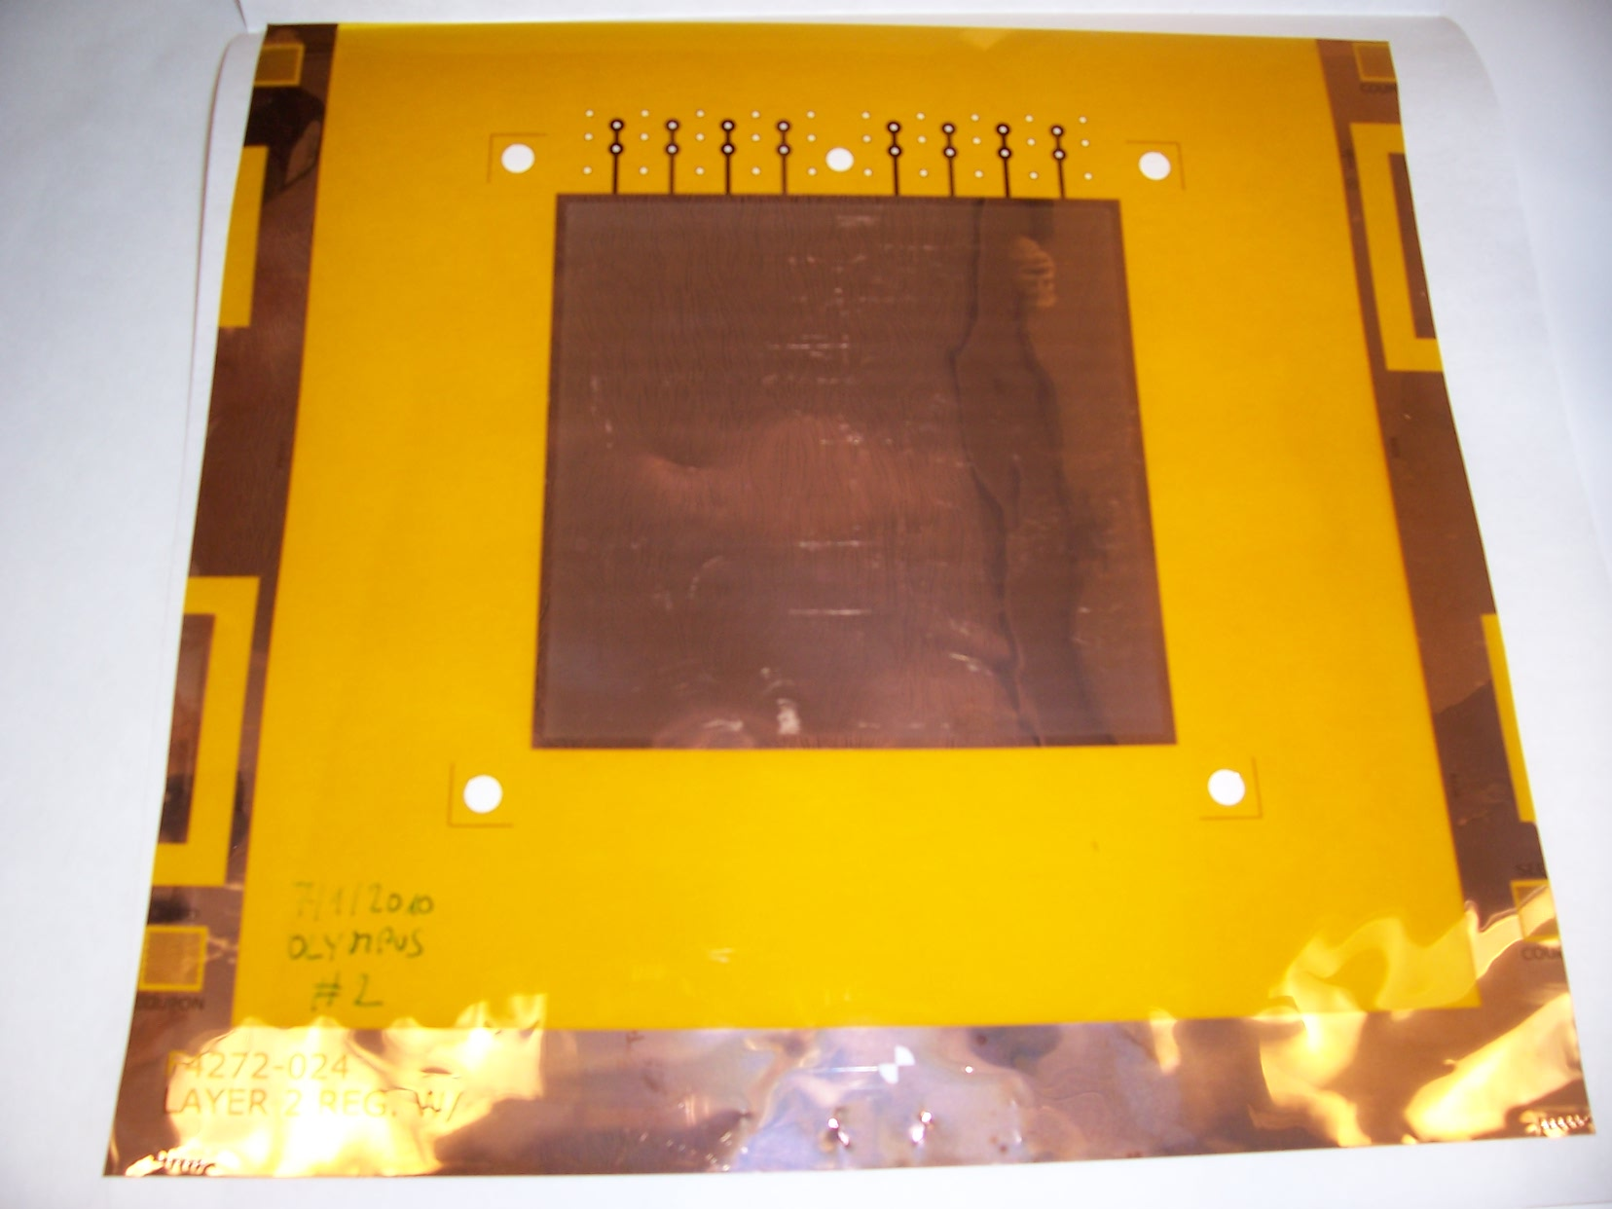
An uncut, raw OLYMPUS GEM foil from Tech-Etch Co

Slide 26
We handled them with care in the Clean Room

Slide 27
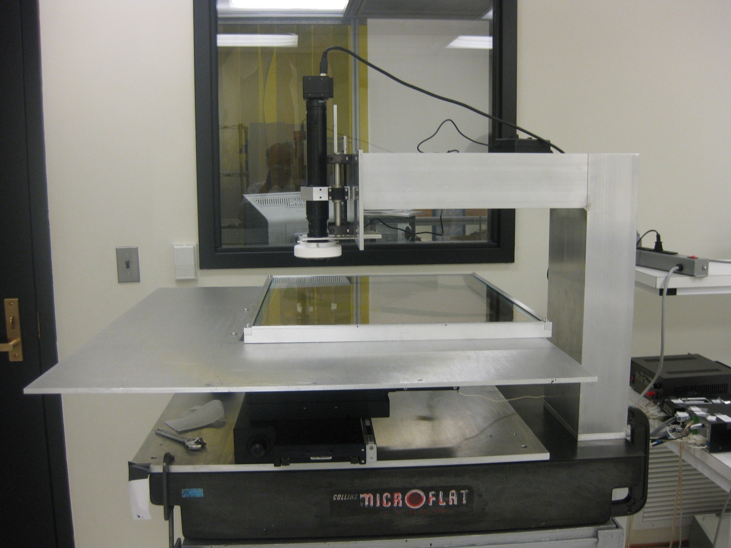
Optical inspection by using CCD Camera at MIT

Slide 29
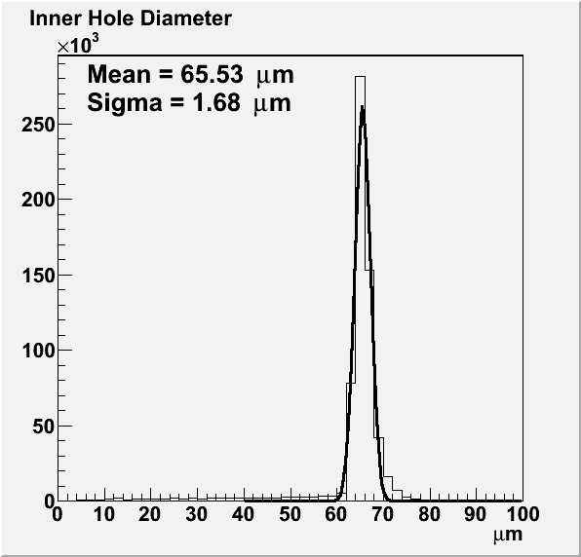
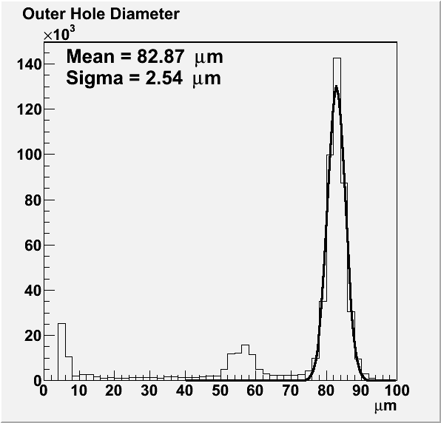
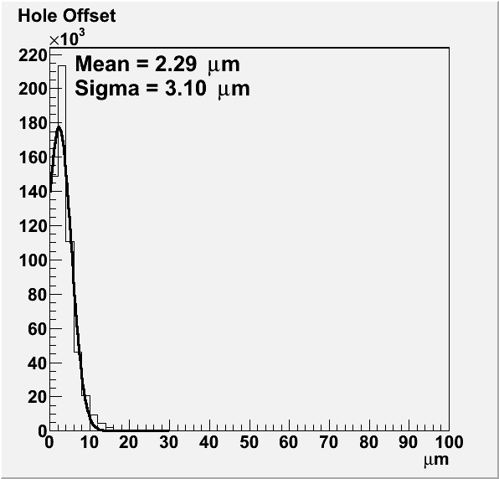
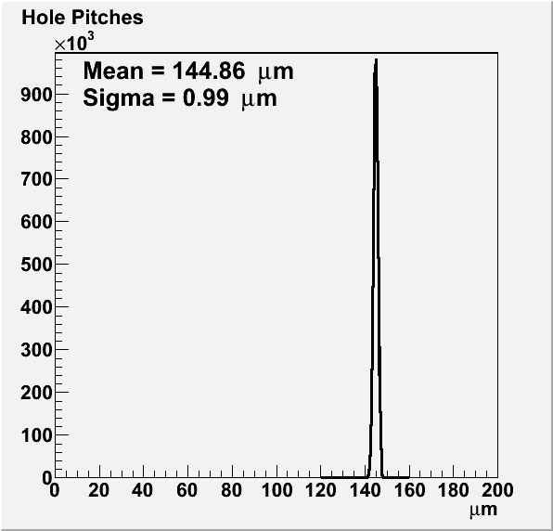
2ND Batch Foil #8

Slide 30
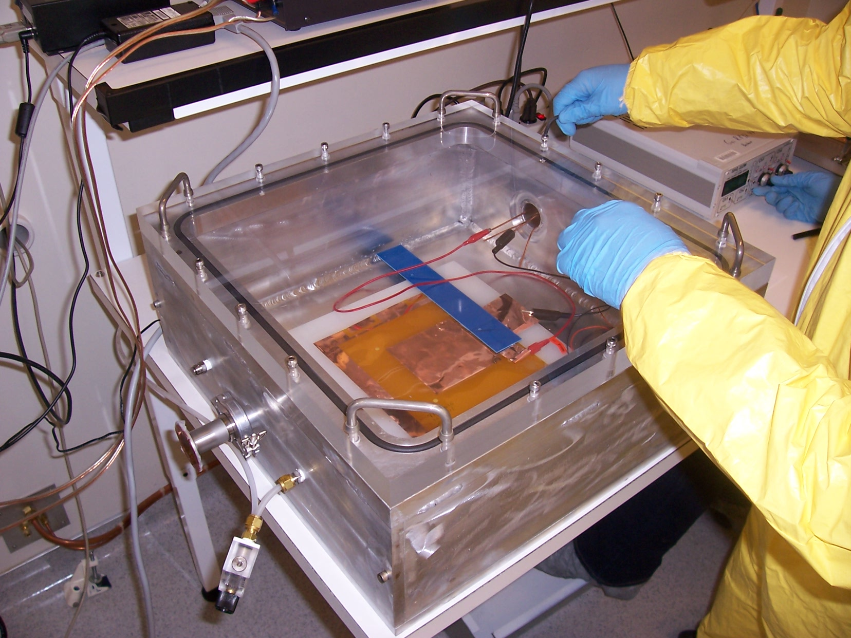
Initial HV testing at MIT

Slide 31
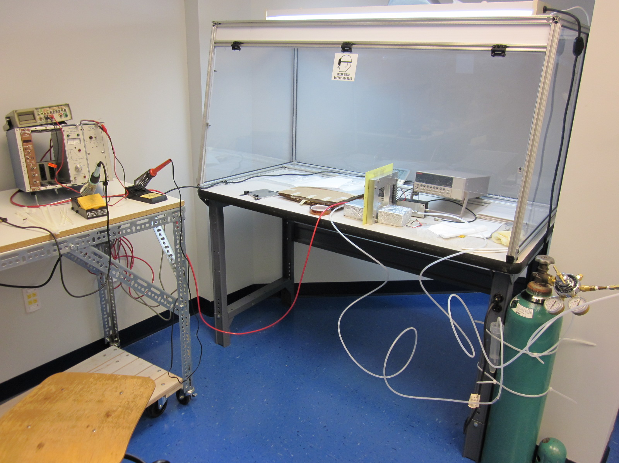
GEM Lab at HU

Slide 32
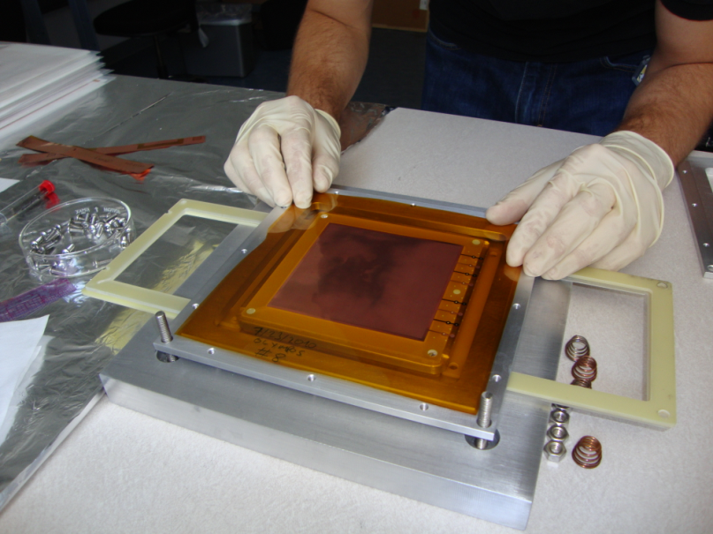
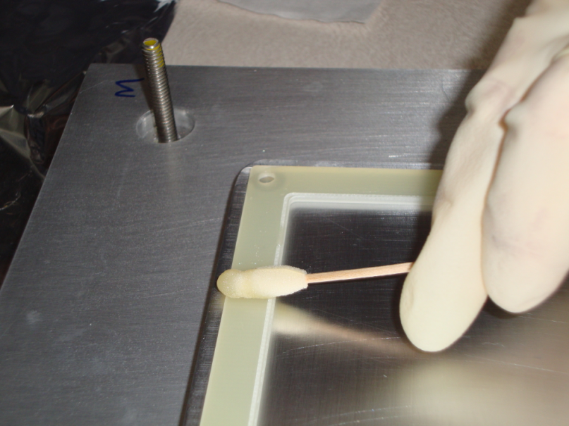
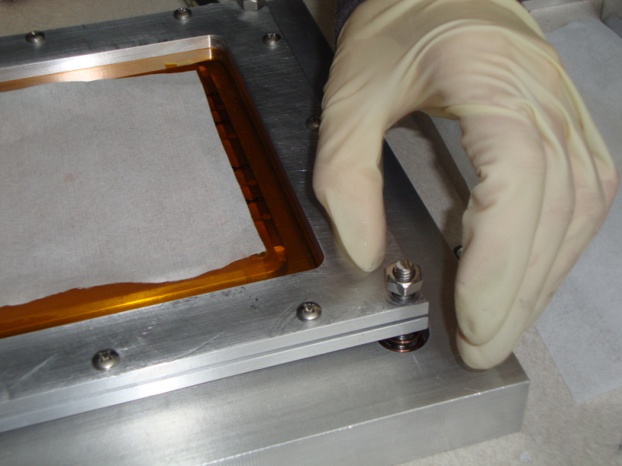
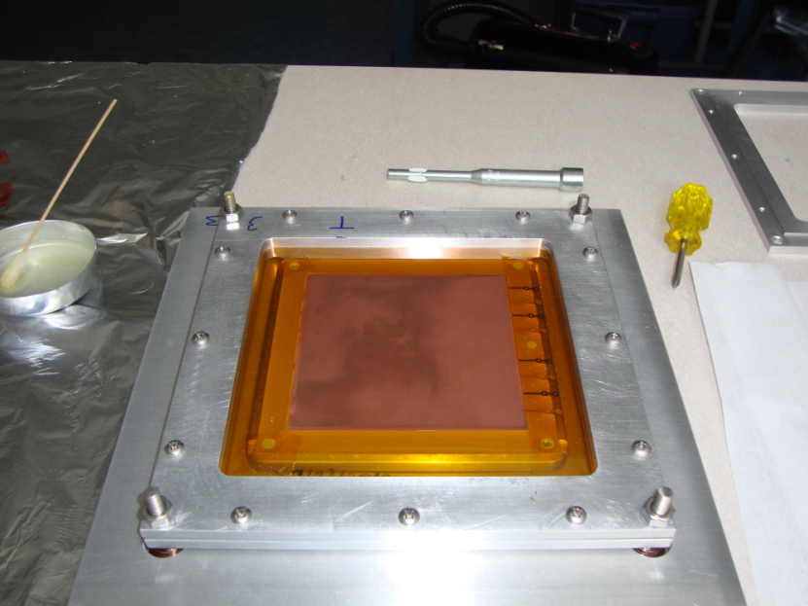
Stretching and gluing of GEM foils at HU

Slide 33
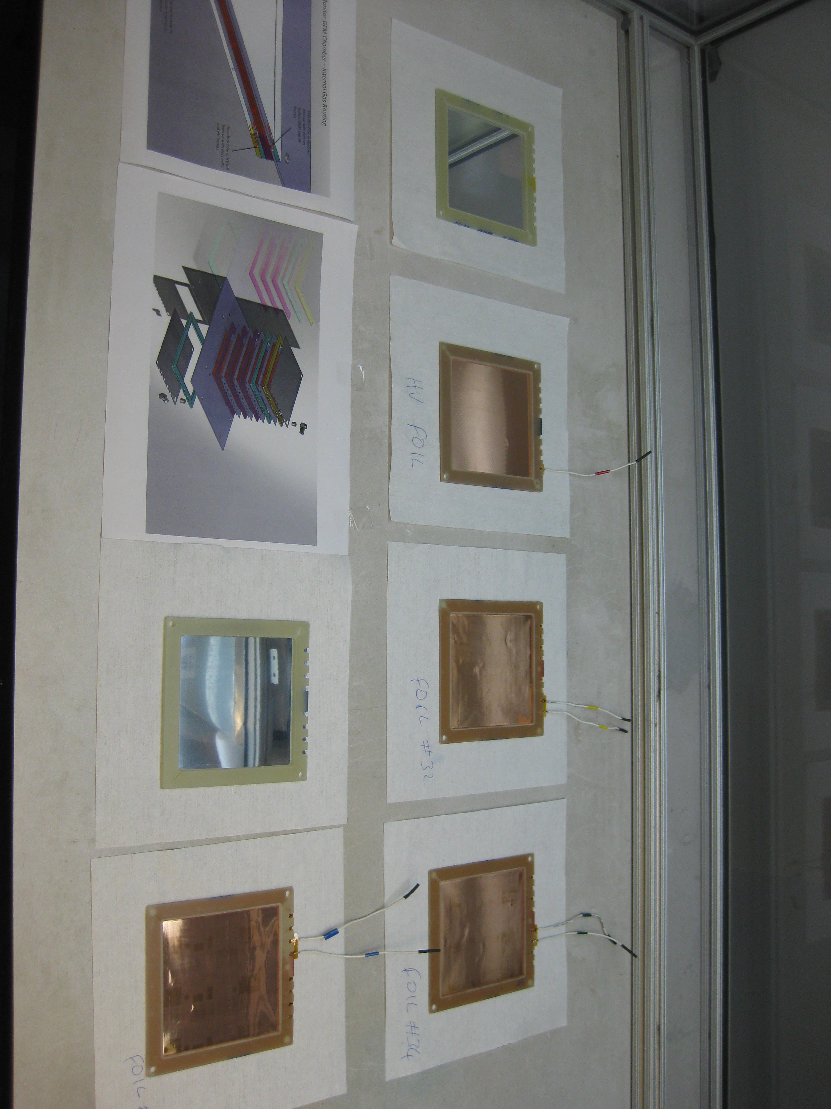
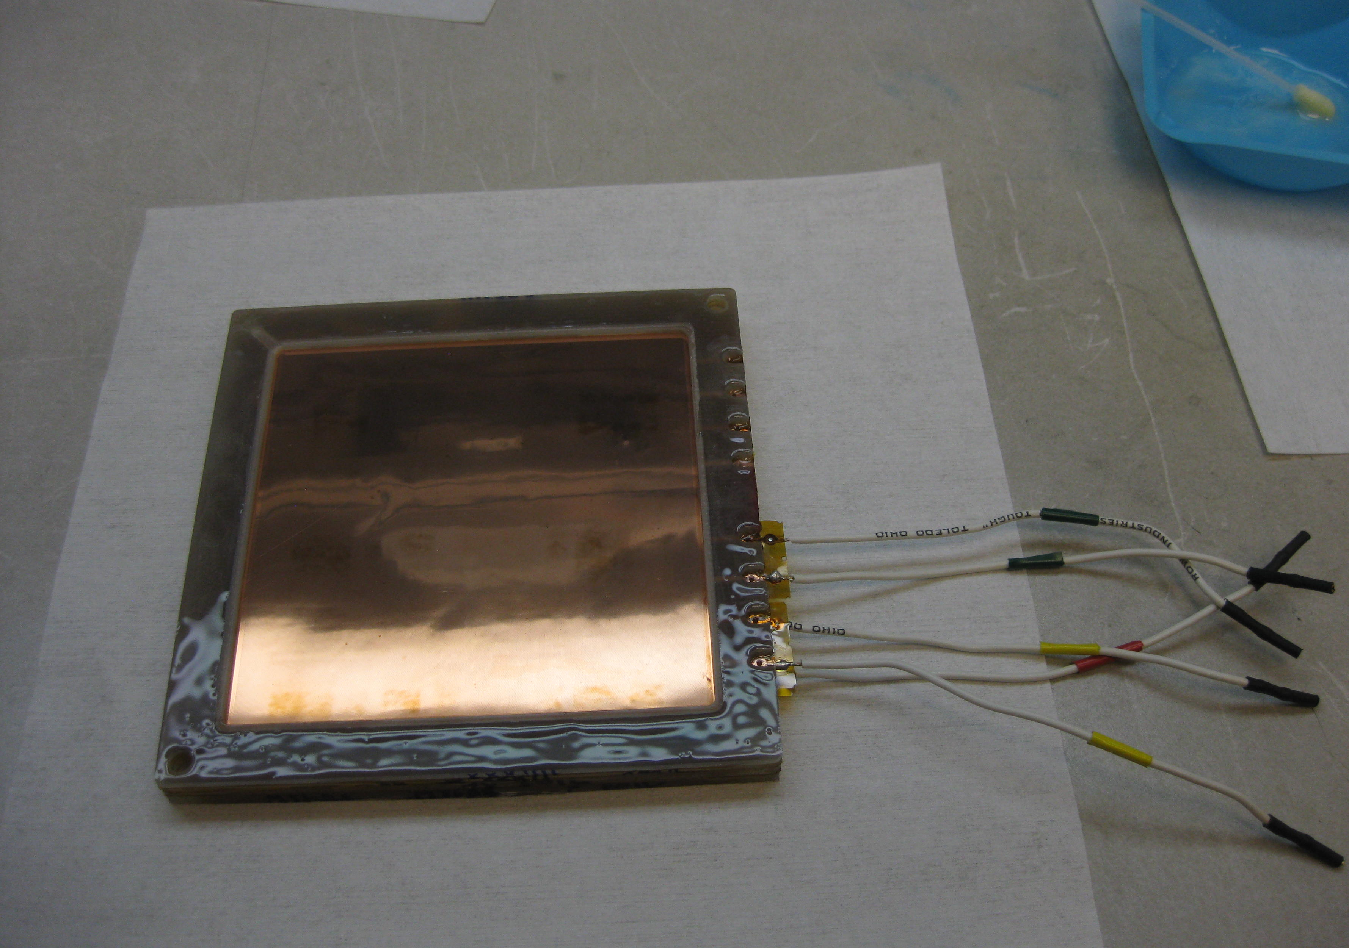
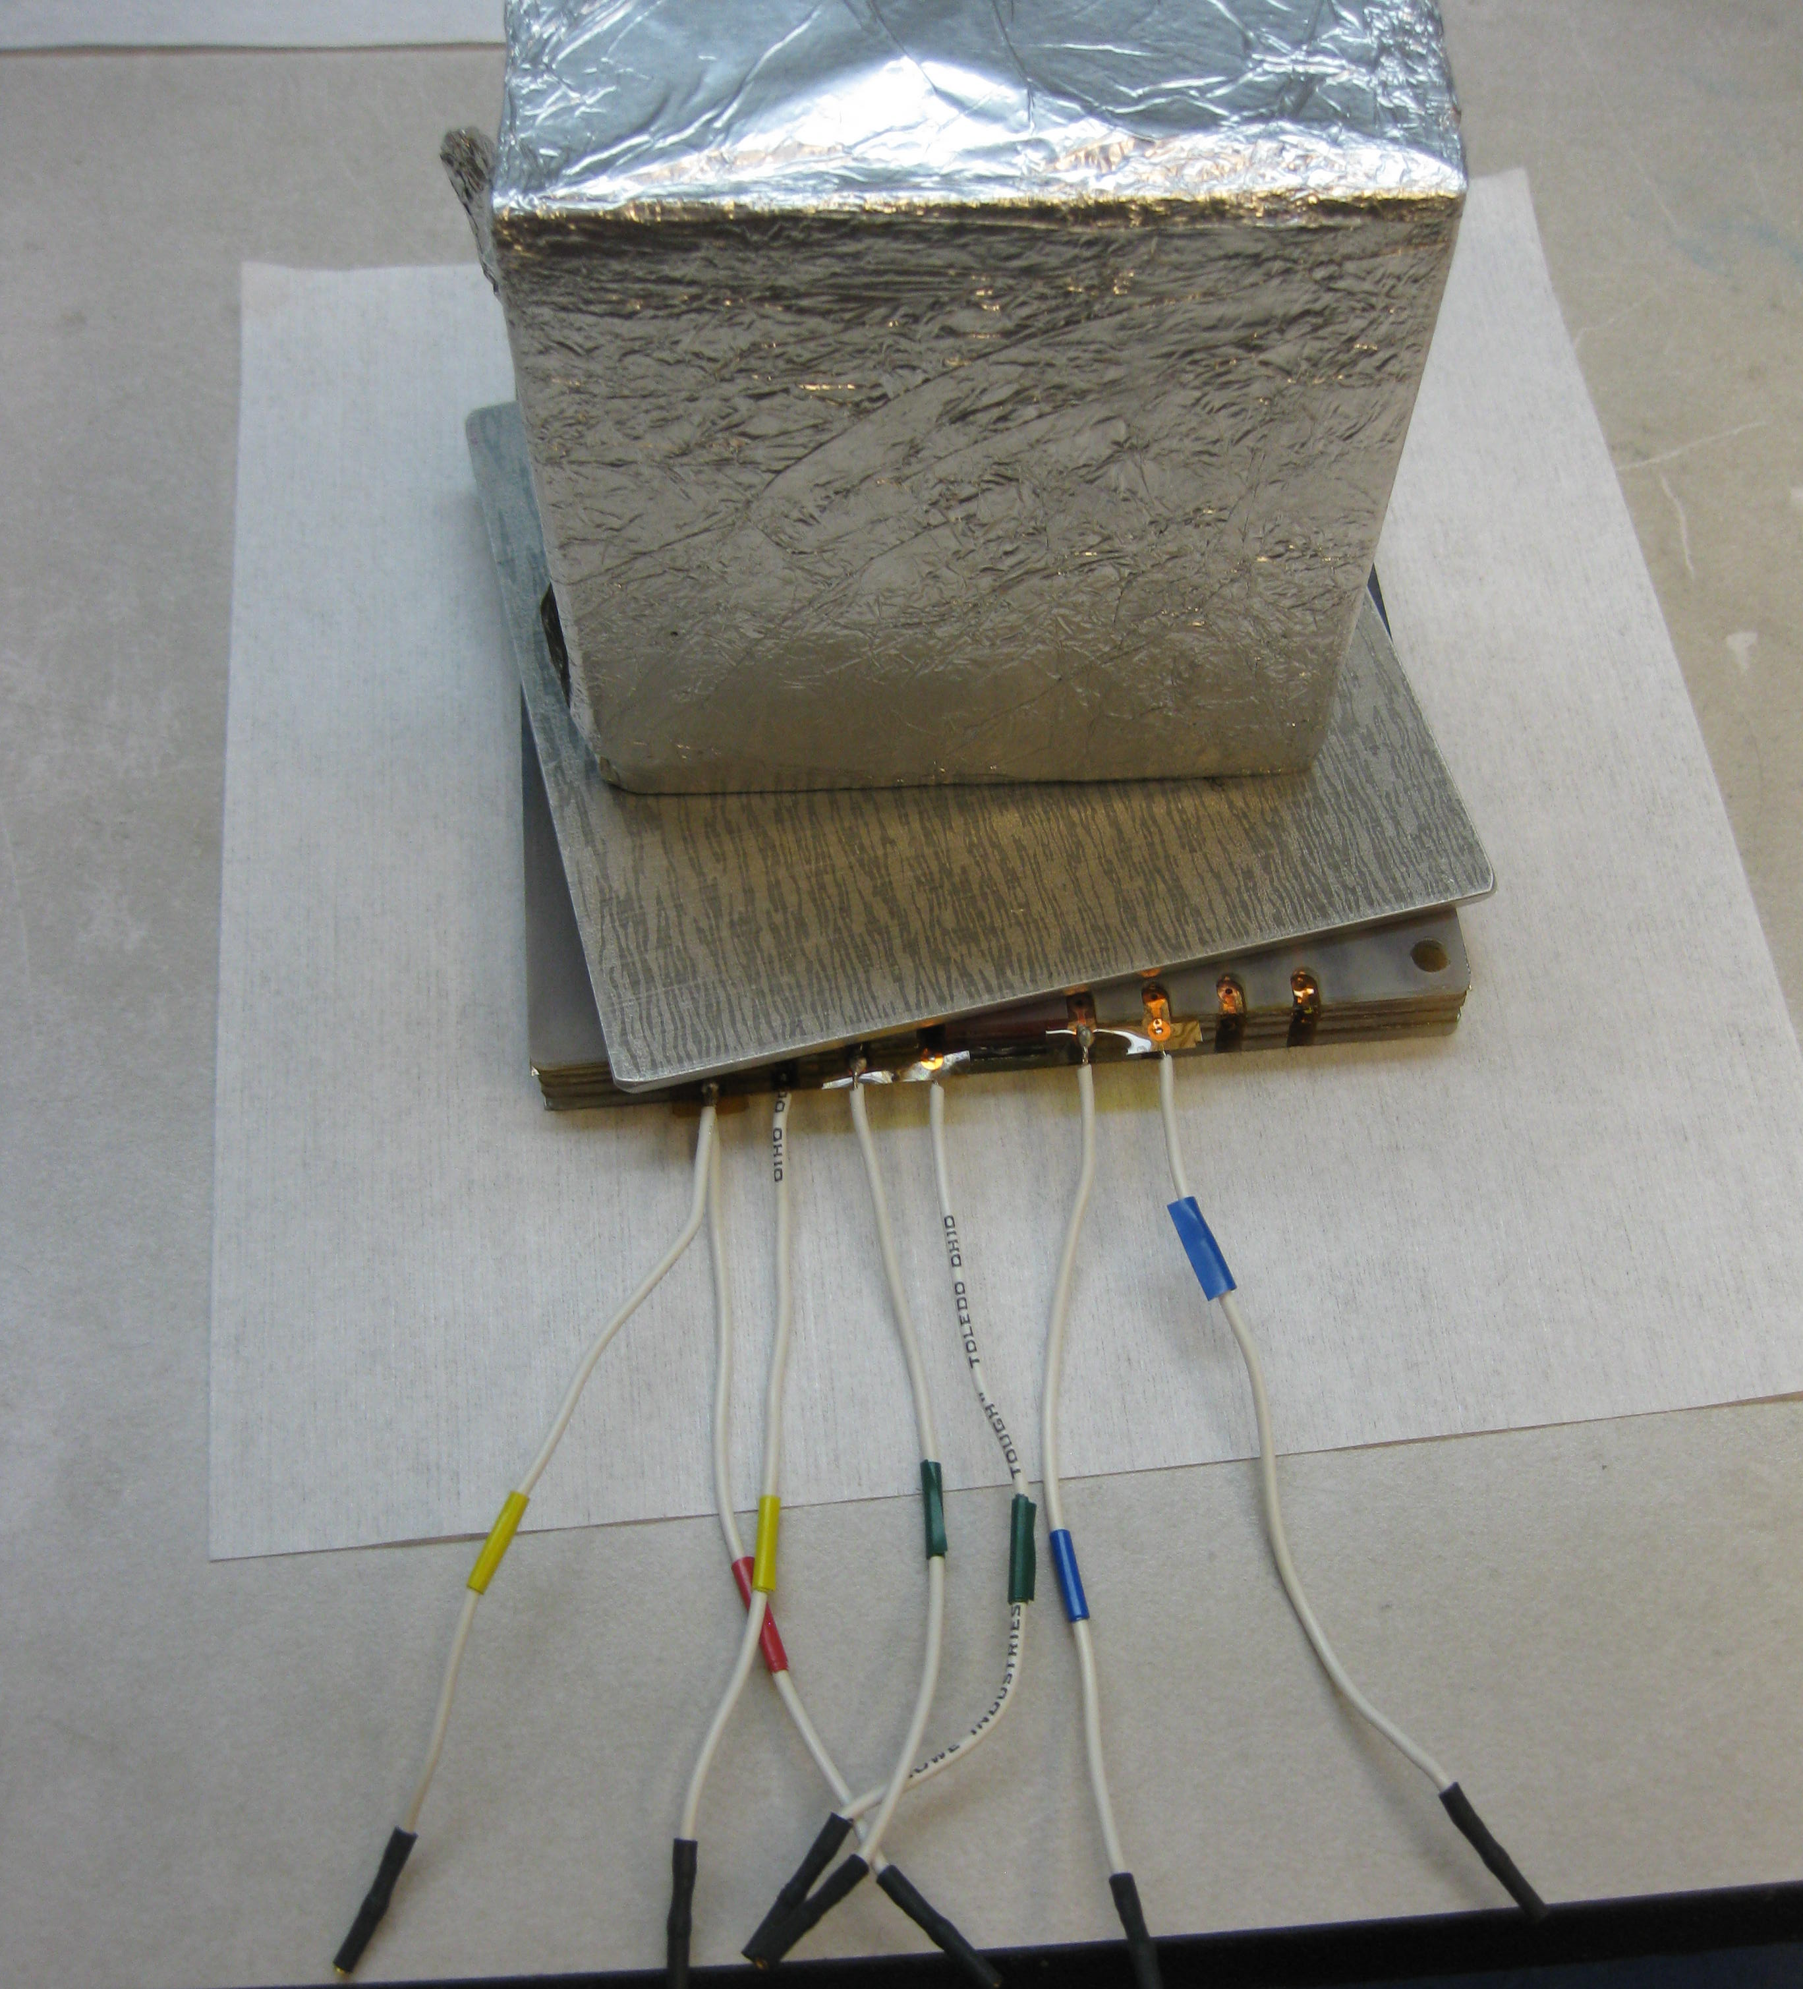
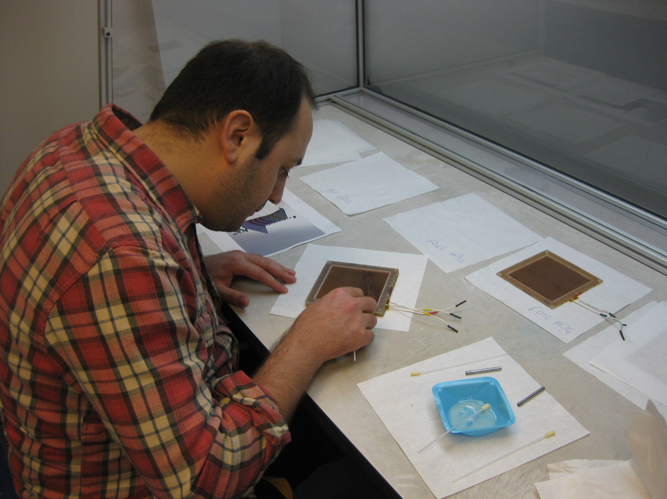
Gluing of The First Stack
January 19, 2011

Slide 34
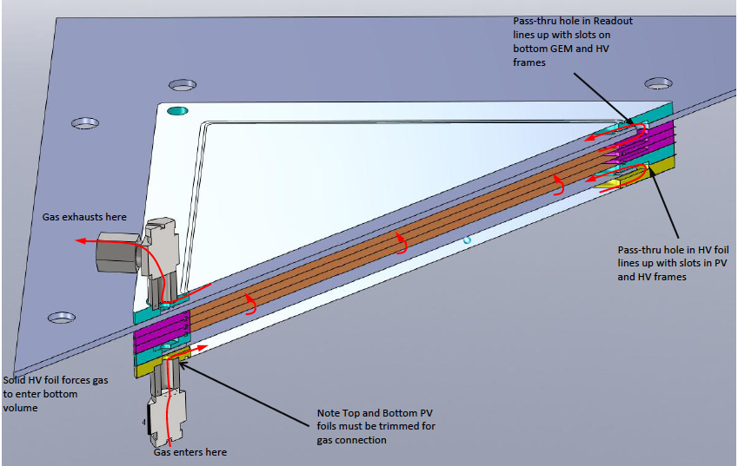
Schematic View of a Triple GEM

Slide 35
GEMs at DESY Test Beam Facility 22

Slide 36
GEMs tested at Testbeam@22
GEM telescope with APV readout
COLLIMATOR
←130cm→
←42cm→
←33cm→
←507.7cm→
BEAMSPOTS: 2 GeV Electrons, Triggered Plastic Scint. Finger 4

Slide 37
GEMs tested at Testbeam@22
GEM telescope with APV readout
COLLIMATOR
←130cm→
←42cm→
←33cm→
←507.7cm→
BEAMSPOTS: 2 GeV Electrons, Triggered Plastic Scint. Finger 4

Slide 38
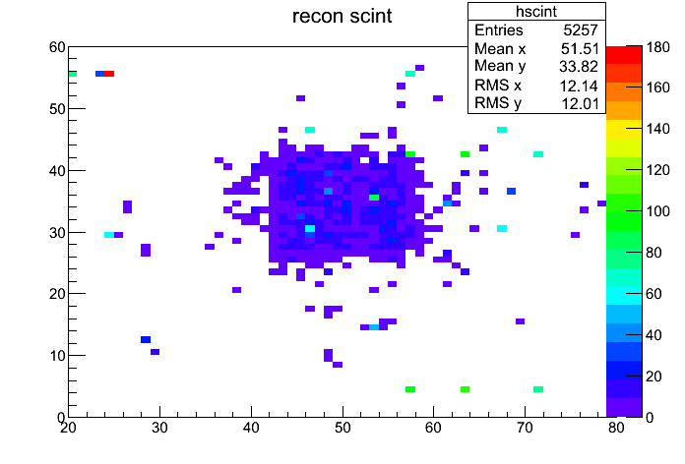
Testbeam@22 Data Results
mm
mm
←130cm→
←42cm→
←33cm→
←507.7cm→
mm
mm
BEAMSPOTS: 2GeV Electrons, Triggered Plastic Scint. Finger 4

Slide 39
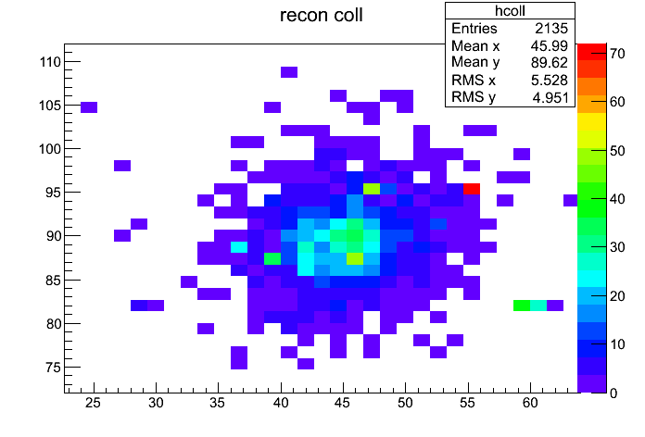
Testbeam@22 Data Results
mm
COLLIMATOR
←130cm→
←42cm→
←33cm→
←507.7cm→
mm
mm
BEAMSPOTS: 2GeV Electrons, Triggered Plastic Scint. Finger 4

Slide 40
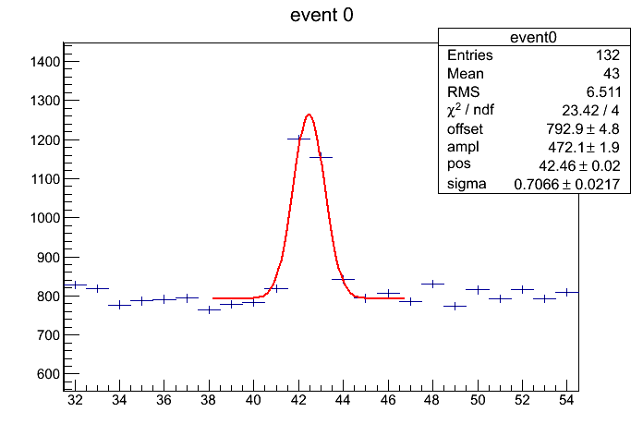
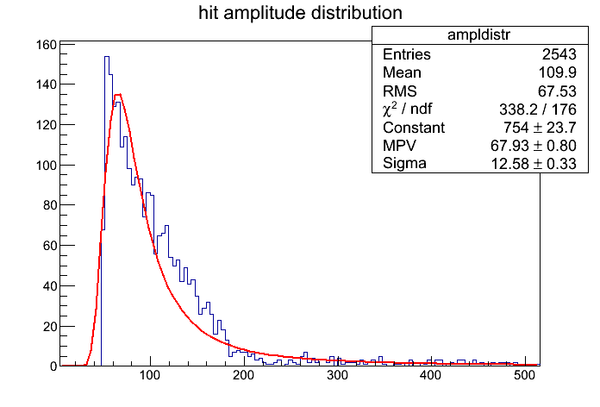
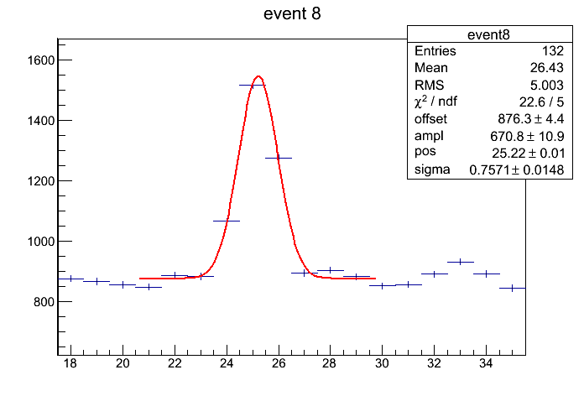
Testbeam@22 Data Results: Summed up all Charge Ampl.
Histogram All Amplitudes
ADC
Landau Distribution
channels

Slide 41
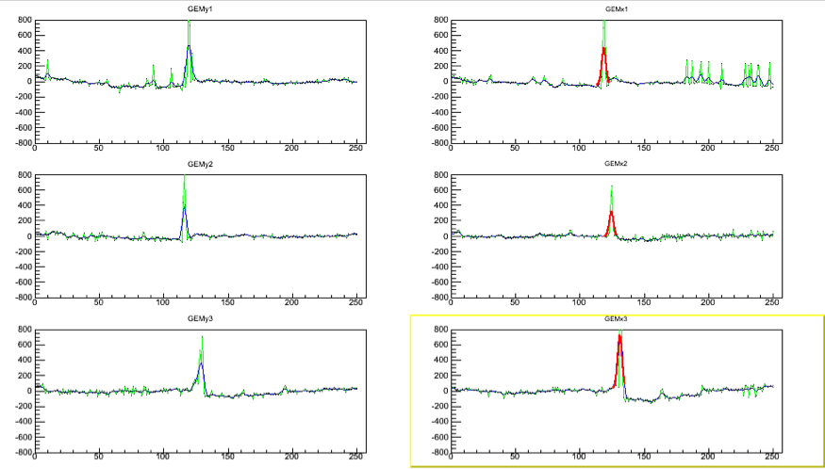
Testbeam@22: Track Candidates from GEM Elements
ADC
DS Yaxis
DS Xaxis
channels
MI Yaxis
MI Xaxis
US Yaxis
US Xaxis

Slide 42
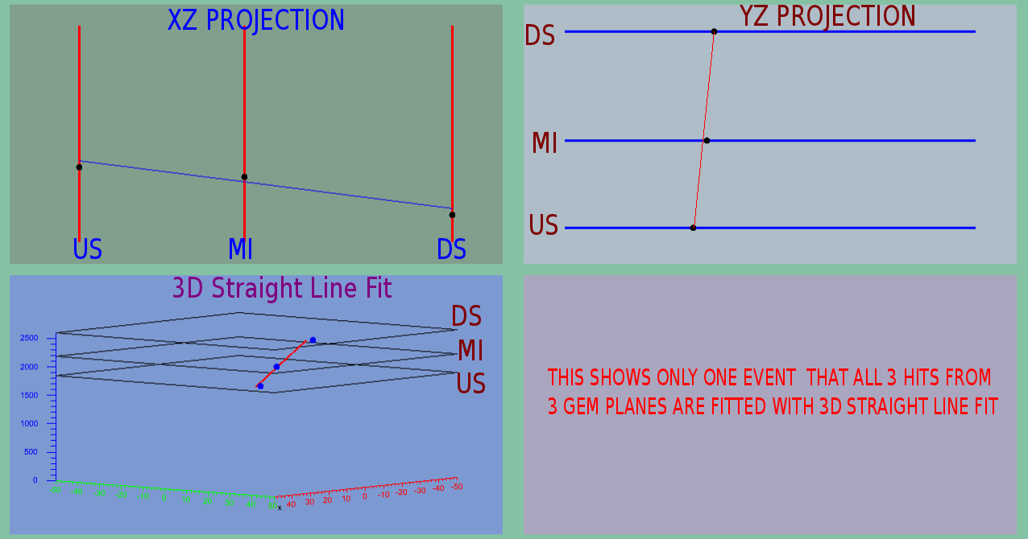
Doris Feb Run: Straight Line Fits in Event Viewer

Slide 43
DORIS Feb Run: 2D Charge Sharing of Readout Strips

Slide 44
DORIS Feb Run: Resolutions of GEM Elements

Slide 45
DORIS Feb Run: 2D Efficiency Maps of GEM Elements

Slide 46
Doris Feb Run: OLYMPUS Track Fitter (Curved Tracks)
angle
MeV
mm
mm

