Slide 1
The Muon Neutrino Quasi-Elastic Cross Section Measurement on Plastic Scintillator
Tammy Walton
December 4, 2013
Hampton University Physics Group Meeting

Slide 2
Outline
Introduction
Detector
Analysis
Preliminary Results
  Will not go into the details of the systematics.
  Therefore will show statistical errors only.

Slide 3
Why Main INjector ExpeRiment ν-A ?
Neutrino Physics
  Enter an era of precision neutrino oscillation experiments.
    One of the goals is to measure the Dirac CP phase violating factor.
    Currently neutrino cross section measurements have large uncertainties. MINERvA will help reduced the systematics on the cross sections.
Nuclear Physics
  Neutrinos interact via the weak nuclear force.
    Sensitive to the axial structure of the nucleon. The axial structure is related to the spin of the nucleon.
  Measure the A-dependence of the cross sections.

Slide 4
What Neutrino Interactions Do MINERvA Measured?
Everything!!!

Slide 5
What Neutrino Interactions Do MINERvA Measured?
Today’s focus will be on the quasi-elastic “like” cross section.
What is Quasi-Elastic Like (QE-like)?
But first, let’s look at the Quasi-Elastic.

Slide 6
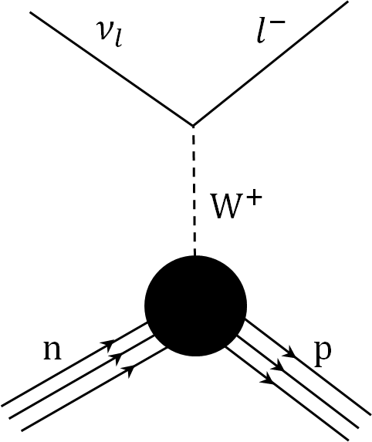


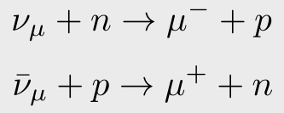
Neutrino Quasi-Elastic Scattering
Note: this is the primary neutrino interaction channel for neutrino oscillation experiments.
Reconstructed kinematics from lepton arm only for both the antineutrino and neutrino scattering.
Only for the neutrino scattering can kinematics be reconstructed from the proton.
Assume nucleon is at rest for kinematic reconstruction.

Slide 7


Neutrino Quasi-Elastic Scattering
The weak interaction is a parity violating theorem.
The neutrino quasi-elastic cross section is sensitive to the axial form factor.
For the free nucleon, the quasi-elastic cross section depends on a pseudoscalar form factor that is proportionally to the axial from factor. ( cross section also depends on the electric and magnetic form factors as well )
The axial form factor is parameterized as a dipole.
Measured from nuclear beta decay.
The parameter which neutrino experiments have extracted.

Slide 8
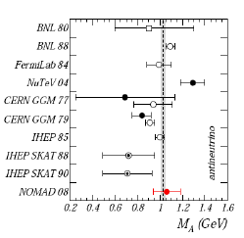

Neutrino Quasi-Elastic Scattering
The axial Mass has been measured by many different neutrino experiments, mainly the bubble chamber experiments ( filled with Deuterium ).
World average as of 2002 was M_{A} = 1.026 ± 0.021 GeV
Remember, today that most neutrino experiments are composed of heavier nuclei, Carbon, Iron, etc.

Slide 9
Neutrino Quasi-Elastic Scattering on Carbon Based Detectors
MiniBooNE
NOMAD
What Gives?
MiniBoonNE prefers a higher value of the axial mass at low neutrino energy.
NOMAD at higher values of the neutrino energy is consistent with the data on deuterium.

Slide 10
MINERvA’s First QE Results
anti-neutrinos
neutrinos
The Short Conclusions: The data prefers the Transverse Enhancement Model convoluted with the Relativistic Fermi Gas Model with an axial mass of 0.99.
TEM is an empirical models which modifies the magnetic form factors to reproduce an enhancement in the transverse QE cross-section.

Slide 11
MINERvA recently published QE results confirming explanations of the discrepancy between MiniBooNE and NOMAD data.
What’s the significance of my analysis?
First, let’s remind ourselves of the MINERvA detector.

Slide 12
The MINERvA Experiment

Slide 13
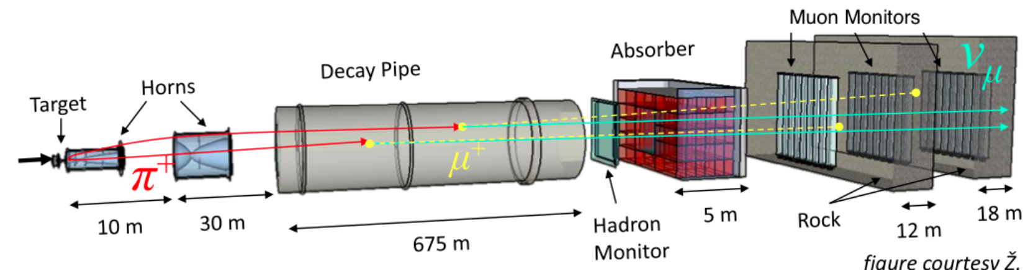
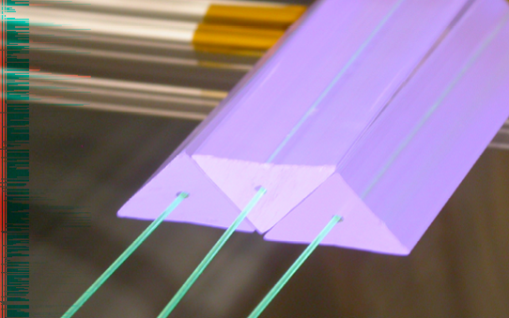
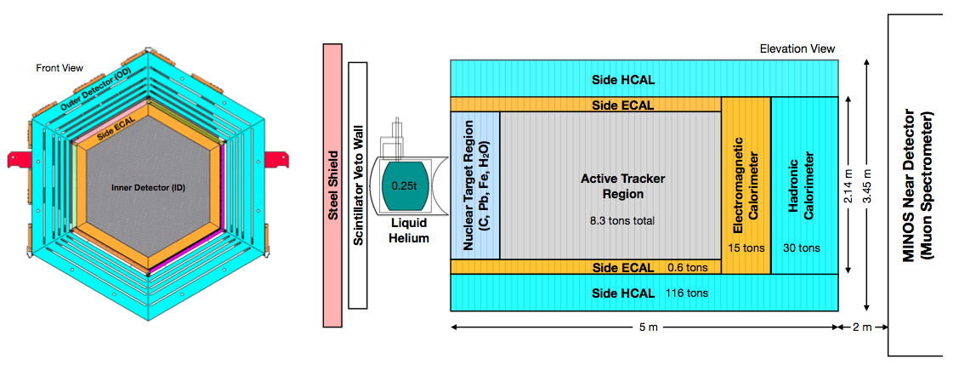
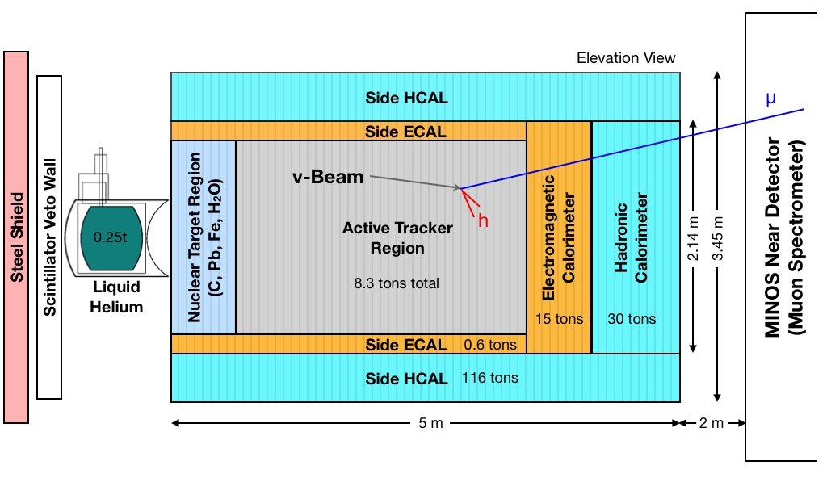
The NuMI Beam Line
3 orientations
The MINERvA Detector
3 orientations
0°, +60°, −60°
3 orientations
0°, +60°, −60°

Slide 14
The Analysis of Quasi-Elastic Like Cross Section

Slide 15
Quasi-Elastic Like Scattering
The first QE publication measured the cross section for this signal.
In addition to, only the muon track was reconstructed and the muon track had to be captured and reconstructed by the MINOS near detector.
They did not care about the proton.

Slide 16
Quasi-Elastic Like Scattering
In this analysis, the muon and proton are reconstructed as tracks.
Does not care about the topology of the muon.
Care very much about the proton. The proton must be tracked and contained in the Inner part of the detector.
Additional, this analysis does not use any QE hypothesis kinematic cuts to isolate the signal.
QE hypothesis kinematic cuts are very much dependent on the models in the neutrino event generator ( GENIE ).
Instead of defining the signal based on GENIE, the signal is defined based on what is observed.
We will observed the muon and proton tracks.

Slide 17
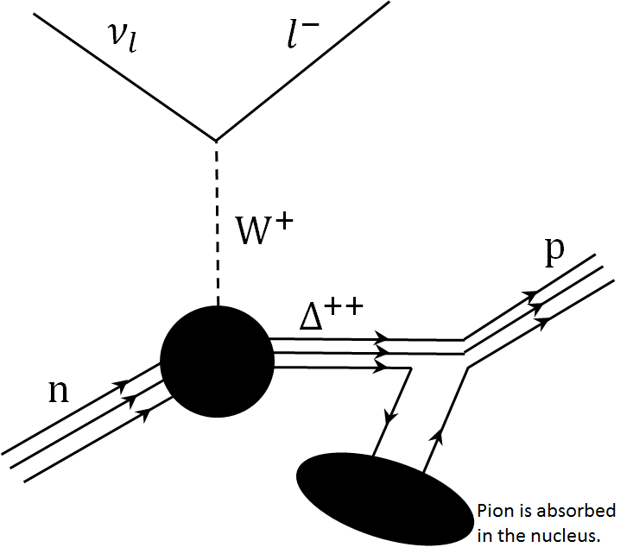

Quasi-Elastic Like Scattering
The neutrino scatters via the quasi-elastic channel.
Today, most neutrino detectors are composed of heavier nuclei, for high event rate.
Thus, there are events that are observed in the detectors which resemble a quasi-elastic signal, such as.
p
$$π^{+}$$

Slide 18
What’s the difference between the first QE results and my analysis?
  Well, the event selection is different.
  I introduced a fraction of the Delta production and Deep Inelastic Scattering neutrino events into the equation.
  However, the QE physics is still the same.
What will we learn from this analysis results that’s different from the previous results?

Slide 19
Until about 7 months ago, I was not working on the 2track QE-like on the plastic scintillator.
I was analyzing events in this region of the detector. The QE-like events on Carbon, Iron, and Lead.
In order to justify the results on the passive nuclear targets, we needed the corresponding analysis on the scintillator. In addition to, we can measured the ratio of the cross section to plastic scintillator for cancelling out certain systematics.

Slide 20
I will only presented results for the QE-like neutrino interactions on the tracker region of the detector. The nuclear targets region is much more complicated. There’s still much work need to be done for a cross section measurement.

Slide 21
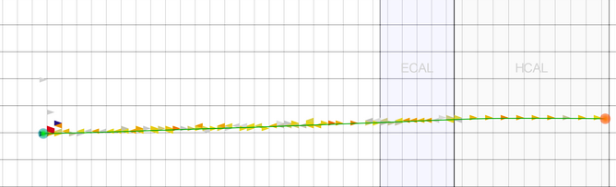
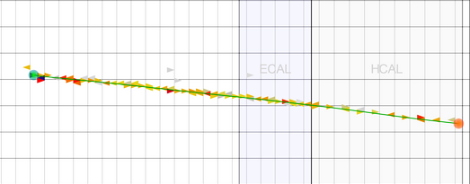

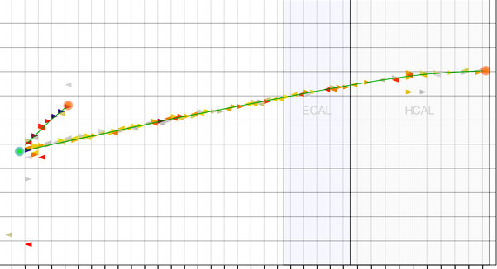
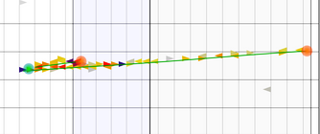
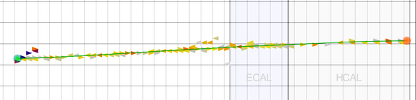
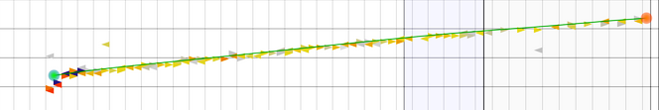
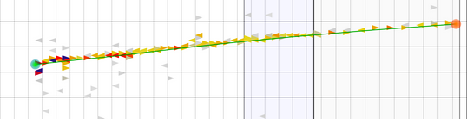
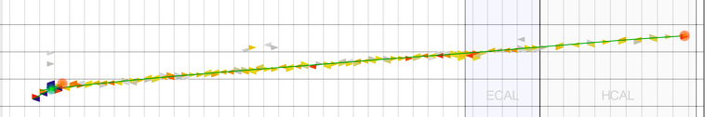
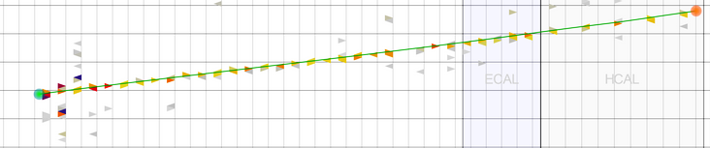
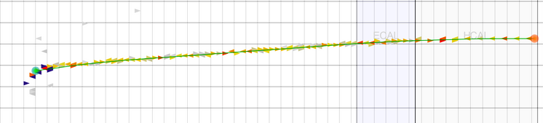
Isolated the QE-like Signal
QE-like Candidates

Slide 22
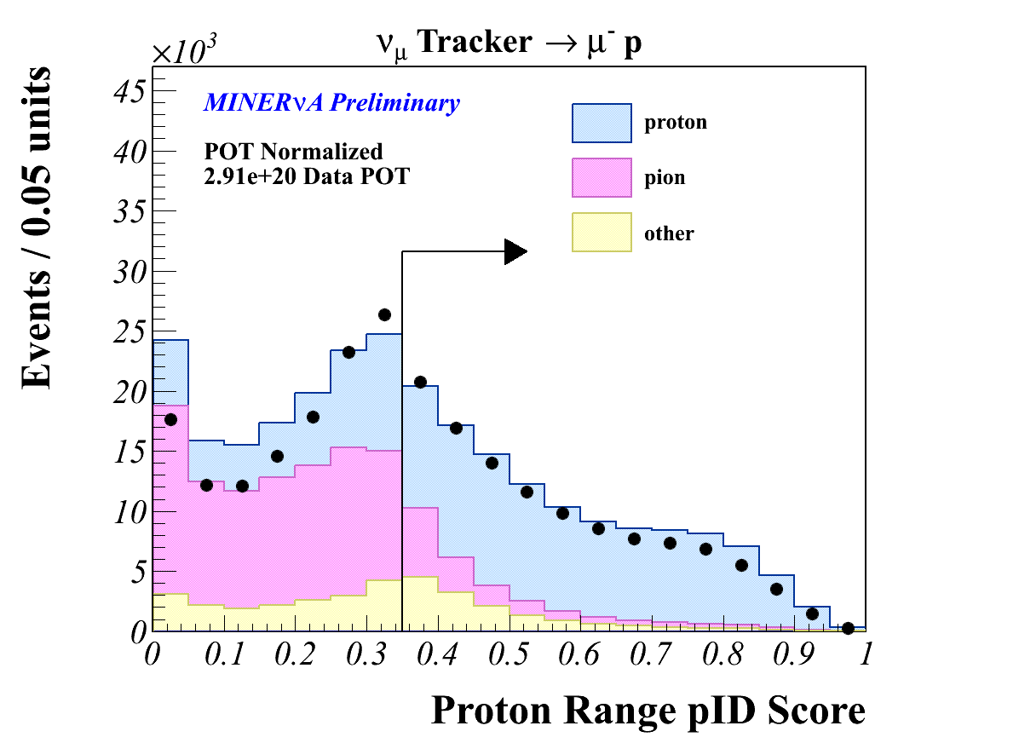
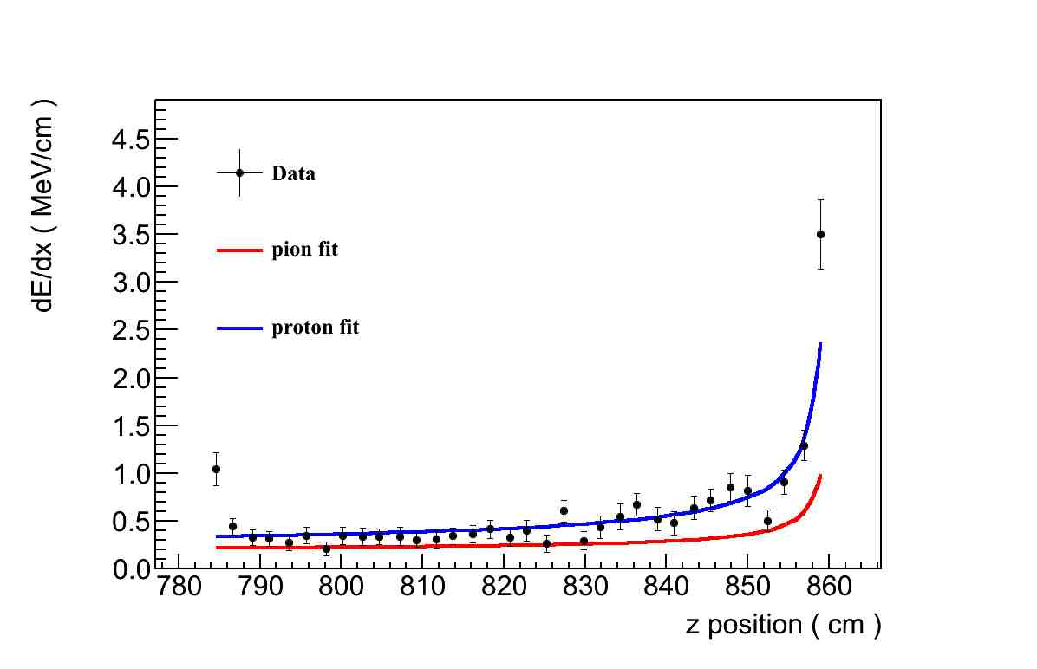
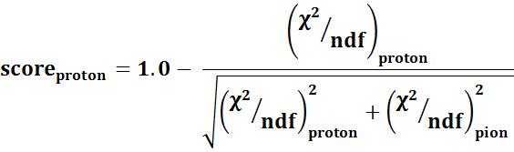
Cut 1: Proton pID Range Score
Require that the hadron track looks like a proton that ranges out in the detector.
Fit the measured dE/dx profile of the hadron’s track to the proton and pion calculated dE/dx profiles of various momentum.

Slide 23
Cut 2: E^{vis}_{unattach}( Q²_{QE,proton} )
E^{vis}_{unattach} is the visible energy in Tracker or ECAL regions of the detector that is not associated with the muon or proton track.
Unattached Energy is defined as the isolated energy in these two regions of the detector.

Slide 24
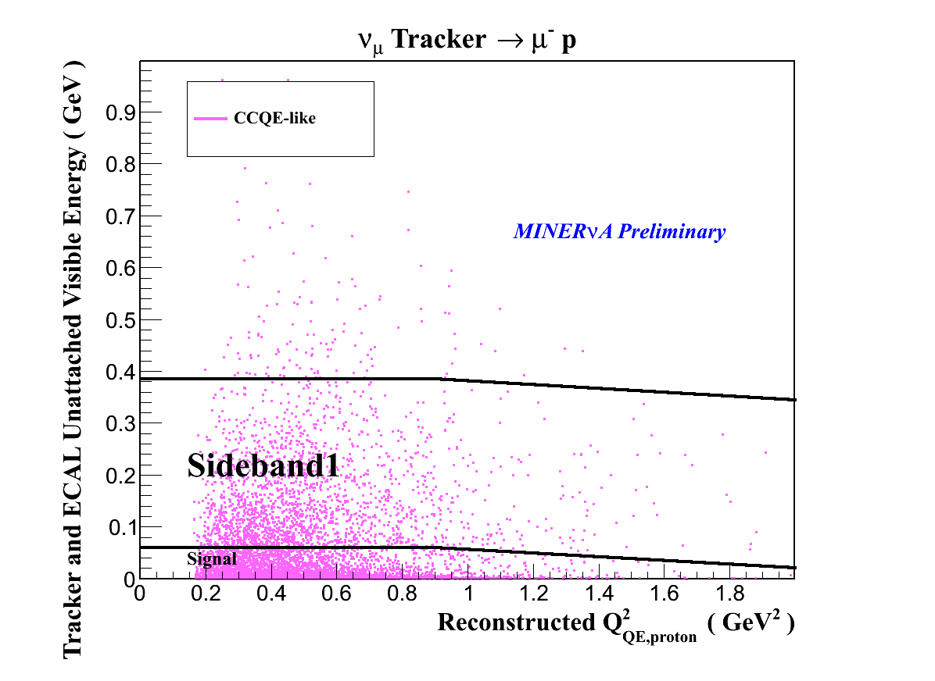
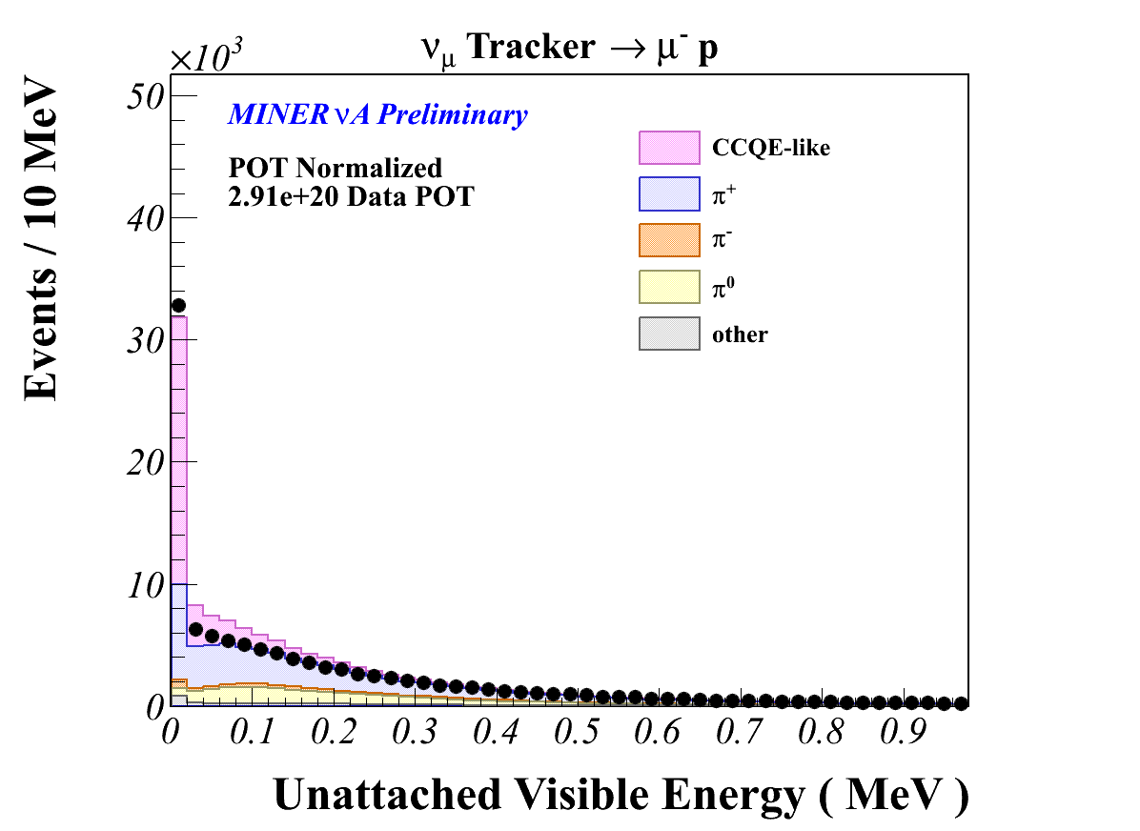
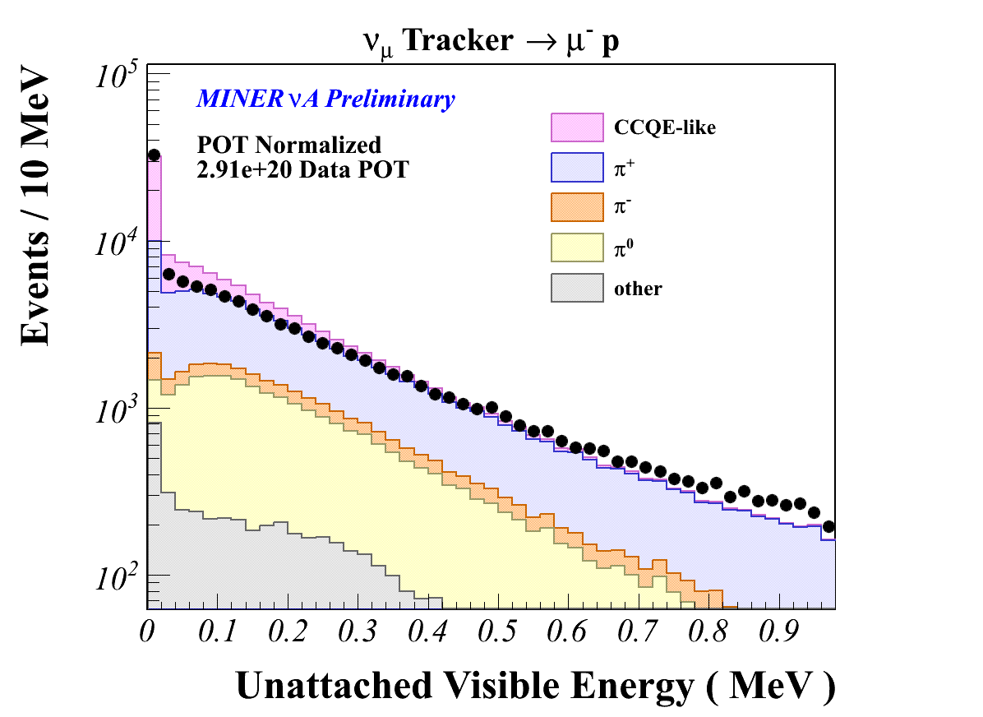
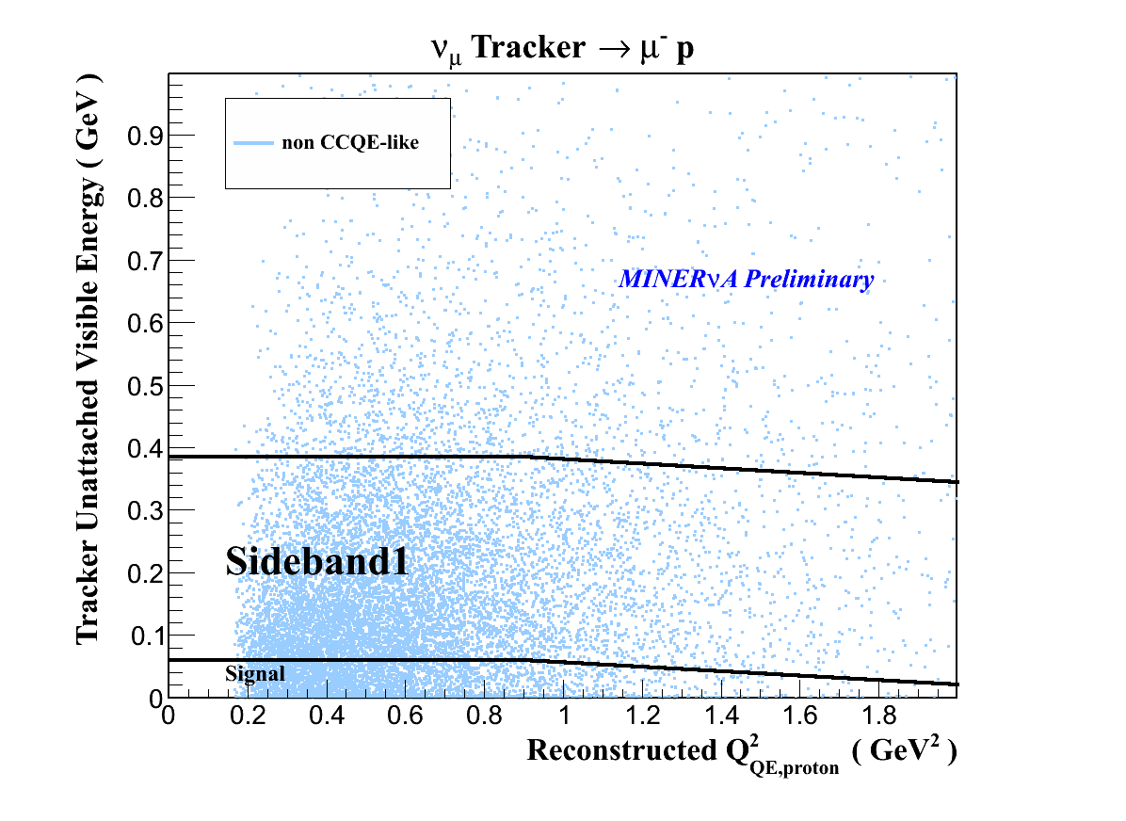
Cut 2: E^{vis}_{unattach}( Q²_{QE,proton} )
E^{vis}_{unattach} is the visible energy in Tracker or ECAL regions of the detector that is not associated with the muon or proton track.

Slide 25
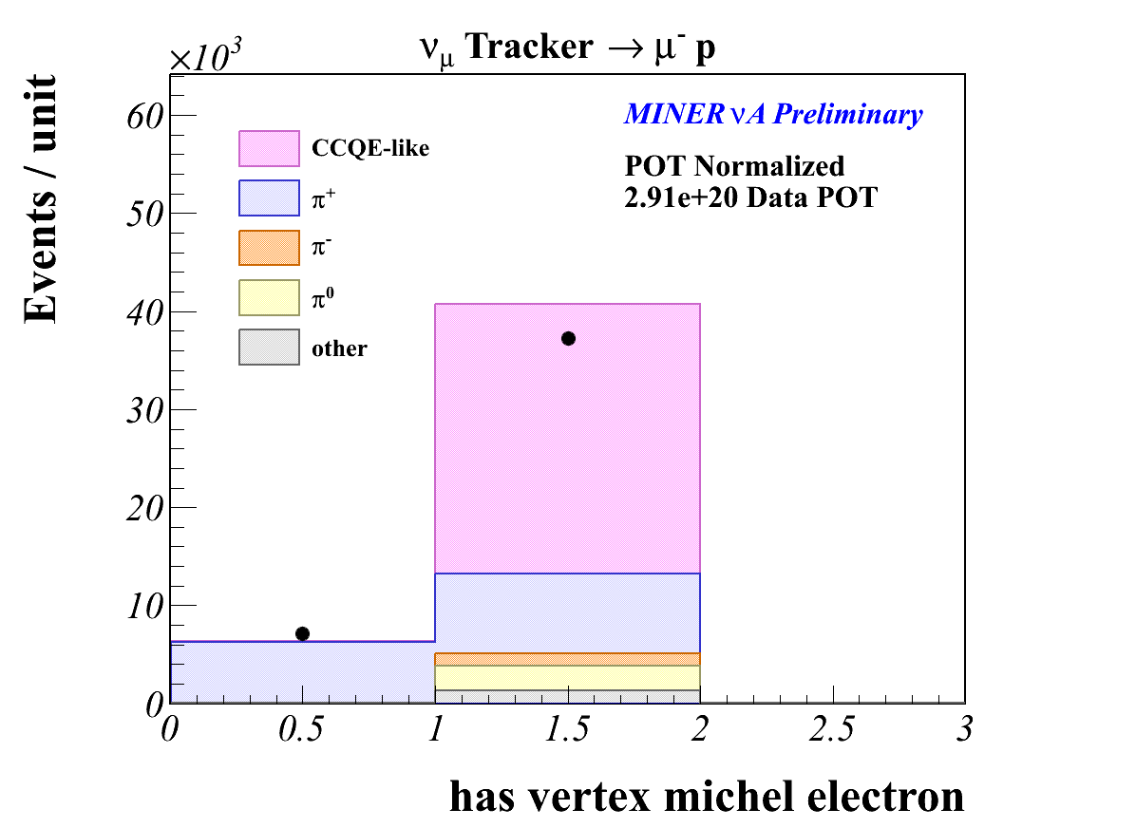


Cut 3: Michel Veto
Requires that a Michel electron is not found at the interaction vertex.
For soft pions ( pions with very low energy ),
$$π^{+}→μ^{+}+ ν_{μ}$$
$$μ^{+}→e^{−}{\overline{ν}}_{e}ν_{μ}$$
Observed the Michel electron in the detector. This is an indication that there was a pion in the final state. Not the signature of a QE-like event.

Slide 26
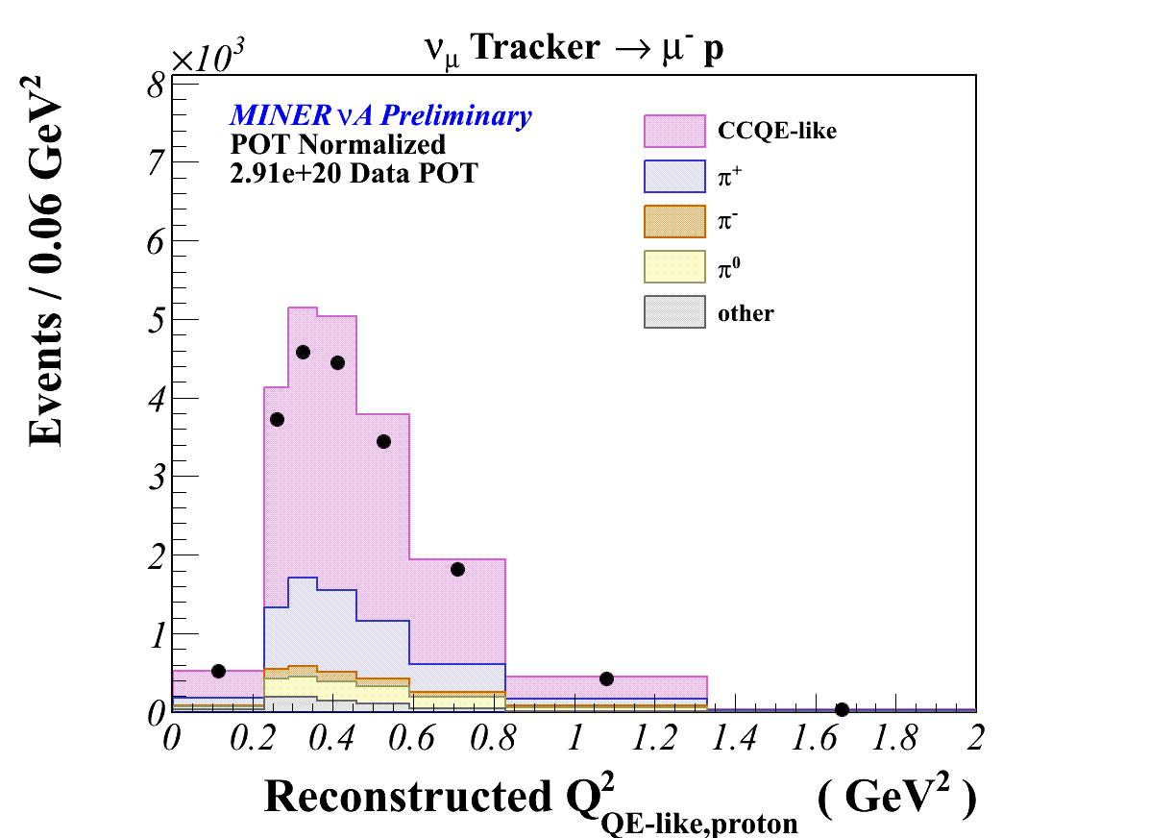
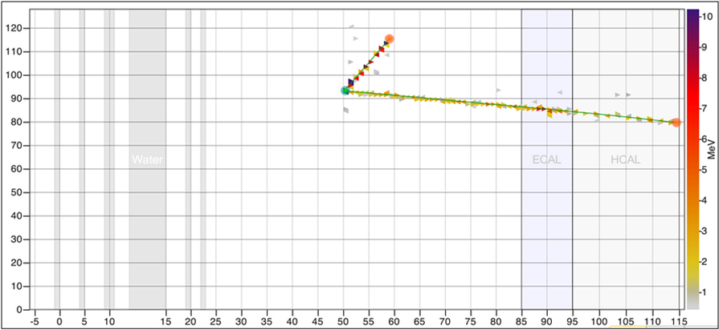

QE-like Candidates
Because we don’t care about the muon’s topology, the Q² must be reconstructed from the proton arm.
  Muons that are not tracked and matched by the MINOS near detector have poor momentum reconstruction.
Assume scattering off of a free nucleon at rest.
$$M^{′}= M_{n}−bindingEnergy$$
$$Q^{2}={\left(M^{′}\right)}^{2} − M_{proton}^{2}+2M^{′}\left(T_{proton}^{kinetic}+ M_{proton}− M^{′} \right)$$

Slide 27
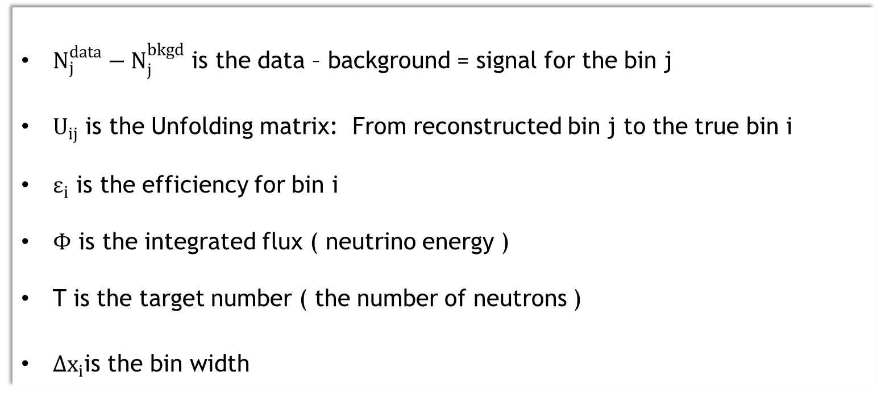
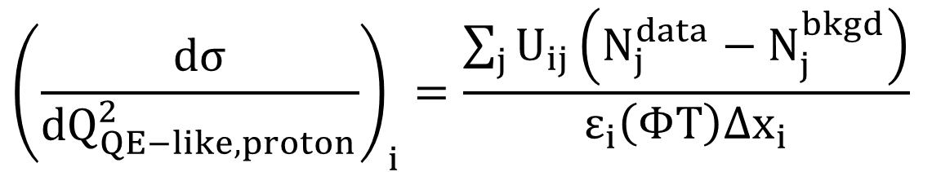
Forming the Cross Section
$${\left(\frac{dσ}{{dQ}_{QE−like,proton}^{2}}\right)}_{i}=\frac{\sum_{j}{U_{ij}\left(N_{j}^{data}−N_{j}^{bkgd}\right)}}{ε_{i}\left(ΦT\right){Δx}_{i}}$$
$N_{j}^{data}−N_{j}^{bkgd}$ is the data – background = signal for the bin j
$U_{ij}$ is the Unfolding matrix: From reconstructed bin j to the true bin i
$ε_{i}$ is the efficiency for bin i
$Φ$ is the integrated flux ( neutrino energy )
T is the target number ( the number of neutrons )
${Δx}_{i}$is the bin width

Slide 28
Neutrino experiments rely heavily on the event generator to estimate the backgrounds coming neutrino interactions.
The background tuning technique will not be showed.
The data is used to tune the background.

Slide 29
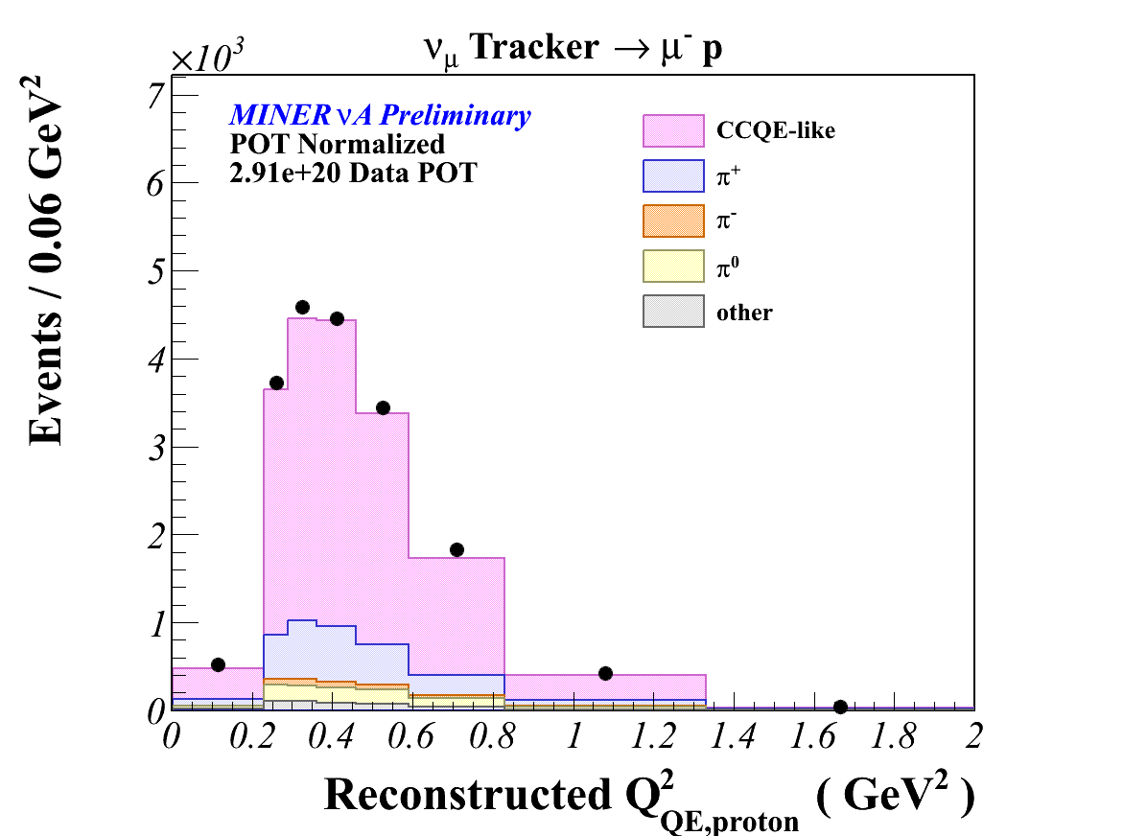
Before Tuning the Backgrounds
After Tuning the Backgrounds

Slide 30
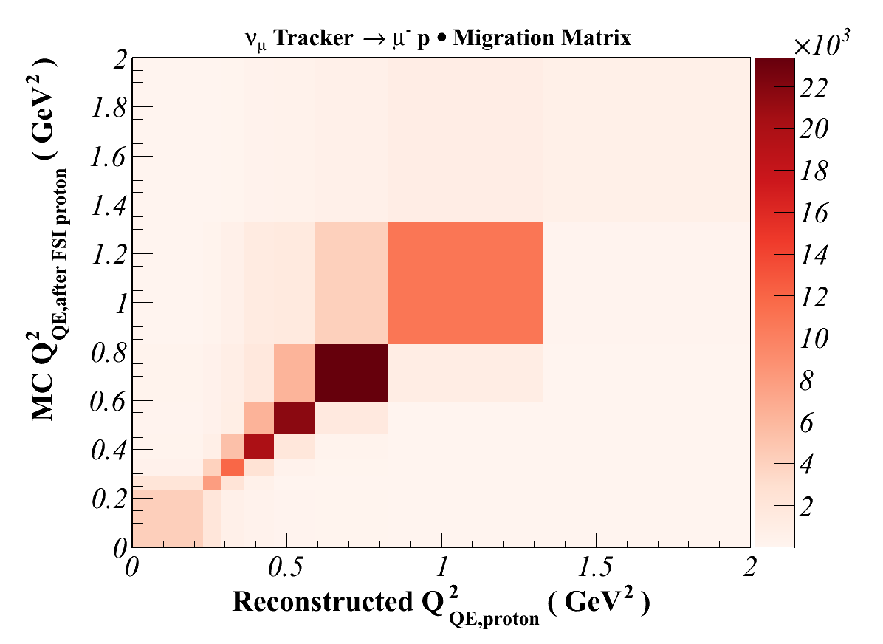
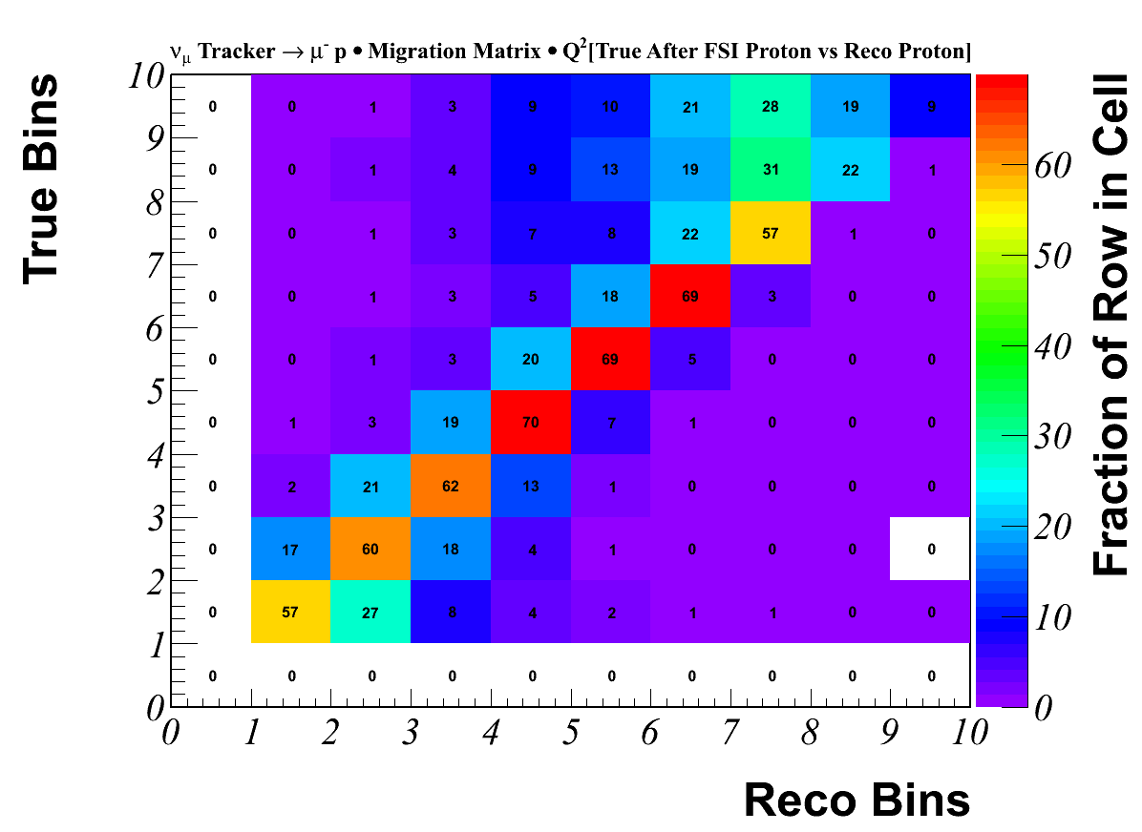
The Next Step is to Unfolded the Distribution.
Unfolding: The measured distribution is often affected by the distortions in the detector resolution. The Unfolding procedure corrects for the detector resolution.
For this analysis, we unfolded the reconstructed Q² from the proton to a Q² using the most energetic proton’s kinetic energy in the final state.

Slide 31
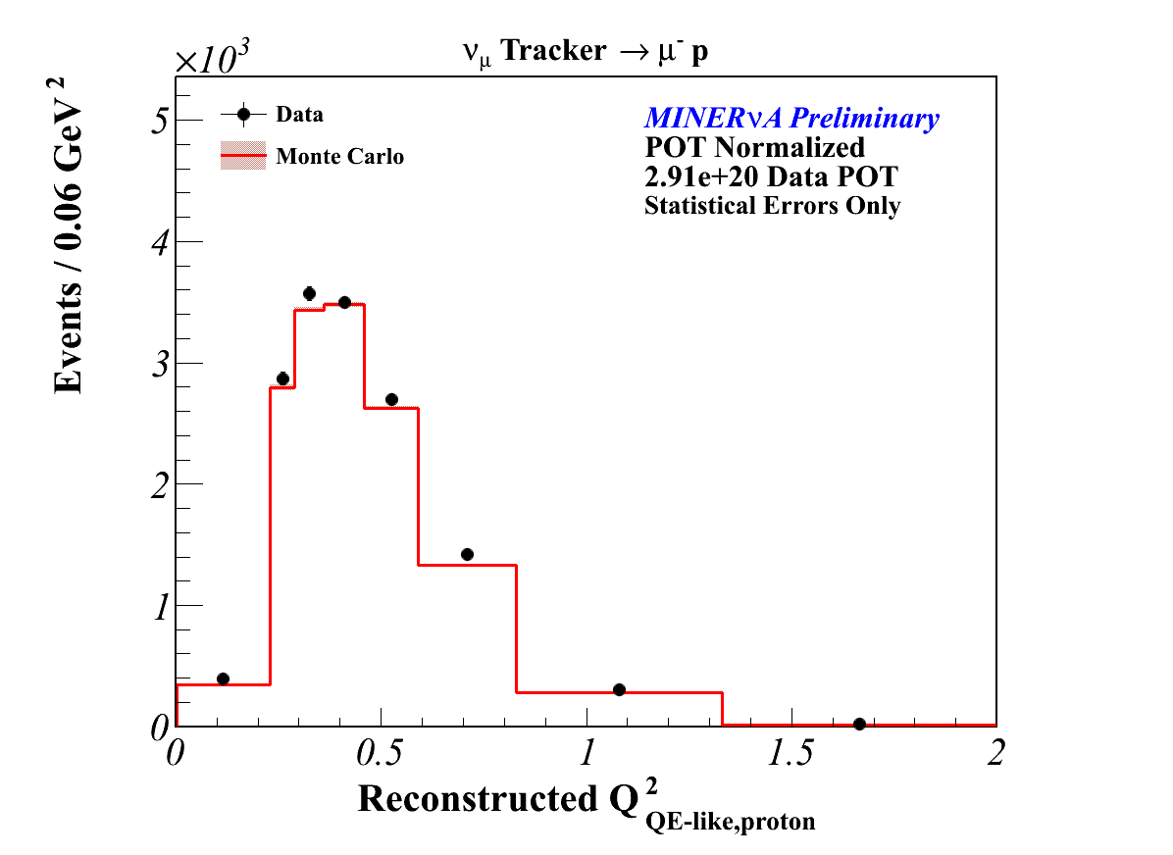
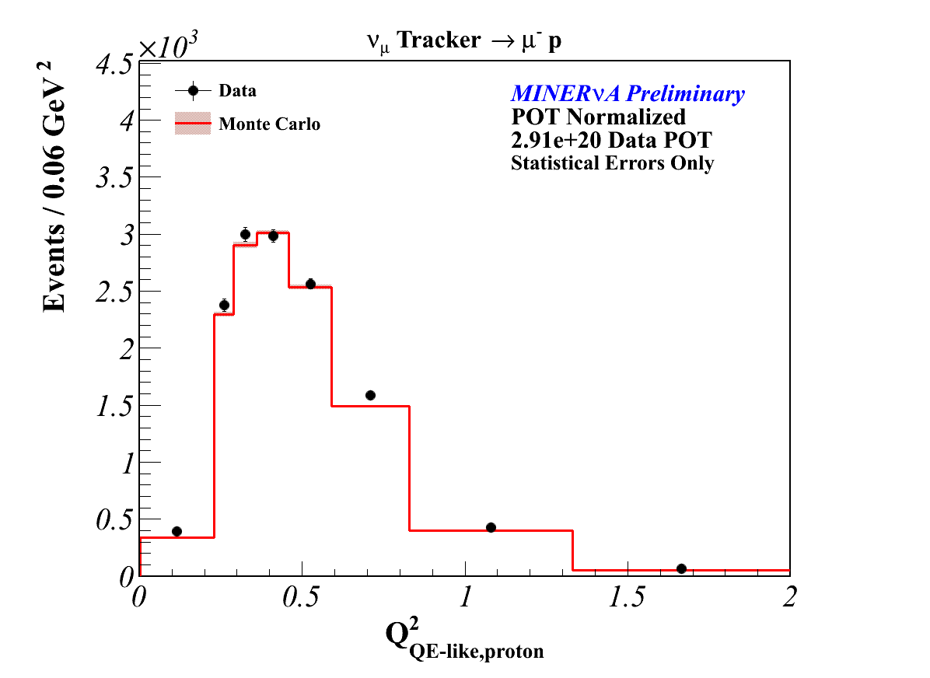
Background Subtracted
Unfolded

Slide 32
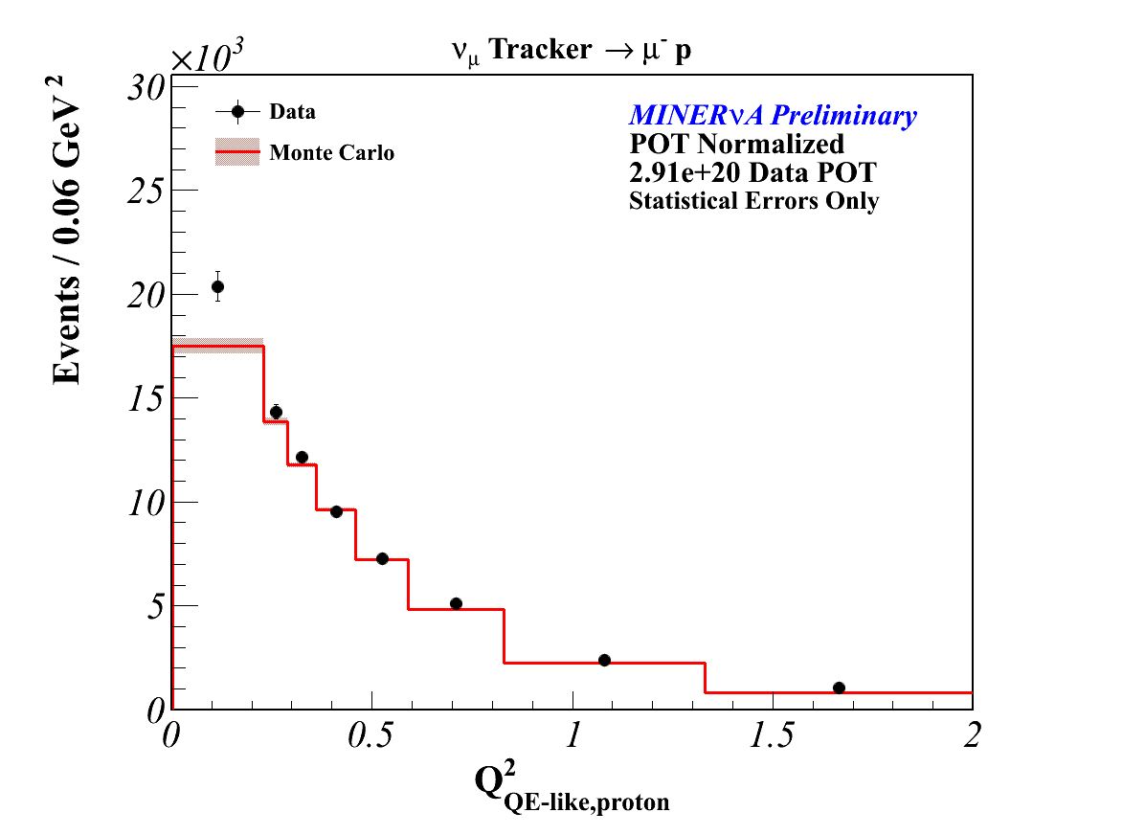
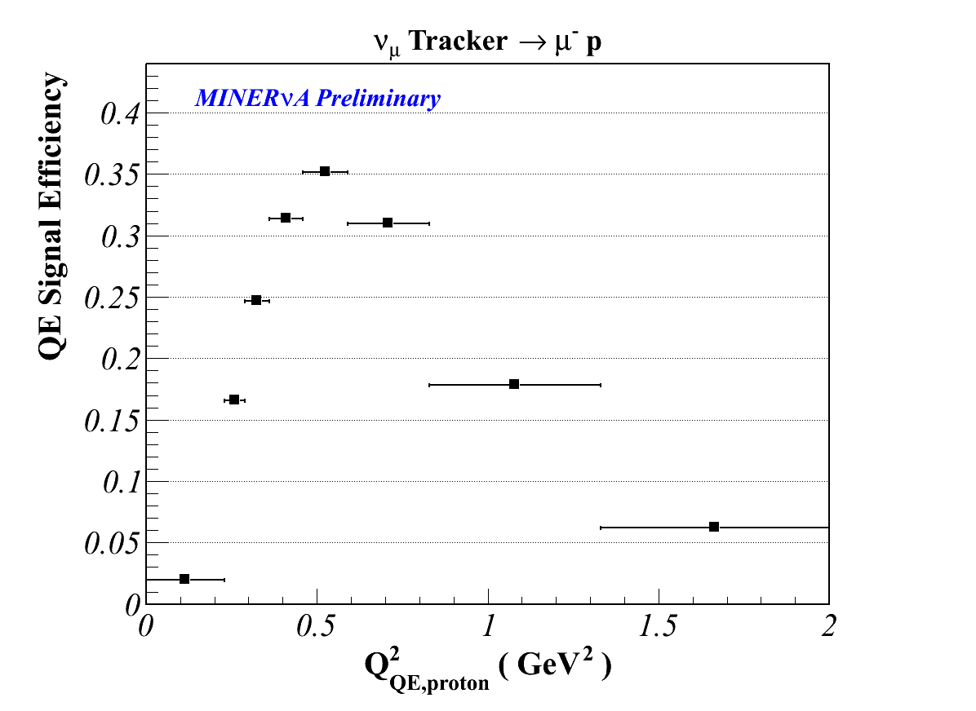
The Third Step is to Correct by the Efficiency
Unfolded

Slide 33
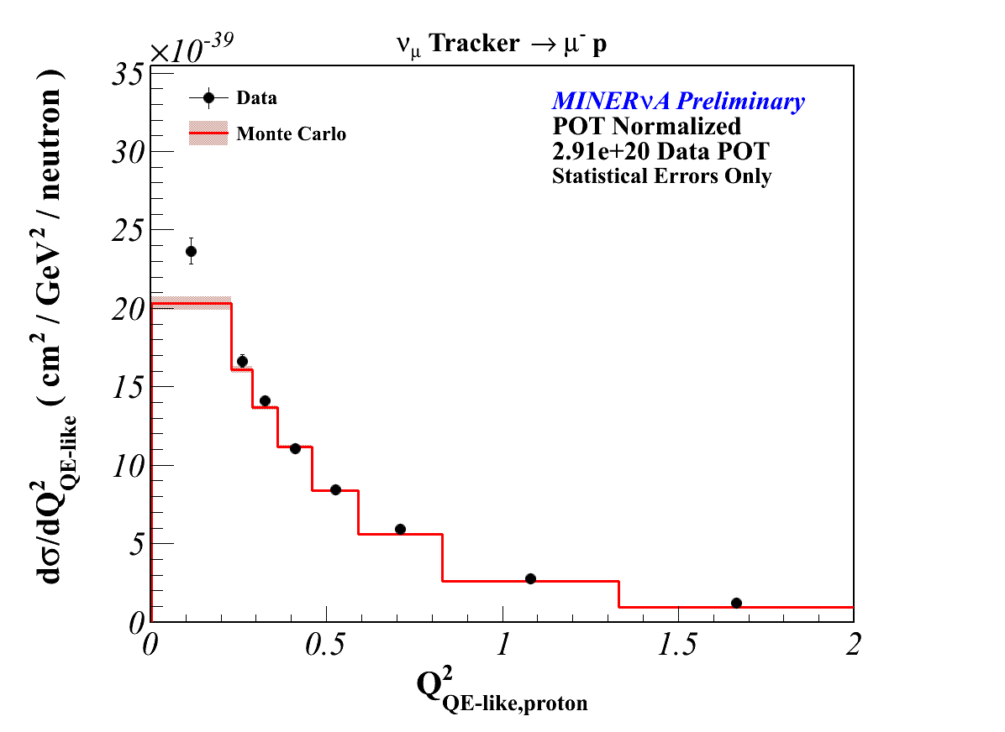
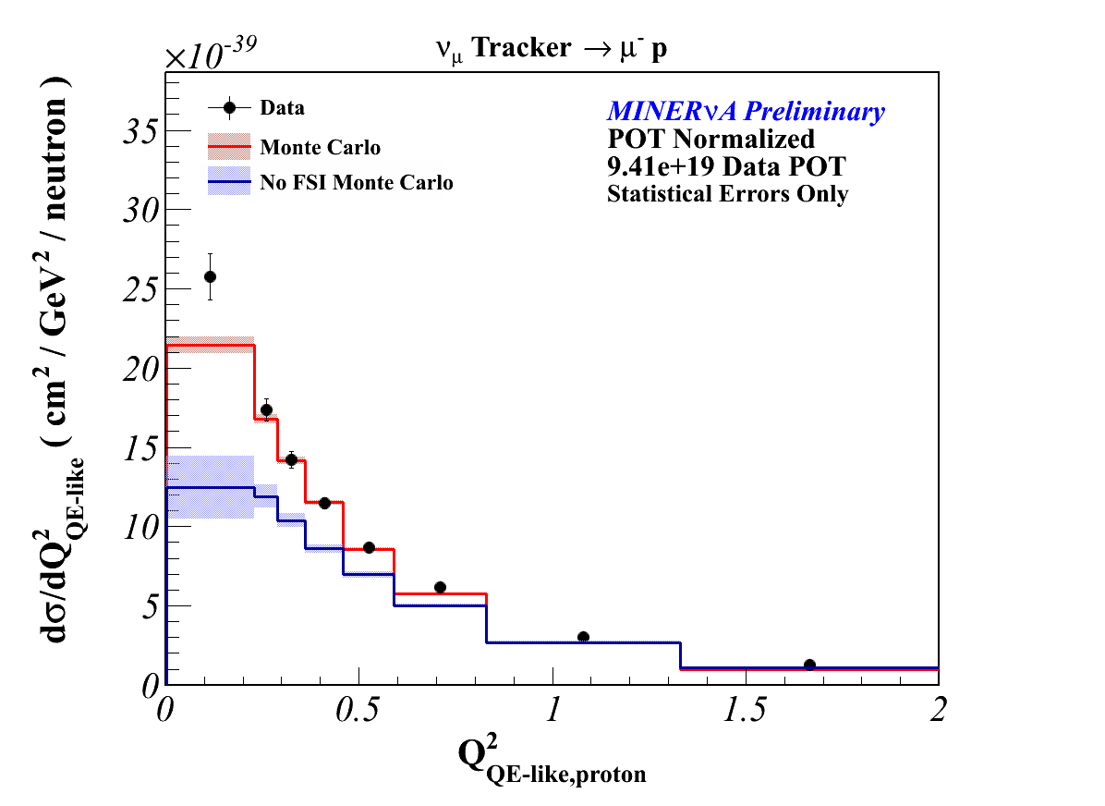
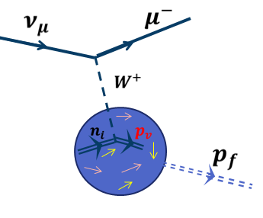
Final the Cross Section

Slide 34
Conclusions
I think this will be the first ever publishable results of a measured cross section from the proton arm for neutrino scattering.
The goal is to make a statement about the final state interactions.
  How well do understand it? How well does the intra nuclear cascade models the nucleon and/or pion propagation in the nucleus.
  What’s missing from the event generators?
  Study the A-dependence of the cross section.
  Study the Q² reconstructed from the muon vs. proton.
Currently, I am working with a theorist to produce model comparisons. It will be extremely interesting to see the model comparisons with this sample.
Working hard on completing the systematics.
Expect a paper sometimes in the early year of 2014.

