Slide 1


Hypernuclei Production Experiment E05115 at Jefferson Laboratory by the (e,e’K⁺) Reaction
Outline
Introduction
Experimental Setup and Kinematics
System Calibration
Preliminary Results
Summary
Chunhua Chen
March 31, 2012
Notes:
Good afternoon, I am going to talk about the hypernuclei production experiment e05115 at jlab by the (e,e’k+) reaction which was done in 2009
I will give some introduction, the setup and kinematics of the experiment, system calibration, then some preliminary results will be given, finally is summary.

Slide 2
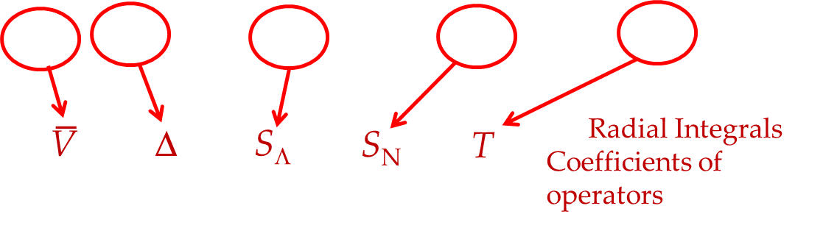
Introduction
E05115：
The 3rd generation spectroscopic investigation of Lambda hypernuclei by the Reaction (e,e’K⁺) at Jlab Hall C
Physical Goals:
  To understand YN and YY interactions
  To explore and understand nuclear structure using Λ as a probe
    Model the baryonic many body system
    Study the role of Λ in the nuclear medium
Shield Model with Λ-N Effective Potential (p_{N}s_{Λ})
V_{ΛN}= V₀(r)+V_{σ}(r)s_{N}⋅s_{Λ}+V_{Λ}(r)L_{NΛ} ⋅s_{Λ}+V_{N}(r)L_{NΛ} ⋅s_{N}+V_{T}(r)S₁₂
Additional Contribution: Λ-Σ coupling
ΛΣ
Notes:
E05115 is the third generation spectrocopic investigation of lambda hypernuclei by the reation(e,e’k+) at Jlab hallc
The physical goal to study the lambda hypernuclear spectroscopy first is to understand hyperon-nucleon interactions
Second is to explore and understand nuclear structure using lambda as a probe by model the baryonic many body system and study the role of lambda in the nuclear medium.
The five two-body matrix elements depend on the radial integrals associated with each component in equation. They are denoted by the parameters v_bar,delta,s_lambda, s_n and T.

Slide 3
Introduction-Cont.
Merits of (e,e’K⁺) experiment:
Large momentum transfer → Excitation of deeply-bound state
p to Λ conversion → Mirror or Neutron-rich hypernuclei
Production of both spin-flip/non-flip states;
High resolution because of the quality of the CEBAF beam
Experimental Goals:
Spectroscopy of Medium - heavy hypernucleus
  ⁵²Cr(e,e’K+) ⁵²_{Λ}V
  Spectroscopy of Light Λ hypernuclei- p shell hypernuclei
  ¹²C(e,e'K+)¹²_{Λ}B , ⁷Li(e,e'K+)⁷_{Λ}He, ¹⁰B(e,e'K+)¹⁰_{Λ}Be , and ⁹Be(e'K+)⁹_{Λ}Li
  Calibration by the elementary process p(e,e’K⁺)Λor Σ: H₂O and CH₂
Results are important in determining ΛΣ , S_{N} and V₀ terms from Λ_{s} states and S_{Λ} term from states with Λ at higher orbits
Notes:
The reasons we use the reaction(e,e’k) are
First, from the large momentum transfer, the deeply-bound state can be excited
Second, conversion of pronton to lambda hyperon can produce mirror or Neutron-rich hypernuclei
Third, it is also the production of both spin flit and non-flit states
Last one is high energy resolution due to cebaf beam’s quality
The experimental goals can be separated to two parts:
The first part focuses on medium – heavy hypernuclear spectroscopy of Vanadium 52 Lambda off Cr 52 target.
The second part is about spectroscopy of light Lambda hypernuclei, the experiment studies 4 p-shell hypernuclei: B12 lambda, He 7 Lambda, Be 10 Lambda and Li 9 lambda.
We also taking important calibration data, which are single particle production Lambda and sigma from CH2 and water target.
The results are important

Slide 4
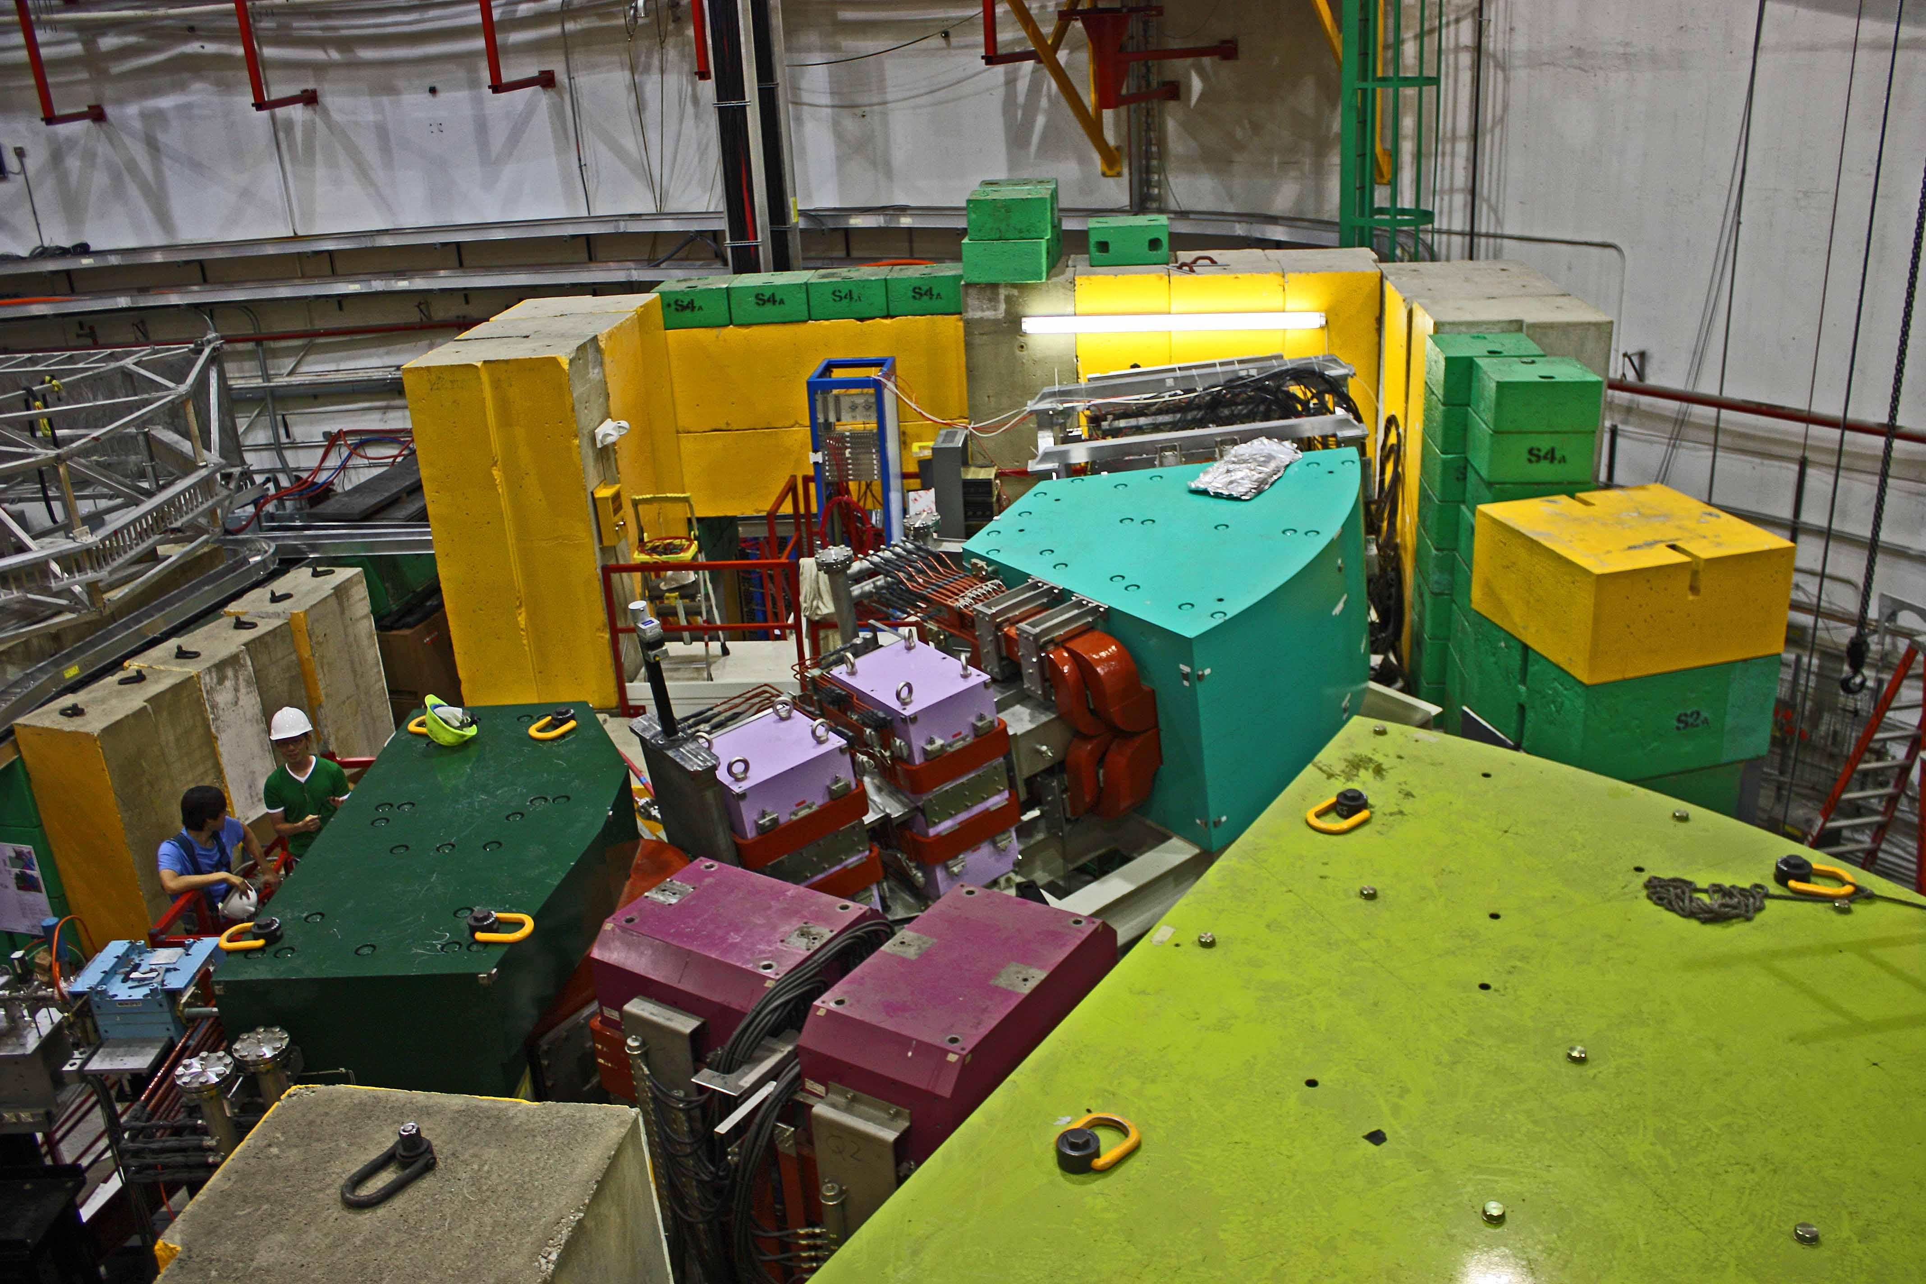
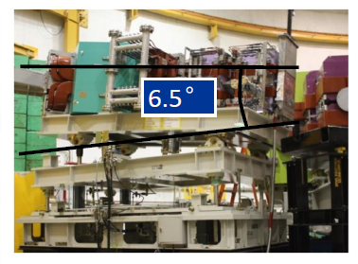
Experimental Setup
e’
HES
e
Virtual photon flux factor Γ
Splitter
Magnet
HKS
Bremsstralung flux
K⁺
Notes:
This is a view of the experimental setup, this is HKS, Quadruple 1, Quardruple2 and Dipole,
The electron spectrometer enge in 2005 experiment is replaced by HES, also has Q1, Q2 and Dipole with the same tilt technique by 6.5 degree.
The common splitter magnet is also new.
4

Slide 5

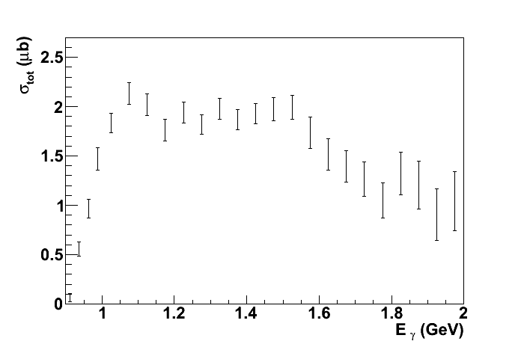
Kinematics of the E05-115 Experiment
Scattered electron
Target
nucleus
Electron beam
Momentum: 0.844GeV/c ±17%
Angular acceptance: 3°〜9°
Momentum: 2.344GeV/c
Λ
Coincidence measurement
1.5GeV γ*
γ+p →Λ+K⁺
p
K⁺
Momentum: 1.2GeV/c ±12.5%
Angular acceptance : 1°〜13°
Notes:
The experimental kinematics is illustrated as following. We used 2.344 GeV/c beam scatters off the nucleus target at forward angle between 3-9 degree, with central momentum 0.844GeV/c. It produces 1.5GeV virtual photon, and it converts a proton to a lambda and emits a K plus at central momentum 1.2GeV/c , in a wide angle 1-13 degree. In order to get the missing mass, we must take the scattering electron and K plus in coincidence. Here 1.5GeV/c corresponding to maximum the cross section of the elementary process.

Slide 6
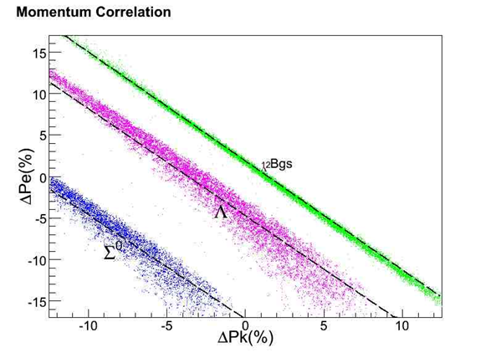
Spectrometer System Calibration
Spectrometer system calibration: key to reach 400 keV energy resolution
Common splitter : Separated single arm kinematics calibration is not possible
Technique: 2-arm coupled calibration for both kinematics and optics
Using known masses of Λ, Σ⁰ from CH2 target and identified known hypernuclear bound states ¹²_{Λ}Bgs for spectrometer calibration
HES spectrometer system
Kinematics coverage
To beam dump
HKS
Λ
HES
¹²_{Λ}B (gs)
Sieve Slit
Σ⁰
Splitter
Sieve Slit
Target
Beam
Kaon Momentum (MeV/c)
Notes:
In order to obtain the 400 kev energy resolution, The calibration of the spectrometer system is a crucial step in data analysis.

Slide 7
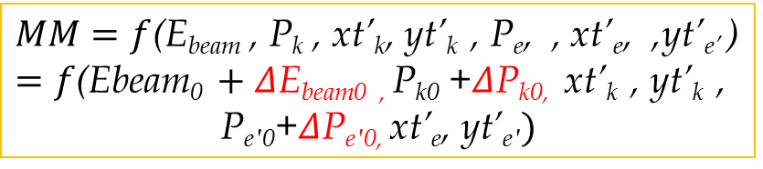
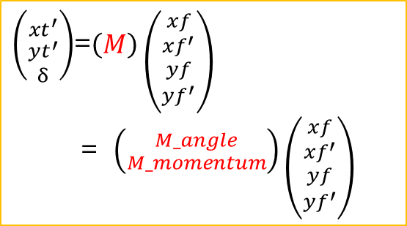

Calibration Procedure
$\left({{xt}^{′} \atop \begin{aligned}{yt}^{′} \\ δ\end{aligned}}\right)$=$\left(M\right)\left({xf \atop \begin{aligned}{xf}^{′} \\ yf \\ {yf}^{′}\end{aligned}}\right)$
= $\left({M_angle \atop M_momentum}\right)\left({xf \atop \begin{aligned}{xf}^{′} \\ yf \\ {yf}^{′}\end{aligned}}\right)$
$MM=f$(E_{beam} , P_{k} , xt’_{k}, yt’_{k} , P_{e}, , xt’_{e}, ,yt’_{e’} )
$=f\text{(}\text{Ebeam}\text{0 }+Δ\text{E}\text{beam}\text{0 , }\text{P}\text{k}\text{0}\text{ +}Δ\text{P}\text{k}\text{0, }$ $\text{xt}\text{’}\text{k} \text{, }\text{yt}\text{’}\text{k} \text{, }$
$$\text{P}\text{e}\text{′0}\text{+}Δ\text{P}\text{e}\text{′0, }\text{xt}\text{’}\text{e}\text{, }\text{yt}\text{’}\text{e}\text{′})$$
$P=P0$(1+δ/100)
Field Map Correction Real Optics （Yuncheng Han T10）
  Agreement between Simulation data and Real SS data
  Independence of invariant mass to reconstructed kinematical parameters. (Λ&Σ; P,xt’,yt’)
Initial Matrices
Mathematical optimization by Nonlinear Least Chi² fitting
  Central kinematics scan (m_{Λ},m_{Σ},Δm_{ΛΣ})
  Angular matrices (m_{Λ},m_{Σ},σ)
  Momentum matrices (¹²_{Λ}Bgs)
  Iteration

Slide 8
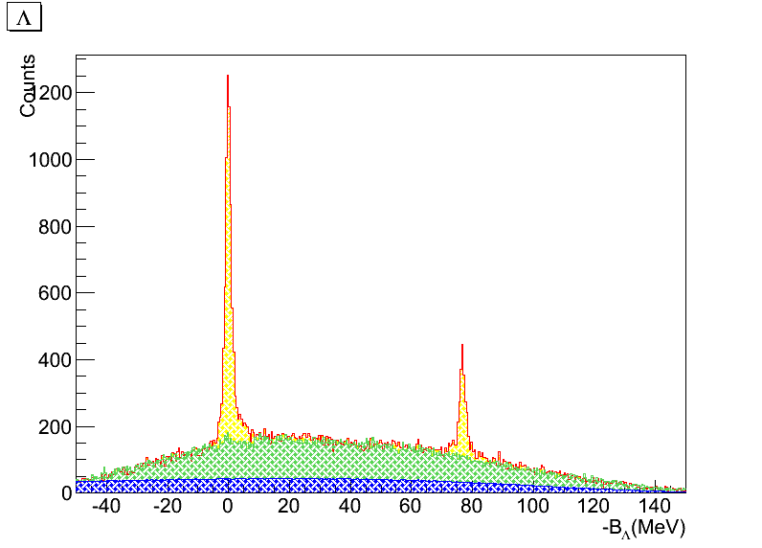
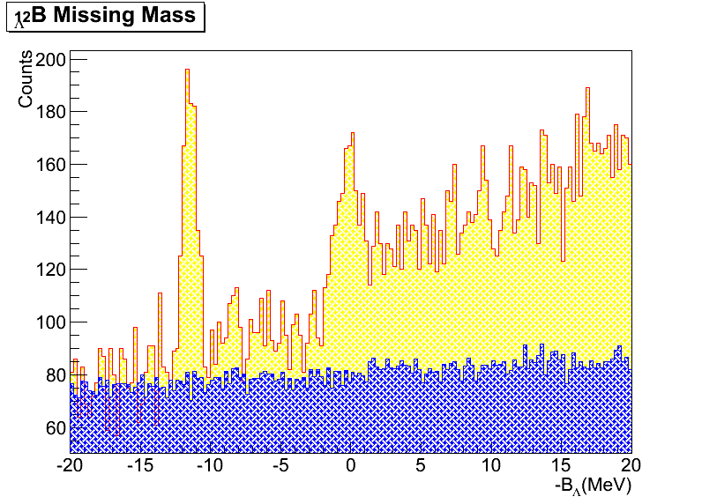
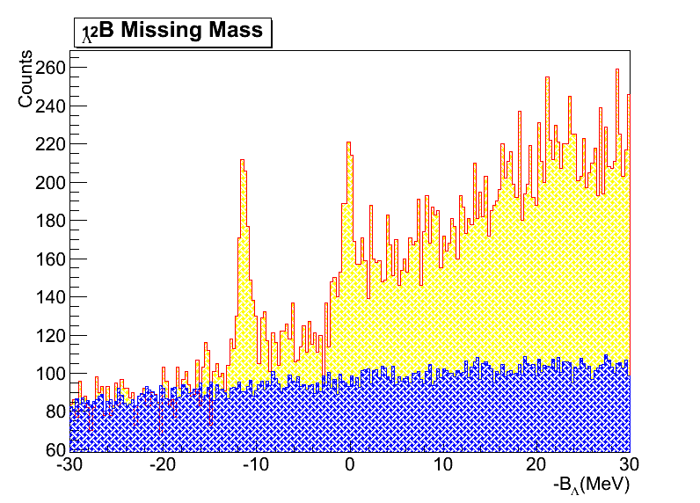
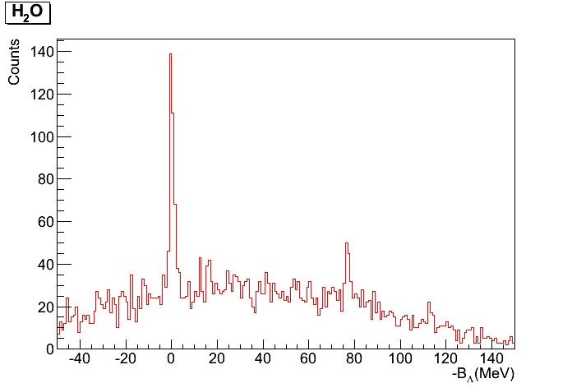
Preliminary Status
P(e,e’K+)Λ&Σ⁰ (CH₂)
#2
FWHM
~1.675MeV
#1
FWHM
~1.775MeV
P(e,e’K+)Λ&Σ⁰ (H₂O)
FWHM
~1.7MeV
Peak# | Mean(MeV) | σ (MeV)
1 | -11.39 | 0.411
2 | -0.40 | ~1.8
FWHM
~2.0MeV

Slide 9
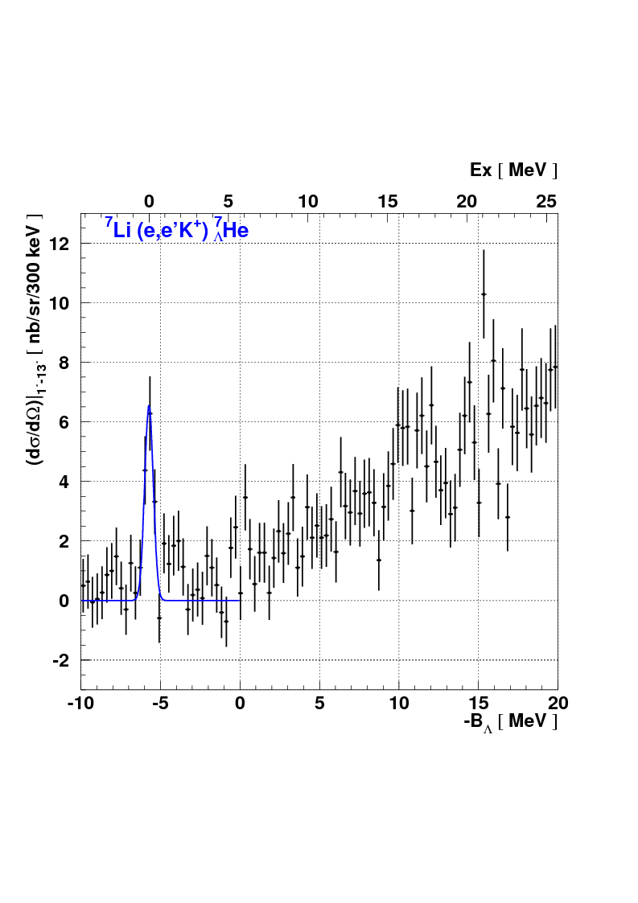
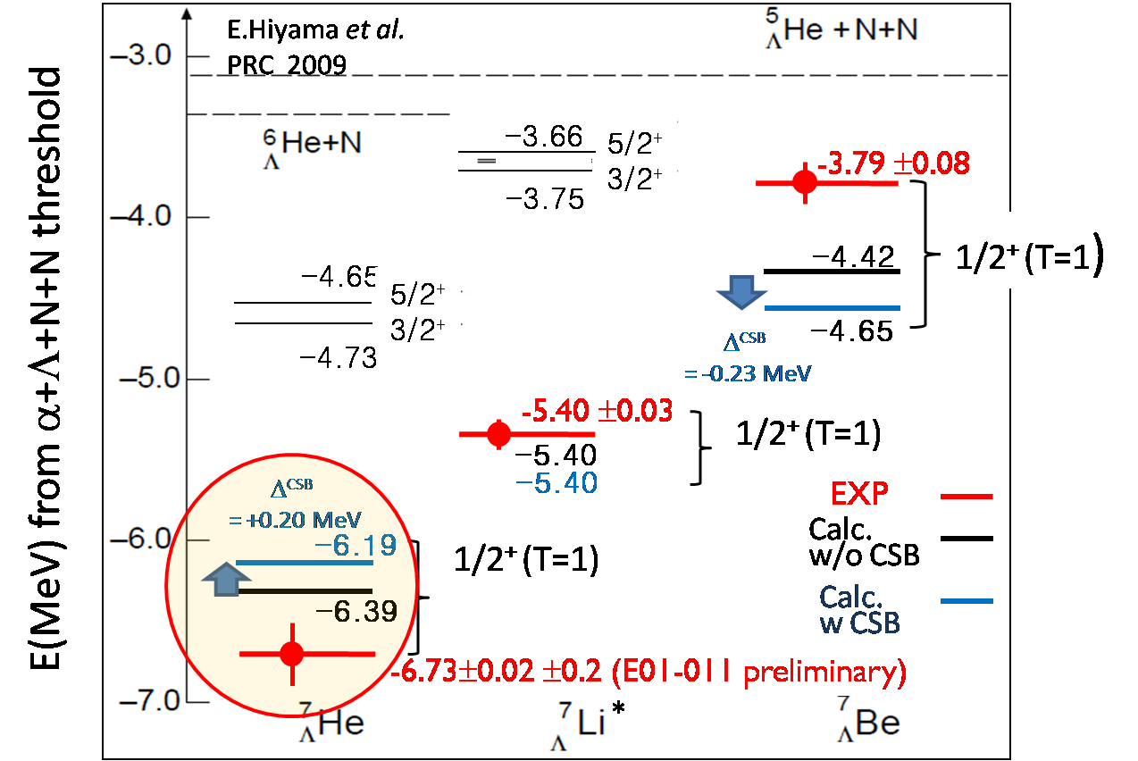
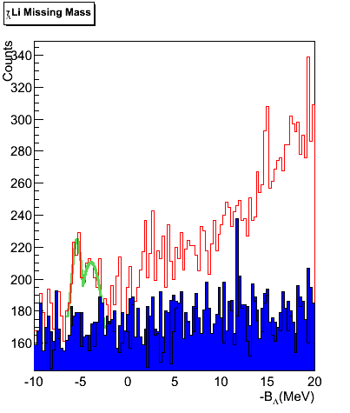
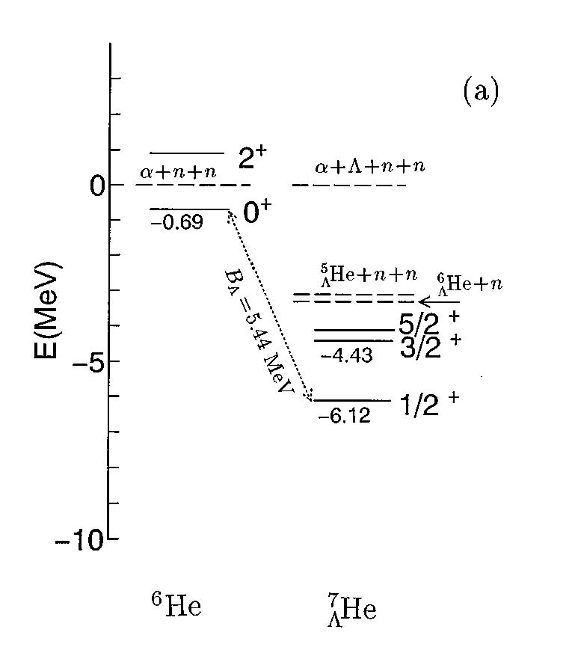
Preliminary Result ⁷_{Λ}He
E01011 data
E05115 data
3/2⁺&5/2⁺
⁶He core
n
α
n
E. Hiyama, et al., PRC53 2078 (1996)
Notes:
Level structures of the T = 1 isotriplet hypernuclei He7 lambda, Li7 lambda and Be7 lambda were calculated by Hiyama et al. in lambda +α + + N + N four-body cluster model

Slide 10
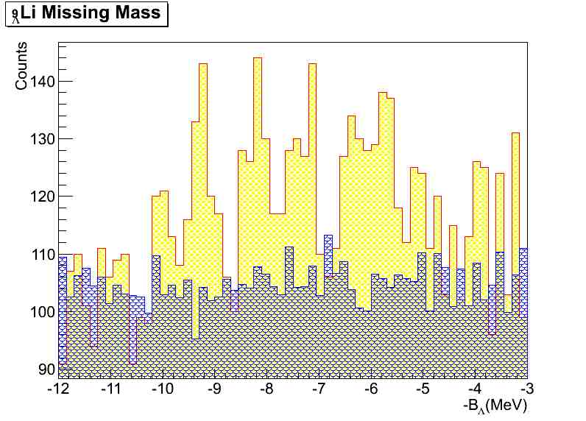
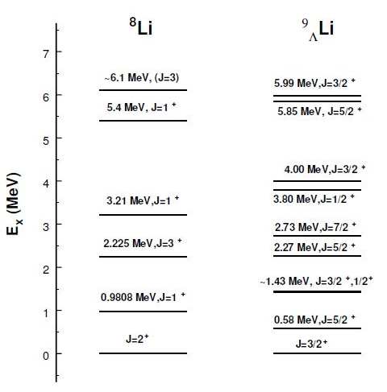

Preliminary Results ⁹_{Λ}Li
Hall C HKS
E05-115
~4.38
~3.77
Λ_{s}
~ 2.75
Λ_{s}
~1.90
Λ_{s}
~0.84
Λ_{s}
Ex: 0.0
Sotona and Millener
Saclay-Lyon model for elementary process
B_{Λ} = -10.1 ± 0.3
B_{Λ} = -8.53±0.18
(emulsion, average over
only 8 events)

Slide 11
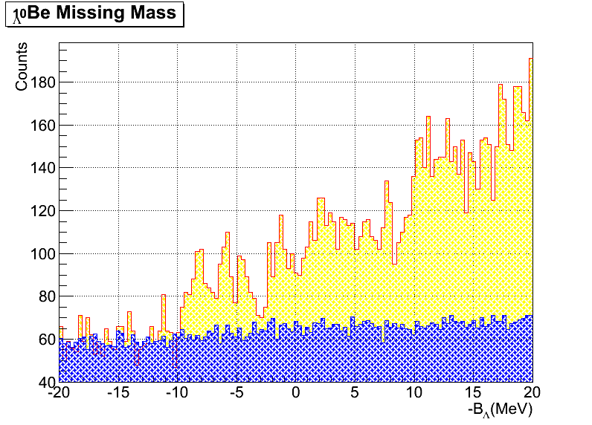
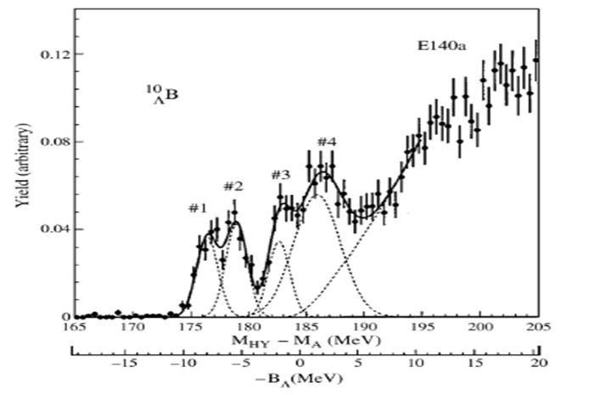
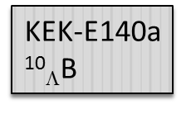
Preliminary Result ¹⁰_{Λ}Be
4⁻
11.53
11.28
7/2⁻
Λs
10.93
3⁻
7.94
5/2⁻
4⁻
6.76
9/2⁺
6.51
6.43
6.38
Λs
3⁻
7/2⁻
5.59
3/2⁻
4.70
3/2⁺
3.04
5/2⁺
2.59
2.78
1/2⁻
3⁻
2.48
Λs
2⁻
2.43
5/2⁻
1.68
1/2⁺
0.11
0.00
3/2⁻
2⁻
Λs
1⁻
0.00
Low Lying ⁹Be
Level Structure
¹⁰_{Λ}Be
Theory
(< 0.1)
E05115

Slide 12
Summary and to do
By current calibration method, we are able to get clear mass spectroscopy , which is not included in the calibration data set;
Current resolution is still factor of 2 away from expected resolution, the iteration will continue to improve the optical matrices as well as the kinematics;
Other issue: High multiplicity tracking problem for heavy target data.

Slide 13
Backup

Slide 15

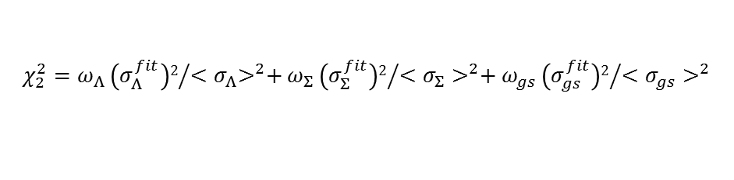
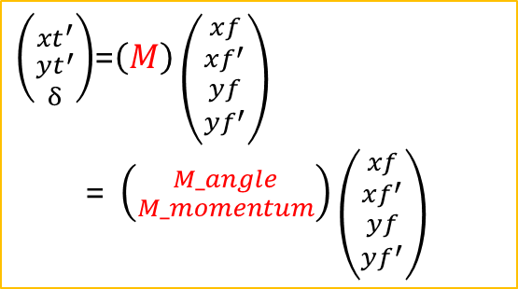
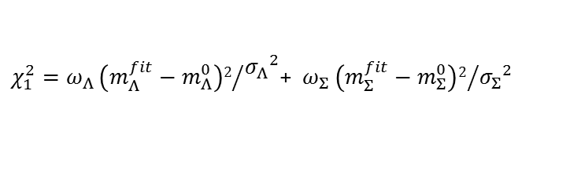


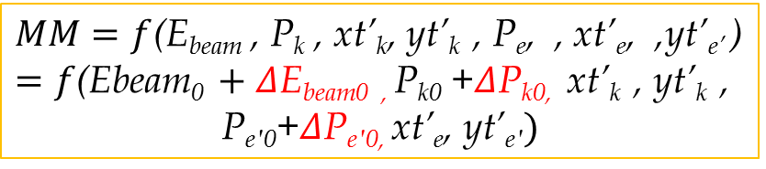
Calibration Procedure
$\left({{xt}^{′} \atop \begin{aligned}{yt}^{′} \\ δ\end{aligned}}\right)$=$\left(M\right)\left({xf \atop \begin{aligned}{xf}^{′} \\ yf \\ {yf}^{′}\end{aligned}}\right)$
= $\left({M_angle \atop M_momentum}\right)\left({xf \atop \begin{aligned}{xf}^{′} \\ yf \\ {yf}^{′}\end{aligned}}\right)$
$MM=f$(E_{beam} , P_{k} , xt’_{k}, yt’_{k} , P_{e}, , xt’_{e}, ,yt’_{e’} )
$=f\text{(}\text{Ebeam}\text{0 }+Δ\text{E}\text{beam}\text{0 , }\text{P}\text{k}\text{0}\text{ +}Δ\text{P}\text{k}\text{0, }$ $\text{xt}\text{’}\text{k} \text{, }\text{yt}\text{’}\text{k} \text{, }$
$$\text{P}\text{e}\text{′0}\text{+}Δ\text{P}\text{e}\text{′0, }\text{xt}\text{’}\text{e}\text{, }\text{yt}\text{’}\text{e}\text{′})$$
$P=P0$(1+δ/100)
ΔE_{beam0}
optimization
Beam Energy Scan
Kinematical
Calibration
ΔP_{K},ΔPe optimization
$χ_{1}^{2}=ω_{Λ}{\left(m_{Λ}^{fit}−m_{Λ}^{0}\right)2}/{\begin{aligned}{σ_{Λ}}^{2} \\ \end{aligned}}$+ $ω_{Σ}{\left(m_{Σ}^{fit}−m_{Σ}^{0}\right)2}/{{σ_{Σ}}^{2}}$
$$χ_{2}^{2}=ω_{Λ}{\left(σ_{Λ}^{fit}\right)2}/{{{<σ}_{Λ}>}^{2}+}ω_{Σ}{\left(σ_{Σ}^{fit}\right)2}/{<{σ_{Σ}>}^{2}+ω_{gs}{\left(σ_{gs}^{fit}\right)2}/{<{σ_{gs}>}^{2}}}$$
iterate
Momentum
Matrix
Nonlinear
least $χ$² fitting
gs : ¹²_{Λ}B_{gs}
Optical
Calibration
iterate
Angle
Matrix
Notes:
Backward calibration is a mathematic method based on well known Lambda sigma mass. Due to the mass equation, we should calibrate kinematics and optical matrices. We use nonlinear least chi square fitting to optimize momentum and angle matrix, separately, and also the center momentum of scattered electron and kaon plun. Beam energy center optimization is based on chi2 one and chi2 two. Here, m0 lambda and m0 sigma is theoretical mass, and sigma fit is fitted width of the spectroscopy. For nonlinear least chi2 fitting, the mass

Slide 16
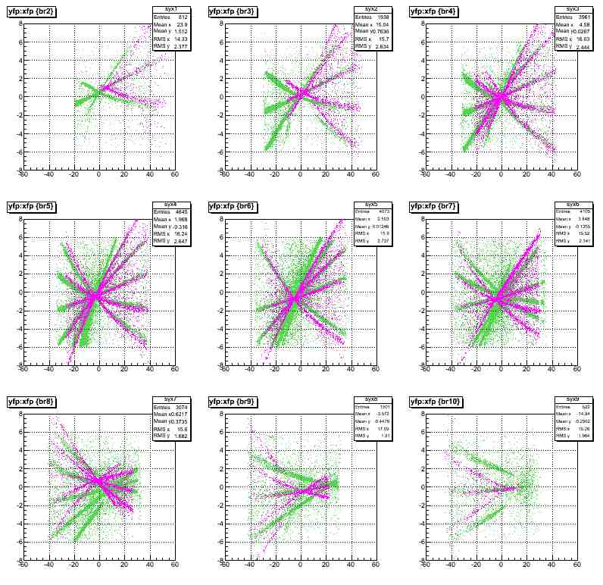
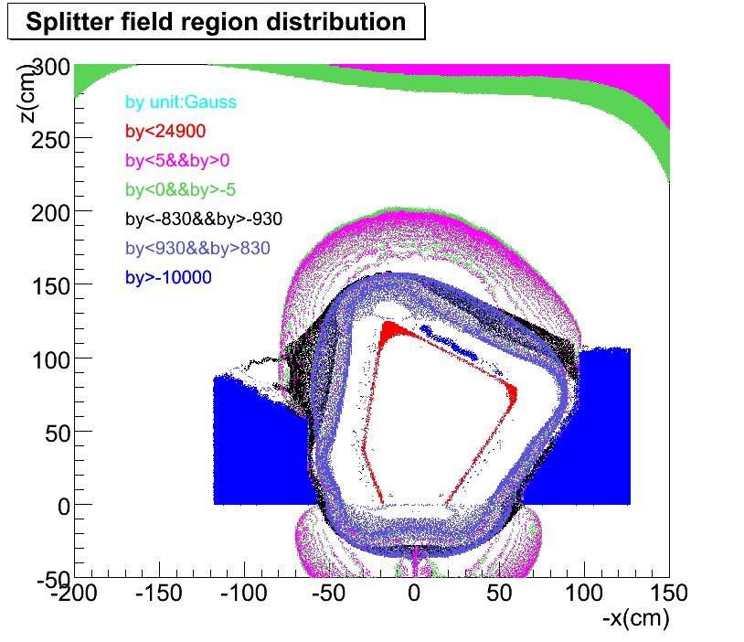
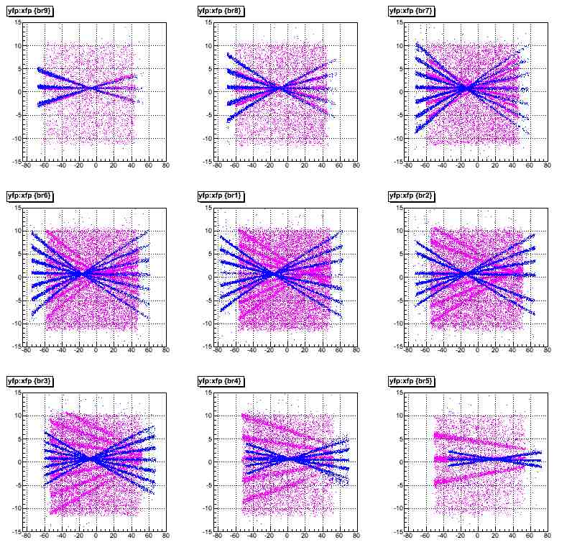
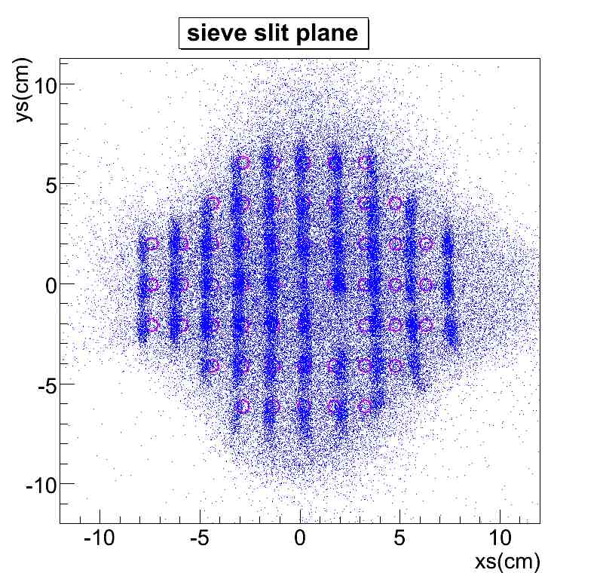
Forward Optics Tuning
Beam
Kaon
Q2
Q1
Target
Splitter field contour on xoz plane
Purple: Geant4 simulation green: Real HES SS data
Purple: Real HKS SS data Blue: Geant4 Simulation
The leakage of splitter fringe field causes the cross talk between the splitter and quadrupoles
Notes:
In these figures, all are y focal plane vs x focal plane. Each of them is one column cut on SS plane, and each of them can stand for independent kinematic space. Purple is real ss data and blue is geant4 simulation data with initial map. And the first one two of them match OK, however, as going down, the real data is farer away from the simulation data. The last one, there are percentage difference between each other. Here is the spliter counour on xoz plane. The splliter magnet is very close to quardruple q1, and the sharp wedge of the splitter causes fringe field leakage. Therefore there is a cross talk between spliter magnetics field and Q1, which causes asymetry of q1 magnetics field. This also happen to HES side. Because of the geometry set is difference, it looks slightly different from HKS side.

Slide 17
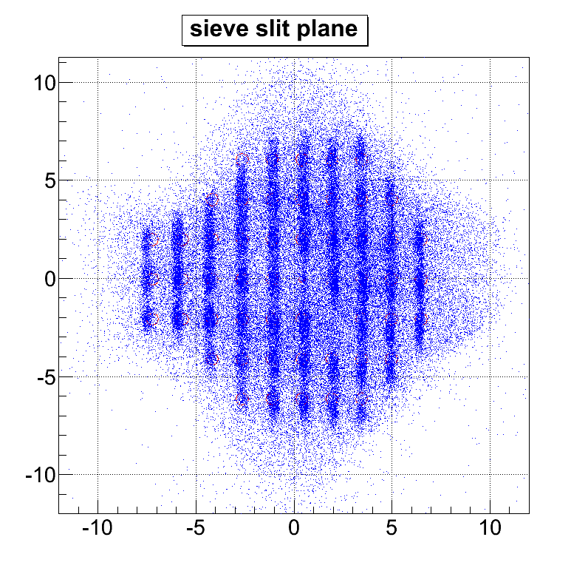
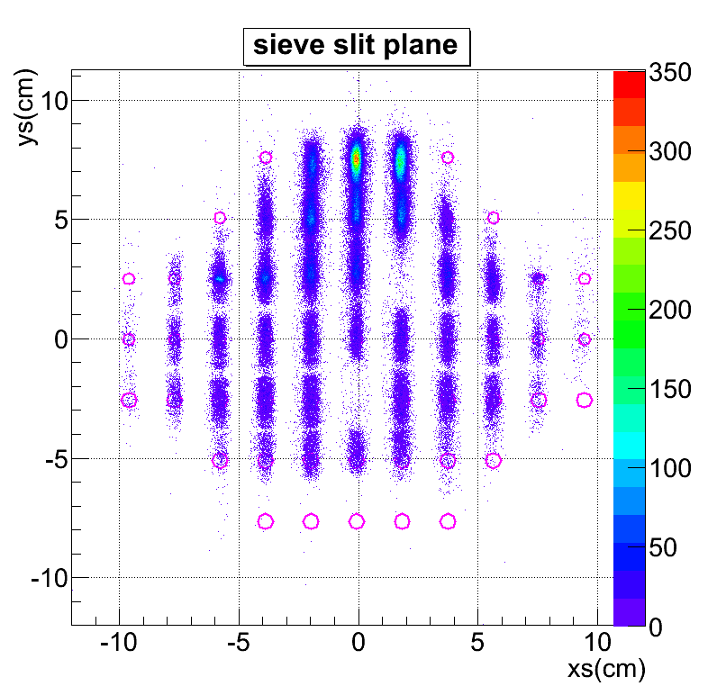
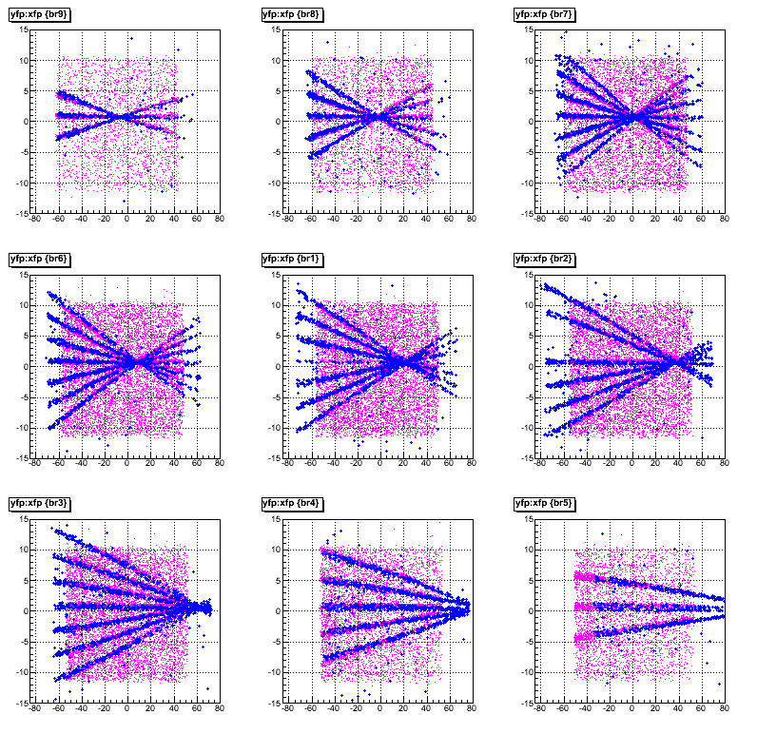
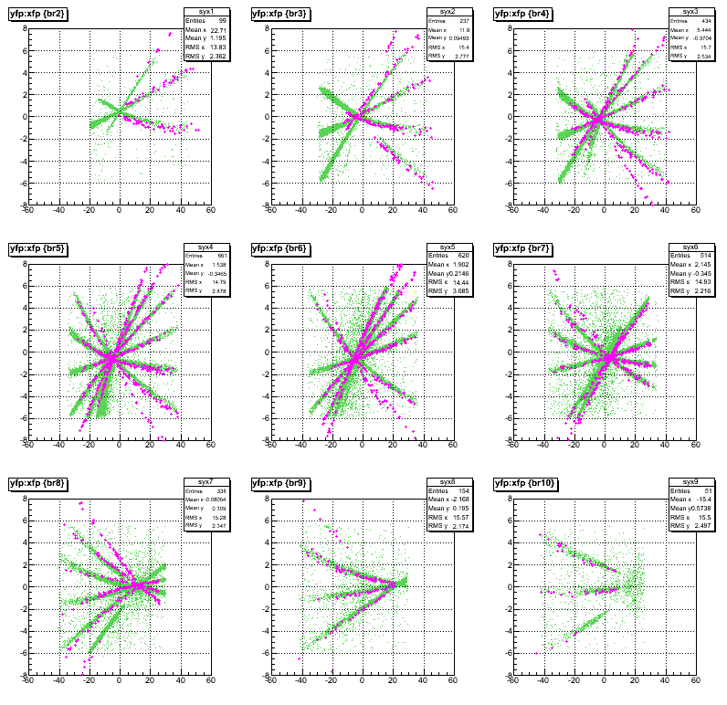
Forward Optics Tuning
The asymmetry functions are introduced and tuned for HKS&HES quadruple field Bx and By, independently.
Notes:
In order to solve the problem, I studied the application of every component of all the magnets, it took me long time. Finally, the asymmetry functions are found and introduced for HKS&HES quadruple field Bx and By, independently. However, it took me another long time to tune the functions. It is worth. Now we have good match between simulation data and real data. It makes us confident. And the SS pattern also have good match to the hole.

Slide 18
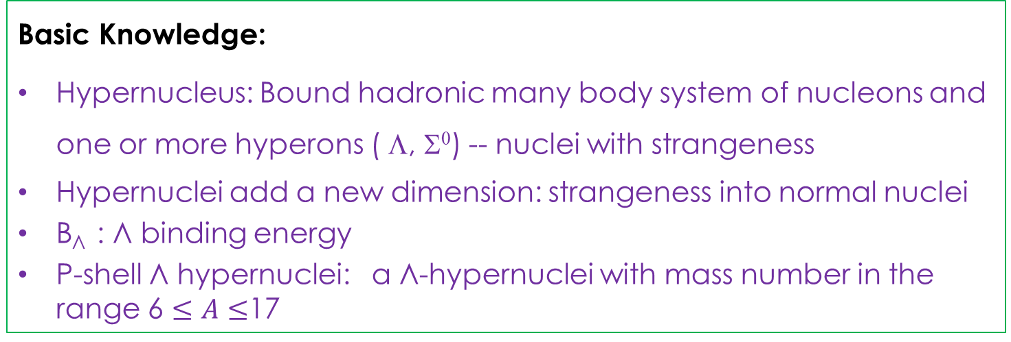
Introduction
Basic Knowledge:
Hypernucleus: Bound hadronic many body system of nucleons and one or more hyperons ( Λ, Σ⁰) -- nuclei with strangeness
Hypernuclei add a new dimension: strangeness into normal nuclei
B_{Λ} : Λ binding energy
P-shell Λ hypernuclei: a Λ-hypernuclei with mass number in the range 6 $≤A≤$17
Physical Goals:
  To understand YN and YY interactions
  To explore and understand nuclear structure using Λ as a probe
    Model the baryonic many body system
    Study the role of Λ in the nuclear medium
Notes:
(c) The \Lambda
s -hypernuclear species for baryon numbers A=3,4, and 5 are konwn as the s-shell hypernuclei , since they consist of a \Lambda
paraticle bound to an s-shell nucleus.

