Slide 1
Measurement Of the
Proton Form Factor Ratio
at High Q²
by Using The
Double Spin Asymmetries
Spin
Asymmetries of the
Nucleon
Experiment
( E07-003)
Anusha Liyanage
APS April Meeting, February 15, 2010

Slide 2
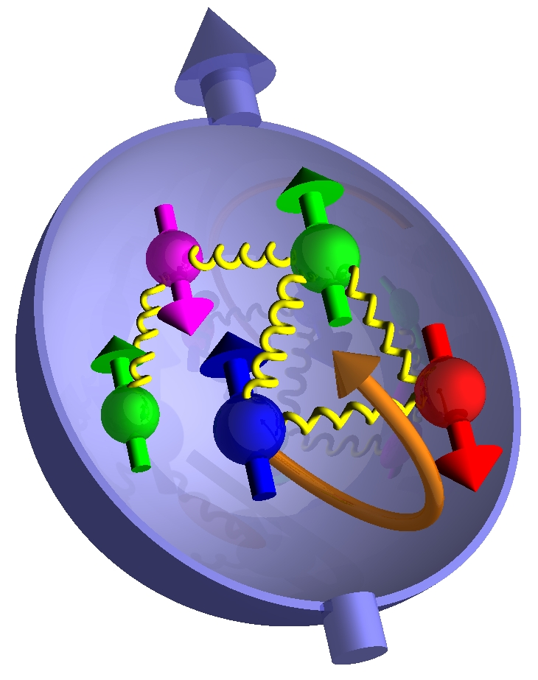
Outline
Physics Motivation
Experiment Setup
Elastic Kinematic
Data Analysis
Error Propagation
SIMC Simulation
Future Work
BETA Detector
HMS Detector
Polarized Target

Slide 3
Physics Motivation
Dramatic discrepancy between
Rosenbluth and recoil polarization
technique.
Multi-photon exchange considered the
best candidate for the explanation
M. Jones et al., PRC74 (2006) 035201
RSS (Jlab)
Q² = 1.5 (GeV/c)²
Dramatic discrepancy !
New data points for the
Polarization transfer technique
using the exp. GeP-III, Hall C
at Q² = 5.2 (GeV/c)² , 6.7 (GeV/c)²
and 8.5 (GeV/c)²
SANE
5.17
6.25

Slide 4
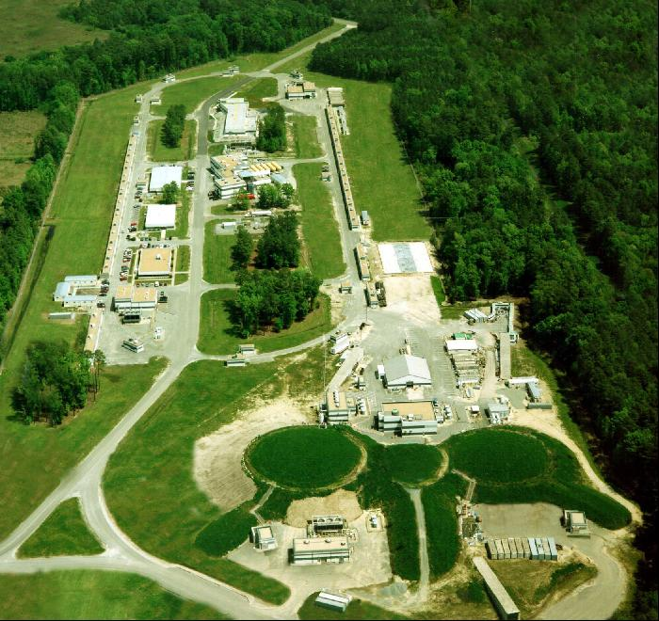
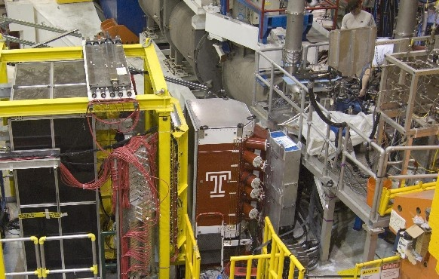
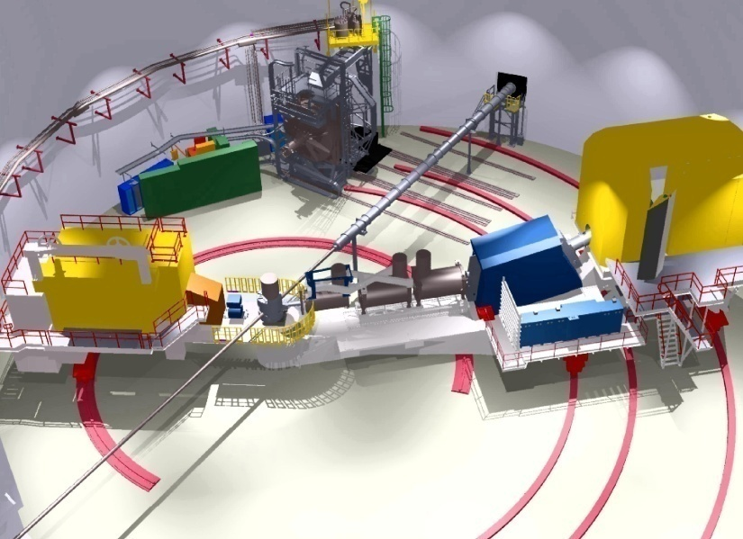
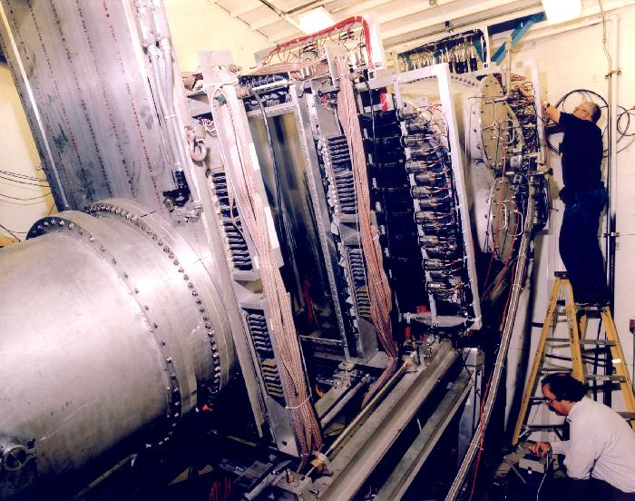
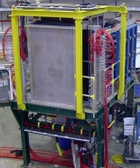
Experiment SANE
BETA for coincidence electron
detection
Central scattering angle :40 °
Over 200 msr solid angle
coverage
Hall C at Jefferson Lab
Elastic (e , e’p) scattering from
the polarized NH₃ target using a longitudinally polarized electron
beam
(Data collected from Jan – March ,2009)
HMS for the scattered
proton detection
Central angles are
22.3° and 22.0°
Solid angle ~10 msr
e⁻p → e⁻p

Slide 5
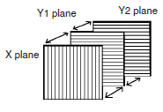
Big Electron Telescope Array – BETA
3 planes of Bicron Scintillator provide
early particle tracking
Forward Tracker
N2 gas cerenkov
Provides particle ID
8 mirrors and 8 PMTs
Cerenkov
BigCal
Lucite Hodoscope
Tracker
Lucite Hodescope
28 bars of 6cm wide Lucite
Bars oriented horizontally for Y
tracking
PMTs on either side of bar provides
X resolution
Cherenkov
Big Cal (GEP III Collaboration)
Lead glass calorimeter
1744 blocks aprx. 4cm x 4cm
energy and position measurement

Slide 6
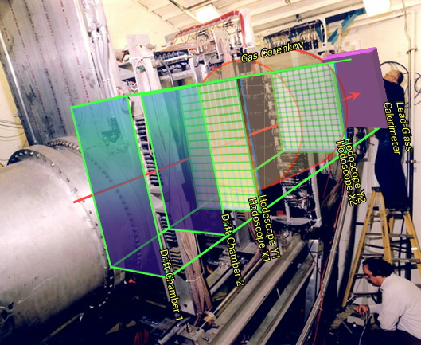
High Momentum Spectrometer – HMS
Each plane has a set of alternating field and
sense wires Filled with an equal parts
Argon-Methane mixture
Track particle trajectory by multiple planes.
χ² fitting to determine a straight trajectory.
Drift Chambers
V,V’
U,U’
α
Drift Cham I
Drift Cham II
X,X’
∆Z = 81.2 cm
α = ± 15°
Each plane contains 10 to 16 Scintillator paddles
with PMTs on both ends
Each Paddle is 1.0 cm thick and 8.0 cm wide
Fast position determination & triggering
Time of Flight (TOF) = T2-T1 determines β
Hodescopes
Time of particle
detection, T
Gas Cerenkov
Two mirrors (top & bottom) connected to two PMTs
Used as a Particle ID
X₁, Y₁
X₂, Y₂
Length of the
particle trajectory, L=2.2 m
S1 plane
S2 plane
4 layers of 10 cm x 10cm x70cm blocks stacked 13 high.
Used as a Particle ID
Lead Glass Calorimeter
(β = L/c x TOF)

Slide 7
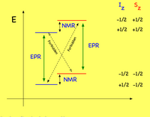
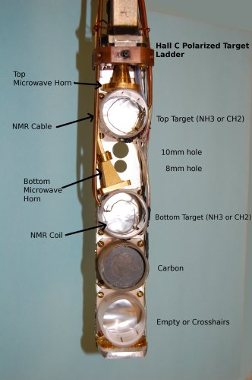
Polarized Target
• C ,CH₂ and NH₃
• Dynamic Nuclear Polarization (DNP) polarized
the protons in the NH₃ target up to 90%
• Used microwaves to excite spin flip transitions
• Polarization measured using NMR coils
• Refrigerator - 1 K
• Magnetic Field - 5 T
• NMR system
• Microwaves - 55 GHz - 165 GHz
The Polarized Target Assembly

Slide 8
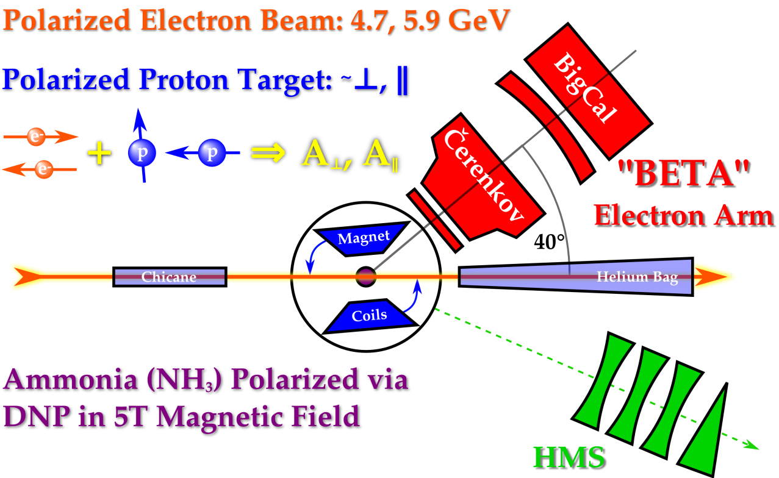
Run Dates | Beam Energy | Magnet Orientation | Run Hours/ Proposed PAC hours | Average Beam Polarization
Elastic Kinematics
E Beam GeV | 4.725 | 5.891
P GeV/C | 3.585 | 4.170
Θ (Deg) | 22.30 | 22.00
Q² (GeV/C)² | 5.170 | 6.259
# of Total runs | ~44 | ~135
e-p Events | ~153 | ~980
Used perpendicular Magnetic field
configuration
Beam polarization is ~ 73 %
Average target polarization is ~ 70 %
Θ_{B} = 80°
Θ_{B} = 180°
( 80 and 180 deg )

Slide 9
Extracted the elastic events
Data Analysis
Definitions :
X/Yclust - Measured X/Y positions on
the BigCal
X = horizontal / in-plane coordinate
Y = vertical / out – of – plane
coordinate
Eclust - Measured electron energy at the
BigCal
Yclust
Xclust
e’
Θ_{P}
P
e
By knowing
the energy of the polarized electron beam, E_{B}
and
the scattered proton angle, Θ_{P}
We can predict the
X/Y coordinates - X_HMS, Y_HMS and
( Target Magnetic Field Corrected)
The Energy - E_HMS
of the coincidence electron on the BigCal

Slide 10
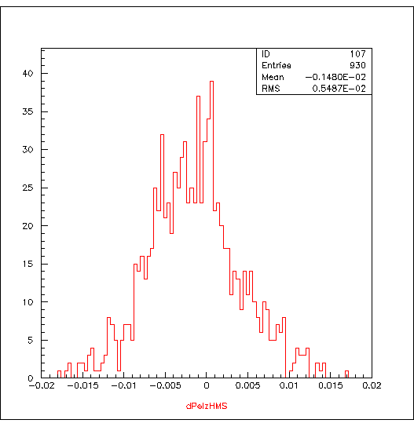
Momentum difference
Momentum Difference , dPel_hms
H
M
S
C
O
IN
Elliptic cut
y_{i} = variable
a_{i} = offset
σ_{i} = cut
HMS – abs(dPel_hms ) < 0.02
abs(hsdelta) < 8
hcer_npe < 0.2
hsshtrk/hse > 0.01
COIN - abs(EHMS-eclust+0.37) <1
abs(XHMS-xclust-0.15) < 5
abs(YHMS-yclust+0.41) < 10

Slide 11
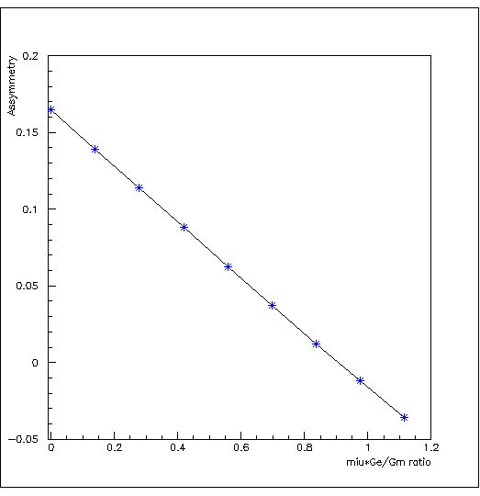
From The Experiment
The calculated asymmetry vs μG_{E}/G_{M}
The raw asymmetry,
The elastic asymmetry,
The beam-target asymmetry,
Here,
N⁺ - N⁻
N⁺ + N⁻
N⁺= Helicity + Counts
N⁻ = Helicity - Counts
A_{m} =
At Q²=6.259 (GeV/C)²
and
≈ 102° and = 0
A_{m}
f P_{B}P_{T}
P_{B},P_{T} = Beam & Target Pol.
f = Dilution Factor
Nc = A Correction Term
A_{P} = + Nc
P_{T} + = ~71.0% , P_{T} - = ~-65.0%, P_{B} = ~73.0%,
r = G_{E} /G_{M}
a, b, c = kinematic factors
, = pol. and azi. Angles between q and S
≈ 102° and = 0
From the HMS kinematics, r² << c

Slide 12
Error Propagation From The Experiment…..
Using the experiment data at
Q²=6.259 (GeV/C)²,
∆r = 0.118
μ ∆r = 2.79 x 0.118
μ ∆r = 0.3
Where , μ – Magnetic Moment of the
Proton
The error on the μ ∆r from the experimental data with total ep events ~1000,
μ ∆r = 0.3

Slide 13
SIMC Simulation
HMS Single Arm Variables
- at the Target -
HMS Coincidence with BigCal Variables
σ = 0.79
σ = 2.98
σ = 1.69
σ = 4.21
X position
Momentum in Fraction
X position diff.
Y position diff.
SIMC Simulation
σ = 0.0041
Experimental Data
σ = 0.0055
SIMC Counts = 1696
Data = 950
In plane angle
Out of plane angle
Momentum diff in Fraction
• Target Magnetic Field is corrected
• Normalized to Charge, Tracking Efff. and Comp. L.T.

Slide 14
To Do …..
Improve the SIMC simulation
Correct the data with the detector Efficiencies
Extract the Asymmetry and the G_{E}/G_{M} Ratio

Slide 15
SANE Collaborators:
U. Basel, Christopher Newport U., Florida International U., Hampton U., Mississippi State U., Norfolk S. U., North Carolina A&M, IHE-PProtvino, Ohio U., U. of Regina, Rensselaer Polytechnic I., Rutgers U., Seoul National U., Temple U., TJNAF, U. of Virginia, William & Mary, U. of Witwatersrand, Yerevan Physics Inst.
Spokespersons: S. Choi (Seoul), M. Jones (TJNAF), Z-E. Meziani (Temple),
O. A. Rondon (UVA)
Thank You

