Slide 1
Data Analysis Strategy to Obtain High Precision Missing Mass Spectra
For E05-115 Experiment
Spectroscopic investigation of Lambda hypernuclei in the wide mass region using the (e,e’K+) reaction
(HKS-HES Collaboration)
Zhihong Ye
Hampton University
Feb. 16th 2010, APS Meeting, Washington DC
Notes:
Chunhua just gave you the review of E05-115. Here I am going to continue talking about the analysis strategy to obtain missing mass spectra.

Slide 2
Outline
Detector Calibration:
Tracking, Timing, Particle Identification
Optics Calibration:
Splitter, HKS, HES (Angle, Momentum, Time)
Kinematics Calibration:
Beam energy offset, target effect, center momentum and center angle deviation.
Flow Chart
Current Status
Notes:
Here is the outline. First, I am going to talk about our detector calibration,optics calibration, as well as kinematics calibration.
Then I will give you the flow chart of whole analysis flow chart and current status.

Slide 3
Detectors Calibration
Tracking: --- Focal Plan Info
KDC1(6)
KDC2(6)
K+
100.2 cm
HKS: Two identical Wire Chambers
Resolution: Position: x, y ~ 0.015 cm,
Angle: x’, y’ ~ 0.3 mrad
EDC1(10)
EDC2(6)
e’
~30.0 cm
HES: Honeycomb Chamber + Wire Chamber
Resolution: Position: x ~ 0.007 cm, y ~ 0.015 cm,
Angle: x’ ~ 0.5 mrad, y’ ~ 0.9 mrad
K1X(17) K1Y (9) K2X(18)
Timing: -- Trigger, TOF
HKS Hodoscopes: 1X(17)+1Y(9)+2X(18)
HES Hodoscopes: 1X(25)+2X(25)
K+
15.9 cm 133.6 cm
E1X (25) E2X(25)
e’
30.0 cm
Time Correction: Pulse High Correction, Alignment, Offsets.
Resolution: Single PMT ~ 110 ps, Δβ ~ 0.025
Notes:
We have to calibration tracking of two wire chambers on HKS side for kaon and other two on HES side for electron to gain high resolution position and angle information on each focal plane.
Second, We use three layers of hodoscopes on kaon side and two layers of hodoscopes on electron side for online coincident triggering and offline TOF calculation. Accurate pulse height correction for single PMT, alignment between hodoscopes on the same layers, and time offsets between different layers have to be done to reach 110ps for single PMT and TOF Beta resolution upto 0.025.

Slide 4
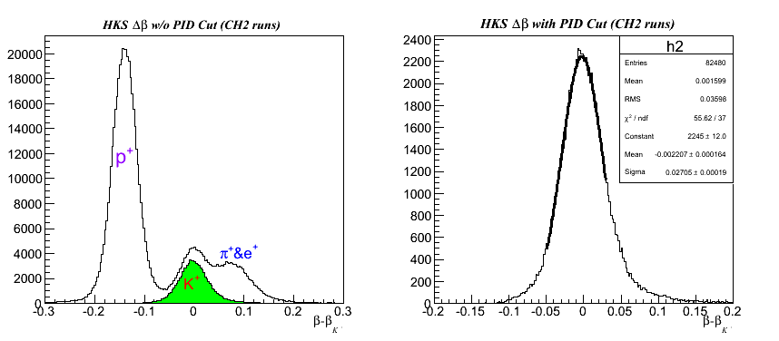
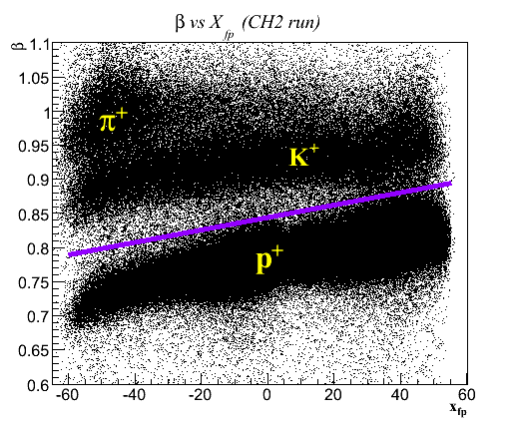
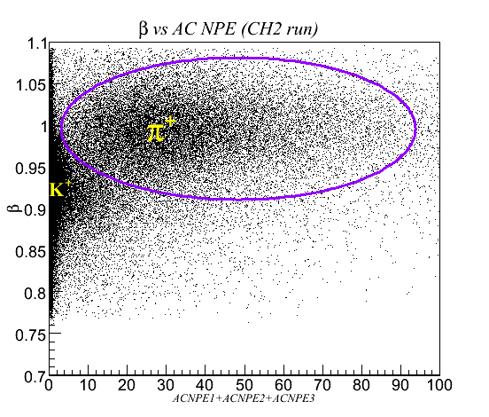
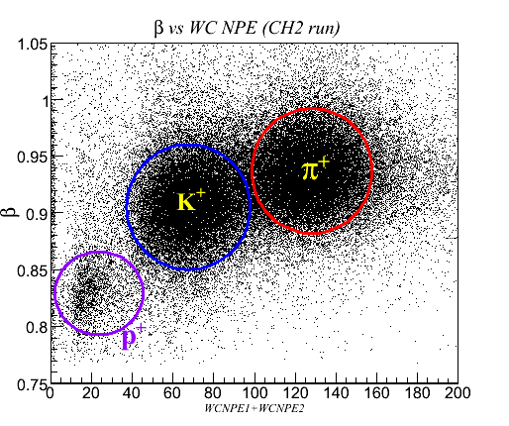
Particle ID:
Online Trigger: !(AC1+AC2+AC3) & (WC1+WC2)
AC (π⁺< 99%), WC (p⁺< 99%),
Offline KID: Cuts on number of photon electrons (NPE)
Optimize Cutting values – More Kaon, less Pion & Proton
σ=0.027
Kaon Beta
HKS X
WC NPE
AC NPE
Notes:
During online data taking, we used AC and WC to suppress 99% of Pion and Proton. And we can continue to apply cuts on their number of photon electrons to extract pure kaon from them. Using the momentum distribution along X, and correlating with TOF Beta, we can get rid of most of proton, and rest of them can be eliminate by applying WC NPE cut. For Pion, we can apply AC NPE cut to remove most of them. So after applying PID cut, we can get very clean Kaon distribution.

Slide 5
Optics Calibration
Optics:
HKS / HES
Beam
Splitter
K⁺/e’
Target Plane
Sieve Slit
Focal Plane
Notes:
Here is the carton of our whole spectrometer system. The splitter magnet separate kaon and scattered electron into HKS/HES spectrometers, which are two similar Quadropole-Quadrople-Dipole magnets. We need three parts of matrices to do target reconstruction. The angle matrices includes two parts. One is HKS/HES angle matrices to reconstruct kaon and electron position and angle on focal planes back to sieve slits planes, which are in between splitter and the first quadro-pole of HKS/HES. The Splitter angle matrices reconstruct sieve slit position, as well as momentum back to target plane to get angle info of kaon and electron. Momentum and time matrices reconstruct focal info back to target plane to get momentum and reaction time of kaon and electron.
Basically we use Geant4 simulation data to generate initial matrices and use different method to calibration them. First, we use sieve slit data to calibration angle matrices of HKS/HES, from the graphic you can see that the initial matrices are still not very close the realistic ones, espicially for HES side, because of the tracking problem for Y’. Because slieve slit data only cover the range from SS to FP, we only can use Lambda and Sigma spectra to calibration splitter matrices and momentum matrices. We use the property of RF time to do time reconstruction.

Slide 6
Optics Calibration
Optics:
HKS / HES
Beam
Splitter
K⁺/e’
Target Plane
Sieve Slit
Focal Plane
Reconstruction:
Angle:
Momentum:
Target Time:
Notes:
Here is the carton of our whole spectrometer system. The splitter magnet separate kaon and scattered electron into HKS/HES spectrometers, which are two similar Quadropole-Quadrople-Dipole magnets. Three parts of matrices are used to do target reconstruction. The angle matrices includes two parts. One is HKS/HES angle matrices to reconstruct kaon and electron position and angle on focal planes back to sieve slits planes, which are in between splitter and the first quadro-pole of HKS/HES. The Splitter angle matrices reconstruct sieve slit position, as well as momentum back to target plane to get angle info of kaon and electron. Momentum and time matrices reconstruct focal info back to target plane to get momentum and reaction time of kaon and electron.
Basically we use Geant4 simulation data to generate initial matrices and use different method to calibration them. First, we use sieve slit data to calibration angle matrices of HKS/HES, from the graphic you can see that the initial matrices are still not very close the realistic ones, espicially for HES side, because of the tracking problem for Y’. Because slieve slit data only cover the range from SS to FP, we only can use Lambda and Sigma spectra to calibration splitter matrices and momentum matrices. We use the property of RF time to do time reconstruction.

Slide 7
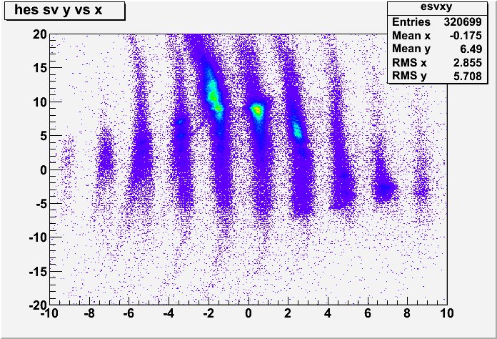
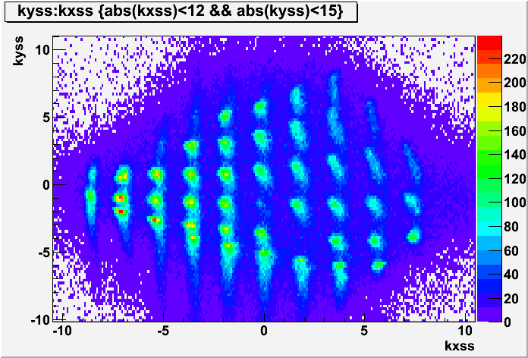
Optics Calibration
Optics:
HKS / HES
Beam
Splitter
K⁺/e’
Target Plane
Sieve Slit
Focal Plane
Reconstruction:
Angle:
Momentum:
Target Time:
Matrices:
Optimized using Sieve Slit data.
Generated from Geant4 simulation
Optimized using Λ&Σ Spectra.
Optimized using Λ&Σ Spectra.
Path length correction using RF time.
Notes:
Here is the carton of our whole spectrometer system. The splitter magnet separate kaon and scattered electron into HKS/HES spectrometers, which are two similar Quadropole-Quadrople-Dipole magnets. Three parts of matrices are used to do target reconstruction. The angle matrices includes two parts. One is HKS/HES angle matrices to reconstruct kaon and electron position and angle on focal planes back to sieve slits planes, which are in between splitter and the first quadro-pole of HKS/HES. The Splitter angle matrices reconstruct sieve slit position, as well as momentum back to target plane to get angle info of kaon and electron. Momentum and time matrices reconstruct focal info back to target plane to get momentum and reaction time of kaon and electron.
Basically we use Geant4 simulation data to generate initial matrices. First, we use sieve slit data to calibration angle matrices of HKS/HES, from the graphic you can see that the initial matrices are still not very close the realistic ones, espicially for HES side, because of the tracking problem for Y’. Because slieve slit data only cover the range from SS to FP, we only can use Lambda and Sigma spectra to calibration splitter matrices and momentum matrices. We use the property of RF time to do time reconstruction.

Slide 8
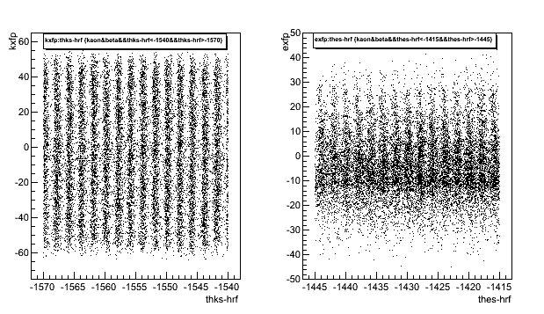
Coincident
Electron pulse
RF Structure:
Jlab electron beam has a 2ns pulse pattern.
2 ns
t
After Path length correction
RF vs HKS X
RF vs HES X
Notes:
As I just mention, Jlab electron beam has a 2ns RF structure, so after doing further path length correction using HKS/HES focal plane info, we obtain more precise target time. By subtracting with RF time, we can see very sharp 2ns RF structure. The subtraction of electron and kaon target time, will provide us the coincident time spectra, where the highest peak represent the real events, and other peaks are accidental events.

Slide 9
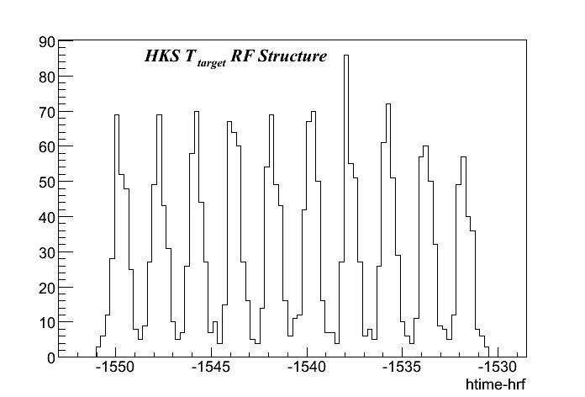
Coincident
Electron pulse
RF Structure:
Jlab electron beam has a 2ns pulse pattern.
2 ns
t
After Path length correction
2ns
RF vs HKS X
RF vs HES X
Notes:
After reconstruction, we have the reaction time on the target plane, we then need to determine real coincident events. We used the true of 2ns RF structure of Jlab electron beam, to do further path length correction using HKS/HES focal plane info, and obtain more precise target time. The subtraction of electron and kaon target time, will provide us the coincident time spectra, where the highest peak represent the real events, and other peaks are accidental events.

Slide 10
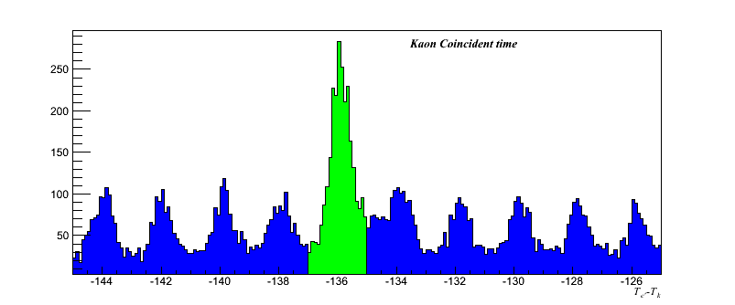
Coincident
Electron pulse
RF Structure:
Jlab electron beam has a 2ns pulse pattern.
2 ns
t
After Path length correction
2ns
RF vs HKS X
RF vs HES X
Coincident Time:
Real Events
Select coincident Kaon and electron events:
Accidental
Notes:
After reconstruction, we have the reaction time on the target plane, we then need to determine real coincident events. We used the true of 2ns RF structure of Jlab electron beam, to do further path length correction using HKS/HES focal plane info, and obtain more precise target time. The subtraction of electron and kaon target time, will provide us the coincident time spectra, where the highest peak represent the real events, and other peaks are accidental events.

Slide 11
Kinematics Calibration
Ebeam = 2.344 GeV±0.01%; Pk0 = 1.2GeV/c ± 12.5%; Pe0 = 0.844 GeV/c ±17%;
Missing Mass:
Notes:
Once we have the reconstructed momentum and angle information of coincident kaons and electrons, combining with our single kinematics setting, we can calculate the missing mass. But before we do that, we still need to look into the real kinematics very carefully.

Slide 12
Kinematics Calibration
Ebeam = 2.344 GeV±0.01%; Pk0 = 1.2GeV/c ± 12.5%; Pe0 = 0.844 GeV/c ±17%;
Missing Mass:
Target effect:
Due to Bremsstrahlung, Ionization, Multi-Scattering and so on..
Using SIMC (Hall-C standard Monte-Carlo simulation package), for different targets and thickness, we have:
Notes:
Once we have the reconstructed momentum and angle information of coincident kaons and electrons, combining with our single kinematics setting, we can calculate the missing mass. But before we do that, we still need to look into the real kinematics very carefully.
Due to bremsstrahlung, ionization, multi-scattering and other target effects, particle traveling inside target medium should have energy loss.

Slide 13
Kinematics Calibration
Ebeam = 2.344 GeV±0.01%; Pk0 = 1.2GeV/c ± 12.5%; Pe0 = 0.844 GeV/c ±17%;
Missing Mass:
Target effect:
Due to Bremsstrahlung, Ionization, Multi-Scattering and so on..
Using SIMC (Hall-C standard Monte-Carlo simulation package), for different targets and thickness, we have:
Beam Energy Offset:
Two energy scan run: E = E_{beam} ± 1.0 MeV, we have the correction function:
Notes:
During the experiment data taking, we observe beam energy shift period by period, so we took two energy scan run with known energy offsets. Using the relationship between beam energy and the beam curve measured by six Hall C beam position monitors, we can construct correction function for energy shift events by events.

Slide 14
Central Momentum & Angle Offsets:
Central Momentum:
Central Angle:
Magnet field setting, Installation, and Coordinate definition…
Notes:
The other aspect we need to consider is that because of …., the central momentum and central angle should have deviations. Again, we used the data of Lambda and sigma, which masses are very well-known, to gain those offsets values. By defining a Chi-Square, equal to missing mass of Lambda plus Sigma times their own statistic weights, and set those offsets as parameters, we can fit the lambda and sigma data to minimize the Chi-Square to get their true values.
Once we corrected the energy loss, beam energy shifts and center momentum and center angle offsets, we can calculate all missing mass of hypernuclei.

Slide 15
Central Momentum & Angle Offsets:
Central Momentum:
Central Angle:
Magnet field setting, Installation, and Coordinate definition…
Using the well-known Λ&Σ masses, define Chi-Square:
And set ΔX’_{k0}, ΔY’_{k0}, ΔP_{k0}, ΔX’_{e0}, ΔY’_{e0}, ΔP_{e0} as parameters, we can fit Λ&Σ data to minimize the Chi-Square, and obtain offset values:
Notes:
The other aspect we need to consider is that because of …., the central momentum and central angle should have deviations. Again, we used the data of Lambda and sigma, which masses are very well-known, to gain those offsets values. By defining a Chi-Square, equal to missing mass of Lambda plus Sigma times their own statistic weights, and set those offsets as parameters, we can fit the lambda and sigma data to minimize the Chi-Square to get their true values.
Once we corrected the energy loss, beam energy shifts and center momentum and center angle offsets, we can calculate all missing mass of hypernuclei.

Slide 16
Central Momentum & Angle Offsets:
Central Momentum:
Central Angle:
Magnet field setting, Installation, and Coordinate definition…
Using the well-known Λ&Σ masses, define Chi-Square:
And set ΔX’_{k0}, ΔY’_{k0}, ΔP_{k0}, ΔX’_{e0}, ΔY’_{e0}, ΔP_{e0} as parameters, we can fit Λ&Σ data to minimize the Chi-Square, and obtain offset values:
Missing Mass:
Notes:
The other aspect we need to consider is that because of …., the central momentum and central angle should have deviations. Again, we used the data of Lambda and sigma, which masses are very well-known, to gain those offsets values. By defining a Chi-Square, equal to mass differences of Lambda plus Sigma times their own statistic weights, and set those offsets as parameters, we can fit the lambda and sigma data to minimize the Chi-Square to get their true values.
Once we corrected the energy loss, beam energy shifts and center momentum and center angle offsets, we can calculate all missing mass of hypernuclei with correct kinematics.

Slide 17
Flow Chart
Tracking
(KDC)
Geant4 Simulation
Need to do
Data & Info
HKS Focal Plane
(X,X’,Y,Y’,T_{fp})
TOF
(Hodoscopes)
Optics
(HKS+Splitter)
HKS
HKS Target Plane
(X’, Y’, P, T_{tar})
HKS Sieve Slit
KID
(AC,WC,LC)
Kinematics Correction
(Beam, Target effects, Momentum, Angular)
Coincident
(RF )
Missing Mass
Raw Data
Lambda&Sigma
Spectra
Tracking
(EDC)
HES Sieve Slit
Optics
(HES+Splitter)
HES
HES Focal Plane
(X,X’,Y,Y’, T_{fp})
HES Target Plane
(X’, Y’, P, T_{tar})
TOF
(Hodoscopes)
Notes:
So our whole analysis procedure can be represented by this flow chart. We have two regions, HKS & HES, and three analysis steps. First step is to calibration all detectors to get focal plane information. Second step is the calibration of Optics and Kinematics by using Sieve Slit data and Geant4 simulation. Once we obtain the angle information of coincident Kaons and electrons events on target, we can calculate missing masses. And the spectra of Lambda and Sigma will go back to the second step to optimize splitter matrices and kinematics. There will be many iterations between this two steps to reach the final spectra.

Slide 18
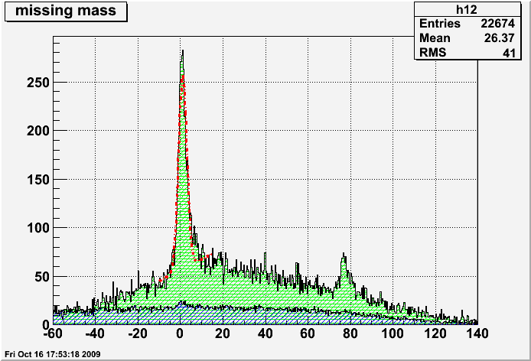
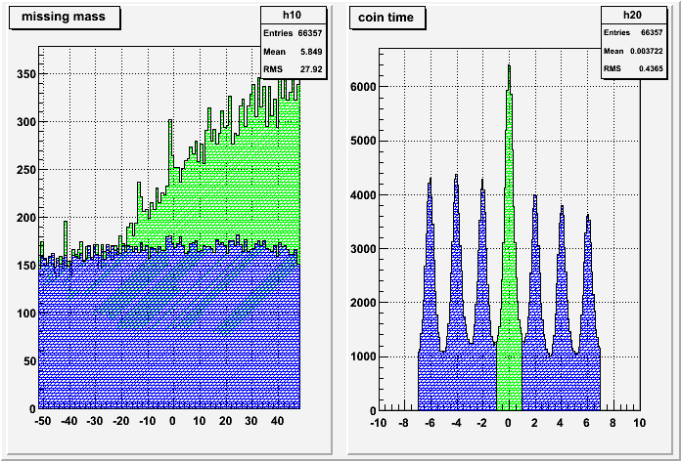
Current Status & Plan
We are currently working on precise calibration of all detectors.
To Do:
Tracking: Solve HES y’ problem.
Timing: Improve timing and TOF resolution.
PID: Standardize AC, WC cutting values for different targets.
Optics: Optimizing matrices using Sieve Slit data
Kinematics: Improving minimization method.
Λ
P Shell?
G.S?
σ~1 MeV
Σ
Very Preliminary
Need a lot of work to reach 350 KeV!
Thank you!
Notes:
We currently are still working on early step of detectors calibration. Here I give you two very preliminary missing mass spectra. First one is the Lamba and Sigma spectra. Without any precise detectors calibration, and no any work on optics and kinematics, the sigma of lambda is about 1Mev, which is much better comparing with 2005 data, and the background is much lower. The other spectrum is B12 lambda, the G.S and p shell are visible without further calibration.
We need to continue working on tracking to solve HES Y’ problem. For timing, we need to improve timing and TOF resolution….

