Slide 1
Proton Form Factor Ratio G_{E}/G_{M}
from
Double Spin Asymmetry
with
Polarized Beam and Target
Spin
Asymmetries of the
Nucleon
Experiment
( E07-003)
Anusha Liyanage

Slide 2
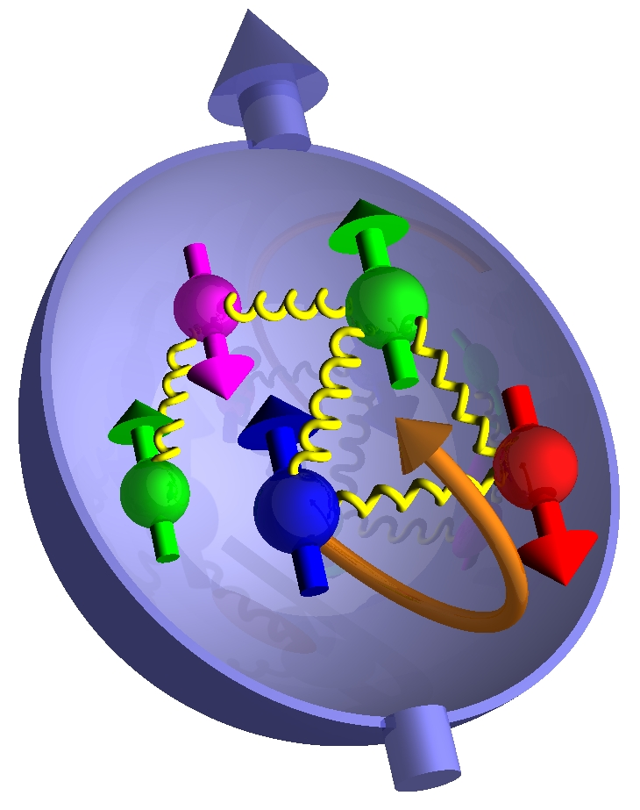
Outline
Physics Motivation
Experiment Setup
Elastic Kinematics
Data Analysis
• Electrons in HMS
• Protons in HMS
Future Work/Conclusion
Polarized Target

Slide 3
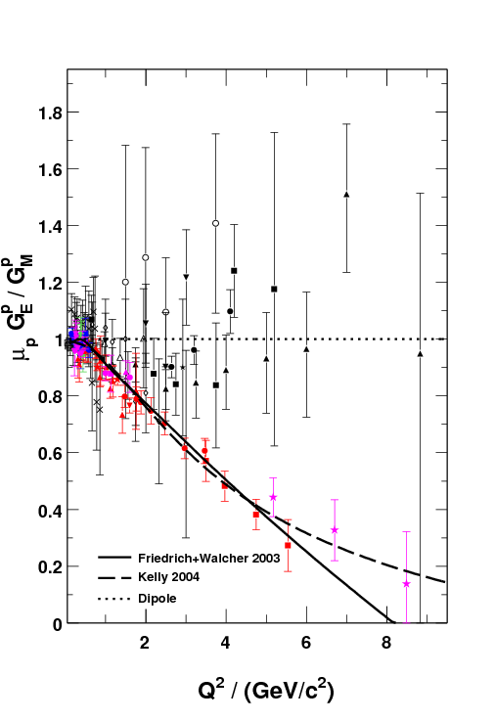
Physics Motivation
Dramatic discrepancy between
Rosenbluth and recoil polarization
technique.
Multi-photon exchange considered the
best candidate for the explanation
M. Jones et al., PRC74 (2006) 035201
RSS (Jlab)
Q² = 1.50 (GeV/c)²
A.J.R. Puckett et al., Phys. Rev. Lett. 104 (2010) 242301
GeP-III (Jlab)
Q² = 5.2 (GeV/c)² , 6.7 (GeV/c)² and 8.5 (GeV/c)²
Dramatic discrepancy !
Dramatic discrepancy !
SANE
2.20
5.17
6.25

Slide 4
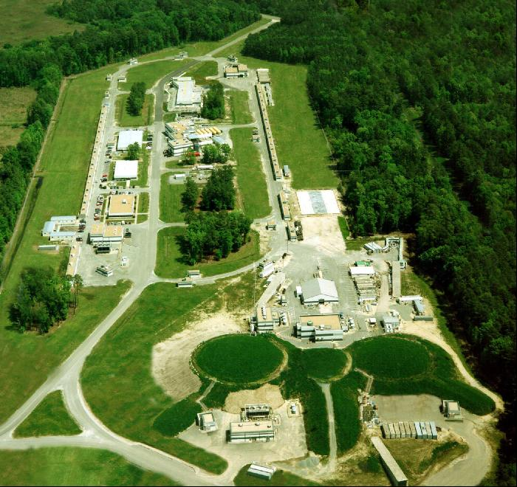
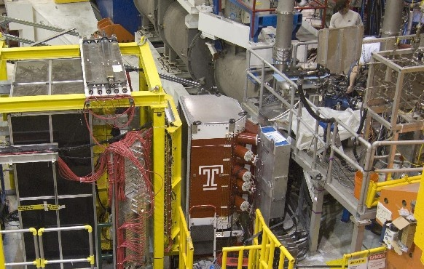
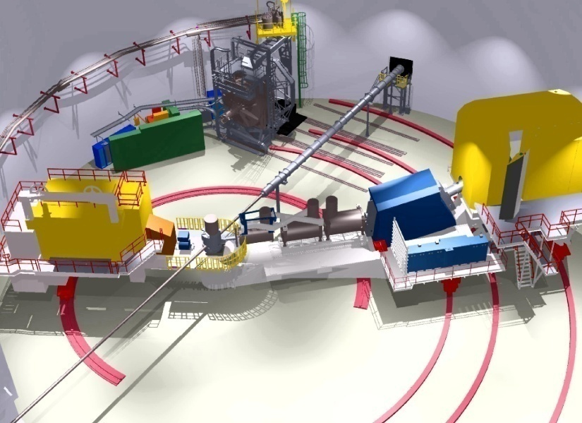
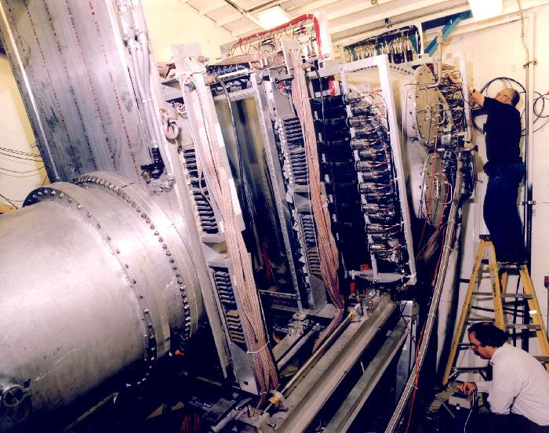
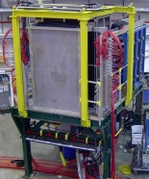
Experiment SANE
BETA for coincidence electron
detection
Central scattering angle :40 °
Over 200 msr solid angle
coverage
e⁻
p/e⁻
Hall C at Jefferson Lab
HMS for the scattered
proton detection
Single arm electron
detection
Central angles are
22.3° and 22.0°
Solid angle ~10 msr
Elastic (e , e’p) scattering from
the polarized NH₃ target using a longitudinally polarized electron
beam
(Data collected from Jan – March ,2009)
e⁻ p e⁻ p

Slide 5
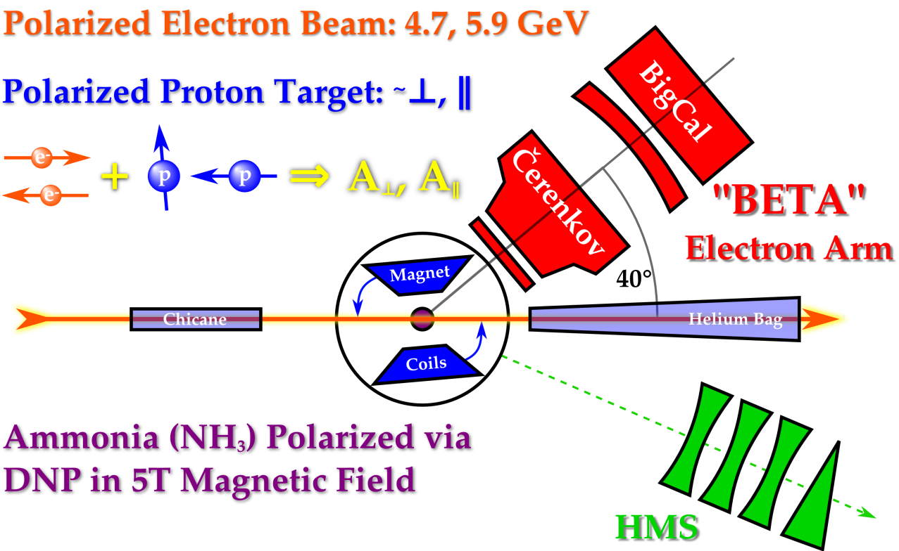
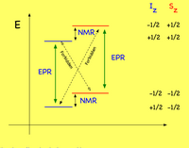
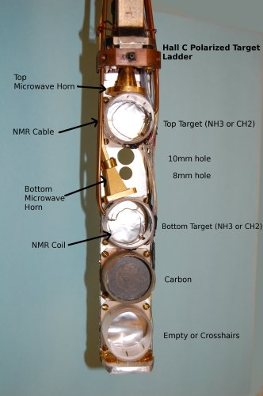
Polarized Target
• C ,CH₂ and NH₃
• Dynamic Nuclear Polarization (DNP)
polarized the protons in the NH₃
target up to 90%
• Used microwaves to excite spin flip
transitions
• Polarization measured using NMR coils
Θ_{B} = 80°
Θ_{B} = 180°
( 80 and 180 deg )
Used perpendicular Magnetic
field configuration
Average target polarization is
~ 70 %
Beam polarization is ~ 73 %
• Refrigerator - 1 K
• Magnetic Field - 5 T
• NMR system
• Microwaves - 55 GHz - 165 GHz

Slide 6
Run Dates | Beam Energy | Magnet Orientation | Run Hours/ Proposed PAC hours | Average Beam Polarization
Elastic Kinematics
Spectrometer mode | Coincidence | Coincidence | Single Arm
HMS Detects | Proton | Proton | Electron
E Beam GeV | 4.72 | 5.89 | 5.89
P GeV/C | 3.58 | 4.17 | 4.40
Θ (Deg) | 22.30 | 22.00 | 15.40
Q² (GeV/C)² | 5.17 | 6.26 | 2.20
Total Hours (h) | ~40 (~44 runs) | ~155 (~135 runs) | ~12 (~15 runs)
e-p Events | ~113 | ~824 | -

Slide 7
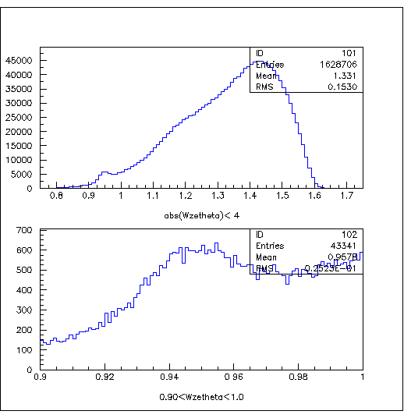
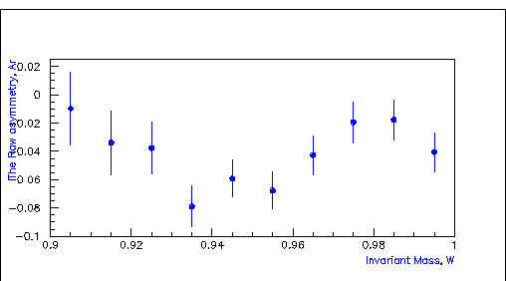
Data Analysis
PART I : Electrons in HMS
By knowing the beam energy, E and the scattered electron angle,
The Invariant mass
Θ
e⁻
The Raw Asymmetries
abs(W)<4
The Raw Asymmetry, A_{r}
0.9<(W)<1
Invariant Mass, W
• Used only the Electron selection cuts.
Further analysis requires a
study of the dilution factor and backgrounds
in order to determine the
physics asymmetry and G_{E}/G_{M}. (at Q²=2.2 (GeV/C)² )

Slide 8
Extracting the elastic events
PART II: Protons in HMS
Definitions :
X/Yclust - Measured X/Y positions
on BigCal
X = horizontal /in-plane coordinate
Y = vertical / out – of – plane
coordinate
Eclust - Measured electron energy at
BigCal
Yclust
Xclust
e’
Θ_{P}
P
e
By knowing
the energy of the polarized electron beam, E_{B}
and
the scattered proton angle, Θ_{P}
We can predict the
X/Y coordinates - X_HMS, Y_HMS and
( Target Magnetic Field Corrected)
The Energy - E_HMS
of the coincidence electron on BigCal

Slide 9
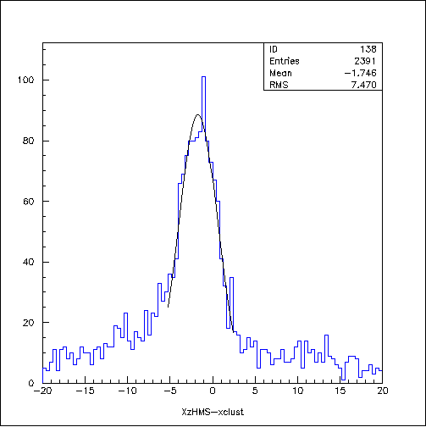
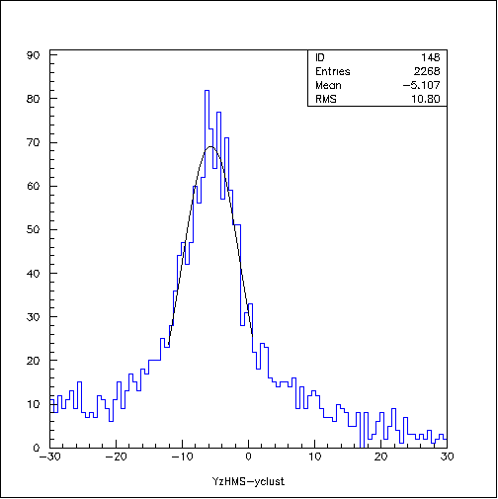
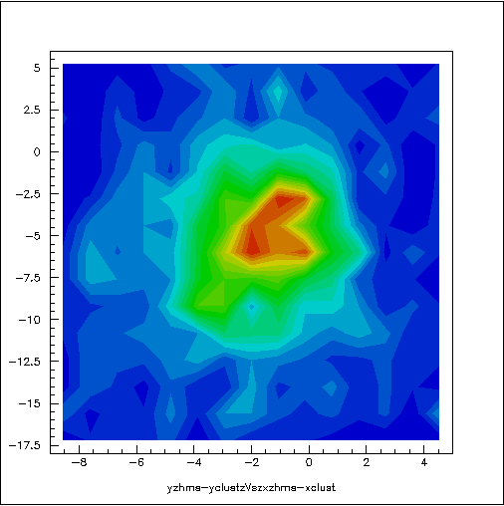
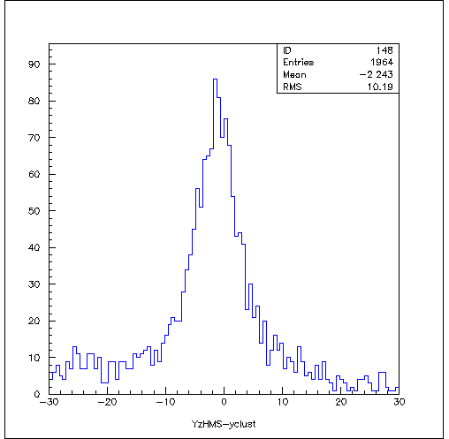
Extracting the Elastic
Events…
X position difference
Y position difference
abs(X_HMS-Xclust+1.6)<7
abs(Y_HMS-Yclust+5.7)<12
Y position diff. Vs X position diff.
X_HMS-Xclust (cm)
Y_HMS-Yclust (cm)
The Elliptic cut,
Y_HMS-Yclust (cm)
Y_HMS-Yclust (cm)
Suppresses background most effectively
Here, ∆X = X_HMS – xclust
∆Y = Y_HMS – yclust
X(Y)_{max} = The effective area cut
X_HMS-Xclust (cm)
X_HMS-Xclust (cm)
y position difference
abs(Y_HMS-yclust) < 10
Y_HMS-yclust (cm)

Slide 10
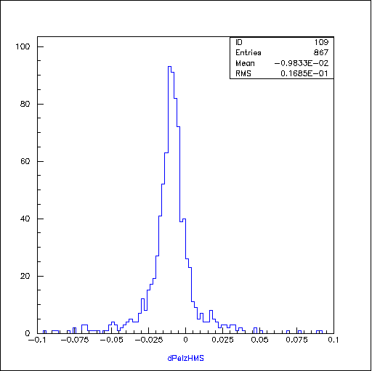
Momentum difference
The Momentum Difference , dPel_hms
P_{HMS} – Measured Proton momentum by
HMS
P_{cal} – Calculated Proton momentum by
knowing the beam energy, E and the
Proton scattered angle,
P_{cent} – HMS central momentum
abs(dpel_hms+0.01)<0.04
dpel_hms
The final elastic events are selected by using,
• The Elliptic cut and
• The ‘dpel_hms’ cut
Here , M is the Proton mass.

Slide 11
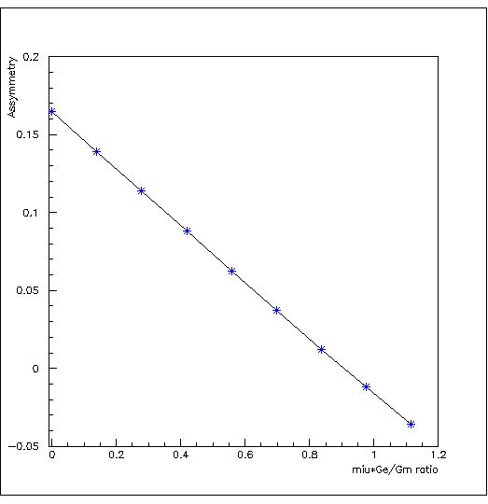
From The Experiment
The raw asymmetry, A_{r}
N⁺ = Counts for the + helicity
N⁻ = Counts for the – helicity
∆A_{r} = Error on the raw asymmetry
The elastic asymmetry, A_{p}
f = Dilution Factor
P_{B},P_{T} = Beam and Target polarization
∆A_{p} = Error on the elastic asymmetry
N_{c}= A correction term to eliminates the contribution from quasi-elastic ¹⁵N scattering under the elastic peak
The beam - target asymmetry, A_{p}
The calculated asymmetry vs μG_{E}/G_{M}
0.20
At Q²=6.26 (GeV/C)²
and
≈ 102° and = 0
Asymmetry
0.15
Here,
r = G_{E} /G_{M}
0.10
a, b, c = kinematic factors
, = pol. and azi. Angles between q and S
Pol. Tran. Tech
0.05
≈ 102° and = 0
From the HMS kinematics, r² << c
0.00
Rosenbluth Tech.
0.0
-0.05
0.4
0.0
0.2
0.6
0.8
1.0
1.2
μ G_{E}/G_{M} Ratio

Slide 12
Future Work ..
Extract the physics asymmetry and the G_{E}/G_{M} ratio
Improve the MC/SIMC simulation and
estimate the background
Conclusion ..
Measurement of the beam-target asymmetry in elastic electron-proton scattering offers an independent technique of determining G_{E}/G_{M} ratio.
This is an ‘explorative’ measurement, as a by-product of the SANE experiment.
Plan to submit a proposal to PAC for *dedicated* experiment with higher statistics after the 12 GeV upgrade.

Slide 13
SANE Collaborators:
Argonne National Laboratory, Christopher Newport U., Florida International U., Hampton U., Thomas Jefferson National Accelerator Facility, Mississippi State U., North Carolina A&M, Norfolk S. U., Ohio U., Institute for High Energy Physics, U. of Regina, Rensselaer Polytechnic I., Rutgers U., Seoul National U., State University at New Orleans , Temple U., Tohoku U., U. of New Hampshire, U. of Virginia, College of William and Mary, Xavier University, Yerevan Physics Inst.
Spokespersons: S. Choi (Seoul), M. Jones (TJNAF), Z-E. Meziani (Temple),
O. A. Rondon (UVA)
Thank You

Slide 14
Backup Slide

Slide 15
Error Propagation From The Experiment…..
Using the experiment data at
Q²=6.26 (GeV/C)² ,
with total ep events ~824, ∆A_{p}=0.11
∆r = 0.22
μ ∆r = 2.79 x 0.22
μ ∆r = 0.6
Q²=5.19 (GeV/C)² ,
with total ep events ~113, ∆A_{p}=0.26
∆r = 0.46
μ ∆r = 2.79 x 0.46
μ ∆r = 1.29
Where , μ – Magnetic Moment of the
Proton

