Slide 1



Spectroscopic Investigation of Λ Hypernuclei in the Wide Mass Region by the (e,e’K⁺) Reaction
Chunhua Chen
Hampton University
Nov.6,2010/DNP
Notes:
I am going to talk about our measurement of lambda hypernuclear spectroscopy, the experiment was done at the end of 2009 in JLAB HALLC

Slide 2
Outline
Experimental Goal
Experimental Setup
Analysis
  Analysis flow chart
  Analysis difficulties and status
Conclusion and to do
Notes:
It is my outline
First is our experiment goal, which is the base for our target option;
Second, I am going to remind our experimental setup
The dominant part of my talk is the analysis
Here I am going to show you the analysis flow chart, and then I would like to discuss about the challenge part of our analysis and the status
Finally, I would show my conclusions and what need to do

Slide 3
Experimental Goal
The 3rd Generation (e,e’K⁺) Hypernuclear Spectroscopy in JLab-HallC
    Medium - heavy hypernuclear spectroscopy
    ⁵²Cr(e,e’K⁺) ⁵²_{Λ}V
  Λ hyperon bound in the mean field
  quark picture vs. conventional picture
Light Λ hypernuclear spectroscopy
    ΛN interaction, ls coupling, Charge Symmetry Breaking
      p shell hypernuclei : ¹²_{Λ}B , ⁷_{Λ}He, ¹⁰_{Λ}Be , and ⁹_{Λ}B
    Calibration by the elementary process p(e,e’K⁺)Λor Σ: H₂O and CH₂
Notes:
We plan to determine high-precision binding energies of lambda single particle states with various l from the excitation spectra of lambda hpernuclei up to A=52

Slide 4
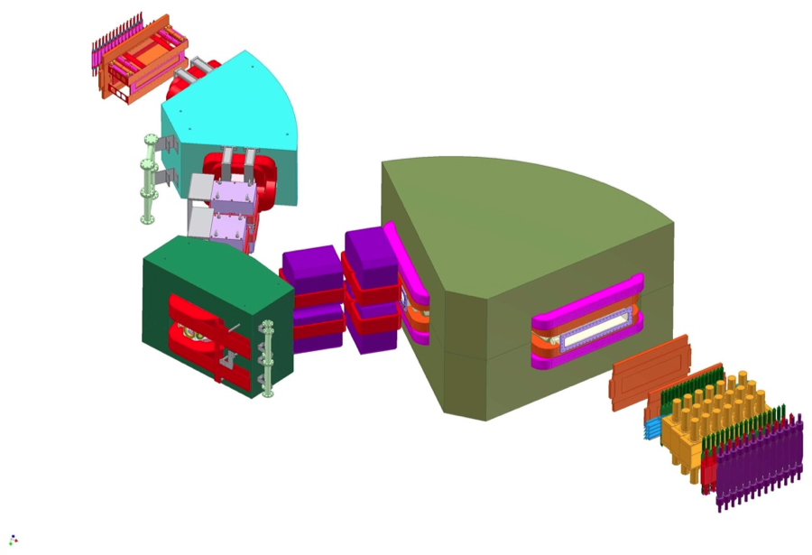
Experimental Setup
HES
HES detector
HKS
e’
New
splitter
K⁺
2.344GeV
e beam
Target
HKS detector

Slide 5
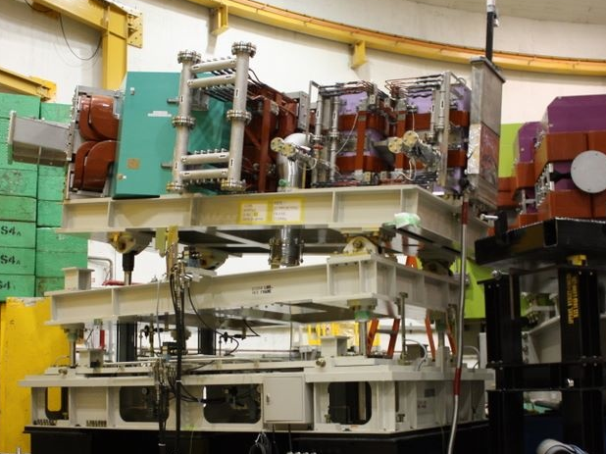
Experimental Setup
6.5°
HES
HES detector
HKS
e’
New
splitter
K⁺
2.344GeV
e beam
Target
HKS detector
Notes:
In order to avoid the high rate of Blau and moller, we used title hes by 6.5 degree similar as the experiment in 2005.Here, our new spectrometer HES and the new Splitter enlarge the acceptance of angle and momentum, which allow us to get higher beam energy, at the same time improve the signal to noise ratio. At this case, we are able to run the heavy target.

Slide 6
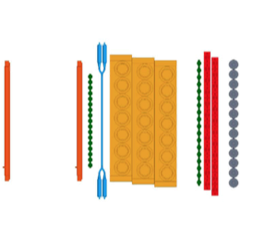
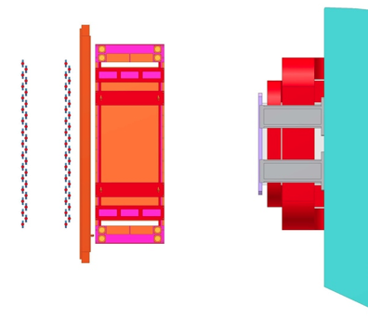
Experimental Setup
KTF1Y
KTF2X
KLC
KDC1
KDC2
HKS detector package
HKS-D
KTF1X
KAC
KWC
EDC2
EDC1
HES detector package
e’
HES-D
EHOD2
EHOD1
Notes:
Here are show our detector package, the above one is the HKS detector package. We have two drift chambers, three layers of timing counter, three layers of Algerol Cherenkov detectors, two layers water Chernkov detectors and one layer of lucite Cherenkove. Since particle type in HES side is easy, only electron, what we need is only time and position, so we have two wire chambers and two layers of timin counter.

Slide 7
Analysis Flow Chart
Tracking
(KDC)
Geant4 Simulation
Need to do
Data & Info
HKS Focal Plane
(X,X’,Y,Y’,T_{fp})
TOF
(Hodoscopes)
Optics
(HKS+Splitter)
HKS
HKS Target Plane
(X’, Y’, P, T_{tar})
HKS Sieve Slit
KID
(AC,WC,LC)
Kinematics Correction
(Beam, Target effects, Momentum, Angular)
Coincident
(RF )
Missing Mass
Raw Data
Lambda&Sigma
Spectra
TOF
(Hodoscopes)
HES Sieve Slit
Optics
(HES+Splitter)
HES
HES Focal Plane
(X,X’,Y,Y’, T_{fp})
HES Target Plane
(X’, Y’, P, T_{tar})
Tracking
(EDC)
Notes:
We have two arms, and take the raw data.
After doing TOF, particle ID and tracking, we can get focal plane position and time. At help of geant4 simulation, and also the sieve slit data, we can get the initial optics matrices, also do preliminary Kinematics Corrections. With the optics matrices, we can reconstruct from focal plane to target plane. With the coincident data, the Missing mass is calculated. We use lambda and Sigma spectra to do the iteration of optical tuning and kinematics tuning.

Slide 8
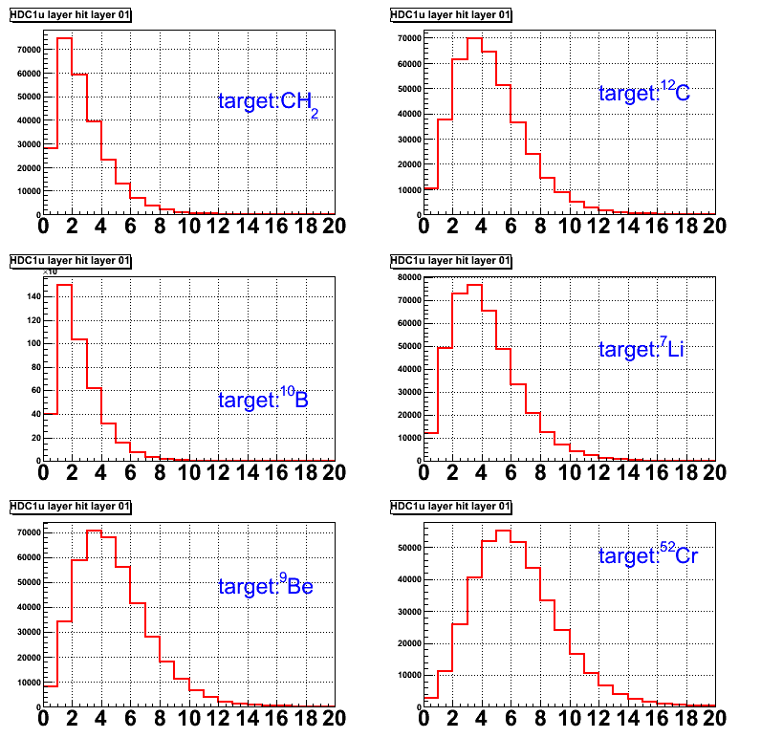
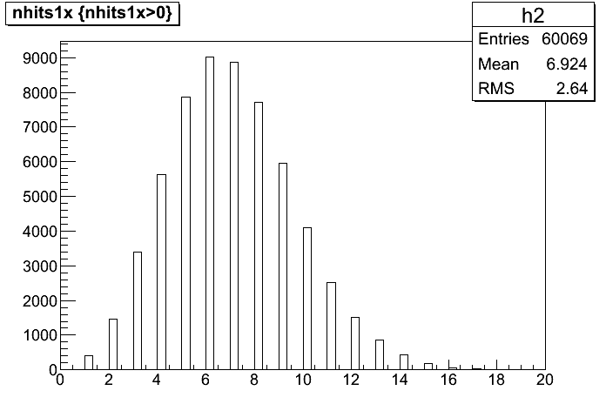
Analysis Difficulty 1-HKS Tracking
Sources: High multiplicity
*Multiple hit TDCs are used for both drift chambers and timing counters;
*Because of the high rate of background particles, there might be several kinds of particles among those hits;
Number of hits per trigger on
one layer of HKS drift chamber
for different target
Number of hits per trigger on
one layer of timing counter
For target ⁵²Cr

Slide 9
Analysis Difficulty 1-HKS Tracking
* Original tracking code do too much “average”, which is unable to handle our special case .
Purpose of software improvement:
Cut off the background;
To match the hits on the drift chambers and timing counters;
2. Pre-tracking cut
SP
DC1
t0₁₁
t0₁₂
DC2
t0₂₂
t0₂₁
d2
1 .Choose the most possibility hits by single chamber track fitting;
×
1X
t₁₂
3. Individual start time is calculated for almost every track by linear projection
Example:
t0₁₁ = t₁₁-(t₂₁-t₁₁)*d2/d1
t₁₁
×
d1
2X
t₂₁
t₁₂

Slide 10
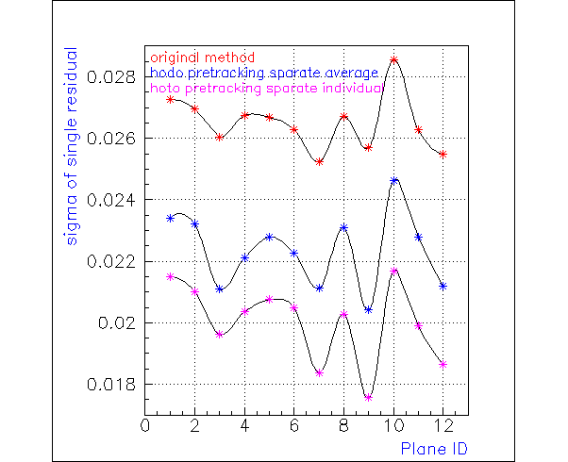
Analysis Difficulty 1-HKS Tracking
(cm)
The newest tracking algorithm works well for light target. However, for the heavy target (⁵²Cr), the cut which I used would cause event lost. We are still working for it.
Completely new tracking code which can handle high multiplicity may need to be developed.
Original (Target: CH₂)
After projecting cut
Individual start time is calculated

Slide 11
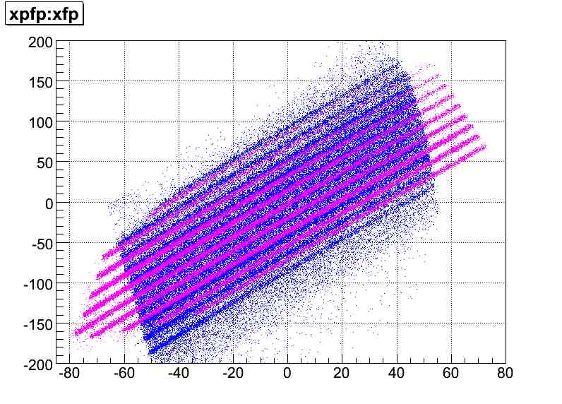
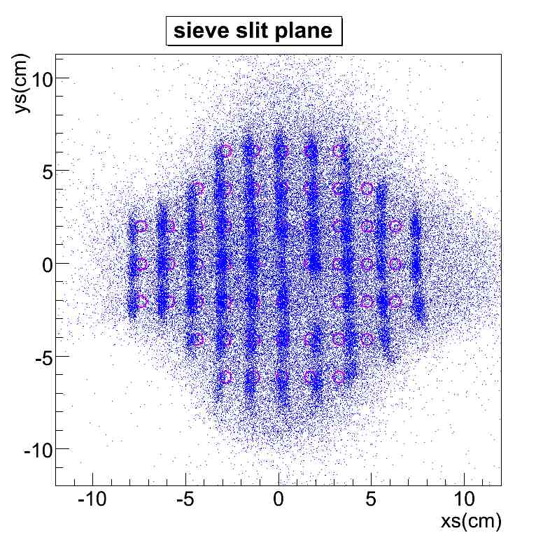
Analysis Difficulty 2-Unsymmetrical Forward Optics
-HKS-
Purple: Simulation
Blue: Real SS data
br10
br6
br1
br1
br2
br5
br10
br6
br2
br5
The survey result has been included in the geant4 code
Notes:
The left figure is the xp vs x on focal plane of sieve slit data, the purple markers are from geant4 simulation and the blue markers are real sieve slit data. The right figure shows the sieve slit plane correlation which is reconstructed from focal plane, where the matrix is fitted by geant4 simulation data. The circles are the positions where the real sieve slit located. Here we can see, the difference between the real position of the hole and the reconstructed correlation is at percentage level, but our purpose for the optics tune is at the level of 10⁻⁴. We rely one geant4 simulation to create the first hand optical matrices. So if the simulation data is far away from the real data, we are not able to get the initial reconstruction parameters. In addition, the optical field is used to choose the angle and momentum of the particles. If the initial optics matrices is not correct, which would cause overloading either on angular matrices or momentum matrices when we do optics iteration tuning by physical data. For this case we are not able to get high resolution spectroscopy, or even the spectroscopy might be shifted. So our purpose for the optics tune is to get the uncertainty at the level of 10-4, however, from the sieve slit plane, we can see, the difference not is at percentage level.
Here I would like to decide my gcut, the middle band I defined as br1, goes down is to br5 which is to high momentum side, and goes up is from br6 to br10, which is to low momentum side. On sieve slit plane, which is reconstructed by the optics from geant4 simulation, we have the matched data groups.

Slide 12
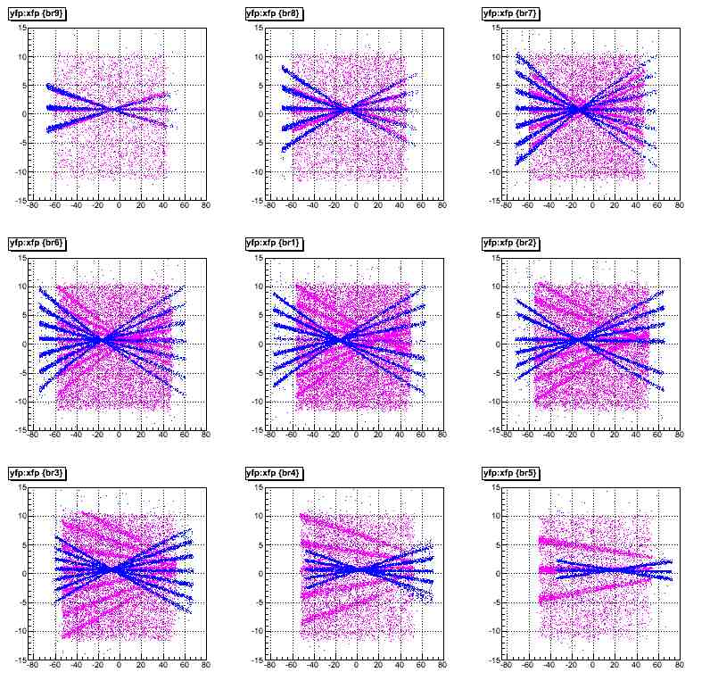
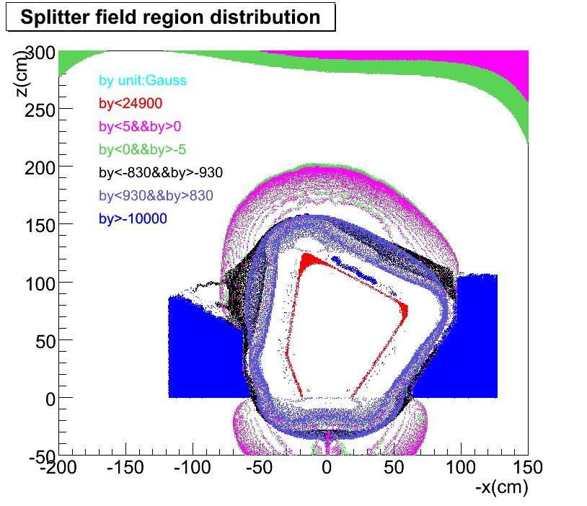
Analysis Difficulty 2-Unsymmetrical Forward Optics
-HKS-
Beam
Kaon
Q2
Q1
Target
Purple: Real HKS SS data Blue: Geant4 Simulation
Splitter field contour on xoz plane
The leakage of splitter fringe field causes the cross talk between the splitter and quadrupole

Slide 13
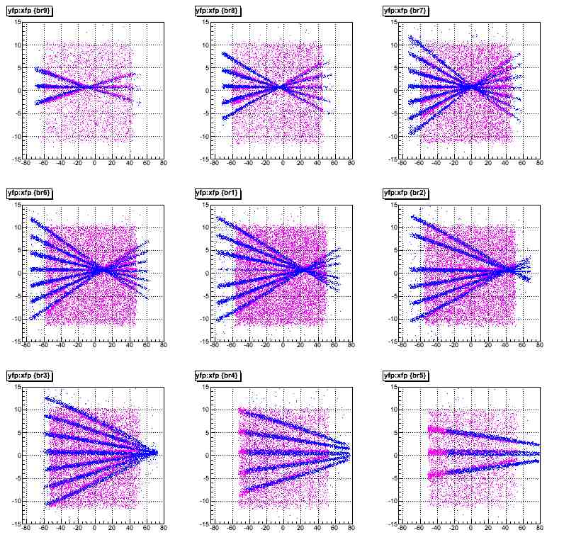
Analysis Difficulty 2-Unsymmetrical Forward Optics
-HKS-
The asymmetry functions are introduced and tuned for HKS quadrupole field Bx and By, independently.

Slide 14
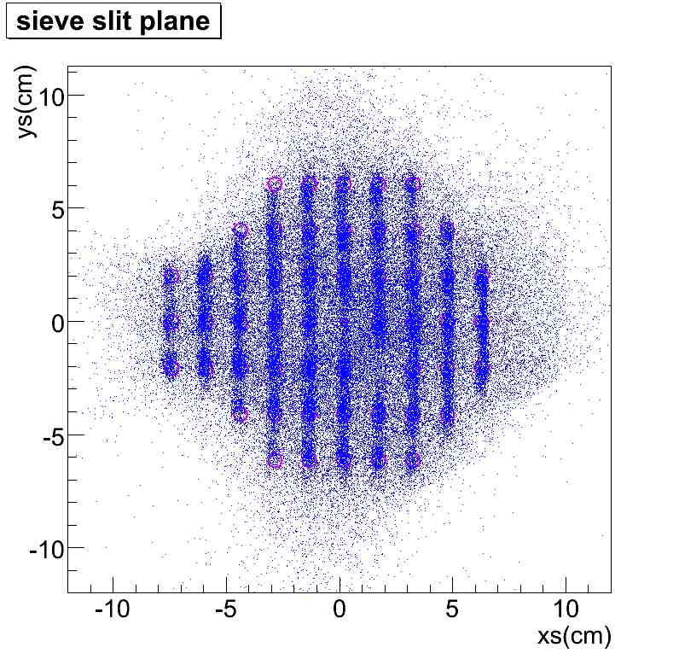

Analysis Difficulty 2-Unsymmetrical Forward Optics
-HKS-

Slide 15
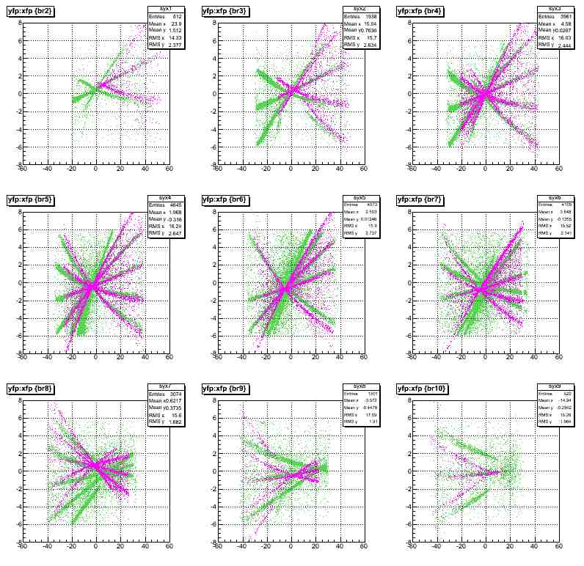
Analysis Difficulty 2-Unsymmetrical Forward Optics
-HES-
Purple: Geant4 Simulation
Green: Real HES SS data

Slide 16
Conclusion And To Do
The third-generation (e,e’k⁺)at Jlab hallC data taking has been successfully done at the end of 2009 ;
The detector calibration of the experiment has almost done;
The forward HKS optical matrices are almost ready;
The algorithm of HKS tracking for high luminosity target need to be improved;
HES forward optics needed to be done;
Kinematics calibration ;
Iteration of kinematics calibration and optical calibration.

Slide 17
Thank You!

Slide 18
Software
-Single Hit Selection-
Cases:
If there are both hits inside and outside the timing window-choose the inside ones
If there are only hits which is later than the timing window- choose the earliest one . (?’ hits across wire ‘)
If there are only hits before the timing window- choose the latest one
If there are several hits inside the timing window- combine all of them with the hits on other layers, decide “left or right” and fit them, choose the one with minchi2
Precondition: (multiple combination).le.10 (98%)
(test by run76312:9.05%)
* Timing window :Defined by the distribution of the Drift Time
(-5ns<dt<125ns)

Slide 19
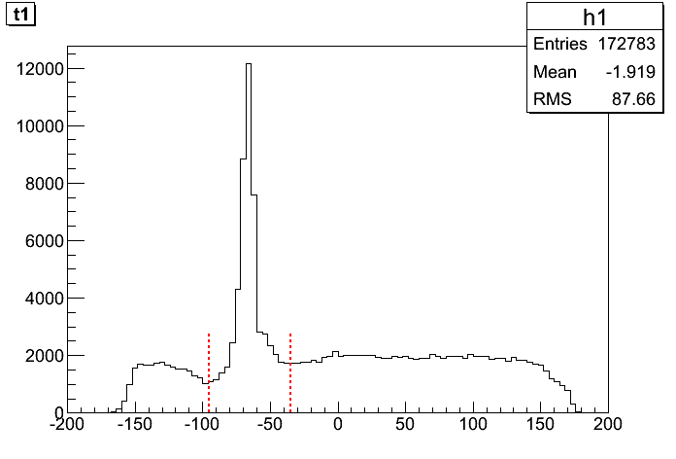
Analysis Difficulty 1-HKS Tracking
Sources:
High accidental background
Run76312(CH₂)
Run76989(⁵²Cr)
Mean time distribution of one layer of timing counter
run#76989(⁵²Cr)
Drift timing distribution

Slide 20
Analysis Difficulty 2-Unsymmetrical Forward Optics
-HKS-
My improvement:
Q1 X-Asymmetry Factor Functions
  Bx: F(x)=1.0+0.12/17.0*(x+7)+0.0075*(x+7)²/17² ,(X>-15)
  By: F(x)=1.0+0.2/17.0*(x+7)-0.004*(x+7)²/17² ,(x>-7)
Q1 Y-Asymmetry Scaling Factor
  If y>=0,Bx=Bx*0.994; if y<0, Bx=Bx
Scaling Factor
  Spl:0.9852916 Q1: 0.969024 Dipole:0.98678
  Q2:0.933256
Focal Plane residual Y and Yp correction
  Yfp=(Yfp-1.0)*F(Xpfp)+1.0
  F(Xpfp)=1.0+0.25/300.0*(Xpfp+150)-0.10*(pow(Xpfp+150),2))/pow(300,2)
  Ypfp= (Ypfp+1.0)*G(Xfp)-1.0
G(Xfp)=1.0+0.19/300.0*(Xfp+150)-0.10*(pow(Xfp+150),2))/pow(300,2)

Slide 21
Experimental Setup
KTF1Y
KTF2X
KLC
KDC1
KDC2
HKS detector package
HKS-D
KTF1X
KAC
KWC
EDC2
EDC1
HES detector package
e’
HES-D
EHOD2
EHOD1
Notes:
Here are show our detector package, the above one is the HKS detector package. We have two drift chambers, three layers of timing counter, three layers of Algerol Cherenkov detectors, two layers water Chernkov detectors and one layer of lucite Cherenkove. Since particle type in HES side is easy, only electron, what we need is only time and position, so we have two wire chambers and two layers of timin counter.

Slide 22
Data summary
Quasi-free Λ & expected g.s. yields
Target | Number of Quasi-Free Λ (observed) | Quasi-Free Λ Cross Section (assumed) | Hypernuclei (g.s) Cross Section (assumed) | Expected number of g.s
⁷Li | 6.4 x10⁴ | 1.0 μb/sr | 21 nb/sr | 1300
⁹Be | 4.5 x10⁴ | 1.2 μb/sr | 4 nb/sr | 150
¹⁰B | 4.8 x10⁴ | 1.3 μb/sr | 21 nb/sr | 780
¹²C | 3.4 x10⁴ | 1.5 μb/sr | 112 nb/sr | 2500
⁵²Cr | 1.4 x10⁴ | 4.7 μb/sr | 69 nb/sr | 210
Cross section of QF Λ is assumed as 0.2*A^{0.8} [μb/sr]
# of g.s is calculated as (# of as Λ)*(g.s cross section)/(QF Λ cross section)
Cross Section of ⁹Be is derived by Progress of Theoretical Physics Supplement No.117 (1994) pp. 151-175 (M. Sotona and S. Frullani) and other cross sections are summarized in E05-115 experiment proposal (JLab PAC 28 and 33).

