Slide 1
Target Training
1. Theory: This talk (~ 1½ h)
  theory, basics, reference. Questions answered…
2. Read How-tos, control system guide, etc.
  http://hallaweb.jlab.org/equipment/targets/cryotargets/Halla_tgt.html
3. Practical: Sit ~1 shift with trained target operator
  explore, find buttons, try things!
4. Email J-P that you have completed steps 1, 2, & 3
jpchen@jlab.org

Slide 2
Essential Responsibilities
At start of your shift:
  Verify power settings, configuration, program
  Verify alarm handler & logger are functional
  Make sure alh visible in all workspaces
  Complete the checklist
Log alarms, configuration changes
Service alarms from lowest level in tree
Contact MCC before & after tgt motion
Know the essential “How-tos”
Notes:
How to’s etc. are on the website
Essential resposibilities:
Know which cryogens are in which loop
Talk to SL re program for the shift (make sure program is compatible with the target. Max currents, rasters etc.)
Make sure alarm handler is running and visible
Know how to service alarms
Talk to MCC before and after each target move.
1st line of defense against catastrophe
Don’t want to trip the beam to the other Hall’s (FSD system)

Slide 3
Your Job (Do’s)
Keep tgt safe & within specs (~8 litres of LH₂!!!)
Monitor! Watch! Listen! Think!
Service & log alarms
Change targets (thru MCC)
Respond to ESR changes with JT
  Keep ~100 W reserve heater power for PID
Log configuration changes, etc. Fill out the checklist.
Notes:
Normally temp. kept constant through feedback loop, but you must watch, ensure that there’s enough reserve power heating to offset the beam power.

Slide 4
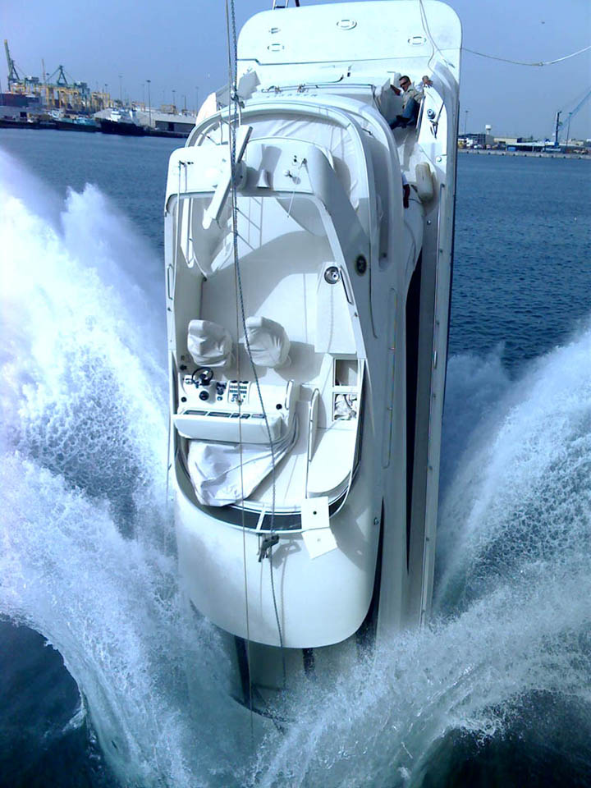
Don’ts
Cooldown
Warmup (unless asked to by an expert)
Manipulate gas panel
Change alarm setpoints
  Unless asked to do so by a tgt expert
  At least email J-P about it
Leave tgt console unattended
Fail to acknowledge alarms
Let system go sub-atmospheric or more than 3K below setpoint (for LH₂)
Move tgt while beam is on
Panic
Notes:
Cooldown is done by the target group!
Warmup: if necessary you’ll do this in consultation with and expert
Setpoints: important that we don’t get an accumulated large adjustment as a result of several people making small harmless ones.
Leaving unattended:
Of course you can go to the bathroom (tell the SL)
Don’t go off to have lunch (can arrange to have another qualified TO sit in for you but make sure SL knows)
Sub-atmospheric: Problematic because air seeping in will make ice.

Slide 5
Experts
Name | Work | Home | Pager | Cell
J-P Chen | 7413 | 867-7380 | 584-7413 | 218 0722
John LeRose | 7624 | 565-5060 | 584-7624 | 810-6784
Dave Meekins | 5434 | 874-4750 | 584-5434
Chris Keith | 5878 | 596-3002 | 584-5878
If you need help, call these people in the order listed.
(pager or cell first if off hours)
Notes:
Emphasize priority order (there is no “target pager” anymore)

Slide 6
Basic Components
LH₂ & LD₂ cells & re-circulation loops
Re-circulation fan/pump (60 Hz)
800 W (max) heater (on PID) to replace P_{beam}
800 W (Helium) heat exchanger
  He Supply ~ 14K, 12 atm
  He Return ~ 19K, 3 atm
  JT controller on He Supply
T&P instrumentation
Control System
Gas Panel, Ballast tank, Electronics
Notes:
Closed loops in which cryogens (LH2, LD2) recirculate.
Fan=pump
Feedback on heater (Proportional Integrated D…. Aka PID
JT valve: Controls rate of flow of coolant (no the target cryogen) and hence the amount of cooling. You will adjust the flow rate from time to time. More later.

Slide 7
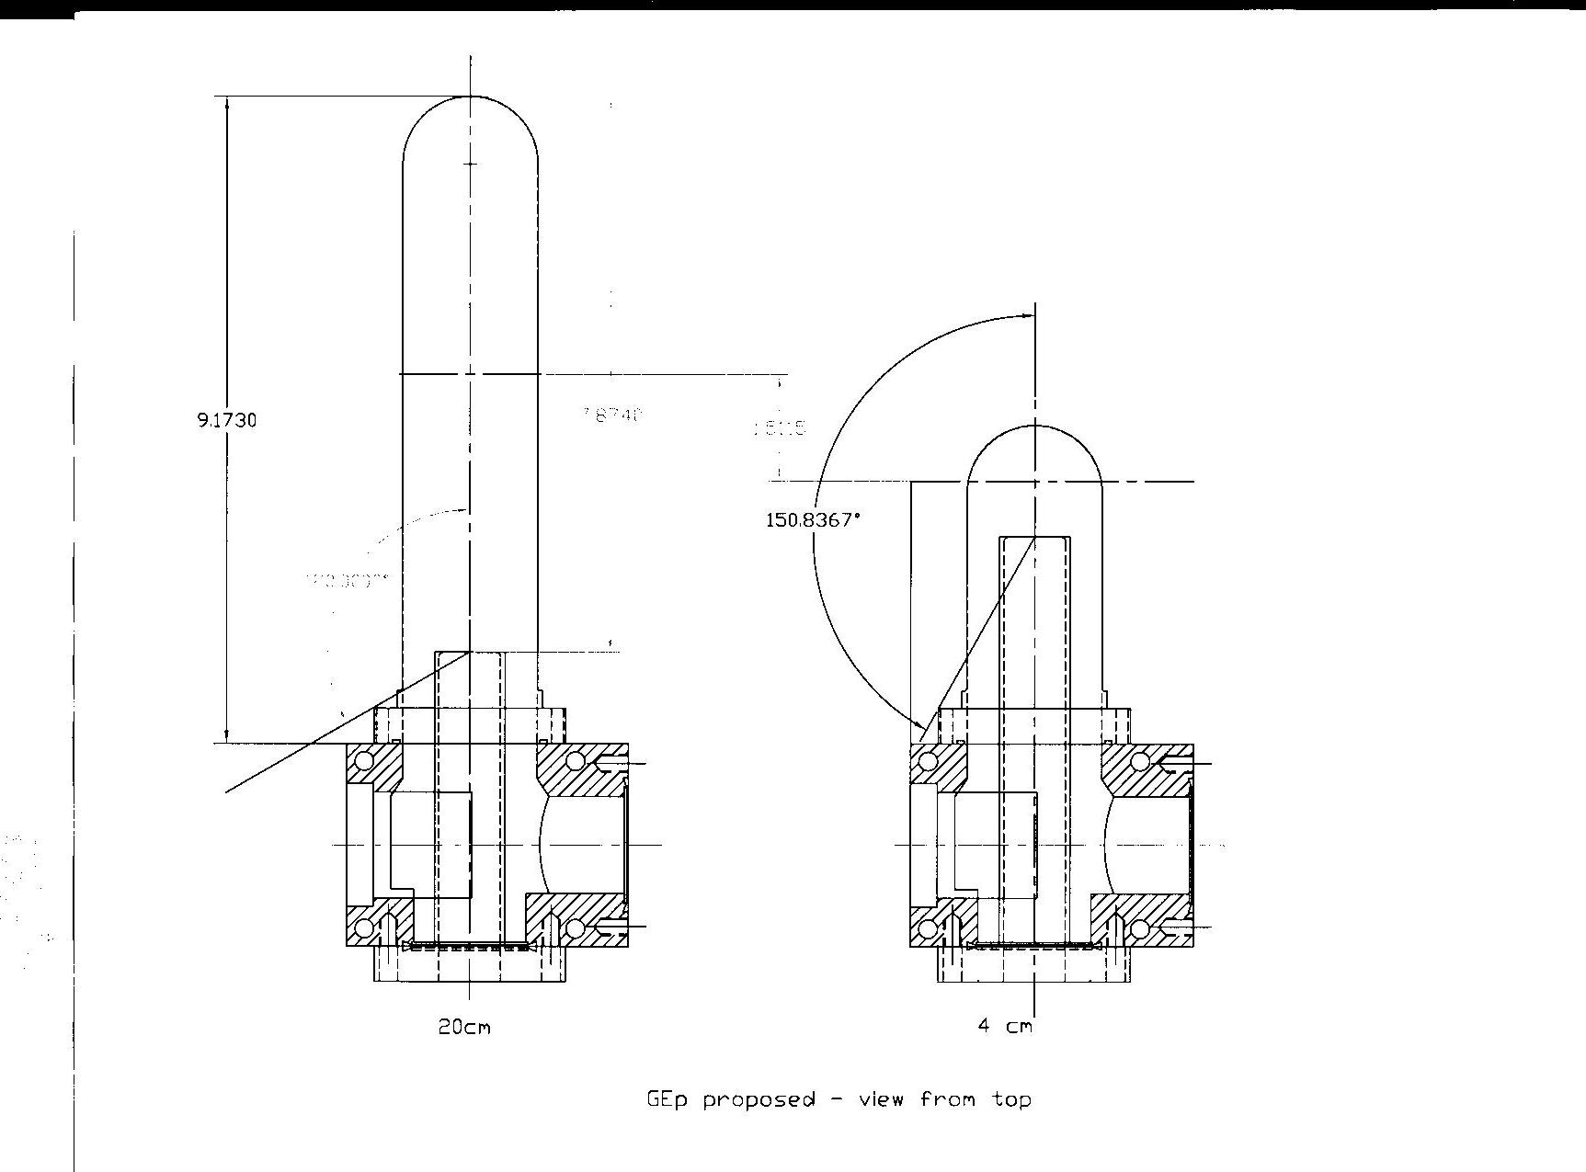
Gep Cells made September, 2007
7.8740”
1.5115”
120.000°
Notes:
Basic cell geometry
beam entrance and exit windows etc.

Slide 8
H Target Specifications
LH2 (20 cm cell):
LD2 (20 cm cell):
T=19 ± 0.01 K (T_{F}=13.8K, T_{B}=22.2K)
P~24 ± 1 psia (9 psig)
P_{beam} ~ 550W @ 80 µA
  (110 W for the 4cm tgt)
Reserve power ~ 100 W
Fan ν=60 Hz (25%)
2x2 mm² uniform raster (always on)
ρ = 0.0723 g/cm³
dE/dx = 4.84 MeV/g/cm² (@ 4 GeV)
T=22 ± 0.01 K (T_{F}=18.7K, T_{B}=25.3K)
P~24 ± 1 psia (9 psig)
P_{beam} ~ 630W @ 80 µA
Reserve power ~ 75 W
Fan ν=60 Hz (25%)
2x2 mm² uniform raster (always on)
ρ = 0.1674 g/cm³
dE/dx = 2.42 MeV/g/cm² (@ 4 GeV)
Notes:
Goal parameters for LH2 and LD2
Note differences
Want liquid temperature to always be 3° below boiling
Freezing point and boiling point define operating range (operating window)
Note differences in Tf and Tb between LH2 and LD2 (important to know what’s in the loop)
In general pressure is not an issue (incompressible fluid)
Explain difference between psia and psig (absolute vs gauge ~15psi offset) like °F and °C but simpler, just an offset. More like °C and °K.
Reserve power: if it isn’t there the feedback loop can’t do its job. (keeping the sum of heater power and beam power constant)
Fan speed: ALWAYS 60 hz (25% for historical reasons)
Talk about need for raster (don’t want to punch holes in the target).

Slide 9
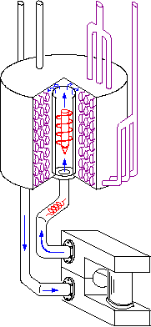
Loop Anatomy
H2/D2 in/out
He coolant in/out
Fan
HX
Heater
Upper cell blk (absent in ½ height cells)
Cell/tuna can/tahini can
Thermometers
beam
Cell block (H2 manifold)
Notes:
Walk through the functioning of the loop. Animation shows motion of packet of material through the loop.
Red ball = warm
Blue ball = cold

Slide 10
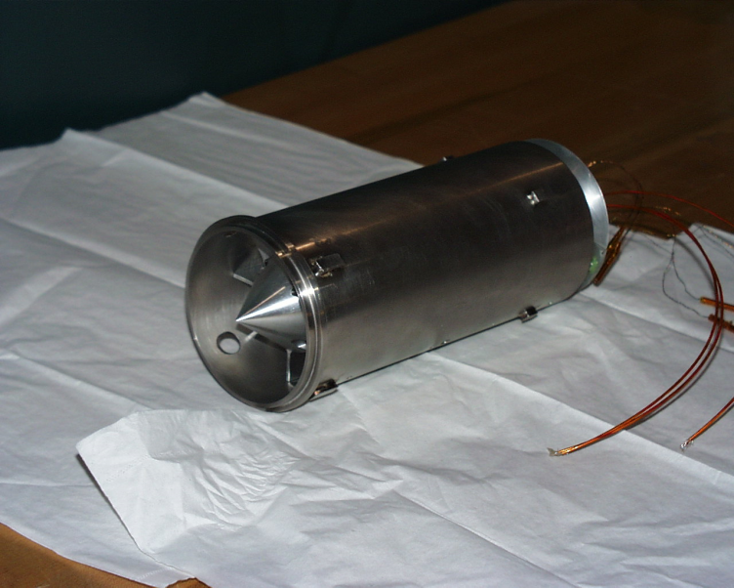
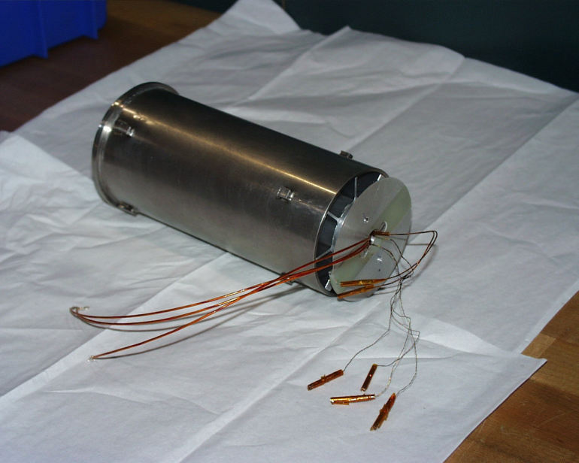
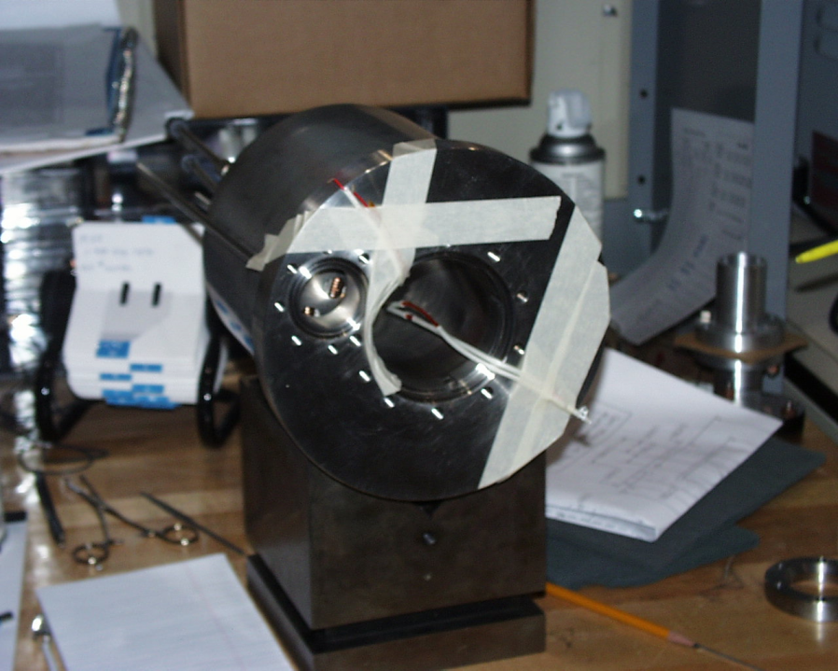
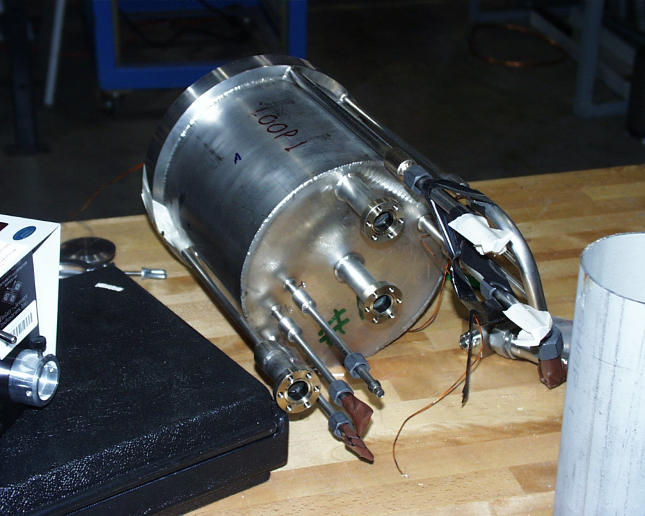
Fan & Heat Exchanger
Notes:
Nice to know what they actually look like.

Slide 11
Goal Parameters
H₂: T=19.00 ± 0.02 K, P~23 ± 2 psia
D₂: T=22.00 ± 0.02 K, P~23 ± 2 psia
ESR: T~14 ± 1 K, P~12 atm, m~17 g/s
  Note Σ (A+C) < 25 g/s!
Fans: 60 Hz (25%)
Heaters: P_{tot} = P_{beam} + P_{reserve} ~ 550 + 100 ~ 650 W at 80 µA
.
Notes:
ESR: mass flow A+C < 25 g/s
If you hit the sum Hall C gets reduced flow
If you see it getting close talk to the other Hall
Reduce heater power in unused target
Reduce coolant flow (J-T valve) in unused target
More next:

Slide 12
Parking
You are running 2 cryotargets simultaneously!
  Only one is in the beam, so reduce power on the other!
If you know one will not go in beam for at least a day → park it (reduces ESR load)
Park means:
  Close JT to minimize P_{reserve} ~ 50W
  possibly also drop ν_{fan} to expert specified value
Better not to mess with fans unless you absolutely have to!
Notes:
Parking: close JT to reduce flow and reserve power.
Reducing fan speed not a good idea. Can get stuck.

Slide 13
Basic Equations
dE/dx(MeV/g/cm²) I_{b}(μA)
ΔT=
c_{p}(J/gK) d_{raster}(cm) v_{s}(cm/s)
Δρ/ρ ≈ 1.5% ΔT
P_{b}(W)=I_{b}(μA) ρ(g/cm³) t(cm) dE/dx(MeV/g/cm²)
Where: | LH2 (19K,23 psia) | LD2 (22K, 23 psia)
ρ (g/cm³) | 0.07231 | 0.1674
de/dx (MeV/g/cm²) | 4.8 @ 3 GeV | 2.4 @ 3 GeV
C_{p}(J/gK) | 8.8 | 6.8
Notes:
Basic equations (Physics of targets)
“green” one (the first green one for me!) is a good rule of thumb.
“red” one (the other green one) tells you the beam power loss for the target.
Plotted in next slide.

Slide 14
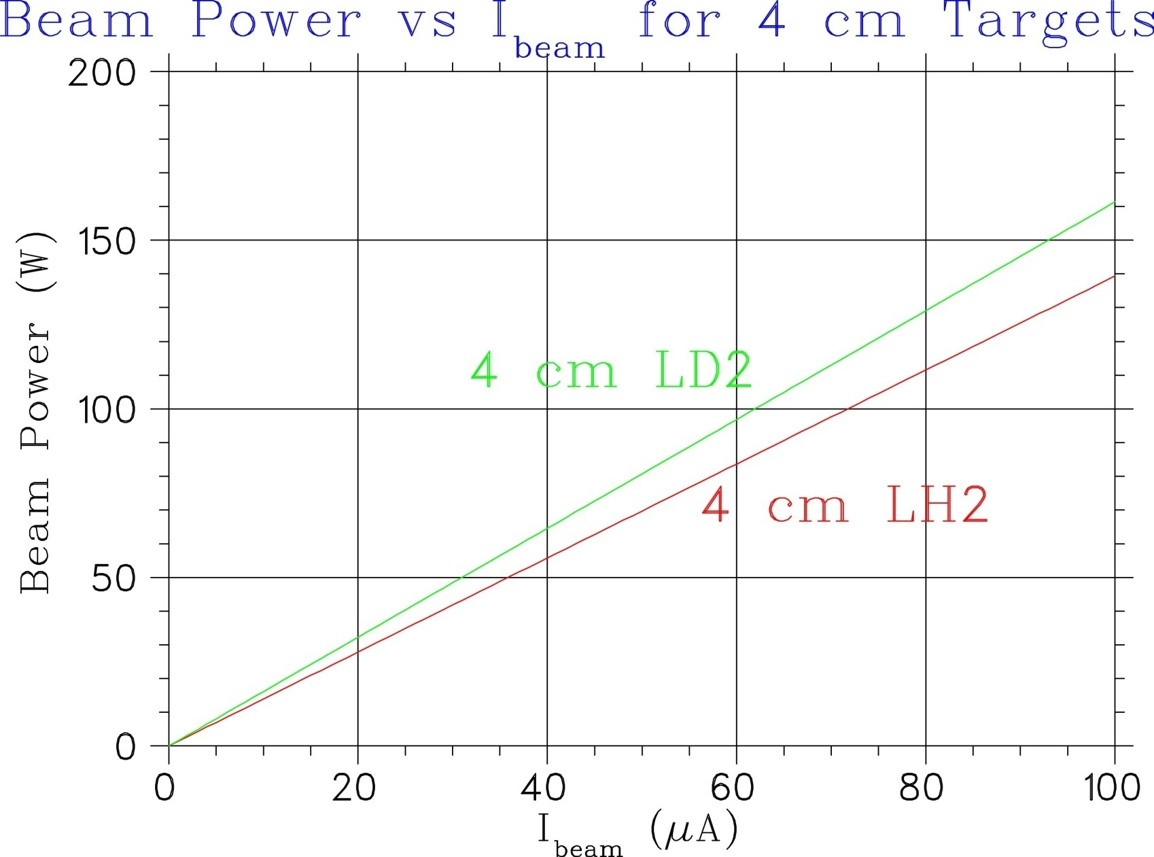
Beam Power
Note: Normally have an additional 50-100 W of reserve power.
Notes:
Normally total heater power is beam power + 50-100 W
Note: depends on target length and material.

Slide 15
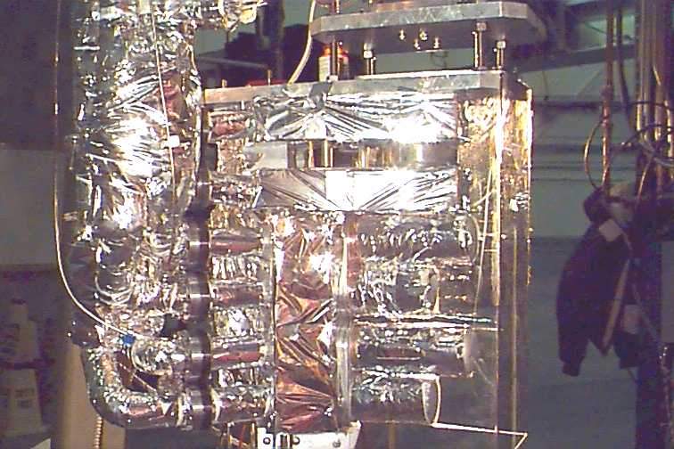
Cryostack
Loop 1 High Pressure He
Loop 2 LH₂ or LD₂
(spare?)
Loop 3 LH₂ or LD₂
Notes:
What’s in there “NOW”.
Briefly discuss different targets and their uses
Hall A picture

Slide 16
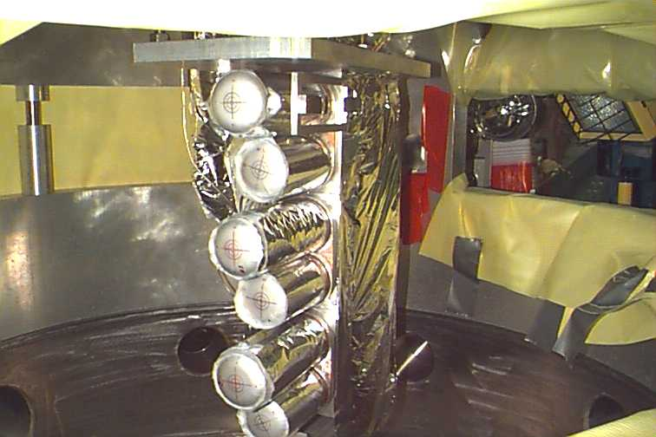
H₂ Cells

Slide 17
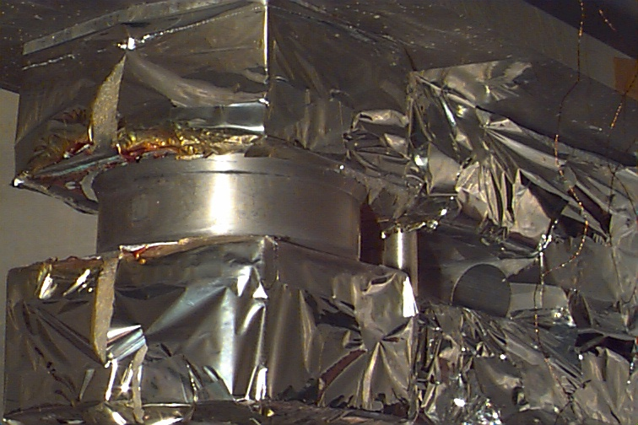
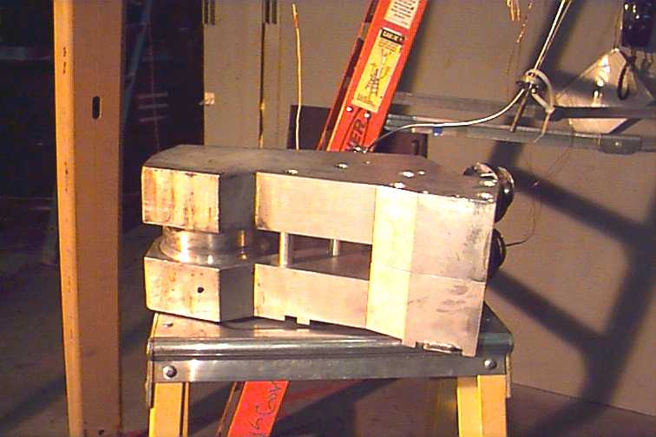
He Cells

Slide 18
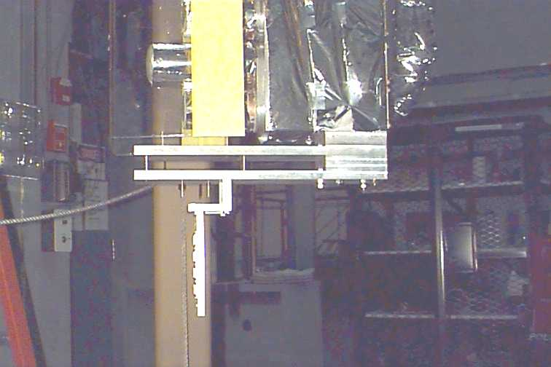
Solid Targets
Notes:
Hall A Picture

Slide 19
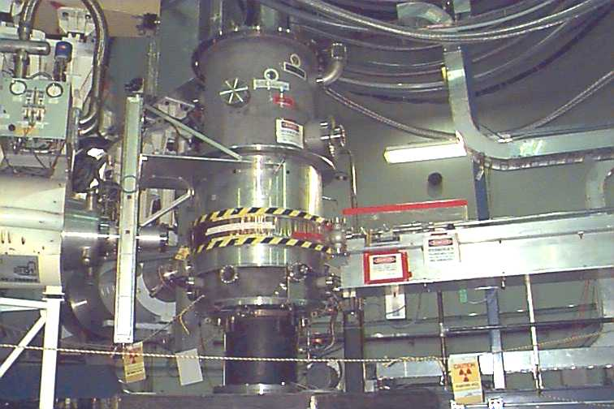
Target on the Pivot
JT’s, Gas & Coolant lines
Lifter Mechanism
Scattering Chamber
Notes:
General description:
Cryo lines going in at top
bellows allows vertical motion (single motor drives three ball screws)
Hall A setup

Slide 20
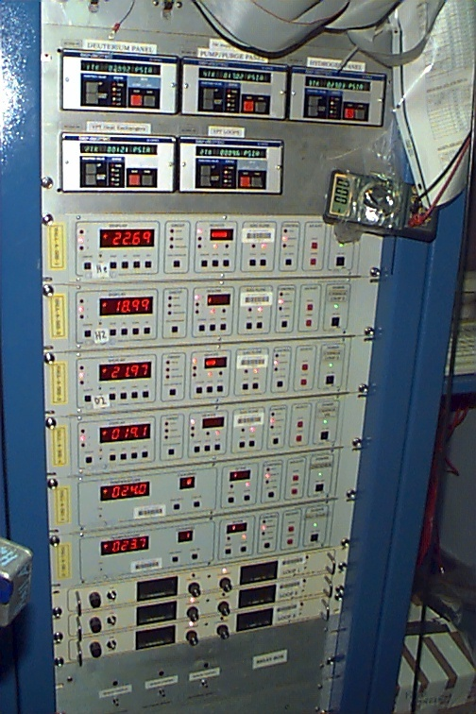
Target
Electronics
Lift/rot. controllers
Loop 1 & 2 Temps
Loop 3 Temps
Cryogen Temps
JT control
Tachometers
Fan controllers
HPH power supplies
P readouts
Notes:
Just to show what the racks look like in the Hall
This is the Hall A picture

Slide 21
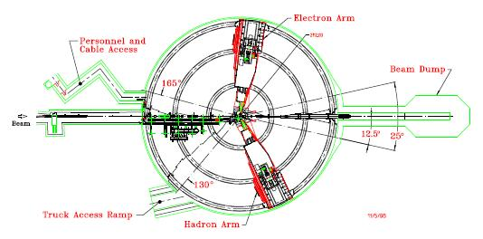
Hall A Layout
Target
Target gas panel
Target Electronics
Notes:
Note where things are in the Hall

Slide 22
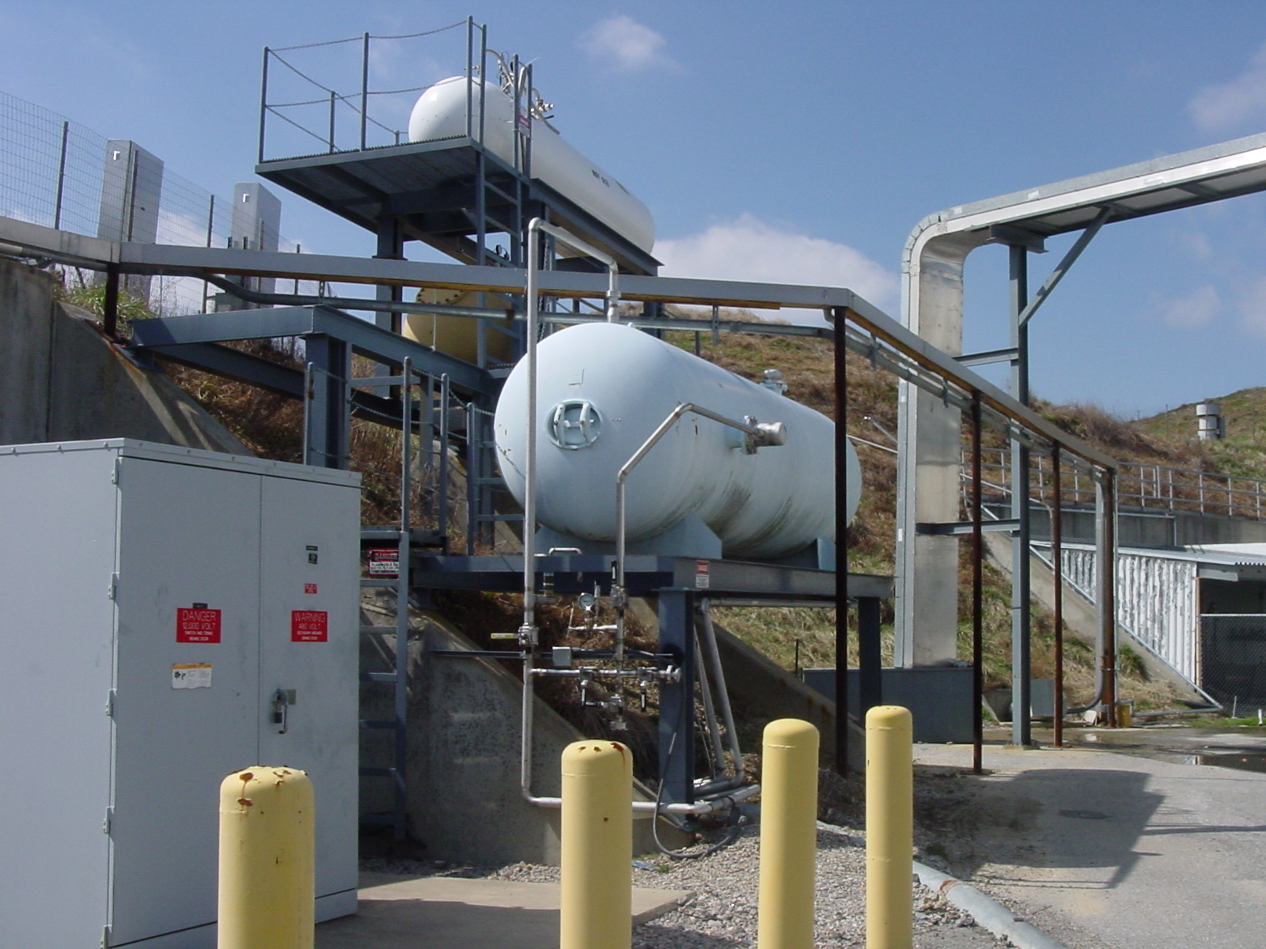
Ballast Tanks
H2
D2
G0
Notes:
Leads into discussion of diurnal cycle
Tanks:
outside
Big
Connected directly to target in the Hall (no valves)
Purpose is to act as a pressure reservoir (if liquid boils expands 800 fold)
Sun heats the tank the pressure in the target changes
Good news: while the density depends strongly on Temperature (which we regulate carefully) it doesn’t depend very strongly at all on pressure (see next slide)

Slide 23
Diurnal ΔP
Ballast tank outside, and P ∝ T.
  Ex: ΔT=15C (5%) → ΔP=1 psi
Systematic effect on target ρ negligible:
Notes:
Demonstrates the lack of density dependence on pressure.

Slide 24
Archived ΔP
5 days in December, G0 tgt
24h
Notes:
Example of what you can do with the archiver.

Slide 25
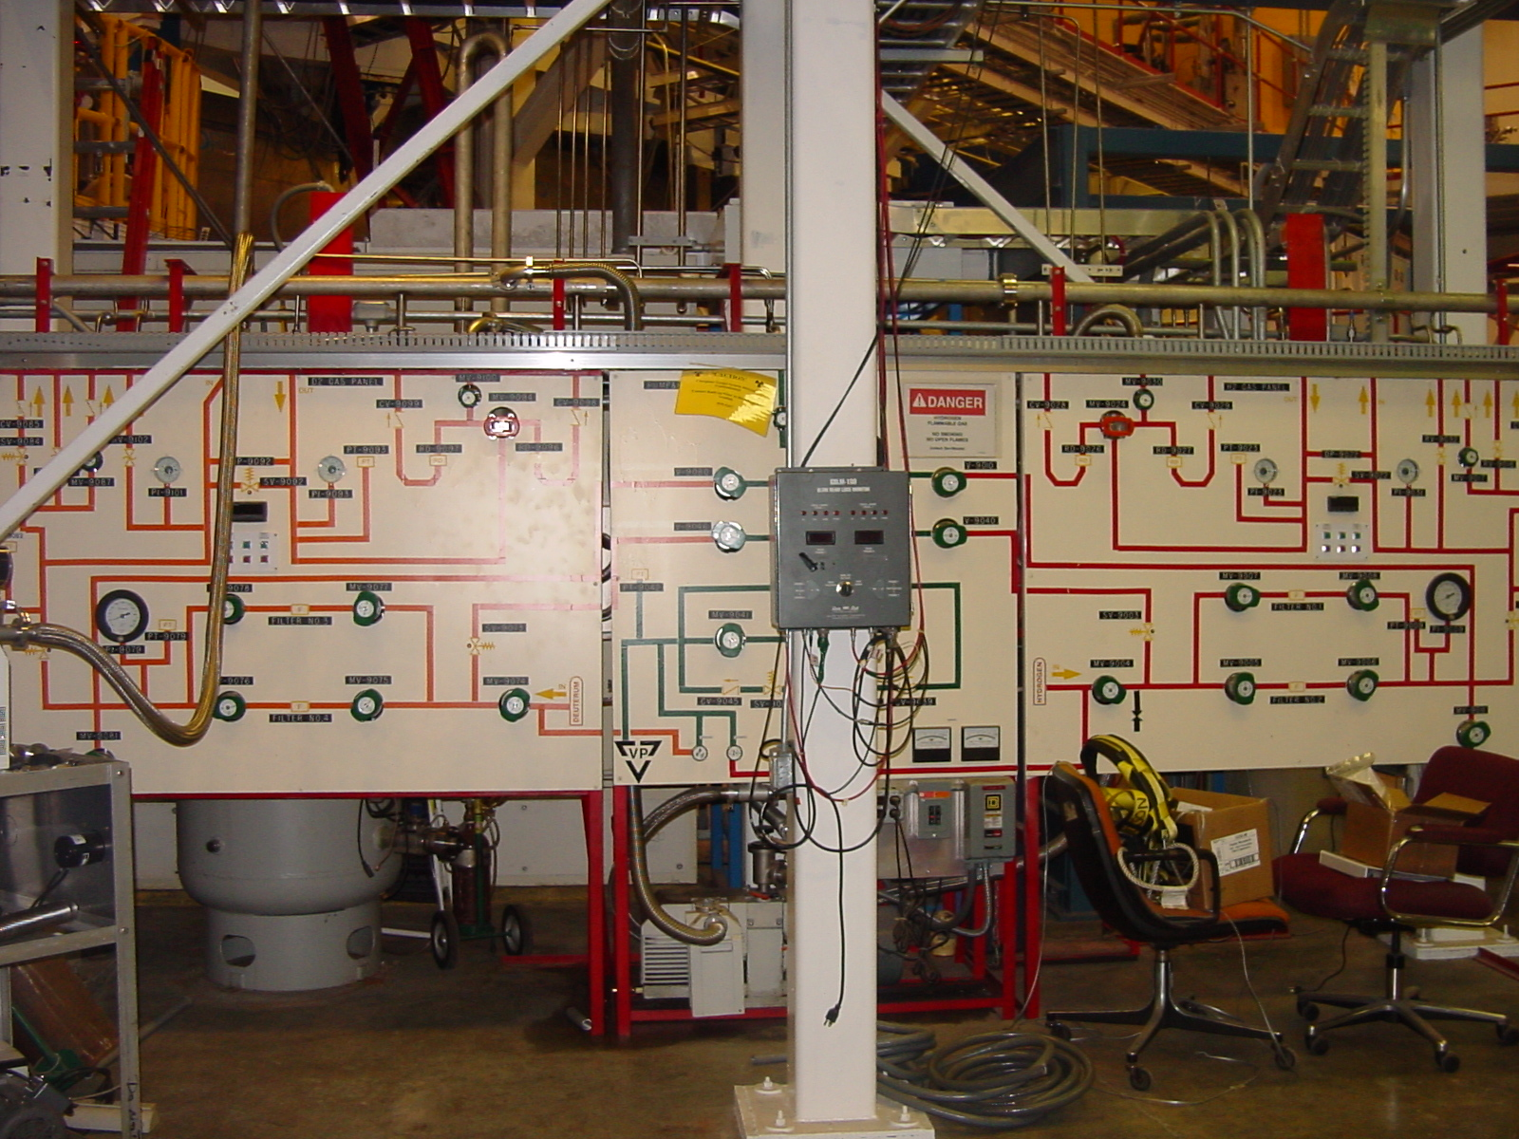
Gas Panel
D2
H2
He
Notes:
Just to show you what it looks like. LEAVE IT ALONE!

Slide 26
Recommended Studies
Position scans
  Horizontal (crucial!)
  Vertical (less sensitive)
  Move beam in small steps across the target
Luminosity scans
  Characterize boiling vs I_{beam}
  Watch tracking efficiency (Eric)
  Use cuts to define e’s in HMS cleanly
Notes:
Sorts of target related studies that should be done at the beginning of an experiment
Need to know:
Where the beam really hits the target
Target density properties vs beam current. (establishes operating parameters for the experiment)

Slide 27
4cm Tuna Can Boiling

Slide 28
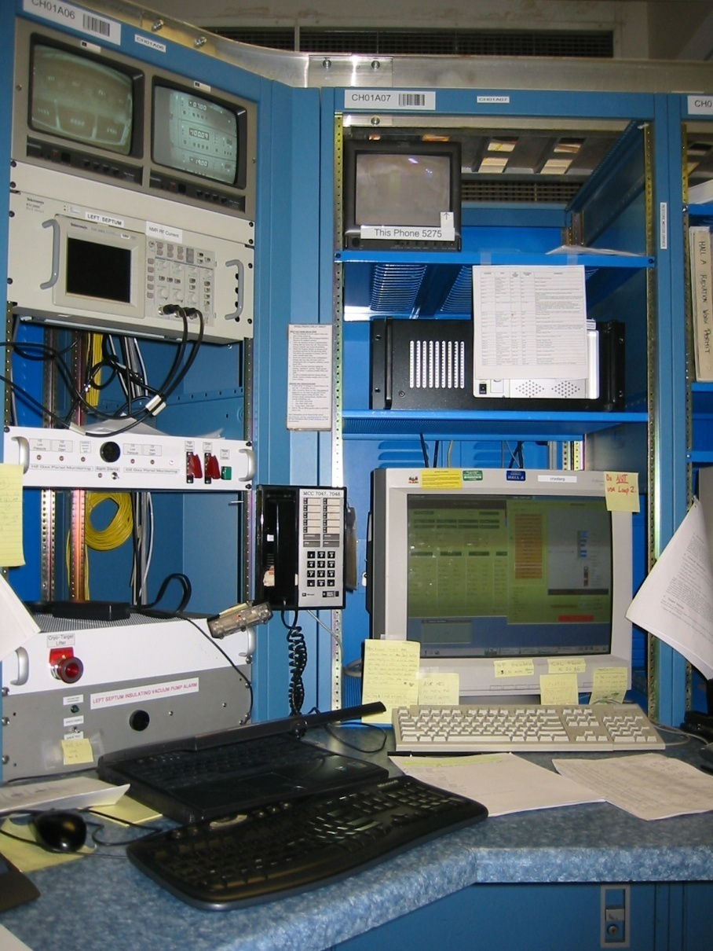
In the Counting House
JT valves
Target ops limits
Cell Temperatures
Target TV
Panic buttons
Alarms
Controls
Terminal
Emergency lifter crash
Notes:
Panic Buttons:
Emergency lifter crash: kill power to lifter (a nightmare to reset but…)
Kill power to HP heaters
Slam JT’s shut (should never need)

Slide 29
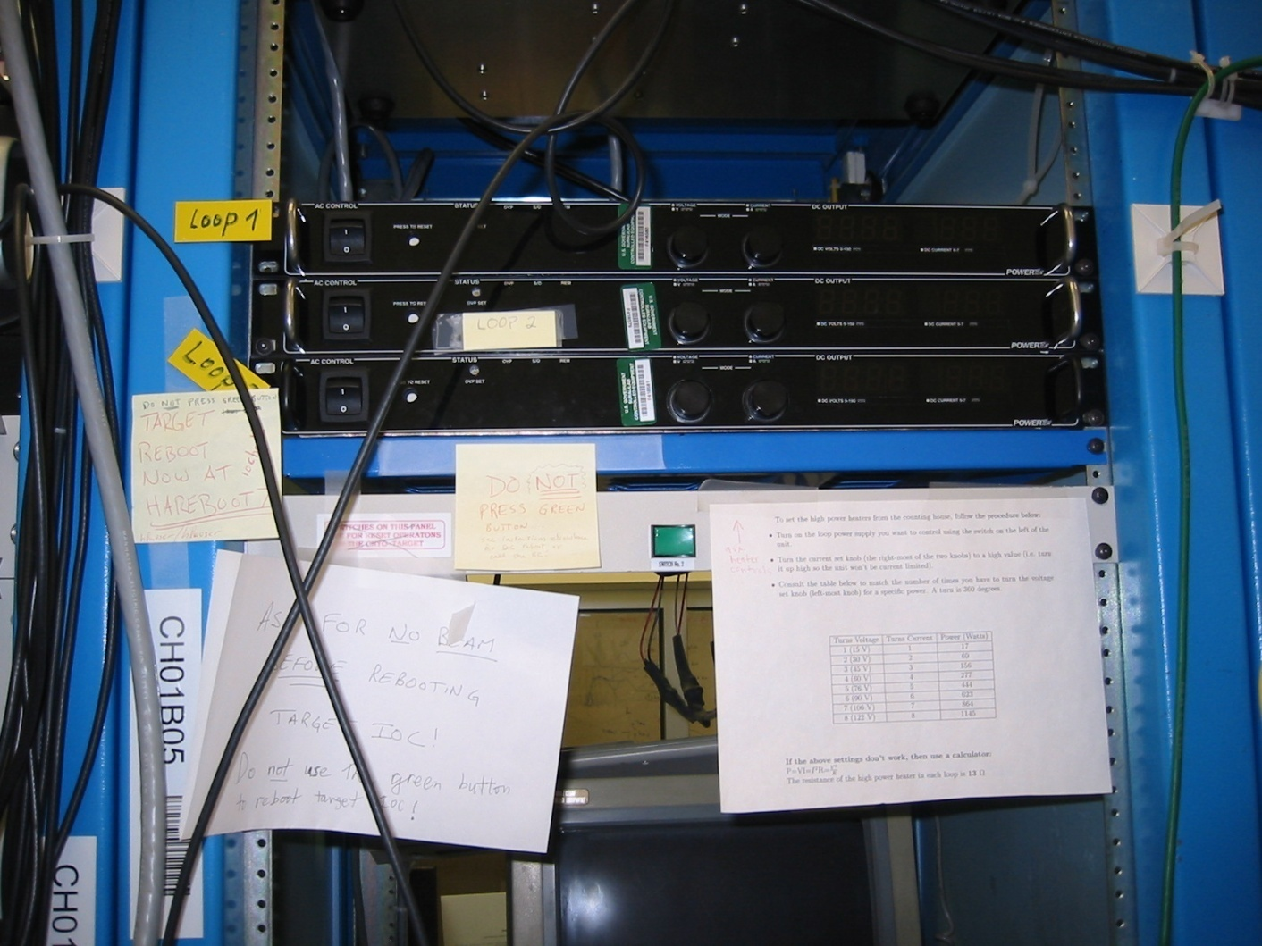
More Counting House: in the center room
HP heater
controls
HP heater
Setting Instructions
To reboot:
Use hareboot7
Old “green button”
Do Not Press to reboot

Slide 30
Getting Started
Assuming you have an x-session on the “cryotarg” console:
  Open an xterm
  Go to the target directory by typing:
    atarg@cryotarg> $GUI
  Start the target GUI by typing:
    atarg@cryotarg> tgtgui
  This will launch main GUI.
  From main GUI, launch alh, strip charts, etc.
  Insure alh visible everywhere (each workspace). Heartbeat OK?
  Open secondary GUI’s from main GUI
Computer Prompt
Notes:
Step by step Instructions
Need a picture of the terminal.

Slide 31
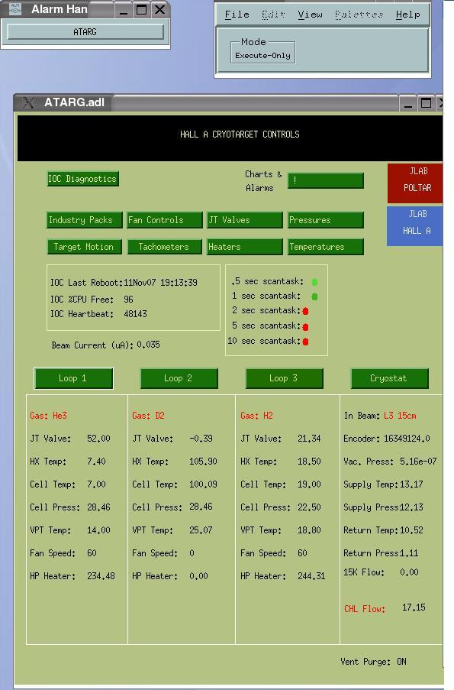
Main GUI
Alarm Handler
Access to sub panels
Heartbeat
Access to loops
& cryostat panels
Notes:
Main GUI
Provides access to other auxiliary GUI’s
Heartbeat: If it’s stopped you definitely have a problem (reboot) but just because the heart is beating it doesn’t mean the patient isn’t sick.
Target motion is right there
Has panels with basic information about loops and coolant
Access to alarm handler

Slide 32

Alarm Handler
Alarm Handler GUI must be visible in each workspace
If not running, from main GUI click:
  Charts & Alarms in upper right corner
  Choose Start TCL Alarm Handler
  Load appropriate alarm file (usually ctarg.alh)
Alarm Colors:
  Red: major, outside wide limits
  Yellow: minor, outside narrow limits
  White: readout error
Alarm Color States:
  Steady: alarm condition was transient
  Flashing: alarm condition is active
Notes:
Self contained

Slide 33
Servicing Alarms
Click on alh bar to open alarm tree GUI
Click lit main branch (left side) text button
Click lit sub-branch (right side) “P” button
On this new GUI look at the alarming sub-branch. Shows current value and all the alarm limits.
  OK? → click lit button left of sub-branch to clear the alarm. Transients can happen.
  Not OK?
    May be telling you something (adjust JT?). Think!
    If can’t understand why it’s alarming, call an expert.
Log the event
Change alarm limits only if asked to by an expert
Notes:
Step by step
See next slide

Slide 34
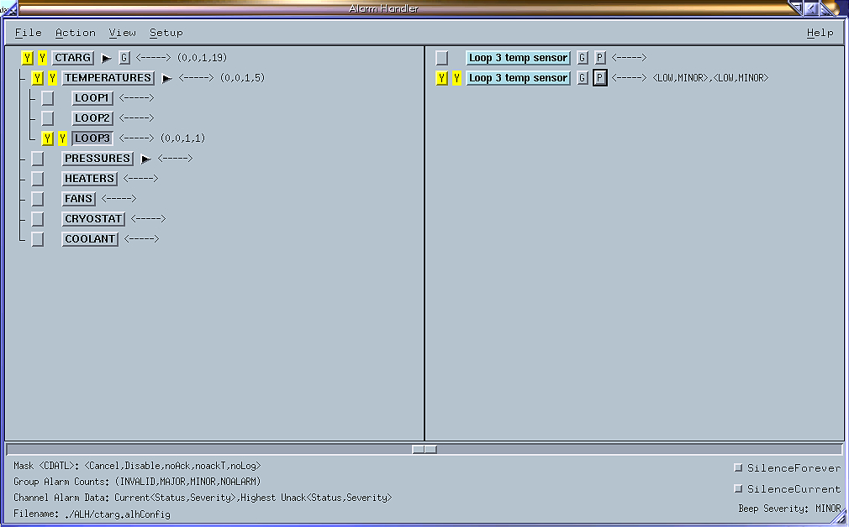
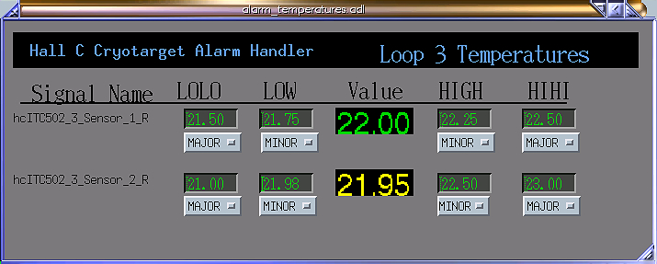
Alarm Handler GUI
1
3
2
0
Notes:
Most common alarms are transient. They take care of themselves. You clear the alarm and it’s gone.
Otherwise: investigate source of alarm, think, take corrective action
Otherwise: call an expert
0. Alarm blinking:-> click on button
Identify top level -> click to see the whole tree (if the last person didn’t close it the panel may be iconized and you’ll have to look for it)
P for parameter opens panel with details (actual value and limits), G for guidance . Too high? Too low? Why? Corrective action?
Click to clear
Always go all the way down (except after a reboot)
Log the event (not the transients unless they happen at an annoying rate)

Slide 35
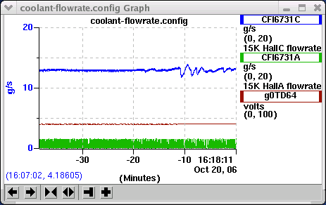
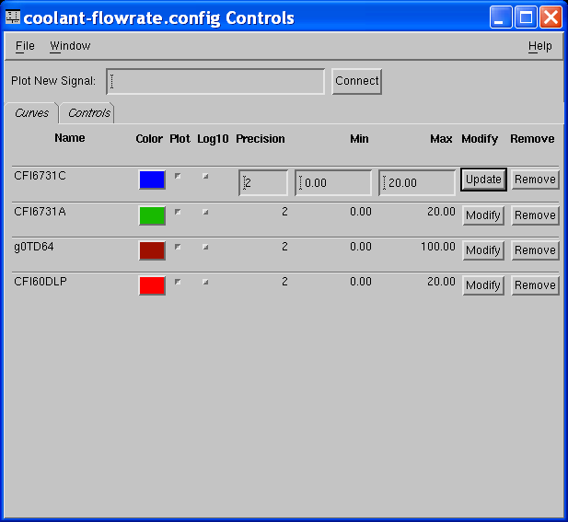
StripTool
Watch out: vertical scale only appropriate for selected color. Have to click on desired variable to see its scale!
Horizontal Scale: Buttons in lower left corner of the graph
  If you zoom, you may also want to right justify!
Vertical Scale: Right-click inside graph to bring up controls dialog
Notes:
Give pointers on use
Vertical scale selection
Scrolling vs panning

Slide 36
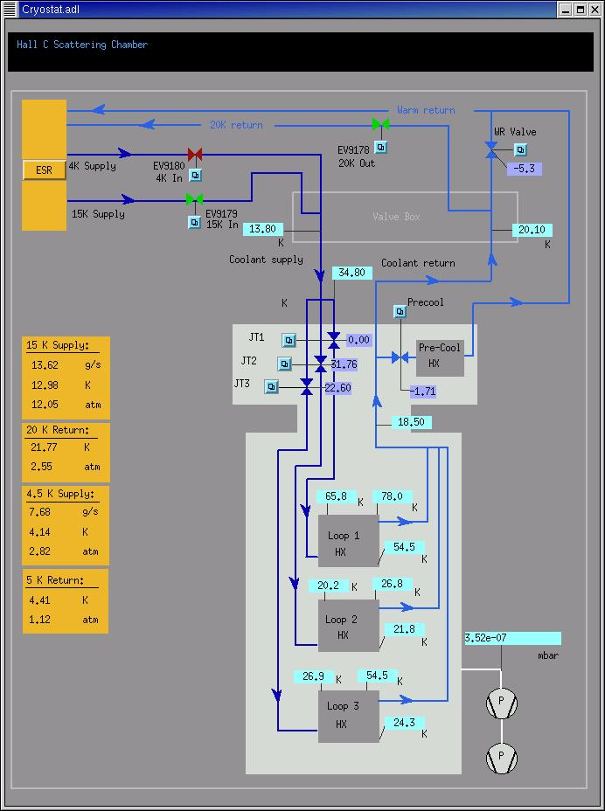
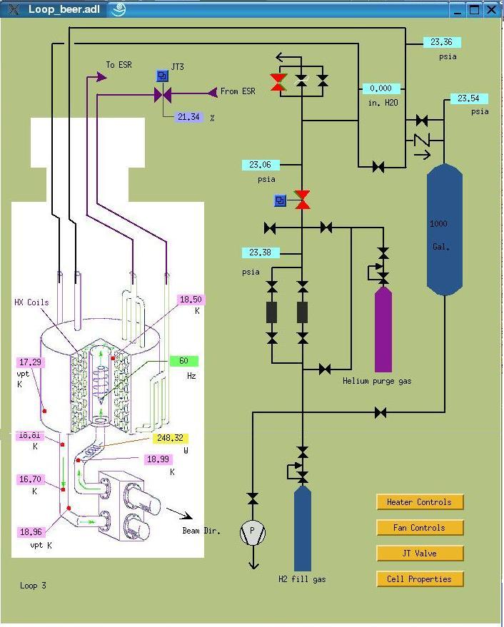
Cryostat & Loop GUIs
Notes:
General info re cryostat and loops (temps, pressures, etc.)
Left one gives some ESR parameters: note 15K system is very much independent of the 4K system
(need crysostat panel from Hall A. Loop alread is Hall A’s)

Slide 37
Checklist
From main GUI, click the
  chart/alarms/checklist button
  Select Checklist
This overwrites the file ~/Ctarg/Checklist
Print the file with the command:
/apps/bin/pdq –Pchchp2 Checklist
(from the appropriate directory)
Output look OK? Put into binder.
Use ksnapshot to put a picture of the main gui and/or the stripcharts into halog
OR

Slide 38
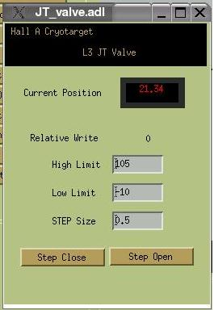
Adjusting the Heat Load
P_{beam}~150 W at 100 µA, P_{reserve}~50-100 W
  For 4 cm LH2/LD2
With beam on, need ~50-100 W on HPH
With beam off should have ~250 W on HPH
  (if off a long time, can reduce)
HPH power adjusted automatically
  (in PID looking at T_{loop} & I_{beam})
To adjust, use JT:
  Open JT to increase HPH power
  Close JT to lower HPH power
Notes:
You cannot adjust the heater directly. Must do it indirectly.
Adjusting JT valve:
Open for more cooling close for less cooling
Panel shows position in %
Don’t make large fast changes (->crash ESR!)
Small steps (~2%)
After each step stop and observe results

Slide 39
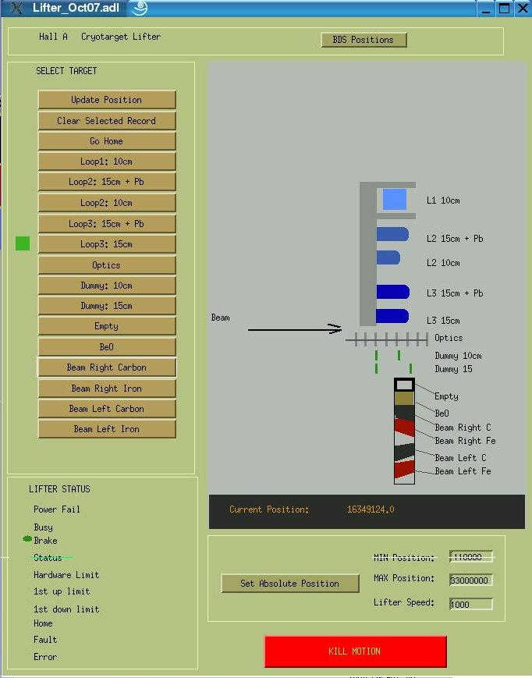
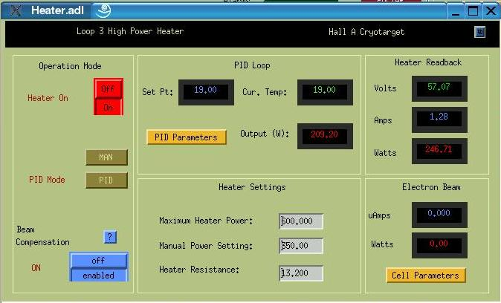
Lifter, Heater, & JT GUIs
Note: It takes
~1/2 minute to
see effects of a JT change
0 < Step ≤ 2%
Notes:
Heater GUI:
Set goal Temp.
PID always on
Beam compensation normally ON (can adjust parameters, target length/beam energy loss)
When the beam current drops the heater rises
When the beam current rises the heater drops
Target: easy see next slide
JT’s again: small steps, wait after each step.

Slide 40
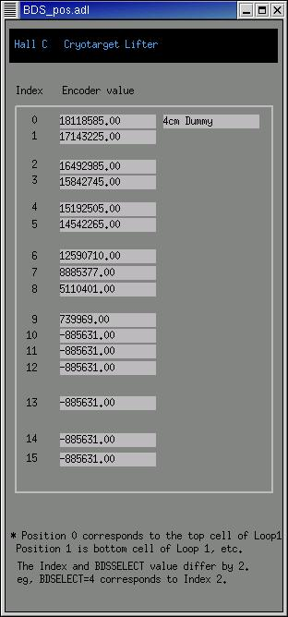
Changing Targets
Call MCC: beam off, mask tgt motion
FSD, explain which tgt you’re going to
From main GUI, click:
  Target Motion, then choose Cryotarget Lifter
  Click on the chosen target button
  Click on the Move Target button. Observe
  motion on TV. Hit panic button if necessary.
  Note: light switch & dimmer pot on main console
  Wait for the green light to come back, check you are where you should be. Tgt motion slower now.
  Close the relevant GUIs
Call MCC: beam & FSD on, new I_{b} & tgt
  check I_{beam} limit OK! Use operational restriction web page (link on my cryotgt page)
Log configuration change
BDS
positions
(~50k/mm)

Slide 41

Rebooting the Target IOC
Why? Heartbeat lost, stripcharts flat, white medm readouts, etc.
Don’t panic. You can do this!
Call MCC for beam off.
Set manual HPH pots for appropriate power
  LH2 & LD2 will differ depending on which was in beam (beam power + reserve).
Flip appropriate manual HPH switches on.
Monitor temps via TV, fine-tune HPH pots.
  TV image bad, so use DVMs in counting room!
Notes:
HPH pot settings guide on next slide
Reboot GUI: find target IOC reboot and push reboot
see slide after the next one

Slide 42
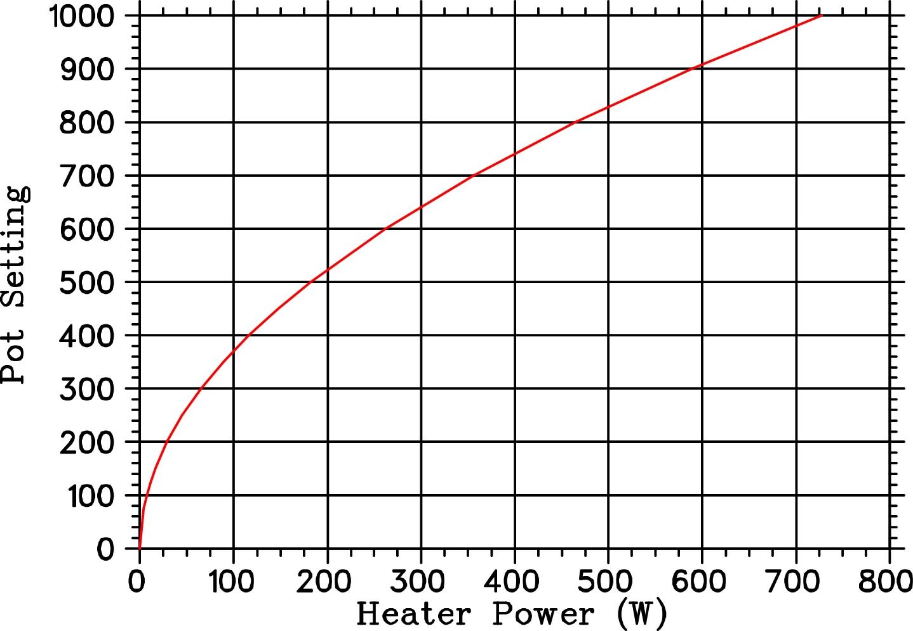
HPH Pot Settings

Slide 43
Rebooting the Target IOC, ctd.
On DAQ/CODA reboot GUI, enable buttons, then click on tgtIOC (hcvme4) reboot button. Wait ~2 min. until heartbeat, green lights, medm fields, etc. come back.
  if network is down, IOC won’t come back! Keep trying every 5-10 minutes.
Keep monitoring TV/DVM temps! Adjust pots as necessary, keep |T-T_{goal}| < ~ 0.5º K.
PID OK? Then flip manual HPH switches back off. Check that PID is “pidding”. Heartbeat? Stripcharts? TV temps OK?
Call MCC for beam back. Log event in hclog.

Slide 44
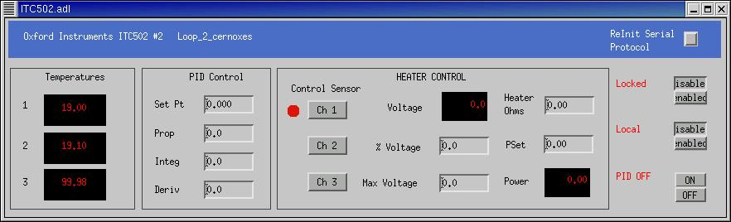
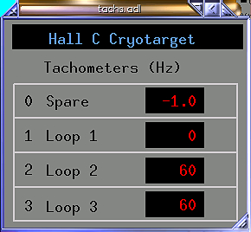
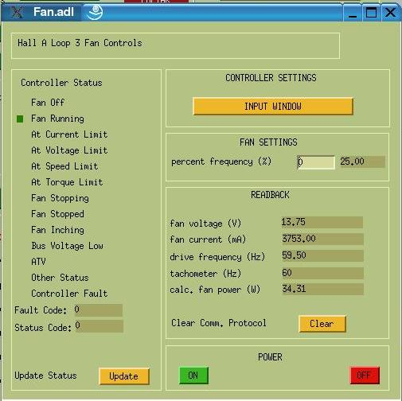
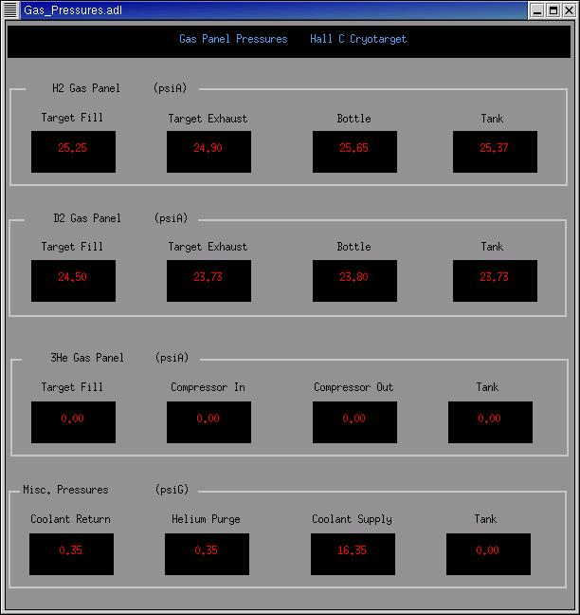
Temp., Press., & Fan GUIS
60Hz = 25%
Notes:
Fan can trip off. Turn it back on at 25% (60 Hz)

Slide 45
Emergency Procedures
Why? ESR crash, power failure, LOV, etc.
Ask for beam off if not already off.
Call an expert. May advise controlled access.
If T climbing, turn off heaters.
Fan speeds to 20 Hz, then power off when T > 30K.
Keep close eye on loop pressure, must not go sub-atmospheric. In certain situations, expert may ask you to hit the 2 panic buttons (HPH & JT).
  Normally, after boil-off P rises to 40-45 psia.
  You can’t save tgt by opening JTs if the ESR has crashed. Let it go.
Tgt expert may ask you to do a warm-up over the phone (together, & only thru MCC). See link in Cryogenic Target at www.jlab.org/Hall-C/
Notes:
Every emergency is different, just call an expert.

Slide 46
ρ (T, P)
Hydrogen
Deuterium
T (K) | P (psig) | ρ (H2) (g/cm³)
18.5 | 8.22 | 0.07283
19.0 | “ | 0.07231
19.5 | “ | 0.07176
19.0 | 7.35 | 0.07230
“ | 8.22 | 0.07231
“ | 9.09 | 0.07231
T (K) | P (psig) | ρ (D2) (g/cm³)
21.5 | 8.3 | 0.16868
22.0 | “ | 0.16743
22.5 | “ | 0.16613
22.0 | 7.3 | 0.16741
“ | 8.3 | 0.16743
“ | 9.3 | 0.16744
Notes:
Reference tables

Slide 47
Energy Loss
P_{e} (GeV/c) | LH2 (MeV/g/cm²) | LD2 (MeV/g/cm²)
1 | 4.63 | 2.32
2 | 4.74 | 2.37
3 | 4.80 | 2.40
4 | 4.84 | 2.42
5 | 4.88 | 2.44
6 | 4.90 | 2.46
Notes:
More useful info.

Slide 48
High Pressure He?
Simpler than LH₂ and LD₂
  Controls are the same.
  Only have the gaseous phase (no danger of freezing)
  Have fixed relatively small volume
  Over temperature →
    Vents at 260 psi
  Normal parameters:
    T = 6.6 K
    P = 200 psi
Over pressure

Slide 49
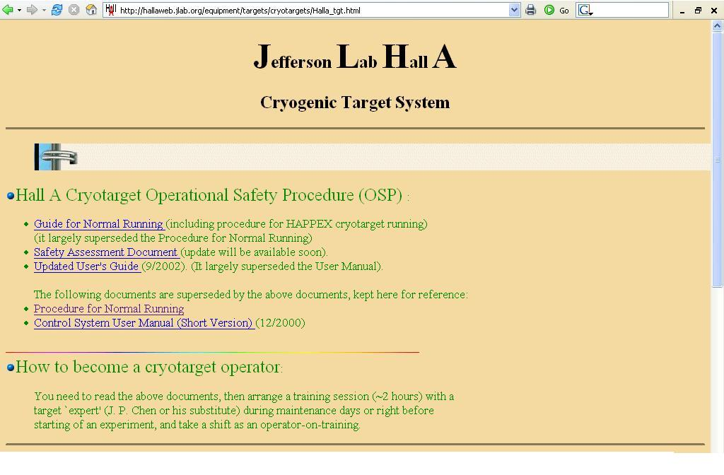
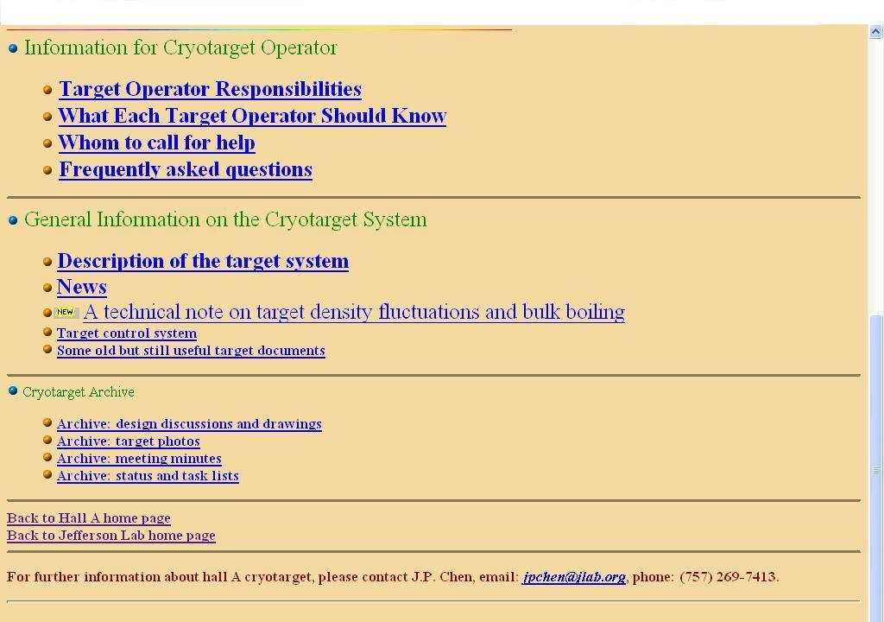
Cryotarget Web Page
Hall A Cryotarget link :
http://hallaweb.jlab.org/equipment/targets/cryotargets/Halla_tgt.html
Contents:
Control system guide
How-tos
Contacts
This talk
Goal parameters
Thicknessess
Documentation
Etc.

Slide 50
A Typical Shift
(what you’ll really wind up doing)
Monitor tgt parameters
Service the occasional alarm
Log target parameters & changes
Change targets
Adjust JT in response to changes at ESR
Occasional tgt IOC reboot
That’s all!
Notes:
Mainly just babysit!

Slide 51
Done!
Remember to sit ~1 shift with a trained operator to complete your practical
Read documentation available from the Hall-A Cryotarget website
Stay cool!

