Slide 1
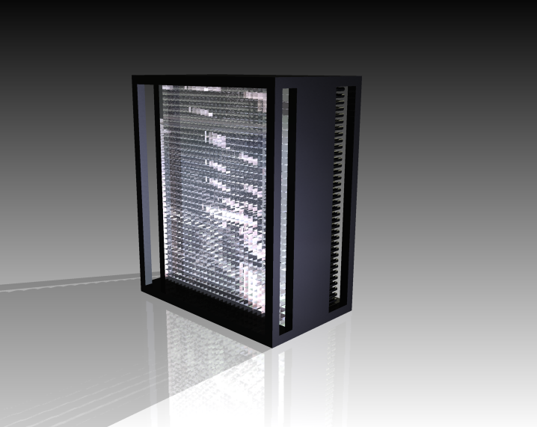
Test results for the recent SIC PWO crystals
Carlos Muñoz Camacho, IPN-Orsay
for the NPS Collaboration at Jefferson Lab
SICCAS, Shanghai, July 23 (2018)

Slide 2
Red denotes relaxed parameters in the 2018 procurement
NPS: 2.05cm x 2.05cm x 20cm
PbWO4 crystal specification
Parameter | Unit | NPS Required | COMCAL/FCAL | PANDA specifications
Light Yield at RT | phe/MeV | ≥15 | ≥9.5 | ≥16
LY uniformity between the blocks (%) |  | <10 (<20)
LY(100ns)/LY(1us) | % | >90 | >90 | >90
Longitudinal Transmission at
λ = 360nm | % | ≥35 (≥25) | ≥10 | ≥35
λ = 420nm | % | ≥60 | ≥55 | ≥60
λ = 620nm | % | ≥70 | ≥65 | ≥70
Transverse Transmission and LY uniformity along the crystal | % | 10
Inhomogeneity of Transverse Transmission
D λ at T=50% | nm≤ | ≤5 | ≤6 | ≤3
Induced irradiation absorption coefficient dk at λ =420nm and RT, for integral dose >10Gy | m-1 | <1.1 (<1.5) | <1.5 | ≤1.1
Mean value of dk | m-1 | ≤0.75 |  | ≤0.75
Tolerance in Length | µm | ≤±100 | +0/, -100 | ≤±50
Tolerance in sides | µm | ≤±50 | +300, -0. | ≤±50
Surface polished, roughness Ra | µm | ≤0.02
Tolerance in Rectangularity | degree | ≤0.1 |  | ≤0.01
Mo contamination | ppm | <10 |  | <1
La, Y, Nb, Lu contamination | ppm | <40ppm (≤100) |  | ≤40
Prefer a method of labeling crystals that does not leave traces of glue when removing sticker

Slide 3
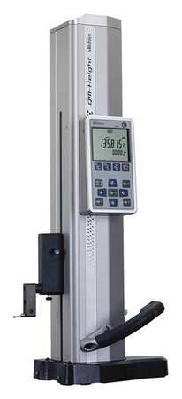
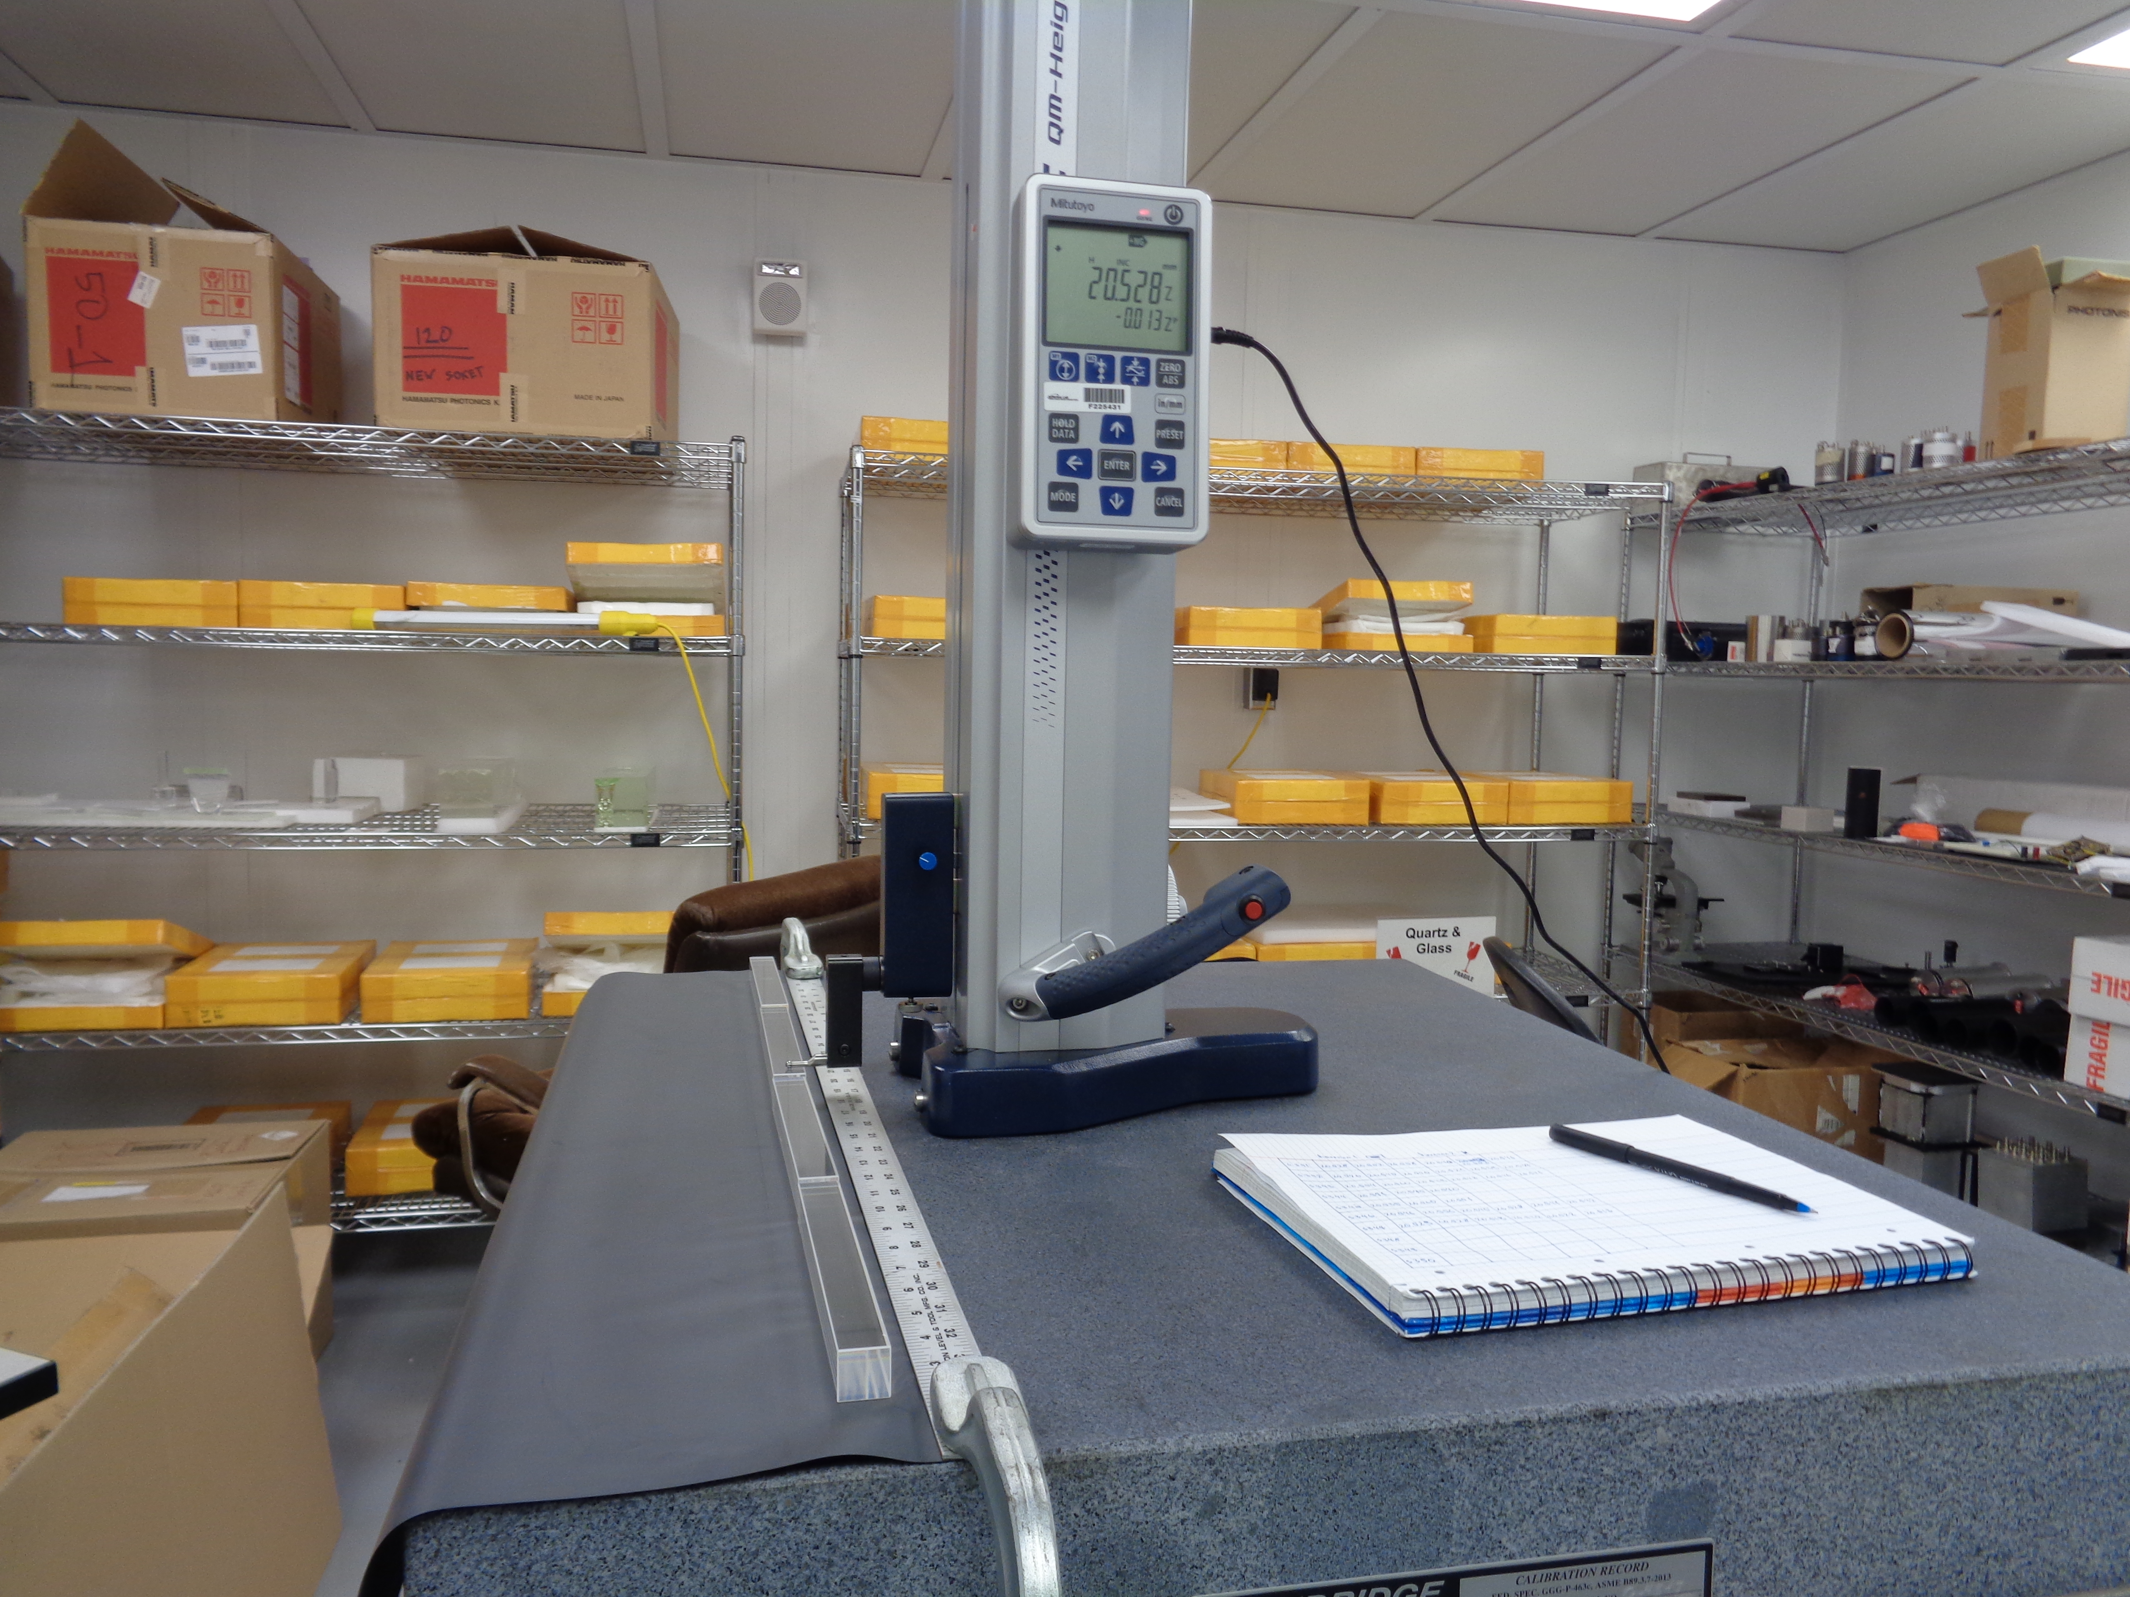
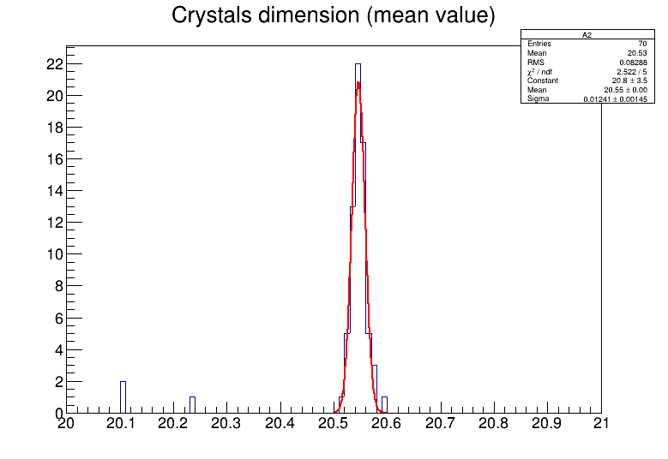
Dimension measurements
Mitutoyo height gage tool (accuracy ~1um)
Granite table AA class (flatness accuracy ~ 6 um)
Safe and high precision method(~25 um)
Six measurements per one crystal
out-layers

Slide 4
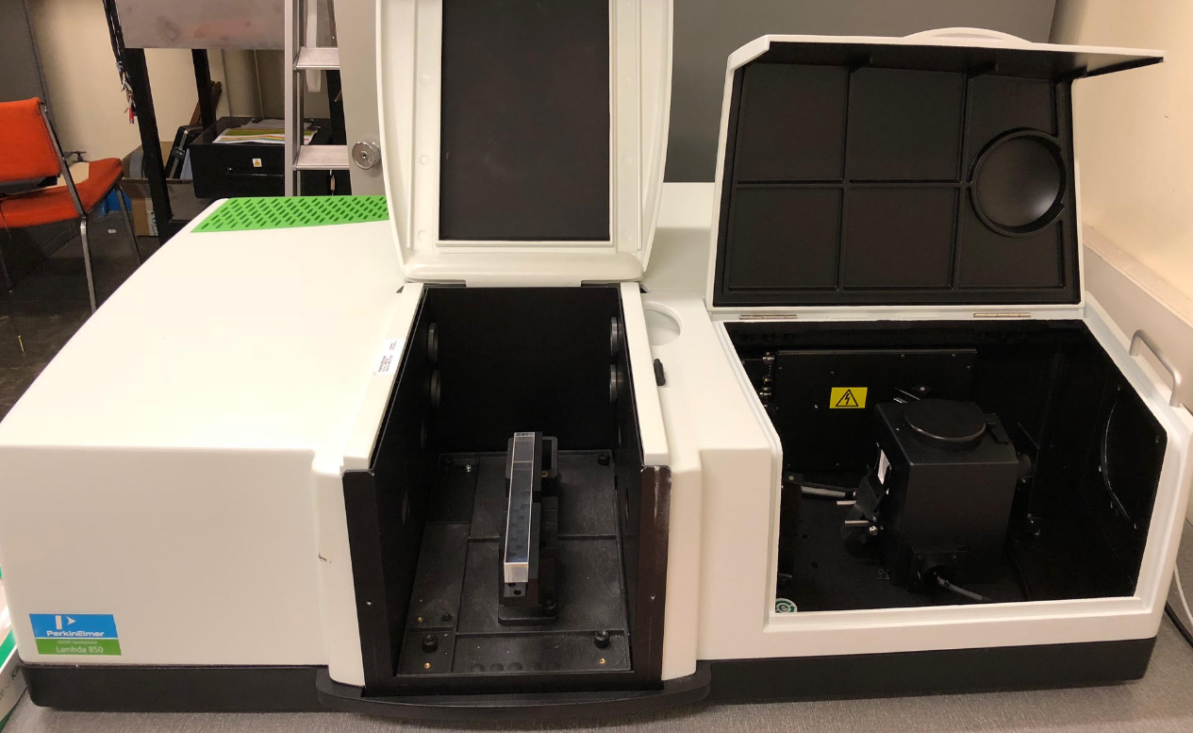
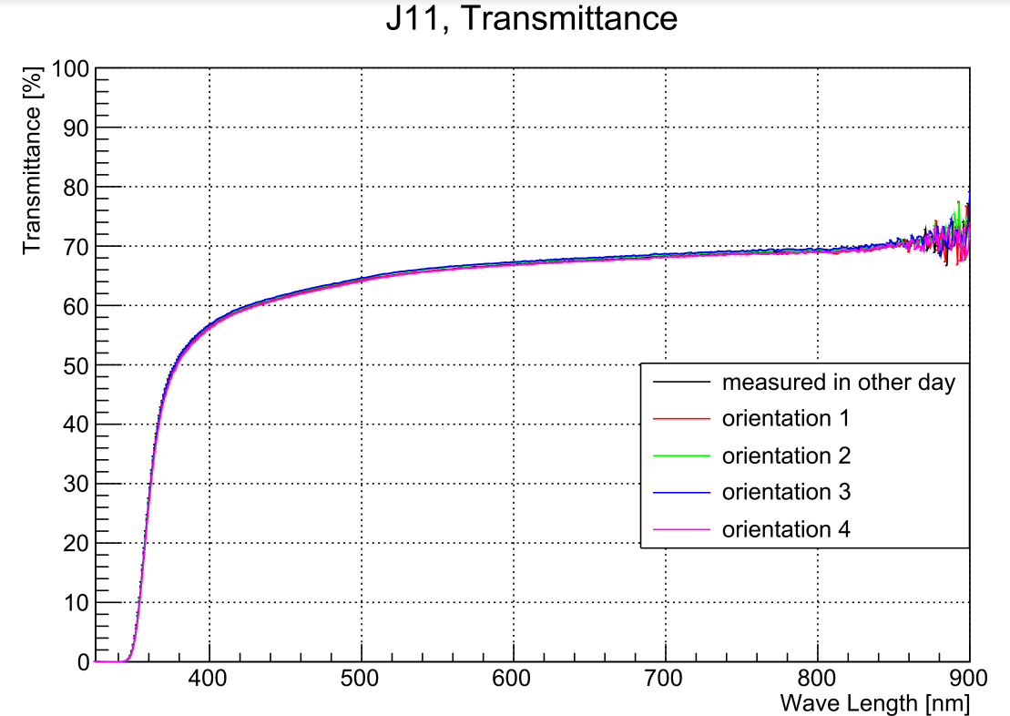
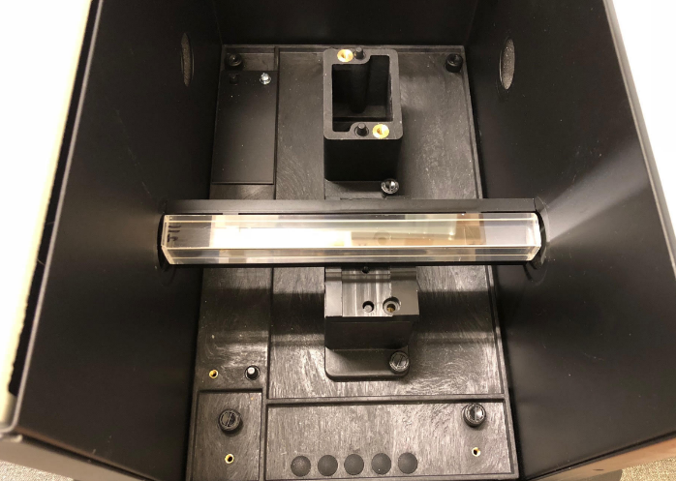
Optical transmittance measurements: PerkinElmer Lambda 850
Double beam spectrometer
Integrating sphere
Excellent (<0.1%) reproducibility of measurements

Slide 5
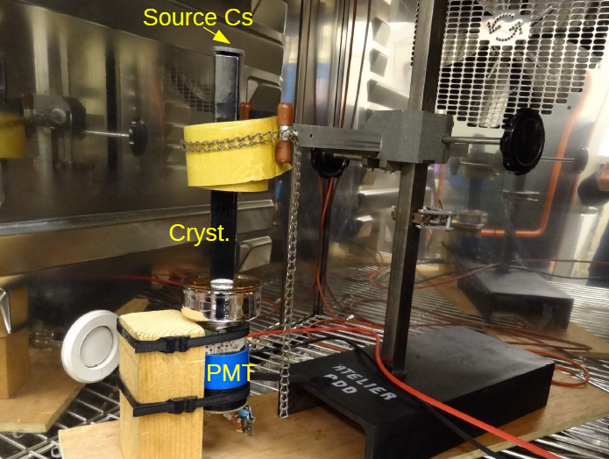
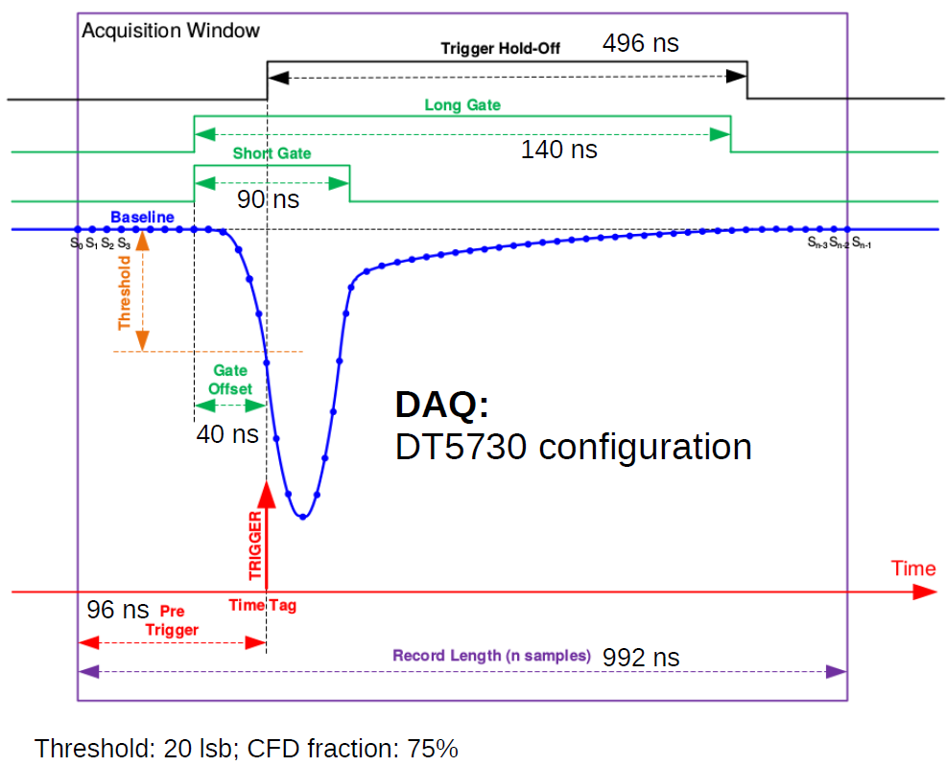
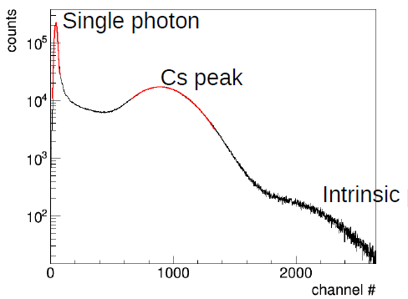
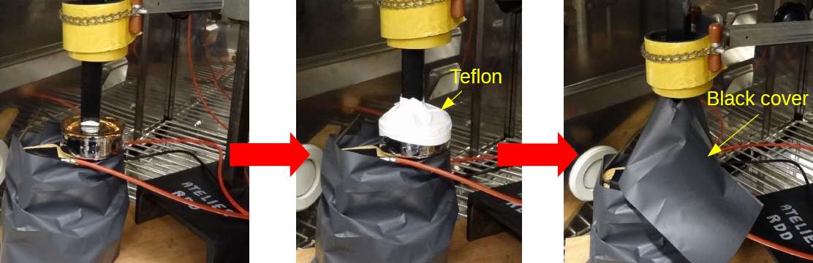
Light yield measurements: Cs-source in a temperature controlled chamber
Light yield measurements: Cs-source in a temperature controlled chamber
Temperature: 18 deg C

Slide 6
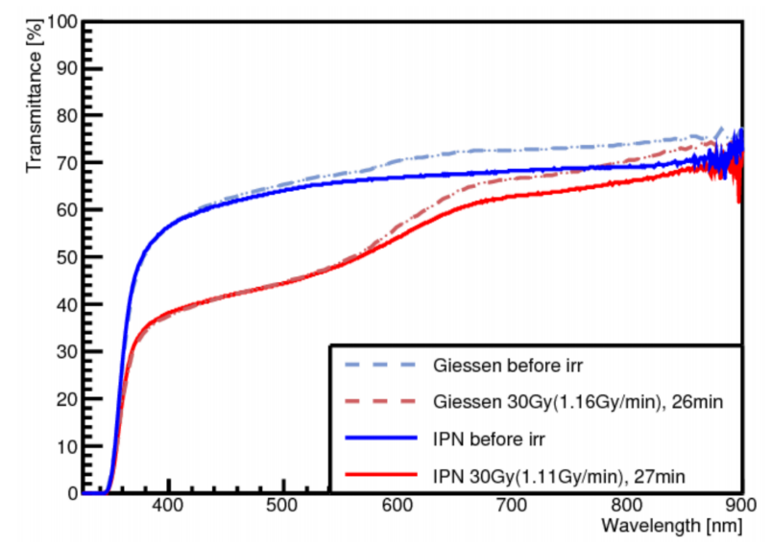
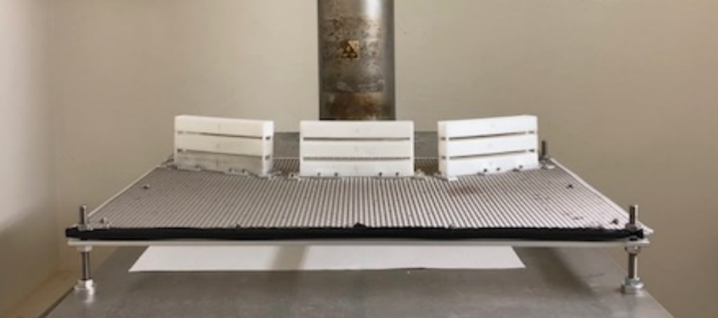
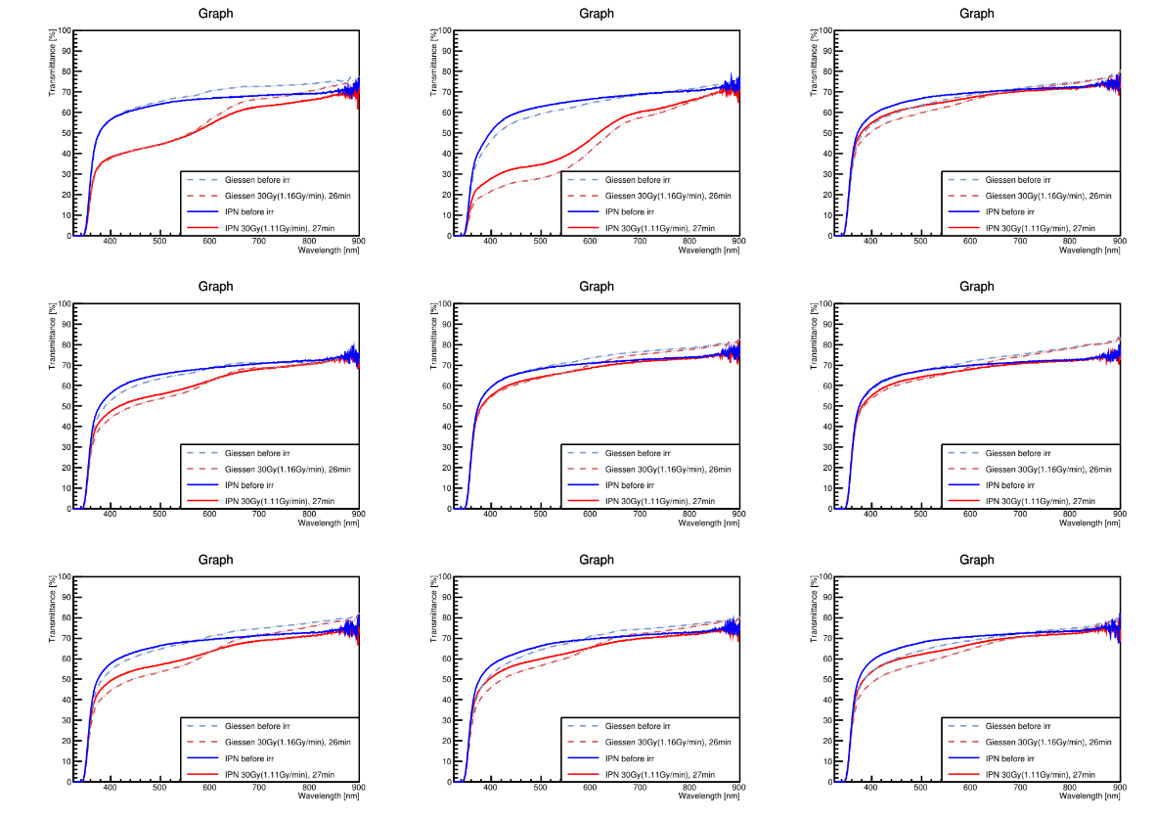
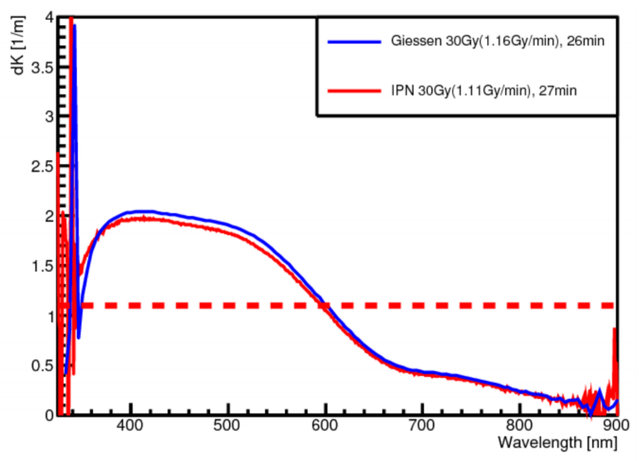
Radiation hardness measurements: high activity ⁶⁰Co source
30 Gy total dose, at a rate of ~1Gy/min

Slide 7
Experimental Investigations
Initial Inspection and Labeling
Visual inspection including green laser
Longitudinal and transverse dimensions
Optical transmission
Longitudinal and transverse
Luminescence yield, temperature dependence, and decay kinetics
Radiation resistance
Chemical and surface analysis, as needed

Slide 8
Conditions for crystal certification and acceptance
NPS collaboration is responsible for the certification of the crystals delivered by SICCAS
NPS collaboration is not obliged to disclose the results of the certification to SICCAS, except for rejected crystals
Result of certification summary includes these parameters
Individual crystal number
Dimension of crystal
Visual inspection report
Optical properties of crystal
Scintillation yield
Radiation hardness (if measured)
Examples of additional items in 2018 procurement to ensure quality:
  Scintillation kinetics (if measured)
  Non-uniformity of transmission and light yield (if measured)
  Contamination (if measured)

Slide 9
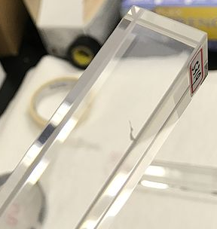
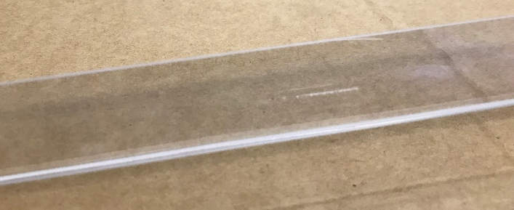
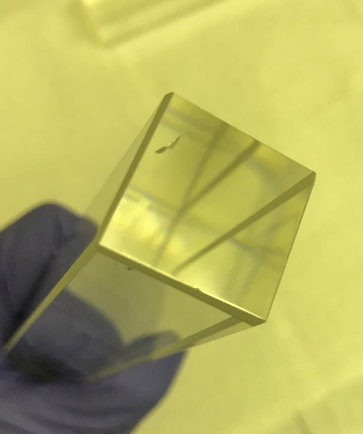
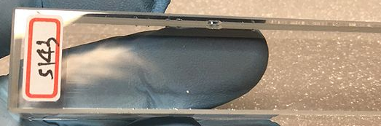
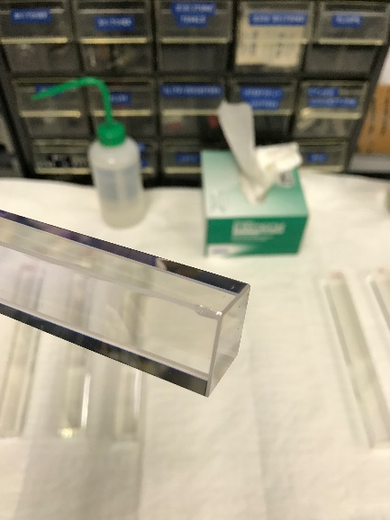
Visual Inspection
Long scratches and cracks
Excessive number of small chips along edges or large chips on corners

Slide 10
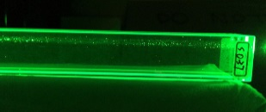
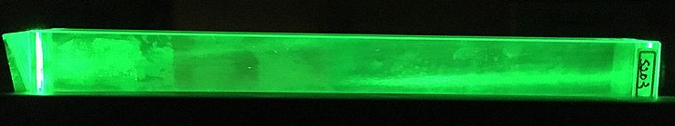
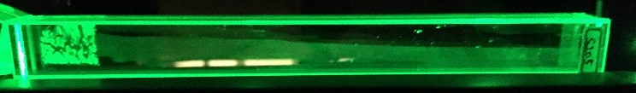
Visual Inspection – cont.
Excessive number of bubbles in bulk
Chemical film on surface
Traces of old labels or markings on surface

Slide 11
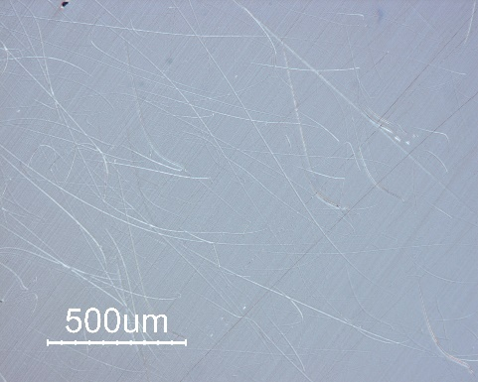
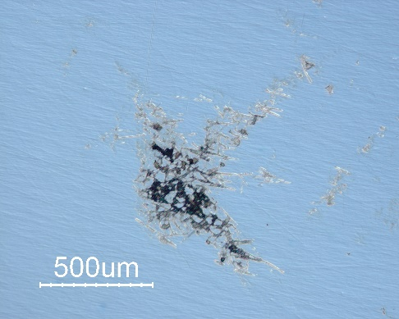
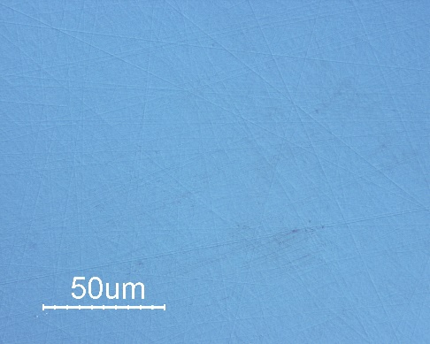
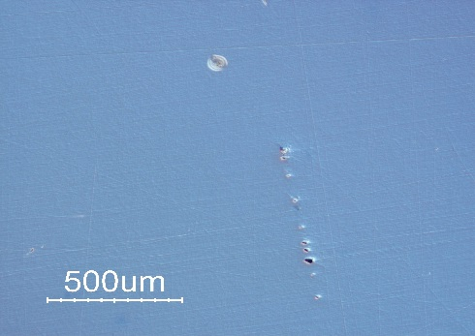
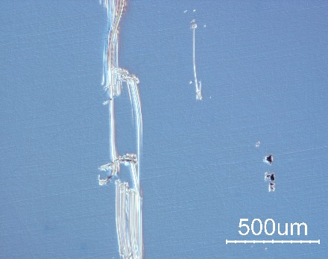
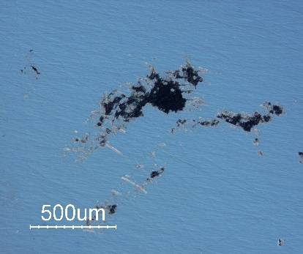
Surface analysis
Typical crystal surface quality
BTCP
SICCAS
CRYTUR
Looking deeper into defects:
Bubble
Deep scratches
Pits
Defects result in high, but non-uniform light yield

Slide 12
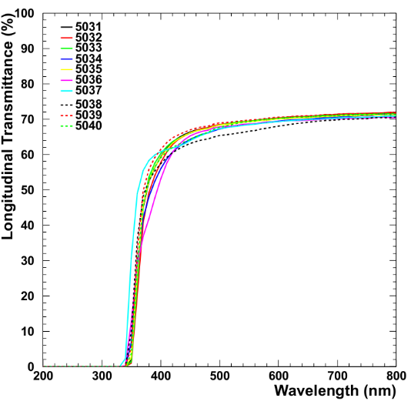
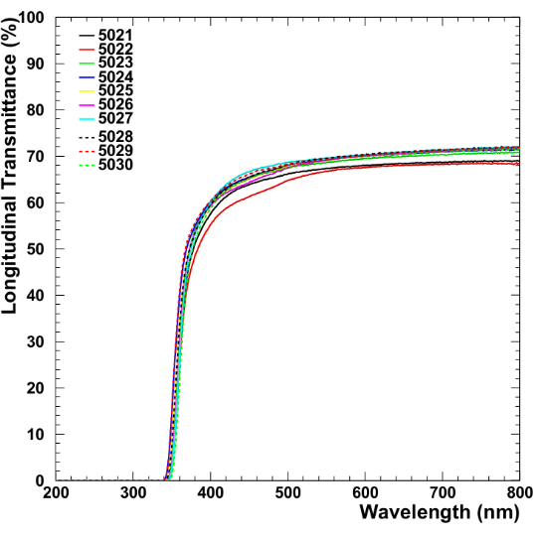
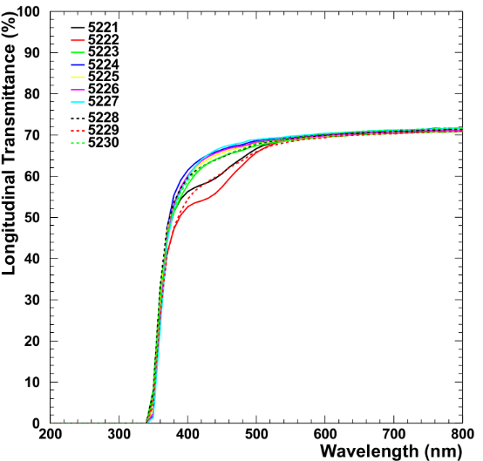
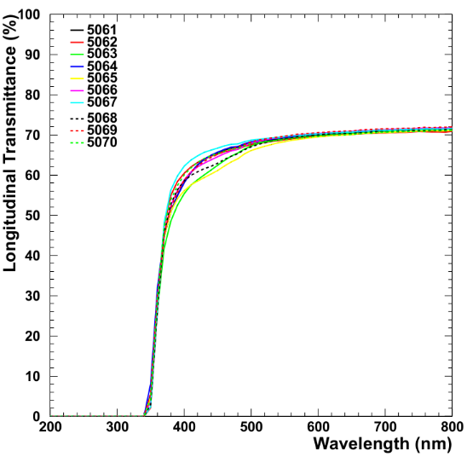
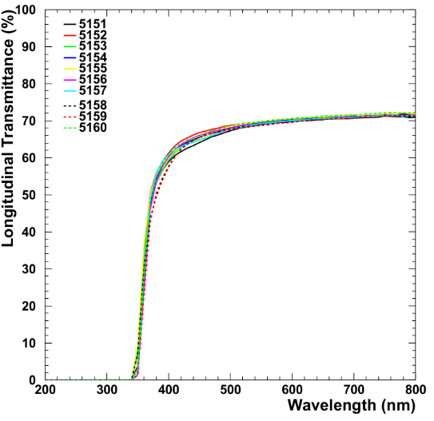
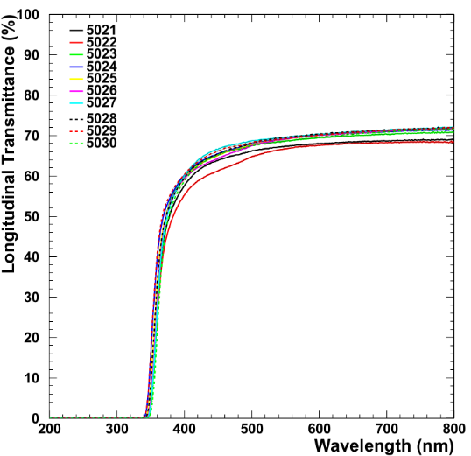
Longitudinal Transmittance:
Correlated with observed defects

Slide 13
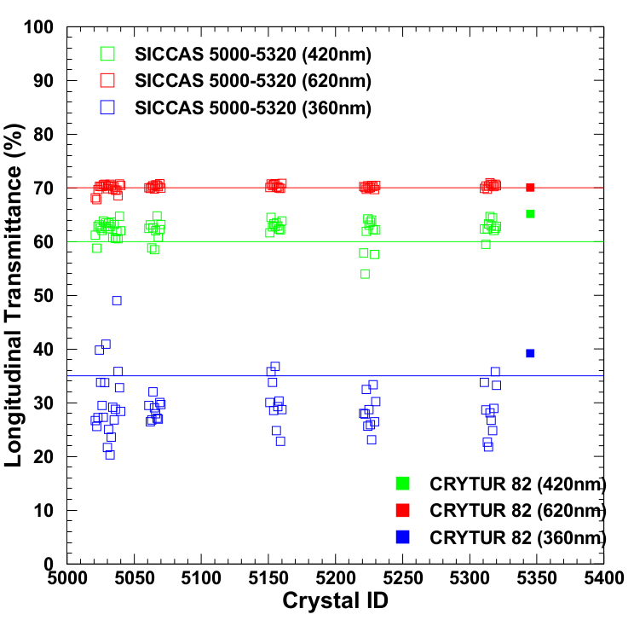
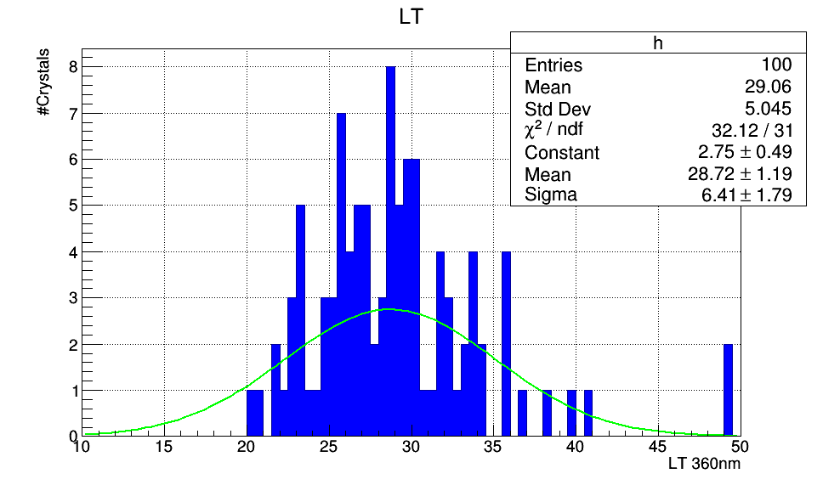
Longitudinal Transmittance:
Concern is the width of the distribution at each wavelength

Slide 14
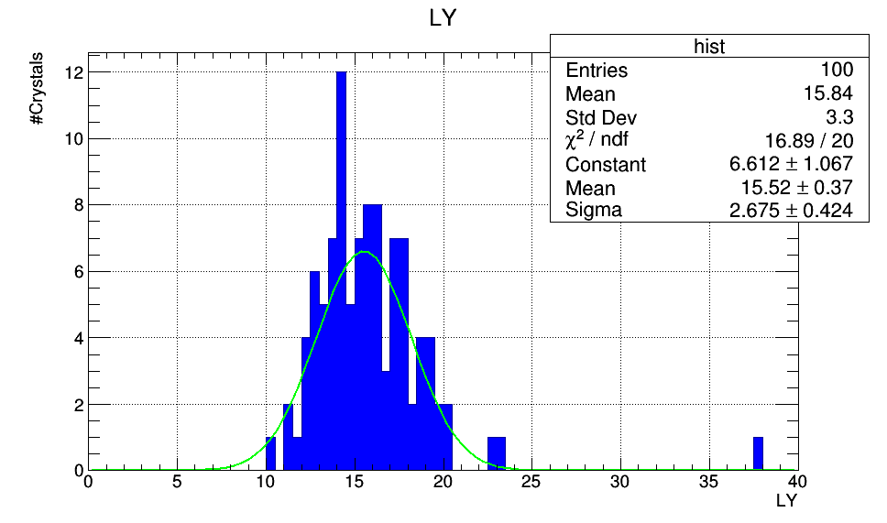
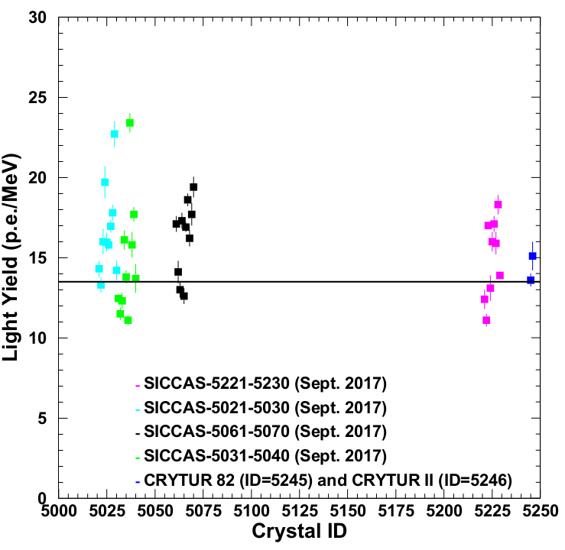
Light Yield:
High light yield, but non-uniform due to defects, e.g. bubbles
Concerns:
Large variations in light yield
Non-uniformity of light yield within one crystals due to defects
Very high light yields due to defects in crystal bulk

Slide 15
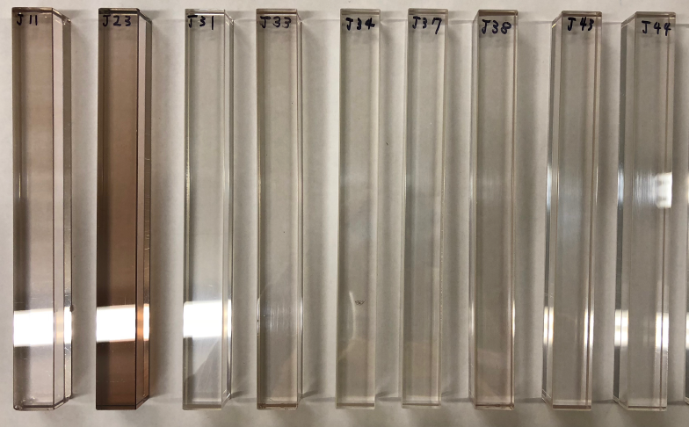
Radiation Resistance

Slide 16
Summary 2017: Three major failure categories
Out of a subset of ~200 crystals tested, the “bad” crystals fall into three major categories:
8% fail: Chips, scratches, old labels
13% fail: Bubbles and other defects
10% fail: LY @420nm < 60% or light yield

Slide 17
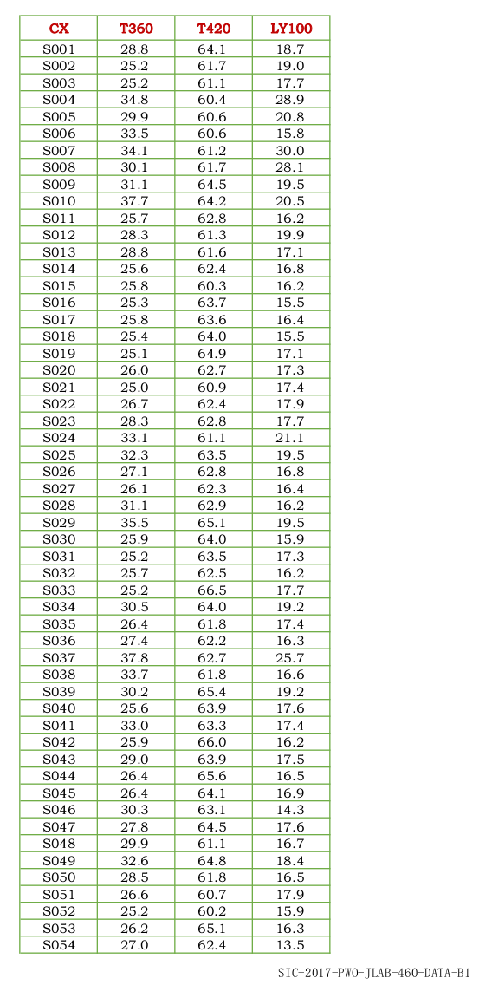
Example report from SICCAS 2017
SICCAS results
NPS results
CX | NPS T360 | NPS T420 | NPS LY100
S021 | 26.7 | 61.2 | 14.3
S022 | 25.6 | 58.7 | 13.3
S023 | 27.2 | 62.9 | 16.0
S024 | 39.8 | 63.1 | 19.7
S025 | 33.8 | 62.5 | 16.0
S026 | 29.5 | 62.1 | 15.8
S027 | 27.3 | 63.8 | 17.0
S028 | 33.7 | 62.8 | 17.8
S029 | 40.9 | 63.5 | 22.7
S030 | 21.7 | 62.4 | 14.2
S031 | 25.06 | 63.47 | 12.45
S032 | 20.3 | 62.8 | 11.5
S033 | 23.6 | 63.6 | 12.3
S034 | 29.2 | 60.7 | 16.1
S035 | 26.8 | 66.2 | 13.8
S036 | 28.8 | 60.6 | 11.1
Measurement methods used?

Slide 18
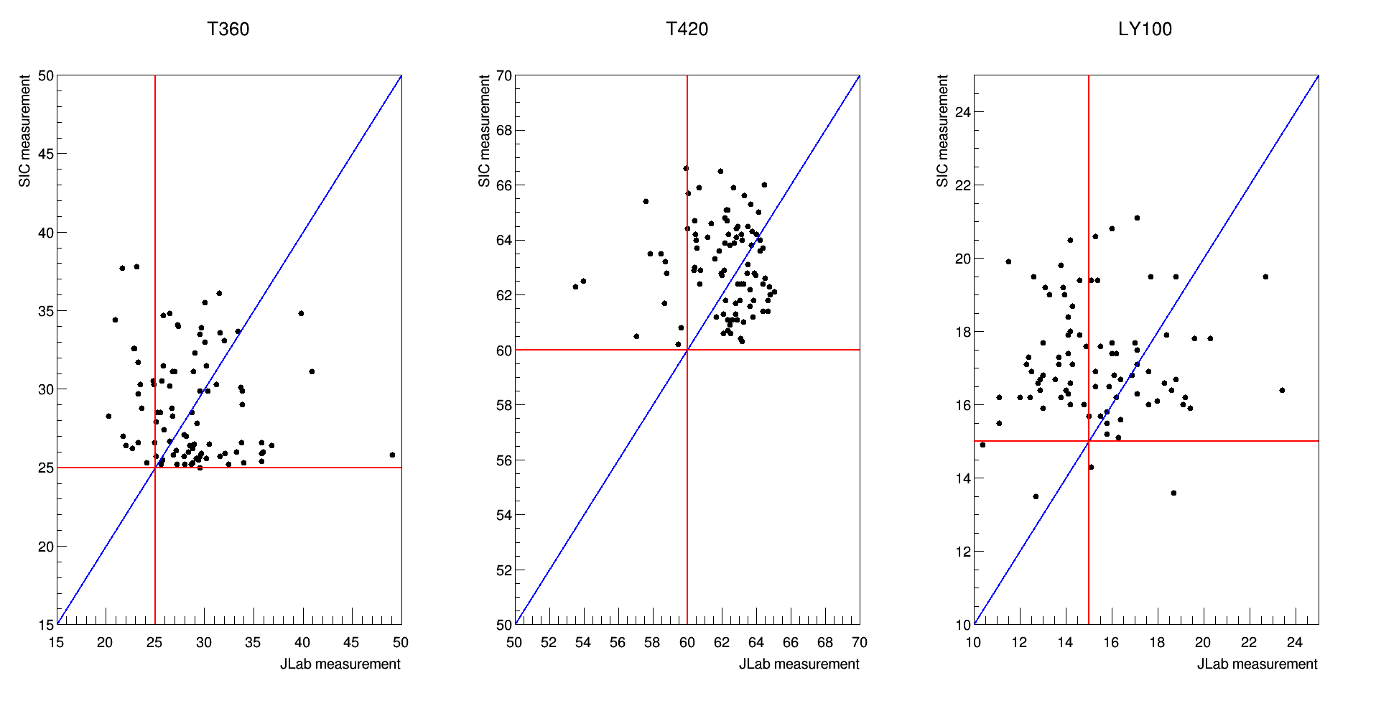
SIC and Jlab measurements comparaison (~200 samples)
No clear correlation of results
Transmittance and LY generally lower at JLab than SIC
Should discuss methods and measurement procedures

