Slide 1
GEM chambers for SoLID
Nilanga Liyanage
University of Virginia

Slide 2
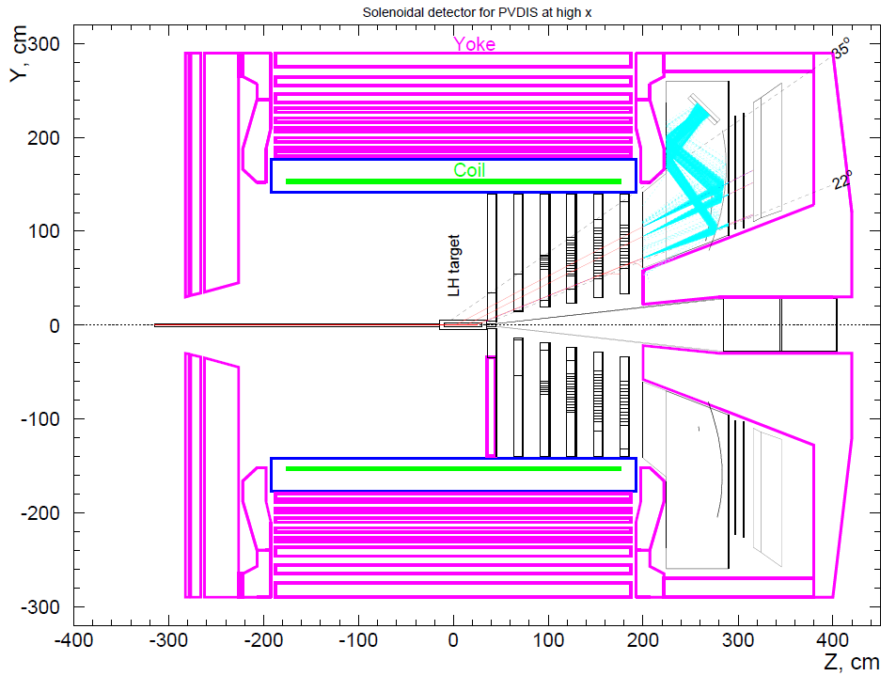
Tracking needs for SoLID (PVDIS)
Rate: from 100 kHz to 600 kHz (with baffles), GEANT3 estimation
Spatial Resolution: ∼0.2 mm (sigma)
Total area: 23 m² total area (30 sectors x4 planes, each sector cover 10 degree)
Need to be Magnetic field tolerant
Lumi = 5.4E38 /cm²/s

Slide 3
Choice of the technology
System Requirements | Tracking Technology
 | Drift | MPGD | Silicon
High Rate (up to): 1 MHz/cm² | NO | MHz/mm² | MHz/mm²
Resolution: 200 μm | Achievable | 50 μm | 30 μm
Large Area: Single chamber up to 0.5 m² total 23 m² | YES | Doable | Very Expensive
Flexibility in readout geometry and lower spark rate
GEM
μMs
New recent development in resistive μM and GEM + μM to improve spark rate

Slide 4

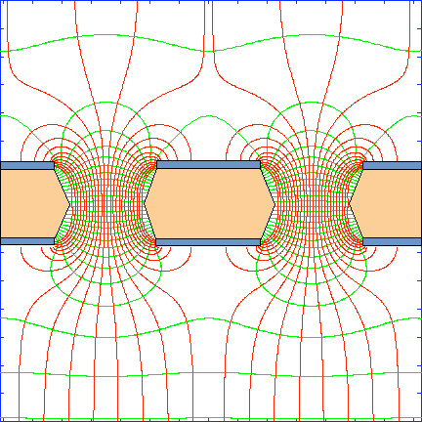
GEM working principle
GEM foil: 50 μm Kapton + few μm copper on both sides with 70 μm holes, 140 μm pitch
Ionization
Multiplication
(x20)
Multiplication
(x20)
Multiplication
(x20)
Readout
Strong electrostatic field in the GEM holes
Recent technology: F. Sauli, Nucl. Instrum. Methods A386(1997)531

Slide 5
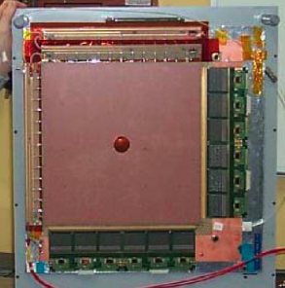
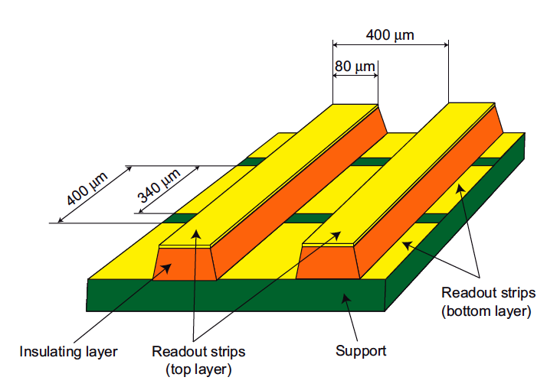
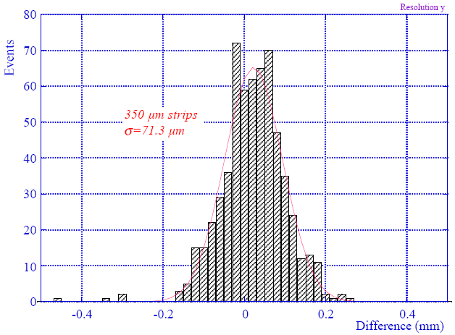
COMPASS GEM Tracker
A tracker of twenty two 31 cm x 31 cm GEM chambers successfully operated for years
Rates as high as 2.5 MHz/cm²
COMPASS readout plane (31x31 cm²)
70 μm resolution achieved by strips centroid
⇒ Analog readout required (used the APV25 chip)

Slide 6
GEM Rate capability
Multiplication stages shielded from each other: much reduced feed back
Slow moving positive ions localized to holes, away from the induction region
Most of the created electrons contribute to signal: can operate at low gains
Much higher rates compared to wire chambers: ~ 50 MHz/cm²
~ 600 kHz/cm²
Maximum rate expected for SoLID GEM trackers
Triple GEM
Poli Lener, PhD Thesis - Rome 2005

Slide 7
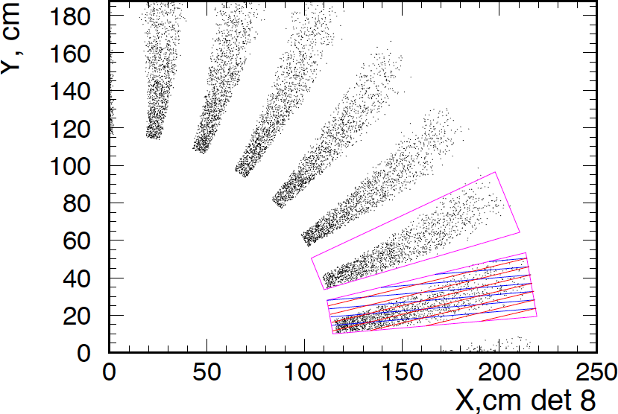
PVDIS GEM configuration
Current proposal to instrument locations 5, 6, 7, and 8 with GEM:
30 GEM modules at each location: each module with a 10-degree angular width.
Plane | Z (cm) | R_{I} (cm) | R_{O} (cm) | Active area (m²)
5 | 150 | 55 | 115 | 2.7
6 | 190 | 65 | 140 | 4.0
7 | 290 | 105 | 200 | 7.6
8 | 310 | 115 | 215 | 8.6
total: |  |  |  | ~ 23
Outline of a GEM module
Largest GEM module size required: 100 cm x (20-38) cm

Slide 8
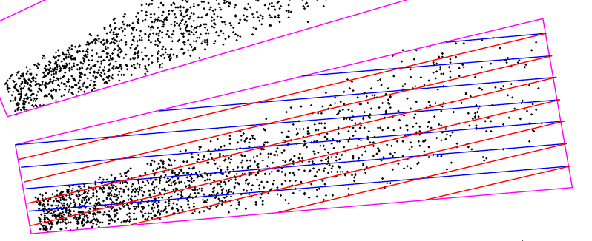
PVDIS GEM configuration
Suggested readout scheme:
  a 2D readout optimized to get high accuracy in the φ coordinate, lower but sufficient resolution in the r coordinate.
  each set of stripes parallel to one of the radial sides of the module: i.e. stripes at a 10-deg stereo angle to each other.
  strip pitch is 0.6 mm for locations 7 and 8;
  0.4 mm for locations 5 and 6.
  Issues:
    High capacitance in long readout strips; will signal to noise ration be an issue ?
    How well will the 10-deg stereo angle separated strip layers work ? – need to test with prototypes.

Slide 9
PVDIS GEM configuration
For this readout scheme readout channel estimation
Plane | Z (cm) | R_{I} (cm) | R_{O} (cm) | # of channels
5 | 150 | 55 | 115 | 30 k
6 | 190 | 65 | 140 | 36 k
7 | 290 | 105 | 200 | 35 k
8 | 310 | 115 | 215 | 38 k
total: |  |  |  | 140 k
with 20% spares, we will need about 170 k channels.
Good news: cost of electronics going down – cost per channel for the RD51 SRS APV-25 based readout is estimated to be ~ $ 2.50 - $ 3.00 + R&D expenses to optimize electronics for SoLID needs.
The total cost of readout electronics can be less than $ 1 M

Slide 10
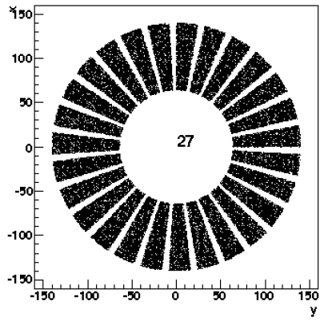
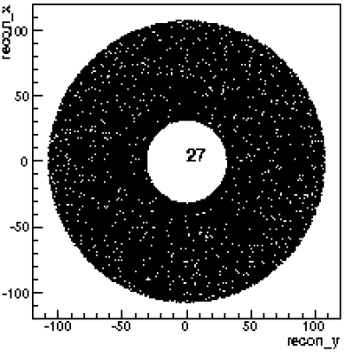
SIDIS GEM configuration
Six locations instrumented with GEM:
PVDIS GEM modules can be re-arranged to make all chamber layers for SIDIS. – move the PVDIS modules closer to the axis so that they are next to each other
More than enough electronic channels from PVDIS setup.
The two configurations will work well with no need for new GEM or electronics fabrication.
Plane | Z (cm) | R_{I} (cm) | R_{O} (cm) | Activearea | # of channels
1 | 197 | 46 | 76 | 1.1 | 24 k
2 | 250 | 28 | 93 | 2.5 | 30 k
3 | 290 | 31 | 107 | 3.3 | 33 k
4 | 352 | 39 | 135 | 5.2 | 28 k
5 | 435 | 49 | 95 | 2.1 | 20 k
6 | 592 | 67 | 127 | 3.7 | 26 k
total: |  |  |  | ~18 | ~ 161 k
SIDIS
PVDIS

Slide 11
large area GEM chamber challenges
SoLID needs GEM modules as large at 100 cm x 40 cm.
The biggest challenge used to be the non-availability of large area GEM foils.
Not a problem anymore: CERN shop can make foils as large as 200 cm x 50 cm now.
One problem may be the production capacity of the CERN shop: especially if a LHC related large GEM project gets underway.
Currently work going on to develop large GEM production capabilities in China.

Slide 12
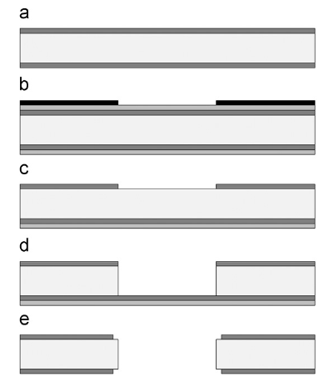
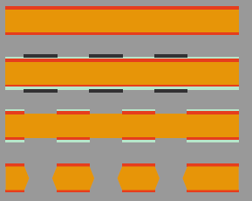
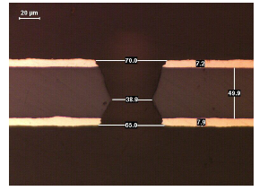
Major recent development at CERN PCB shop towards large GEM foils
Base material only ~ 45 cm wide roll.
Used a double mask technique for etching: hard to the two masks accurately: Max area limited to ~ 45 cm x 45 cm previously.
Bias top surface to – w.r.t chemical bath
Double Mask
Single Mask
Single Mask technique allows to make GEM foils as large as 200 cm x 50 cm

Slide 13
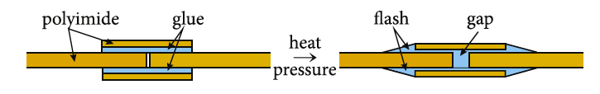
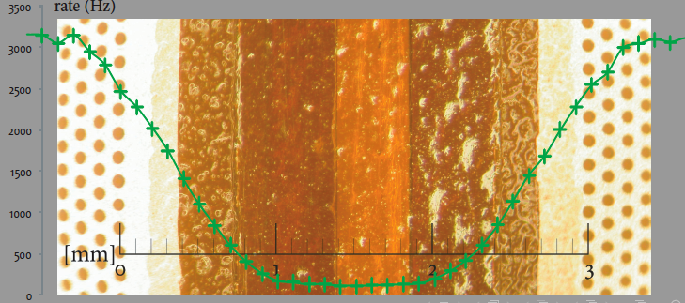
Major recent development towards large GEM foils
Splicing GEM foils together: seam is only 2 mm wide
Performance of the rest of the GEM foil unaffected

Slide 14
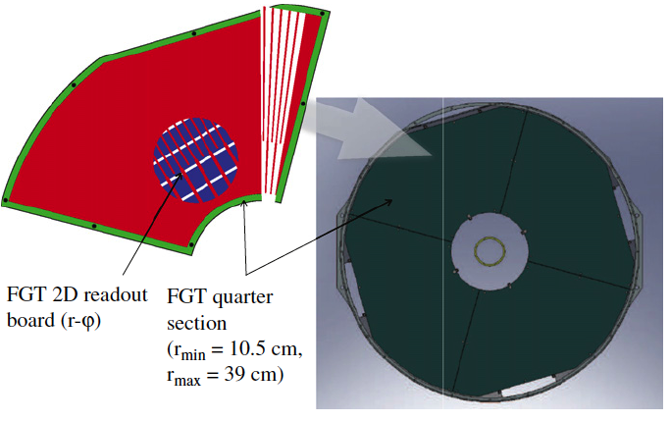
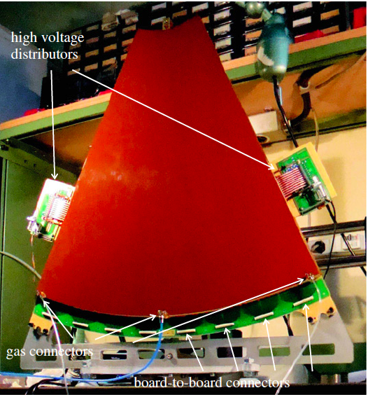
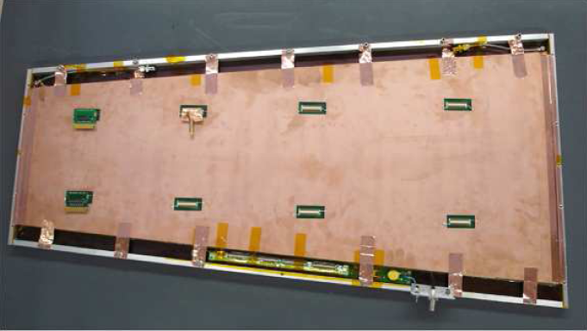
Large GEM chamber projects
STAR Front GEM Tracker
  6 triple-GEM disks around beam
  IR~10.5 cm, OR~39 cm
  APV25 electronics
Large prototype GEM module for CMS: 99 cm x (22 – 45.5) cm
TOTEM T1 prototype made with single mask GEM foils (33 cm x 66 cm)
CMS prototype similar the the dimensions of largest SoLID chambers

Slide 15
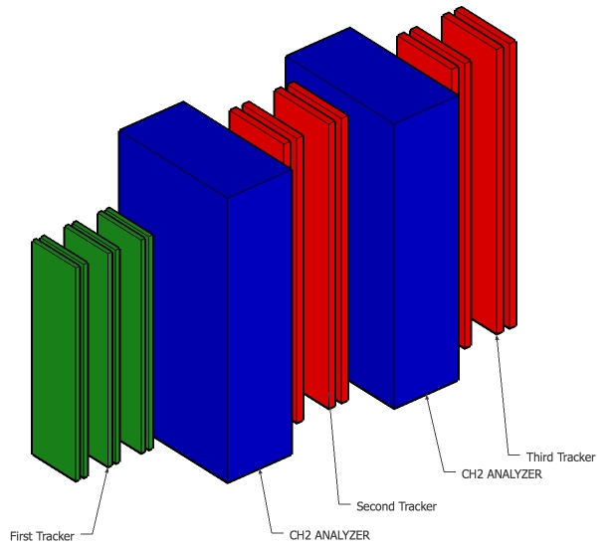
Jefferson Lab SBSTrackers – Front Tracker
Front Tracker
Geometry
18 modules
In Italy
x6
50 cm x 40 cm Modules are assembled to form
larger chambers with different sizes
Front tracker: Six 40 cm x 150 cm GEM layers
  INFN Funding: to be built in Italy
Polarimeter trackers: Eight 50 cm x 200 cm GEM layers
  to be built in Virginia
Total GEM coverage of SBS ~ 16 m²
76 modules
In Virginia
SBS GEM module construction currently going on in Italy and at UVa

Slide 16
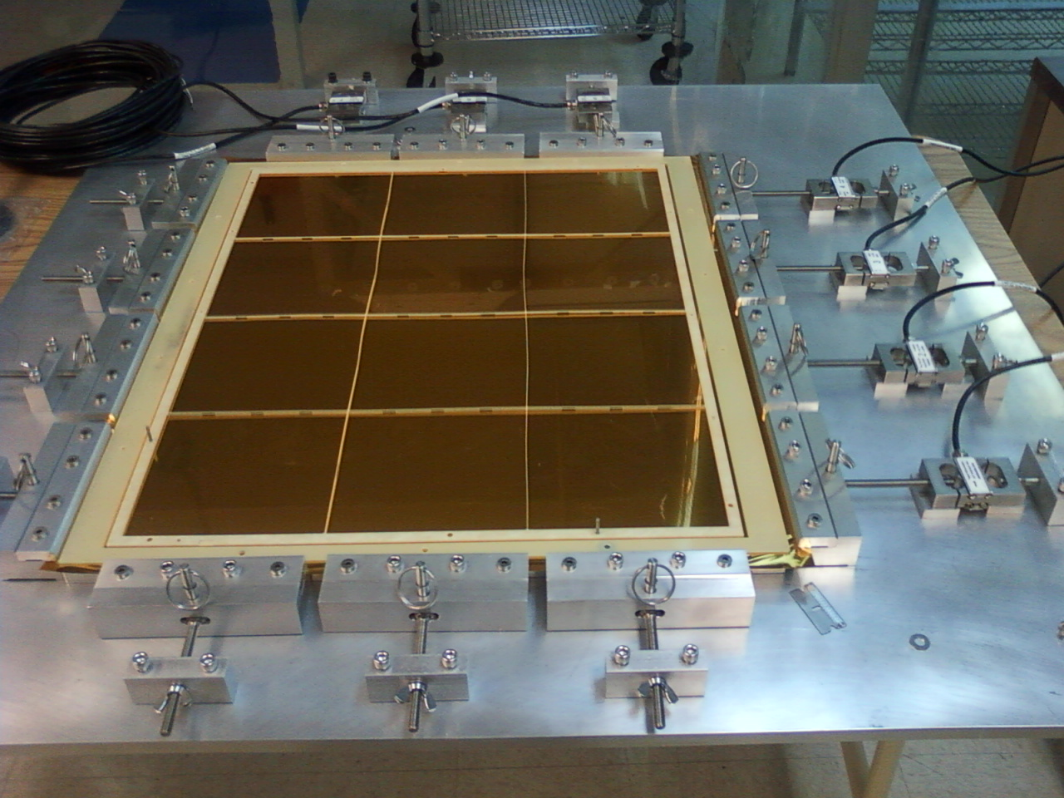
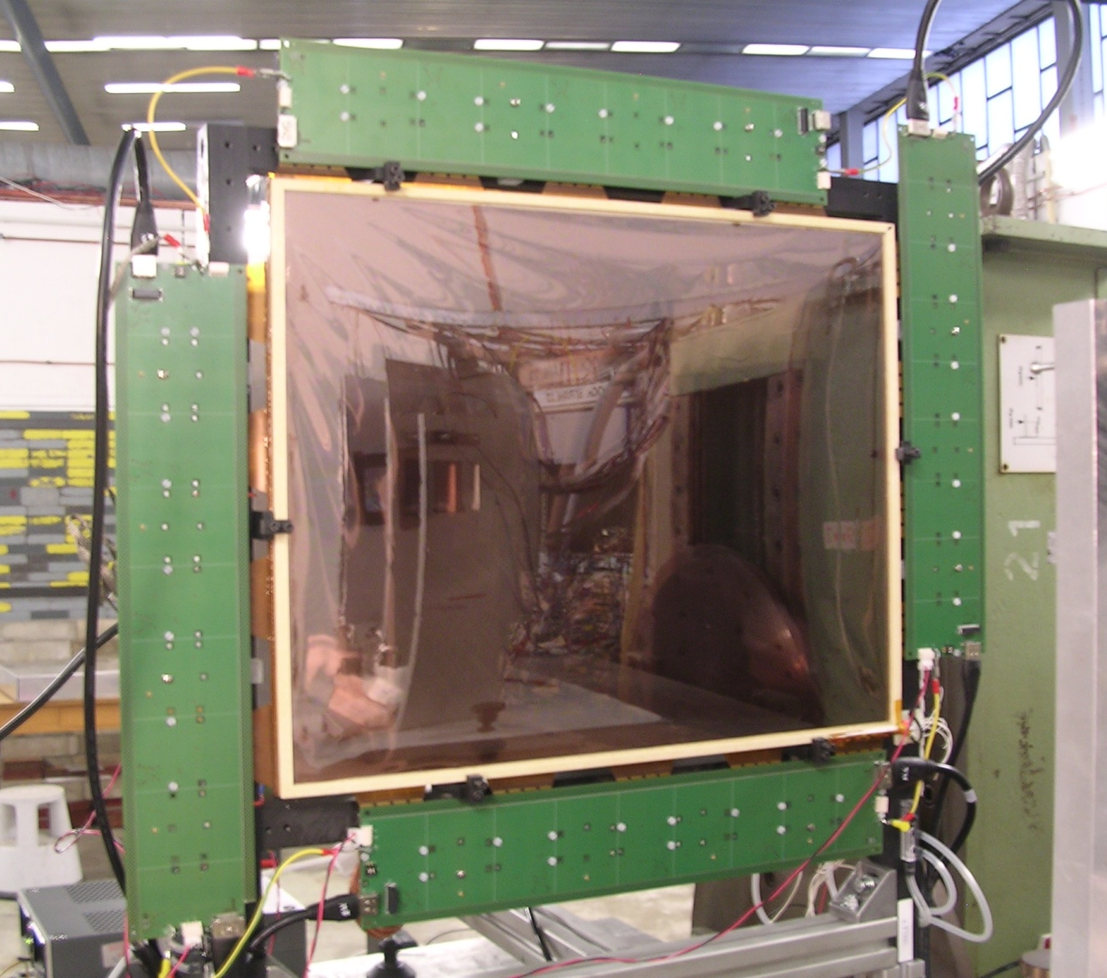
The currenty ongoing GEM chamber work
New 40 cm x 50 cm GEM stretcher at Uva
Stretching time ~ 1 – 2 hours
Foil Tension: T ~ 0.5 kg/cm
Fully equipped INFN prototype 40x50 cm² GEM module for a beam test at DESY
A 100 cm x (25-40) cm prototype GEM module with 2D readout is currently under design at Uva. (EIC detector R&D effort)
Expect to construct and test this chamber this Fall - Can learn a great deal for SoLID GEMs from this:
  develop techniques for fabrication of large GEM modules.
  study readout schemes: 10 degree stereo angle
  Study issues of signal to noise ratio for long readout strips.

Slide 17
Bottom-line
With the strong effort led by RD-51 towards large GEM chambers and readout electronics:
  Costs are coming down
  Many technical challenges are overcome
But SoLID is a very large and very complicated GEM project from any standard; no one has ever done anything even close to this size.
We are now starting on SBS GEM construction, this is about 70% of the size of the SoLID GEM project.
So with:
  large GEM chamber construction for SBS in Rome and at UVa
  the infrastructure and expertise we gain from large GEM prototyping at UVa, and
  Expertise gained by our Chinese collaborators.
  we will be ready for the SoLID GEM construction in a couple of years.

Slide 18
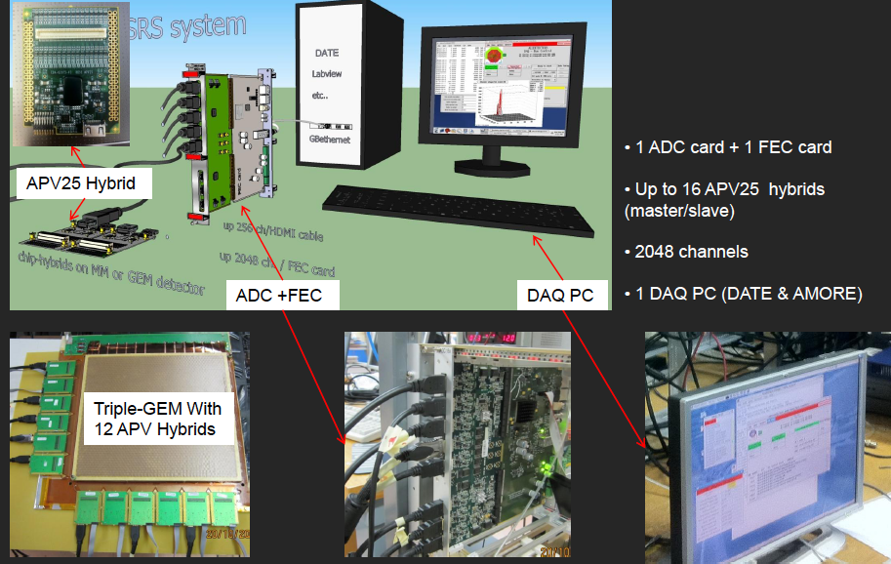
GEM chamber electronics
The RD-51 Scalable Readout System provides a low-cost, common platform that can accommodate different readout chips.
Currently tested with APV25-S1 chip.
Drawback with the APV25 chip: may not be fast enough for SoLID
Need to work on finding a suitable chip for SoLID readout and incorporating it into SRS (?)
SRS system has the benefit of the large team effort backed by RD-51
RD-51 plans to commercialize the fabrication; there will be the possibility to get very large systems in the future.

Slide 19
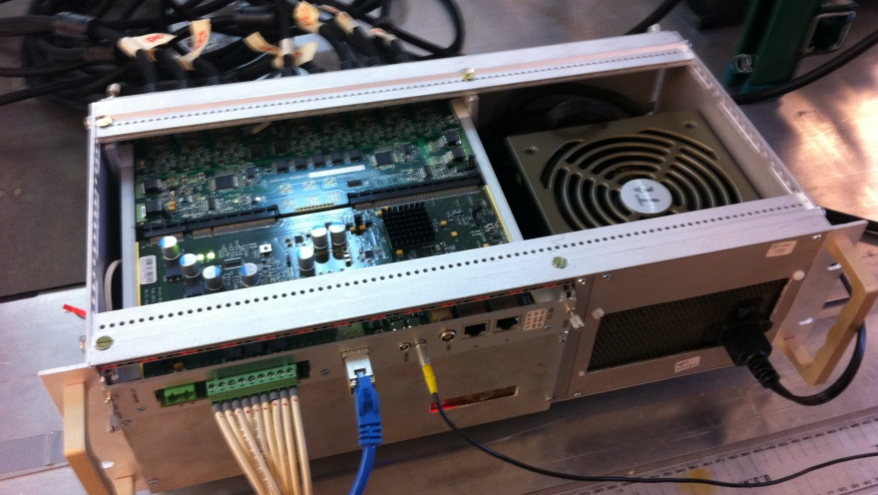
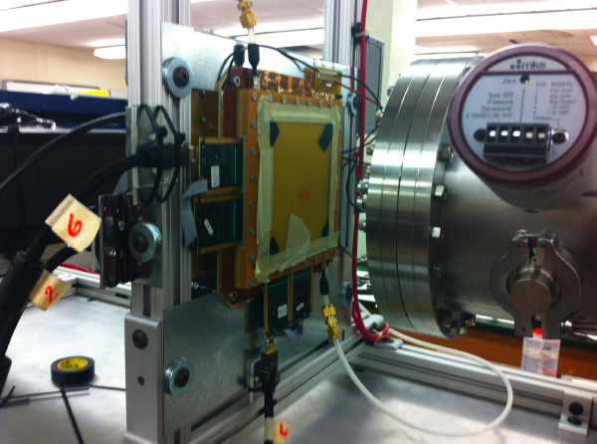
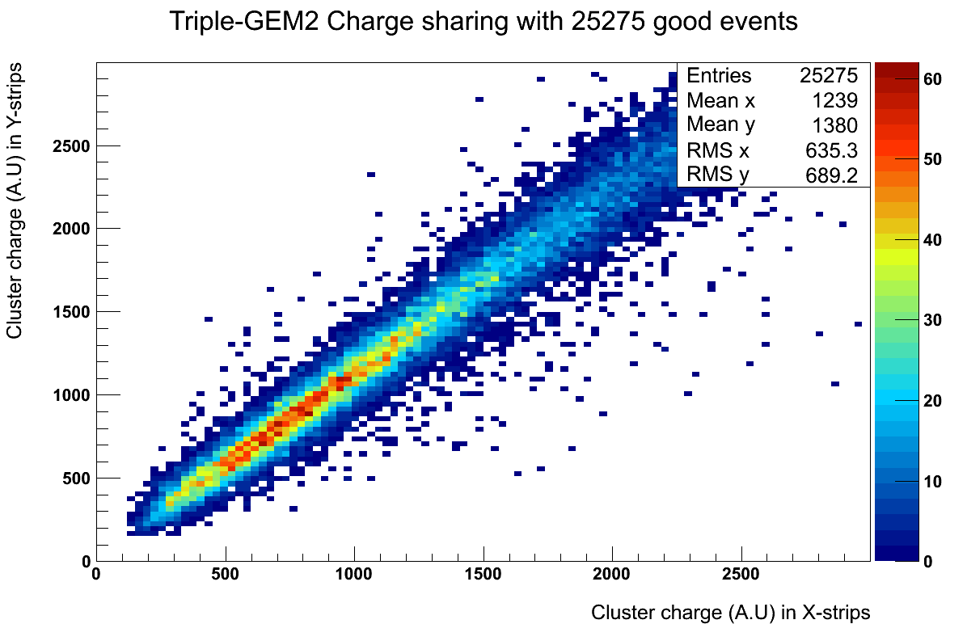
Uva group now owns an APV25 system (2000 chan.) from the RD-51 Scalable Readout System (SRS) development.

Slide 20
SoLID GEM chamber Collaboration
University of Science and Technology of China (USTC)
Tsinghua University
Lanzhou University
China Institute of Atomic Energy (CIAE)
Institute of Modern physics
INFN-Rome
University of Virginia

Slide 21
rough cost estimate
Item | Quantity | Unit cost | Total cost | Material only unit cost | Material only total cost
GEM foil | ~100 m² | $2000/m² | 0.2 M | $3000/m² | 0.2 M
readout boards | 120 | $ 2500 | 0.3 M | $ 2500 | 0.3 M
chamber support frame | 120 | $ 1500 | 0.2 M | $ 1500 | 0.2 M
Supplies and tooling |  |  | 0.1 M |  | 0.1 M
FEE and DAQ | 200 k | $ 5.0 | 1.0 M | $ 3.0 | 0.6 M
cables, power, etc |  |  | 0.5 M |  | 0.5 M
Gas system |  |  | 0.1 M |  | 0.1 M
Labor: Technicians | 6 FTE-years | $ 100 k | 0.6 M |  | -
Labor: Grad students | 6 student-years | $ 50 k | 0.3 M |  | -
support structure and integration |  |  | ??? |  | ???
TOTAL: |  |  | ~ 3.3 M |  | ~ 2.0 M
With 33% contingency |  |  | ~4.4 M |  | ~2.7 M
R&D and prototyping expenses: ~ $ 300 k

Slide 22
Production at CERN
GEM size
  With existing equipments 1.5m x 0.5m active area
  Mid 2011: 2m x 0.5m active area
Volumes
  With existing equipment: 10 GEMs/month.technician
    We can hire one more technician
  Mid 2011: 24GEMs/month.technician (240GEM/year)
  With some offers for large volume production we start to see the limit price of the GEMs : in the range of 600 CHF/sqr.meter

