Slide 1
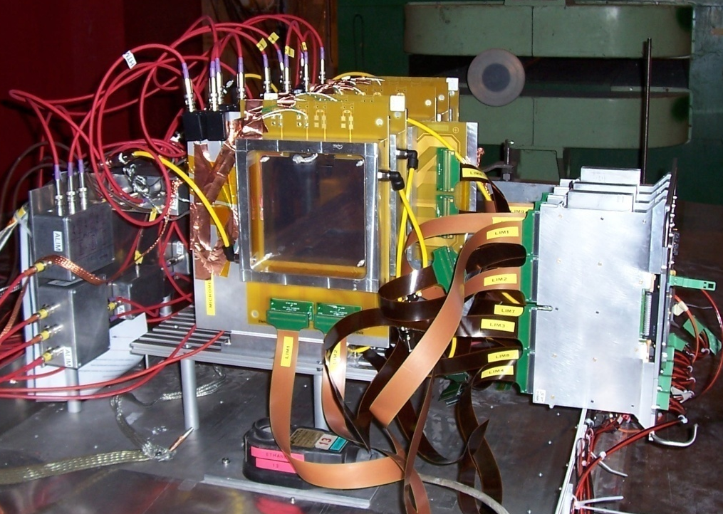
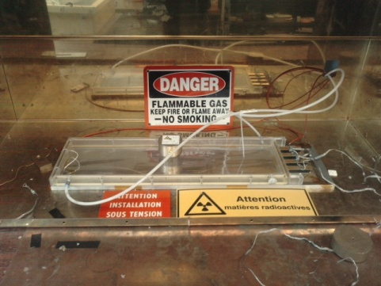
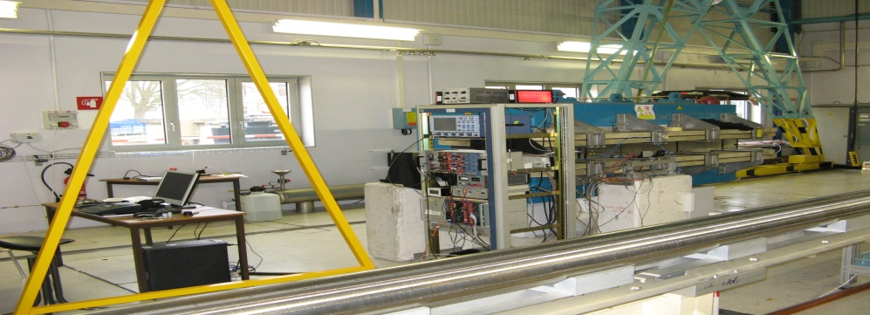
Micromegas detectors for the CLAS12 central tracker
Update on R&D
Brahim Moreno (for the Saclay group)
CLAS12 technical workshop 03/17/ 2010
Jefferson lab

Slide 2
Micromegas detectors for the CLAS12 central tracker
Update on R&D
Introduction
Experiments
Conclusions and outlook

Slide 3
Introduction: micromegas and CLAS12
 | Adressed | Analysis undergone | Experiment undergone | Upcoming experiment
bMM feasibility | 
cbMM feasibility | 
MM behaviour in magnetic field | 
Sparking rate (in barrel configuration: ) |  | 
Sparking rate (in forward configuration: ) |  |  | 
Sparking rate VS incident particle momentum |  |  |  | 
Long prototypes characterization |  |  | 
Experimental estimation of hadron flux in central region |  |  |  | ?
Spatial resolutions
and detection efficiencies (with beam)
Experiment at CERN (SPS)
Experiment at CERN (PS)
Experiment at Saclay
bMM: bulk micromegas cbMM: curved bluk micromegas

Slide 4
Experiments
Experiment at CERN (SPS): new results
Ongoing work
Upcoming experiment

Slide 5
Experiments
Experiment at CERN: new results
Ongoing work
Upcoming experiment

Slide 6
Experiment at CERN (1)
Main goal: evaluating sparking rate in presence of or without magnetic field
Barrel configuration
y
Goliath
5
4
3
2
1
x
z
Beam
y
magnet
z
Scintillator paddles coupled to PMTs
Pitch: region a → 400μm
region b → 1000μm
x
10 cm
Distance between strips: 100μm
Region a
Gaz: 5% Isobutane/Ar
Region b

Slide 7
Experiment at CERN (2)
Main detectors characteristics
 | MM Type | Drift gap | Drift material | Amplification gap | Mesh material | Orientation
1 | Classic | 5 mm | Aluminized mylar | 128 μm | Copper | X
2 | Bulk | 5 mm | Aluminized mylar | 128 μm | Stainless steel | Y
3 | Bulk | 2 mm | Aluminized mylar | 128 μm | Stainless steel | X
4 | Bulk | 5 mm | Stainless steel | 128 μm | Stainless steel | X
5 | Bulk | 5 mm | Aluminized mylar | 128 μm | Stainless steel | X

Slide 8
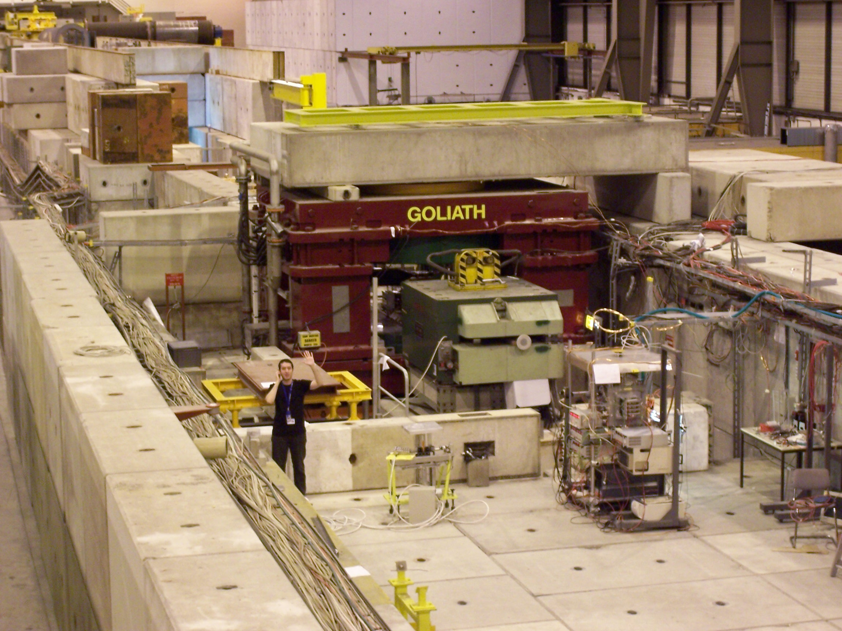
Experiment at CERN (3)
Magnet
Upper coil
Beam
1.77 m

Slide 9

Experiment at CERN (4)
Detectors
Beam
Electronics

Slide 10
Experiment at CERN (5)
Running conditions and data for the CERN experiment
Beam Characteristics:
Nature: pion or muon
Energy: 150 GeV
Spill duration: 9s
Time between spill: 1mn
Particle/spill: ~10⁶ part/spill
Experiment: 23rd Oct 2009 – 3rd Nov 2009
~210 runs
Measurements at: 0, 0.28, 0.56, 0.7, 0.84, 1.12 and 1.4 T

Slide 11
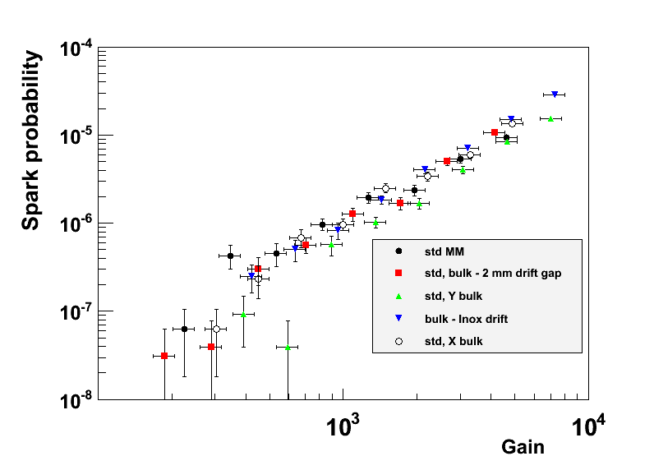
Spark probability (1): as a function of gain
No sizeable different behaviours between classic and bulk micromegas

Slide 12
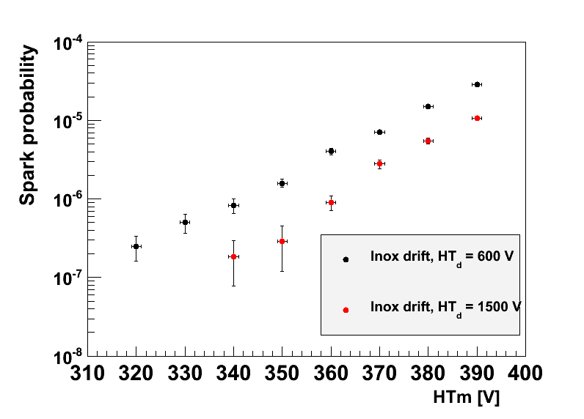
Spark probability (2): transparency effect
Transparency : probability for a primary electron to get through the mesh
Transparency decreases (at fixed mesh HV) as drift HV increases
Stainless steel drift electrode
Less electron getting through mesh at 1500V than at 600V
Increasing drift HV requires to increase the gain in order to compensate the loss in transparency
Lower spark probability
Drift HV: 1500V
Drift HV: 600V
HV mesh (V)

Slide 13
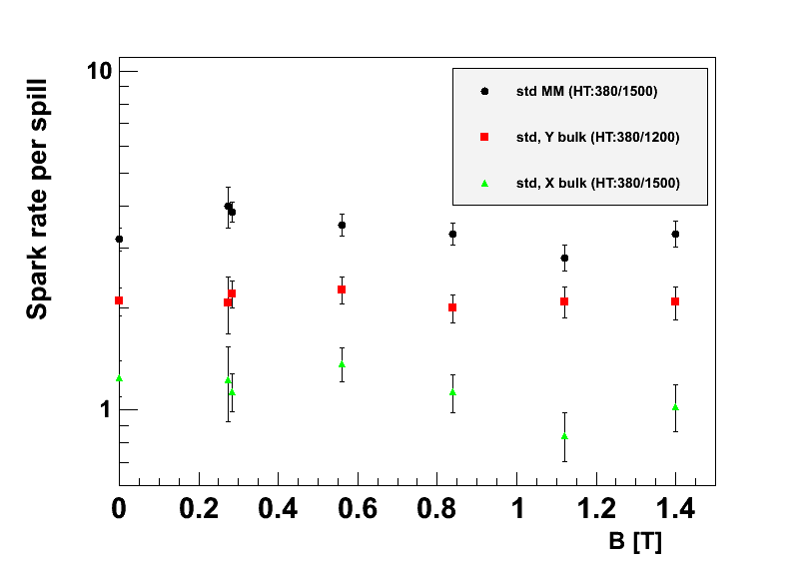
Spark probability (3): magnetic field effect
Classic MM: HV 380/1500
Y Bulk : HV 380/1200
X Bulk : HV 380/1500
No sizeable (transverse) magnetic field effect

Slide 14
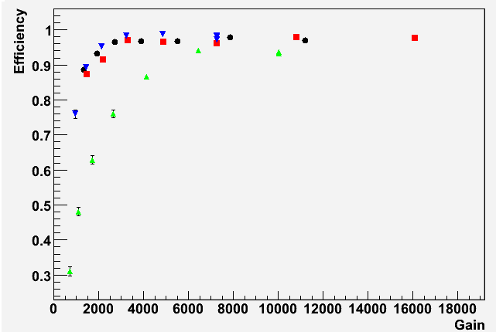
Experiment at CERN (6)
Detection efficiencies
Classic MM (5mm drift gap)
Bulk MM (5mm drift gap)
Bulk MM (2mm drift gap)
Classic and bulk micromegas with equal drift gap behave the same:
efficiency plateau reached at gain ≈ 3000
Bulk MM (5mm drift gap, stainless steel drift electrode)
Pitch = 400 μm
Muon beam (150 GeV)
No magnetic field
Y-detector de-activated for tracking

Slide 15
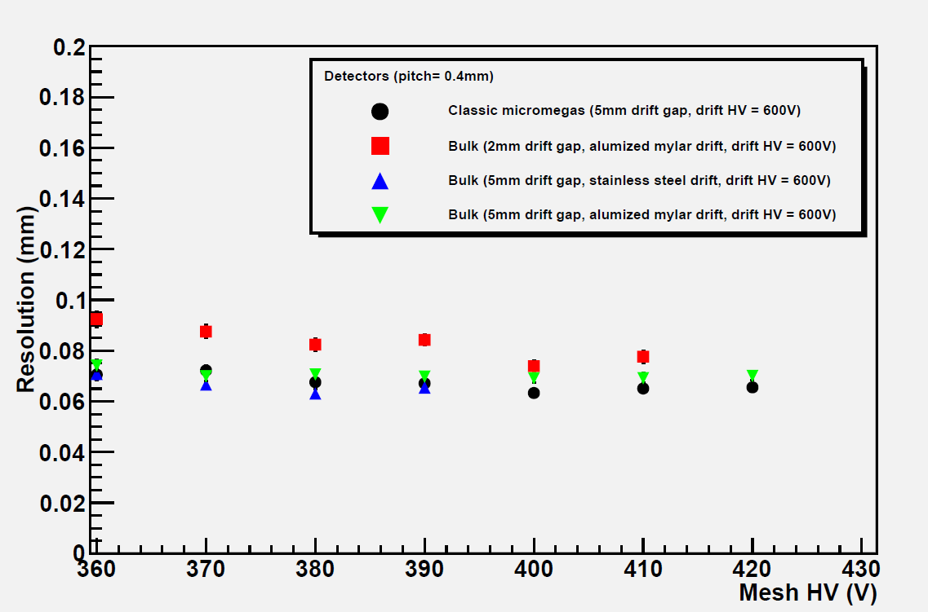
Experiment at CERN (7)
Resolutions
Classic and bulk micromegas with equal drift gap behave the same:
resolution ≈ 70 μm
Resolution weakly depends on mesh HV
Pitch = 400 μm
Muon beam (150 GeV)
No magnetic field
Approximative start of efficiency plateau
Y-detector de-activated for tracking

Slide 16
Experiments
Experiment at CERN: new results
Ongoing work
Upcoming experiment

Slide 17
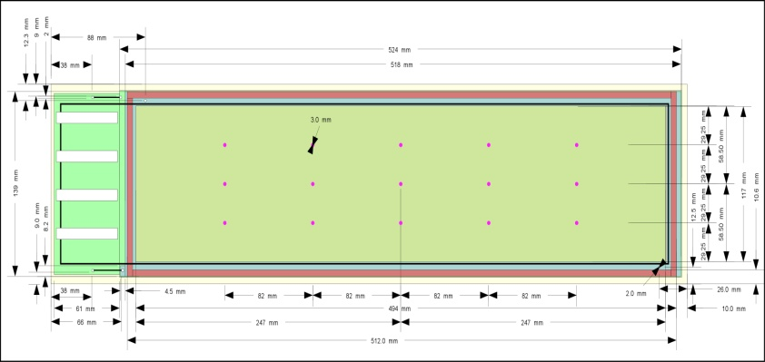
Ongoing work: new long prototypes tests (1)
Main goal: Characterization of nominal CLAS12 MM (and also mecanics tests, drift electrode tests)
Detectors may also be used for experiment and get knowledge on nominal CLAS12 MM behaviour (efficiency, in beam resolution…)
  Location: Saclay
Detector to be tested: bulk MM (512117 mm, amplification gap = 128 μm, 472 strips, pitch = 400 μm)
Gaz: 5% Isobutane/Ar
To do list:
  Characterization flat / curved detector:
    Gain
    Energy resolution
  Comparison between flat and curved detector results
512 mm
In progress
117 mm
To be done

Slide 18

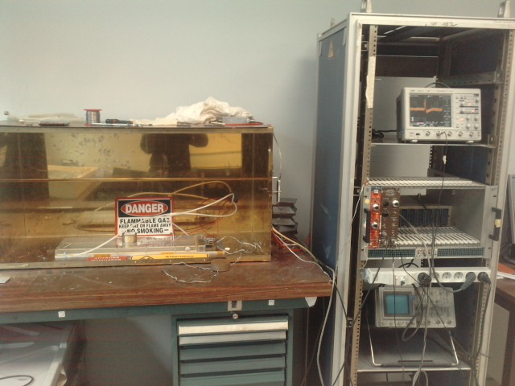
Ongoing work: new long prototypes tests (2)
Test bench for flat detector characterization
Gaz entry
⁵⁵Fe source
Very good eyes may see the peak associated with the ⁵⁵Fe source on the oscilloscope…
Gaz exit

Slide 19
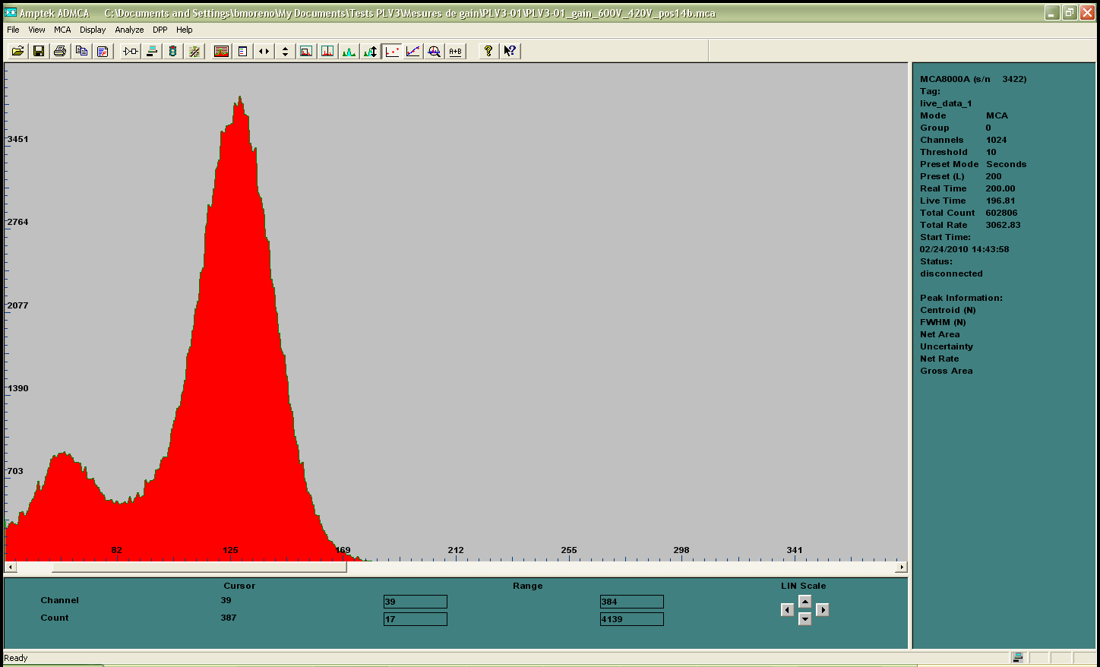
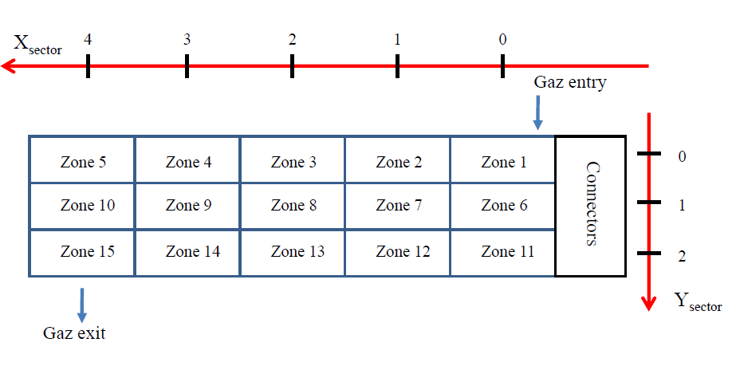
Ongoing work: long prototypes latest version tests (3)
Detector characterization
Active surface was divided into 15 zones for homogeneity test
Spectra obtained with ⁵⁵Fe source in zone 14
Peak associated with 5.9 KeV photons
Drift HV = 600V
Mesh HV = 420V
Detector in flat configuration

Slide 20
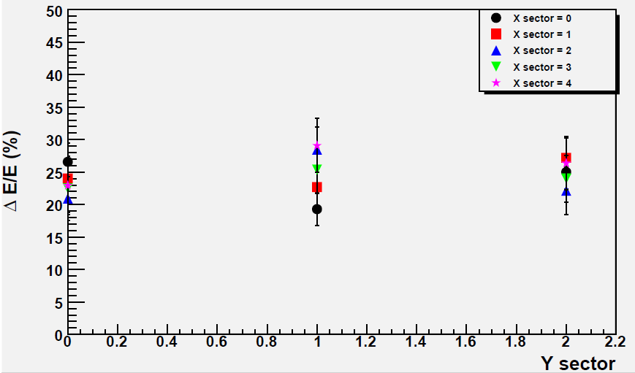
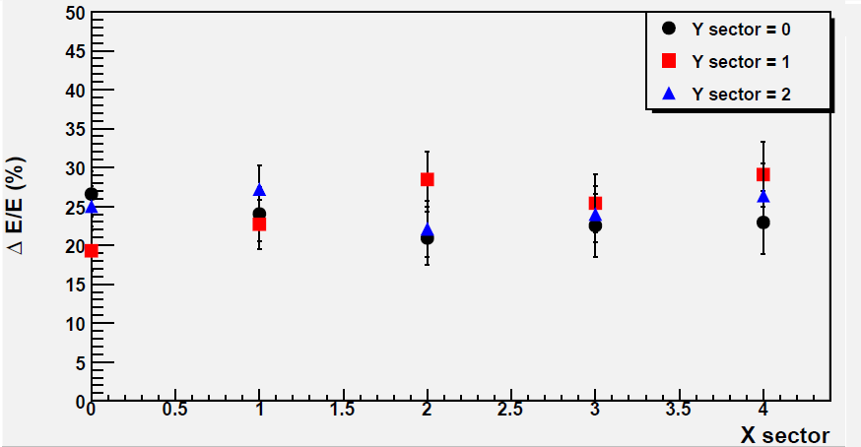
Ongoing work: long prototypes latest version tests (3)
Resolution in flat detector configuration
Drift HV = 600V
Mesh HV = 420V

Slide 21
Ongoing work: tests with longitudinal magnetic field (1)
Forward configuration
Main goal: Study longitudinal magnetic field effects on sparking rate
  Location: Saclay
Detector: bulk MM with stainless steel drift electrode (used for our CERN tests)
To do : sparking rate VS magnetic field (using α source) for
      Different gaz mixture
      Different drift and mesh HV
      Different drift gap
y
z
x
10 cm
Region a
Region b
Pitch: region a → 400μm
region b → 1000μm

Slide 22
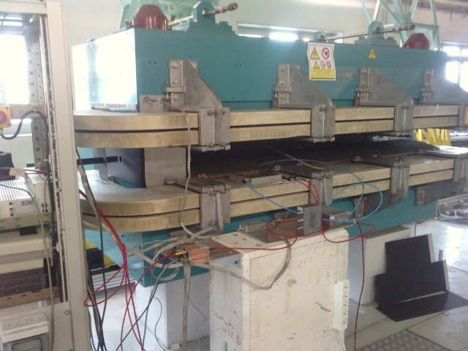
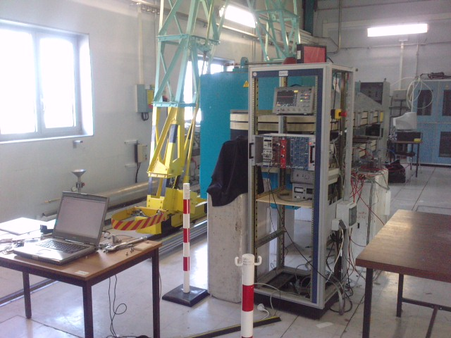
Ongoing work: tests with longitudinal magnetic field (2)
Experimental set-up
Magnet (0,1.5T)
Electronics
Magnet
Acquisition PC
Detector to be placed inside the magnet

Slide 23
Experiments
Experiment at CERN: new results
Ongoing work
Upcoming experiment

Slide 24
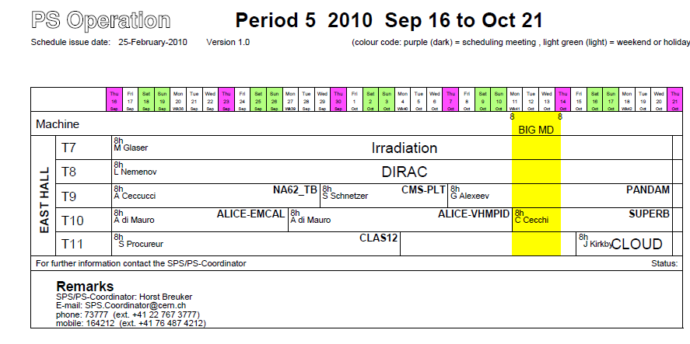
Upcoming experiment: new beam test at CERN (1)
Goals:
Study sparking rate VS incoming particles momentum
Drift gap influence
Mesh type effects
Gaz mixture effects
  Location: CERN using the Proton Synchrotron (PS)
  Date: 16th September 2010-3rd October 2010
Detectors:
1 X-bulk (reference) with 5 mm drift gap
1 Y-bulk (reference) with 5 mm drift gap
2 X-bulk with adjustable drift gap
1 X-bulk with a second mesh type
1 X-bulk with a third mesh type
1 X-bulk with a thick drift electrode
Main goal
Priority
Detector optimization

Slide 25
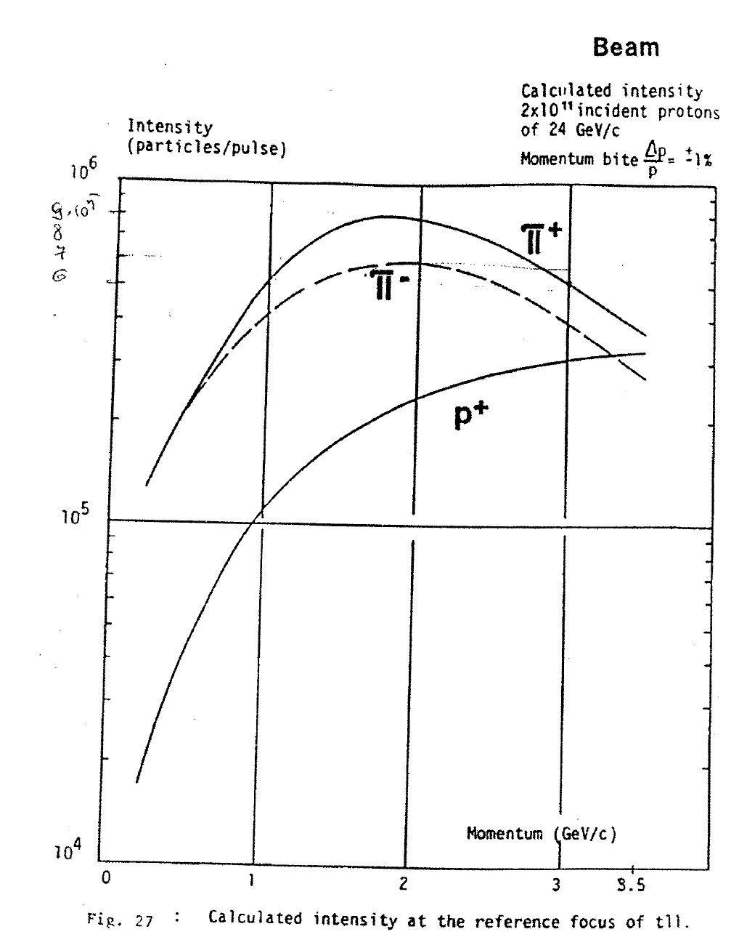
Upcoming experiment: new beam test at CERN (2)
PS beam
PS main advantages:
Beam energy close to CLAS12 central tracker running conditions
Adjustable beam energy
Energy range planned to be used

Slide 26
Conclusions and outlooks
Lot of work in progress:
  October CERN tests analysis almost finalized
  Tests of third generation prototypes ongoing
  Experimental sparking rate investigation in forward region configuration begun
New experiment in autumn at CERN using PS to
study sparking rate VS incident particle momentum

Slide 27
Back up slides

Slide 28
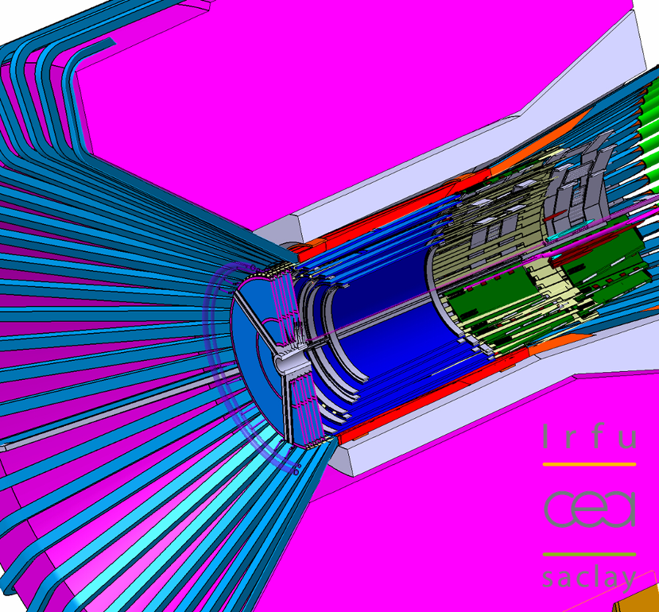
Micromegas and CLAS12 (2)
Use: alternative/complement to silicon vertex tracker
(for π @ 0.6 GeV/c , θ = 90°)
 | 4 x 2MM | 4 x 2SI | 2 x 2SI + 3 x 2MM | Specs.
σ_{pT}/p_{T} (%) | 2.9 | 2.1 | 1.6 | 5
σ_{θ} (mrad) | 1.3 | 15.1 | 1.4 | <10-20
σ_{ϕ} (mrad) | 10.9 | 2.9 | 2.6 | <10
σ_{z} (μm) | 212 | 1522 | 267 | tbd.
A mixed solution combines advantages of both the silicon (SI) and micromegas (MM) detectors
Flat bulk micromegas
Curved bulk micromegas

Slide 29
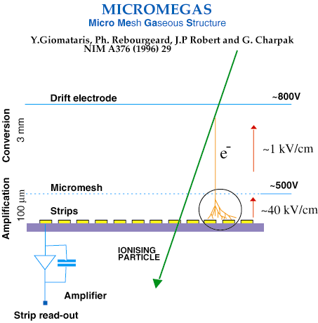
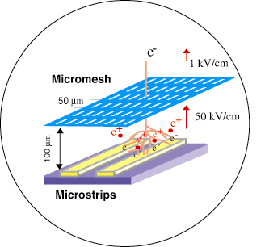
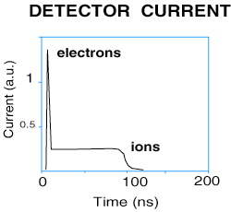
Basic principles of a micromegas detector
~100 μm
thin gap

Slide 30
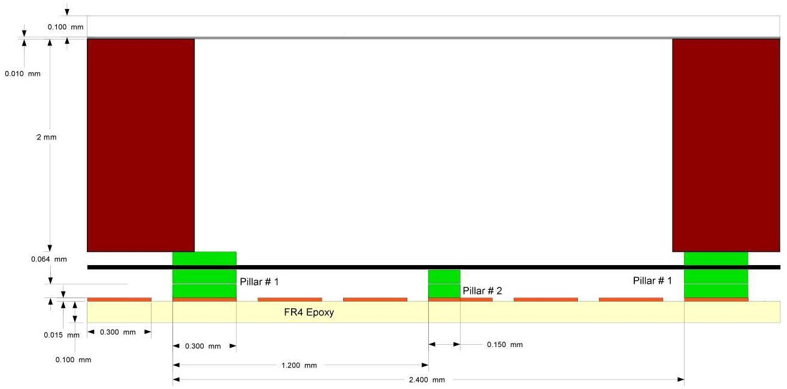
Basic principles of a micromegas detector: bulk-micromegas
Drift electrode
Conversion
Micromesh
Strips
Amplification
Advantages:
Detector built in nearly one process
Geometry (flexible PCB)
Same principle as « classic » micromegas
Difference lies in construction process: mesh embedded on the PCB

Slide 31
What is a spark? (1)
Ionizing particle (MIP)
Drift electrode
600V
conversion
e-
Mesh
400V
Signal amplified
amplification
PCB
Charge collected
on the strips

Slide 32
What is a spark? (2)
Ionizing particle (hadron)
Drift electrode
600V
conversion
Mesh
400V
Discharge
amplification
High charge density
PCB
Discharge blinds MM detector because it sets mesh and strip to the same voltage
Recovery time depends on Protection circuit (~1 ms)
Spark = discharge in amplification gap

Slide 33
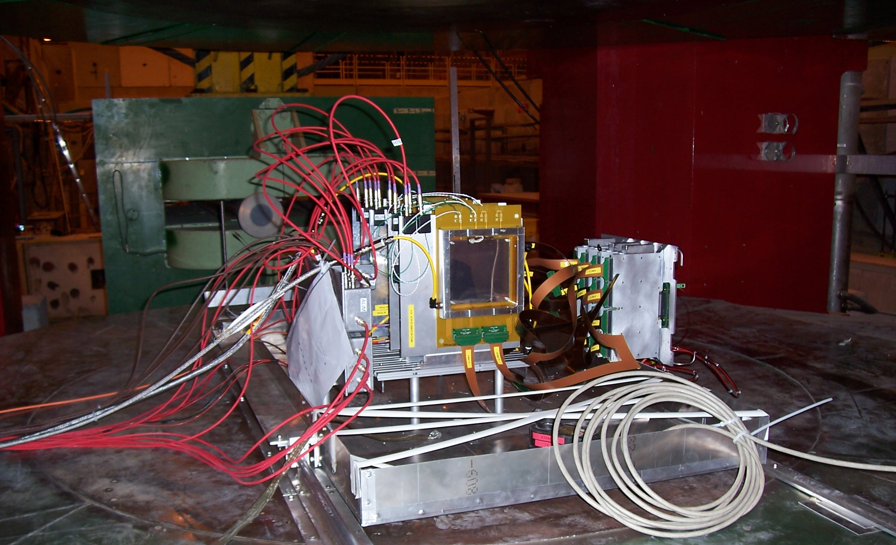
Description
Oct the 23rd – Nov the 3rd
Detectors
Electronics
Beam

Slide 34
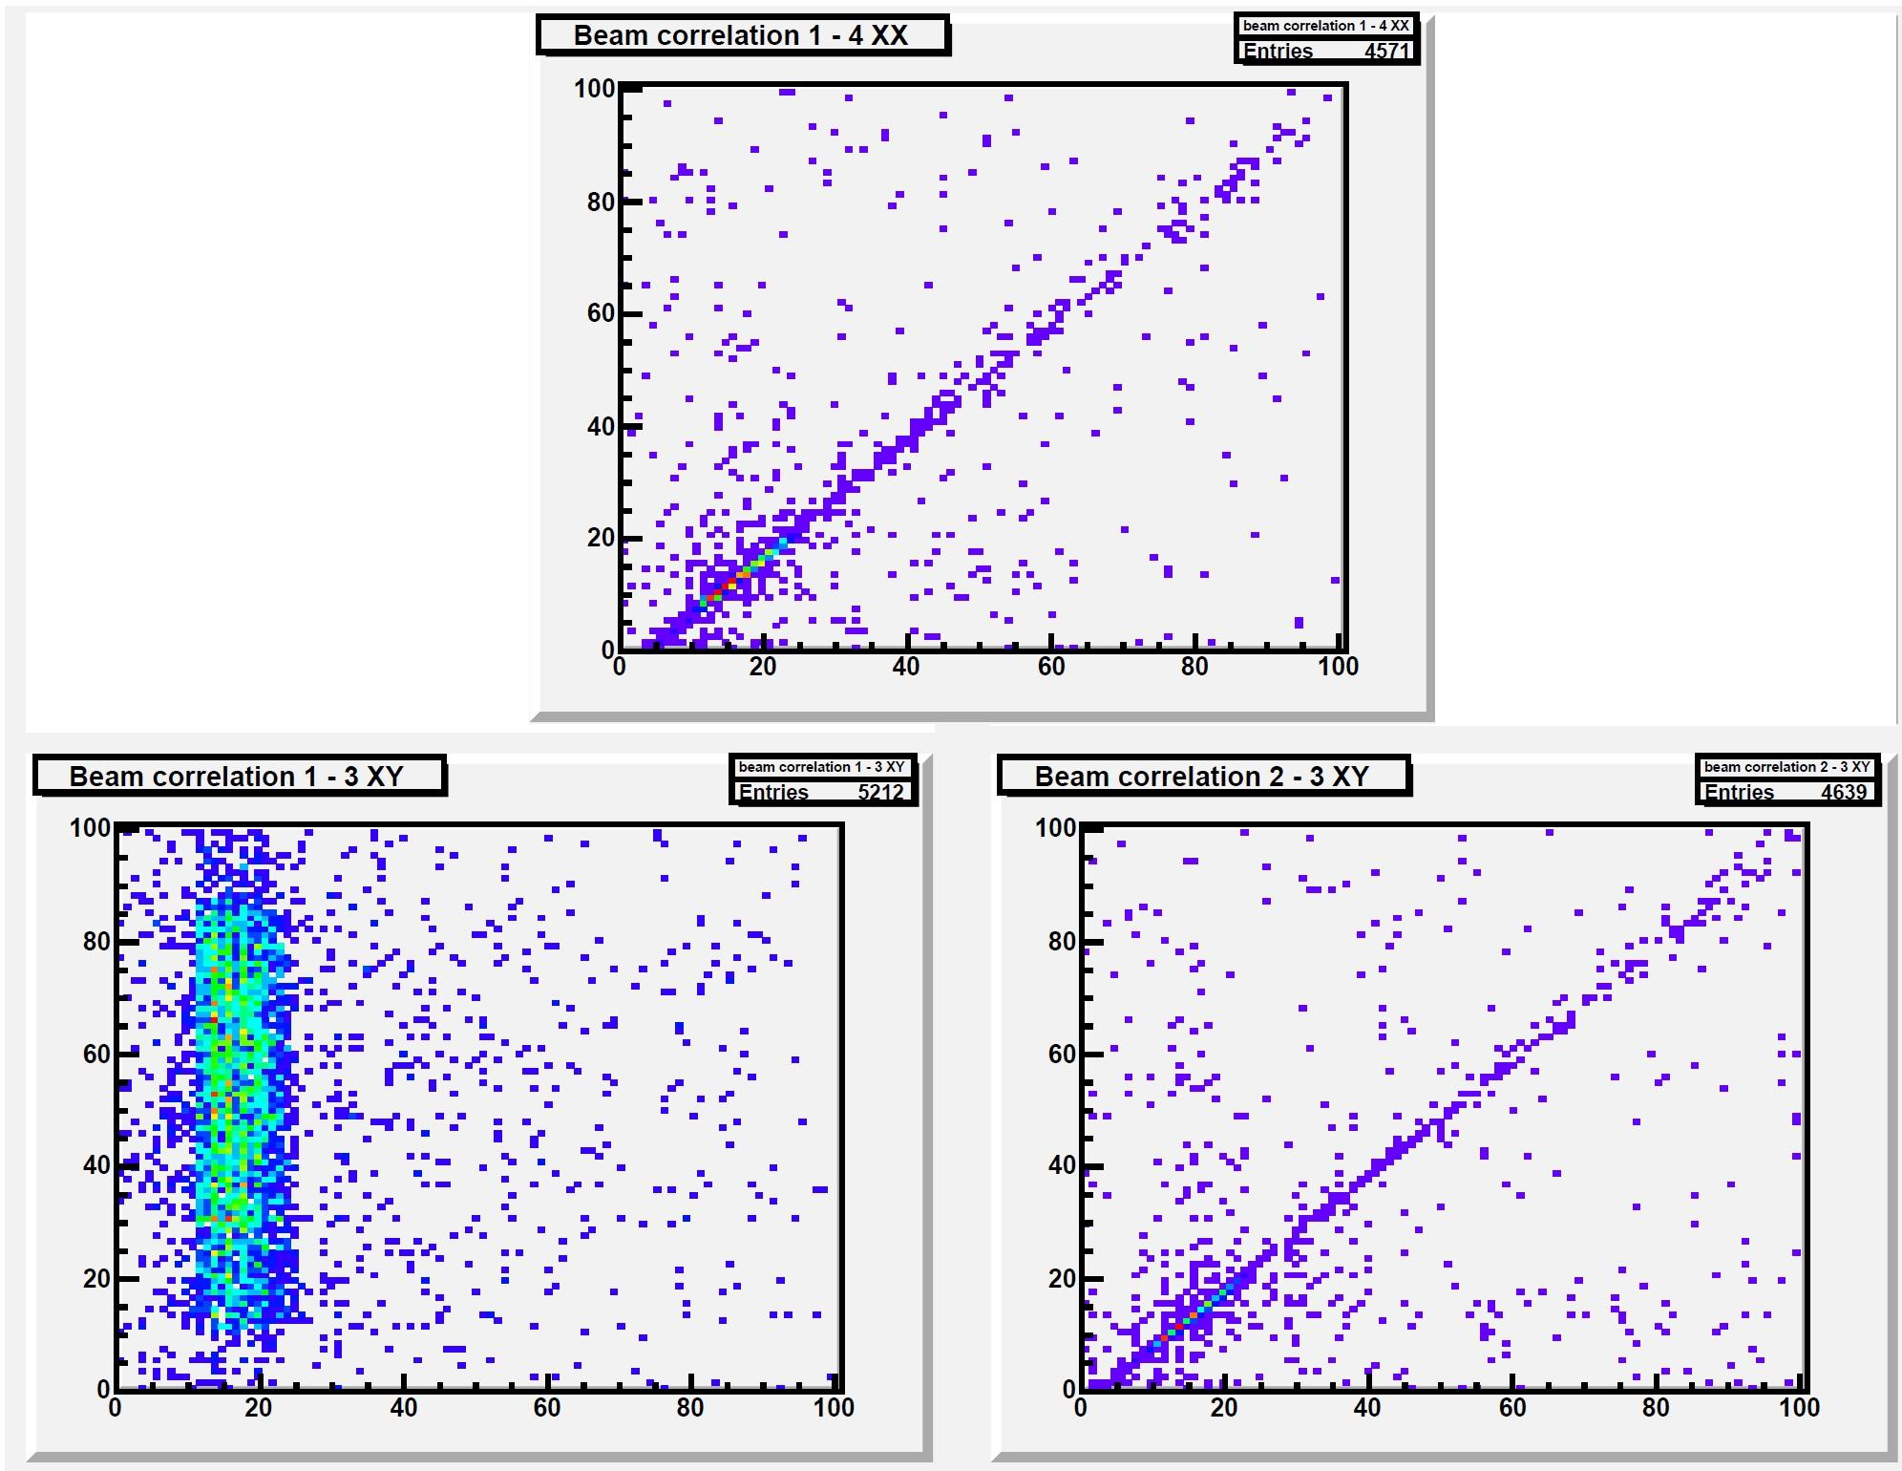
Preliminary results: beam profile
Correlation 1-3 (XX)
X3 (mm)
Online monitoring
X1 (mm)
Correlation 1-2 (XY)
Y2 (mm)
2D beam profiles
Run with beam spread in Y
Muon beam (~150 GeV)
1 = classic MM (X-strips)
2 = bMM (Y-strips)
3 = bMM (X-strips)
X1 (mm)

Slide 35
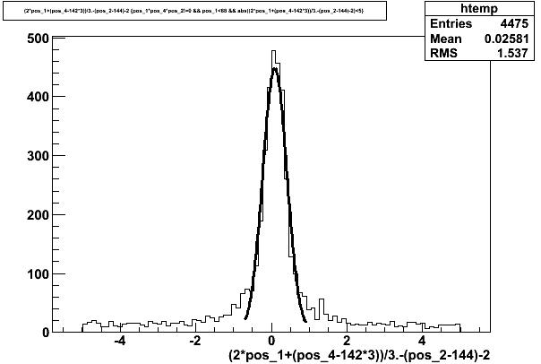
Preliminary results for tracking
Residual
Only the small pitch region (400 μm) is taken into account
Before alignment correction
σ < pitch/(12)^{1/2}
ΔX (strip)
ΔX (strip) = difference between expected and measured hit position

