Slide 1
New global study of the A-dependence of the EMC effect and the extrapolation to nuclear matter
Patricia Solvignon
Argonne National Laboratory
Work done in collaboration with:
John Arrington, Dave Gaskell, Aji Daniel and Jason Seely
Physics Division Seminar
Argonne National Laboratory
October 6, 2008
Notes:
Good afternoon.
I am going to present today the close-to-final results from Jefferson Lab on the EMC effect. While the analysis is in the final stage, we thought it was important to have another look at the world data on the EMC effect and the extrapolation to nuclear matter. Also I will try to show how these new results could impact our understanding on the mechanism of the EMC effect.
This work is being done in collaboration with …

Slide 2
Outline
Introduction to the nucleon structure function and the EMC effect
JLab E03-103 close to final results:
Q²-dependence study with Carbon
Light nuclei
Heavy nuclei and Coulomb distortion
Global analysis
Coulomb distortion
Study of the A- and ρ-dependence
New extrapolation to nuclear matter
Summary and outlook
Notes:
Need work

Slide 3
The structure of the nucleon
Deep inelastic scattering ➔ probe the constituents of the nucleon: the quarks and the gluons
4-momentum transfer squared
e⁻
e⁻
Invariant mass squared
γ∗
Bjorken variable
Notes:
Need work
Structure function and Parton model
In order to investigate the internal structure of the nucleon, physicists have been using deep inelastic scattering in which high energy incident electrons interact with the nucleon by exchange of virtual photons. The energy and the q-vector determine the resolution of the probe. The relevant variable in this talk are Q2, W2 and x which represents in the parton model the fraction of the nucleon momentum carried by the struck quark.
The cross section of the reaction is expressed as the point-like cross section multiplied by a term taking into account the internal structure of the nucleon.

Slide 4
The structure of the nucleon
Deep inelastic scattering ➔ probe the constituents of the nucleon: the quarks and the gluons
4-momentum transfer squared
e⁻
e⁻
Invariant mass squared
γ∗
Bjorken variable
use to select DIS
~ momentum per quark
Notes:
Need work
Structure function and Parton model
In order to investigate the internal structure of the nucleon, physicists have been using deep inelastic scattering in which high energy incident electrons interact with the nucleon by exchange of virtual photons. The energy and the q-vector determine the resolution of the probe. The relevant variable in this talk are Q2, W2 and x which represents in the parton model the fraction of the nucleon momentum carried by the struck quark.
The cross section of the reaction is expressed as the point-like cross section multiplied by a term taking into account the internal structure of the nucleon.

Slide 5
Structure functions in the parton model
In the infinite-momentum frame, at high Q²:
no time for interactions between partons
Partons are point-like non-interacting particles: σ_{Nucleon} = Σ_{i} σ_{i}
Notes:
In the parton model, the nucleon is considered in the infinite momentum frame and therefore the partons can be seen as point-like non-interacting particles. Thus the nucleon cross section is the sum of the individual parton cross sections. And the structure function can be written in function of the parton distribution functions.

Slide 6
The quest for higher precision data
e⁻
e⁻
γ∗
Nucleon
e⁻
e⁻
To increase the luminosity, physicists decided to use heavy nuclei to study the structure of the proton instead of a hydrogen target.
γ∗
Nucleus
Notes:
(history)
Now important to understand EMC effect because of neutrinos and muons experiments which have a very low sigma.

Slide 7
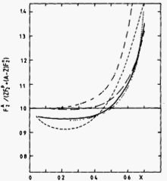
Discovery of the EMC effect
e⁻
e⁻
=
Z
+
N
γ∗
γ∗
γ∗
p
n
Aubert et al., PLB123, 275 (1983)
Nucleus at rest
(A nucleons = Z protons + N neutrons)
Theoretical prediction:
after corrections due to the motion of the nucleons in the nucleus (slowly moving nucleons weakly bound)
A/(Zp+Nn)
Notes:
The idea was that the cross section measured in a nuclei will be a simple linear combination of the proton cross section and the neutron cross section.

Slide 8
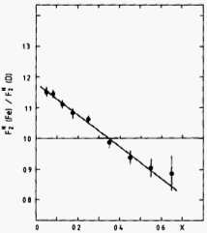
Discovery of the EMC effect
e⁻
e⁻
≠
Z
+
N
γ∗
γ∗
γ∗
p
n
Aubert et al., PLB123, 275 (1983)
Nucleus at rest
(A nucleons = Z protons + N neutrons)
(A/d)_{iso}
A/(Zp+Nn)
Nuclear structure:
Notes:
Data are A/d, curves are A/p+n

Slide 9
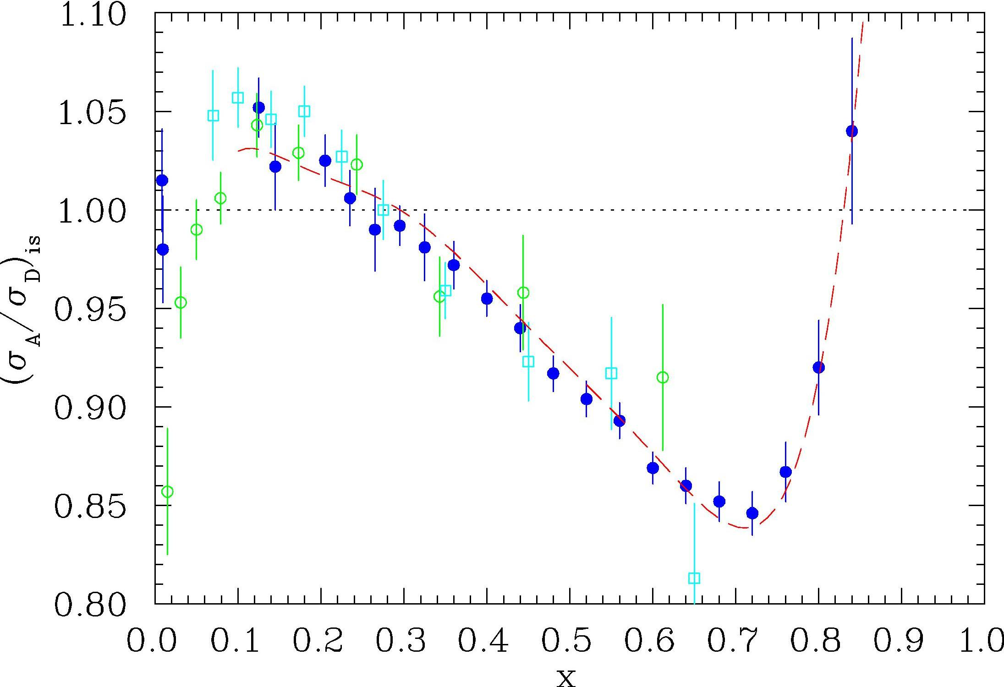
EMC effect confirmed
e⁻
e⁻
≠
Z
+
N
γ∗
γ∗
γ∗
p
n
Nucleus at rest
(A nucleons = Z protons + N neutrons)
Effects found in several experiments at CERN, SLAC, DESY
σ_{A}/σ_{D}
EMC (Cu) BCDMS (Fe) E139 (Fe)
x

Slide 10
Existing EMC Data
E139
SLAC E139:
Most complete data set: A=4 to 197
Most precise at large x
Q²-independent
universal shape
magnitude dependent on A

Slide 11
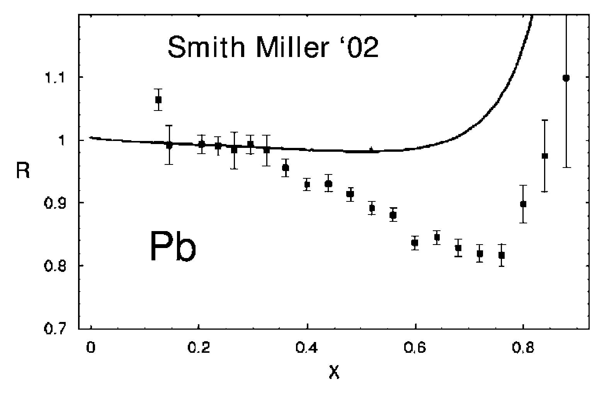
Nucleon only model
Assumptions on the nucleon structure function:
not modified in medium
the same on and off the energy shell
Fermi momentum << M_{nucleon}
➔ is narrowly peaked and
Smith & Miller,
PRC 65, 015211 and 055206 (2002)
➔
no EMC effect
“… some effect not contained within the conventional framework is responsible for the EMC effect.”
Smith & Miller, PRC 65, 015211 (2002)
Notes:
Miller calculations: Light-cone, no binding= no offshell effects

Slide 12
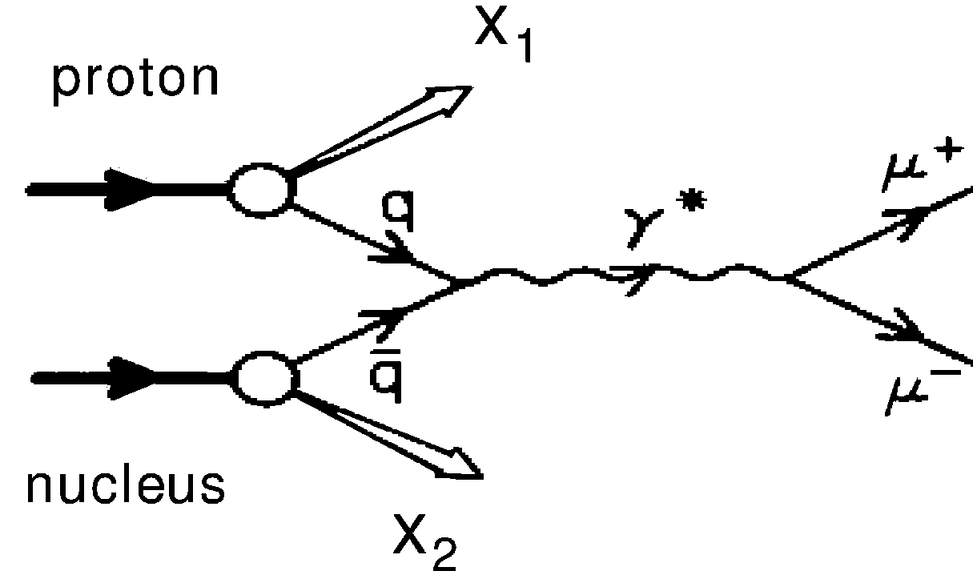
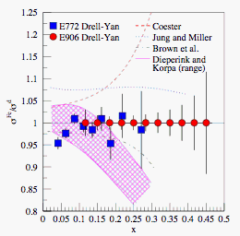
Nucleons and pions model
Pion cloud is enhanced and pions carry an access of plus momentum:
and using is enough to reproduce the EMC effect
But excess of nuclear pions ➔ enhancement of the nuclear sea
Fig from P. Reimer, Eur.Phys. J A31, 593 (2007)
E772 Drell-Yan
E906 projected
But this enhancement was not seen in nuclear Drell-Yan reaction

Slide 13
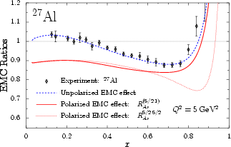
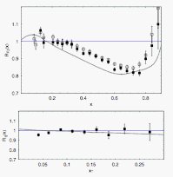
Another class of models
Cloet, Bentz, and Thomas, PLB 642, 210 (2006)
Interaction between nucleons
Model assumption:
nucleon wavefunction is changed by the strong external fields created by the other nucleons
Smith & Miller, PRL 91, 212301 (2003)
Model requirements:
Momentum sum rule
Baryon number conservation
Vanishing of the structure function
at x<0 and x>A
Should describe the DIS and DY data
Notes:
Need work

Slide 14
More data needed
JLab E03-103 will improve with
Higher precision data for ⁴He
Addition of ³He data
Precision data at large x for light and heavy nuclei
⇨ Lowering Q² to reach high x region
Notes:
Need work
The advantage of light nuclei is that they can be compared to full calculations.
Heavy nuclei are necessary for extrapolation to nuclear matter where also exact calculations can be done.

Slide 15
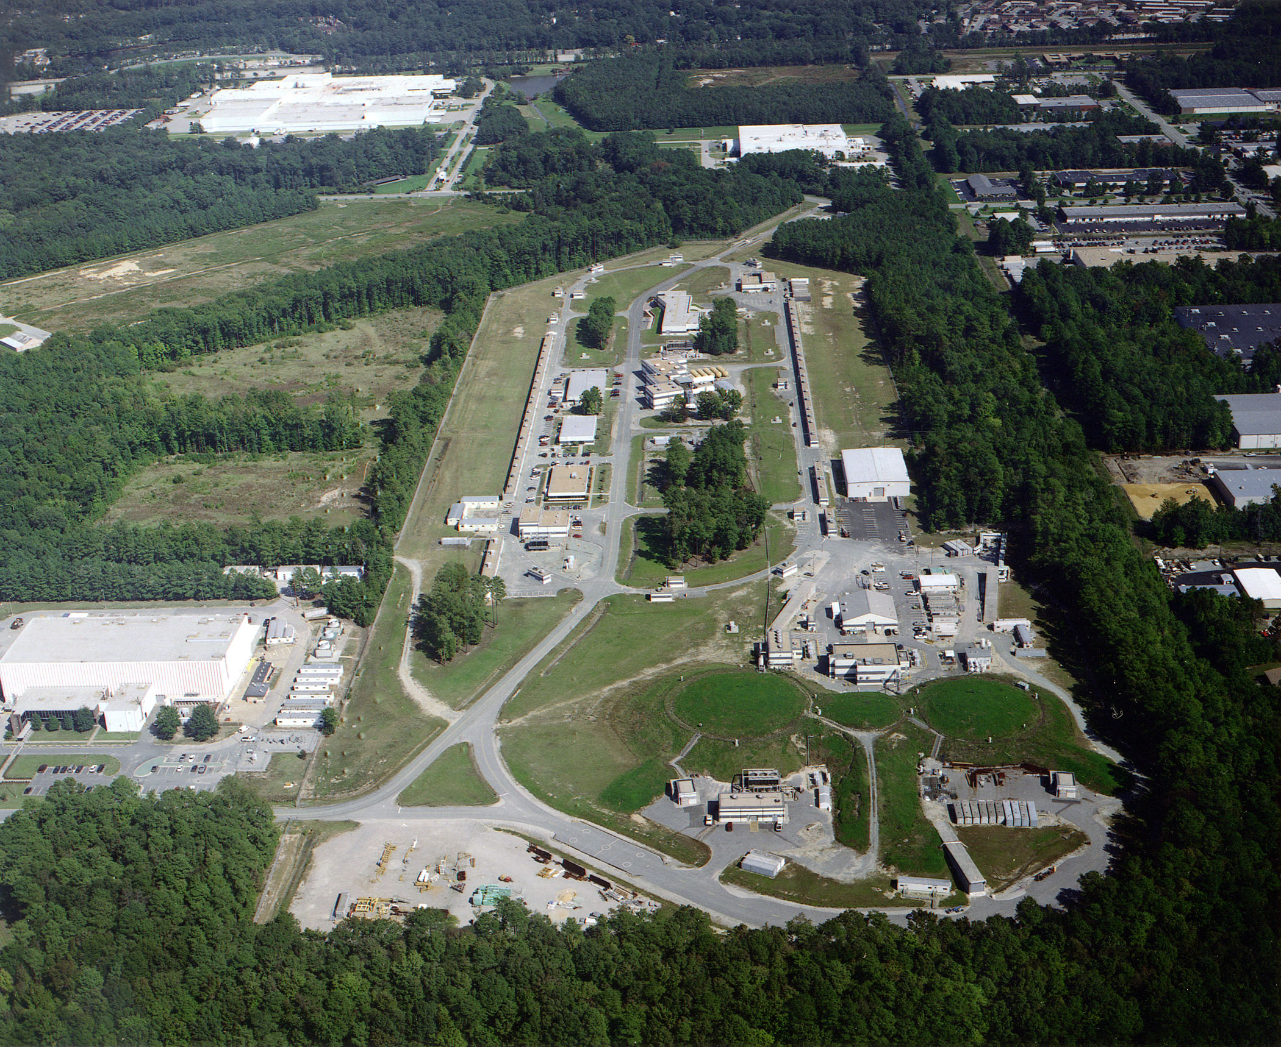
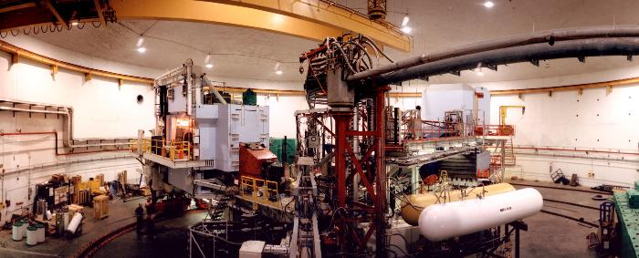
JLab and HallC
A
B
C
Notes:
Need work

Slide 16
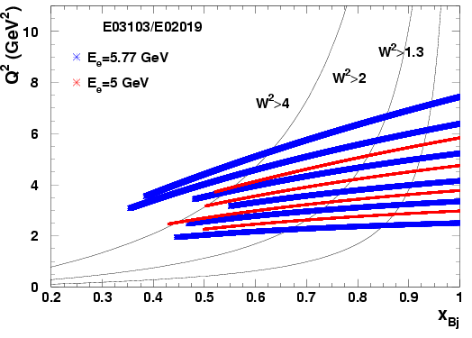
JLab Experiment E03-103
Spokespersons: D. Gaskell and J. Arrington
Post-doc: P. Solvignon
Graduate students: J. Seely and A. Daniel
A(e,e’) at 5.0 and 5.8 GeV in Hall C
Targets:
H, ²H, ³He, ⁴He,
Be, C, Al,
Cu, Au
10 angles to measure
Q²-dependence
W²=1.2GeV²
W²=4.0GeV²
W²=2GeV²
Notes:
Need work
All targets at large angles: 40, 46 and 50.
C and D data at all angles to verify precise scaling and our extraction of the EMC ratio is Q2-dependence.

Slide 17
E03-103: Carbon EMC ratio and Q²-dependence
at x=0.6
Preliminary
Small angle, low Q² ➔ clear scaling violations for x>0.6-0.7

Slide 18
E03-103: Carbon EMC ratio and Q²-dependence
Preliminary
At larger angles ➔ indication of scaling to very large x

Slide 19
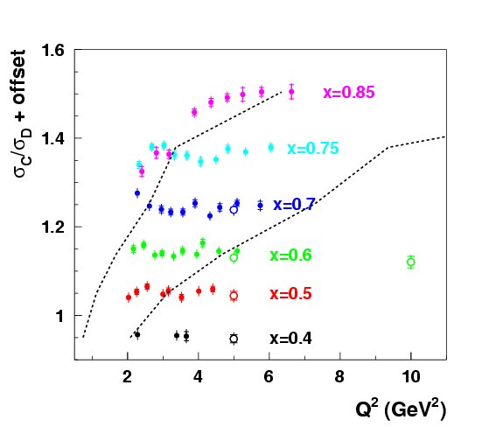
More detailed look at scaling
C/D ratios at fixed x are Q² independent for:
W²>2 GeV²
and
Q²>3 GeV²
limits E03-103 coverage
to x=0.85
Note: Ratios at larger x will be shown, but could have small HT, scaling violation
W²>2 GeV²
W²>4 GeV²
E03-103
SLAC e139
Notes:
Ratios at larger x will be shown, but should be taken cautiously

Slide 20
E03-103: Carbon EMC ratio and Q²-dependence
Used the combined two highest Q2 in the rest of this talk
Preliminary
At larger angles ➔ indication of scaling to very large x

Slide 21
E03-103: Carbon EMC ratio
W²>4.0 GeV²
W²>2.0 GeV²
X
1.2<W²<2.0 GeV²
SLAC fit A=12
Preliminary

Slide 22
E03-103: ⁴He EMC ratio
JLab results consistent with SLAC E139
Improved statistics and systematic errors
Preliminary
Notes:
Reduction of the error due to the use of cryogenic 4He. SLAC had a high gas pressure cell.

Slide 23
E03-103: ⁴He EMC ratio
JLab results consistent with SLAC E139
Improved statistics and systematic errors
Models shown do a reasonable job describing the data, but very few real few-body calculations (most neglect structure, scale NM)
Preliminary
Notes:
Smirnov ~ physics-inspired global fit
Cloet: A/p+n

Slide 24
Isoscalar correction
Isoscalar correction

Slide 25
Isoscalar correction
³He
Isoscalar correction
Au
bound n and p
free n and p
Notes:
Need work
- New figure including John’s isoscalar correction curve in Gold

Slide 26
E03-103: ³He EMC ratio
Large proton excess correction
Isoscalar correction done using ratio of bound neutron to bound proton at E03-103 kinematics
Preliminary
Notes:
Noticeable smaller than previous shown results using SLAC free-DIS n/p.

Slide 27
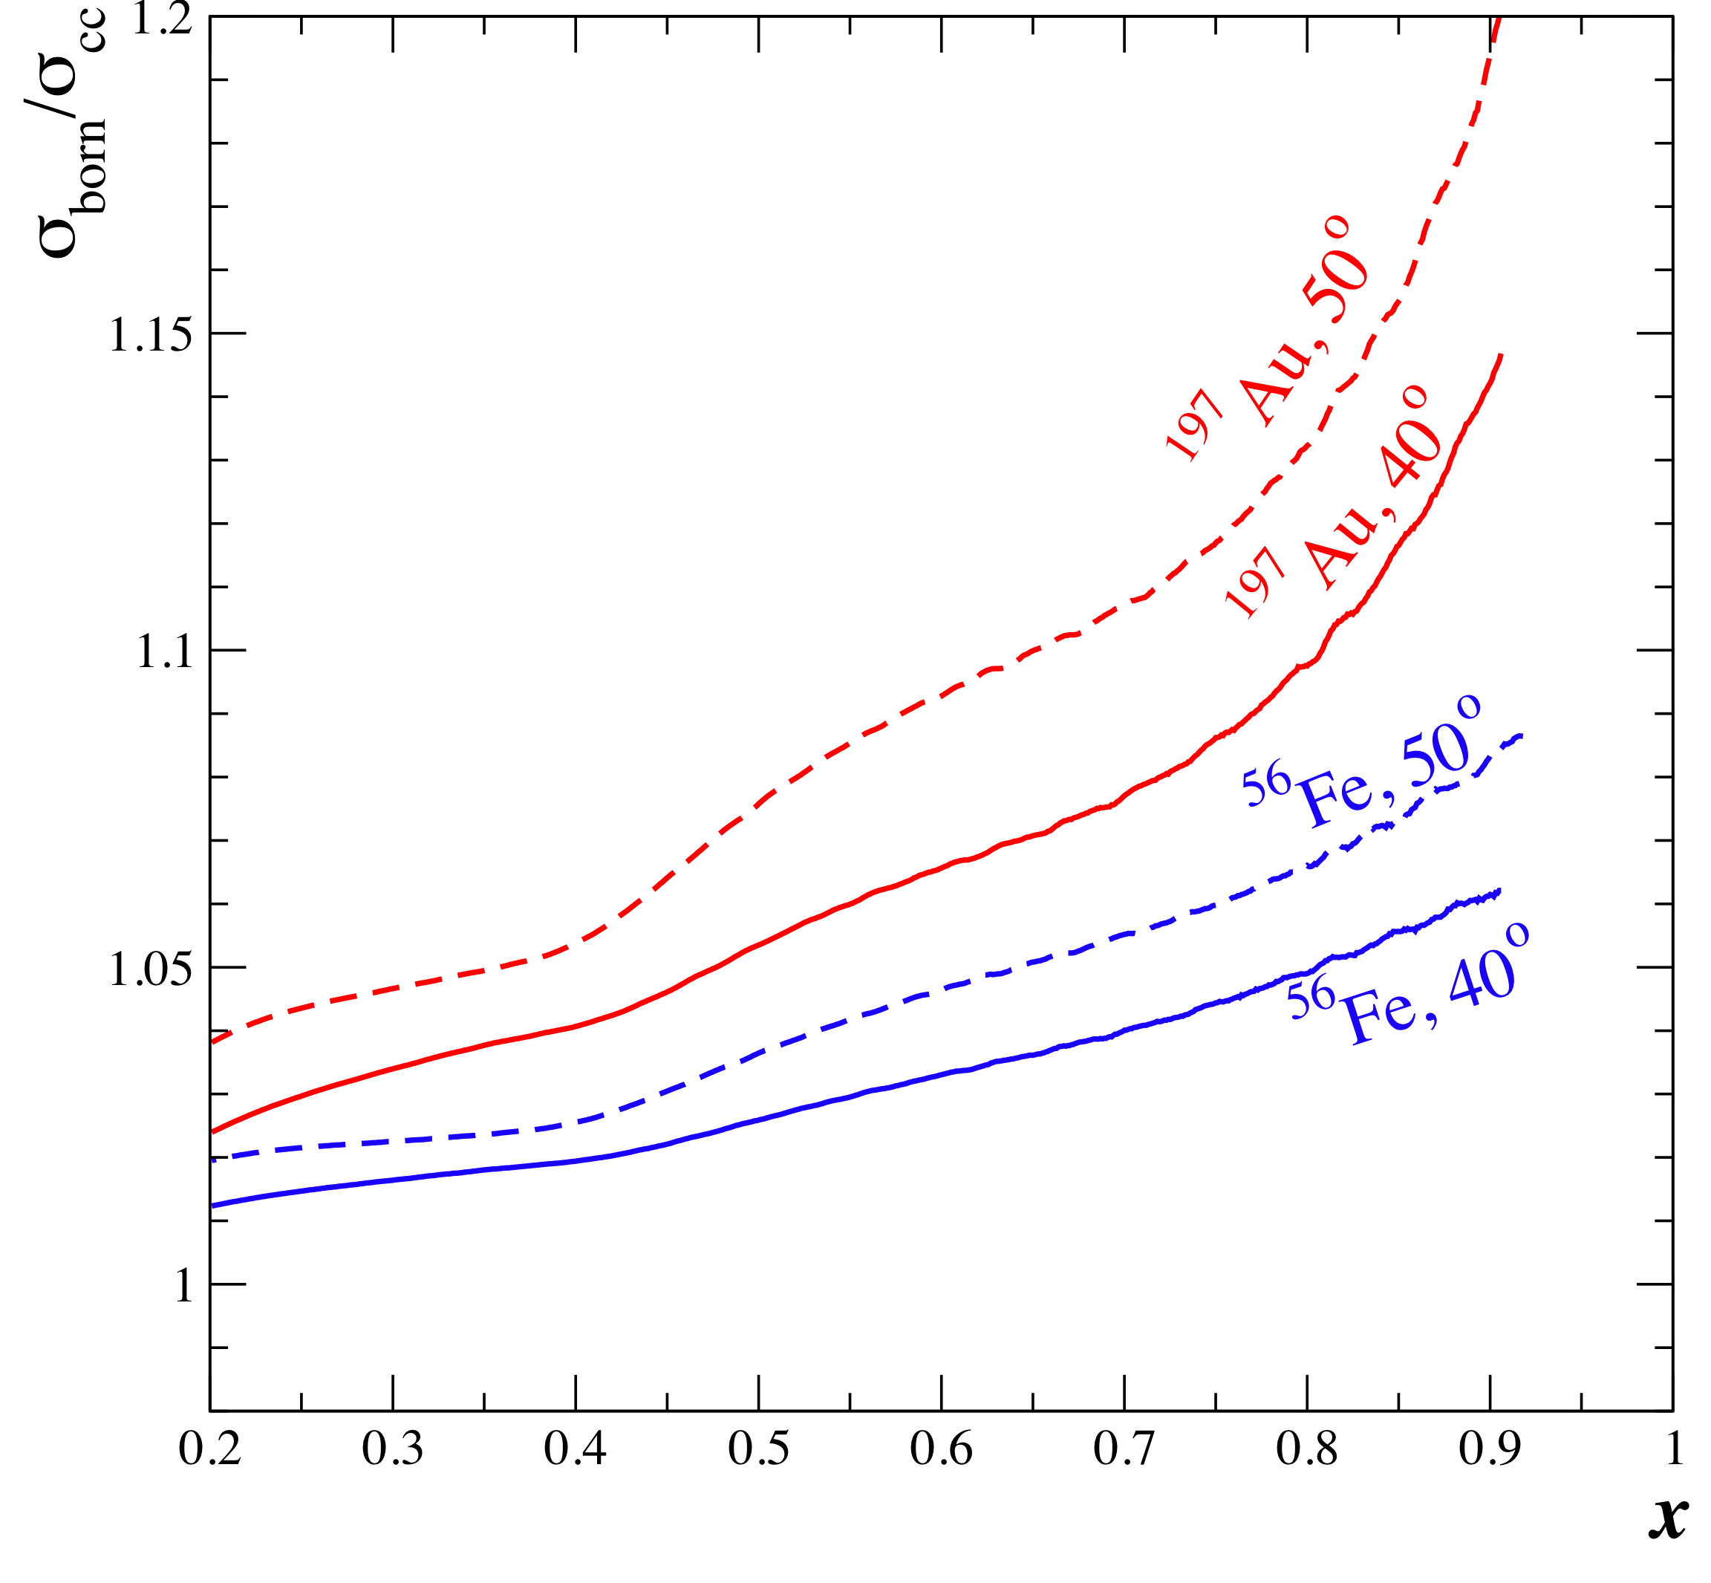
Coulomb distortions on heavy nuclei
Initial (scattered) electrons are accelerated (decelerated) in Coulomb field of nucleus with Z protons
Not accounted for in typical radiative corrections
Usually, not a large effect at high energy machines
Important for E’<<E (e.g. large θ, x)
E03-103 uses modified Effective Momentum
Approximation (EMA)
Aste and Trautmann, Eur, Phys. J. A26, 167-178(2005)
E → E+Δ
E’ → E’+Δ
Δ ~ “boost in the Coulomb field” calibrated against lower E quasi-elastic cross sections

Slide 28
E03-013 heavy target results
Before coulomb corrections
preliminary
Notes:
ok

Slide 29
E03-013 heavy target results
After coulomb corrections
preliminary
Notes:
ok

Slide 30
E03-103: EMC effect in heavy nuclei
E03-103 data corrected for coulomb distortion
Preliminary
Scale errors: 1.6-2%
Notes:
Need work

Slide 31
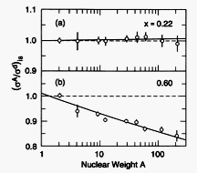
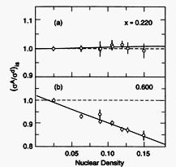
A or density dependence ?
Figs from J. Gomez, PRC49, 4348 (1994))
Density calculated assuming a uniform sphere of radius: R_{e} (r=3A/4pR_{e}³)

Slide 32
A or density dependence ?
Magnitude of the EMC effect for C and ⁴He very similar, and
ρ(⁴He) ~ ρ(¹²C)
EMC effect: ρ−dependent
(A-dep. ➔ factor of 2)
Preliminary
Notes:
SLAC 2fits: one versus ln(A) and one versus rho

Slide 33
A or density dependence ?
Magnitude of the EMC effect for C and ⁴He very similar, and
ρ(⁴He) ~ ρ(¹²C)
EMC effect: ρ−dependent
(A-dep. ➔ factor of 2)
Preliminary
Magnitude of the EMC effect for C and ⁹Be very similar, but
ρ(⁹Be) << ρ(¹²C)
EMC effect: A-dependent
(ρ-dep. ➔ factor of 2)
Preliminary

Slide 34
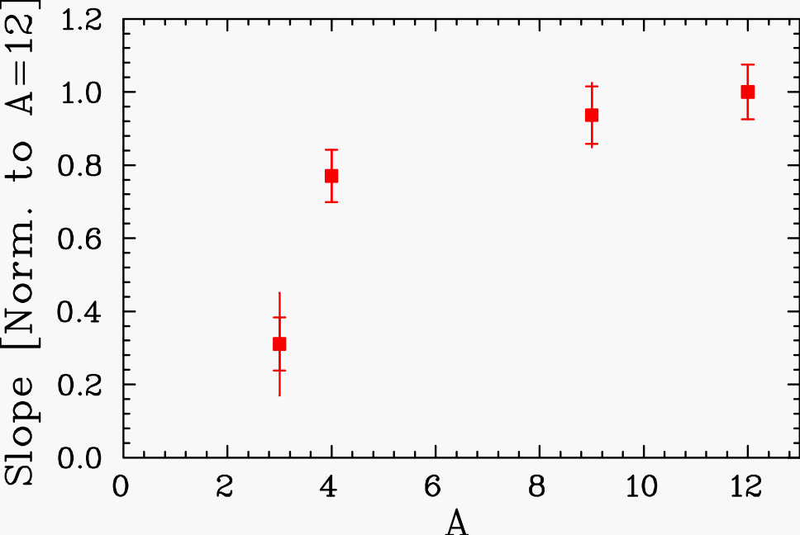
A or density dependence ?
Fit of the EMC ratio for 0.3<x<0.7 and look at A-dependence of the slope
E03-103

Slide 35
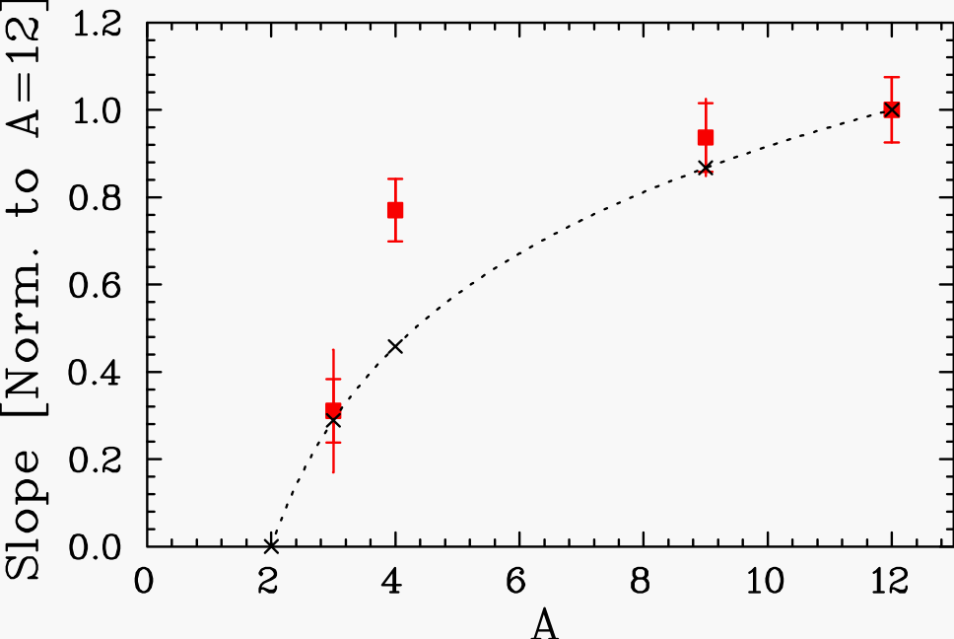
A or density dependence ?
Fit of the EMC ratio for 0.3<x<0.7 and look at A-dependence of the slope
SLAC A-dep. parametrization
E03-103

Slide 36
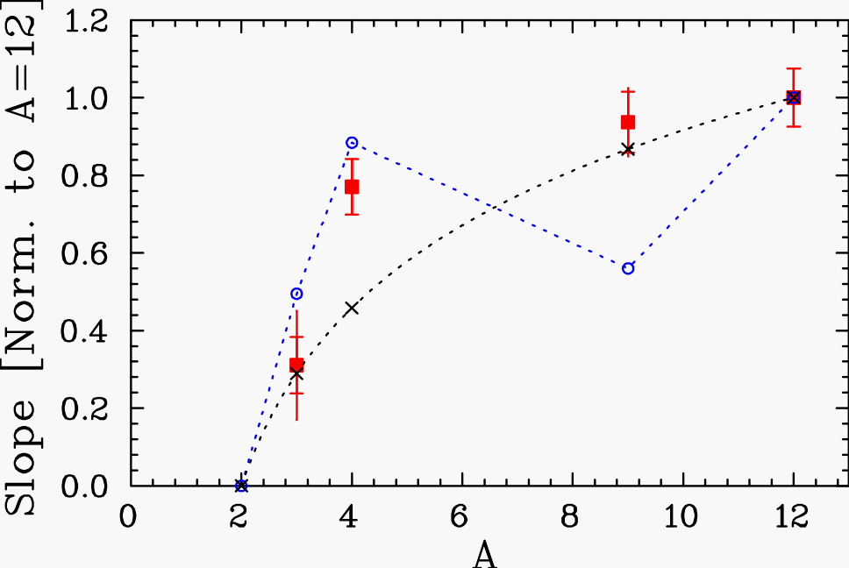
A or density dependence ?
Fit of the EMC ratio for 0.3<x<0.7 and look at A-dependence of the slope
SLAC A-dep. parametrization
E03-103
SLAC ρ-dependence fit

Slide 37
A or density dependence ?
⁹Be ~ 2α-cluster+n
⬇
<ρ> small
but
ρ_{local}(⁹Be) ~ ρ(⁴He)
➔ hint of local density dependence
➔ overlap with nearest neighbors ?
Fit of the EMC ratio for 0.3<x<0.7 and look at A-dependence of the slope
SLAC A-dep. parametrization
E03-103
SLAC ρ-dependence fit

Slide 38
World data re-analysis
Experiments | E (GeV) | A | x-range | Pub. 1st author
CERN-EMC | 280 | 56 | 0.050-0.650 | Aubert
 |  | 12,63,119 | 0.031-0.443 | Ashman
CERN-BCDMS | 280 | 15 | 0.20-0.70 | Bari
 |  | 56 | 0.07-0.65 | Benvenuti
CERN-NMC | 200 | 4,12,40 | 0.0035-0.65 | Amaudruz
 | 200 | 6,12 | 0.00014-0.65 | Arneodo
SLAC-E61 | 4-20 | 9,27,65,197 | 0.014-0.228 | Stein
SLAC-E87 | 4-20 | 56 | 0.075-0.813 | Bodek
SLAC-E49 | 4-20 | 27 | 0.25-0.90 | Bodek
SLAC-E139 | 8-24 | 4,9,12,27,40,56,108,197 | 0.089-0.8 | Gomez
SLAC-E140 | 3.7-20 | 56,197 | 0.2-0.5 | Dasu
DESY-HERMES | 27.5 | 3,14,84 | 0.013-0.35 | Airapetian

Slide 39
Extrapolation to nuclear matter
EMC
SLAC
fit A≥3
fit A≥12
NM
NM
Improved density calculation (calculated with density distributions from R. Wiringa and S. Pieper )
Notes:
Density dependence is tricky: we don’t really know how to calculate it, especially for 3He.
Adding heavy nuclei data doesn’t bring much, but the light nuclei constrain a lot more fits.

Slide 40
Extrapolation to nuclear matter
After coulomb corrections
EMC
SLAC
fit A≥3
NM
fit A≥12
NM
Improved density calculation (calculated with density distributions from R. Wiringa and S. Pieper )
Apply coulomb distortion correction

Slide 41
Extrapolation to nuclear matter
After coulomb corrections
EMC
JLab E03-103 prel.
SLAC
fit A≥3
NM
fit A≥12
preliminary
preliminary
NM
Improved density calculation (calculated with density distributions from R. Wiringa and S. Pieper ).
Apply coulomb distortion correction.
In progress: n/p at large Q² and low x, and large x and large Q^{2.}
Target mass correction to be looked at.
Note: n/p correction is also A-dependent !
Notes:
New data : more light nuclei → level arm vs. model-dependence.

Slide 42
EMC effect in nuclear matter
From A^{-1/3} dependence
From ρ-dependence
Notes:
Need work

Slide 43
EMC effect in nuclear matter
From A^{-1/3} dependence
From ρ-dependence
Notes:
Need work

Slide 44
EMC effect in nuclear matter
From A^{-1/3} dependence
From ρ-dependence
preliminary
preliminary
Notes:
Need work

Slide 45
EMC effect in nuclear matter
From A^{-1/3} dependence
From ρ-dependence
preliminary
preliminary
Notes:
Need work

Slide 46
Summary
JLab E03-103 provides:
Precision nuclear structure ratios for light nuclei
Access to large x EMC region for ³He → ¹⁹⁷Au
Preliminary observations:
Scaling of the structure function ratios for W<2GeV down to low Q²
First measurement of the EMC effect in ³He: very sensitive to isoscalar correction
Similar large x shape of the structure function ratios for A>3
In progress:
Coulomb correction systematics
Nuclear density calculations
Smeared n/p at correct kinematics and for each nucleus
Target mass correction
Notes:
Need work

Slide 47
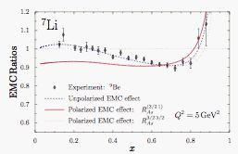
Outlook
New JLab data (light nuclei and high x precision) indicate:
the need to go beyond the simple A- or ρ-based fits
the importance of detailed calculations with real n/p input
Updated/new extrapolation to the EMC effect in nuclear matter
Important to understand EMC effect for neutrinos experiments.
Future related measurements:
³H and ³He (n/p in nuclei) at
Jlab 12 GeV
JLab BONUS (6 and 12 GeV)
→ free n/p
First measurement of the polarized
EMC effect first test
Cloet, Bentz, and Thomas, PLB 642, 210 (2006)
Notes:
Need work

Slide 48
Back-ups
Notes:
Need work

Slide 49
Density calculations
Calculation from S. Pieper
Calculation from R. Wiringa & S. Pieper
Average density:
with

Slide 50
E03-103: QE subtraction effect
preliminary
preliminary
Notes:
Need work

Slide 51
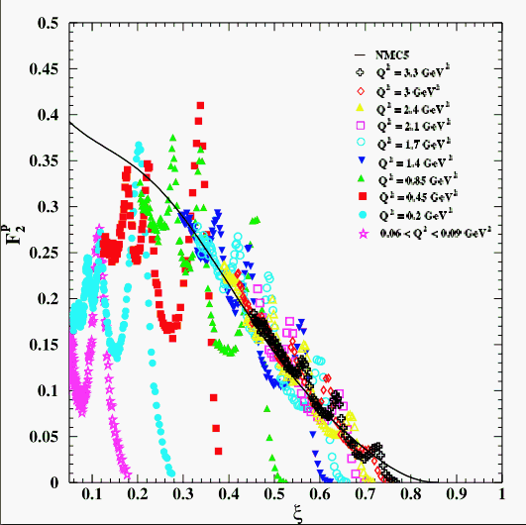
Quark-hadron duality
I. Niculescu et al., PRL85:1182 (2000)
First observed by Bloom and Gilman in the 1970’s on F₂:
Scaling curve seen at high Q² is an accurate average over the resonance region at lower Q²
Notes:
To access the large x region, one needs a Q2 of above 18GeV2.
But the phenomenom of quark-hadron duality may be of great help to access this region by lowering our W2 cut on the data to be included.

Slide 52
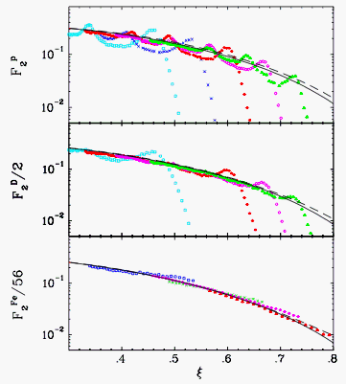
Quark-hadron duality
J. Arrington, et al., PRC73:035205 (2006)
First observed by Bloom and Gilman in the 1970’s on F₂:
Scaling curve seen at high Q² is an accurate average over the resonance region at lower Q²
In nuclei, the averaging is in part done by the Fermi motion.
Notes:
To access the large x region, one needs a Q2 of above 18GeV2.
But the phenomenom of quark-hadron duality may be of great help to access this region by lowering our W2 cut on the data to be included.

Slide 53
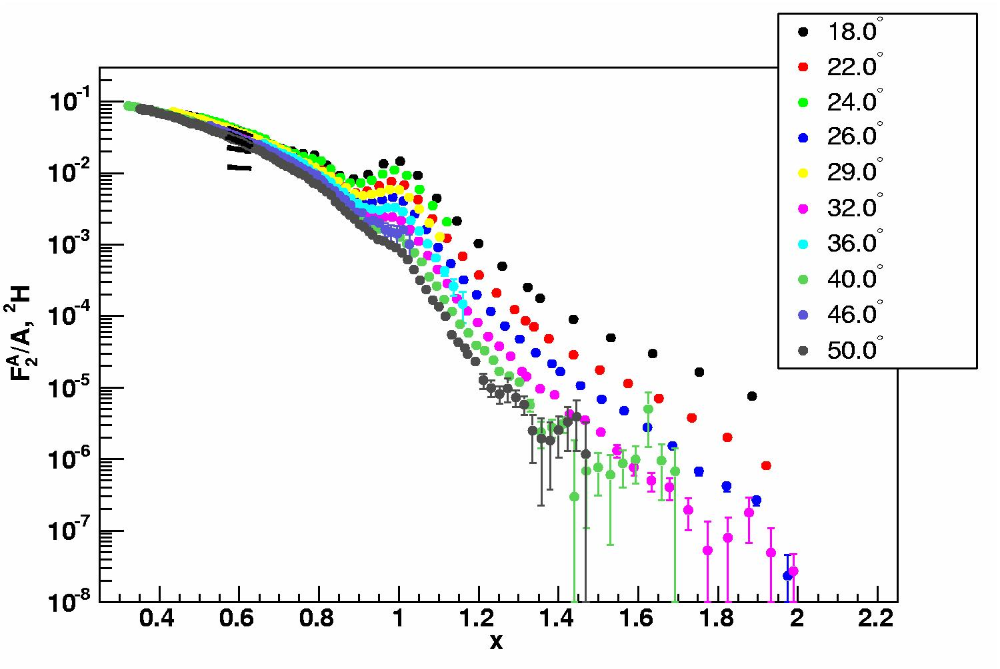
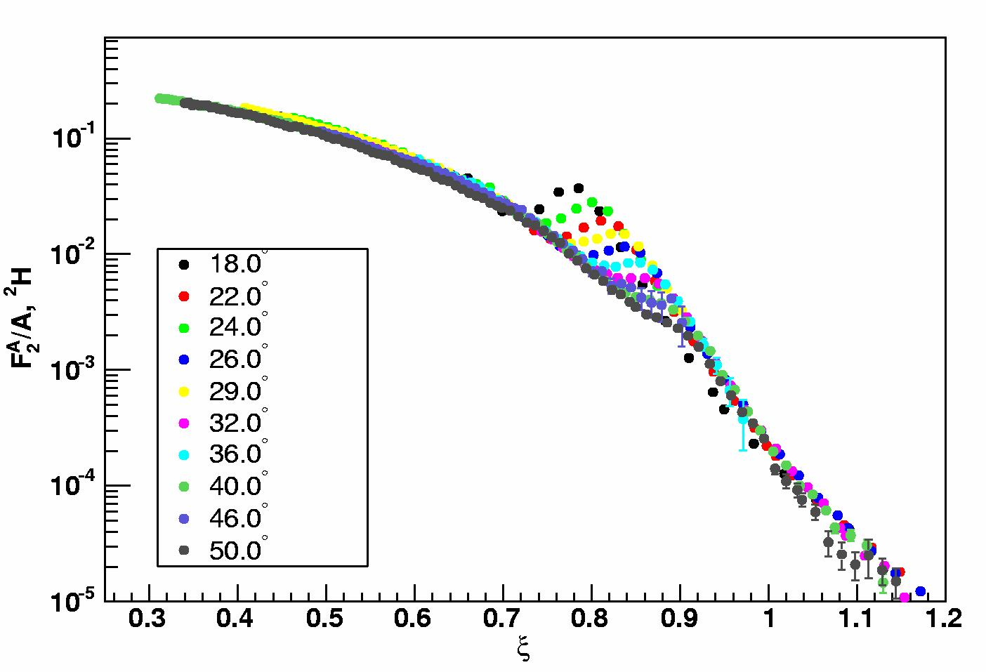
Scaling of the nuclear structure functions
F₂(x,Q²) consistent with QCD evolution in Q² for low x values (x<0.5)
Huge scaling violations at large x (especially for x>1)
F2(ξ,Q²) consistent with QCD evolution in Q² to much larger ξ values
Scaling violations are mostly the “target-mass” corrections (plus a clear contribution from the QE peak)
→ Nearly independent of A

Slide 54
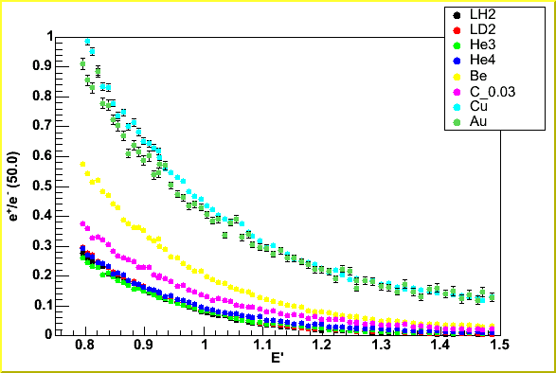
E03-103: Experimental details
Main improvement over SLAC due to improved ⁴He targets:
Source of uncertainty
Statistics
*Density fluctuations
Absolute density
SLAC E139
1.0-1.2%
1.4%
2.1%
JLab E03-103
0.5-0.7%
0.4%
1.0%
(1.5% for ³He)
* - size of correction is 8% at 4 uA vs. 4% at 80 uA
Main drawback is lower beam energy:
Requires larger scattering angle to reach same Q²
Larger π⁻ contamination
Large charge-symmetric background
Larger Coulomb distortion corrections
Ratio of e+ to e- production
Ratio of e+ to e- production
Notes:
Say something about e+/e-: worse case and we can compare with ratio at lower angle

