Slide 1
Does a nucleon appears different when inside a nucleus ?
Patricia Solvignon
Argonne National Laboratory
Postdoctoral Research Symposium
September 11-12, 2008
Notes:
Good afternoon.
I am going to present today experimental results from Jefferson Lab which goal was to try to answer the following question: Does a nucleon appears different when inside a nucleus ?

Slide 2
Outline
Brief introduction to the EMC effect
JLab E03-103 preliminary results:
Q²-dependence study with Carbon
Light nuclei
Heavy nuclei and Coulomb distortion
New extrapolation to nuclear matter

Slide 3
The structure of the nucleon
Deep inelastic scattering ➔ probe the constituents of the nucleon: the quarks and the gluons
4-momentum transfer squared
e⁻
e⁻
γ∗
Invariant mass squared
Bjorken variable
To increase the luminosity, physicists decided to use heavy nuclei to study the structure of the proton instead of a hydrogen target. But …
Notes:
It has been 40 years that physicists are using DIS to probe the internal structure of the nucleon. In this talk I am going to talk of an inclusive experiment where unpolarized high energy electrons scatter on an unpolarized target.The relevant variables are the four-momentum transfer, the invariant mass of the undetected products and the bjorken variable x which is defined as the fraction of the nucleon momentum carried by the struct quark. In order to increase the luminosity,

Slide 4
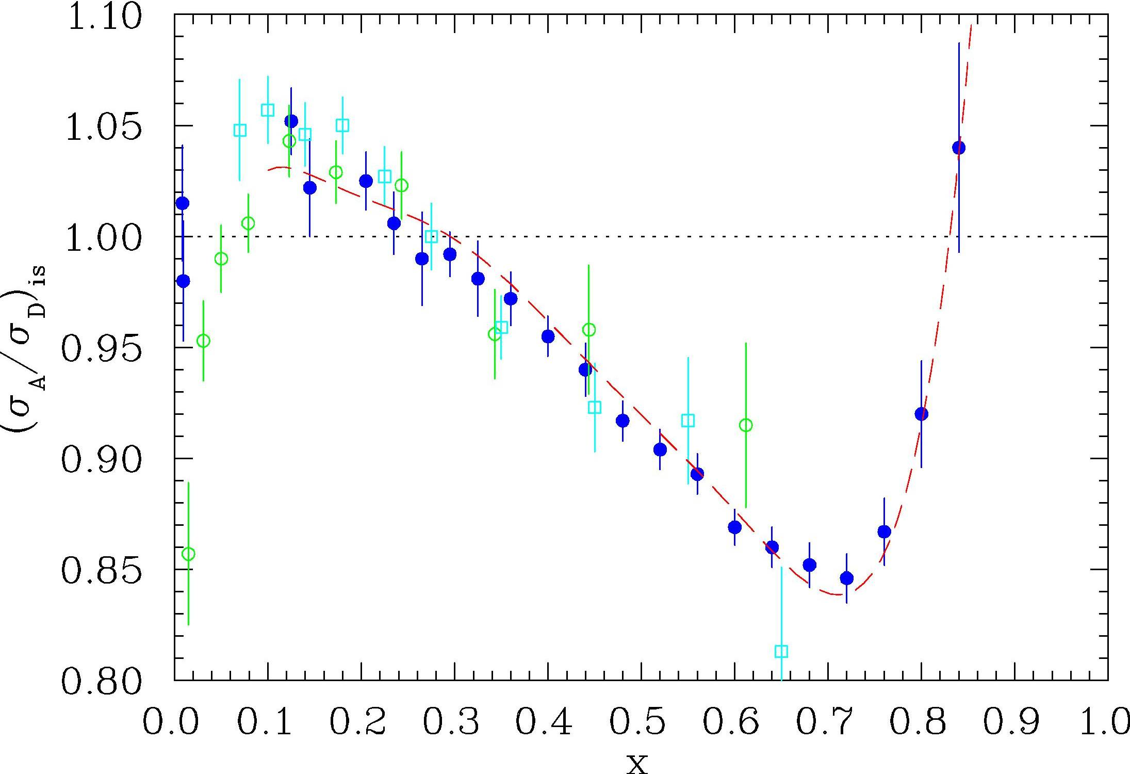
Discovery of the EMC effect
e⁻
e⁻
≠
Z
+
N
γ∗
γ∗
γ∗
p
n
Nucleus at rest
(A nucleons = Z protons + N neutrons)
σ_{A}/σ_{D}
Nuclear structure:
σ_{A} ≠ Z.σ_{p} + N.σ_{n}
EMC (Cu) BCDMS (Fe) E139 (Fe)
Effects found in several experiments at CERN, SLAC, DESY
x

Slide 5
Existing EMC Data
E139
SLAC E139
Most complete data set: A=4 to 197
Most precise at large x
Q²-independent
universal shape
magnitude dependent on A
E03-103 will improve with
Higher precision data for ⁴He
Addition of ³He data
Precision data at large x and on heavy nuclei
⇨ Lowering Q² to reach high x region

Slide 6
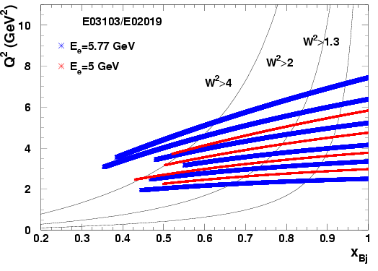
JLab Experiment E03-103
Spokespersons: D. Gaskell and J. Arrington
Post-doc: P. Solvignon
Graduate students: J. Seely and A. Daniel
A(e,e’) at 5.0 and 5.8 GeV in Hall C
Targets:
H, ²H, ³He, ⁴He,
Be, C, Al,
Cu, Au
10 angles to measure
Q²-dependence
W²=1.2GeV²
W²=4.0GeV²
W²=2GeV²
Notes:
All targets at large angles: 40, 46 and 50.
C and D data at all angles to verify precise scaling and our extraction of the EMC ratio is Q2-dependence.

Slide 7
E03-103: Carbon EMC ratio and Q²-dependence
at x=0.6
Preliminary
Small angle, low Q² ➔ clear scaling violations for x>0.7

Slide 8
E03-103: Carbon EMC ratio and Q²-dependence
at x=0.6
Preliminary
At larger angles ➔ indication of scaling to very large x

Slide 9
E03-103: Carbon EMC ratio
W²>4.0 GeV²
W²>2.0 GeV²
X
1.2<W²<2.0 GeV²
Preliminary

Slide 10
E03-103: ⁴He EMC ratio
JLab results consistent with SLAC E139
Improved statistics and systematic errors
Preliminary

Slide 11
E03-103: ⁴He EMC ratio
JLab results consistent with SLAC E139
Improved statistics and systematic errors
Models shown do a reasonable job describing the data
Preliminary

Slide 12
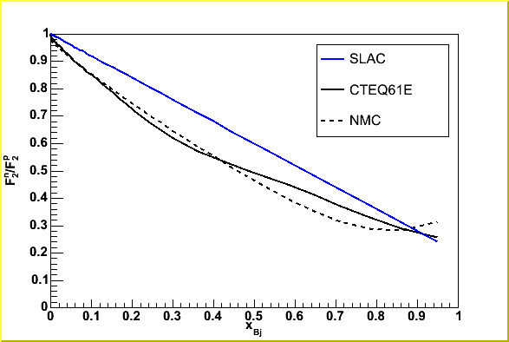
Isoscalar correction
Isoscalar correction
SLAC fit: (1-0.8x)

Slide 13
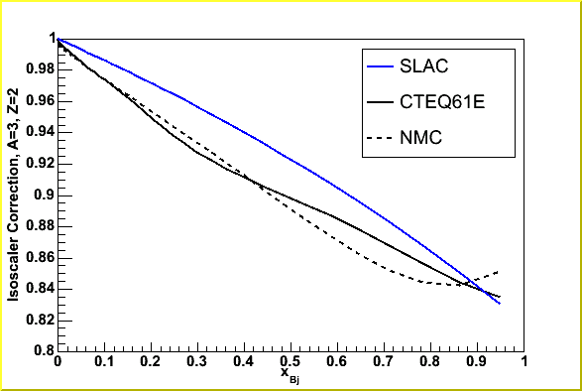
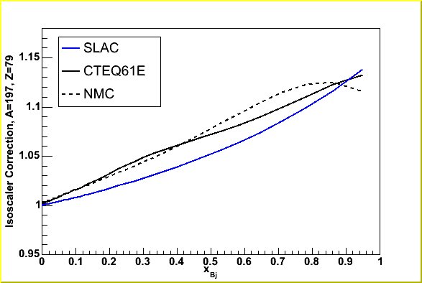
Isoscalar correction
Isoscalar correction
³He
Au
SLAC fit: (1-0.8x)

Slide 14
E03-103: ³He EMC ratio
Large proton excess correction
Isoscalar correction done using ratio of bound neutron to bound proton
Preliminary
Notes:
we have to be careful not to get into a long discussion about it. By the way, I can't tell - is that slide HERMES without any isoscalar correction? If so, it's hard to show that
without getting into a discussion of the way they normalized their ratios, after applying isoscalar corrections. So different isoscalar correction
--> different normalization on the uncorrected data. So for this talk, I think I'd skip this altogether (and remove the "GOOD agreement with HERMES" on the previous slide, since we don't want to emphasize the agreement if we can't get into the details).

Slide 15
A or density dependence ?
Magnitude of the EMC effect for C and ⁴He very similar, and
ρ(⁴He) ~ ρ(¹²C)
EMC effect: ρ−dependent
Preliminary

Slide 16
A or density dependence ?
Magnitude of the EMC effect for C and ⁴He very similar, and
ρ(⁴He) ~ ρ(¹²C)
EMC effect: ρ−dependent
Preliminary
Magnitude of the EMC effect for C and ⁹Be very similar, but
ρ(⁹Be) << ρ(¹²C)
EMC effect: A-dependent
Preliminary

Slide 17
A or density dependence ?
Magnitude of the EMC effect for C and ⁴He very similar, and
ρ(⁴He) ~ ρ(¹²C)
EMC effect: ρ−dependent
Preliminary
Hint of local density dependence
Magnitude of the EMC effect for C and ⁹Be very similar, but
ρ(⁹Be) << ρ(¹²C)
EMC effect: A-dependent
Preliminary

Slide 18
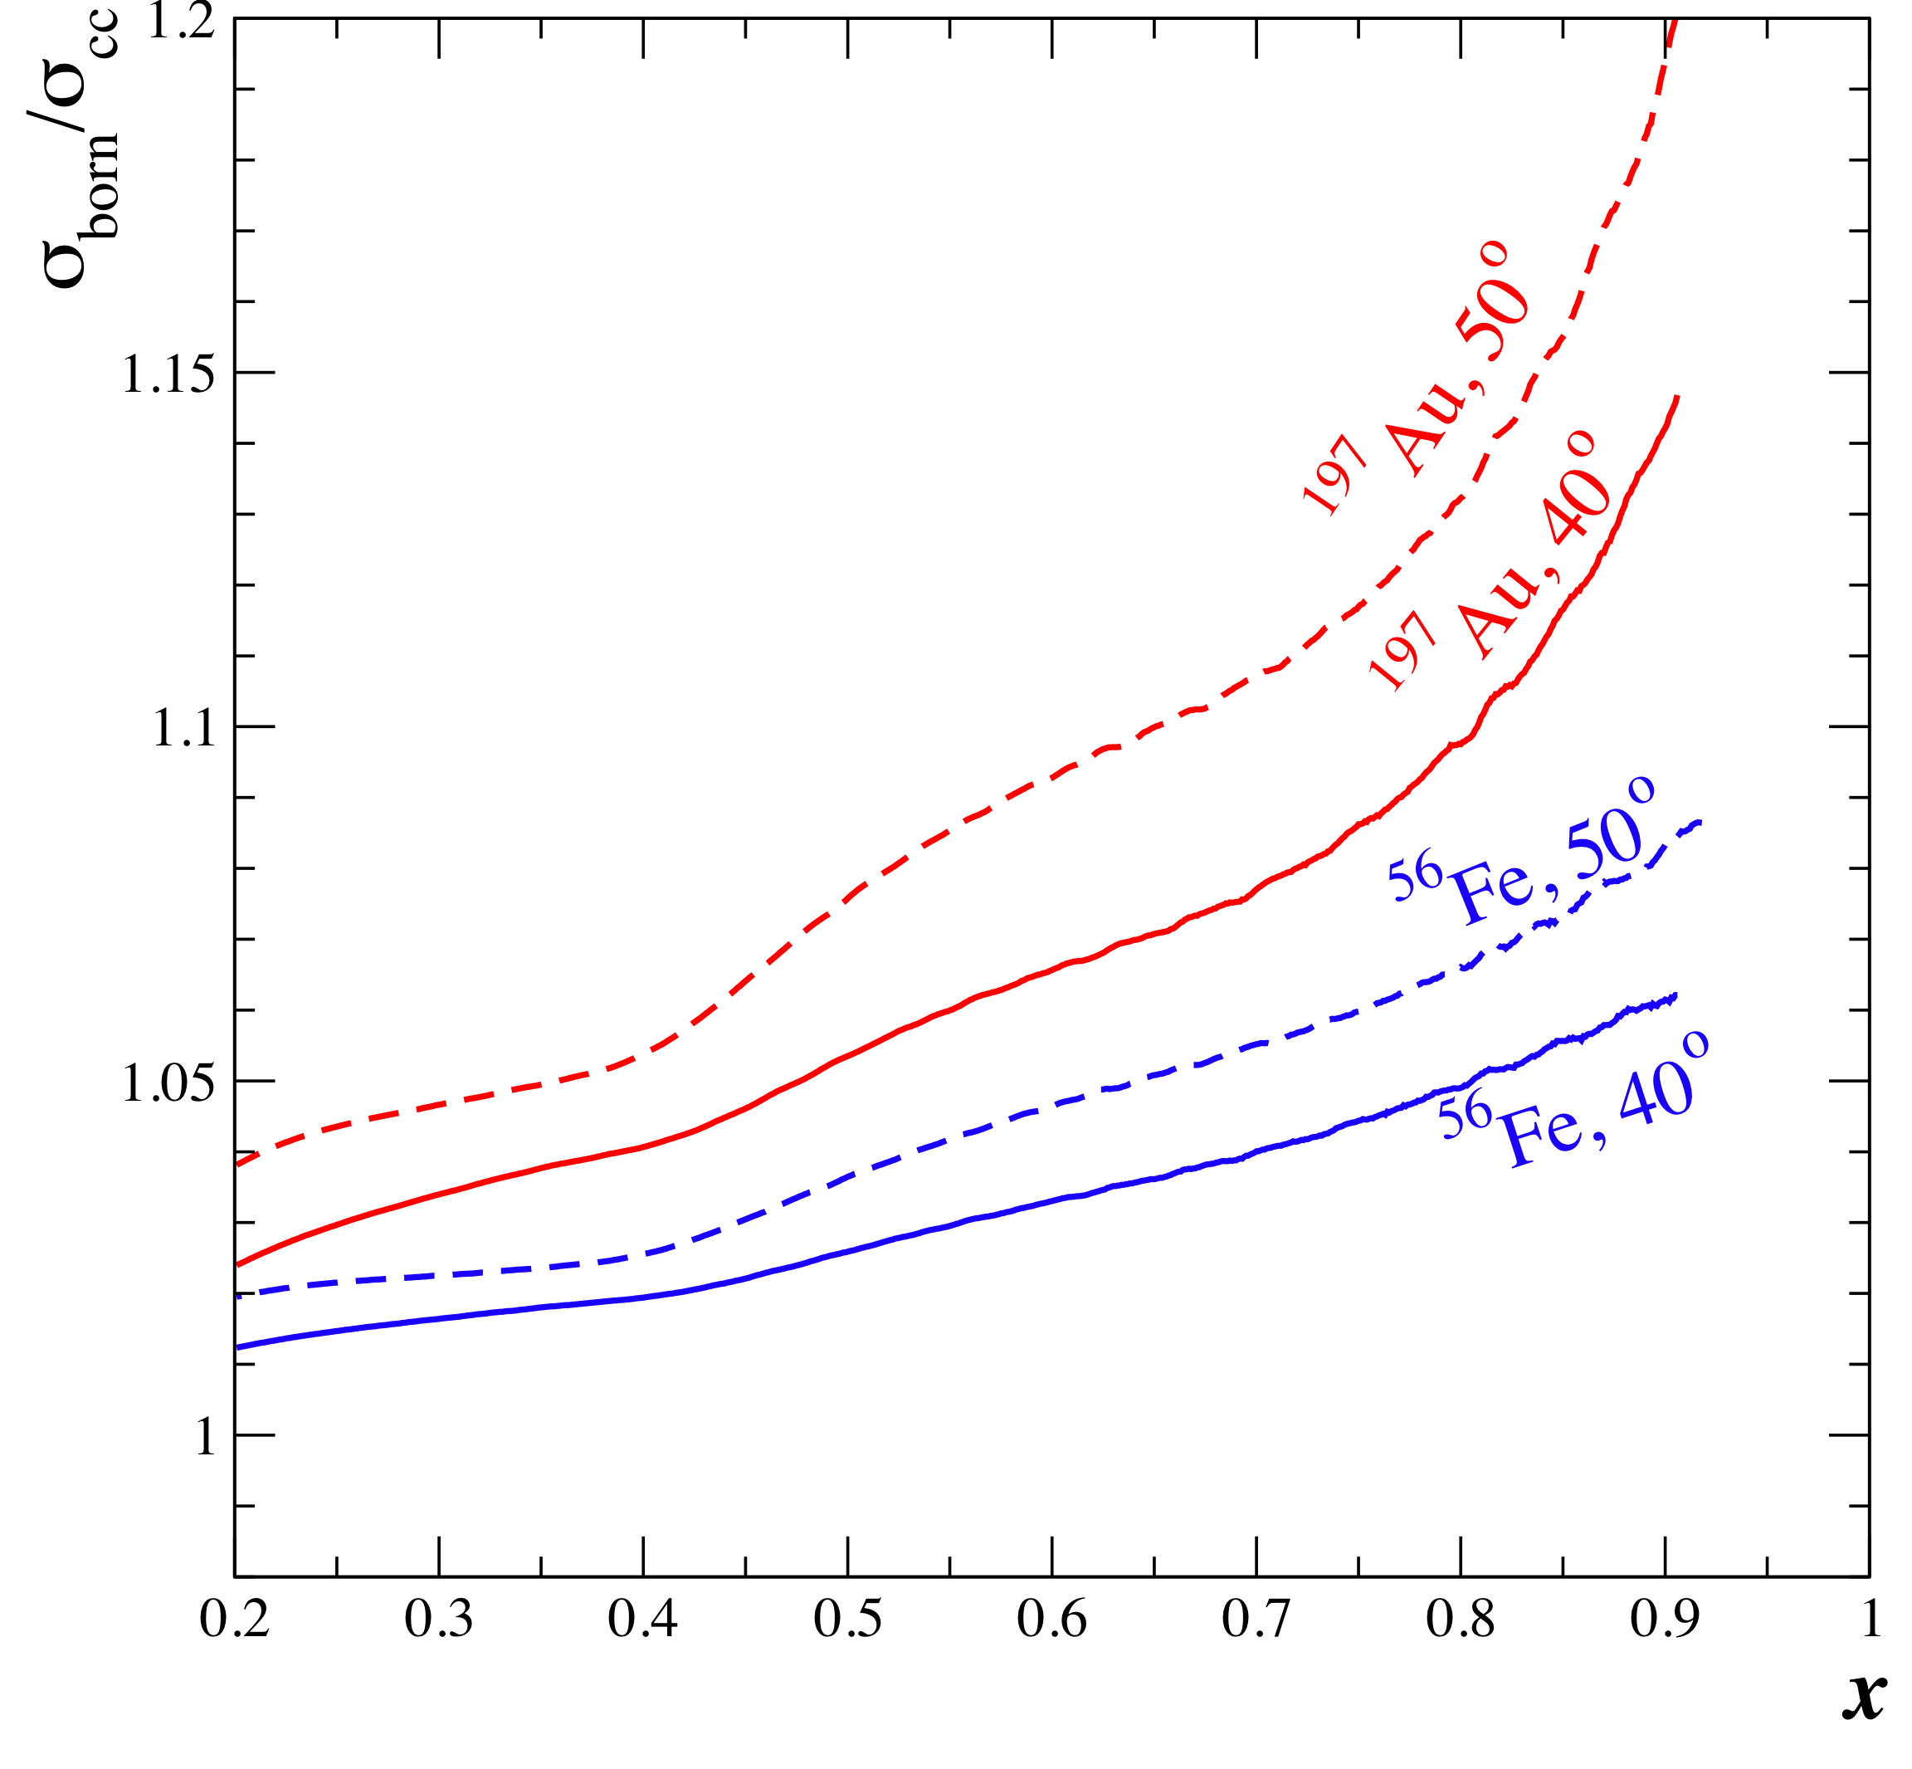
Coulomb distortions on heavy nuclei
Initial (scattered) electrons are accelerated (decelerated) in Coulomb field of nucleus with Z protons
Not accounted for in typical radiative corrections
Usually, not a large effect at high energy machines – not true at JLab (6 GeV!)
E03-103 uses modified Effective Momentum
Approximation (EMA)
Aste and Trautmann, Eur, Phys. J. A26, 167-178(2005)
E → E+Δ
E’ → E’+Δ
with Δ = -¾ V₀
V₀ = 3α(Z-1)/(2r_{c})

Slide 19
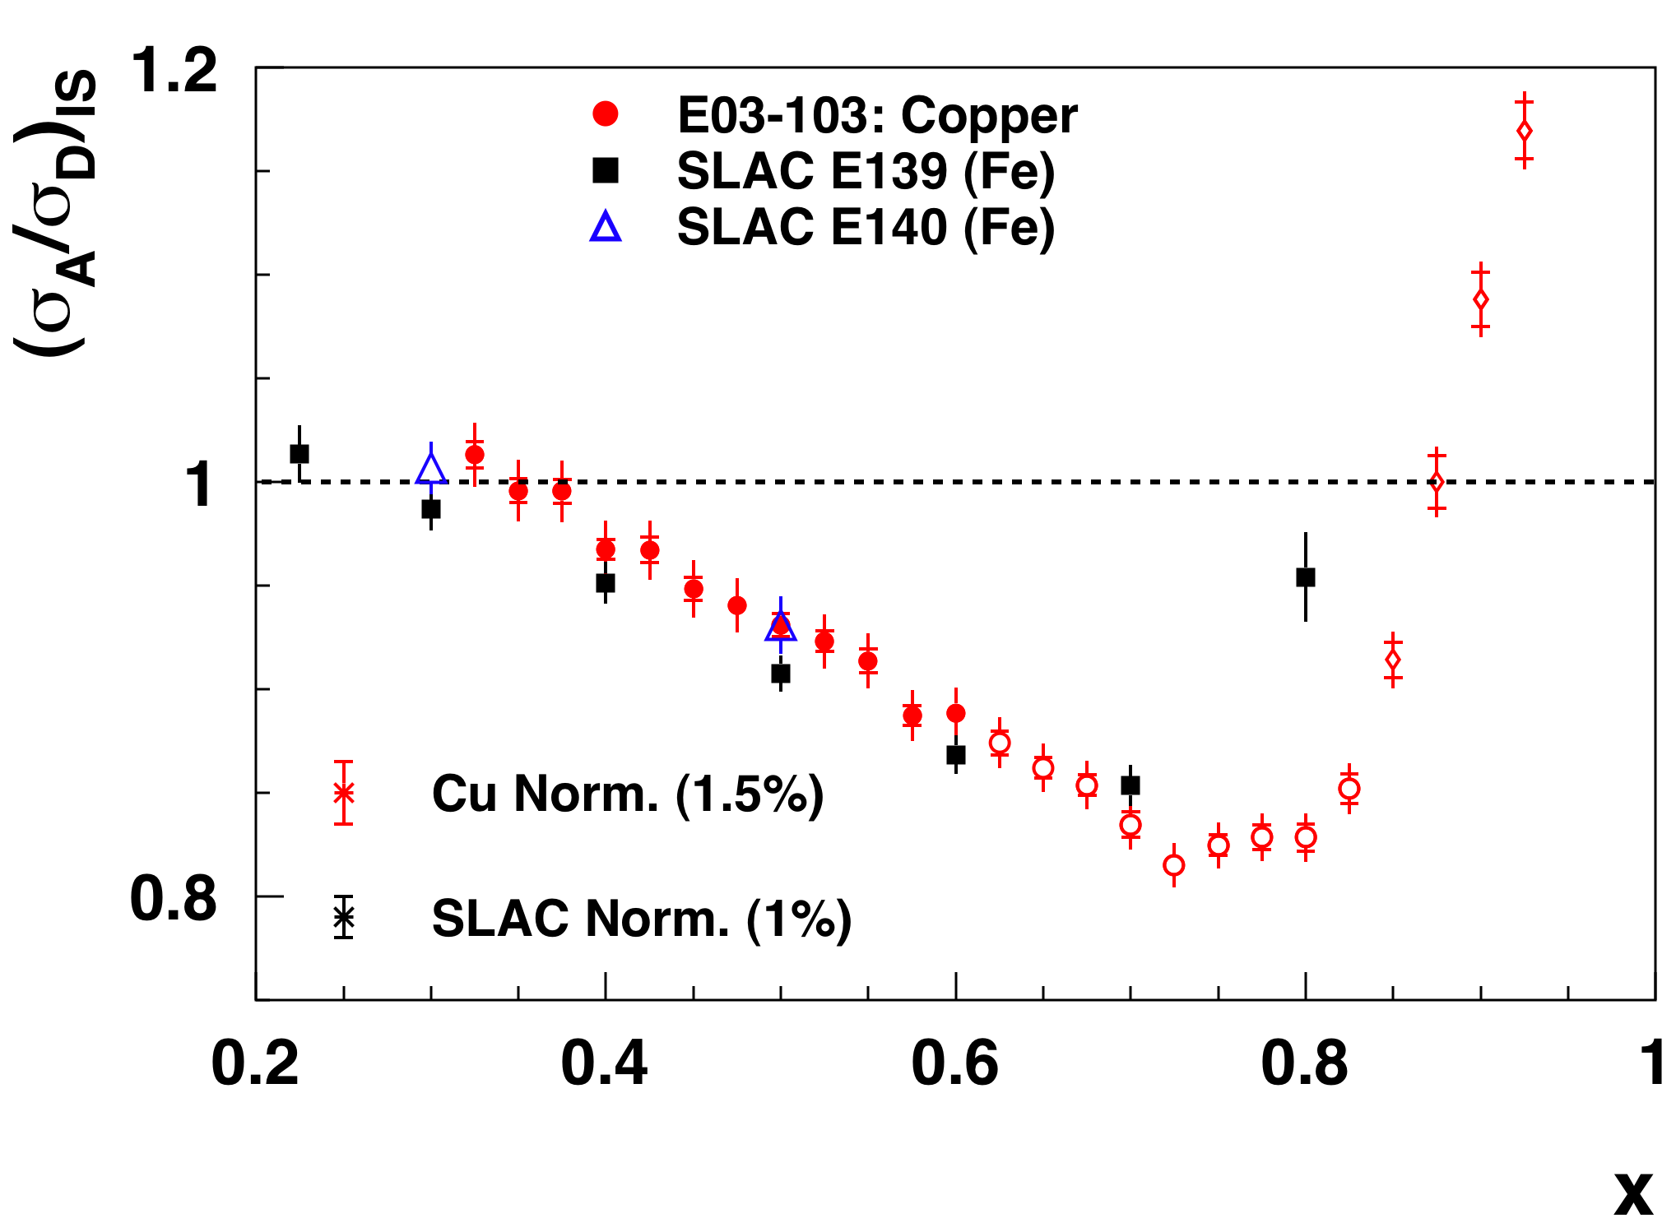
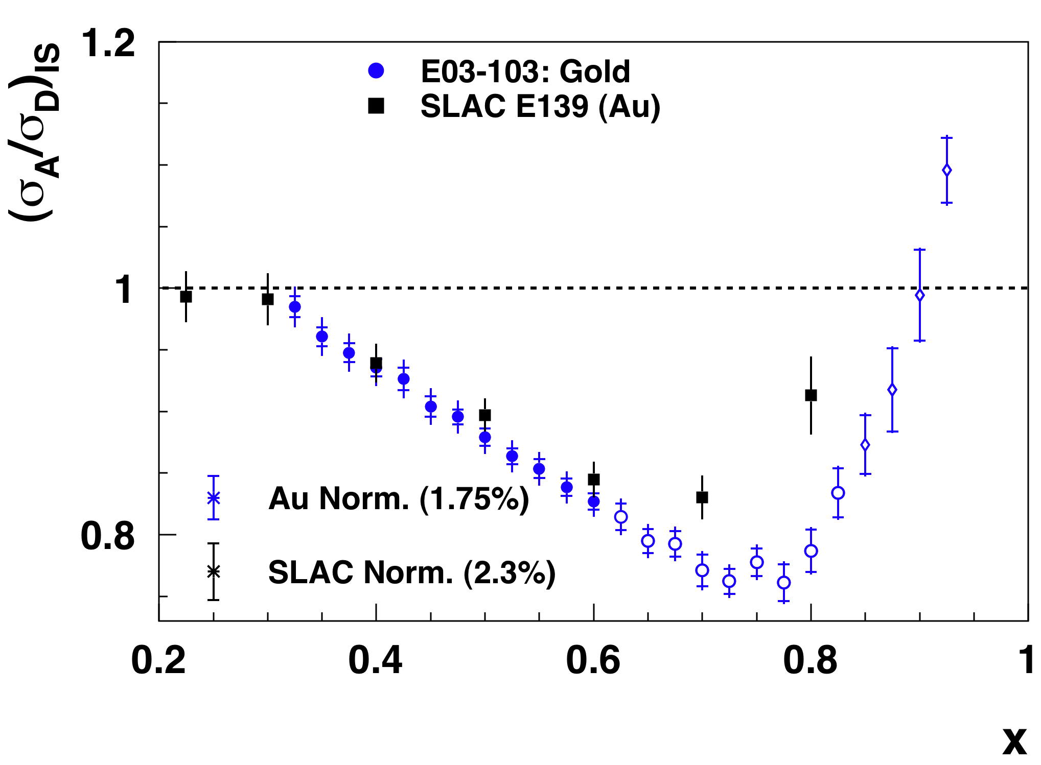
E03-013 heavy target results and world data
Before coulomb corrections
preliminary
preliminary
Notes:
About 1% correction for coulomb distortions in SLAC data

Slide 20
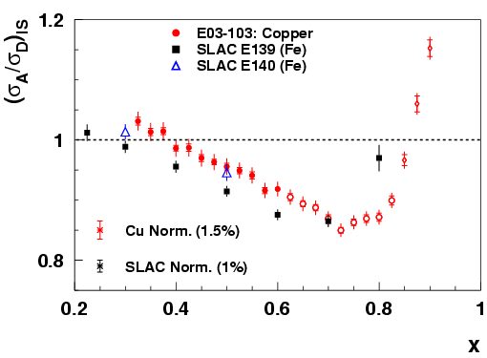
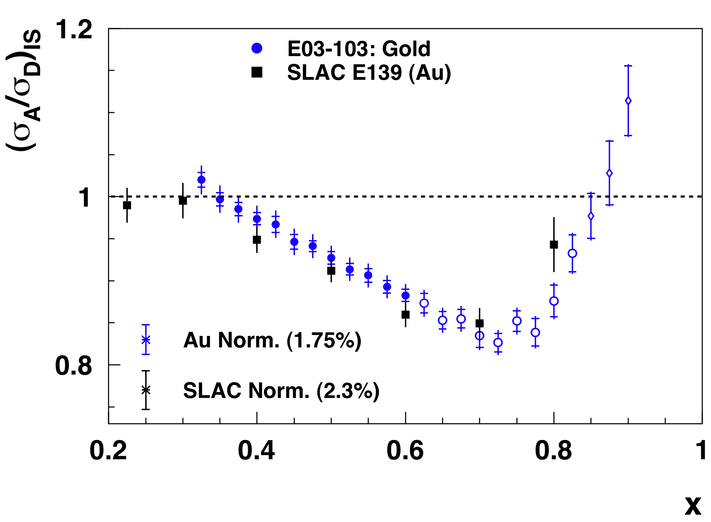
E03-013 heavy target results and world data
After coulomb corrections on all data
preliminary
preliminary
Notes:
As Dave pointed out, Fe seems to be a bit of an outlier (low)
for E139, and Cu seems to be a bit of an outlier up for us. From slide
25, it appears that the x=0.6 might be a worse case for us (Cu is
basically on top of C at 0.6, but inbetween Cu and Au elsewhere). In any
event, I'd emphasize that the heavy nuclei are preliminary (CC, neutron
excess, etc...), and be ready to say that we don't yet know why they don't
agree, but that it's only a single x bin, and it's not clear if it's an
issue with one data set, the other, both, or just a fluctation.

Slide 21
E03-103: EMC effect in heavy nuclei
E03-103 data corrected for coulomb distortion
Preliminary
Notes:
Scale errors: 1.2-2%

Slide 22
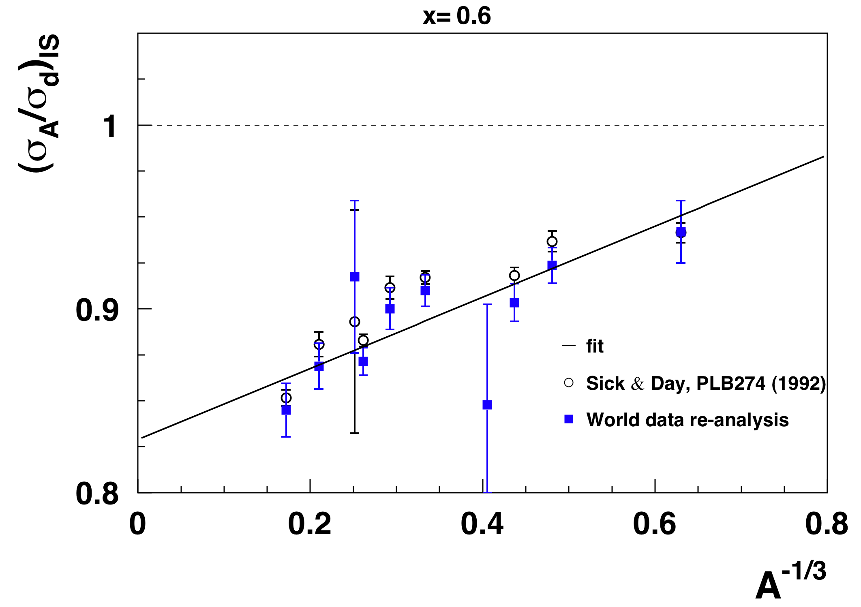
Nuclear dependence of the EMC effect
NM
Main difference due to E139 data sets used:
- Sick & Day used E139 Q²-avg tables
- we used E139 constant Q² to be able to apply CC
Notes:
Density dependence is tricky: we don’t really know how to calculate it, especially for 3He.
Adding heavy nuclei data doesn’t bring much, but the light nuclei constrain a lot more fits.

Slide 23
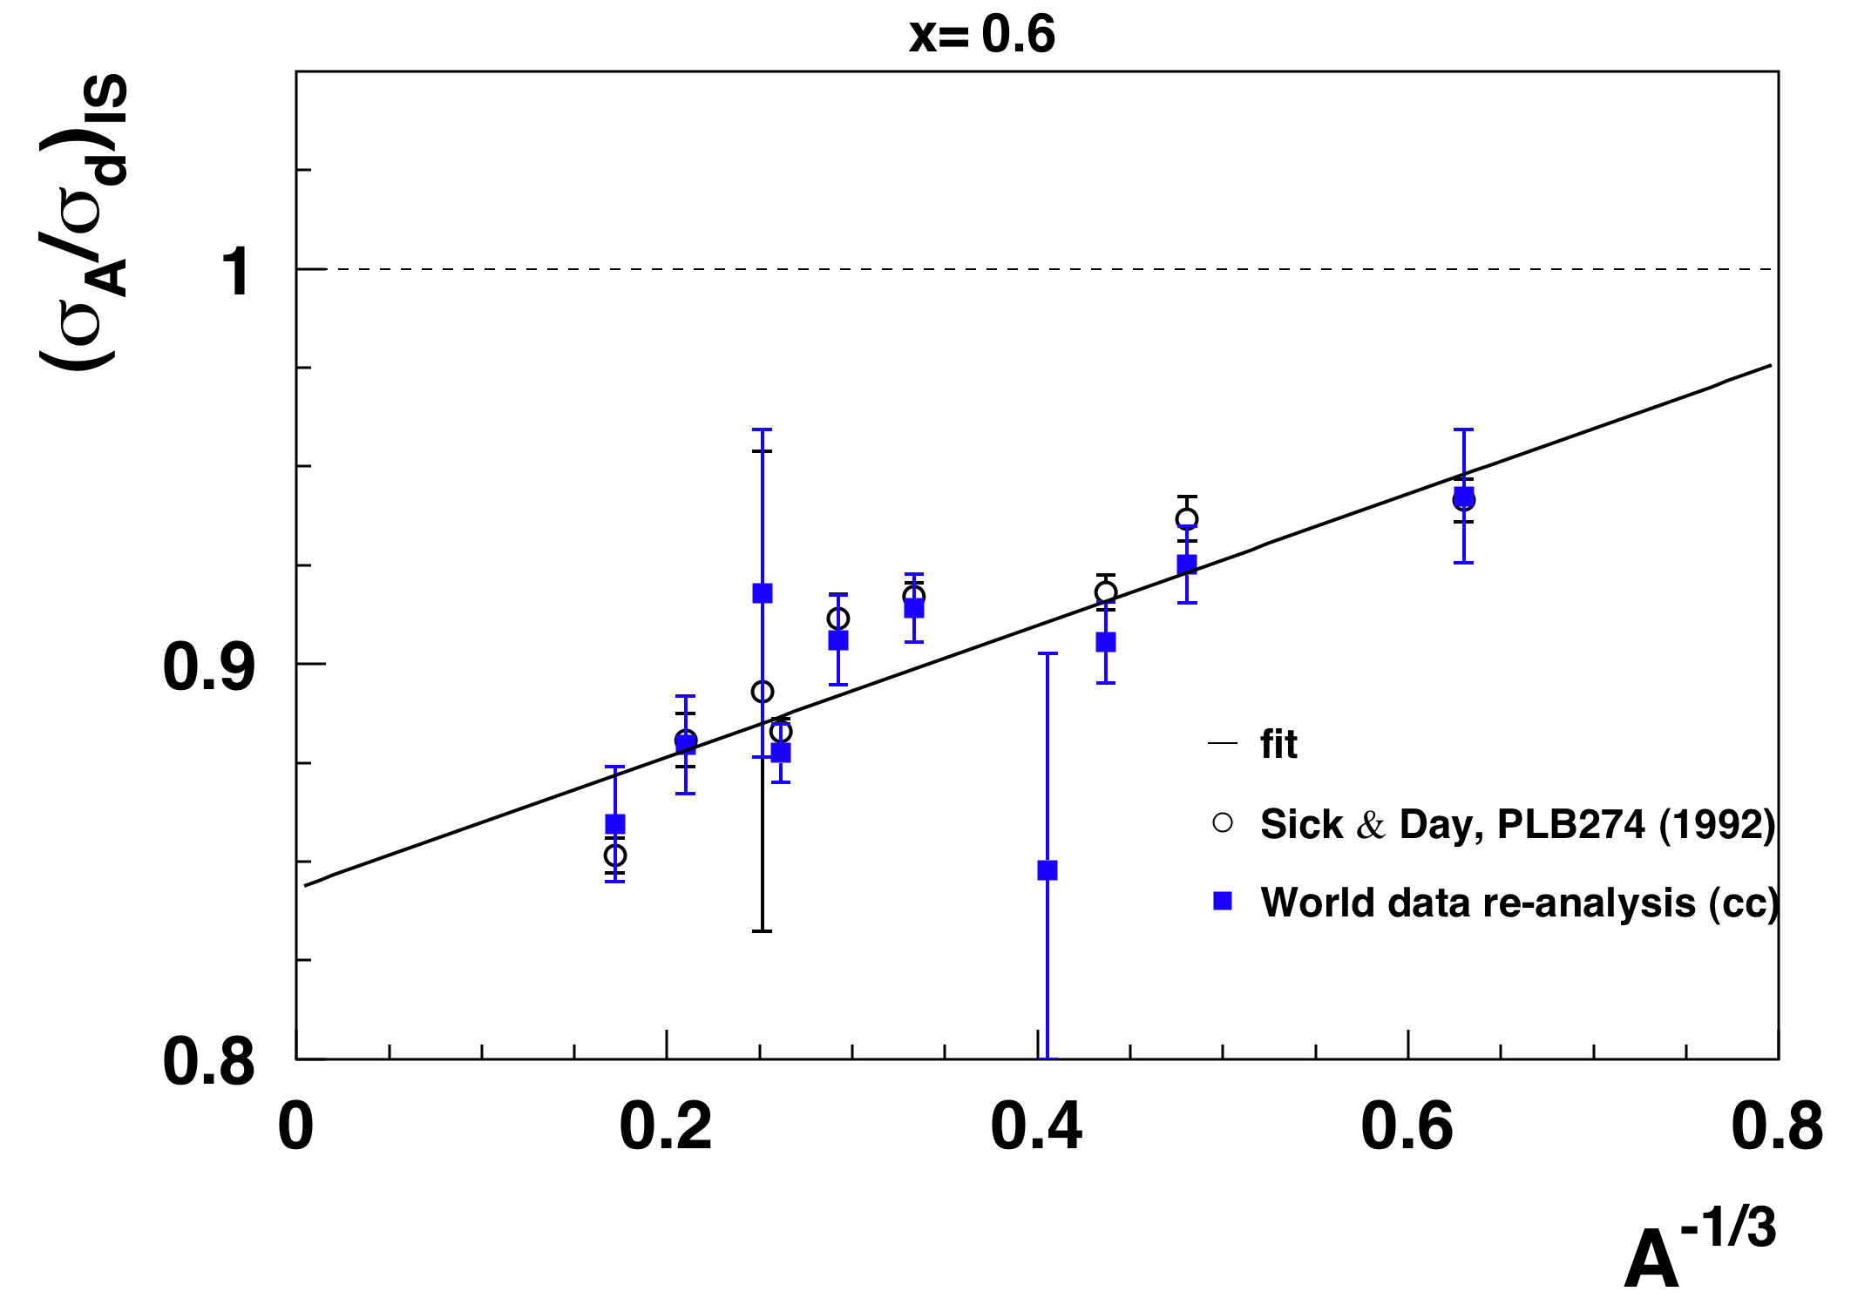
Nuclear dependence of the EMC effect
After coulomb corrections
NM

Slide 24
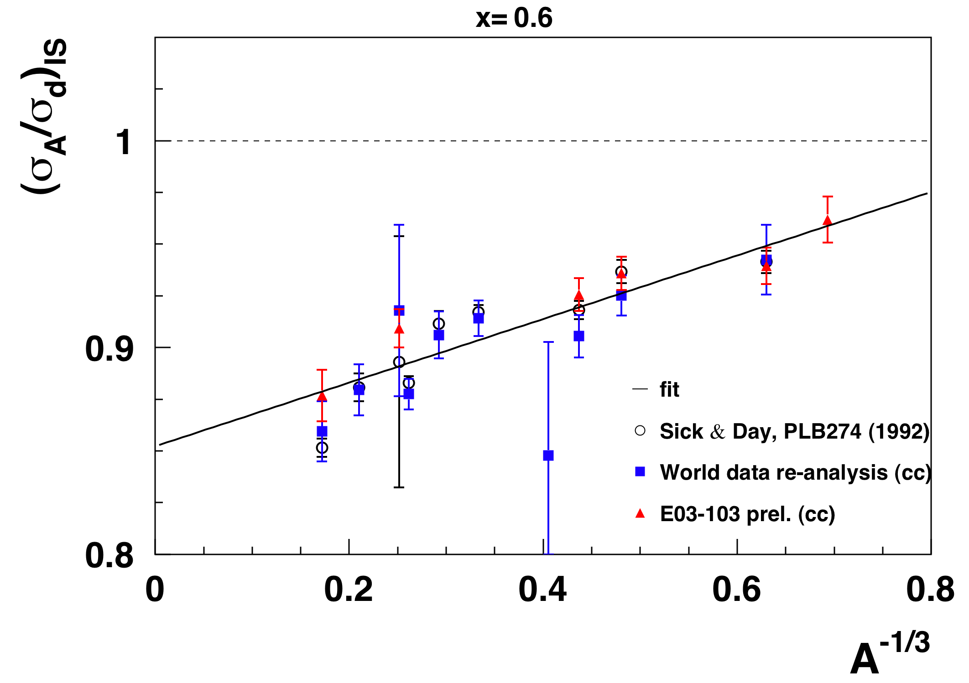
Nuclear dependence of the EMC effect
After coulomb corrections
preliminary
NM
Good agreement between E03-103 and SLAC E139 data after Coulomb corrections.
Preliminary E03-103 results confirm A-dependence of the EMC effect.
Note: n/p correction is also A-dependent !

Slide 25
Nuclear matter
preliminary

Slide 26
Nuclear matter
preliminary

Slide 27
Nuclear matter
preliminary

Slide 28
Summary
JLab E03-103 provides:
Precision nuclear structure ratios for light nuclei
Access to large x EMC region for ³He → ¹⁹⁷Au
Preliminary observations:
Scaling of the structure function ratios for W<2GeV down to low Q²
First measurement of the EMC effect in ³He: very sensitive to isoscalar correction
Similar large x shape of the structure function ratios for A>3
In progress:
Absolute cross sections for ¹H, ²H, ³He and ⁴He: test models of σ_{n}/σ_{p} and nuclear effects in few-body nuclei
Nuclear density calculations
Target mass correction

Slide 29
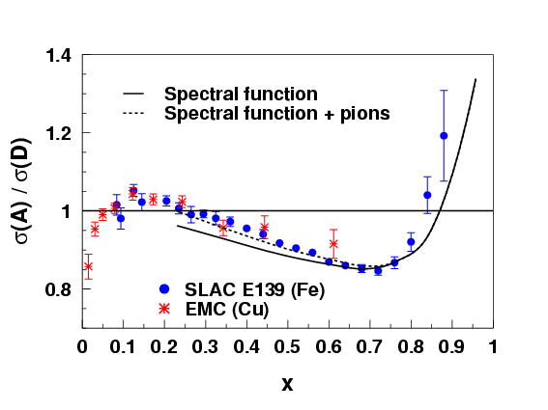
Mapping the EMC Effect
Models should include conventional effects:
Fermi motion and binding dominate at high x
Binding also affects quark distribution at all x
Then more “exotic” explanations may be added if these effects are not enough to describe the data like:
Nuclear pions
Multiquark clusters
Dynamical rescaling
Many of these models can reproduce the large x region but failed in other x-regions or for other data (Drell-Yan) or didn’t include conventional effects.
Benhar, Pandharipande, and Sick
Phys. Lett. B410, 79 (1997)
Notes:
Theoretical activities have since then tried to map out the EMC effect.
It seems that most the ideas converge on common requirements which are that models should include fermi motion and binding because these effects dominate at high x. Binding effects also extend to all x.
Then, if the Fermi motion-binding contribution are not enough to reproduce the data, more exotic explanations can be added like nuclear pions, multiquark clusters, dynamical rescaling.
(read blue sentence)
For exemple, here a plot from Benhar et al comparing their calculation to SLAC and EMC data. It can be seen that the model including nuclear pions does reproduce well the data in the for x between 0.2 and 0.75.

Slide 30
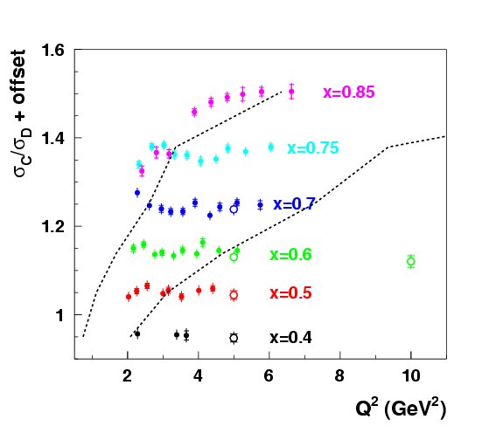
More detailed look at scaling
C/D ratios at fixed x are Q² independent for:
W²>2 GeV²
and
Q²>3 GeV²
limits E03-103 coverage
to x=0.85
Note: Ratios at larger x will be shown, but should be taken cautiously
W²>2 GeV²
W²>4 GeV²
E03-103
SLAC e139
Notes:
Ratios at larger x will be shown, but should be taken cautiously

