Slide 1
Monte Carlo Simulation
for Deuteron and He4 Elastic Measurements
Zhihong Ye

Slide 2
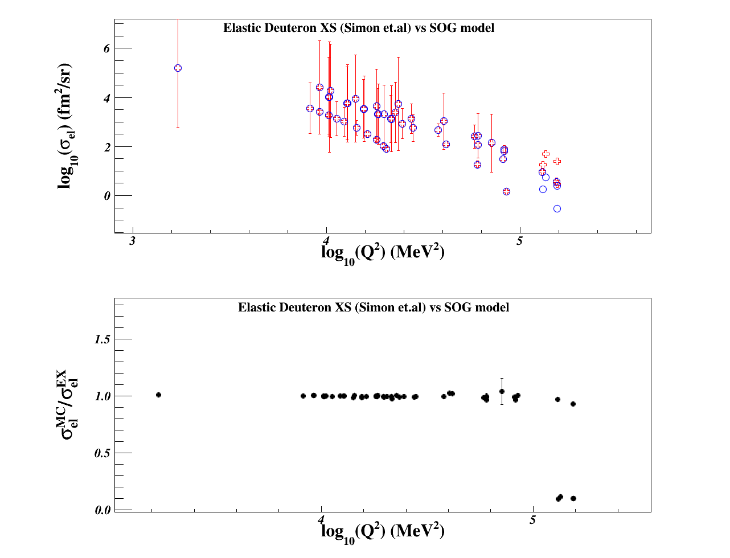
Elastic Cross Section Models
Deuteron: Sum of Gaussians (SOG) Parameterization
G_C, G_Q and G_M are fitted from experimental data with SOG function
(I. Sick, Pro. Part. Nucl. Phys. 47 (2001))
Fitting Parameters are obtained from I. Sick indirectly
I coded the model in a C++ subroutine
The model has been compared with several experiental data
No Radiative “folding”

Slide 3
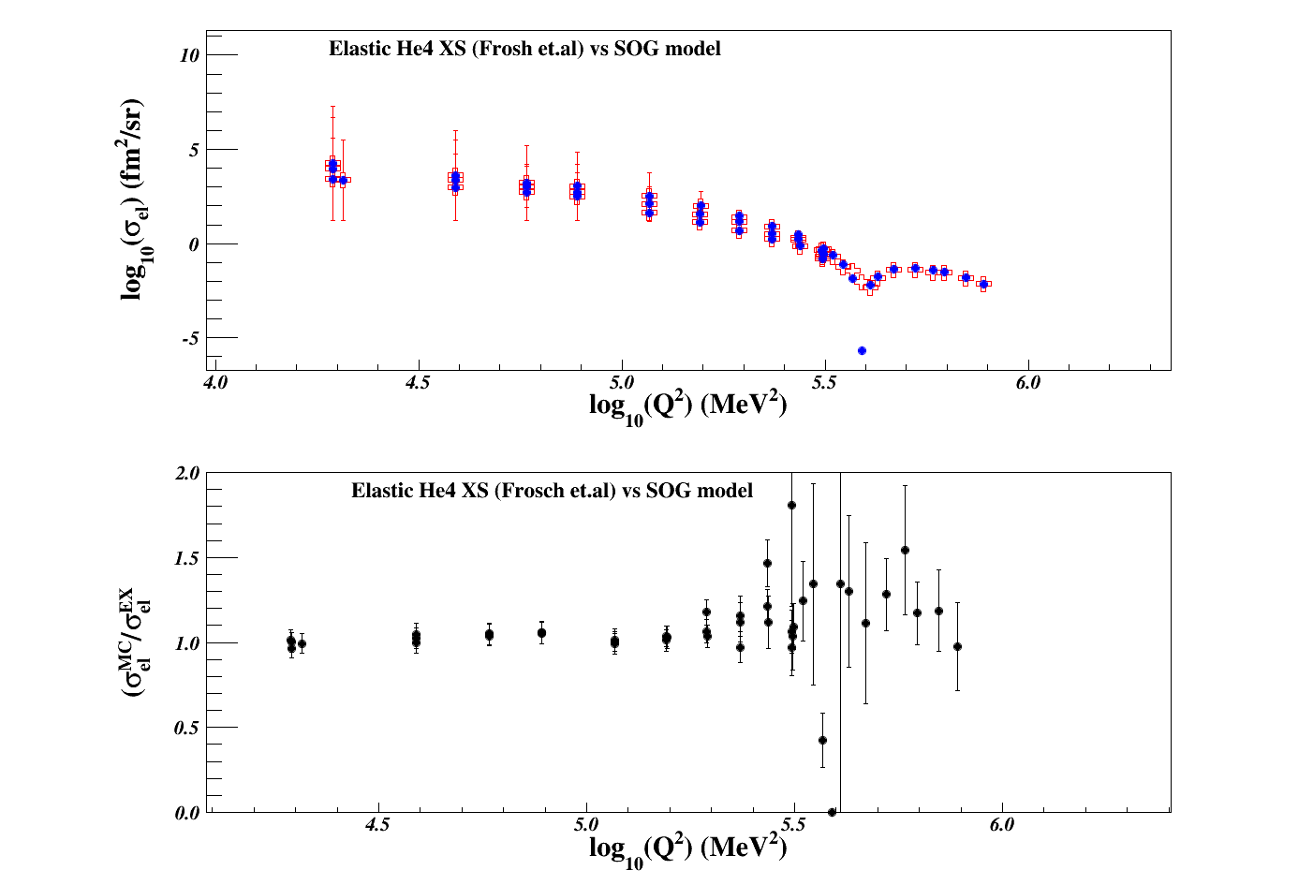
Elastic Cross Section Models
He4:
Fit of C. Ottermann et al, Nucl. Phys. A436 (1985)
Obtained from Doug Higinbotham’s MCEEP in Fortran, I converted it into C++
The model has been compared with several experiental data
No Radiative “folding”

Slide 4
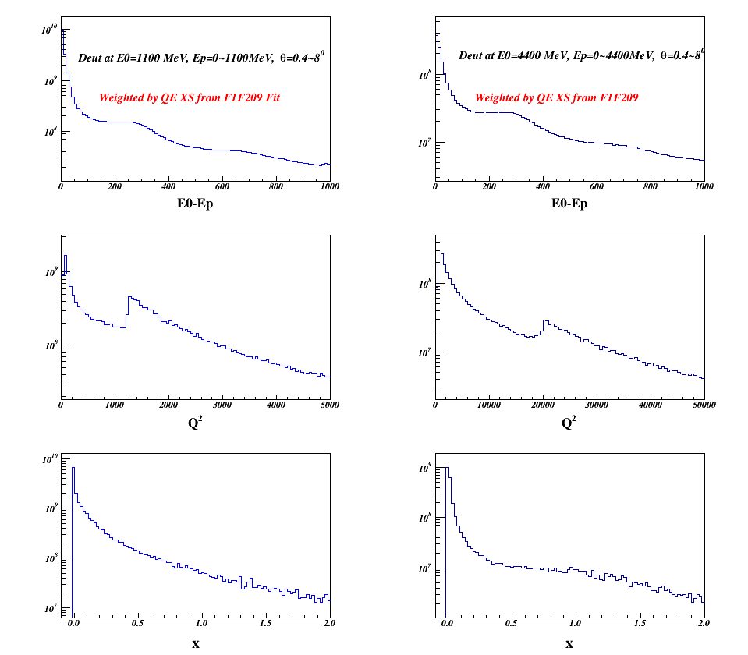
Quasi-Elastic Cross Section Model
I have my own code with three different models:
1, XEM: Fy-scaling function to discribe the QE peak
2, F1F2QE09: Peter Bosted’s 2009 fit
3, QFS: a very old QE model
Radiative Effects are “folded”
by the Peaking Approximation
Problem: all these models don’t
work *at all* at very low Q2
(e.g., <0.01GeV²)
Missing the QE-peak here

Slide 5
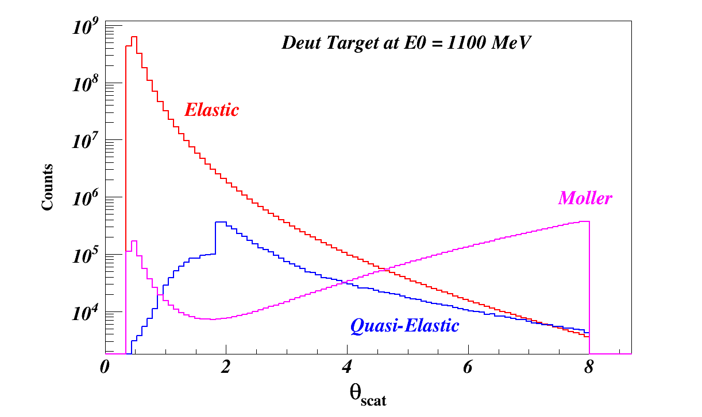
Moller Cross Section Model
Basically use the same one as Chao’s but I do the calculation in the Lab frame

Slide 6
The Monte Carlo Simulation
Use the PRAD Setting: 0.4<Theta<8.0, E0 = 1100/2200/3300/4400 MeV
Generate Elastic, QE and Moller events separately
Project the position (x,y) of the scattered electrons on the HyCal with
randomly generated Theta & Phi at the target.
Smear the position by the GEM resolution (0.1mm), recalculation Theta & Phi
Smear the scattered electron momentum by HyCal resolution → 27MeV/sqrt(E’)

Slide 7
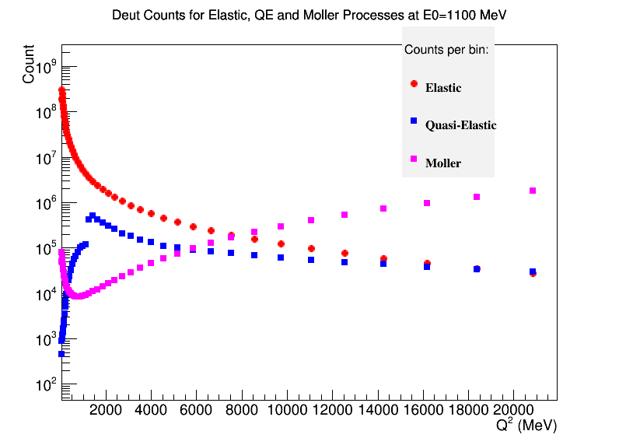
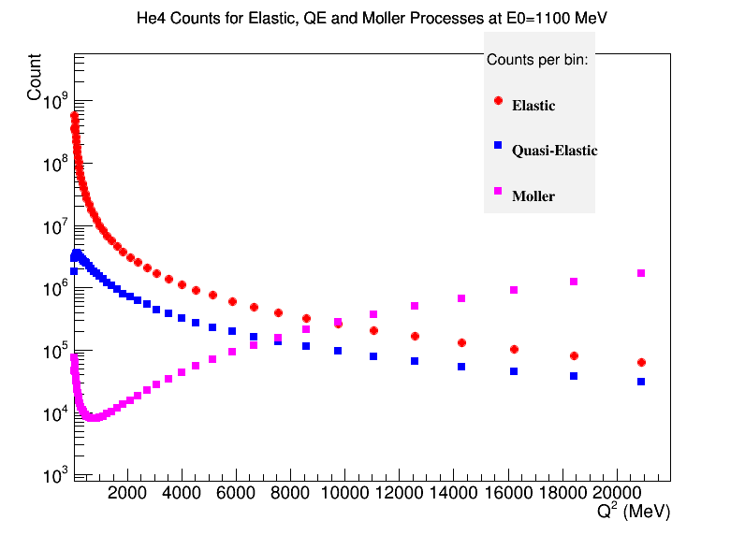
Binning: (no resolutions are included yet)
Calcualte “weight” of each event with the cross section, phase space,
target luminosity, beam charge (assuming 1 day), detector efficiency (90%).
For Elastic data, binning on log10(Theta) for each energy setting
Choose the bin-range by requring the statistically uncertaincy to be 1%
Once the bins are determined by the elastic data, use the same bins to calculate the stastistics of QE and Moller events in each bins.

Slide 8
To do:
Include radiative effects in the Deutron and He4 Elastic models
Find a right QE model (with radiative effect) working at very low Q2
Includ the detector resolutions and optmize the binning
Evaluat the QE contamination and the ways to suppress it (e.g., kinematic variable cuts, calibration runs, and/or experimental techniques)
Feed the generated events to the PRAD-Geant4 simulation to evaluate backgrounds
My codes can be found at:
www.jlab.org/~yez/Work/prad/cross_section_model.tar.gz

