Slide 1
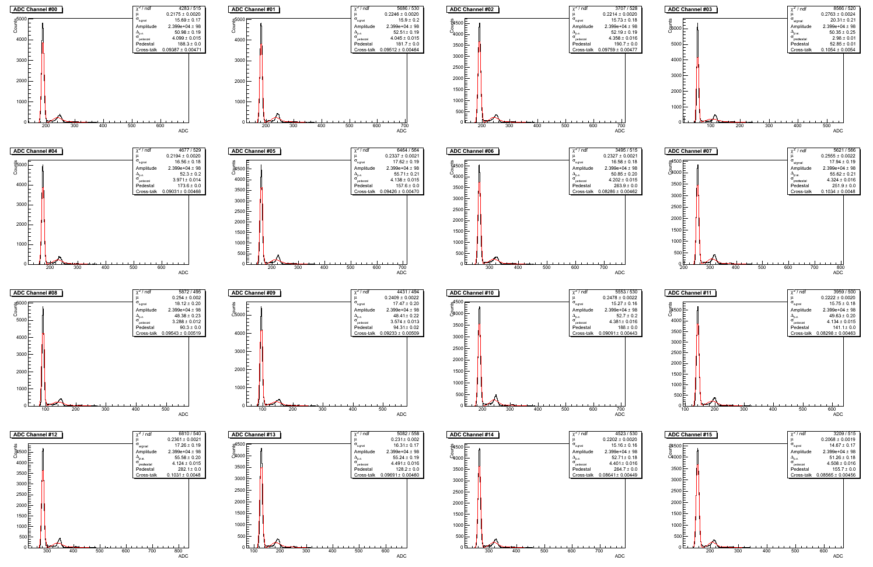
Dark Spectrum

Slide 2
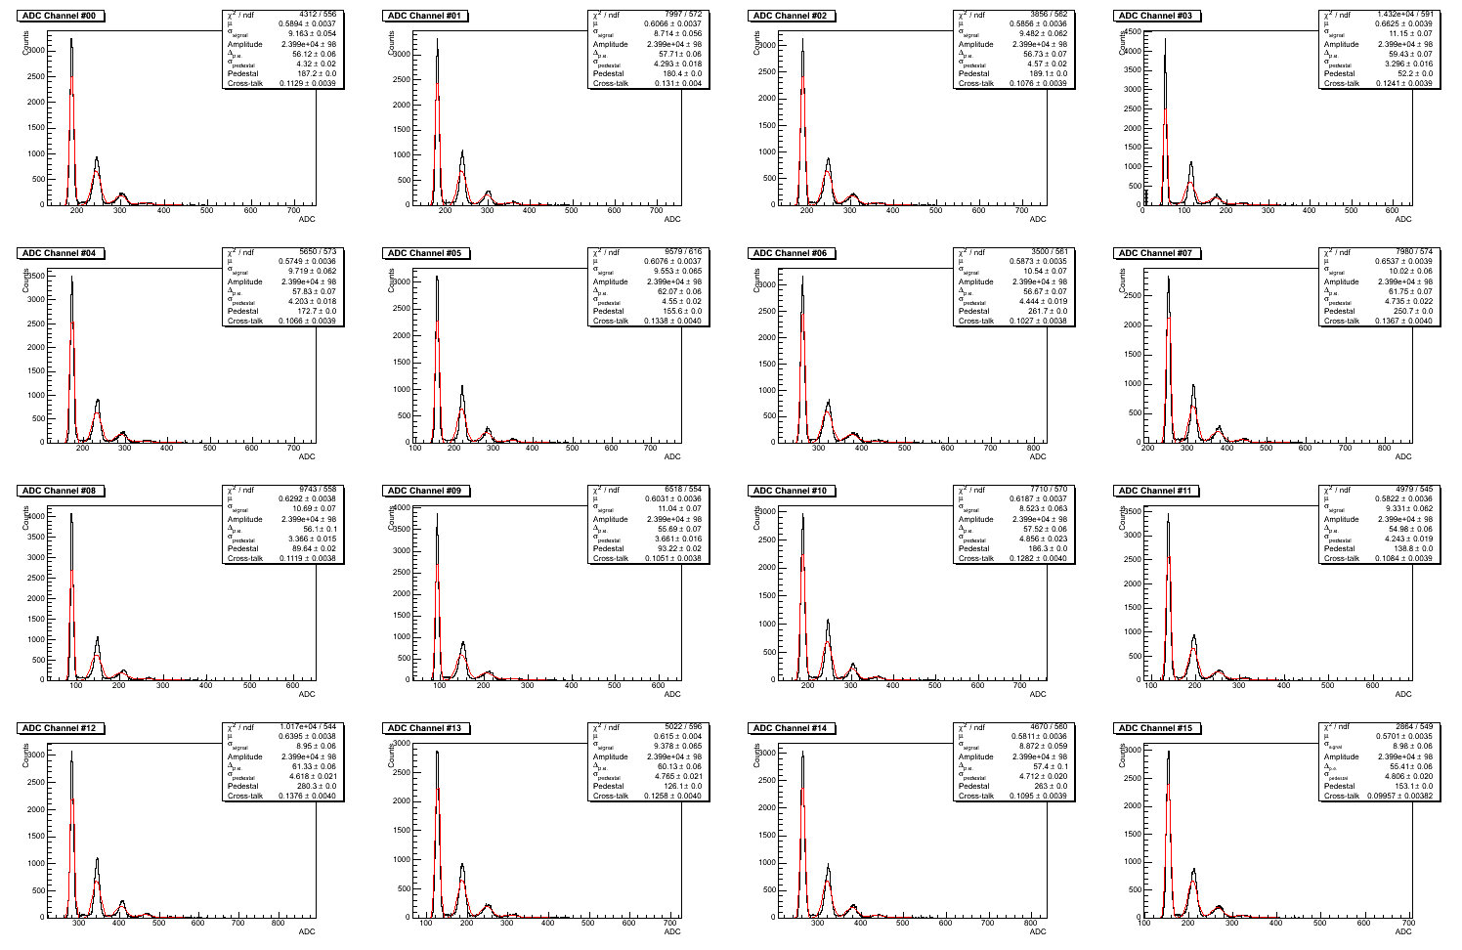
1.6% Light Input

Slide 3
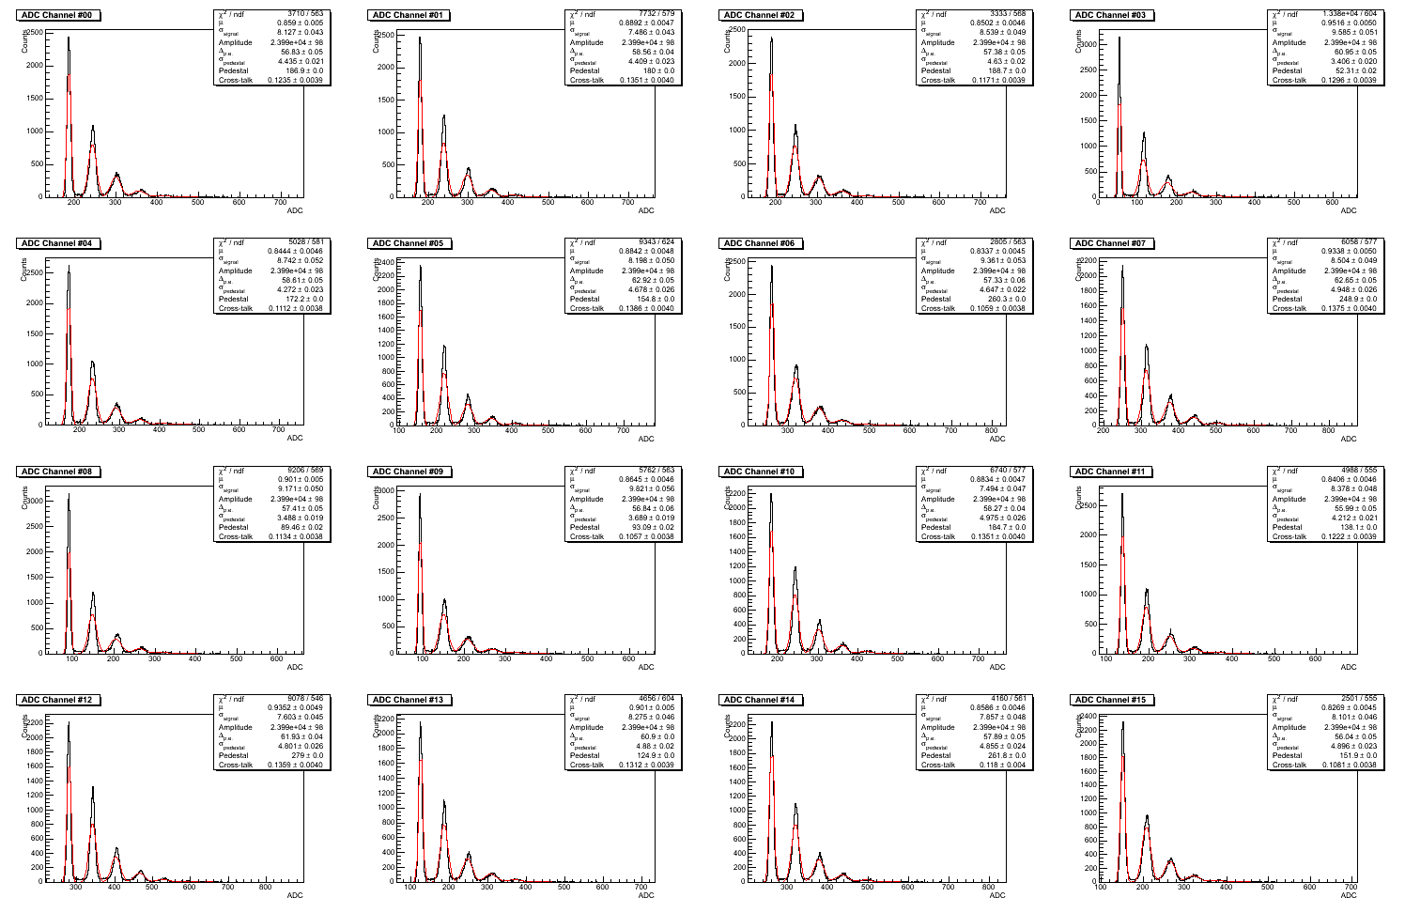
2.7% Light Input

Slide 4
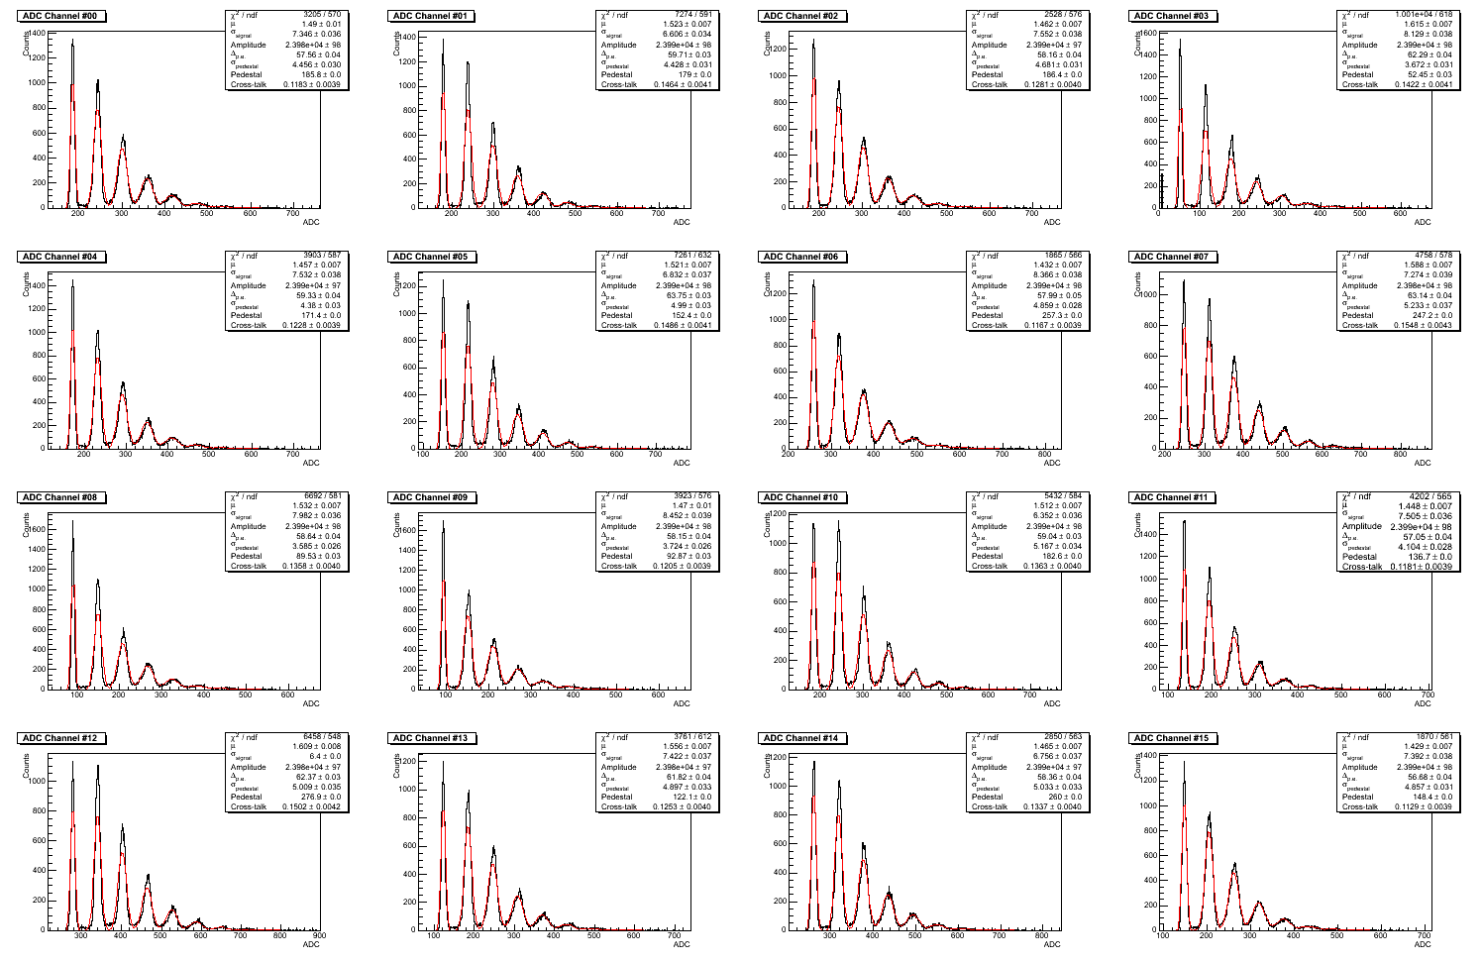
5.3% Light Input

Slide 5
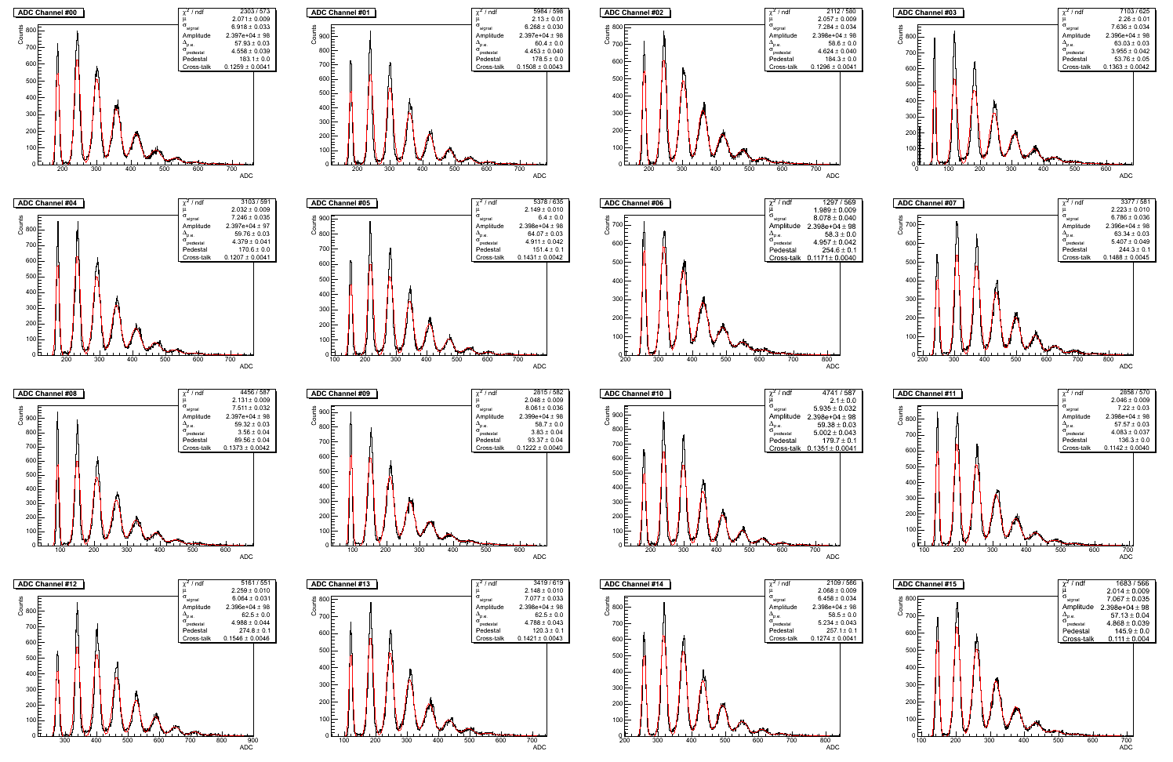
7.8% Light Input

Slide 6
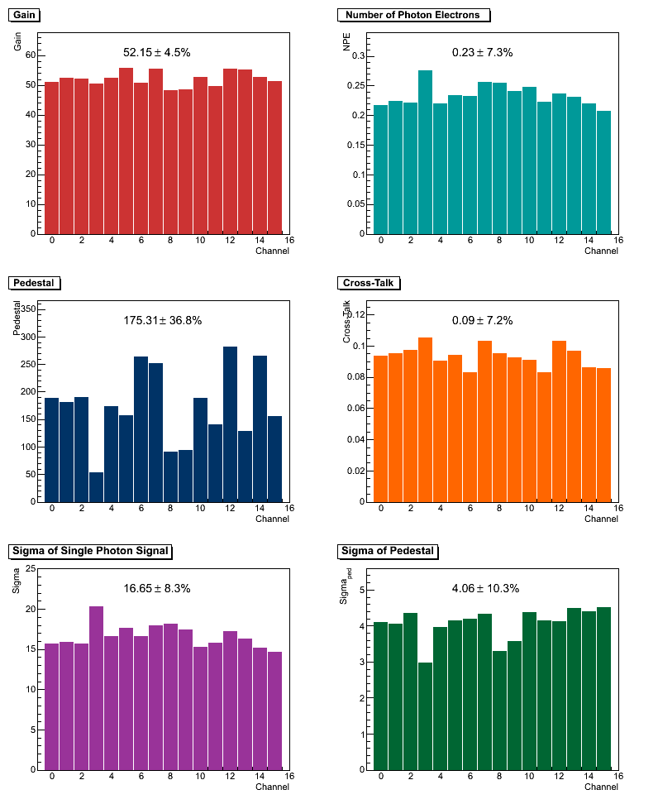
Dark
Spectrum
Gate = 200ns
μ=0.23±7.3%
f = 1.15 MHz

Slide 7
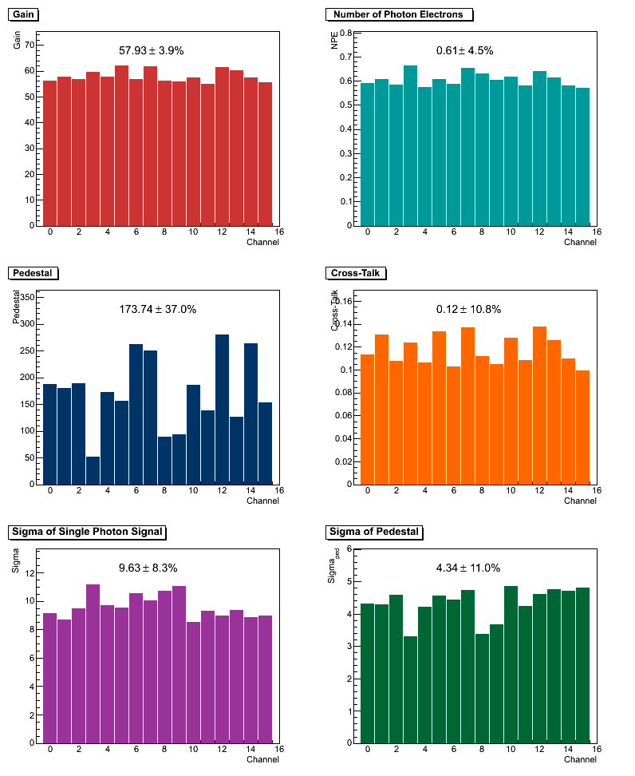
1.6%
Light Input
μ=0.61±4.5%

Slide 8
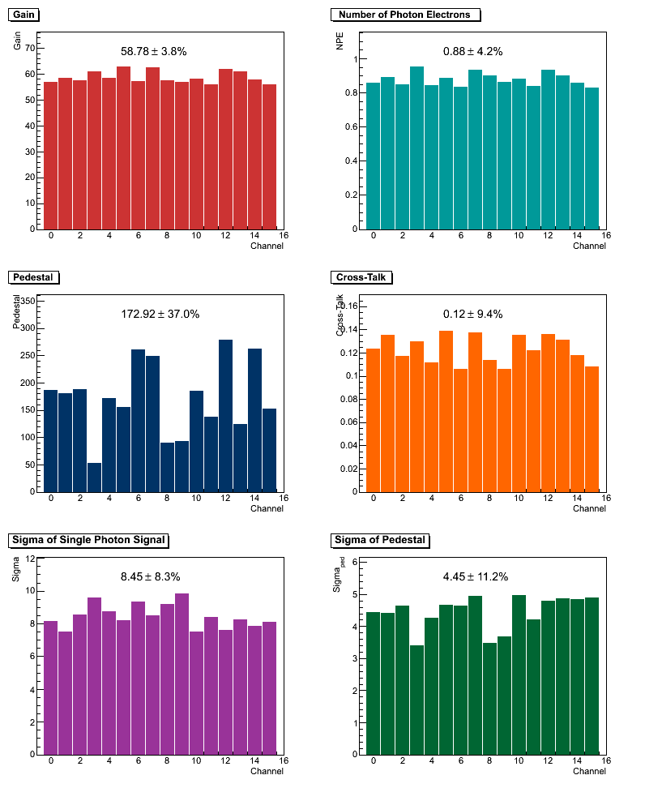
2.7%
Light Input
μ=0.88±4.2%

Slide 9
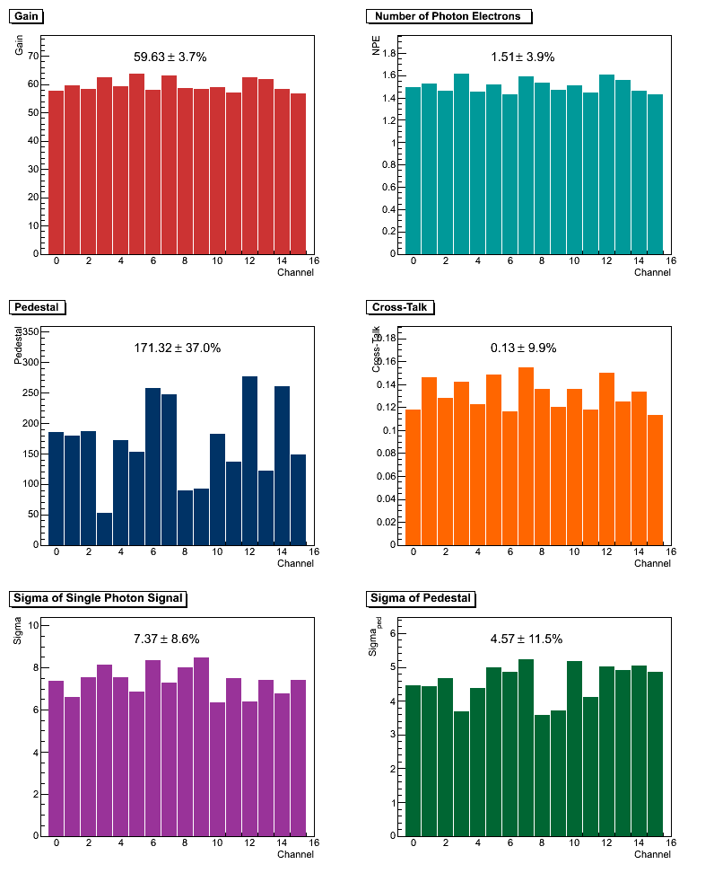
5.3%
Light Input
μ=1.51±3.9%

Slide 10
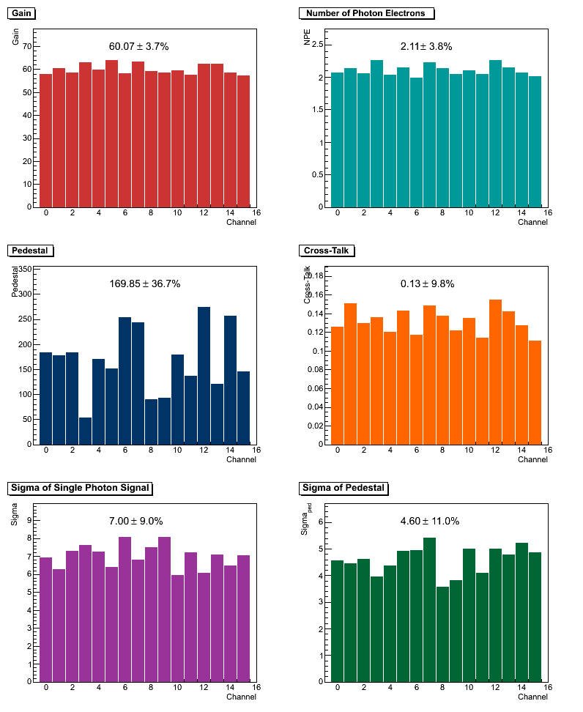
7.8%
Light Input
μ=2.11±3.8%

Slide 11
Light Input | NPE | Gain | Cross-Talk
0 | 0.23 | 52.2 | 0.09
0.016 | 0.61 | 57.9 | 0.12
0.027 | 0.88 | 58.8 | 0.12
0.053 | 1.51 | 59.6 | 0.13
0.078 | 2.11 | 60.1 | 0.13

