Slide 1
Experimental Setup and FEL Interface
Will Williams and Zheng-Tian Lu
Argonne National Lab

Slide 2
Goal: Produce Metastable Krypton using optical fields
Review from this morning:
Currently use an RF discharge source
Poor efficiency
Contamination problem
Replace with optical source
5p[3/2]₂
5p[5/2]₃
819nm
811nm
Cycling
5s[3/2]⁰₁
5s[3/2]⁰₂
123.5nm
4p⁶ ¹S₀

Slide 3
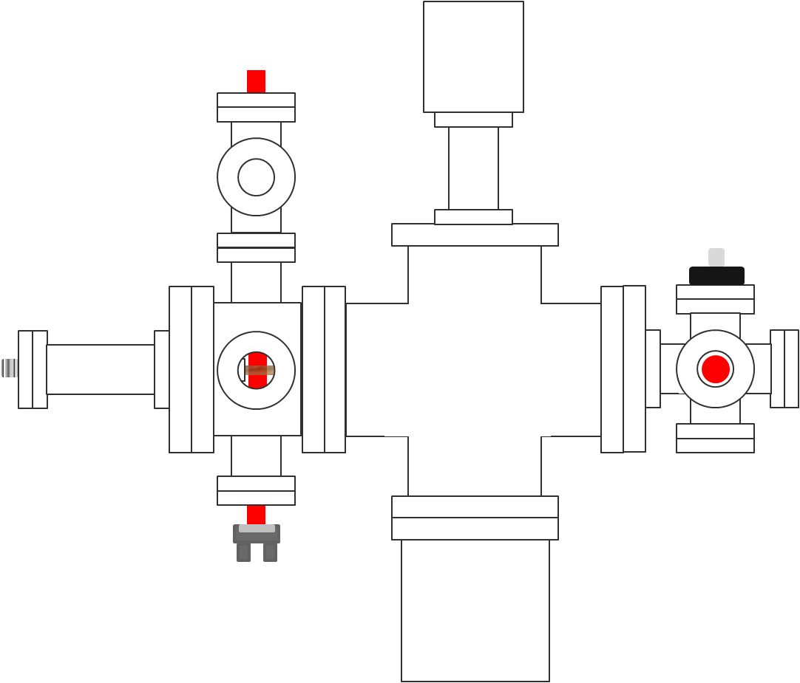
Atomic Beam Line: Side View
Krypton in
26 inches

Slide 4
Atomic Beam Line: Side View
Capillary Plate
(5mm thick; 50μm holes)
Krypton in
Atomic Beam travelling to the right
26 inches

Slide 5
Atomic Beam Line: Side View
5p[3/2]₂
5p[5/2]₃
819nm
(retro-reflected)
819nm
811nm
Cycling
5s[3/2]⁰₁
5s[3/2]⁰₂
123.5nm
Capillary Plate
(5mm thick; 50μm holes)
Krypton in
4p⁶ ¹S₀
FEL light
into slide
Atomic Beam travelling to the right
26 inches

Slide 6
Atomic Beam Line: Side View
819nm
(retro-reflected)
Capillary Plate
(5mm thick; 50μm holes)
Krypton in
FEL light
into slide
Atomic Beam travelling to the right
26 inches

Slide 7
Atomic Beam Line: Side View
819nm
(retro-reflected)
RGA
Capillary Plate
(5mm thick; 50μm holes)
Krypton in
FEL light
into slide
250 L/s
Turbo
Atomic Beam travelling to the right
26 inches

Slide 8
Atomic Beam Line: Side View
5p[3/2]₂
5p[5/2]₃
819nm
(retro-reflected)
RGA
819nm
811nm
Cycling
5s[3/2]⁰₁
5s[3/2]⁰₂
Photo-detector
Capillary Plate
(5mm thick; 50μm holes)
123.5nm
Krypton in
4p⁶ ¹S₀
811nm
into slide
FEL light
into slide
250 L/s
Turbo
Atomic Beam travelling to the right
26 inches

Slide 9
Atomic Beam Line: Side View
819nm
(retro-reflected)
RGA
Photo-detector
Capillary Plate
(5mm thick; 50μm holes)
Krypton in
811nm
into slide
FEL light
into slide
250 L/s
Turbo
Atomic Beam travelling to the right
26 inches

Slide 10
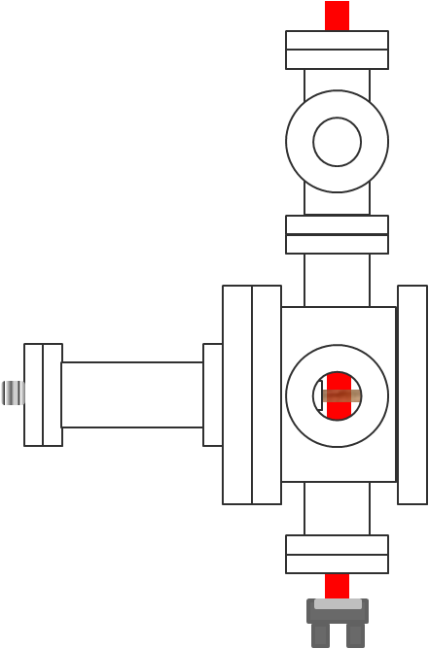
Atomic Beam Line: Side View -> Looking down beam line toward the source
819nm
(retro-reflected)
Capillary Plate
(5mm thick; 50μm holes)
Krypton in
FEL light
into slide
Atomic Beam travelling to the right -> Atomic Beam coming out of slide

Slide 11
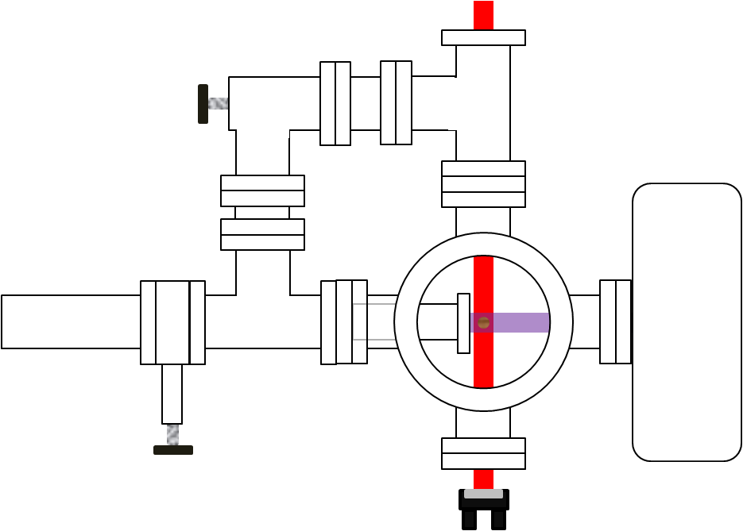
Atomic Beam Line: Looking down beam line toward the source
819nm
(retro-reflected)
Capillary Plate
(5mm thick; 50μm holes)
FEL light
FEL light
Atomic Beam coming out of slide

Slide 12
Atomic Beam Line: Looking down beam line toward the source
819nm
(retro-reflected)
Capillary Plate
(5mm thick; 50μm holes)
MgF Window
FEL light
Custom Flange
FEL light
Atomic Beam coming out of slide

Slide 13
Atomic Beam Line: Looking down beam line toward the source
819nm
(retro-reflected)
Angle Valve
Capillary Plate
(5mm thick; 50μm holes)
MgF Window
Gate Valve
FEL light
Custom Flange
FEL light
Atomic Beam coming out of slide

Slide 14
Atomic Beam Line: Looking down beam line toward the source
819nm
(retro-reflected)
Angle Valve
Capillary Plate
(5mm thick; 50μm holes)
MgF Window
Gate Valve
FEL light
VUV detector
Custom Flange
FEL light
Atomic Beam coming out of slide

Slide 15
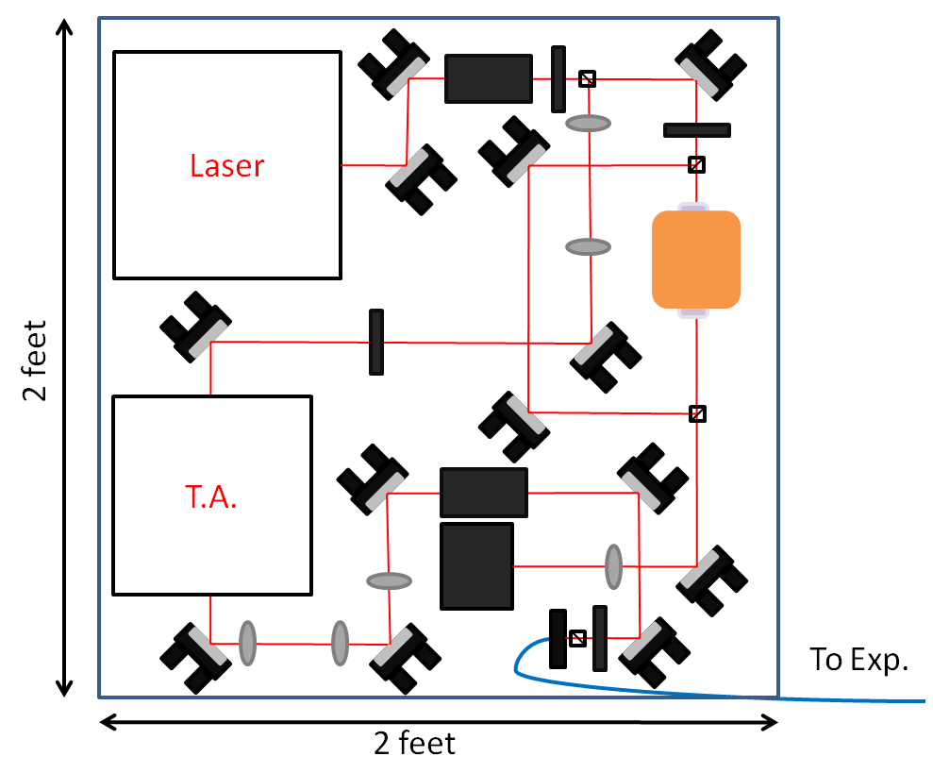
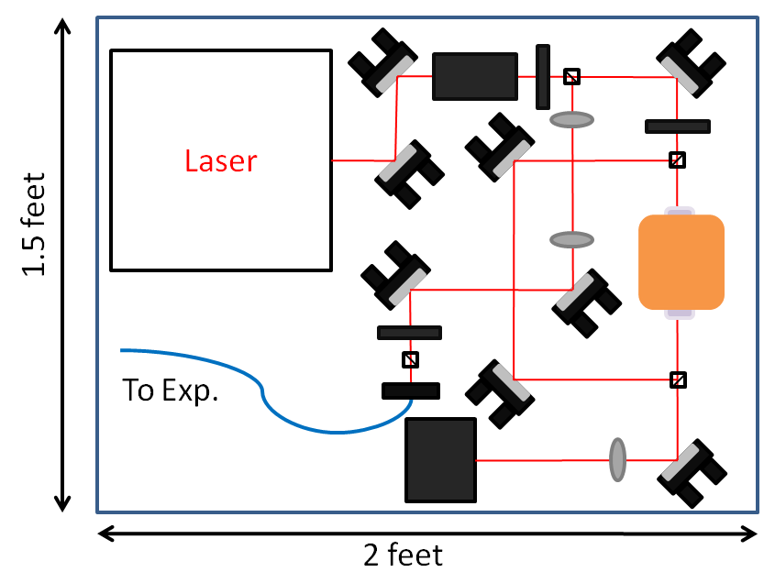
Lasers
819 nm laser setup
811 nm laser setup

Slide 16
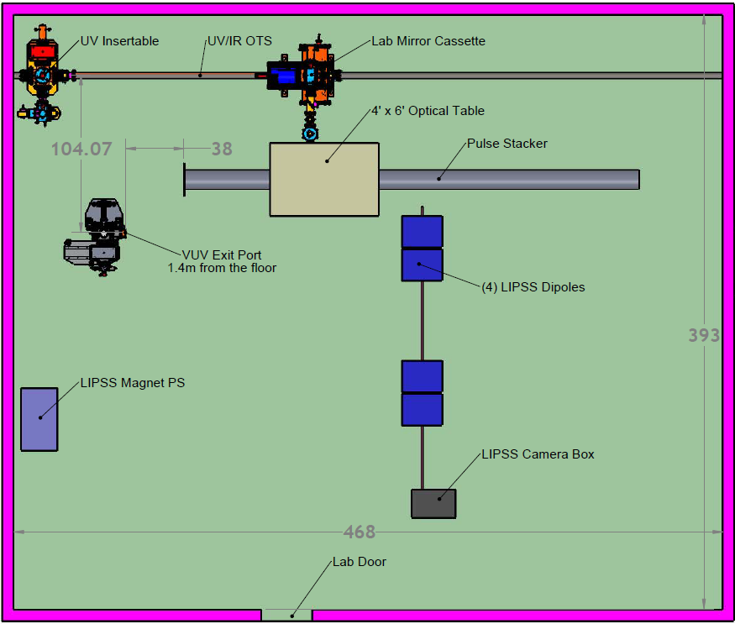
Lab Overview

Slide 17
Lab Overview
Beamline Table
40 inches x 24 inches

Slide 18
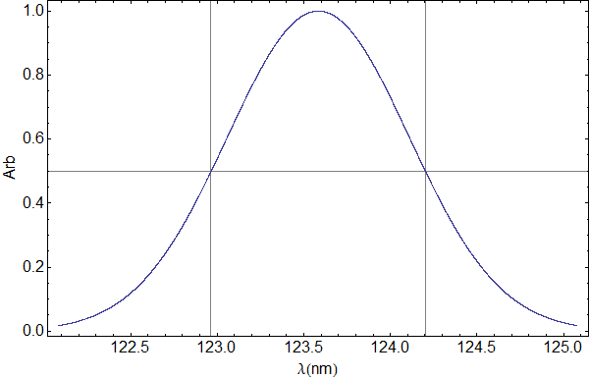
Expectations
1.24nm

Slide 19
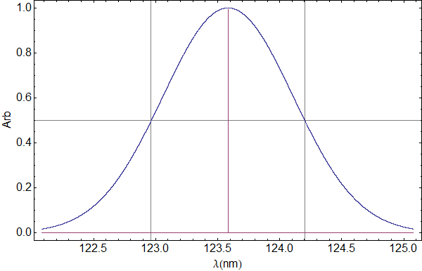
Expectations
γ=312 MHz
(~2.5 fm)
1.24nm

Slide 20
Expectations
Assumes a laser waist of 3.5mm
1.24nm
γ=312 MHz
(~2.5 fm)

Slide 21
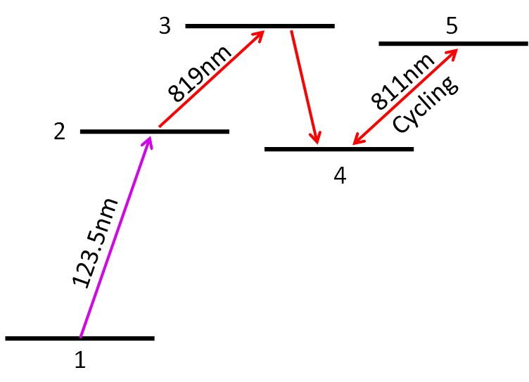
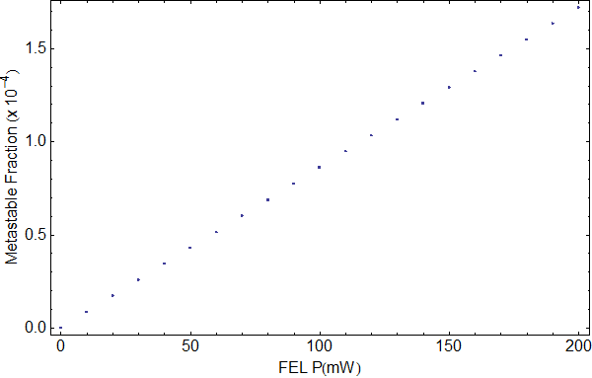
Expectations
Parameters
819 laser | 100x saturation
FEL FWHM | 1.24nm
FEL waist | 3.5mm
t_{Interaction} | 28.5μs

Slide 22
Expectations
1 x 10⁻⁵
Parameters
819 laser | 100x saturation
FEL FWHM | 1.24nm
FEL waist | 3.5mm
t_{Interaction} | 28.5μs
RF Discharge efficiency ~10⁻⁴

Slide 23
Expectations
Expected maximum efficiency | 1 x 10⁻⁵
Expected maximum metastable flux | 1 x 10⁹ atoms/sec/cm²
Detectable flux (fluorescence) | 1 x 10⁸ atoms/sec/cm²
Detectable flux (lock-in) | 1 x 10⁷ atoms/sec/cm²
Detectable flux using a lock-in amplifier is about ~1% of our expected metastable flux.

Slide 24
End of Slideshow

Slide 25
Atomic Beam Line

Slide 27
Lasers
819 nm laser setup
Laser
2 feet
T.A.
To Exp.
2 feet

Slide 28
Lasers
811 nm laser setup
Laser
1.5 feet
To Exp.
2 feet

