Slide 1
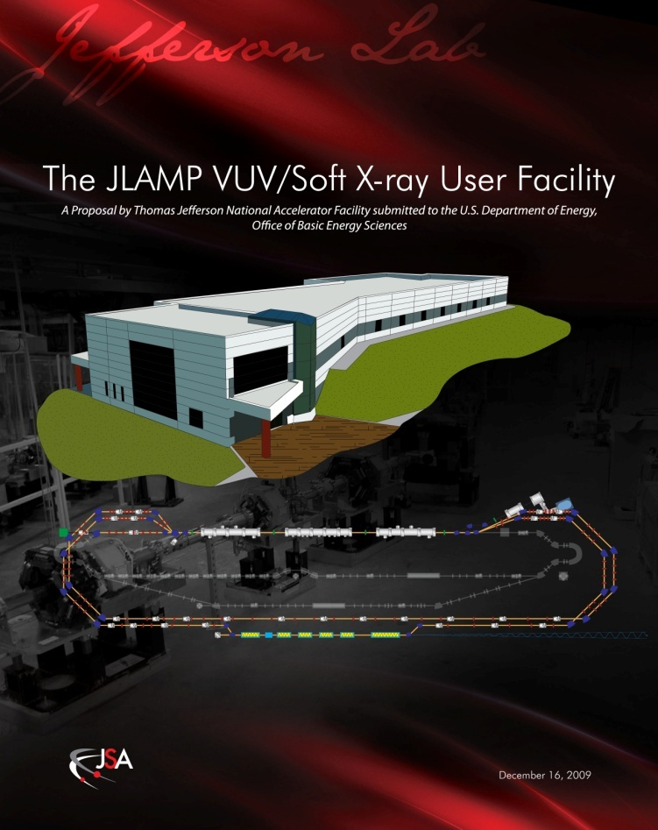
Plans for a VUV Science Program at the FEL
George R. Neil
Associate Director
Jefferson Lab
12000 Jefferson Avenue
Newport News, Virginia 23606
VUV Program Directors Review

Slide 2
Existing JLab IR/UV Light Source
E = 135 MeV
Up to135 pC pulses @ 75 MHz
20 μJ/pulse in (250)–700 nm UV-VIS
120 μJ/pulse in 1-10 μm IR
1 μJ/pulse in THz
The first high current ERL
14 kW average power in IR
Ultra-fast (150 fs)
Ultra-bright

Slide 3
UV Demo Commissioning Timeline
January 2006 - Install and commission Cornell wiggler with new gap mechanism.
Spring and Summer 2009 – Install beamline components except for optical cavity and wiggler chamber.
Fall 2009 – CW beam through UV beamline.
Spring 2010 – Install new zone 3 module and commission.
June 2010 – Lase at 630 nm, 67 pC in IR laser with 135 MeV beam.
July 2010 – Recirculate laser quality 1 mA CW beam through wiggler sized aperture.
August 17, 2010 – First electron beam through wiggler.
August 19, 2010 – First lasing, 150 W CW at 700 nm.
August 31, 2010 – First lasing in UV, 140 W @400 nm, 68 W @372 nm
December 9, 2010 – First measurement of 124 nm light
Notes:
3

Slide 4
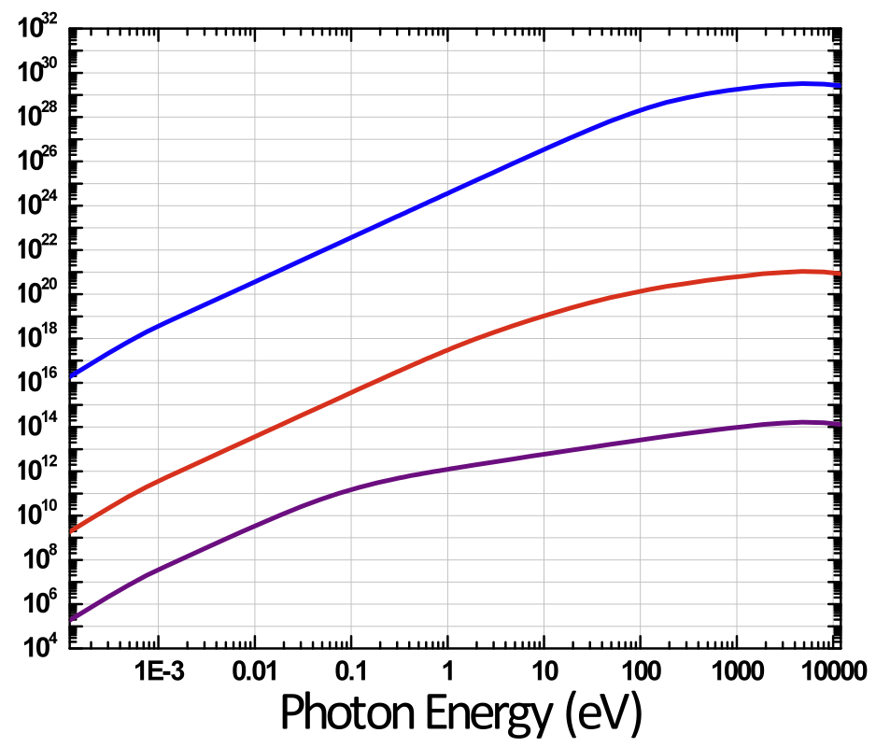
JLab FEL VUV Opportunities
JLab FEL
potential
upgrade path
JLab FEL
Average Brightness
(photons/sec/mm2/mrad2)
harmonics
JLab THz
VUV Output
Work function of metals
Table-top laser limit
Photon Energy (eV)

Slide 5
A Vision for Photon Science at Jefferson Lab
Ultraviolet Laser
(100 mW @ 10 eV)
Today
5 years
Soft X-ray Laser
( 500 eV)
10 years
“Next Generation
Light Source”
(2000 eV X-rays)

Slide 6
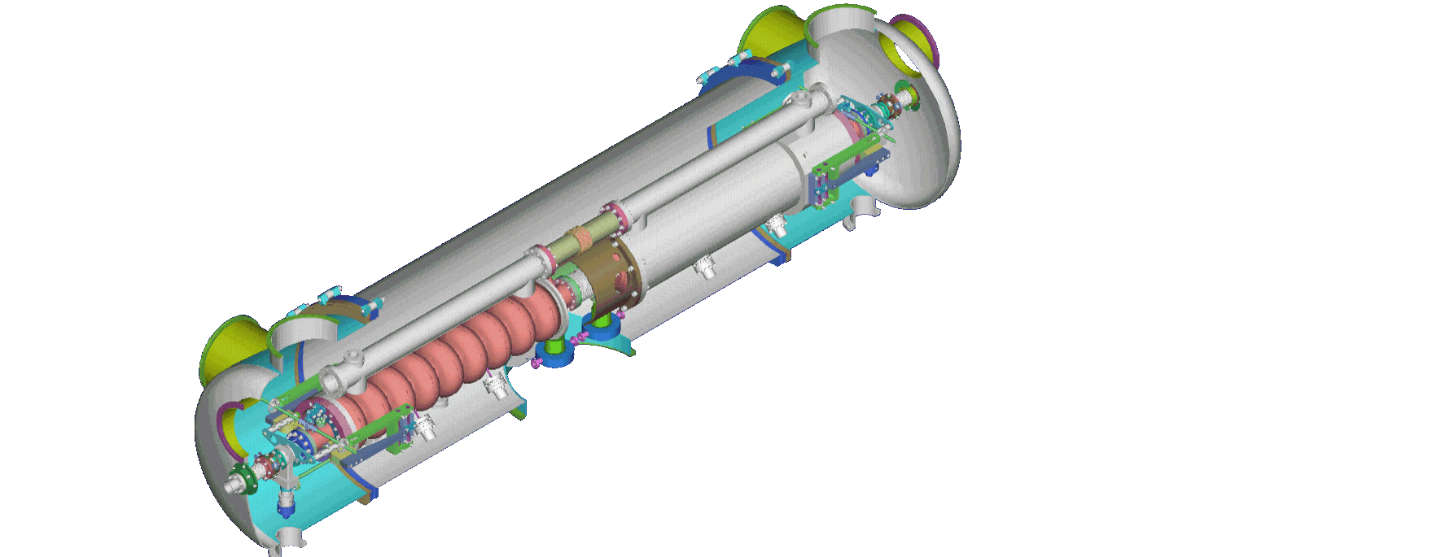
Major components for a high-repetition rate, seeded, VUV–soft X-ray FEL facility
Array of ~10 configurable FELs, each up to 100 kHz bunch rate
Independent control of wavelength, pulse duration, polarization
Each FEL configured for experimental requirements; seeded, attosecond, ESASE, mode-locked, echo effect, etc
Beam
Phase-space manipulation
Beam transport and switching
CW superconducting linac
2.5 GeV, 13 MeV/m
Low-emittance,
MHz bunch rate photo-gun
≤ 1 nC
<1 mm-mrad
Laser systems,
timing & synchronization
~700 m

Slide 7
On-going actions
Plan for VUV Ops
Measure harmonic brightness
Get replacement for Cornell undulator from APS
(now at STI for trimming)
Review user requirements
Reinstall and commission with any required optical transport upgrades
Schedule running late summer/early fall

Slide 8
Backups

Slide 9
BES Grand Challenges
Directing Matter and Energy; 5 Challenges for Science & the Imagination
1. How do we control materials processes at the level of the electrons?
Pump-probe time dependent dynamics
2. How do we design and perfect atom- and energy-efficient synthesis of new forms of matter with tailored properties?
PLD, photo-chemistry, XRS
3. How do remarkable properties of matter emerge from the complex correlations of atomic and electronic constituents and how can we control these properties?
Pump-probe time dependent dynamics, XRS
4. How can we master energy and information on the nanoscale to create new technologies with capabilities rivaling those of living things?
Pump-probe time dependent dynamics, XRS
5. How do we characterize and control matter away -- especially very far away -- from equilibrium?
Non-linear dynamics, ultra-bright sources
Report - Graham Fleming and Mark Ratner (Chairs).
Ultrafast, ultrabright, tunable THz/IR/UV/X-Ray light from next generation light sources

Slide 10
from the announcement:
“ 5 nanoJoules of fully coherent light was measured in each 10eV micropulse, which represents approximately 0.1% of the energy in the fundamental, as expected. These numbers allow us to anticipate being able to deliver 25 - 100 mW by operating CW at up to 4.687 MHz with more optimized water-cooled optics, and several 100's of mW with cryogenically-cooled optics. Optics upgrades, and installation of an optical transport beamline to a user laboratory for full characterization, including bandwidth, are in progress. We note that for many applications the anticipated narrow bandwidth eliminates the need for a spectrometer. This allows substantially higher flux to be delivered to user experiments than is possible at storage rings. “

Slide 11
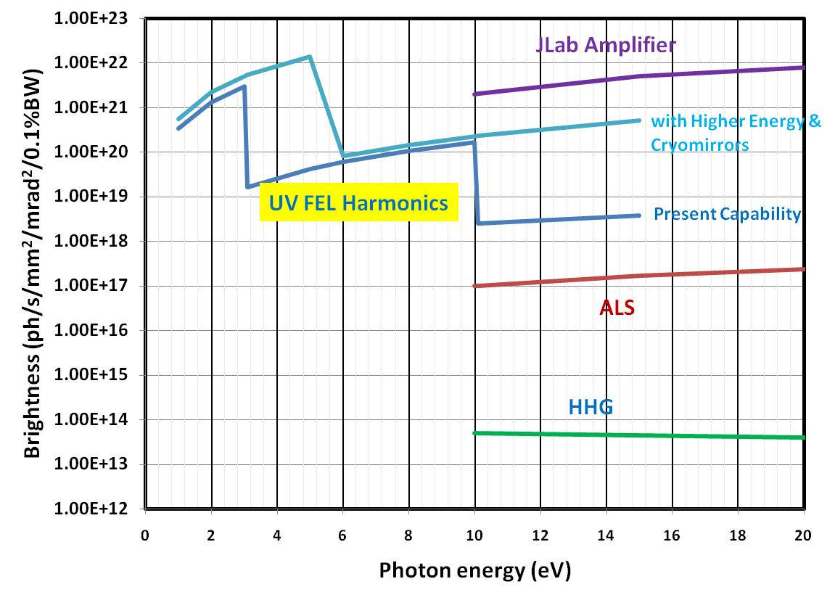
Wavelength (nm)
600 300 200 150 120 100 88 77 68 62

Slide 12
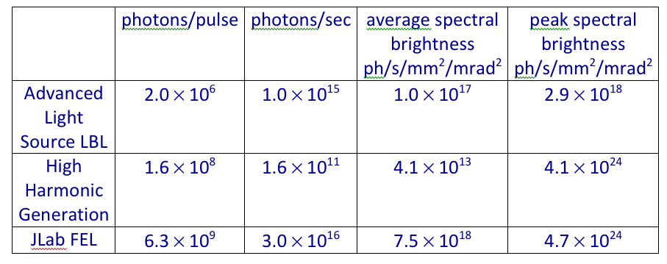
Real Numbers
Jefferson Lab appears to have an advantage of 75, but the ALS requires a monochromator, which has a transmission of 10% at most.
Jefferson Lab could also increase repetition rate by factor of 16 with optics cryo-cooling
So – potential gain of JLab FEL in near-future could be 3-4 orders of magnitude.
- above table is for 10 eV photon energy, 0.1% bandwidth
- assumes JLab FEL at 4.7 MHz, 230 fs FWHM

Slide 13
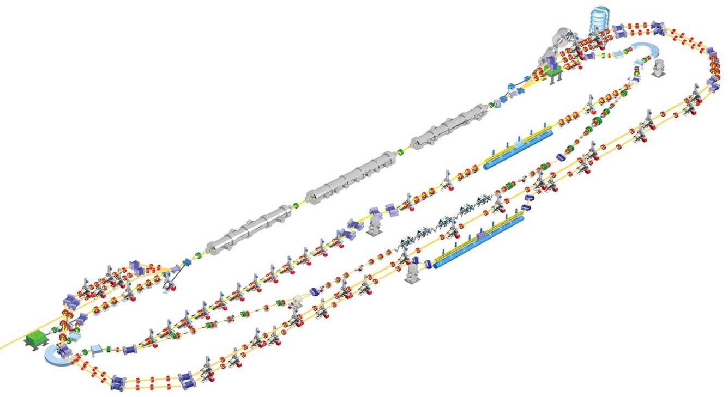
JLAMP FEL designed for unparalleled 10-100 eV average brightness
600 MeV, 2 pass acceleration
200 pC, 1 mm mrad injector
Up to 4.68 MHz CW repetition rate
Recirculation and energy recovery
10 nm fundamental output, 10 nm/H harmonic
50 fs-1000 fs near-Fourier-limited pulses
Baseline: seeded amplifier operation using HHG
HGHG amplifier + oscillator capability
THz Wiggler for synchronized pump/probe

Slide 14
CW operation gives high average brightness in both fundamental and harmonics
NLS
JLAMP
XFEL
JLAB-UV FEL
JLAMP harm
LCLS
4th Gen
UV harm
FLASH
JLAB-THz
Infrared FELs
3rd Gen
2nd Gen

