Slide 1
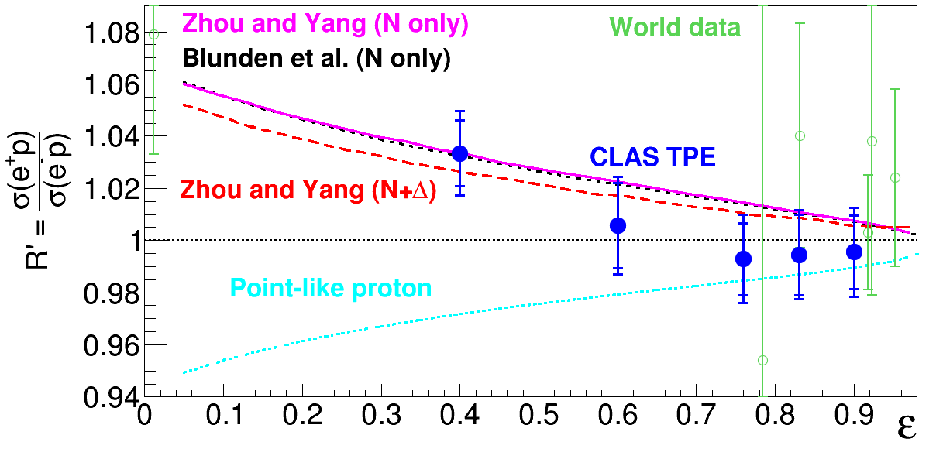
Exploring Proton Structure with Electrons and Positrons
The proton electric form factor G_{E}^{p}, describes the proton charge distribution.
There is a discrepancy between G_{E}^{p} measurements with polarized and unpolarized electrons.
A mixed electron and positron beam was produced in Jefferson Lab’s Hall B. Complementary experiments at VEPP-3 at Novosibirsk and OLYMPUS at DESY used sequential beams.
The scattered electron or positron and struck proton were detected in the CEBAF Large Acceptance Spectrometer.
Unpolarized Measurements
Polarized Measurements
The e⁺p and e⁻p cross section ratio versus
virtual photon polarization ε at Q² = 1.5 GeV².
This big discrepancy is possibly due to two photon exchange, which can’t be calculated exactly.
Comparing electron and positron scattering off protons directly measures the two photon exchange correction.
The positron to electron (e⁺p/e⁻p) ratios agree with hadronic two photon exchange calculations, which would resolve the proton form factor discrepancy up to Q² ~2.5 GeV². This also has relevance for the proton radius extraction.
D. Adikaram et al. (Jefferson Lab CLAS Collaboration), Phys. Rev. Lett. 114 062003 (2015).
DOI: http://dx.doi.org/10.1103/PhysRevLett.114.062003

