Slide 1
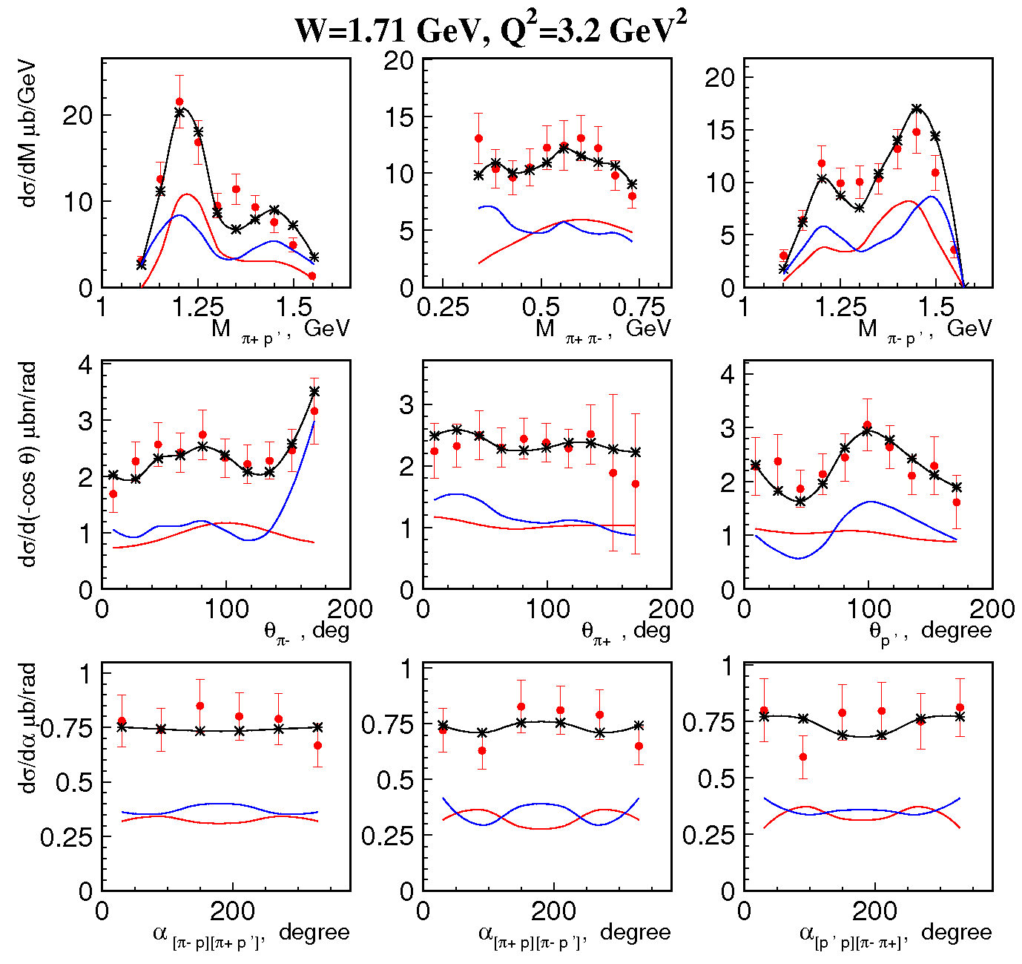
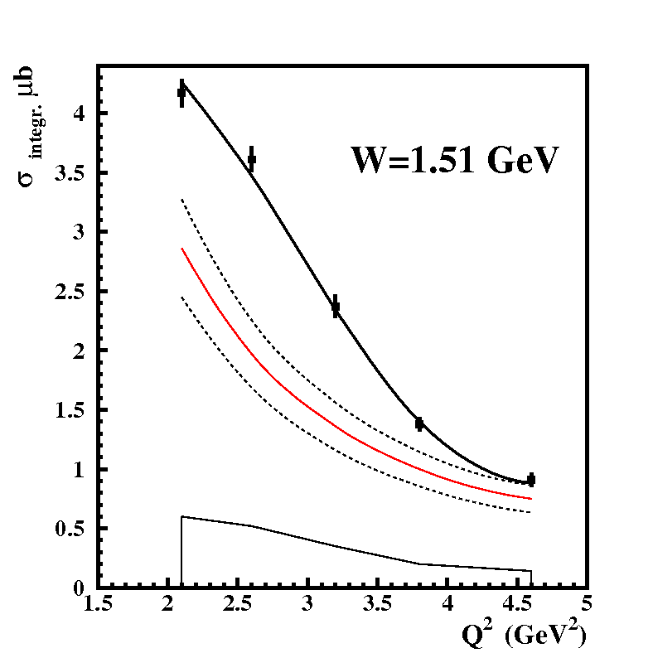
Measurements of ep → e’pπ⁺π⁻ Cross Sections with CLAS at
1.40 GeV < W < 2.0 GeV and 2.0 GeV² < Q² < 5.0 GeV²
Fully integrated π⁺π⁻p electroproduction cross
sections off protons
E.L. Isupov, V.D. Burkert, D.S. Carman, R.W. Gothe, K. Hicks, B.S. Ishkhanov, V.I. Mokeev and CLAS Collaboration, Phys. Rev C 96, 025209 (2017)
Description of nine
1-fold differential cross
sections within JM17
model:
Full JM17
N(1685)5/2⁺,Δ(1700)3/2⁻,
N(1740)3/2⁺,N’(1720)3/2⁺
Non-resonant
contributions
N(1440)1/2⁺
N(1520)3/2⁻
Resonant
contributions
First results on nine independent 1-fold differential and fully integrated π⁺π⁻p cross sections in this W/Q² domain
Successful data description with JM17 model should allow extraction of most resonance electrocouplings for Q² from 2.0 - 5.0 GeV² for the first time and for validation of new baryon states
Relative growth of resonant contributions with photon virtualiity Q² emphasizes the capabilities of obtaining resonance electrocouplings in the full Q²-range covered by the measurements
Full π⁺π⁻p integrated
cross section
Resonant contribution
and its uncertainties

