Slide 1
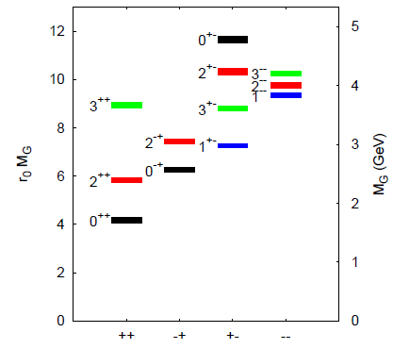
Scalar mesons and glueballs from CLAS
f₀ → K_{S}⁰ K_{S}⁰
Clear coincidence K_{S}⁰ K_{S}⁰
There are 4 isoscalar states identified by experiment: f₀(980), f₀(1370), f₀(1500) and f₀(1710)
There are only 2 slots for the f₀ states in the quark model
Mass(π₂⁺ π₂⁻)
f₀(1500)
Mass(π₁⁺ π₁⁻)
Result: The f₀(1500) has a strong t-channel coupling to the photon, suggesting it does NOT have a significant glueball mixing.
Lattice glueball mass

Slide 2
Double-K_{S}⁰ Photoproduction at CLAS
Ref: S. Chandavar et al. (CLAS) Phys. Rev. C 97, 025203 (2018).
Reaction: γ p → K_{S}⁰ K_{S}⁰ p → (π⁺ π⁻) (π⁺ π⁻) p
Motivation: search for a f₀ meson → K_{S}⁰ K_{S}⁰, which has definite CP = ++.
The scalar mesons (f₀) can mix with the J^{PC} = 0⁺⁺ glueball (lowest mass).
The glueball has no charge, giving a weak coupling to the photon.
CLAS data shows a clear peak for the f₀(1500) with t-channel production.
The paper shows f₀(1500) for various cuts on Mandelstam variable t.
Angular distributions are consistent with J=0 decay of f₀ → K_{S}⁰ K_{S}⁰.
Result: The f₀(1500) has strong photo-coupling, so it is likely to have small mixing with the glueball. Hence the f₀(1710) is likely mixed with the lowest-mass glueball state (0⁺⁺). Further data from CLAS12.

