Slide 1
Hadronization and Color Transparency with CLAS
Hovanes Egiyan
Jefferson Lab
for the CLAS Collaboration
Material provided by:
Kawtar Hafidi
Lamiaa Elfassi
Raphael Dupre
Aji Daniel
Taisia Mineeva

Slide 2

Overview
Overview
Hadronizaton in cold nuclear matter
Recent data from CLAS
Color Transparency
Recent CLAS results on $ρ^{0}$ electroproduction
Summary and Outlook

Slide 3
SIDIS on Nuclear Targets

Slide 4


Hadronization in Nuclei
quark/parton
prehadron
hadron
t
production time t_{p}
col. neut. time t_{cn}
formation time t_{h}
Study of the hadronization :
  Process through which partons produced in elementary reactions are turned into hadrons.
  Non perturbative QCD process.
The presence of cold nuclear matter affects the hadronization process.
Use nuclei as space-time analyzers in nuclear SIDIS
  Kinematics is more constrained
  Nuclear medium is understood
  Nucleons serve as femto-detectors
  Low final state multiplicity compared to h+A or A+A

Slide 5
Motivation for Experiments
Space-time evolution of hadronization
  Study QCD confinement
  Evaluating parton energy loss in QCD medium
  Possible signatures of the LPM effect
  Measuring the formation times
  Understanding pre-hadron structure
  Multiple scattering inside nuclei
Benefits for other fields
  Input for studies of A+A scattering
  Hadron attenuation corrections for ν oscillation experiments
  Constraints for Monte-Carlo generators

Slide 6
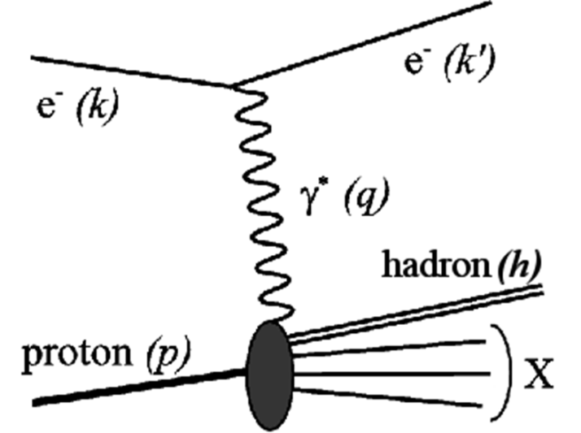

Variables and Observables
Reaction is fully defined by 5 variables :
  $Q2=−4EE^{′}sin2\frac{θ}{2}$ , $ν=E−E^{′}$ ,
  $z=\frac{k∙p}{q∙p}=\frac{Eh}{ν}$ , $\vec{Pt}=\vec{Ph}−\frac{\vec{Ph}∙\vec{q}}{∥q∥}\vec{q}$
Multiplicity Ratio for hadrons:
  $$R_{A}^{h}\left(Q^{2}, xB, z, PT\right)= \frac{N_{A}^{h}(Q^{2}, xB, z, PT)/N_{A}^{e}(Q^{2}, xB)}{N_{D}^{h}(Q^{2}, xB, z, PT)/N_{D}^{e}(Q^{2}, xB)}$$
Transverse Momentum Broadening (P_{T} -broadening)
  $$ΔP_{T}^{2}=\left\langle P_{T}^{2}\right\rangle A −\left\langle P_{T}^{2}\right\rangle D$$
A

Slide 7
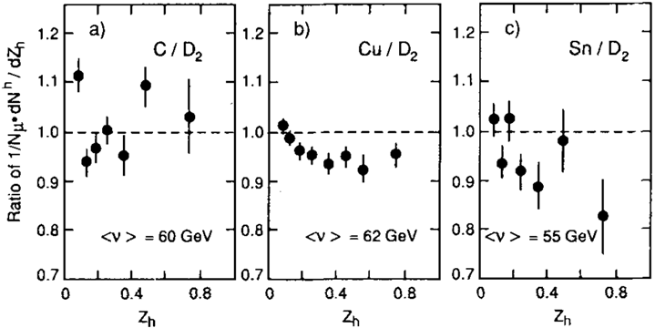
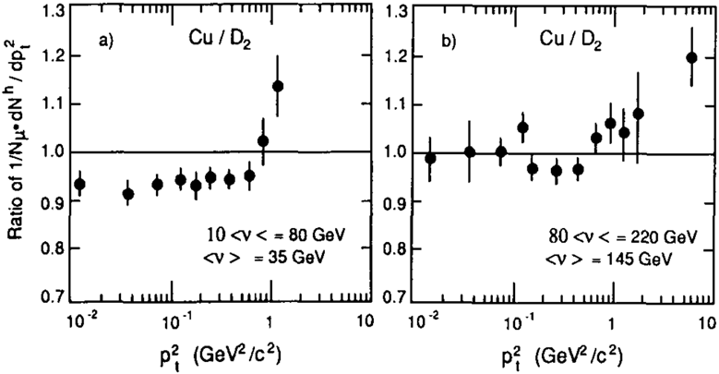
EMC Multiplicity Ratios
Ashman et al., Z.Phys. C52(1991)
Studied hadron production in DIS with muon beam.
  20 GeV < ν < 220 GeV
Increased attenuation as a function of z_{h} observed for heavier nuclei.
Attenuation decreases as a function of ν (not shown).
High transverse momentum bins have increased hadron production
Attenuation is reduced at high ν > 50 GeV.
Partonic energy loss and hadronic attentuation type models can explain these observations.

Slide 8
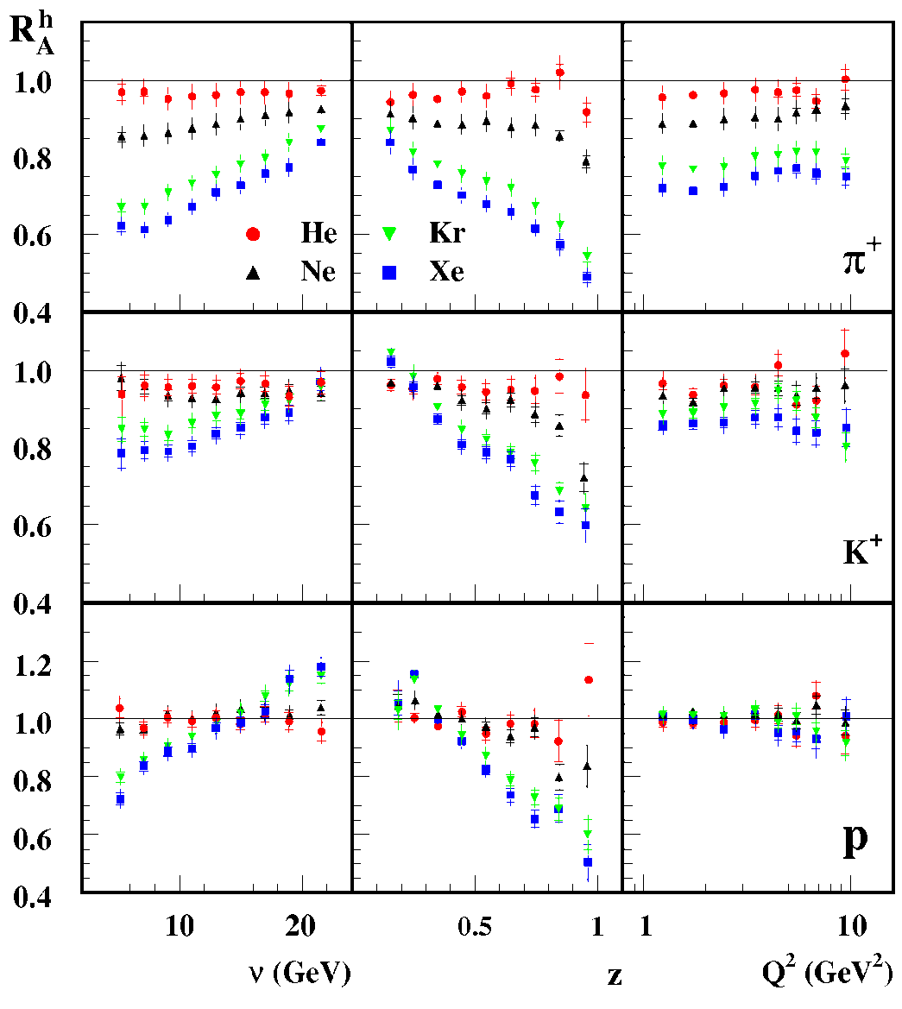
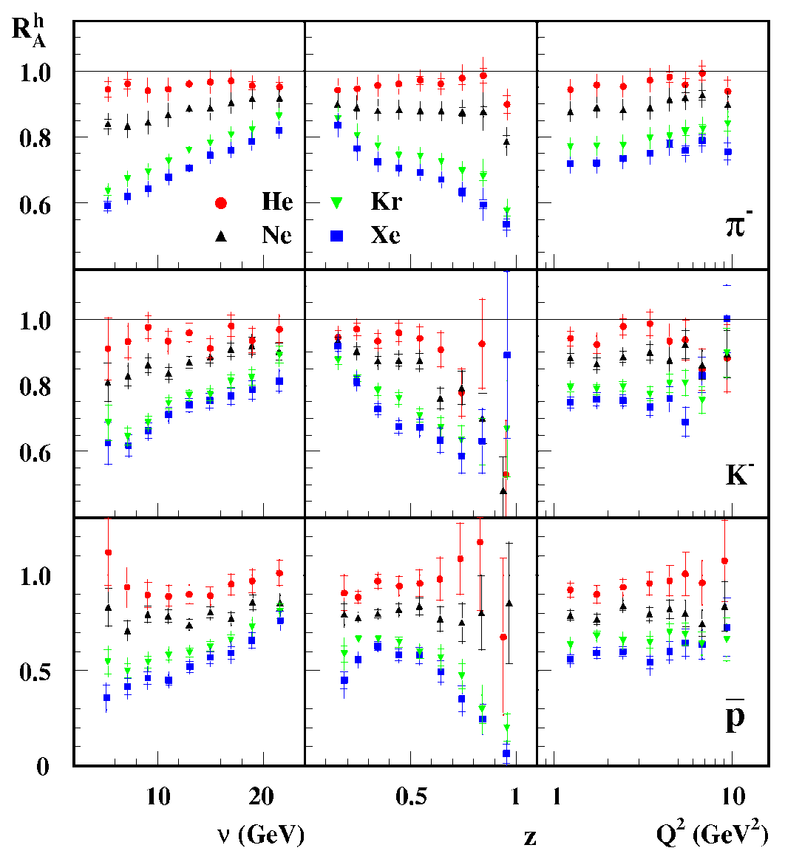
HERMES: Multiplicity Ratios
Airapetian et al., Nucl. Phys. B780 (2007)

Slide 9
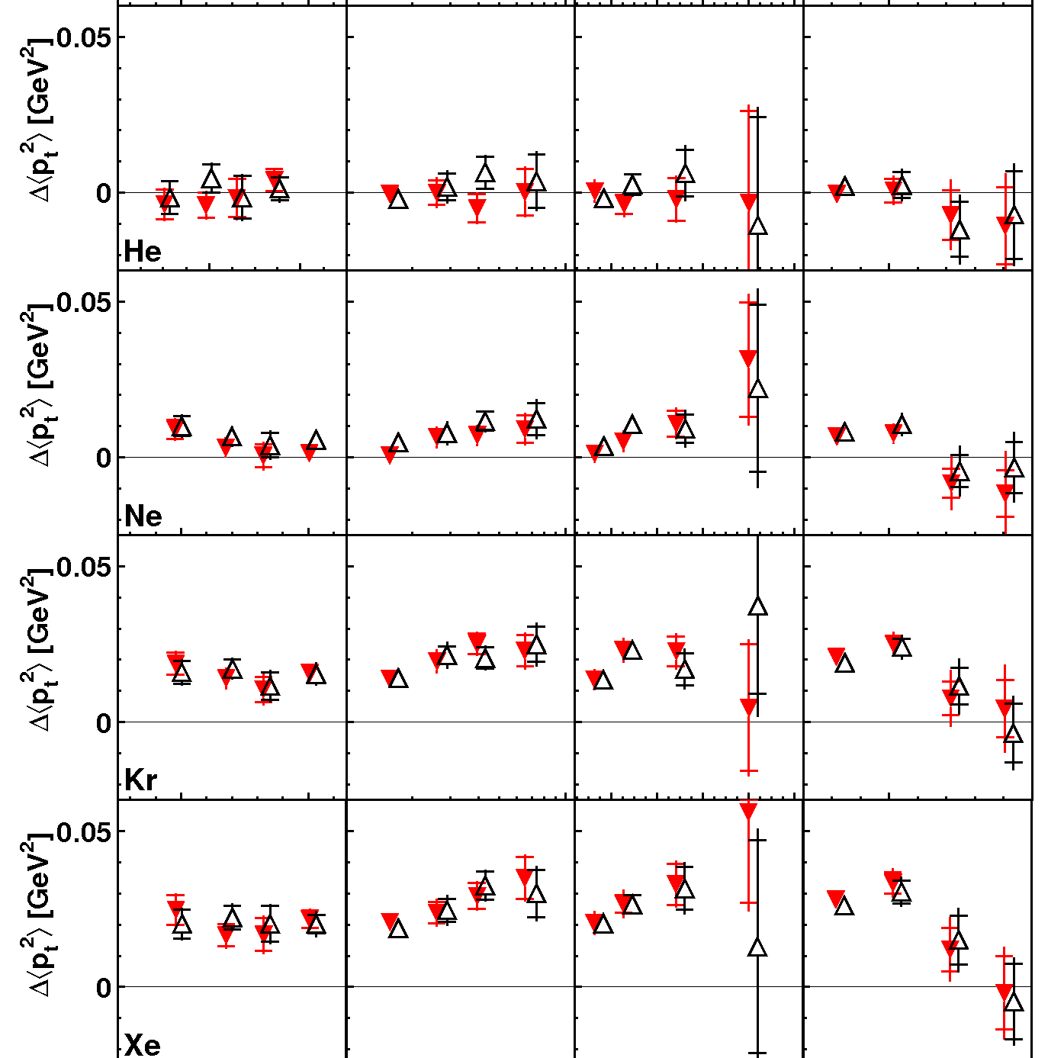
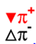
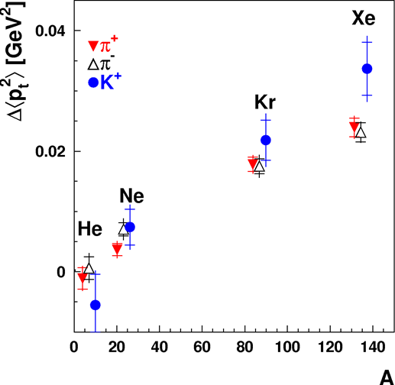
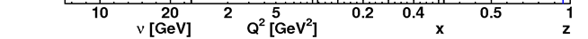

HERMES: $PT$ Broadening
Airapetian et al., Phys.Lett. B684 (2010)
Effect increases with Q² and x_{B}
Goes to 0 near z=1.
  Not due to multiple scattering of prehadrons or hadrons
Mostly independent of ν.
Broadening effect increases with A.
  Can’t determine the functional form.

Slide 10

HERMES
Substantial attenuation increases with atomic number A.
  Quark energy loss or hadronic absorption.
Difference in $R_{A}^{h}$ for K⁺ and K⁻, while not much difference between pions.
  Different type of valence quarks.
Substantial nuclear attenuation observed as a function of kinematic variables ν, z, p_{T}² and Q².
Increase of $R_{A}^{h}$ versus ν can be due to the
  increase of the formation length with higher ν
  partonic energy loss independent of energy.
Decrease in $R_{A}^{h}$ versus z can be explained by
  shift in z due energy loss by partons and the z-dependence of FF;
  absorption over a shorter formation length.
Broadening of p_{T}² due to re-scattering, enhanced multiplicity ratios at large p_{T}², as observed in p-A scattering and heavy-ion collisions.
Detailed two-dimensional studies of the nuclear attenuation is performed as functions of ν and z, scaling with L_{c}.
Formation length dependence of the nuclear attenuation has been studied.
More statistics, more channels and multidimensional binning is needed.

Slide 11
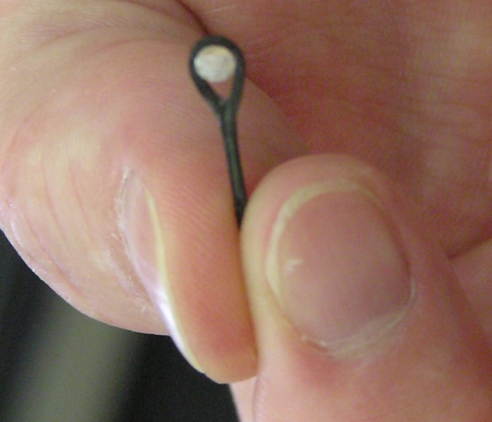
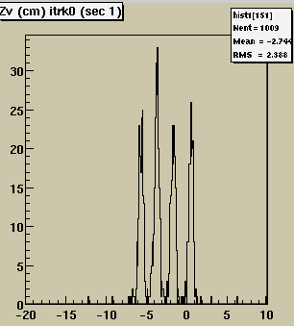
CLAS EG2 Run
Electron Beam 5 GeV (50 days) & 4 GeV (7days)
Targets: ²H&Fe, ²H&C, ²H&Pb
Luminosity ~ 2x10³⁴ cm⁻²s⁻¹
Hakobyan et al, NIM A592 (2008)
Al + MT target
BEAM

Slide 12
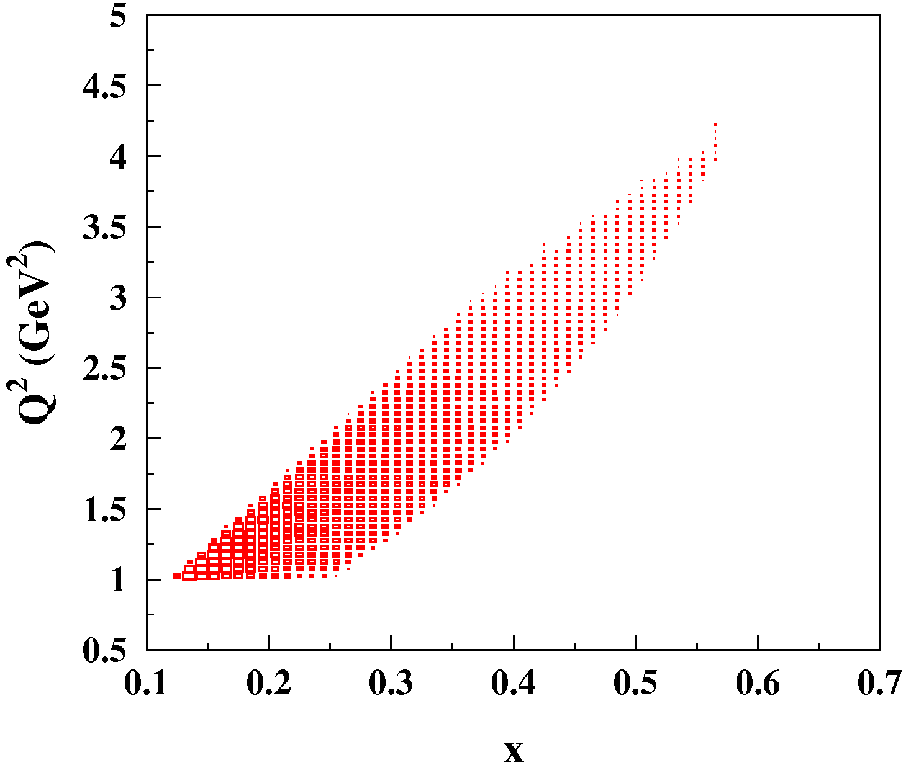
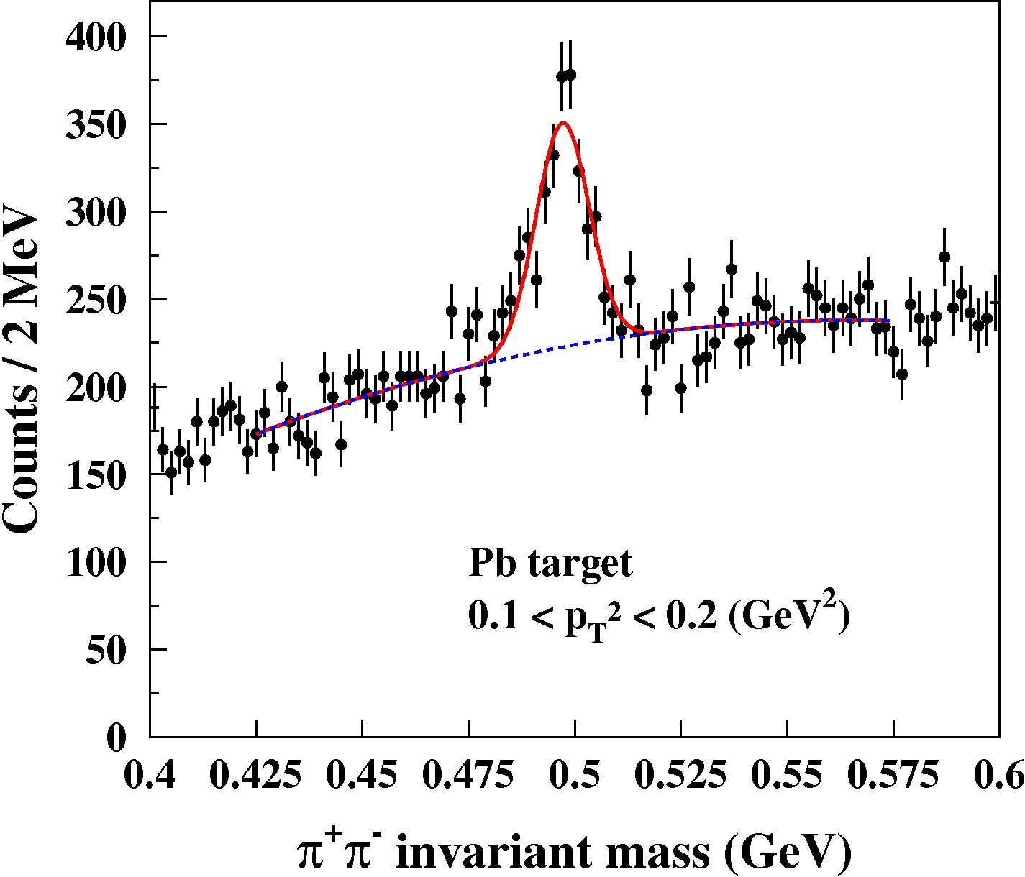


CLAS $K_{s}^{0}$Analysis
Daniel et al., Phys.Lett. B706 (2011)
$Q^{2}>1$ GeV² , $W>2$ GeV
  To select DIS kinematics
$y=\frac{υ}{E}<0.85$
  to avoid regions with large Rad. Corrections.
$K_{s}^{0}$–s are found using π⁺π⁻ pairs.
Kaon yields are extracted by fitting the yields for $K_{s}^{0}$–s in 0.425 < $Mππ$< 0.575 GeV.
Acceptance corrections are estimated using PYTHIA generator
Radiative effects are part of systematic uncertainties.

Slide 13
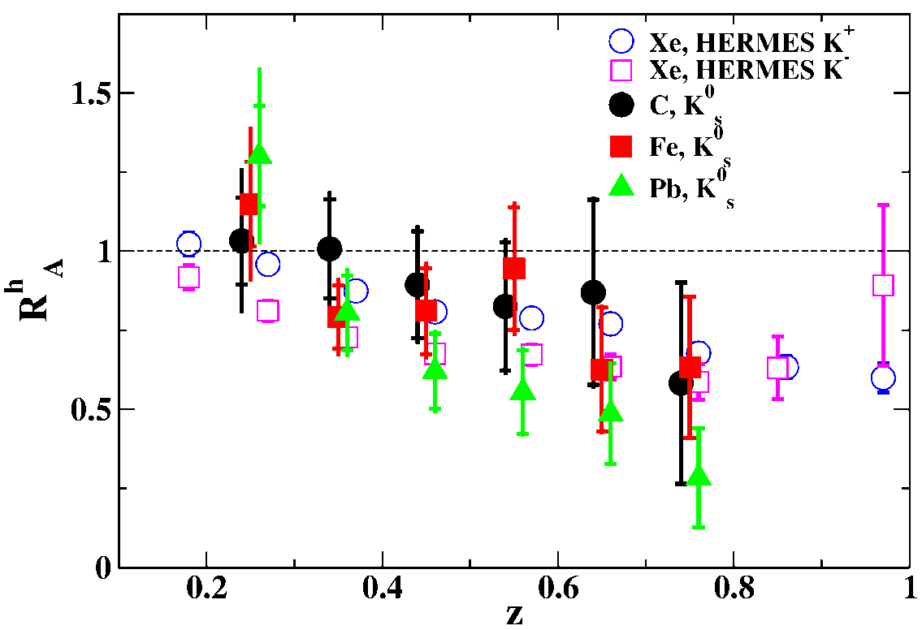
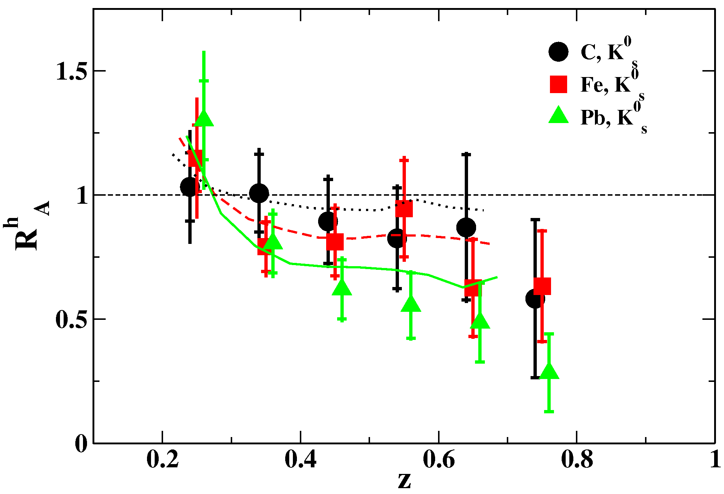
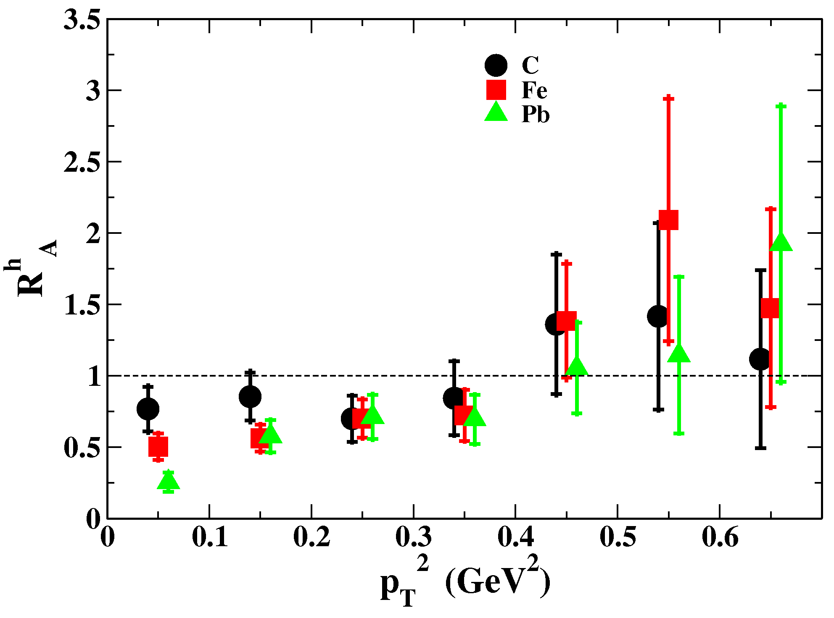


CLAS $K_{s}^{0}$ Results
Daniel et al., Phys.Lett. B706 (2011)
0.3 < z < 0.8
The trend in z-dependence is similar to that of HERMES data on charged kaons.
GiBUU model describes the new CLAS data.
$ΔP_{T}^{2} dependence show clear target dependence for ΔP_{T}^{2}<0.2$ GeV².
Hint of Cronin effect.

Slide 14
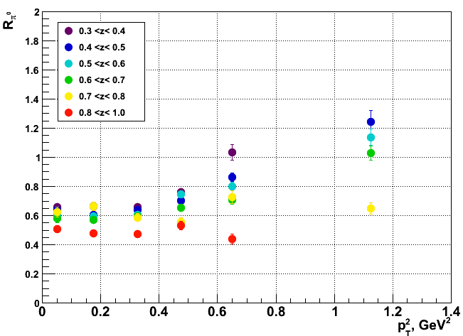
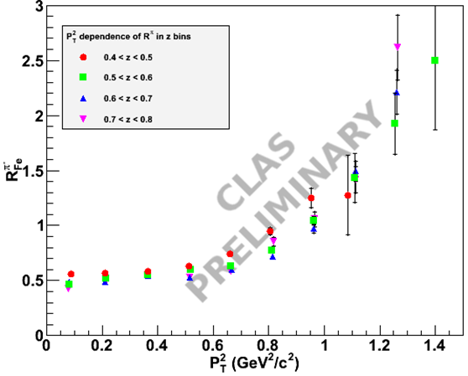
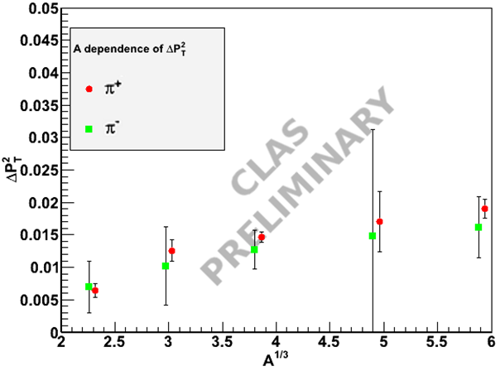

CLAS Pion Results
R. Dupre
π⁰
Mineeva
CLAS
PRELIMINARY
π⁻
Dupre
Data on π⁺, π⁻, π⁰, K⁺ will be finalized in the near future.
Very high statistical accuracy of the pion data allowing multidimensional binning
Cronin effect can be seen in $R_{A}^{h}$
$ΔP_{T}^{2} i$ncreasing with A, indication of saturation.
Data analysis needs to finalized.
π⁻, π⁺
Dupre, Hakobyan

Slide 15
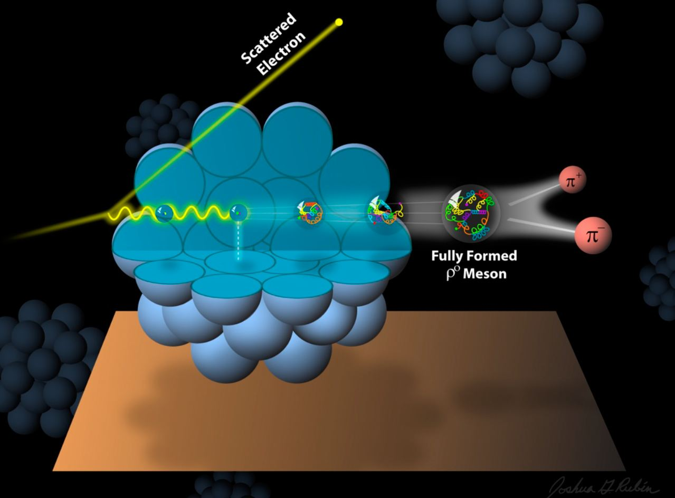
Color Transparency

Slide 16

Color Transparency
Color Transparency is the decrease of the strong interaction for Small Size Configurations (SSC).
Conditions for observing CT:
  Creation of SSC, for instance in process with high momentum transfer.
  Reduced strong interaction for SSC as it develops into the hadron.
  Long enough hadron formation time (compared to the size of the nuclear medium).
Measuring the nuclear transparency versus momentum transfer is a way of observing CT.
  High momentum transfer can pick the states with small transverse size (SSC).
  The SSC will interact with the nucleons with smaller dipole-like cross section $σ\sim b^{2}$
  The size of the nucleus should not be larger than the formation time $tf=\frac{2υ}{M^{′2}−M2}$

Slide 17
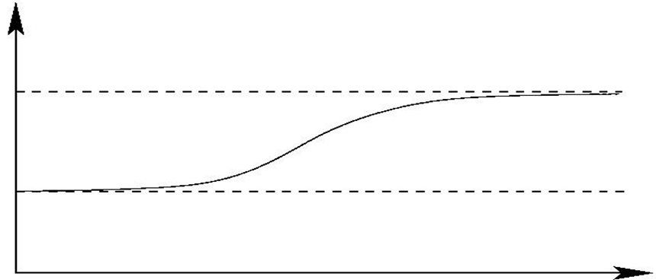

Measuring CT
Why study CT?
  CT is predicted by QCD
  CT is related to the factorization theorem for exclusive processes.
  Study creation of SSC.
  Study the hadronization process
Measure nuclear transparency transparency $TA= \frac{σA}{AσN}$ vs Q² for
  Quasielastic A(e,e’p)
  Scaler meson elctroproduction A(e,eπ)
  Vector meson electroproduction A(e,e’ρ)
T_{A}
Complete Transparency
1.0
Glauber
0.0
Momentum Transfer

Slide 18
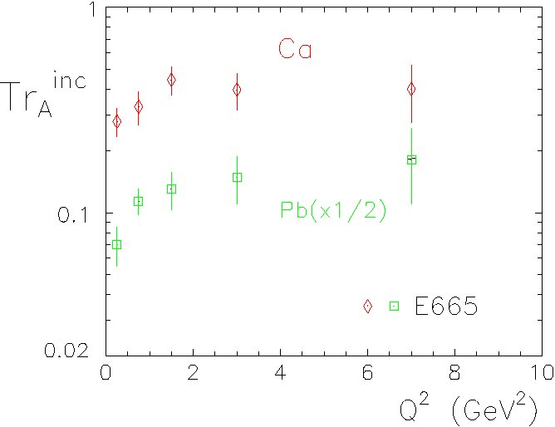
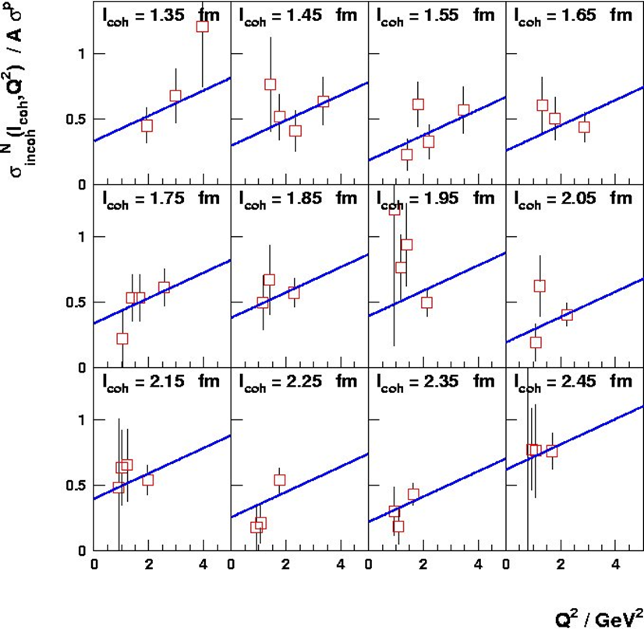
Experimental Data on CT
Quasi-elastic A(p,2p) [Brookhaven]
  A. Leksanov et al. , PRL (2001)
Quasi-elastic A(e,e’p) [ SLAC and JLab]
  N. C. R. Makins et al. PRL 72 (1986)
  G. Garino et al. PR C45 (1992)
  D. Abbott et al. PRL 80 (1998)
  K. Garrow et al. PR C66 (2002)
Di-jets diffractive dissociation. [Fermilab]
  E. Aitala et al, PRL 86 (2001)
Pion Production ⁴He(γ,pπ⁻) [Jlab –HallA]
  Dutta et al, PR C68 (2003)
Pion Production A(e,e’π⁺) [Jlab-HallC]
  Classie et al, PRL 99 (2007)
ρ⁰ lepto production. [Fermilab, HERMES]
  Adams et al., PRL 74, (1995)
  Airaptyan et al., Phys. Rev. Lett. 90 (2003) 052501
ρ⁰ lepto production [ JLab - CLAS ]
  El Fassi et al, Phys. Lett. B712 (2012)
FERMILAB ρ
HERMES ρ
Q² (GeV²)

Slide 19
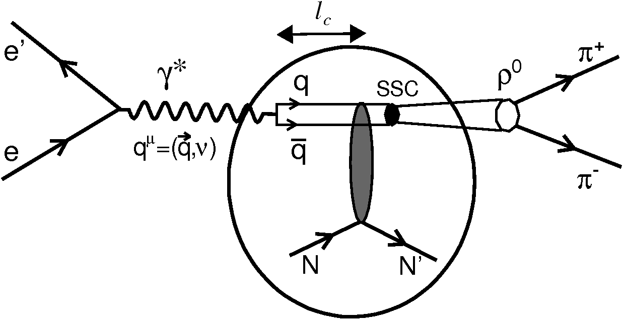



CT in $ρ0$ with CLAS
$ρ^{0}$ has the same quantum numbers as γ
It should be easier to form SSC with two quarks.
VMD production mechanism is well understood
Coherent length $lc=\frac{2υ}{Q^{2}+M_{ρ}^{2}}$ fluctuation distance of $q\overline{q}$

Slide 20
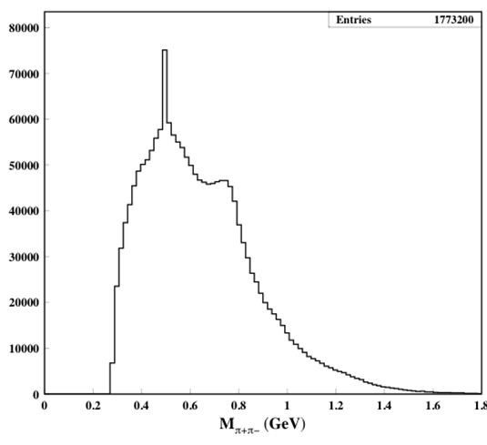
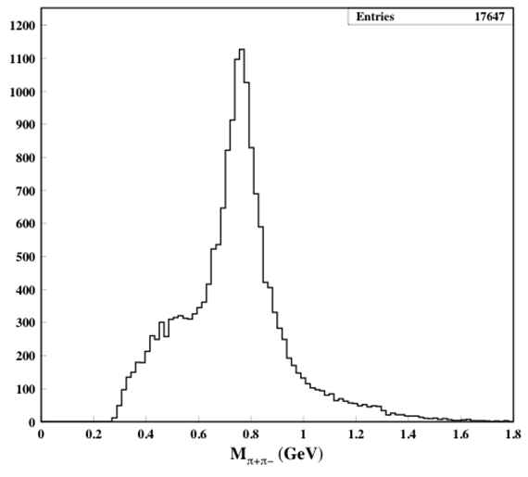
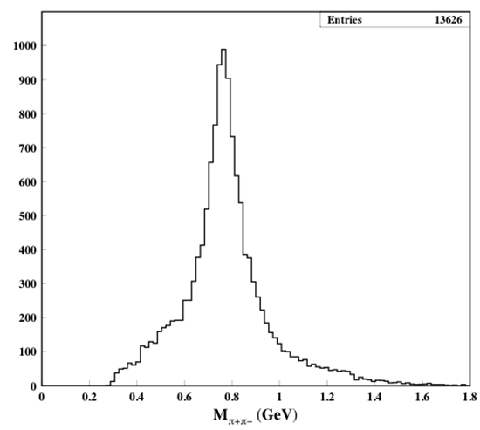
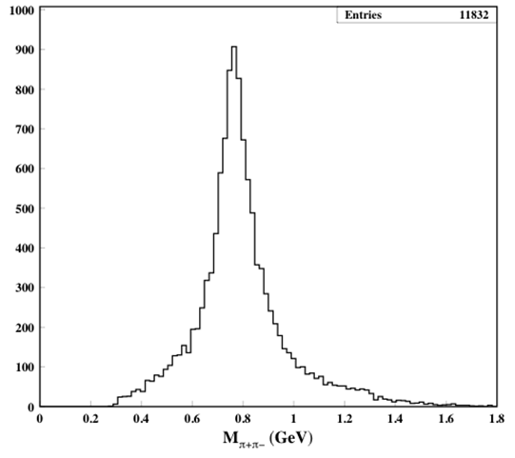

Event Selection
El Fassi et al. , Phys. Lett. B712 (2012)
Reaction of interest is:
e + A → e’ + X + ρ ⁰ → e’ + X + π⁺ + π⁻
Use EG2 data again
$W>2$ GeV
  To exclude the resonance region
0.1 < -t < 0.4 GeV ²
  Selects diffractive, incoherent process.
$z=\frac{Eρ}{υ}>0.9$
  selects elasticcally produced ρ -s.
After W-cut
After t-cut
After W- and t-cuts
After W- , t- and z-cuts

Slide 21
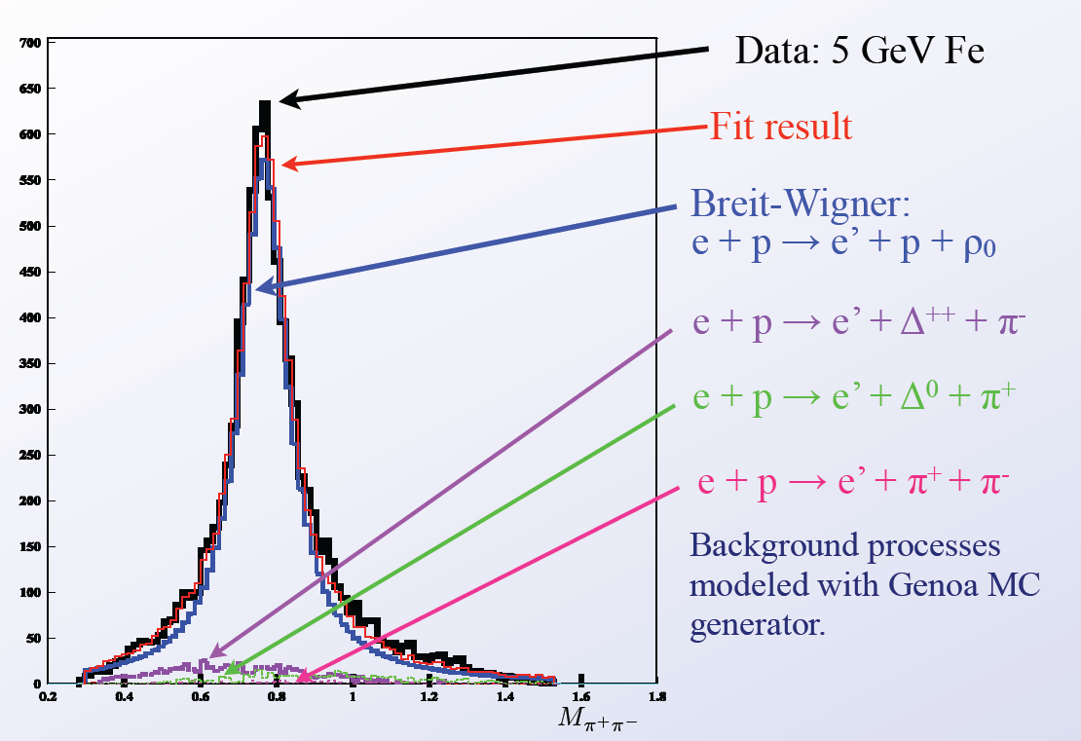

$π+π−$ Invariant Mass
El Fassi et al. , Phys. Lett. B712 (2012)
Background shape was determined from MC simulations
Acceptance corrections on event-by-event basis
Invariant mass distributions are fitted with B-W + BKG
Background shape determined from MC simulations.
Radiative corrections applied.

Slide 22
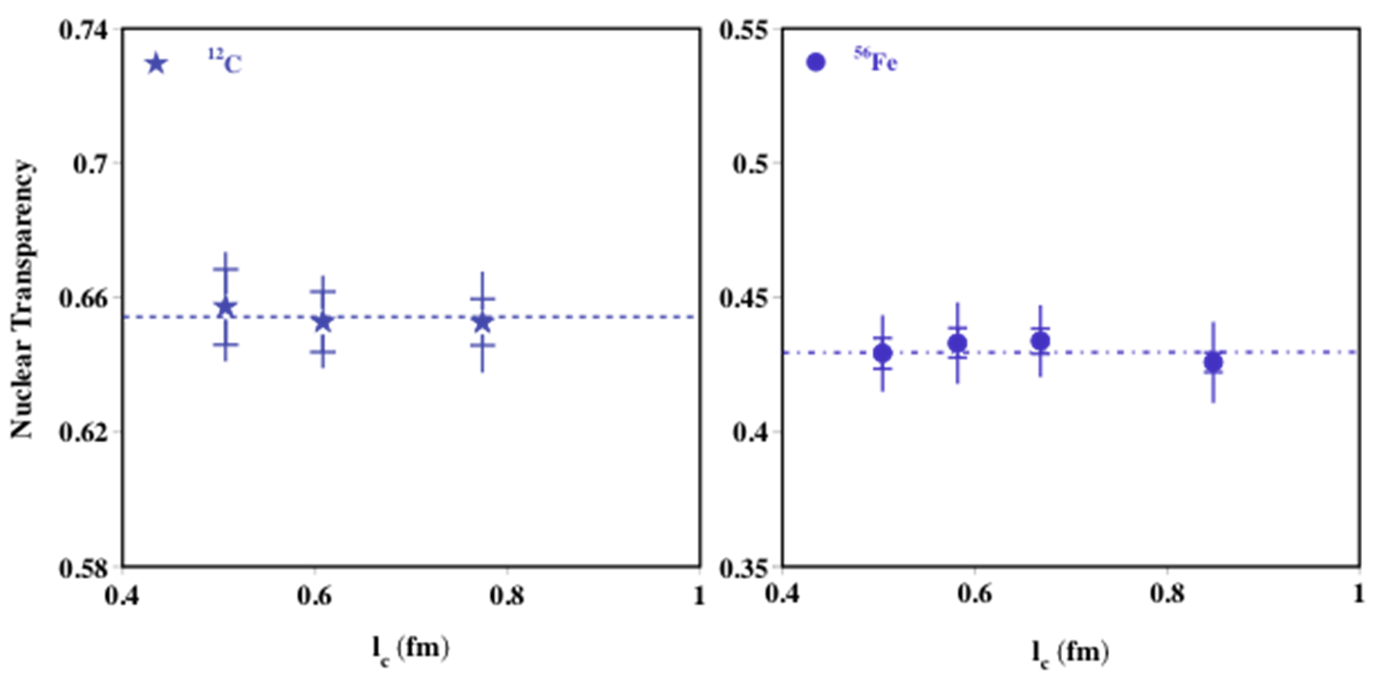


CT vs Coherent Length
El Fassi et al. , Phys. Lett. B712 (2012)
$lc=\frac{2υ}{Q^{2}+M_{ρ}^{2}}$
“Global” systematic uncertainties are not shown in this plot.
Observed transparency does not depend on $lc$
  No initial state interaction state effects
Can integrate over $lc$ and study $Q^{2}$ dependence.

Slide 23
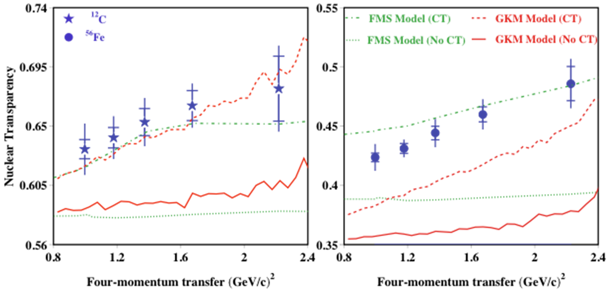

Transparency vs $Q^{2}$
El Fassi et al. , Phys. Lett. B712 (2012)
There is visible trend towards increasing of transparency with Q².
  Increase of 11% (Fe) and 12% (C).
The onset of CT for ρ⁰ happens earlier than for π⁺.
For both ¹²C and ⁵⁶F the data point are consistent with the model versions with CT included.
The FMS model slightly underestimated the observed transparency increase.

Slide 24

Summary and Outlook
First CLAS results on hadronization of $K_{s}^{0}$has been published.
  Consistent with HERMES charged kaon data and existing theory.
More data from CLAS is expected on pion with significantly larger statistical precision.
  Will allow for multidimensional binning.
New CLAS results on CT evidence in ρ⁰ electroproduction has been published.
  Increase of ρ⁰ transparency of 11% (Fe) and 12% (C).
  Onset of CT is earlier in ρ⁰ production than pion production.
E12-06-117 with CLAS12, Brooks et al :
  Quark Propagation and Hadron Formation
E12-06-106 with CLAS12, Hafidi et al :
  Study of Color Transparency in Exclusive Vector Meson Electroproduction off Nuclei
E12-06-107 with Hall C, Dutta et al:
  The Search for Color Transparency at 12 GeV

Slide 25
The End
Thanks!

Slide 26
Extra Slides

Slide 27
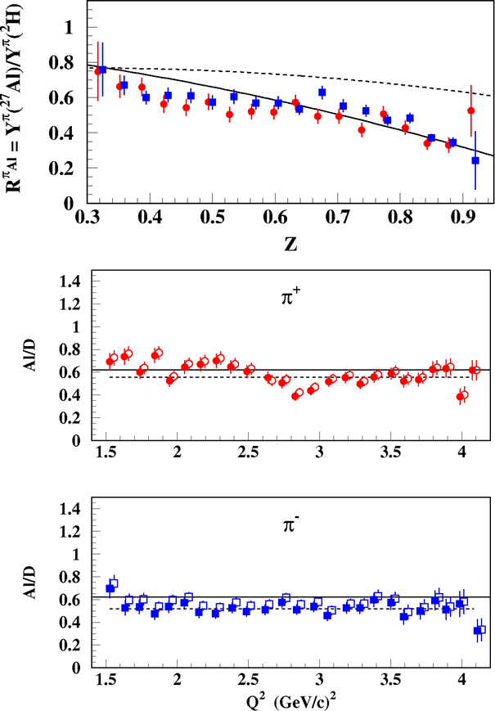

Hall C Results
Asaturyan et al., Phys.Rev. C85 (2012)
Came as a bonus from pion SIDIS studies.
High precision data.
Limited kinematics
  Low values of $PT$
Cross section ratio instead of the $R_{A}^{h}$.
  Ratio falls with $z$.
  x_{B}-dependence is consistent with EMC parameterization.
  Q² dependence is nearly flat
Good data for cross checks for experiments with larger kinematic coverage.

Slide 28
Nuclear Physics Topics at CLAS
Short Range Correlations (covered by Or Chen)
EMC Effect
Hadronization in nuclei
Color transparency
GPDs of nuclei
Photodisintegration of light nuclei

