Slide 1







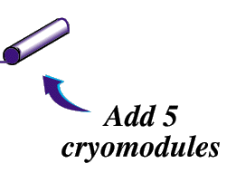
JLab 12 GeV Program
Volker D. Burkert
Jefferson Lab
Add new Hall
CHL-2
New equipment in existing halls

Slide 2
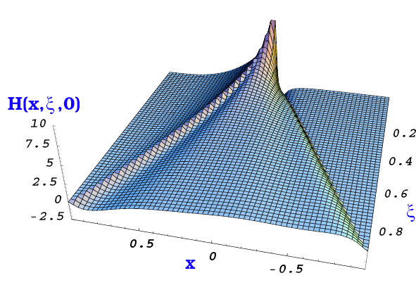
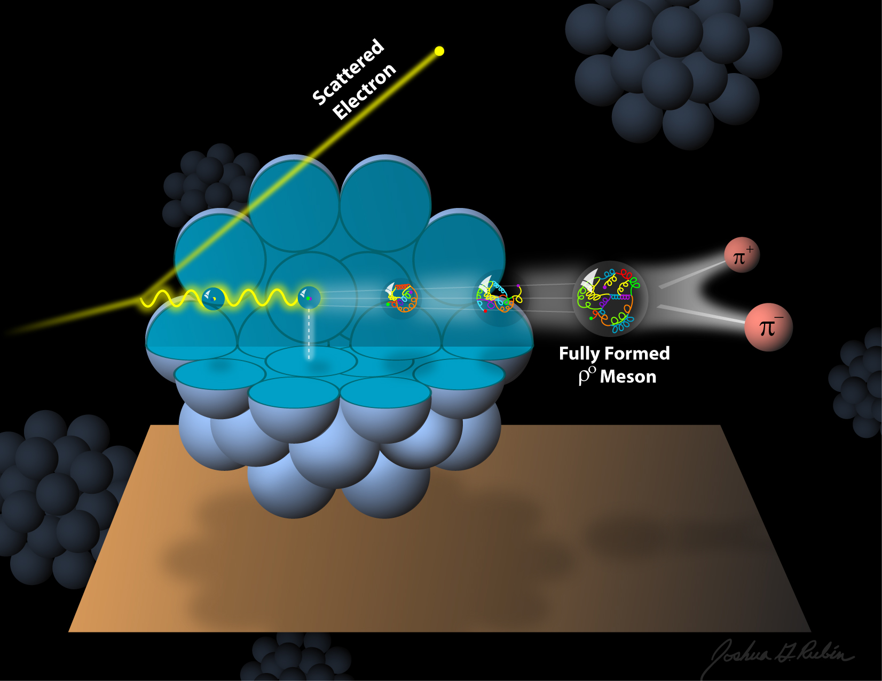
The science program at JLab
Quark confinement and the role of the glue in meson and baryon spectroscopy
The 3D structure of the nucleon – from form factors and PDFs to GPDs and TMDs
The strong interaction in nuclei – evolution of quark hadronization, nuclear transparency of hadrons
Search for science beyond the Standard Model – precision and intensity frontiers
Physics Opportunities with the 12 GeV Upgrade at Jefferson Lab, J. Dudek et al., arXiv:1208:124

Slide 3
12 GeV Experiments by Physics Topics
Updated PAC39, June 2012
 | Topic | Hall A | Hall B | Hall C | Hall D | Total
 | The Hadron spectra as probes of QCD (GlueX and heavy baryon and meson spectroscopy) |  | 1 |  | 1 | 2
 | The transverse structure of the hadrons (Elastic and transition Form Factors) | 5 | 3 | 3 |  | 11
 | The longitudinal structure of the hadrons (Unpolarized and polarized parton distribution functions) | 2 | 2 | 4 |  | 8
 | The 3D structure of the hadrons (Generalized Parton Distributions and Transverse Momentum Distributions) | 5 | 13 | 4 |  | 22
 | Hadrons and cold nuclear matter (Medium modification of the nucleons, quark hadronization, N-N correlations, hypernuclear spectroscopy, few-body experiments) | 2 | 2 | 5 |  | 9
 | Low-energy tests of the Standard Model and Fundamental Symmetries | 3 | 1 |  | 1 | 5
 | TOTAL | 17 | 22 | 16 | 2 | 57
Current PAC approved experiments represent over 6 years of running at 35 weeks/year and Hall multiplicity of 2.9
Notes:
We are at the stage where a substantial number of experiments is approved.
This is great; it demonstrates that we are building something the users desire.
In the next slides I will step though some of these experiments

Slide 4
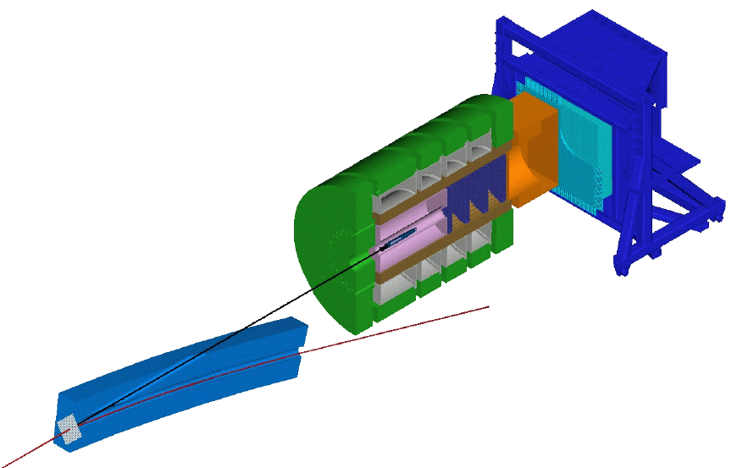
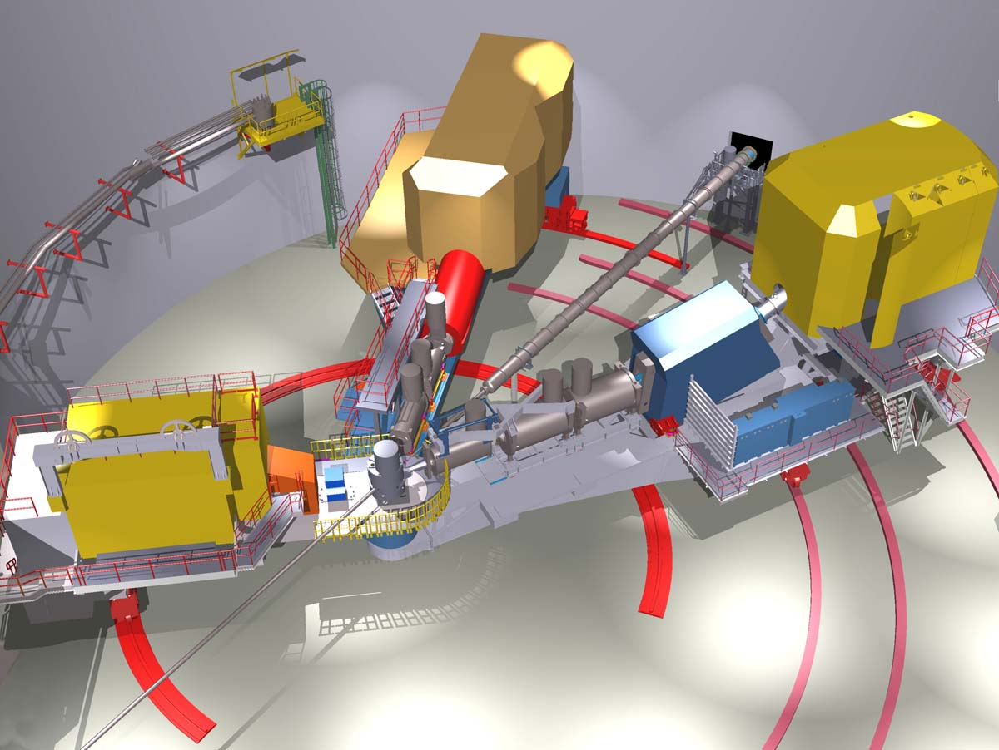
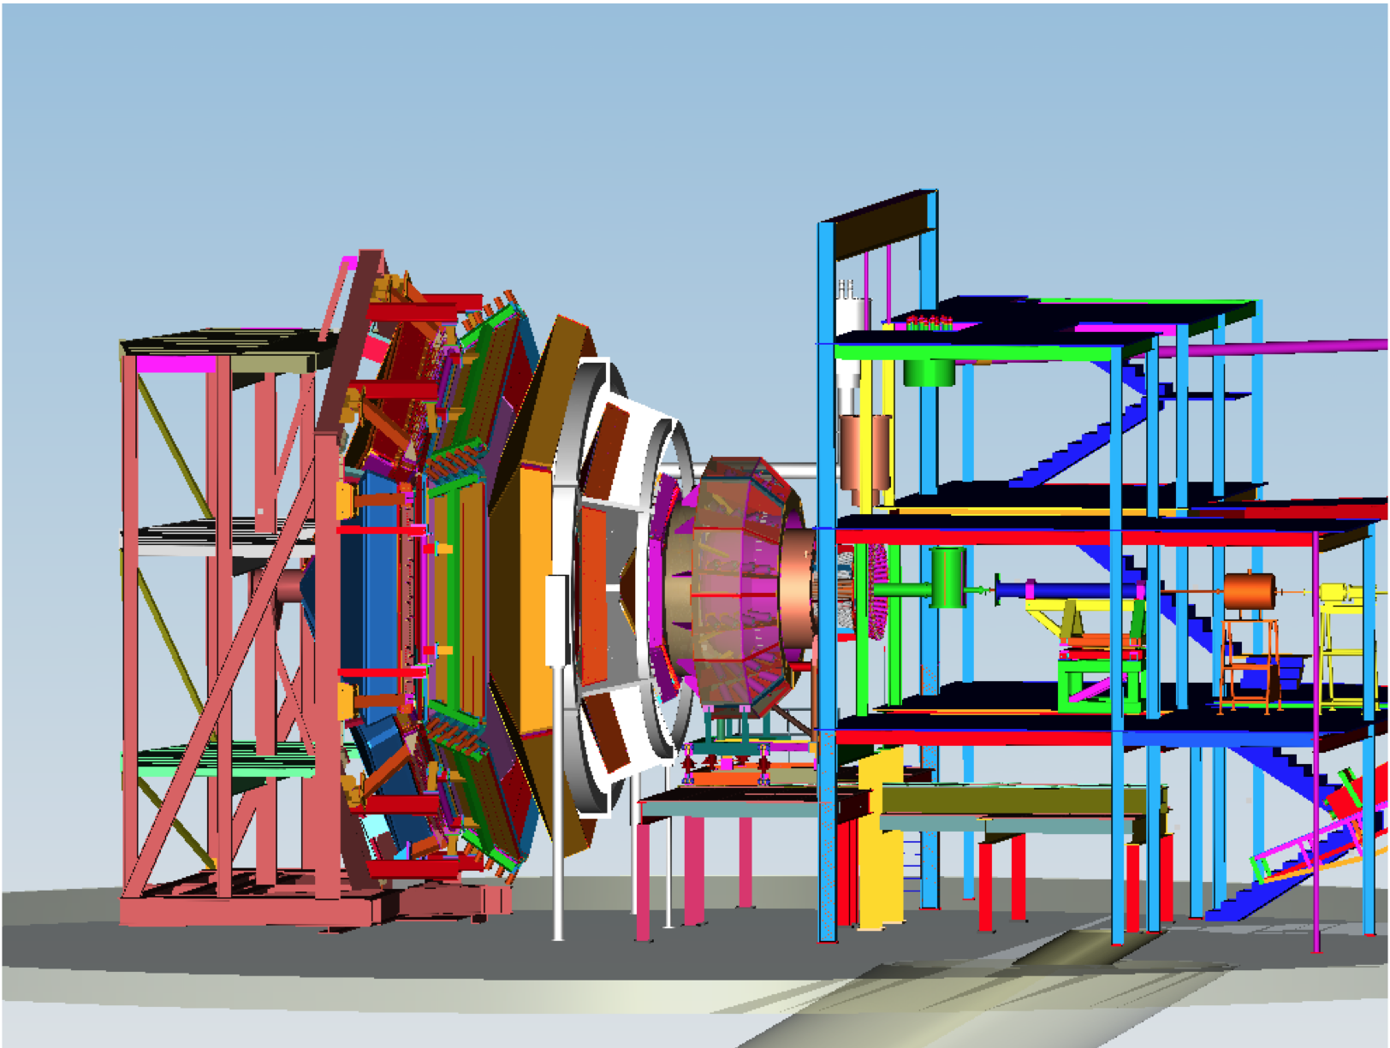

New Capabilities in Halls A, B, & C, and a New Hall D
D
C
9 GeV tagged polarized photons and a 4π hermetic detector
Super High Momentum Spectrometer (SHMS) at high luminosity and forward angles
B
A
High Resolution Spectrometer (HRS) Pair, and specialized large installation experiments
+ SBS (+ proposals for Moller & SOLID )
CLAS12 high luminosity, large acceptance + RICH + user provided equipment
Notes:
A new Hall will be constructed to house the GlueX detector, that will conduct a search for excited mesons with gluonic components, and the existing Halls will be upgraded with new equipment as well. Hall C will have an additional super high momentum spectrometer. Hall A will retain the existing spectrometers and provide space for new specialized equipment to address a variety of physics topics. Hall B will house the CLAS12 detector which is the focus of this of workshop. At 12 GeV JLab will be ideal for precision studies at large Bjorken x.

Slide 5
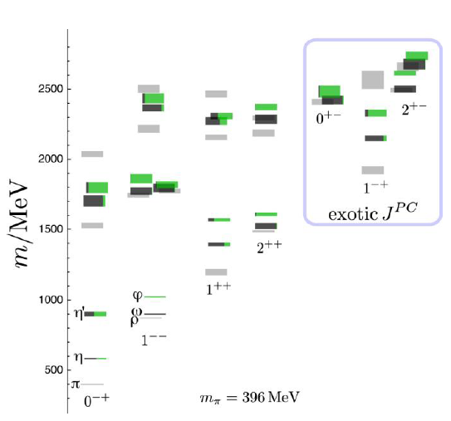
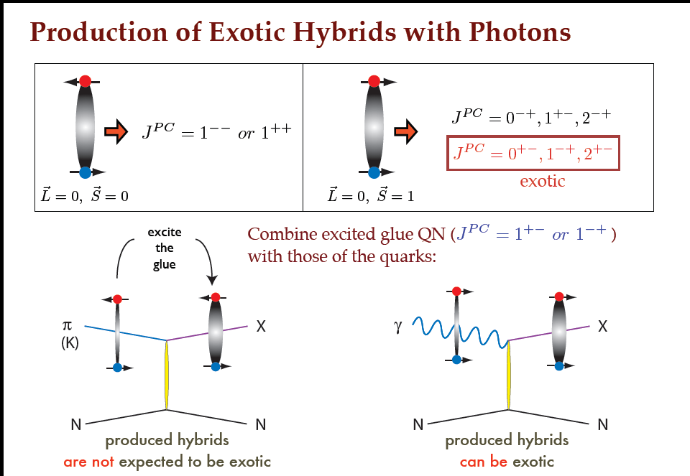
Gluonic d.o.f. in meson excitations
Isoscalar mesons from LQCD
ss-bar
uu-bar + dd-bar
isovector
Real photons may be a good probe of exotic mesons.
Large program is in preparation with the GlueX experiment.
J. Dudek et al., arXiv:1208:124

Slide 6
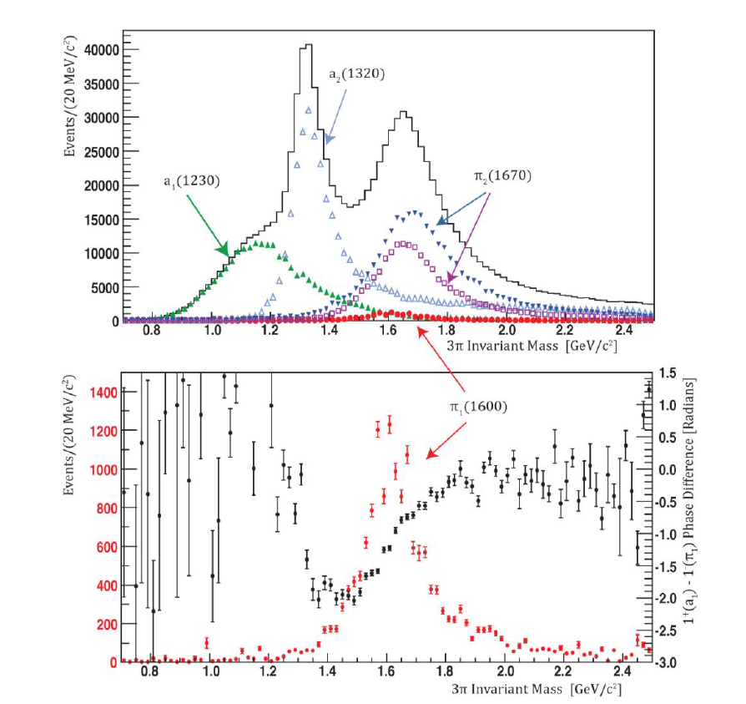
Extracting an exotic J^{PC} signal in GlueX
E12-06-102
γp->π⁺π⁺π⁻n
Amplitude analysis of MC generated data shows that a very small exotic π₁(1600) signal can be isolated from the much larger signals of ordinary mesons.
CLAS results set upper limit of 13.5nb for π₁(1600) production in this channel, less than 2% of a₂(1320).
M. Nozar, PRL 102 (2009) 102002.
Phase motion
1⁺(a₁) – 1⁻(π₁)
A complementary program is
in preparation using CLAS12 with quasi-real photons.
π₁ intensity
E12-11-005

Slide 7
DIS structure functions and d_{v}(x)/u_{v}(x)
d(x)/u(x) poorly constrained at x > 0.5 due to uncertainty in nuclear corrections
F₂^{n}
1+4d/u
F₂^{p}
≈
4+ d/u

Slide 8
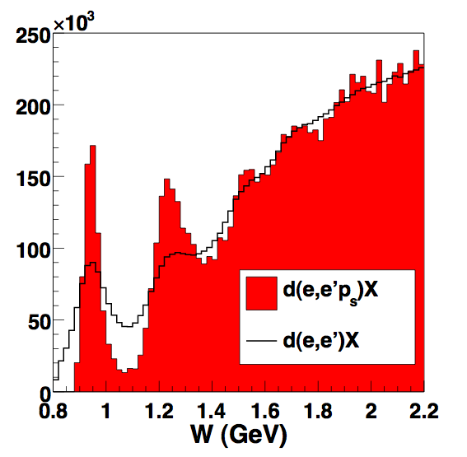
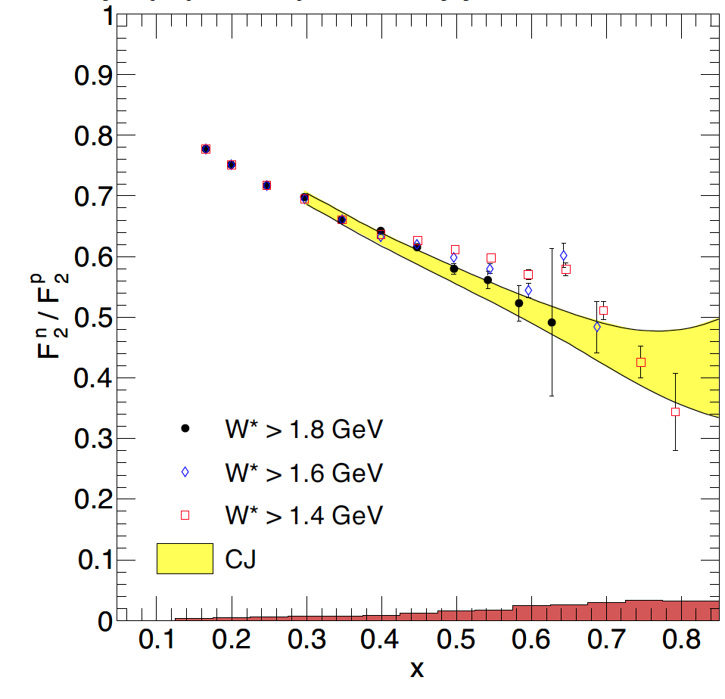
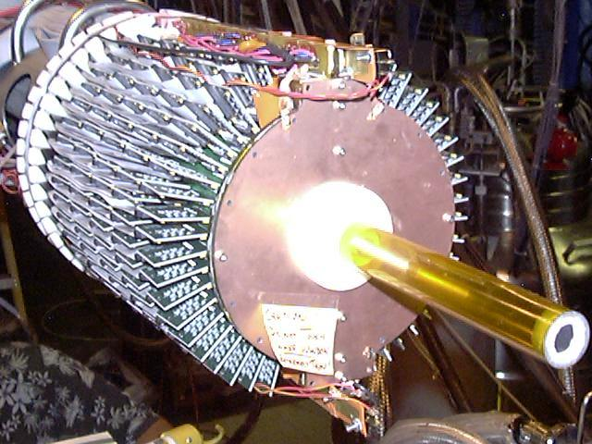
Neutron structure and quark distributions
F₂^{n}/F₂^{p} ratio by tagging almost unbound neutrons using detection of low momentum protons in a radial TPC. Other experiment will measure ³H/³He.
E12-10-102
E12-10-103
e⁻D→e⁻p_{s}X
N(1680)
n
N(1520)
Δ
e⁻
n
e⁻
p
p_{s}
>70MeV/c
BONUS Detector
5 Tesla
mag. field
First model-independent measurement of F₂^{n}/F₂^{p}
Projected results for d(x)/u(x) for 12 GeV experiment.
Notes:
One of the unresolved issues in neutron structure functions studies at high Bjorken x is the correction for the nuclear binding effect in deuteron. Different corrections have resulted in vastly different results. A model-independent way is to tag the neutron by measuring the spectator proton to very low momentum using, e.g. a gas target and a low density tracking detector. Protons with momentum down to 70 MeV/c (T=2.5MeV) must be detected. The corrections for the neutron momentum in deuteron is shown in this graph. The elastic peak and the resonance structure show up clearly. The corrected ratio F2n/F2p is shown with the red points. The ratio of d-quark to u-quark distribution functions is shown here. The maximum xB is limited by the beam energy of 5.2 GeV. However, the trend is to rule out the scalar diquark model. Future experiments at the 12GeV upgrade will extend this range up to 0.9.

Slide 9
Proton spin structure
Proton spin decomposition:
J^{p} = ½ [ ΔΣ + ΔG + L^{q} + L^{g} ]
What we do know about the individual contributions
Quark helicity: ΔΣ~0.25-0.30
Gluon helicity contributions ΔG ~ 0.10-0.20
Orbital angular momentum contribution to proton spin should be large, i.e. L^{q} + L^{g} > 0.5
Latest LQCD results: ΔΣ~0.25, ΔG+L^{g} ~ 0.25, L^{q} ~ 0.5
K.F. Liu et al., arXiv:1203.6388
  How to improve data on ΔG(x)
  How to access L^{q} (x)

Slide 10
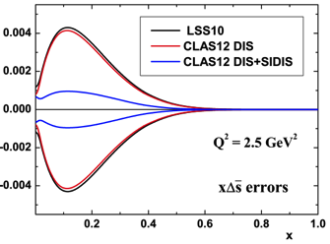
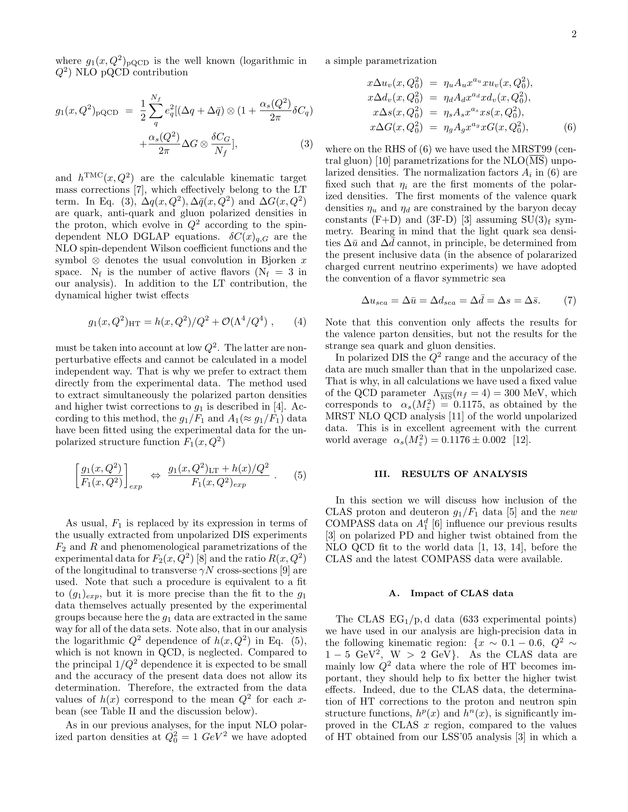
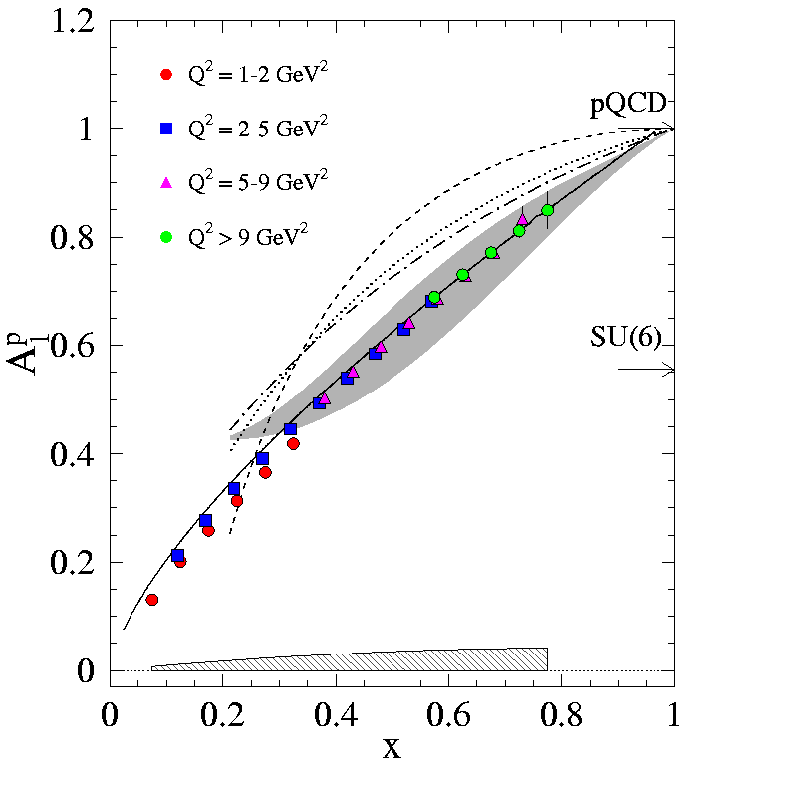
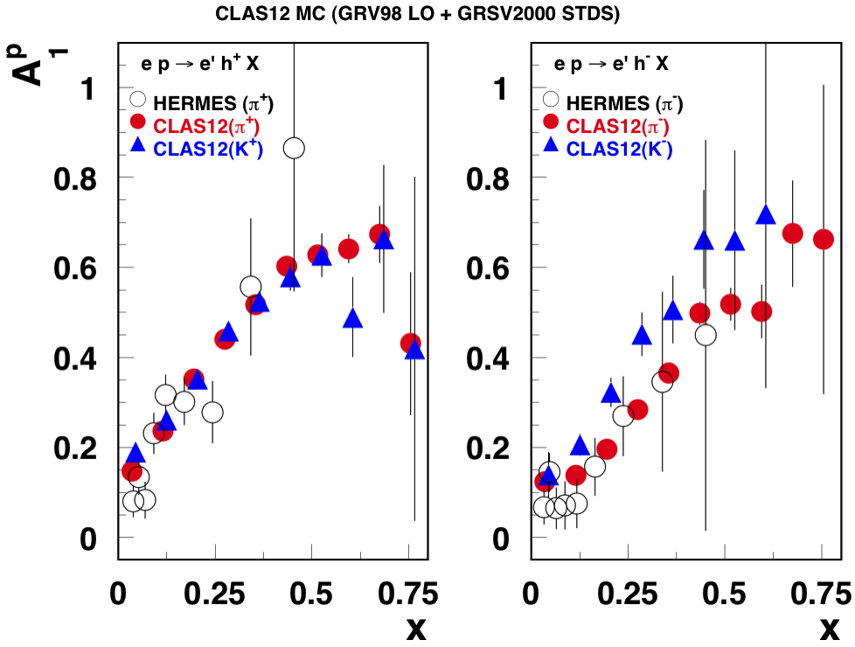
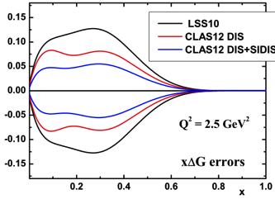
Polarized PDFs at 12GeV
Precise information on A₁(x, Q²) with flavor tag can strongly reduces uncertainties in quark helicity distributions. The Q² dependence and evolution provides model-independent ΔG(x).
Improved PDFs from NLO analyses
E12-06-109
E12-06-110
E12-09-007

Slide 11
Generalized Parton Distributions
(Quantum phase-space quark distribution in the nucleon)
Polarized DVCS directly probes GPDs
Integrate over momentum space
Sensitivity to GPD
~
Generalized Parton Distributions (GPD) H, H, E, E
UP
LP
TP
H, H, E
~
~
~
Nucleon polarization
H, H, E
3D nucleon imaging in transverse coordinate and longitudinal momentum space
E, H

Slide 12
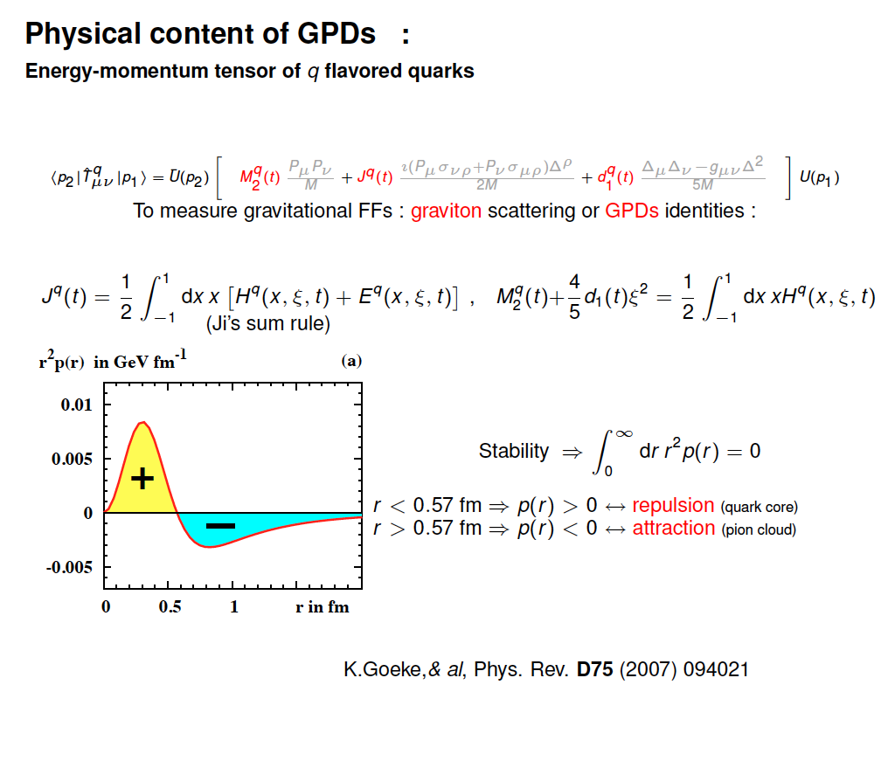
Physical content of GPDs H, E
Nucleon energy-momentum tensor of q flavored quarks:
(Ji’s relation for t=0)
Fourier transformation relates J(t) to the quark angular momentum distribution in b_{T} space.

Slide 13
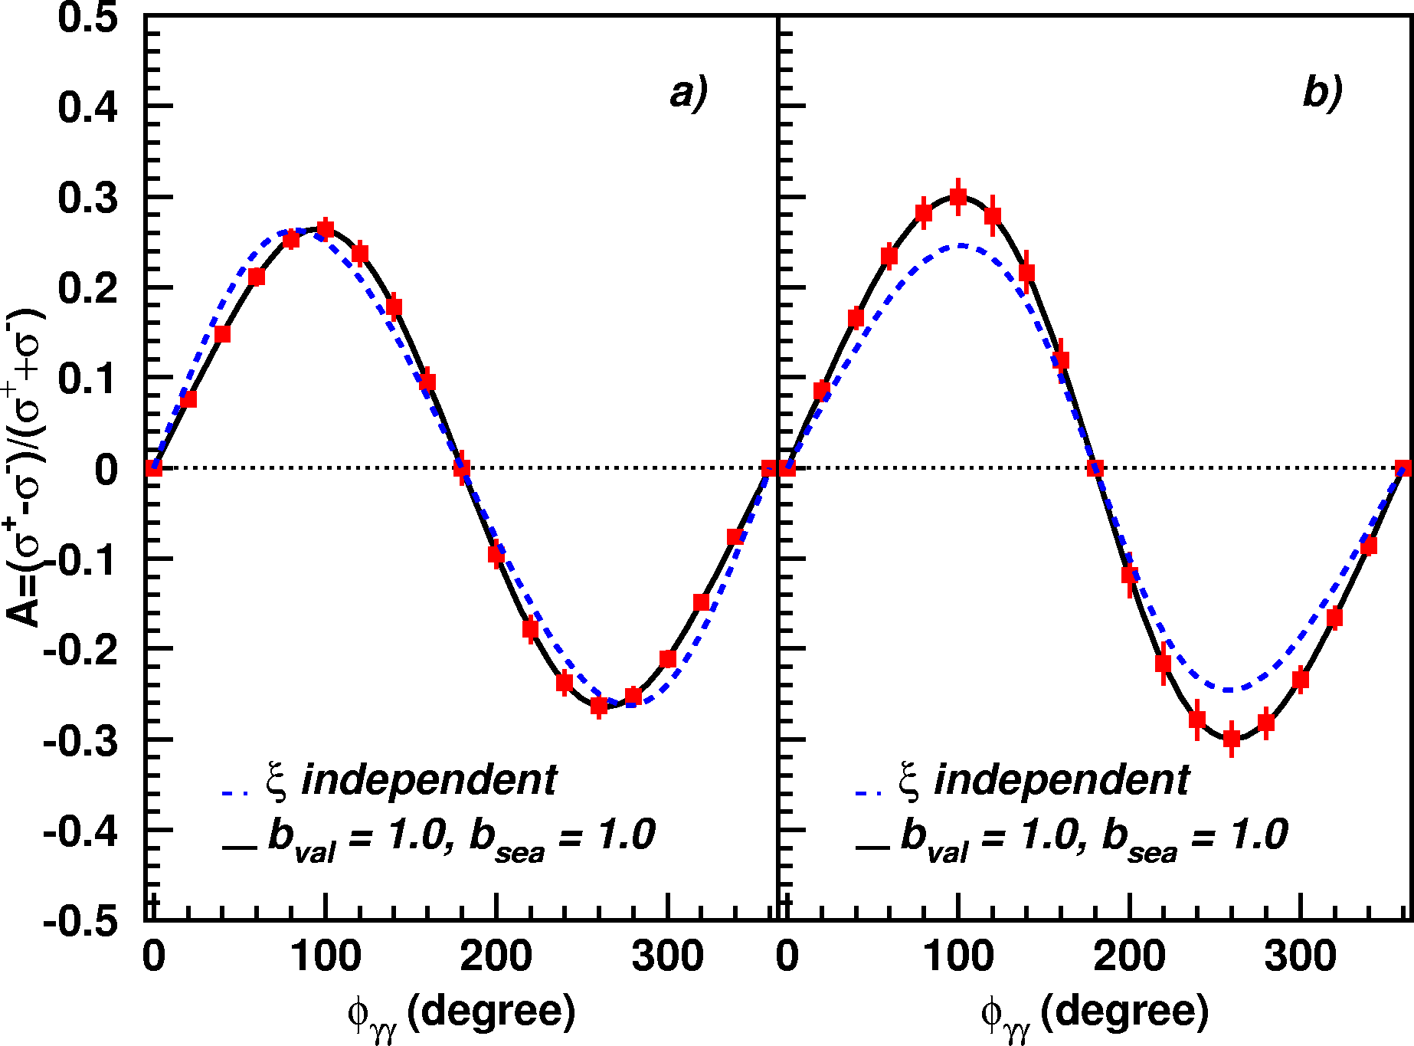
A_{LU} projections for JLab@12GeV
~
ep --> epγ
Δσ_{LU} ~ sinφ {F₁H + ξ(F₁+F₂)H +kF₂E}dφ
A_{LU}
E12-06-114
E12-06-119

Slide 14
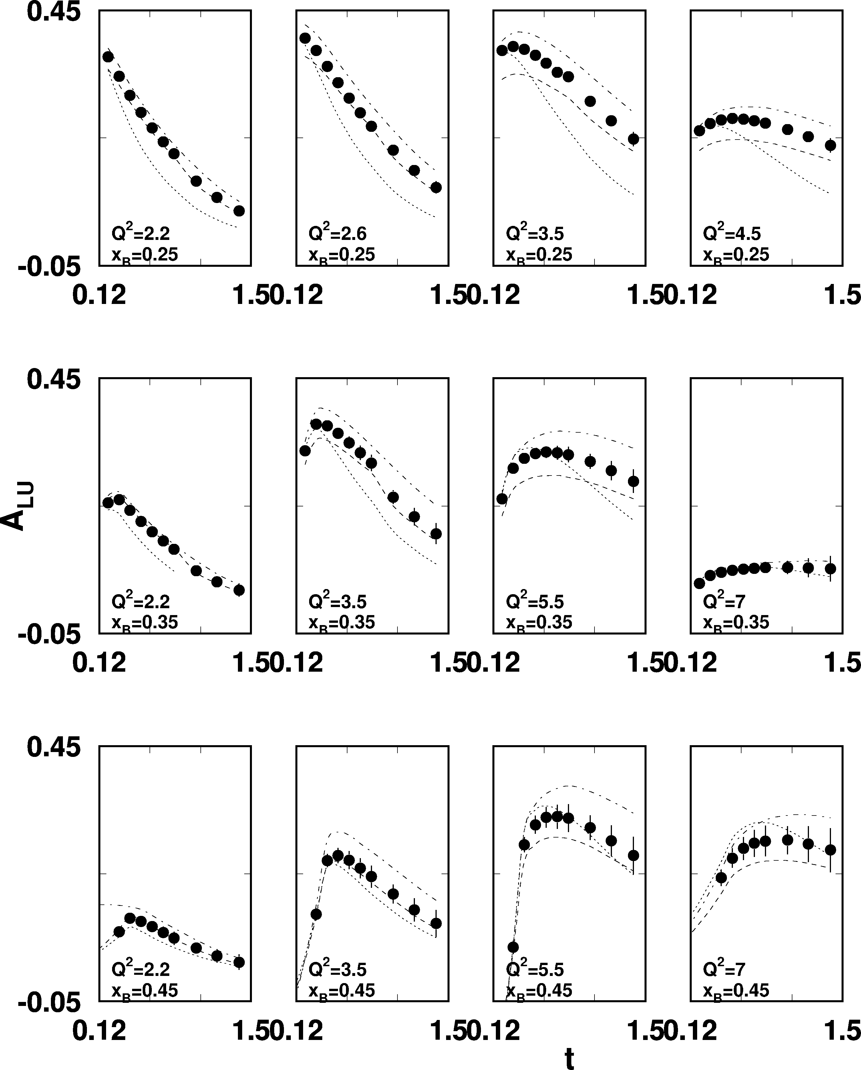
A_{LU} projections for protons
e p epγ
~
Δσ_{LU} ~ sinφ {F₁H + ξ(F₁+F₂)H +kF₂E}dφ
E_{e}=11GeV
sinφ
, GeV²

Slide 15
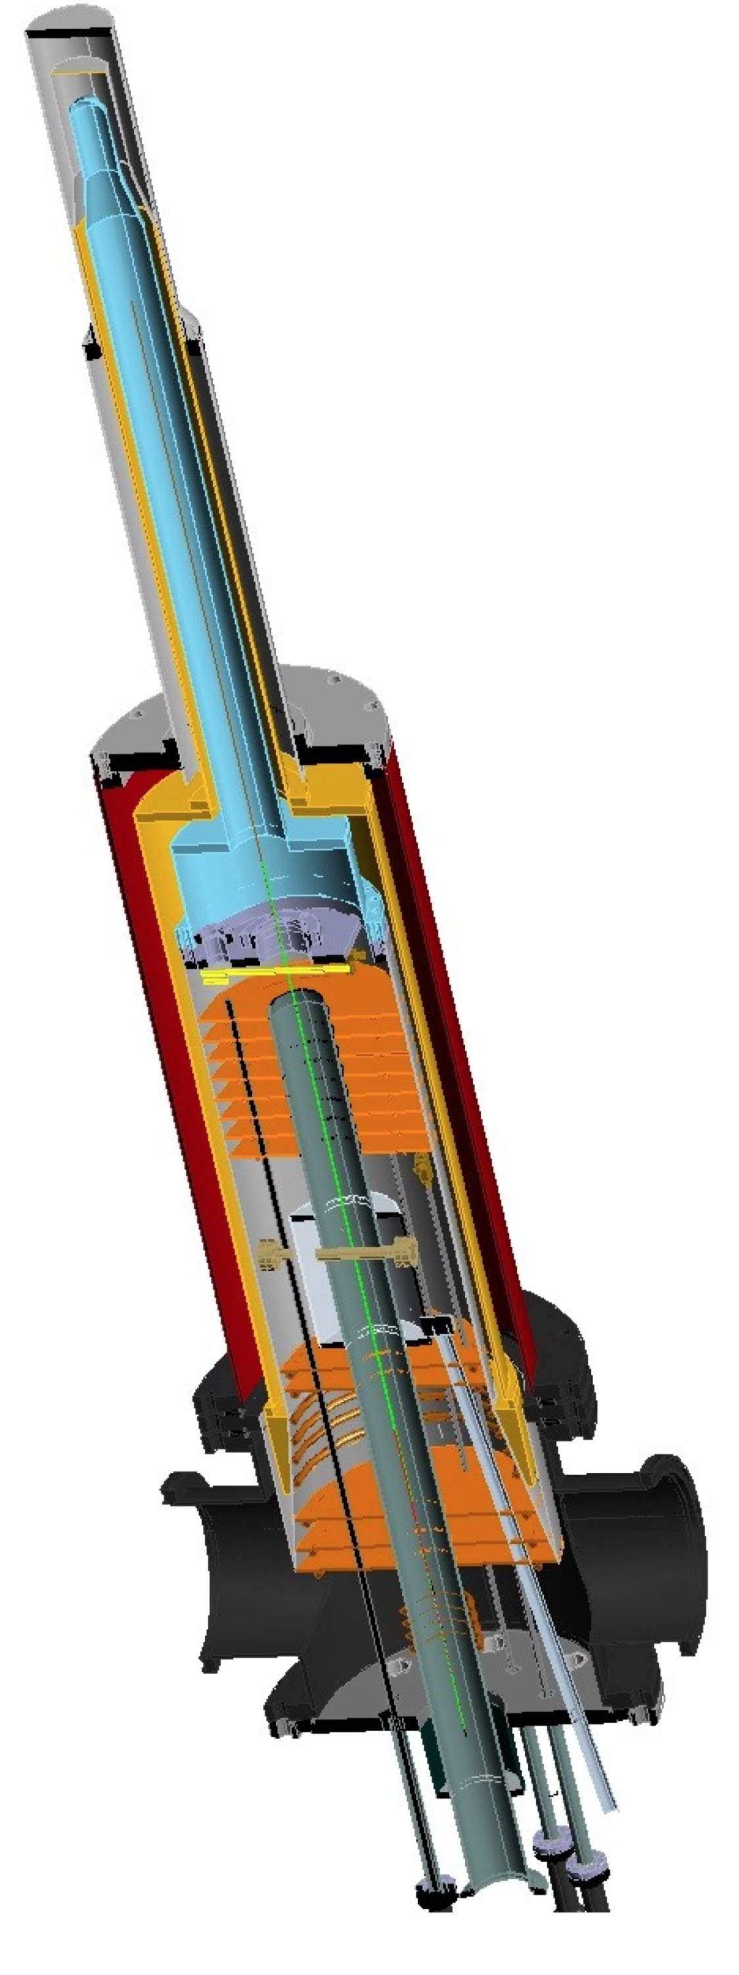
A_{UL} projections for protons
e p epγ
~
Δσ_{UL} ~ sinφ {F₁H+ξ(F₁+F₂)(H +ξ/(1+ξ)E)}dφ
~
Dynamically polarized target NH₃, ND₃
L = 1x10³⁵ cm⁻²s⁻¹
T = 2000 hrs
ΔQ² = 1GeV²
Δx = 0.05
A_{UL}
E12-06-119

Slide 16
A_{UT} projections for 12GeV
ep epγ
Δσ_{UT} ~ cosφsin(φ_{s}-φ){k(F₂H – F₁E)}dφ
polarized HD
P_{p}=0.60
Dilution = 0.8
C12-12-010
cosφ
x=0.25,
Q²=2 GeV² t=-0.55 GeV²
A_{UT} and A_{LT} are sensitive to the u and d-quark helicity content of the proton spin

Slide 17
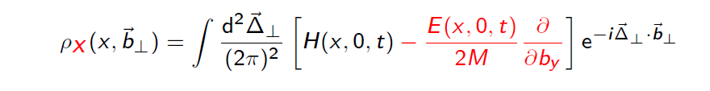
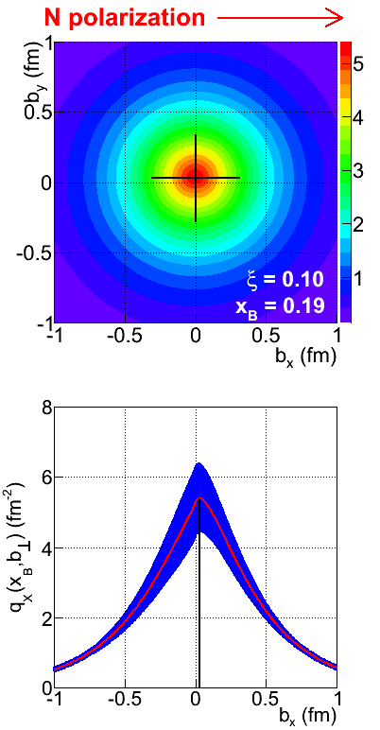
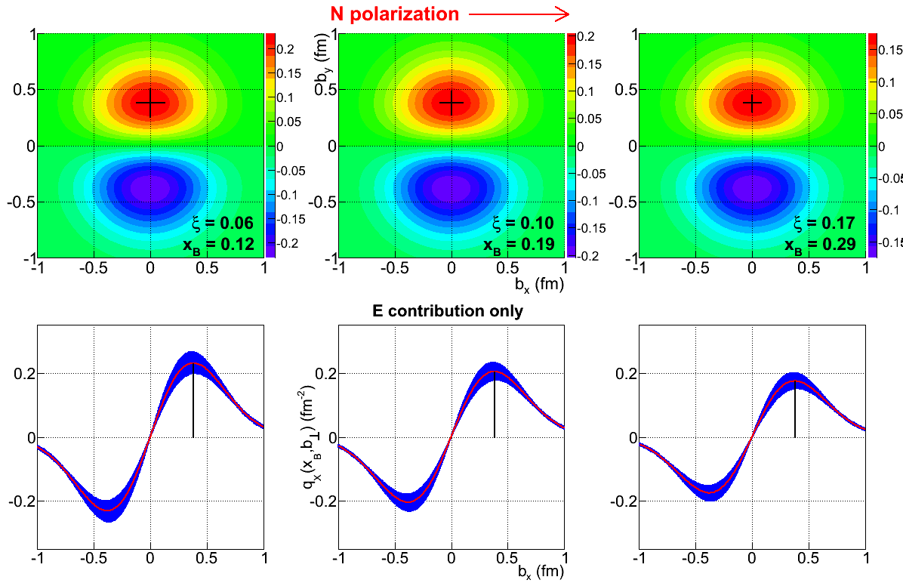
Projected quark densities in impact parameter
Fourier transform of GPDs give access to the quark densities distribution in impact parameter space.
GPD E probes the u- and d-quark separation in impact parameter space. Transversely polarized proton shows flavor dipole.
2nd x-moment of GPD E
probes quark orbital angular momentum
Contribution of H+E
Contribution of E

Slide 18
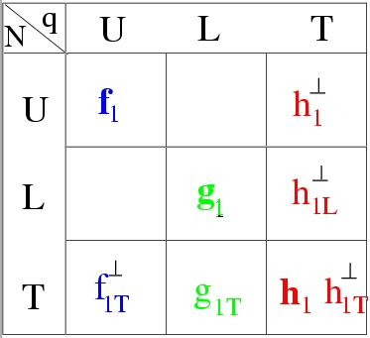
Transverse Momentum Distributions
(Quantum phase-space quark distribution in the nucleon)
JLab has complete SIDIS program with π/K to extract quark TMDs
Integrate over
spatial dimensions
Quark spin polarization
Transverse Momentum-dependent Distributions (TMD)
Nucleon polarization
3D imaging of the nucleon in momentum space
The SIDIS program will map the 4D phase space in Q², x, z, P_{T}

Slide 19
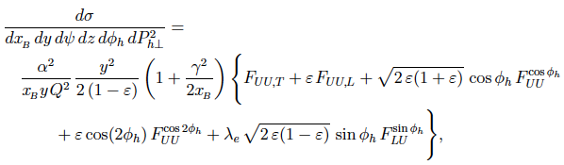
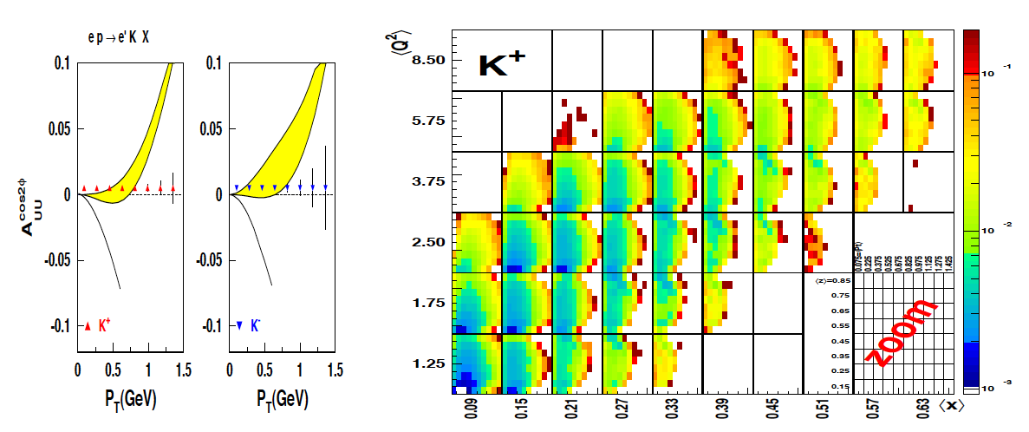
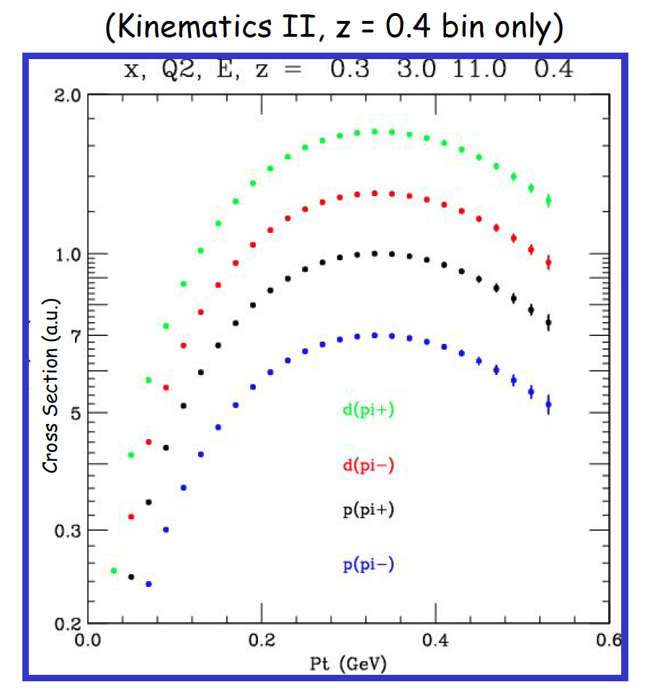
SIDIS pion/kaon on unpolarized protons
E12-06-112, E12-09-007
E12-09-008
E12-09-017
Notes:
… the graphs shows the projected uncertainties of the x and Pt dependences of the asymmetry for different pion and kaon flavors.

Slide 20
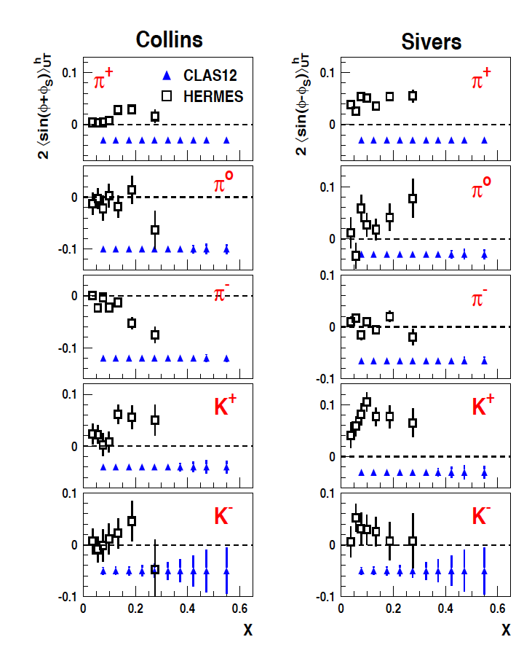
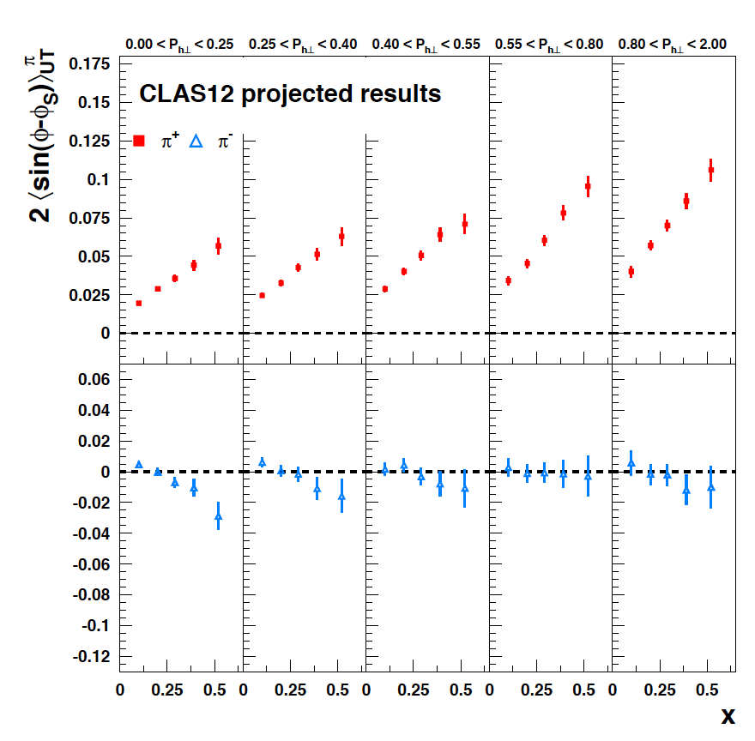
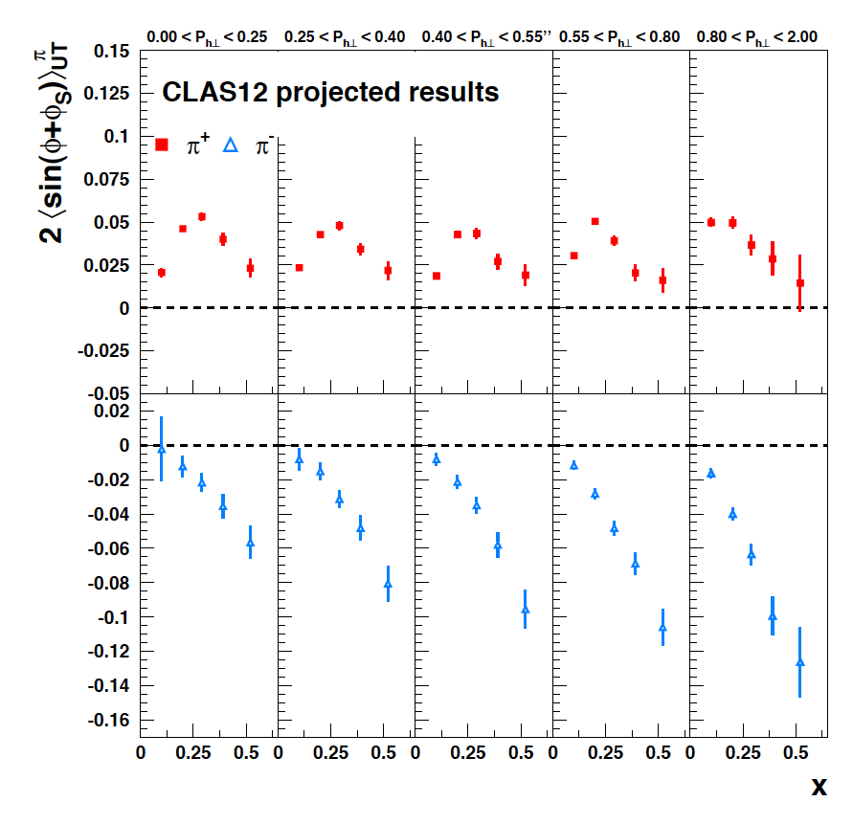
A_{UT} with transverse proton target
E12-09-018
E12-11-108
C12-11-111
Collins
Sivers
High statistics allows for x-P binning
T

Slide 21
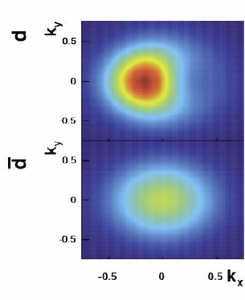
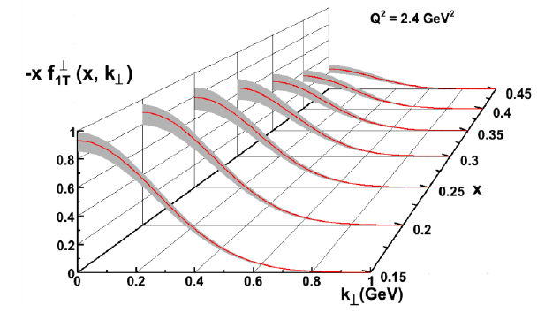
Momentum Tomography with TMDs
Sivers function for u- quarks extracted from model simulations with a polarized ³He target.
d-quark momentum tomography for Sivers function. The d-quark momentum density shows a distortion in k_{x}. A non-zero value requires a non-zero orbital angular momentum.

Slide 22
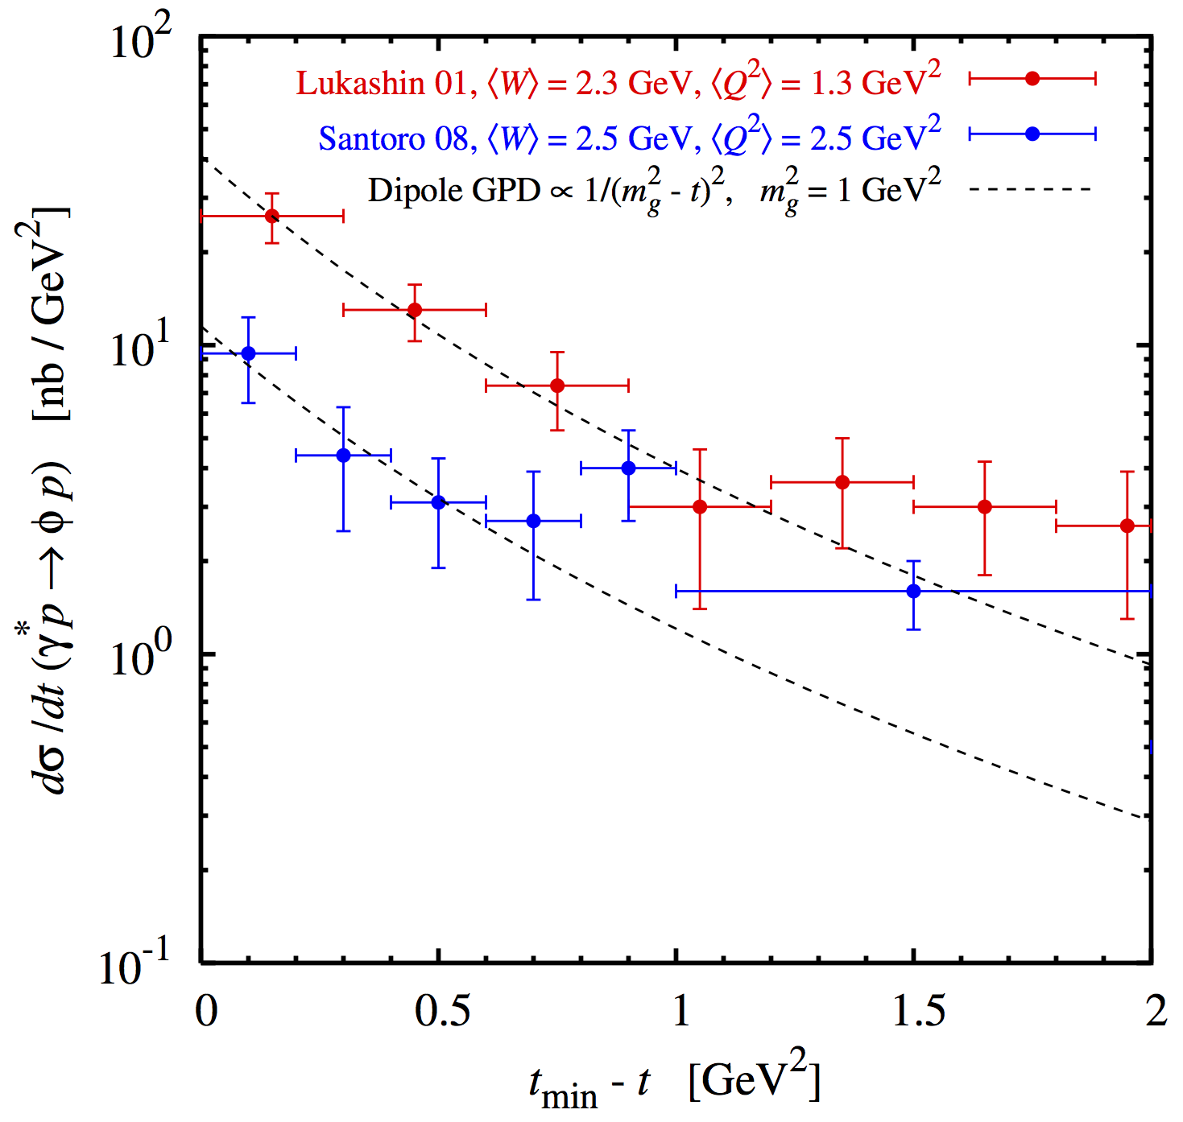
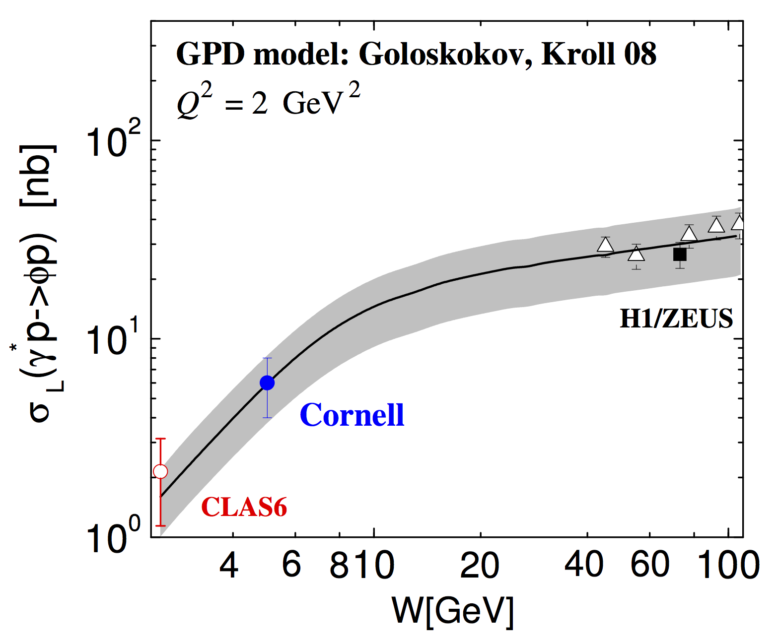
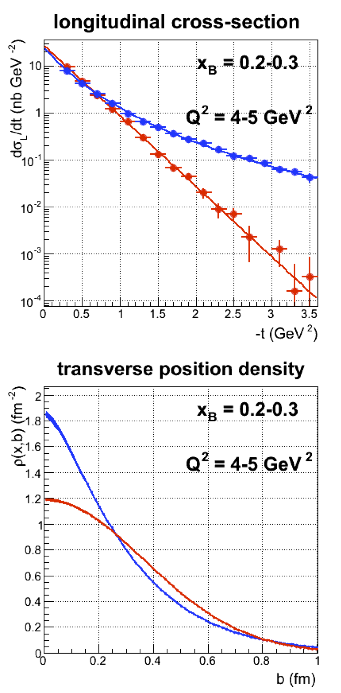
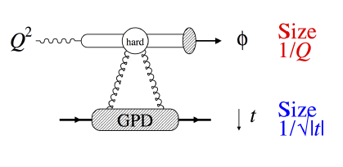
Proton gluonic radius
E12-12-007
Gluon density is high at x_{B} > 0.1
Probe gluonic radius in φ production
Gluonic radius at 6 GeV from CLAS data consistent with extrapolation from higher energy w/ dipole mass m²_{g} ~ 1 GeV² .

Slide 23
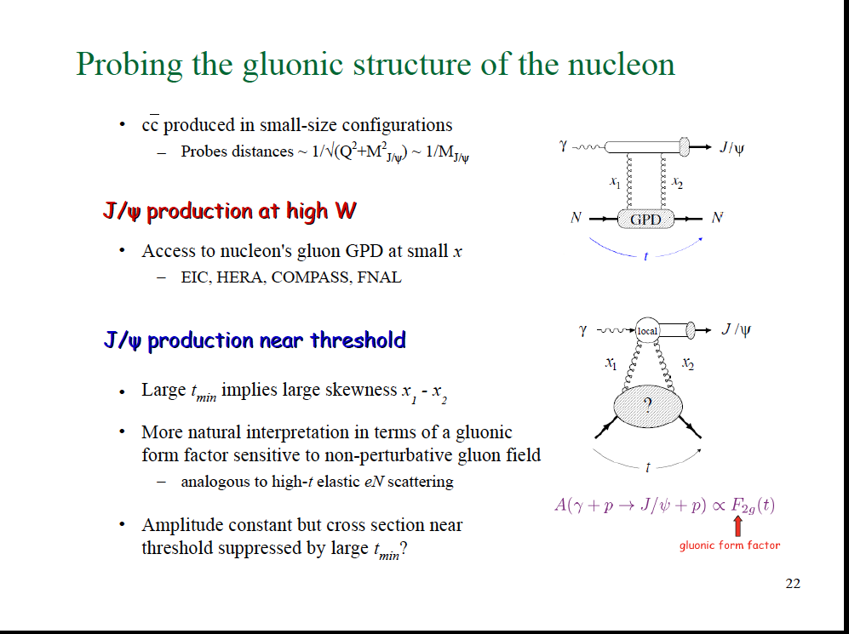
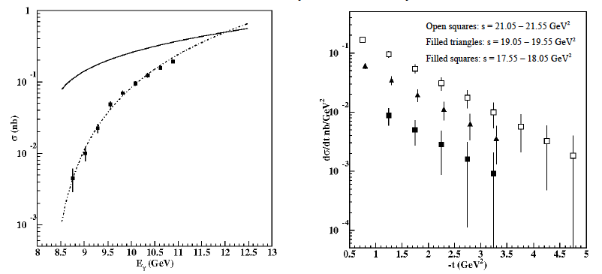
Exclusive J/ψ production near threshold
produced in small-size configurations
- probes small distances ~ 1/M_{J/ψ}
E12-12-001
E12-12-006
J/ψ production at high W
Access to gluon GPDs at small x.
J/ψ production near threshold
Large t_{min} implies large skewness x₁-x₂
More natural interpretation in terms of a gluonic form factor sensitive to non-perturbative gluon field.

Slide 24
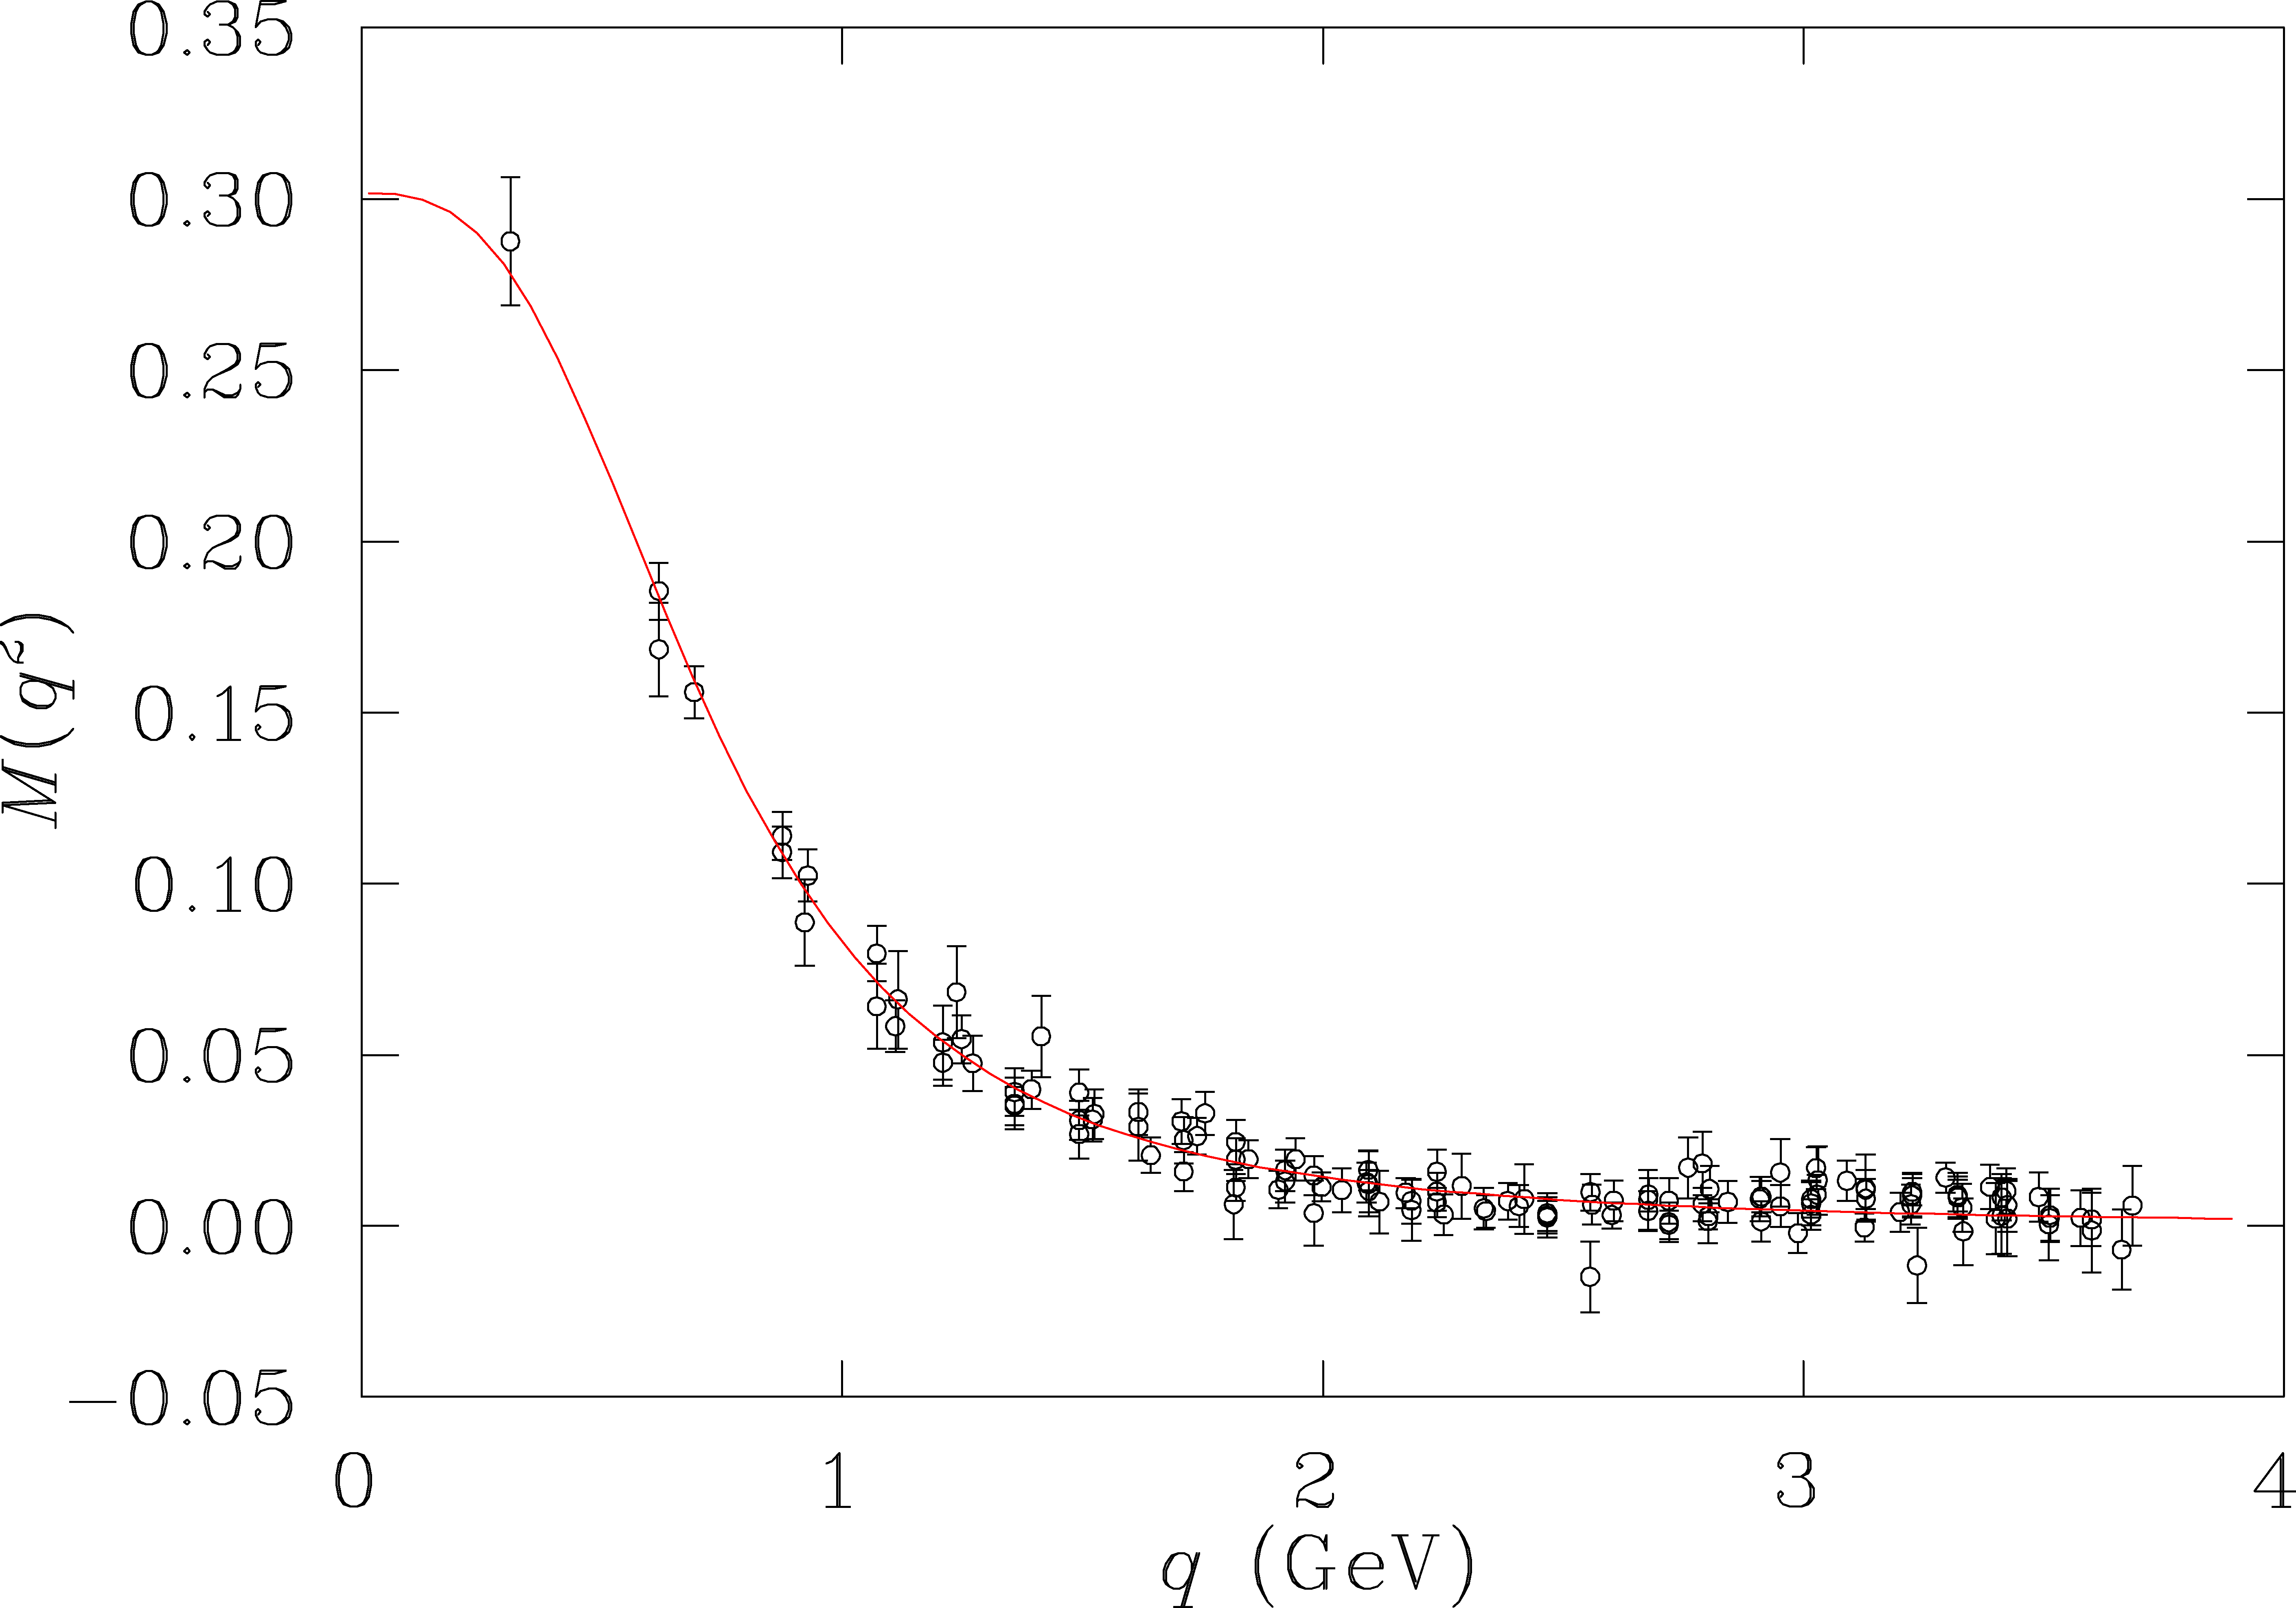
N* transition and quark mass evolution
Probe quark mass dependence on momentum transfer
N* transition form factors are sensitive to running quark mass
accessible
at 6 GeV
P₁₁(1440)
quark mass (GeV)
accessible
at 12 GeV
projected at 12GeV
E12-09-003
At 12 GeV we probe the transition from dressed quarks to elementary quarks.

Slide 25
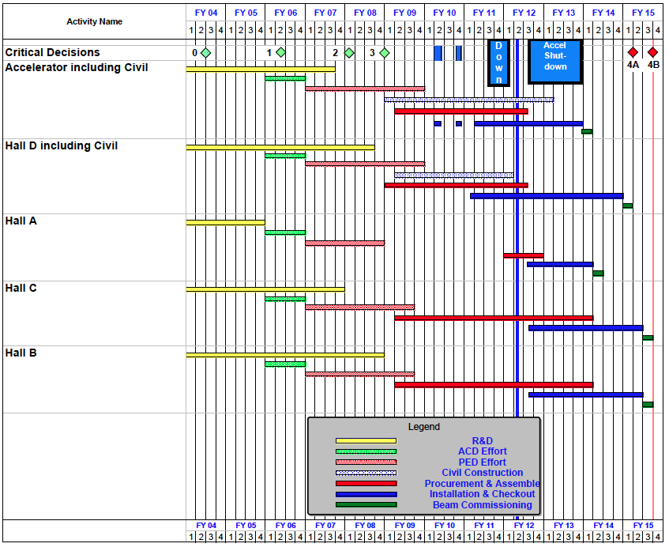
Expect schedule shift of project completion to 9/2016.

Slide 26
Summary
JLab 12 GeV upgrade has a broad and well defined science program covering many facets of hadron physics.
Exotic mesons resulting from the excitations of the gluon field.
Extending knowledge of PDFs to high x in measurements of (un)polarized structure functions using tagging. Addresses the nucleon “spin-puzzle” and extend knowledge of quark density distribution at high x.
Precision studies of DVCS in polarization measurements give access to GPDs and enables quark spatial imaging, and relate to the quark spin distribution and orbital angular momentum.
Precise measurements of SIDIS give access to TMDs and quark momentum tomography, and relate to the quark orbital angular momentum.
Gluonic structure of the proton in exclusive processes.
Many topics not discussed, high precision parity experiments, nucleon e.m. form factors, drak matter searches, QCD and nuclei, ….

Slide 27
Additional slides

Slide 28
CEBAF energy doubling from 6 GeV to 12 GeV
Superconducting rf structures operating at 2K provide cw beam acceleration with 1.5 GHz micro bunch structure.
Add new hall
CHL-2
Enhance equipment in existing halls
Notes:
A major focus of hadron physics with electromagnetic probes is the determination of new multi-dimensional parton distribution functions in a large kinematics range. This requires experiments at high luminosity and at sufficiently high energy. For this the existing accelerator will be equipped with accelerating superconducting RF cavities with much higher gradients. The additional 5 cryo modules will provide the same energy boost as the 20 existing ones. In addition some of the lower gradient cryo modules will be refurbished

Slide 29
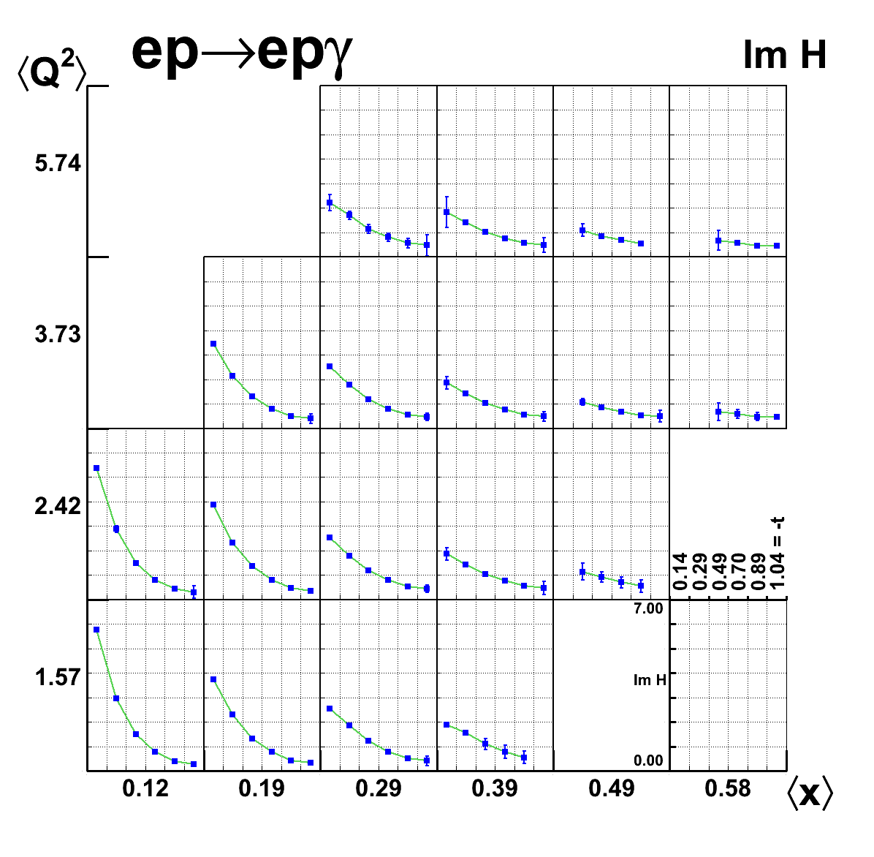
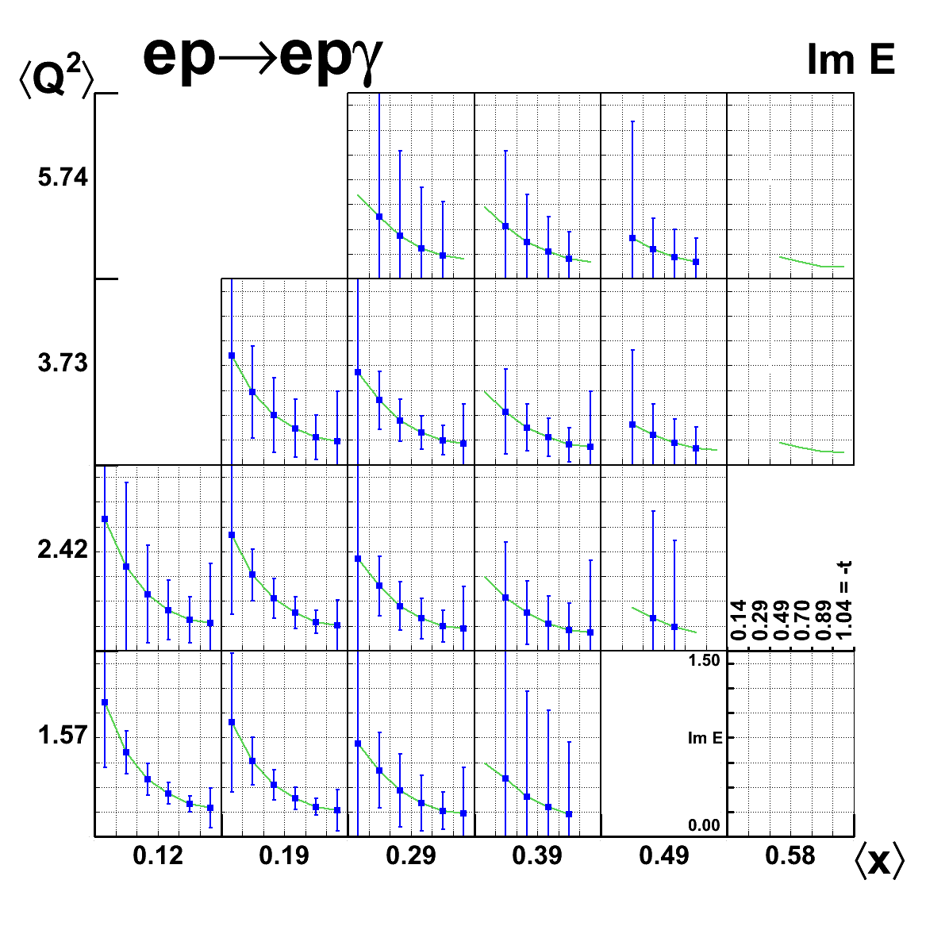
E(Q²,x,t) and H(Q²,x,t) from projected DVCS
Input: VGG model GPD parameterizations (Phys.Rev. D60 (1999) 094017)
Full CLAS12 acceptance simulation and event reconstruction for all 3 polarization observables and diff. cross section.
Output: Reconstructed CFF/GPDs in twist-2 approximation
t-dependence allows determination of quark densities in transverse impact parameter space through Fourier transform

Slide 30
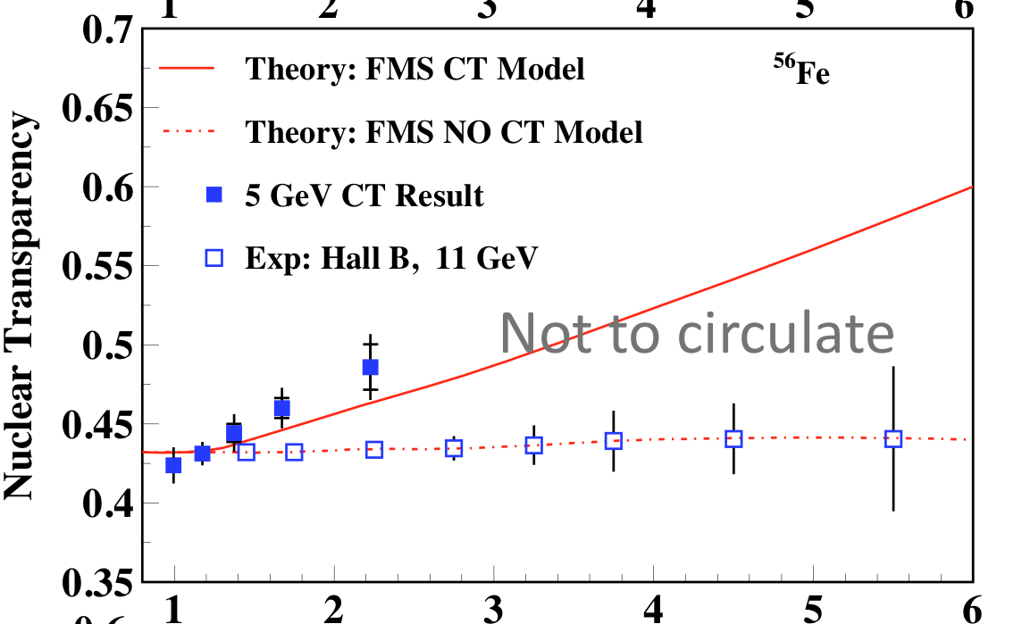
Nuclear transparency of ρ⁰ mesons
eA→eρ⁰X
JLab@12Gev projected
Q²(GeV²)
ρ⁰ meson photo-production is most suitable for studies of Color Transparency at medium energies as the photon couples directly to the ρ⁰ in a small size configuration from which it evolves to become a full meson.
At JLab@12GeV the Color Transparency QCD effect should become highly significant.

Slide 31
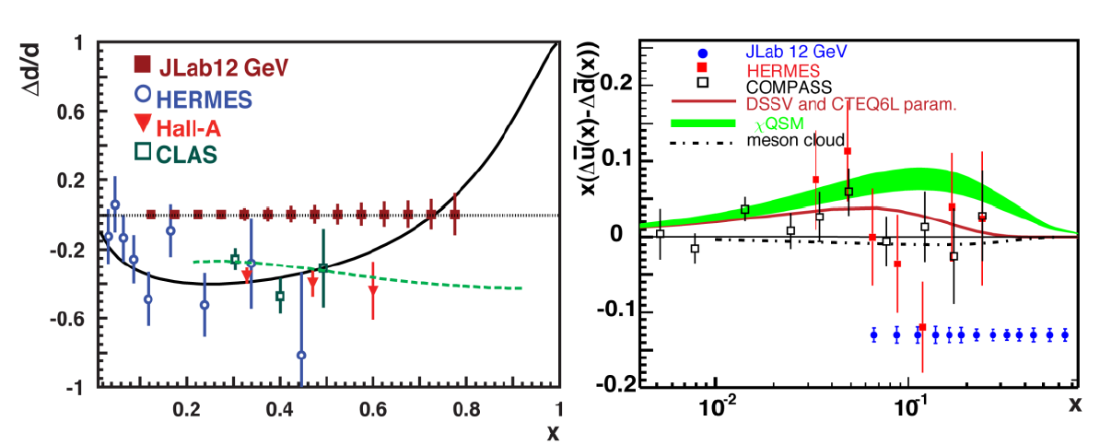
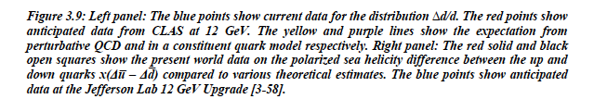
Flavor-tagged polarized PDFs

Slide 32
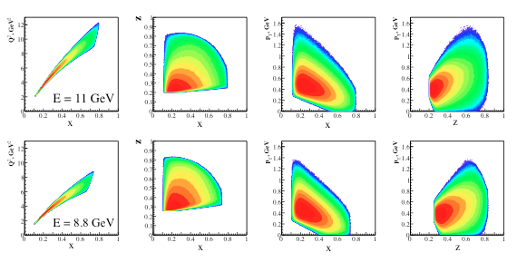
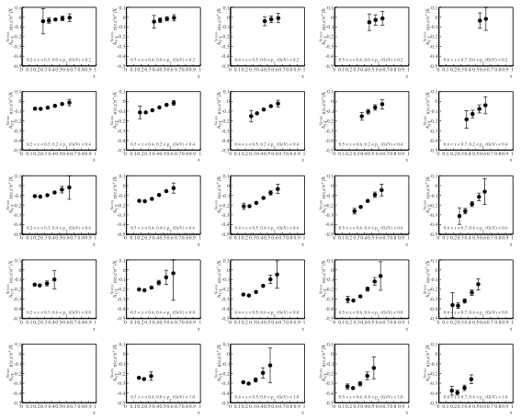
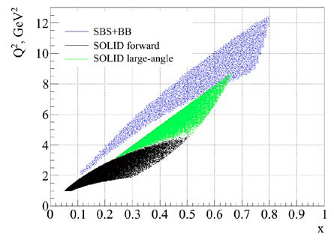
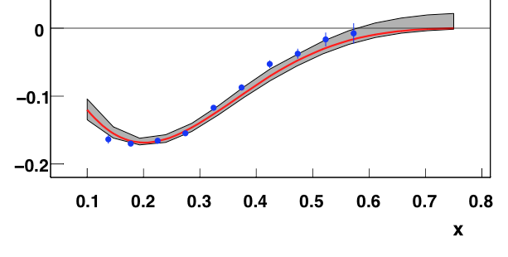
SBS/BB A_{UT} on ³He Target
³He(e,e’π^{+,-,o}), ³He(e,eK^{+,-})
n(e,e’π⁺)
C12-09-018
B. Wojtsekhowski
Sivers asymmetry

Slide 33



Transversity function from dipion production
Use Belle measurement
Use Belle measurement
in models extract h₁^{u}
100 days of transversely polarized HD will allow precision measurement of the transversity distribution.

