Slide 1
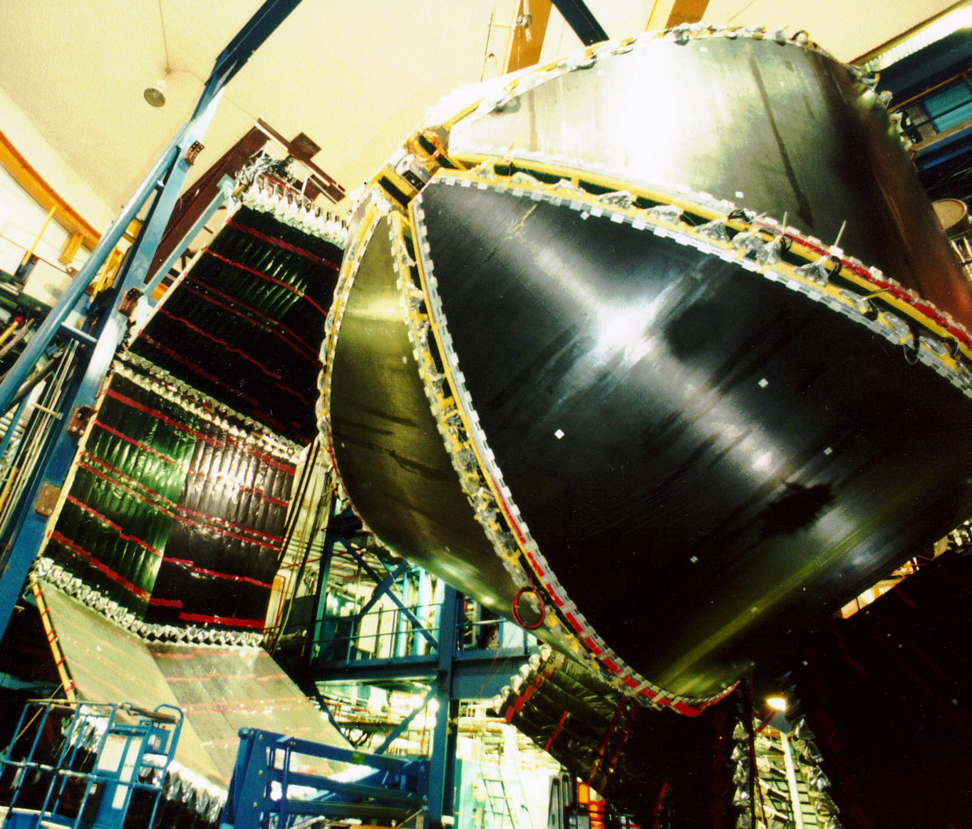
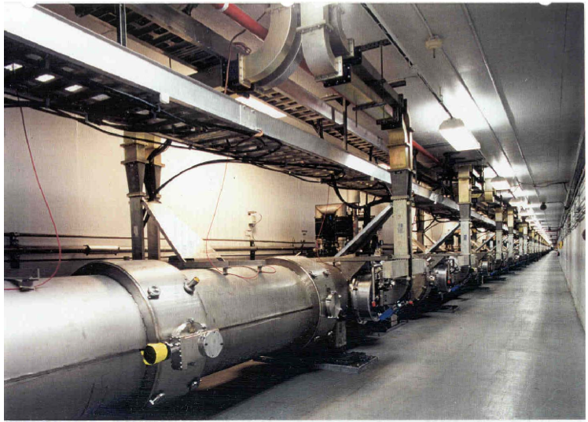
Meson Spectroscopy at CLAS
D.P. Weygand
CLAS Collaboration
Thomas Jefferson National Accelerator Facility

Slide 2
GLUE88/BNL
I have been using the constituent quark model for many years now as a tool for understanding the spectrum and properties of the low-lying mesons and baryons. For most of this time I have been painfully aware of the difficulty of understanding from first principles (i.e., from QCD) why such a model should work. I have nevertheless had faith that we would eventually be able to justify the use of this model simply because it is such a good representation of the physics.
At the same time, the picture I will propose to rationalize the success of the quark model (which is related to the old string model) leads inevitably to a model for states beyond the quark model: hybrids, glueballs, and multiquark states.
Nathan Isgur, b. 1947, d. 2001

Slide 3
photoproduction

Slide 4


Partial Wave Analysis
X
isobar
Likelihood function:

Slide 5
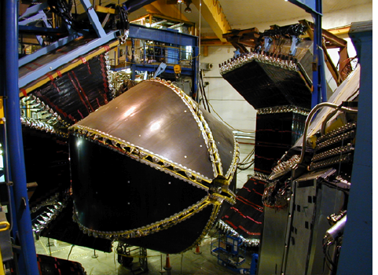
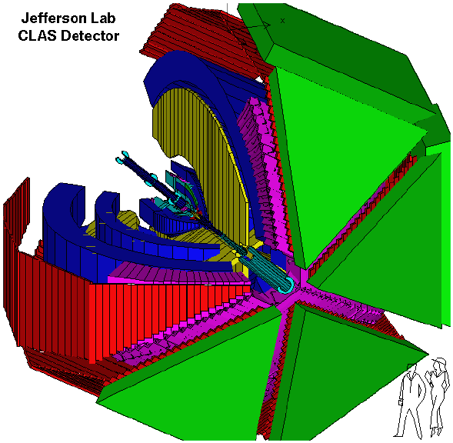
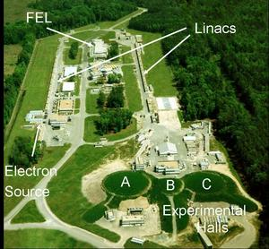
CLAS g₁₂ run
CLAS g₁₂ run
E_{e} = 5.715 GeV
I = 65 nA
E_{γ} = 3.58-5.45 GeV
26.2 X 10⁹ triggers
L = 68 pb⁻¹

Slide 6

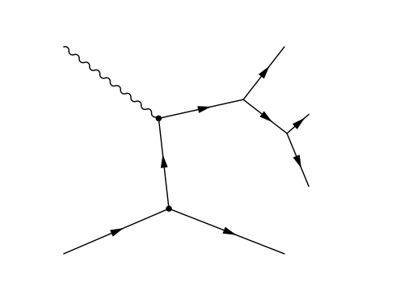
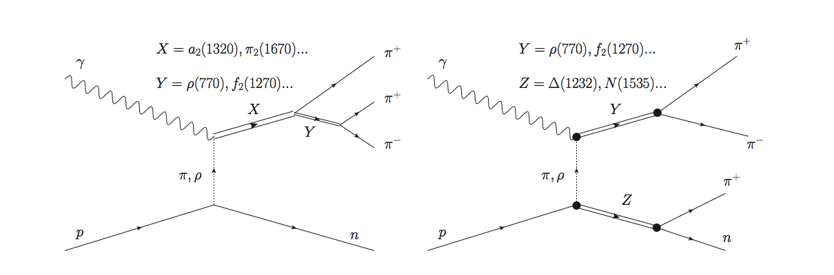

Slide 7
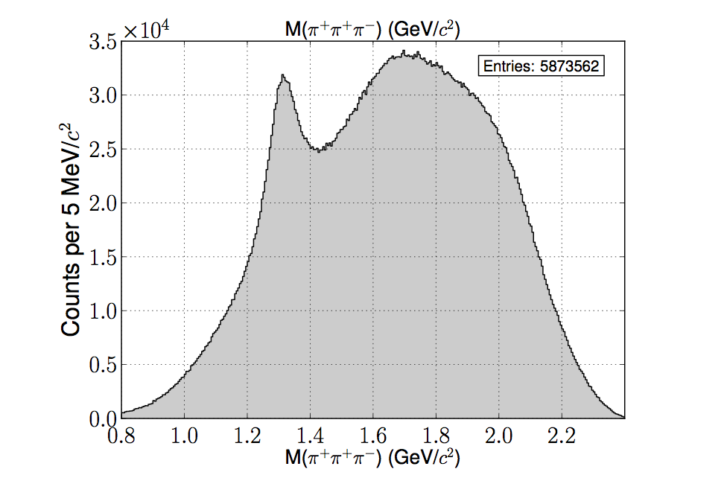
Raw πππ mass spectra
C. Bookwalter thesis

Slide 8
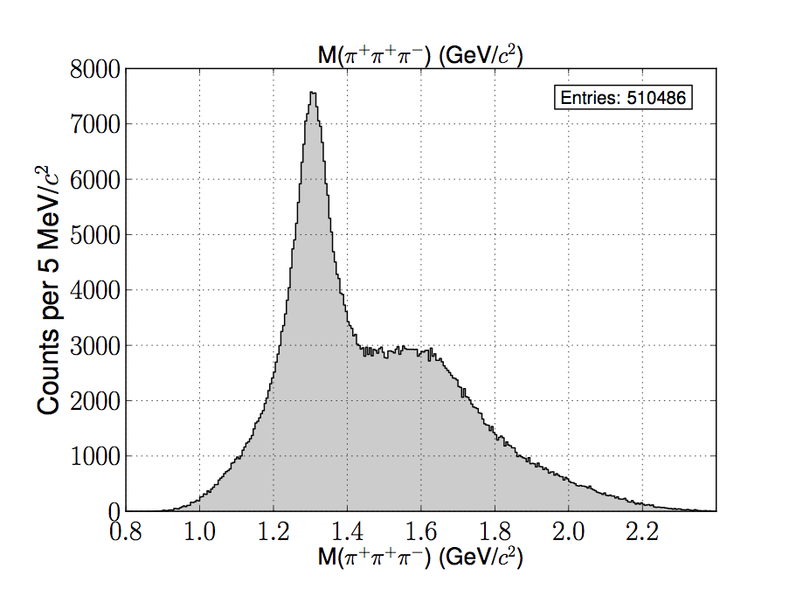
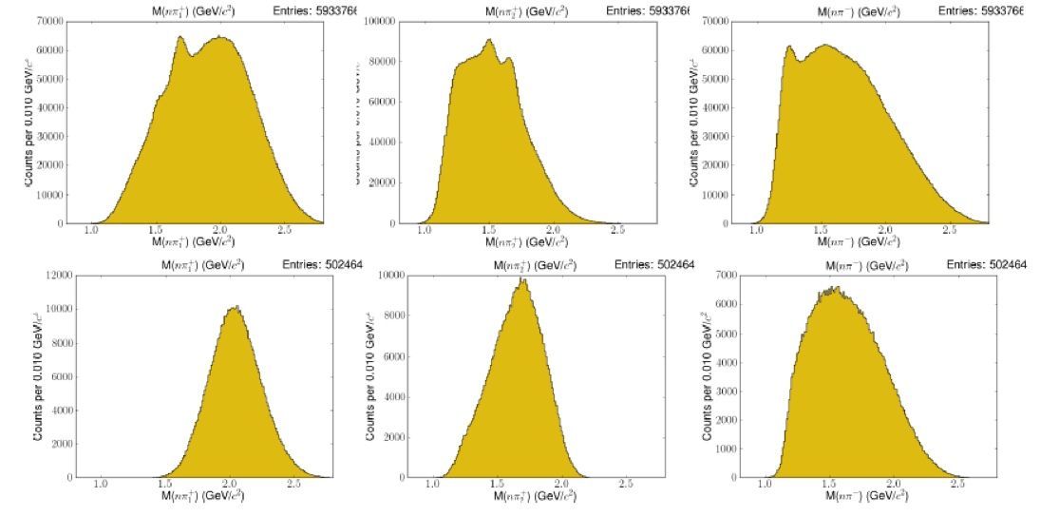
Baryon background

Slide 9
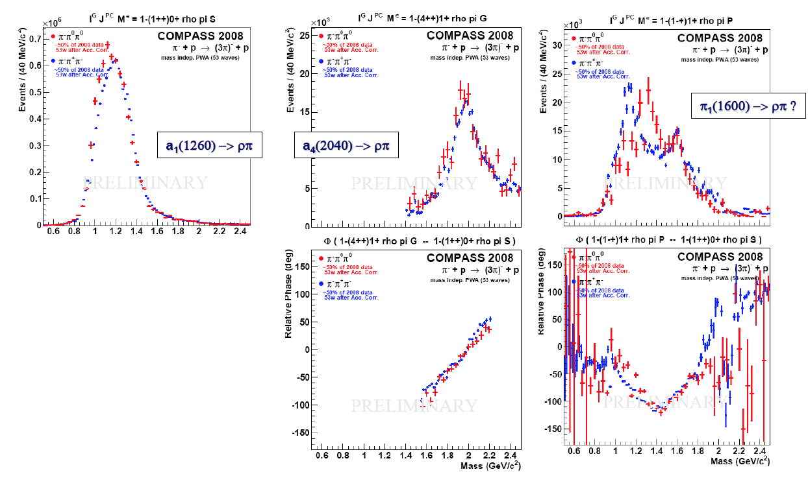
COMPASS

Slide 10
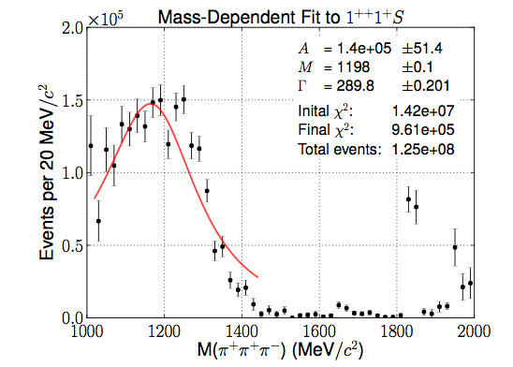
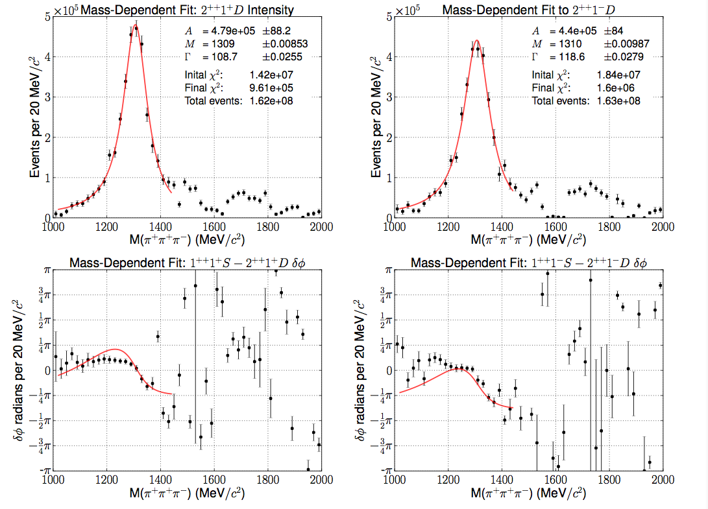
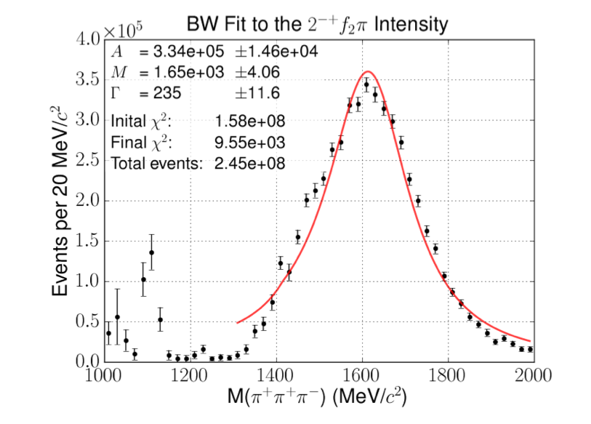
a₁(1260)/a₂(1320)/π₂(1670)

Slide 11
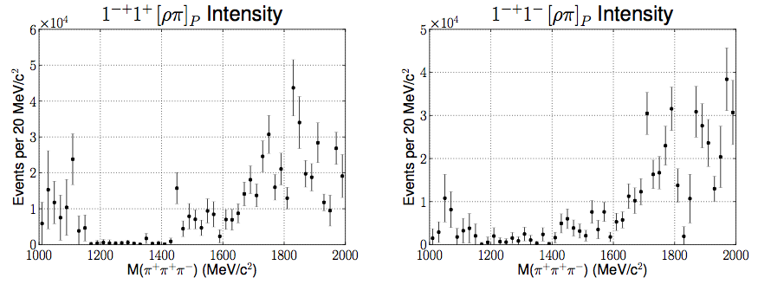
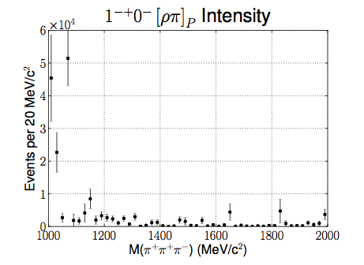

Slide 12
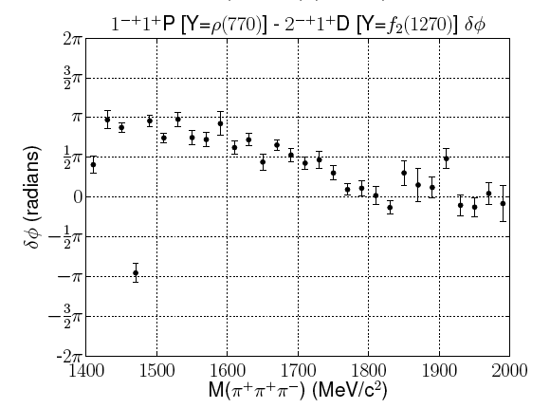
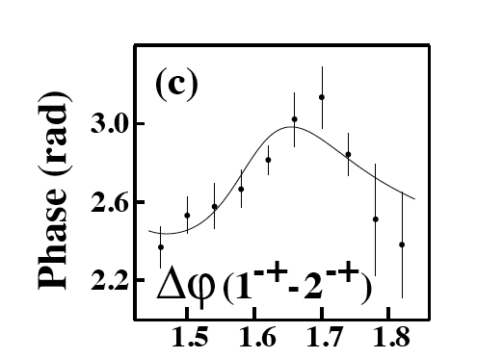

π₁(1600) phase
E852/1998

Slide 13
πππ mass
πππ mass
sideband subtracted
π⁰ sidebands
GeV/c²
GeV/c²
GeV/c²

Slide 14
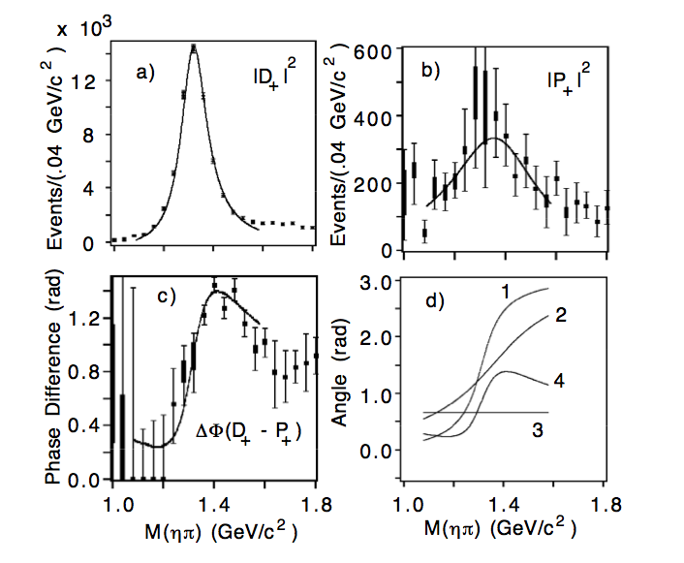
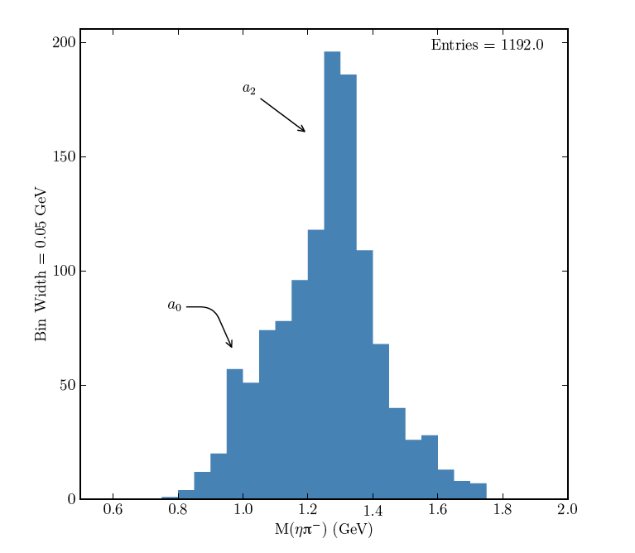
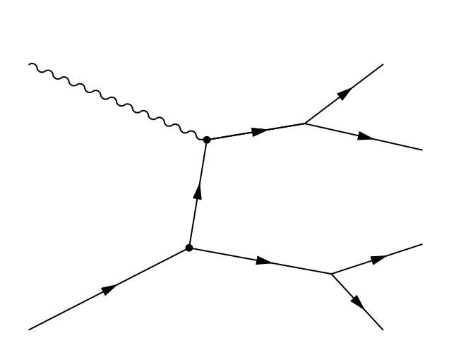
E852 1997
D. Schott Thesis

Slide 15
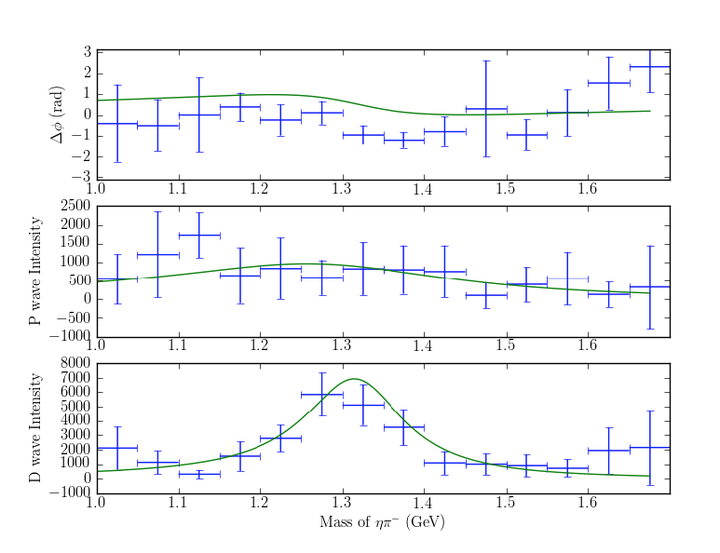
PWA
P M=1
D M=1

Slide 16
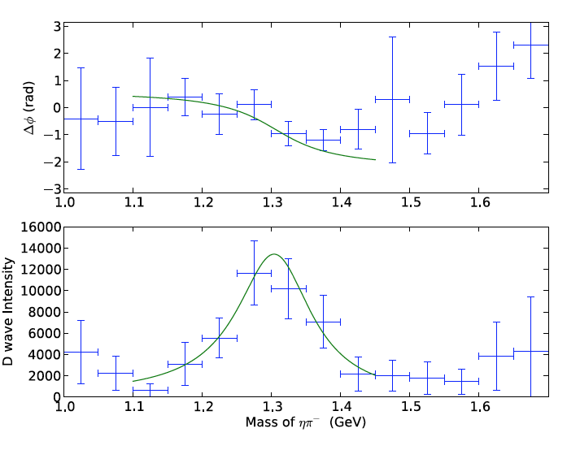
a2(1320) Breit-Wigner
mass = 1.32± 0.01 GeV
Γ = 0.14 ± 0.01 GeV

Slide 17
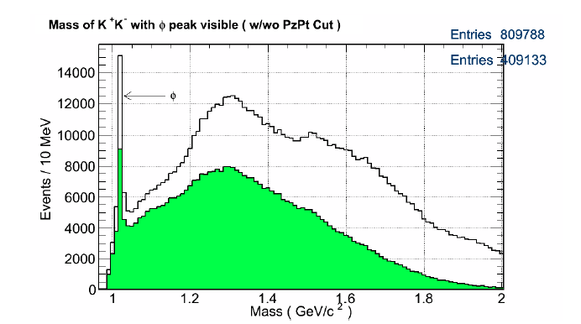
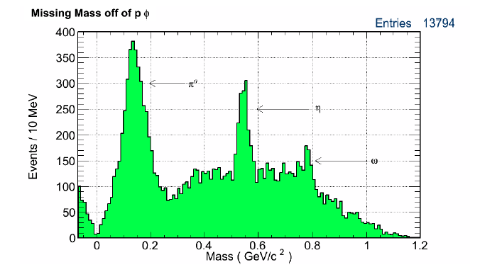
M. Saini Thesis

Slide 18
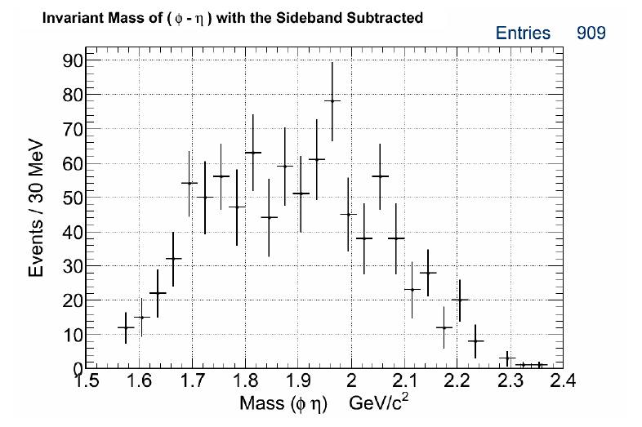
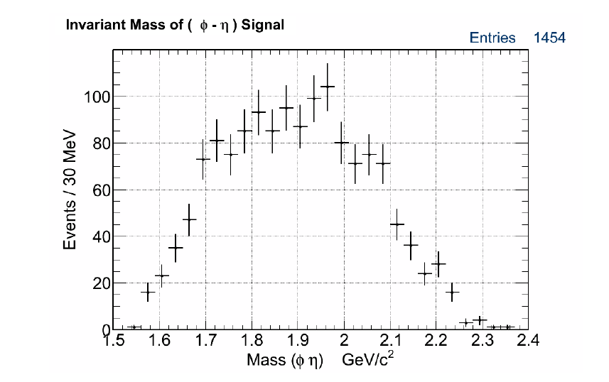

Slide 19
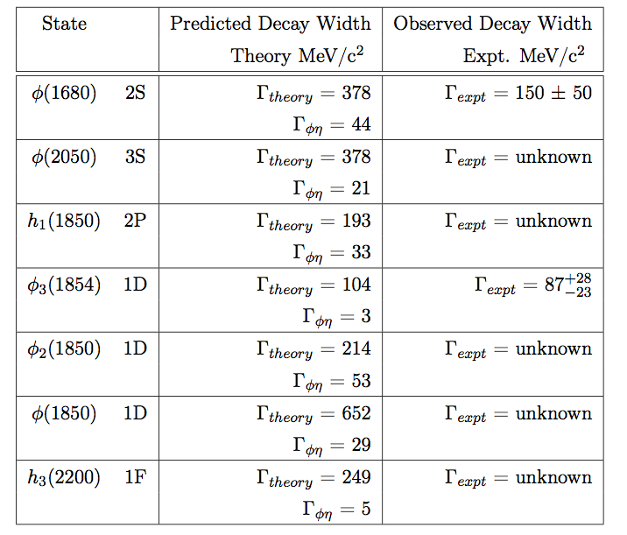
Strangeonium
LQCD: Hadron Spectrum Collaboration
J^{PC} | Mass (MeV)
1⁻⁻ | 1023 1819 1862
2⁻⁻ | 1979
3⁻⁻ | 2123
1+- | 1489

Slide 20
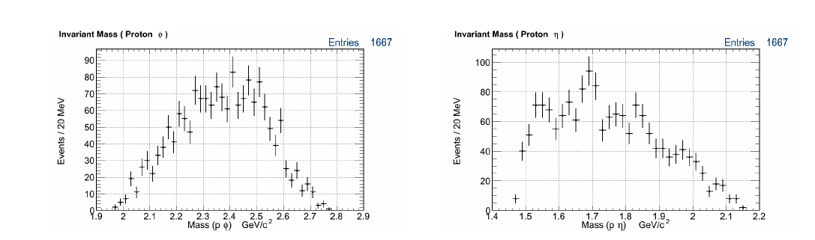

Slide 21
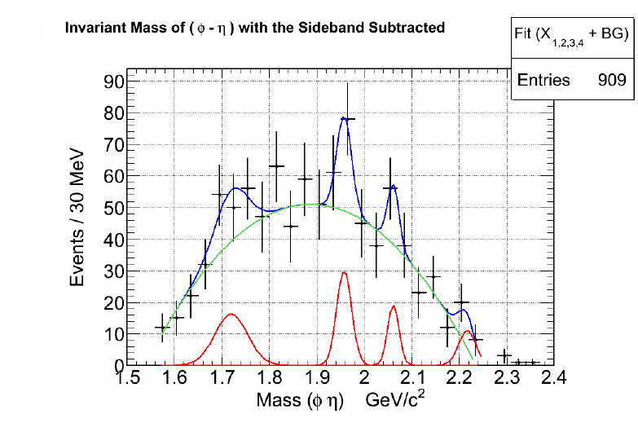

Slide 22
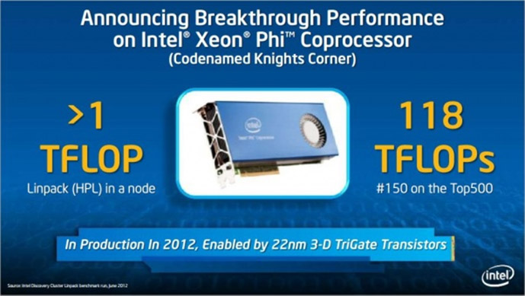
Xeon Phi
PWA fitting program currently being developed on Xeon Phi MIC

Slide 23
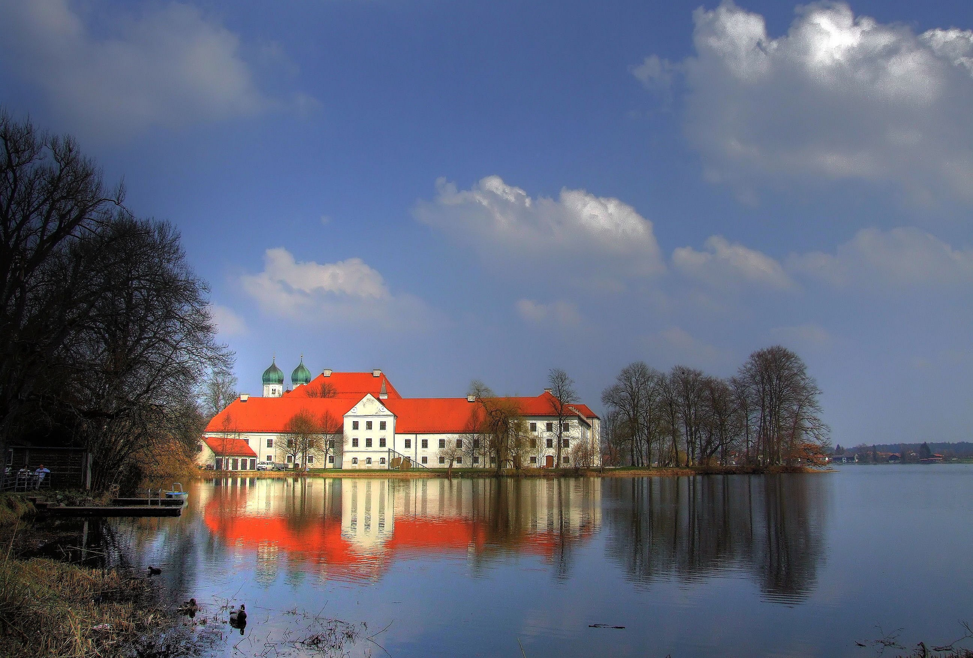
Summary
CLAS-g12: High luminosity, high energy data set (5.5 GeV/c, 68 pb⁻¹)
~10⁶ exclusive γ p → n π⁺π⁺π⁻ events
  PWA from 1 to 2 GeV
  Clear signals for a₁(1260), a₂(1320) and π₂(1670)
  No evidence for π₁(1600) exotic (neither intensity nor phase)
    Consistent with previous CLAS result
    Consistent with Pomeron exchange
Search for exotic π₁(1400) in ηπ− (π exchange)
  Clear signal for a₂(1320)
  No evidence for π₁(1400)
Strangeonium (φ η)
  No significant resonant structures
Prospects
  Neutral π⁺π⁻π⁰
  K_{s}K_{s}
  K⁺K⁻
Collaborative (Jlab,GWU) Effort to Include Baryon Resonances in PWA

Slide 24
Other Slides

Slide 25
π₁(1600) phase

Slide 26
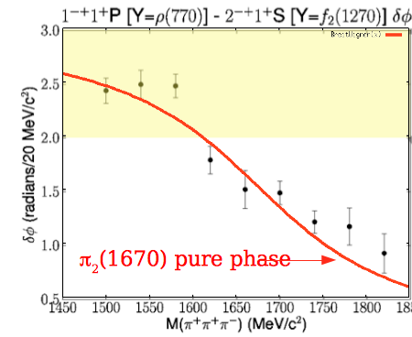
π₁(1600) phase
E852/1998

Slide 27
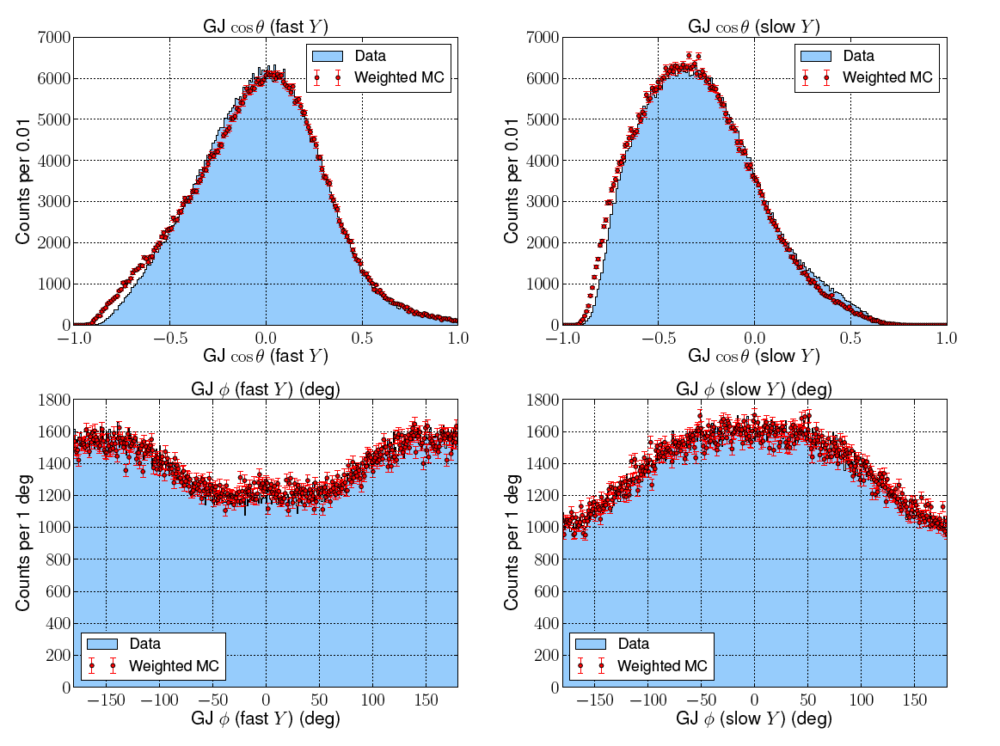
Jackson Frame Angles

Slide 28
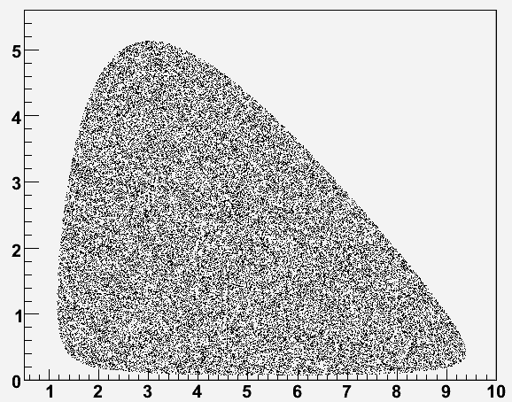

Slide 29
