Slide 1








The JLab 12 GeV Project
Volker D. Burkert
Jefferson Lab
Add new hall
CHL-2
Enhance equipment in existing halls

Slide 2
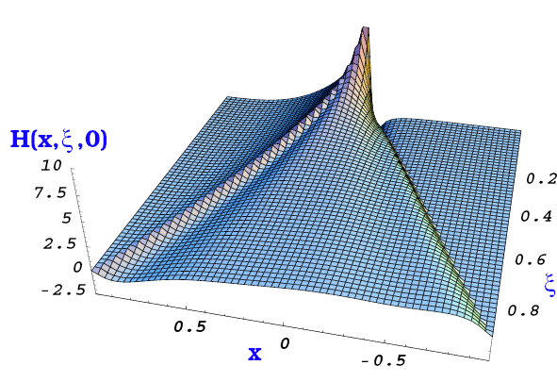
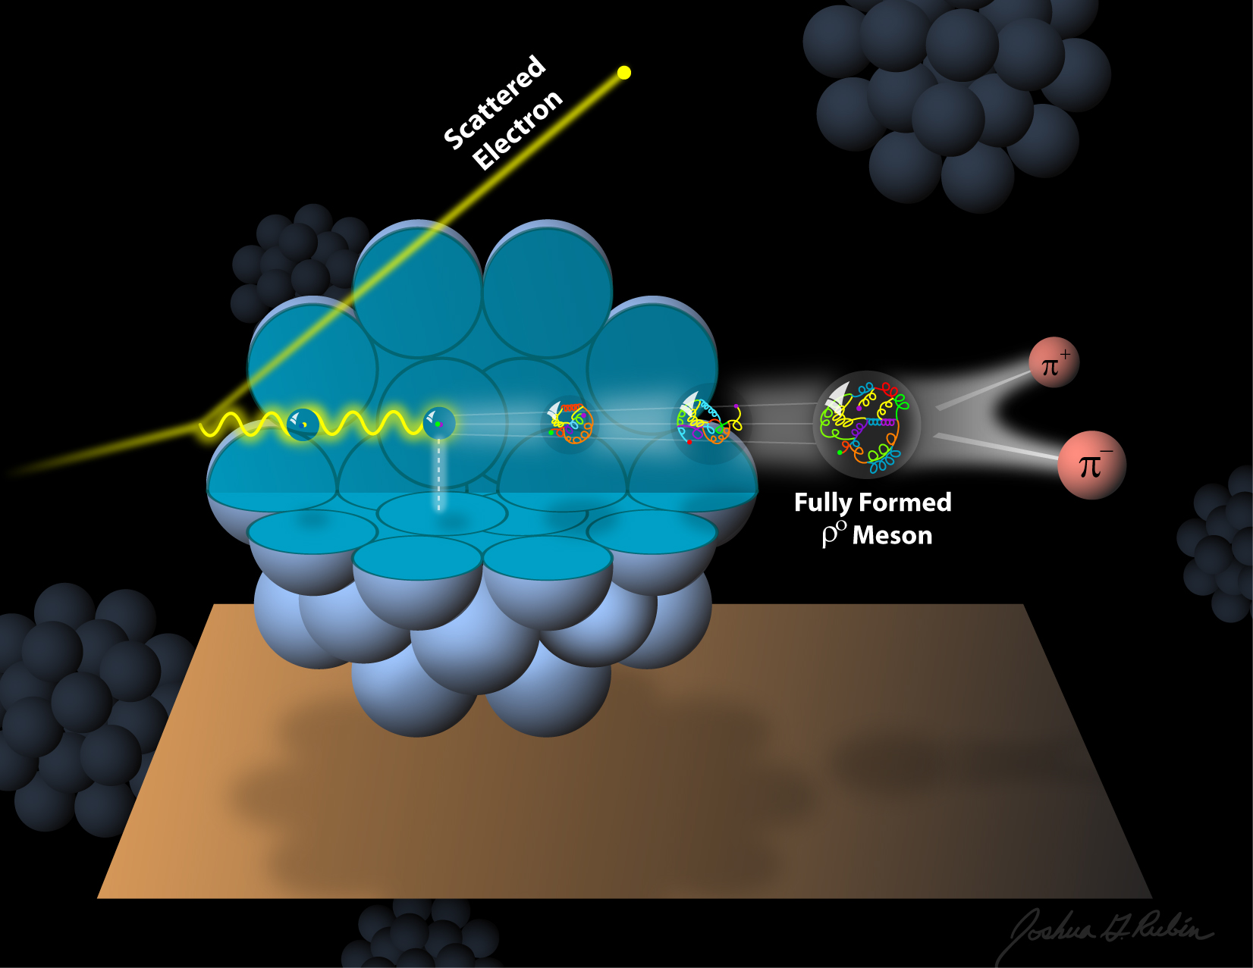
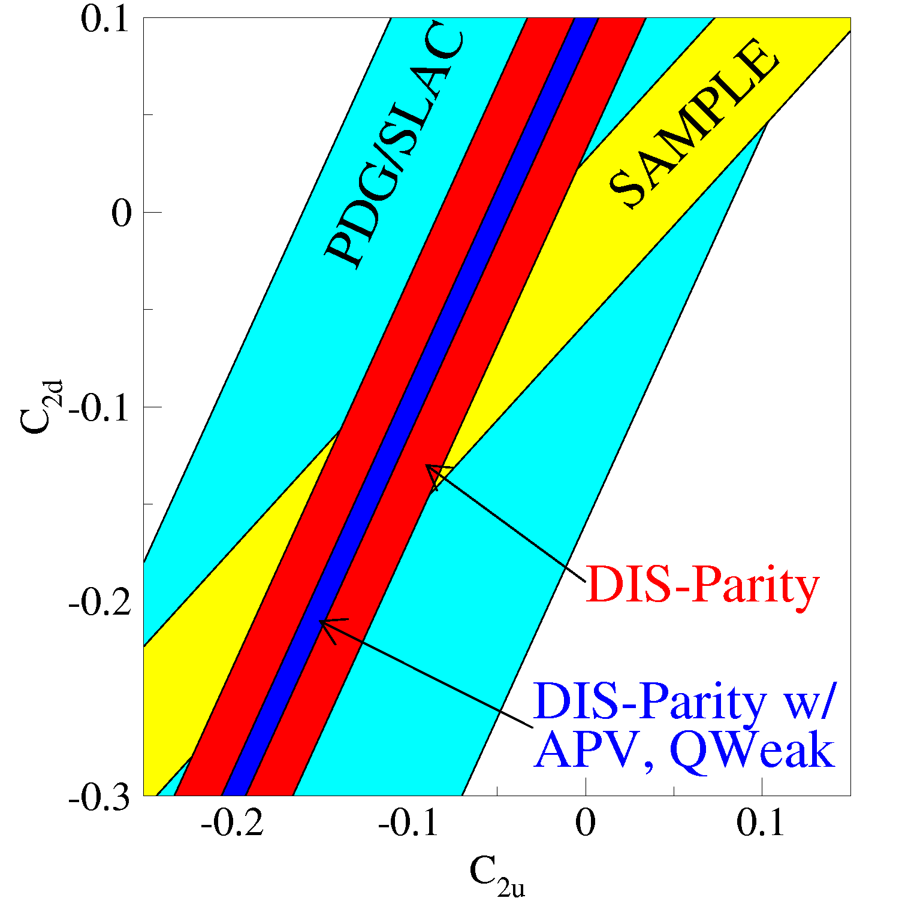
The science program at JLab @ 12GeV
Quark confinement and the role of the glue in meson and baryon spectroscopy
The 3D structure of the nucleon – from form factors and PDFs to GPDs and TMDs
The strong interaction in nuclei – evolution of quark hadronization, nuclear transparency of hadrons
Search for science beyond the Standard Model – precision and intensity frontiers
Physics Opportunities with the 12 GeV Upgrade at Jefferson Lab, J. Dudek et al., EPJ A48 (2012) 187
Notes:
The JLab energy upgrade serves a broad experimental scientific program that one may broadly describe within 4 categories: 1) Better understanding the quark confinement through studies of the role of glue in meson and baryon spectroscopy. 2) The study of the multi-dimensional spatial and momentum structure of the nucleon from e.m. form factors and PDFs to GPDs and TMDs. 3) Strong interaction in nuclei and 4) The search for science beyond the Standard Model, especially through the precision measurement of fundamental quantities. Many of these topics are discussed in some detail in this paper.

Slide 3
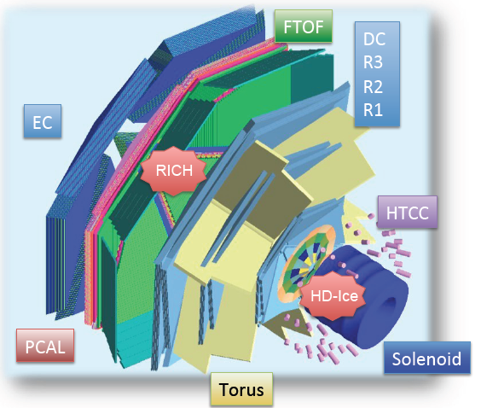
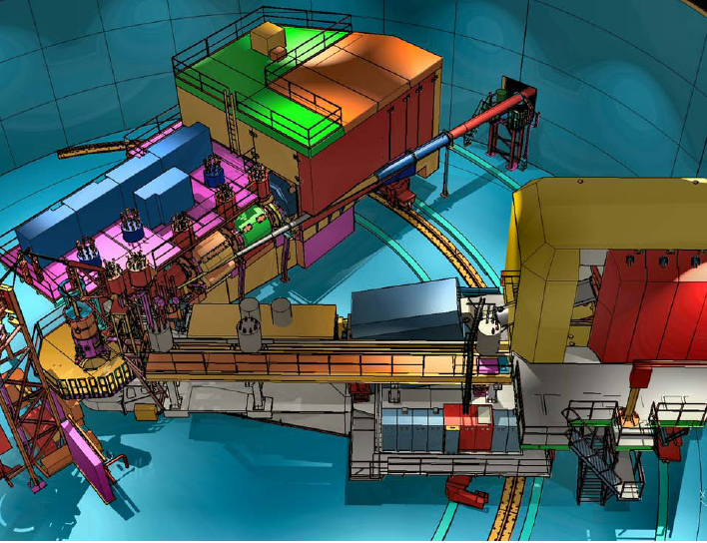
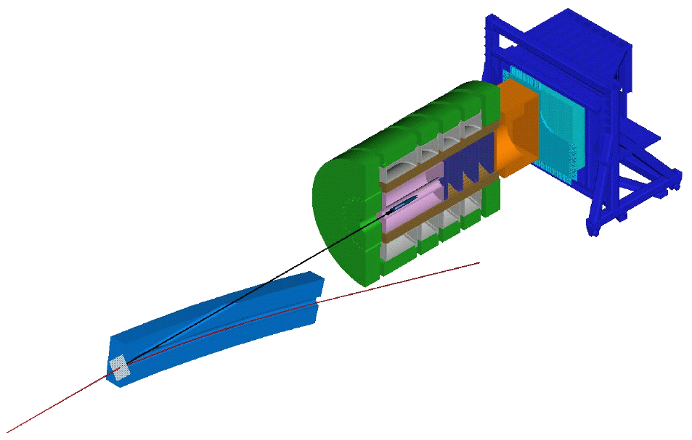
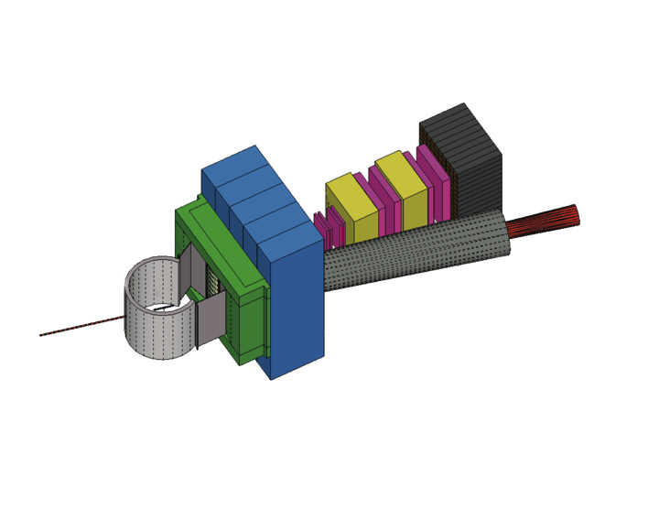
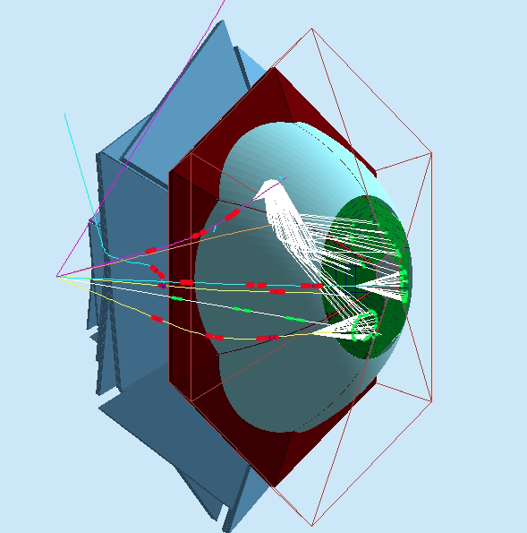
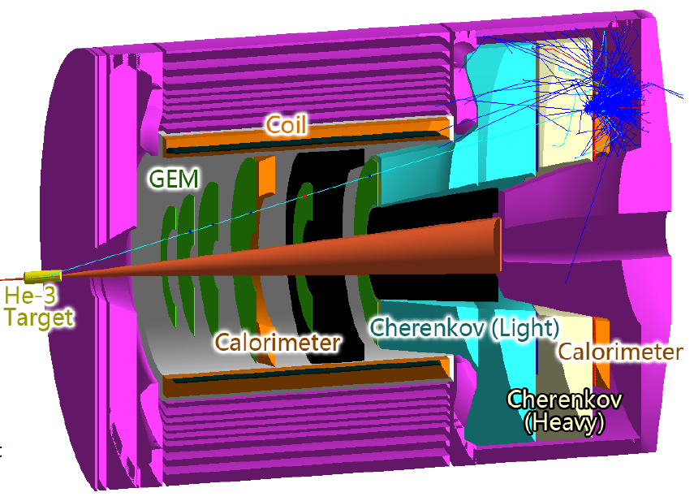
Base equipment & proposed equipment
Hall B
Hall C
Hall D
CLAS12
SHMS
GlueX
additional equipment (proposed)
SBS-Hall A
Hadron calorimeter
CLAS12 RICH
SOLID - Hall A
Tracker
Scattering chamber
CH2 analyzer
Beam line Pb shield

Slide 4
12 GeV Experiments by Physics Topics
Updated PAC40, June 2013
 | Topic | Hall A | Hall B | Hall C | Hall D | Total
 | The Hadron spectra as probes of QCD (GlueX and heavy baryon and meson spectroscopy) |  | 2 |  | 2 | 4
 | The transverse structure of the hadrons (Elastic and transition Form Factors) | 4 | 3 | 3 | 1 | 11
 | The longitudinal momentum structure of the hadrons (Unpolarized and polarized parton distribution functions) | 2 | 2 | 6 |  | 10
 | The 3D quark structure of the hadrons (Generalized Parton Distributions and Transverse Momentum Distributions) | 5 | 14 | 4 |  | 23
 | Hadrons and cold nuclear matter (Medium modification of the nucleons, quark hadronization, N-N correlations, hypernuclear spectroscopy, few-body experiments) | 4 | 2 | 6 |  | 12
 | Low-energy tests of the Standard Model and Fundamental Symmetries | 3 | 1 |  | 1 | 5
 | TOTAL | 18 | 23 | 19 | 4 | 64
PAC fully and conditionally approved experiments: 64
More than 7 years of parallel running experiments.
Notes:
There are now 57 fully approved experiments and if I include conditionally approved ones the number grows to 64.

Slide 5
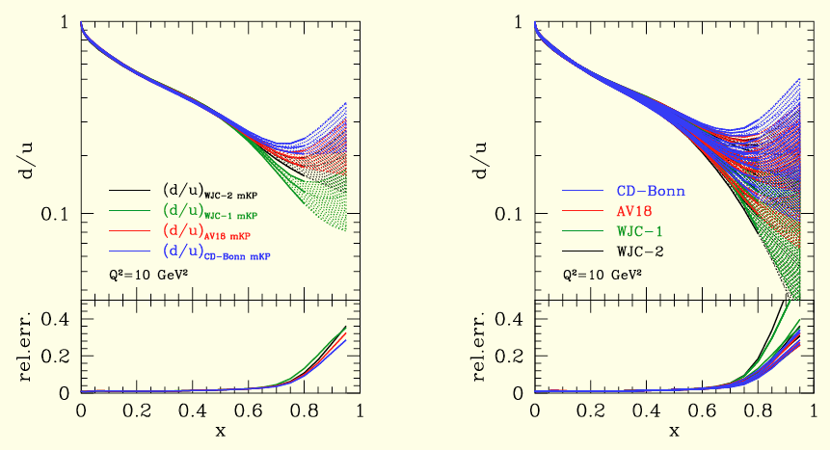
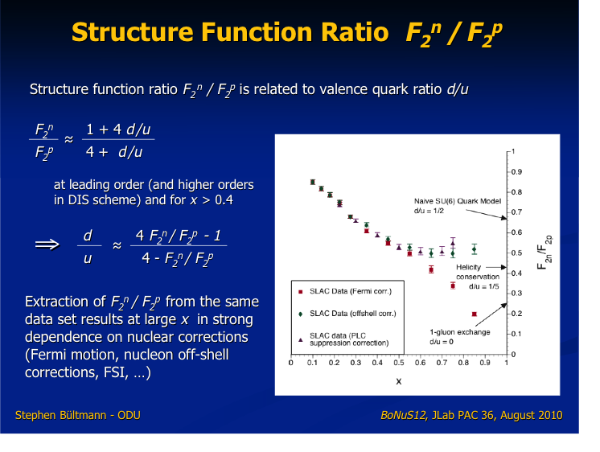
DIS structure functions and d_{v}(x)/u_{v}(x)
From F₂^{n}/F₂^{p} measurements
d(x)/u(x) poorly constrained at x > 0.5

Slide 6
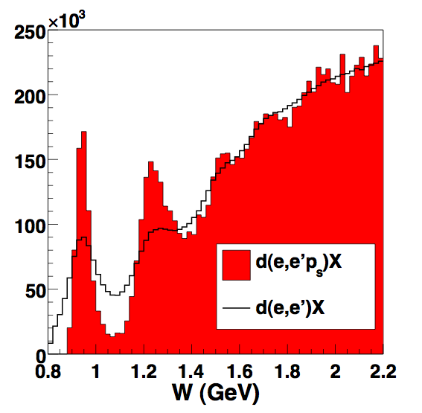
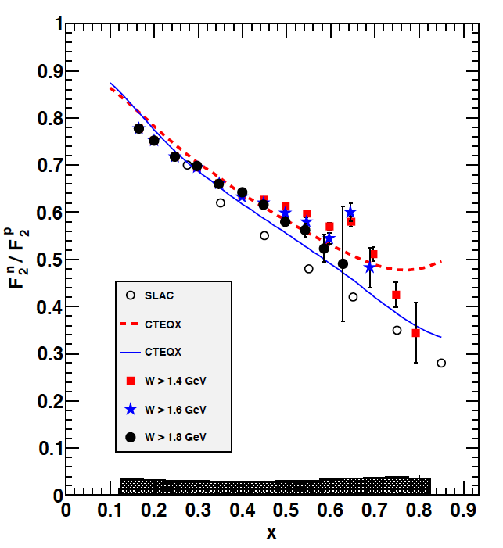
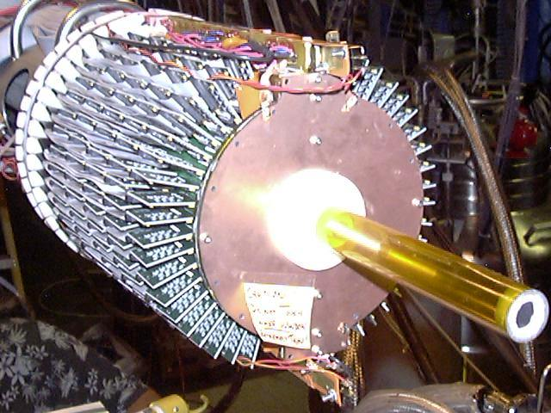
Neutron structure and quark distributions
1) Measure F₂^{n}/F₂^{p} by tagging almost unbound neutrons using detection of low
momentum protons in a radial TPC. 2) Other experiment will measure ³H/³He.
E12-10-102
e⁻D→e⁻p_{s}X
N(1680)
n
N(1520)
Phys.Rev.Lett. 108 (2012) 199902
Δ
e⁻
n
e⁻
p
p_{s}
>70MeV/c
BONUS GEM Detector
5 Tesla
mag. field
First model-independent measurement of F₂^{n}/F₂^{p}
Projected results for d(x)/u(x) for 12 GeV experiment.
Notes:
One of the unresolved issues in neutron structure functions studies at high Bjorken x is the correction for the nuclear binding effect in deuteron. Different corrections have resulted in vastly different results. A model-independent way is to tag the neutron by measuring the spectator proton to very low momentum using, e.g. a gas target and a low density tracking detector. Protons with momentum down to 70 MeV/c (T=2.5MeV) must be detected. The corrections for the neutron momentum in deuteron is shown in this graph. The elastic peak and the resonance structure show up clearly. The corrected ratio F2n/F2p is shown with the red points. The ratio of d-quark to u-quark distribution functions is shown here. The maximum xB is limited by the beam energy of 5.2 GeV. However, the trend is to rule out the scalar diquark model. Future experiments at the 12GeV upgrade will extend this range up to 0.9.

Slide 7
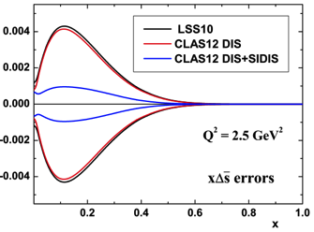
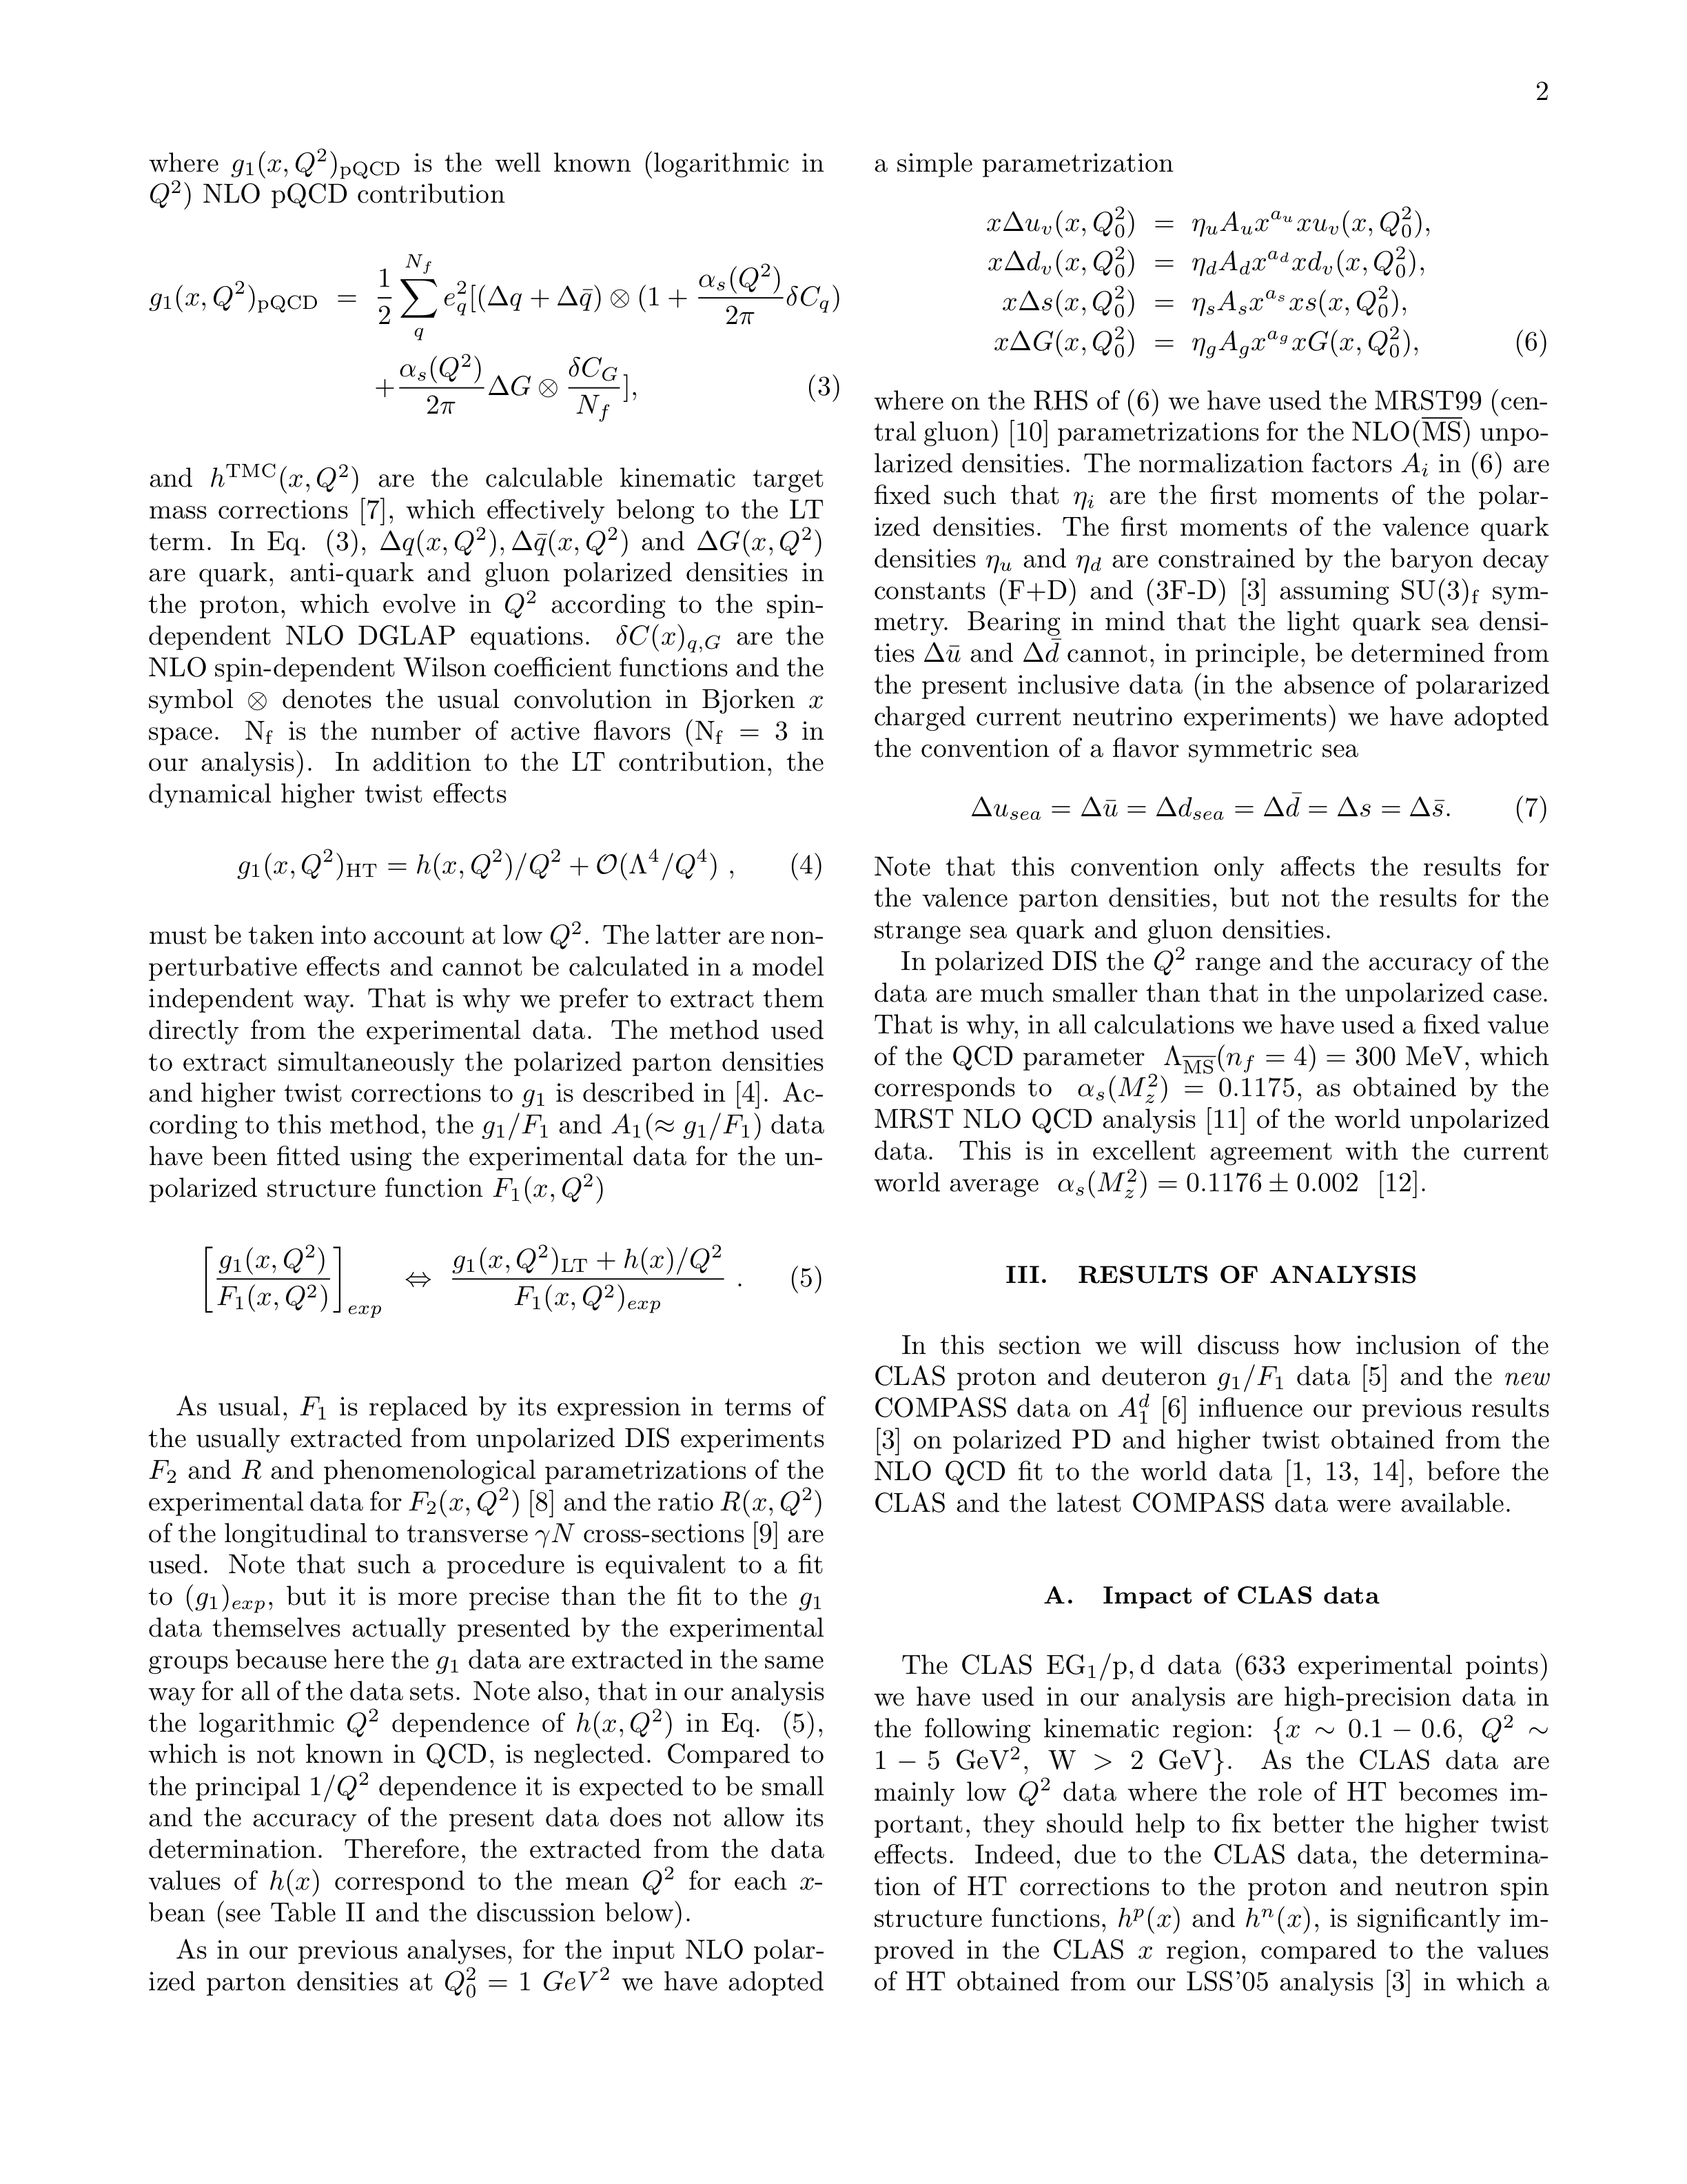
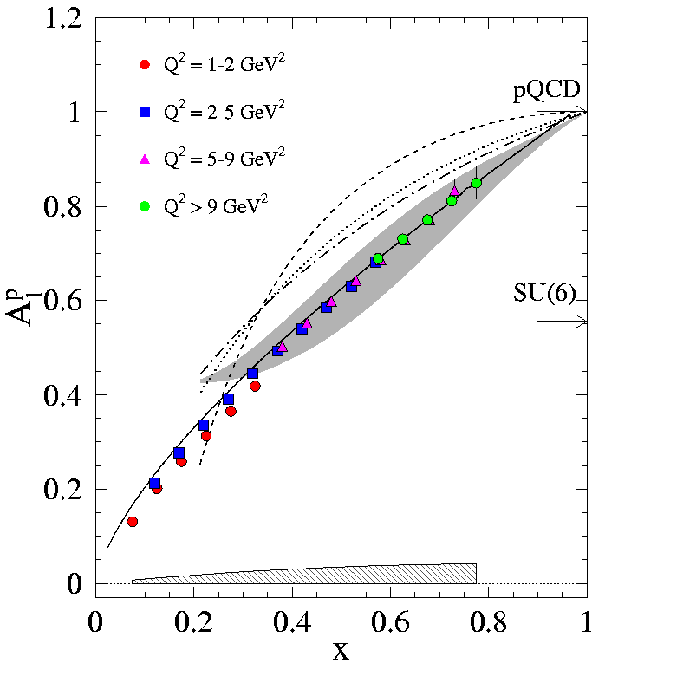
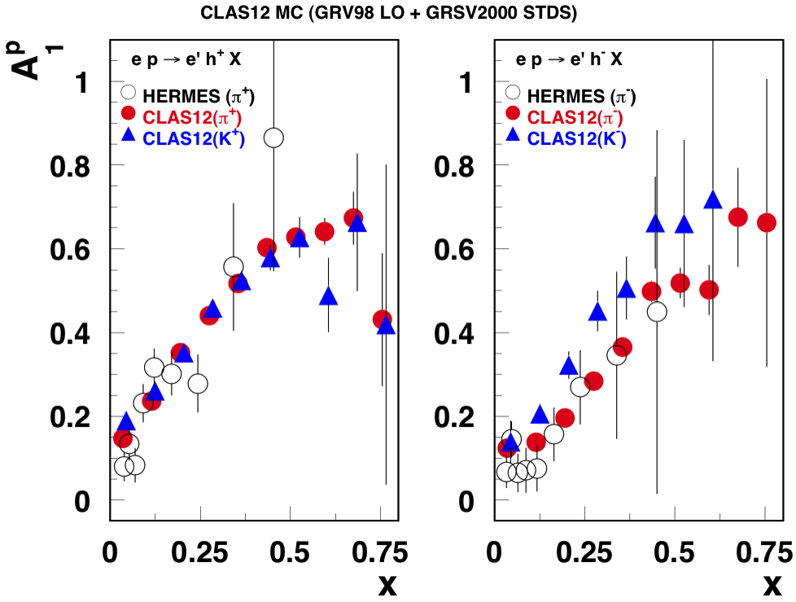
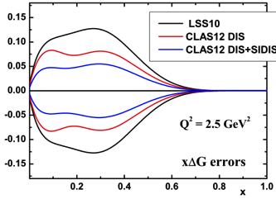
Polarized PDFs on p/d at 12GeV
Precise information on A₁(x, Q²) with flavor tag can reduce uncertainties in parton helicity distributions. The Q² dependence and QCD evolution can provide model-independent ΔG(x).
Improved PDFs from NLO analyses
E12-06-109
E12-06-110
E12-09-007

Slide 8
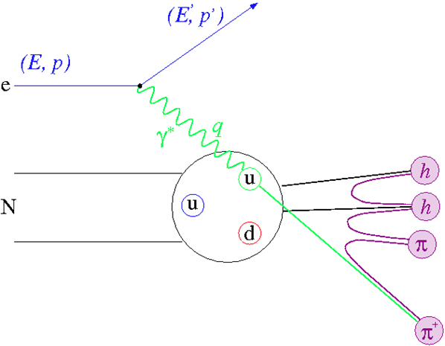
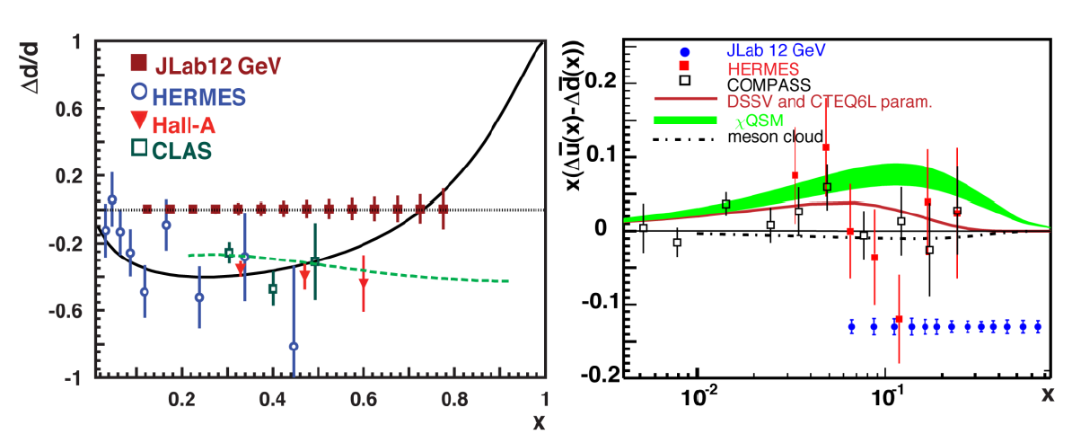
Flavor-tagged polarized PDFs
Extraction of the individual contributions of quarks and anti-quarks to the nucleon spin. Use polarized & unpolarized proton and deuteron targets.
E12-09-007

Slide 9
Generalized Parton Distributions
(Quantum phase-space quark distribution in the nucleon)
Polarized DVCS directly probes GPDs
Integrate over transverse momentum space
Sensitivity to GPD
~
Generalized Parton Distributions (GPD) H, H, E, E
UP
LP
TP
H, H, E
~
~
~
Nucleon polarization
H, H, E
3D nucleon imaging in transverse coordinate and longitudinal momentum space
E, H

Slide 10
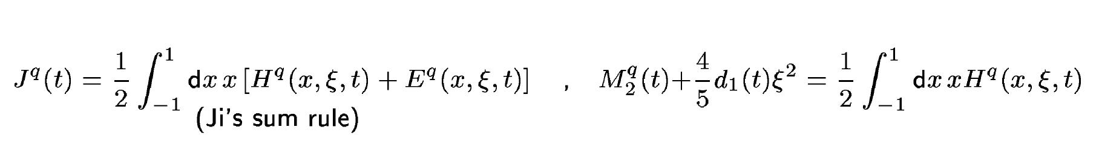
Structural content of GPD E & H
Nucleon matrix element of the Energy-Momentum Tensor of q flavored quarks:
M₂(t) : Mass density in the nucleon
J (t) : Angular momentum density
d₁(t) : Pressure and shear forces
J^{q}(t)
χQSM
related to “D-term”
To determine J(t), measurements of the x and t dependence of GPDs are needed.
To separate M₂(t) and d₁(t) measurements at small and large ξ(x_{B}) are needed.
Notes:
The nucleon matrix element of the energy-momentum tensor is known to contain 3 form factors (R. Pagels, 1965). For a long time they were of little interest as the only known process where they could be directly measured is elastic scattering of gravitons off the nucleon. However, these form factors appear as moments of the unpolarized GPDs as shown here. The quark angular momentum in the nucleon is given by the 2nd moment of the sum of GPD H and E. The mass and pressure distribution of the quarks are given by the 2nd moment of H where the pressure is probed by parameter xi.

Slide 11
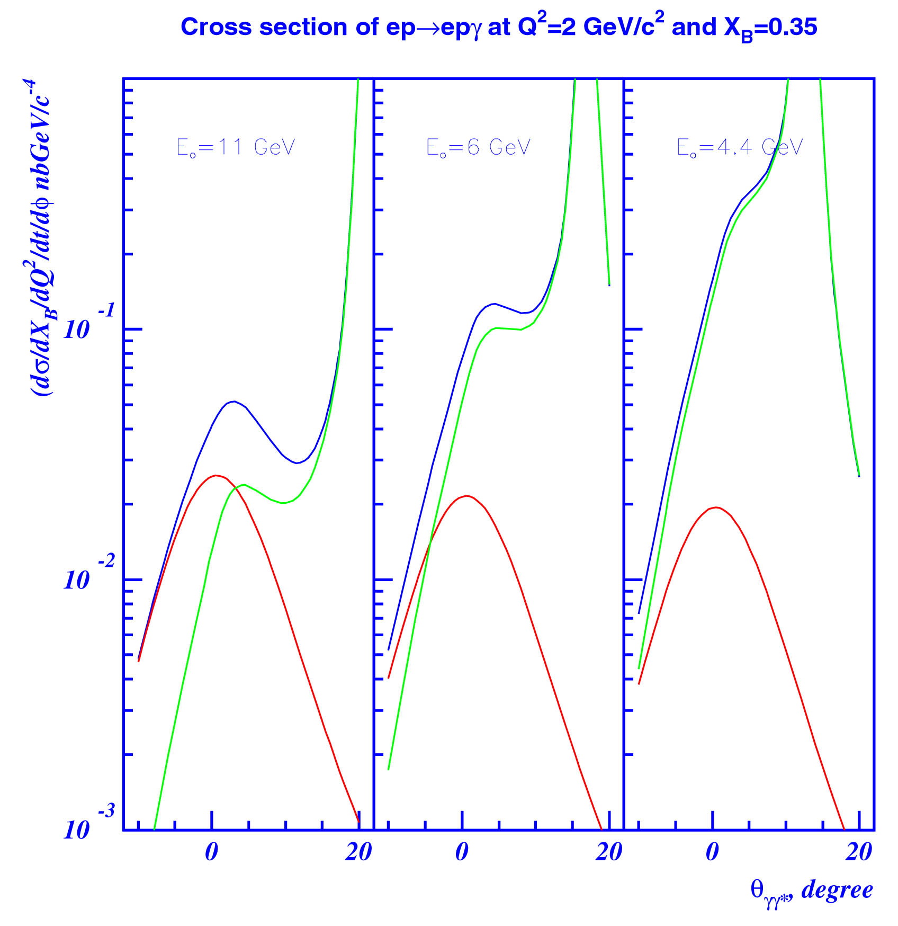
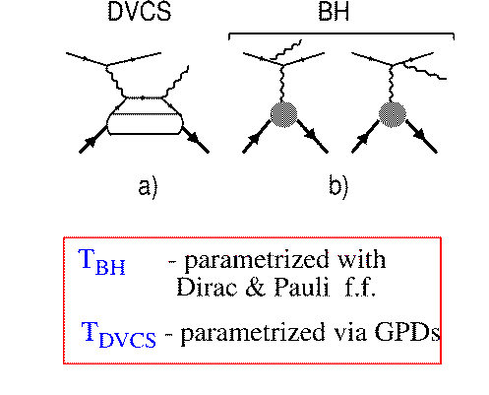
DVCS and Bethe-Heitler Process
d⁴σ
~ |T^{DVCS} + T^{BH}|²
dQ²dx_{B}dtdφ
E_{o} = 11 GeV
E_{o} = 6 GeV
E_{o} = 4 GeV
DVCS
BH
T^{BH :} given by elastic form factors
T^{DVCS}: determined by GPDs
BH
DVCS
BH-DVCS interference generates
beam and target polarization asymmetries that encode the nucleon structure content.

Slide 12
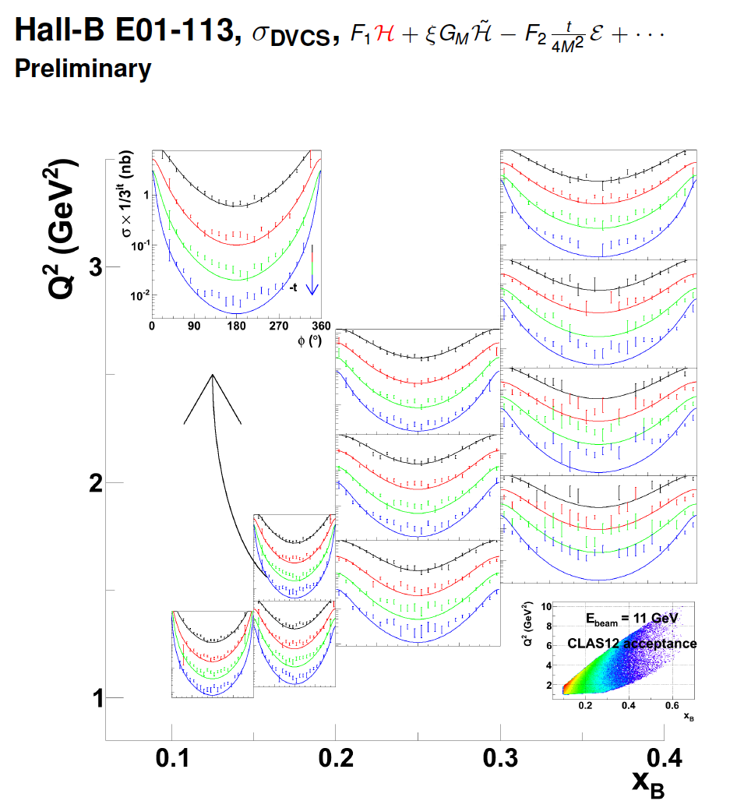
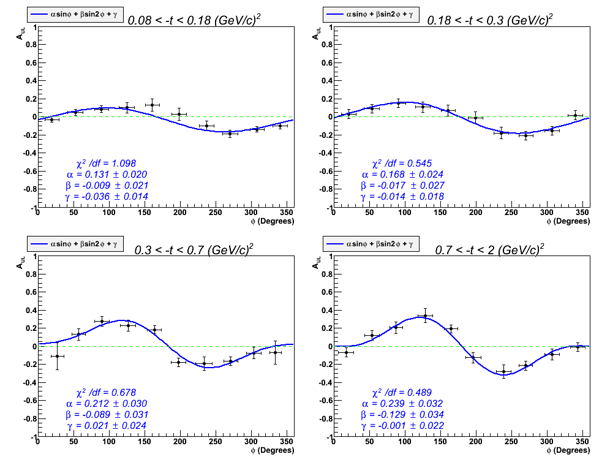
CLAS DVCS/BH cross sections
Large kinematical range in Q², x_{B}, t
Target Asymmetry A_{UL} (preliminary)
Differential cross section (preliminary)
φ(deg)

Slide 13
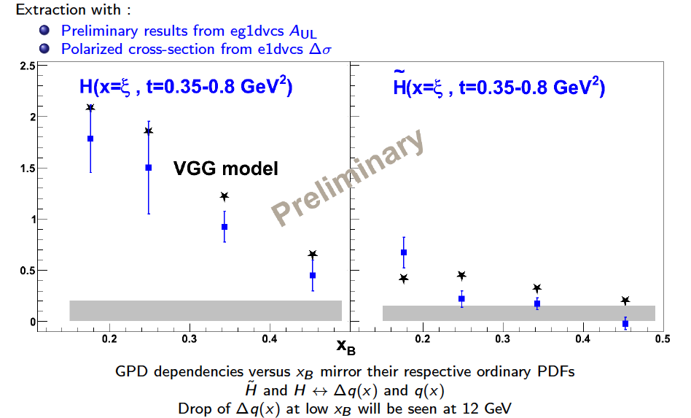
Extracting CFF/GPDs from DVCS
Extraction in leading twist with:
  Preliminary results from CLAS on A_{UL}, A_{LL}
  Cross sections σ

Slide 14
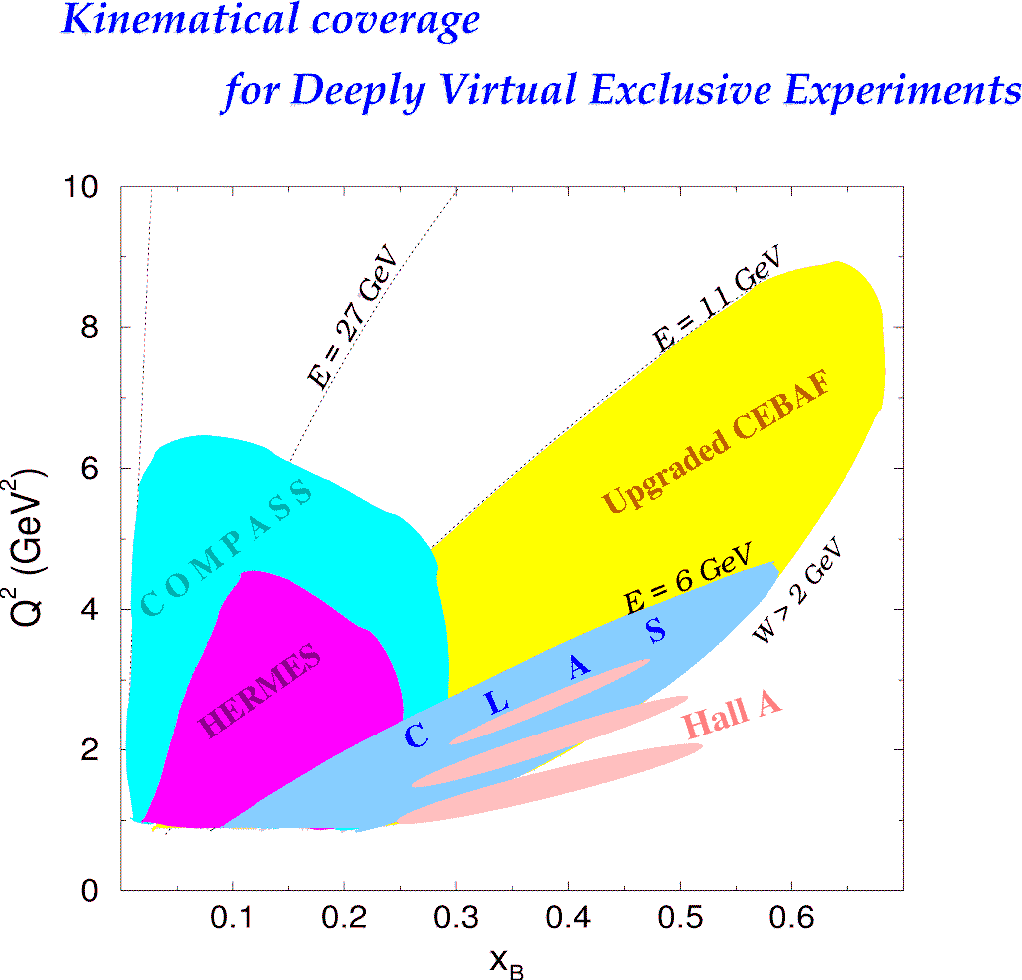
Kinematic coverage of DVCS @ 12GeV
H1, ZEUS
Probing the high x_{B} domain
requires high luminosity
H1, ZEUS
27 GeV
11 GeV
200 GeV
11 GeV
JLab Upgrade
JLab @ 12 GeV
COMPASS
W = 2 GeV
HERMES
The 12 GeV Upgrade is well matched to studies in the valence quark regime.
0.7
Notes:
The kinematics range that can be covered in exclusive processes with high precision data is shown with this yellow area. This will be the only accelerator where rhe valence quark regime can be fully covered with high precision data. other existing machines, even at much higher energies can not cover this regime due to the much lower luminosity at HERA or COMPASS.
My own personal view is that several experiments, in some of which I participated, eg EMC and E665, but also HERA, the physics, especially at high x was limited by the lack of luminosity.
Jefferson Lab has luminosity, also good spin control in both beam and targets.
So high x is (still) there for the taking and given 12 GeV, it is accessible kinematically.

Slide 15
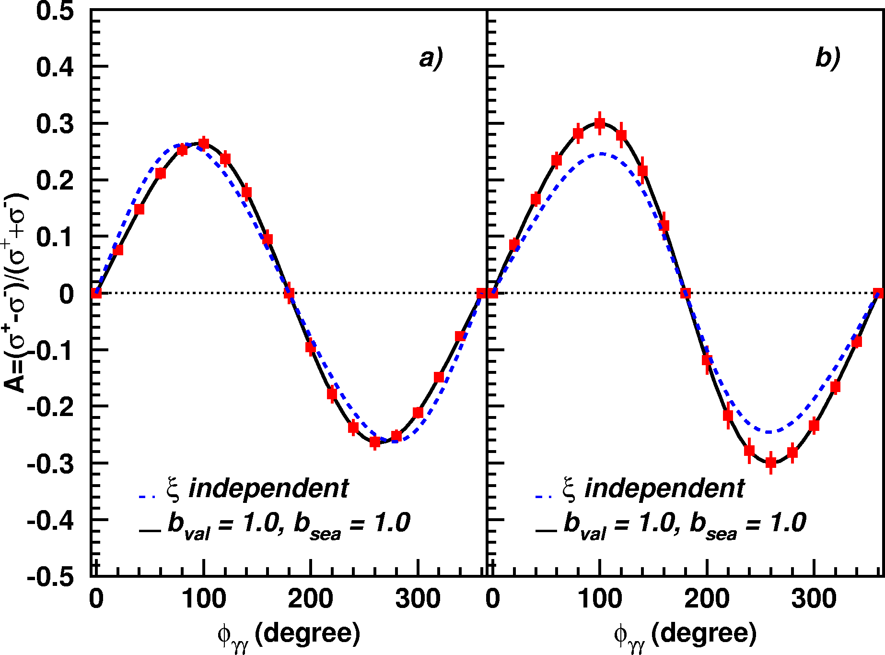
A_{LU} projections for JLab@12GeV
~
ep --> epγ
Δσ_{LU} ~ sinφ {F₁H + ξ(F₁+F₂)H +kF₂E}dφ
A_{LU}
E12-06-114
E12-06-119

Slide 16
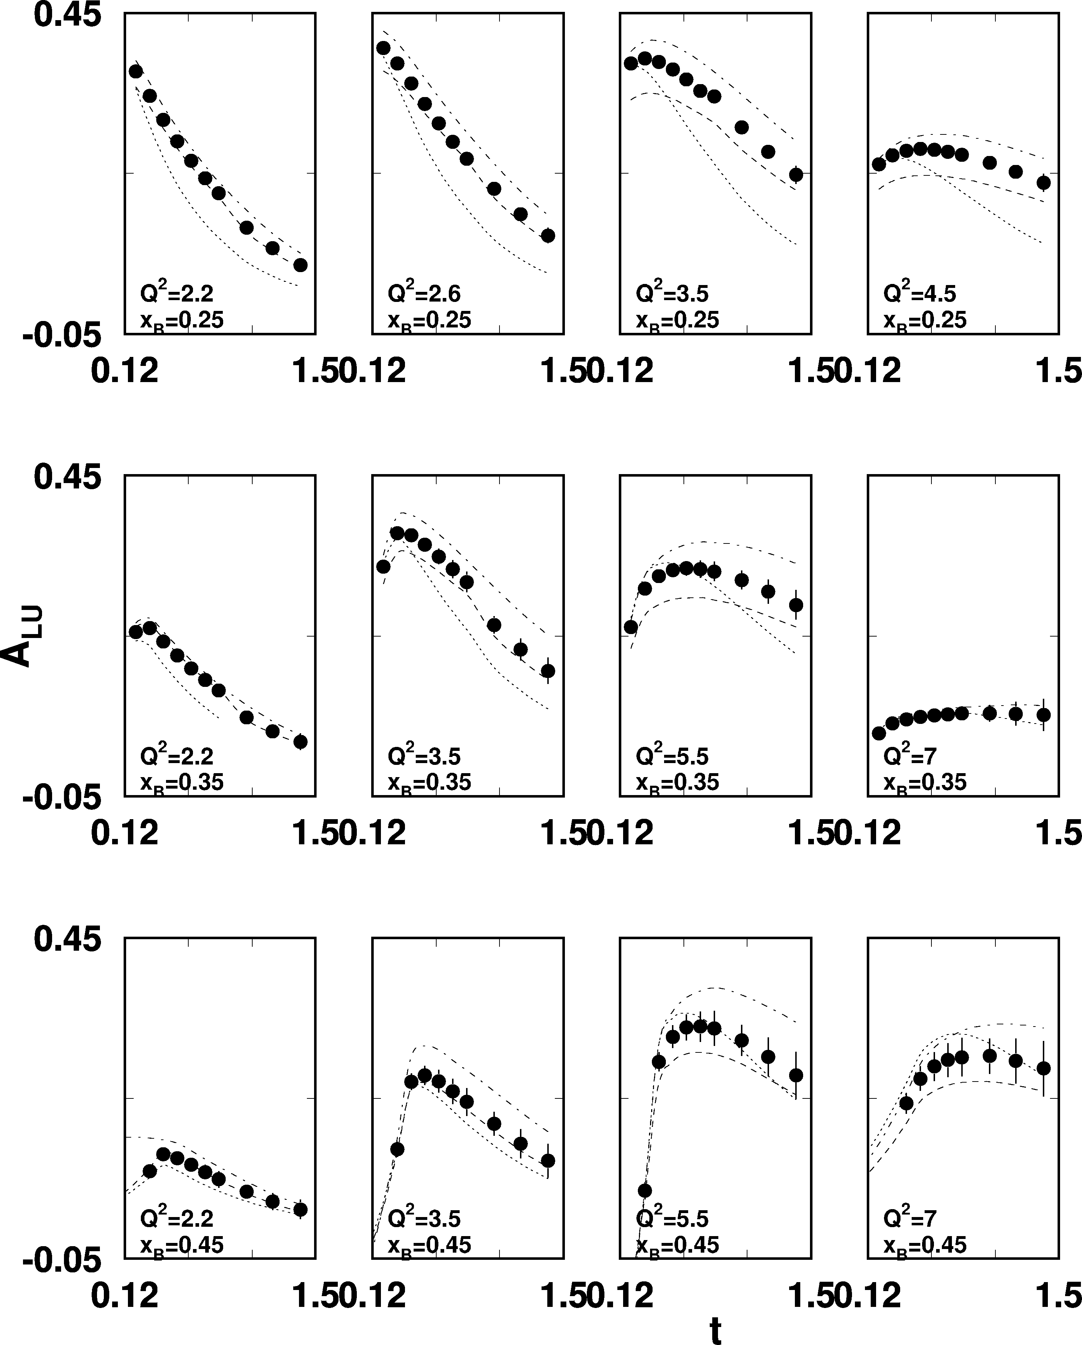
A_{LU} projections for protons
e p epγ
~
Δσ_{LU} ~ sinφ {F₁H + ξ(F₁+F₂)H +kF₂E}dφ
E_{e}=11GeV
sinφ
, GeV²

Slide 17
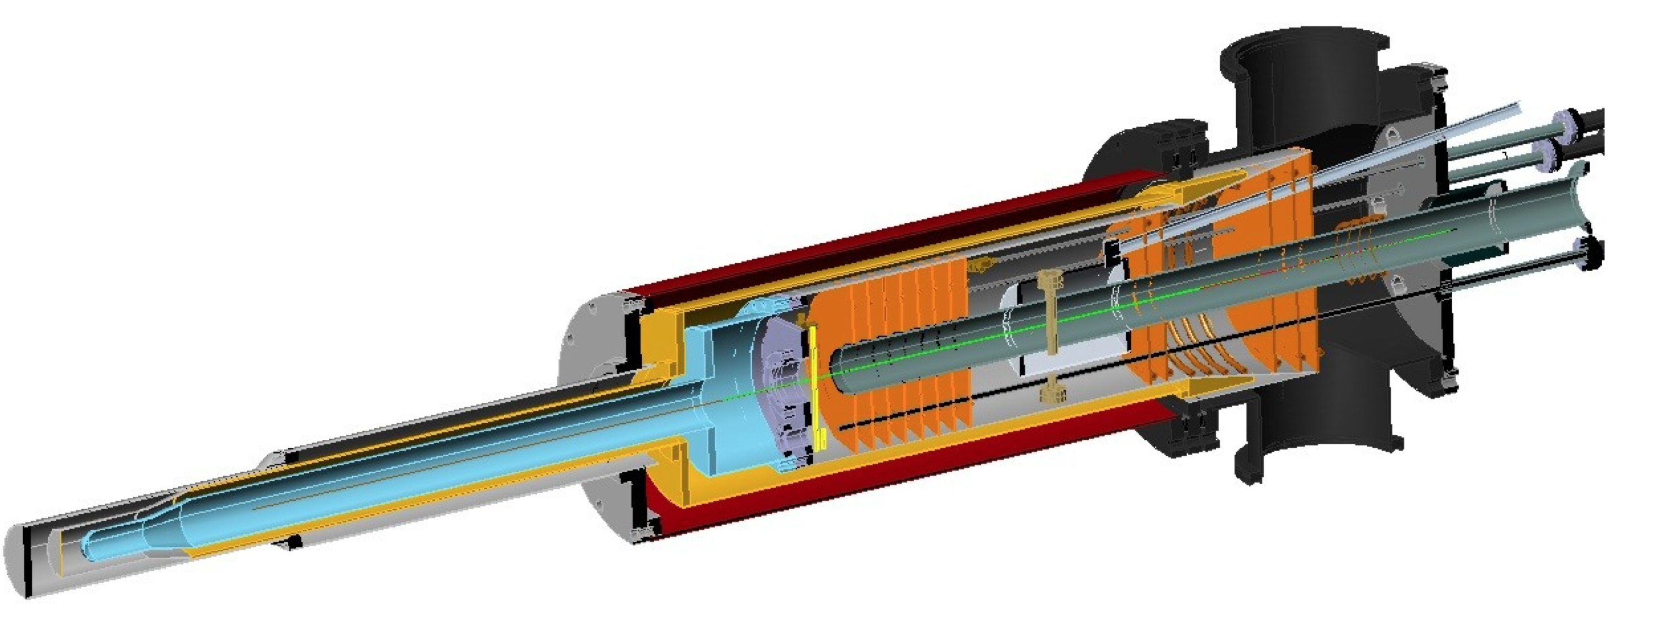
A_{UL} projections for protons
e p epγ
~
Δσ_{UL} ~ sinφ {F₁H+ξ(F₁+F₂)(H +ξ/(1+ξ)E)}dφ
~
Dynamically polarized target NH₃, ND₃
A_{UL}
L = 1x10³⁵ cm⁻²s⁻¹
T = 2000 hrs
Δx = 0.05
E12-06-119

Slide 18
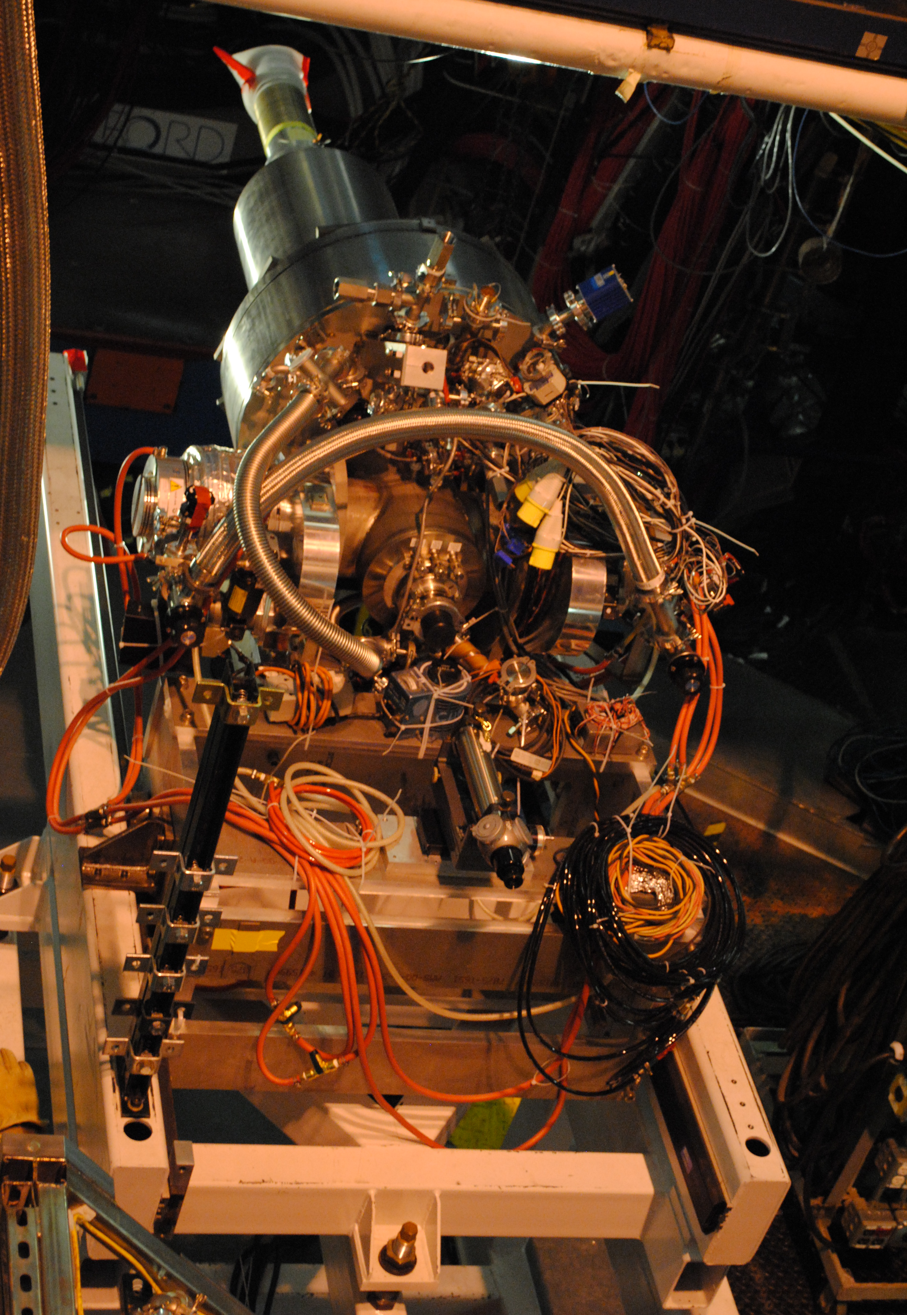
A_{UT} projections for 12GeV
ep epγ
Δσ_{UT} ~ cosφsin(φ_{s}-φ){k(F₂H – F₁E)}dφ
polarized HD
P_{p}=0.60
Dilution = 0.8
C12-12-010
cosφ
x=0.25
Q²=2 GeV²
A_{UT} and A_{LT} are sensitive to the u and d-quark helicity content of the proton spin

Slide 19
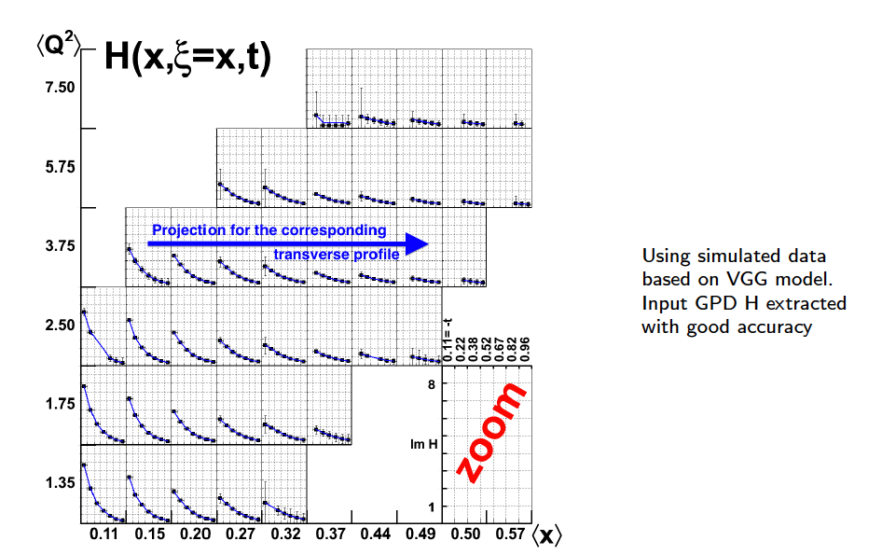
GPD H from projected CLAS12 data
Review article: M. Guidal, H. Moutarde, M. Vanderhaeghen, Rept.Prog.Phys. 76 (2013) 066202
LO fit to all observables: σ, A_{LU}, A_{UL}, A_{LL}, A_{Ux}, A_{Uy}, A_{Lx}, A_{Ly}
For corrections see
talk by H. Moutarde

Slide 20
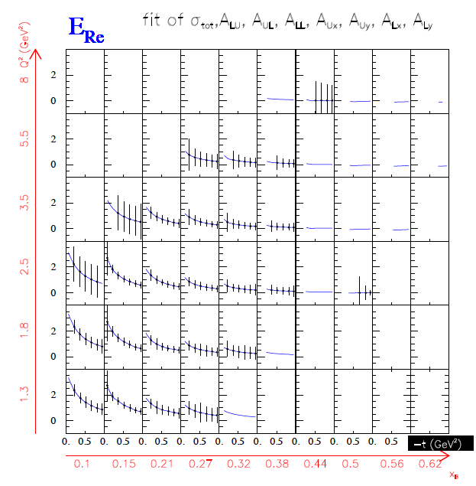
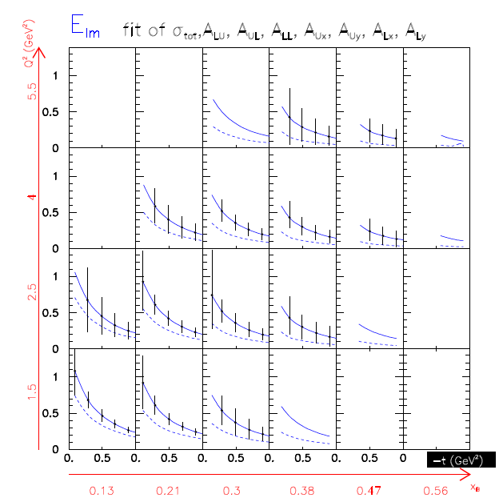
CFF E from projected CLAS12 data

Slide 21
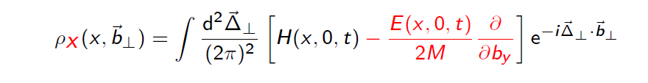
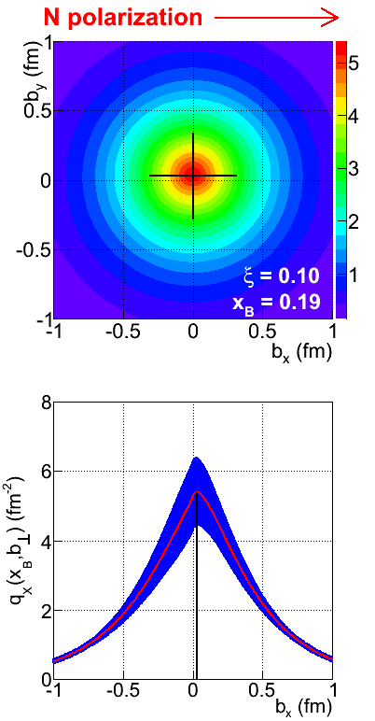
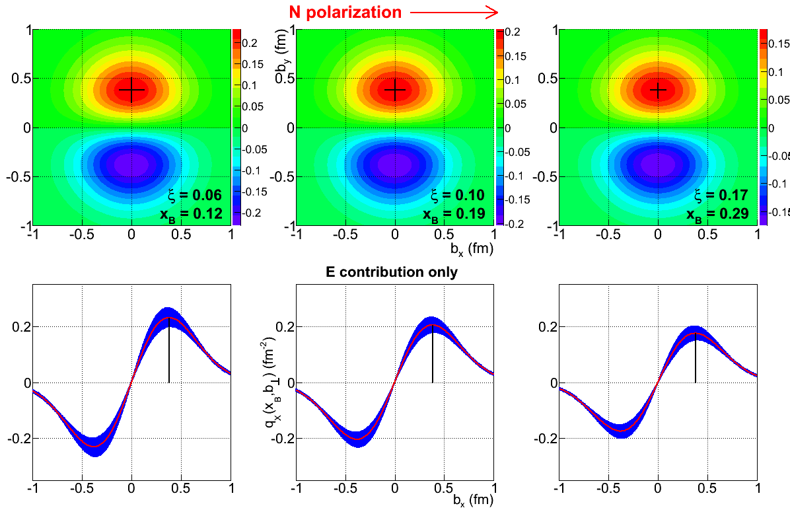
Projected quark densities in impact parameter
Fourier transform of GPDs to access quark densities in impact parameter space.
GPD E probes the u- and d-quark separation in impact parameter space. Transversely polarized proton shows flavor dipole.
Contribution of H+E
Contribution of E

Slide 22
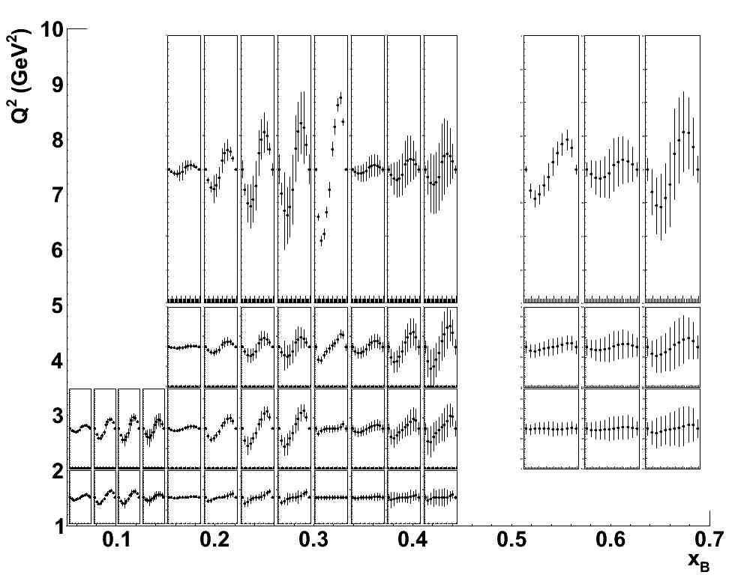
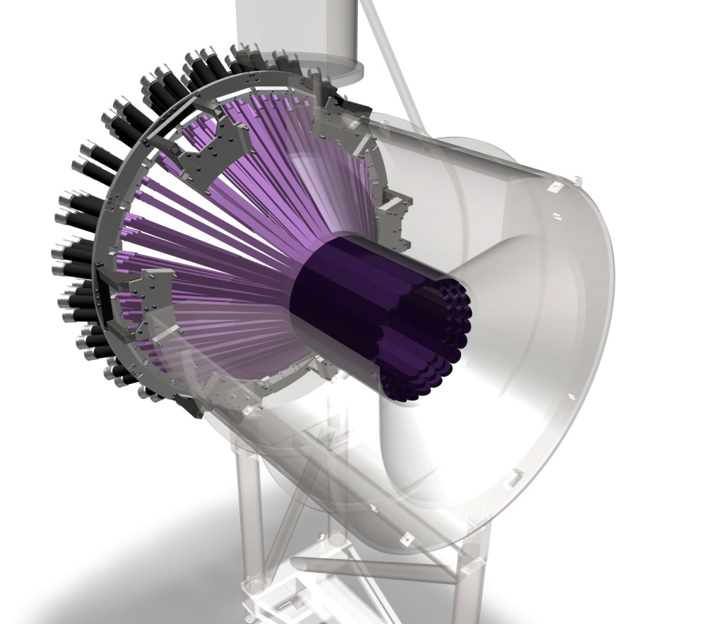
Beam asymmetries A_{LU} for neutrons
E12-11-003
Total of 588 bins in t, Q², x_{B}, φ
t=-0.35GeV²
Q²=2.75GeV² x_{B}=0.225
Central Neutron Detector
A_{LU}
A_{LU} is highly sensitive to d-quark helicity contribution to nucleon spin.

Slide 23
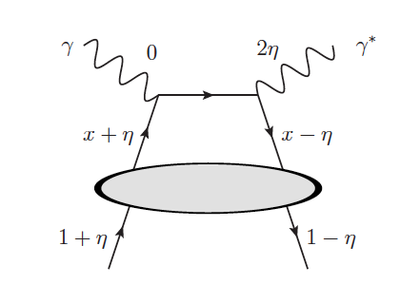
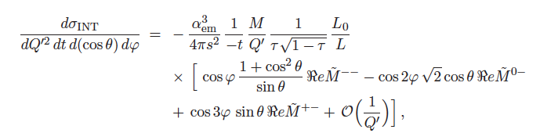

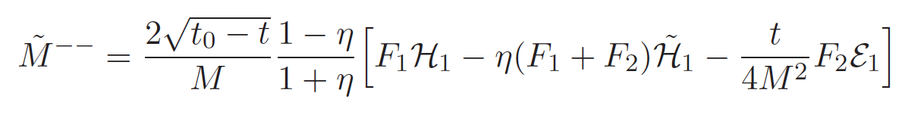
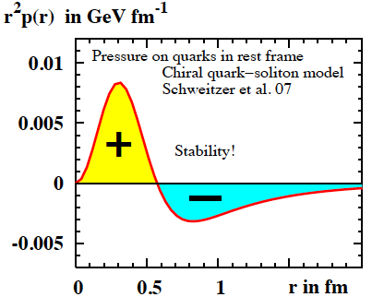
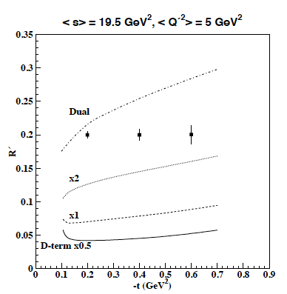
Time-like Compton Scattering (TCS)
handbag
TCS-BH Int.
In handbag dominance only one term survives
E12-12-001
Cosine moment of the weighted cross section integrated over θ.
DD+D-term
Highly sensitive to D-term,
i.e. pressure on quarks in rest frame.
Also measure threshold behavior of J/ψ production, E12-12-006.

Slide 24
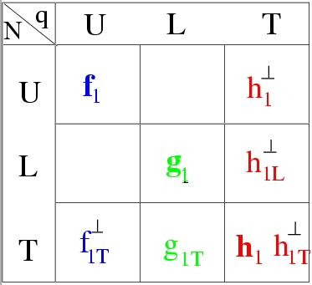
Transverse Momentum Structure of Nucleon – TMDs
(Quantum phase-space quark distribution in the nucleon)
Integrate over
spatial dimensions
Quark spin polarization
Transverse Momentum-dependent Distributions (TMD)
Nucleon polarization
3D imaging of the nucleon in momentum space
JLab has planned a complete SIDIS program with π/K to access quark TMDs

Slide 25
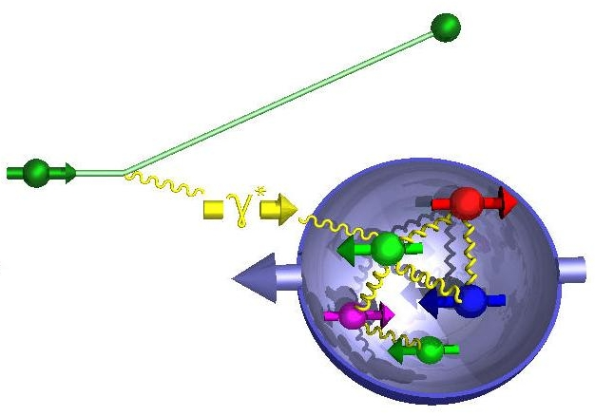
SIDIS and Transverse Momentum Distribution
SIDIS cross section in leading twist:
e’
e
π,K
The 8 structure functions factorize into TMD parton distributions, fragmentation functions, and hard parts:
Integrals over transverse momentum of initial and scattered parton
A full program to access L.T. TMDs from measurements requires separation of the structure function using polarization, and coverage of a large range in x, z, P_{T} along with sensitivity to Q², and the flavor separation in u, d, s quarks.

Slide 26
JLab TMD Proton Program @ 12 GeV
Leading twist TMD parton distributions: information on correlations between quark orbital motion and spin
CLAS12
Hall C
Hall A
Quark spin polarization
E12-06-112: π⁺,π⁻,π⁰
E12-09-008: K⁺, K⁻,K⁰
E12-09-017: π⁺,π⁻, K⁺,K⁻
C12-11-102: π⁰
HMS
SHMS
E12-07-107: π⁺,π⁻,π⁰
E12-09-009: K⁺,K⁻,K⁰
Nucleon polarization
C12-11-111: π⁺,π⁻,π⁰
K⁺, K⁻
E12-11-108: π⁺,π⁻
SOLID
H₂, NH₃, HD
H₂
NH₃
The TMD program will map the 4D phase space in Q², x, z, P_{T}

Slide 27
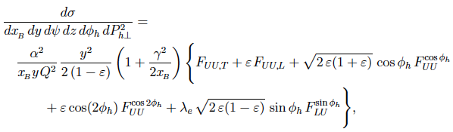
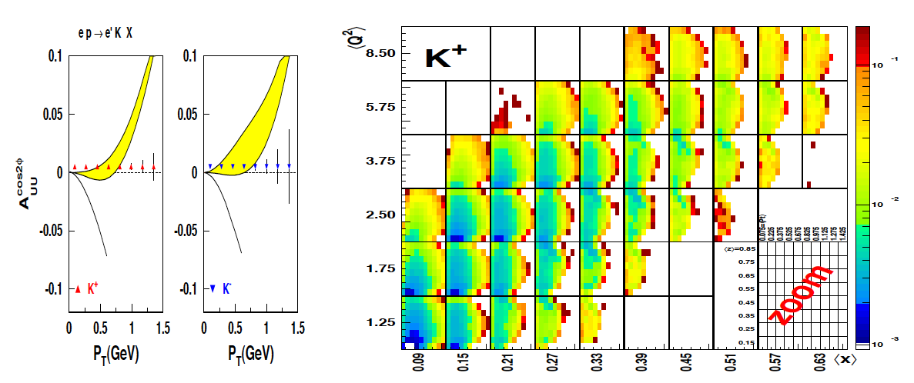
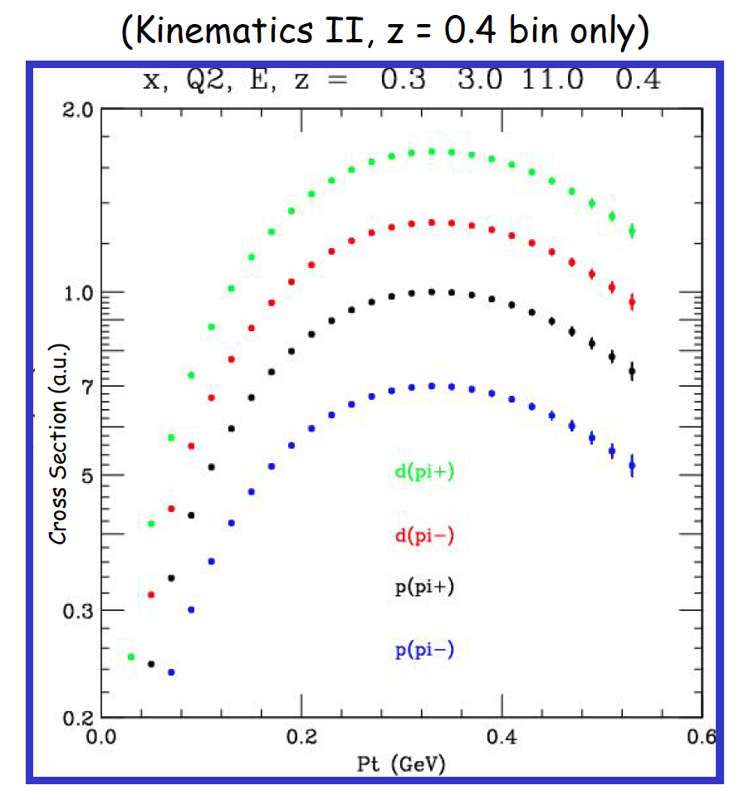
SIDIS π/K on unpolarized protons/deuterons
E12-06-112
E12-09-008
E12-09-017
Notes:
… the graphs shows the projected uncertainties of the x and Pt dependences of the asymmetry for different pion and kaon flavors.

Slide 28


CLAS12 A_{UL} on longitudinally polarized target
The Kotzinian-Mulders function measures the momentum distribution of transversely polarized quarks in a longitudinally polarized nucleon.
E12-07-107
E12-09-009
Target spin
Quark spin
Only leading twist azimuthal moment for longitudinally polarized target. The sin2φ moment is sensitive to spin-orbit correlations.

Slide 29



A_{UT} on transverse polarized proton
E12-11-108
C12-11-111
Collins
Sivers
High statistics allows for x-P binning
T

Slide 30
JLab TMD D₂ Program @ 12 GeV
Leading twist TMD parton distributions: information on correlations between quark orbital motion and spin
CLAS12
Hall C
Quark spin polarization
E09-008: π⁺,π⁻,π⁰
K⁺, K⁻,K⁰
E12-09-017: π⁺,π⁻, K⁺,K⁻
C12-11-102: π⁰
HMS
SHMS
E07-107: π⁺,π⁻,π⁰
E09-009: K⁺,K⁻,K⁰
Nucleon polarization
D₂, ND₃
D₂

Slide 31
JLab TMD ³He Program @ 12 GeV
Leading twist TMD parton distributions: information on correlations between quark orbital motion and spin
Hall A
Quark spin polarization
Nucleon polarization
E12-07-007: π⁺, π⁻
Solid
E10-006: π⁺,π⁻
E12-09-018: π⁺,π⁻ , K⁺,K⁻
Solid
SBS
³He

Slide 32


Momentum Tomography with TMDs
δk_{x}
Sivers function for d-quarks extracted from model simulations with a transverse polarized ³He target.
d-quark momentum tomography for Sivers function. The d-quark momentum density shows a distortion and shift in k_{x}. A non-zero δk_{x} value requires a non-zero orbital angular momentum.
δk_{x}

Slide 33

12 GeV UPGRADE REBASELINE SCHEDULE
1st beam October 2013
1st beam October 2014
1st beam February 2014
1st beam January 2016

Slide 34
Summary
JLab 12 GeV upgrade has a broad science program covering many facets of hadron physics.
Extending knowledge of PDFs to high x in measurements of (un)polarized structure functions using tagging. Addresses part of the nucleon “spin-puzzle” and extend knowledge of quark density distribution at high x.
Precision studies of DVCS in polarization measurements give access to GPDs and enable quark spatial imaging. They relate to the quark spin, mass and force distributions in the nucleon (confinement?).
Precise measurements of SIDIS improve access to TMDs and quark momentum tomography, and relate to the quark orbital angular momentum.
Many topics not discussed, hadron spectroscopy, high precision parity experiments, nucleon e.m. form factors, dark matter searches, QCD and nuclei, ….

Slide 35
Additional slides

Slide 36

Preliminary Plans for
First Years of Beam in Hall B
Highly rated experiments in first 3 years of running
PCR, HPS, pDVCS, nDVCS, pSIDIS, g₁^{p}/g₁^{n}
High discovery potential during first year
CLAS12 Construction
11 GeV beam experiments
< 6 GeV beam
pDVCS
& GPDs
pSIDIS &
TMDs
nDVCS
& GPDs
nSIDIS
& TMDs
g₁^{p} , g₁^{n}
large x
spin str.
Proton TMDs Transverse spin structure
Heavy Photon Search
Proton
Charge Radius
Heavy Photon Search
Installation
11 GeV
1st beam
CY 2014
CY 2015
CY 2016
CY 2017
CY 2018

Slide 37


Exclusive J/ψ production near threshold
produced in small-size configurations
- probes small distances ~ 1/M_{J/ψ}
E12-12-001
E12-12-006
J/ψ production at high W
Access to gluon GPDs at small x.
J/ψ production near threshold
Large t_{min} implies large skewness x₁-x₂
More natural interpretation in terms of a gluonic form factor sensitive to non-perturbative gluon field.

Slide 38


Gluonic d.o.f. in meson excitations
Isoscalar mesons from LQCD
ss-bar
uu-bar + dd-bar
isovector
Real photons may be a good probe of exotic mesons.
Large program is in preparation with the GlueX experiment.
J. Dudek et al., arXiv:1208:124

Slide 39

Extracting an exotic J^{PC} signal in GlueX
E12-06-102
γp->π⁺π⁺π⁻n
Amplitude analysis of MC generated data shows that a very small exotic π₁(1600) signal can be isolated from the much larger signals of ordinary mesons.
CLAS results set upper limit of 13.5nb for π₁(1600) production in this channel, less than 2% of a₂(1320).
M. Nozar, PRL 102 (2009) 102002.
Phase motion
1⁺(a₁) – 1⁻(π₁)
A complementary program is
in preparation with CLAS12 with quasi-real photons.
π₁ intensity
E12-11-005

Slide 40


CFF H from projected CLAS12 data
M. Guidal, H. Moutarde, M. Vanderhaeghen, Rept.Prog.Phys. 76 (2013) 066202

