Slide 1
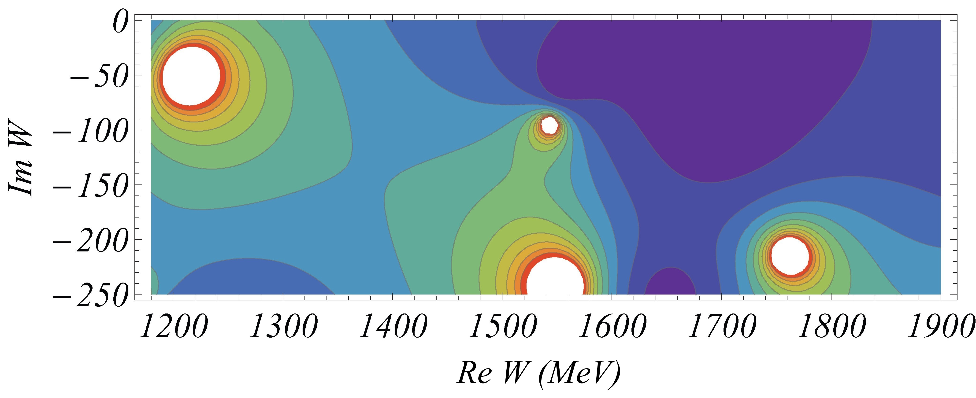
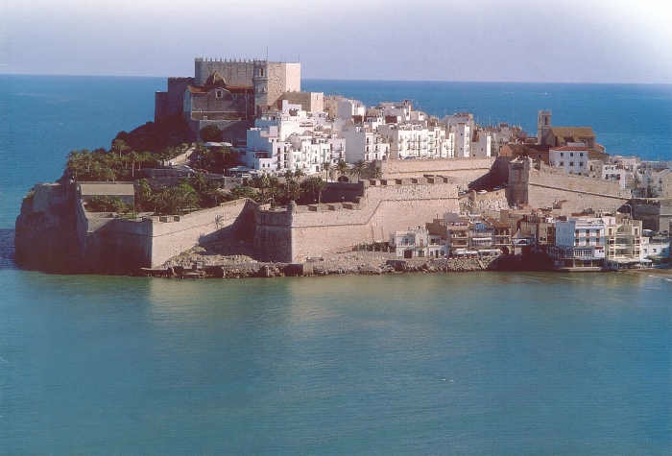


Study of excited Nucleons and their Structure
Volker D. Burkert
Jefferson Lab
NSTAR 2013 Workshop May 27-30, 2013 Peñiscola, Spain.

Slide 2
The relevant degrees of freedom?
The N* spectrum reflects the underlying degrees of freedom and the effective forces between them.
Baryon-meson
system
Vigorous experimental program is needed along two avenues
  Search for undiscovered excited states (BESIII, ELSA, GRAAL, JLab, MAMI)
  Measure the resonance strength versus distance scale (JLab/JLab12,..)
Developments in theory – LCQM, χQM, DSE/QCD, AdS/QCD, DMs, Lattice QCD, …

Slide 3
Experimental search for new states
QCD
Precision measurements of photo-induced processes in wide kinematics, e.g. γp→πN, ηp, KY, .., γn→πN, K⁰Y⁰, ..
Polarization observables are essential
More complex reactions, e.g. γp → ωp, pφ, ππp, ηπN, K*Y, .. may be sensitive to high mass states through direct transition to ground state or through cascade decays
LQCD
N*, Δ*
Models
N-N*
- I.G. Aznauryan, et al. (White Paper), Int. J. Mod. Phys. E, 22, 1330015 (2013)
- V. Crede, W. Roberts, arXiv:1302.7299 (2013)
- I.G. Aznauryan, V. D. Burkert, Prog. Part. Nucl. Phys. 67, 1 (2012)
- L. Tiator, D. Drechsel, S. Kamalov, M. Vanderhaeghen,
Eur. Phys. J. ST198 (2011)
- E. Klempt, J.M. Richard, Rev. Mod. Phys. 82, 1095 (2010)
Reaction
Theory
Amplitude
analysis
Engagement of groups to extract physics in theoretically sound analyses is essential.
Data
Hadronic
production
Electromagnetic
production

Slide 4
Strangeness production γp→K⁺Λ→K⁺pπ⁻
M. Mc Cracken et al.(CLAS), Phys.RevC81,025201,2010
A.V. Anisovich et al, EPJ A48, 15 (2012)

Slide 5
Strangeness production γp→K⁺Λ→K⁺pπ⁻
M. Mc Cracken et al.(CLAS), Phys.RevC81,025201,2010
A.V. Anisovich et al, EPJ A48, 15 (2012)
M. Mc Cracken et al. (CLAS), Phys. Rev. C 81, 025201, 2010
D. Bradford et al. (CLAS), Phys.Rev. C75, 035205, 2007

Slide 6
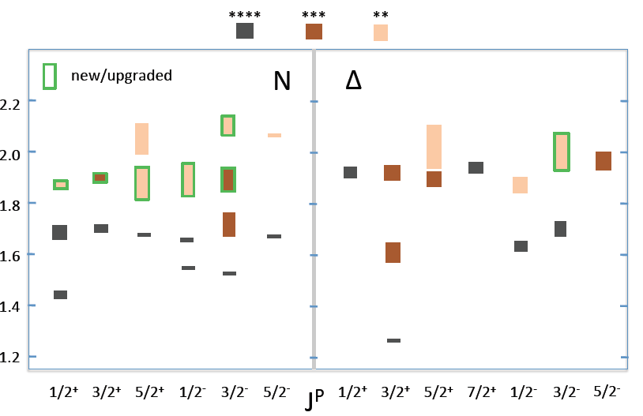
N/Δ spectrum in PDG RPP 2012
All new candidate states need confirmation in independent analyses

Slide 7
N* spectrum in LQCD
Projected new states constrained largely from meson photoproduction
N(2060)5/2⁻
N(2120)3/2⁻
N(1875)3/2⁻
N(1895)1/2⁻
N(1900)3/2⁺
N(1880)1/2⁺
N(1675)5/2⁻
N(1700)3/2⁻
N(1520)3/2⁻
N(1650)1/2⁻
N(1535)1/2⁻
m_{π}=396MeV
New candidate states may be accommodated in LQCD projections

Slide 8
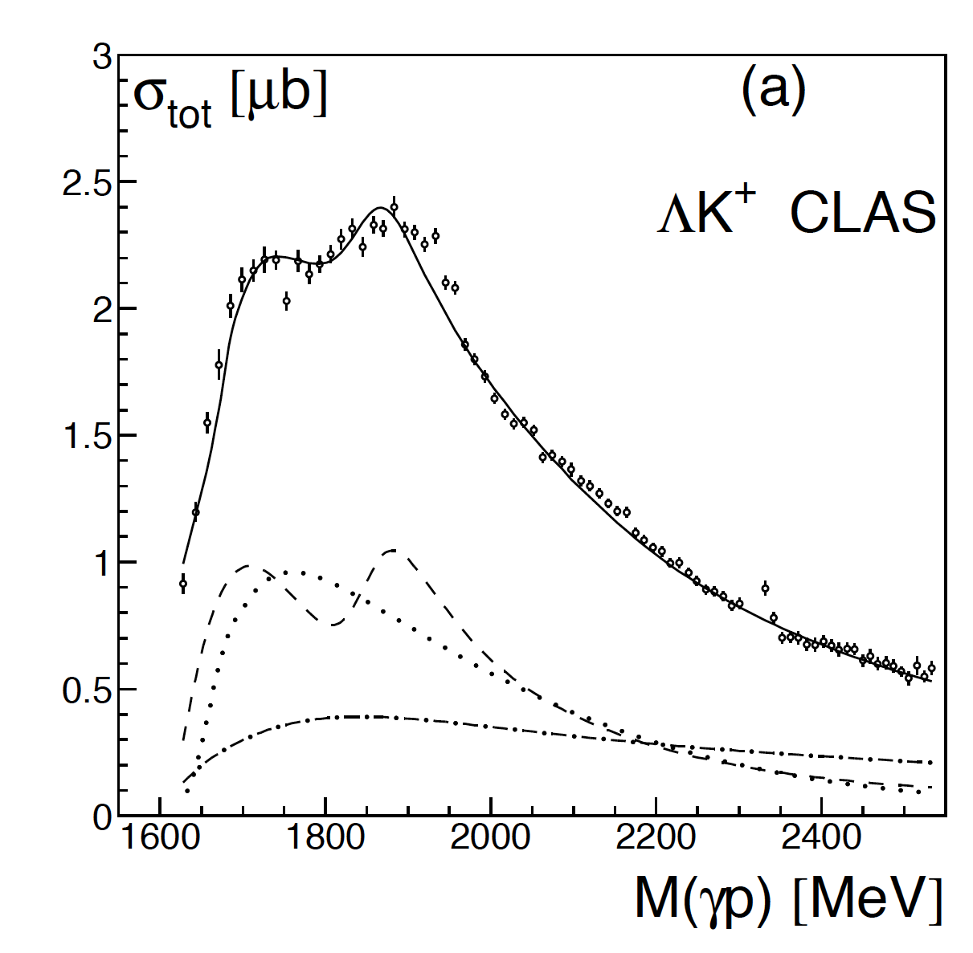
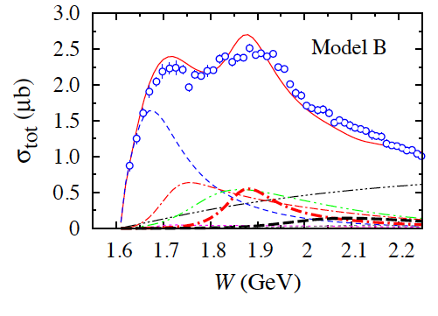
The N(1900)3/2⁺ State
Bonn-Gatchina
State solidly established in coupled-channel analysis making use of very precise KΛ data, resulting in *** assignment in PDG2012.
State was confirmed in covariant isobar model analysis (T. Mart & M. J. Kholili arXiv:1208.2780) of single channel analysis γp → K⁺Λ.
Confirmed in an effective Langrangian resonance model analysis (O. V. Maxwell, PRC85,034611, 2012) of photo- and electroproduction of single channel K⁺Λ data.
State may be ready for promotion to **** assignment and to become the first baryon resonance observed and confirmed in electromagnetic meson production.
P₁₃
T. Mart & M. Kholili
P₁₃

Slide 9
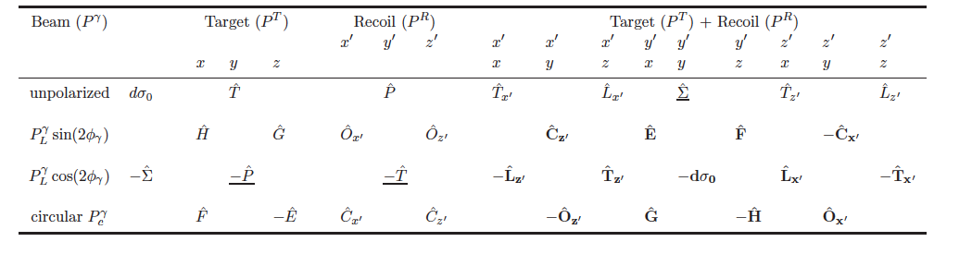
(Over)complete experiments
The holy grail of baryon resonance analysis
Process described by 4 complex, parity conserving amplitudes
8 well-chosen measurements are needed to determine amplitude.
Up to 16 observables measured directly
3 inferred from double polarization observables
13 inferred from triple polarization observables
Λ weak decay has large analyzing power
A. Sandorfi, S. Hoblit, H. Kamano, T.-S.H. Lee, J.Phys. 38 (2011) 053001

Slide 10
Search for new states with CLAS
Obserables | σ | Σ | T | P | E | F | G | H | T_{x} | T_{z} | L_{x} | L_{z} | O_{x} | O_{z} | C_{x} | C_{z}
pπ⁰ | ✔ | ✓ | ✓ | (✓) | ✓ | ✓ | ✓ | ✓
nπ⁺ | ✔ | ✓ | ✓ | (✓) | ✓ | ✓ | ✓ | ✓
pη | ✔ | ✓ | ✓ | (✓) | ✓ | ✓ | ✓ | ✓
pη’ | ✔ | ✓ | ✓ | (✓) | ✓ | ✓ | ✓ | ✓
pω/φ | ✔ | ✓ | ✓ |  | ✓ | ✓ | ✓ | ✓
K⁺Λ | ✔ | ✓ | ✓ | ✔ | ✓ | ✓ | ✓ | ✓ | ✓ | ✓ | ✓ | ✓ | ✓ | ✓ | ✔ | ✔
K⁺Σ⁰ | ✔ | ✓ | ✓ | ✔ | ✓ | ✓ | ✓ | ✓ | ✓ | ✓ | ✓ | ✓ | ✓ | ✓ | ✔ | ✔
K^{0*}Σ⁺ | ✔ | ✓ |  |  |  |  |  |  |  |  | ✓ | ✓
pπ⁻ | ✔ | ✓ |  | (✓) | ✓ | ✓ | ✓
pρ⁻ | ✓ | ✓ |  | (✓) | ✓ | ✓ | ✓
K⁻Σ⁺ | ✓ | ✓ |  | (✓) | ✓ | ✓ | ✓
K⁰Λ | ✓ | ✓ | ✓ | ✓ | ✓ | ✓ | ✓ |  | ✓ | ✓ | ✓ | ✓ | ✓ | ✓ | ✓ | ✓
K⁰Σ⁰ | ✓ | ✓ | ✓ | ✓ | ✓ | ✓ | ✓ |  | ✓ | ✓ | ✓ | ✓ | ✓ | ✓ | ✓ | ✓
K^{0*}Σ⁰ | ✓ | ✓ |  |  |  |  |  |  |  |  | ✓ | ✓
Plenary:
E. Pasyuk
A4:
N. Walford
C2:
R. Tucker
S. Park
Y. Mao
B5:
I. Senderovich
Proton targets
Tensor polarization, SDME
C2:
T. Kageya
A4:
C. Taylor
P. Mattione
Neutron targets

Slide 11
N* states in γp➝pω➝pπ⁺π⁻(π⁰)
M. Williams, et al. (CLAS) Phys. Rev. C80:065209, 2009
W=1.7 – 2.4 GeV, ΔW=10 MeV bins
Spin density matrix elements ρ⁰_{00,} ρ⁰_{1-1,} ρ⁰₁₀ in blue - blue shades. Previous world data in red.
B1:
B. Vernarsky
E. Phelps
B4:
D. Martinez
SDMEs with linearly and circularly polarized beams are being finalized. Together with ρ⁰_{00,} ρ⁰_{1-1,} ρ⁰₁₀ they represent precise data sets for coupled-channel analyses.

Slide 12
N* states in γp➝pω➝pπ⁺π⁻(π⁰)
M. Williams, et al. (CLAS) , Phys.Rev.C80:065209,2009
The data are used as input to a single channel event-based, energy independent partial wave analysis (the first ever for baryons).
ω photoproduction is dominated by the well known F₁₅(1680) and G₁₇(2190), and the “missing” ** F₁₅(2000).
F₁₅(2000)/G₁₇(2190)

Slide 13
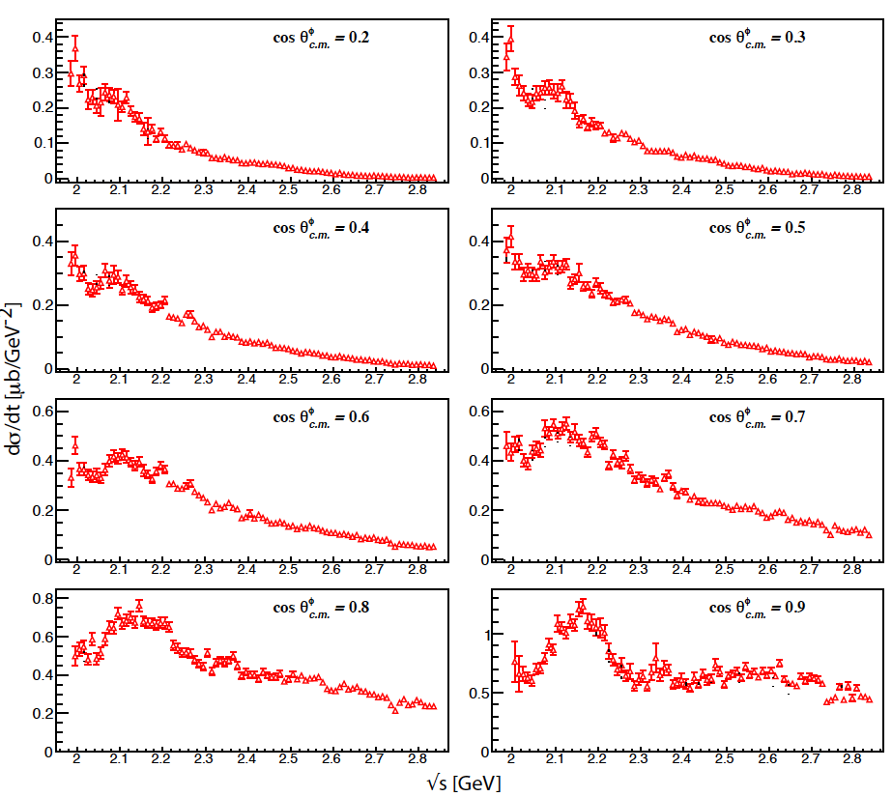
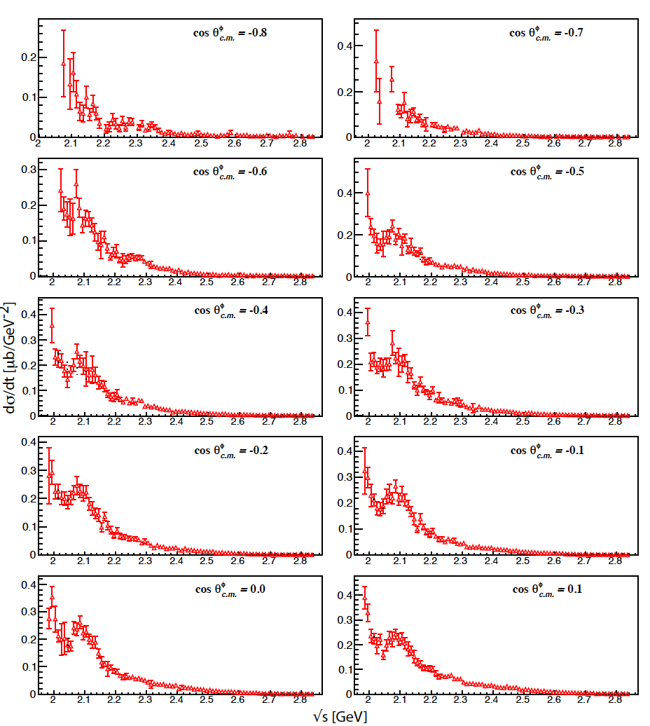
Differential cross sections γp pφ(K⁺K⁻)
First precision measurement in W=10 MeV bins and nearly full angle range (CLAS)
φ K⁺K⁻ (49%)
Effect due to intrinsic s-sbar contributions (C.S. An, B.S. Zou, arXiv:0802.3996)?, s-channel N*, or interference with K⁺Λ(1520)?
Coupled-channel analysis needed
neutral decay K^{S}K^{L} (34%) avoids interference

Slide 14
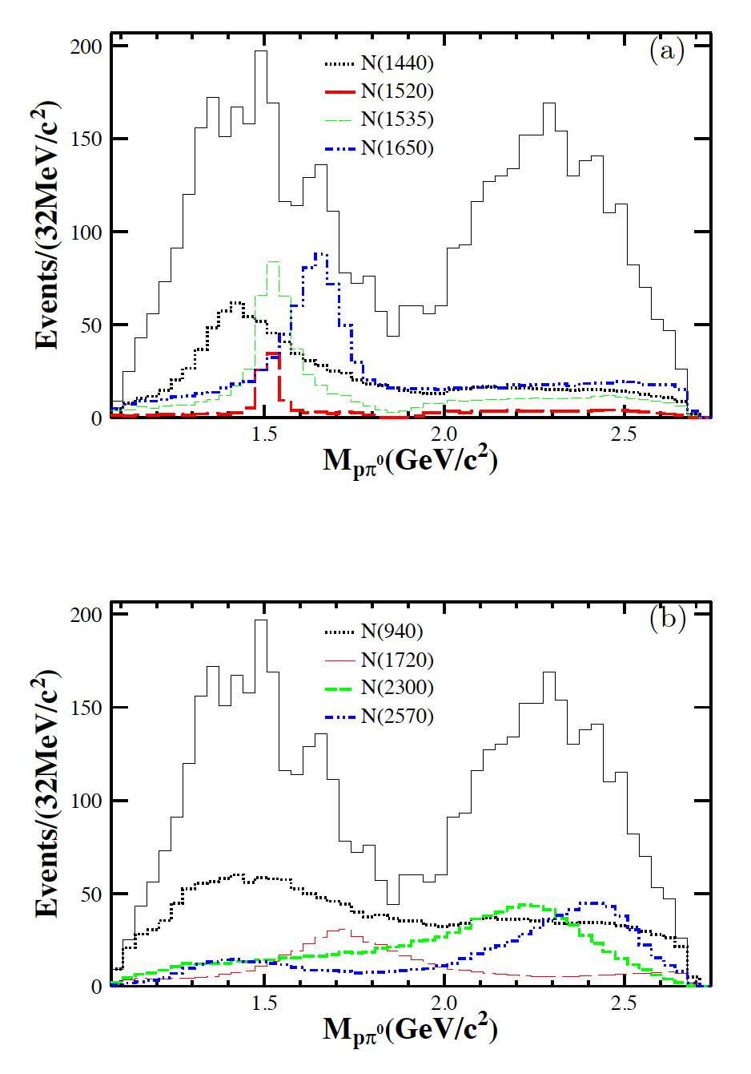
Evidence for N(2300)1/2⁺, N(2570)5/2⁻
M. Ablikim et al. (BESIII), Phys.Rev.Lett. 110 920130 022001
BES-III
e⁺e⁻ --> ψ’ --> ppπ⁰
Isospin ½ filter
Suppresses large OAM L_{pπ} ≤ 2
=> Sensitive to N1/2⁻, N1/2⁺, N3/2⁺, N3/2⁻, N5/2⁻ states only, greatly simplifies PWA
Plenary:
Yutie Liang

Slide 15
Electroexcitation of N/Δ resonances
Probe resonance strength vs photon virtuality Q
How do effective dof change with distance scale?
Nature of excited states: QQQ, QQQG, MB
Plenary talks:
V. Mokeev
R. Gothe
2
N(1680)5/2⁺
N(1720)3/2⁺
SU(6)xO(3)
[56,2⁺]
L_{3q}
e’
π, η, ππ
N(1520)3/2⁻
N(1535)1/2⁻
Δ(1700)3/2⁻
γ_{v}
1
e
N*,△*
Q
[70,1⁻]
N
N’
[56,0⁺]
A_{1/2}, A_{3/2}, S_{1/2}
E, M, S multipoles
0
Δ(1232)3/2⁺
N(940)
N(1440)1/2⁺
[70,0⁺]
0
1
N [ħω]
2

Slide 16
NΔ Transition form factor & multipoles
Magnetic Dipole Form Factor
Quadrupole Ratios
CLAS
Hall A
Hall C
MAMI
MB
R_{EM}
QM
Pascalutsa,
Vanderhaeghen
CLAS
Hall A
Hall C
MAMI
R_{SM}
Sato, Lee
0.2
Large MB contributions (1/3) needed to describe magnetic dipole transition at Q²=0
For G*_{M} the MB contribution are decreasing with increasing Q²
R_{EM} and R_{SM} well described with MB contributions only.

Slide 17
Electrocouplings of the N(1535)1/2⁻
open symbols pη (S_{1/2}=0)
full symbols nπ+
CQM
Dynamical model analyses (Doering, Oset) show the state may have a significant coupling to KΛ and pφ which could indicate sizeable qqqs-sbar component (An, Zou).
Explains the mass ordering, the large pη branching ratio, and sign of S_{1/2}.
Are there higher mass N* states with significant pφ coupling?
=> Include pφ data in coupled channel analysis

Slide 18
Electrocouplings of ‘Roper’ N(1440)1/2⁺
I. Aznauryan et al. (CLAS), PRC80, 055203 (2009), V. Mokeev et al. (CLAS), PRC86, 035203 (2012)
nrQM
LC QM
Q³+Nσ
Nσ
A_{1/2} dominant amplitude at high Q² indicates radial QQQ excitation
Significant meson-baryon coupling at small Q²

Slide 19
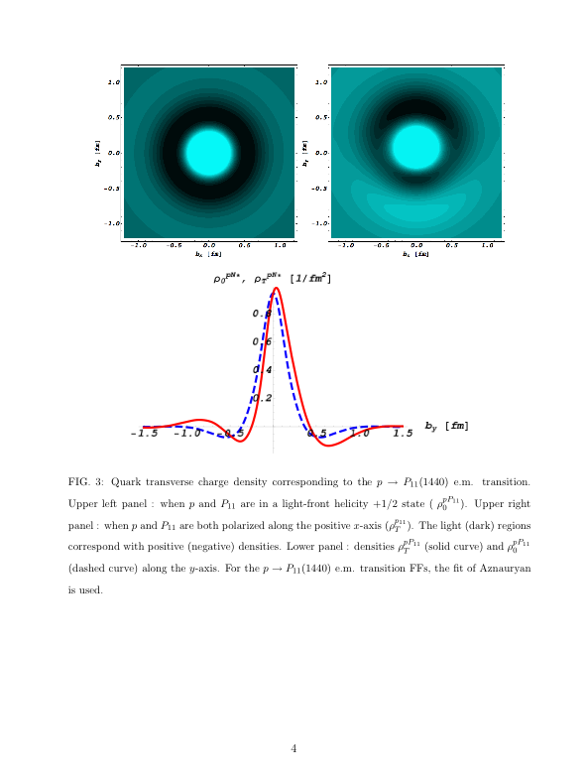
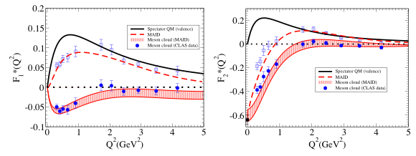
Transition charge density of “Roper” N(1440)1/2⁺
Fourier transform of transition f.f. on LF
Covariant valence quark model with diquark as spectator.
γp→N⁺(1440)P₁₁ in LF helicity +1/2→ +1/2 dominated by up quarks in central region, and by down quarks in an outer band.
L. Tiator, M. Vanderhaeghen, PLB672, 344.
G. Ramalho and K. Tsushima, PRD81, 074020
Notes:
Knowing the helicity amplitudes up to high Q2 allows one to perform a Fourier transform on the light front to determine the transition charge density in impact parameter. This is seen in the graph on the left showing the dominance of positive charge in the central region and the negative charge density in an outer band. Using a covariant valence quark model with a diquark as spectator one can subtract the quark contributions from the data and determine the meson cloud contributions from the data as shown by the blue points that extend out to Q2=1.5GeV2.

Slide 20
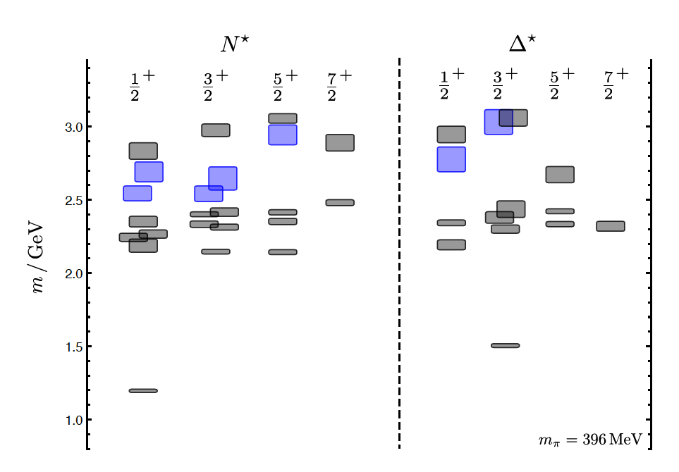
Hybrid Baryons in LQCD
J.J. Dudek and R.G. Edwards, PRD85 (2012) 054016
T. Barnes and F.E. Close, PLB128, 277 (1983)
LQCD
regular states
clustered
in mass
hybrid states
1.3GeV
N
Hybrid states have same J^{P} values as Q³ baryons. How to identify them?
- Overpopulation of N1/2⁺ and N3/2⁺ states compared to QM projections?
- Transition form factors in electroproduction have different Q² dependence

Slide 21
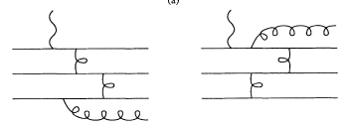
Separating Q³G from Q³ states?
Z.P. Li, V.Burkert, Zh. Li, PRD46 (1992)70; C.E. Carlson, N. Mukhopadhyay, PRL 67, 3745, 1991
Lowest mass QQQG state N1/2⁺
q³G
q³G
For hybrid “Roper”, transverse amplitude A_{1/2}(Q²) drops off faster with Q², and S_{1/2}(Q²) ~ 0.

Slide 22
Conclusions
Community achieved important milestone in the search for new baryon states from photoproduction – 6 new candidates, 2 almost certain in RPP 2012. Two further confirmations for N(1900)3/2⁺.
Precise new data including double polarization data available or soon to be available, some data sets are “complete”.
BES III – finds evidence for 2 new high mass N* states.
Precise φ and ω photoproduction data available, can constrain the PWA in the search for high mass states. Should be included in coupled-channel PWA.
Transition form factors have sensitivity to the underlying degrees of freedom and are essential in identifying the nature of states, MB or (QQQ)QQ-bar contributions are important and decreasing with increasing Q².
The Q² dependence of resonance transition form factors may be employed to separate hybrid baryons from ordinary baryons.

