Slide 1
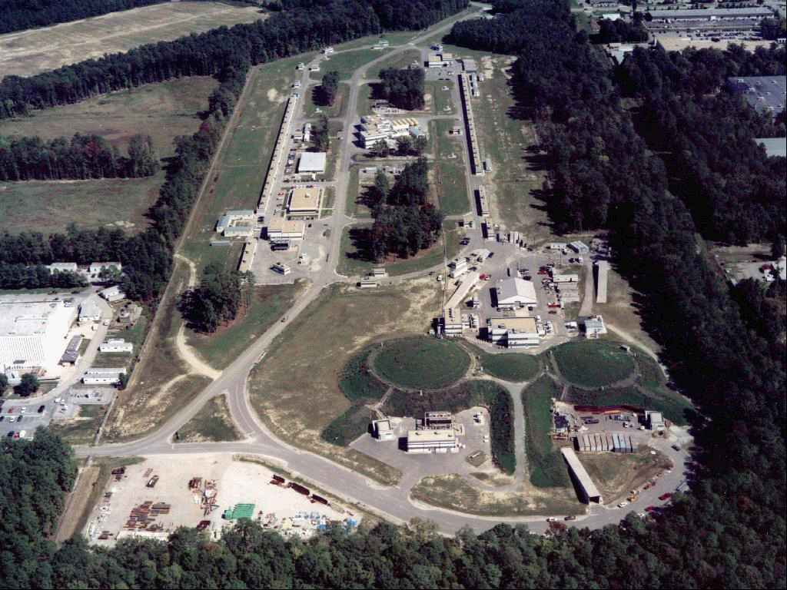

Transition Form Factors:
A unique Opportunity to Connect
Non-Perturbative Strong Interaction to QCD
Ralf W. Gothe
NSTAR 2013
9th International Workshop on the Physics of Excited Nucleons
May 27-30, 2013, Peñiscola, Valencian Community,Spain
γ_{v}NN* Experiments: The Best Access to the Baryon and Quark Structure?
  Spectroscopy, Elastic Form Factors, and Transition Form Factors
Analysis: Phenomenological Extraction … who can do better?
  Consistent extraction of γ_{v}NN* electrocouplings in various decay channel with various models
QCD based Theory: Solve Non-Perturbative QCD and Confinement?
Outlook: Extended kinematics, new experiments … what can be done next?
Notes:
My talk will be about the electroexcitation of nucleon resonances. This conferences is all about nucleons and baryons.
Nathan Isgur has been a strong supporter of a nucleon research program at this laboratory. He formulated the importance of studies of the nucleon in 3 remarks he made at the N*2000 conferences in this auditorium:

Slide 2
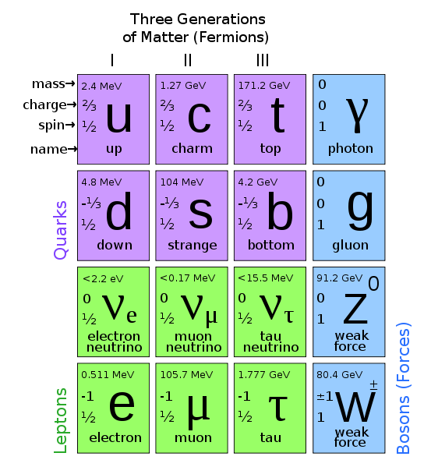
Build your Mesons or Excite Baryons …

Slide 3
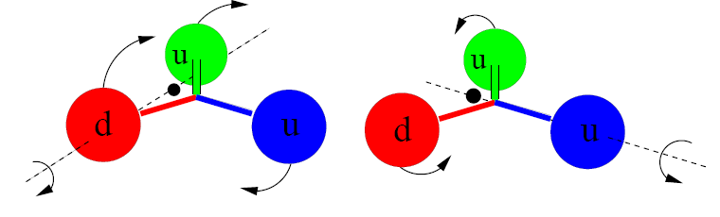
N and Δ Excited Baryon States …
Orbital excitations
(two distinct kinds in contrast to mesons)
Radial excitations
(also two kinds in contrast to mesons)

Slide 4
Quark Model Classification of N*
D₁₃(1520)
S₁₁(1535)
+ q³g
+ q³qq
+ N-Meson
+ …
New P₁₁, P₁₃, D_{13, …} states?
Δ(1232)
Roper P₁₁(1440)
- q²q
- …
1135 MeV 1545 MeV 1839MeV 2130 MeV Mass
Notes:
Lambda(1405) N-K molecule, Roper N-gluon excitation, di-quark pointlike in contrast to DSE dynamic and non-pointlike

Slide 5
Hadron Structure with Electromagnetic Probes
Q²
Study the structure of the nucleon spectrum in the domain where dressed quarks are the major active degree of freedom.
Explore the formation of excited nucleon states in interactions of dressed quarks and their emergence from QCD.
π,ρ,ω…
low
N,N*,Δ,Δ*…
k
3q-core+MB-cloud
K_{2μ}
N
P_{2μ}
*
3q-core
²
Q² = −K_{μ}
K_{1μ}
N
P_{1μ}
pQCD
high
Notes:
5
Why do we use electromagnetic probes to study hadron structure? I think the answer is that the e.m. probe allows us to efficiently address the central question of hadron physics: What are the relevant degrees of freedom at varying distance scales? To simply illustrate this I show here the quark propagator mass calculated in LQCD, Dyson Schwinger, and other approaches as a function of the momentum transfer. In the em probe we can vary the resolution and momentum transfer. In doing so, we probe the effective degrees of freedom in the nucleon from meson-nucleon, to constituent quarks, to elementary partons. The study of nucleon resonance transitions provides a testing ground for our understanding of these effective degrees of freedom.

Slide 6
Hard Scattering off
Bound and Confined Quarks

Slide 7
Quark-Hadron Duality
Baryon Excitations and Quasi-Elastic Scattering
PRL 16 (1970) 1140, PR D4 (1971) 2901
E.D. Bloom and F.J. Gilman
W = 1.9 GeV
E’ = 17.6 GeV
ν = 2.37 GeV
Q² = 1.72 GeV
m_{q} = 0.36 GeV
m_{q} = Q²/2ν
p_{F} = 0.67 GeV
r_{F} = 0.79 fm
Δr_{F} = hc *√9π/2
Δp_{F}
Deep Inelastic Scattering
S. Stein et al., PR D22 (1975) 1884

Slide 8
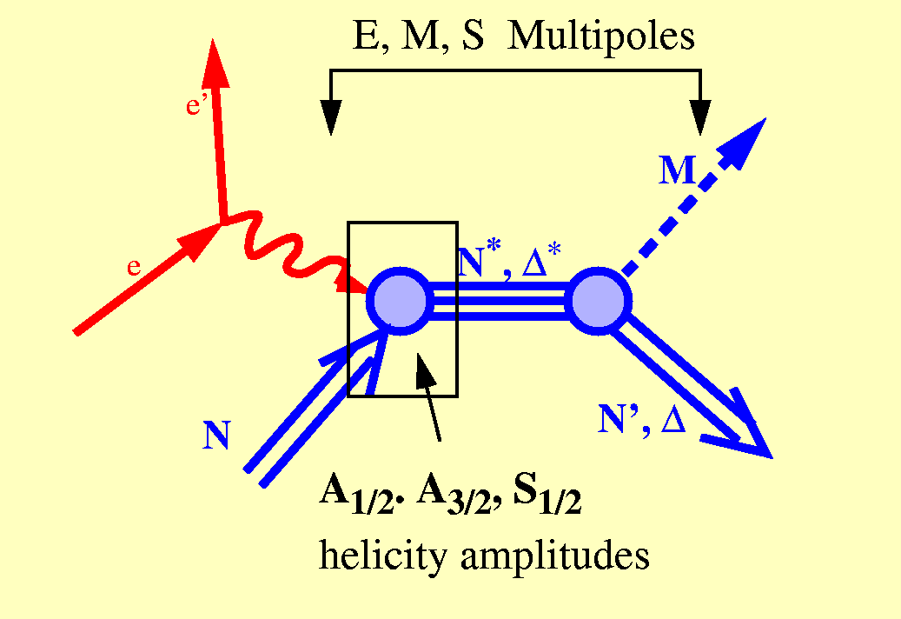
Baryon Excitations and Quasi-Elastic Scattering
λ_{γp}=1/2
γ_{v}
N
λ_{γp}=3/2
Deep Inelastic Scattering
S. Stein et al., PR D22 (1975) 1884

Slide 9
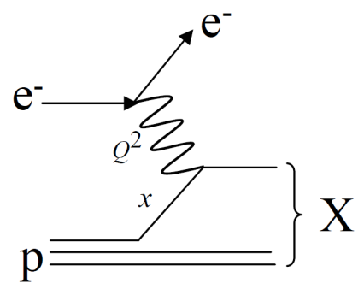
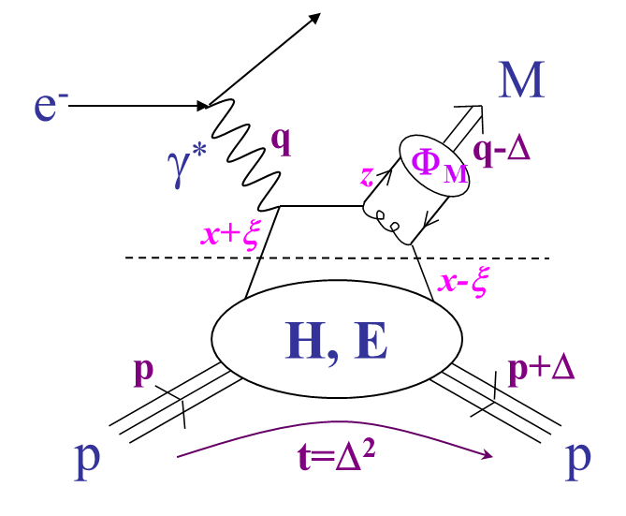
Baryon Excitations and Quasi-Elastic Scattering
hard and
confined
Elastic Form Factors
Transition Form Factors
quasi-elastic
hard
soft
Deep Inelastic Scattering
S. Stein et al., PR D22 (1975) 1884

Slide 10
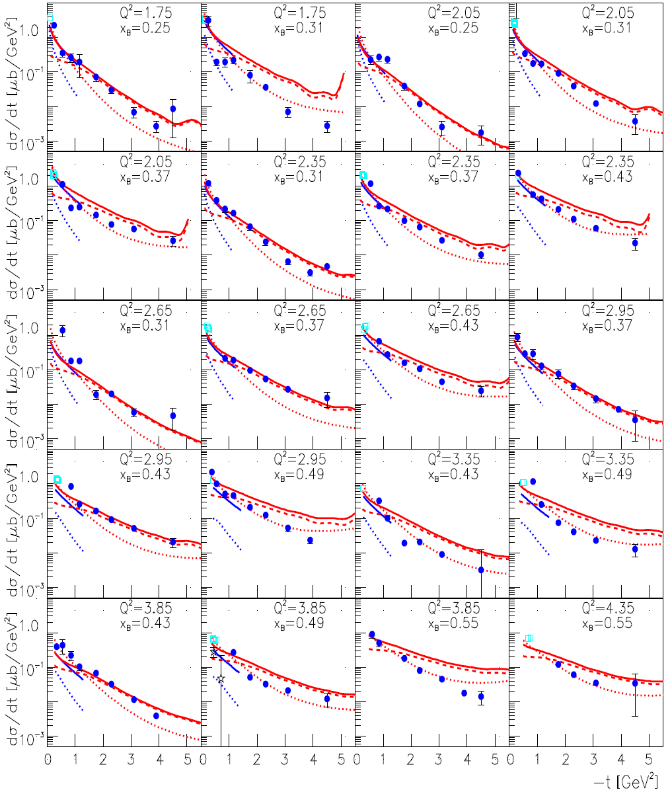
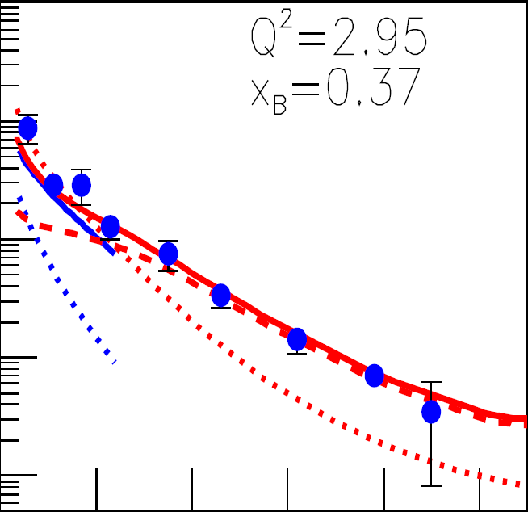
Deep Exclusive π⁺ Electroproduction off the Proton
K. Park et al., Eur. Phys. J. A 49 (2013) 16
The red solid (dσ/dt), dotted (dσ_{L}/dt), and dashed (dσ_{T} /dt) curves are the calculations from a hadronic model (Regge phenomenology) with (Q², t)-dependent form factors at the photon-meson vertices. The blue solid and dotted curves are the calculations of dσ/dt and dσ_{L}/dt, respectively, of a partonic model (handbag diagrams).
Notes:
S. V. Goloskokov, P. Kroll, Eur. Phys. J. C 65, 137 18 (2010) and Eur. Phys. J. A 47, 112 (2011).
J. M. Laget, Phys. Rev. D 70, 054023 (2004).

Slide 11
Elastic
Form Factors
Notes:
EBAC: dynamical coupled channel analysis is based on the world data set on piN. gammaN, and gamma*N and constrained by unitarity. (to Npi, Neta, N2pi)
This allows the extraction of the meson-baryon contributions under minimal model assumptions

Slide 12
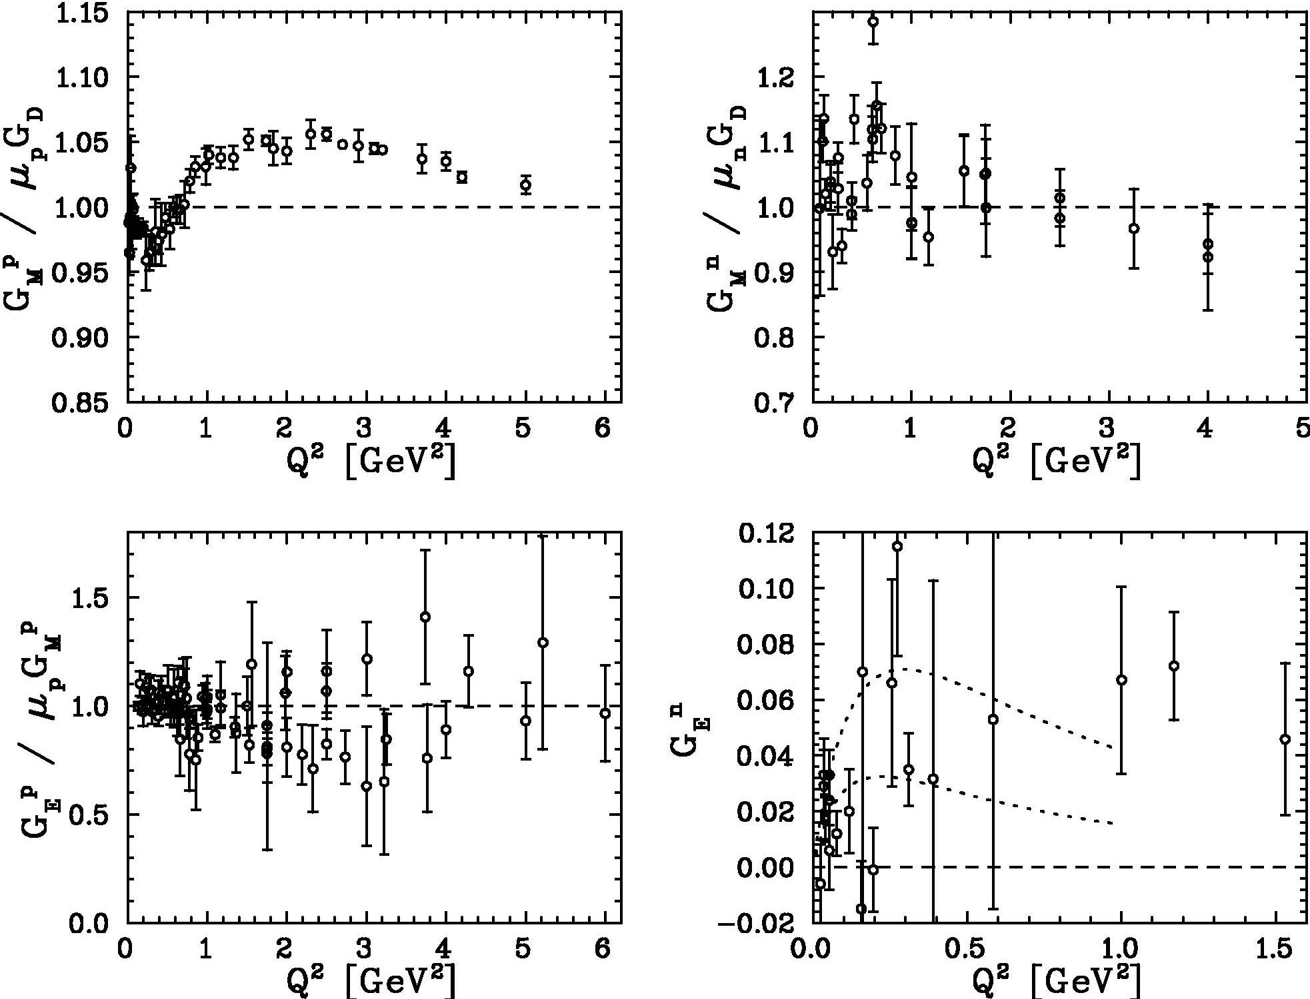
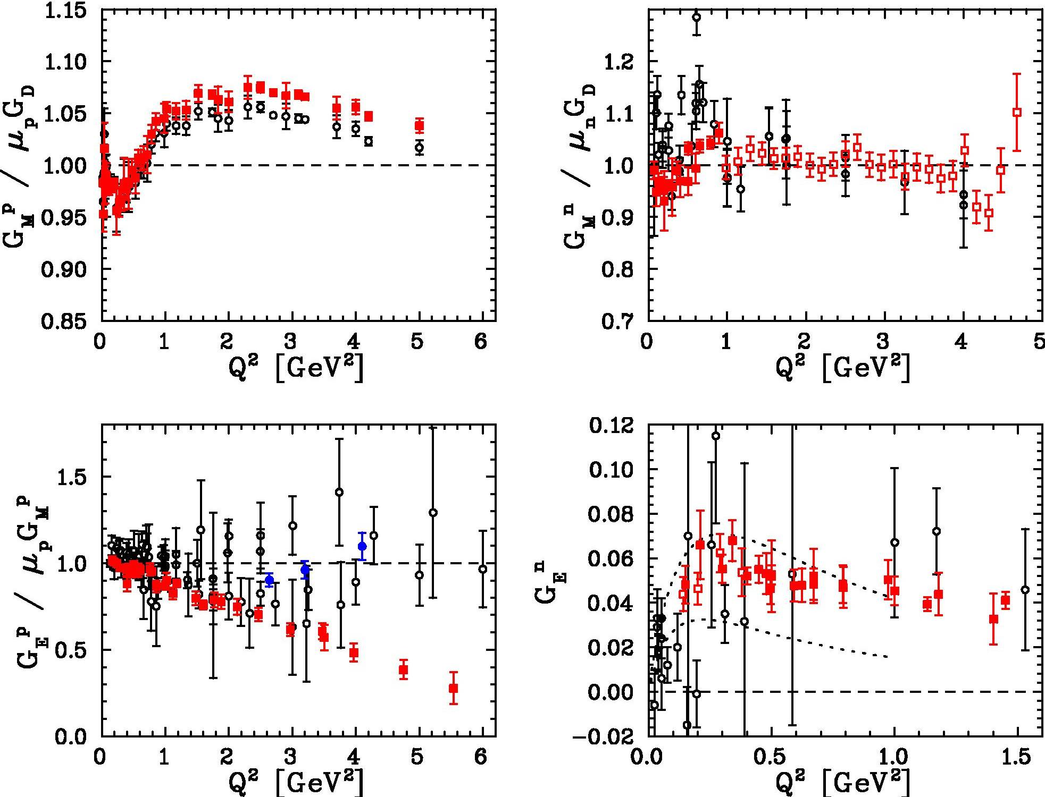
Nucleon Form Factors: Last Ten Years
Nucleon Form Factors: Last Ten Years
Neutron
J. Arrington
Proton
Notes:
GEn: 4.5 @ 6, GMn: 8 @ 6, 15@12, GEp: 15@12, GMp: 18@12, L/T for 10-13

Slide 13
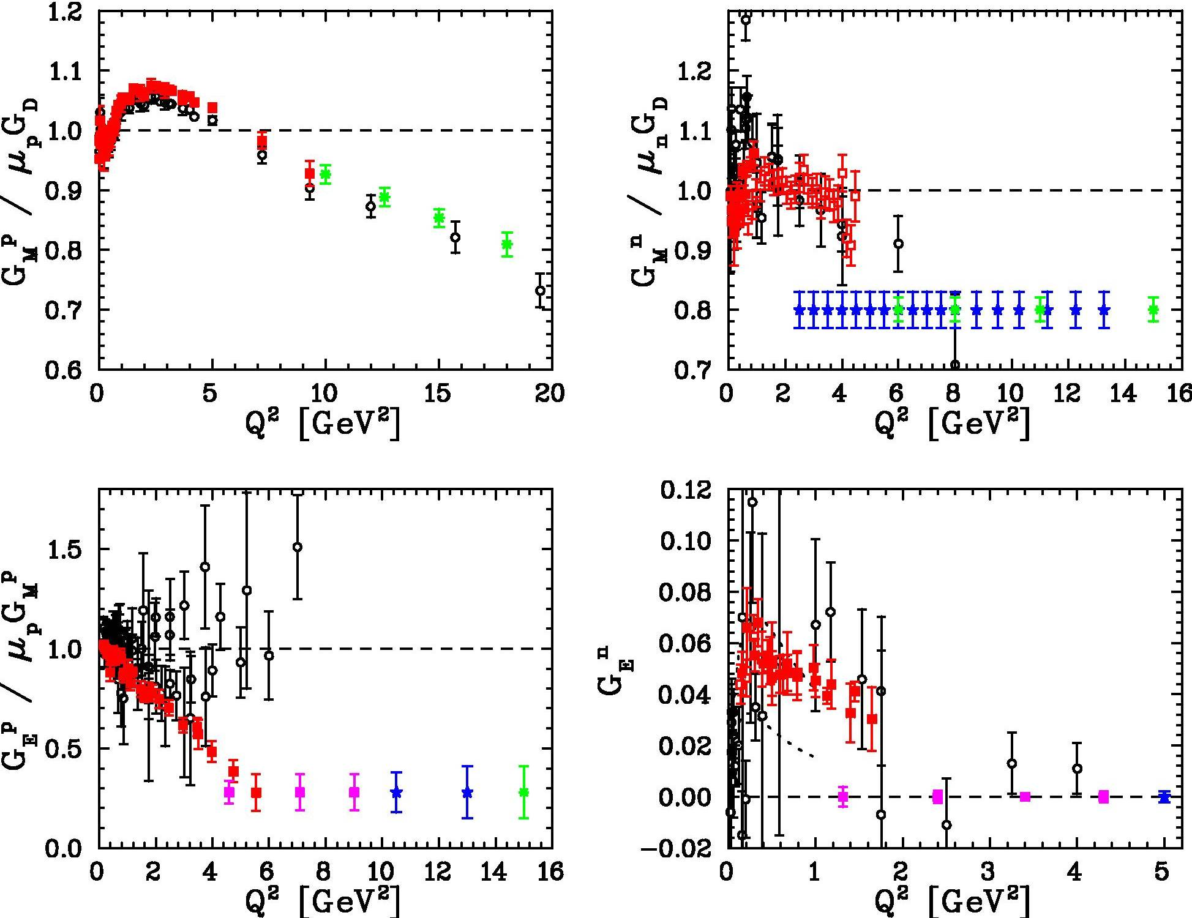
Extensions with JLab 12 GeV Upgrade
J. Arrington
CDR or PAC30 approved
under development
under analysis
~8 GeV²

Slide 14
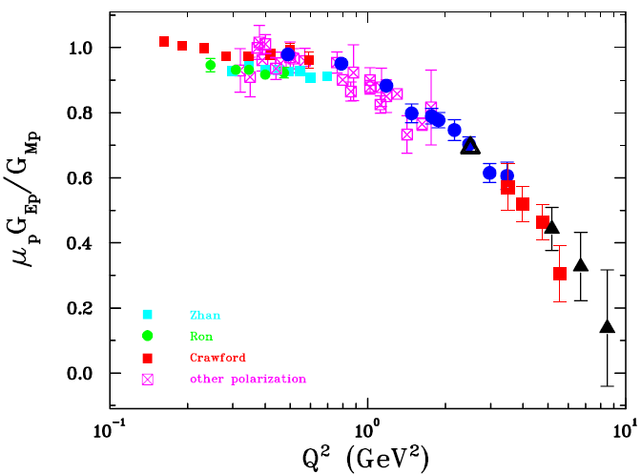
Recent Proton Form Factor Ratios
C. Perdrisat
Notes:
It includes the data of GEp(3). Regards. Charles Note that the GEp(2) data shown are the result of a reanalysis, which have been submitted for publication. The is just a polynomial fit to the data points, no physics input.

Slide 15
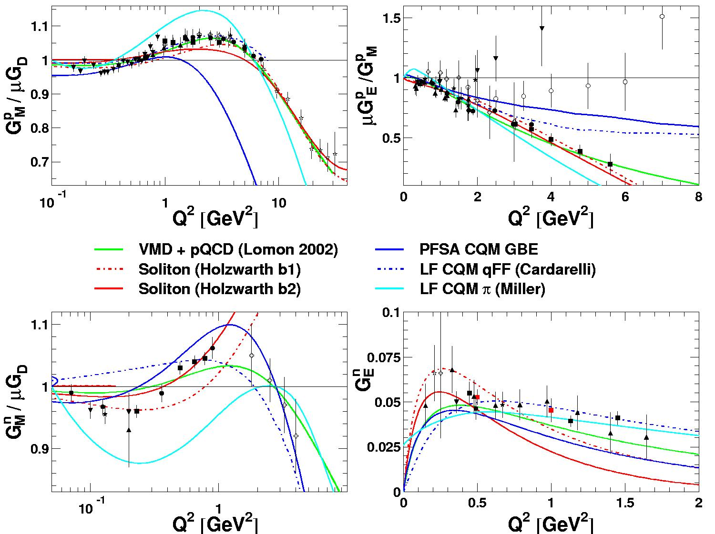
Small Sample of Recent Calculations
J. Arrington
Notes:
point-form spectator approximation (PFSA), Goldstone-boson-exchange (GBE)

Slide 16
Transition
Form Factors
Notes:
EBAC: dynamical coupled channel analysis is based on the world data set on piN. gammaN, and gamma*N and constrained by unitarity. (to Npi, Neta, N2pi)
This allows the extraction of the meson-baryon contributions under minimal model assumptions

Slide 17
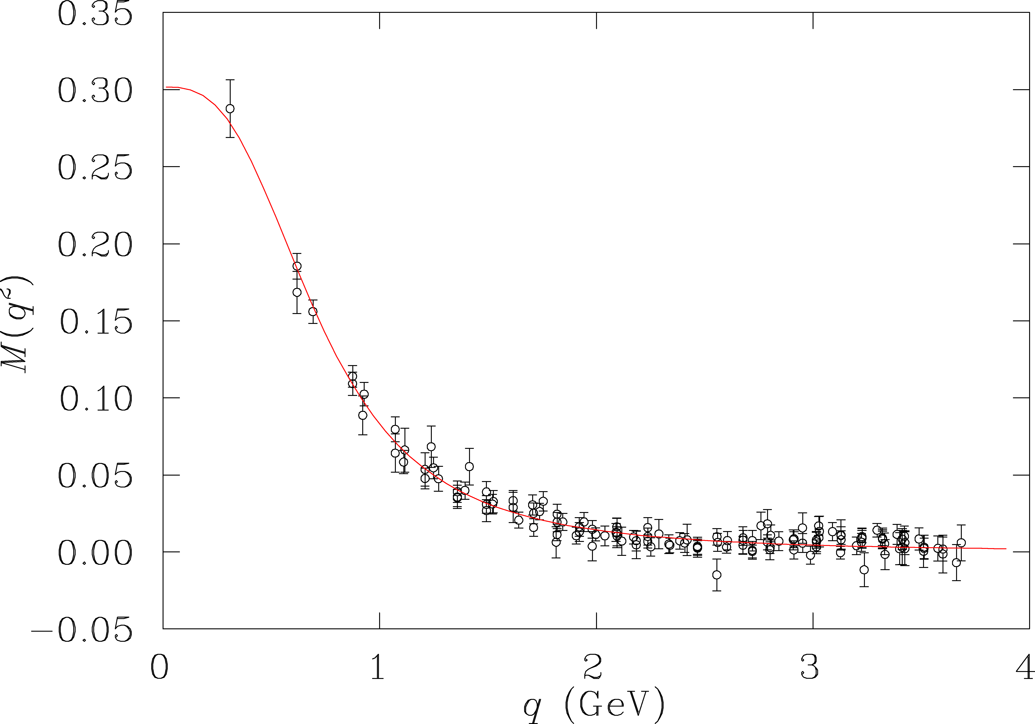
Hadron Structure with Electromagnetic Probes
Study the structure of the nucleon spectrum in the domain where dressed quarks are the major active degree of freedom.
Explore the formation of excited nucleon states in interactions of dressed quarks and their emergence from QCD.
π,ρ,ω…
Q²
Quark mass extrapolated to the chiral limit, where q is the momentum variable of the tree-level quark propagator using the Asqtad action.
low
N,N*,Δ,Δ*…
q
meson dressed quark
LQCD, DSE and …
3q-core+MB-cloud
confinement
quark mass (GeV)
3q-core
current quark
e.m. probe
pQCD
high
Notes:
17
LQCD, DSE, or Gribov-Zwinziger, Kugo-Ojima (all in Landau gauge)
Why do we use electromagnetic probes to study hadron structure? I think the answer is that the e.m. probe allows us to efficiently address the central question of hadron physics: What are the relevant degrees of freedom at varying distance scales? To simply illustrate this I show here the quark propagator mass calculated in LQCD, Dyson Schwinger, and other approaches as a function of the momentum transfer. In the em probe we can vary the resolution and momentum transfer. In doing so, we probe the effective degrees of freedom in the nucleon from meson-nucleon, to constituent quarks, to elementary partons. The study of nucleon resonance transitions provides a testing ground for our understanding of these effective degrees of freedom.

Slide 18
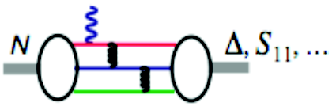
Evidence for the Onset of Scaling?
Phys. Rev. C80, 055203 (2009)
S₁₁ Q³A_{1/2}
F₁₅ Q⁵A_{3/2}
P₁₁ Q³A_{1/2}
D₁₃ Q⁵A_{3/2}
A_{1/2} α 1/Q³
A_{3/2} α 1/Q⁵
F₁₅ Q³A_{1/2}
G_{M} α 1/Q⁴
*
D₁₃ Q³A_{1/2}

Slide 19
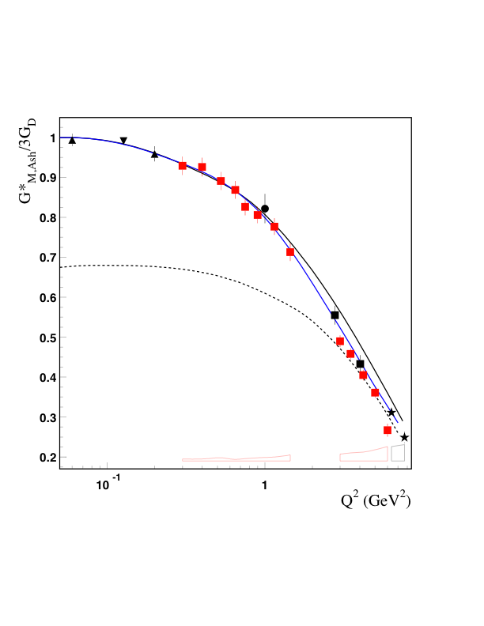
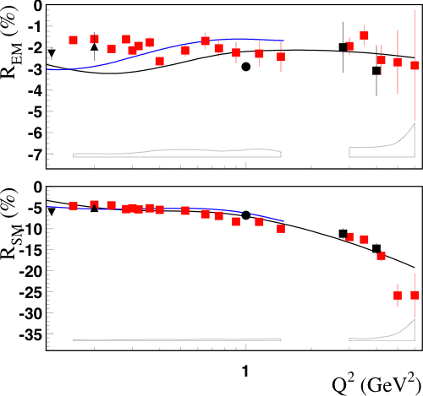
N → Δ Multipole Ratios R_{EM} , R_{SM}
CLAS
Hall A
Hall C
MAMI
Bates
Phys. Rev. Lett. 97, 112003 (2006)
Meson
Cloud
Effect
Pascalutsa
Vanderhaeghen
Sato-Lee
New trend towards pQCD behavior does not show up
CLAS12 can measure G_{M} , R_{EM} , and R_{SM} up to Q²~12 GeV²
R_{EM} +1 R_{SM} const
G_{M} 1/Q⁴ G_{M,Ash} 1/Q⁵
*
*
*
Notes:
Pascalutsa large N_c relations link the N to Delta transition to in terms of the electromagnetic properties of the nucleon: GM can be expressed as a function of the nucleon form factors! And so are REM and RSM, Phys. Rev. D 76, 111501(R) (2007)
Helicity conservation, A(3/2)<<A(1/2), REM->+1 derived in pQCD and AdS/QCD, M. Ungaro et al., hep-ex/0606042, triangle down Bates

Slide 20
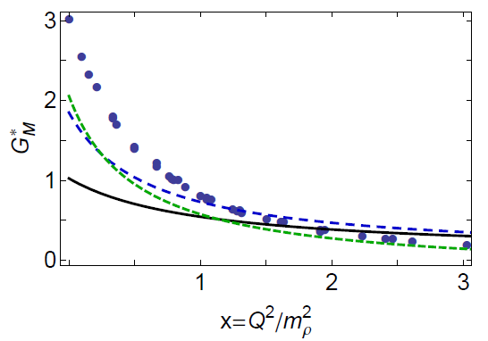
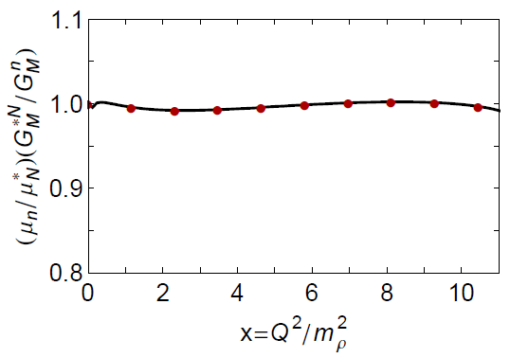
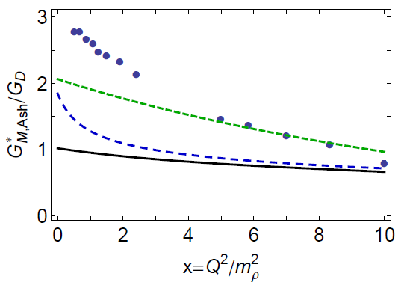
N → Δ Magnetic Transition From Factor
contact interaction
ameliorated
Sato-Lee
contact interaction
J. Segovia et al., arXiv:1305.0292 [nucl-th]
Notes:
Jones-Scadron versus Ash

Slide 21
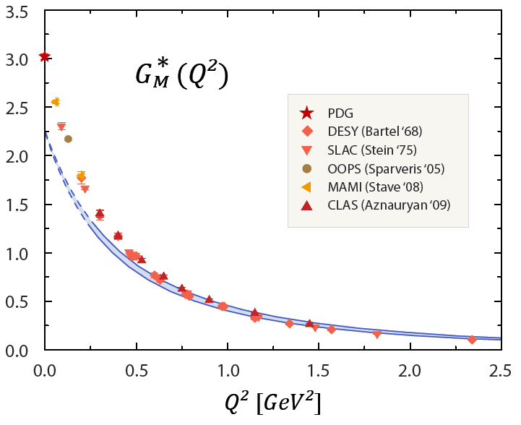
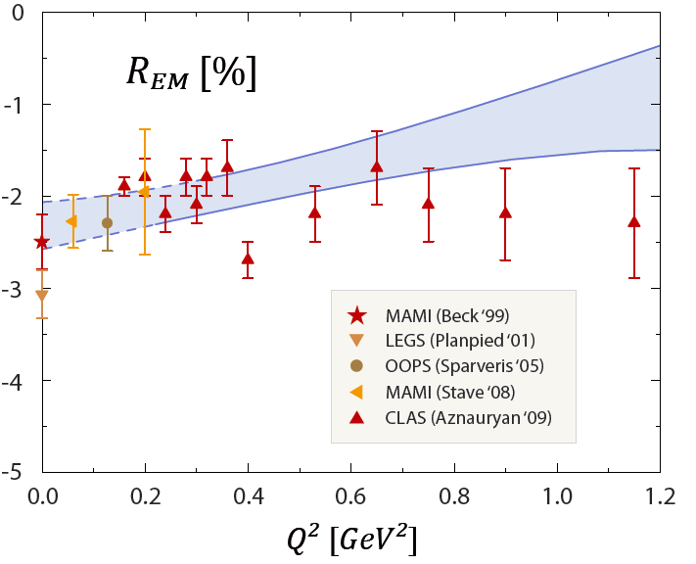
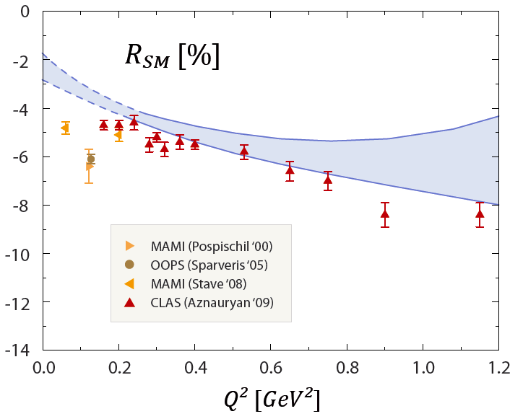
N → Δ Multipole Ratios R_{EM} , R_{SM}
G. Eichmann et al., Phys. Rev. D85 (2012) 093004
Notes:
Jones-Scadron versus Ash

Slide 22
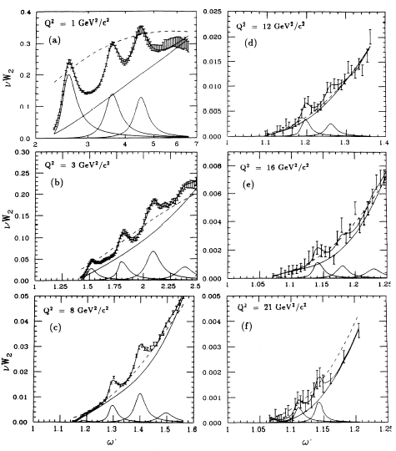
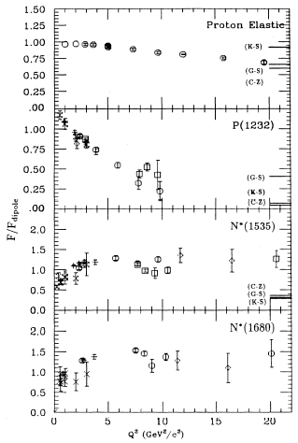
Inclusive Structure Function in the Resonance Region
2nd RR
3rd RR
P. Stoler, PRPLCM 226, 3 (1993) 103-171
Notes:
nuW2 = F2 (non-spinflip structure function)

Slide 23
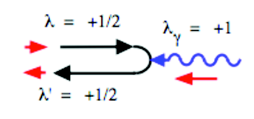
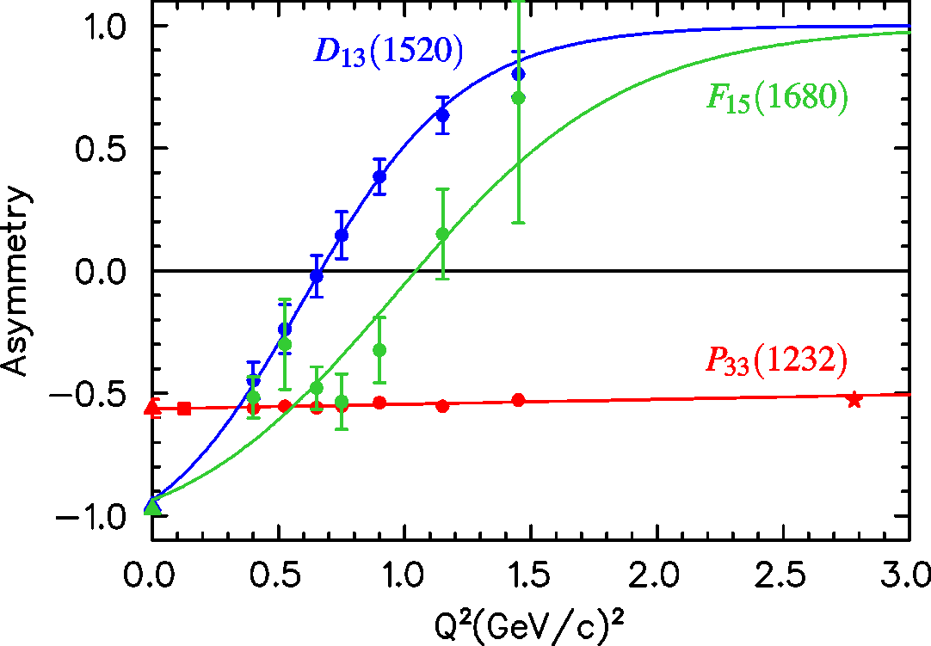
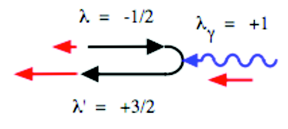
N(1520)D₁₃ Helicity Asymmetry
A_{1/2}² – A_{3/2}²
10⁻³ GeV^{-1/2}
A_{hel} =
A_{1/2}² + A_{3/2}²
A_{1/2}
L. Tiator
A_{3/2}
world data
PDG estimation
Nπ (UIM, DR)
Nπ, Nππ combined analysis
Nππ (JM)
Notes:
N(1720)P13 Ahel (Q2): 0.74 (0), 0 (0.7), 0.88 (1.3)

Slide 24
High-Lying Resonance in Nππ CLAS Data Analysis
Δ(1620)S₃₁
Δ(1700)D₃₃
N(1720)P₁₃
Nπ world
A_{1/2}
A_{1/2}
A_{1/2}
Nππ CLAS
preliminary
A_{3/2}
S_{1/2}
A_{3/2}
Nπ CLAS
(Q² = 0)
π⁺π⁻p electroproduction channel provided first preliminary results on S₃₁(1620), S₁₁(1650), F₁₅(1685), D₃₃(1700) , and P₁₃(1720) electrocouplings of a good accuracy
new features: a) S_{1/2} dominance for S₃₁(1620) and b) |A_{3/2}| ≥ |A_{1/2}| for D₃₃(1700) and P₁₃(1720)
Notes:
V.D.Burkert et al., PRC 67, 035204 (2003)
M.Dugger et al., PRC 79,065206 (2009)

Slide 25
γ_{ν}NN*
Extraction
Notes:
EBAC: dynamical coupled channel analysis is based on the world data set on piN. gammaN, and gamma*N and constrained by unitarity. (to Npi, Neta, N2pi)
This allows the extraction of the meson-baryon contributions under minimal model assumptions

Slide 26
Phenomenological Analyses
Unitary Isobar Model (UIM) approach in single pseudoscalar meson production
Fixed-t Dispersion Relations (DR)
Unitarized Isobar Model for Nππ final state (JM)
Coupled-Channel Approach
(EBAC, Argonne-Osaka, Georgia-Jülich)
Int. J. Mod. Phys. E, Vol. 22, 1330015 (2013) 1-99
Int. J. Mod. Phys. E, Vol. 22, 1330015 (2013) 1-99
Notes:
EBAC: dynamical coupled channel analysis is based on the world data set on piN. gammaN, and gamma*N and constrained by unitarity. (to Npi, Neta, N2pi)
This allows the extraction of the meson-baryon contributions under minimal model assumptions

Slide 27
Phenomenological Analyses in Single Meson Production
Unitary Isobar Model (UIM)
Nonresonant amplitudes: gauge invariant Born terms consisting of t-channel exchanges and s- / u-channel nucleon terms, reggeized at high W.
πN rescattering processes in the final state are taken into account in a
K-matrix approximation.
Fixed-t Dispersion Relations (DR)
Relates the real and the imaginary parts of the six invariant amplitudes in a model-independent way. The imaginary parts are dominated by resonance contributions.
I.G.Aznauryan, Phys. Rev. C67, 015209 (2003), Phys Rev. C80, 055203 (2009),
or see Int. J. Mod. Phys. E, Vol. 22, 1330015 (2013) 1-99

Slide 28
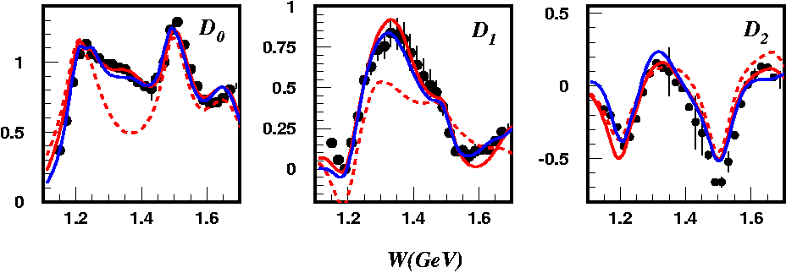
Legendre Moments of Unpolarized Structure Functions
K. Park et al. (CLAS), Phys. Rev. C77, 015208 (2008)
Q²=2.05GeV²
Two conceptually different approaches DR and UIM are consistent. CLAS data provide rigid constraints for checking validity of the approaches.
I. Aznauryan DR fit
I. Aznauryan DR fit w/o P₁₁
I. Aznauryan UIM fit
Notes:
28

Slide 29
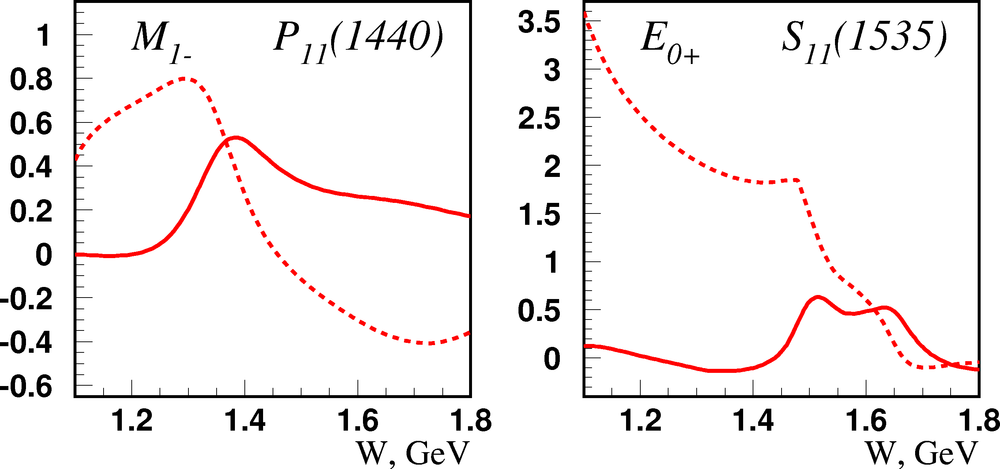
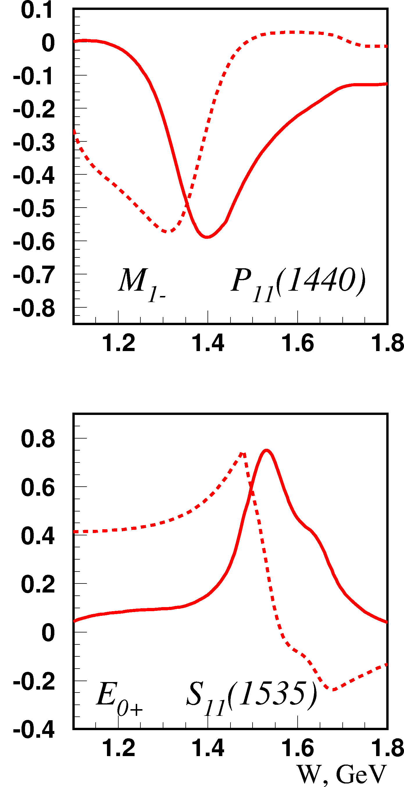
Energy-Dependence of π⁺ Multipoles for P₁₁, S₁₁
Q² = 0 GeV²
Q² = 2.05 GeV²
The study of some baryon resonances becomes easier at higher Q².
Cross sections are extracted in the pπ⁰, pπ⁺, pη; and more are currently under analysis in the pω and pπ⁻ final states.
real part
imaginary part

Slide 30
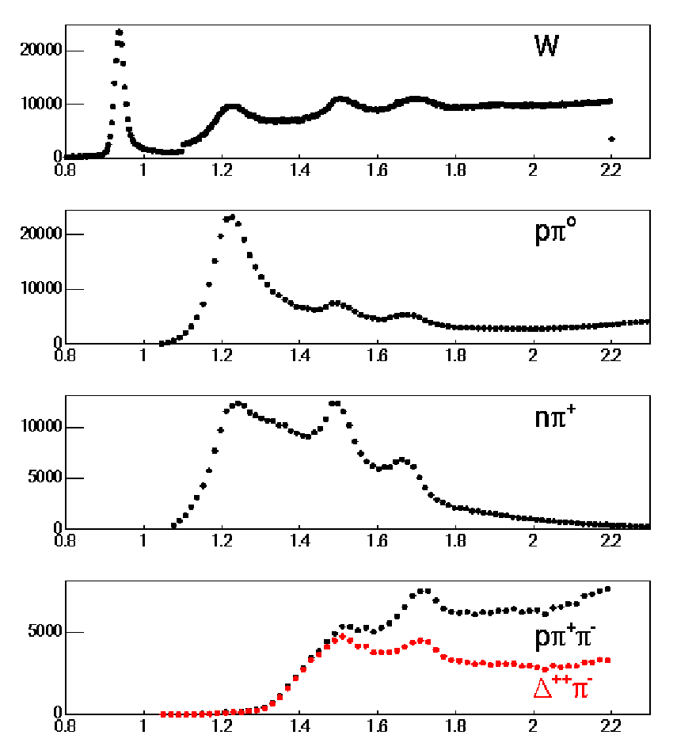
Nucleon Resonances in Nπ and Nππ Electroproduction
Q² < 4.0 GeV²
p(e,e')X
Νππ channel is sensitive
to N*s heavier than
1.4 GeV
Provides information
that is complementary
to the Nπ channel
Many higher-lying N*s
decay preferentially into
Nππ final states
p(e,e'p)π⁰
p(e,e'π⁺)n
p(e,e'pπ⁺)π⁻
W in GeV
Notes:
30
Inclusive and exclusive

Slide 31
JM Model Analysis of the pπ⁺π⁻ Electroproduction
π
Δ(1232)P₃₃, N(1520)D₁₃,
Δ(1600)P₃₃, N(1680)F₁₅
π
Phys. Rev. C 86, 035203 (2012) 1-22
Int. J. Mod. Phys. E, Vol. 22, 1330015 (2013) 1-99
Notes:
Unitarized Breit-Wigner ansatz for resonant amplitudes, I.J.R. Aitchison, Nucl. Phys., A189 (1972) 417
Last diagram 1&2) meson meson 3) meson baryon exchange bubbles, more generally 2q and 3q exchange.

Slide 32
Contributing Mechanisms to γ^{(∗)}p → pπ⁺π⁻
Isobar Model JM05
Full calculations
γp → π⁻Δ⁺⁺
γp → π⁺Δ⁰
γp → π⁺D₁₃(1520)
γp → ρp
γp → π⁻Δ⁺⁺(1600)
γp → π⁺F⁰₁₅(1685)
direct 2π production
The combined fit of nine single differential cross sections allowed to establish all significant mechanisms.
Notes:
Nine single differential cross sections: 3 mass, 3 hadron angles, 3 plane angle combinations

Slide 33
JM Contributions as Determined by the CLAS 2π Data
Full JM
calculation
π⁺Δ⁰
π⁺N(1520) D₁₃
π⁺N(1685) F₁₅
π⁻Δ⁺⁺
2π direct
ρp
Each production mechanism contributes to all nine single differential cross sections in a unique way. Hence a successful description of all nine observables allows us to check and to establish the dynamics of all essential contributing mechanisms.
Notes:
The amplitudes for each process contributing to the overall cross section will have a distinct behavior in each observable as show in the plots above. Requiring a simultaneous fit in all nine observables allows for establishing the dynamics of each process.

Slide 34
Electrocouplings of N(1440)P₁₁ from CLAS Data
PDG estimation
Nπ (UIM, DR)
Nπ, Nππ combined analysis
Nππ (JM)
The good agreement on extracting the N* electrocouplings between the two exclusive channels (1π/2π) – having fundamentally different mechanisms for the nonresonant background – provides evidence for the reliable extraction of N* electrocouplings.
Phys. Rev. C 86, 035203 (2012) 1-22
Notes:
Allows to determine systematic model uncertainties. This consistency check will also be applied at high Q^2.

Slide 35
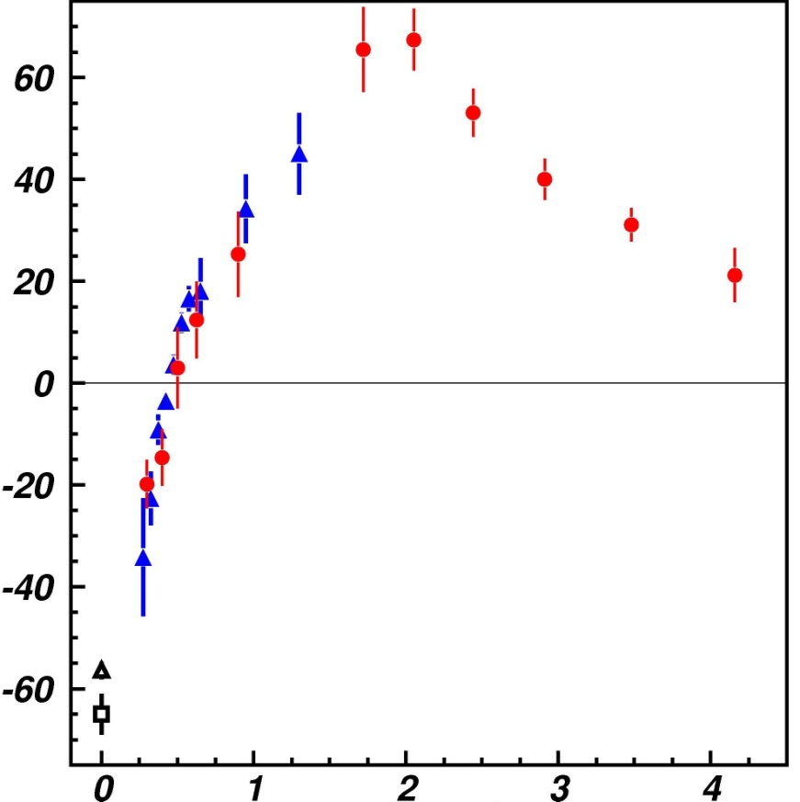
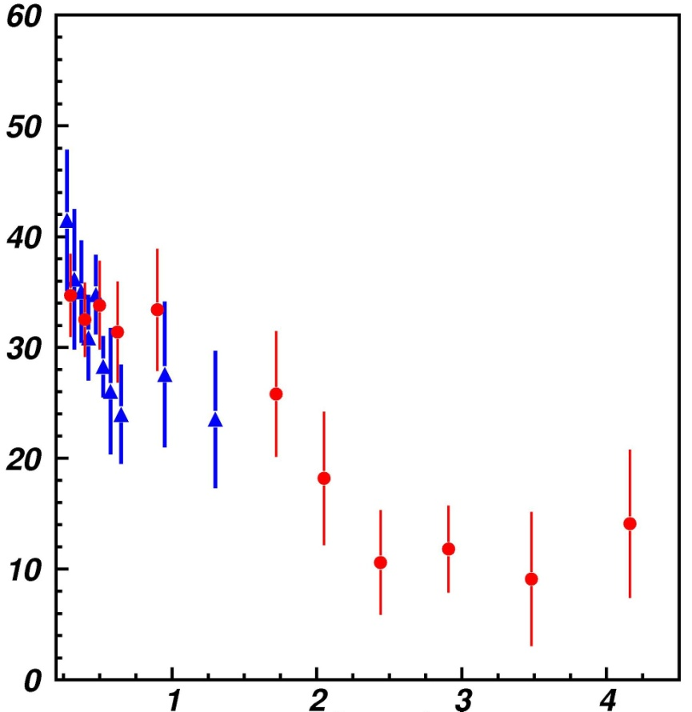
Most recent Electrocouplings of N(1440)P₁₁
preliminary
Gleb Fedotov
10⁻³ GeV^{-1/2}
10⁻³ GeV^{-1/2}
S_{1/2}
A_{1/2}
Q² (GeV²)
Q² (GeV²)
… and beam-helicity dependent 2π cross sections are currently under analysis.
Notes:
red: single pion I.Aznauryan,V.Burkert, et al., PRC 80,055203 (2009), green: two pion Gleb
3 channles times 4 structure functions (12) plus 9 (18) single diff cross sec => 30 observables

Slide 36
QCD-Based
Models and Theory?

Slide 37
Constituent Quark Models (CQM)
With Roper resonance P₁₁(1440) data
nrQM
LC QM
q³+Nσ
q³G
A_{1/2} has zero-crossing near Q²=0.5 and becomes dominant amplitude at high Q²
Eliminates gluonic excitation (q³G) as a dominant contribution
Consistent with radial excitation at high Q² and large meson-baryon coupling at small Q²
Notes:
S. Capstick and B. Keister, Phys. Rev. D51, 3598 (1995)
I.G. Aznauryan, Phys.Rev.C76, 025212 (2007)
L.T. Obukhovsky et al., Phys.Rev. D84, 014004 (2011)

Slide 38
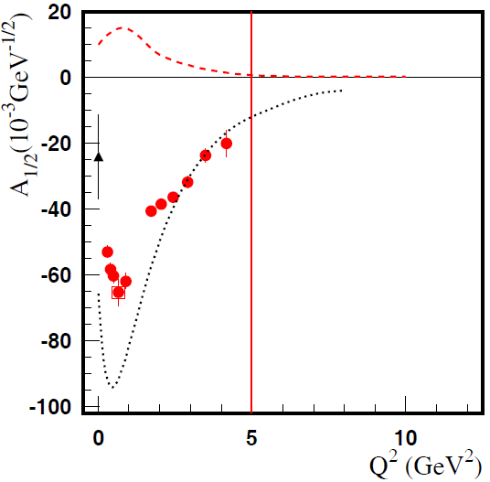
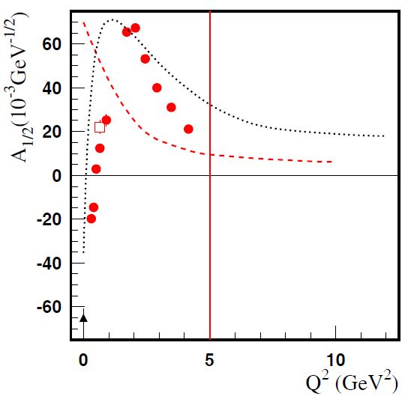
Progress in Experiment and Phenomenology
Meson-Baryon Dressing
D₁₃(1520)
P₁₁(1440)
absolute meson-baryon cloud amplitudes
(EBAC now ANL-Osaka)
quark core contributions (constituent quark models)
CLAS: Nπ and Nπ/Nππ combined (Phys. Rev. C80, 055203, 2009)
Resonance structures can be described in terms of an internal quark core and a surrounding meson-baryon cloud whose relative contribution decreases with increasing Q².
Data on γ_{v}NN* electrocouplings from this experiment (Q² > 5 GeV²) will afford for the first time direct access to the non-perturbative strong interaction among dressed quarks, their emergence from QCD, and the subsequent N* formation.
Notes:
Open box: combined, but double pion is only based on four not nine observables
38

Slide 39
Electrocouplings of N(1520)D₁₃
Electrocouplings of N(1520)D₁₃ and N(1535)S₁₁
A_{3/2}
A_{1/2}
10⁻³ GeV^{-1/2}
10⁻³ GeV^{-1/2}
10⁻³ GeV^{-1/2}
10⁻³ GeV^{-1/2}
A_{1/2}
S_{1/2}
Argonne Osaka / EBAC DCC MB dressing (absolute values)
π⁺π⁻p
2012
π⁺π⁻p
2010
Nπ
2009
M.Giannini/E.Santopinto, hCQM
PRC 86, 065202 (2012)
S.Capstick, B..D.Keister (rCQM)
PRD51, 3598 (1995)
ηp
CLAS/Hall-C
Notes:
Analysis of pη channel assumes S1/2=0
Branching ratios: βNpi = βNeta = 0.45

Slide 40
Dynamical Mass of Light Dressed Quarks
DSE and LQCD predict the dynamical generation of the momentum dependent dressed quark mass that comes from the gluon dressing of the current quark propagator.
These dynamical contributions account for more than 98% of the dressed light quark mass.
Q² = 2.75 GeV²
per dressed quark
DSE: lines and LQCD: triangles
Q² = 12 GeV² = (p times number of quarks)² = 12 GeV² p = 1.15 GeV
The data on N* electrocouplings at 5 GeV²<Q²<12 GeV² will allow us to chart the momentum evolution of dressed quark mass, and in particular, to explore the transition from dressed to almost bare current quarks as shown above.
Notes:
Good agreement between DSE and LQCD. DSE and LQCD are both fundamental approaches to calculate electrocouplings from basic QCD. (Q^2>0.2, p>0.15)
Higgs small, u mass 2.4 MeV, d mass 4.8 MeV -> 1%, 4.5 GeV^2 => p=0.7,
Green mq=425 MeV right Delta-N mass splitting in Nambu Jona Lasinio model, purple typical constituent quark mass of 360 MeV

Slide 41
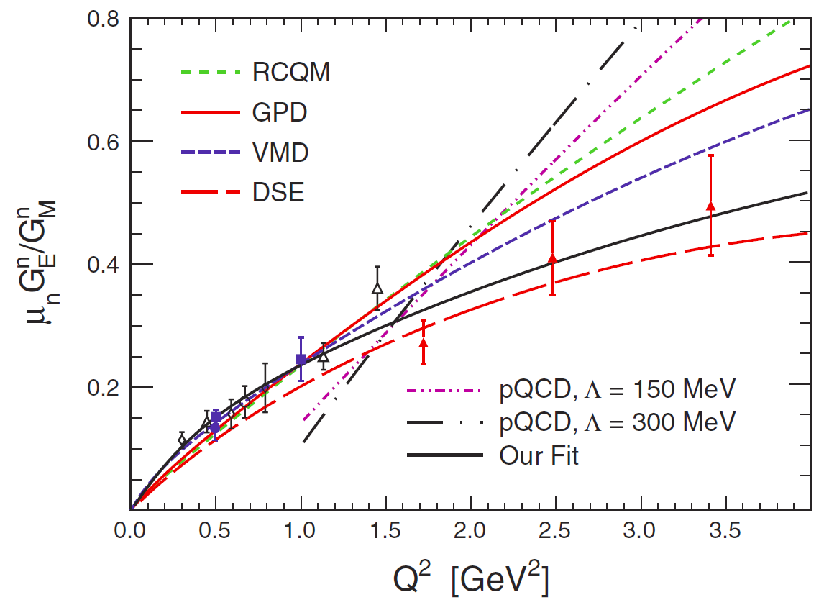
Dyson-Schwinger Equation (DSE) Approach
DSE approaches provide links between dressed quark propagators, form factors, scattering amplitudes, and QCD.
N* electrocouplings can be determined by applying Bethe-Salpeter / Faddeev equations to
3 dressed quarks while the properties and interactions are derived from QCD.
The Faddeev-DSE calculation is very sensitive to the momentum dependence of the dressed-quark propagator.
Data Fit
By the time of the upgrade DSE electrocouplings of several excited nucleon states will be available as part of the commitment of the Argonne NL and the University of Adelaide.
Int. J. Mod. Phys. E, Vol. 22, 1330015 (2013) 1-99
Notes:
DSE and LQCD are both fundamental approaches to calculate electrocouplings from basic QCD.
S. Riordan et al., PRL 105, 262302 (2010), pQCD [Belitsky],RCQM [Miller], DSE [Cloet], GPD [Diehl], and VMD [Lomon]

Slide 42
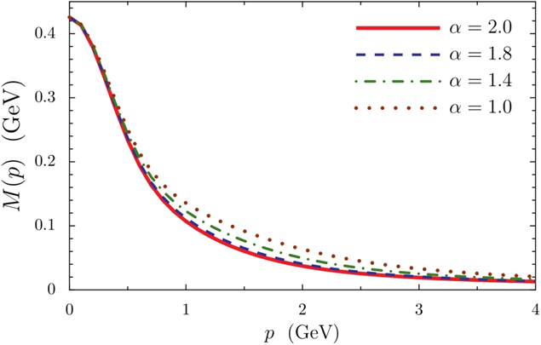
Dyson-Schwinger Equation (DSE) Approach
DSE approaches provide links between dressed quark propagators, form factors, scattering amplitudes, and QCD.
CLAS
CLAS12
EIC
N* electrocouplings can be determined by applying Bethe-Salpeter / Faddeev equations to
3 dressed quarks while the properties and interactions are derived from QCD.
The Faddeev-DSE calculation is very sensitive to the momentum dependence of the dressed-quark propagator.
Data Fit
I.C.Cloet et al., arXiv:1304.0855[nucl-th]
By the time of the upgrade DSE electrocouplings of several excited nucleon states will be available as part of the commitment of the Argonne NL and the University of Adelaide.
Int. J. Mod. Phys. E, Vol. 22, 1330015 (2013) 1-99
Notes:
DSE and LQCD are both fundamental approaches to calculate electrocouplings from basic QCD.
S. Riordan et al., PRL 105, 262302 (2010), pQCD [Belitsky],RCQM [Miller], DSE [Cloet], GPD [Diehl], and VMD [Lomon]

Slide 43
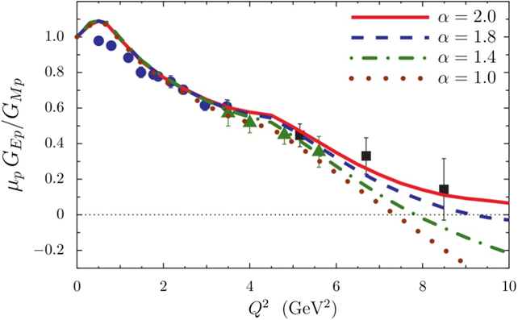
Dyson-Schwinger Equation (DSE) Approach
DSE approaches provide links between dressed quark propagators, form factors, scattering amplitudes, and QCD.
N* electrocouplings can be determined by applying Bethe-Salpeter / Faddeev equations to
3 dressed quarks while the properties and interactions are derived from QCD.
The Faddeev-DSE calculation is very sensitive to the momentum dependence of the dressed-quark propagator.
Data Fit
I.C.Cloet et al., arXiv:1304.0855[nucl-th]
By the time of the upgrade DSE electrocouplings of several excited nucleon states will be available as part of the commitment of the Argonne NL and the University of Adelaide.
Int. J. Mod. Phys. E, Vol. 22, 1330015 (2013) 1-99
Notes:
DSE and LQCD are both fundamental approaches to calculate electrocouplings from basic QCD.
S. Riordan et al., PRL 105, 262302 (2010), pQCD [Belitsky],RCQM [Miller], DSE [Cloet], GPD [Diehl], and VMD [Lomon]

Slide 44
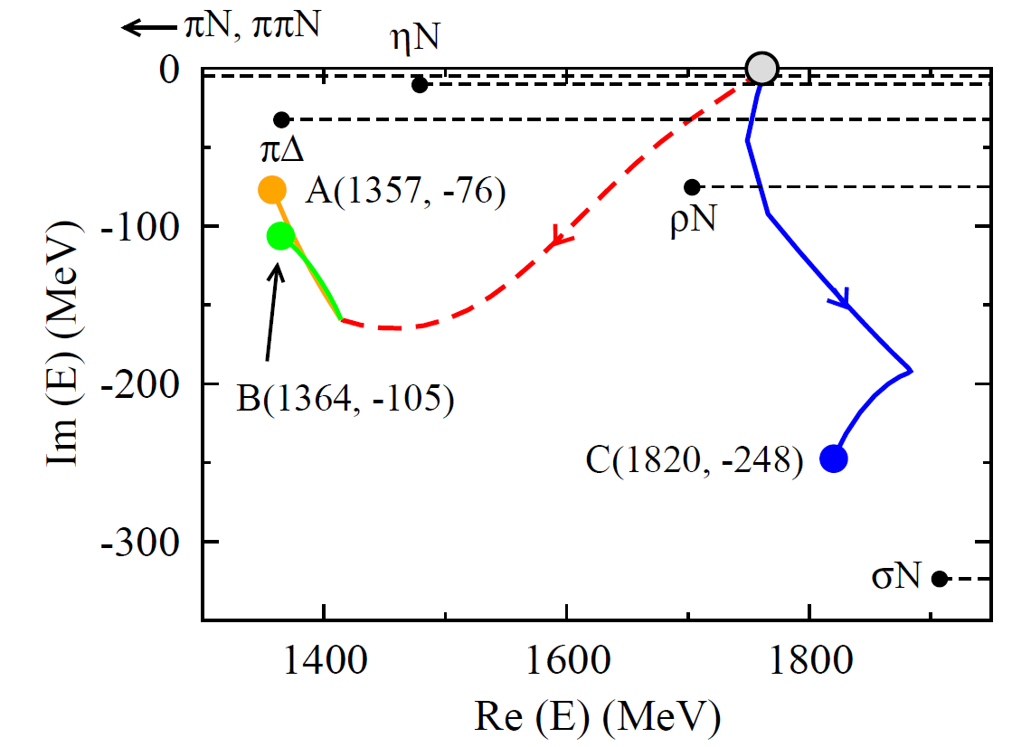
DSE and EBAC Approaches
Location of the first 3-dressed-quark core
radial excitation predicted by DSE
Two poles associated with the Roper resonance and
one with the next higher P₁₁ resonance are all
seeded by the same bare 3-dressed-quark state
Int. J. Mod. Phys. E, Vol. 22, 1330015 (2013)
Notes:
DSE and LQCD are both fundamental approaches to calculate electrocouplings from basic QCD.

Slide 45
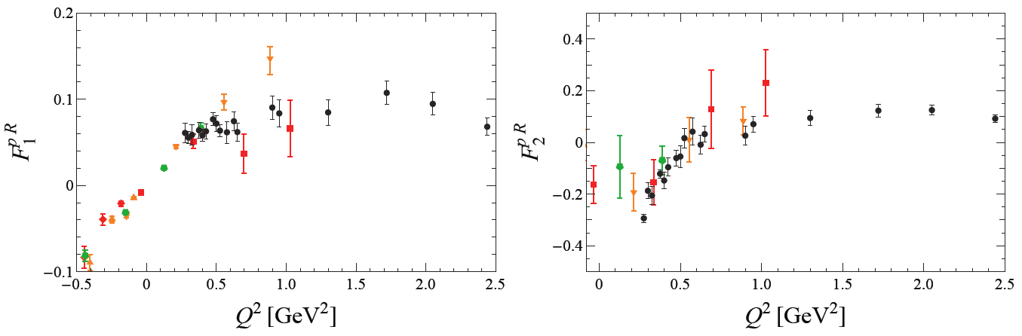
Roper Transition Form Factors in LQCD
p(1440)P₁₁
Huey-Wen Lin and S.D Cohen
CLAS Data
CLAS Data
Lattice QCD calculations of the p(1440)P₁₁ transition form factors have been carried out with various pion masses, m_{π}= 390, 450, and 875 MeV. Particularly remarkable is the zero crossing in F₂ that appears at the current statistics in the unquenched but not in the quenched calculations. This suggests that at low Q² the pion-cloud dynamics are significant in full QCD.
By the time of the upgrade LQCD calculations of N* electrocouplings will be extended to Q² = 10 GeV² near the physical π-mass as part of the commitment of the JLab LQCD and EBAC groups in support of this proposal.
Int. J. Mod. Phys. E, Vol. 22, 1330015 (2013) 1-99
Notes:
m_{πι}= 390, 450, and 875 MeV with volumia 3, 2.5, 2.5 fm, green, red, orange
LQCD offers a straight forward way to relate N* electrocouplings to QCD. Recent LQCD results are just the first step.
High Q^2 LQCD calculations allow us to relate dressed quark interactions to QCD.
Upto now lower Q^2 involves meson baryon contributions and is thus much more complicated.
the so-called quenched approximation can be used, in which the quark fields are treated as non-dynamic "frozen" variables. While this was common in early lattice QCD calculations, "dynamical" fermions are now standard

Slide 46
LQCD & Light Cone Sum Rule (LCSR) Approach
N(1535)S₁₁
LQCD is used to determine the moments of N* distribution amplitudes (DA) and the N* electrocouplings are determined from the respective DAs within the LCSR framework.
Calculations of N(1535)S₁₁ electrocouplings at Q² up to 12 GeV² are already available and shown by shadowed bands on the plot.
By the time of the upgrade electrocouplings of others N*s will be evaluated. These studies are part of the commitment of the Univ. of Regensburg group in support of this proposal.
Int. J. Mod. Phys. E, Vol. 22, 1330015 (2013) 1-99
Notes:
Analysis of pη channel assumes S1/2=0
Branching ratios: βNpi = βNeta = 0.45

Slide 47
E-09-003
… and more?

Slide 48







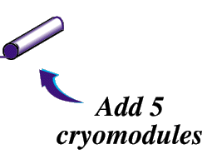
6 GeV CEBAF
12
11
Upgrade magnets and power supplies
CHL-2
Two 0.6 GeV linacs
1.1
1.1
Enhanced capabilities
in existing Halls
Notes:
48
help me

Slide 49
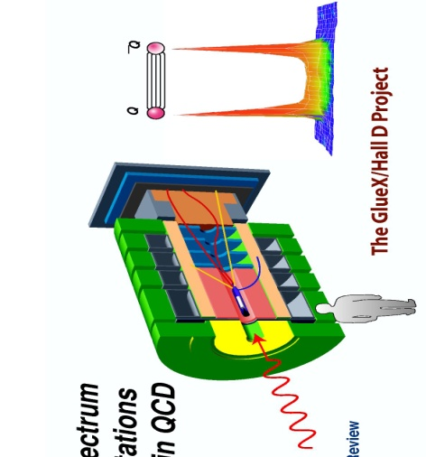
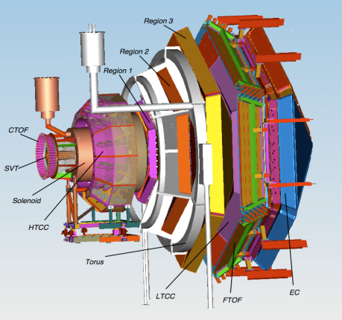
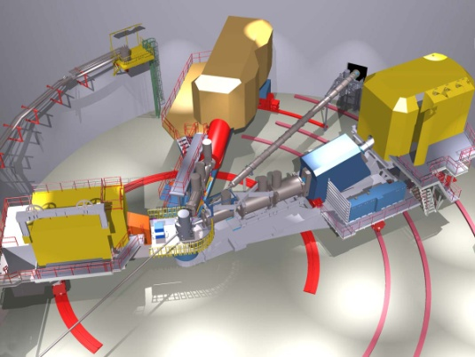

Overview of Upgrade Technical Performance Requirements
Hall D | Hall B | Hall C | Hall A
4π hermetic detector GlueEx | luminosity 10³⁵ CLAS12 | High Momentum Spectrometer SHRS | High Resolution Spectrometer HRS
polarized photons | hermeticity | precision | space
E_{γ} ~ 8.5-9.0 GeV | 11 GeV beamline
10⁸ photons/s | target flexibility
good momentum/angle resolution |  | excellent momentum resolution
high multiplicity reconstruction |  | luminosity up to 10³⁸
.
Notes:
49
Don’t dwell on this too long, they can read it quickly

Slide 50
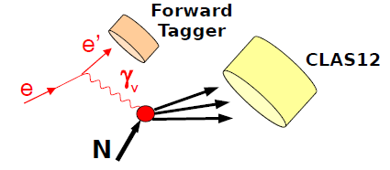
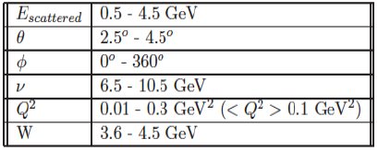
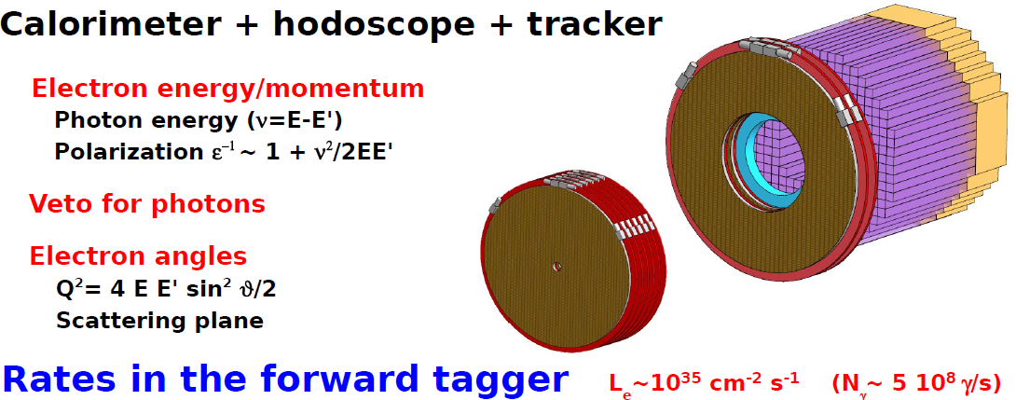
Forward Photon Tagger for Spectroscopy
M. Battaglieri

Slide 51
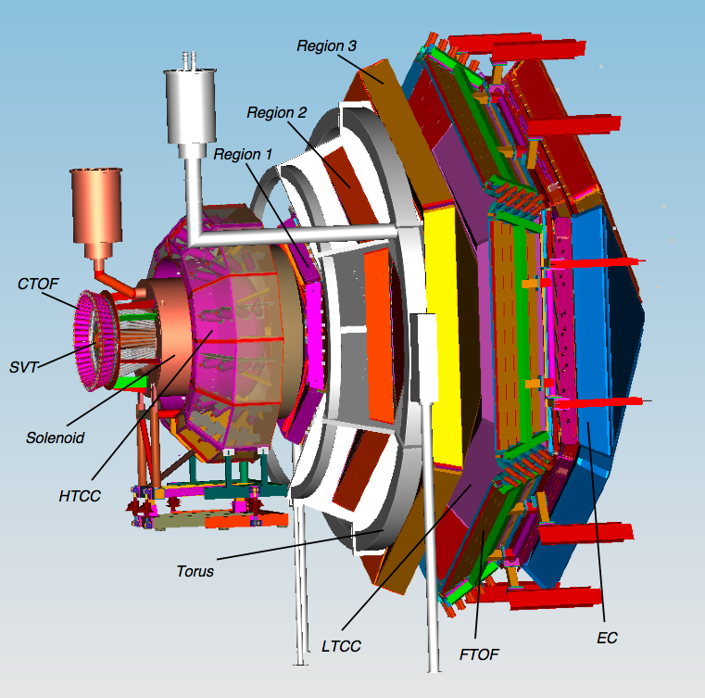
CLAS12
CLAS12
Forward
Detector
Luminosity > 10³⁵ cm⁻²s⁻¹
Hermeticity
Polarization
Baryon Spectroscopy
Elastic Form Factors
N to N* Form Factors
GPDs and TMDs
DIS and SIDIS
Nucleon Spin Structure
Color Transparency
…
Central
Detector
1m

Slide 52
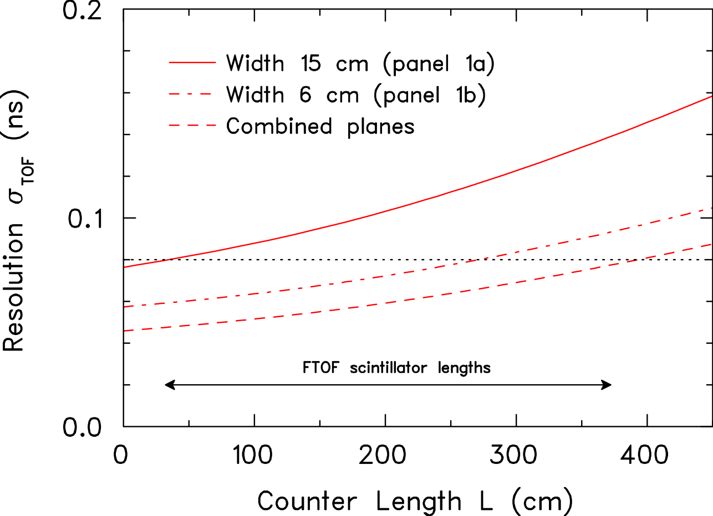


New Forward Time of Flight Detector for CLAS12
panel-2 panel-1b
CLAS
BC-404
World-record time resolution of 48 ns
averaged over the full length of 210 cm
Notes:
1 17.27 29.863; 2 23.62 30.107; 3 30.08 29.723; 4 36.43 30.308; 5 42.89 31.213; 6 49.24 33.760; 9 68.51 34.421; 14 100.48 36.928
28 190.14 50.166; 29 196.6 50.831; 30 202.95 51.093; 31 209.41 54.653
44, 48, 54 ns (210cm); 128, 138, 148 ns (213cm)

Slide 53



New Forward Time of Flight Detector for CLAS12
panel-2 panel-1b
Notes:
1 17.27 29.863; 2 23.62 30.107; 3 30.08 29.723; 4 36.43 30.308; 5 42.89 31.213; 6 49.24 33.760; 9 68.51 34.421; 14 100.48 36.928
28 190.14 50.166; 29 196.6 50.831; 30 202.95 51.093; 31 209.41 54.653
44, 48, 54 ns (210cm); 128, 138, 148 ns (213cm)

Slide 54
CLAS 12 Kinematic Coverage and Counting Rates
Genova-EG
(e',π⁺) detected
Genova-EG
(e',p) detected
(E,Q²) | (5.75 GeV, 3 GeV²) | (11 GeV, 3 GeV²) | (11 GeV, 12 GeV²)
N^{nπ+} | 1.41∗10⁵ | 6.26∗10⁶ | 5.18∗10⁴
N^{pπ0} | - | 4.65∗10⁵ | 1.45∗10⁴
N^{pη} | - | 1.72∗10⁴ | 1.77∗10⁴
40 days
PAC35
60 days
SI-DIS
(e’,π⁺) detected
L=10³⁵ cm⁻² sec⁻¹, W=1535 GeV, ΔW= 0.100 GeV, ΔQ² = 0.5 GeV²
Notes:
54
40 days B+ but 119 days in run group

Slide 55

Kinematic Coverage of CLAS12
60 days
L= 10³⁵ cm⁻² sec⁻¹, ΔW = 0.025 GeV, ΔQ² = 0.5 GeV²
Genova-EG
(e’,pπ⁺π⁻) detected
2π limit >
1π limit >
Q² GeV²
2π limit >
1π limit >
1η limit >
W GeV
Notes:
55
e, p, pi+, pi- are all measured

Slide 56
Anticipated N* Electrocouplings from a Combined Analysis of Nπ & Nππ
P₁₁(1440)
D₁₃(1520)
S₁₁(1535)
CLAS
Hall C
CLAS
CLAS
Open circles represent projections and all other markers the available results with the 6-GeV electron beam
Examples of published and projected results obtained within 60d for three prominent excited proton states from analyses of Nπ and Nππ electroproduction channels. Similar results are expected for many other resonances at higher masses, e.g. S₁₁(1650), F₁₅(1685), D₃₃(1700), P₁₃(1720), …
This experiment will – for the foreseeable future – be the only experiment that can provide data on γ_{v}NN* electrocouplings for almost all well established excited proton states at the highest photon virtualities ever achieved in N* studies up to Q² of 12 GeV².
Notes:
Errors: projections and D13 data stat^2+syst^2, P11 and S11 data only stat
Blue overlap with and red limit of current data

Slide 57
Summary
We will measure and determine the electrocouplings A_{1/2}, A _{3/2}, S_{1/2} as a function of Q² for prominent nucleon and Δ states,
  see our Proposal http://www.physics.sc.edu/~gothe/research/pub/nstar12-12-08.pdf.
Comparing our results with DSE, LQCD, LCSR, and rCQM will gain insight into
  the strong interaction of dressed quarks and their confinement in baryons,
  the dependence of the light quark mass on momentum transfer, thereby shedding light on dynamical chiral-symmetry breaking, and
  the emergence of bare quark dressing and dressed quark interactions from QCD.
This unique opportunity to understand origin of 98% of nucleon mass is also an experimental and theoretical challenge. A wide international collaboration is needed for:
  the development of reaction models that will account for hard quark/parton contributions at high Q² and
  the theoretical interpretation on N* electrocouplings, see our Review Article Int. J. Mod. Phys. E, Vol. 22, 1330015 (2013) 1-99.
Any constructive criticism, help, or participation is always most welcomed, contact:
  Viktor Mokeev mokeev@jlab.org or Ralf Gothe gothe@sc.edu.
Notes:
57
3 channles times 4 structure functions (12) plus 9 single diff cross sec => 21 observables
60 days, lattice, GPDs, easier to study, different branching ratios, combined analysis, transition towards partonic degrees of freedom

Slide 58
Supplement
Notes:
EBAC: dynamical coupled channel analysis is based on the world data set on piN. gammaN, and gamma*N and constrained by unitarity. (to Npi, Neta, N2pi)
This allows the extraction of the meson-baryon contributions under minimal model assumptions

Slide 59
Experimental Facilities
Notes:
EBAC: dynamical coupled channel analysis is based on the world data set on piN. gammaN, and gamma*N and constrained by unitarity. (to Npi, Neta, N2pi)
This allows the extraction of the meson-baryon contributions under minimal model assumptions

Slide 60

Spectroscopy
ELSA
MAMI
BES
LEGS
GRAAL
JLab

Slide 61


Form Factors
Form Factors
+ ELSA and MAMI
A
B
C
Notes:
My talk will be about the electroexcitation of nucleon resonances.
This conferences is all about nucleons and baryons.
Nathan Isgur has been a strong supporter of a nucleon research program at this laboratory. He formulated the importance of studies of the nucleon in 3 remarks he made at the N*2000 conferences in this auditorium:

Slide 62



Jefferson Lab Today
Hall A
Hall B
Two high-resolution
4 GeV spectrometers
Large acceptance spectrometer electron/photon beams
Hall C
A
B
C
7 GeV spectrometer
1.8 GeV spectrometer
Notes:
62
Be brief

Slide 63
Spectroscopy
Notes:
EBAC: dynamical coupled channel analysis is based on the world data set on piN. gammaN, and gamma*N and constrained by unitarity. (to Npi, Neta, N2pi)
This allows the extraction of the meson-baryon contributions under minimal model assumptions

Slide 64
Build your Mesons…

Slide 65



Meson Spectroscopy
Search for mesons with 'exotic' quantum numbers (not compatible with quark-model)
S=S₁⊕S₂ J= L⊕S P = (-1) ^{L+1} C = (-1) ^{L+S}
Not-allowed: J^{PC} = 0⁻⁻ , 0⁺⁻ , 1⁻⁺ , 2⁺⁻
Unambiguous experimental signature for the presence of gluonic
degrees of freedom in the spectrum of mesonic states
Normal meson:
flux tube in
ground state
m=0
CP = (-1)^{S+1}
Hybrid meson:
flux tube in
excited state
m=1
CP = (-1)^{S}
Flux tubes
J^{PC} 1⁻⁺ , 1⁺⁻
Combine excited glue
quantum number with
those of the quarks
exotic
M. Battaglieri
Notes:
Pseudo scalar octett : J^PC=0^-+; rho, omega: 1^-- -> tetraquark can also have exotic quantumnumbers as 0^+- (L=0, S=1)

Slide 66


Meson Spectrum in QCD Lattice Calculations
J. Dudek et al. Phys. Rev. D82 (2010) 034508

Slide 67


Meson Spectrum in QCD Lattice Calculations
also 0⁻⁺ isoscalar
glueball candidate
J. Dudek et al. Phys. Rev. D82 (2010) 034508

Slide 68
Heavy Quark Systems
Notes:
Alpha_bb = 0.189 PDG

Slide 69


Heavy Quark Systems
Bali et al. he-la/0512018
Notes:
Infinetly heavy sources, u,d,ubar,dbar sea-quarks with strange quark mass, which shows that the string breaks at 2 times the strange quark mass, APS 09GHPCDRoberts.pdf

Slide 70
Di-Quarks in Deep Inelastic Scattering
Nucl. Phys. B371 (1992) 3
= 2/3
= 1/4
Only the u valence quark carries
large x in the proton and the only
the d valence quark in the neutron.

Slide 71

Neutron Structure Function at High x
I.C. Cloët, C.D. Roberts, et al., arXiv:0812.0416 [nucl-th]
D. J. Wilson, I. C. Cloët, L. Chang, and C. D. Roberts, arXiv:1112.2212 [nucl-th], Phys. Rev. C85 (2012) 025205
SU(6) symmetry
DSE: “realistic”
pQCD, uncorrelated Ψ
DSE: “contact”
0⁺ qq only
Melnitchouk et al.
Phys.Rev. D84 (2011) 117501
Reviews:
N. Isgur, PRD 59 (1999)
S. Brodsky et al., NP B441 (1995)
R.J. Holt & C.D. Roberts, RMP (2010)
W. Melnitchouk & A.W. Thomas, PL B377 (1996) 11
C.D. Roberts
Notes:
(48)

Slide 72
Di-Quarks in Deep Inelastic Scattering
Arrington et al. (2009)
First model-independent measurement
of F₂^{n}/F₂^{p} and F₂^{n}
Bonus, PRL 108 142001 (2012)
Holt and Roberts, arXiv:1002.4666v3, RMP (2010)
= 1/4
Only the u valence quark carries
large x in the proton and the only
the d valence quark in the neutron
Notes:
CTEQ-Jefferson Lab global PDF fits (CJ), A. Accardi et al., Phys. Rev. D 84, 014008 (2011).
x*=Q2/2pq ~ x/(2-alpha_s) is the Bjorken scaling variable of the struck neutron in the deuteron

Slide 73


γp→K⁺Λ
FROST/HD γN πN, ηN, KΛ, KΣ, Nππ
Process is described by 4 complex, parity conserving amplitudes
8 well-chosen measurements are needed to determine amplitude
For hyperon finals state 16 observables are measured in CLAS ➠ large redundancy in determining the photo-production amplitudes ➠ allows many cross checks and increased accuracy
8 observables measured in reactions without recoil polarization
weak decay has
large analyzing power
Notes:
Photo: 4 complex, 7 independent, 16 total
Electro: 6complex, 11 independent, 36 total
The K-Lambda channel is ideal for complete measurement as the Lambda decays weakly to pi- p with large analyzing power.
73

Slide 74
N* Spectrum in LQCD
The strong interaction physics is encoded in the nucleon excitation spectrum that spans the degrees of freedom from meson-baryon and dressed quarks to elementary quarks and gluons
R. Edwards, J. Dudek,
D. Richards, S. Wallace, PRD84 (2011) 074508
m_{π}=396MeV
LQCD predicts states with the same quantum numbers as the CQM with underlying SU(6)xO(3) symmetry

Slide 75
CLAS Results on γp K⁺Λ K⁺pπ
Bonn-Gatchina Coupled Channel Analysis, A.V. Anisovich et al., EPJ A48, 15 (2012)
(includes nearly all new photoproduction data)

Slide 76
First New N* States in PDG 2012
BnGa energy-dependent coupled-channel PWA of CLAS K⁺Λ and other data
S₁₁(1895)
D₁₃(1875)
D₁₃(2080)
D₁₅(2060)
P₁₁(1880)
P₁₃(1900)
F₁₅(2000)
m_{π}=396MeV
Much more data will still be analyzed
Photoproduction allows us to identify new states but tells us little about their nature

Slide 77

ANL-Osaka Nucleon Resonance Analysis (2012- 2013)
Based on a Dynamical Formulation
which provides interpretation of
the extracted resonances
2. Channels included:
3. Data included:
γΝ, πΝ, ηΝ, ΚΛ, ΚΣ, ππΝ (πΔ, ρΝ, σΝ)
γΝ, πΝ πΝ, ηΝ, ΚΛ, ΚΣ

Slide 78

N* Spectrum from ANL-Osaka Collaboration
T.-S. H. Lee, arXiv:1208.5748 [nucl-th]

Slide 79


N* Spectrum from ANL-Osaka Collaboration
PDG: blue, brown bands
**** ***
Agrees with Juelich except in 2nd P₁₁ and D₃₅

Slide 80


N* Spectrum from ANL-Osaka Collaboration
PDG: blue, brown bands
**** ***
Disagrees with Bonn-Gatchina in the number of N* with masses
> 1.7 GeV (they have six more)

