Slide 1
CLAS and JLab/PANDA collaboration
D G Ireland

Slide 2
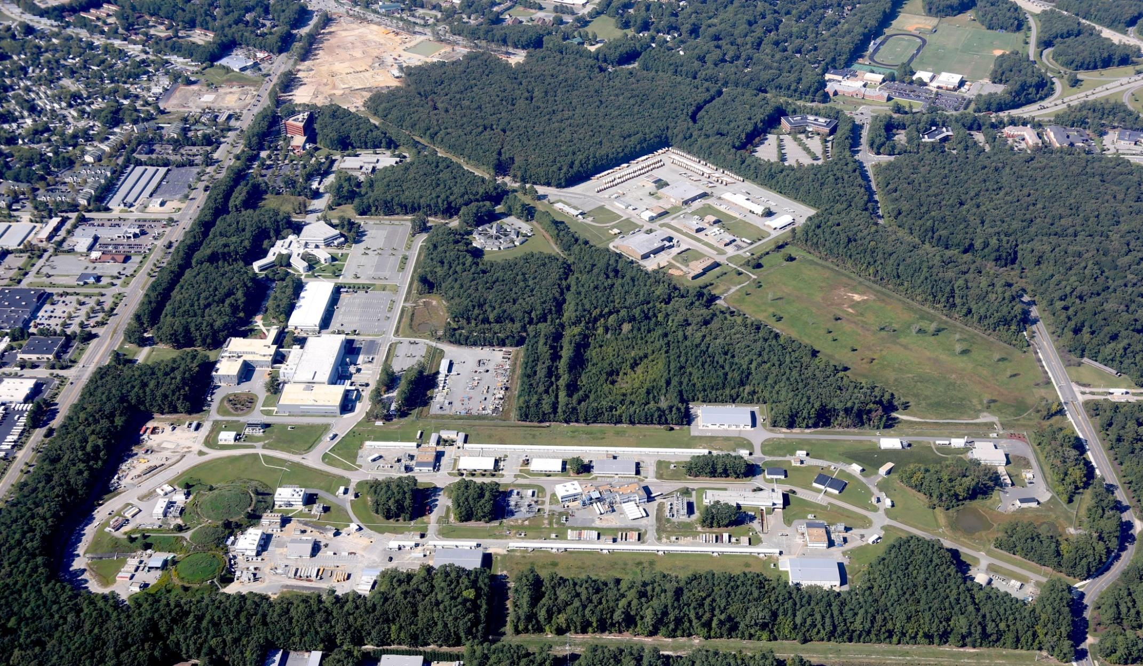

Outline
Brief overview of JLab 12 GeV upgrade
Status of CLAS12
Areas of overlap with PANDA
New results from “old” CLAS data
Further engagement

Slide 3
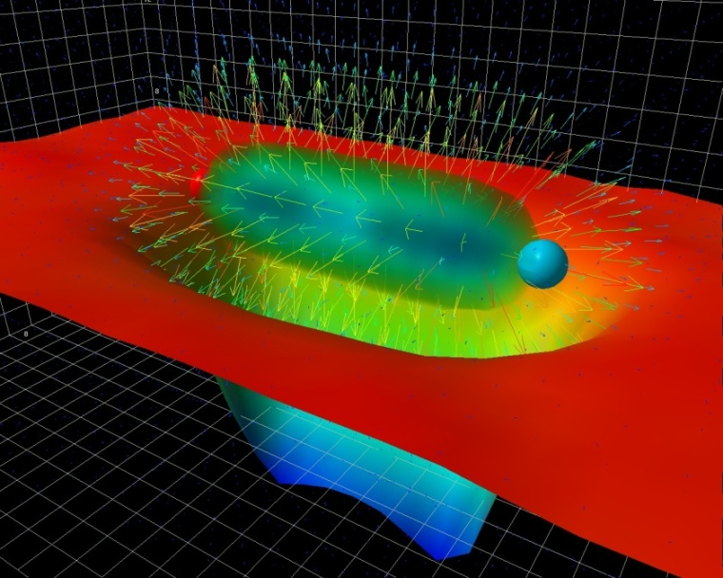
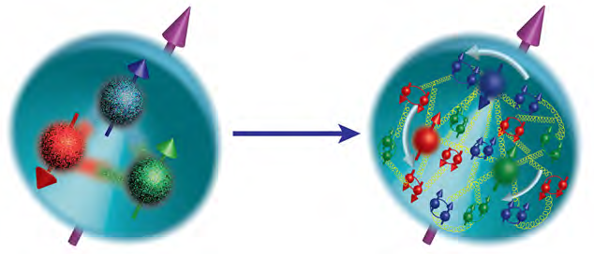
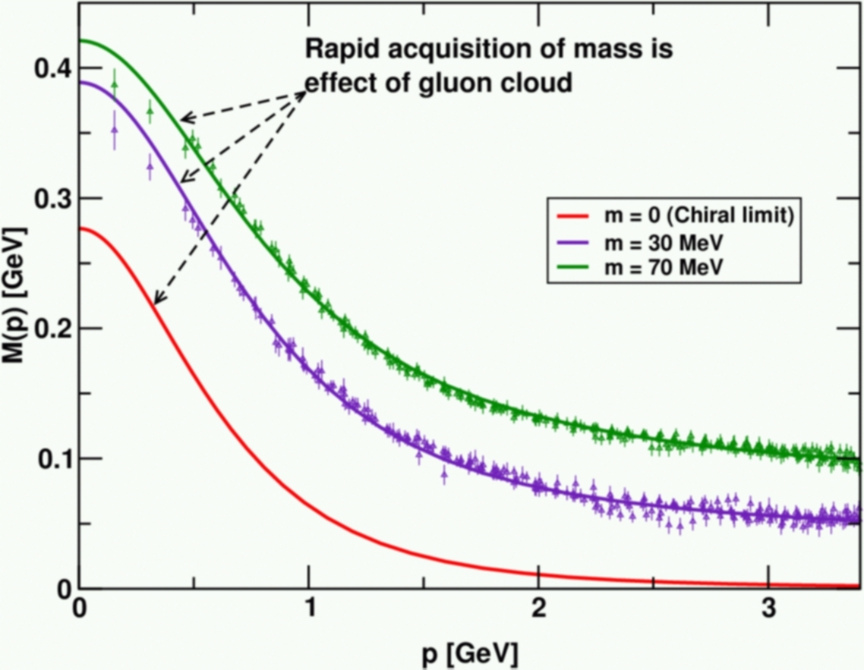
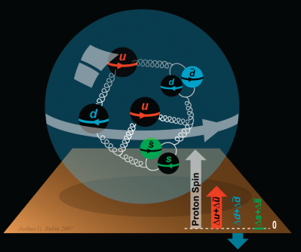
Key Physics Questions
Generation of Mass
Confinement
Nucleon Spin

Slide 4
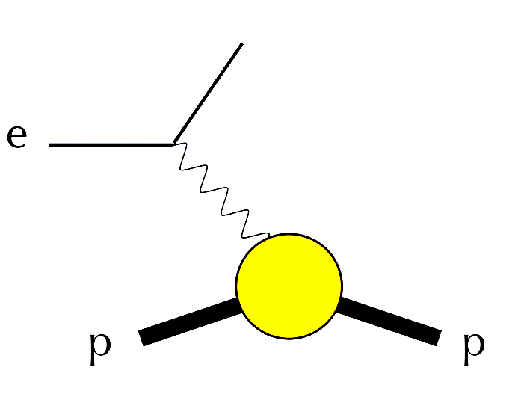
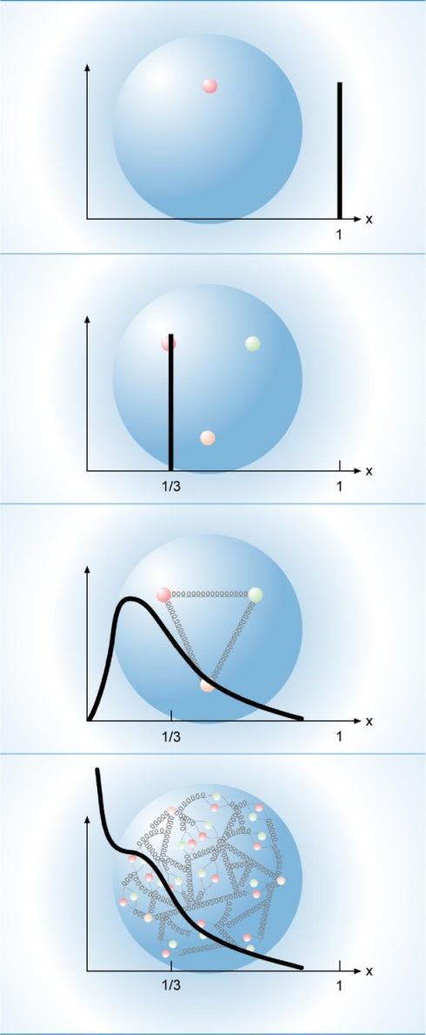
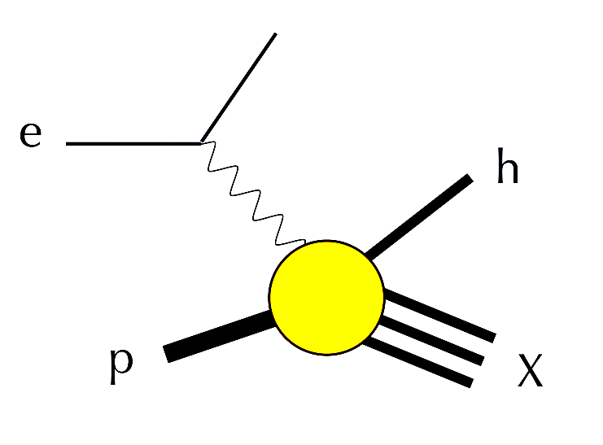
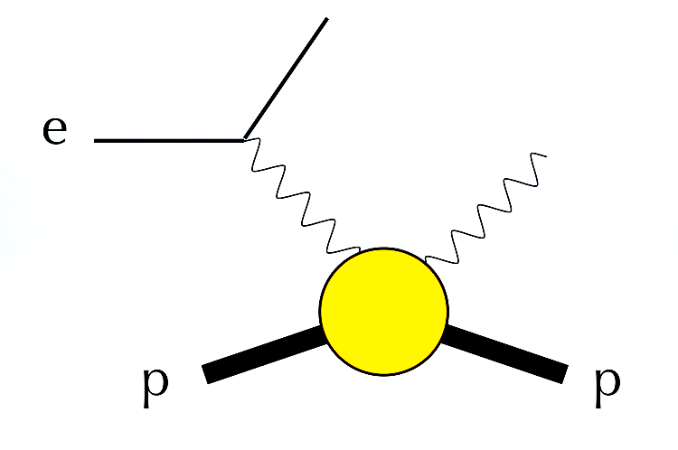
Reactions
Elastic Scattering
Semi-Inclusive Deep Inelastic
Scattering (SIDIS)
Deeply Virtual Compton
Scattering (DVCS)

Slide 5
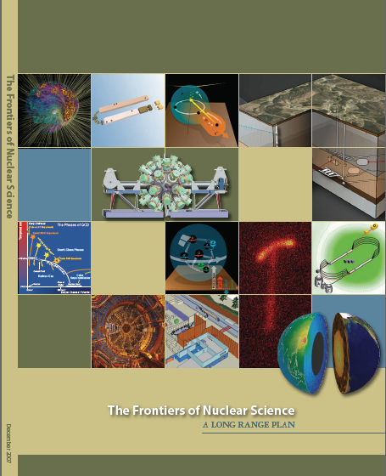
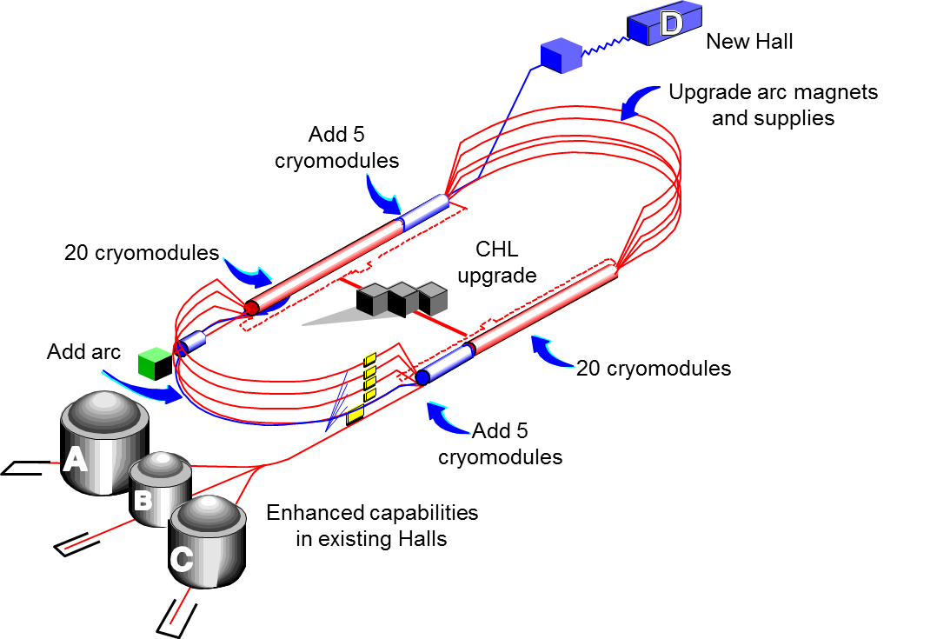

JLab 12 GeV Upgrade
Highest priority in the 2007 NSAC Long Range Plan.
Scope of the project includes:
Doubling the accelerator beam energy
New experimental Hall and beamline
Upgrades to existing Experimental Halls

Slide 6

JLab 12 GeV Upgrade

Slide 7
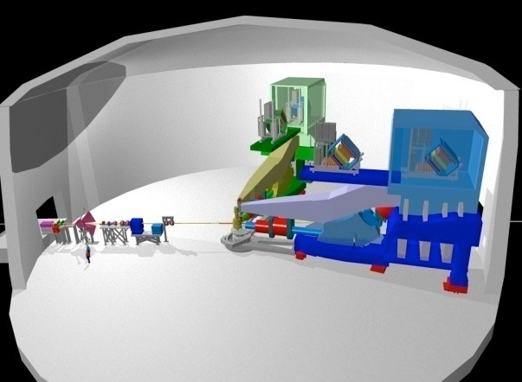
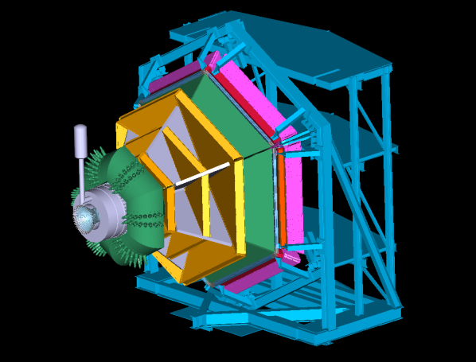

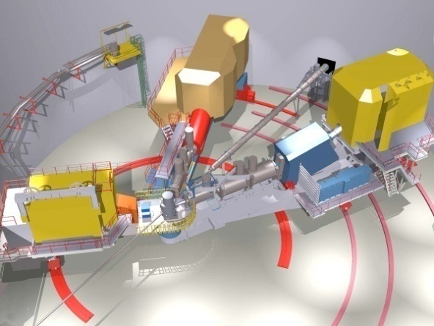
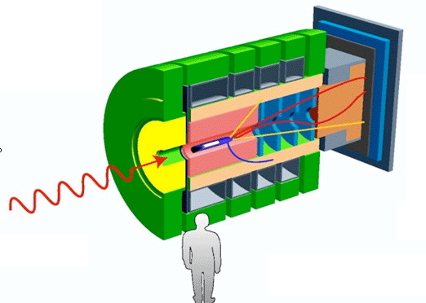

Upgrades to Hall Equipment
Hall A
Hall B
Hall C
Hall D

Slide 8
Upgrades to Hall Equipment
Hall A
High Resolution Spectrometers and new multipurpose large acceptance detectors
short range correlations, form factors, and future new experiments: SOLID, MOELLER, SBS
Hall C
Super High Momentum Spectrometer (SHMS)
precise determination of valence q properties in nucleons and nuclei

Slide 9
Upgrades to Hall Equipment
Hall D
GlueX detector for photoproduction
explore origin of confinement by studying hybrid mesons

Slide 10
Upgrades to Hall Equipment
Hall B
Large acceptance detector CLAS12 for high luminosity measurements (10³⁵cm⁻²s⁻¹)
Understanding nucleon structure via GPDs and TMDs and hadron spectroscopy

Slide 11
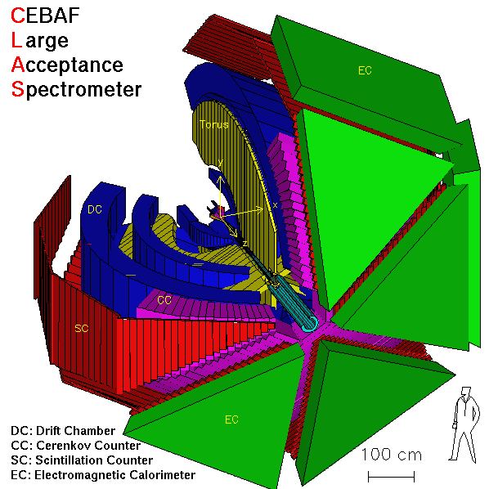
Hall B: Previous Detector

Slide 12
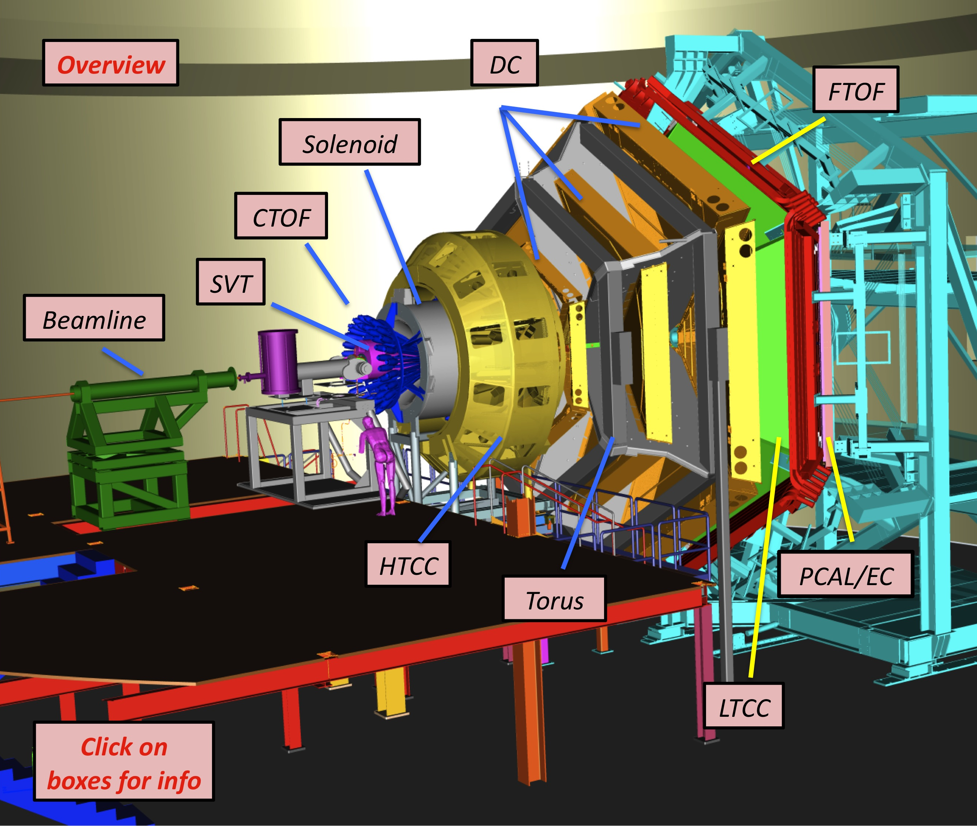
The CLAS12 Detector
Baseline Equipment:
Forward Detector (FD)
TORUS magnet (6 coils)
HT Cherenkov Counter
Drift chamber system
LT Cherenkov Counter
Forward ToF System
Pre-shower calorimeter
E.M. calorimeter
Central Detector (CD)
SOLENOID magnet
Barrel Silicon Tracker
Central Time-of-Flight
Beamline
Target
Moller polarimeter
Photon Tagger
http://www.jlab.org/Hall-B/clas12-web/

Slide 13
The CLAS12 Detector
Upgrades to the Baseline:
Under construction
MicroMegas
Central Neutron Detector
Forward Tagger
RICH detector (1 sector)
Polarized target (long.)
http://www.jlab.org/Hall-B/clas12-web/

Slide 14
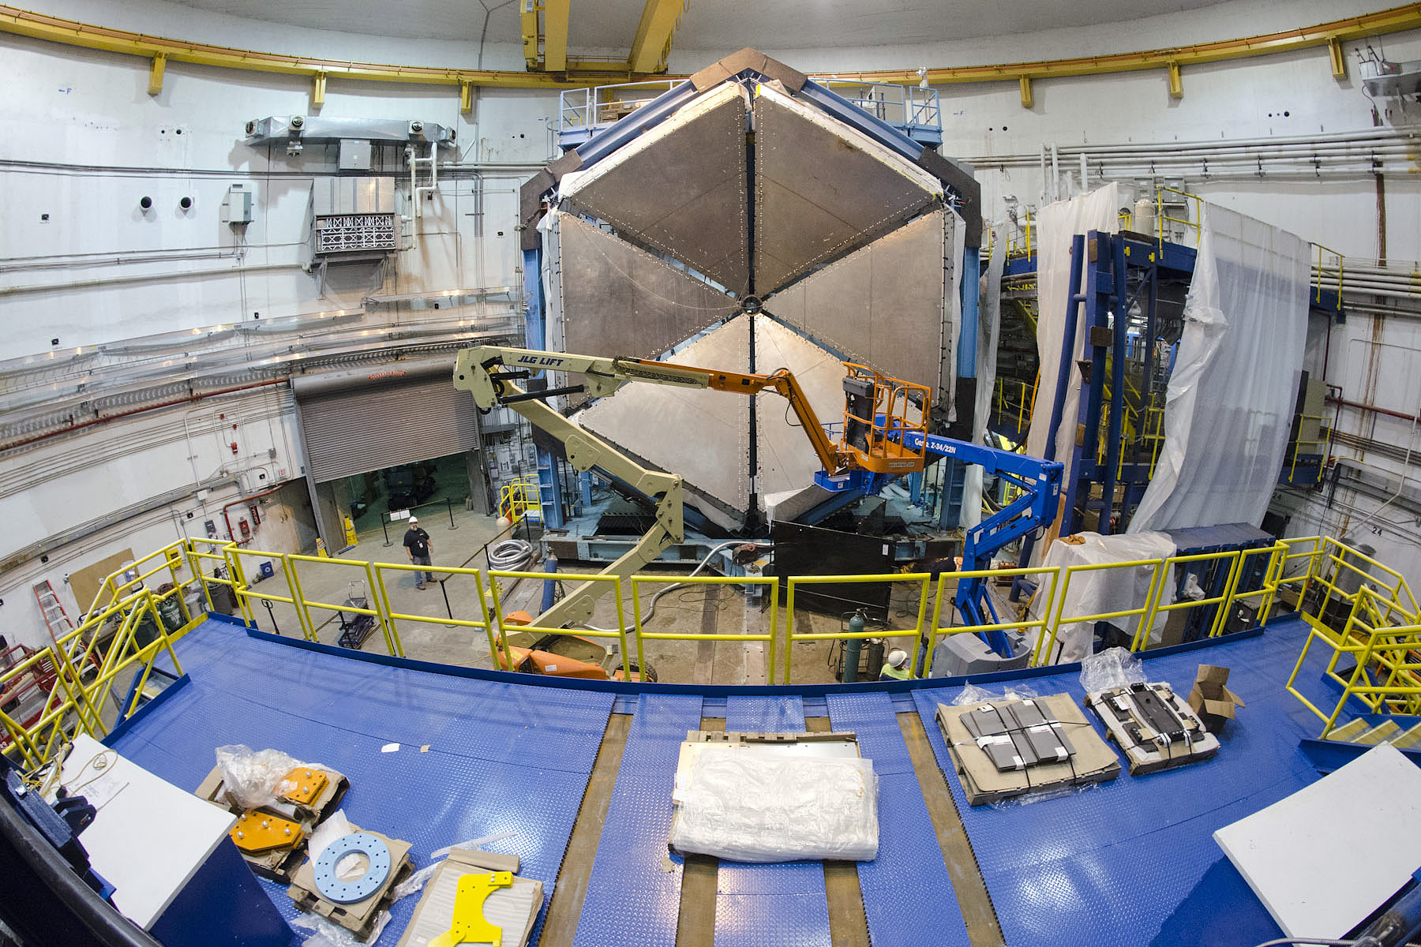
Construction Progress

Slide 15
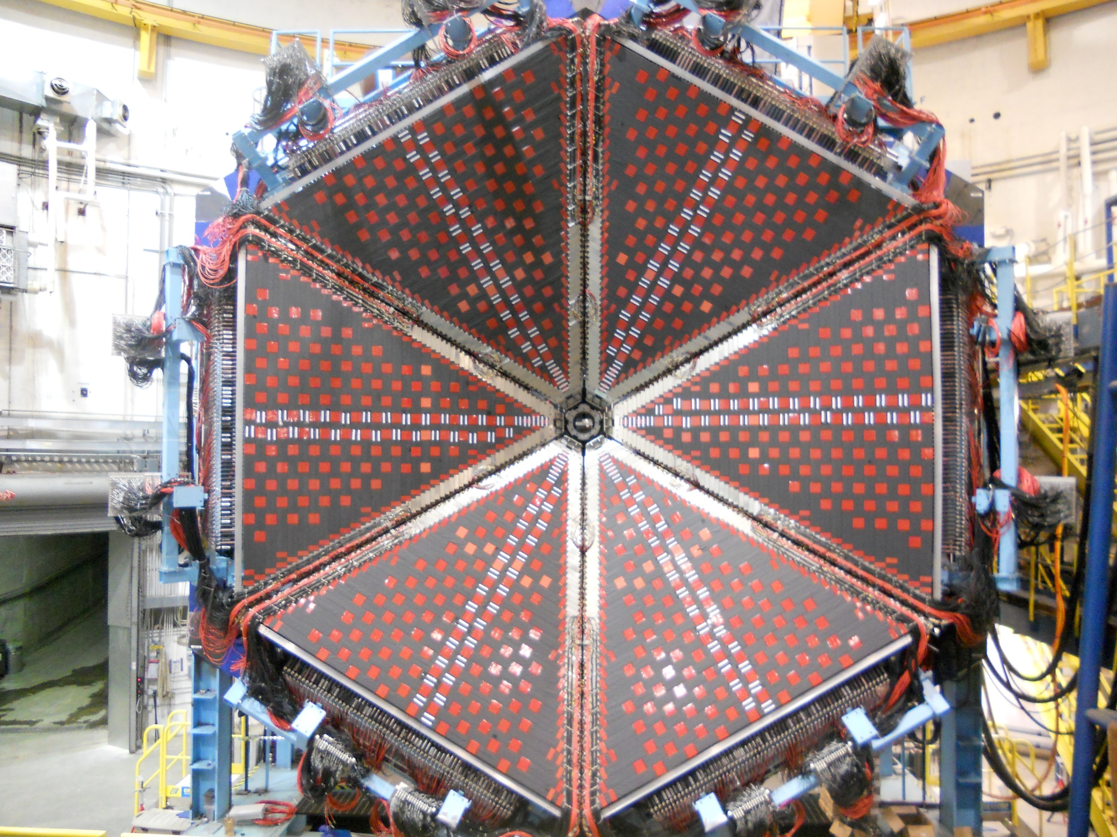
Construction Progress

Slide 16
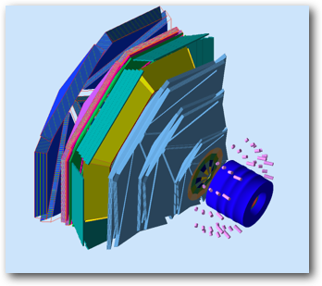
Simulation

Slide 17


Joint Initiative
Four Working Groups with representatives from each collaboration
Board: M.Battaglieri (coordinator), S.Schadmand (coordinator)
V.Burkert, D. Ireland, P.Gianotti, J.Ritman
Nucleon structure: Keith Griffioen, Frank Maas, Marco Mirazita, …
Hadron Spectroscopy: Raffaella De Vita, Diego Bettoni, …
Physics Analysis: Adam Szczepaniak, Klaus Goetzen, Frank Nerling, …
Detectors: Latifa Elouadrhiri, Lars Shmitt, …
Wiki page http://wiki.ge.infn.it/panda-jlab/index.php/Main_Page

Slide 18
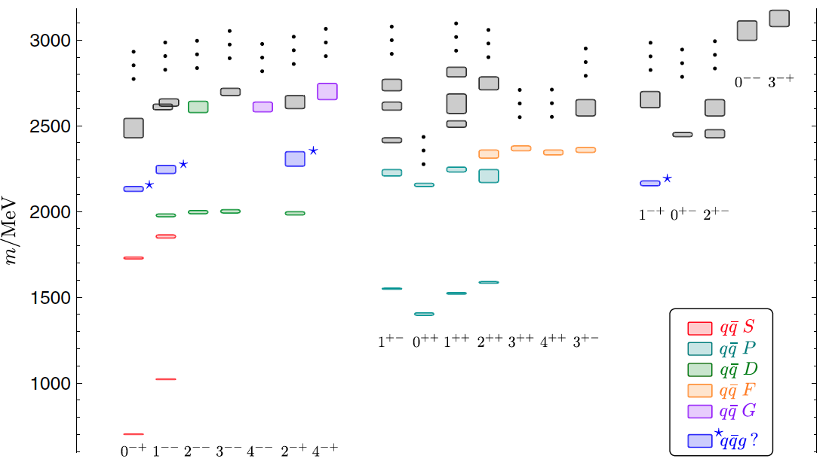
Meson Spectroscopy
J. Dudek et al., Phys. Rev. D84, 074023 (2011)
Physics goals:
Detailed mapping of the meson spectrum up to 2.5 GeV
Study of strangeness rich states
Search for exotics

Slide 19
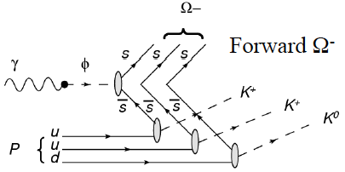
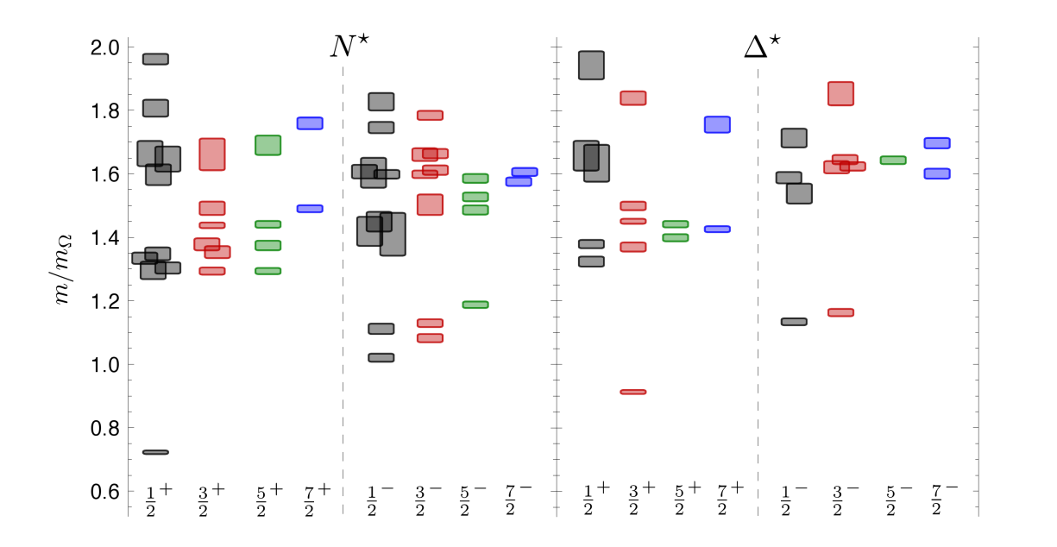
(Very Strange) Baryon Spectroscopy
Physics goals:
Spectroscopy of (very) strange baryons ( Λ*Σ*, Ξ* and Ω⁻)
Study of nucleon resonances with the search for missing states and the investigation of form factors

Slide 20
Hadron Spectroscopy
Forward Tagger
Electromagnetic calorimeter (PbWO)
Micromegas Tracker
Scintillation Hodoscope
Experimental Technique:
Detection of multiparticle final state from hadron decay in the large acceptance spectrometer CLAS12
Quasi-real photo-production: Detection of the scattered electron for the tagging of the quasi-real photon in the novel Forward Tagger
Electro-production: Detection of the scattered electron in CLAS12 to measure the Q² evolution of nucleon resonance form factors

Slide 21
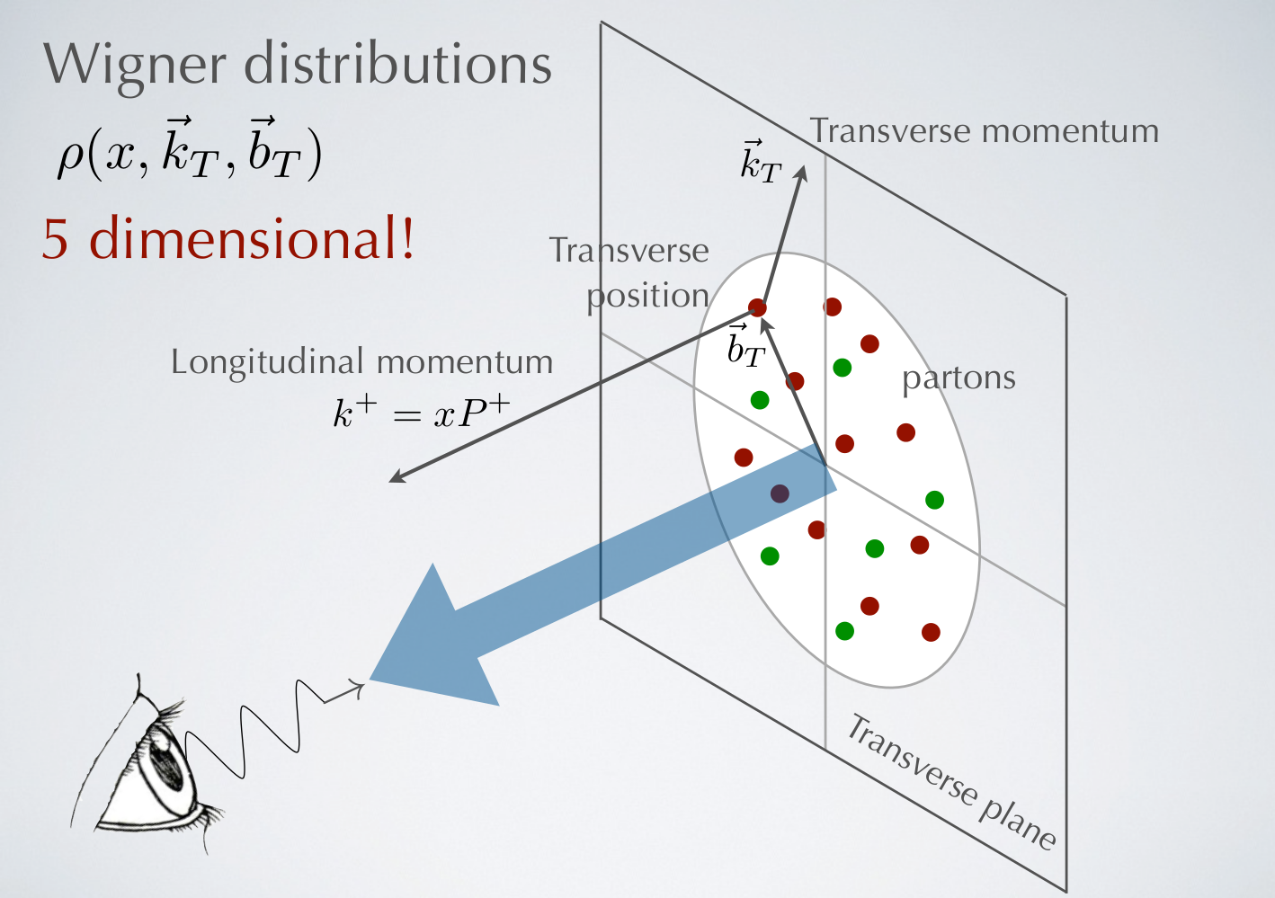
Nucleon Structure

Slide 22
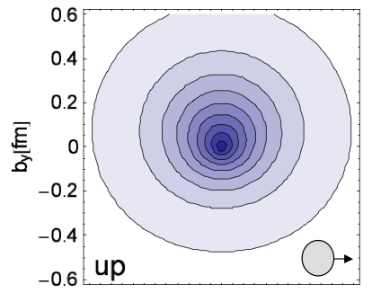
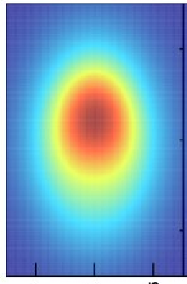
Structure Functions
GPDs
TMDs
2+1 D picture in impact-parameter space
2+1 D picture in momentum space
-0.5
0.0
0.5
Lattice QCD
0.5
F_{1T}┴(x) [Sivers function]
k_{y}
0.0
-0.5
quark density
QCDSF/UKQCD Coll., 2006
b_{x} [fm]
k_{x}
Anselmino et al., 2009
Accessed through exclusive processes
Ji sum rule for nucleon spin
Accessed through Semi-Inclusive DIS
OAM through spin-orbit correlations?
22

Slide 23
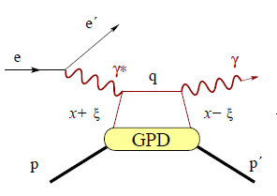
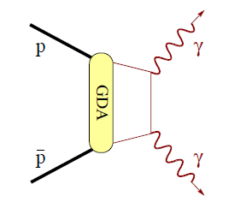
GPDs: JLab and PANDA
DVCS at JLab: large Q2
About one order of magnitude more data are expected with the 12 GeV beam
Hall A&C and CLAS12
neutron measurement → GPD E
Wide Angle Compton Scattering (WACS) at PANDA
Crossed diagram of DVCS
large transverse momentum of the final photons
handbag factorization may work at intermediate energies
Extension to other final states

Slide 24
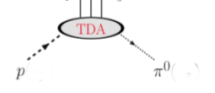

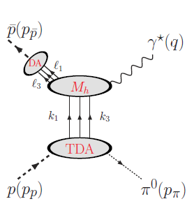
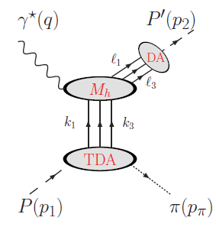
Transition Distribution Amplitudes
GPD: qqbar matrix element
between two proton states
TDA: 3q matrix element
between a proton and a meson
JLab
PANDA
Same final state as for GPD/GDA studies but different kinematic regions
24

Slide 25
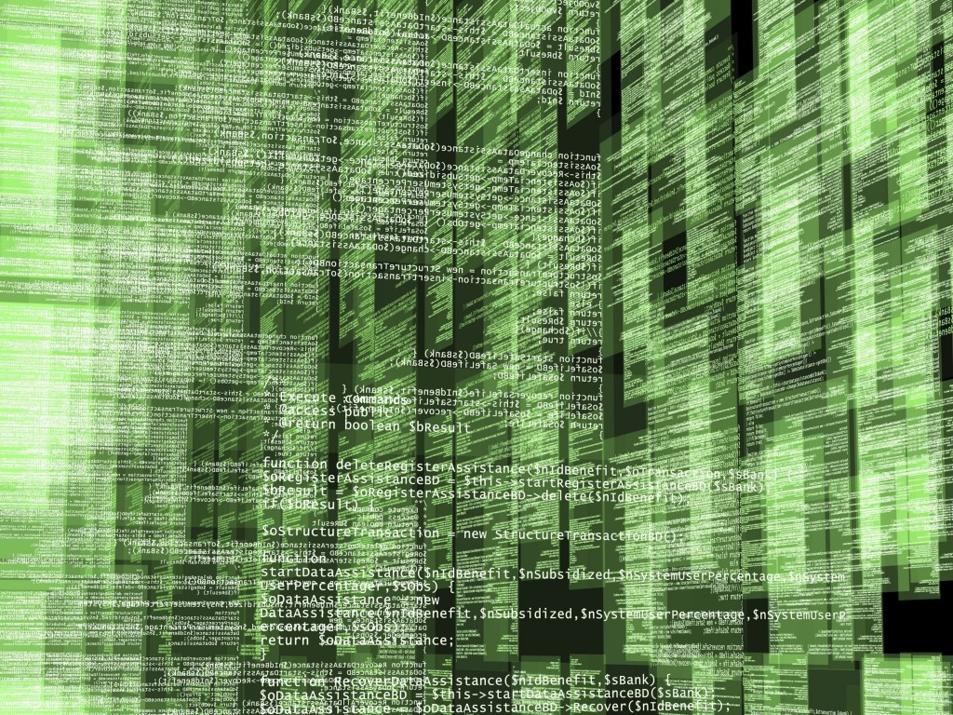
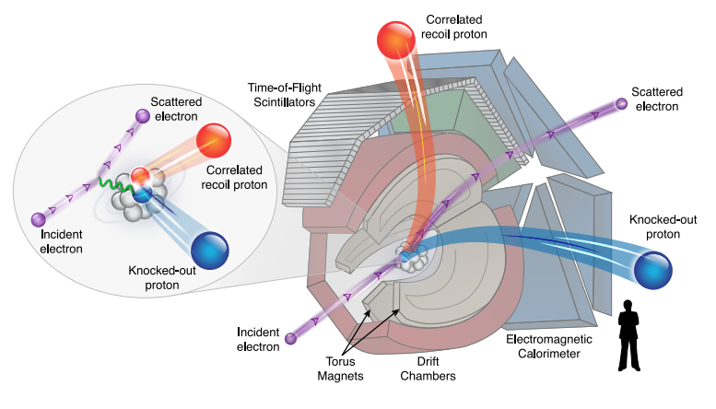
Mining Old Data…

Slide 26
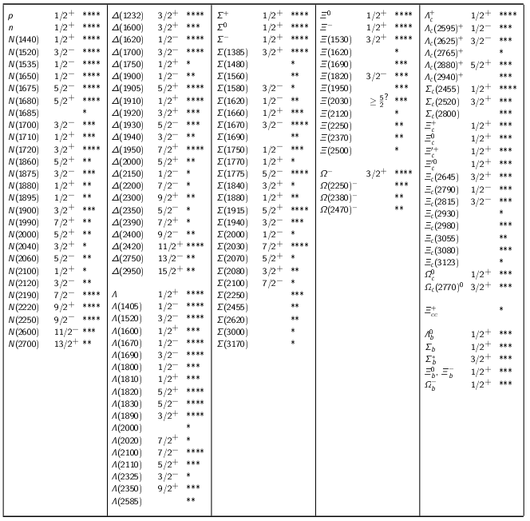
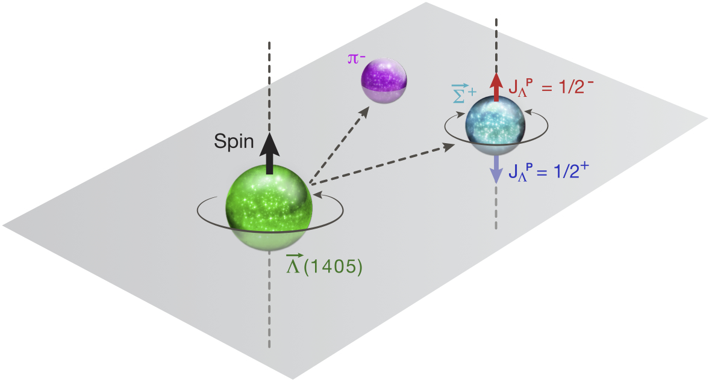
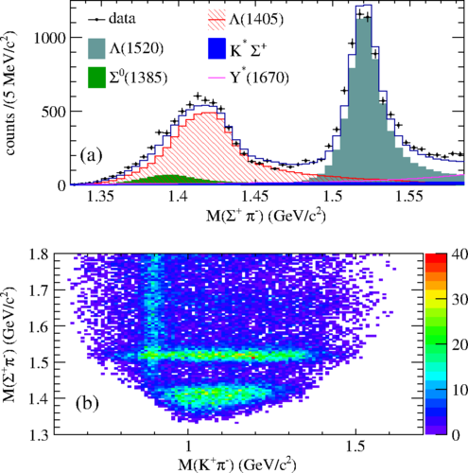
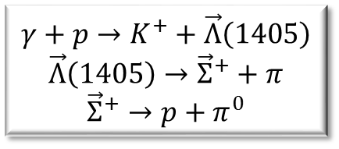
Spin and Parity of the Λ(1405) Baryon
$$γ+p→K^{+}+\vec{Λ}\left(1405\right)$$
$$\vec{Λ}\left(1405\right)→{\vec{Σ}}^{+}+π$$
$${\vec{Σ}}^{+}→p+π^{0}$$
K. Moriya, R. A. Schumacher et al. (CLAS Collaboration),
“Spin and Parity Measurement of the Λ(1405) Baryon.”
Phys. Rev. Lett. 112 082004 (2014).

Slide 27
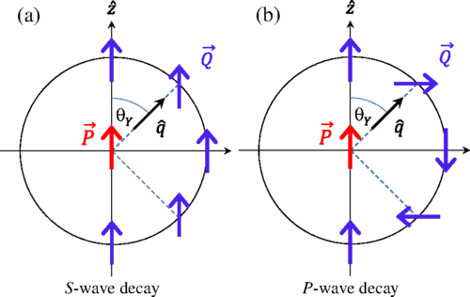
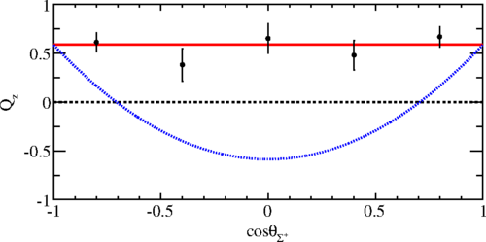
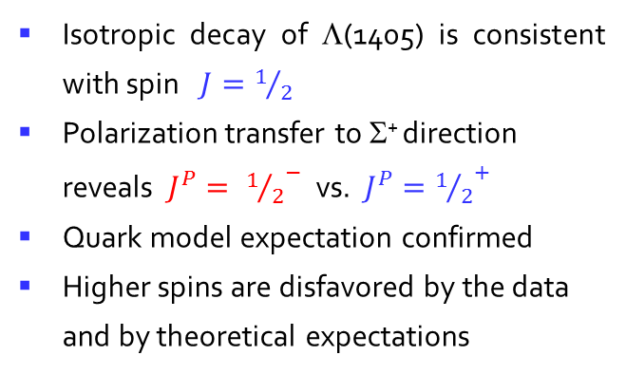
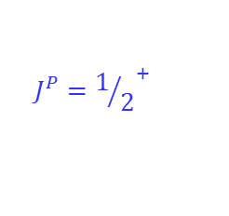
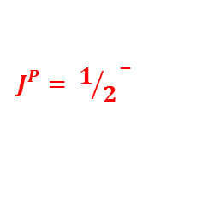
Spin and Parity of the Λ(1405) Baryon
Isotropic decay of $\text{L}$(1405) is consistent with spin $J=1/2$
Polarization transfer to Σ⁺ direction reveals $J^{P}= {1/2}^{−}$ vs. $J^{P}={1/2}^{+}$
Quark model expectation confirmed
Higher spins are disfavored by the data and by theoretical expectations
$$J^{P}= {1/2}^{−}$$
$$J^{P}={1/2}^{+}$$

Slide 28






Exclusive Baryon Meson Production
baryon
ud
$$q$$
meson
$$\overline{q}$$
$$q\overline{q}$$
Final State
eʹ
u
$$u\overline{u}$$
π⁰ p
$$d\overline{d}$$
π⁺ n
$$s\overline{s}$$
Κ⁺ Λ
e
uud
proton

Slide 29
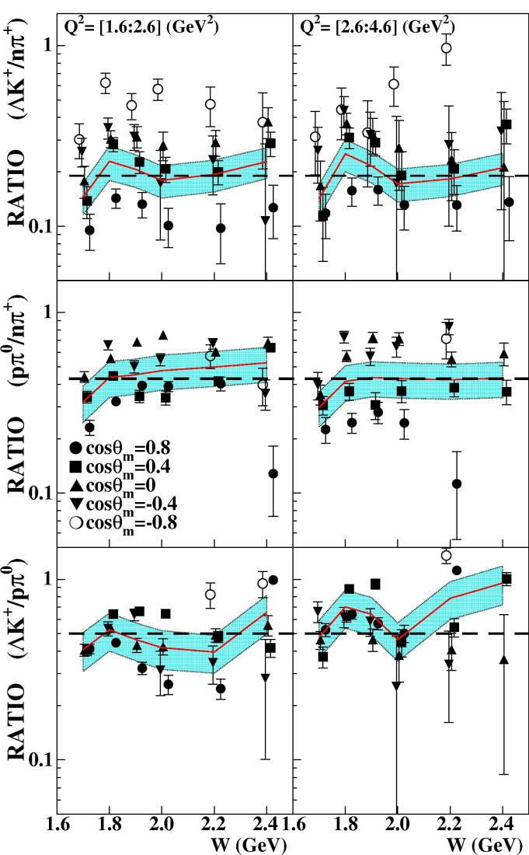
Cross Section Ratios
K⁺Λ/π⁺n
.19
+/- .03
.43
+/- .09
π⁰p/π⁺n
K⁺Λ/π⁰p
.50 +/- .12
* M.D. Mestayer, K. Park et al. (CLAS Collaboration) Phys. Rev. Lett. 113, 15204 (2014). Published 10 October 2014 Illustration by Kandice Carter, Joanna Korolyshyn.

Slide 30
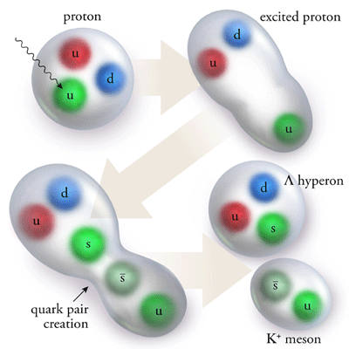
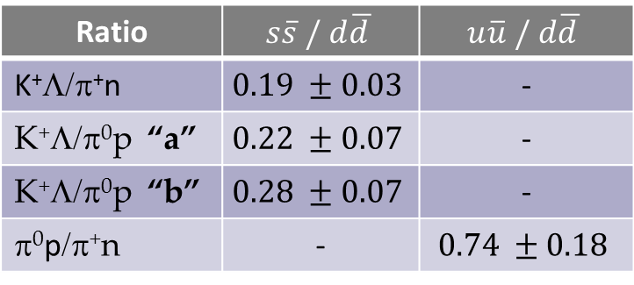
“Strangeness Suppression”
Ratio | $s\overline{s} /$ $d\overline{d }$ | $u\overline{u} /$ $d\overline{d }$
K⁺Λ/π⁺n | $$0.19 ±0.03$$ | -
K⁺Λ/π⁰p “a” | $$0.22 ±0.07$$ | -
K⁺Λ/π⁰p “b” | $$0.28 ±0.07$$ | -
π⁰p/π⁺n | - | $$0.74 ±0.18$$
PRL Editors' Suggestion
“Strange quark–anti-quark pairs are less likely to be produced in hadronic collisions than their light quark counterparts, providing insight into color confinement in QCD.”
* M.D. Mestayer, K. Park et al. (CLAS Collaboration) Phys. Rev. Lett. 113, 15204 (2014). Published 10 October 2014 Illustration by Kandice Carter, Joanna Korolyshyn.

Slide 31
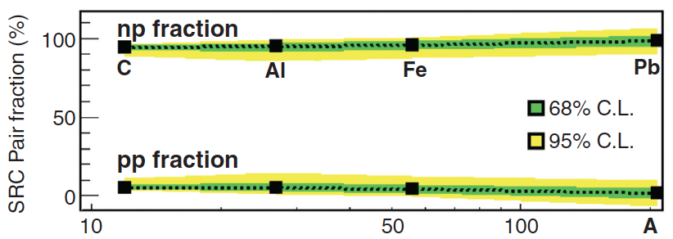
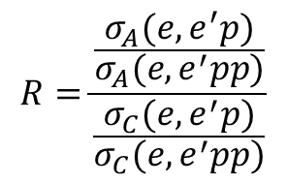
np and pp correlations
Evaluate double ratio of
cross sections:
$$R=\frac{\frac{σ_{A}(e,e^{′}p)}{σ_{A}(e,e^{′}pp)}}{\frac{σ_{C}(e,e^{′}p)}{σ_{C}(e,e^{′}pp)}}$$
Estimate ratio of np/pp in nucleus
Found to be independent of momentum
O. Hen et al., Science 346 (2014) 614, doi:10.1126/science.1256785
The Jefferson Lab CLAS Collaboration
Selected for Science Express (16 October 2014)

Slide 32
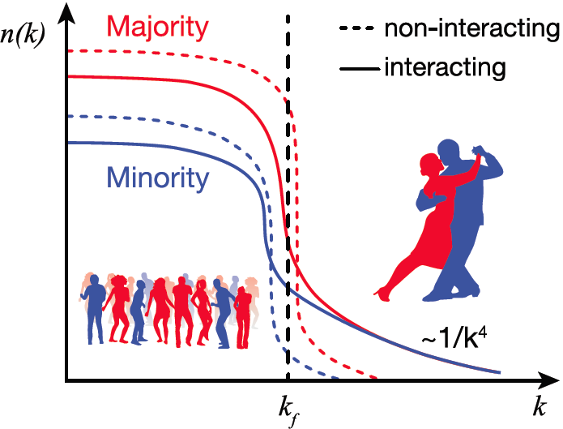
Momentum Inversion
Findings:
np pairs dominate high momentum tail, even in neutron-rich heavy nuclei.
average proton momentum is increased
implications for nuclear equation-of-state
possible universal behaviour in imbalanced Fermi systems
O. Hen et al., Science 346 (2014) 614, doi:10.1126/science.1256785
The Jefferson Lab CLAS Collaboration
Selected for Science Express (16 October 2014)

Slide 33
Engagement in CLAS
Informal Collaboration:
Preparation of common analysis tools (e.g. HASPECT,…)
Joint funding applications
Joint workshops
Cross membership of review committees
Limited Membership:
Data analysis (unstudied channel / physics topic, previous run group)
Training
Full Membership:
Substantial input to hardware / software development
Participation in development of physics programme
MoU

Slide 34
Light Meson Decay Working Group
Started from MesonNet project (network initiative in HP3 involving Juelich, LNF, GSI, Bonn, Uppsala)
CLAS involvement via the Light Meson Decay CLAS Approved Analysis
Interest in theoretical communities (EU and US)
New students and staff involved
Limited CLAS membership
Regular meetings and presentations

Slide 35
HASPECT
HAdron SPEctroscopy CenTer
Based at INFN Genova
Jefferson Lab Physics Analysis Center (JPAC) direct involvement
Theoretical contributions from EU/US groups
New analysis using CLAS data and contributions from PANDA Collaboration (tools, analysis procedures …)
Search for CLAS12/PANDA common interests
Regular meetings and joint workshops (ATHOS / PWA)

Slide 36
Summary
JLab 12 GeV upgrade is progressing
CLAS12 in construction; preparation for commissioning
CLAS and PANDA science overlaps and is complementary
Analysis of CLAS data is ongoing
Further engagement…?

