Slide 1
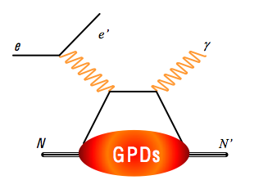
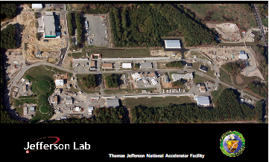
Experimental Studies of Generalized
Parton Distributions
Latifa Elouadrhiri
Jefferson Lab
Introduction
GPDs ad DVCS
Recent DVCS Results 6 GeV
The 12 GeV Upgrade
Future experiments on DVCS
Summary

Slide 2
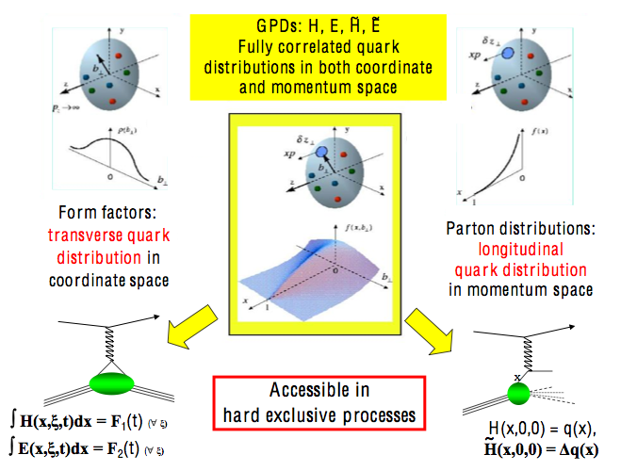
Introduction

Slide 3
Generalized Parton Distributions
(Quantum phase-space quark distribution in the nucleon)
Polarized DVCS directly probes GPDs
Integrate over momentum space
Sensitivity to GPD
~
Generalized Parton Distributions (GPD) H, H, E, E
UP
LP
TP
H, H, E
~
~
Nucleon polarization
~
H, H, E
3D nucleon imaging in transverse coordinate and longitudinal momentum space
E, H

Slide 4
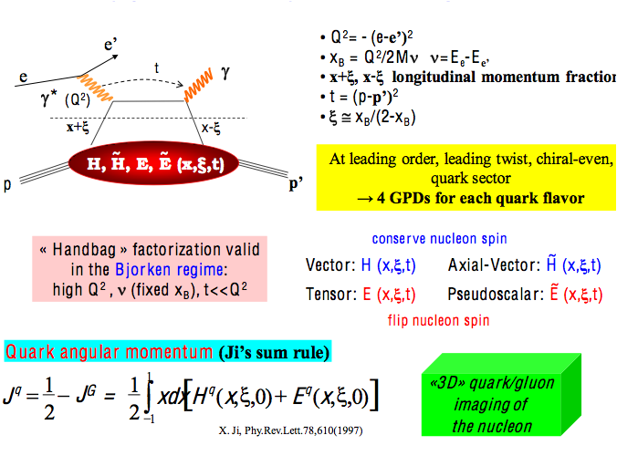
Deeply Virtual Compton Scattering and GPDs

Slide 5
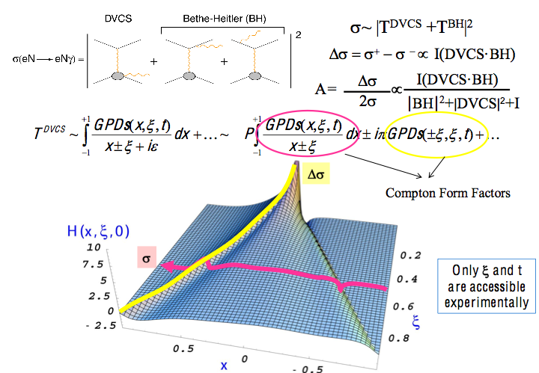
Accessing GPDs through DVCS

Slide 6
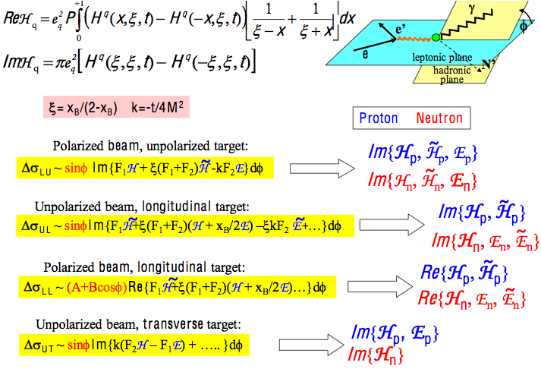
Sensitivity to GPDs Spin Observables

Slide 7
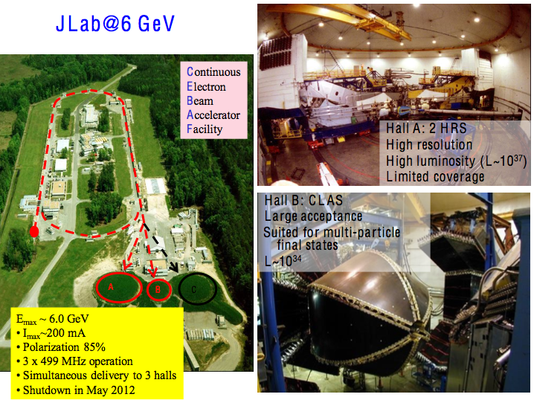

Slide 8
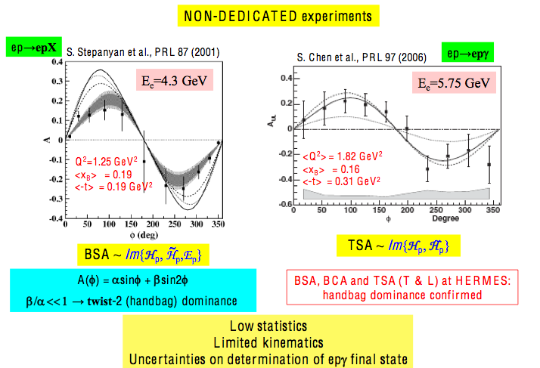
DVCS @ CLAS the first pioneering Results

Slide 9
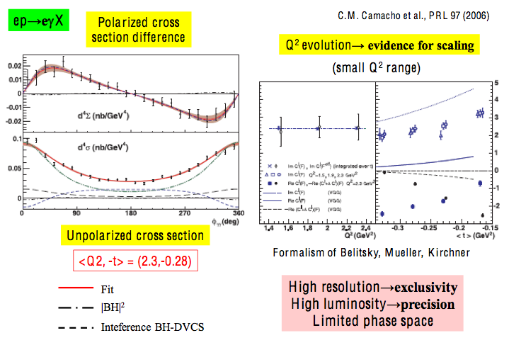
Hall A (Jlab) first dedicated SVCS experiment

Slide 10
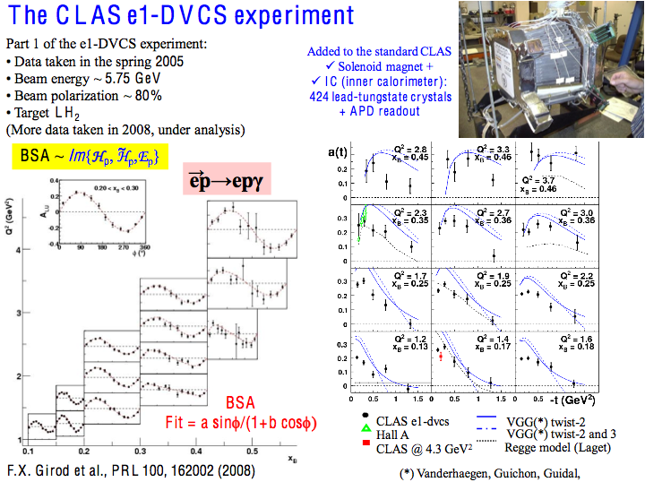

Slide 11
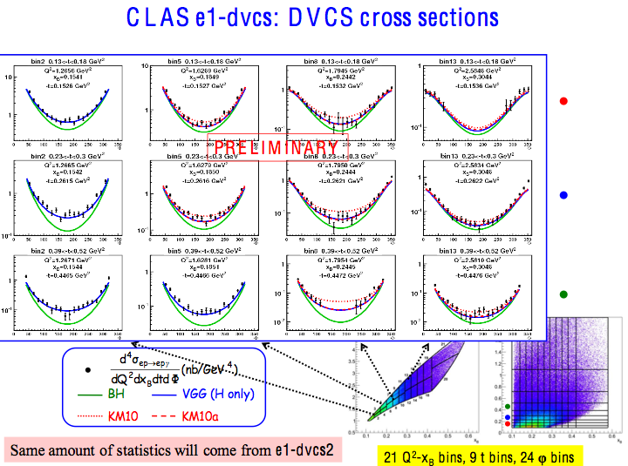

Slide 12
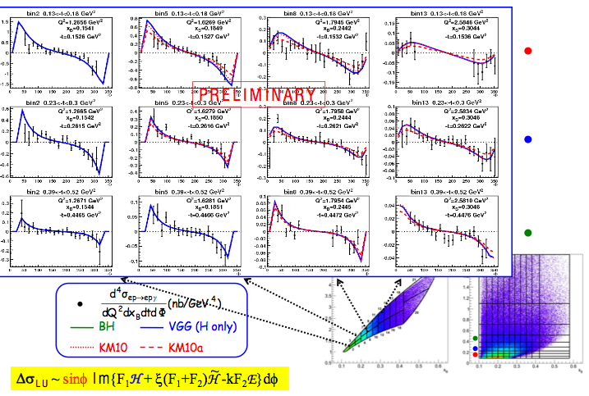
CLAS e1-DVCS Cross section differences

Slide 13
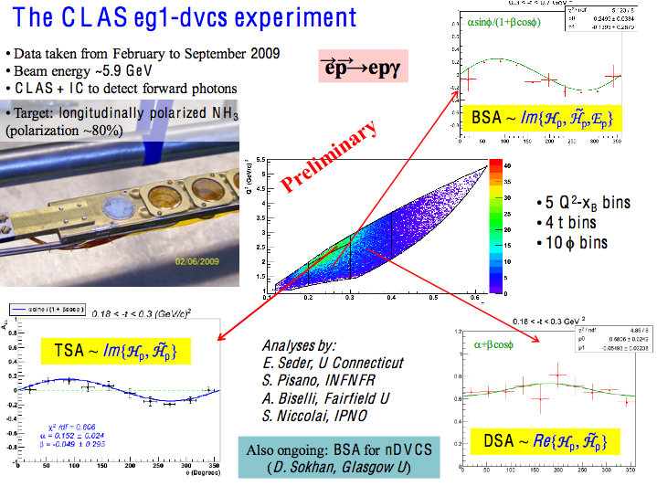

Slide 14
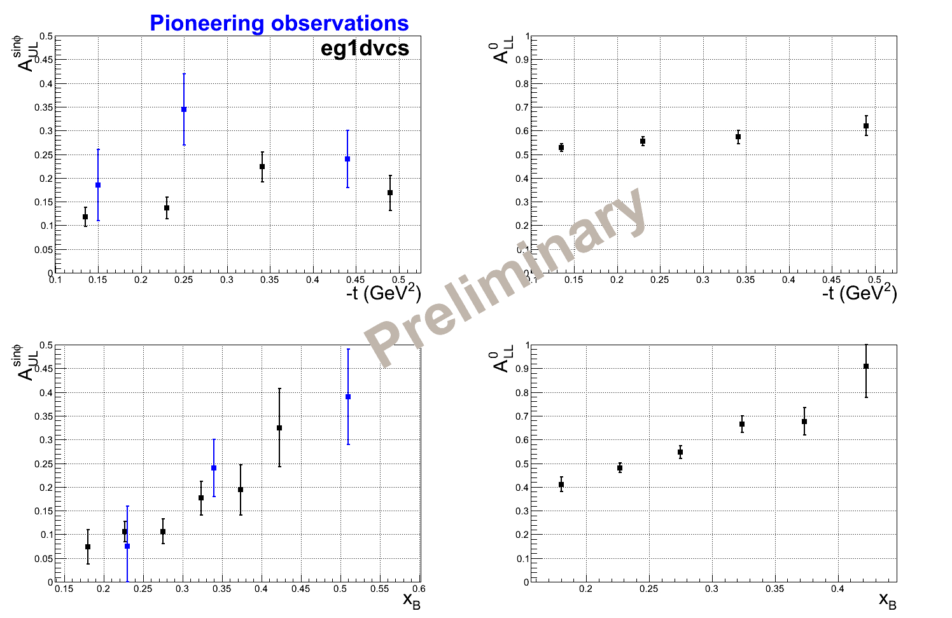
CLAS – Proton Target Spin Asymmetry

Slide 15
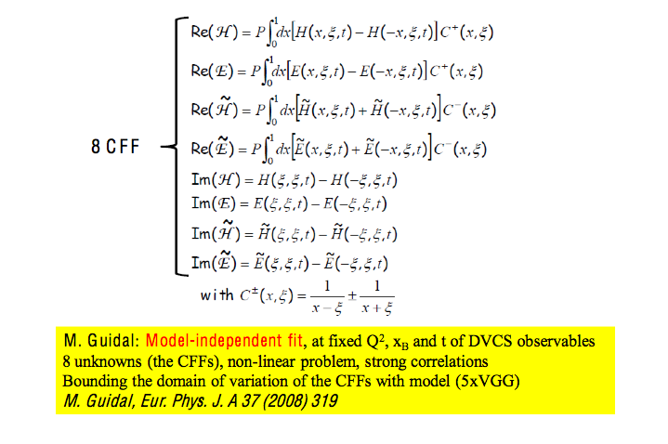
Extraction of Compton Form Factors from DVCS observables

Slide 16
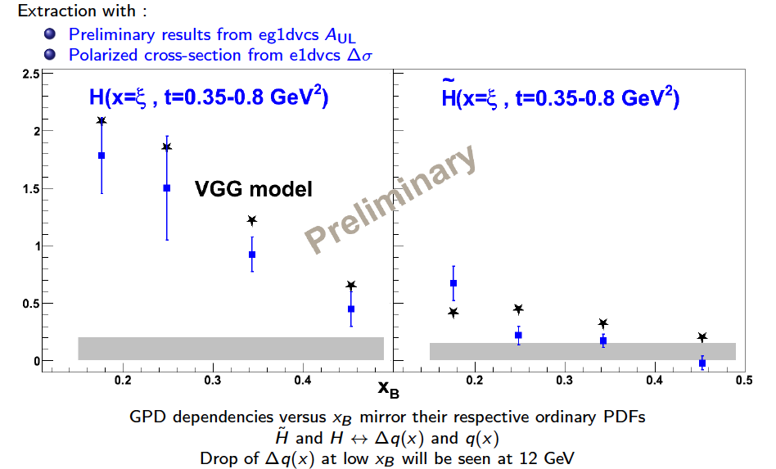
Extracting CFF/GPDs from DVCS
Extraction in leading twist with:
  Preliminary results from CLAS on A_{UL}, A_{LL}
  Cross sections σ

Slide 17
6 GeV: lessson Learned
The feasibility of high luminosity exclusive measurements in complementary high precision (Hall-A) and large acceptance (CLAS) spectrometers has been demonstrated.
The ﬁrst dedicated generation of experiments suggests precocious scaling in Deeply Virtual Compton Scattering
The experimental results have triggered theoretical developments for the consistent description of higher twist corrections
Several approaches investigate Generalized Parton Distribution extraction methods from data

Slide 18
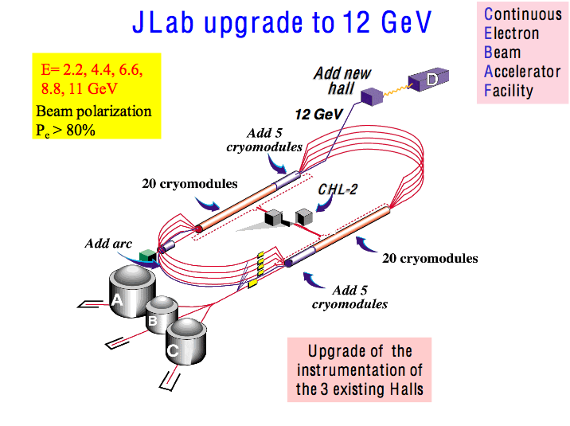

Slide 19
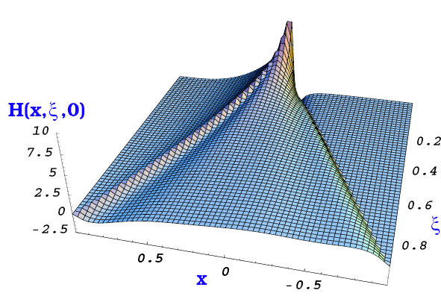
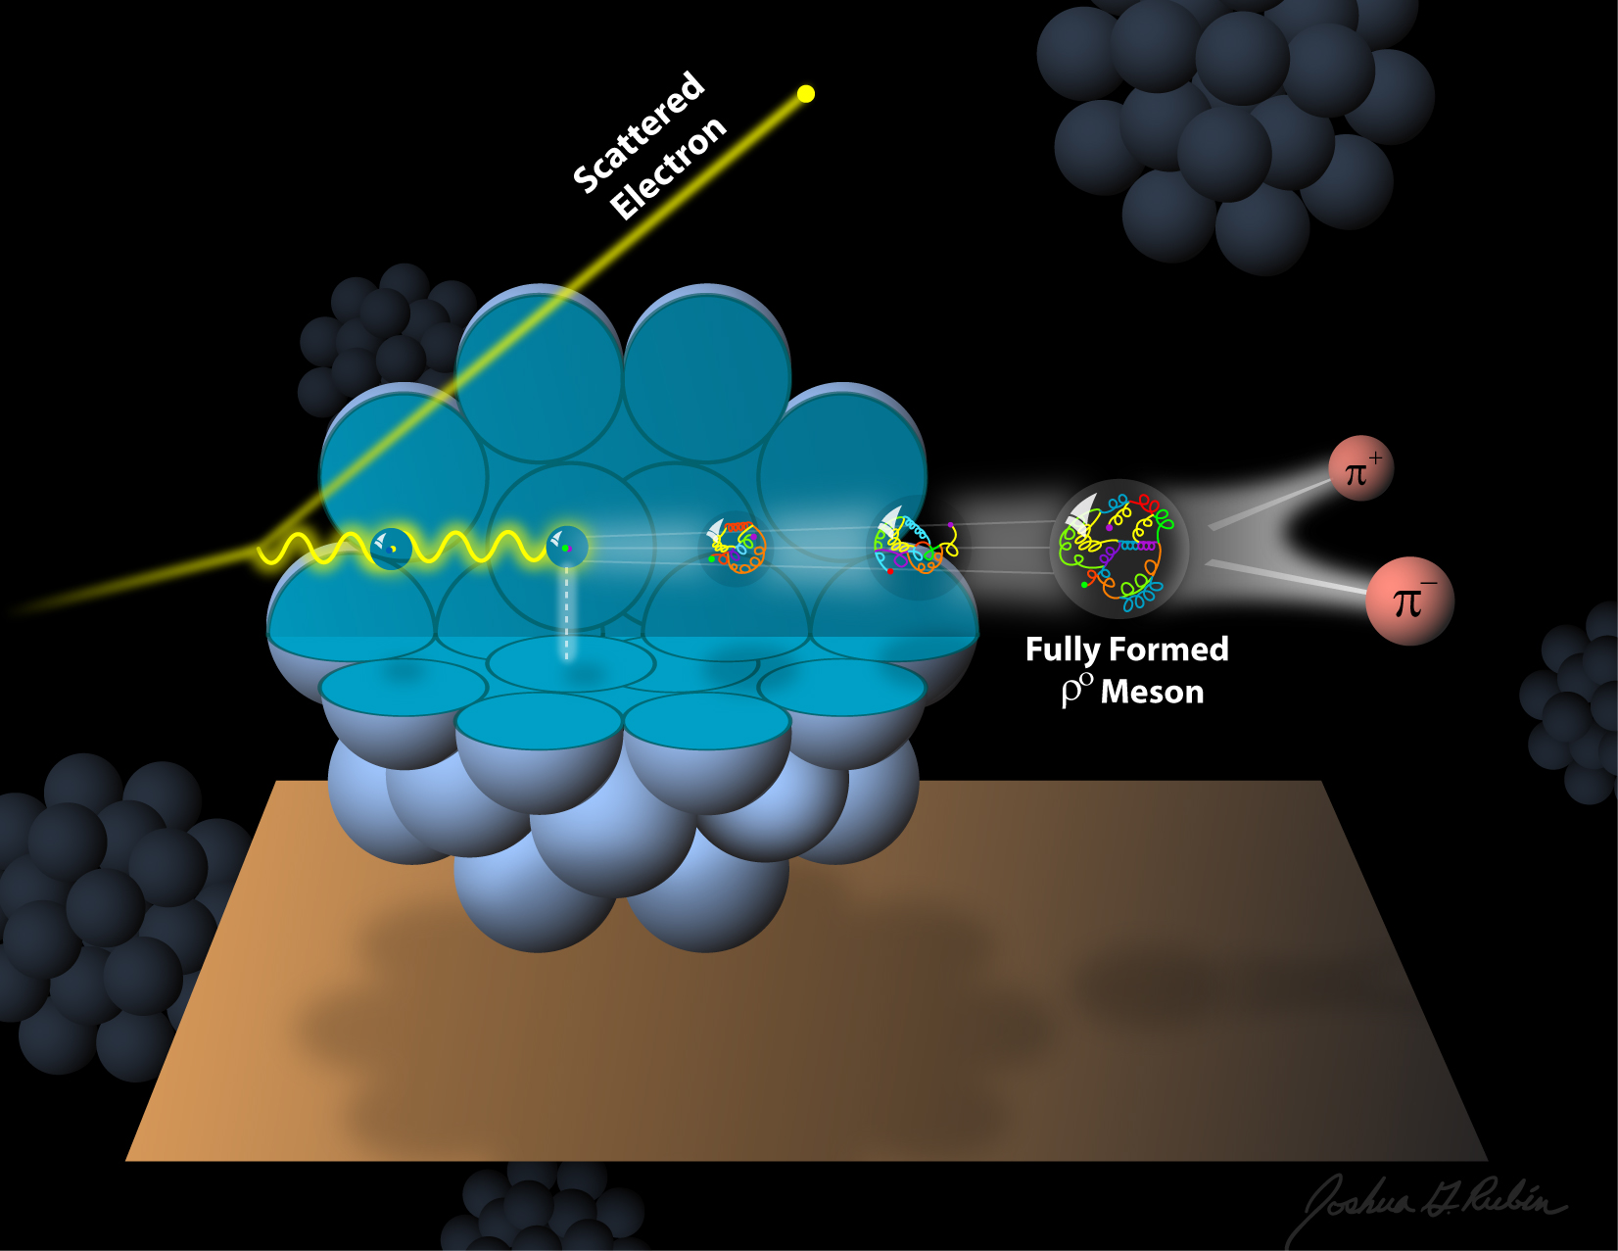
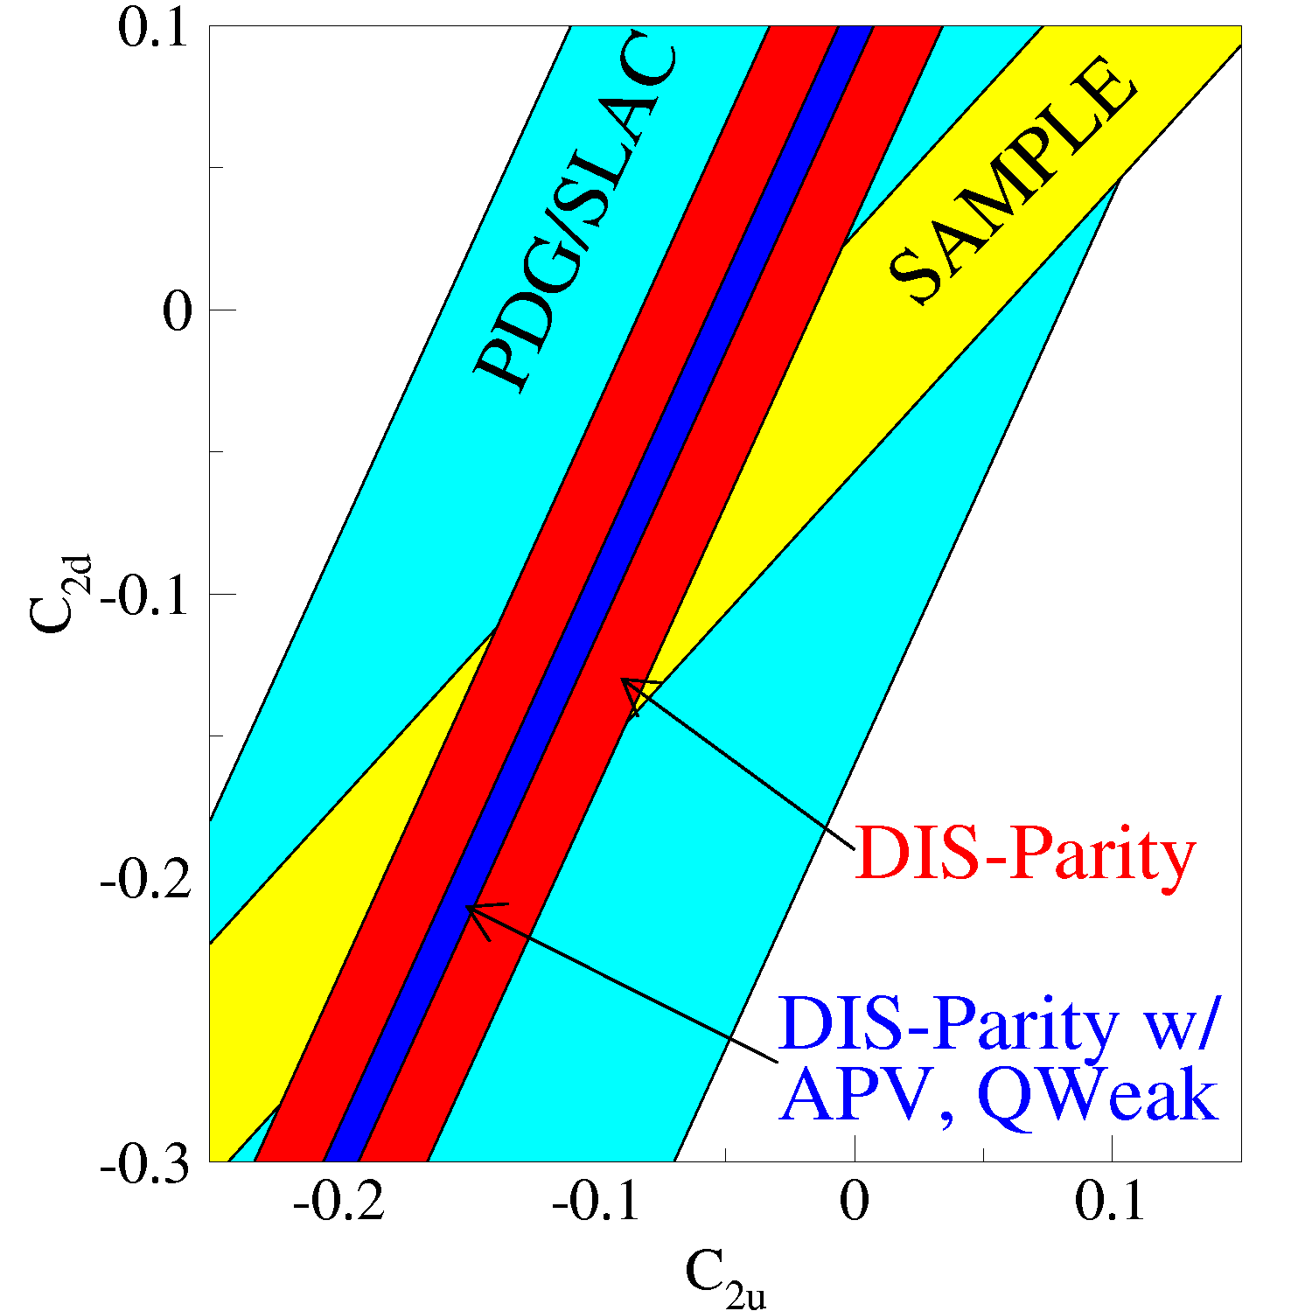
The science program at JLab @ 12GeV
Quark confinement and the role of the glue in meson and baryon spectroscopy
The 3D structure of the nucleon – from form factors and PDFs to GPDs and TMDs
The strong interaction in nuclei – evolution of quark hadronization, nuclear transparency of hadrons
Search for science beyond the Standard Model – precision and intensity frontiers
Notes:
The JLab energy upgrade serves a broad experimental scientific program that one may broadly describe within 4 categories: 1) Better understanding the quark confinement through studies of the role of glue in meson and baryon spectroscopy. 2) The study of the multi-dimensional spatial and momentum structure of the nucleon from e.m. form factors and PDFs to GPDs and TMDs. 3) Strong interaction in nuclei and 4) The search for science beyond the Standard Model, especially through the precision measurement of fundamental quantities. Many of these topics are discussed in some detail in this paper.

Slide 20
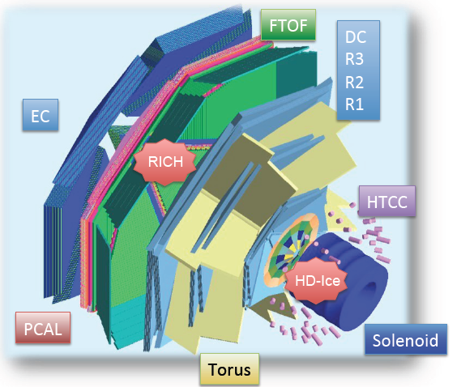
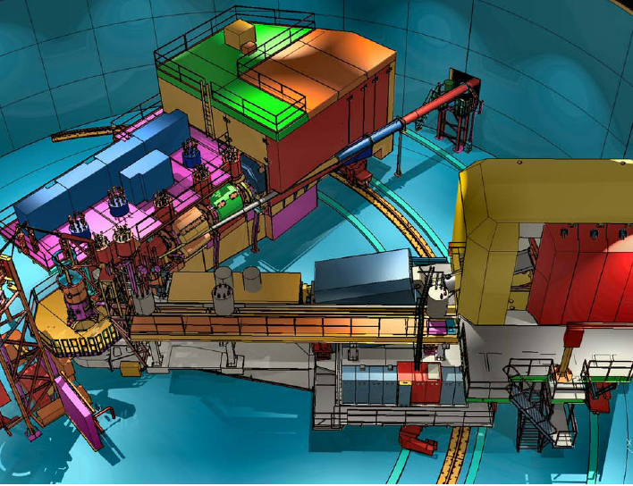
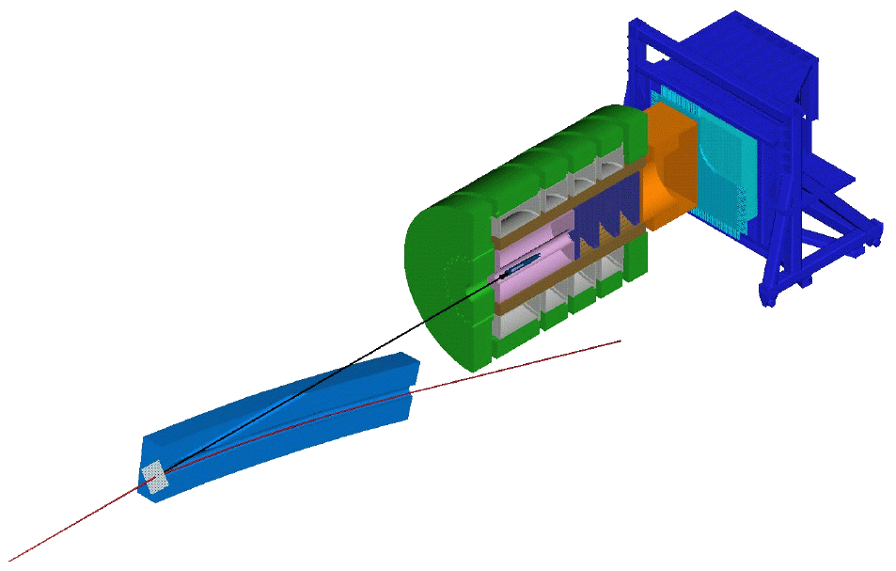
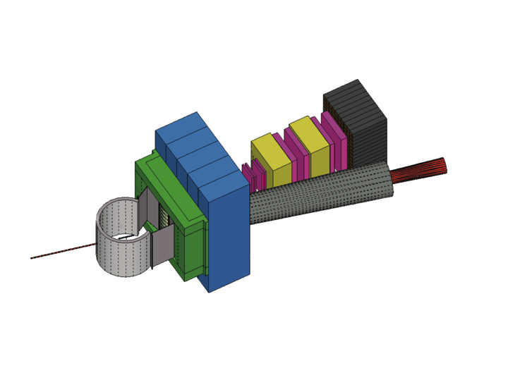
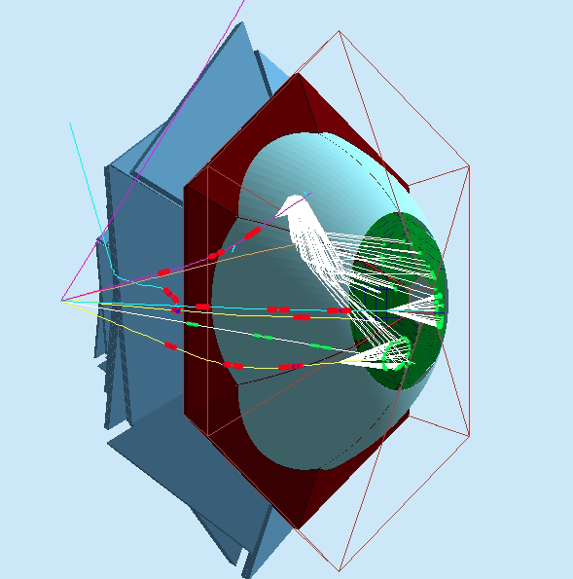
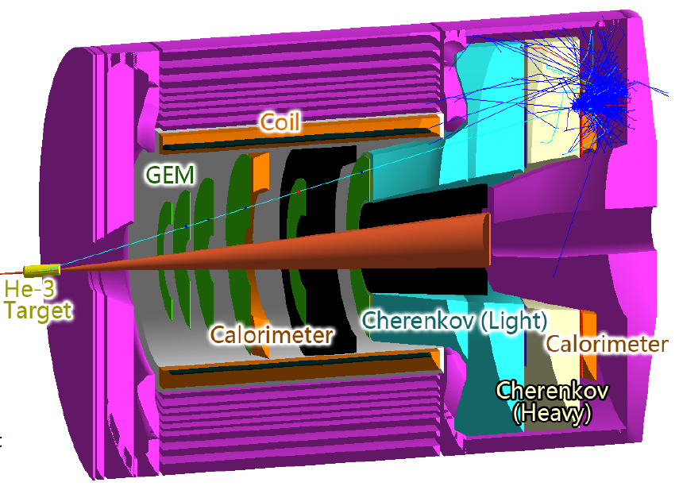
Base equipment & proposed equipment
Hall B
Hall C
Hall D
CLAS12
SHMS
GlueX
additional equipment (proposed)
SBS-Hall A
Hadron calorimeter
CLAS12 RICH
SOLID - Hall A
Tracker
Scattering chamber
CH2 analyzer
Beam line Pb shield

Slide 21
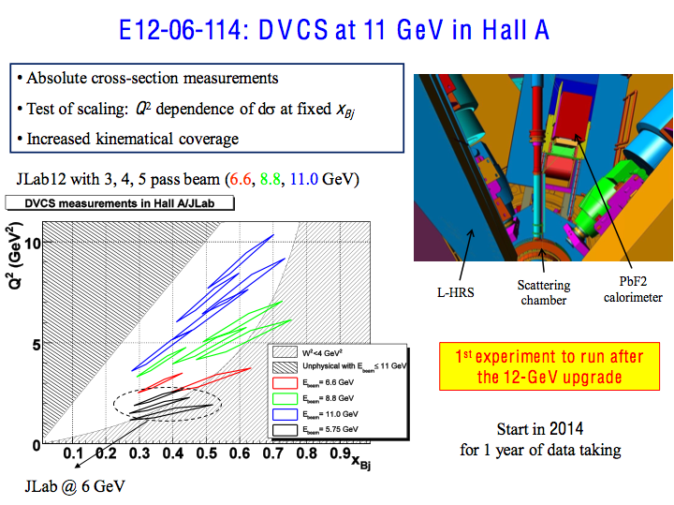

Slide 22

The CLAS12 Detector
Baseline equipments
Forward Detector (FD)
  - TORUS magnet (6 coils)
  HT Cherenkov Counter
  Drift chamber system
  LT Cherenkov Counter
  Forward ToF System
  Pre-shower calorimeter
  E.M. calorimeter
Central Detector (CD)
  SOLENOID magnet
  Barrel Silicon Tracker
  Central Time-of-Flight
Beamline
  Polarized target (transv.)
  Moller polarimeter
  Photon Tagger
Upgrade of the CLAS Detector
Optimized for exclusive and semi-inclusive reactions
Capable to operate at luminosity up to 10³⁵ cm⁻²sec⁻¹
To be used with polarized target
Particle ID up to high momentum for e⁻/π⁻, π/K/p, γ/πº separation
Good momentum & angle resolution for use of missing mass techniques
Coverage of large ranges in ϑ and φ angles
Upgrades to the baseline &
under construction
RICH detector (FD)
  Forward Tagger (FD)
  Neutron detector (CD)
  Micromegas (CD)
  Polarized target (long.)

Slide 23
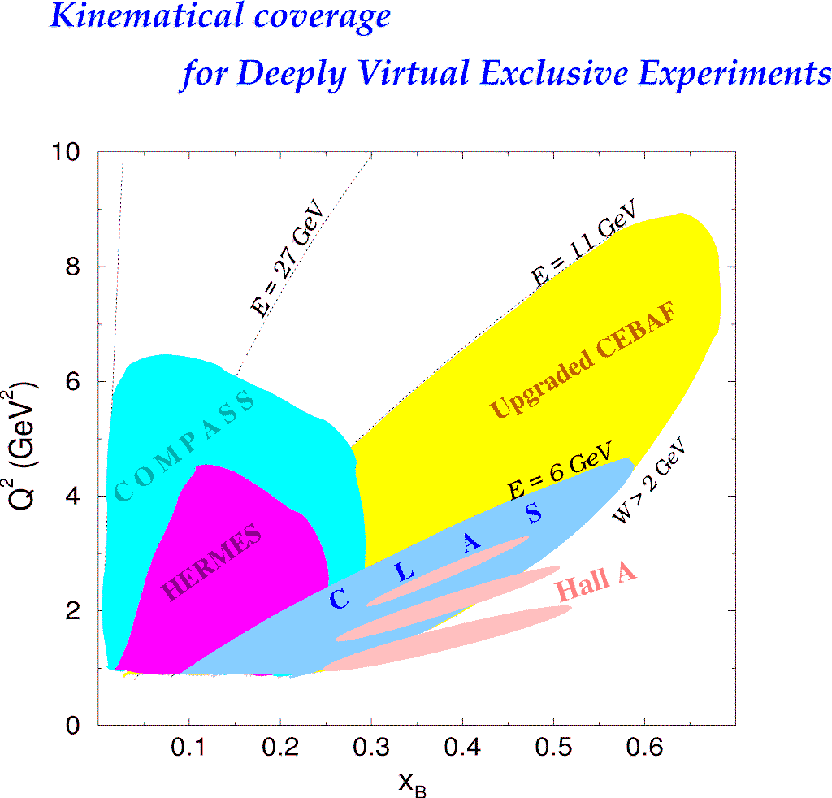
DVCS Experiments Worldwide
H1, ZEUS
Study of high x_{B} domain
requires high luminosity
H1, ZEUS
27 GeV
11 GeV
200 GeV
11 GeV
JLab Upgrade
JLab @ 12 GeV
COMPASS
W = 2 GeV
HERMES
The 12 GeV Upgrade is well matched to studies in the valence quark regime.
0.7
Notes:
The kinematics range that can be covered in exclusive processes with high precision data is shown with this yellow area. This will be the only accelerator where rhe valence quark regime can be fully covered with high precision data. other existing machines, even at much higher energies can not cover this regime due to the much lower luminosity at HERA or COMPASS.
My own personal view is that several experiments, in some of which I participated, eg EMC and E665, but also HERA, the physics, especially at high x was limited by the lack of luminosity.
Jefferson Lab has luminosity, also good spin control in both beam and targets.
So high x is (still) there for the taking and given 12 GeV, it is accessible kinematically.

Slide 24
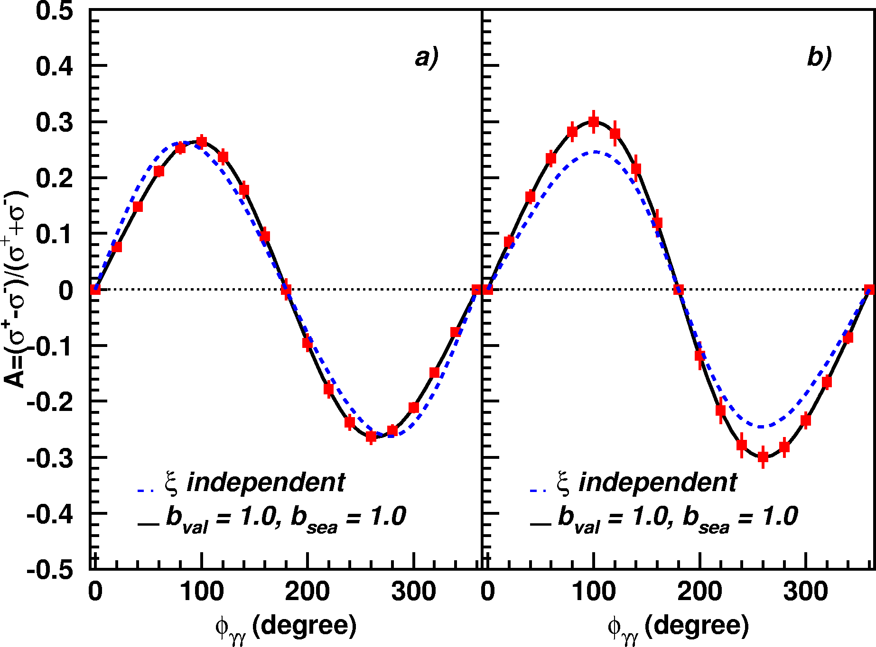
A_{LU} projections for JLab@12GeV
~
ep --> epγ
Δσ_{LU} ~ sinφ {F₁H + ξ(F₁+F₂)H +kF₂E}dφ
A_{LU}
E12-06-114
E12-06-119

Slide 25
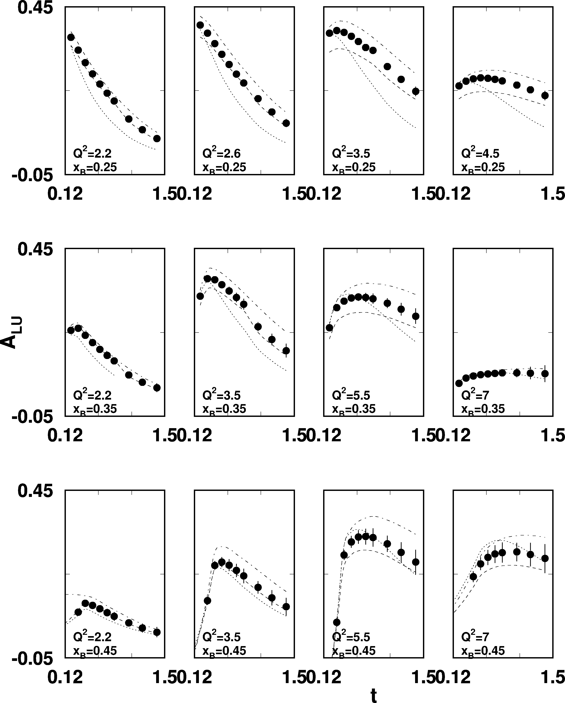
A_{LU} projections for protons
e p epγ
~
Δσ_{LU} ~ sinφ {F₁H + ξ(F₁+F₂)H +kF₂E}dφ
E_{e}=11GeV
sinφ
, GeV²

Slide 26
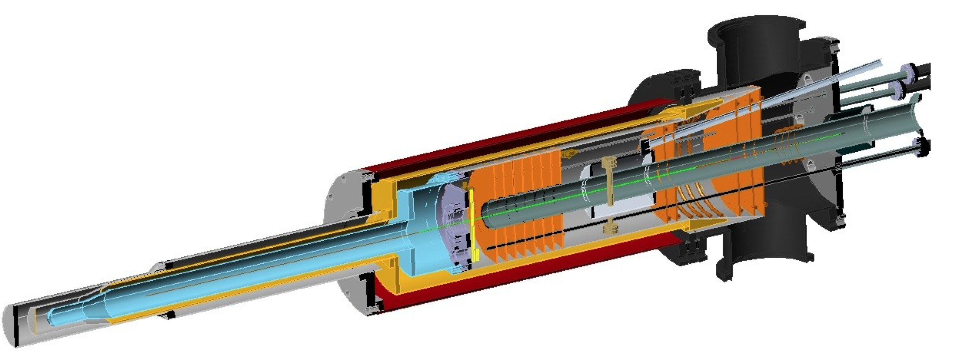
A_{UL} projections for protons
e p epγ
~
Δσ_{UL} ~ sinφ {F₁H+ξ(F₁+F₂)(H +ξ/(1+ξ)E)}dφ
~
Dynamically polarized target NH₃, ND₃
A_{UL}
L = 1x10³⁵ cm⁻²s⁻¹
T = 2000 hrs
Δx = 0.05
E12-06-119

Slide 27
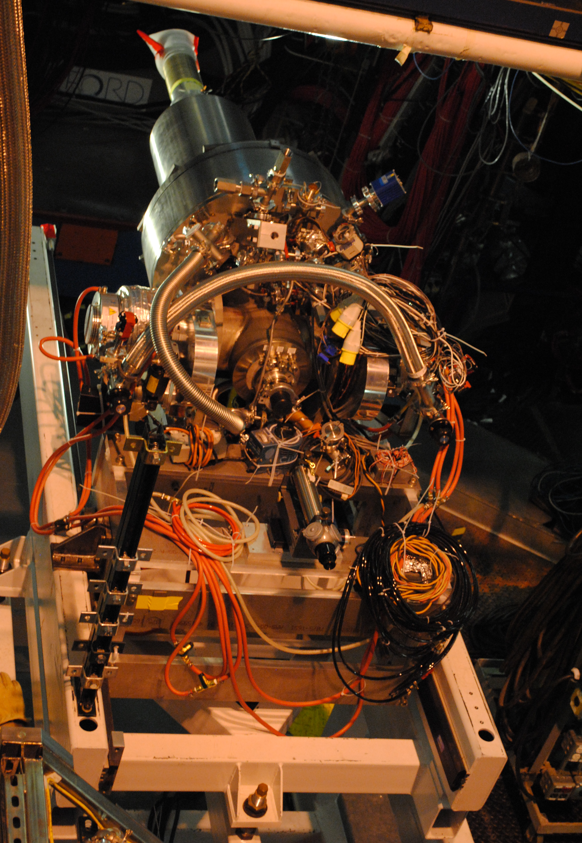
A_{UT} projections for 12GeV
ep epγ
Δσ_{UT} ~ cosφsin(φ_{s}-φ){k(F₂H – F₁E)}dφ
polarized HD
P_{p}=0.60
Dilution = 0.8
C12-12-010
cosφ
x=0.25
Q²=2 GeV²
A_{UT} and A_{LT} are sensitive to the u and d-quark helicity content of the proton spin

Slide 28
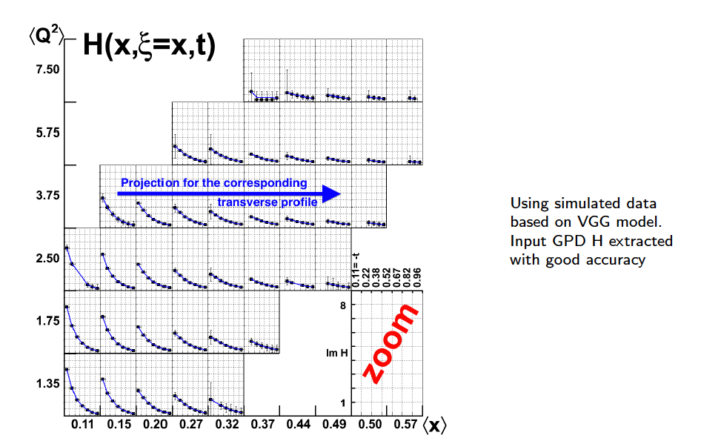
GPD H from projected CLAS12 data
Review article: M. Guidal, H. Moutarde, M. Vanderhaeghen, Rept.Prog.Phys. 76 (2013) 066202
LO fit to all observables: σ, A_{LU}, A_{UL}, A_{LL}, A_{Ux}, A_{Uy}, A_{Lx}, A_{Ly}

Slide 29
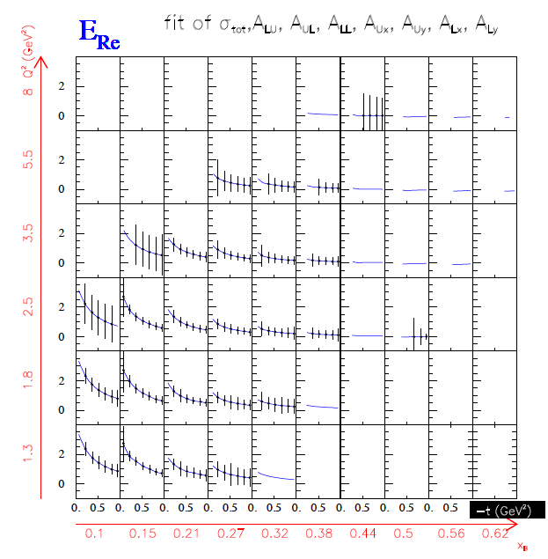
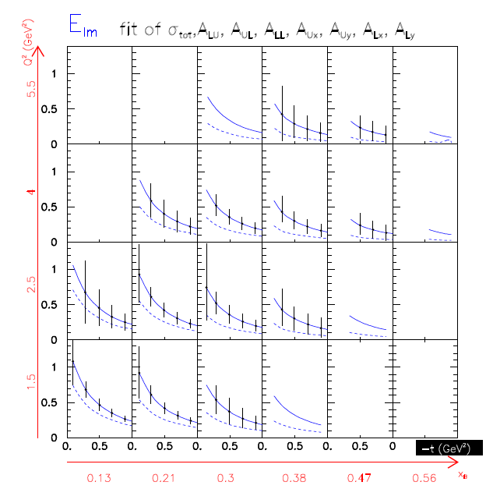
CFF E from projected CLAS12 data

Slide 30
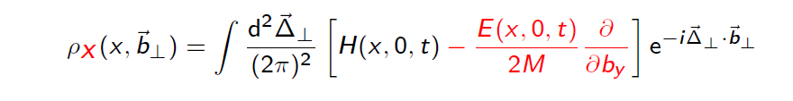
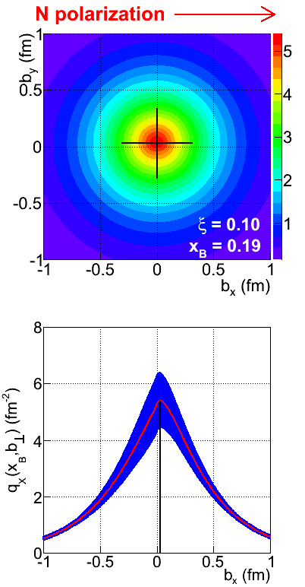
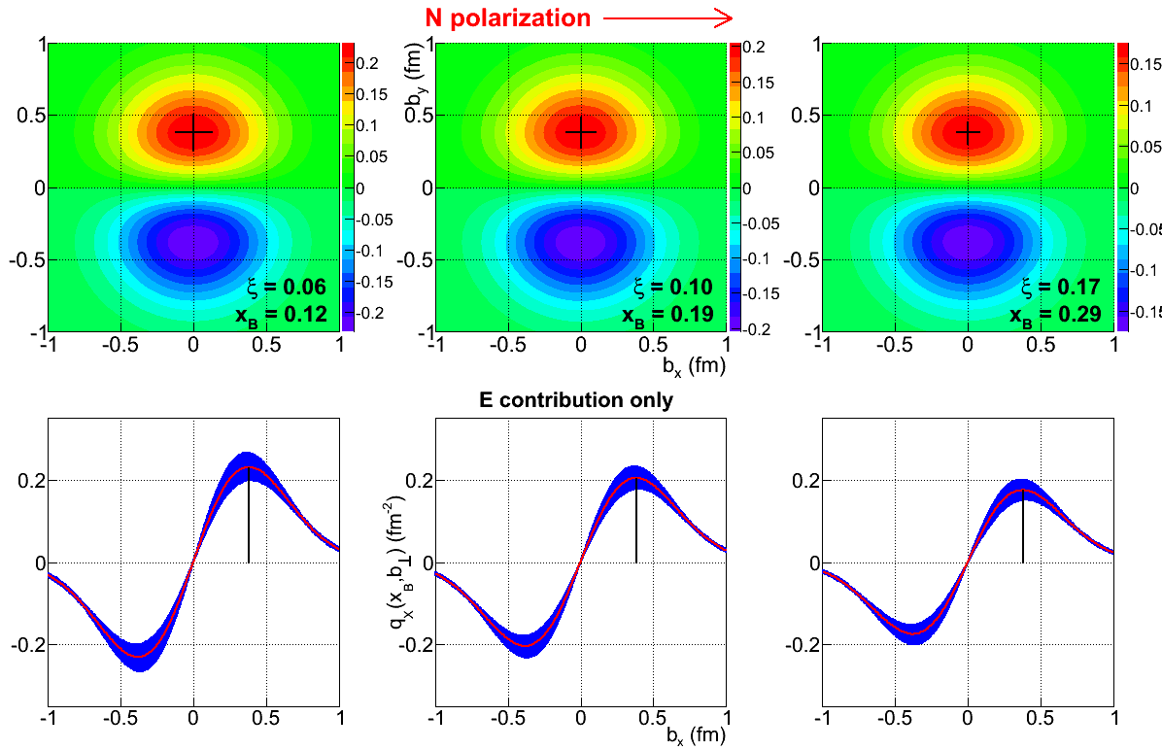
Projected quark densities in impact parameter
Fourier transform of GPDs to access quark densities in impact parameter space.
GPD E probes the u- and d-quark separation in impact parameter space. Transversely polarized proton shows flavor dipole.
Contribution of H+E
Contribution of E

Slide 31
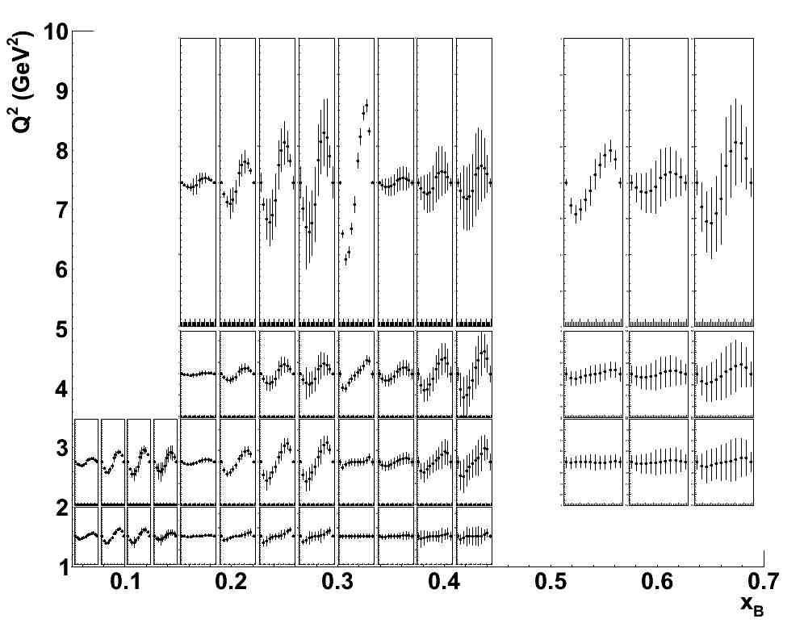
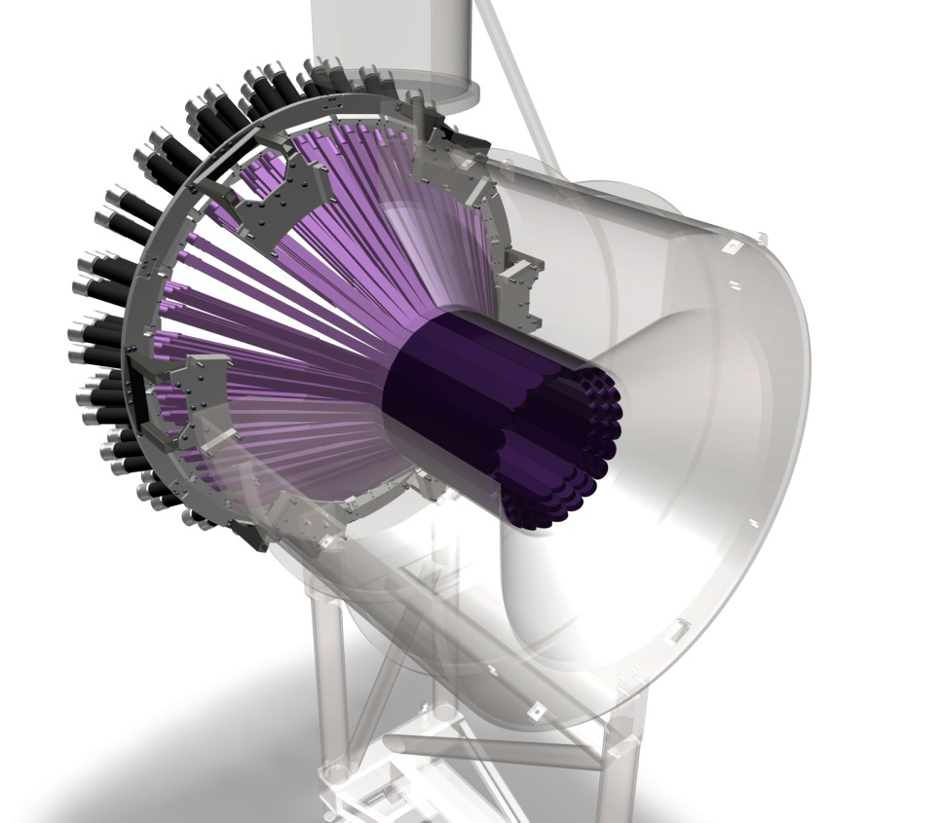
Beam asymmetries A_{LU} for neutrons
E12-11-003
Total of 588 bins in t, Q², x_{B}, φ
t=-0.35GeV²
Q²=2.75GeV² x_{B}=0.225
Central Neutron Detector
A_{LU}
A_{LU} is highly sensitive to d-quark helicity contribution to nucleon spin.

Slide 32
Summary
A uniﬁed framework for nucleon tomography has been established
The ﬁrst dedicated results on Compton Scattering suggest precocious handbag dominance
Accurate information on Generalized Parton Distributions in the valence region and at moderate momentum transfer was gathered
The long range plan to extract GPDs has begun
Interplay between spin and ﬂavor decompositions requires also other reactions
JLab 12 GeV will precisely test scaling and carry out the tomography of valence quarks
Future measurements are planned at CERN/Compass and DESY/Panda
The EIC will expand the reach and probe the sea and gluons

