Slide 1
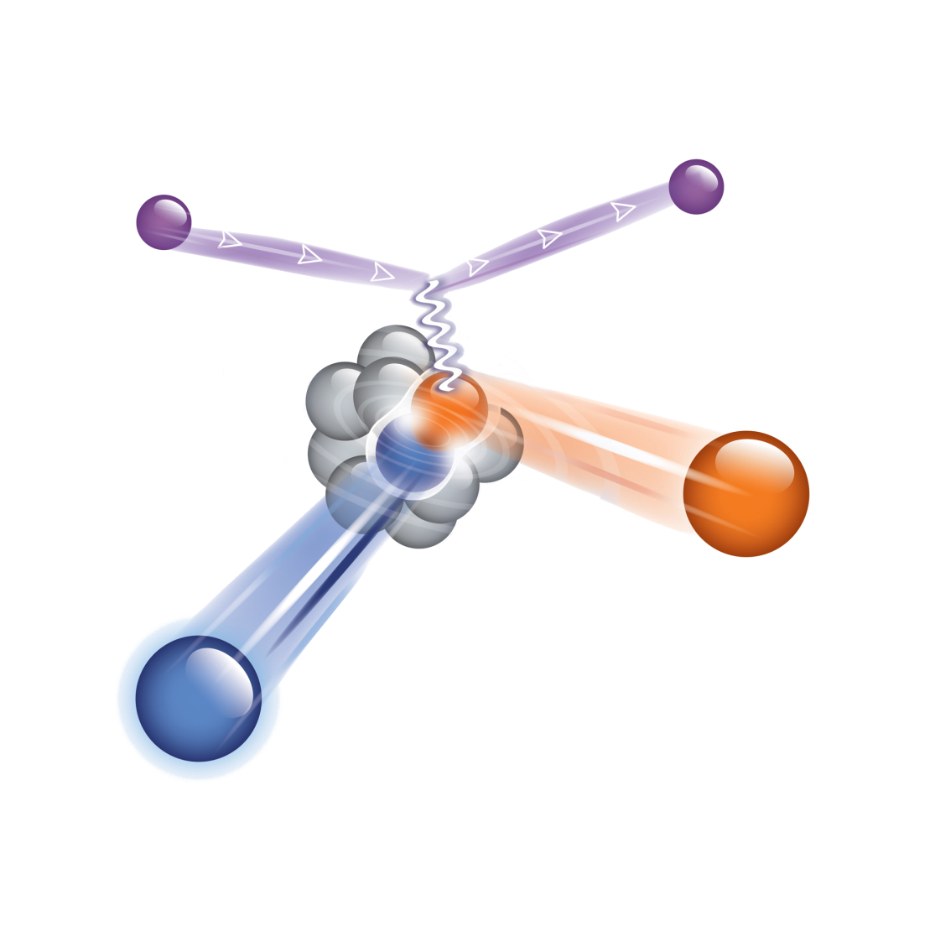
Experimental Studies of Short Range Correlation in Nuclei
short-range correlations in N/Z asymmetric nuclei
neutron-proton momentum distributions
Two Fermions systems and the Contact term
SRC role in the nuclear equation of state
Eli Piasetzky
Tel Aviv University ISRAEL

Slide 2
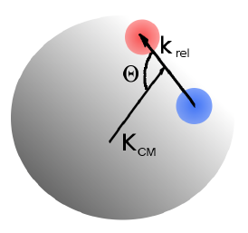

What are Short (intermediate) Range Correlations in nuclei ?
(tensor)
2N-SRC
SRC ~R_{N}
LRC ~R_{A}
~1 fm
≤1.f
1.7f
k_{F} ~ 250 MeV/c
High momentum tail:
300-1000 MeV/c
1.5 K_{F} - 5 K_{F}
1.7f
1.7 fm
ρ_{o} = 0.16 GeV/fm³
Nucleons
In momentum space:
K ₁
A pair with large relative momentum between the nucleons and small CM momentum.
K ₁
K ₂
K ₁ > K_{F} ,
K ₂ > K_{F}
K ₂
Notes:
2

Slide 3
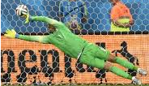
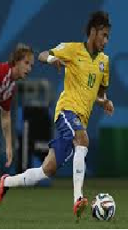

Quasi-Free scattering off a nucleon in a short range correlated pair
Hard exclusive
triple – coincidence measurements
K ₁
K ₂
Pmiss [MeV/c] | pairs | nuclei | experiment
300-600 | pp only | ¹²C | EVA/BNL
300-600 | pp and np | ¹²C | E01-015/ Jlab
400-850 | pp and np | ⁴He | E07-006/ JLab
300-700 | pp only | C, Al, Fe, Pb | CLAS/JLab

Slide 4
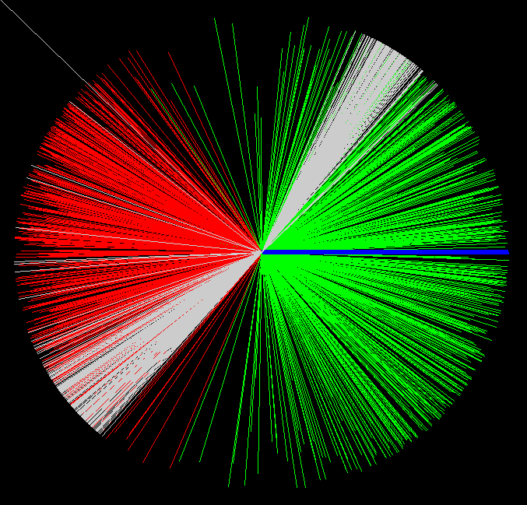
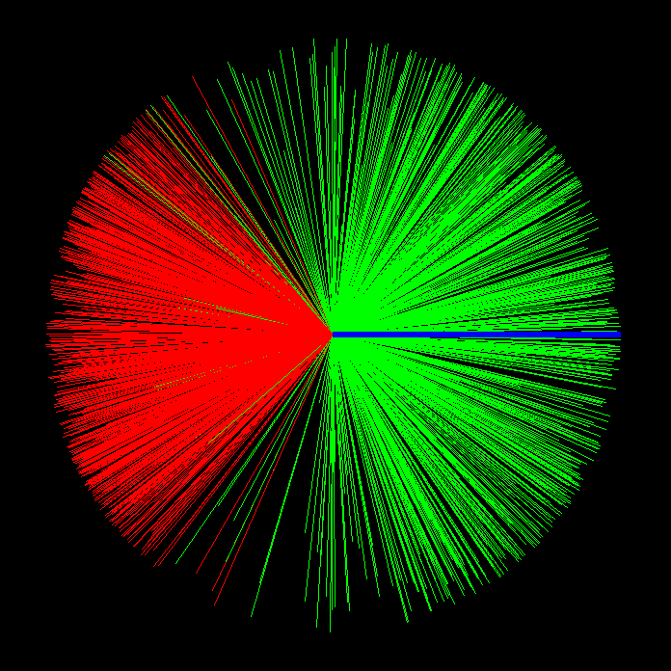
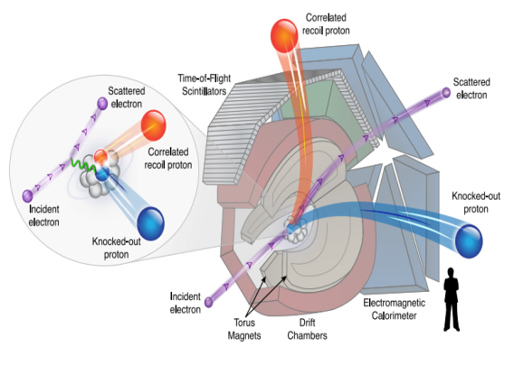
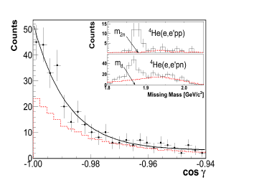
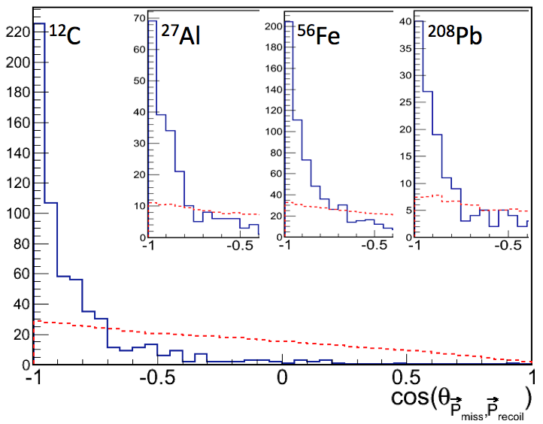
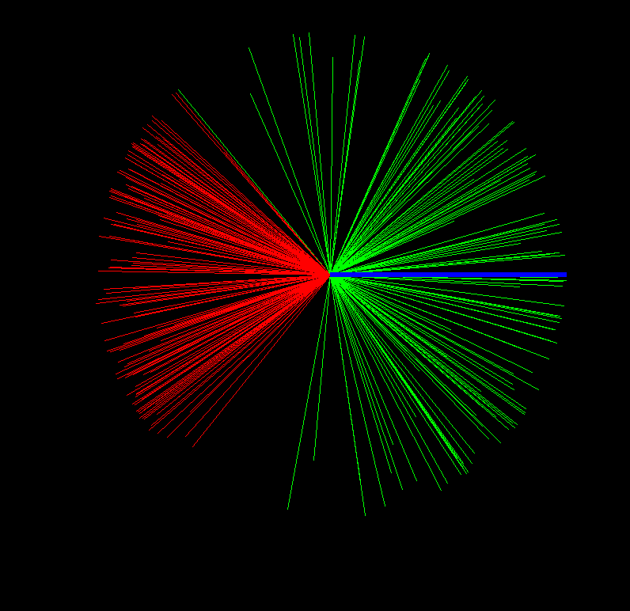
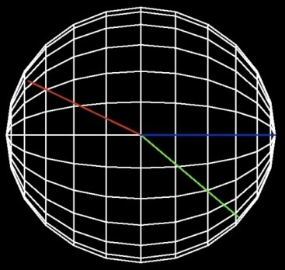
JLab / CLAS, Data Mining, EG2 data set
¹²C(e.e’pp)
P_{recoil}
⁵⁶Fe(e,e’pp)
P_{recoil}
q
q
P_{miss}
²⁰⁸Pb(e,e’pp)
pp-SRC events
q
γ
Ein =5.014 GeV
P_{miss}
Q²>1.5GeV/c²
X>1.2
JLab /Hal A Exp 07-006

Slide 5
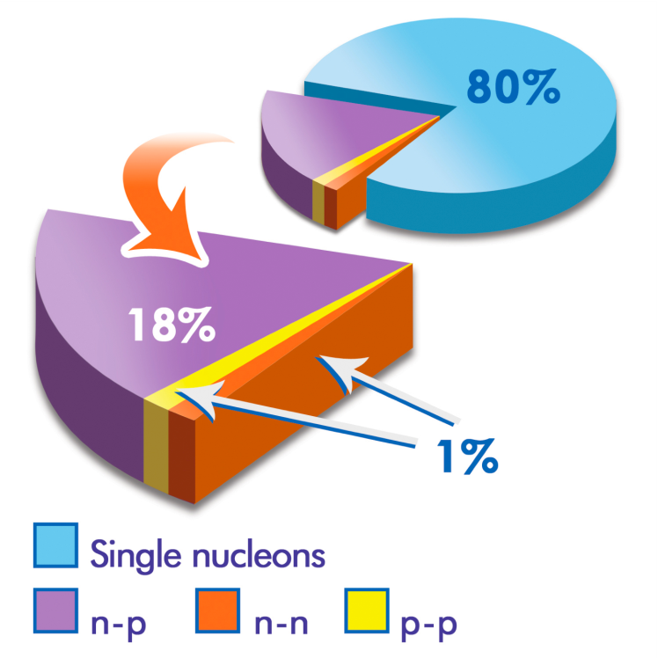
R. Subedi et al., Science 320, 1476 (2008).
¹²C
BNL / EVA
¹²C(e,e’pn) / ¹²C(e,e’p)
[¹²C(e,e’pn) / ¹²C(e,e’pp)] / 2
[¹²C(e,e’pp) / ¹²C(e,e’p)] / 2

Slide 6
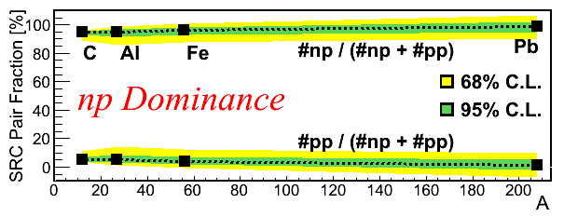
np / pp SRC pairs ratio
c
Al
Fe
Pb
O. Hen et al., Science 346, 614 (2014).

Slide 7
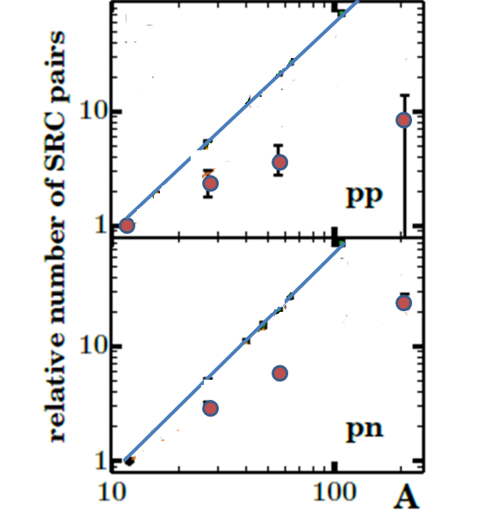
The mass dependence of the SRC pairs
CLAS JLab data see C. Colle et al.
http://arxiv.org/abs/arXiv:1503.06050

Slide 8
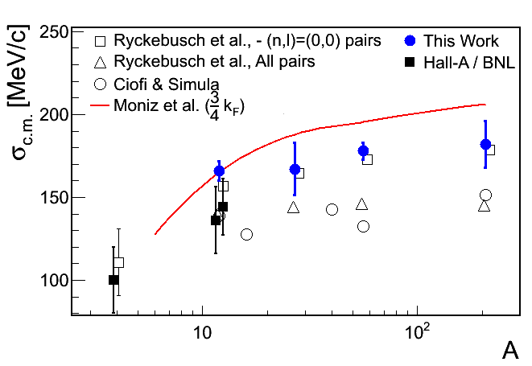
C.M. motion of the pair
P
PRELIMINARY
O. Hen E. Cohen et al., in preparation

Slide 9
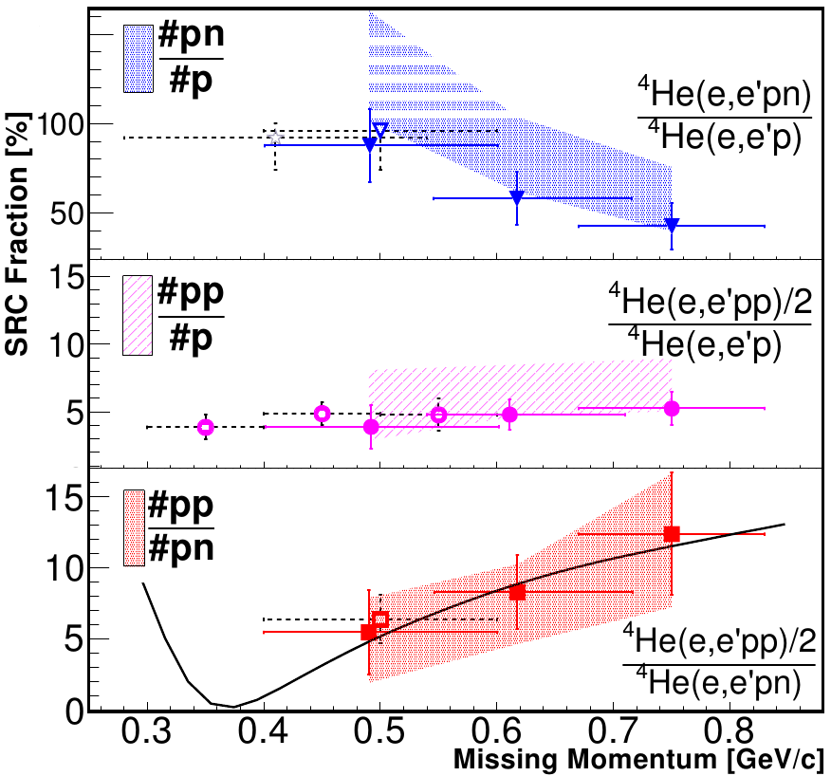
E07-006 (2011) ⁴He
I. Korover et al. Phys. Rev. Let. 113, 022501 (2014).

Slide 10
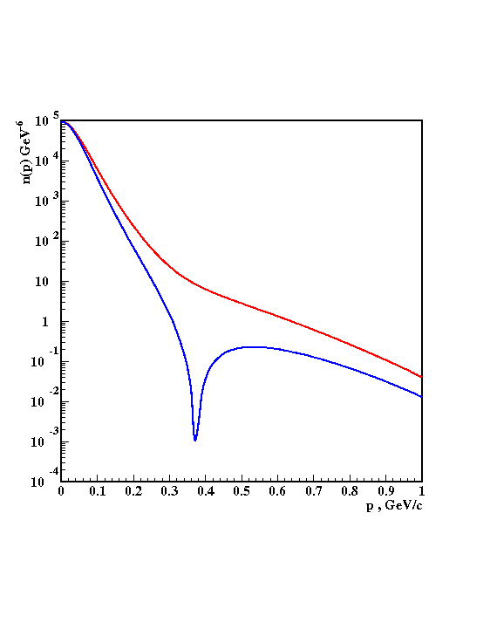
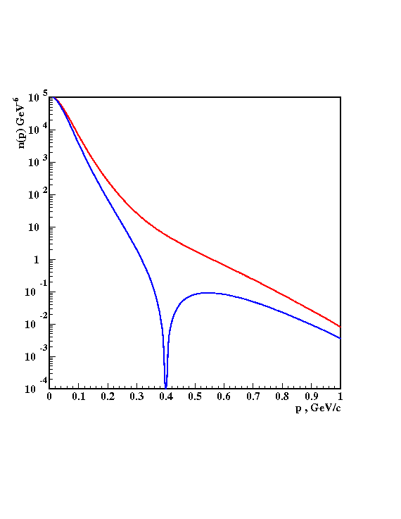
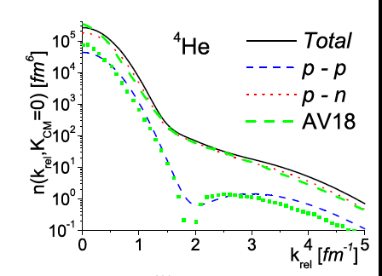
At 300-600 MeV/c there is an excess strength in the np momentum distribution due to the strong correlations induced by the tensor NN potential.
³He
³He
np
np
pn
pp
pp
pp
V18
Bonn
pp/np
Schiavilla, Wiringa, Pieper, Carson, PRL 98,132501 (2007).
³He
SRC
L = 0, 2
Ciofi and Alvioli
PRL 100, 162503 (2008).
Sargsian, Abrahamyan, Strikman, Frankfurt PR C71 044615 (2005).

Slide 11
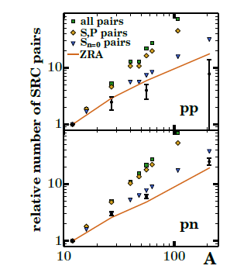

The mass dependence of the SRC pairs
N=0 (nodeless) L=o
IMP pairs
Predominantly:
L=0,2 T=0 S=1
(deuteron like) pairs
http://arxiv.org/abs/arXiv:1503.06050

Slide 12
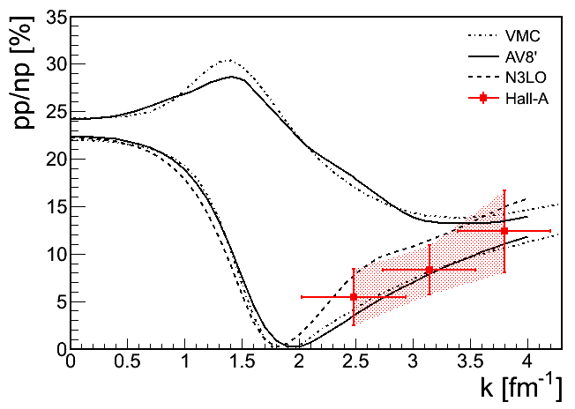
Wiringa, Schiavilla, Steven, Pieper, and Carlson, PRC 89, 024305 (2014).
Neff, Feldmeier, Horiuchi, Weber : arXiv:1503.06122
Korover et al. PRL 113, 022501 (2014).
All pairs
K_{cm}=0

Slide 13
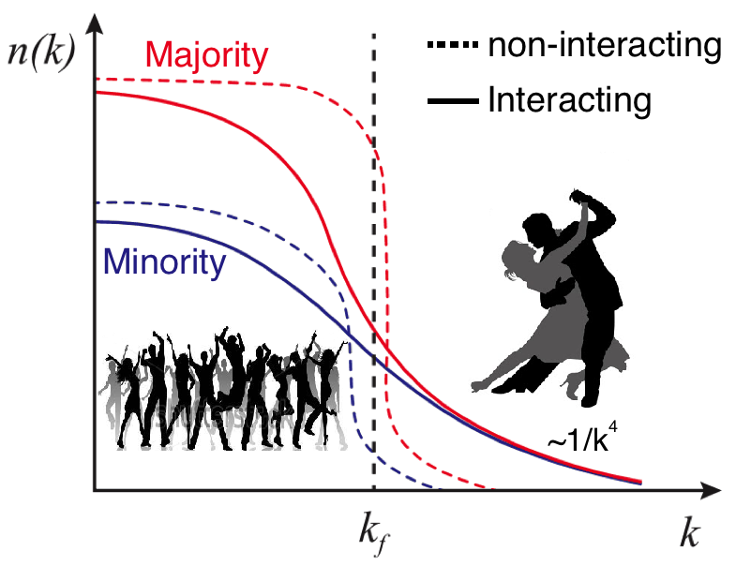
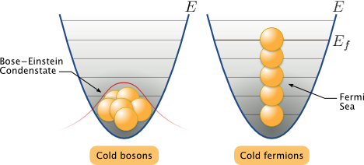
np-dominance and asymmetric neutron rich nuclei
  Pauli Principle:
neutrons
Majority
Minority
protons
proton
Universal property
A proton have a greater probability than a neutron to be above the Fermi sea
Possible inversion of the momentum sharing :
?

Slide 14
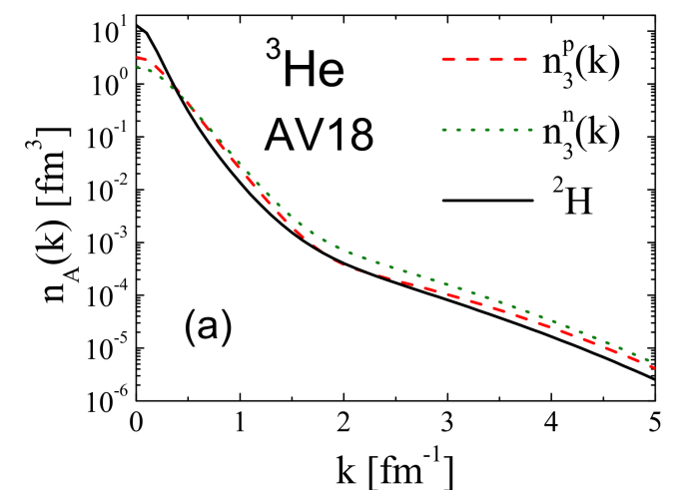
Protons move faster than neutrons in N>Z nuclei
( protons move faster than neutrons in N>Z nuclei )
<KE>
<KE>
Light nuclei A<11
p
n
p − n
Variational Monte Carlo calculations by the Argonne group
Wiringa et al.
phys. Rev. C89, 034305 (2014).
Notes:
Fix this up
Choose the n star stuff to include

Slide 15
Short distance structure of nuclei
1
The probability for a nucleon to have momentum ≥ 300 MeV / c in medium nuclei is ~25%
1
CLAS / HALL B
5
2
More than ~90% of all nucleons with momentum ≥ 300 MeV / c belong to 2N-SRC.
1
. PRL. 96, 082501 (2006)
Most of kinetic energy of nucleon in nuclei
is carried by nucleons in 2N-SRC.
2
4
3
Probability for a nucleon with momentum 300-600 MeV / c to belong to np-SRC is ~18 times larger than to belong to pp-SRC.
1
PRL 98,132501 (2007).
In light asymmetric nuclei :
2
3
2
EVA / BNL and Jlab / HALL A
3
In heavy asymmetric nuclei ?
PRL 162504(2006); Science 320, 1476 (2008).

Slide 16
Short distance structure of nuclei
4
Dominant NN force in the 2N-SRC is tensor force.
The high momentum tail (300-600 MeV/c) is dominated by
L=0,2 S=1 np –SRC pairs.
4
These pairs are produced from Sn=0 IPM pairs
Three nucleon SRC are present in nuclei. They contribute about an order of magnitude less than the 2N_SRC
6
Isospin structure ? Geometry ? Abundance ?
CLAS / HALL B
6
.

Slide 17
SRC Outreach
See the following talk by Or Hen
Particle Physics
The EMC Effect.
Neutrino-Nucleus Scattering.
The NuTeV Anomaly.
Astrophysics
Neutron Stars.
Nuclear Symmetry Energy.
Quantum \ Atomic Physics
Energy Sharing in Imbalance Fermi Systems.
Contact Interaction in Universal Fermi Systems.

Slide 18
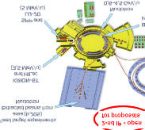

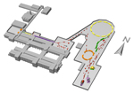

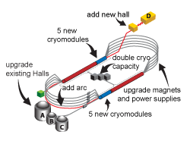
Number of hard triple coincidence events (World data)
nn pairs | np pairs | pp pairs | experiment
- | 18 | - | EVA/BNL
- | 179 | 263 | E01-015/JLab
- | 223 | 50 | E07-006/JLab
- | - | 1533 | CLAS/JLab
0 | <450 | <2000 | Total
5 GeV/c 10⁹ protons/sec fixed target
>10k events/100 Hr
12 GeV electrons at JLab fixed target
X5-10 Mott cross section
X10 Luminosity in CLAS12

Slide 19

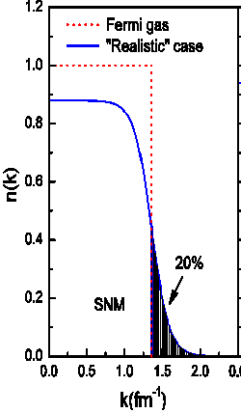
Mapping the transition from mean field to SRC
n
EVA / BNL:
Only 18 ¹²C(p,2p+n) events with p_{n}>k_{F}
With 100ps TOF resolution:
Migdal jump

Slide 20
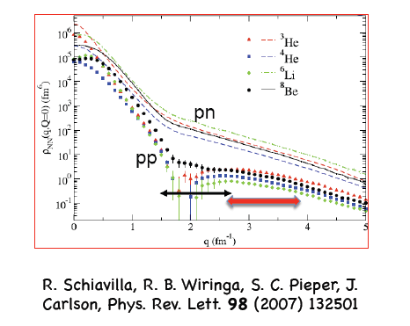

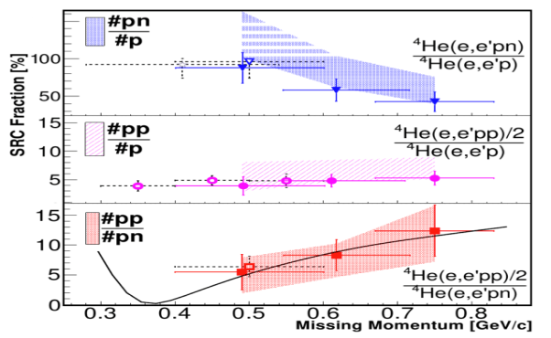
SRC Isospin Structure and the Tensor Force
³He
At 400-600 MeV/c.
Sargsian, Abrahamyan, Strikman, Frankfurt PR C71 044615 (2005).
I. Korover, et al. Phys. Rev. Lett 113, 022501 (2014).
. We propose :
First measurement below 400 MeV/c
Better statistics above 600 MeV/c
\

Slide 21
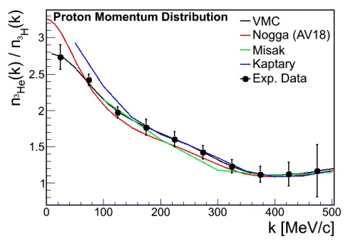
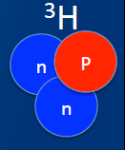
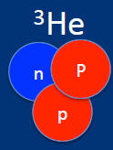

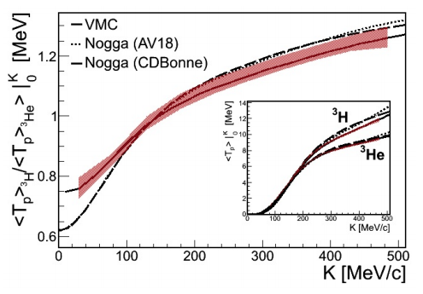
Momentum sharing in the A=3 nuclei
JLab E14-011 (Approved)

Slide 22
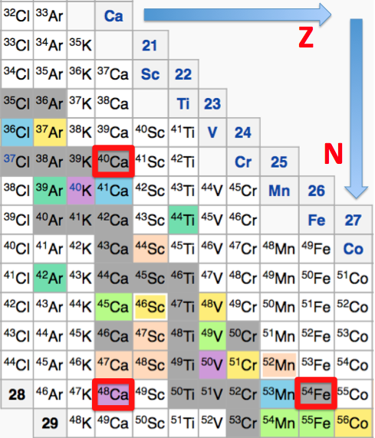
Asymmetric nuclei N>Z:
Who are the parents of the 2N-SRC pairs ?
Z=20
N=20
Add 8 f7/2 neutrons
Z=20
N=28
Z=26
N=28
Add 8 protons

Slide 23

What is the role played by short range correlation of more than two nucleons ?

Slide 24
Summary
See the following talk by Or Hen

Slide 25
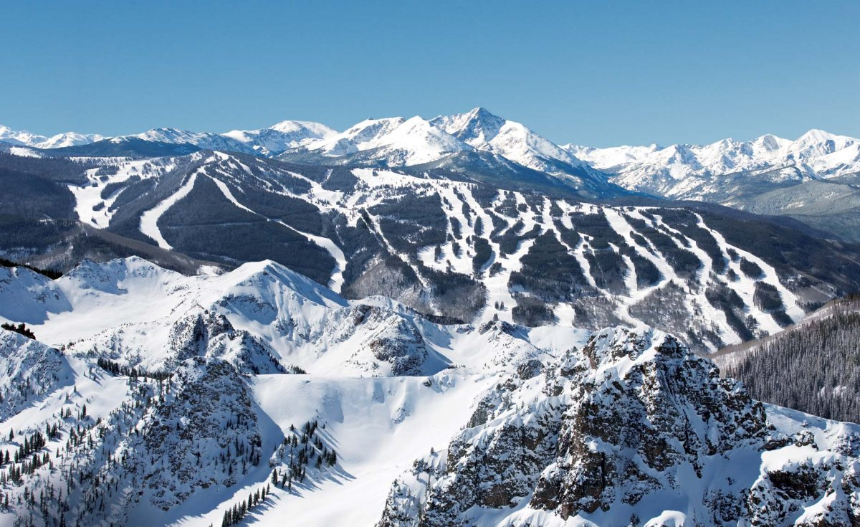


I thanks the organizers for the invitation
Douglas Higinbotham
And the early birds for showing up at 8AM for this talk

