Slide 1

12 GeV CEBAF Upgrade
12 GeV CEBAF
The Physics and Experiments
D
A
B
C

Slide 2
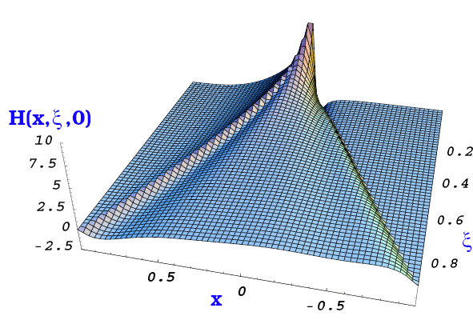
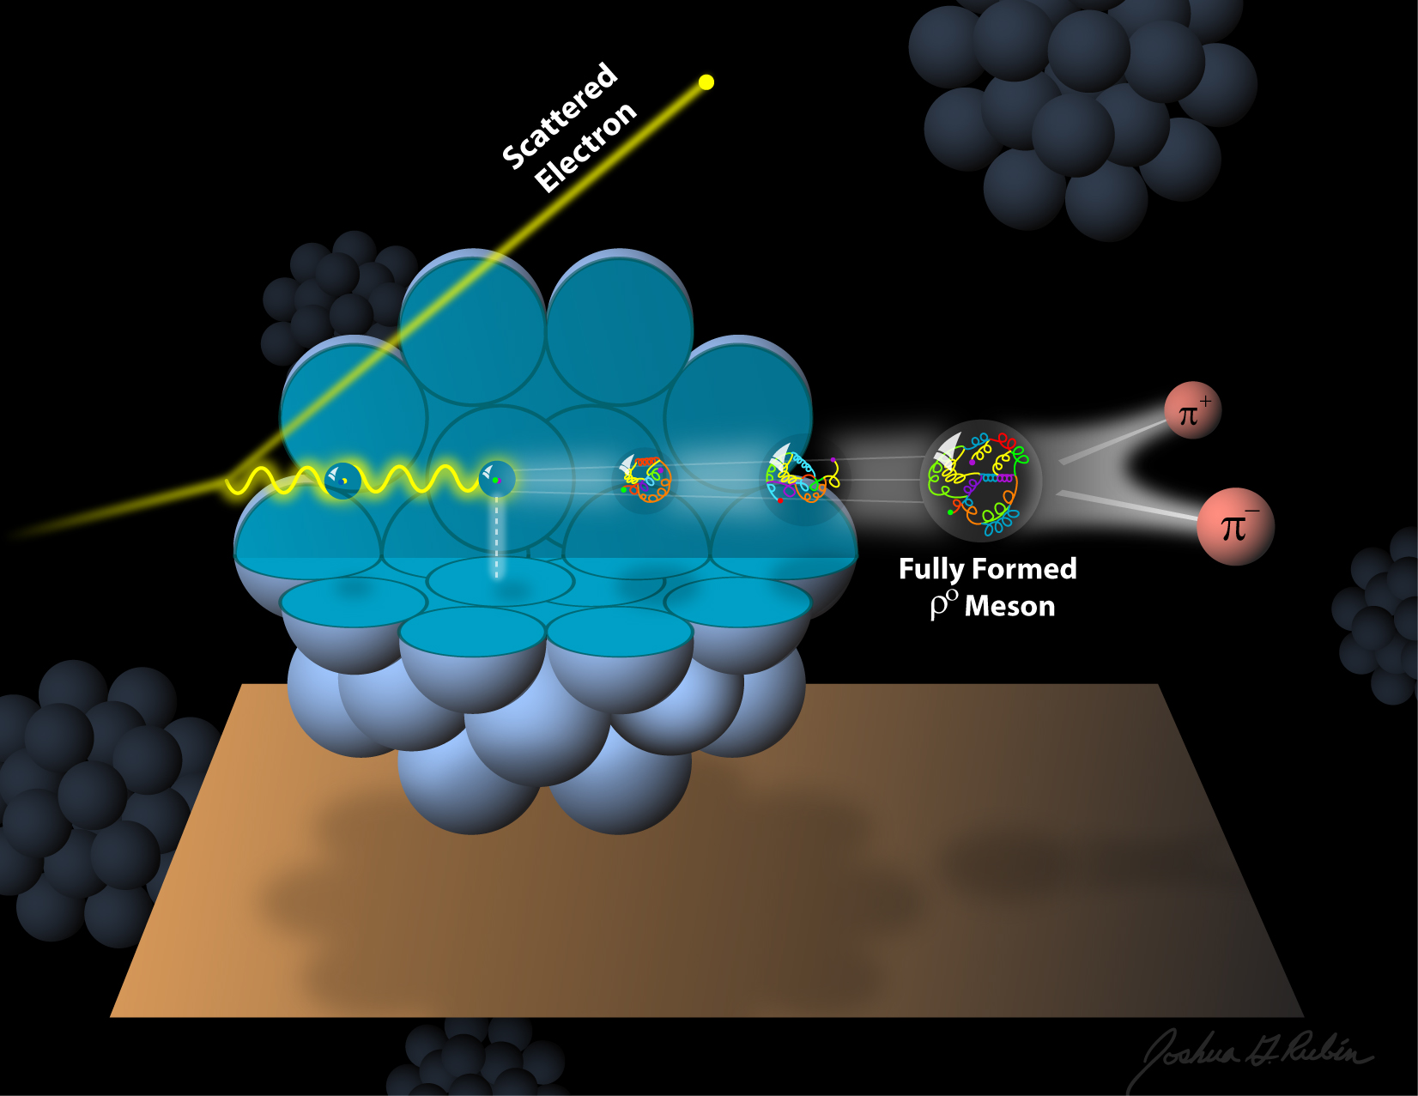
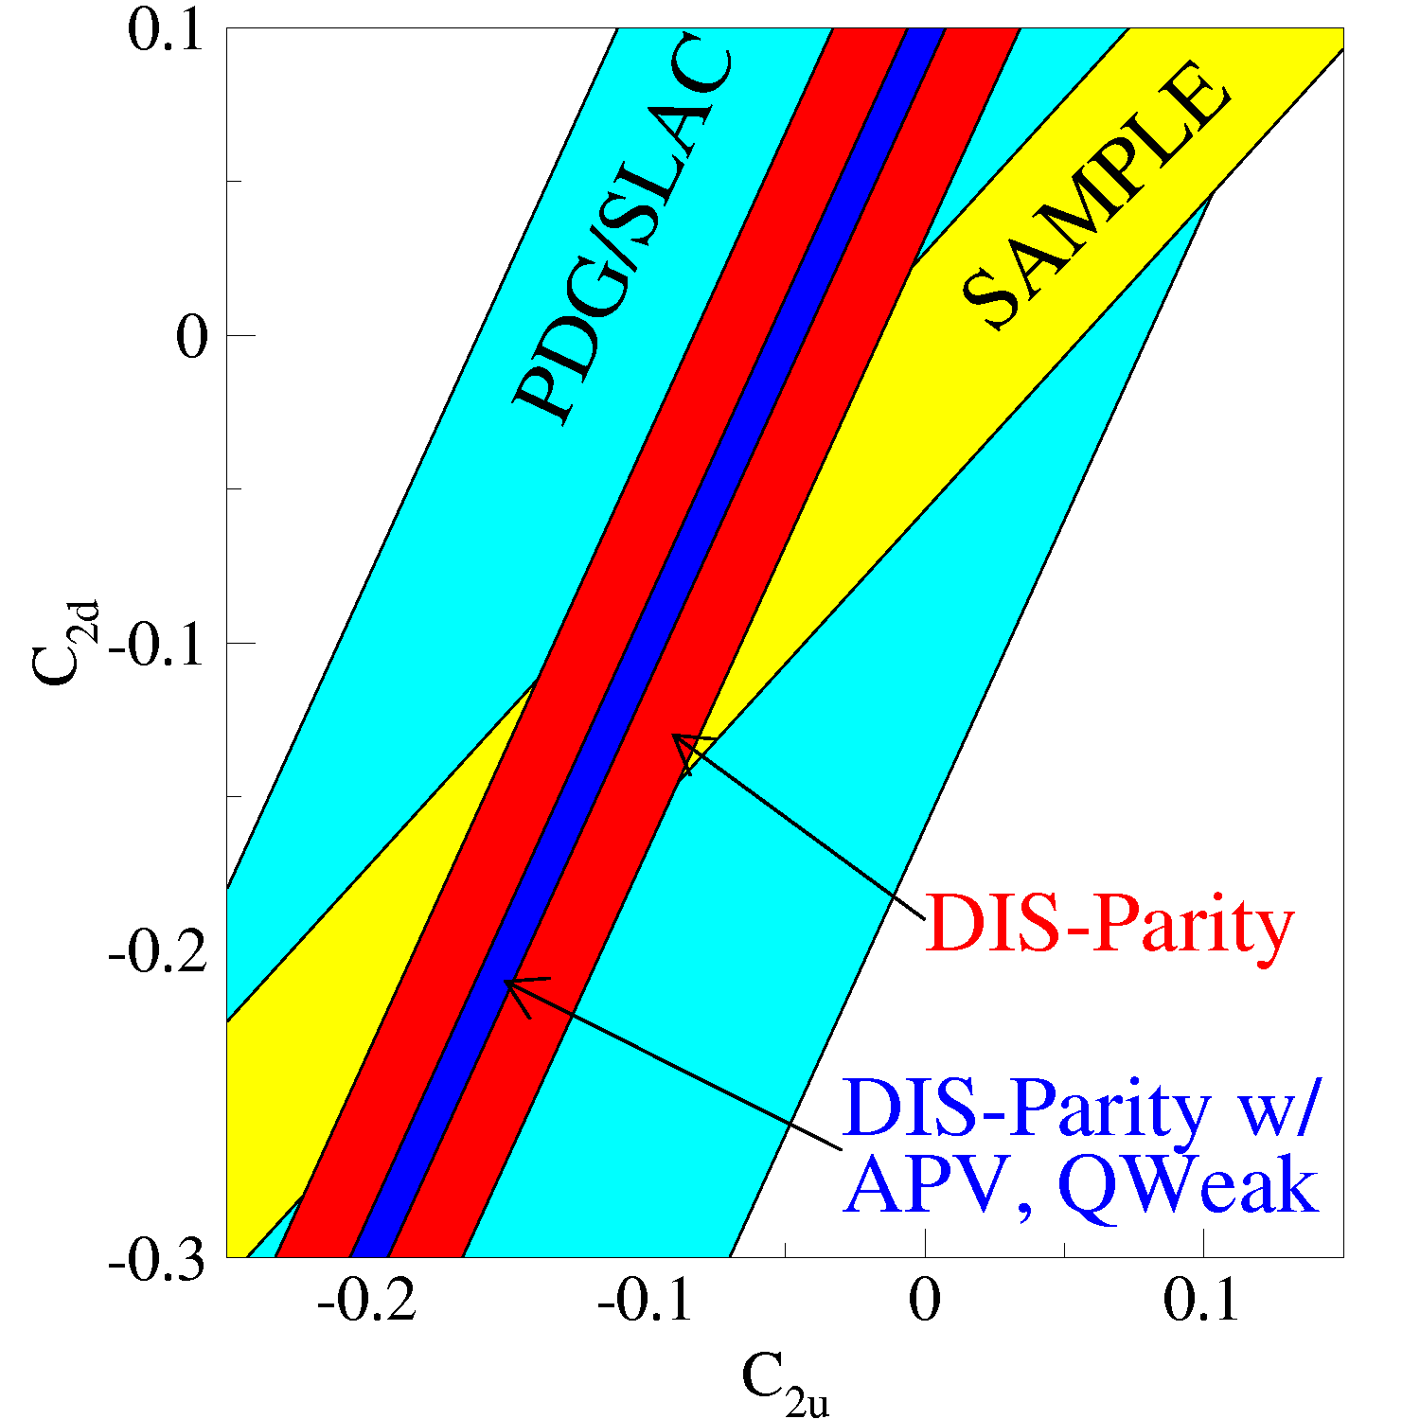
The science program at JLab @ 12GeV
Confinement forces and the role of the glue in spectroscopy
The 3D structure of the nucleon – from PDFs and elastic form factors and TMDs and GPDs
The strong interaction in nuclei – evolution of quark hadronization, nuclear transparency of hadrons
Science beyond the Standard Model – precision measurements at low energies
Notes:
The JLab energy upgrade serves a broad experimental scientific program that one may broadly describe within 4 categories: 1) Better understanding the quark confinement through studies of the role of glue in meson and baryon spectroscopy. 2) The study of the multi-dimensional spatial and momentum structure of the nucleon from e.m. form factors and PDFs to GPDs and TMDs. 3) Strong interaction in nuclei and 4) The search for science beyond the Standard Model, especially through the precision measurement of fundamental quantities. Many of these topics are discussed in some detail in this paper.

Slide 3
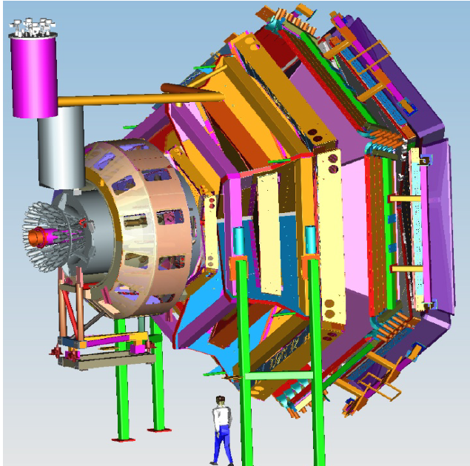
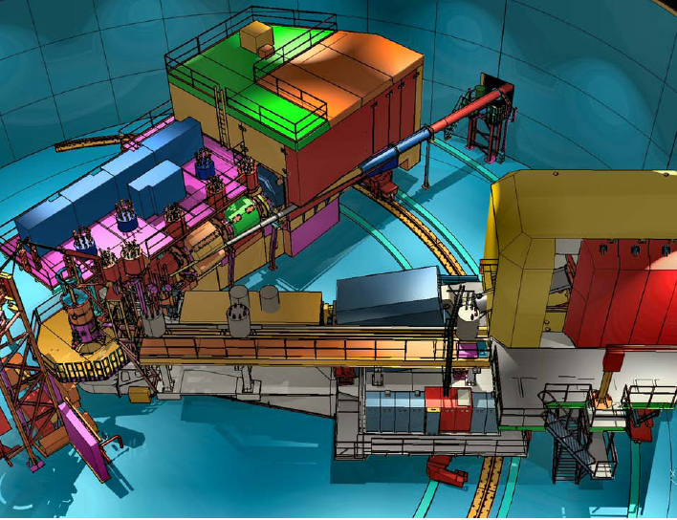
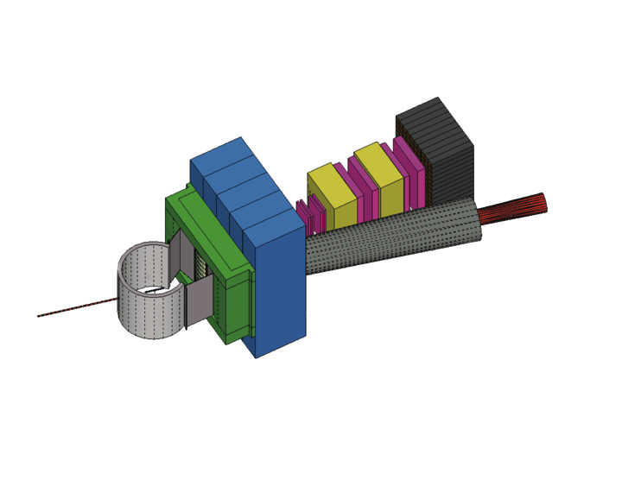
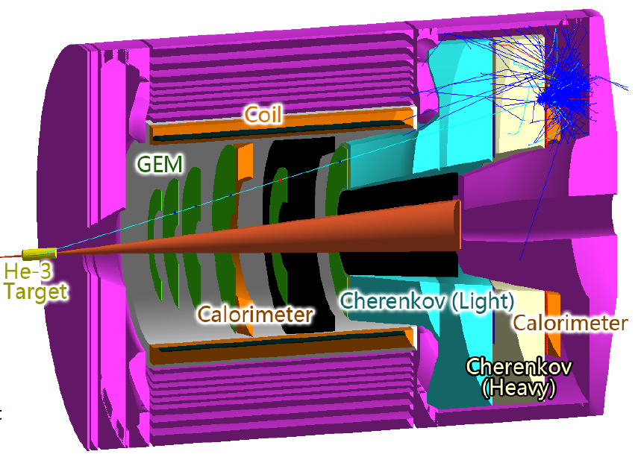
Base equipment & proposed equipment
Hall B
Hall C
Hall D
CLAS12
SHMS
GlueX
additional equipment – under construction
proposed
HRS + SBS-Hall A
Tracker
Hadron calorimeter
SOLID - Hall A
Scattering chamber
CH2 analyzer
Beam line Pb shield

Slide 4
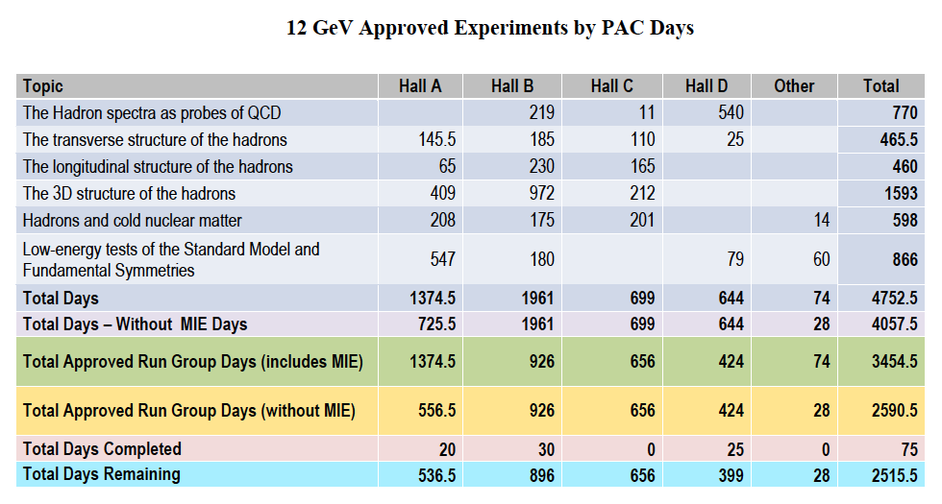
12 GeV Approved Experiments by PAC Days
75 approved experiments

Slide 5
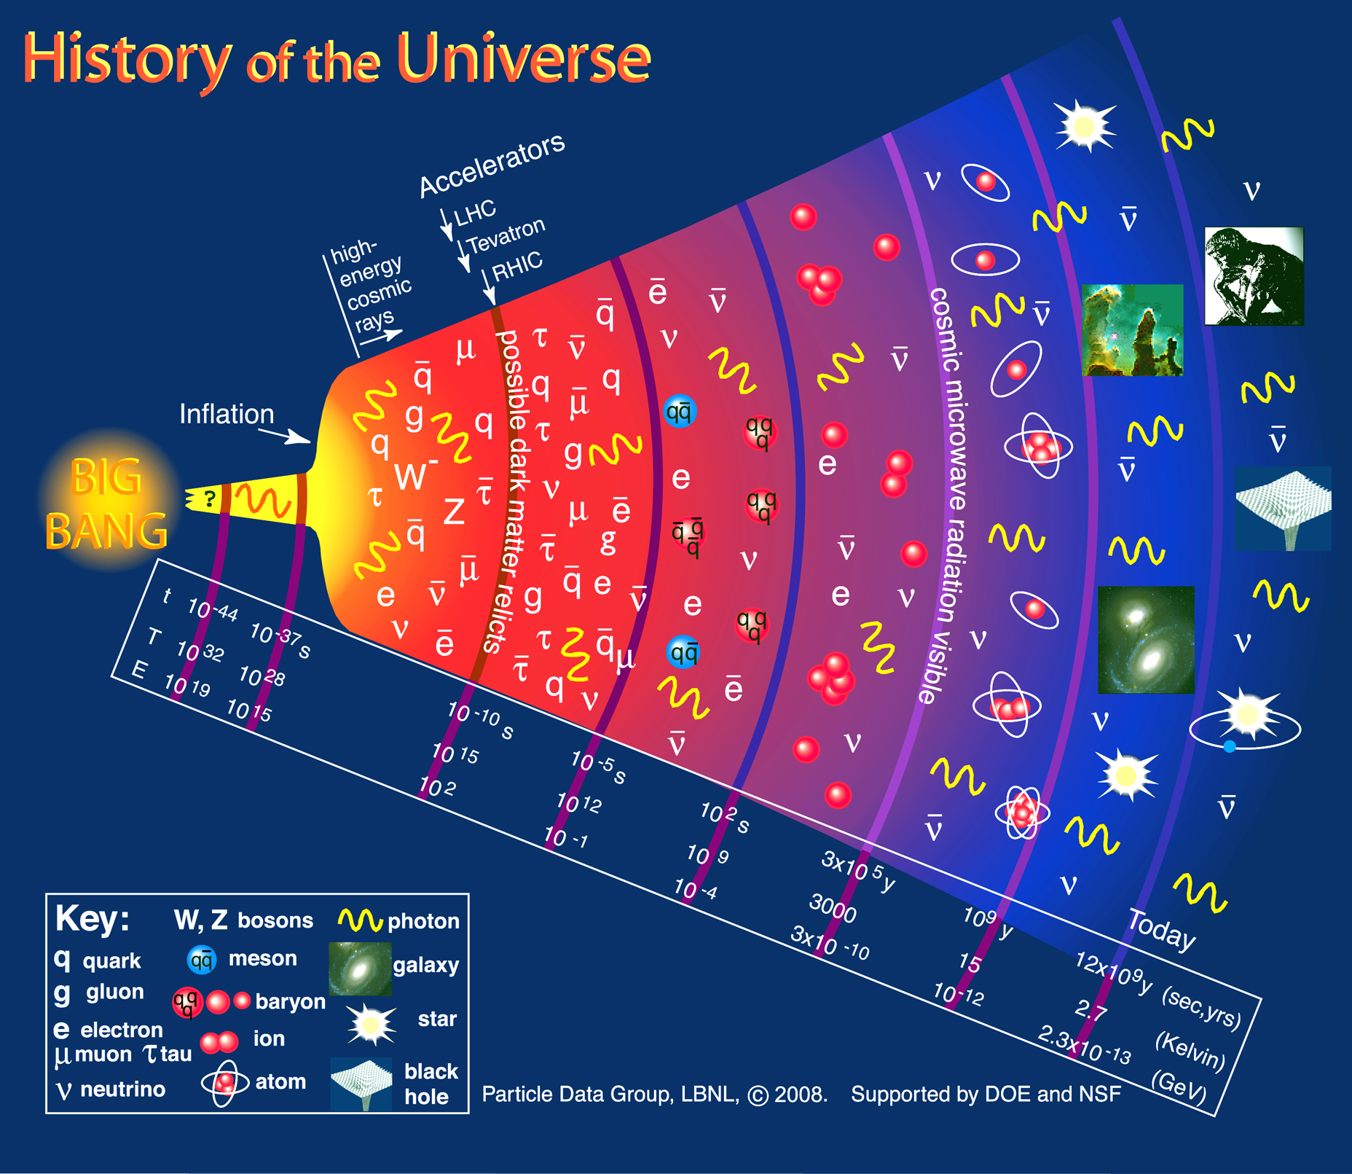
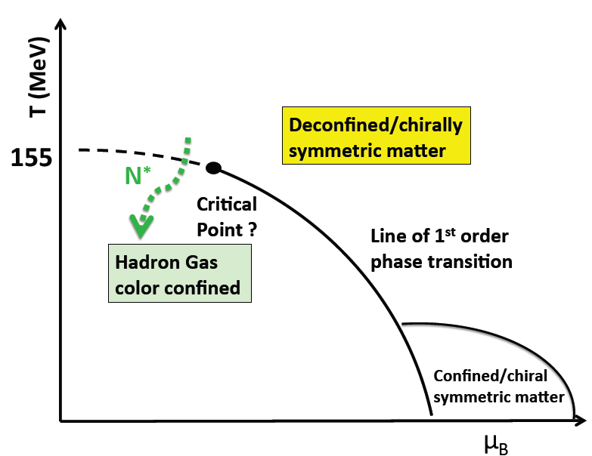
Confinement and Strong QCD
CEBAF
N*
Dramatic events occur in the transition from the QGP phase to hadron phase
Chiral symmetry broken, confinement occurs => PDFs, TMDs, GPDs
How does QCD lead to confinement? => Study confinement forces
Quarks attain masses dynamically => Elastic and resonance form factors
Transition is driven by baryon excitations => Search for missing baryons
Spin is important in all aspects of this program

Slide 6
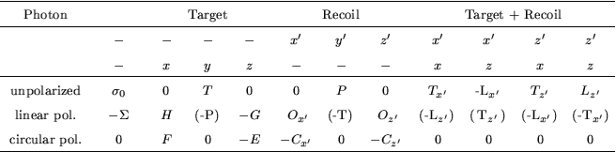
Spin in Baryon Spectroscopy
Ongoing program to resolve “missing” light-flavor baryons issue through exclusive meson production processes
In hyperon photoproduction p(γ,KΛ), 4 complex amplitudes are involved
Differential cross section is just one of the observables, insufficient in search for small resonance signals
With polarized beam and measurement of Λ recoil polarization (Λ->pπ⁻) 7 observables can be obtained.
polarized photons
long. and transv. polar. target

Slide 7
Strangeness production γp→K⁺Λ→K⁺pπ⁻
Establishing the N* spectrum
M. Mc Cracken et al. (CLAS), Phys. Rev. C 81, 025201, 2010
D. Bradford et al. (CLAS), Phys.Rev. C75, 035205, 2007
A. Anisovich et al. , EPJ A 48,15 (2012)
Notes:
…. the Lambda recoil polarization can be extracted… With a circularly polarized photon beam, we can also measure the polarization transfer… again the fit is from BnGa.., it serves here the purpose to demonstrate the required precision of the data to make significant progress….

Slide 8
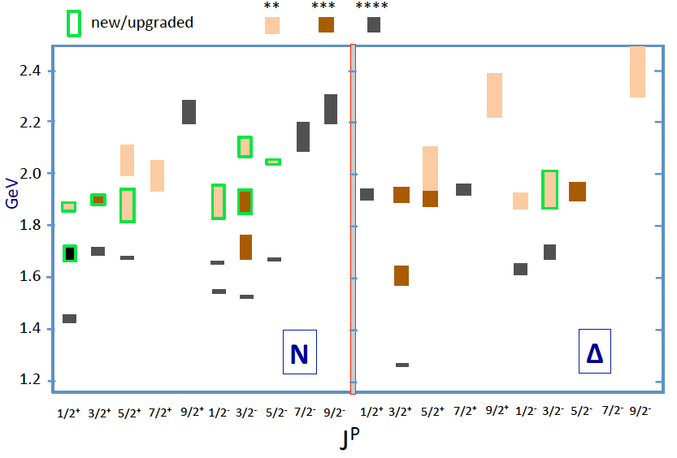
Lower mass N*/Δ* states in 2016
?
Are we observing mass degenerate spin multiplets and parity duplets?
Mass degenerate parity duplets may indicate restoration of chiral symmetry
Notes:
This shows the status of states with masses below 2.4 GeV and minimum of 2* rating. The newly observed states, or states that have been upgraded due to the new data are shown with the green frames. Out of the 8 new N* states 5 fall within a narrow mass range, that may indicate a mass degenerate spin multiplet at 1.9 GeV that nearly repeats a similar set of states at 1.7GeV, and a set of now 7 Delta states, also near 1.9 GeV. The mechanism for such multiplets is not understood and is not predicted within the quark model. Channel coupling might have something to do with it, but no quantitative evaluation has been done.
The other important question is if these new states fit within the symmetry underlying the constituent quark model.

Slide 9
Differential cross section for γp→πN
high statistical precision
M. Dugger et al., Phys.Rev.C76:025211,2007.
M. Dugger et al., Phys.Rev. C79 (2009) 065206
pπ⁰
nπ⁺
need polarization data at large masses
Notes:
Single pion production is very sensitive to baryon resonances at lower masses where one clearly sees large resonance strength. Very high precision data on single pion production cross section have been been taken that also cover the higher mass range where there are no obvious resonance structures. To search for evidence of new baryon states in this energy range it is critical to include polarization data into the fit. Some of the data are shown ……

Slide 10
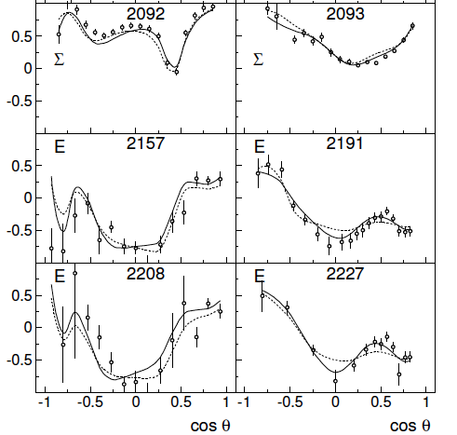
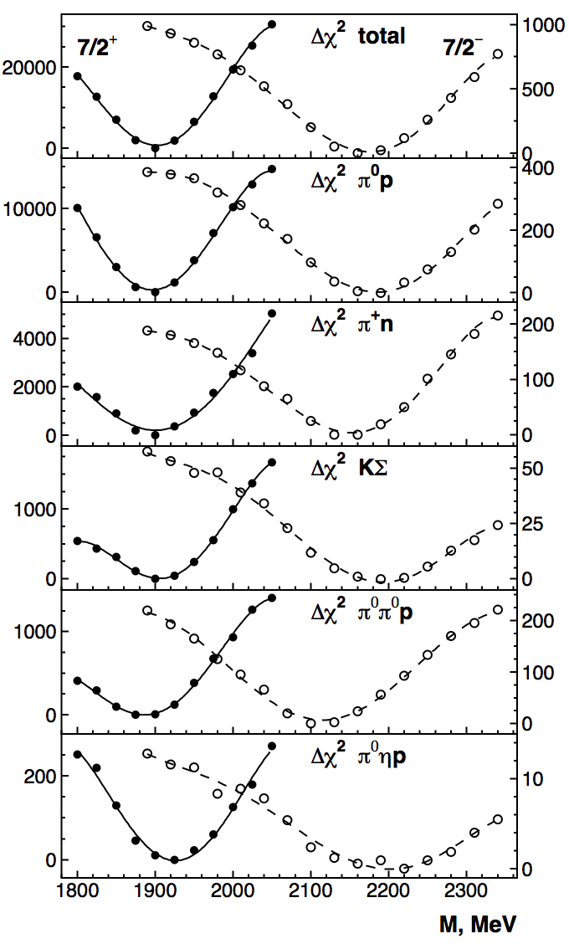

Is there a parity doublet Δ*(1950)7/2 ?
Δ(1950)7/2⁺
Δ(2200)7/2⁻
Beam
Asymmetry
pπ⁰
nπ⁺
Helicity
Asymmetry
nπ⁺
Δ(2200)7/2⁻
Clear evidence for new state
--> Nπ - 3.5% !
A.V. Anisovich et al., arXiv:1503.05774
Notes:
New polarization data with polarized beam asymmetry and double polarization helicity asymmetry are shown here. Helicity asymmetry is especially sensitive to higher spin states. The mass scan clearly shows strong sensitivity to 7/2+ spin parity, and gives the mass, and pi0 over pi+ give the isospin. This result has impact in addressing the question of restoration of chiral symmetry at high masses. The mass spectrum I showed earlier shows evidence for mass degeneracy for certain spin-parity duplets. The question is if there are mass degenerate parity-duplets at higher mass that would confirm this trend? If we include this new state into the spectrum…..

Slide 11
Lower mass N*/Δ* states in 2016
?
Are we seeing mass degenerate spin multiplets and parity duplets?
The search for new baryon states continues at JLab@12.
We are not seeing mass degenerate parity duplets for spin J=7/2!
E12-16-10
Notes:
This shows the status of states with masses below 2.4 GeV and minimum of 2* rating. The newly observed states, or states that have been upgraded due to the new data are shown with the green frames. Out of the 8 new N* states 5 fall within a narrow mass range, that may indicate a mass degenerate spin multiplet at 1.9 GeV that nearly repeats a similar set of states at 1.7GeV, and a set of now 7 Delta states, also near 1.9 GeV. The mechanism for such multiplets is not understood and is not predicted within the quark model. Channel coupling might have something to do with it, but no quantitative evaluation has been done.
The other important question is if these new states fit within the symmetry underlying the constituent quark model.

Slide 12
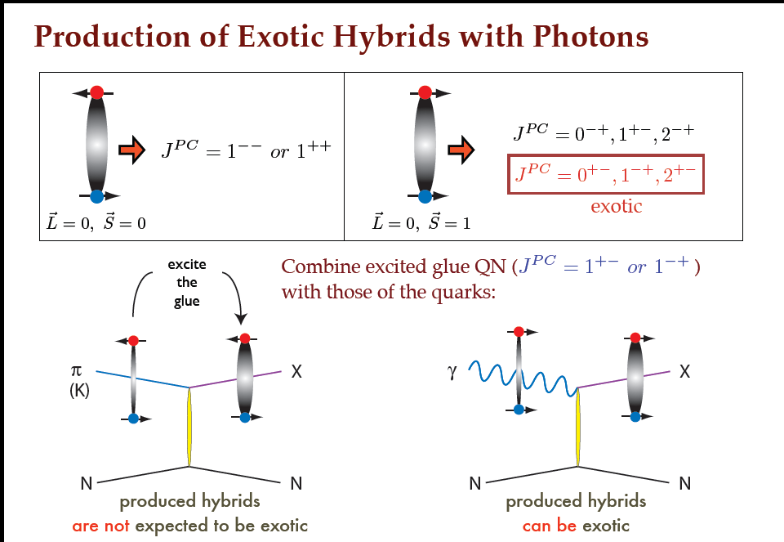
Polarized Beam in Meson Spectroscopy
E12-06-102
E12-13-003
Employ linear photon polarization in hybrid meson spectroscopy.
Beam Asymmetry
~40% Polarization
first data

Slide 13
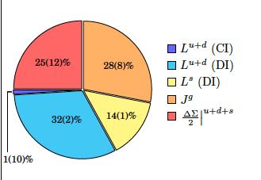
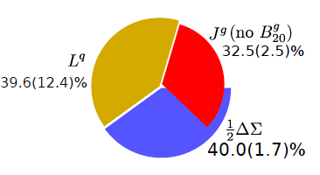
Proton Spin Decomposition
In LQCD, gauge invariant decomposition (X. Ji):
J_{p} = ½ = (½ ΔΣ^{q} + L^{q}) + J^{g}
m_{π}=140MeV
OAM
L^{q}=46%
L^{q}=40%
K.F. Liu, C. Lorce, arXiv:1508.00911
C. Alexandrou et al., arXiv:1609.00253
LQCD projections: OAM 40-50%, nearly all quark OAM is the result of disconnected interactions.
Quark OAM is experimentally the least constrained contribution
=> Strong motivation of spin physics at 12 GeV

Slide 14
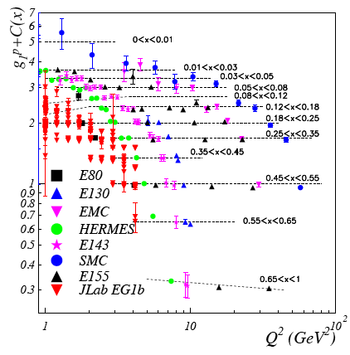
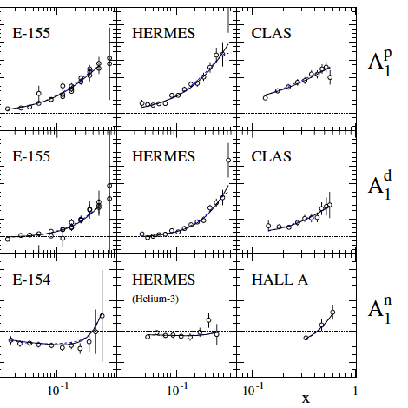
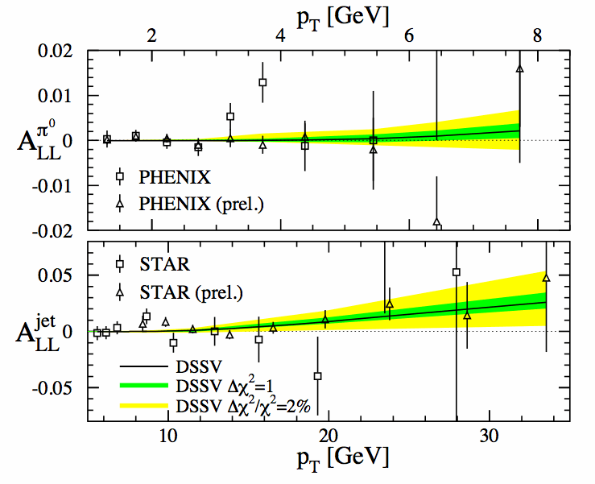
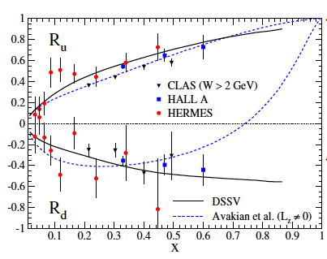
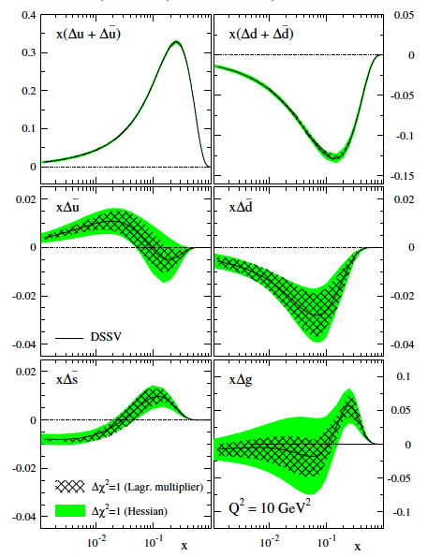
Polarized PDFs – the present situation
Asymmetries in pp at RHIC
Δu/u
DSSV, PRD 80,
034030 (2009)
? OAM ?
Δd/d
Δu/u, Δd/d are not well constrained at x > 0.5

Slide 15
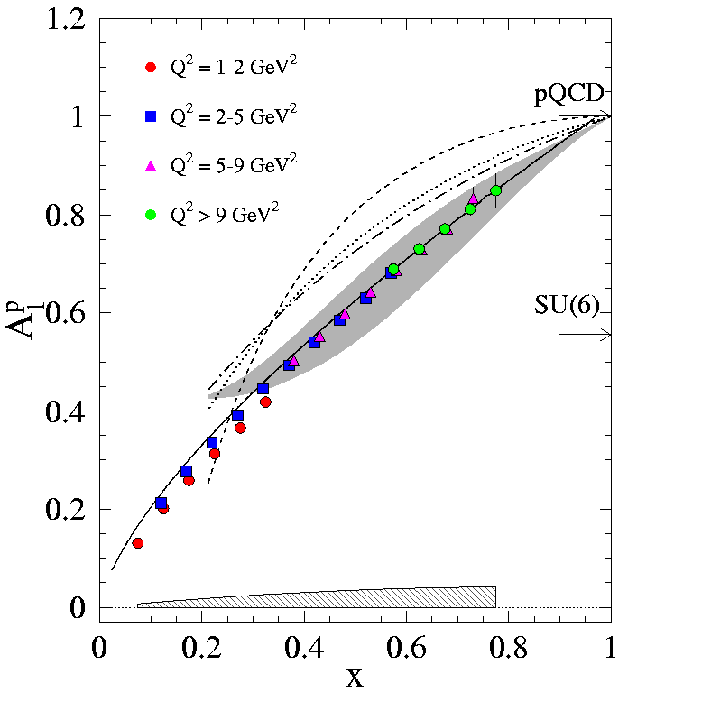
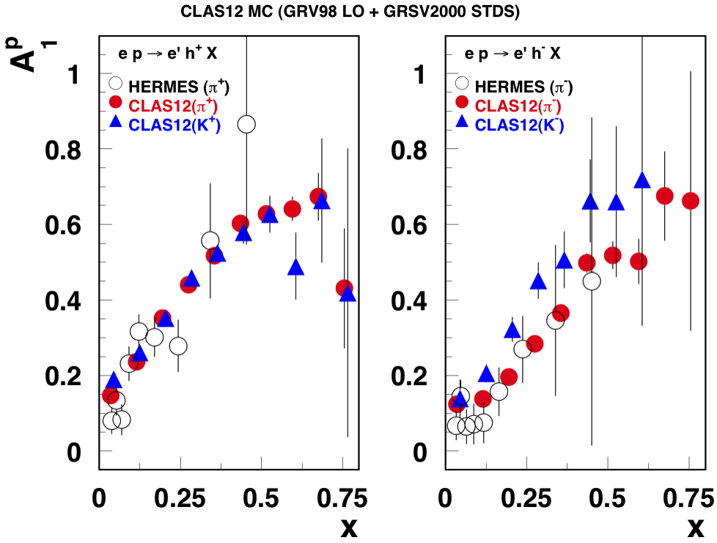
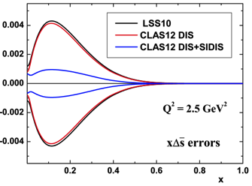
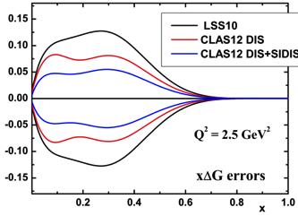
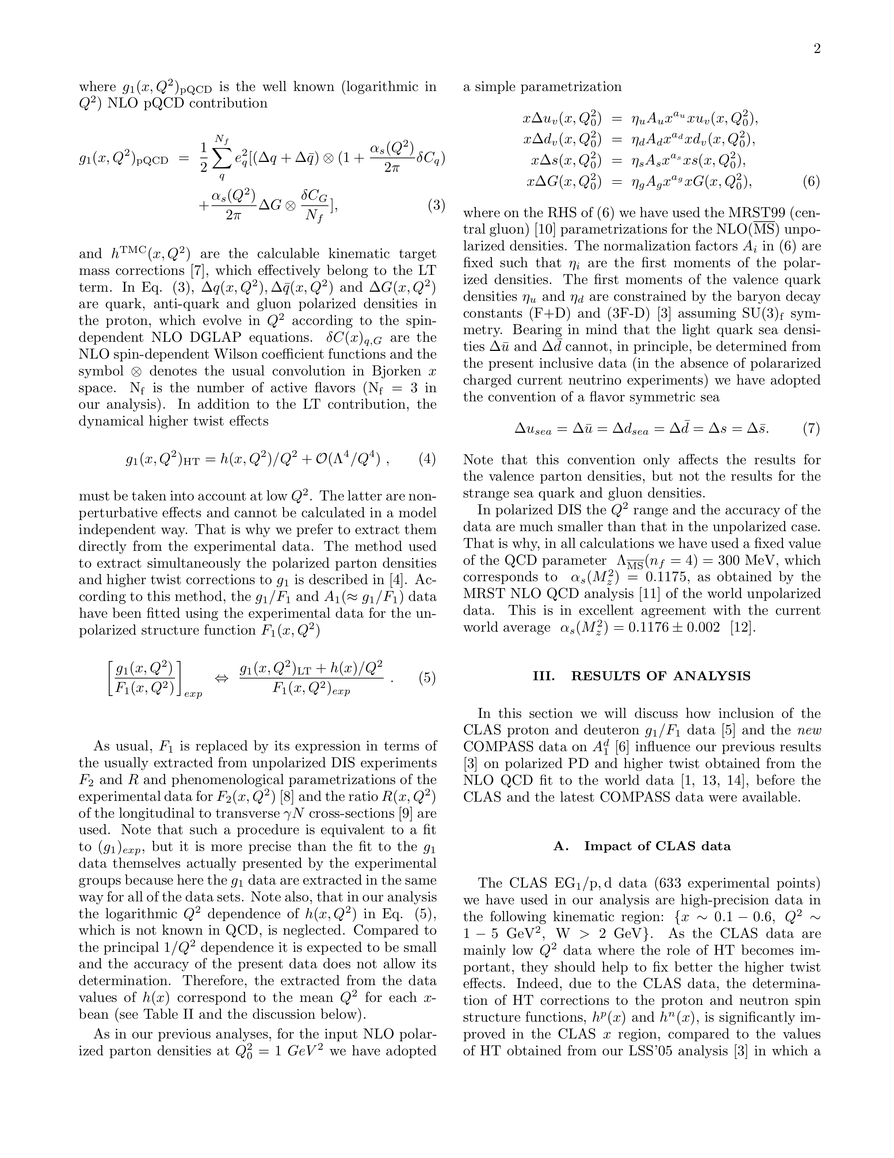
Proton PDFs – JLab 12GeV extension
Improved PDFs from NLO analyses
E12-06-109
E12-09-007
Precise information on A₁(x, Q²) with flavor tag can reduce uncertainties in parton helicity distributions.
The Q² dependence and QCD evolution can provide model-independent ΔG(x).

Slide 16
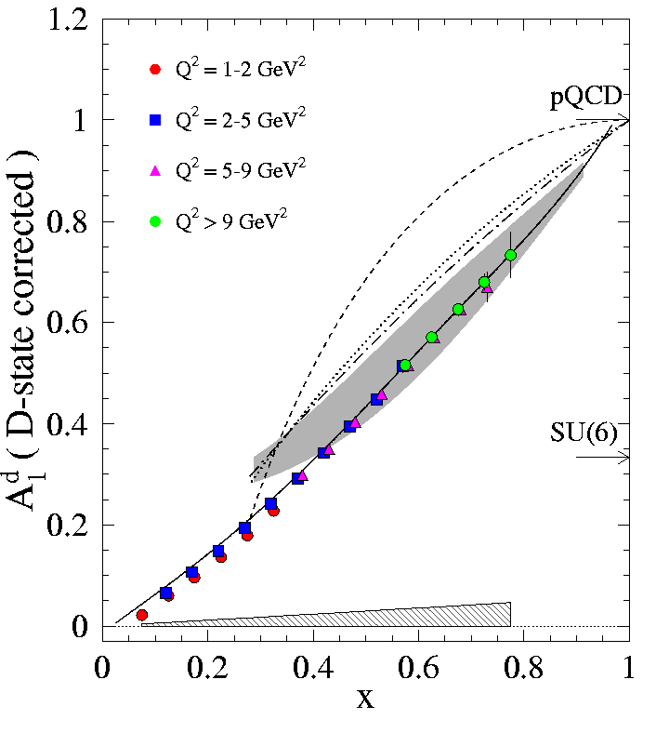
Neutron PDFs - 12GeV extension
ND₃
A₁^{D}/A₁^{n} helicity asymmetry
³He
W > 2 GeV; Q² > 1 GeV²
E12-06-109
E12-06-110
E12-06-122

Slide 17
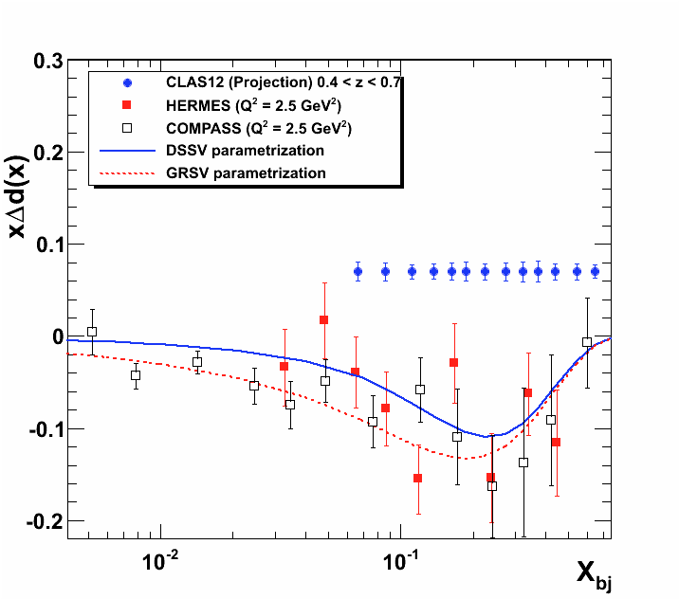
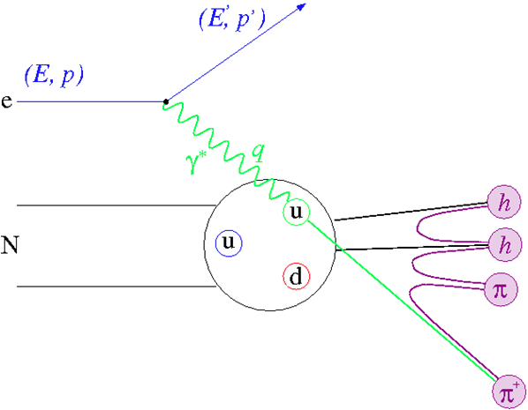
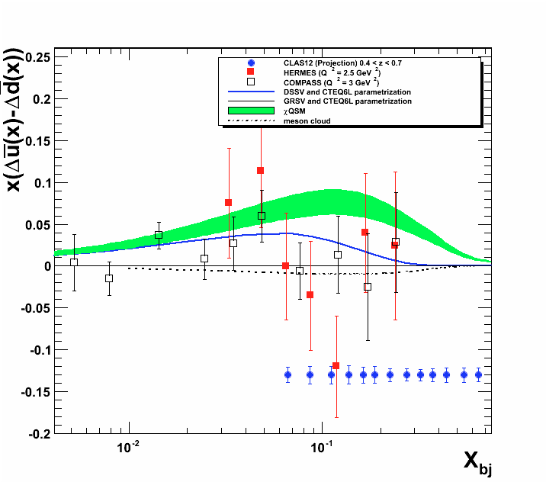
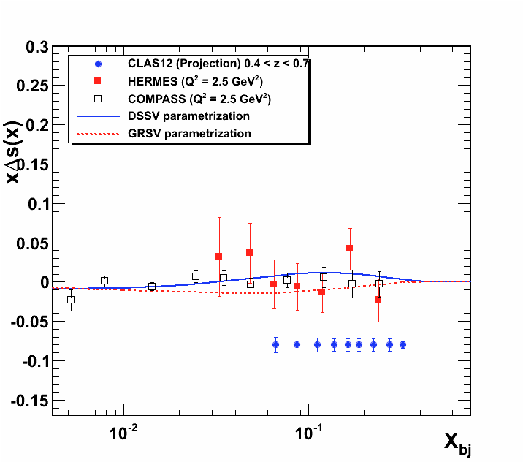
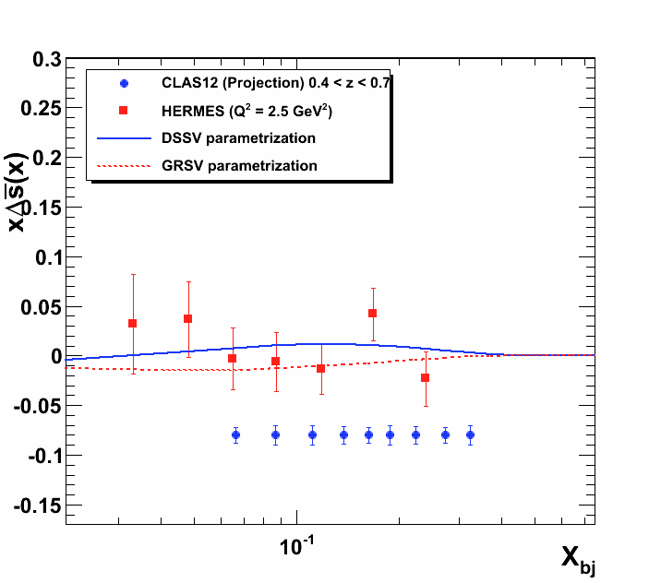
Flavor-tagged PDFs - 12GeV extension
E12-09-007
u, d, and s - flavored quark contributions to the nucleon spin are accessible from π/K SIDIS using polarized and unpolarized hydrogen and deuterium targets.
π^{+/-/0}, K^{+/-/0}

Slide 18
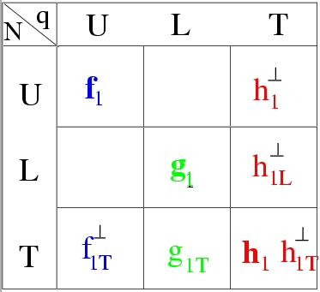
Transverse Momentum Structure of Nucleon – TMDs
(Quantum phase-space quark distribution in the nucleon)
Wigner function:
Quark spin polarization
Integrate over
spatial dimensions
Transverse Momentum-dependent Distributions (TMD)
Nucleon polarization
3D imaging of the nucleon in momentum space
JLab has a complete SIDIS program with π/K to separate the quark TMDs.
Provides access to a new set of twist-2 parton distribution function

Slide 19
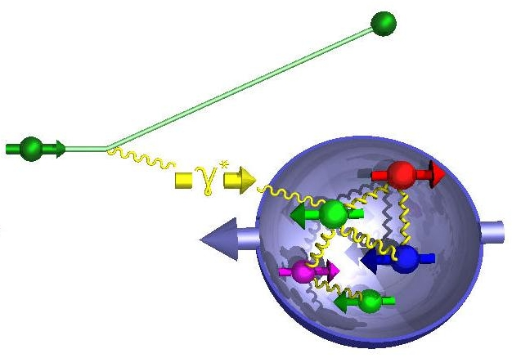
SIDIS and Transverse Momentum Distribution
SIDIS cross section:
e’
e
π,K
The 8 structure functions factorize into TMD parton distributions, fragmentation functions, and hard parts:
Integrals over transverse momentum of initial and scattered parton
A full program to access L.T. TMDs from measurements requires separation of the structure function using polarization and azimuthal dependencies, and the flavor separation in u, d, s quarks.

Slide 20
JLab TMD Proton Program @ 12 GeV
Leading twist TMD parton distributions: information on correlations between quark orbital motion and spin
CLAS12
Hall C
Hall A
Quark spin polarization
E12-06-112: π⁺,π⁻,π⁰
E12-09-008: K⁺, K⁻,K⁰
E12-09-017: π⁺,π⁻, K⁺,K⁻
C12-11-102: π⁰
HMS
SHMS
E12-07-107: π⁺,π⁻,π⁰
E12-09-009: K⁺,K⁻,K⁰
Nucleon polarization
C12-11-111: π⁺,π⁻,π⁰
K⁺, K⁻
E12-11-108: π⁺,π⁻
SOLID
H₂, NH₃, HD
H₂
NH₃
The TMD program will map the 4D phase space in Q², x, z, P_{T}

Slide 21
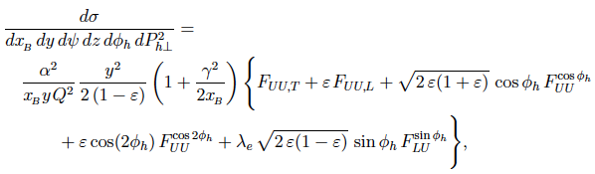
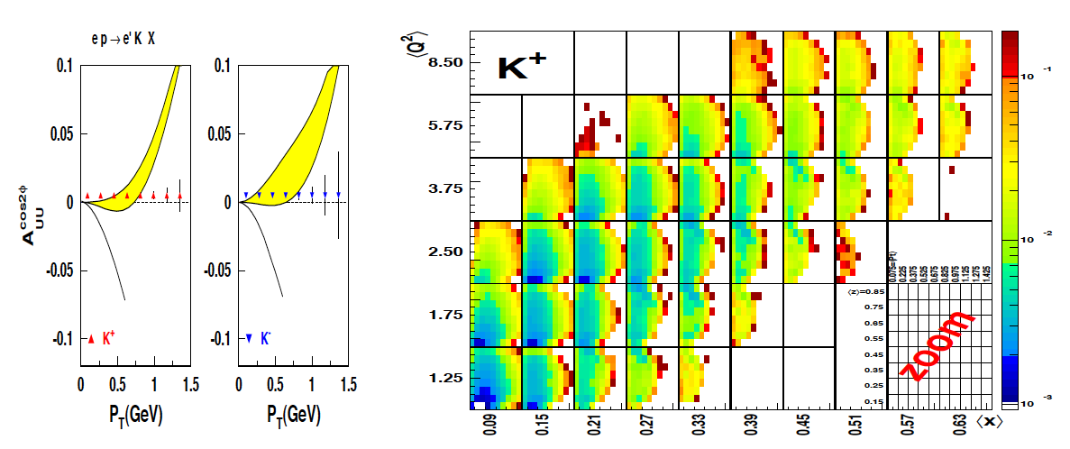
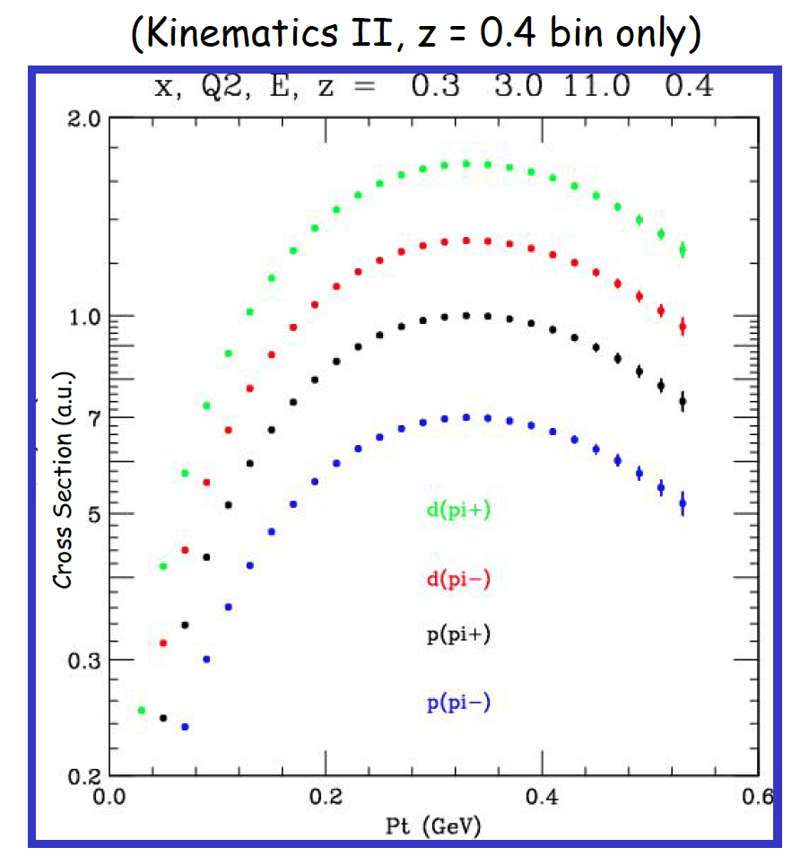
SIDIS π/K on unpolarized protons/deuterons
E12-06-112
E12-09-008
E12-09-017
Notes:
… the graphs shows the projected uncertainties of the x and Pt dependences of the asymmetry for different pion and kaon flavors.

Slide 22
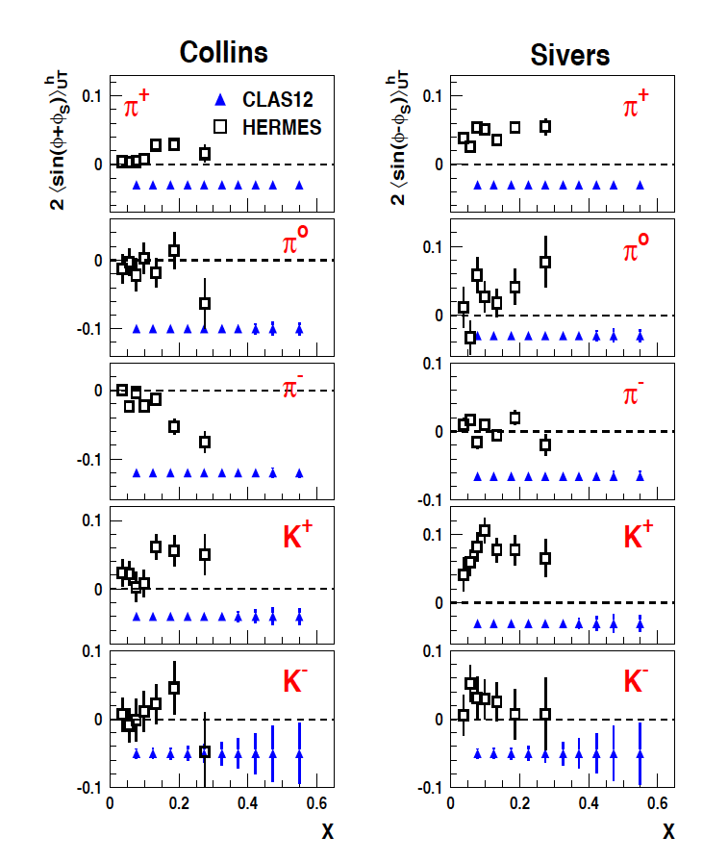
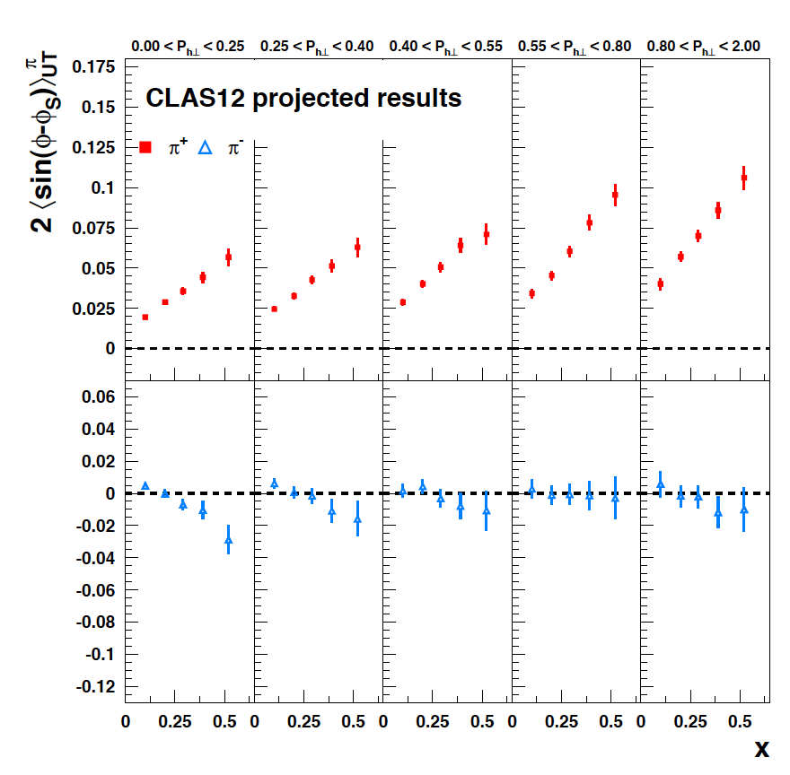
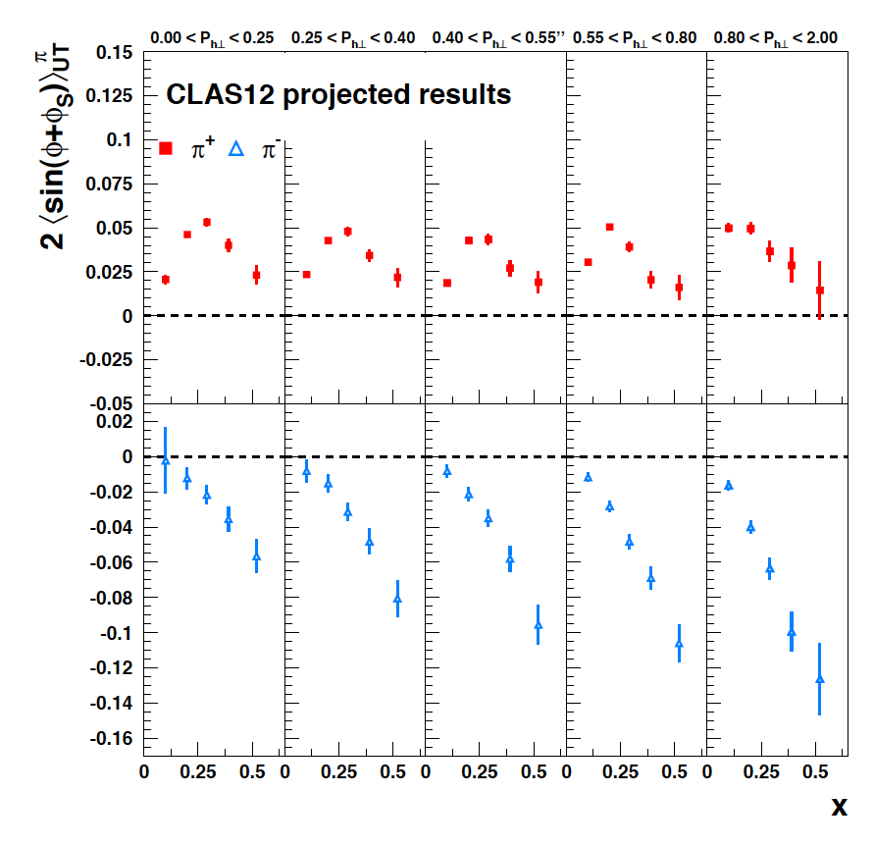
A_{UT} on transverse polarized proton
E12-11-108
C12-11-111
Collins
Sivers
High statistics allows for x-P binning
T

Slide 23
JLab TMD ³He Program @ 12 GeV
Leading twist TMD parton distributions: measures correlations of quark orbital motion and spin
Hall A
Quark spin polarization
Nucleon polarization
E12-07-007: π⁺, π⁻
Solid
E12-10-006: π⁺,π⁻
E12-09-018: π⁺,π⁻ , K⁺,K⁻
Solid
SBS
³He

Slide 24
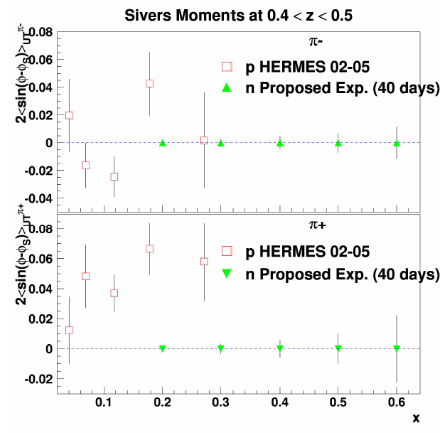
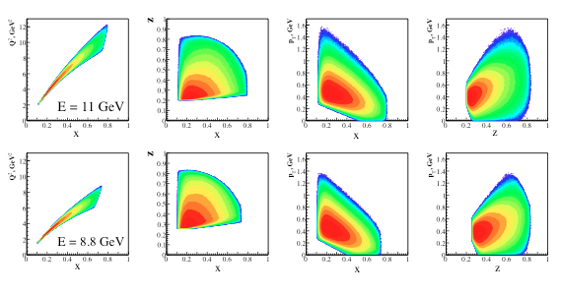
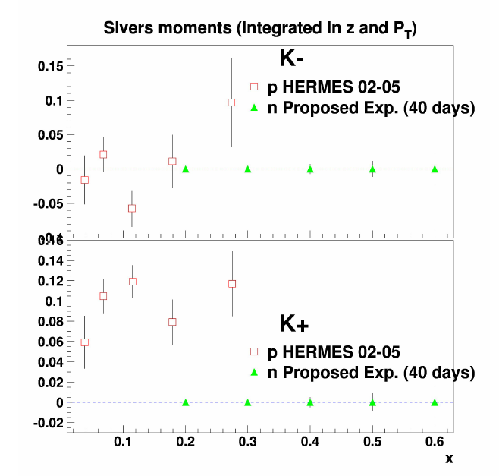
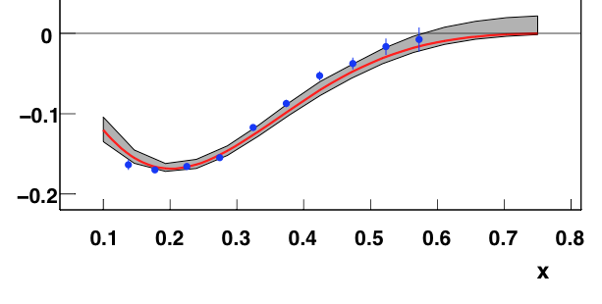
SBS/BB A_{UT} on ³He Target
³He(e,e’π^{+,-,o}), ³He(e,eK^{+,-})
Sivers asymmetry
E12-09-018

Slide 25
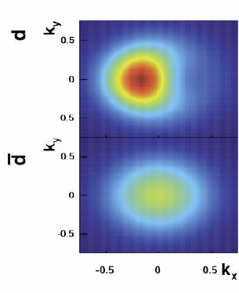
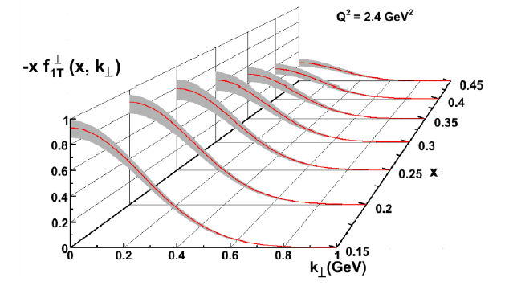
Momentum Tomography with TMDs
δk_{x}
Sivers function for d-quarks extracted from model simulations with a transverse polarized ³He target.
d-quark momentum tomography for Sivers function. The (model) d-quark momentum density shows a distortion and shift in k_{x}.
A non-zero δk_{x} value requires a non-zero orbital angular momentum.
TMDs provide input to momentum tomography of the nucleon.

Slide 26
Generalized Parton Distributions
(Quantum phase-space quark distribution in the nucleon)
Sensitivity to GPD
Integrate over transverse momentum space
~
BLP
TLP
TTP
H, H, E
~
Generalized Parton Distributions (GPD) H, H, E, E
Beam/Target polarization
H, H, E
~
~
E, H
3-D nucleon imaging in transverse coordinate and longitudinal momentum space
e.g. H(x, ξ, t, Q²)

Slide 27
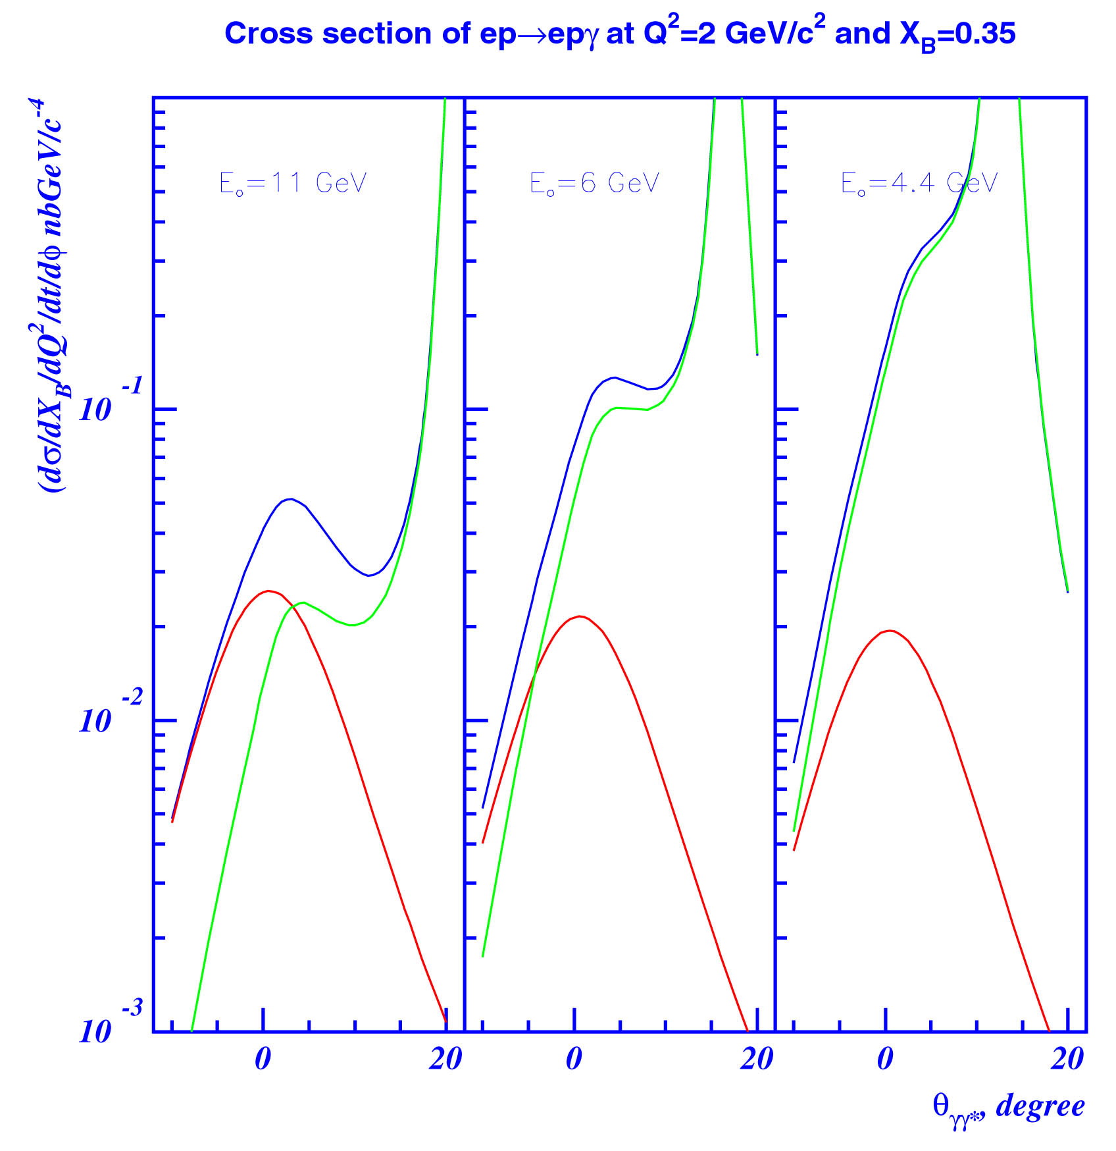
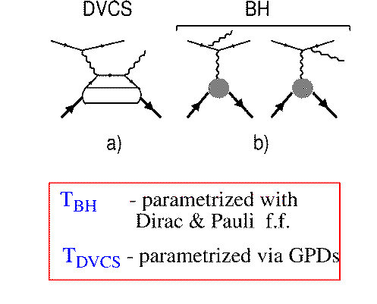
Accessing GPDs through polarized DVCS
DVCS is “cleanest” process to study GPDs
DVCS
BH
E_{o} = 11 GeV
E_{o} = 6 GeV
E_{o} = 4 GeV
d⁴σ
~ |T^{DVCS} + T^{BH}|²
dQ²dx_{B}dtdφ
BH
T^{BH :} real, given by elastic form factors
T^{DVCS}: complex, determined by GPDs
DVCS
BH-DVCS interference generates beam spin and target spin asymmetries that contain the nucleon GPDs.

Slide 28
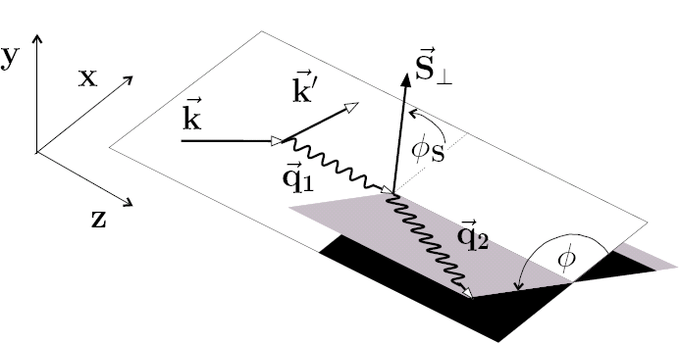
A path towards extracting GPDs
σ⁺ − σ⁻
σ⁺ + σ⁻
Δσ
2σ
ξ ~ x_{B}/(2-x_{B})
A =
=
k = t/4M²
Polarized beam, unpolarized target:
~
H(ξ,t)
Δσ_{LU} ~ sinφ {F₁H + ξ(F₁+F₂)H +kF₂E}dφ
Unpolarized beam, longitudinal target:
~
~
Δσ_{UL} ~ sinφ {F₁H+ξ(F₁+F₂)(H +ξ/(1+ξ)E)}dφ
H(ξ,t)
Unpolarized beam, transverse target:
E(ξ,t)
Δσ_{UT} ~ cosφsin(φ_{s}-φ){k(F₂H – F₁E)}dφ
Unpolarized total cross section:
Re(T^{DVCS})
Notes:
The most direct way of accessing GPDs is through polarization measurements. Using polarized electron beams we can measure the cross section difference for opposite electron helicities. The cross section difference depends on the 3 GPDs H, H-tilde, and E. The kinematical factors suppress the contributions of H-tilde and of E so that the beam spin asymmetry is dominated by GPD H. For longitudinally polarized target the asymmetry is dominated by H-tilde as H and E are kinematically suppressed at not too large xi giving access to H-tilde. With a transversely polarized target one has access to a combination of H and E. With these 3 measurements we are able to disentangle 3 GPDs H, E, H-tilde.

Slide 29

Kinematic coverage of DVCS @ 12GeV
H1, ZEUS
Probing the high x_{B} domain
requires high luminosity
H1, ZEUS
27 GeV
11 GeV
11 GeV
200 GeV
JLab Upgrade
JLab @ 12 GeV
COMPASS
W = 2 GeV
HERMES
The 12 GeV Upgrade is well matched to studies in the valence quark regime.
0.7
0.7
Notes:
The kinematics range that can be covered in exclusive processes with high precision data is shown with this yellow area. This will be the only accelerator where rhe valence quark regime can be fully covered with high precision data. other existing machines, even at much higher energies can not cover this regime due to the much lower luminosity at HERA or COMPASS.
My own personal view is that several experiments, in some of which I participated, eg EMC and E665, but also HERA, the physics, especially at high x was limited by the lack of luminosity.
Jefferson Lab has luminosity, also good spin control in both beam and targets.
So high x is (still) there for the taking and given 12 GeV, it is accessible kinematically.

Slide 30
A_{LU} projections for JLab@12GeV
~
ep --> epγ
Δσ_{LU} ~ sinφ {F₁H + ξ(F₁+F₂)H +kF₂E}dφ
A_{LU}
E12-06-119

Slide 31


DVCS with polarized e⁻ beam in Hall A
E12-06-114
=> plenary talk by C. Munoz

Slide 32

A_{UL} projections for protons - projected
e p epγ
~
Δσ_{UL} ~ sinφ {F₁H+ξ(F₁+F₂)(H +ξ/(1+ξ)E)}dφ
~
Dynamically polarized target NH₃, ND₃
L = 1x10³⁵ cm⁻²s⁻¹
T = 2000 hrs
ΔQ² = 1GeV²
Δx = 0.05
A_{UL}
E12-06-119

Slide 33

A_{UT} projections for 12GeV
ep epγ
Δσ_{UT} ~ cosφsin(φ_{s}-φ){k(F₂H – F₁E)}dφ
polarized HD
P_{p}=0.60
Dilution = 0.8
C12-12-010
cosφ
x=0.25,
Q²=2 GeV² t=-0.55 GeV²
A_{UT} and A_{LT} are sensitive to J_{u} =Σ_{u}+ L_{u} and J_{d} =Σ_{d}+ L_{d} distribution in the proton

Slide 34

CFF H from projected 12GeV data
M. Guidal, H. Moutarde, M. Vanderhaeghen, Rept.Prog.Phys. 76 (2013) 066202
Twist-2 fit to all observables: σ, A_{LU}, A_{UL}, A_{LL}, A_{Ux}, A_{Uy}, A_{Lx}, A_{Ly}
H_{Im}
E12-06-114
E12-06-119
C12-12-010
Similar sensitivity to
H_{Re}

Slide 35


CFF E from projected CLAS12 data
M. Guidal, H. Moutarde, M. Vanderhaeghen, Rept.Prog.Phys. 76 (2013) 066202
LT fit to all observables: σ, A_{LU}, A_{UL}, A_{LL}, A_{Ux}, A_{Uy}, A_{Lx}, A_{Ly}
E_{Re}
E_{Im}
In LT these are independent of Q²

Slide 36



Projected quark densities in impact parameter
Fourier transform of GPDs give access to the quark densities distribution in impact parameter space.
GPD E probes the u- and d-quark separation in impact parameter space. Transversely polarized proton shows flavor dipole.
2nd x-moment of GPDs E+H
measures total quark angular momentum J^{q} => L^{q} +Σ^{q}
Contribution of H+E
Contribution of E

Slide 37


How does QCD achieve confinement?
GPDs can provide an experimental answer by exploiting their equivalence to the gravitational form factors of the nucleon energy-momentum-tensor (fundamental nucleon properties).
mass & energy
distribution
experiment
not doable
angular
momentum
distribution
force & pressure
distribution
Gravitational form factors can be accessed through GPDs
M.V. Polyakov, PLB 555 (2003) 57

Slide 38

GPDs and Confinement Forces
projected results
d₁(t) form factor appears in 2nd x moment of GPD H
E12-06-119, E12-16-010
World data model fit result
Predicted error band
χQSM
Pressure r²p(r) (GeV fm⁻¹)
Stability requires forces compensate
Separate A(t) and d₁(t) through measurements of ξ² dependence.
r (fm)
With FT of d₁(t) we access pressure distribution on the quarks r²p(r).
There are no constraints other than integral must be = 0 for stability.
Notes:
The nucleon matrix element of the energy-momentum tensor is known to contain 3 form factors. They describe ….. and can only be measured directly in elastic graviton-nucleon scattering. However, these form factors appear as moments of the unpolarized GPDs as shown here. The quark angular momentum in the nucleon is given by the 2nd moment of the sum of GPD H and E. The mass and pressure distribution of the quarks are given by the 2nd moment of H where the pressure is probed by parameter xi.

Slide 39


Search for Physics beyond the SM
Two new experiments have been proposed to search for science beyond the SM by measuring the weak mixing angle in polarized e +e –> e + e (Møller scattering) and in parity violating e+ p -> e + X DIS, with high precision.
Møller
E12-09-005
E12-10-007
Expected precision of weak mixing angle in Qweak and proposed future experiments using polarized Møller scattering and e - DIS parity violation at 12GeV.
Notes:
Low Energy Tests of the Standard Model and Fundamental Symmetries
In future, would like to do better. Two Hall A proposals
Moller -- as the name suggests, apparatus 30 m long 1 m diameter, aspect ratio of pencil. Would advance by factor 5 on QWeak, precision comparable to LEP-SLD. Just started to discuss how to move forward with DOE; likely proposal this summer.
SOLID – Parity Violating DIS, also access higher twist.
Apparatus can be reconfigured for the ultimate SIDIS Program., significant Chinese interest.
Either or both would require substantial resources

Slide 40



Spin polarized EMC effect
Model calculations show strongly different behavior for the polarized EMC effect on polarized ⁷Li target.
E12-14-001
Unpolarized EMC effect`
EMC effect on polarized ⁷Li (projected)
R2=A||(⁷Li)/A||(p)
0.2
0.4
0.6
0.8
x
1.0

Slide 41

Search for Heavy Photon A’
HPS & APEX search for an electro-produced hidden sector photon (A’) decaying to e⁺e⁻ pairs
A’s could mediate dark matter annihilations and interactions with our matter
E12-10-009
E12-11-006
Bump
Vertex
1 GeV
2.2 GeV
4.4 GeV
Both experiment identify A’s with invariant mass and HPS also measures separated vertices.
1 week 1.1 GeV
1 week 2.2 GeV
2 week 4.4 GeV

Slide 42



Proton Radius Experiment
E12-11-106
Understand the discrepancy of different electric proton radius measurements.
Use a non-magnetic setup, and cover
Q² as low as 1x10⁻⁴ GeV², one order below previous measurements.
Components:
Open cell gas target, vacuum drift space, GEM tracker, Hybrid Cal.
online
analysis

Slide 43
Summary
The science program of the 12 GeV energy upgrade addresses many open questions in hadron physics that will challenge theory to come to a better understanding of strong QCD.
Polarized beams and targets have been essential in baryon spectroscopy and will be an important tool in the search for hybrid hadrons.
The higher energy and high luminosity polarization experiments will address part of the “spin-puzzle” and extend our knowledge of polarized parton density distribution to high x.
A comprehensive program of polarized SIDIS gives access to the TMDs and input to momentum tomography of nucleons that relate to the quark OAM.
Precision studies of DVCS in polarization measurements give access to GPDs and constrain quark OAM, and enable spatial imaging.
The GPD correspondence with the gravitational form factors are essential constraining the confining forces and the pressure distribution of quarks in the proton.
Spin polarized nuclear targets open a new avenue to study the EMC effect.
Precision experiments with high intensity polarized electron beams and additional instrumentation (MOLLER, SOLID) will allow for searches for physics beyond the SM.

Slide 44
Backup slides

Slide 45
CLAS12 A_{UU} for pions on unpolarized protons.
E12-06-112
Measures momentum distribution of transverse polarized quarks in unpolarized nucleon
4 <Q²< 5 GeV²
E12-???
Wide x and P_{T} range needed to map out phase space in longitudinal and transverse quark momentum
Notes:
… the graphs shows the projected uncertainties of the x and Pt dependences of the asymmetry for different pion and kaon flavors.

Slide 46


CLAS12 A_{UL} on longitudinally polarized target
The Kotzinian-Mulders function measures the momentum distribution of transversely polarized quarks in a longitudinally polarized nucleon.
E12-07-107
E12-09-009
Target spin
Quark spin
Only leading twist azimuthal moment for longitudinally polarized target. The sin2φ moment is sensitive to spin-orbit correlations.

Slide 47
JLab TMD D₂ Program @ 12 GeV
Leading twist TMD parton distributions: information on correlations between quark orbital motion and spin
CLAS12
Hall C
Quark spin polarization
E09-008: π⁺,π⁻,π⁰
K⁺, K⁻,K⁰
E12-09-017: π⁺,π⁻, K⁺,K⁻
C12-11-102: π⁰
HMS
SHMS
E07-107: π⁺,π⁻,π⁰
E09-009: K⁺,K⁻,K⁰
Nucleon polarization
D₂, ND₃
D₂

Slide 48
A_{UL} projections for protons - projected
e p epγ
~
Δσ_{UL} ~ sinφ {F₁H+ξ(F₁+F₂)(H +ξ/(1+ξ)E)}dφ
~
Dynamically polarized target NH₃, ND₃
L = 1x10³⁵ cm⁻²s⁻¹
T = 2000 hrs
ΔQ² = 1GeV²
Δx = 0.05
A_{UL}
E12-06-119

Slide 49

A_{LU} projections on nDVCS
For quark flavor separation DVCS on neutrons needed.
Total of 588 bins in t, Q², x_{B}, φ
t=-0.35GeV²
Q²=2.75GeV² x_{B}=0.225
A_{LU}
A_{LU} is highly sensitive to d-quark helicity content of the neutron.

Slide 50

A_{UL} projections for nDVCS
L = 3/20∙10³⁵cm⁻²s⁻¹, Time = 50 days , P_{t} = 0.4
1
0
-t
1.2
TSA ~ 0.2
First time measurement
0
-1

