Slide 1
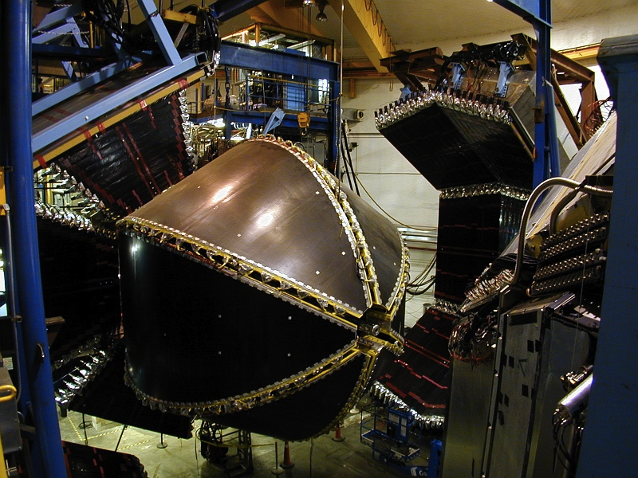
Resonant Contributions to DIS/SIDIS from γ_{v}NN* Electrocouplings
V.I. Mokeev,
Jefferson Laboratory
Precision Radiative Corrections for Next Generation Experiments

Slide 2
Input from N* studies to the Exploration of DIS Processes
Experimental results on nucleon resonance electrocouplings for all prominent nucleon resonances can be of interest for:
exploration of quark-hadron duality;
extension of the information on different inclusive and semi-inclusive structure functions towards large x_{B} in the N* excitation region;
evaluation of hadronic tensor as a part of radiative corrections for semi-inclusive and fully exclusive processes both in the DIS and the N* regions.

Slide 3
Major Directions in the Studies of N*-Spectrum and Structure with CLAS
The experimental program on the studies of N* spectrum/structure in exclusive meson photo-/electroproduction with CLAS seeks to determine:
  γ_{v}NN* electrocouplings at photon virtualities up to 5.0 GeV² for most of the excited proton states through analyzing major meson electroproduction channels
  extend knowledge on N*-spectrum and on resonance hadronic decays from the data for photo- and electroproduction reactions, in particular, with multiple mesons in the final state
A unique source of information on different manifestations of the non-perturbative strong interaction in generating different excited nucleon states as relativistic bound systems of quarks and gluons.
Review papers:
I.G. Aznauryan and V.D. Burkert, Prog. Part. Nucl. Phys. 67, 1 (2012).
I.G. Aznauryan et al., Int. J. Mod. Phys. E22, 133015 (2013).
I.C. Cloët and C.D. Roberts, Prog. Part. Nucl. Phys. 77, 1 (2014).

Slide 4
Quark Distributions in the Ground and Excited Nucleons Constrained by the Data on Elastic and Transition N→N* Form Factors
I.V. Anikin, V.M. Braun, N. Offen, Phys. Rev. D92, 014018 (2015).
V.M. Braun et al., Phys. Rev D89, 094511 (2014).
Ground
Nucleon
N(1535)1/2⁻
x_{i} stands for the momentum fraction
of i-th valence quark
Studies of the nucleon elastic and transition p→N(1535)1/2⁻ EM form factors revealed the differences
for the Quark Distribution Amplitudes in the nucleon and its chiral partner N(1535)1/2⁻ elucidating
Dynamical Chiral Symmetry Breaking.

Slide 5
Extraction of γ_{v}NN* Electrocouplings from the Exclusive Meson Electroproduction off Nucleons
Resonant amplitudes
Non-resonant amplitudes
e’
π, η, ππ, KY,…
π, η, ππ, KY,…
γ_{v}
e
*
N*,△
+
N
N’
N’
N
Real A_{1/2}(Q²), A_{3/2}(Q²), S_{1/2}(Q²)
or
G₁(Q²), G₂(Q²), G₃(Q²)
or
G_{M}(Q²), G_{E}(Q²), G_{C}(Q²)
I.G. Aznauryan and V.D. Burkert, Prog. Part. Nucl. Phys. 67, 1 (2012).
Definition of N* photo-/electrocouplings
employed in the CLAS data analyses:
Γ_{γ} stands for N* electro-
magnetic decay widths at the
photon point (Q²=0) and
W=M_{N*} on the real energy axis.
  Consistent results on γ_{v}NN* electrocouplings from different meson electroproduction channels and different analysis approaches demonstrate reliable extraction of these quantities.

Slide 6
Summary of the CLAS Data on Exclusive Meson Electroproduction off Protons in N* Excitation Region
Hadronic final state | Covered W-range, GeV | Covered Q²-range, GeV² C | Measured observables
π⁺n | 1.1-1.38 1.1-1.55 1.1-1.7 1.6-2.0 | 0.16-0.36 0.3-0.6 1.7-4.5 1.8-4.5 | dσ/dΩ dσ/dΩ dσ/dΩ, A_{b} dσ/dΩ
π⁰p | 1.1-1.38 1.1-1.68 1.1-1.39 | 0.16-0.36 0.4-1.8 3.0-6.0 | dσ/dΩ dσ/dΩ, A_{b},A_{t},A_{bt} dσ/dΩ
ηp | 1.5-2.3 | 0.2-3.1 | dσ/dΩ
K⁺Λ | thresh-2.6 | 1.40-3.90 0.70-5.40 | dσ/dΩ P⁰, P’
K⁺Σ⁰ | thresh-2.6 | 1.40-3.90 0.70-5.40 | dσ/dΩ P’
π⁺π⁻p | 1.3-1.6 1.4-2.1 | 0.2-0.6 0.5-1.5 | Nine 1-fold differential cross sections
dσ/dΩ−CM angular
distributions
A_{b},A_{t},A_{bt}-longitudinal
beam, target, and
beam-target asym-
metries
P⁰, P’ –recoil and
transferred polarization
of strange baryon
Almost full coverage
of the final hadron
phase space in
πN, π⁺π⁻p, ηp, KY electroproduction
The data on exclusive electroproduction for all listed final states are available from CLAS and
stored in the CLAS Physics Data Base http://clas.sinp.msu.ru/cgi-bin/jlab/db.cgi.

Slide 7
Approaches for Extraction of γ_{v}NN* Electrocouplings from the CLAS Exclusive Meson Electroproduction Data
Analyses of different pion electroproduction channels independently:
π⁺n and π⁰p channels:
Unitary Isobar Model (UIM) and Fixed-t Dispersion Relations (DR)
I.G. Aznauryan, Phys. Rev. C67, 015209 (2003).
I.G. Aznauryan et al., CLAS Coll., Phys Rev. C80, 055203 (2009).
I.G. Aznauryan et al., CLAS Coll., Phys. Rev. C91, 045203 (2015).
Reggeized background employing DR & Finite Energy Sum Rules: under development by JPAC
ηp channel:
Extension of UIM and DR
I.G. Aznauryan, Phys. Rev. C68, 065204 (2003).
Data fit at W<1.6 GeV, assuming S₁₁(1535) dominance
H. Denizli et al., CLAS Coll., Phys. Rev. C76, 015204 (2007).
π⁺π⁻p channel:
Data driven JLAB-MSU meson-baryon model (JM)
V.I. Mokeev, V.D. Burkert et al., Phys. Rev. C80, 045212 (2009).
V.I. Mokeev et al., CLAS Coll., Phys. Rev. C86, 035203 (2012).
V.I. Mokeev, V.D. Burkert et al., Phys. Rev. C93, 054016 (2016).
B₅ Veneziano model for 3-body background: under development by JPAC
Global coupled-channel analyses of the CLAS/world data of γ_{r,v}N , πN, ηN, ππN, KΛ, KΣ exclusive channels:
T.-S. H. Lee , AIP Conf. Proc. 1560, 413 (2013).
H. Kamano et al., Phys. Rev. C88, 035209 (2013).

Slide 8
Summary of the Results on γ_{v}pN* Electrocouplings from CLAS
Exclusive meson electroproduction channels | Excited proton states | Q²-ranges for extracted γ_{v}NN* electrocouplings, GeV²
π⁰p, π⁺n | Δ(1232)3/2⁺ N(1440)1/2⁺,N(1520)3/2⁻, N(1535)1/2⁻ | 0.16-6.0 0.30-4.16
π⁺n | N(1675)5/2⁻, N(1680)5/2⁺ N(1710)1/2⁺ | 1.6-4.5
ηp | N(1535)1/2⁻ | 0.2-2.9
π⁺π⁻p | N(1440)1/2⁺, N(1520)3/2⁻ Δ(1620)1/2⁻, N(1650)1/2⁻, N(1680)5/2⁺, Δ(1700)3/2⁻, N(1720)3/2⁺, N’(1720)3/2⁺ | 0.25-1.50 0.5-1.5
The values of resonance electrocouplings can be found in:
https://userweb.jlab.org/~mokeev/resonance_electrocouplings/
The prospect:
γ_{v}pN* electrocoupling of all prominent nucleon resonances in mass range M_{N*}<2.0 GeV will be
determined from independent analyses of Nπ, Nππ, and KY channels measured with the CLAS.

Slide 9
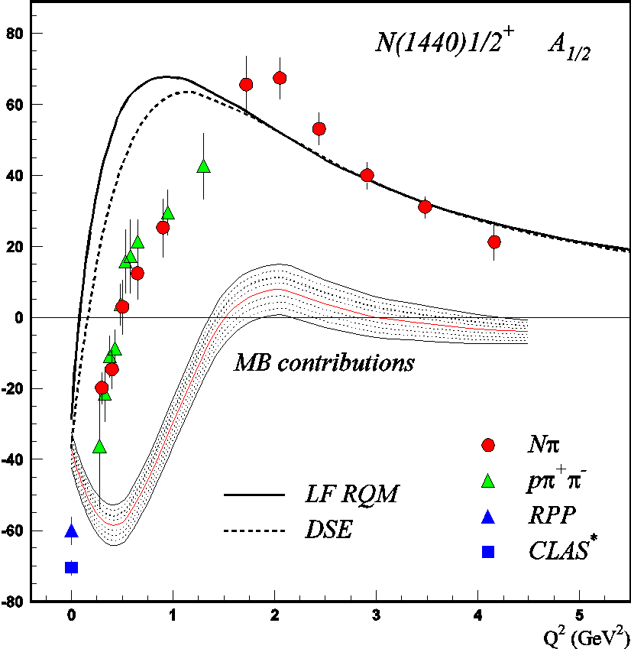
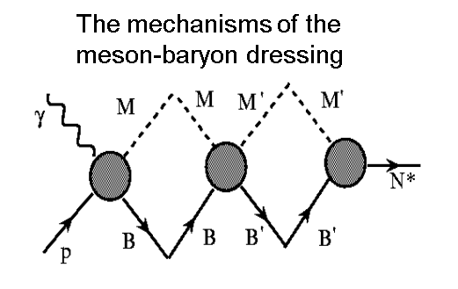
V. D. Burkert, Baryons 2016
DSE describe successfully the nucleon elastic and the transition
N→Δ(1232)3/2⁺, N→N(1535)1/2⁻ form factors with the same dressed
quark mass function (J.Segovia, et al., PRL 115, 171801 (2015)).

Slide 10
γ_{v}pN* Electrocouplings from Nπ, π⁺π⁻p, and ηp Electroproduction
H Denizli et al., Phys. Rev. C76, 015204 (2007).
I.G. Aznauryan et al., Phys. Rev. C80, 055203 (2009).
V.I. Mokeev et al., Phys. Rev . C86, 035203 (2012).
K. Park et al., Phys. Rev. C91, 052014 (2015).
V.I. Mokeev et al., Phys. Rev . C93, 054016 (2016).
  Consistent values of resonance electrocouplings from analyses of Nπ/ π⁺π⁻p and Nπ/Nη exclusive channels strongly support:
  reliable electrocoupling extraction;
  capabilities of the reaction models to obtain resonance electrocouplings in independent analyses of these channels;
  First results on electrocouplings of the 3rd
  resonance region N* states have become available

Slide 11
Electrocouplings of the Excited States in the Third Resonance Region from the CLAS π⁺π⁻p Electroproduction Data
V.I. Mokeev and I.G. Aznauryan., Int. J. Mod. Phys. Conf. Ser. 26. 146080 (2014)
V.I. Mokeev et al.,
PRC 93, 054016 (2016)
Δ(1700)3/2⁻
A_{1/2}
Δ(1620)1/2⁻
S_{1/2}
N(1720)3/2⁺
A_{3/2}
Independent fits in different W-intervals:
green: 1.51<W<1.61 GeV red: 1.61<W<1.71 GeV black: 1.71<W<1.81 GeV
magenta: 1.56<W<1.66 GeV blue: 1.66<W<1.76 GeV
The π⁺π⁻p electroproduction is the major source of the information on electrocouplings of the N* states in the 3rd resonance region which decay preferentially to the Nππ final states.
The electrocouplings of Δ(1620)1/2⁻, N(1650)1/2⁻, N(1680)5/2⁺, Δ(1700)3/2⁻, and N(1720)3/2⁺ resonances have become available from the π⁺π⁻p electroproduction off protons for the first time.

Slide 12
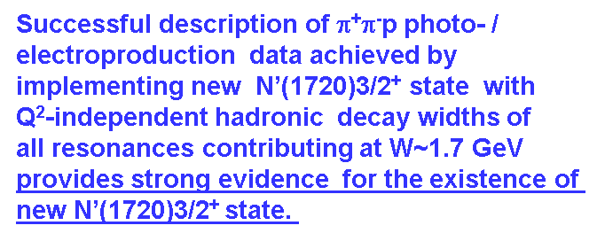
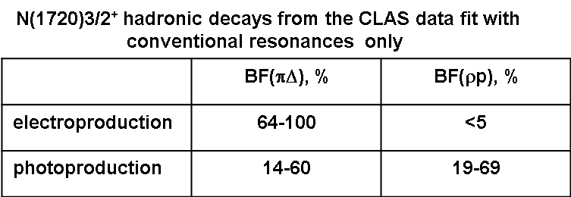
Further Evidence for the Existence of the New State N’(1720)3/2⁺ from Combined π⁺π⁻p Analyses in both Photo- and Electroproduction
V.I. Mokeev, et al, Eur. Phys. J, Web Conf. 113. 01013 (2016)
Almost the same quality of the photo-/electroproduction data fit was achieved with and without N’(1720)3/2⁺ new state BUT:
The contradictory BF values for N(1720)3/2⁺ decays to the πΔ and ρp final states deduced from photo- and electroproduction data make it impossible to describe the data with conventional states only.
N* hadronic decays from the data fit that
incorporates the new N’(1720)3/2⁺ state
Resonance | BF(πΔ), % | BF(ρp), %
N’(1720)3/2⁺ electroproduction photoproduction | 47-64 46-62 | 3-10 4-13
N(1720)3/2⁺ electroproduction photoproduction | 39-55 38-53 | 23-49 31-46
Δ(1700)3/2⁻ electroproduction photoproduction | 77-95 78-93 | 3-5 3-6

Slide 13
The Parameters of N’(1720)3/2⁺ New State from the CLAS Data Fit
Different photo-/electrocouplings of N’(1720)3/2⁺ and conventional N(1720)3/2⁺ states
N’(1720)3/2⁺
Almost the same masses and widths
Resonance | Mass, GeV | Total width, MeV
N’(1720)3/2⁺ | 1.715-1.735 | 120±6
N(1720)3/2⁺ | 1.743-1.753 | 112±8
N(1720)3/2⁺
New π⁺π⁻p electroproduction data from CLAS will elucidate the differences in the structure
of the regular N(1720)3/2⁺ and new N’(1720)3/2⁺ states for the first time

Slide 14

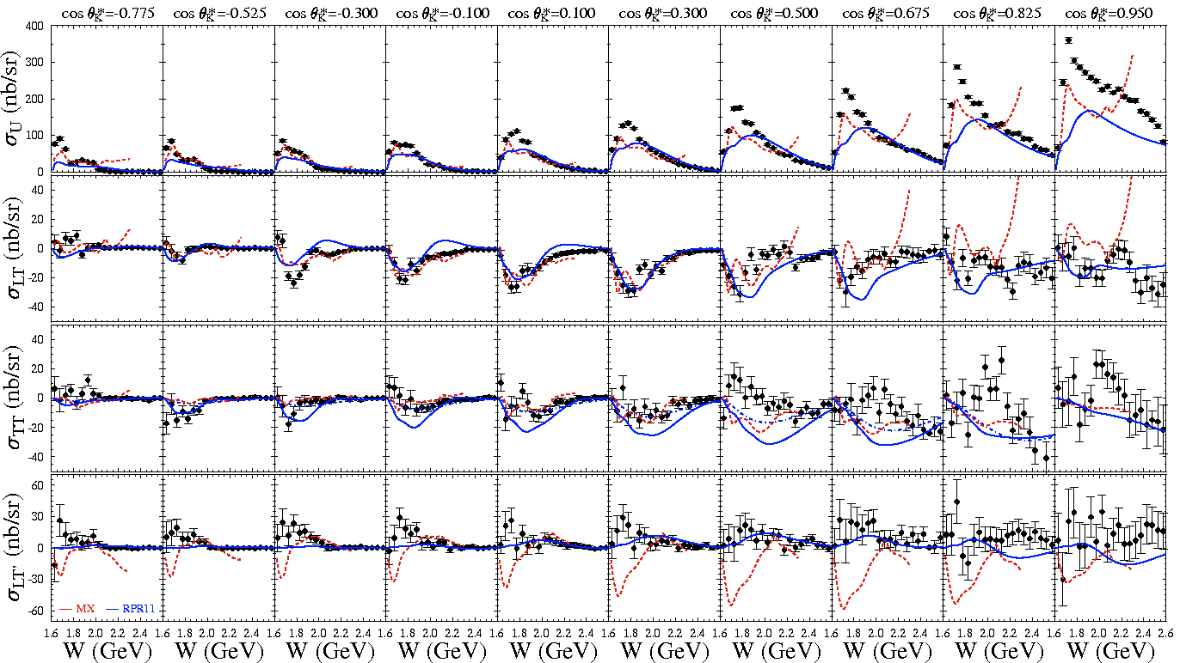
K⁺Λ Structure Functions
E = 5.5 GeV, W: thr – 2.6 GeV, Q² = 1.80, 2.60, 3.45 GeV²
[Carman et al., PRC 87, 025204 (2013)]

Slide 15
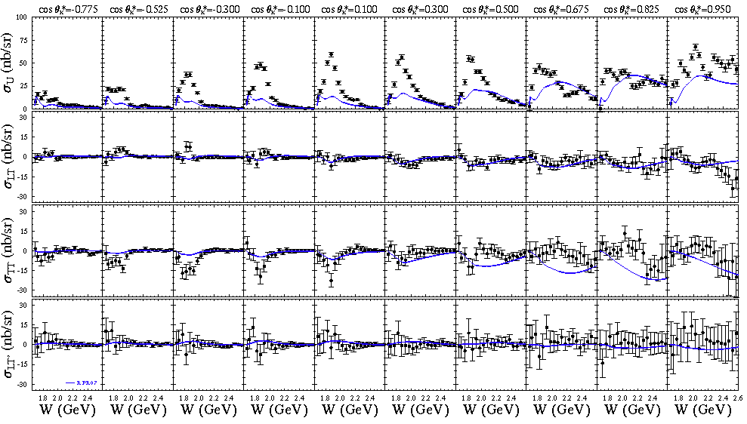
K⁺Σ⁰ Structure Functions
E = 5.5 GeV, W: thr – 2.6 GeV, Q² = 1.80, 2.60, 3.45 GeV²
[Carman et al., PRC 87, 025204 (2013)]

Slide 16

Signals from N* states in the CLAS KY electroproduction data
Q²=1.8 GeV²
Q²=2.6 GeV²
Q²=3.45 GeV²
3/2 ⁻ 5/2⁻
(1950)
KΛ
the structures in W
dependencies of C_{l} –moments at the same W-values in all Q²-bins are consistent with the contributions from resonances of spin-parities listed in the plots
1/2 ⁺3/2⁺
(1850)
1/2⁺3/2⁺
(2000)
KΣ
The electrocouplings
of high-lying N* from
analyses of KY electro-
production will allow us to
check their values available
from other channels in almost
model independent way
KΣ
3/2⁻5/2⁻
(2050)
W GeV

Slide 17
Interpolation/Extrapolation of the CLAS Results on γ_{v}pN* electrocpouplings
N(1440)1/2⁺
A_{1/2}
N(1440)1/2⁺
S_{1/2}
N(1720)3/2⁺
A_{3/2}
N’(1720)3/2⁺
A_{3/2}
The CLAS results on γ_{v}pN* electrocouplings for the excited states in mass range up to 1.8 GeV are
interpolated/extrapolated at 0.GeV² <Q² < 5.0 GeV² (userweb.jlab.org/~isupov/couplings/).
The Fortran code for computation of the interpolated electrocoupling values are available upon request
(E.L.Isupov, isupov@jlab.org)

Slide 18
Resonant Contributions to Exclusive, Semi- Inclusive, and Inclusive Processes
Resonant amplitude in exclusive γp→MB channel :
α,β label the N* states included, sum over repetitive α and β is assumed.
Resonance electroproduction f _{α γp} and hadronic decay f _{β MB} amplitudes
are related to the γ_{v}pN* electrocouplings and partial N* hadronic decay
width Γ_{β} (V.I. Mokeev, et al., PRC 86, 035203 (2012) )
N*_{α}
N*_{α}
diagonal
Inverse of the unitarized resonant propagator:
N*_{α}
N*_{β}
off-diagonal
Accounting for the transition between the same and
different N* states makes the resonant amplitude
consistent with the restrictions imposed by a general
unitarity condition the most advanced version
of the Breit-Wigner ansatz.
N(1535)1/2⁻ ↔ N(1650)1/2⁻
N(1520)3/2⁻ ↔ N(1700)3/2⁻
N’(1720)3/2⁺ ↔ N(1720)3/2⁺
The resonant contribution to semi-inclusive and inclusive processes can be evaluated by summing
up the described above resonant amplitudes over all contributing meson-baryon channels.

Slide 19
Evaluated Resonant Contributions to Exclusive π⁺π⁻p Electroproduction off Protons
Preliminary
Preliminary
Relative resonant contributions increase with Q²
Tails from the resonant contribution may become relevant in DIS region as Q² increases

Slide 20
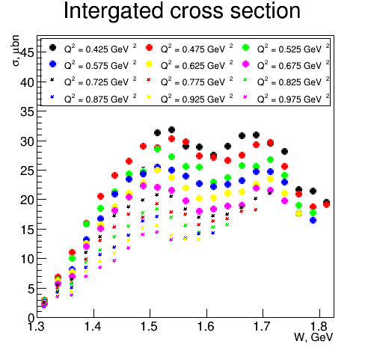
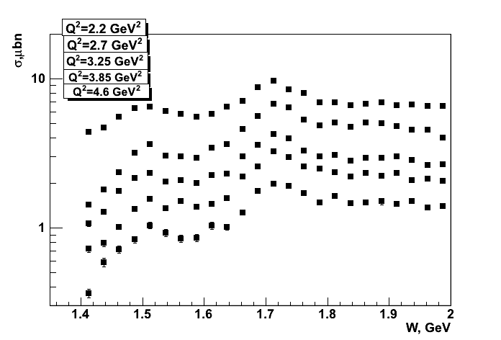
Extension of the CLAS π⁺π⁻p Electroproduction Data
Fully integrated π⁺π⁻p electroproduction cross
sections off protons
Nine 1-fold differential cross sections are
available In each bin of W and Q² shown in
the plots.
Resonance structures are clearly seen at
W ~1.5 GeV and ~1.7 GeV at 0.4< Q²< 5.0 GeV²
(red lines) .
R.W.Gothe,
G.V.Fedotov,
USC/MSU
Analysis objectives:
Extraction of γ_{v}pN* electrocouplings and πΔ, ρp decay widths for most N*s in mass range up to 2.0 GeV and 0.4< Q²< 5.0 GeV² .
Exploration of the new N’(1720)3/2⁺ candidate-state (V.I. Mokeev et al., Eur. Phys. J. Web Conf. 113, 01013 (2016)).
Search for others new states suggested by the global analysis of exclusive meson photoproduction (A.V. Anisovich et al., Eur. Phys. J. A48, 15 (2012)) in condition of increasing relative resonant contribution with Q².
E.L. Isupov, K.Hicks
MSU/Univ. of Ohio

Slide 21
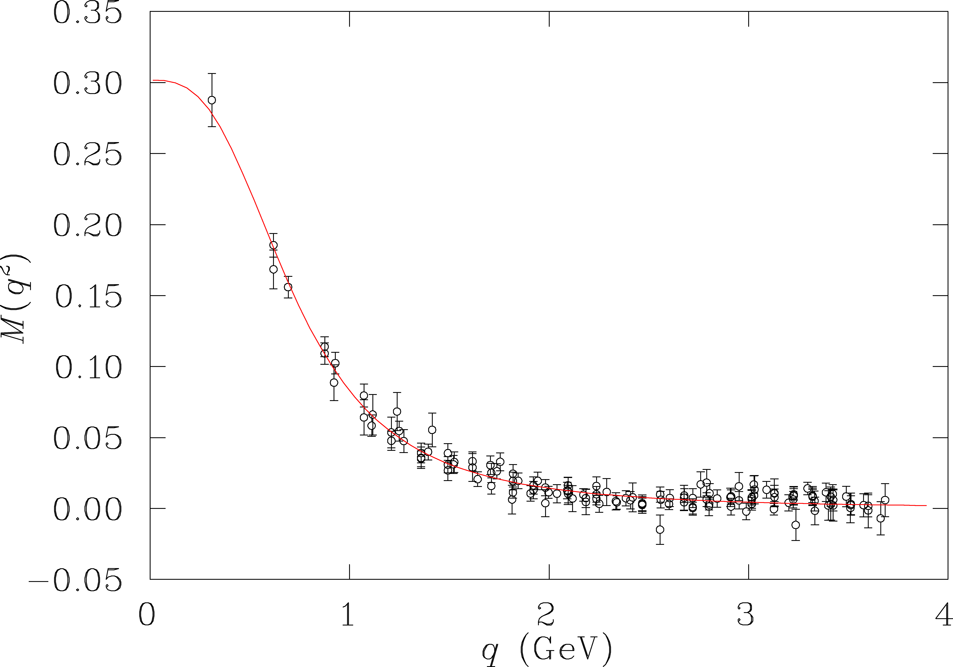
Resonance Transitions with the CLAS12
12 GeV experiments, E12-09-003, E12-06-108A, will extend access to electrocouplings for all prominent N* states in the range up to Q²=12GeV².
Resonance electrocouplings in regime of quark core dominance can be related to the running quark masses and their dynamical structure.
accessible
at 6 GeV
LQCD
DSE
quark mass (GeV)
accessible
at 12 GeV
Probe the transition from confinement to pQCD regimes, allowing us to explore how confinement in baryons emerge from QCD and how >98 % of baryon masses are generated non-perturbatively via dynamical chiral symmetry breaking.

Slide 22
Development of the Reaction models with Explicit Implementation of Quark Degrees of Freedom for Extraction of γ_{v}pN* Electrocouplings at Q²>5.0 GeV²
Modeling of the amplitudes other than photon-proton s-channel resonances for the exclusive
Nπ, KY, πΔ, and ρp electroproduction at Q² up to 12 GeV² from minimal accessible W<2.0 GeV
to 3.0 GeV. The models should account for:
a) hard processes in terms of diagrams with factorized explicit quark degrees of freedom;
b) relevant soft contributions in terms of meson-baryon degrees of freedom.
Adjustment of the reaction model parameters to all measured with the CLAS observables at
Q²>3.0 GeV²
γ
M
γ
M
γ
M
full
=
α
MB
d.o.f.
quark
d.o.f.
+
β
p
B
p
B
p
B
M = π, K, ρ
B = N/Δ, Y, p
α + β = 1
The most urgent task for theory support of the upcoming experiments on the N*
structure studies with CLAS12!
V.I. Mokeev, ECT* 2015 Workshop on Nucleon Resonances, October 12-16, 2015

Slide 23
Conclusions and Outlook
The experimental results on γ_{v}pN* electrocouplings available from the CLAS for most excited nucleon states in the mass range up to 1.8 GeV and at Q² up to 5.0 GeV² can be used in:
Exploration of quark-hadron duality;
Evaluation of different inclusive and semi-inclusive structure functions at large x_{B} in the resonance region;
The modeling of hadronic tensor for radiative corrections in the resonance region.
In the near term future the γ_{v}pN* electrocouplings will be obtained from the CLAS meson electroproduction data for most excited states in the mass range up to 2.0 GeV and at Q² up to 5.0 GeV².
Input from DIS community is needed on the optimal way for delivery of the results on the resonant contribution to inclusive, semi-inclusive and exclusive processes: i.e. stored resonant amplitudes for
relevant meson-baryon channels and/or their bi-linear combinations that describe the resonant contributions to the observables.
From the future experiments with the CLAS12 detector, the resonance electrocouplings will be available at Q² up to 12 GeV² for most excited states including possible new states of baryon matter (hybrid baryons, ``missing” resonances) in the mass range up to 3.0 GeV.
The models for the non-resonant contributions to exclusive π⁺n, π⁰p, KY, πΔ, ρp electroproduction at W<2.0 GeV and 5 GeV²<Q²<12 GeV² that incorporate quark degrees of freedom are urgently needed and greatly appreciated support from the DIS community in order to facilitate the extraction of the γ_{v}pN* electrocouplings from the future data with CLAS12.

