Slide 1
The Nucleon Spin STructure Program With CLAS and CLAS12
Sebastian Kuhn, Old Dominion University
What have we learned and what will we learn about
ΔΣ, Bjorken Sum Rule, and their real photon limits (GDH, γ₀)
Higher Twist, χPT, quark-hadron duality, spin structure of resonances
Δu, Δd (x →1)
Δs and ΔG at moderately large x
Nuclear binding modifications
through experiments at 1-6 GeV with CLAS and 11 GeV with CLAS12?
Tools: inclusive double spin asymmetries, p_{T} – integrated SIDIS π and K double spin asymmetries; longitudinally polarized H, D and ⁷Li targets, and polarized electron beam

Slide 2
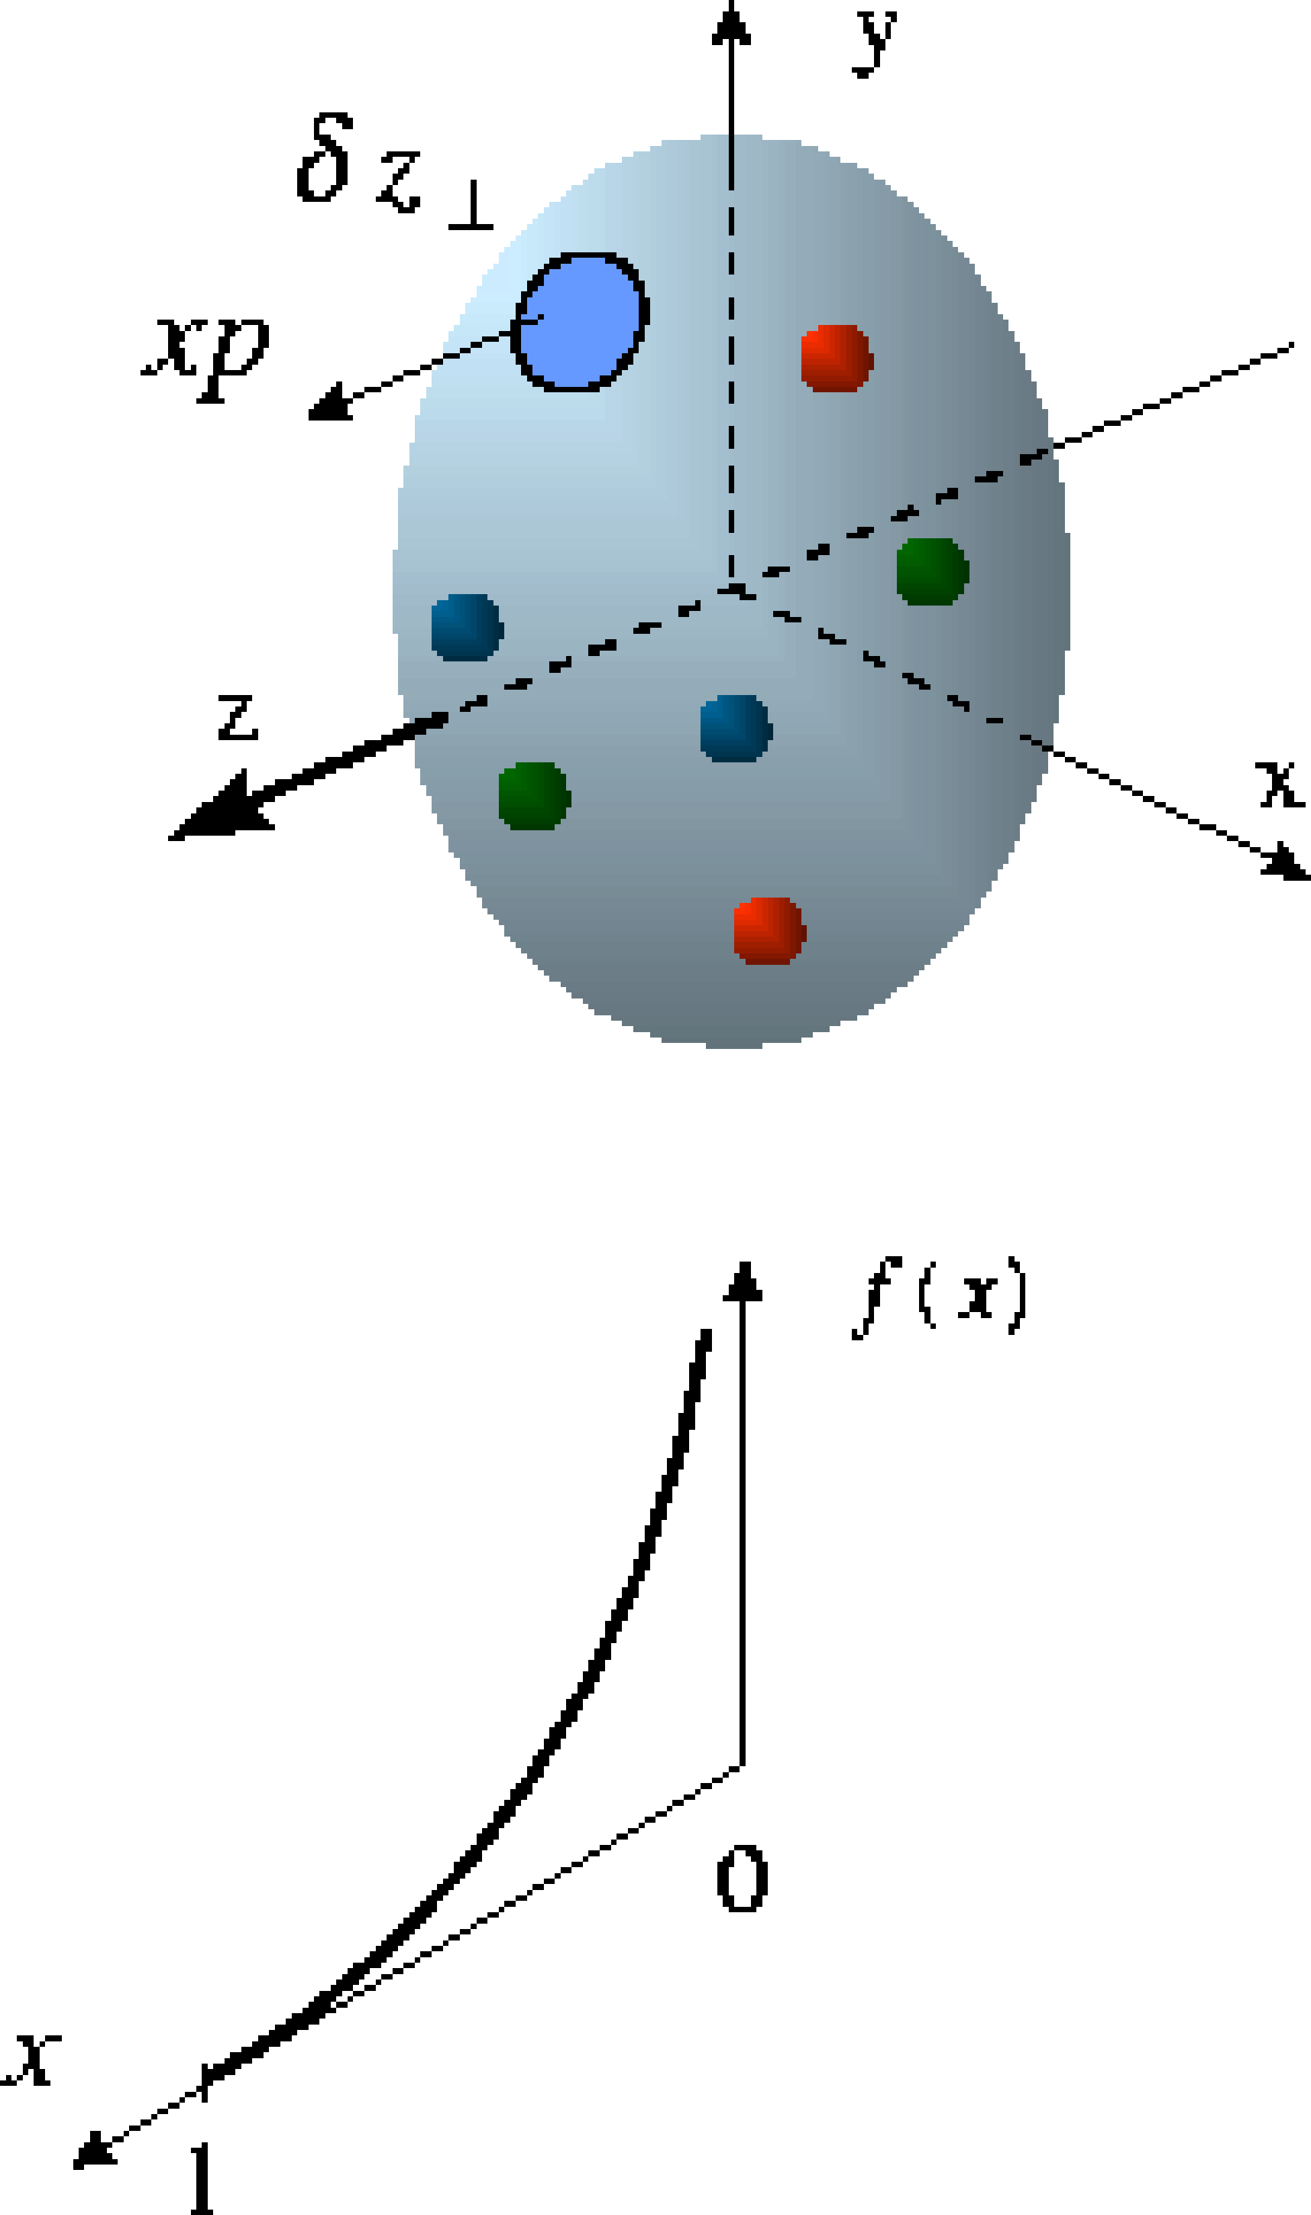
Reminder:
Inclusive lepton scattering off spin ½ object
Parton model
Callan-Gross
Wandzura-
Wilczek
Cross section difference:
p
H
Asymmetry:
Notes:
Spell out “SIDIS”

Slide 3
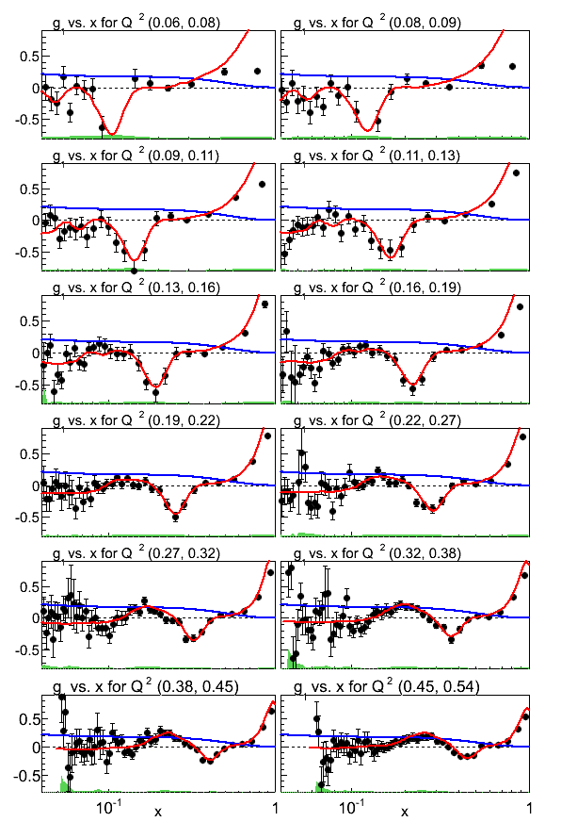
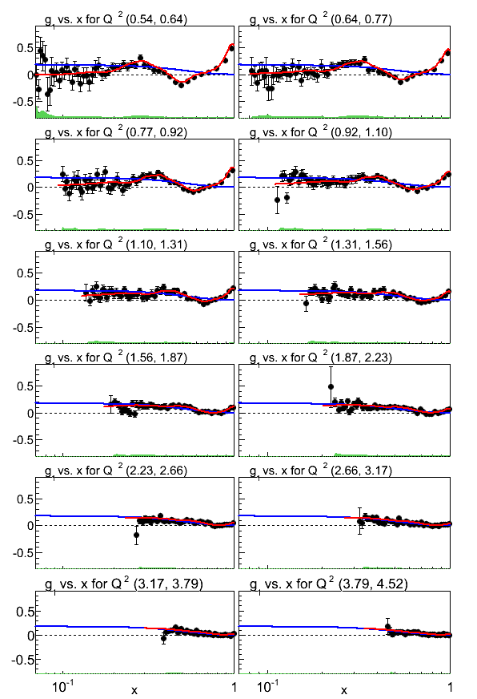
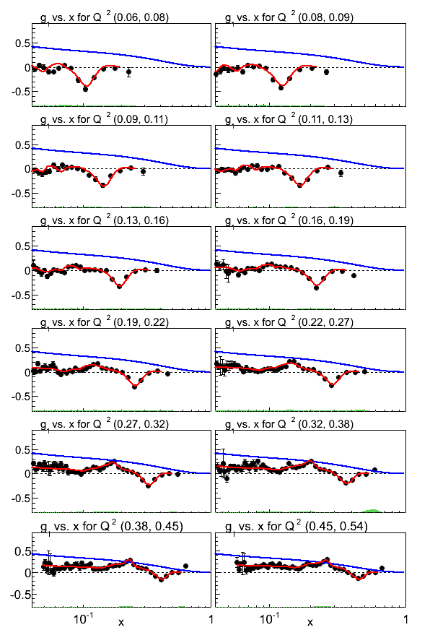
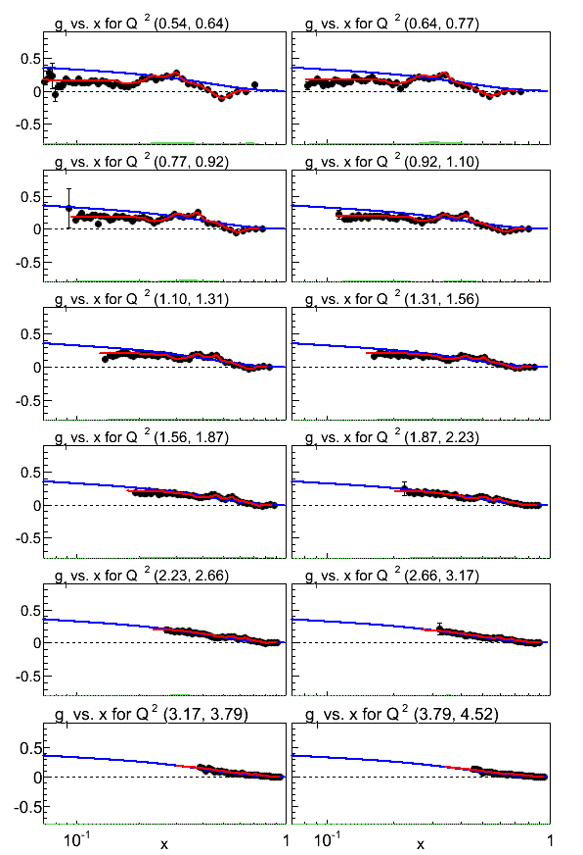
The SF g₁ – recent results
EG1
Neutron
EG1
Deuteron
EG1
Proton
EG1-dvcs Proton
EG1-dvcs Deuteron
Notes:
K. Adhikari Next talk

Slide 4
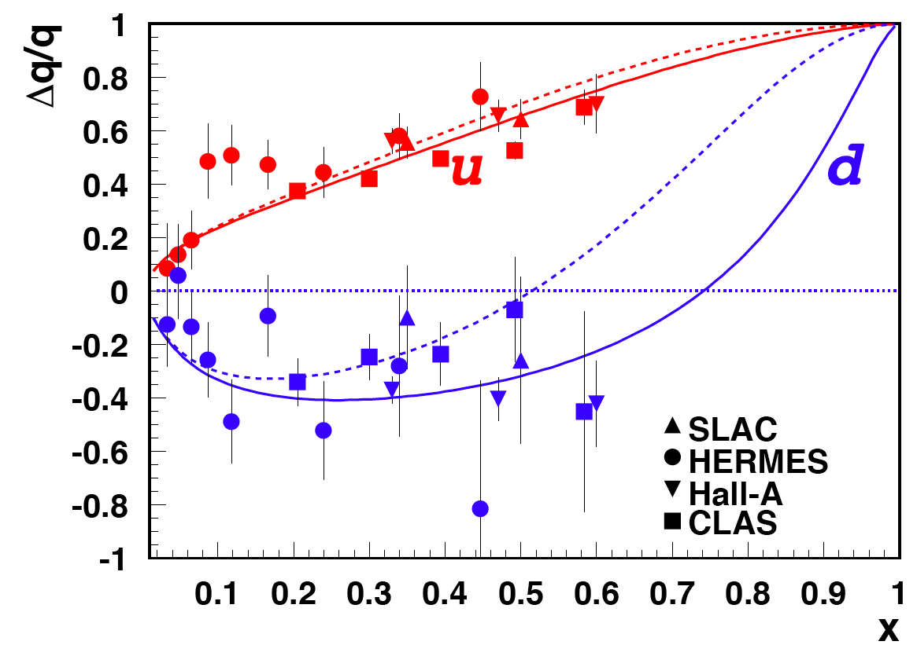
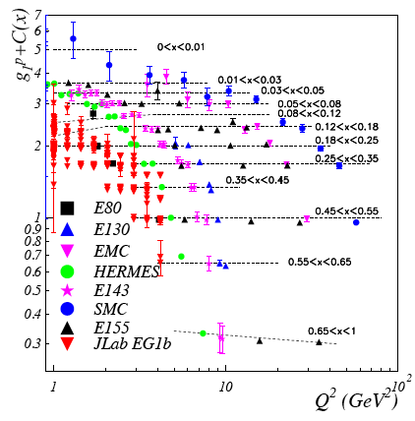
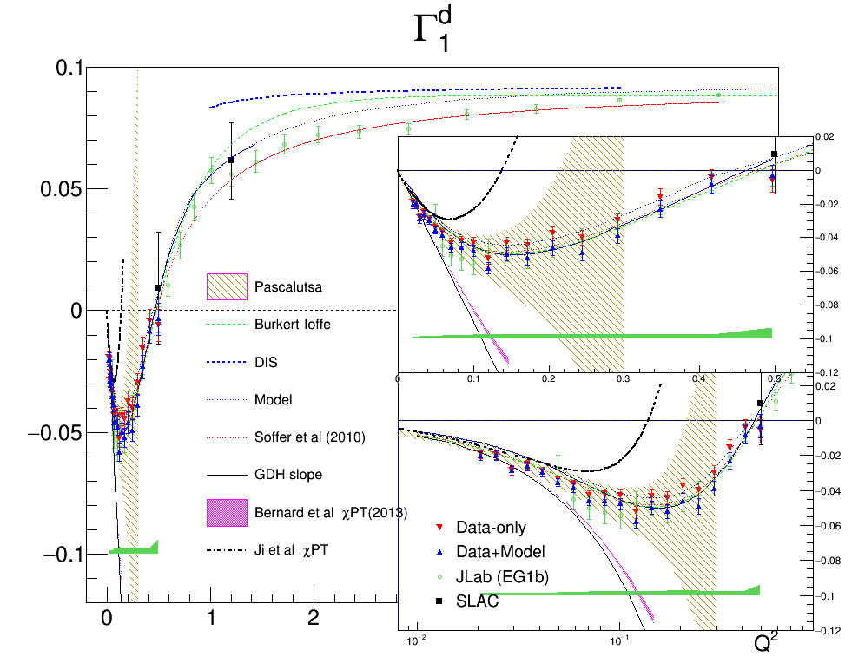
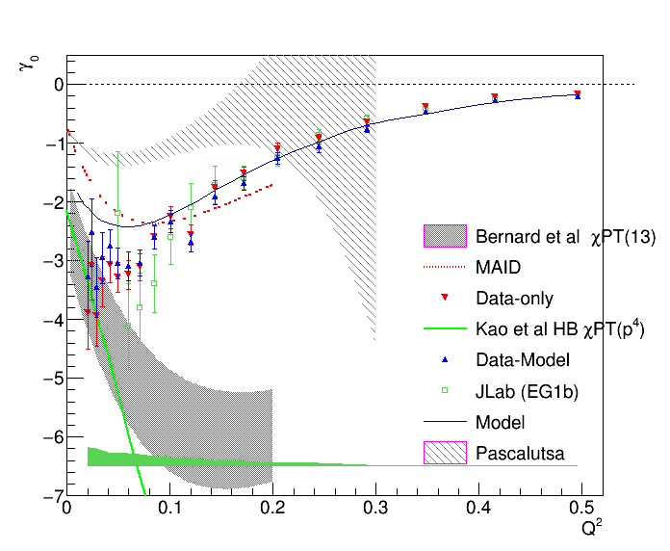
present situation
“h.H”
g₁
Notes:
Show integrals, HT, Duality

Slide 5
JAM
Coll.

Slide 6
What’s Missing?
Δu/u and Δd/d at high x still poorly constrained
What is happening with the strange sea polarization?
>0? =0? <0? Zero crossing? (Tension DIS – SIDIS)
Is the sea polarization isospin-symmetric? (note: we already know )
Gluon helicity distribution at large x and a small x? What is the integral ΔG?
What happens at really small x << 0.01?
… and where is the rest of the nucleon spin? (only 30-40% explained by quark helicities)
Orbital angular momentum of quarks, total angular momentum carried by gluons…
Notes:
Explain why d is uniquely suited for this: d-quarks from n (least possible nuclear effects), s quarks from Kaon asymmetries (u and d normally dominate but cancel largely for D), Gluons from DGLAP -> requires large leverarm in Q2, good control of HT and isoscalar target to minimize contribution from non-singlet evolution

Slide 7
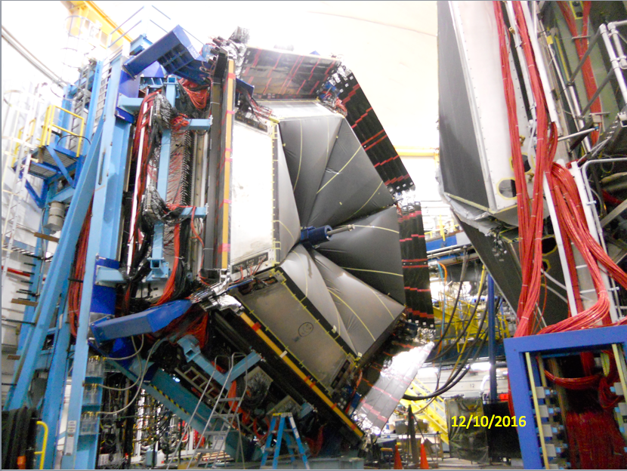
12 GeV in Hall B
E12-06-109, E12-06-119b, E12-07-107, E12-09-007b, E12-09-009 approved for 120 « PAC days » on H and 50 « PAC days » on D
CLAS12
VERY large acceptance
Full PID (K and π)
(K ID with new RICH)
Moderately high luminosity (10³⁵ cm⁻²s⁻¹)
(matched to NH₃, ND₃)
Polarized Target
Standard DNP longitudinal NH₃, ND₃ targets (and ⁷Li) Horizontal ⁴He evaporation cryostat
5 T B-field provided by central detector
Double-cell design to minimize false asymmetries

Slide 8
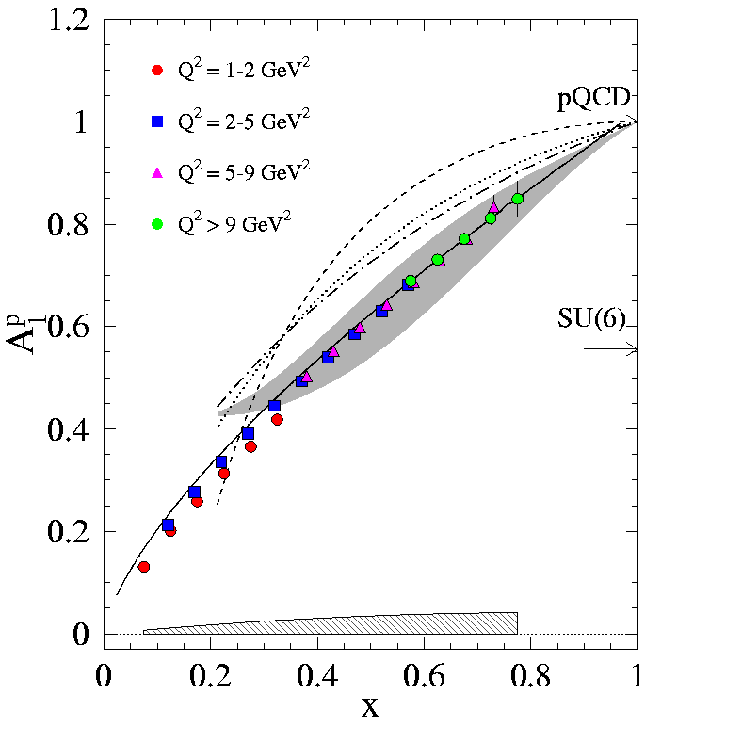
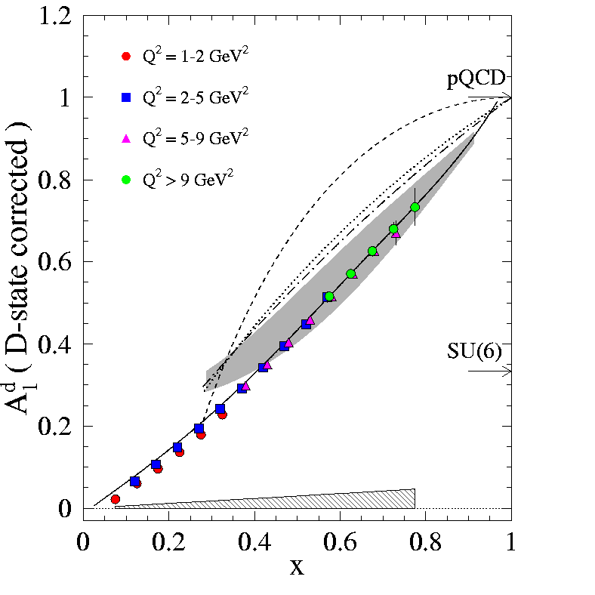
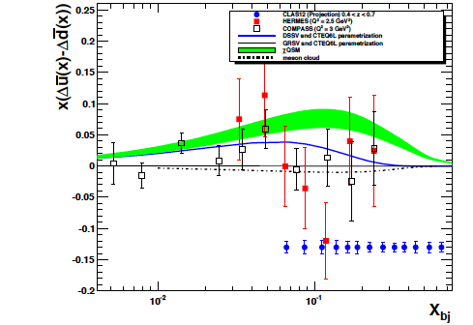
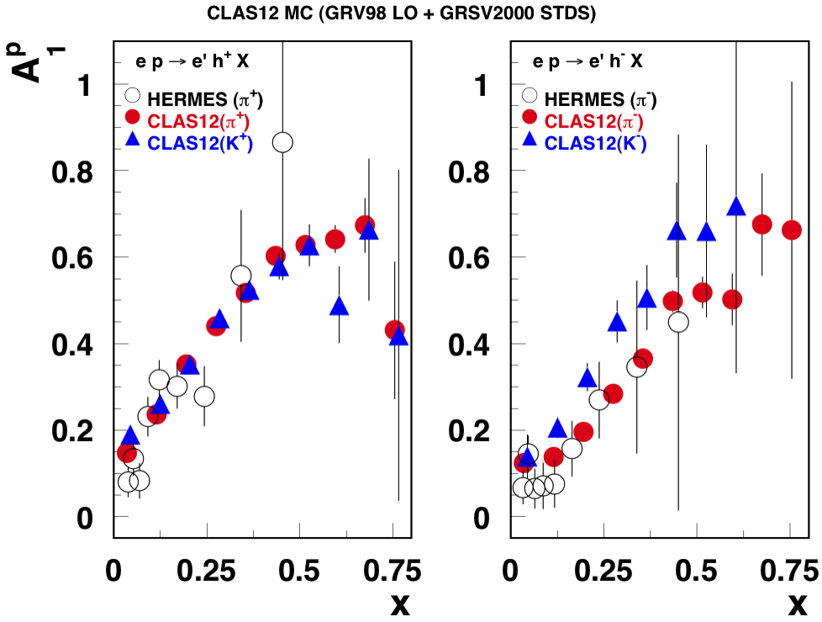
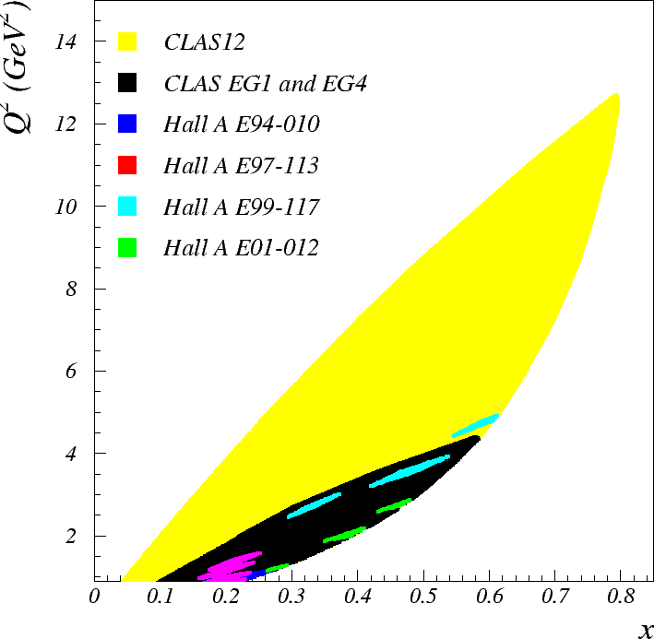
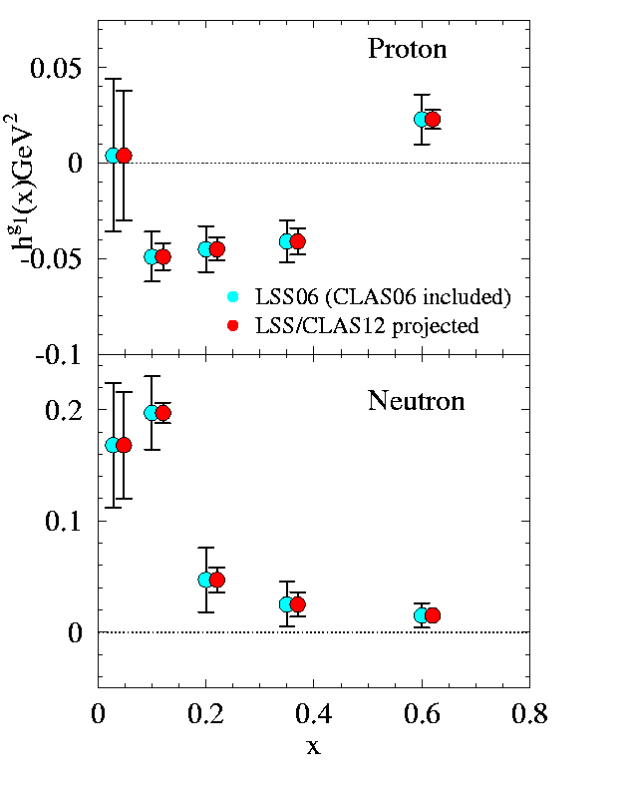
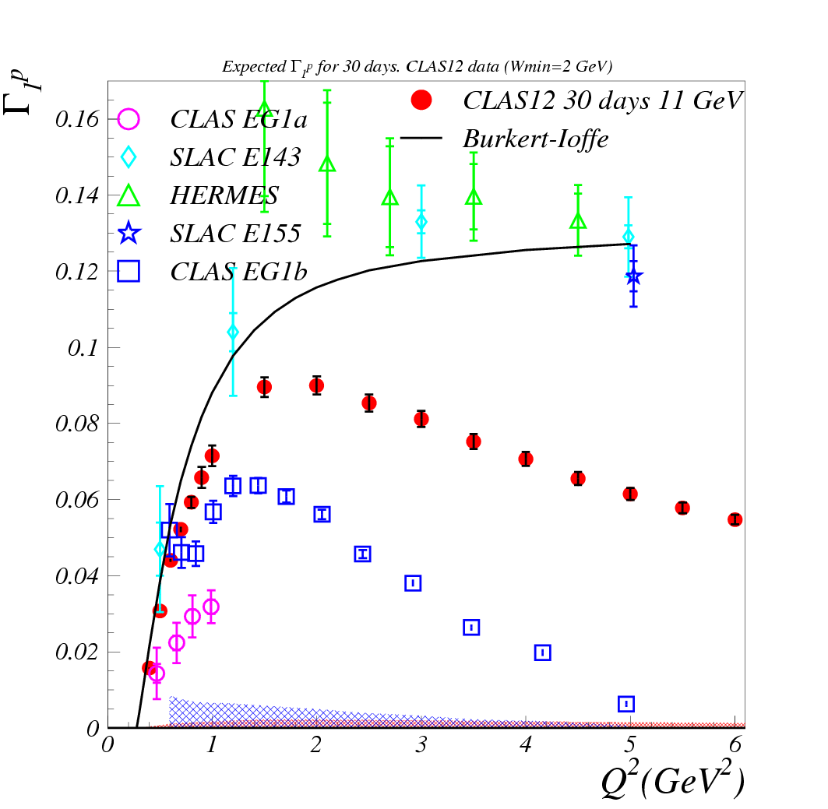
Inclusive + Tagged SSF – Hall B
SIDIS A₁
W > 2
Proton
Deuteron
h⁺
h⁻
Greater
x-coverage
for Γ₁
Kinematic Coverage (DIS)
Better determination of Higher Twist vs. x
Improved coverage to
evaluate moments

Slide 9
Delta-D / D
Δu⁺
Δd⁺
50 days on ND3

Slide 10
Polarized EMC EFFect
E12-14-001 Approved for 50 days with 11 GeV beam and 5 days for auxiliary measurements
Compare polarized ⁷Li with polarized p
Δσ Ratio
A|| Ratio

Slide 11
Summary
Collinear Spin Structure Functions remain fundamental for our understanding and provide an important benchmark for the coming 3D picture of the nucleon
Large body of experimental data from CLAS in the 6 GeV era at low to moderate Q²
  Constrain quark PDFs in the valence region
  Study transition from the scaling limit to the photon limit
  Test OPE, duality and χPT
Extensive program of inclusive and semi-inclusive measurements ahead with CLAS12
  Complete picture at high x, anchor DGLAP analyses (including higher twist) at low Q², and get more information on flavor-separated quark/gluon PDFs
  Extend precision measurements of moments over a larger part of the x-Q² plane
  Study nuclear modifications of the spin structure of the nucleon

Slide 12
Extras
What about Δs?

