Slide 1



Results from the JLab CLAS EG4 experiment
M. Ripani
INFN Genova

Slide 2
The EG4 experiment Group
Main goal: measurement of the generalized Gerasimov-Drell-Hearn (GDH) sum
for the proton and deuteron at low Q².
E03-006 (NH₃):
Spokespeople: M. R., M. Battaglieri, A.Deur, R. de Vita
Students: H. Kang (Seoul U.), K. Kovacs✦ (UVa)
E06-017 (ND₃)
Spokespeople: A.Deur, G. Dodge, M. R., K. Slifer
Students: K. Adhikari✦ (ODU)
EG4 ran from Feb. to May 2006.
Main goal: inclusive analyses. Also, exclusive analysis by X. Zheng^{(♣)}
✦ Graduated
(♣) X. Zheng et al. (CLAS Collaboration), PRC 94, 045206 (2016)

Slide 3
The GDH and Generalized GDH Sum Rules
Sum rule: relation between an integral of a dynamical quantity (cross section, structure function,...) and a global property of the target (mass, spin,...).
Can be used to:
Test theory (e.g. QCD) and hypotheses with which they are derived. Ex: GDH, Ellis-Jaffe, Bjorken sum rules.
Measure the global property (e.g. spin polarizability sum rules)

Slide 4
The GDH and Generalized GDH Sum Rules
Sum rule: relation between an integral of a dynamical quantity (cross section, structure function,...) and a global property of the target (mass, spin,...).
Can be used to:
Test theory (e.g. QCD) and hypotheses with which they are derived. Ex: GDH, Ellis-Jaffe, Bjorken sum rules.
Measure the global property (e.g. spin polarizability sum rules)
GDH sum rule: derived for real photons (Q² =0):
fine structure
constant
∞
target anomalous
magnetic moment
σA(ν)-σP(ν)
-4π²Sακ²
∫ dν =
νthr
ν
M²
target mass
target spin
photoprod. cross section with photon spin anti-parallel to S
photon spin parallel to S

Slide 5
The GDH and Generalized GDH Sum Rules
Sum rule: relation between an integral of a dynamical quantity (cross section, structure function,...) and a global property of the target (mass, spin,...).
Can be used to:
Test theory (e.g. QCD) and hypotheses with which they are derived. Ex: GDH, Ellis-Jaffe, Bjorken sum rules.
Measure the global property (e.g. spin polarizability sum rules)
GDH sum rule: derived for real photons (Q² =0):
fine structure
constant
∞
target anomalous
magnetic moment
σA(ν)-σP(ν)
-4π²Sακ²
∫ dν =
νthr
ν
M²
target mass
target spin
photoprod. cross section with photon spin anti-parallel to S
photon spin anti-parallel to S
Generalized GDH sum rule: valid for any Q². Recover the original GDH sum rule at Q² =0
xth
Q²
g₁(ν,Q²): first spin structure function (mostly a longit. target pol. observable)
I₁(ν,Q²): first covariant polarized VVCS amplitude
Γ1(Q²) = ∫g1(x,Q²)dx= I₁(0,Q²)
0
2M²
Hadronic degrees
of freedoms
Partonic degrees
of freedoms
⇒Study QCD at any scale
EG4
Q²
I₁(0,Q²) :
Chiral perturbation
theory (χpt)
OPE, pQCD
Lattice QCD, DSE, AdS/QCD

Slide 6
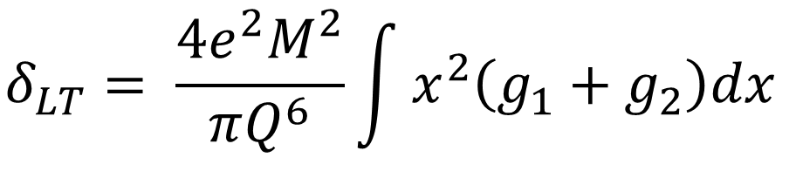
Spin Polarizabilities Sum Rules
Sum rule: relation between an integral of a dynamical quantity (cross section, structure function,...) and a global property of the target (mass, spin,...).
Can be used to:
Test theory (e.g. QCD) and hypotheses with which they are derived. Ex: GDH, Ellis-Jaffe, Bjorken sum rules.
Measure the global property (e.g. spin polarizability sum rules)
Spin polarizability sum rules involve higher moments:
Generalized forward spin polarizability:
g₂(ν,Q²): second spin structure function (mostly a perp. target pol. observable)
Contribution suppressed in γ₀
$γ_{0}= \frac{4e^{2}M^{2}}{πQ^{6}}\int{x^{2}\left(g_{1}−\frac{4M^{2}}{Q^{2}}x^{2}g_{2}\right)dx}$=$\int{x^{2}A_{1}F_{1}dx}$
Longitudinal-transverse spin polarizability:
$$δ_{LT}= \frac{4e^{2}M^{2}}{πQ^{6}}\int{x^{2}\left(g_{1}+g_{2}\right)dx}$$
Waiting for g₂ data
Not further discussed in this presentation

Slide 7
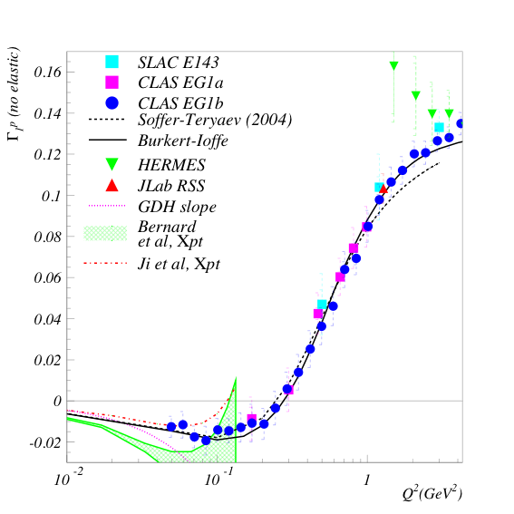
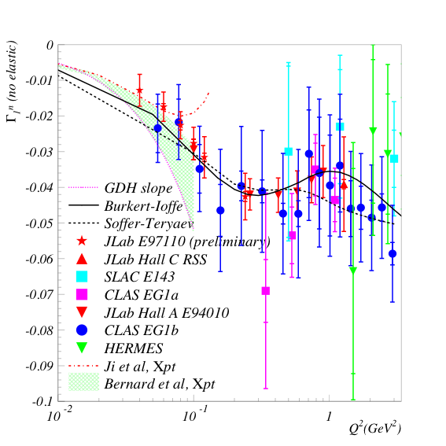
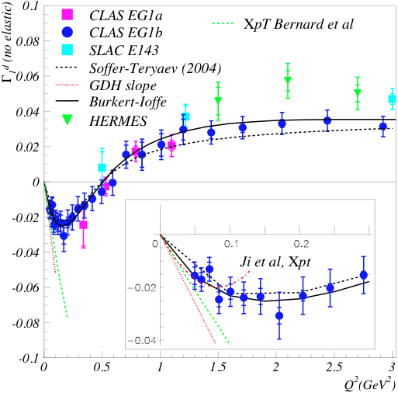
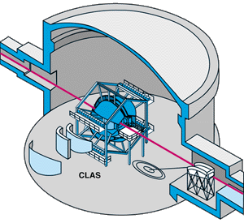

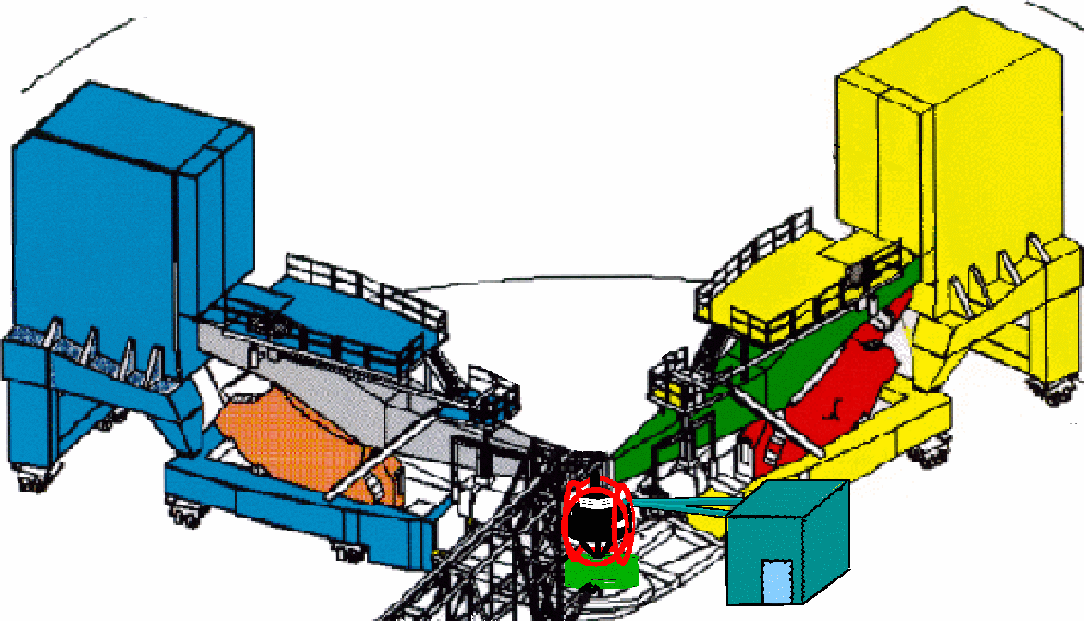
Previous data: high to intermediate Q²
Before EG4 run (2006):
Proton
Neutron
Deuteron
Precise mapping of intermediate Q² region for p, n and d.
pQCD, models and data agree.
Not so clear for χpT.

Slide 8
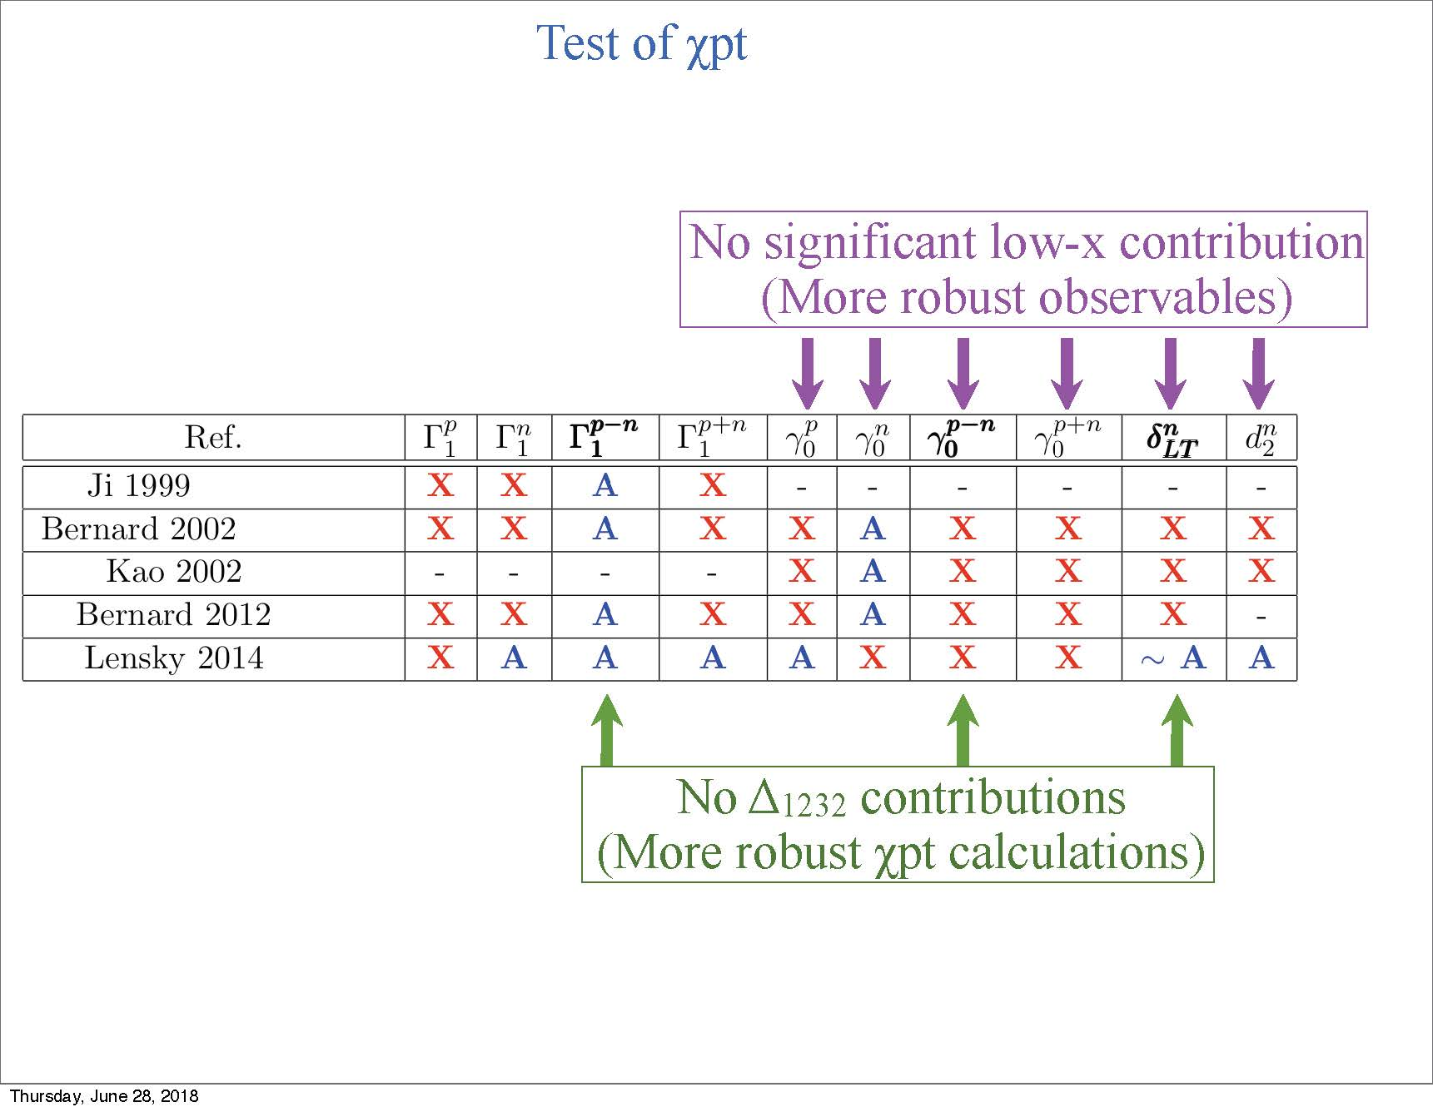
A = agree
X = disagree
- = no calculation available

Slide 9
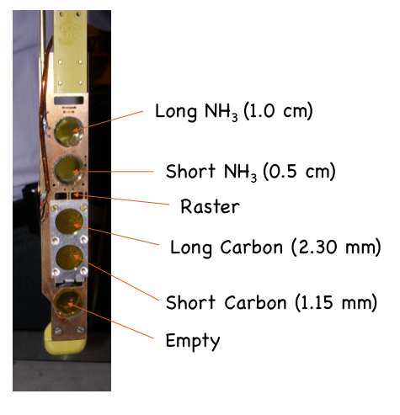
EG4 setup
Q²>0: electron beam (polarized). Energies: 3.0, 2.3, 2.0, 1.3 & 1.0 GeV
g1^{p,n}: ~longitudinally polarized target
DNP NH3 and
ND3 target:
g1 from pol. cross-section differences (not asymmetries, as in EG1, EG1dvcs)
Advantage: dilution from unpol. target material cancels out
Small angles: outbending torus field, new Møller shield; target at -1m
Cross-section ⇒ controlled (i.e high) efficiency at small angles.
→New Cherenkov detector (INFN). Installed in sector 6. Cover down to 6º

Slide 10
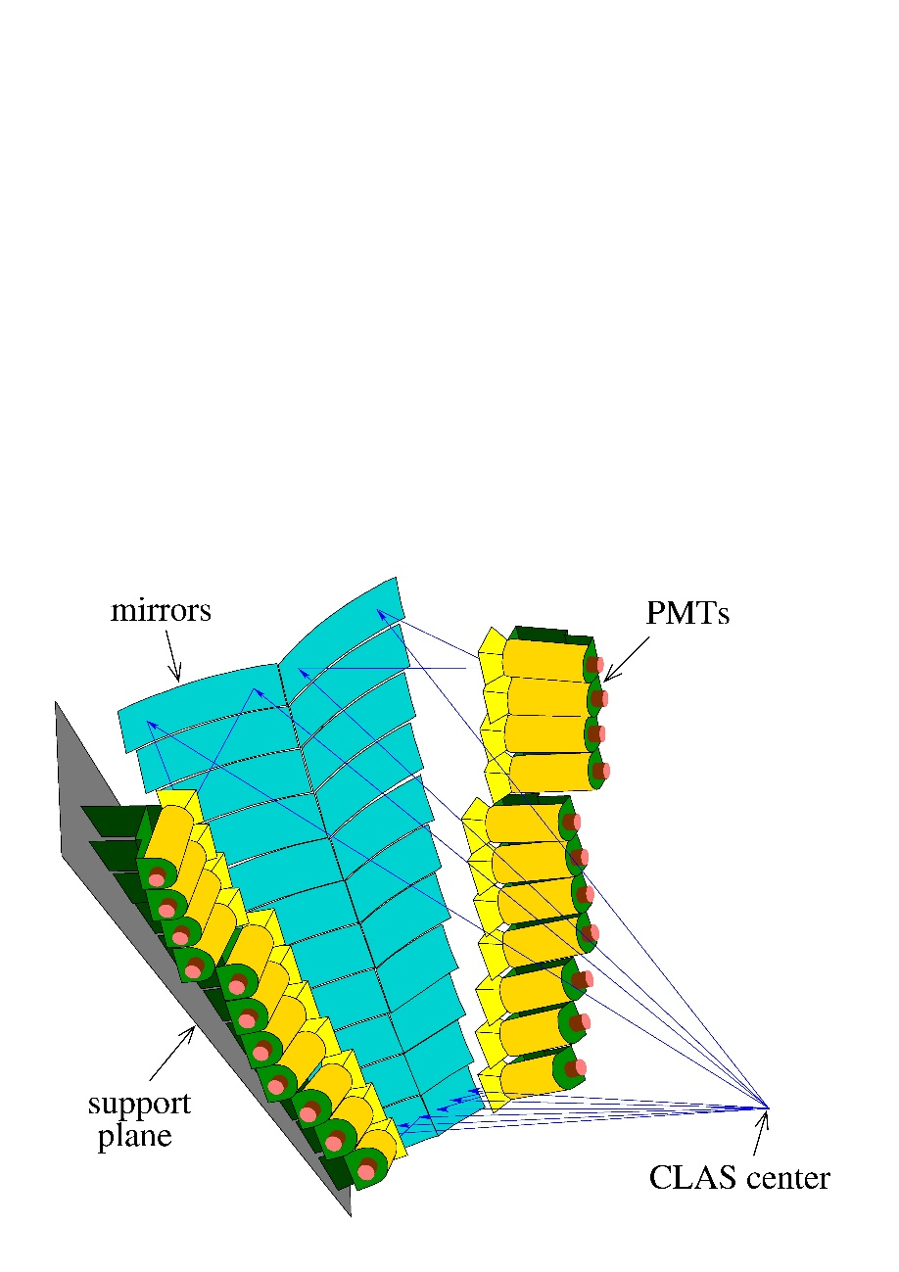
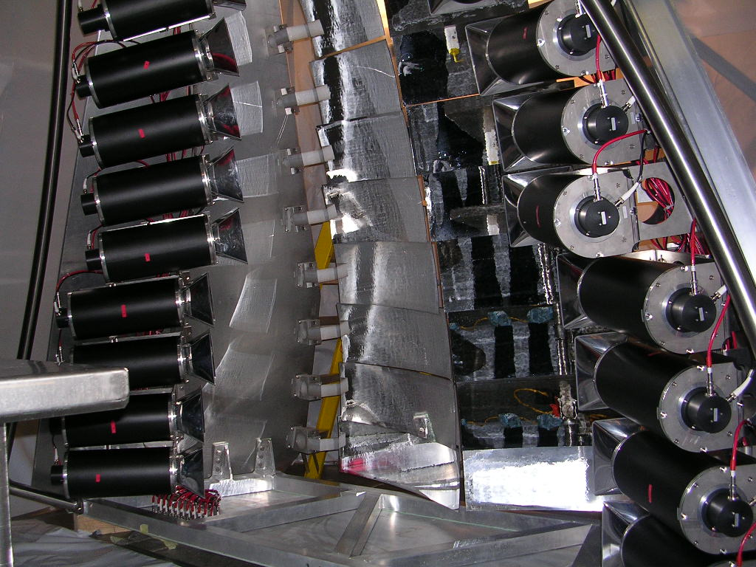
EG1: Largest possible kinematic coverage -> inbending and outbending configuration,
E = 1.6…5.8 GeV
EG4: Focus on low Q² => lower beam energies, new Cherenkov for optimal acceptance in outbending configuration, θ_{e} as small as 6 degrees
… and EG1-DVCS: Highest statistics at large x, Q²

Slide 11
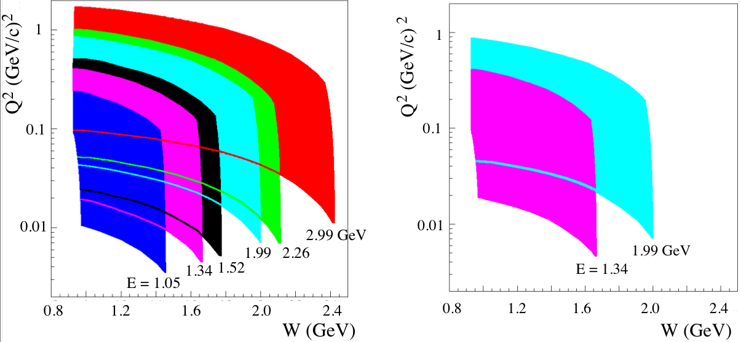
EG4 kinematic coverage
Proton
Deuteron
( )
1.52 GeV proton only for commissioning purposes

Slide 12
Experimental procedure
g1 from pol. cross-section differences (not asymmetries, as in EG1, EG1dvcs)
Advantage: dilution from unpol. target material cancels out
$$\frac{∆dσ^{theor}}{dΩdE^{′}}≡\frac{dσ^{→⇒}}{dΩdE^{′}}−\frac{dσ^{←⇒}}{dΩdE^{′}}= \frac{4α^{2}E^{′^{2}}}{MEνQ^{2}}\left[\left(E−E^{′}cosθ\right)g_{1}\left(x,Q^{2}\right)−2Mxg_{2}\left(x,Q^{2}\right)\right]$$
Small Q² → small x →g₂ contribution suppressed
Actual experimental quantity measured:
Extracted from elastic asymmetry
(*)
$$∆N^{exp}\left(∆E^{′},∆Ω\right)≡N^{→⇒}\left(∆E^{′},∆Ω\right)−N^{←⇒}\left(∆E^{′},∆Ω\right)=P_{f}\text{L}{ P}_{b}P_{T}\frac{∆dσ^{theor}}{dΩdE^{′}}∆E^{′}∆Ω {ε }_{det}$$
where
P_{f} = packing fraction (how much target cell filling with ammonia beads)
L = integrated luminosity (how many electrons on target times nominal target surface thickness) (*)
P_{b} = beam polarization (85 ± 2%)
P_{b} = target polarization (59 to 71 % for H, 30 to 45 % for D)
ε_{det} = detector acceptance/efficiency
(*) there is a small correction due to the beam charge asymmetry, not shown here

Slide 13
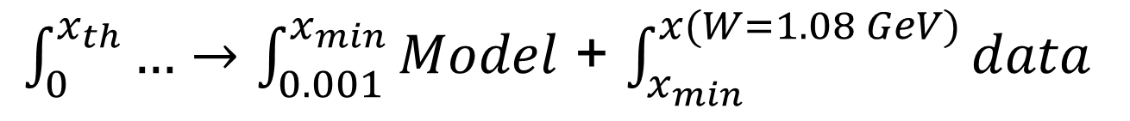
Experimental procedure
Sum rule integrals
Deuteron
$\int_{0}^{x_{th}}{…}$ $→\int_{0.001}^{x_{min}}{Model}$ + $\int_{x_{min}}^{x(W=1.15 GeV)}{data}$ + $\int_{x(W=1.15 GeV)}^{x(W=1.07 GeV)}{Model}$
For the lowest Q² bin, 0.020 GeV², x_{min} = 0.0073
For the largest Q² bin considered for integration, 0.592 GeV², x_{min} = 0.280
In the 3rd integral, the model is used rather than data to avoid quasielastic scattering and radiative tail contaminations
Proton
$\int_{0}^{x_{th}}{…}$ $→\int_{0.001}^{x_{min}}{Model}$ + $\int_{x_{min}}^{x(W=1.08 GeV)}{data}$

Slide 14
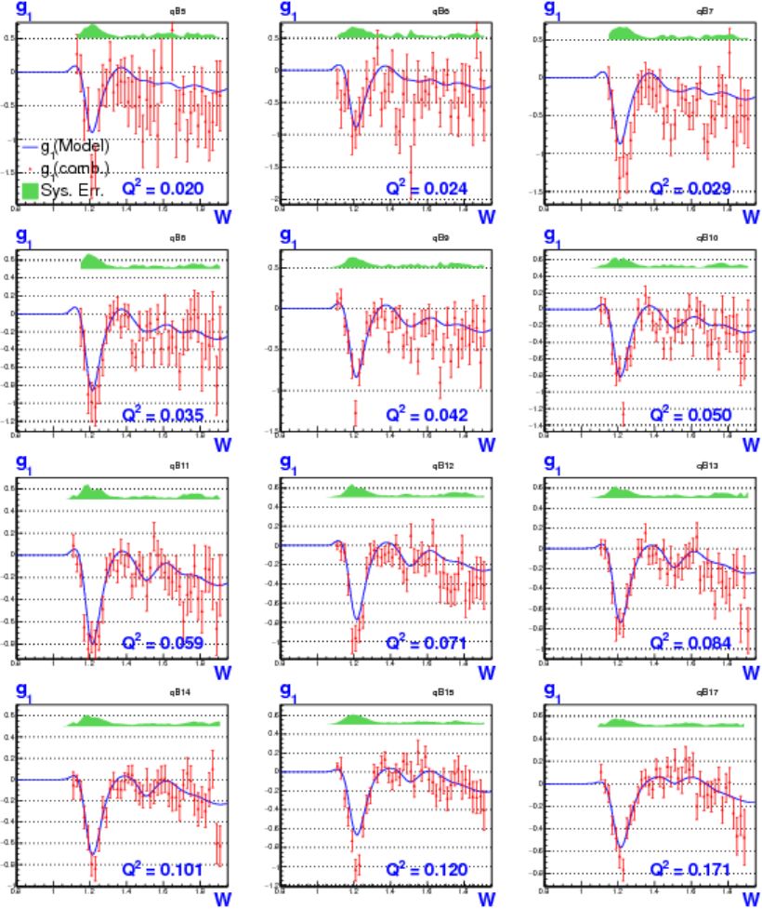
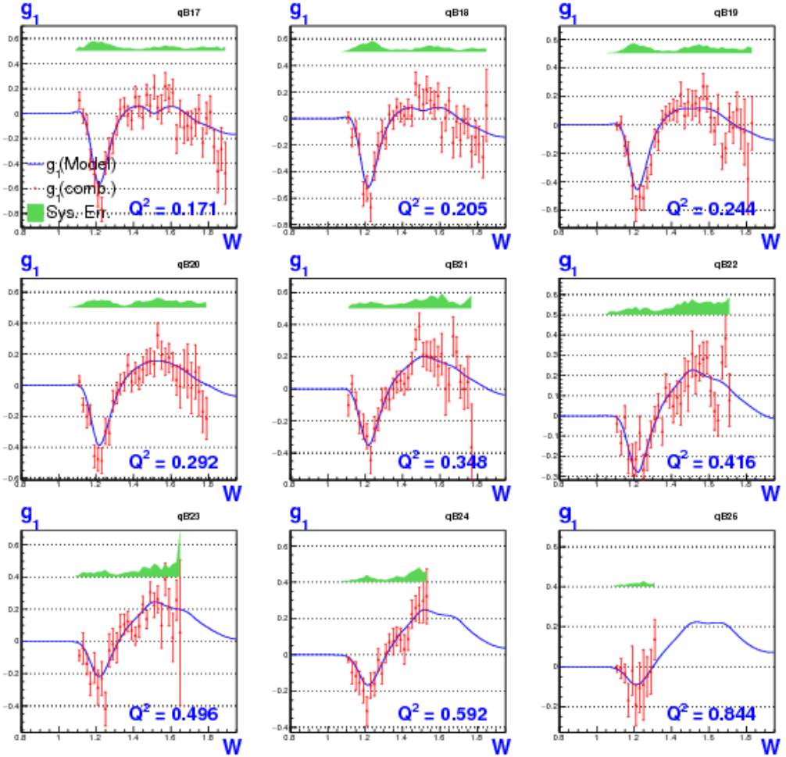
g1^{d} from EG4 polarized cross-section difference
K. Adhikari, S. Kuhn
EG4 data
systematic uncertainty
“Model” (used as intermediate
step to extract g1^{D}).

Slide 15
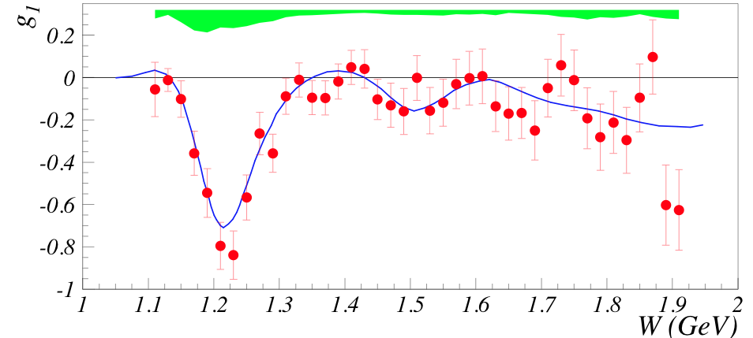
g1^{d} from EG4 polarized cross-section difference
K. Adhikari, S. Kuhn
EG4 data
systematic uncertainty
“Model” (used as intermediary
step to extract g1^{D}.
<Q²>=0.1 GeV²

Slide 16
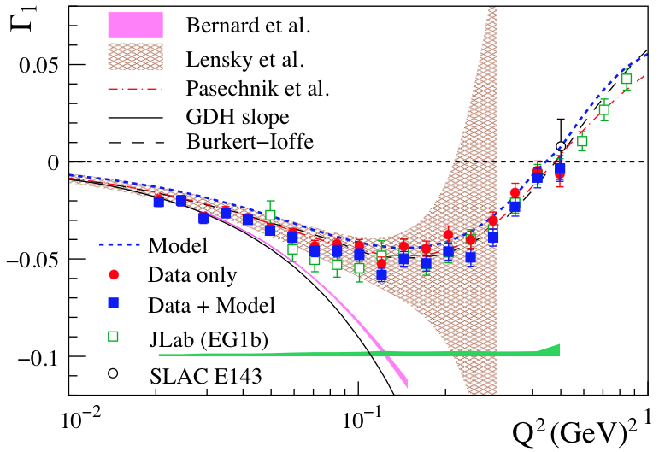
Γ1^{d} =∫g1^{d}(x,Q²)dx
K. Adhikari, S. Kuhn
K.P. Adhikari et al. (CLAS Collaboration). PRL 120, 062501 (2018)
Lowest Q² decreased by factor of ~2.5
Much improved precision
Small unmeasured low-x and large-x contributions
⇒Clean test of χpt

Slide 17
Γ1^{d} =∫g1^{d}(x,Q²)dx
K. Adhikari, S. Kuhn
K.P. Adhikari et al. (CLAS Collaboration). PRL 120, 062501 (2018)
EG4 and EG1 Γ1 data agree well.
EG4 data agree well with χPT results of Lensky et al.
Bernard et al. χPT calculation agrees only for the lowest Q² points.
Phenomenological models (Pasechnik et al, Burkert-Ioffe) agree well.

Slide 18

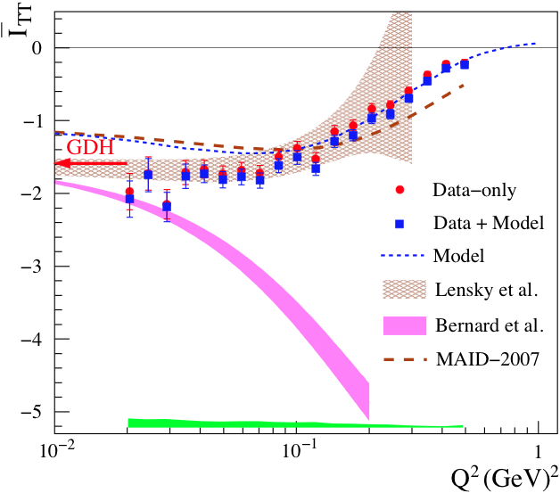
Generalized GDH sum ITT =
σA(ν)-σP(ν)
∫ dν
ν
Data agree well with χPT results of Lensky et al.
Bernard et al. χPT calculation does not agree as well.
Maid model disagrees at low Q²=0.
sum rule:

Slide 19
σA(ν)-σP(ν)
Generalized GDH sum ITT =
∫ dν
ν
Data agree well with χPT results of Lensky et al.
Bernard et al. χPT calculation does not agree as well.
Maid model disagrees at low Q²=0.
Extrapolation to Q²=0 tests original GDH sum rule:
ITT^{d} = −1.724±0.027(stat)±0.050(syst)
Sum rule expectation: −1.574±0.026
ITT^{n} = −0.955±0.040(stat)±0.113(syst)
Sum rule expectation: −0.803

Slide 20
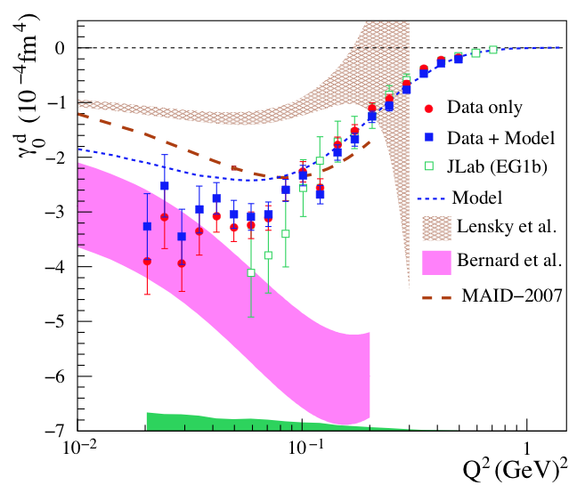
Higher moment γ0
Incoherent sum of p and n →χPT results of Lensky et al. disagree with data.
Bernard et al. χPT calculation agree for lowest Q² points only.
Maid model disagrees at low Q².

Slide 21
Conclusion from deuteron data
No χPT single method describes well both Γ1, ITT, and ɣ0, except at the lowest Q².
A satisfactory theoretical description of spin observables at low Q² remains challenging.

Slide 22
g1^{p} from EG4 polarized cross-section difference
Very
H. Kang
Currently revisiting analysis with same technique as deuteron
(X. Zheng with essential support from L. El Fassi and J. Zhang)

Slide 24
X. Zheng et al.
(CLAS Collaboration), PRC 94, 045206 (2016)

Slide 25
Summary and perspectives
EG4: Low Q² measurement using polarized e⁻ on polarized p and d, over a large x-range in order to study spin sum rules.
New detector necessary to reach these kinematics.
Main goal: unambiguous test of χPT.
Doubly polarized inclusive cross-section analysis.
Exclusive data for π⁺ and π⁻ spin-dep. electroprod. on p published in 2016 (asym. analysis).
Inclusive analysis on d recently published
Data on Γ1, ITT, and ɣ0 for the deuteron shows that χPT has mixed success, depending on the χPT method and observable.
Original GDH sum rule (Q²=0) checked on d and n.
First result of larger JLab program to measure benchmark spin observables for χPT ⇒More low Q² data to come:
X. Zheng et al. (CLAS Collaboration), PRC 94, 045206 (2016)
K.P. Adhikari et al. (CLAS Collaboration), PRL 120, 062501 (2018)
g1, Γ1, ITT, and ɣ0 for the proton (CLAS EG4).
g1, g2, Γ1, Γ2, ITT, ɣ0 and δLT for the neutron and ³He (Hall A E97110).
g2, g1, Γ2, Γ1, ITT, δLT and ɣ0 for the proton (Hall A E08027).

