Slide 1

Duality in the Neutron Structure Function
Ioana Niculescu
James Madison University
September 24, 2018
Bloom Gilman Duality
Local duality on the neutron
Summary

Slide 2

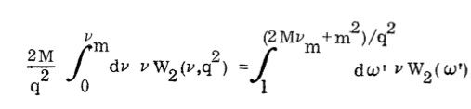
“Bloom-Gilman” Duality:
Inclusive Electron Scattering
Bloom and Gilman at SLAC compared resonance production data with deep inelastic scattering data using ad hoc variable
Integrated F₂ strength in nucleon resonance region equals strength under scaling curve.
Finite energy sum rule:
Resonances oscillate around curve at all Q²
F₂
Q² = 0.5
Q² = 0.9
F₂
Q² = 1.7
Q² = 2.4
ω’ = 1+W²/Q²

Slide 3
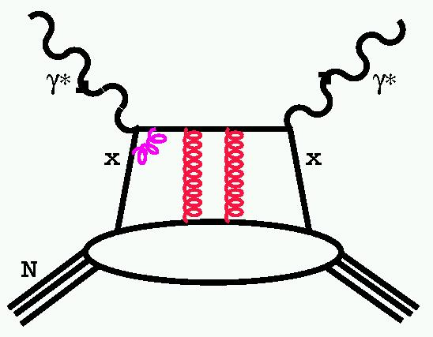
Cornwall-Norton moments
Duality is described in the Operator Product Expansion
as higher twist effects being small or canceling DeRujula, Georgi, Politzer (1977)
Logarithmic dependence
Higher twists

Slide 4
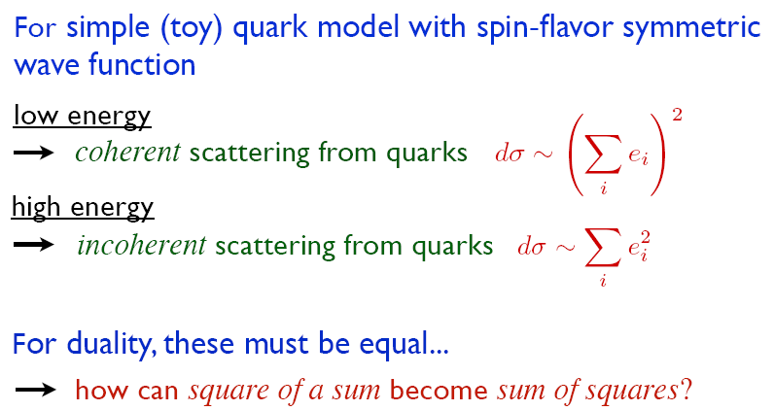

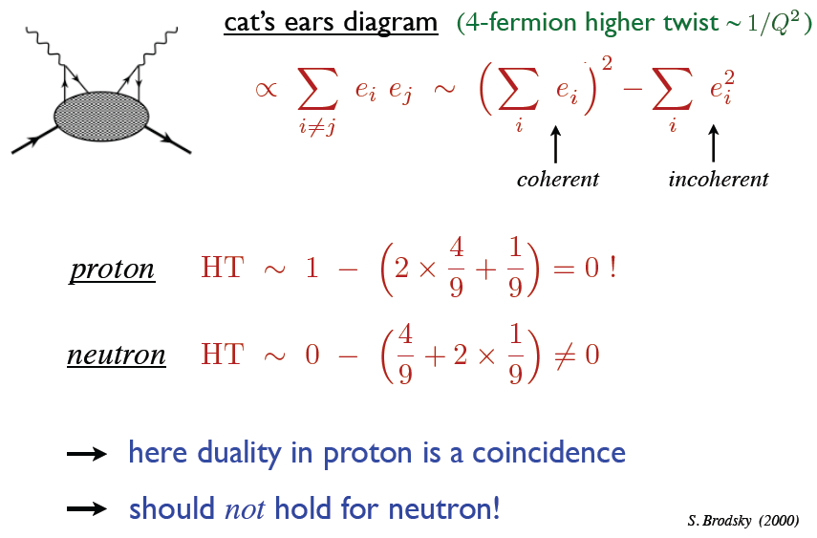

Wally Melnitchouk at

Slide 5
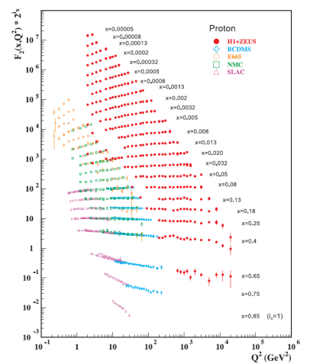
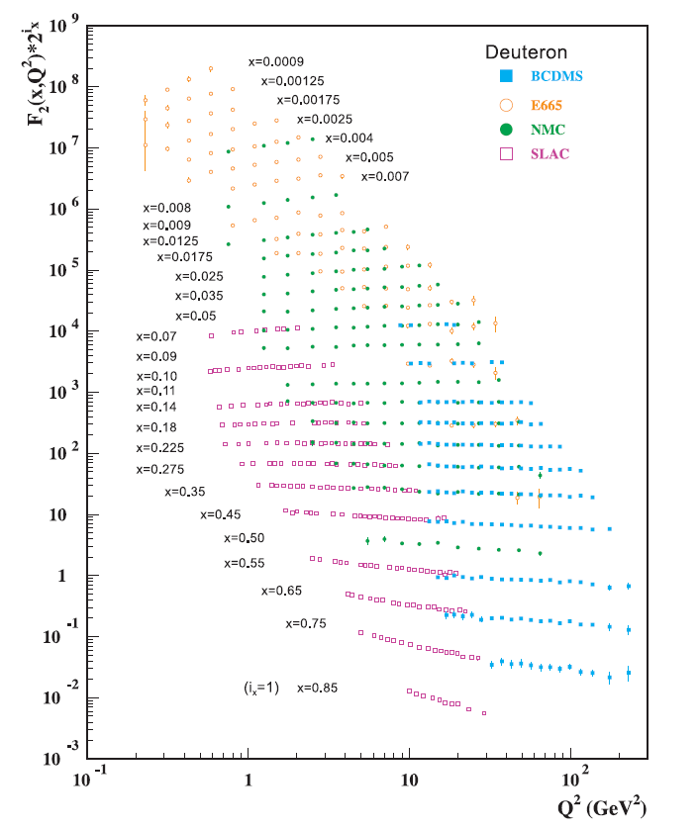
The Proton Structure Function

Slide 6
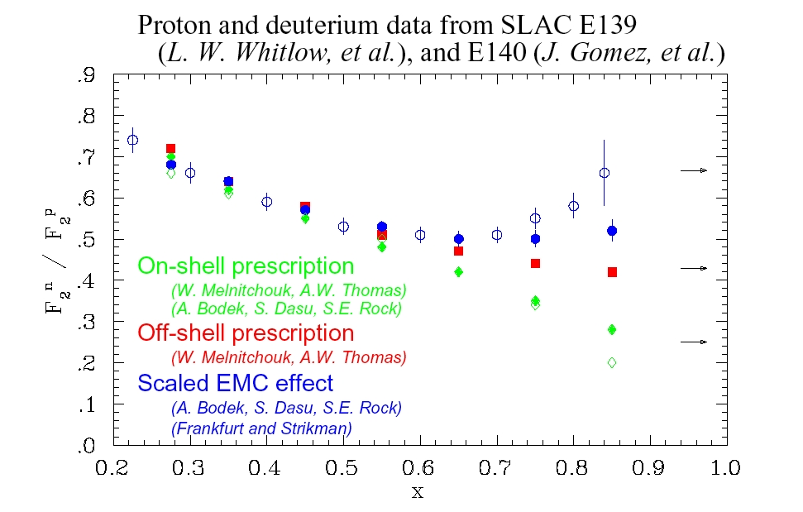
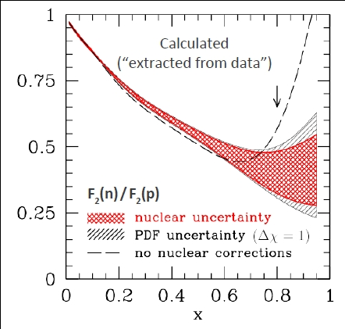
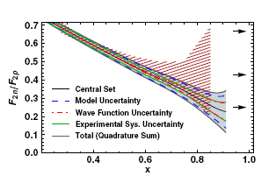
Extract neutron from deuteron data
Large uncertainties due to nuclear effects
A. Accardi et al., PRD 84 014008 (2011)
J. Arrington, J.G. Rubin,W.Melnitchouk PRL 108, 252001 (2012)

Slide 7
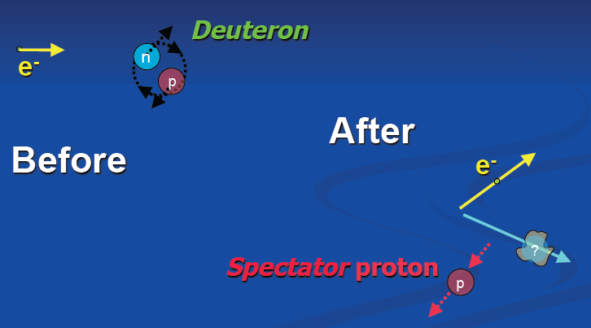
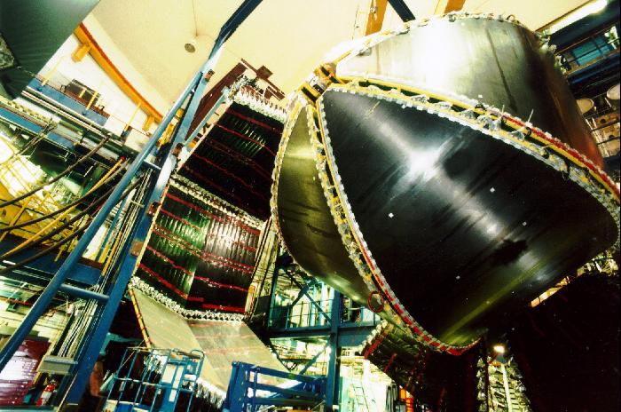
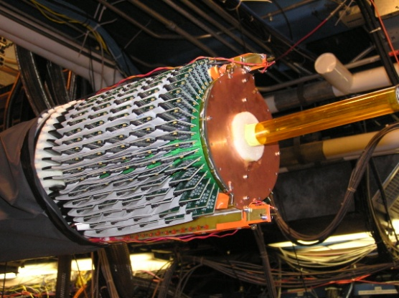
The BONUS Experiment
to CLAS
n
p
To BoNuS RTPC
Beam

Slide 8
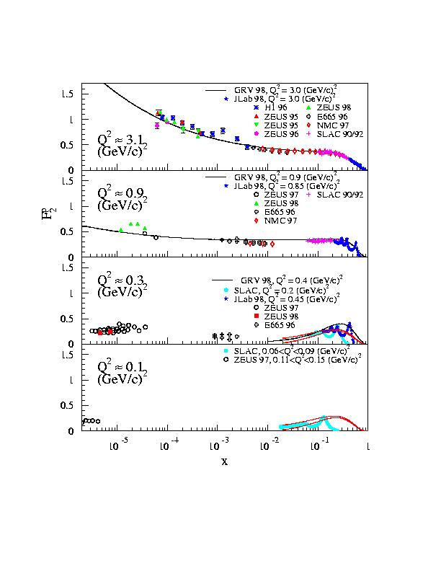
F₂ proton
Need full range of data
Higher order moments large x weighted – JLab regime

Slide 9
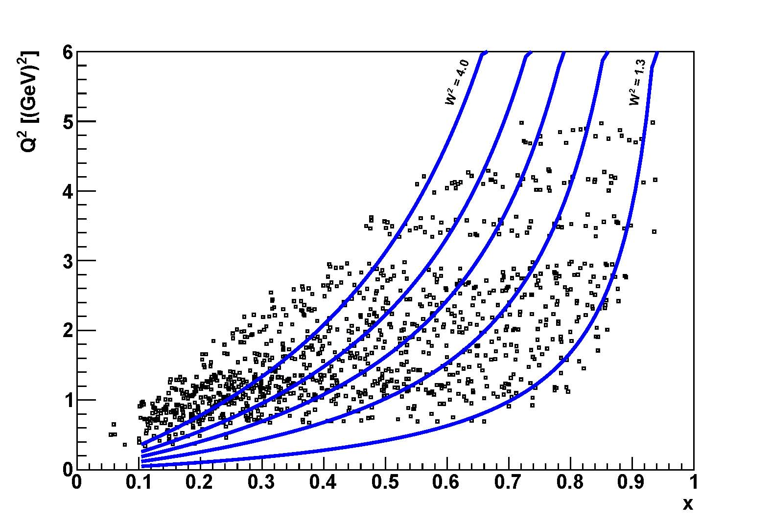
BONUS Kinematic Coverage

Slide 10
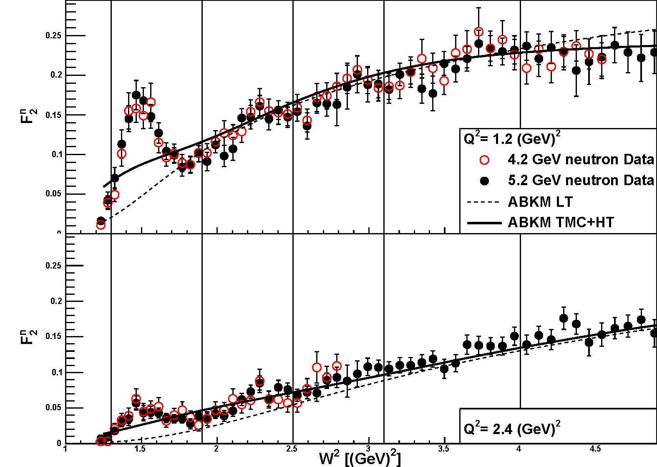
Truncated Moments and Local Duality
As defined in A. Psaker, W. Melnitchouk, E. Christy, C. Keppel, PRC 78 025206 (2008).
BONuS data

Slide 11
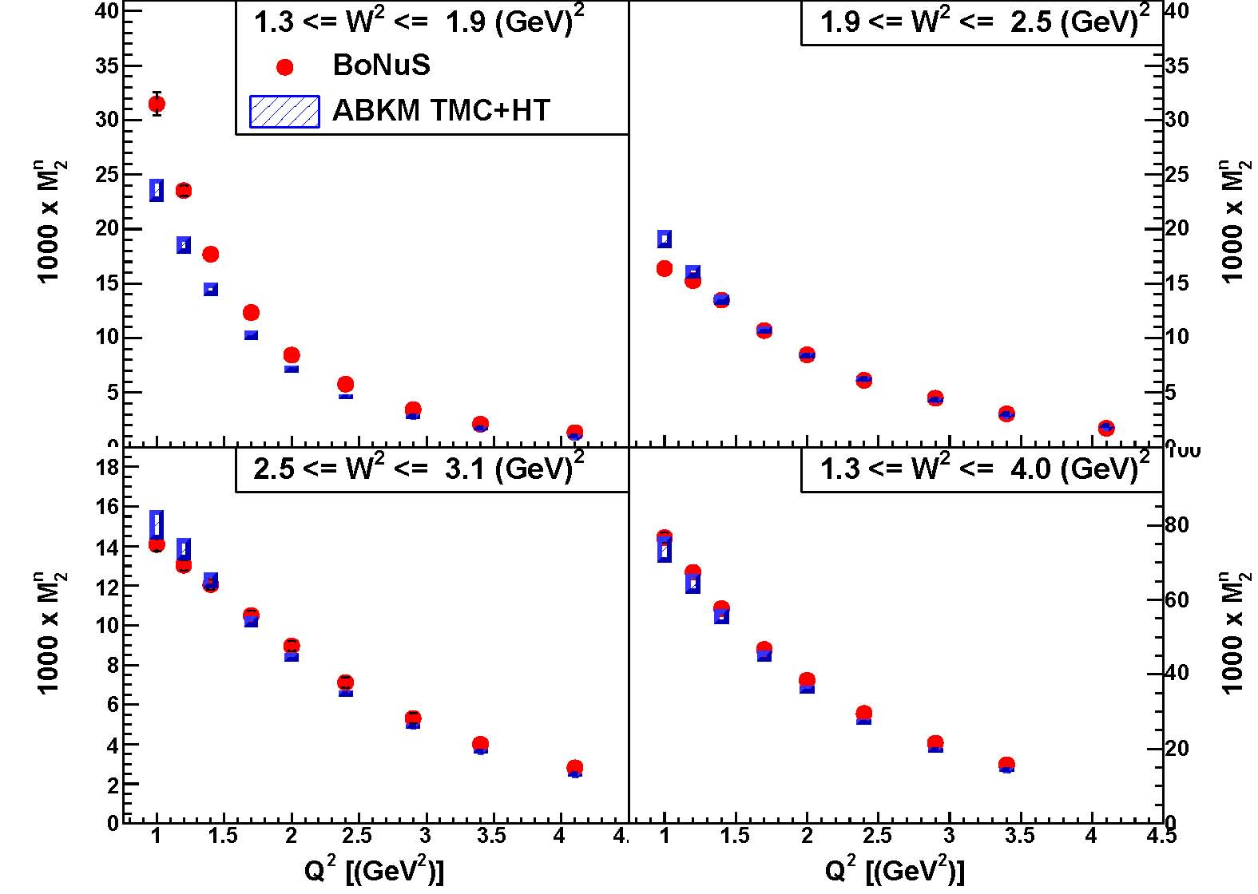
BONUS Truncated Moments
2nd resonance region
Δ resonance region
3rd resonance region
whole resonance region

Slide 12
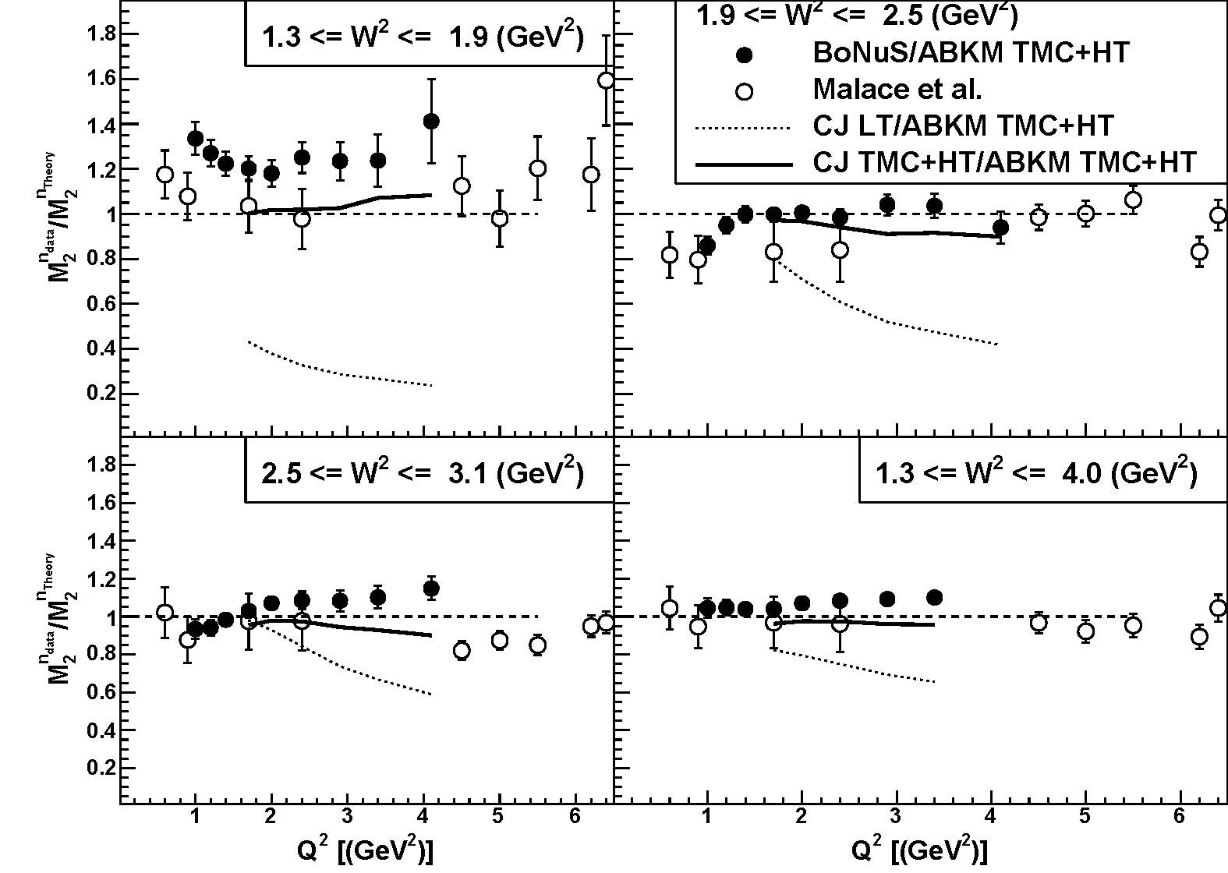
Local Quark Hadron Duality – Neutron
Δ resonance region
2nd resonance region
M₂^{n} data / M₂^{n} theory
S. Malace et al., PRL 104, 102001 (2010)
3rd resonance region
whole resonance region

Slide 13
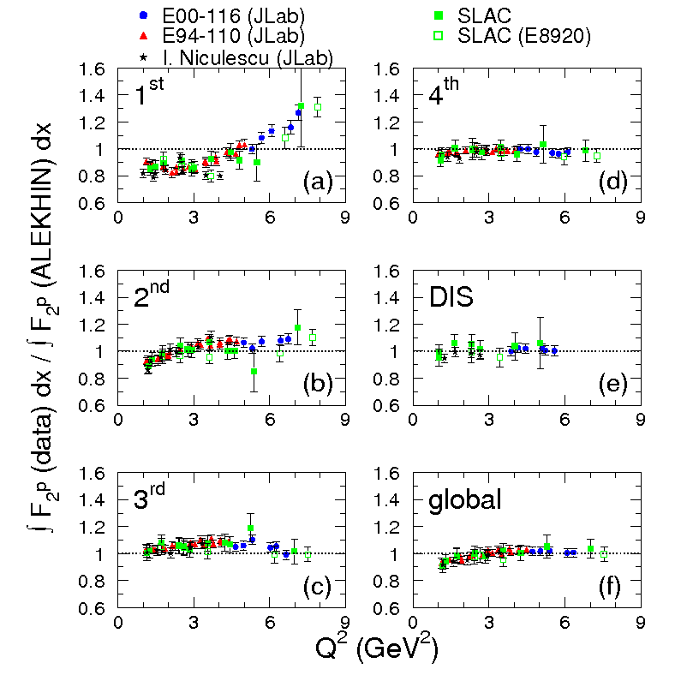
Local Quark Hadron Duality – Proton
S. Malace et al., PRC 80, 035207 (2009)

Slide 14
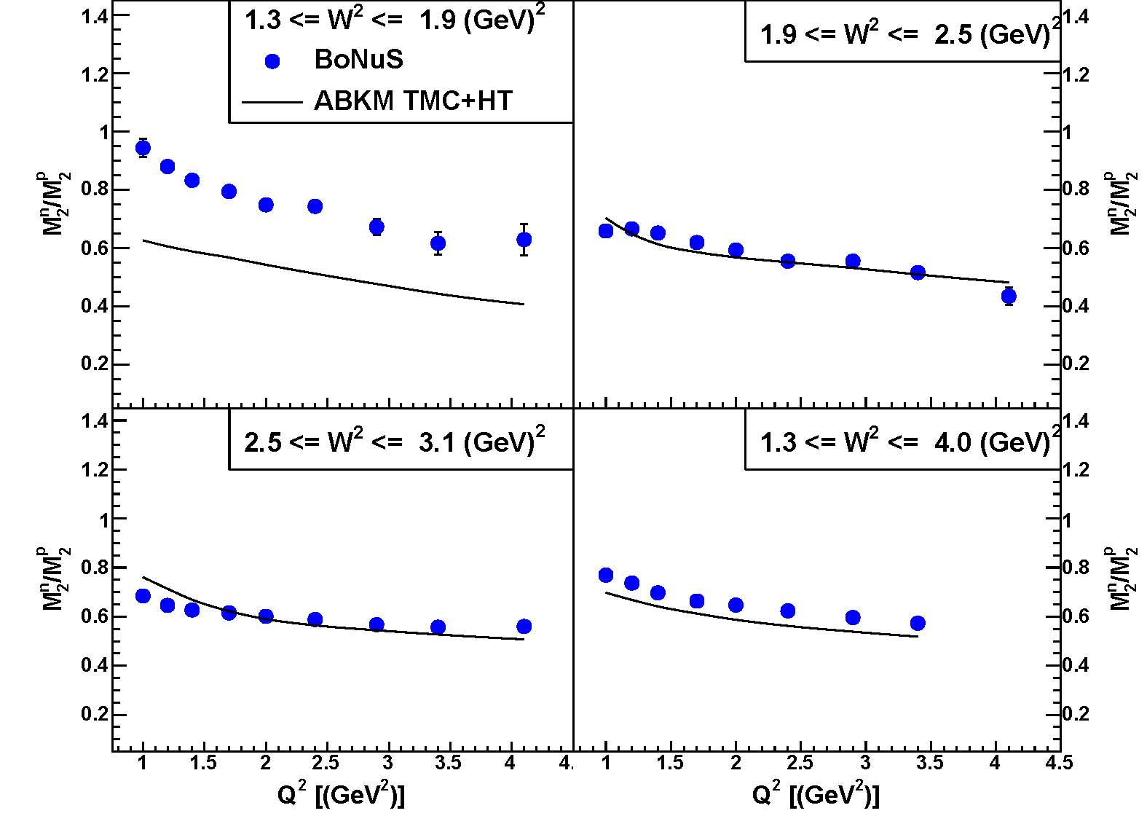
Proton/Neutron Comparison
2nd resonance region
Δ region
M₂ neutron / M₂ proton
3rd resonance region
whole resonance region

Slide 15

F₂^{p} & F₂^{d} at Jlab after Upgrade
JLab12 Hall C commissioning experiment aims to reduce uncertainties in F₂^{p} and F₂^{d} structure functions at large x and high Q².

Slide 16
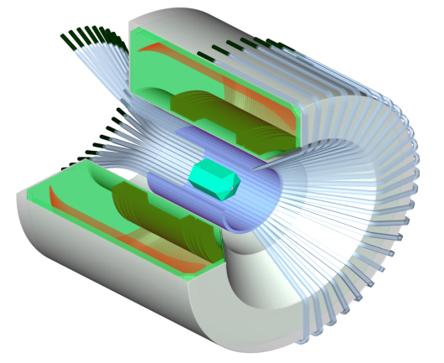

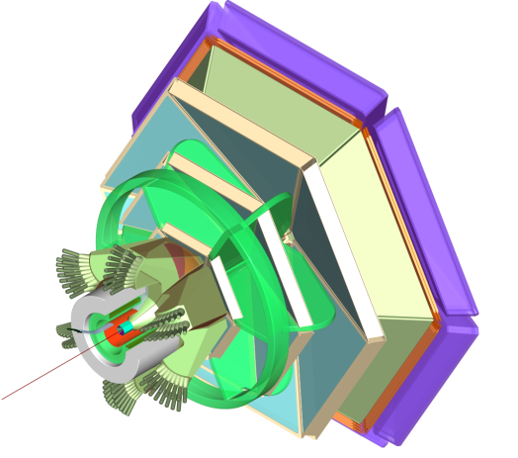
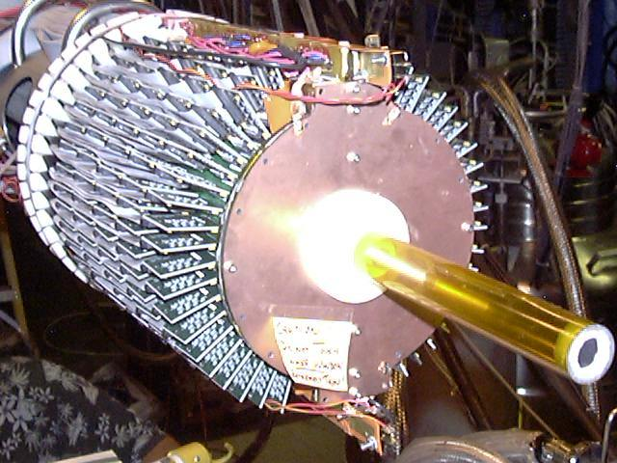
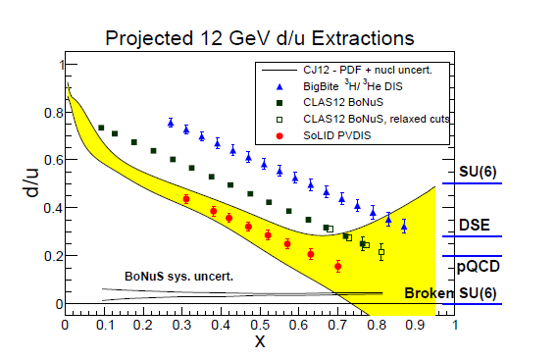
E12-06-113 BONUS at 12 GeV
Data in early 2020
Data taking:
35 days on D₂
5 days on H₂
DIS region with
  Q ² > 1 GeV ²/c ²
  W *> 2 GeV
Notes:
16

Slide 17
Conclusion
Quark-hadron duality is somehow a fundamental property of nucleon structure
  Works generally in every process studied
  Studies now quite numerous
Challenges to quantifying experimentally
  pQCD predictions for large x, low Q have large uncertainties
Integral OR Q²-dependence or both?
  what is the average curve?

Slide 18
Extra Slides

Slide 19
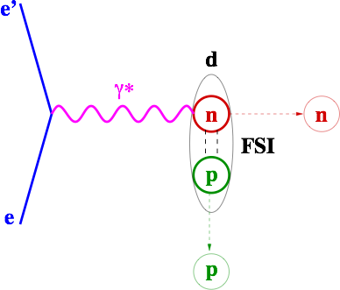
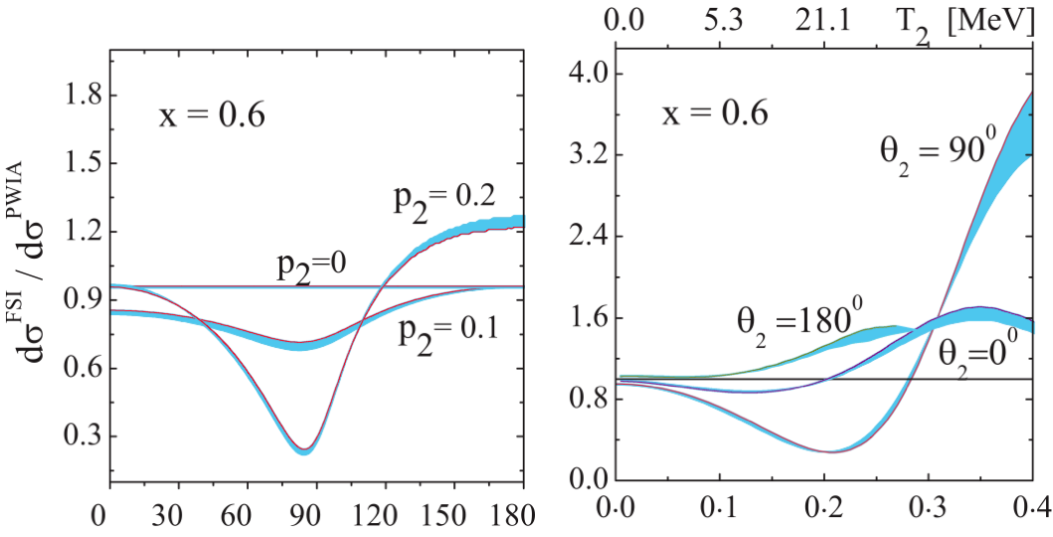
Final State Interaction
struck neutron can interact with the spectator proton
proton momentum is enhanced
FSIs are small at low ps and large Θpq
Palli et al, PRC80(09)054610
Several groups have calculated FSIs
Few percent for low momentum
ps
Θpq

Slide 20
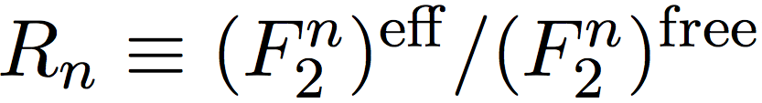
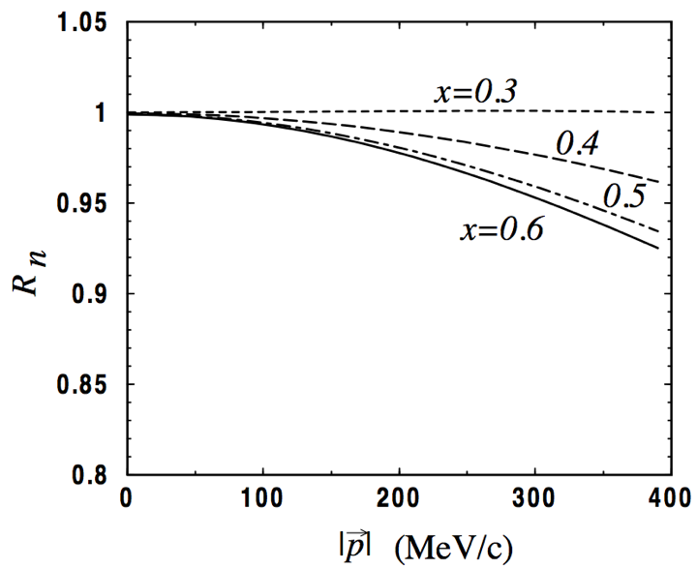
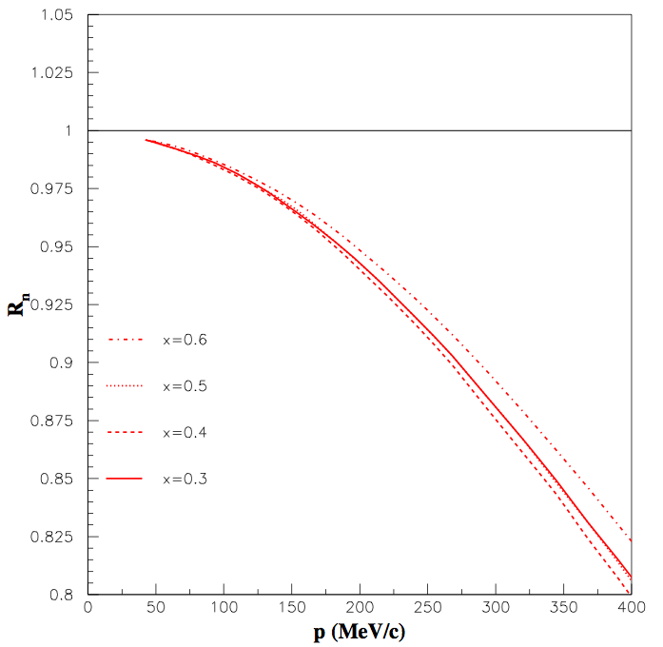
Off – shell Effects
Melnitchouk et al, PLB335(94)11
Liuti & Gross PLB356(95)157
0.965
0.985
0.93
BoNuS ps
detection range

Slide 21
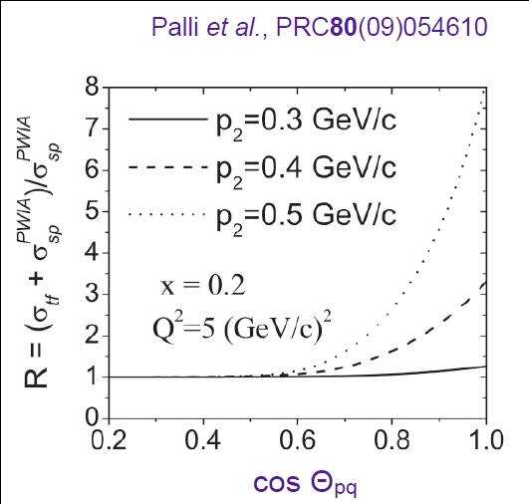
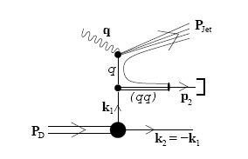
Target Fragmentation
Enhancement in proton
yield over PWIA negligible
for backward protons

Slide 22
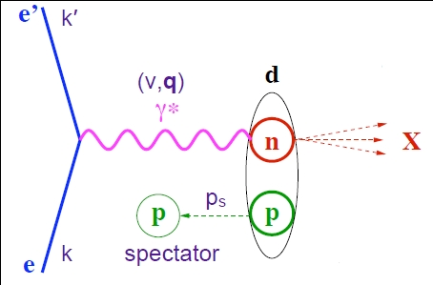
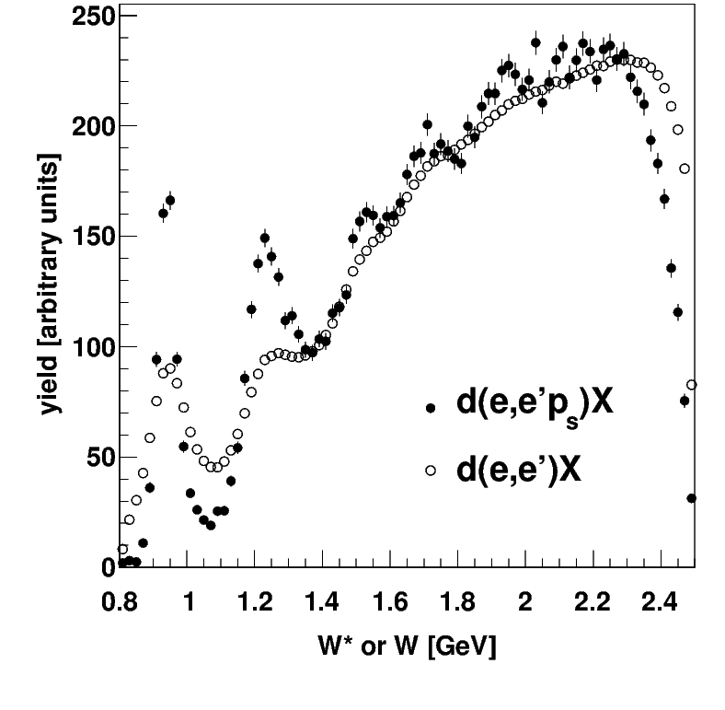
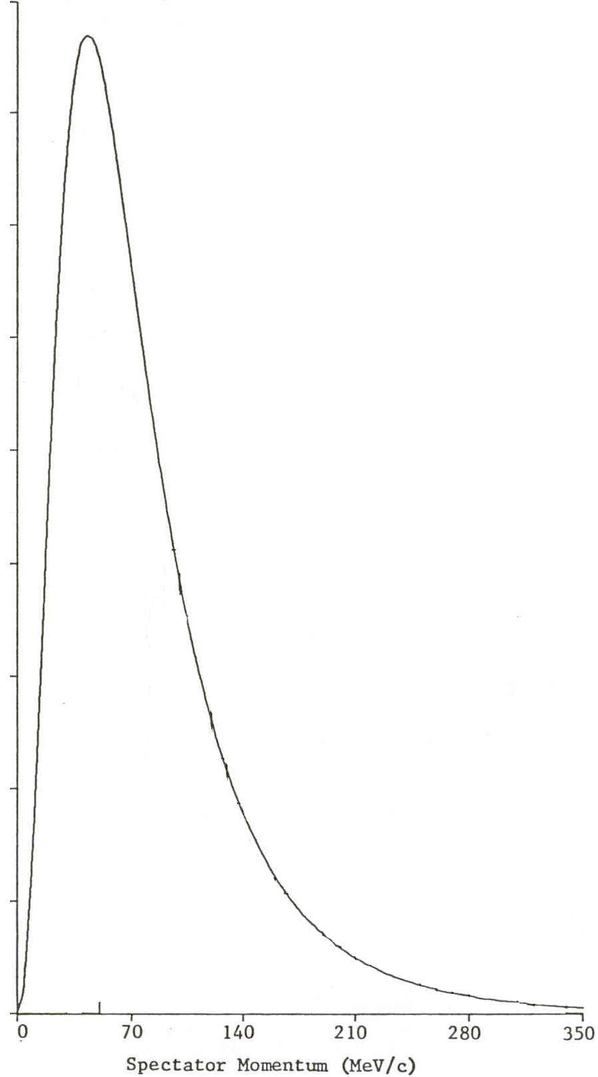
Kinematic reconstruction with tagged protons
W*² = (p_{n}+ q)² ≈ M*² +2Mν(2- α_{s} ) - Q²
ps distribution
70 MeV/c 100 MeV/c
VIPs
W² = M² +2Mν - Q²
Notes:
22

Slide 23
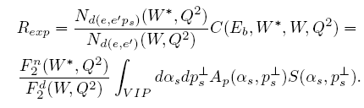
Ratio Method
N. Baillie et al., PRL108, 199902 (2012)
S. Tkachenko et al., PRC 89, 045206 (2014)
VIP (Very Important Protons)
P_{s} < 100 MeV/c, _{pq} ≥ 100 deg
Experimental ratio

Slide 24
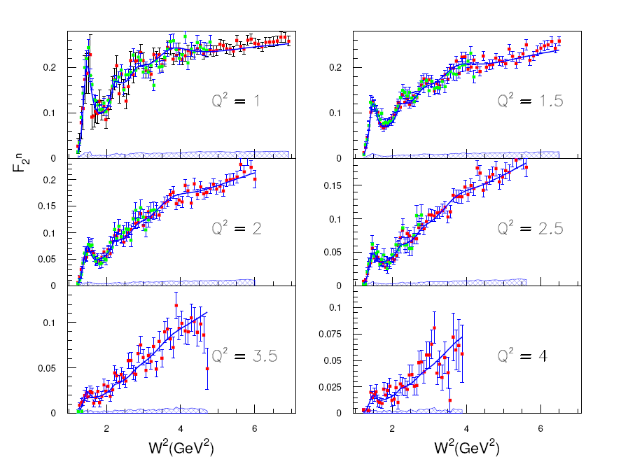
Results
E=4.2 and 5.3 GeV
Systematic unc.
S. Tkachenko et al., PRC 89, 045206 (2014)

Slide 25
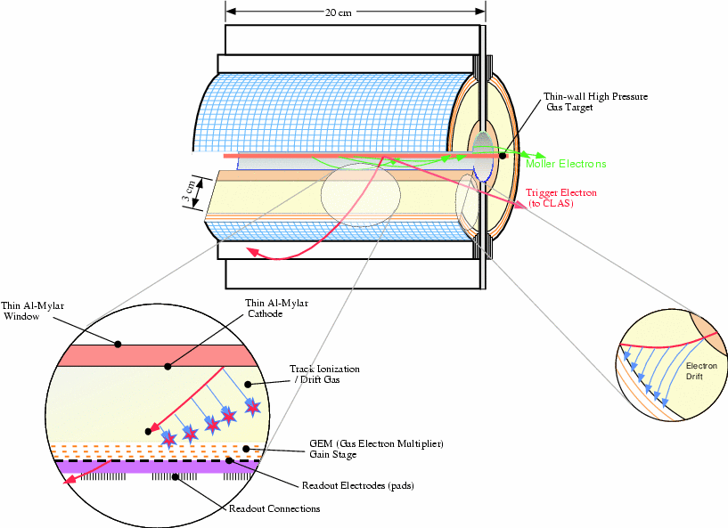
Experimental Setup: BoNuS RTPC
H. Fenker et al., Nucl. Instrum. Meth. A 592, 273 (2008)
beam
Helium/DME at 80/20 ratio
Notes:
25

Slide 26
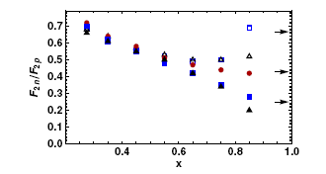
Extract neutron from deuteron data
Large uncertainties due to nuclear effects
A. Accardi et al., PRD 84 014008 (2011)
Other (older) extractions
J. Arrington, J.G. Rubin,W.Melnitchouk PRL 108, 252001 (2012)

Slide 27
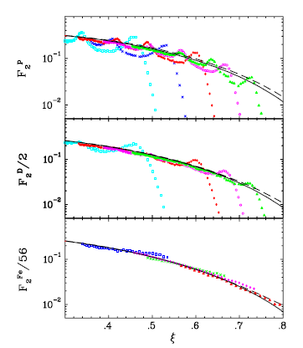
The Proton and the Deuteron
Scaling (duality) is observed in nuclei
Resonances less pronounced – washed out by Fermi motion
J.Arrington et al., PRC 73 (2006) 035205

Slide 28
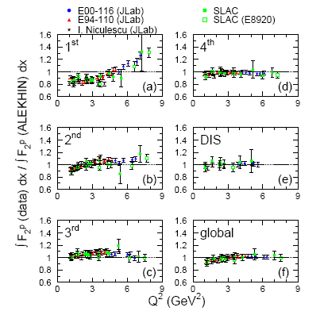
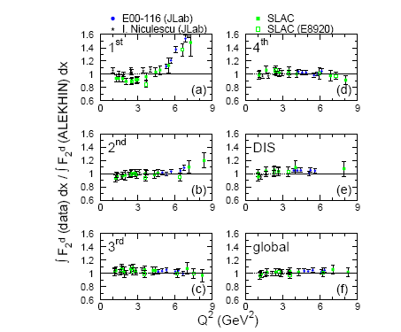
Local duality
The proton
The deuteron
S. Malace et al., PRC 80, 035207 (2009)

Slide 29
Does it work for the Neutron?
Frank E. Close, Nathan Isgur PLB 509 (2001) 81
“for the proton duality may be satisfied by W <1.6 GeV”
“For neutron targets […] we anticipate systematic deviations from local duality”
“the S11(1530) […] and the F15(1680) are enhanced relative to the deep inelastic scaling curve for proton targets”
for neutron targets, the S11(1530) region will fall below the scaling curve

