Slide 1
N* Physics with CLAS at Jefferson Lab
Kyungseon Joo
University of Connecticut
Quark and Nuclear Physics 2018
November 13-17, 2018
Tsukuba, Japan

Slide 2
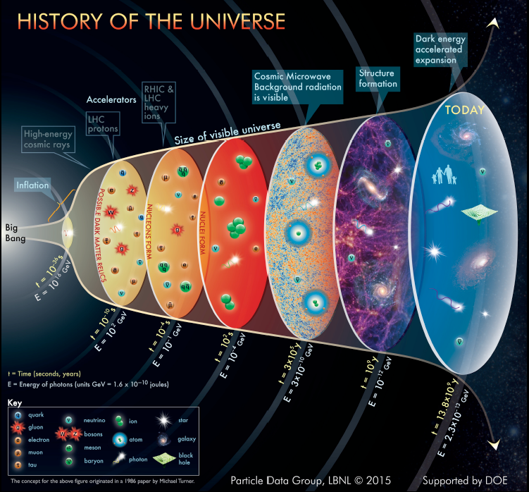
Evolution of the Universe
Evolution of the Universe (2014 version)
Particle Data Group at Lawrence Berkeley National Lab.
Time after the Big Bang
CEBAF
T~ 10⁻⁸ s: QGP
T ~ 10⁻⁶ s: N*, B*
T~ 10⁻⁴ s: Nucleons
T ~ : 10² s: Nuclei
T ~ 300, 000 yrs: Atoms
medium
energy machines
With a few GeV electron machine, explore events to unravel mechanisms of confinement.
- Chiral symmetry is broken
- Light quarks acquire mass
- Confinement emerges
N*
Baryons in PDG insufficient to explain transition
=> missing states!

Slide 3
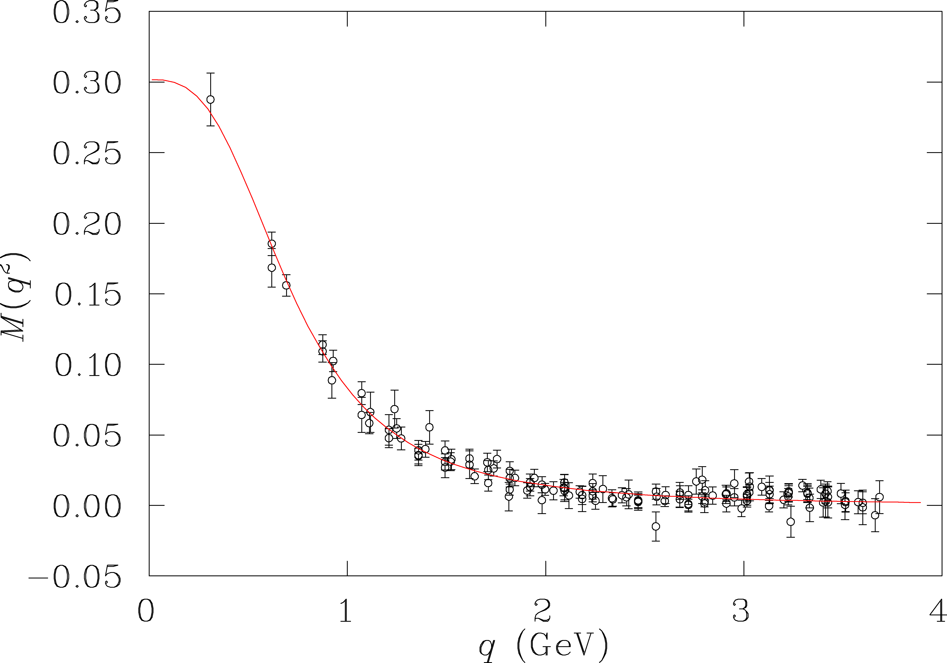
How do light quarks acquire mass?
T>10¹⁴K
DSE/QCD
Lattice QCD (chiral extrapolation)
quark mass (GeV)
confinement
T<10¹⁰K
As the temperature drops, quarks couple to gluons, become massive and form resonances with other quarks before freezing out as stable nucleons.
=> Measure observables that are sensitive to the quark mass.

Slide 4
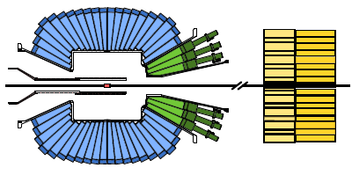
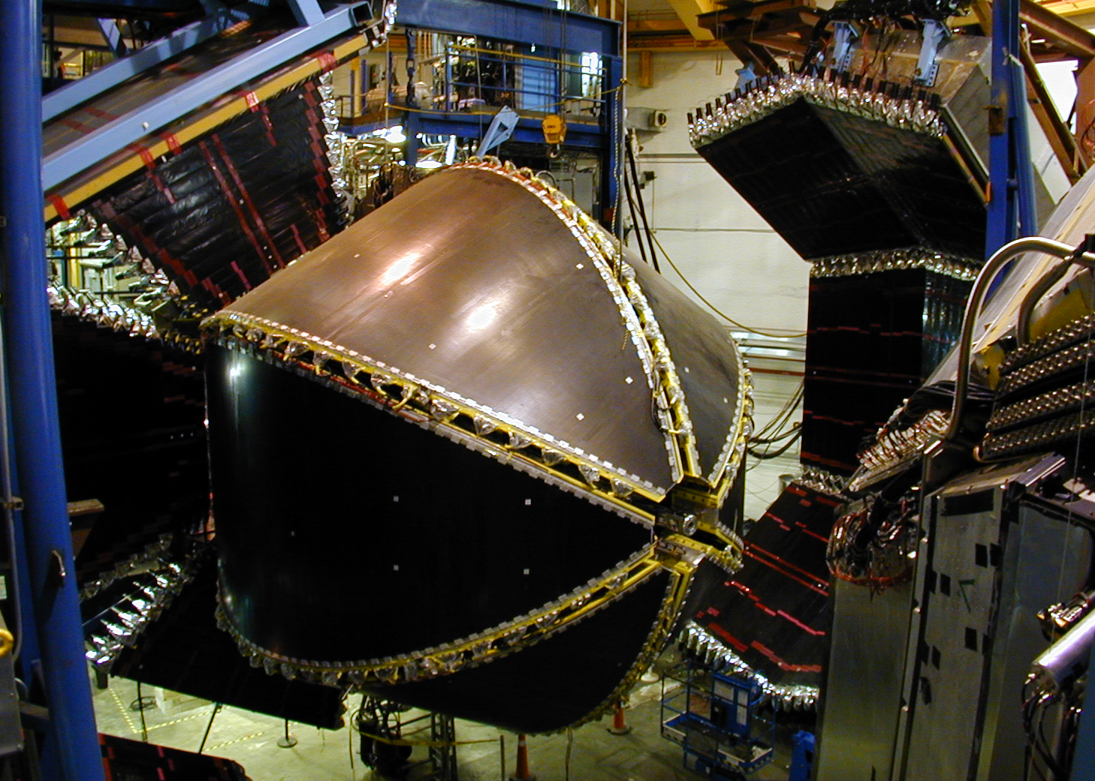

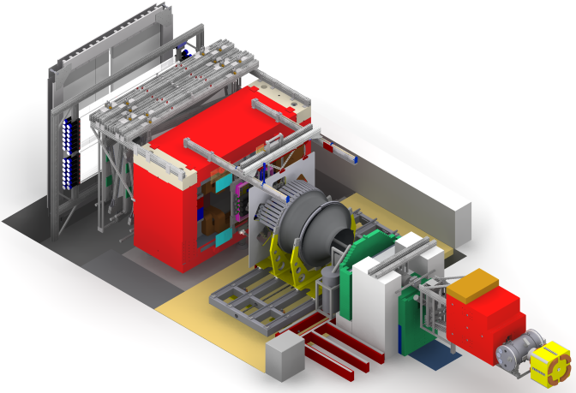

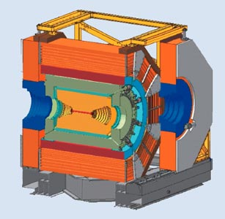

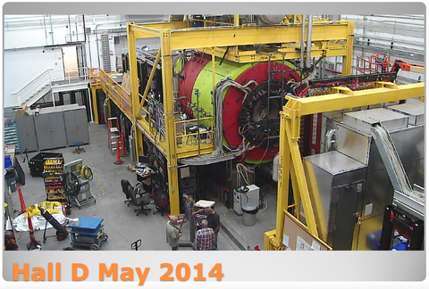
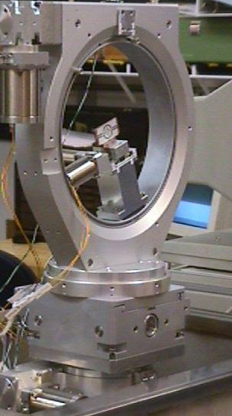
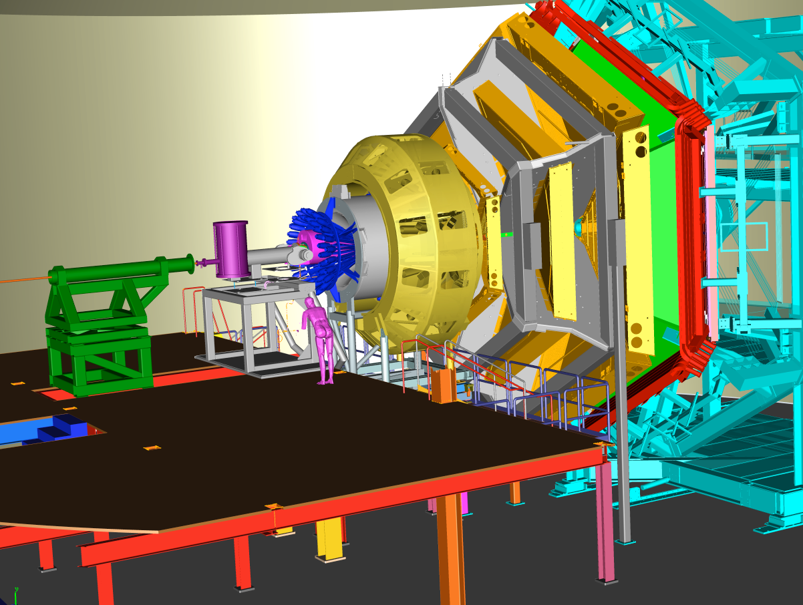
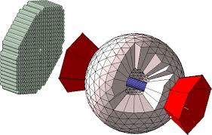
Equipment to explore the excited baryons
CB-ELSA
CLAS
BGO-OD
BES IIII
GLuEx
FROST
CLAS12
Crystal Ball

Slide 5
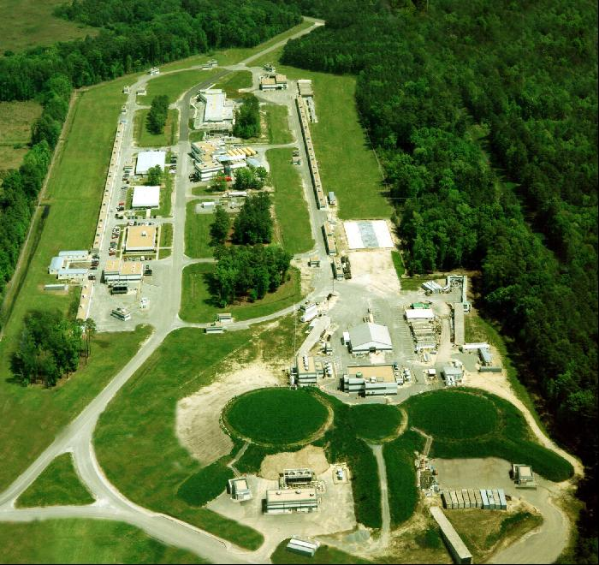
Jefferson Lab Overview
One of 17 U.S. Department of Energy National Laboratories Single program focus on Nuclear Physics Created to build and operate the Continuous Electron Beam Accelerator Facility (CEBAF), world-unique user facility for Nuclear Physics Mission is to gain a deeper understanding of the structure of matter Through advances in fundamental research in nuclear physics Through advances in accelerator science and technology In operation since 1995 Managed for DOE by Jefferson Science Associates, LLC (JSA)
Jefferson Lab by the numbers: 700 employees 169 acre site 1,600 Active Users 27 Joint faculty 608 PhDs granted to-date (211 in progress) K-12 programs serve more than 12,000 students and 950 teachers annually

Slide 6
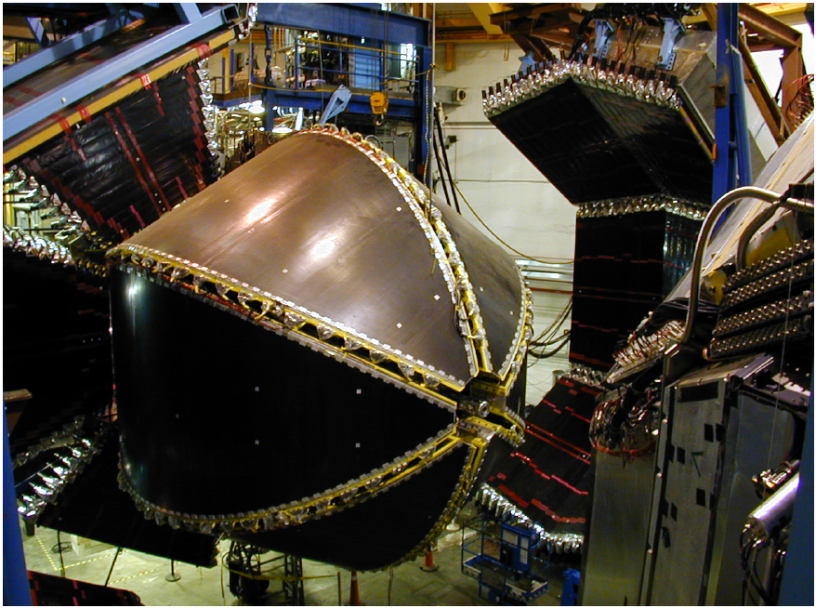
CLAS Experiment 1997- 2012
CLAS12 Experiment 2018 ~
CLAS
CLAS12

Slide 7
N* Program with CLAS at Jefferson Lab
Spectroscopy (mainly driven by real photon scattering)
  Measure the N* spectrum more precisely and more completely.
  The impact of nucleon spectroscopy for QCD compared with that of atomic spectroscopy for QED.
Structure of excited baryons (mainly driven by electron scattering)
  Understanding the effective degrees of freedom

Slide 8
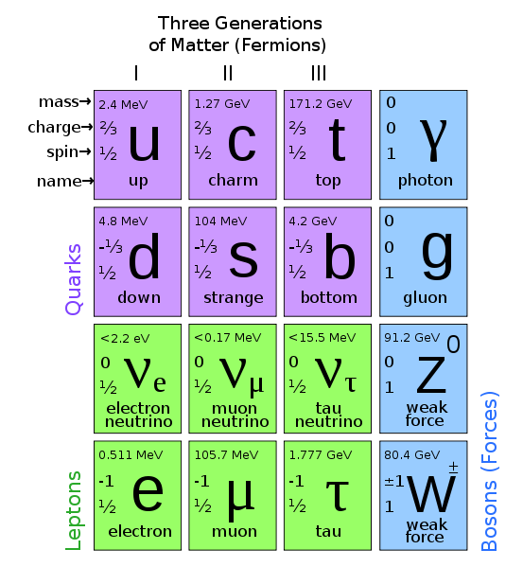
Build your Mesons and Baryons …

Slide 9
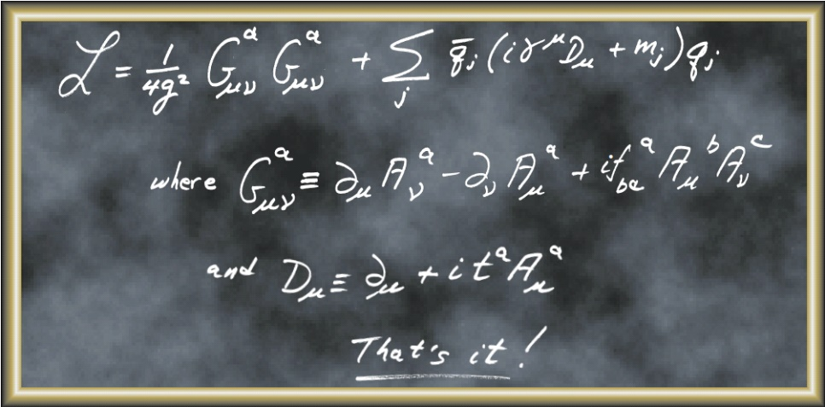
Build your Mesons and Baryons …
Frank Wilczek, Physics Today, August 2000

Slide 10
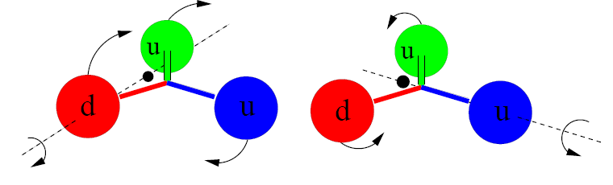
N and Δ Excited Baryon States …
Simon Capstick
Orbital excitations
(two distinct kinds in contrast to mesons)
Radial excitations
(also two kinds in contrast to mesons)

Slide 11
Quark Model Classification of N*
Dietmar Menze
D₁₃(1520)
S₁₁(1535)
+ q³g
+ q³qq
+ N-Meson
+ …
Δ(1232)
Roper P₁₁(1440)
- q²q
- …
1135 MeV 1545 MeV 1839MeV 2130 MeV Mass

Slide 12
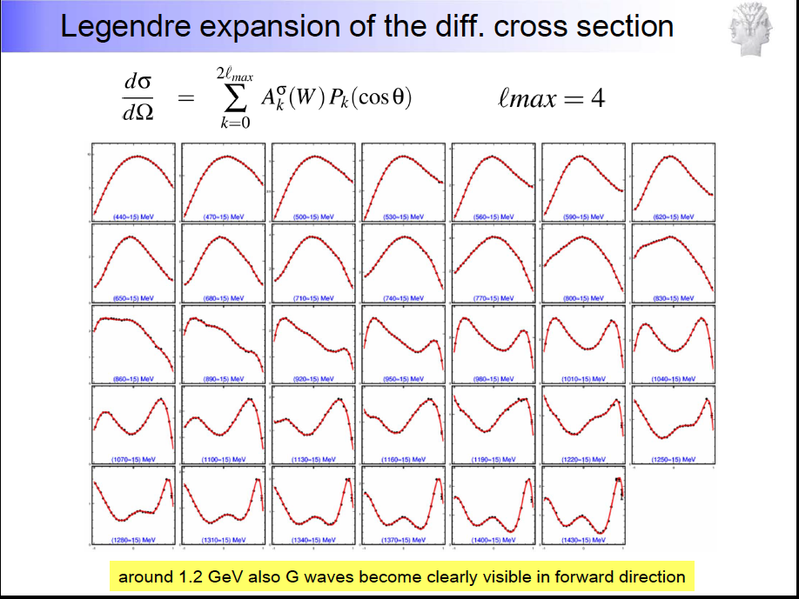
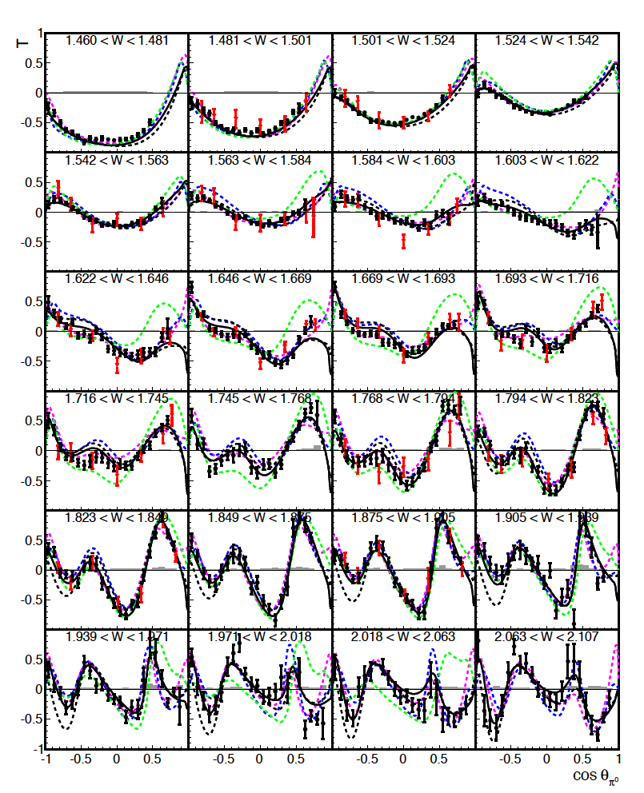
Example of CB-ELSA and MAMI-CB Data
Differential pπ⁰ cross section at MAMI-CB
fitted with L=4 Legendre expansion.
Target Asymmetry in π⁰ production off protons.

Slide 13

Search for excited baryons in 2-body channels
✔ - data acquired ✔ - analyzed/published
Observable | σ | Σ | T | P | E |  | F | G | H | T_{x} | T_{z} | L_{x} | L_{z} | O_{x} | O_{z} | C_{x} | C_{z}
pπ⁰ | ✔ | ✔ | ✓ |  | ✓ |  | ✓ | ✓ | ✓
nπ⁺ | ✔ | ✔ | ✓ |  | ✔ |  | ✓ | ✓ | ✓
pη | ✔ | ✔ | ✓ |  | ✔ |  | ✓ | ✓ | ✓
pη’ | ✔ | ✔ | ✓ |  | ✓ |  | ✓ | ✓ | ✓
K⁺Λ | ✔ | ✔ | ✔ | ✔ | ✓ |  | ✓ | ✓ | ✓ | ✓ | ✓ | ✓ | ✓ | ✔ | ✔ | ✔ | ✔
K⁺Σ⁰ | ✔ | ✔ | ✔ | ✔ | ✓ |  | ✓ | ✓ | ✓ | ✓ | ✓ | ✓ | ✓ | ✔ | ✔ | ✔ | ✔
pω/φ | ✔ | ✔ | ✔ |  | ✔ |  | ✓ | ✓ | ✓ | ✔ SDME
K^{+*}Λ | ✔ |  |  | ✔ |  |  |  |  |  | ✔ SDME
K^{0*}Σ⁺ | ✔ | ✓ |  |  |  |  |  |  |  |  |  | ✓ | ✓ | SDME
pπ⁻ | ✔ | ✔ |  |  | ✔ | ✓ |  | ✓
pρ⁻ | ✓ | ✓ |  |  | ✓ | ✓ |  | ✓
K⁻Σ⁺ | ✔ | ✓ |  |  | ✓ | ✓ |  | ✓
K⁰Λ | ✔ | ✓ | ✓ | ✓ | ✔ | ✓ |  | ✓ |  | ✓ | ✓ | ✓ | ✓ | ✓ | ✓ | ✓ | ✓
K⁰Σ⁰ | ✔ | ✓ | ✓ | ✓ | ✔ | ✓ |  | ✓ |  | ✓ | ✓ | ✓ | ✓ | ✓ | ✓ | ✓ | ✓
K^{0*}Σ⁰ | ✓ | ✓ |  |  |  |  |  |  |  |  |  | ✓ | ✓
2018
γp→X
Talk by Sokhan
Talk by Kageya
γn→X
13
Notes:
Many exclusive 2-body processes have been measured, including diff. cross sections, beam polarization asymmetries, recoil polarization, and target polarization asymmetries and many double-polarization observables, both for hydrogen and deuterium targets. In the following several slides I will show measurements of 4 reaction channels and what we have learned about baryon resonances from these.
The most complete data sets are in Lambda and Sigma hyperon production where also the Lambda recoil polarization is measured. The second set is vector meson production where the spin-density matrix elements are also determined, and finally, single pion production including polarization asymmetries on proton and neutrons.

Slide 14

Establishing the N* spectrum
Hyperon photoproduction γp→K⁺Λ→K⁺pπ⁻
M. Mc Cracken et al.(CLAS), Phys.RevC81,025201,2010
Fit: A.V. Anisovich et al, EPJ A48, 15 (2012)

Slide 15

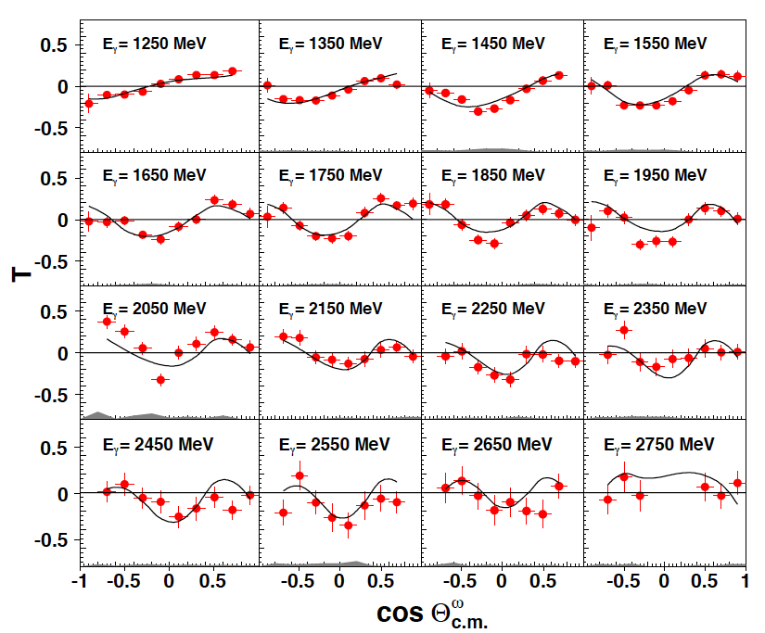
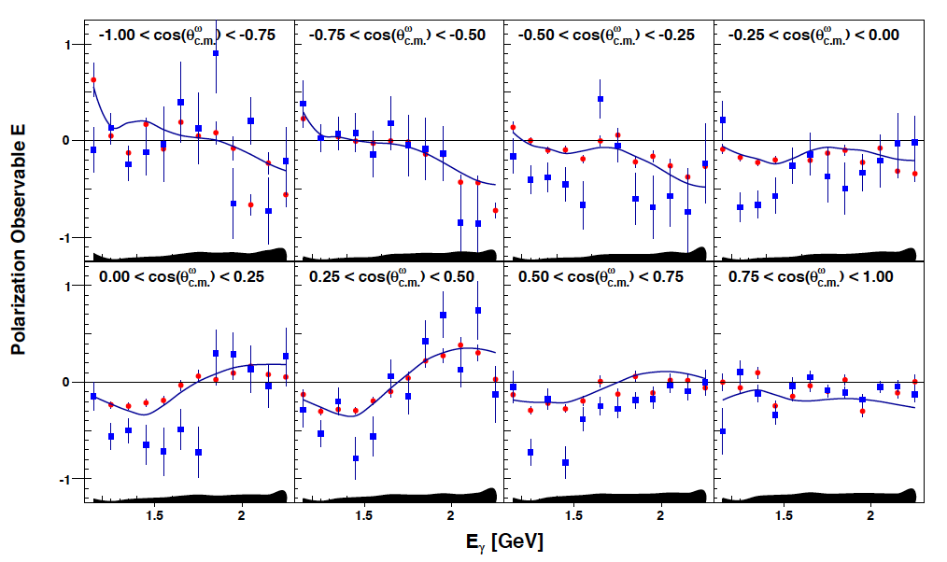
Target T and beam-target E spin asymmetries
p(γ,pω)
CLAS
Transverse target
Longitudinal target
CBELSA
T
E
P. Roy et al. PRC97 (2018) no.5, 055202
Fit: Bonn-Gatchina

Slide 16
Establishing the N* and Δ* Spectrum
Precision data require accurate analysis procedures to establish the baryon spectrum
QCD
V.B., T.S.-H. Lee
IJMP E13 (2004)
LQCD
N*, Δ*
F*₁, F*₂
DSE, RQM
π, η, ππ, K
Reaction
Theory
Dispersion
Relations
γ
Amplitude
analysis
N*,△*
N
N, Y
Data
Hadronic
production
Electromagnetic
production

Slide 17
Quark Model Classification of N*
Dietmar Menze
BnGa energy-dependent coupled-channel PWA of CLAS K⁺Λ and other data
2012
2010
naive q²q model 7
1135 MeV 1545 MeV 1839MeV 2130 MeV Mass

Slide 18
New evidence for excited nucleons
State N((mass)J^{P} | PDG pre 2012 | PDG 2018 evidence | Mass (Pole)
N(1710)1/2⁺ | *** | **** | 1700
N(1880)1/2⁺ |  | *** | 1860
N(2100)1/2⁺ | * | *** | 2100
N(1895)1/2⁻ |  | **** | 1910
N(1900)3/2⁺ | ** | **** | 1920
N(1875)3/2⁻ |  | *** | 1900
N(2120)3/2⁻ |  | *** | 2100
N(2060)5/2⁻ |  | *** | 2070
Δ(2200)7/2⁻ | * | *** | 2150
**** - existence is certain
*** - existence is likely
** - evidence of existence is fair
* - evidence of existence is poor
Photoproduction data led to the discovery of new states and fully established poorly known states.

Slide 19
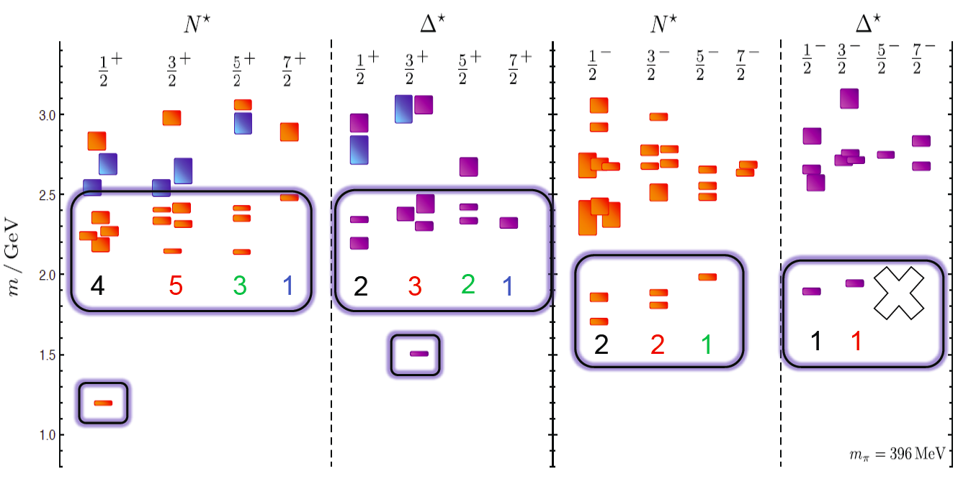
N* Spectrum in LQCD
The strong interaction physics is encoded in the nucleon excitation spectrum that spans the degrees of freedom from meson-baryon and dressed quarks to elementary quarks and gluons.
LQCD predicts states with the same quantum numbers as
CQMs with underlying SU(6)xO(3) symmetry.
R. Edwards et al., arXiv:1104.5152, 1201.2349

Slide 20
Structure of Excited Baryons with Electromagnetic Probes
Q²
Study the structure of the nucleon spectrum in the domain where dressed quarks are the major active degree of freedom.
Explore the formation of excited nucleon states in interactions of dressed quarks and their emergence from QCD.
π,ρ,ω…
low
N,N*,Δ,Δ*…
k
3q-core+MB-cloud
K_{2μ}
B
P_{2μ}
*
3q-core
²
Q² = −K_{μ}
K_{1μ}
N
P_{1μ}
pQCD
high
20

Slide 21

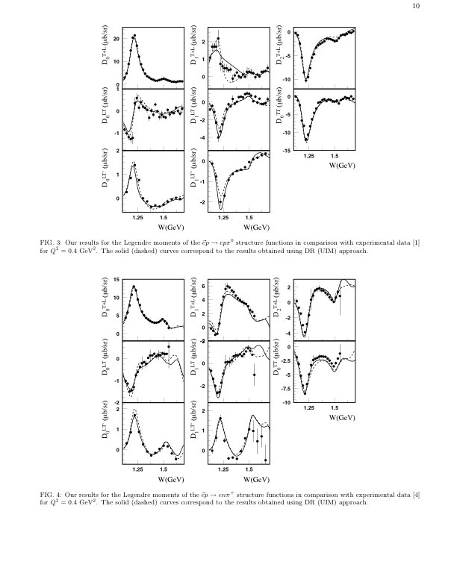
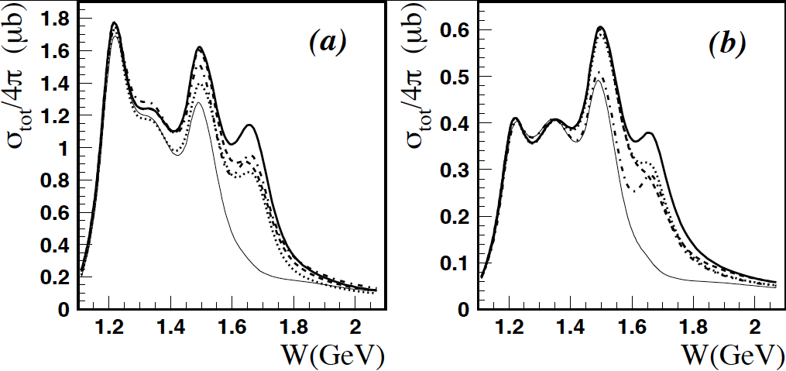
Integrated cross section at W<2GeV
γ*p π⁺n
K. Park et al., PR C77 (2008) 015208; PR C91 (2015) 045203
Why study more than one resonance, aren’t they all the same?
15
Q²=0.4GeV²
Q²=1.7GeV²
Q²=3.15GeV²
σ_{tot}/4π (μb)
10
5
Δ(1232)
N(1520)
Δ(1232)
Roper
N(1520)
Δ(1232)
Roper
N(1520)
Roper
1.25
1.5
1.75
W(GeV)
→ States with different quantum numbers respond differently to increase in Q².

Slide 22
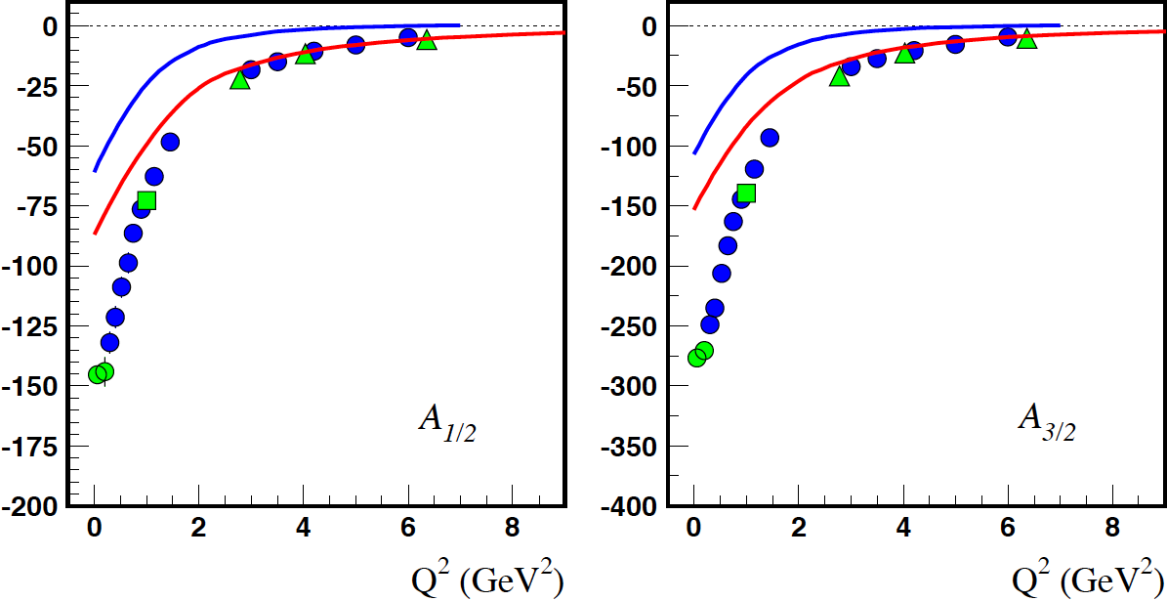
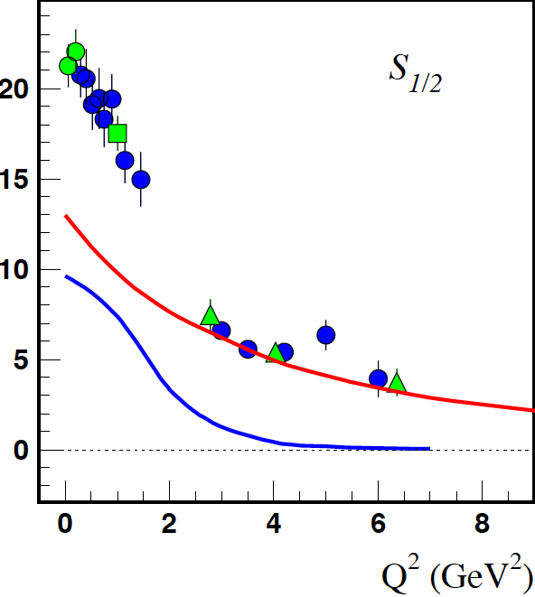
q³ and MB contributions in NΔ(1232)
LC RQM
At Q² = 0 => MB/q³ = 0.7
At Q² > 3 GeV²: => MB/q³ < 0.15
MB (inferred)

Slide 23
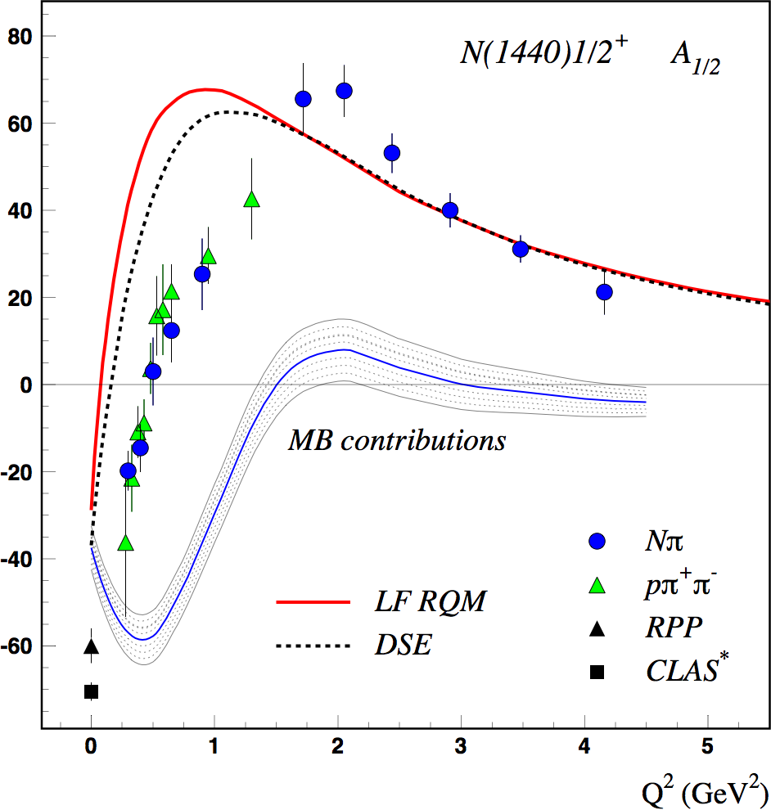
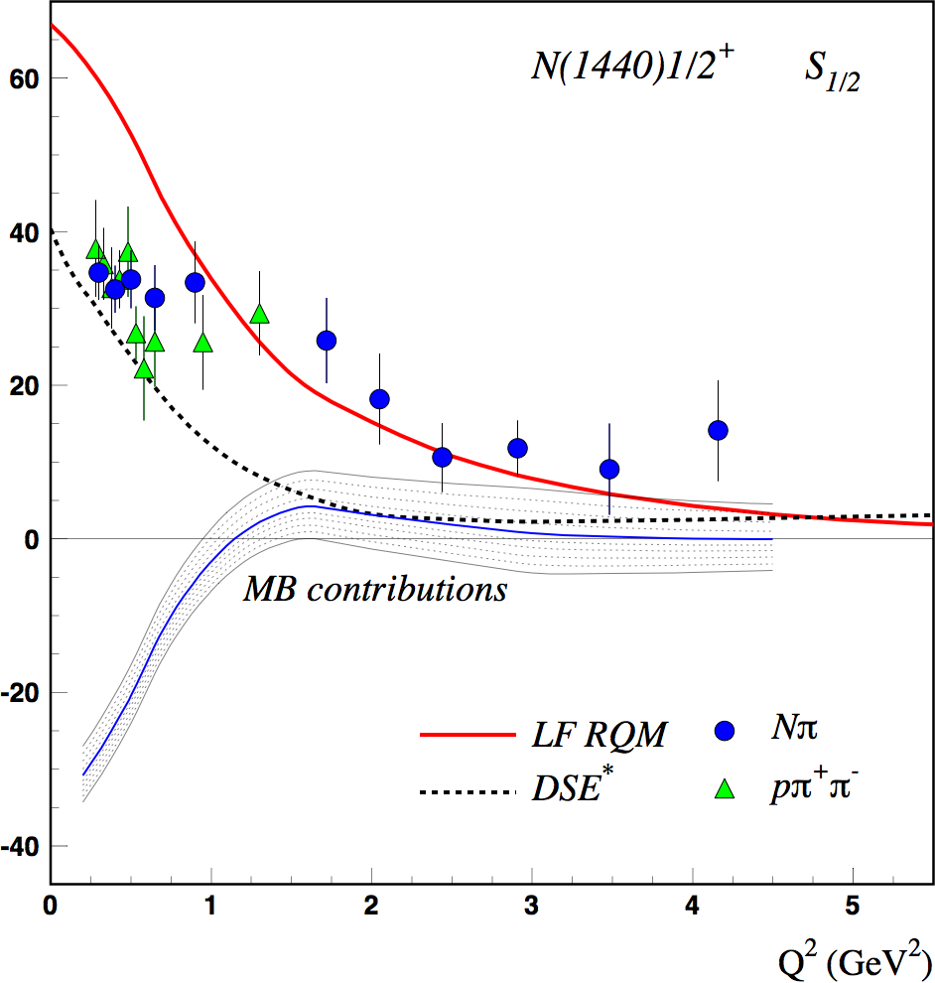
Solving the Roper N(1440)1/2⁺ Puzzle
DSE: J. Segovia et al., PRL 115 (2015); 1504.04386
LF RQM: I. Aznauryan, V.B., 1603.06692
Importance of MB at Q² < 1.5GeV². Quark core contributions dominate at Q² > 2 GeV²
The 1st radial excitation of the 3-quark core seen when the probe penetrates the MB cloud.

Slide 24
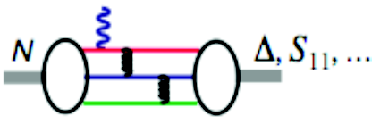
Evidence for the Onset of Precocious Scaling?
I. G. Aznauryan et al., Phys. Rev. C80, 055203 (2009)
S₁₁ Q³A_{1/2}
F₁₅ Q⁵A_{3/2}
P₁₁ Q³A_{1/2}
D₁₃ Q⁵A_{3/2}
A_{1/2} α 1/Q³
A_{3/2} α 1/Q⁵
F₁₅ Q³A_{1/2}
D₁₃ Q³A_{1/2}
24

Slide 25
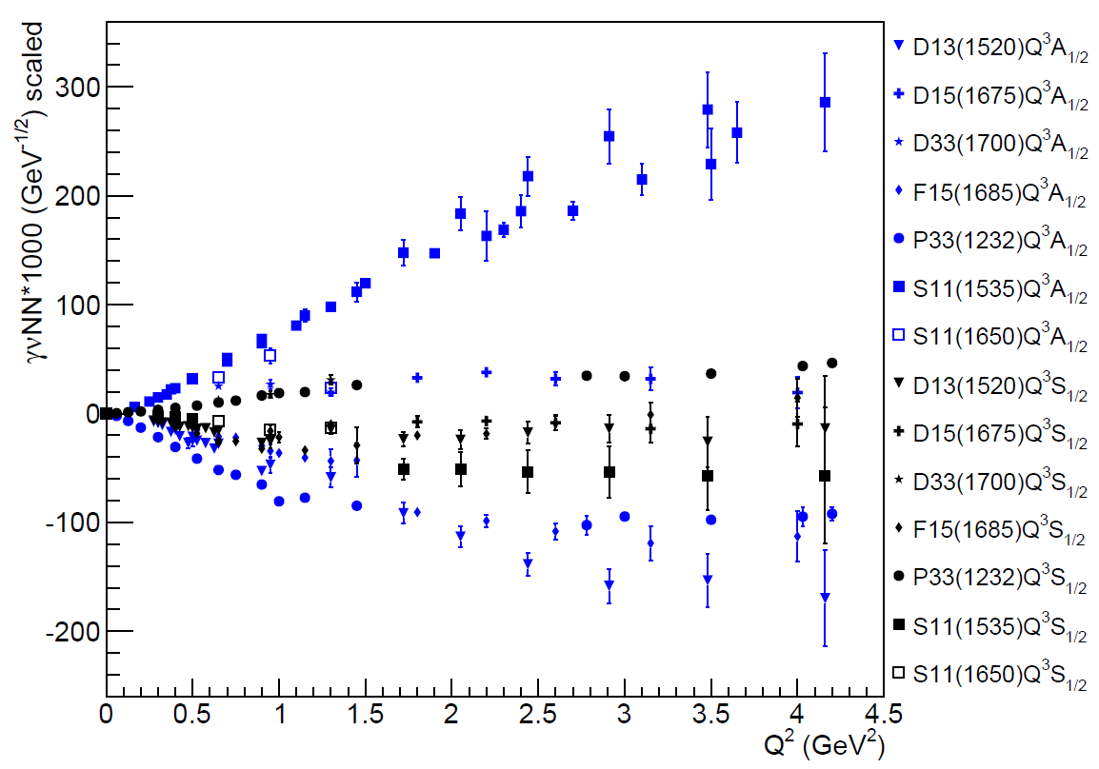
Evidence for the Onset of Precocious Scaling?
Ye Tian
V. Mokeev, userweb.jlab.org/~mokeev/resonance_electrocouplings/ (2016)
25

Slide 26
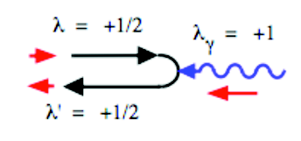
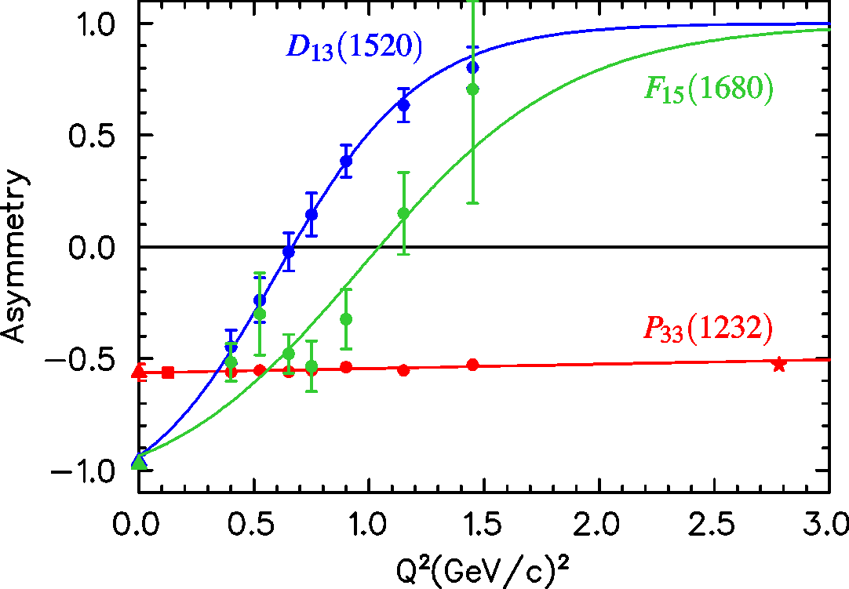
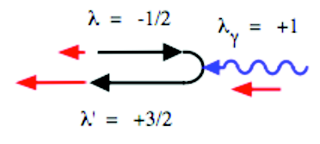
N(1520)D₁₃ Helicity Asymmetry
A_{1/2}² – A_{3/2}²
10⁻³ GeV^{-1/2}
A_{hel} =
A_{1/2}² + A_{3/2}²
A_{1/2}
L. Tiator
A_{3/2}
world data
PDG estimation
Nπ (UIM, DR)
Nπ, Nππ combined analysis
Nππ (JM)
26

Slide 27
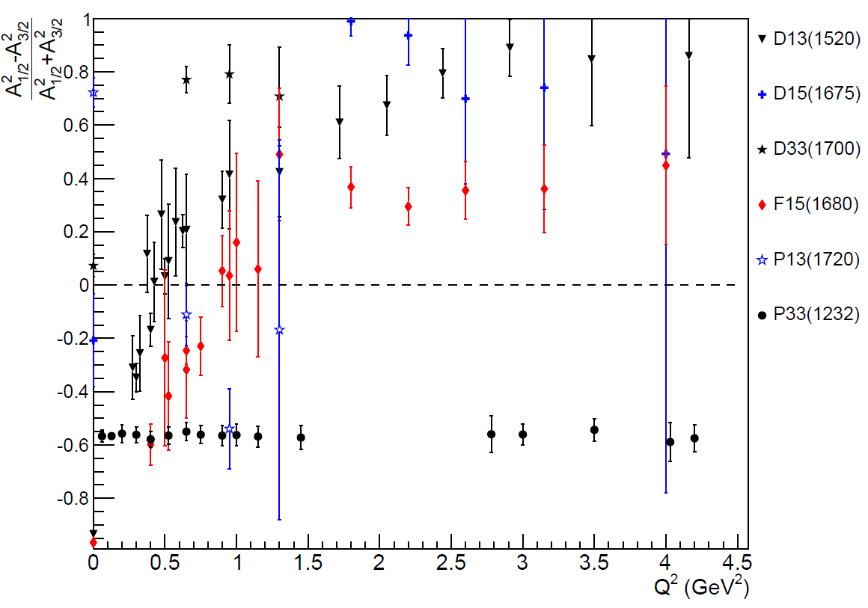
γNN* Helicity Asymmetries
Ye Tian
V. Mokeev, userweb.jlab.org/~mokeev/resonance_electrocouplings/ (2016)
27

Slide 28
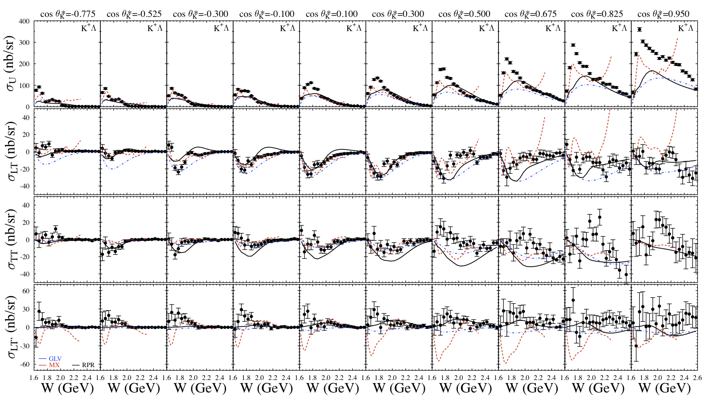
K⁺Λ Structure Functions
[Carman et al., PRC 87, 025204 (2013)]
E = 5.499 GeV, W: thr – 2.6 GeV, Q² = 1.80, 2.60, 3.45 GeV²
CLAS12 experiments E12-06-108A and E12-16-010A
28

Slide 29
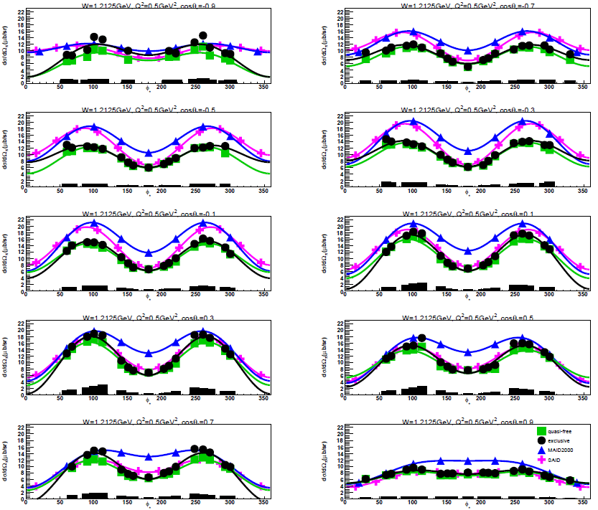
Single π ⁻ Electroproduction off the Deuteron
Ye Tian
W = 1212 MeV
ΔW = 25 MeV
Q² = 0.5 GeV²
ΔQ² = 0.2 GeV²
Preliminary
cos(θ) = -0.7
Δcos(θ) = 0.2
cos(θ) = 0.7
= 20º
Δφ = 40º
φ = 340º
29

Slide 30
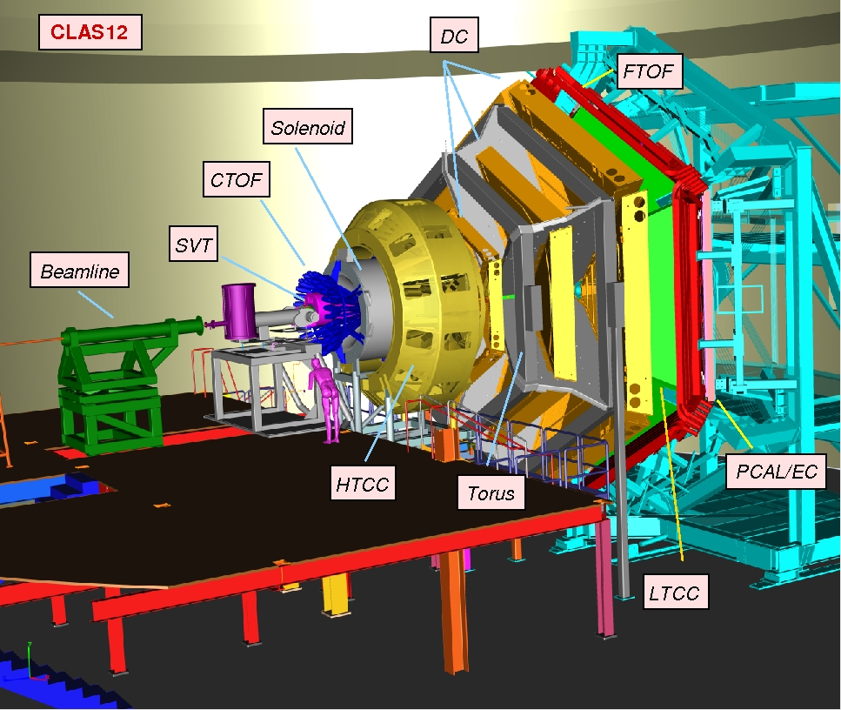
CLAS12 N* Program
Extend the Q2 to a higher range.
Study the hyper-baryon program.
Map out the transition of strong QCD to pertubative QCD
30

Slide 31
Summary
First high precision photo- and electroproduction data have become available and led to a new wave of significant developments in N* program.
Large amounts of high precision data and multi-channel PWA have been essential in the discovery of new N* resonances.
So far there is only qualitative agreement of the measured spectrum with LQCD predictions.
Electroexcitation of nucleon resonances are sensitive to the effective degrees of freedom versus distance scale.
The N* experimental program to higher energies gives access to domains where the transition from dressed to elementary quarks should occur.

