Slide 1
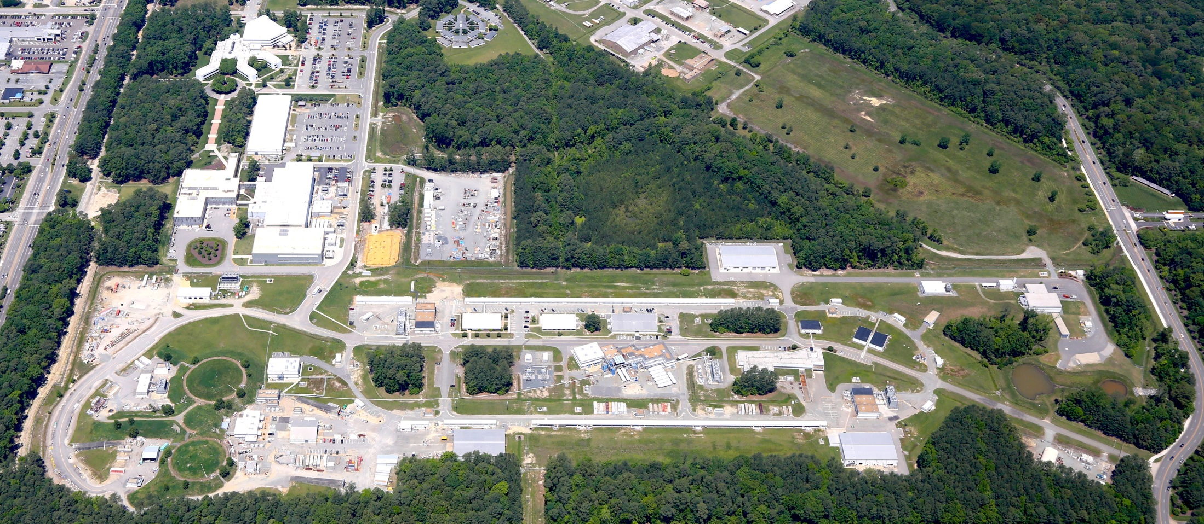

Studies of TMD Partonic Distributions at JLab
Patrizia Rossi

Slide 2
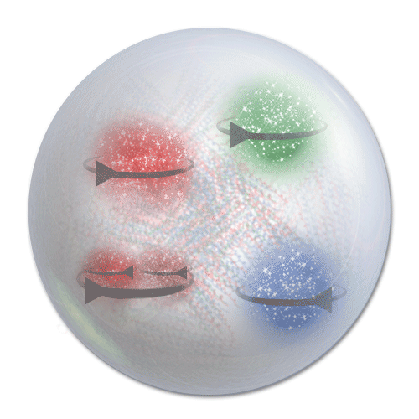

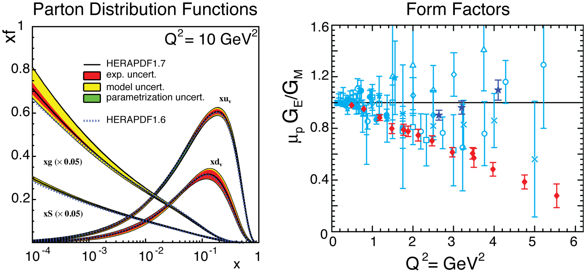
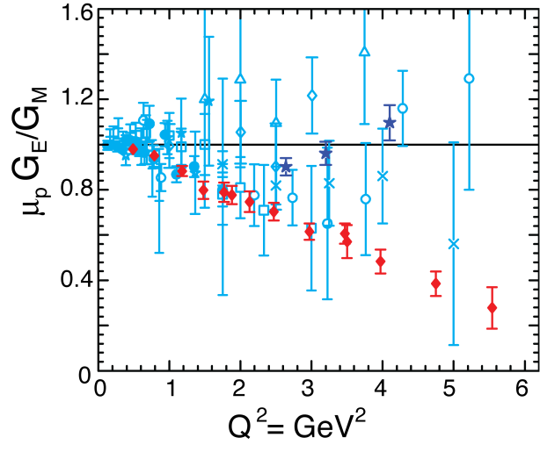
Unified View of the Nucleon Structure
Extended object (1 fm)
Quarks (charged) & gluons (neutral)
Quark-antiquark pairs (sea)
Spin, orbital angular momentum
Tansverse Momentum Dependent distributions
Generalized Parton
Distributions
3D
∨
∨
PDFs
f₁^{u}(x), .. h₁^{u}(x)‏
Form Factors
G_{E}(Q²), G_{M}(Q²)‏
1D
  Major capability with JLab @ 12 GeV: A NEW eye to study the nucleon
  Nucleon femtography and comprehensive description of its internal dynamics
2

Slide 3
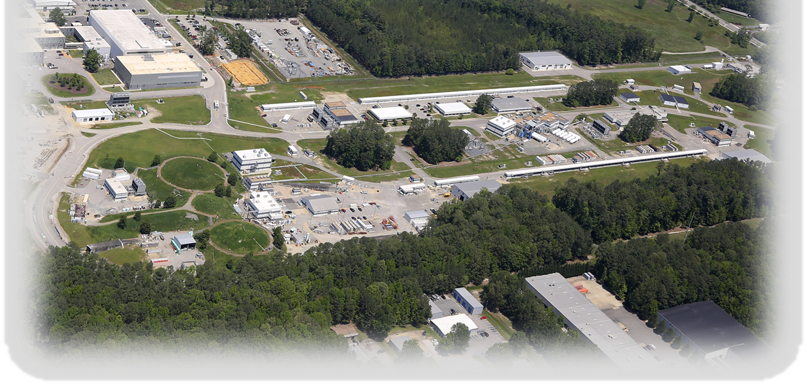
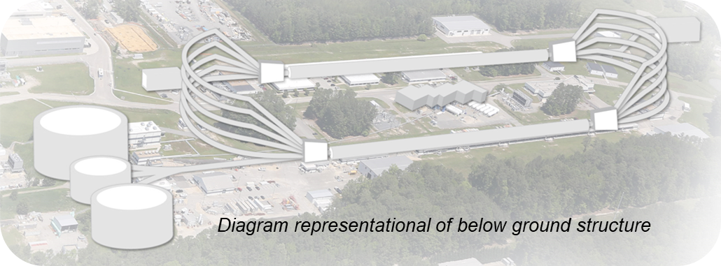
CEBAF at Jefferson Lab
Located in Newport News (VA) – In operation since 1995
D
2
1
3
A
3
2
INJECTOR
LINACS
RECIRCULATION ARCS
B
C
CEBAF World-leading Capabilities
Nuclear experiments at ultra-high luminosities, up to 10³⁹ electrons-nucleons /cm²/ s
World-record polarized electron beams
Highest intensity tagged photon beam at 9 GeV
Unprecedented stability and control of beam properties
Ability to deliver a range of beam energies and currents to multiple experimental halls simultaneously
CEBAF Upgrade completed in September 2017
  CW electron beam
  E_{max} = 12 GeV
  I_{max} = 90 μA
  Pol_{max} ~ 90%
Physics Operation
  4 halls running simultaneously since January 2018

Slide 4
Jefferson Lab’s Mission
JLab’s primary mission is to explore the fundamental nature of confined states of quarks and gluons, including the nucleons that comprise the mass of the visible universe.
  How are quarks confined in nuclear matter?
  What is the internal landscape of protons and neutrons?
  How do the properties of protons and neutrons emerge from their constituent quarks and gluons?
  How do the nuclear forces that lead to nuclei, arise from the basic interactions?
Low energy test of SM
Hadron Spectra as probes of QCD
Trans. Struct. hadrons
Hadrons and cold nuclear matter
Long. structure of hadrons
3D structure of hadrons
12 GeV Physics Program: A Decade of Approved Experiments
Can we discover evidence for physics beyond the standard model ?

Slide 5
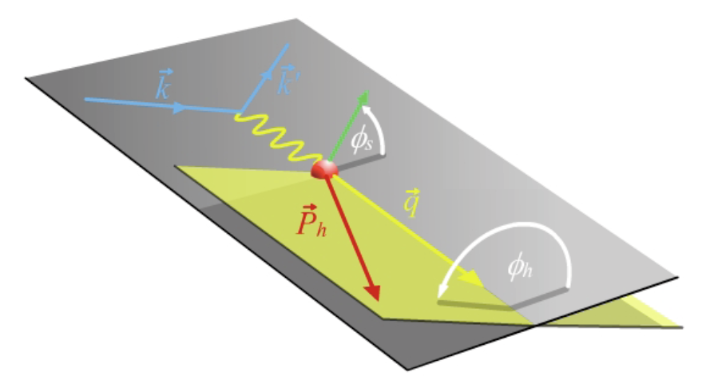
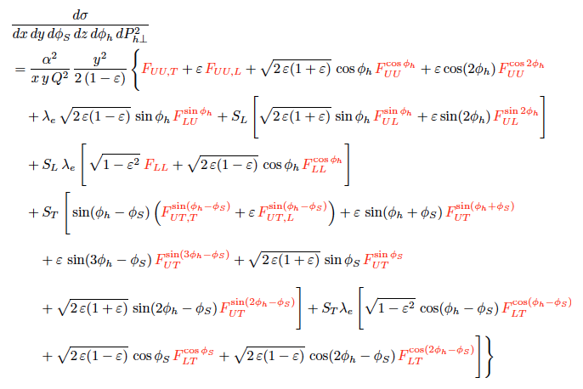
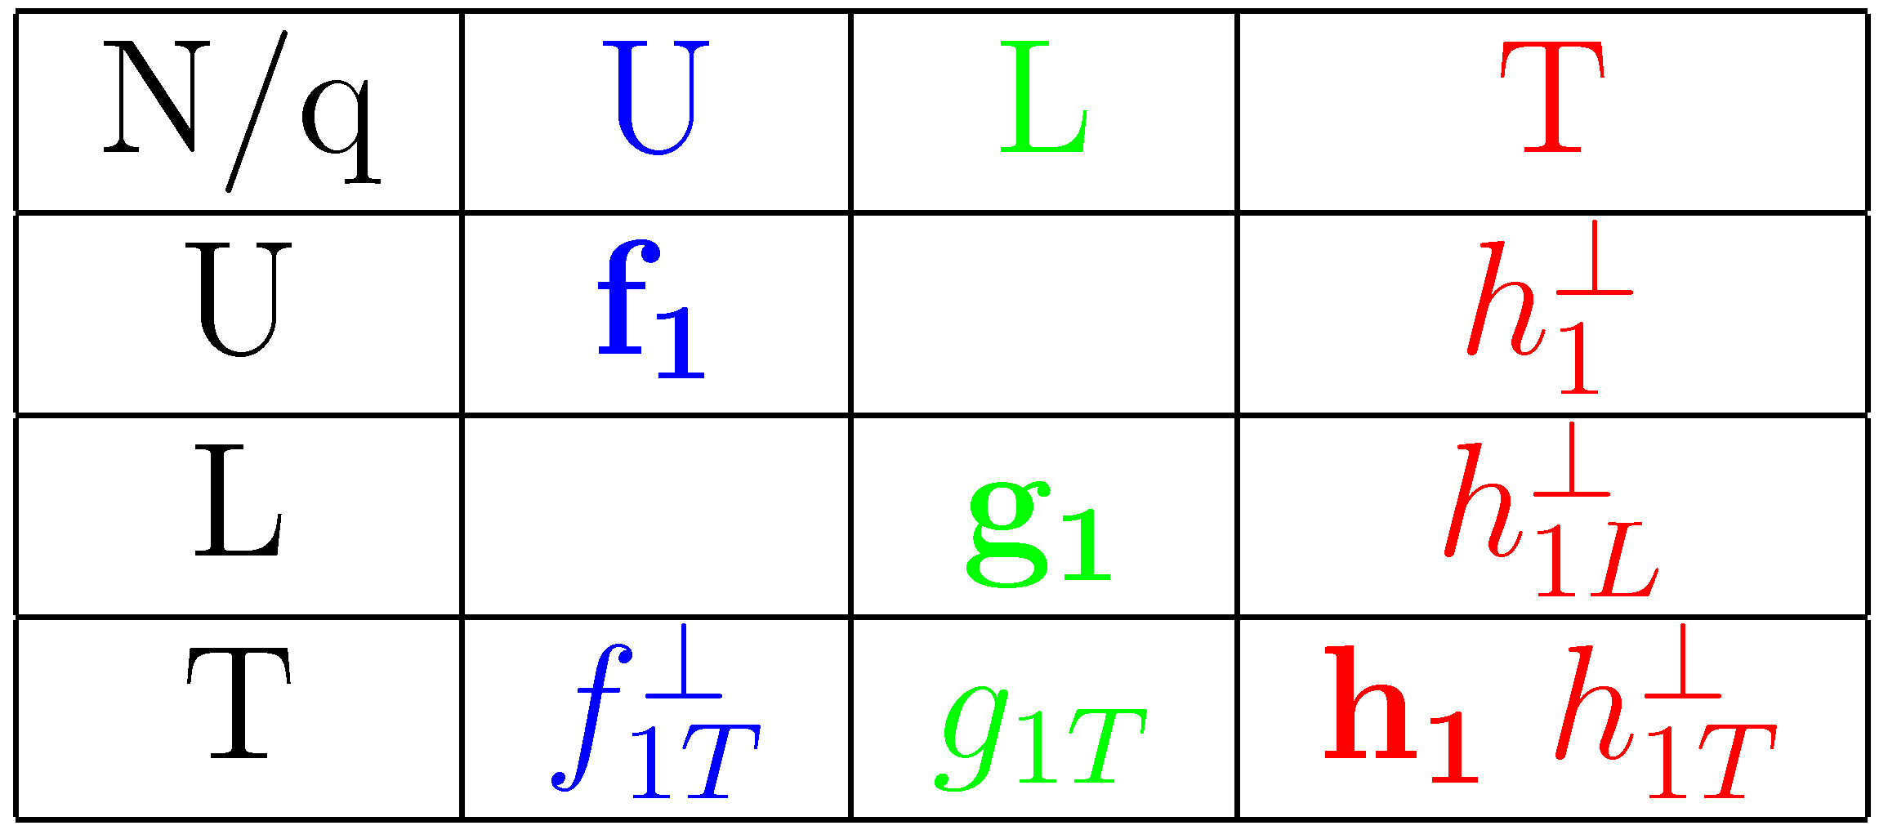

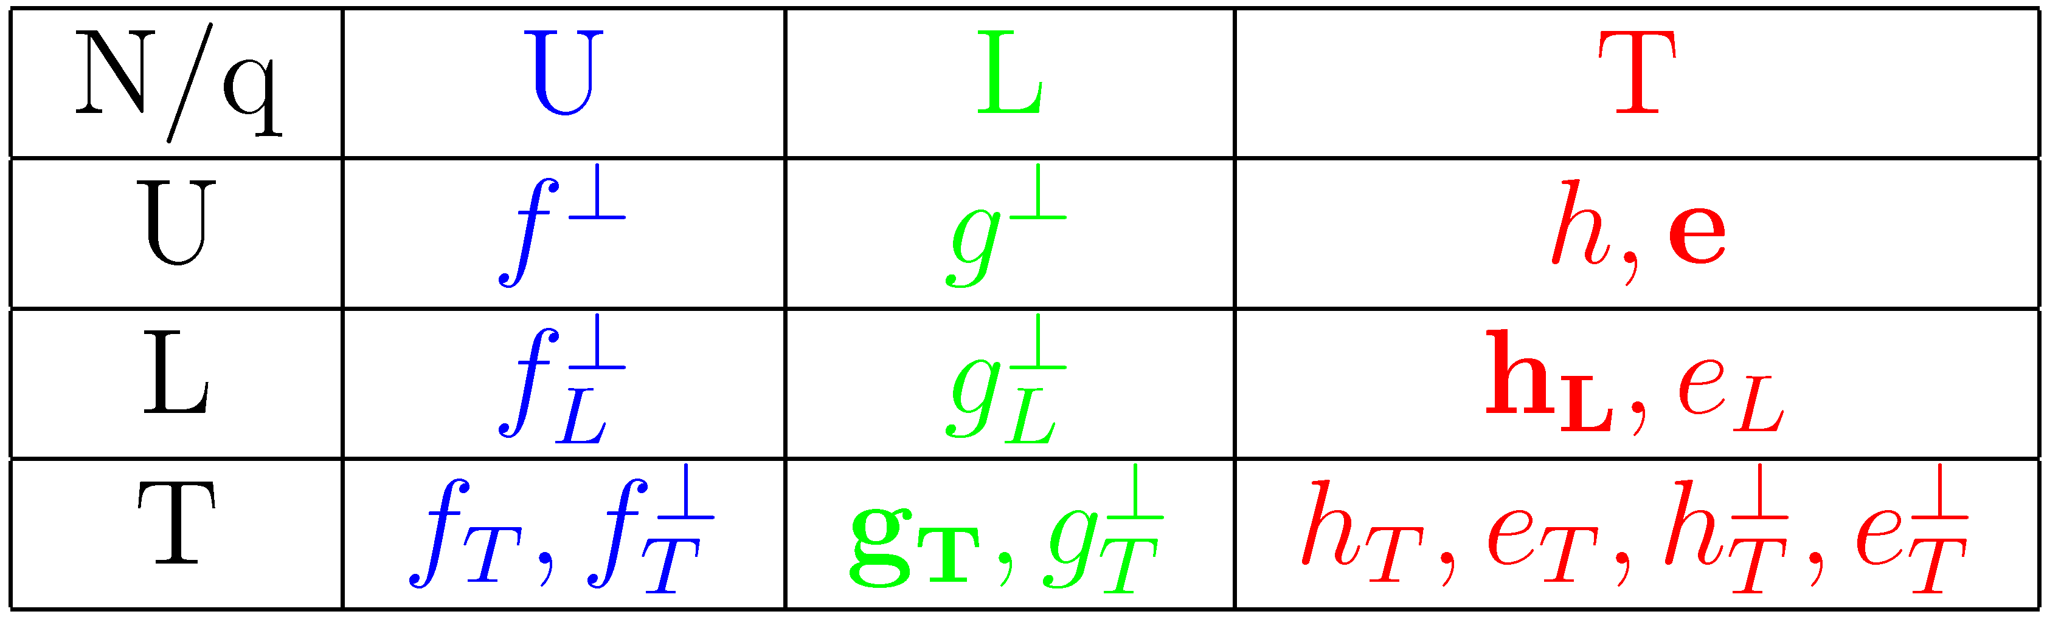
SIDIS
Q²=(k-k’)² ν=E-E’ x=Q²/2Mν z=E_{h}/ν y=ν/E
target angle
Scattering Plane
hadron angle
Leading Order – Leading Twist
Higher Twist
Provide informations on quark-gluon correlations ➔ a key for understanding long-range quark-gluon dynamics
Probability denstities

Slide 6
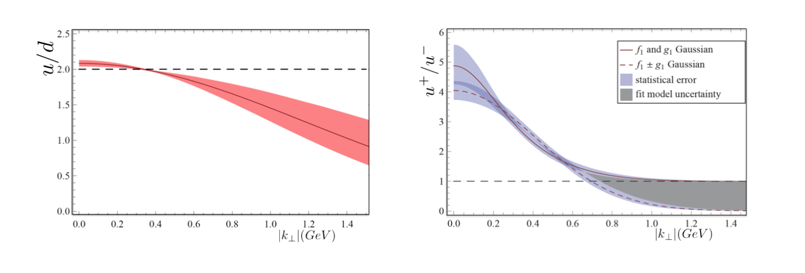
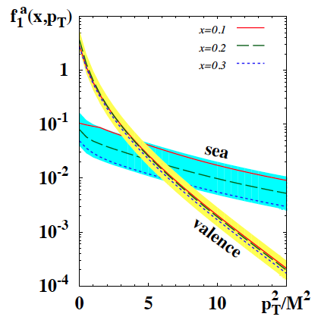
What we have learned so far…
Experiments at JLab, COMPASS and HERMES have collected a wealth of SIDIS data used for an initial understanding of the 3D structure of the nucleon
Data and predictions from dynamical models and lattice suggest that orbital structure of partonic distributions depends on quark flavor and spin, valence and sea quarks,…
Precision data (x-sec., asymmetries,..) from large variety of reactions with different targets & pol. essential to pin down the 3D nucleon structure
B.Musch et al PRD83 (2011) 094507
0 0.5 1.0
P.Schweitzer et al. JHEP 01 (2013) 163
Robust procedure for extractions & validation
Comprehensive approach: - computational
- theoretical
- phenomenological
B.Musch et al PRD83 (2011) 094507
Status of TMD extractions is still in an early stage of development with several challenges
B.Musch et al PRD83 (2011) 094507
Notes:
Higher probability to find a quark anti-aligned with proton spin at large k_{T}

Slide 7
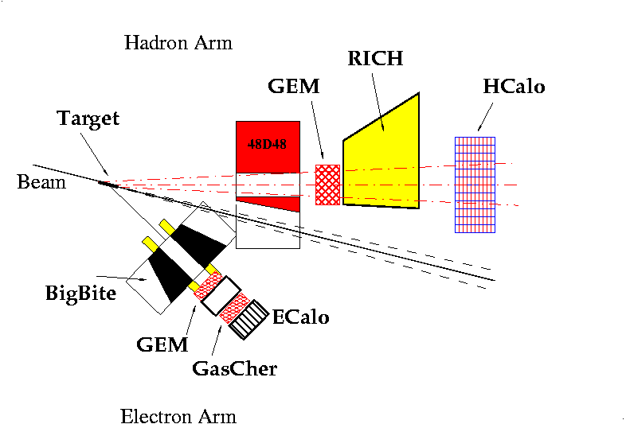
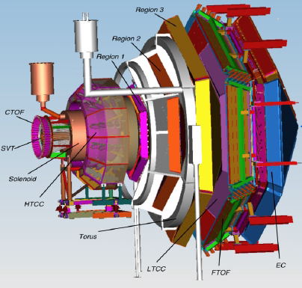
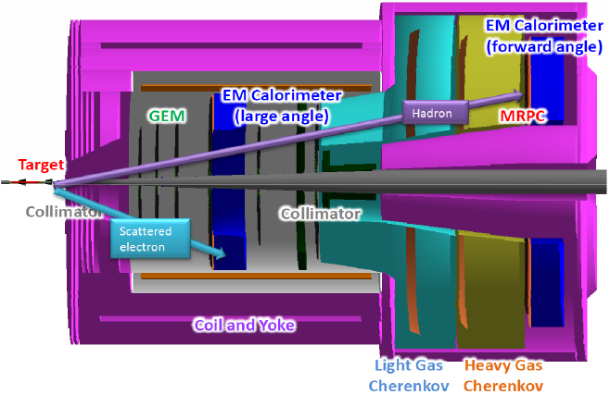
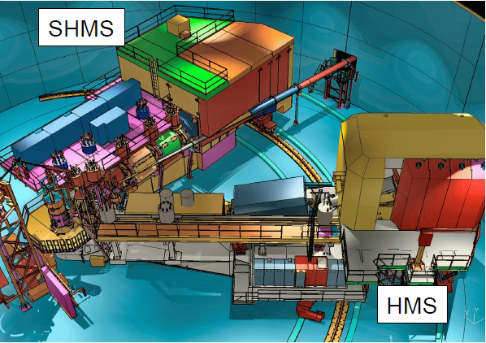
Multi-Hall SIDIS Program
SBS
Use advantages of multi-hall approach
Hall B: Large acceptance (CLAS12)
Unpolarized and polarized H & D targets
azimuthal distributions of final-state particles
cross sections, single & double-spin asymmetries
start kaon SIDIS program with RICH detector
Hall C: SHMS + HMS
Precision magnetic-spectrometer setup, π and K, high luminosity, unpolarized target
L/T separations in SIDIS
precision cross sections and ratios of π⁺ and π⁻ (and K⁺, K⁻)
Hall A: Forward Large acceptance (SoLID) polarized ³He target
longitudinal & transversely polarized ³He
pion & kaon run with BigBite and SBS
→ Access to n structure at high-x and high-Q²
CLAS12
SoLID
SHMS
HMS
7

Slide 8
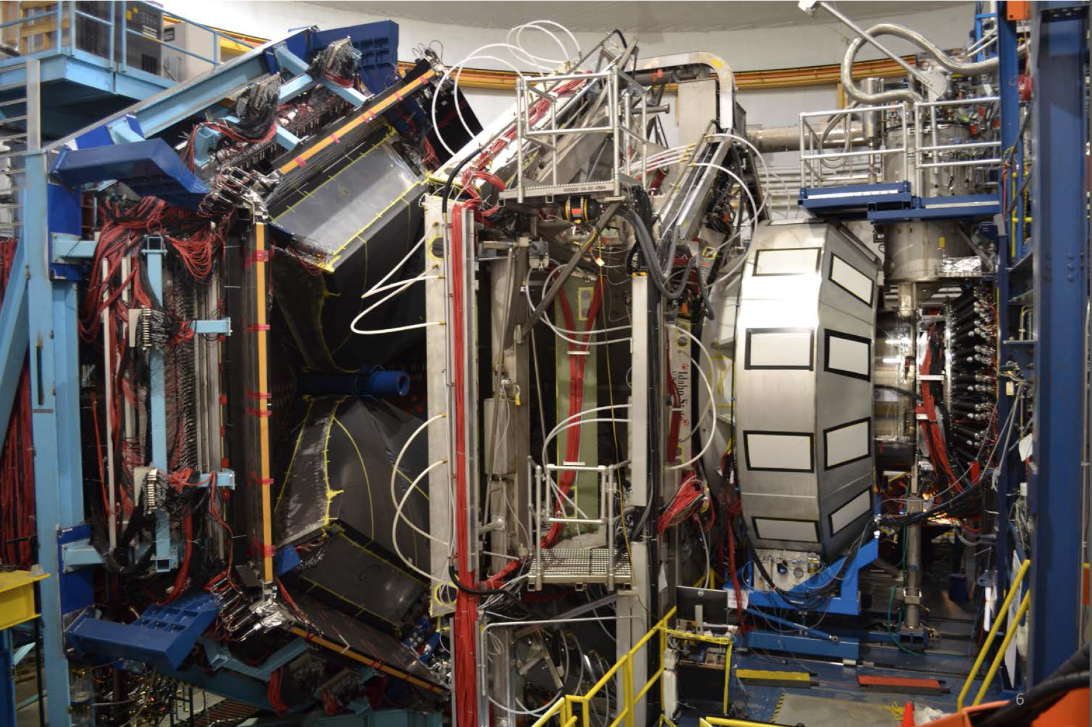
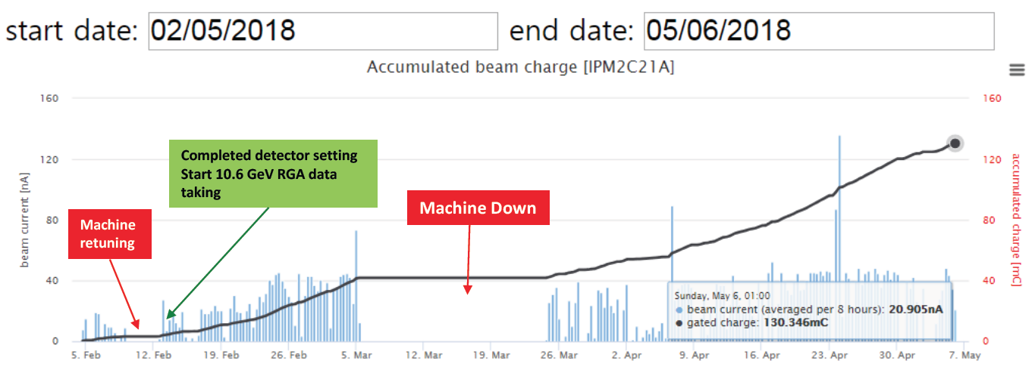
SIDIS 12 GeV Program Just Started….
CLAS12
Feb. 2018 / May 2018
Run Group A (comprises 13 different experiments)
  Target = Un. Hydrogen
  E_{e} =10.6 GeV, P >80%
Total luminosity collected corresponding to about 15% of assigned time
8

Slide 9
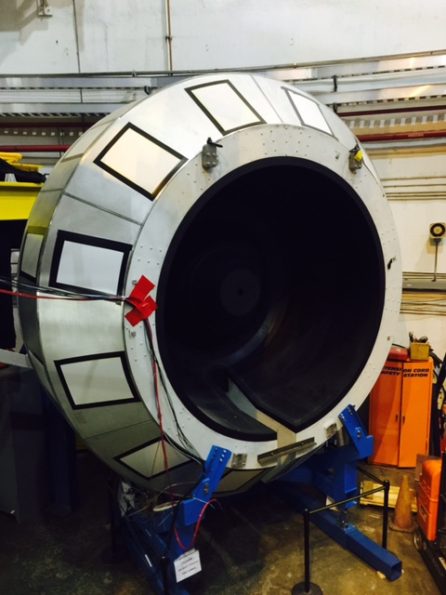
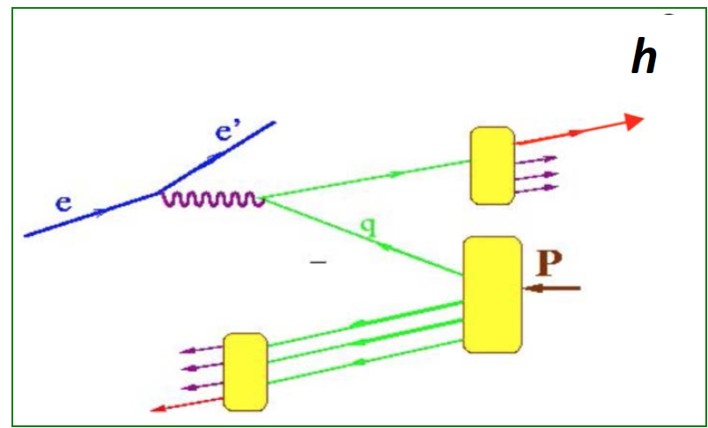
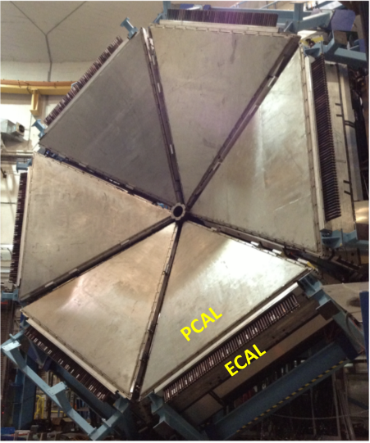
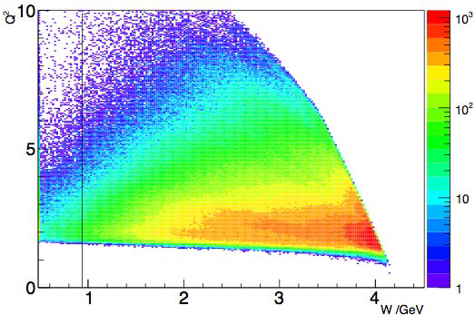
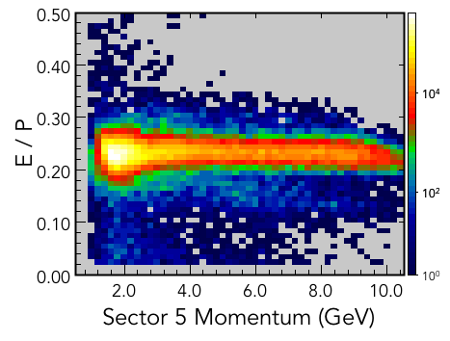
SIDIS Kinematic Coverage
e p → e’ h X
h = π⁺, π⁻, π⁰,…
e.m. calorimeter
Inclusive electrons
HTCC
Q² > 1 GeV² W > 2 GeV
Electron ID
9

Slide 10
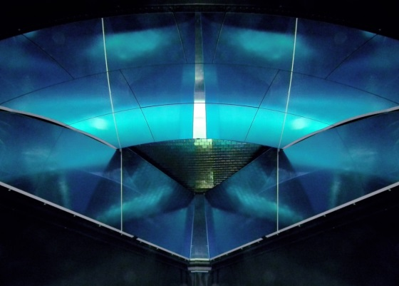
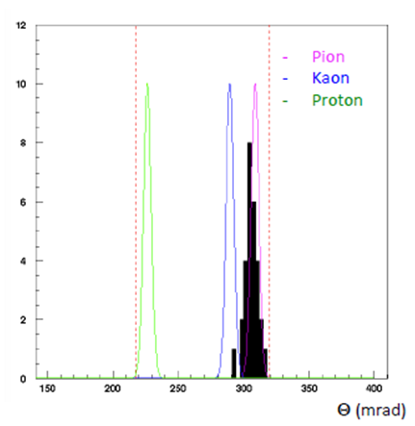
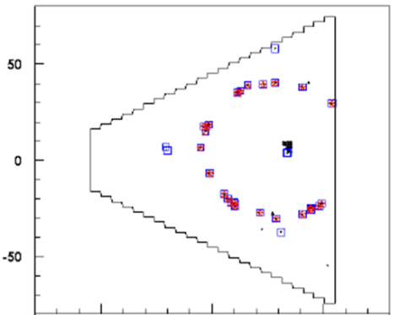
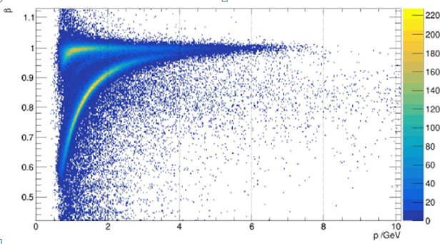
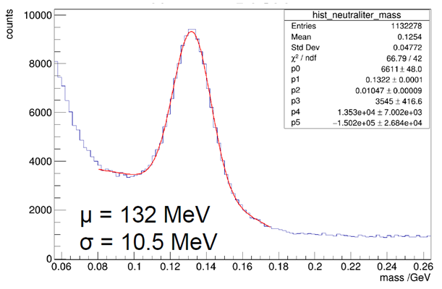
Hadrons Identification
Time-of0Flight
RICH
e.m. calorimeter
π⁰➔2γ
Eγ > 400 MeV
Kaons
Charged Hadrons
P=4.3 GeV/c
R_{QP}(π)=0.997
positive charge, β vs p
Detector performances are confirming the expectations, but calibration is still in progress
10

Slide 11
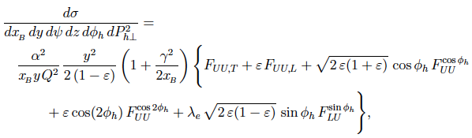
Unpolarized SIDIS
Leading Order – Leading Twist
HT
HT
HT
HT
F_{UU}: φ_{h}- integrated cross section. Transverse momentum dependence of the Multiplicities provides leverage in the quest to unfold, from the transverse hadron momentum P_{hT} , the intrinsic quark k_{T} and fragmentation p_{T}
F_{UU} cos2φ_{h}: h₁⊥ describes correlation between the transverse momentum and transverse spin of quarks; H₁⊥ describe fragmentation of transversely polarized quarks into an unpolarized hadron
Measured Higher Twists asymmetries in most of the cases found to be very significant.
11

Slide 12

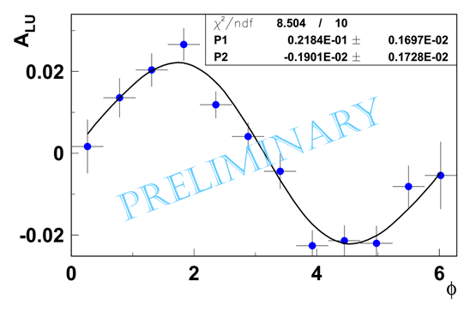
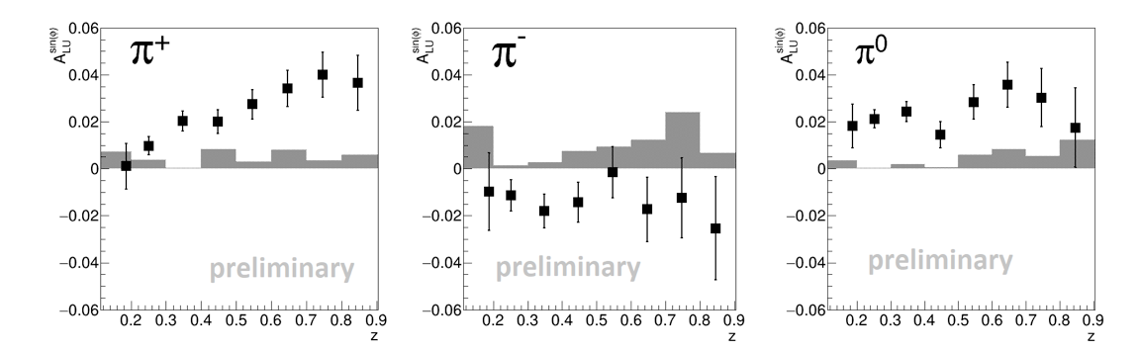
Pion Beam Spin Asymmetry
One day of data taking
Q²>1 GeV² W>2 GeV
Fully integrated kinematics
Results compatible with CLAS @ 6 GeV & Hermes
Other preliminary results about to be released:
Beam SSA for dihadrons
Multiplicities
12

Slide 13
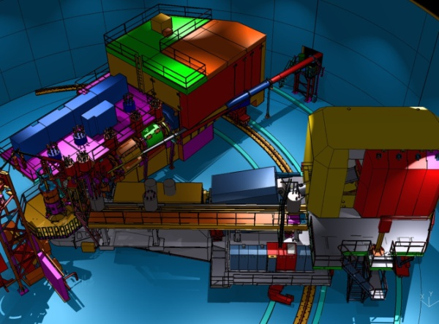
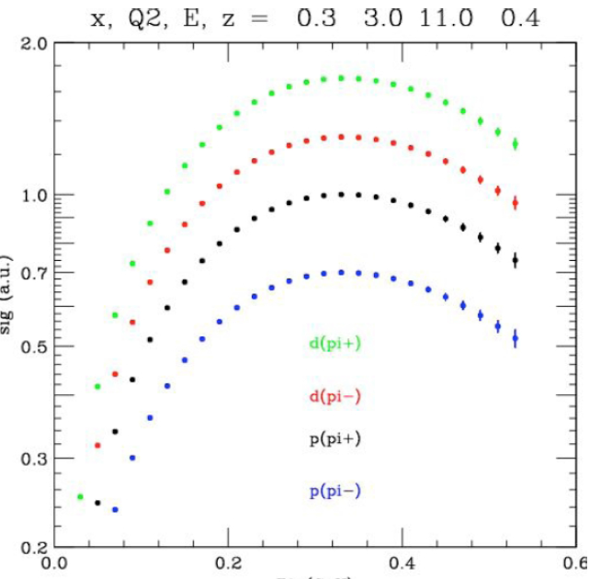
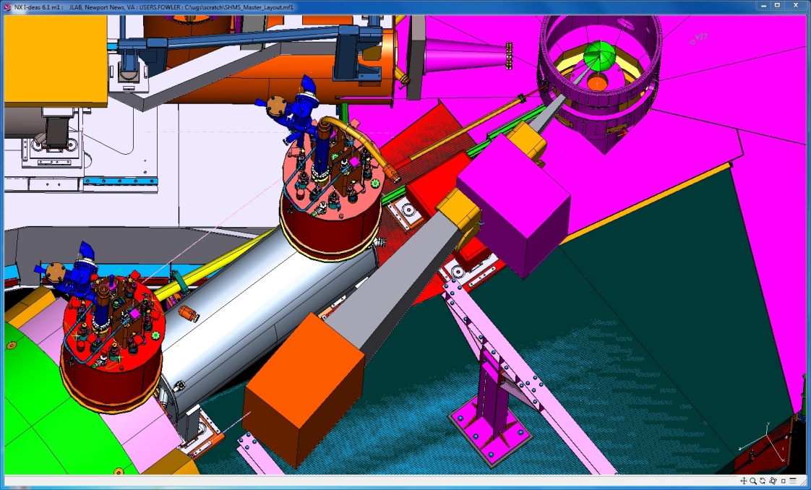
Hall C: SHMS + HMS (+ NPS)
Precise measurements of absolute cross-sections (O 1%) and p_{T} dependence π^{+/-/0} and K^{+/-} on p & d
In the range: 0.2 < x < 0.5, 2 < Q² < 5 GeV² ,0.3 < z < 0.5, P_{t} < 0.5 GeV
π^{+/-} K^{+/-} configuration
SHMS
HMS
E12-09-017
Data taking for charged hadrons started in March 2018
~60% of data acquired, remainder in late 2018
NPS
Cross Section (a.u.)
Magnet
Detector
π⁰ configuration
P_{t} (GeV)
13
13

Slide 14
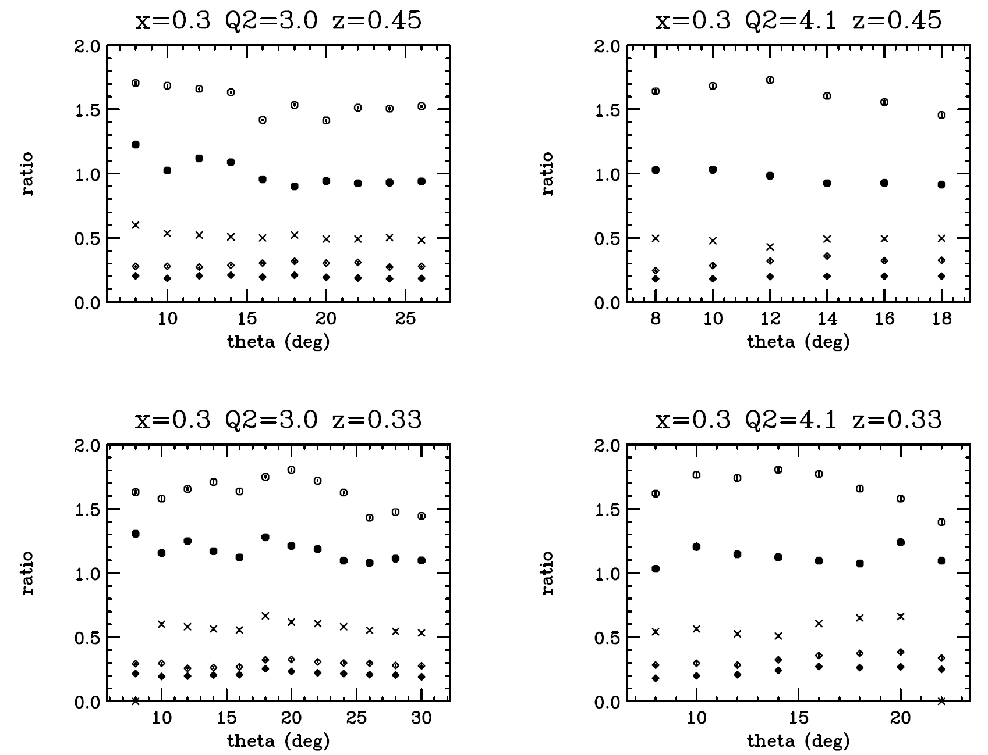
E12-09-017 Quasi-Online Results – Pions
Not normalized by target density: just ratios of counts/mC corrected for computer dead time.
Ratio to π+ from LH2 of
π+ from LD2 (open circles)
π+ from Al (open diamonds)
π- from LH2 (crosses)
π- from LD2 (filled circles)
π- from Al (filled diamonds)
14
14

Slide 15
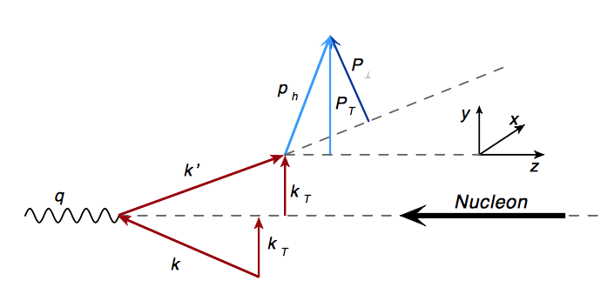
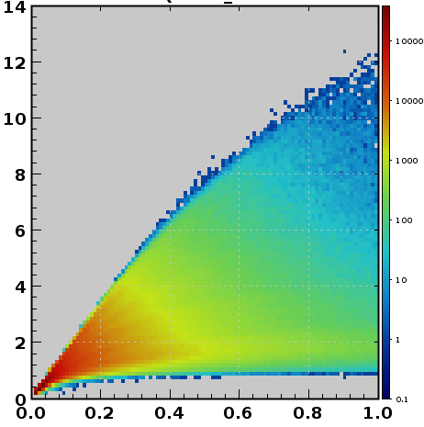
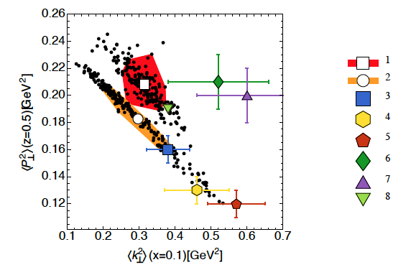
Extraction of Quark Transverse Momentum
From the transverse hadron momentum P_{hT} ➔ information on the intrinsic k_{T} and the p_{T} generated during fragmentation
Pavia Group results, Q² = 1 GeV²
JHEP 06 (2017) 081
The 12 GeV physics program at JLab will be very important to constrain TMD distributions at large x
Q² (GeV²)
x_{B}
15
Notes:
Strong correlation between KT and pT ➔ comparably good fits of SIDIS data can be obtained with different combinations of <𝒌⊥^{𝟐}> and <𝒑⊥^{𝟐}>
Stong anti-correlation between the widths of the distribution and fragmentation Gaussians
The flavor-dependent Gaussian ansatz performs better

Slide 16
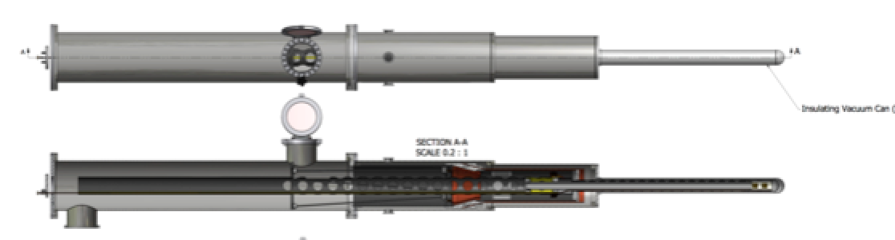
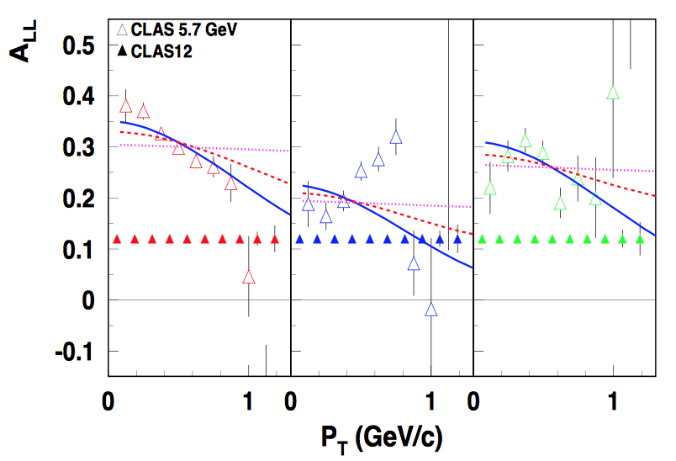
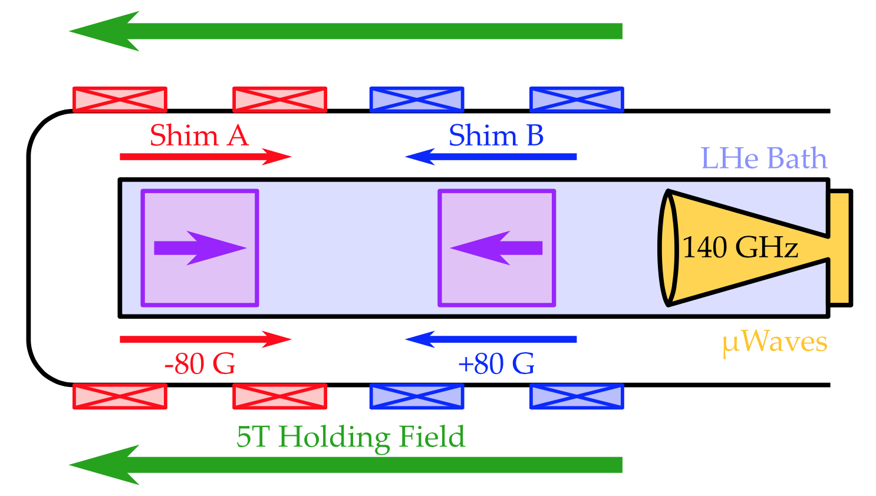
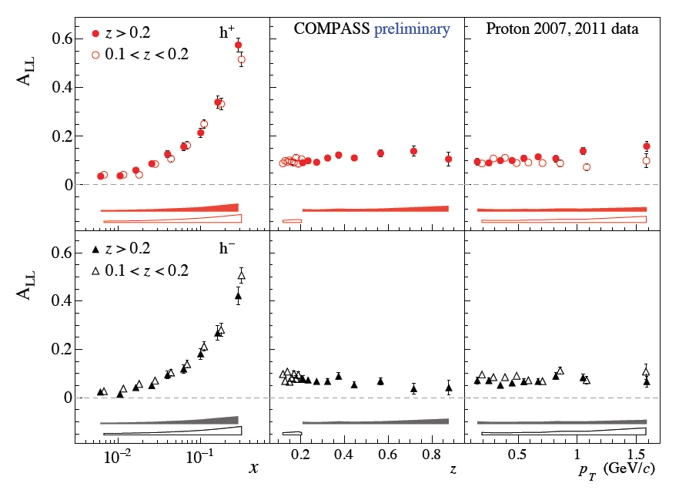
Longitudinally Polarized Target
JLab
π+
π-
π⁰
Overall length 2.6 m
Dual Cell Target w opposite pol.
NH₃ & ND₃
Ready for inst. in summer 2020
CoMPASS
Published CLAS data: Avakian et al., PRL, 105 (2010) 262002
Curves using different k_{T} widths for g₁ (same for f₁ ) ➔ widths of partonic distributions may depend on the spin orientation
Data by COMPASS appeare to be well compatible with a constant function: are k_{T} widths of g₁ and f₁ the same in the kinematics not dominated by valence quarks and non perturbative sea?
16
Parsamiyan PoSD, DIS2017 (2018) 259
Notes:
Published CLAS data: Avakian et al., PRL, 105 (2010) 262002

Slide 17
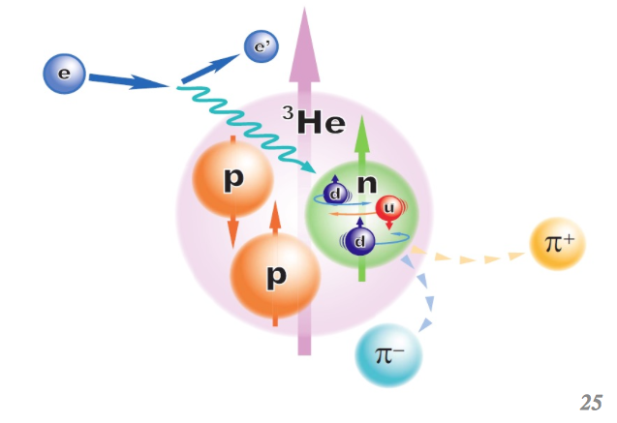
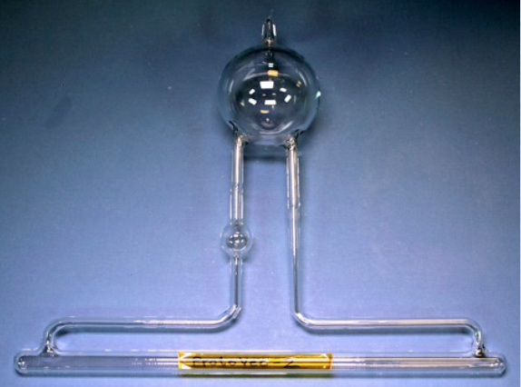
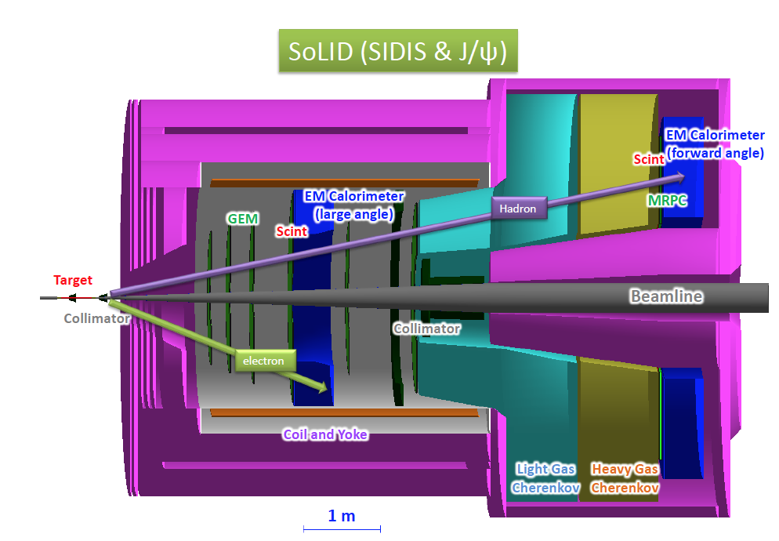
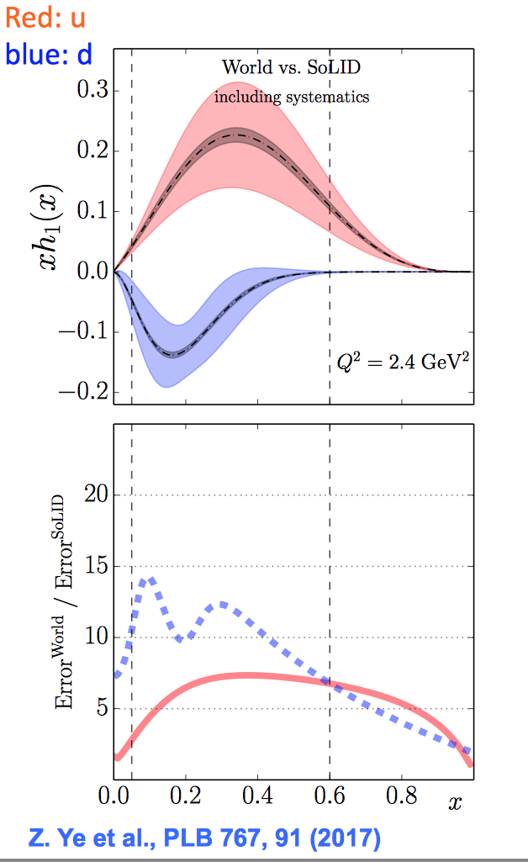
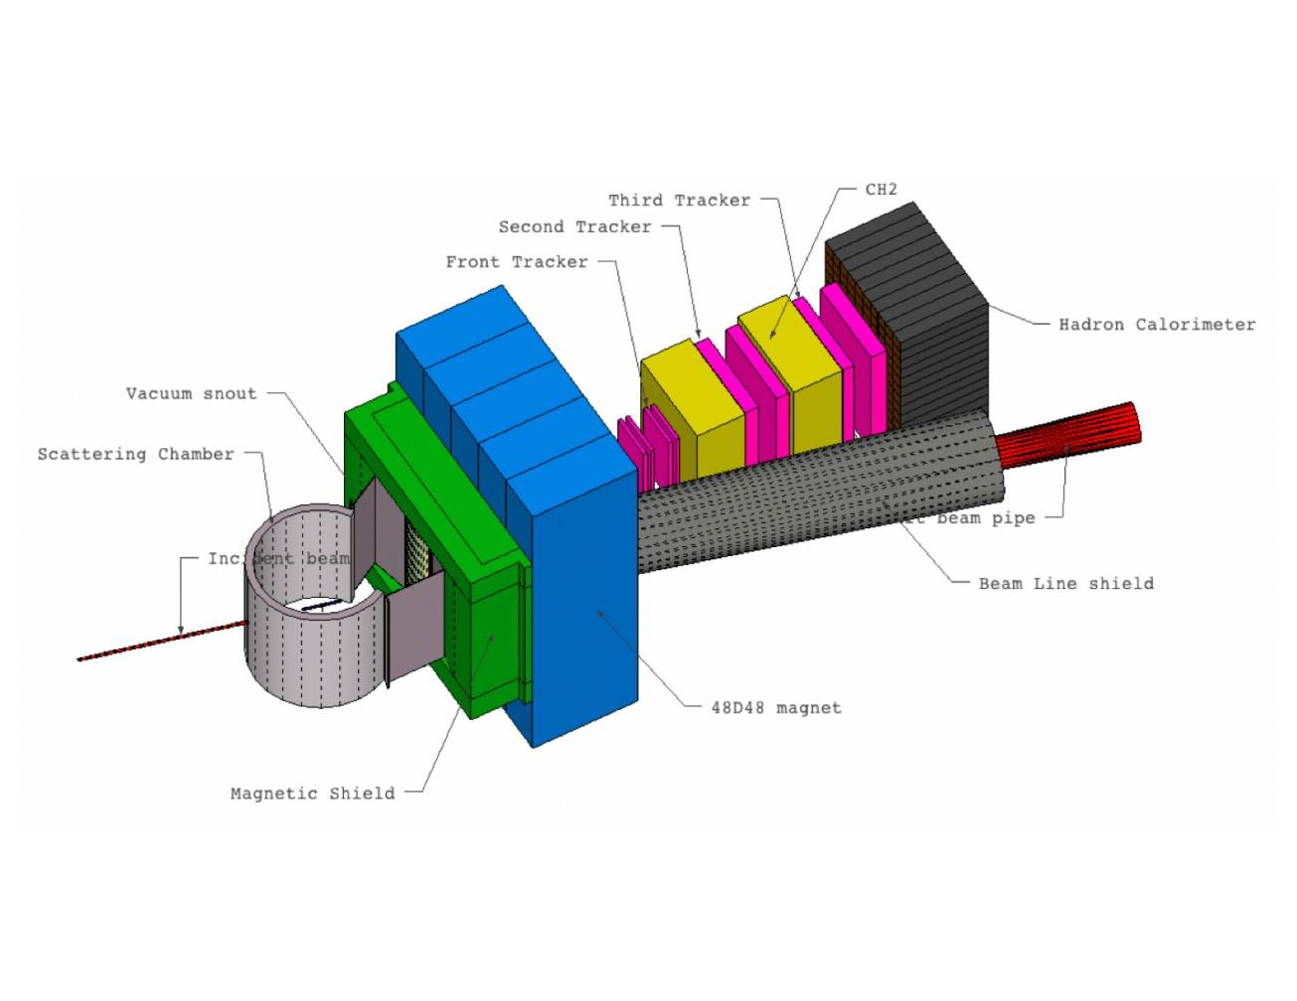
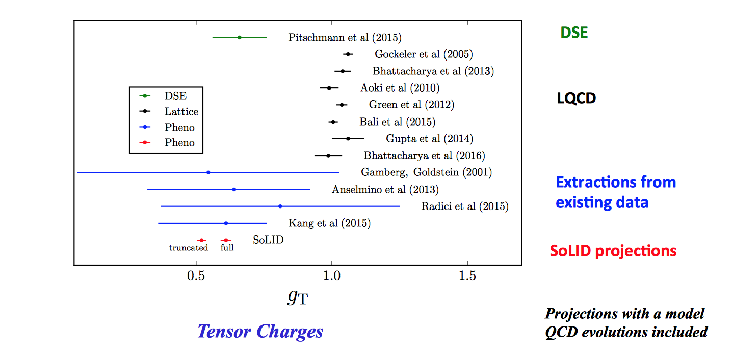
The Hall A TMD Program
TMD program based on:
            2 new detectors
            High FOM ³He target
SoLID
60 μA on 60 cm
L ~ 6.6x10³⁶ cm⁻²s⁻¹
Polarization ~60%
SoLID with transversely polarized n & p
➔precision extraction of u/d quark transversity
Leading Order – Leading Twist
Large acceptance (2π)
Quite large P_{T}
Quite high luminosity (10³⁶ cm⁻²s⁻¹)
Significant improvement, but need to quantify the systematics from modeling
SBS
Moderately large acceptance
Full PID (p and k)
  SBS detector on track to be completed by 2020
Z. Ye PLB 767 (2017) 91
17
Notes:
Tensor charge: lowest moment of transversity distributions
the isovector tensor charge gT = δuv − δdv

Slide 18
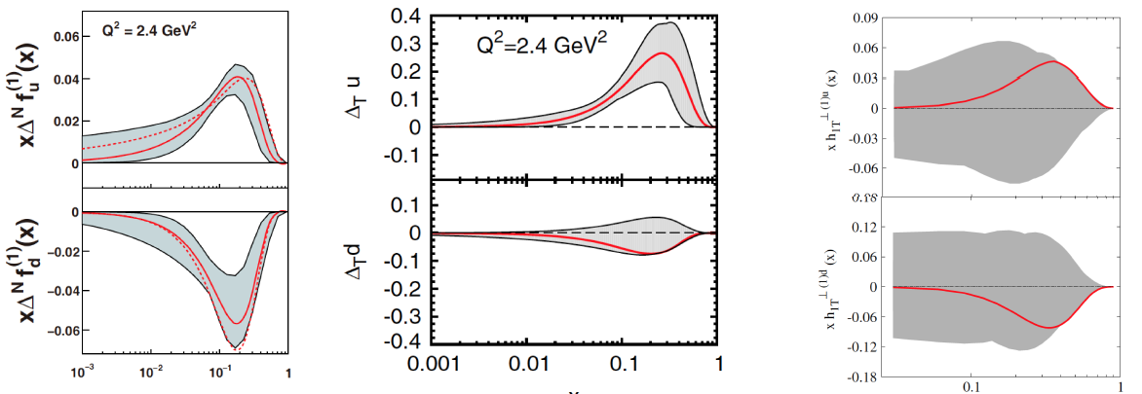
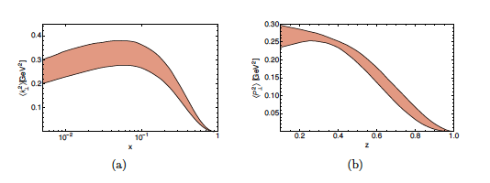
TMDs Extraction
Attempts to extract some TMD parton distributions and fragmentation functions and parton intrinsic transverse momenta have already been performed.
Sivers
Transversity
Pretzelosity
Data from different experiments, at different energy scales, in a large enough range of energy
Frequently used assumption of factorization of x and k_{T} or z and P_{hT} (which may be signicantly violated !)
x
x
x
Anselmino et al. EPJA39, 89 (2009)
Anselmino et al. PRD92, 114023 (2015)
Lefky et al. PRD91, 034010 (2015)
Bacchetta et al. JHEP 06 (2017) 081
A universal analysis framework to enable the extraction and the interpretation of the 3D PDFs, is mandatory
The framework will allow testing different extraction procedures, estimating systematics related to different assumptions and models used, as well as assessing sensitivity to kinematic limitations, radiative corrections, etc..
A 3D PDF Extraction and VAlidation (EVA) framework is under development at JLab
18

Slide 19
Nuclear Femtography Center @ JLab
The 3D imaging requires a comprehensive approach combining experimental, theoretical/phenomenological and computational expertise.
A Nuclear Femtography Center is being established at JLab
Proposal to Commonwealth of VA
Consortium of VA universities
Theoretical physics, experimental physics, computation, statistics – broad involvement
Initial request of $.5M for pilot study, funding of ~$2M/year envisioned
19

Slide 20
Conclusions and Outlook
The nucleon 3D partonic structure is rich and complex
Each TMD PDF/FF contains information on different aspects of the nucleon
TMD @ Jefferson Lab:
  Multi-Halls SIDIS program to study leading and sub-leading twist TMDs
  Precision multi-dimensional mapping in the valence region
E12-06-112B
E12-09-008A
C12-12-009
E12-09-009
E12-13-010
E12-11-007
E12-06-112A
E12-07-105
E12-06-108
E12-06-114
E12-06-112
C12-12-010
E12-09-017
E12-07-107
E12-13-007
E12-09-008
E12-11-003
E12-09-007
E12-16-110B
E12-09-018
The forthcoming years will be a time of unprecedented high precision and high volume data → a multi-dimensional effort is required for the extraction and interpretation of 3D PDFs
E12-11-108
E12-06-104
E12-06-109A
E12-06-119
E12-09-011
E12-17-012B
E12-09-008B
E12-10-006
At Jlab: a) A 3D PDF Extraction and Validation framework is under development b) A Nuclear Femtography Center is being established
20

